Slide 1
The African Monsoon Recent Evolution and Current Status Include Week-1 and Week-2 Outlooks
Update prepared
06 May 2024
For more information, visit:
http://www.cpc.ncep.noaa.gov/products/Global_Monsoons/African_Monsoons/precip_monitoring.shtml

Slide 2
Outline
Highlights
Recent Evolution and Current Conditions
NCEP GEFS Forecasts
Summary

Slide 3
Highlights: Last 7 Days
During the past 7 days, in East Africa, rainfall was above-average in southern and southeastern Ethiopia, some parts of northern and central Somalia, northern, western, central and southern Kenya, southwestern, southern and northeastern Uganda, Rwanda, and some regions in southeastern South Sudan and southeastern Tanzania. Rainfall was below-average in southwestern Ethiopia, southern Somalia, eastern Kenya, western and northeastern Tanzania, central-eastern Burundi, western, northern and central-eastern South Sudan, and pockets of the region in southern Sudan. In central Africa, rainfall was above-average in pockets of regions in southeastern Cameroon, eastern Gabon, northern Congo and southeastern Central African Republic (CAR), and some localized regions in western and eastern Democratic Republic of the Congo (DRC). Rainfall was below-average in many parts of Cameroon, Equatorial Guinea, western Gabon, southern and eastern Congo, southern Chad, western, northern, and eastern CAR, and southwestern, central and northeastern DRC. In West Africa, rainfall was above-average in northern-central Cote d’Ivoire, southwestern Nigeria, and pockets of regions in eastern Guinea, central Togo and eastern Benin. Rainfall was below-average in central Guinea, northern Sierra Leone, southern and eastern Liberia, southwestern and eastern Cote d’Ivoire, western Burkina Faso, northern, western, central and eastern Ghana, northern Togo, western Benin, and some regions in southern Mali. In southern Africa, rainfall was above-average in northern and central-eastern Madagascar and pockets of the region in northeastern Mozambique. Rainfall was below-average in the northern Angola region.
The Week-1 outlook calls for above-average rainfall in central and southeastern Ethiopia, central and southern Somalia, northern and western Kenya, northern and western Tanzania, many parts of Ghana, Togo and Benin, southern Burkina Faso, and pockets of the region in northeastern Madagascar. In contrast, there is an increased chance for below-average in many parts of central Africa, South Sudan, western Ethiopia, eastern Tanzania, Liberia, western Cote d’Ivoire, northern Guinea, Lesotho, Eswatini, eastern South Africa, and central Madagascar. The Week-2 outlook calls for above-average rainfall in many parts of central Africa, South Sudan, Ethiopia, northern Somalia, western Kenya, northern and western Tanzania, western Nigeria, southern parts of Cote d’Ivoire, Ghana and Togo, and eastern and northern Madagascar. In contrast, there is an increased chance for below-average in many parts of Guinea, Sierra Leone, southern Mali, northern Angola, southwestern DRC, eastern Tanzania, and central South Africa.

Slide 4
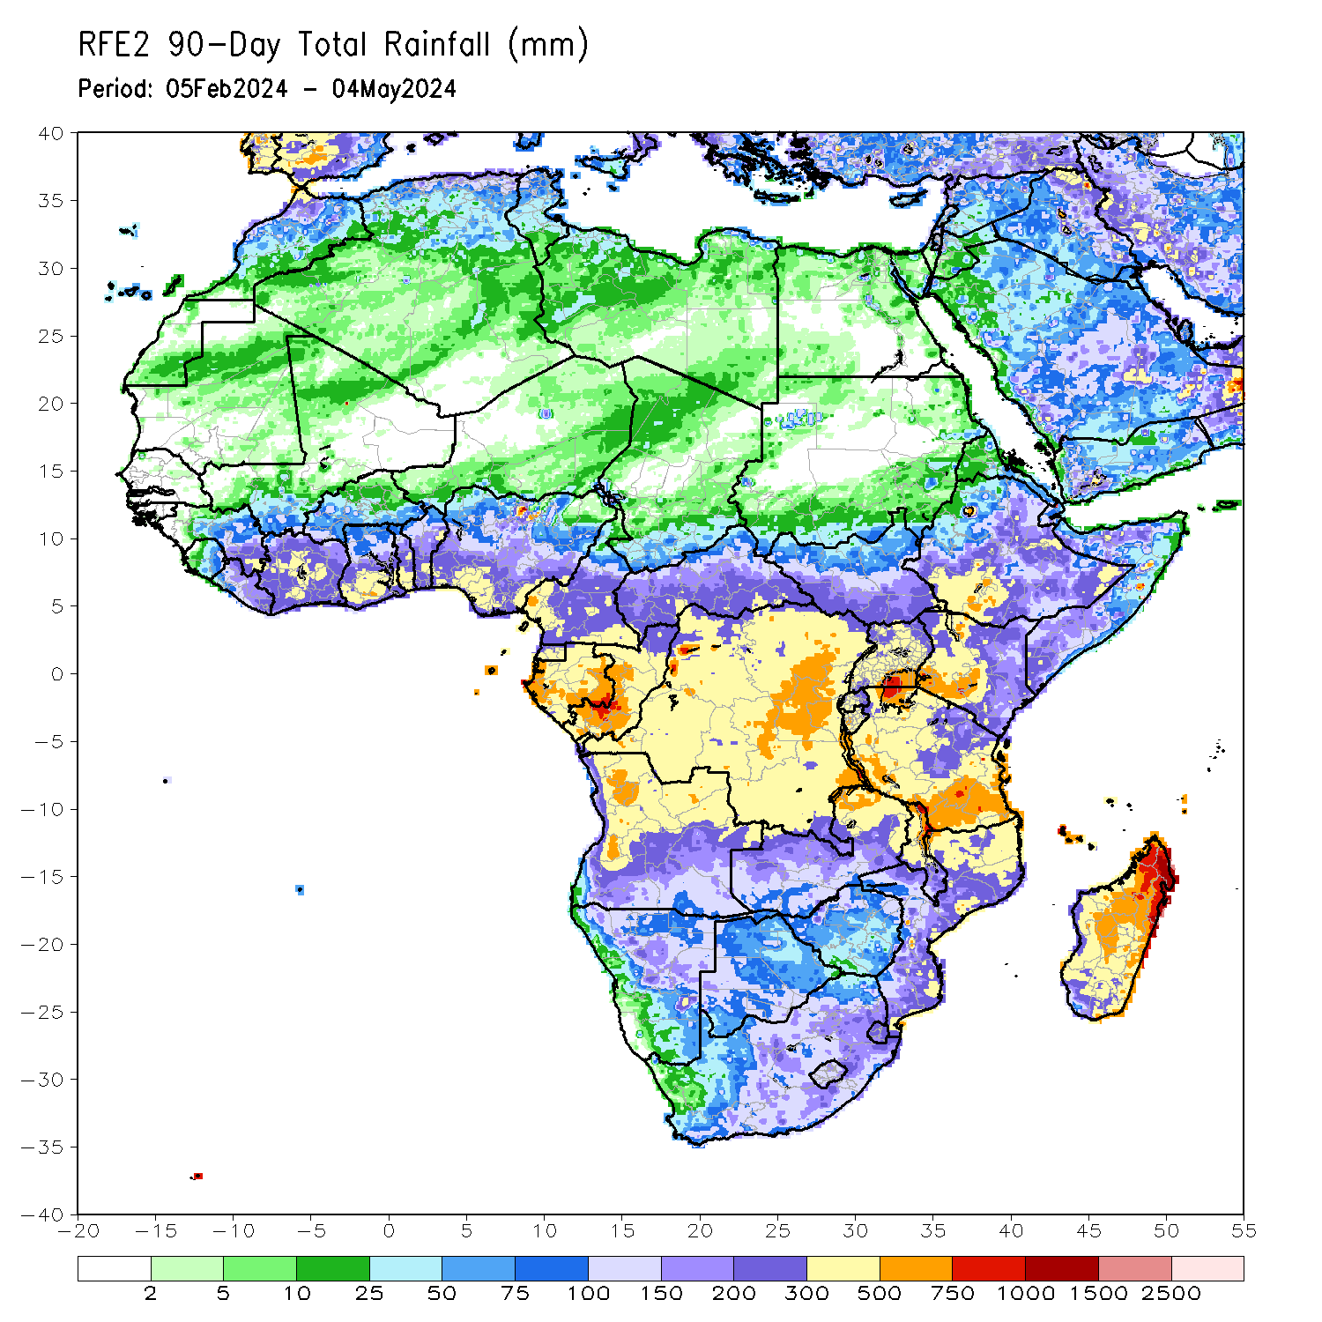
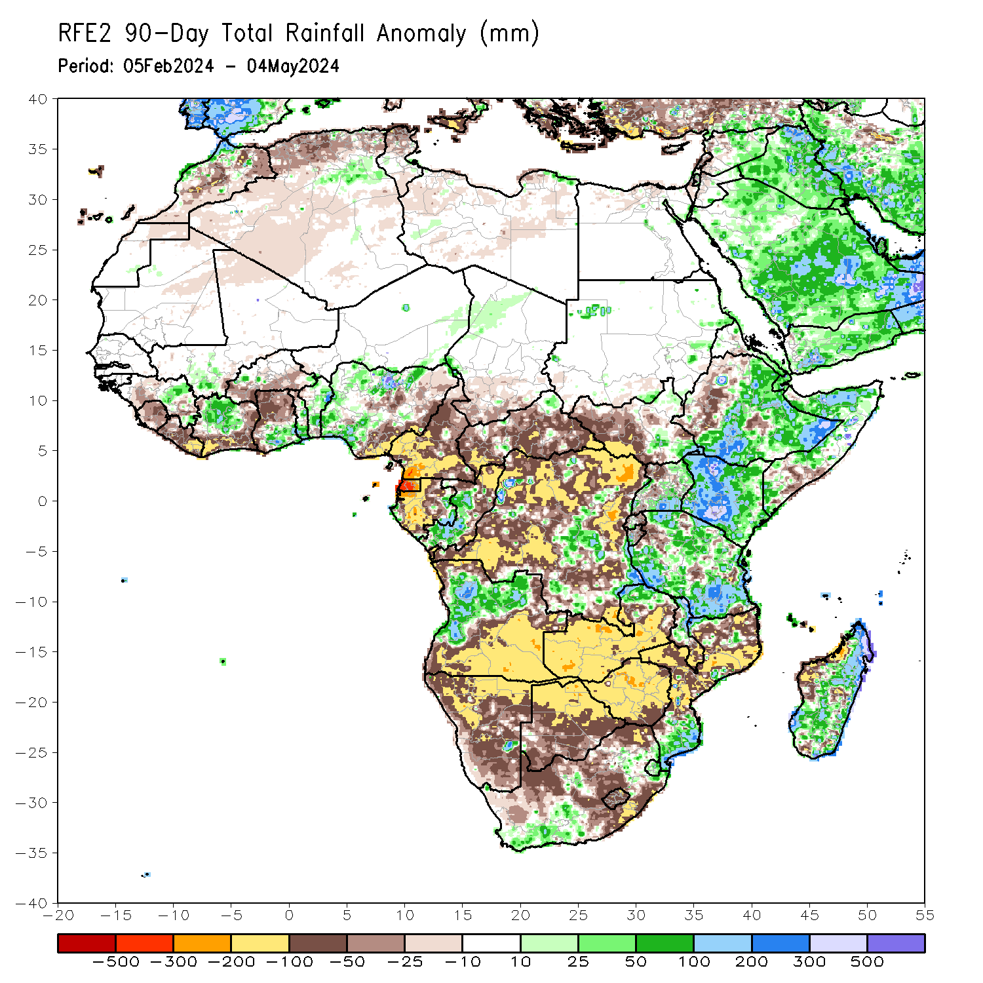
Rainfall Patterns: Last 90 Days
Over the past 90 days, in East Africa, rainfall was above-average in many parts of central, southern eastern, southeastern Ethiopia, southern Eritrea, Djibouti, northern and western Somalia, many parts of Kenya, southern and northeastern Uganda, some regions in southeastern and northeastern South Sudan, eastern Sudan and southwestern Burundi, and northern-central, western, southern and eastern Tanzania. Rainfall was below-average in western and pocket of region in central Ethiopia, central Eritrea, western, southwestern, and central-eastern South Sudan, northwestern Uganda, northern and eastern parts of Rwanda and Burundi, and some regions in northwestern Tanzania. In Central Africa, rainfall was above-average in western and southern Congo, and some regions in eastern Gabon, western Chad and central and southeastern Democratic Republic of the Congo (DRC). Rainfall was below-average in Equatorial Guinea, western, central and northern Gabon, northern Congo, and many parts of Cameroon, Central African Republic (CAR) and northern, western, southwestern and eastern DRC, and southern Chad. In West Africa, Rainfall was above-average in some parts of eastern Guinea, southern Mali, northern and central Cote d’Ivoire, southern Ghana, central and southern Togo, many parts of Benin, northern, western and southwestern Nigeria, and southeastern Niger. Rainfall was below-average in western Guinea, Sierra Leone, Liberia, southern and eastern Cote d’Ivoire, western and northern Ghana, southern Burkina Faso, and southeastern and eastern Nigeria. In southern Africa, rainfall was above-average in western-central and northern Angola, southeastern South Africa, Eswatini, southern Mozambique, some localized regions in northern Zambia and northern Malawi, and northern, central-eastern and southern parts of Madagascar. Rainfall was below-average across southwestern, southern and eastern Angola, many parts of Namibia, Botswana, Zimbabwe and Lesotho, western, central, southern and eastern Zambia, southern Malawi, western, central and northeastern Mozambique, western, central and eastern South Africa, and western Madagascar.
Notes:
4

Slide 5
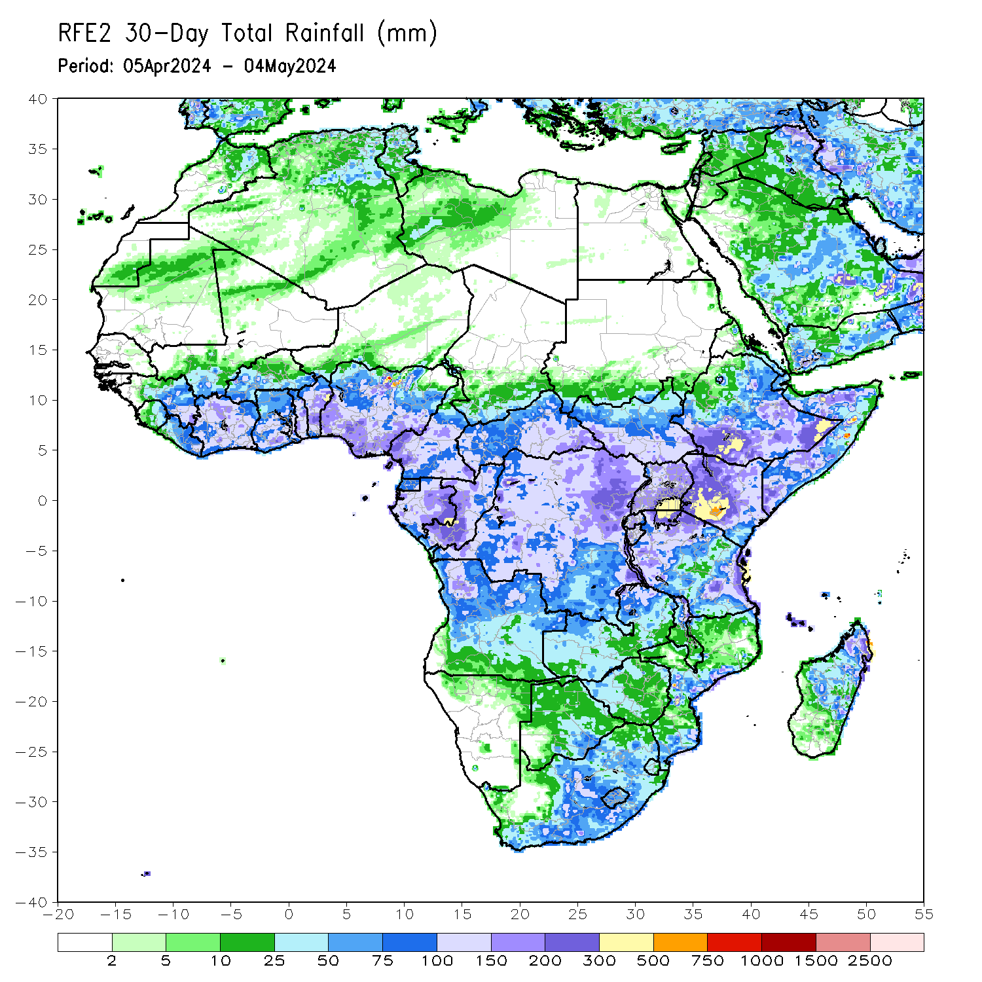
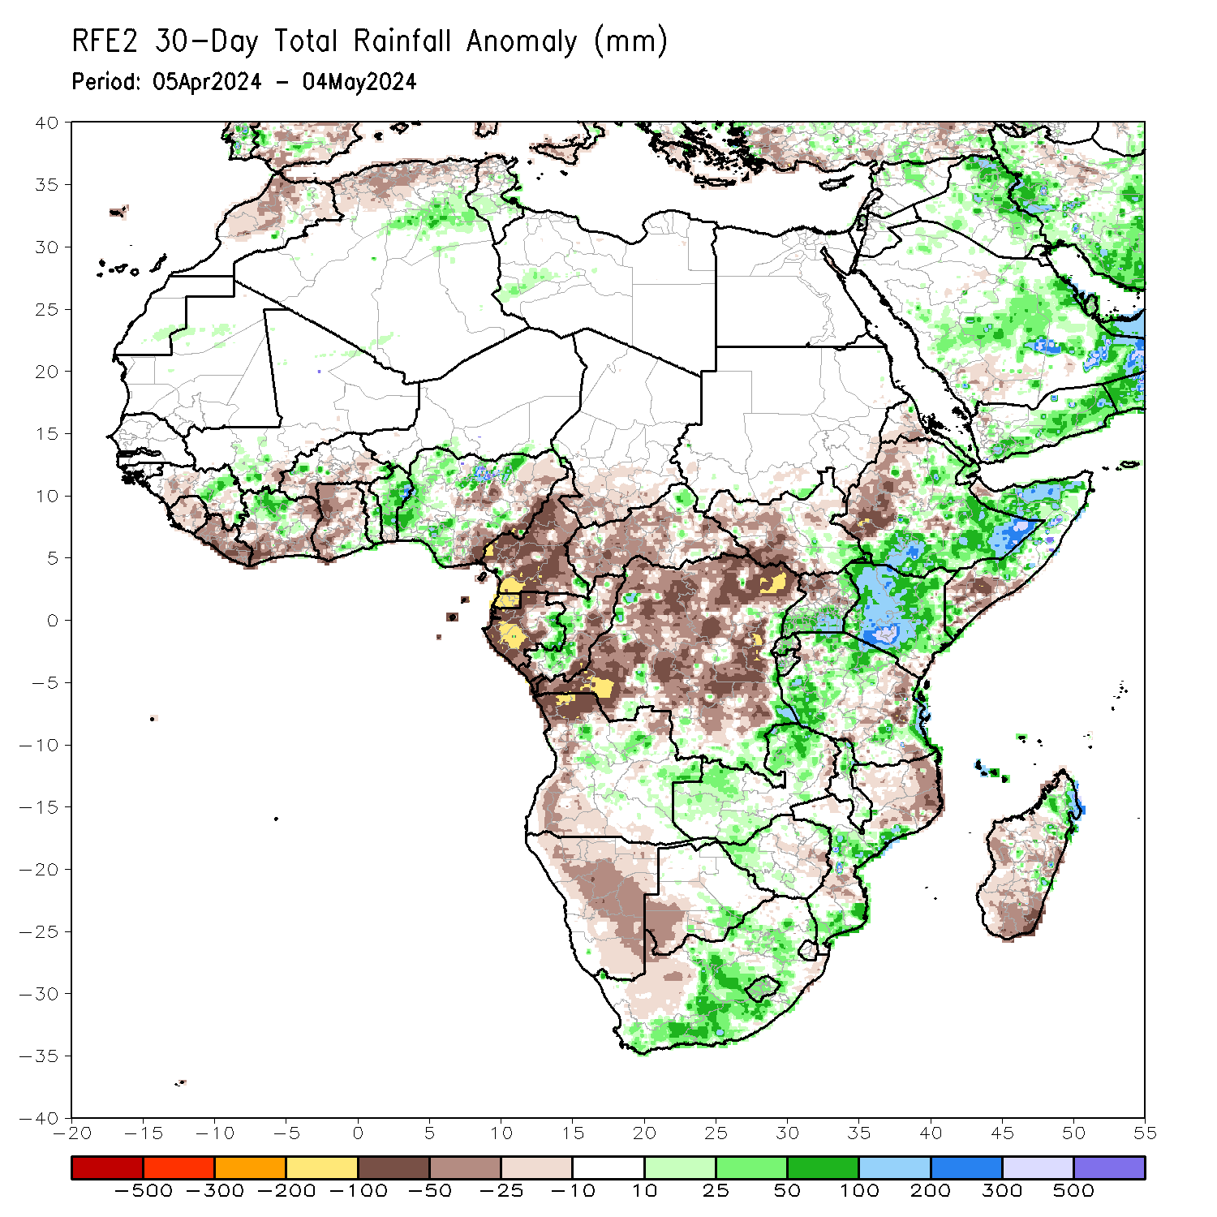
Rainfall Patterns: Last 30 Days
Over the past 30 days, in East Africa, rainfall was above-average in southern, southeastern, and central-eastern Ethiopia, southern Eritrea, Djibouti, northern and western Somalia, many part of Kenya, Rwanda and Burundi, southeastern South Sudan, southern and northeastern Uganda, many parts of western, northern-central and eastern Tanzania. Rainfall was below-average in western Ethiopia, northern Eritrea, western, northwestern and eastern South Sudan, northwestern-central Uganda, and northeastern Tanzania. In Central Africa, rainfall was above-average in eastern Gabon, southwestern Congo, some regions in southeastern and eastern Democratic Republic of the Congo (DRC), and pockets of regions in the northern Central African Republic (CAR). Rainfall was below-average in many parts of Cameroon, Equatorial Guinea, northern and western Gabon, northern and eastern Congo, southern Chad, and many parts of western, central, northern, southern and southeastern CAR and northern, western, central, southern and northeastern DRC. In West Africa, Rainfall was above-average in some regions of central Guinea, southern Mali, northwestern-central Cote d’Ivoire and southeastern Ghana, central and southern Togo, many parts of Benin, and northern, western and southern Nigeria. Rainfall was below-average in southwestern Guinea, Sierra Leone, Liberia, southwestern, southern and eastern Cote d’Ivoire, northern, western and central-eastern Ghana, southern Burkina Faso, and some parts of central and eastern Nigeria. In southern Africa, rainfall was above-average in central-eastern Angola, western and northern Zambia, northern Malawi, some parts of central and southern Mozambique, western Zimbabwe, southern Botswana, western, central-eastern and southeastern South Africa, Lesotho, and northern Madagascar. Rainfall was below-average across northwestern, western and southwestern Angola, many parts of Namibia, southwestern South Africa, northern Mozambique, central Zimbabwe, and many parts of western, southern and central0eastern Madagascar.
Notes:
5

Slide 6
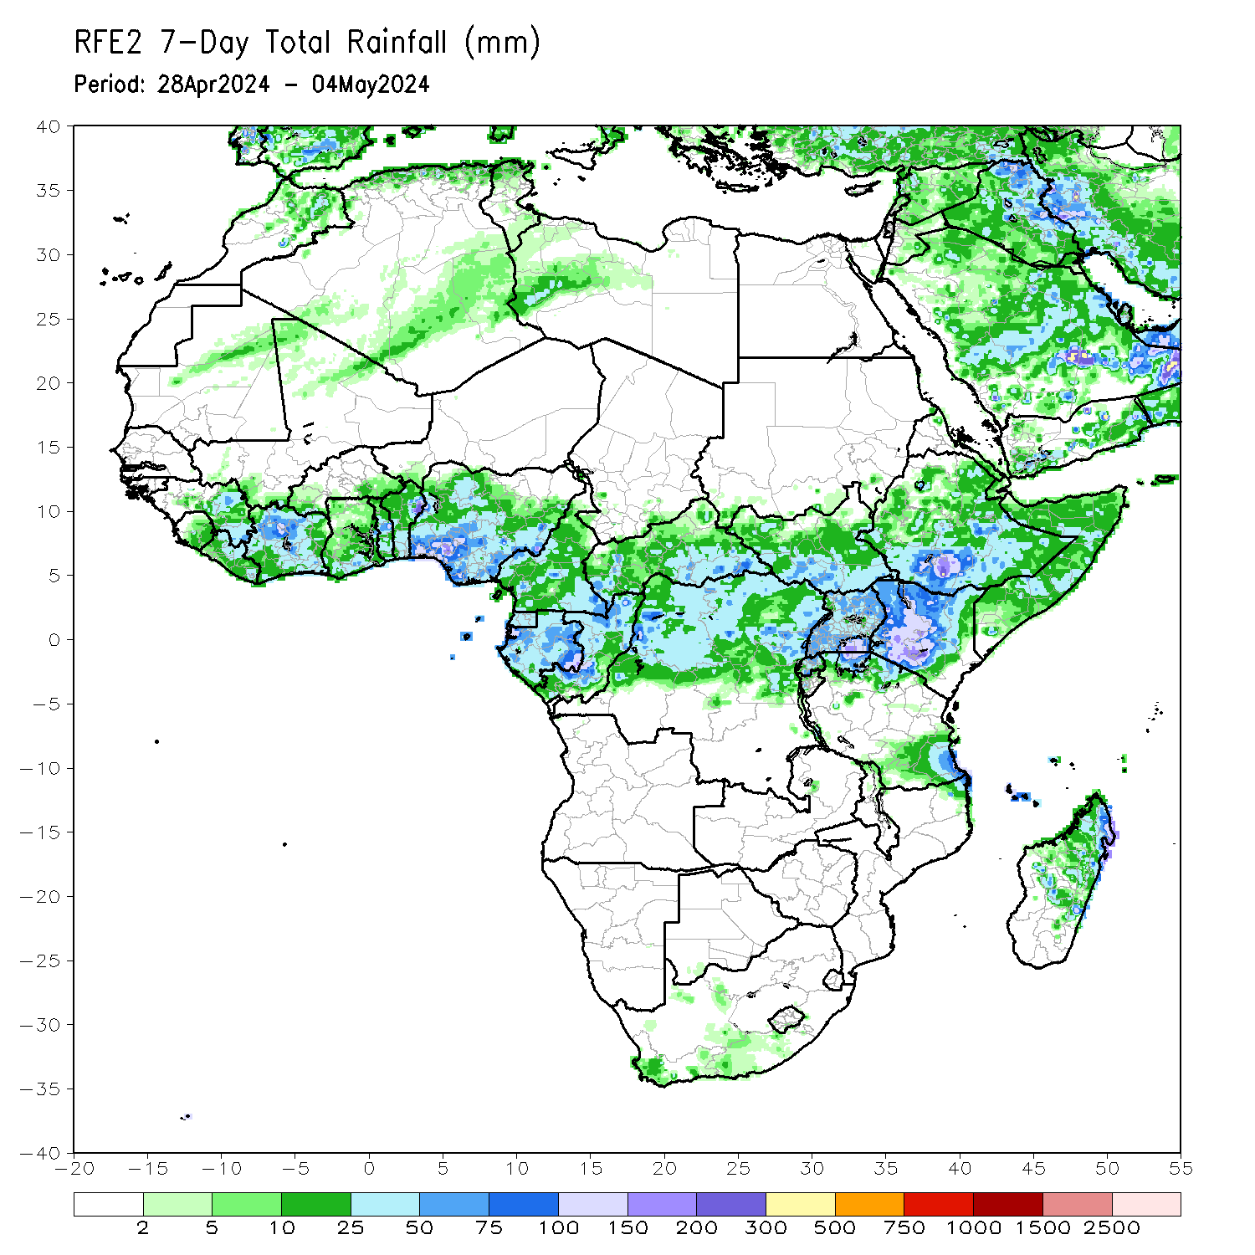
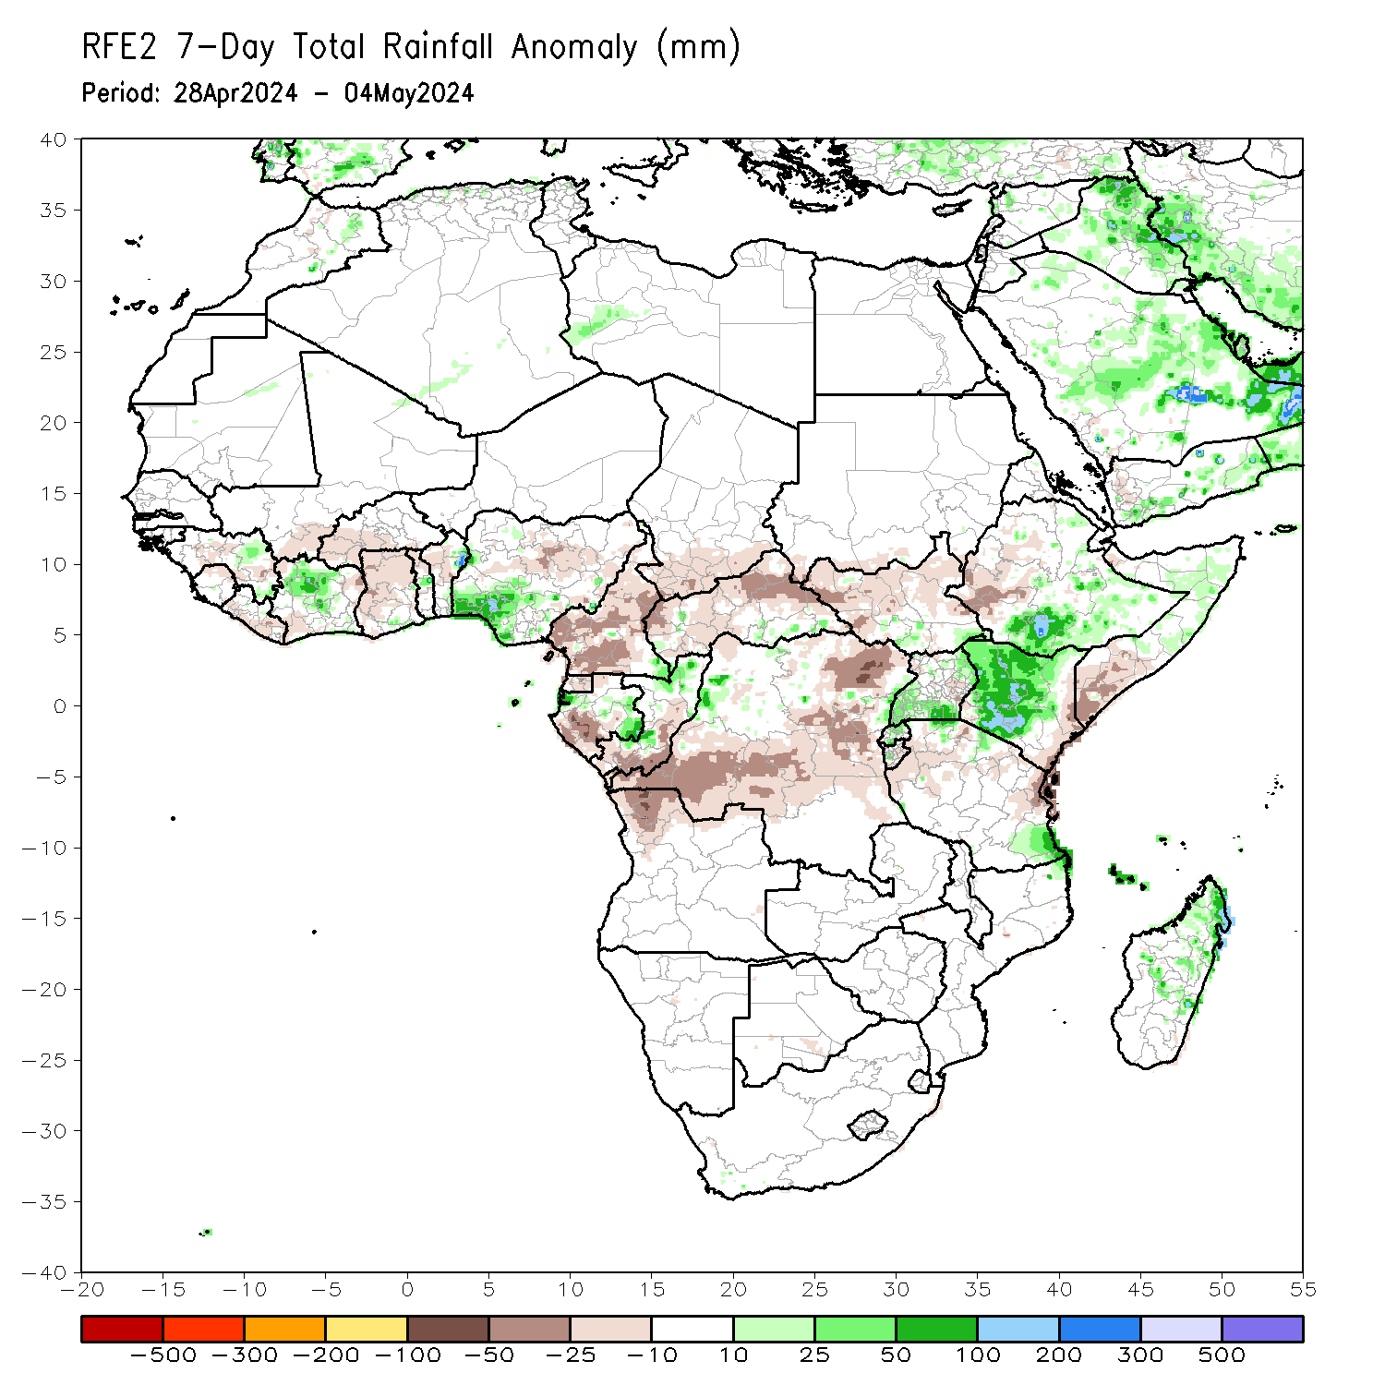
Rainfall Patterns: Last 7 Days
During the past 7 days, in East Africa, rainfall was above-average in southern and southeastern Ethiopia, some parts of northern and central Somalia, northern, western, central and southern Kenya, southwestern, southern and northeastern Uganda, Rwanda, and some regions in southeastern South Sudan and southeastern Tanzania. Rainfall was below-average in southwestern Ethiopia, southern Somalia, eastern Kenya, western and northeastern Tanzania, central-eastern Burundi, western, northern and central-eastern South Sudan, and pockets of the region in southern Sudan. In central Africa, rainfall was above-average in pockets of regions in southeastern Cameroon, eastern Gabon, northern Congo and southeastern Central African Republic (CAR), and some localized regions in western and eastern Democratic Republic of the Congo (DRC). Rainfall was below-average in many parts of Cameroon, Equatorial Guinea, western Gabon, southern and eastern Congo, southern Chad, western, northern, and eastern CAR, and southwestern, central and northeastern DRC. In West Africa, rainfall was above-average in northern-central Cote d’Ivoire, southwestern Nigeria, and pockets of regions in eastern Guinea, central Togo and eastern Benin. Rainfall was below-average in central Guinea, northern Sierra Leone, southern and eastern Liberia, southwestern and eastern Cote d’Ivoire, western Burkina Faso, northern, western, central and eastern Ghana, northern Togo, western Benin, and some regions in southern Mali. In southern Africa, rainfall was above-average in northern and central-eastern Madagascar and pockets of the region in northeastern Mozambique. Rainfall was below-average in the northern Angola region.

Slide 7
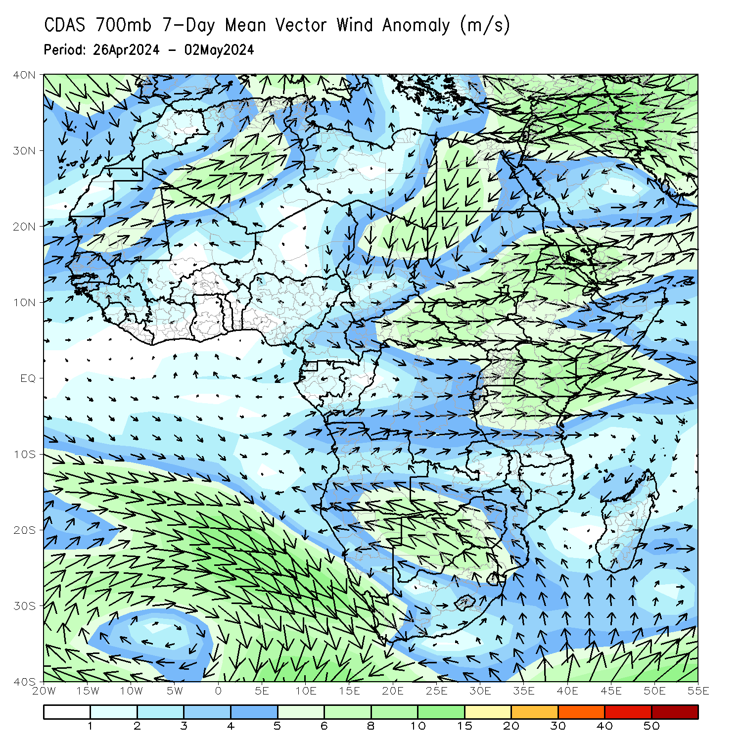
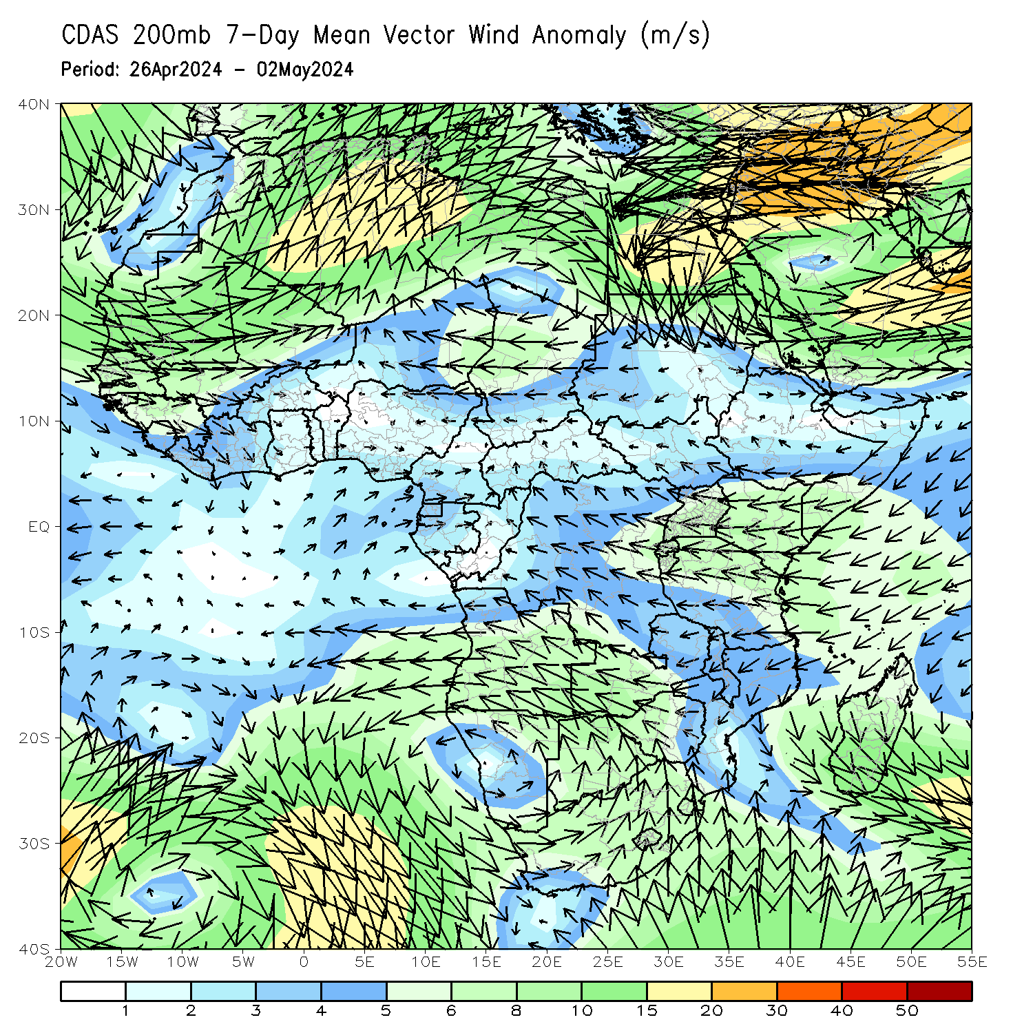
Atmospheric Circulation: Last 7 Days
At 700-hPa level (left panel), lower-level anomalous wind convergence across eastern Africa may have contributed to the observed rainfall increases in some parts of eastern Africa.

Slide 8
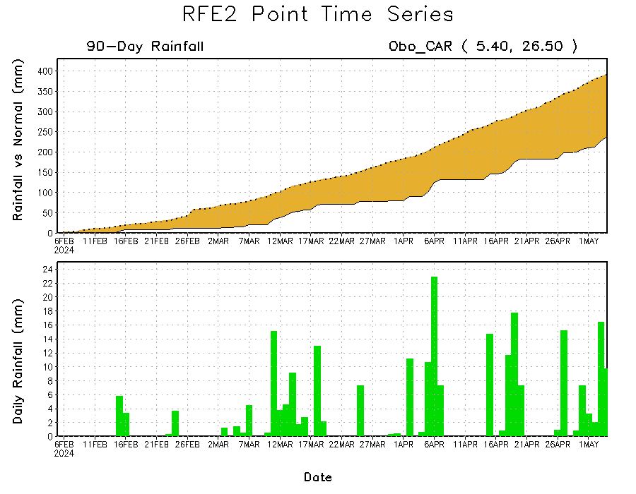
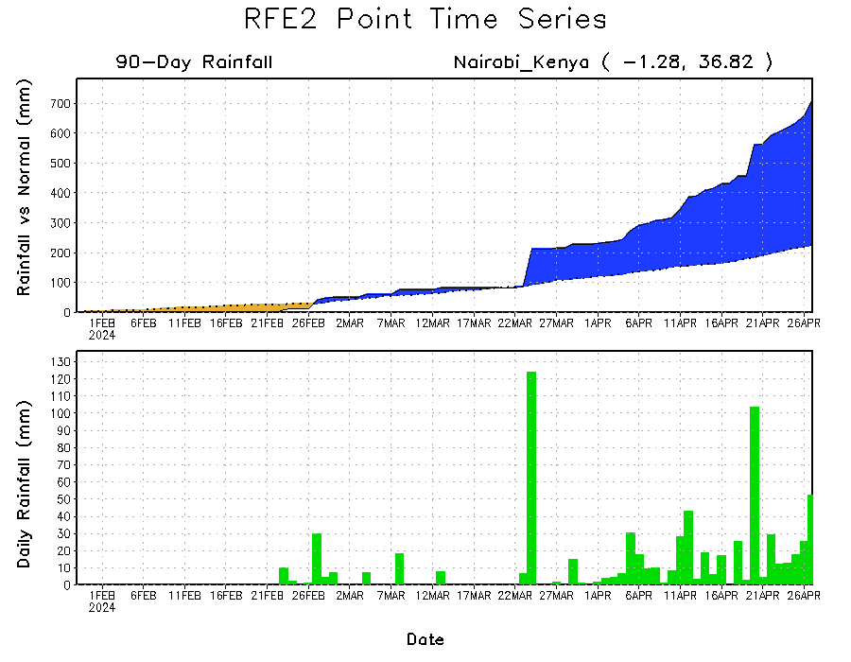
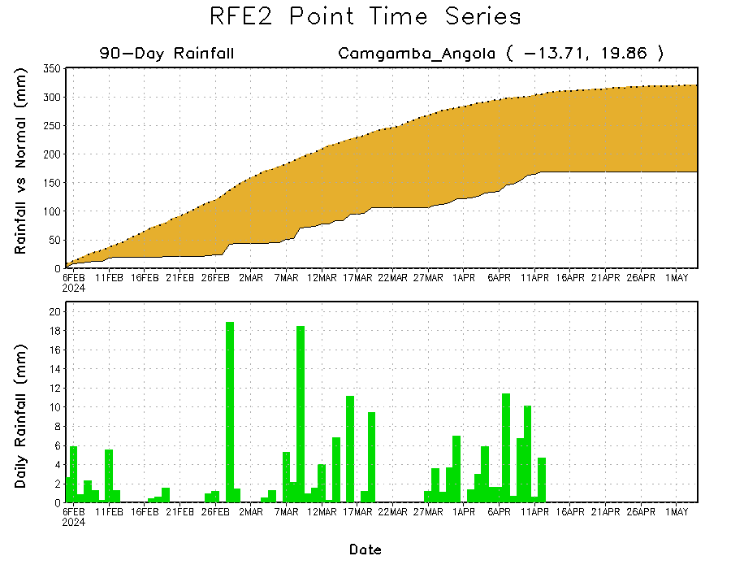
Rainfall Evolution
Daily evolution in rainfall at selected locations over the past 90 days shows deficits over eastern Angola (bottom Left) and eastern Central African Republic (CAR) (top right). Conversely, rainfall surpluses persist in western and southern Kenya due to significant rainfall observed in the last 1-month period (bottom right).

Slide 9
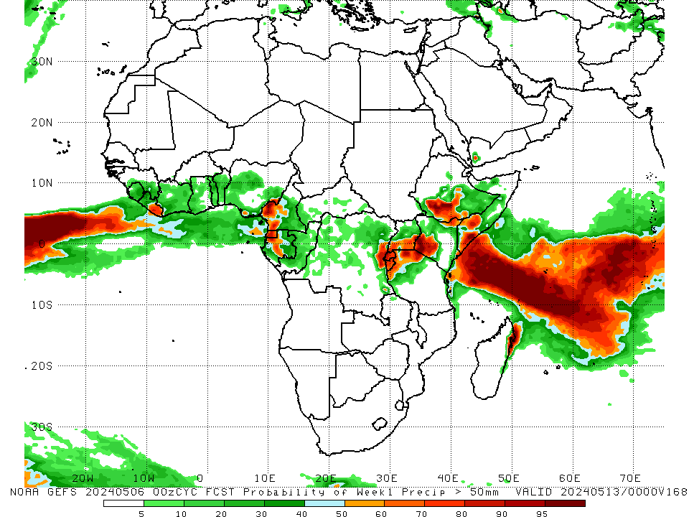
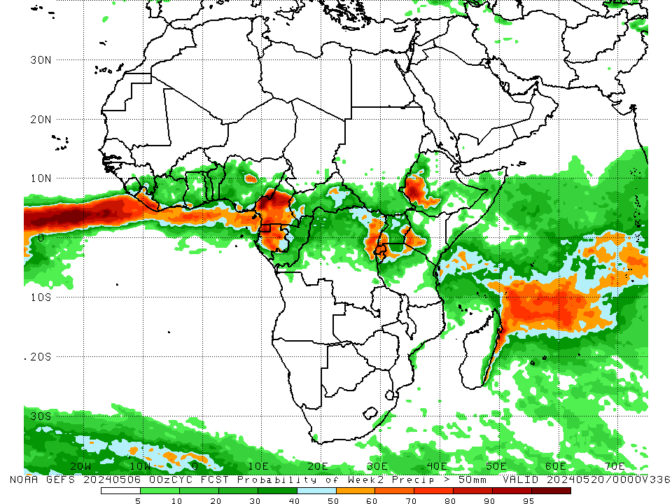
NCEP GEFS Model Forecasts Non-Bias Corrected Probability of precipitation exceedance
Week-1, Valid: 07 – 13May, 2024
Week-2, Valid: 14 – 20May, 2024
For week-1 (left panel) the NCEP GEFS indicates a moderate to high chance (over 70%) for rainfall to exceed 50 mm over eastern Liberia, southwestern Cameroon, Equatorial Guinea, some regions in central Gabon and eastern DRC, Rwanda, Burundi, northern and western Tanzania, southern Uganda, southwestern and northeastern Kenya, southern Ethiopia, some parts of southern Somalia, and pockets of region in eastern Madagascar. For week-2 (right panel), NCEP GEFS indicates a moderate to high chance (over 70%) for rainfall to exceed 50 mm over southern and eastern Liberia, central, western and southern Cameroon, Equatorial Guinea, northern and central-eastern Gabon, some regions in eastern DRC, Rwanda, southwestern parts of Ethiopia and Kenya, and pockets of localized regions in eastern Madagascar.
Notes:
9

Slide 10
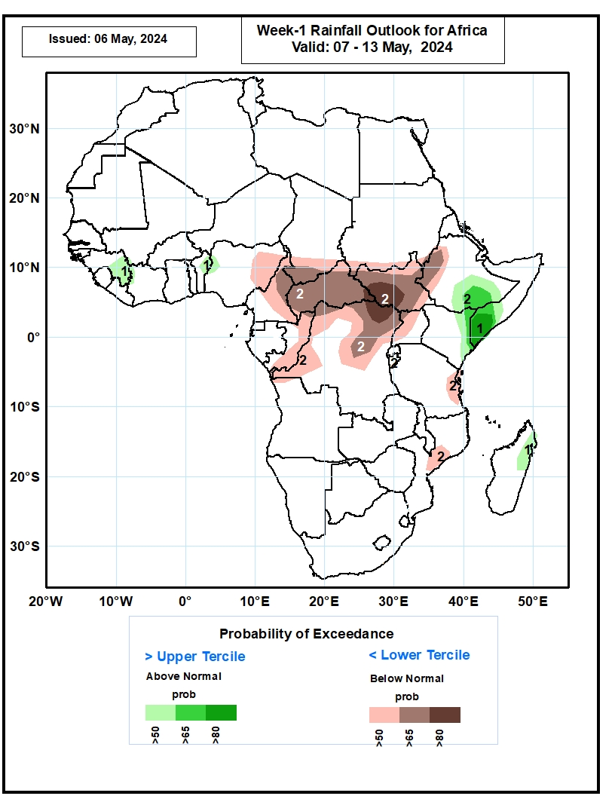
Week-1 Precipitation Outlooks
07– 13 May, 2024
The probabilistic forecasts call for above 50% chance for weekly total rainfall to be above-normal (above the upper tercile) eastern Guinea, northern Benin, southeastern Ethiopia, eastern Kenya, southern Somalia and eastern Madagascar. There is above 65% chance for above-normal rainfall over southeastern Ethiopia and southern Somalia
The probabilistic forecasts call for above 50% chance for weekly rainfall to be below-normal (below the lower tercile) over many places in Central Africa. There is above 65% chance for below-normal rainfall over eastern Nigeria, southern Chad, northern and eastern Cameroon, much of CAR, South Sudan, western Ethiopia, and northern Congo.
Notes:
10

Slide 11
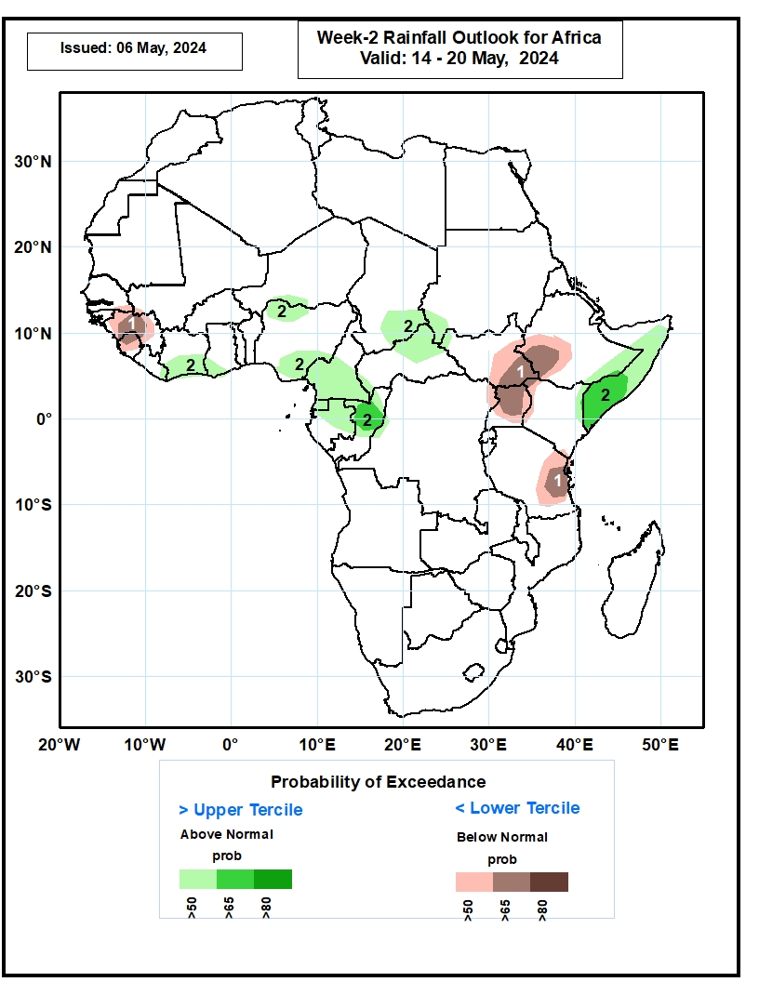
Week-2 Precipitation Outlooks
14 – 20 May, 2024
The probabilistic forecasts call for above 50% chance for weekly rainfall to be below-normal (below the lower tercile) over much of Sierra Leone and Guinea, eastern South Sudan, southwestern Ethiopia, Uganda, and eastern Tanzania There is above 65% chance for below-normal rainfall over central Guinea, southeastern South Sudan, Uganda, southwestern Ethiopia and eastern Tanzania.
The probabilistic forecasts call for above 50% chance for weekly total rainfall to be above-normal (above the upper tercile) over southern Cote d’Ivoire, northwestern and southeastern Nigeria, southern Cameroon, Equatorial Guinea, Gabon, northern Congo, southeastern Chad, northern CAR, and Somalia. There is above 65% chance for above-normal rainfall northern Congo and southern Somalia.
Notes:
11

Slide 12
Summary
Over the past 30 days, in East Africa, rainfall was above-average in southern, southeastern, and central-eastern Ethiopia, southern Eritrea, Djibouti, northern and western Somalia, many part of Kenya, Rwanda and Burundi, southeastern South Sudan, southern and northeastern Uganda, many parts of western, northern-central and eastern Tanzania. Rainfall was below-average in western Ethiopia, northern Eritrea, western, northwestern and eastern South Sudan, northwestern-central Uganda, and northeastern Tanzania. In Central Africa, rainfall was above-average in eastern Gabon, southwestern Congo, some regions in southeastern and eastern Democratic Republic of the Congo (DRC), and pockets of regions in the northern Central African Republic (CAR). Rainfall was below-average in many parts of Cameroon, Equatorial Guinea, northern and western Gabon, northern and eastern Congo, southern Chad, and many parts of western, central, northern, southern and southeastern CAR and northern, western, central, southern and northeastern DRC. In West Africa, Rainfall was above-average in some regions of central Guinea, southern Mali, northwestern-central Cote d’Ivoire and southeastern Ghana, central and southern Togo, many parts of Benin, and northern, western and southern Nigeria. Rainfall was below-average in southwestern Guinea, Sierra Leone, Liberia, southwestern, southern and eastern Cote d’Ivoire, northern, western and central-eastern Ghana, southern Burkina Faso, and some parts of central and eastern Nigeria. In southern Africa, rainfall was above-average in central-eastern Angola, western and northern Zambia, northern Malawi, some parts of central and southern Mozambique, western Zimbabwe, southern Botswana, western, central-eastern and southeastern South Africa, Lesotho, and northern Madagascar. Rainfall was below-average across northwestern, western and southwestern Angola, many parts of Namibia, southwestern South Africa, northern Mozambique, central Zimbabwe, and many parts of western, southern and central0eastern Madagascar.
During the past 7 days, in East Africa, rainfall was above-average in southern and southeastern Ethiopia, some parts of northern and central Somalia, northern, western, central and southern Kenya, southwestern, southern and northeastern Uganda, Rwanda, and some regions in southeastern South Sudan and southeastern Tanzania. Rainfall was below-average in southwestern Ethiopia, southern Somalia, eastern Kenya, western and northeastern Tanzania, central-eastern Burundi, western, northern and central-eastern South Sudan, and pockets of the region in southern Sudan. In central Africa, rainfall was above-average in pockets of regions in southeastern Cameroon, eastern Gabon, northern Congo and southeastern Central African Republic (CAR), and some localized regions in western and eastern Democratic Republic of the Congo (DRC). Rainfall was below-average in many parts of Cameroon, Equatorial Guinea, western Gabon, southern and eastern Congo, southern Chad, western, northern, and eastern CAR, and southwestern, central and northeastern DRC. In West Africa, rainfall was above-average in northern-central Cote d’Ivoire, southwestern Nigeria, and pockets of regions in eastern Guinea, central Togo and eastern Benin. Rainfall was below-average in central Guinea, northern Sierra Leone, southern and eastern Liberia, southwestern and eastern Cote d’Ivoire, western Burkina Faso, northern, western, central and eastern Ghana, northern Togo, western Benin, and some regions in southern Mali. In southern Africa, rainfall was above-average in northern and central-eastern Madagascar and pockets of the region in northeastern Mozambique. Rainfall was below-average in the northern Angola region.
The Week-1 outlook calls for above-average rainfall in central and southeastern Ethiopia, central and southern Somalia, northern and western Kenya, northern and western Tanzania, many parts of Ghana, Togo and Benin, southern Burkina Faso, and pockets of the region in northeastern Madagascar. In contrast, there is an increased chance for below-average in many parts of central Africa, South Sudan, western Ethiopia, eastern Tanzania, Liberia, western Cote d’Ivoire, northern Guinea, Lesotho, Eswatini, eastern South Africa, and central Madagascar. The Week-2 outlook calls for above-average rainfall in many parts of central Africa, South Sudan, Ethiopia, northern Somalia, western Kenya, northern and western Tanzania, western Nigeria, southern parts of Cote d’Ivoire, Ghana and Togo, and eastern and northern Madagascar. In contrast, there is an increased chance for below-average in many parts of Guinea, Sierra Leone, southern Mali, northern Angola, southwestern DRC, eastern Tanzania, and central South Africa.

