Slide 1
The African Monsoon Recent Evolution and Current Status Include Week-1 and Week-2 Outlooks
Update prepared
29 April 2024
For more information, visit:
http://www.cpc.ncep.noaa.gov/products/Global_Monsoons/African_Monsoons/precip_monitoring.shtml

Slide 2
Outline
Highlights
Recent Evolution and Current Conditions
NCEP GEFS Forecasts
Summary

Slide 3
Highlights: Last 7 Days
During the past 7 days, in East Africa, rainfall was above-average in central, southern and eastern Ethiopia, many parts of northern, western and southern Somalia, southern Eritrea, Djibouti, Kenya, and northern, central, western and eastern Tanzania, central and southern Rwanda, Burundi, southwestern and northeastern Uganda, and pockets of localized regions in southern Sudan and northern South Sudan. Rainfall was below-average in southwestern-central South Sudan, northwestern-central Uganda, and some regions in southwestern-central Ethiopia. In central Africa, rainfall was above-average in western and northern-central Central African Republic (CAR), and some localized regions in eastern Gabon, southern Congo and central and eastern Democratic Republic of the Congo (DRC). Rainfall was below-average in many parts of Cameroon and Equatorial Guinea, northern, western and southeastern Gabon, many parts of northern, central and southwestern DRC, southeastern CAR, and central Congo. In West Africa, rainfall was above-average in some parts of northern and central-eastern Cote d’Ivoire, southwestern Ghana, central and southern Togo, Benin, southwestern Nigeria, and pockets of localized regions in southern Guinea and southwestern Mali. Rainfall was below-average in central, southern and eastern Liberia, southwestern Cote d’Ivoire, northern Ghana, central Burkina Faso, and eastern Nigeria. In southern Africa, rainfall was above-average in northern Madagascar and pockets of the localized region in central Mozambique. Rainfall was below-average in northern-western and northeastern Angola and pockets of region in central South Africa, western Lesotho, northeastern Mozambique, and central-eastern Madagascar.
The Week-1 outlook calls for above-average rainfall in central and southeastern Ethiopia, northern and central Somalia, northwestern and western Kenya, northern and eastern Uganda, southeastern Tanzania, northeastern Mozambique, and central and northeastern Madagascar. In contrast, there is an increased chance for below-average in many parts of Gulf of Guinea coast countries and central Africa, South Sudan, Uganda, western Ethiopia, southern Mozambique, western, central and eastern South Africa, Lesotho, Eswatini. The Week-2 outlook calls for above-average rainfall in central and southeastern Ethiopia, southern Somalia, and northeastern, eastern and southwestern Kenya. In contrast, there is an increased chance for below-average in some parts of Gulf of Guinea coast countries, many parts of central Africa, South Sudan, Uganda, western Ethiopia, Tanzania, northern Mozambique, central and eastern South Africa, and Lesotho.

Slide 4
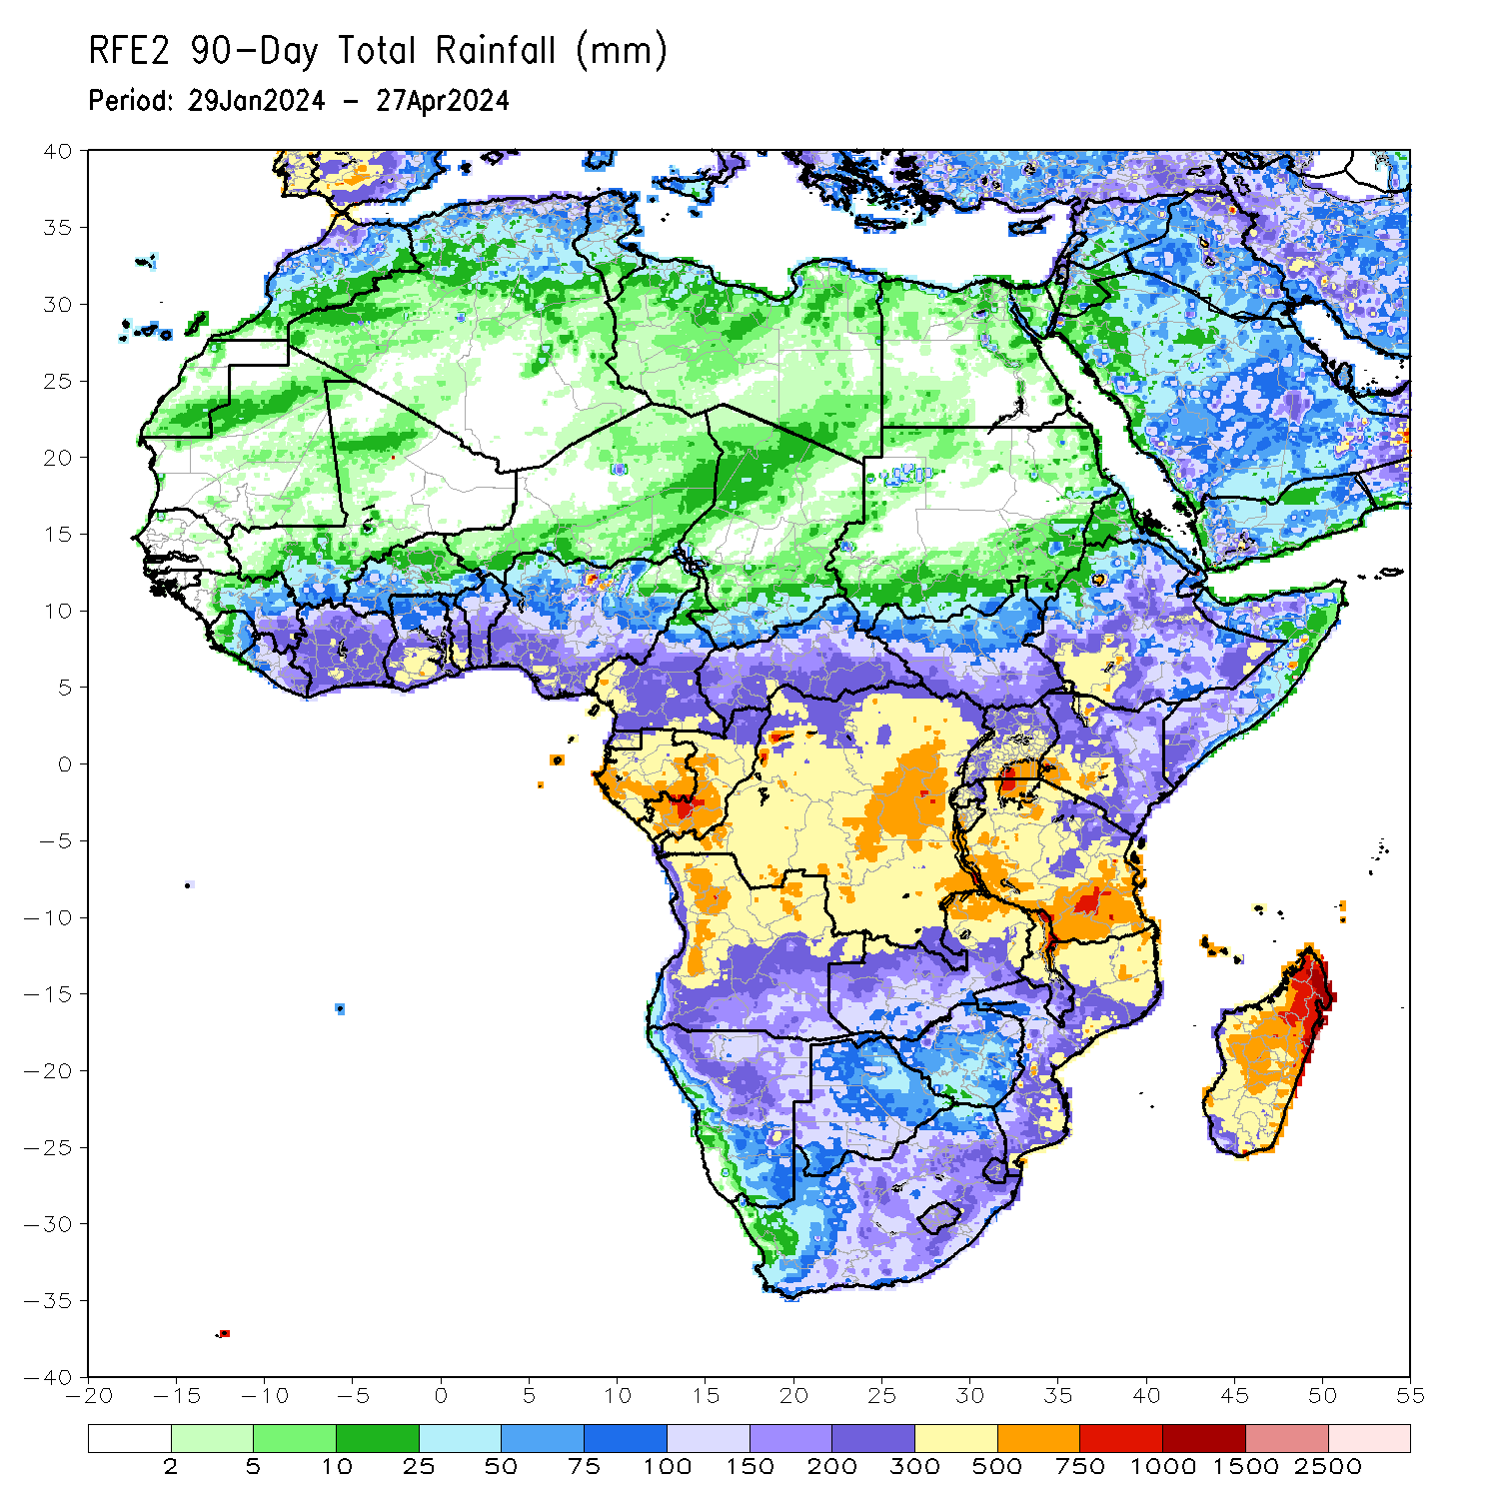
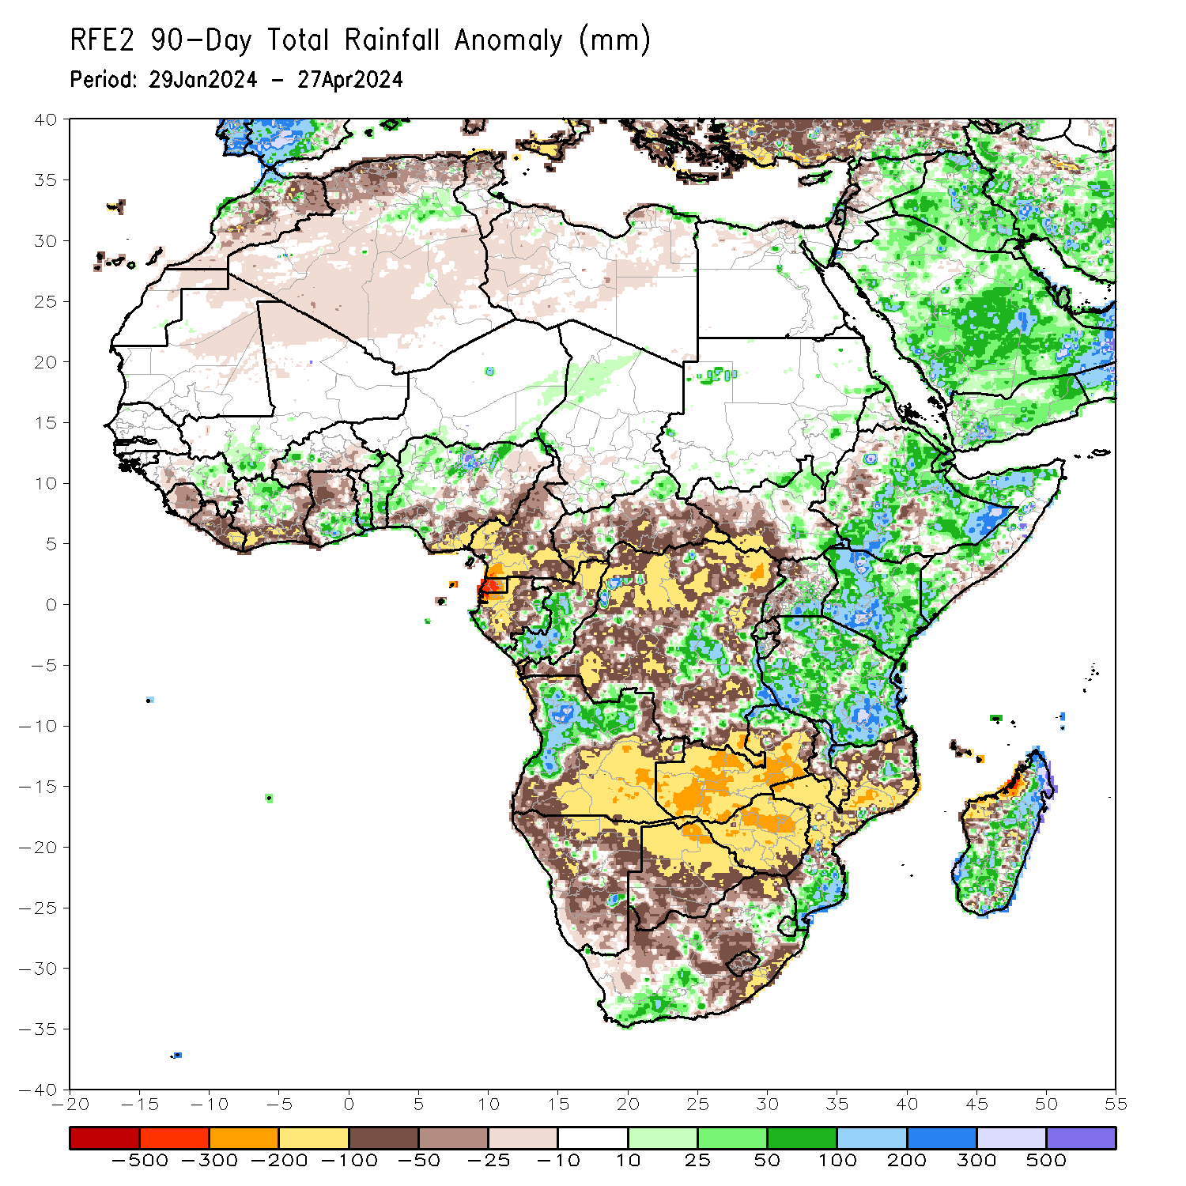
Rainfall Patterns: Last 90 Days
Over the past 90 days, in East Africa, rainfall was above-average in many parts of central, southern northeastern and eastern Ethiopia, southern Eritrea, Djibouti, northern, western and southern Somalia, Kenya, many parts of Tanzania, western parts of Rwanda and Burundi, central-southeastern Uganda, northern and southeastern South Sudan, and some localized regions in southern and eastern Sudan. Rainfall was below-average in western Ethiopia, western and southwestern South Sudan, western Uganda, eastern parts of Rwanda and Burundi, and pockets of localized regions in northwest Tanzania and eastern Somalia. In Central Africa, rainfall was above-average in central and southern Congo, some pockets of regions in northern Central African Republic (CAR), and some regions in central and southeastern Democratic Republic of the Congo (DRC). Rainfall was below-average in Equatorial Guinea, many parts of Cameroon, northern, western and central Gabon, northern Congo, southwestern, central, southern and eastern CAR, and northern, northeastern, western and southern DRC. In West Africa, Rainfall was above-average in some parts of eastern Guinea, southern Mali, northern Cote d’Ivoire, southern Ghana, central and southern Togo, many parts of Benin, northern and western Nigeria, and southeastern Niger. Rainfall was below-average in southwestern Guinea, Sierra Leone, Liberia, southern and eastern Cote d’Ivoire, western and northern Ghana, and southeastern and eastern Nigeria. In southern Africa, rainfall was above-average in western-central and northern Angola, southeastern South Africa, Eswatini, southern Mozambique, some localized regions in northern Zambia and northern Malawi, and northern, central-eastern and southern parts of Madagascar. Rainfall was below-average across southwestern, southern and eastern Angola, many parts of Namibia, Botswana, Zimbabwe and Lesotho, western, central, southern and eastern Zimbabwe, southern Malawi, western and central Mozambique, western, central and eastern South Africa, and western Madagascar.
Notes:
4

Slide 5
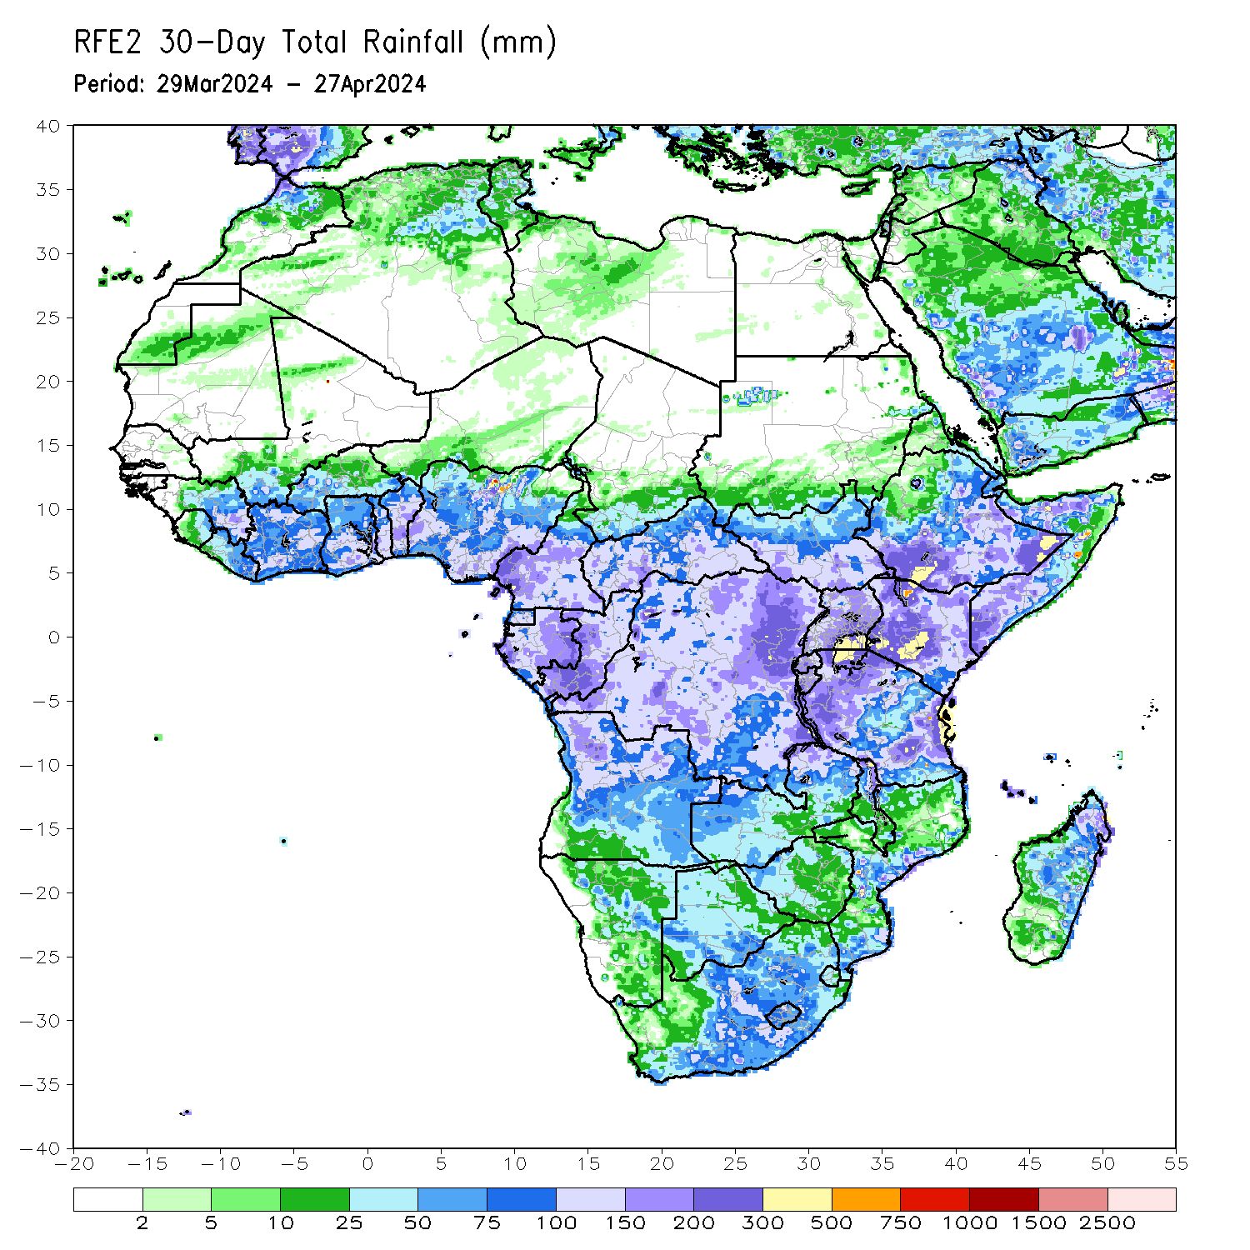
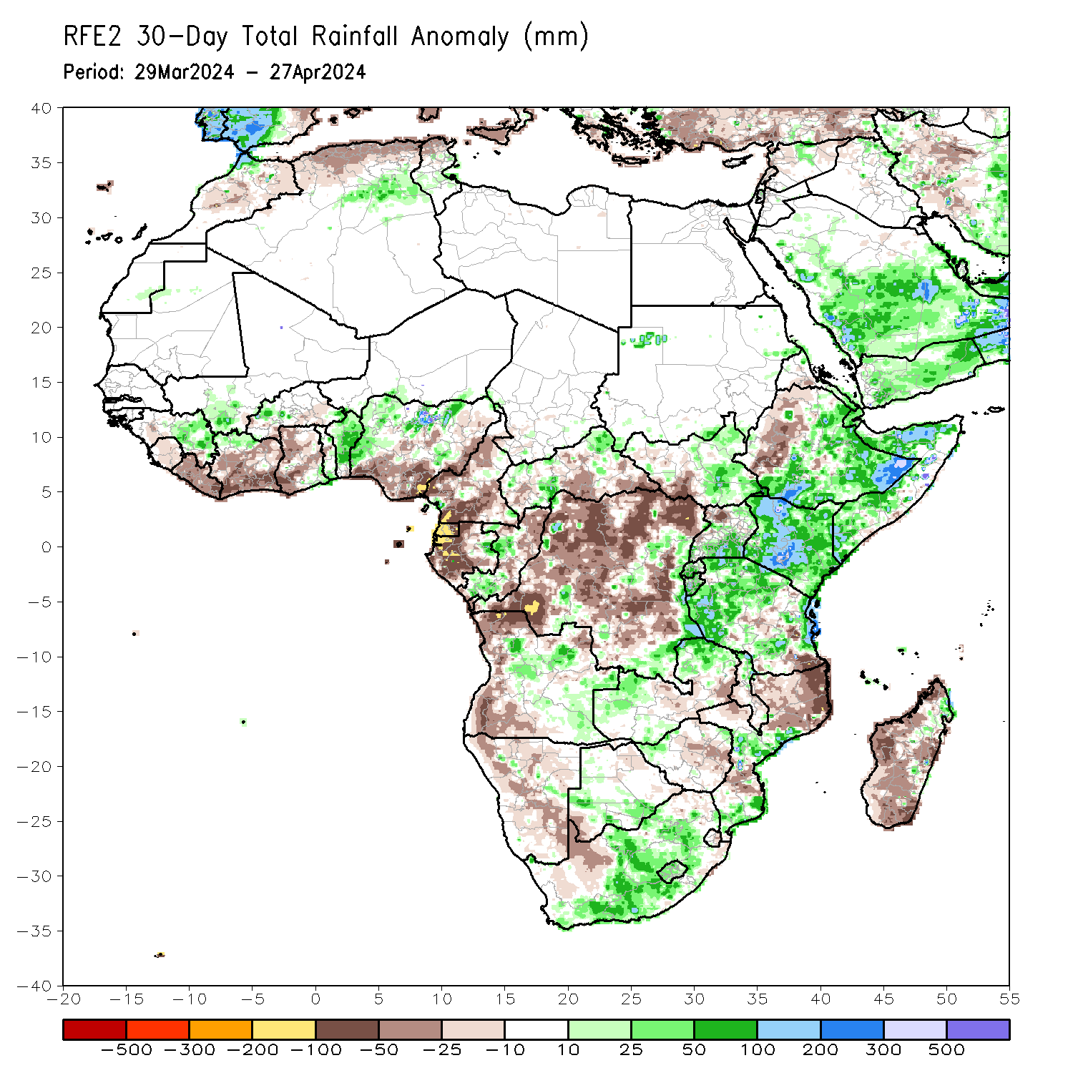
Rainfall Patterns: Last 30 Days
Over the past 30 days, in East Africa, rainfall was above-average in central, southern and eastern Ethiopia, southern Eritrea, Djibouti, northern, western and southern Somalia, Kenya, northeastern and central-southeastern South Sudan, southern, central and northeastern Uganda, Rwanda, Burundi, and northern, western-central and eastern Tanzania. Rainfall was below-average in western Ethiopia, southwestern South Sudan, and northwestern Uganda. In Central Africa, rainfall was above-average in eastern Gabon, southern Congo, some pockets of regions in northern and southwestern Central African Republic (CAR), and some localized regions in eastern and southeastern Democratic Republic of the Congo (DRC). Rainfall was below-average in Equatorial Guinea, western and southern Cameroon, western-central Gabon, northern Congo, northern, western, central and northwestern DRC. In West Africa, Rainfall was above-average eastern Guinea, southern Mali, northern Cote d’Ivoire, and pockets of regions in southwestern Burkina Faso, southern Togo, Benin, and western and northern Nigeria. Rainfall was below-average in Sierra Leone, Liberia, central, southern and eastern Cote d’Ivoire, northern, western and central Ghana, and southern and eastern Nigeria. In southern Africa, rainfall was above-average in central and southeastern eastern Angola, western and northern Zambia, southwestern Zimbabwe, northeastern Malawi, central and southern Mozambique, southern Botswana, western, central and southeastern South Africa, Lesotho, and pockets of localized region in northeastern Madagascar. Rainfall was below-average across northern, western, and southwestern Angola, northern, central and southeastern Namibia, central Zambia, central Zimbabwe, northern Mozambique, southwestern South Africa, and northwestern, western, central-eastern and southern Madagascar.
Notes:
5

Slide 6
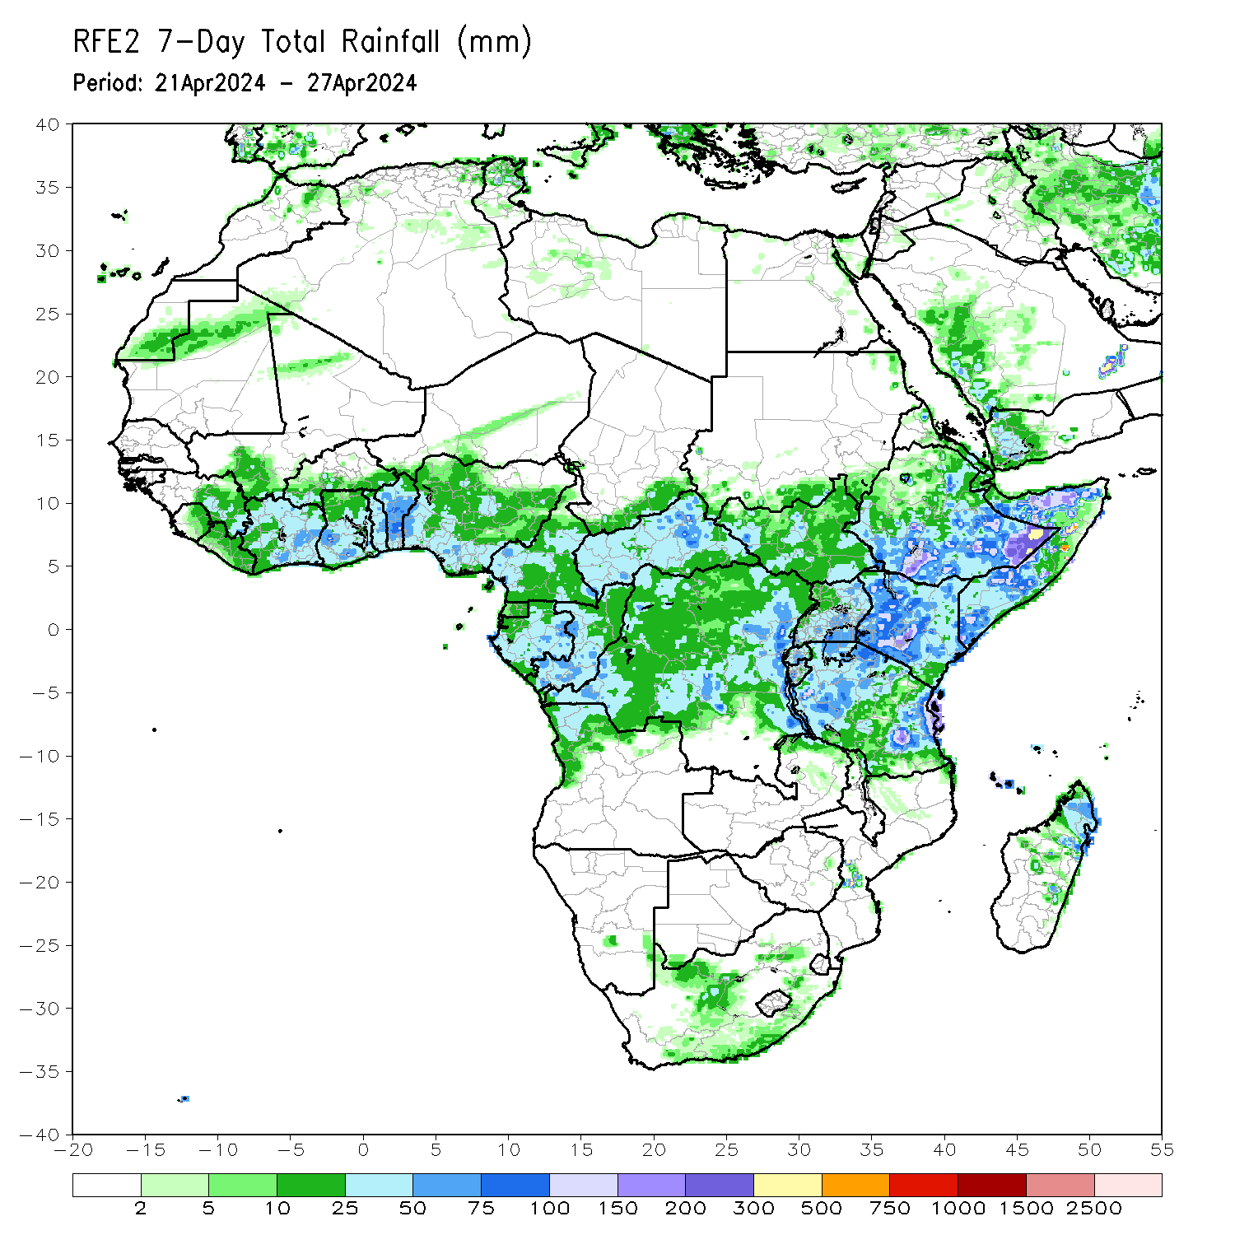
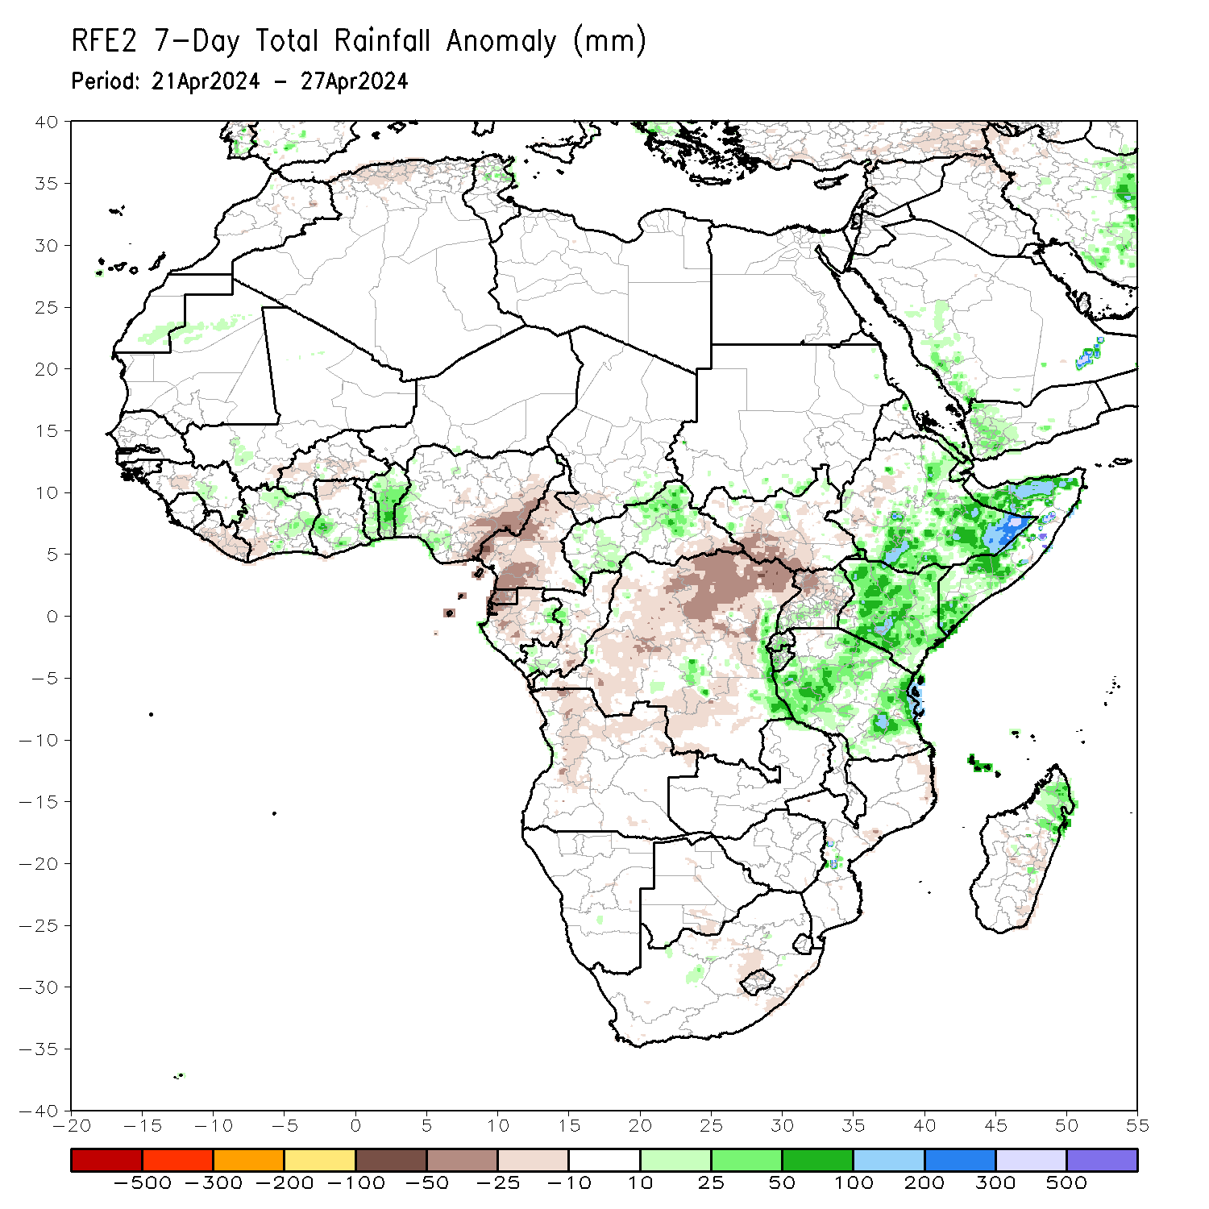
Rainfall Patterns: Last 7 Days
During the past 7 days, in East Africa, rainfall was above-average in central, southern and eastern Ethiopia, many parts of northern, western and southern Somalia, southern Eritrea, Djibouti, Kenya, and northern, central, western and eastern Tanzania, central and southern Rwanda, Burundi, southwestern and northeastern Uganda, and pockets of localized regions in southern Sudan and northern South Sudan. Rainfall was below-average in southwestern-central South Sudan, northwestern-central Uganda, and some regions in southwestern-central Ethiopia. In central Africa, rainfall was above-average in western and northern-central Central African Republic (CAR), and some localized regions in eastern Gabon, southern Congo and central and eastern Democratic Republic of the Congo (DRC). Rainfall was below-average in many parts of Cameroon and Equatorial Guinea, northern, western and southeastern Gabon, many parts of northern, central and southwestern DRC, southeastern CAR, and central Congo. In West Africa, rainfall was above-average in some parts of northern and central-eastern Cote d’Ivoire, southwestern Ghana, central and southern Togo, Benin, southwestern Nigeria, and pockets of localized regions in southern Guinea and southwestern Mali. Rainfall was below-average in central, southern and eastern Liberia, southwestern Cote d’Ivoire, northern Ghana, central Burkina Faso, and eastern Nigeria. In southern Africa, rainfall was above-average in northern Madagascar and pockets of the localized region in central Mozambique. Rainfall was below-average in northern-western and northeastern Angola and pockets of region in central South Africa, western Lesotho, northeastern Mozambique, and central-eastern Madagascar.

Slide 7
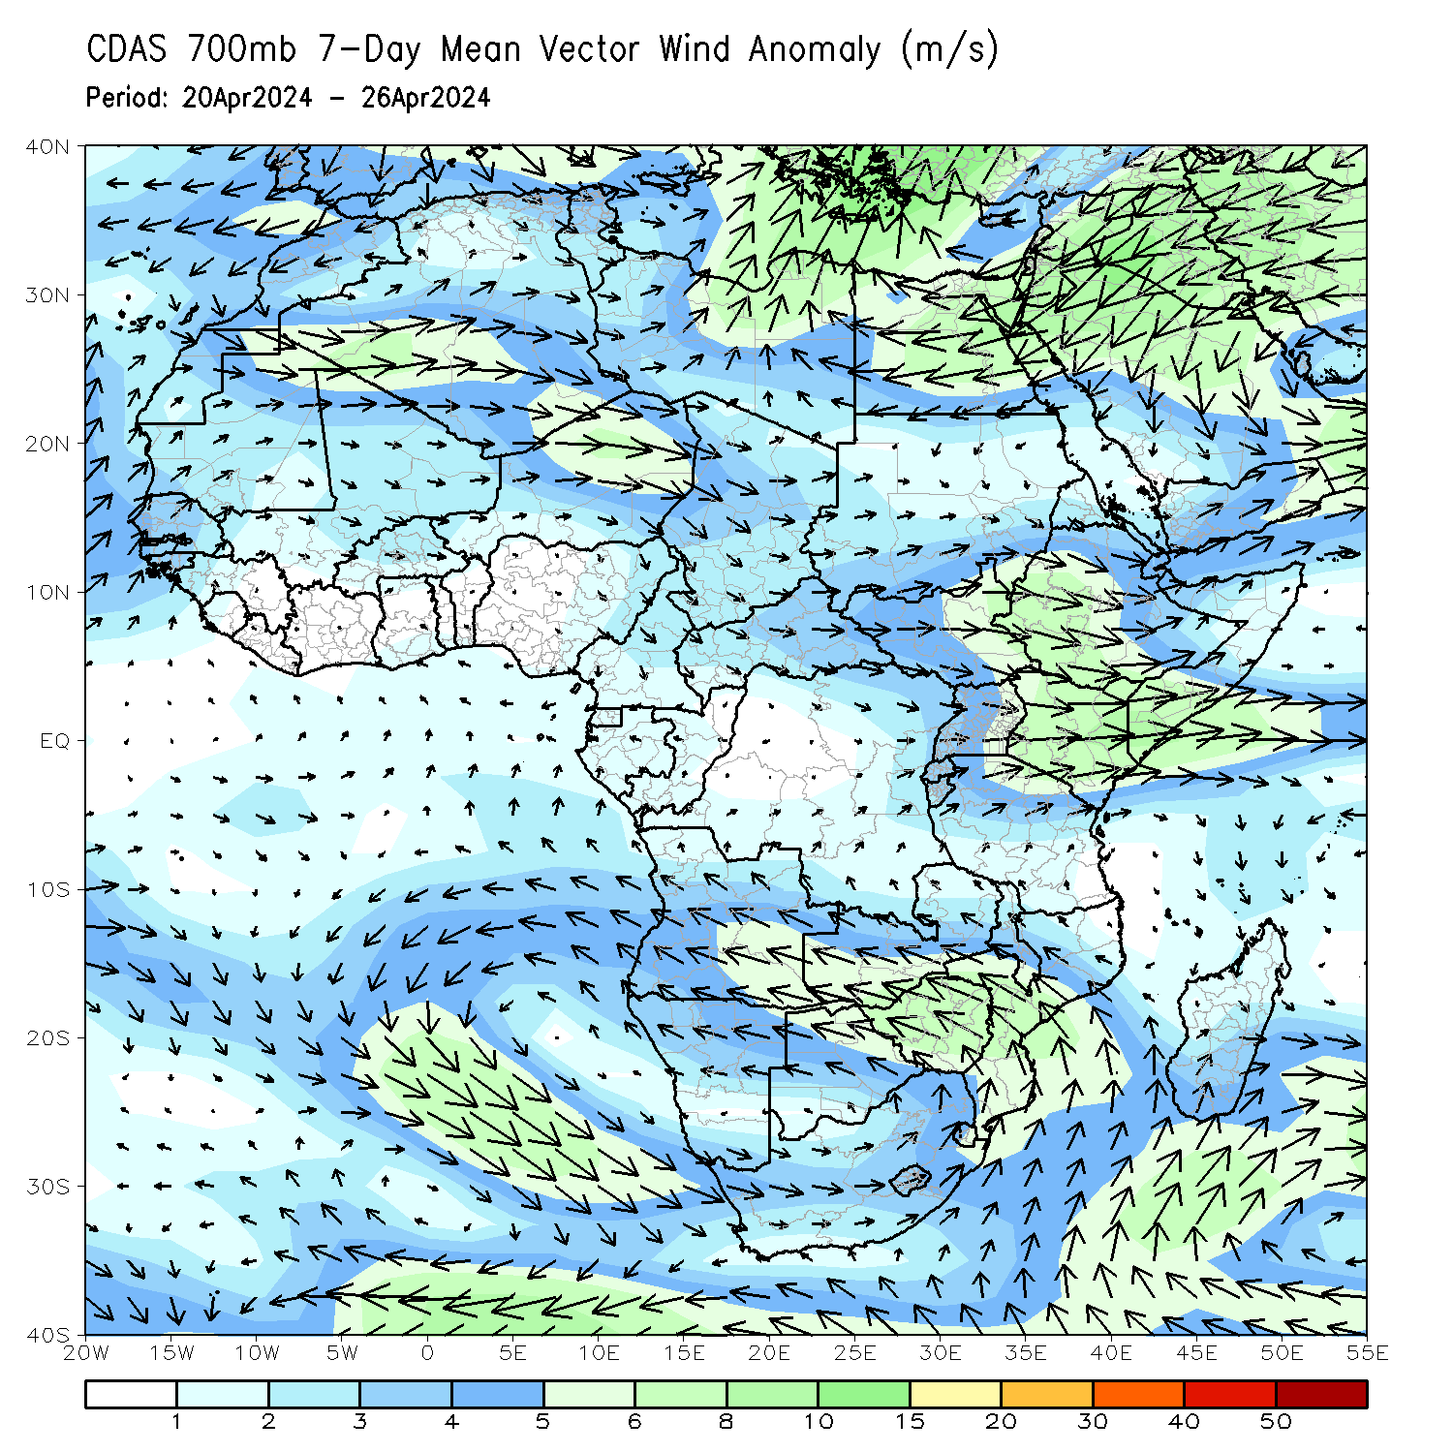
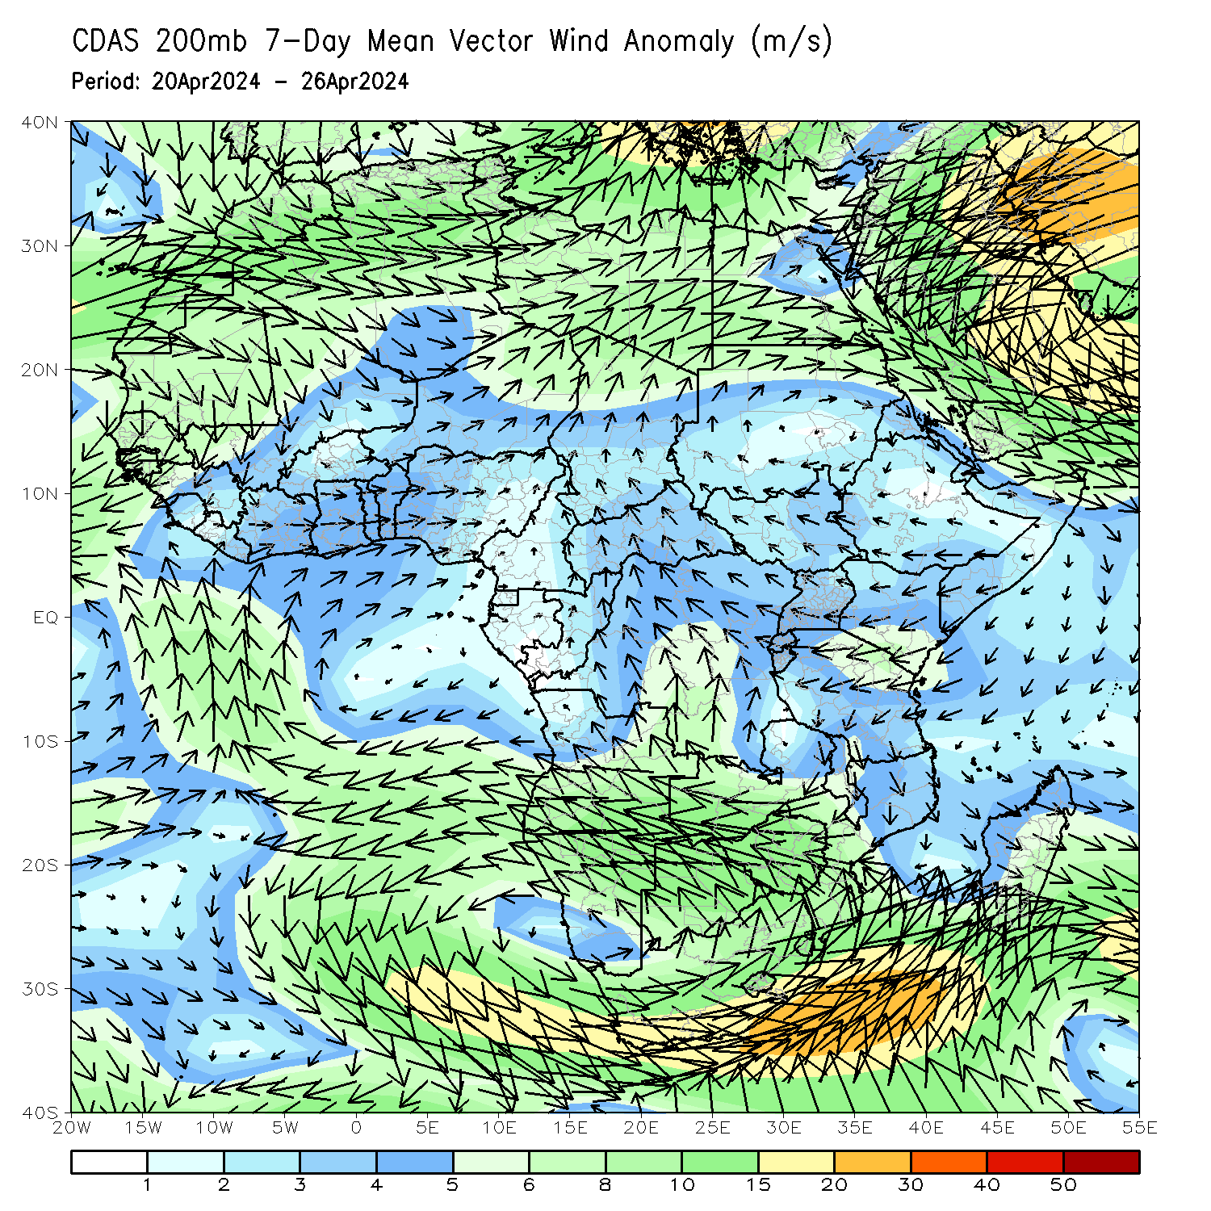
Atmospheric Circulation: Last 7 Days
At 700-hPa level (left panel), lower-level anomalous wind convergence across eastern Africa may have contributed to the observed rainfall increases across eastern parts of Africa.

Slide 8
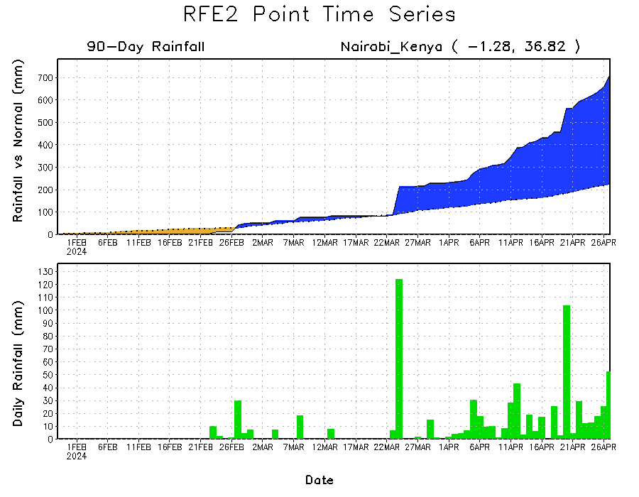
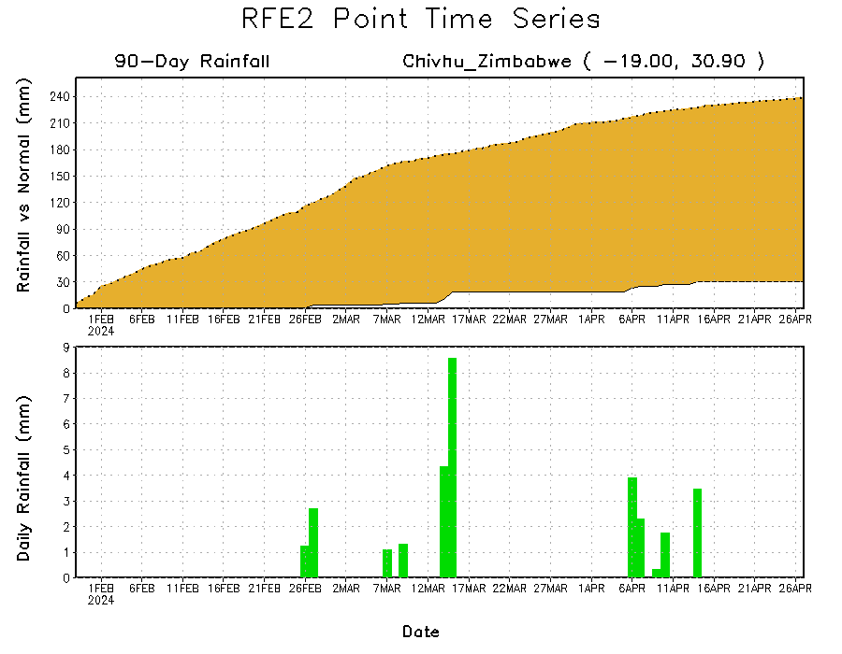
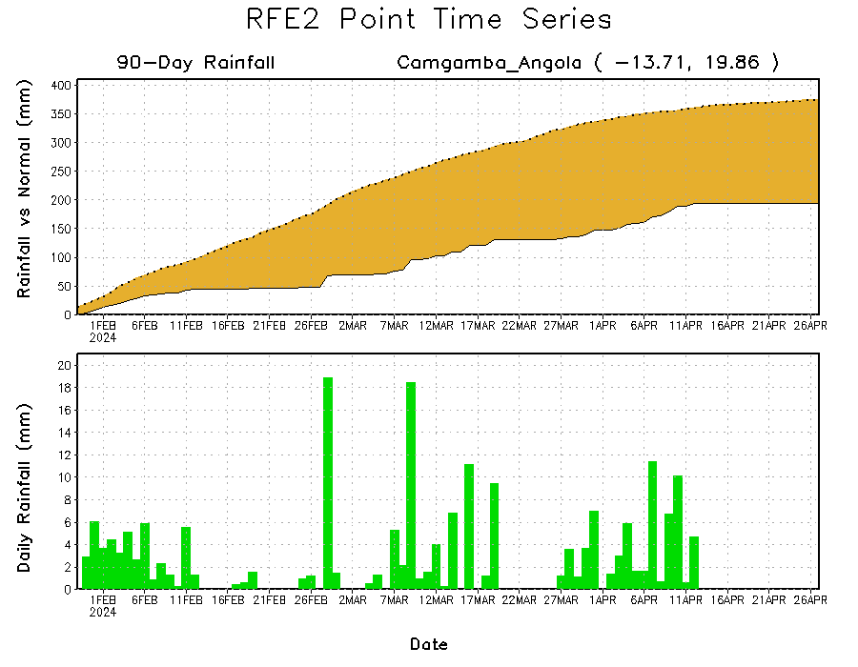
Rainfall Evolution
Daily evolution in rainfall at selected locations over the past 90 days shows deficits over eastern Angola (bottom Left) and much of central Zimbabwe (bottom right). Conversely, rainfall surpluses persist in western and southern Kenya due to significant rainfall observed in last 1-month period (top right).

Slide 9
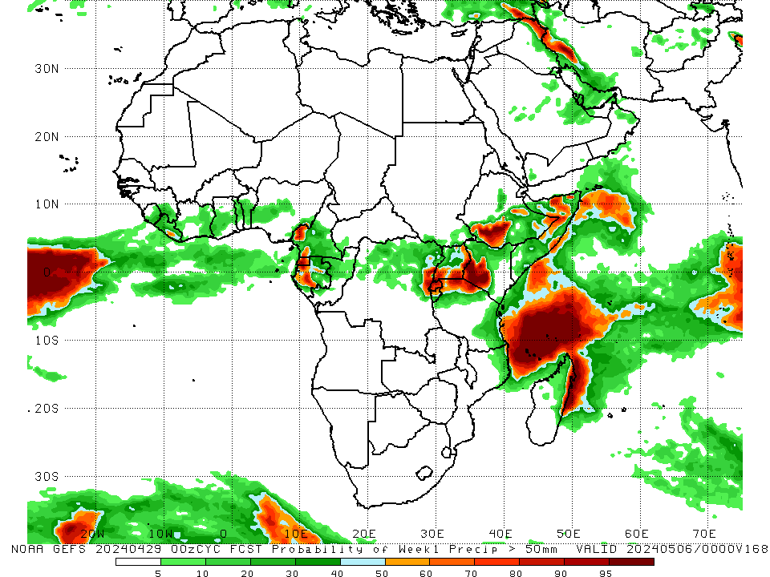
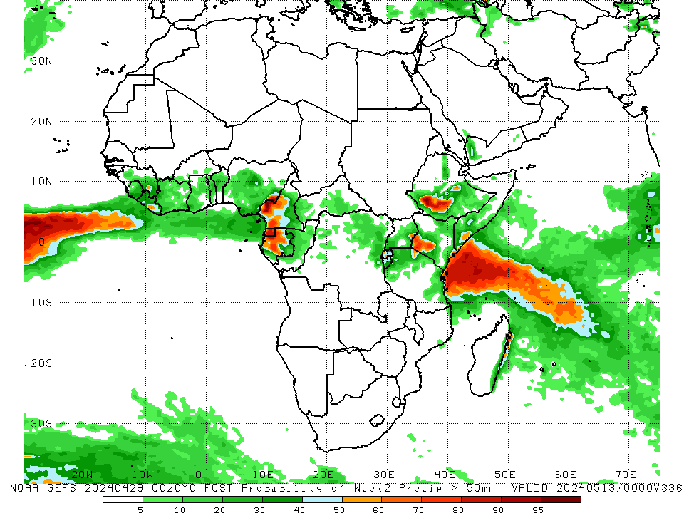
NCEP GEFS Model Forecasts Non-Bias Corrected Probability of precipitation exceedance
Week-1, Valid: 30Apr – 06May, 2024
Week-2, Valid: 07May – 13May, 2024
For week-1 (left panel) the NCEP GEFS indicates a moderate to high chance (over 70%) for rainfall to exceed 50 mm over Equatorial Guinea, pockets of regions in southwestern Cameroon, southwestern Gabon and eastern DRC, Rwanda, northern Tanzania, southern and eastern Uganda, southwestern Ethiopia, northwestern Somalia, and eastern Madagascar. For week-2 (right panel), NCEP GEFS indicates a moderate to high chance (over 70%) for rainfall to exceed 50 mm over Equatorial Guinea, southwestern Cameroon, central Gabon, southwestern Ethiopia, and southwestern Kenya.
Notes:
9

Slide 10
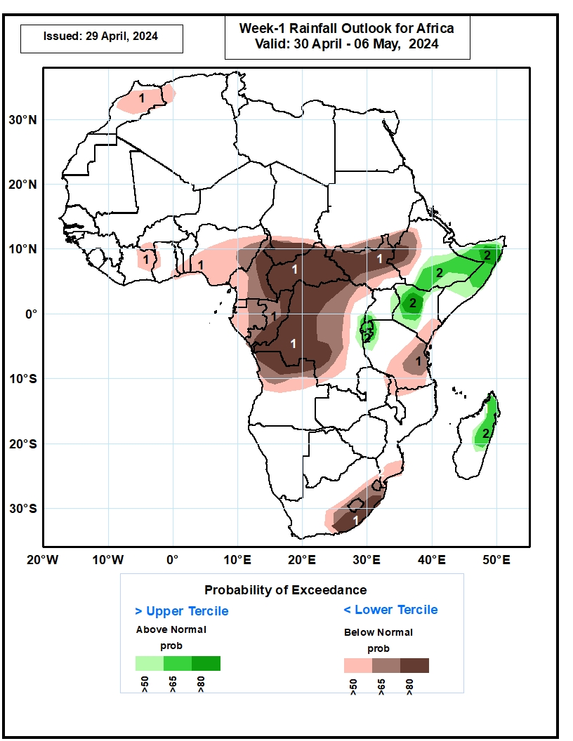
Week-1 Precipitation Outlooks
30 April – 06 May, 2024
The probabilistic forecasts call for above 50% chance for weekly rainfall to be below-normal (below the lower tercile) across the eastern portion of the Gulf of Guinea region and much of Central Africa, and parts of southeastern Kenya, eastern Tanzania, eastern South Africa, Lesotho, Eswatini, and southern Mozambique. There is above 80% chance for below-normal rainfall over southern Chad, parts of Congo, much of CAR, western and northern DRC, northern Angola, South Sudan, southwestern Ethiopia, and southeastern South Africa.
The probabilistic forecasts call for above 50% chance for weekly total rainfall to be above-normal (above the upper tercile) across parts of equatorial East Africa. There is above 65% chance for above-normal rainfall over southeastern Ethiopia, central Somalia, and western Kenya.
Notes:
10

Slide 11
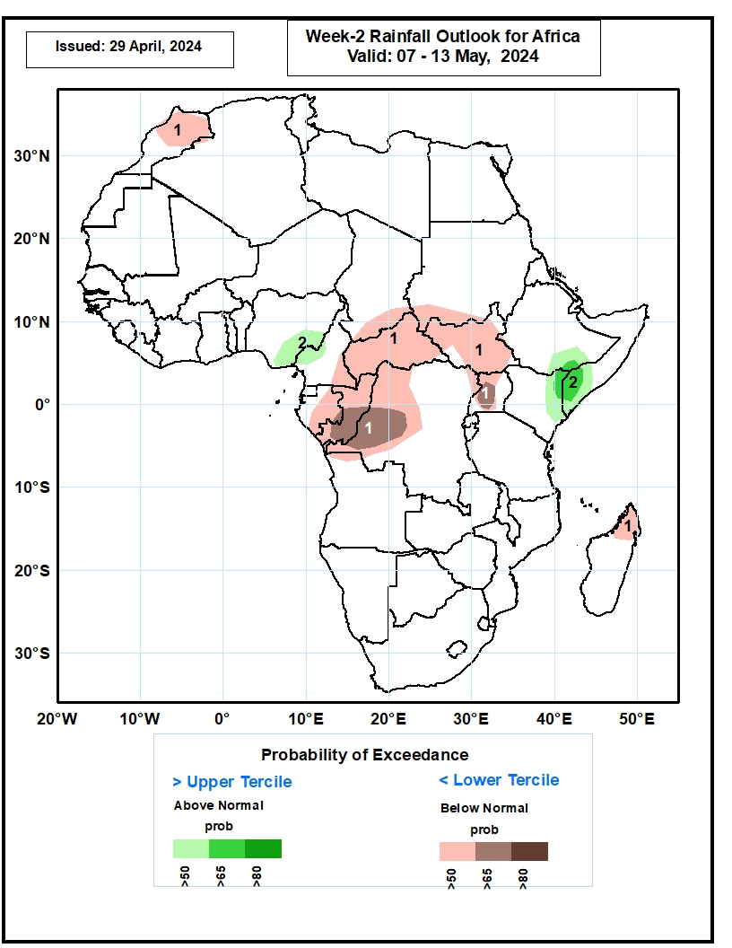
Week-2 Precipitation Outlooks
07– 13 May, 2024
The probabilistic forecasts call for above 50% chance for weekly rainfall to be below-normal (below the lower tercile) over northern Morocco, eastern Gabon, southeastern Chad, CAR, Congo, western and northern DRC, South Sudan, Uganda and northern Madagascar. There is above 65% chance for below-normal rainfall over southern Congo, western DRC and western Uganda.
The probabilistic forecasts call for above 50% chance for weekly total rainfall to be above-normal (above the upper tercile) over eastern Nigeria, southeastern Ethiopia, eastern Kenya and southwestern Somalia. There is above 65% chance for above-normal rainfall over southwestern Somalia.
Notes:
11

Slide 12
Summary
Over the past 30 days, in East Africa, rainfall was above-average in central, southern and eastern Ethiopia, southern Eritrea, Djibouti, northern, western and southern Somalia, Kenya, northeastern and central-southeastern South Sudan, southern, central and northeastern Uganda, Rwanda, Burundi, and northern, western-central and eastern Tanzania. Rainfall was below-average in western Ethiopia, southwestern South Sudan, and northwestern Uganda. In Central Africa, rainfall was above-average in eastern Gabon, southern Congo, some pockets of regions in northern and southwestern Central African Republic (CAR), and some localized regions in eastern and southeastern Democratic Republic of the Congo (DRC). Rainfall was below-average in Equatorial Guinea, western and southern Cameroon, western-central Gabon, northern Congo, northern, western, central and northwestern DRC. In West Africa, Rainfall was above-average eastern Guinea, southern Mali, northern Cote d’Ivoire, and pockets of regions in southwestern Burkina Faso, southern Togo, Benin, and western and northern Nigeria. Rainfall was below-average in Sierra Leone, Liberia, central, southern and eastern Cote d’Ivoire, northern, western and central Ghana, and southern and eastern Nigeria. In southern Africa, rainfall was above-average in central and southeastern eastern Angola, western and northern Zambia, southwestern Zimbabwe, northeastern Malawi, central and southern Mozambique, southern Botswana, western, central and southeastern South Africa, Lesotho, and pockets of localized region in northeastern Madagascar. Rainfall was below-average across northern, western, and southwestern Angola, northern, central and southeastern Namibia, central Zambia, central Zimbabwe, northern Mozambique, southwestern South Africa, and northwestern, western, central-eastern and southern Madagascar.
During the past 7 days, in East Africa, rainfall was above-average in central, southern and eastern Ethiopia, many parts of northern, western and southern Somalia, southern Eritrea, Djibouti, Kenya, and northern, central, western and eastern Tanzania, central and southern Rwanda, Burundi, southwestern and northeastern Uganda, and pockets of localized regions in southern Sudan and northern South Sudan. Rainfall was below-average in southwestern-central South Sudan, northwestern-central Uganda, and some regions in southwestern-central Ethiopia. In central Africa, rainfall was above-average in western and northern-central Central African Republic (CAR), and some localized regions in eastern Gabon, southern Congo and central and eastern Democratic Republic of the Congo (DRC). Rainfall was below-average in many parts of Cameroon and Equatorial Guinea, northern, western and southeastern Gabon, many parts of northern, central and southwestern DRC, southeastern CAR, and central Congo. In West Africa, rainfall was above-average in some parts of northern and central-eastern Cote d’Ivoire, southwestern Ghana, central and southern Togo, Benin, southwestern Nigeria, and pockets of localized regions in southern Guinea and southwestern Mali. Rainfall was below-average in central, southern and eastern Liberia, southwestern Cote d’Ivoire, northern Ghana, central Burkina Faso, and eastern Nigeria. In southern Africa, rainfall was above-average in northern Madagascar and pockets of the localized region in central Mozambique. Rainfall was below-average in northern-western and northeastern Angola and pockets of region in central South Africa, western Lesotho, northeastern Mozambique, and central-eastern Madagascar.
The Week-1 outlook calls for above-average rainfall in central and southeastern Ethiopia, northern and central Somalia, northwestern and western Kenya, northern and eastern Uganda, southeastern Tanzania, northeastern Mozambique, and central and northeastern Madagascar. In contrast, there is an increased chance for below-average in many parts of Gulf of Guinea coast countries and central Africa, South Sudan, Uganda, western Ethiopia, southern Mozambique, western, central and eastern South Africa, Lesotho, Eswatini. The Week-2 outlook calls for above-average rainfall in central and southeastern Ethiopia, southern Somalia, and northeastern, eastern and southwestern Kenya. In contrast, there is an increased chance for below-average in some parts of Gulf of Guinea coast countries, many parts of central Africa, South Sudan, Uganda, western Ethiopia, Tanzania, northern Mozambique, central and eastern South Africa, and Lesotho.

