Slide 1
The African Monsoon Recent Evolution and Current Status Include Week-1 and Week-2 Outlooks
Update prepared
04 March 2024
For more information, visit:
http://www.cpc.ncep.noaa.gov/products/Global_Monsoons/African_Monsoons/precip_monitoring.shtml

Slide 2
Outline
Highlights
Recent Evolution and Current Conditions
NCEP GEFS Forecasts
Summary

Slide 3
Highlights: Last 7 Days
During the past 7 days, in East Africa, rainfall was above-average in southwestern and pockets of central Ethiopia, western, northwestern, southern and western-central Kenya, western, central, southern and eastern Uganda, many parts of Tanzania, western Burundi and eastern Rwanda. Rainfall was below average in pockets of regions in southern Ethiopia. In central Africa, rainfall was above-average in central and southeastern DRC, pockets of northwestern CAR and central Congo, and western-central and eastern Cameroon. Rainfall was below-average in southern and southeastern CAR, northwestern, northern, northeastern and southwestern DRC, northern and southern Congo, southern Cameroon, and many parts of Equatorial Guinea and Gabon. In West Africa, rainfall was above-average in central and northern Cote d’Ivoire, western Ghana, southern parts of Togo and Benin, and southwestern Nigeria. Rainfall was below-average in southeastern Guinea, eastern Liberia, and pockets of southeastern Cote d’Ivoire and southern Ghana. In southern Africa, rainfall was above-average in western-central and northeastern Angola, northern and central Malawi, northern Mozambique, pockets of northern and eastern Zambia, and western and central-eastern Madagascar. Rainfall was below-average across southern and eastern Angola, northwestern and northern Namibia, many parts of Botswana, Zimbabwe, Lesotho and Eswatini, western, central and southern Zambia, western and central Mozambique, southern Malawi, northern, central and eastern South Africa, and northern and southeastern Madagascar.
The Week-1 outlook calls for above-average rainfall in central and southern Uganda, some parts of central and southern Ethiopia, southern Kenya, Rwanda, Burundi, northern, western and central Tanzania, central-northeastern and southern DRC, northern Angola, central and southern Malawi, central parts of Cote d’Ivoire and Ghana, southern Cameroon, northern Gabon and western and southwestern Madagascar. In contrast, there is an increased chance for below-average in many parts of southern Africa, northern DRC, southern Mozambique, southern parts of Togo and Benin, and northern Madagascar. The Week-2 outlook calls for above-normal rainfall in central and southern Cameroon and Congo, central and northern Gabon, Malawi, pockets of northern Mozambique, and southwestern Madagascar. In contrast, there is an increased chance for below-average in many parts of southern Africa, southern Ethiopia, southeastern South Sudan, Uganda, Rwanda, Burundi, western, northern and eastern Tanzania, eastern and southern DRC, northern Madagascar, northern Cote d’Ivoire, and southern Togo and Benin.

Slide 4
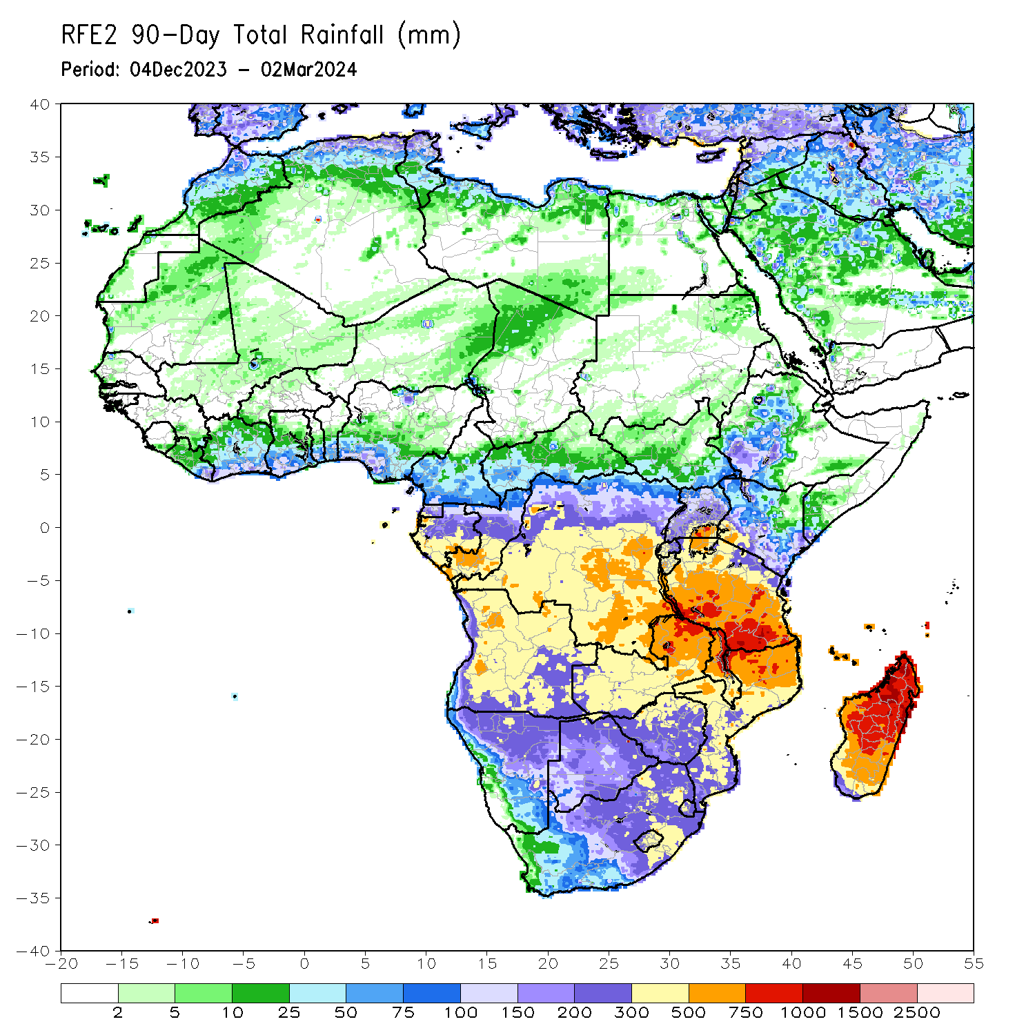
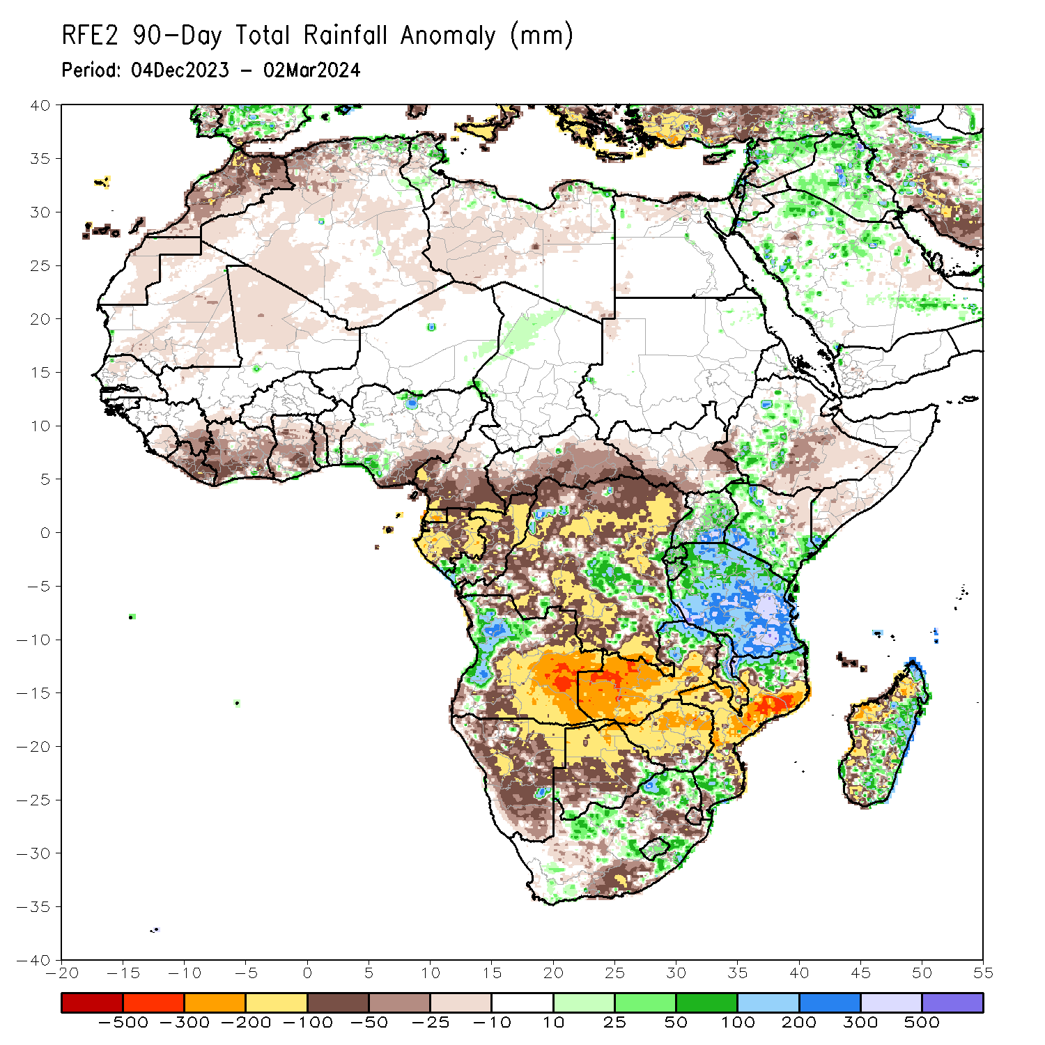
Rainfall Patterns: Last 90 Days
Over the past 90 days, in East Africa, rainfall was above-average in parts of central and southwestern Ethiopia, northern, central, southern and eastern Uganda, and northwestern, western, southern and southeastern Kenya, many prats of Tanzania, Rwanda and Burundi. Rainfall was below-average in western, southwestern, central and eastern South Sudan, southern and central-eastern Ethiopia, southern Somalia, and northeastern and central-eastern Kenya. In Central Africa, rainfall was above-average in some regions in central and southeastern DRC and southern Congo. Rainfall was below-average over in central, western and southern Cameroon, Equatorial Guinea, Gabon, central and northern Congo, western, southern, central and eastern CAR, and many parts of northern, western, northeastern and southern DRC. In West Africa, rainfall was above-average in pockets of southern Togo, Benin and southwestern and northern Nigeria. Rainfall was below-average in northern Senegal, northern and eastern Sierra Leone, Liberia, many parts of Cote d’Ivoire and Ghana, central Togo and Benin, southeastern Nigeria, northern Mali, and central-eastern Mauritania. In southern Africa, rainfall was above-average over western Angola, northern Zambia, northern and eastern Malawi, some regions in northern and southern Mozambique, some parts of northern, western and eastern South Africa, Lesotho, and central and eastern Madagascar. Rainfall was below-average over central, eastern and southern Angola, many parts of Namibia, Botswana, Zimbabwe and Eswatini, western, central, southern and eastern Zambia, southern Malawi, central and western Mozambique, some parts of central and southeastern South Africa, and western and southwestern Madagascar.
Notes:
4

Slide 5
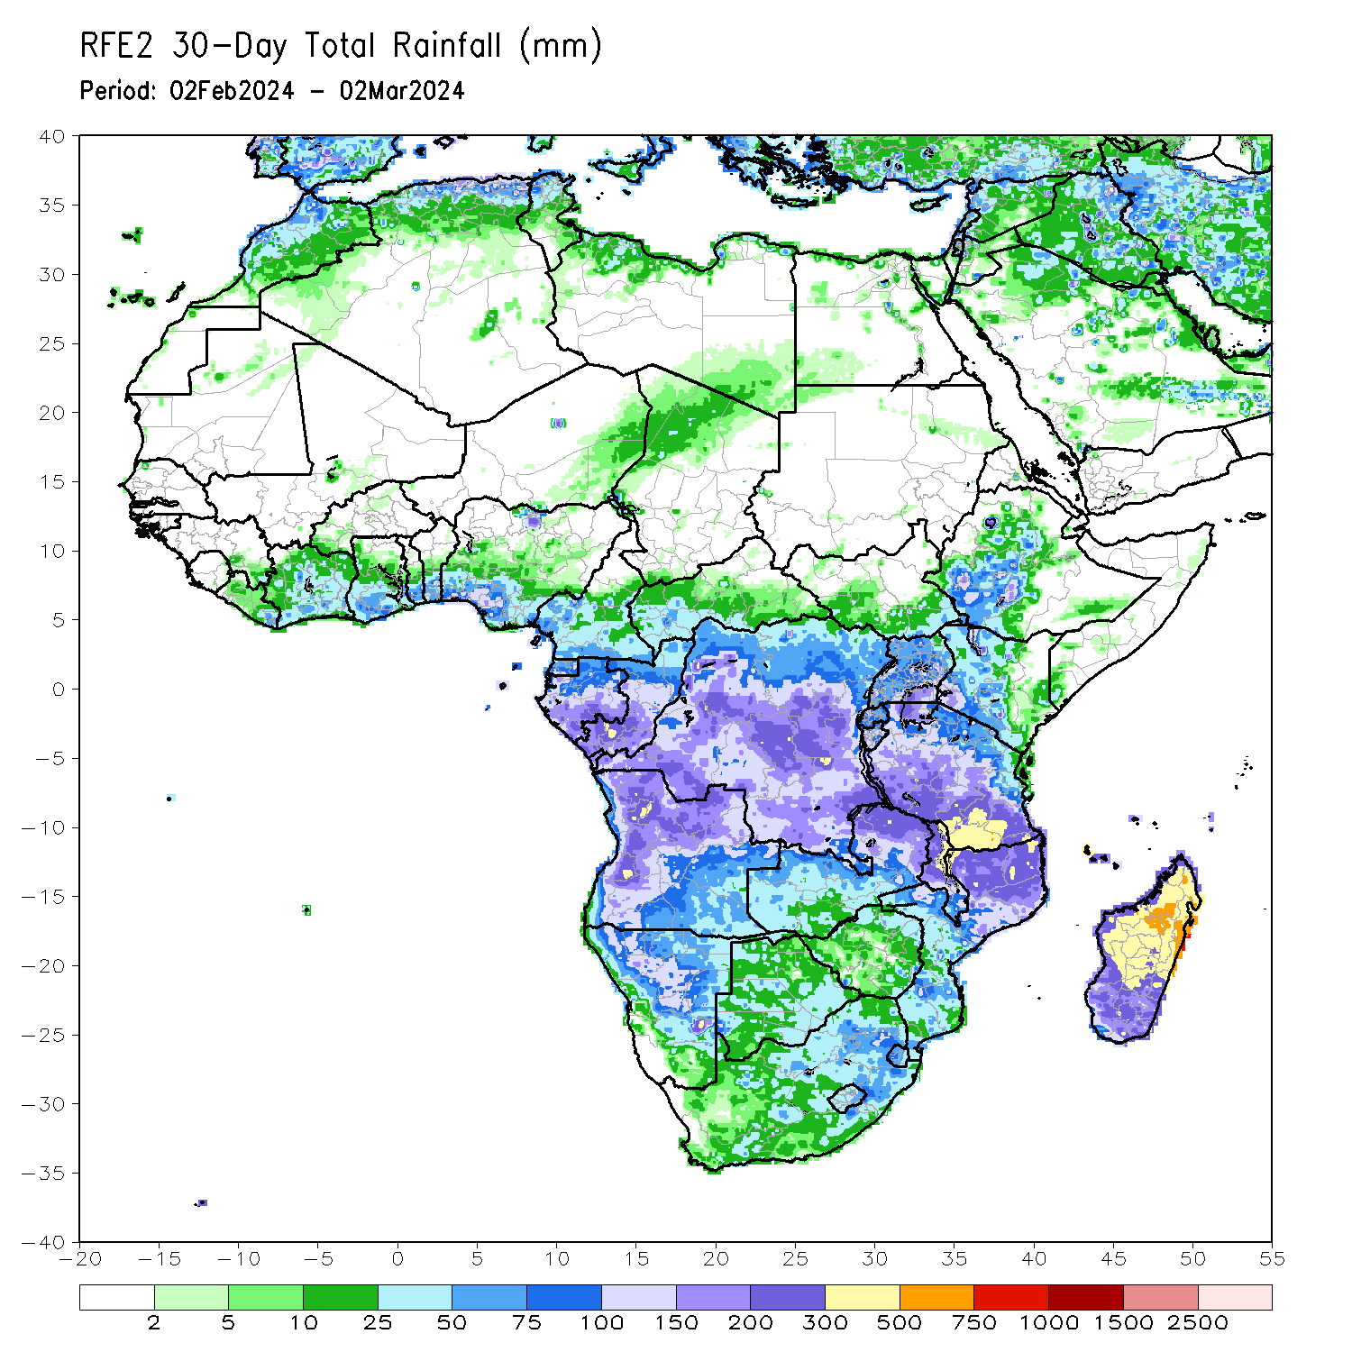
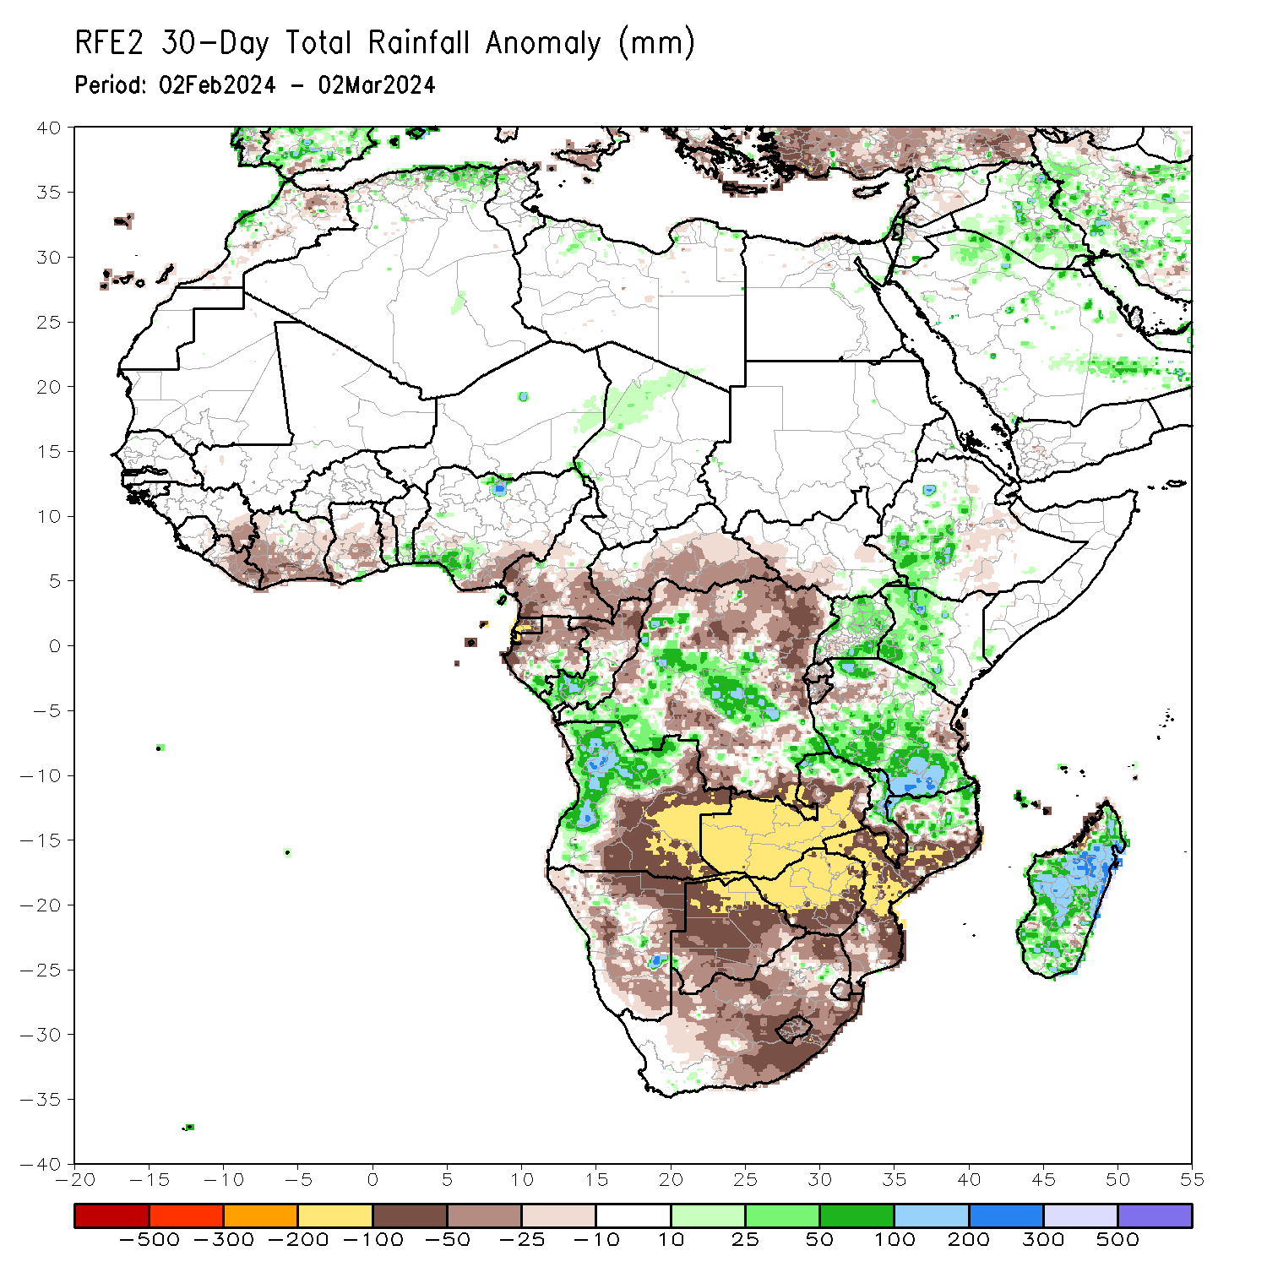
Rainfall Patterns: Last 30 Days
Over the past 30 days, in East Africa, rainfall was above-average in southwestern and some parts of Ethiopia, pockets of southeastern South Sudan, western, northern, central, eastern and southeastern Uganda, northwestern, western, central and southern Kenya, and western, central, southern and northern Tanzania. Rainfall was below-average in western South Sudan, some parts of central-southern Ethiopia, Rwanda, Burundi, and some regions in western and eastern Tanzania. In Central Africa, rainfall was above-average over southwestern and central DRC, southern parts of Gabon and Congo. Rainfall was below-average in central, western and southern Cameroon, Equatorial Guinea, western and northern Gabon, northern Congo, western, southern and eastern CAR, and northern, eastern and southern DRC. In West Africa, rainfall above-average in southern prats of Toga and Benin, and southwestern Nigeria. Rainfall was below-average in eastern Guinea, Liberia, many parts of Cote d’Ivoire and Ghana, central Togo, and southeastern Nigeria. In southern Africa, rainfall was above-average in western and northern Angola, some parts of northern Zambia and northern Mozambique, northern and central Malawi, and many parts of Madagascar. Rainfall was below-average in central, southeastern and eastern Angola, northern, eastern, western and southern Namibia, many parts of Botswana, Zimbabwe, Lesotho and Eswatini, western, central, southern and eastern Zambia, western and central Mozambique, and many parts of northern, western, central and eastern South Africa.
Notes:
5

Slide 6
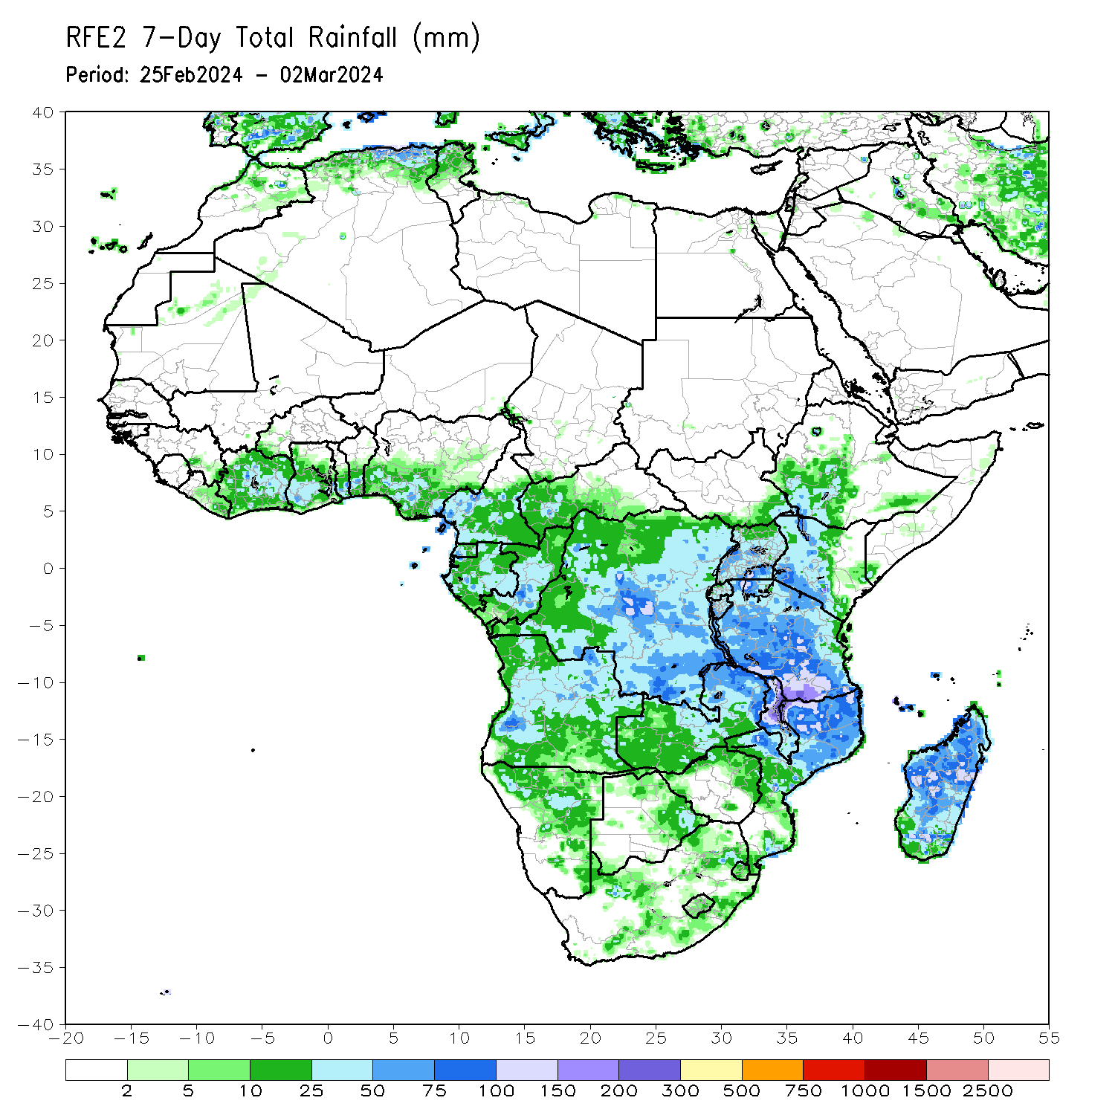
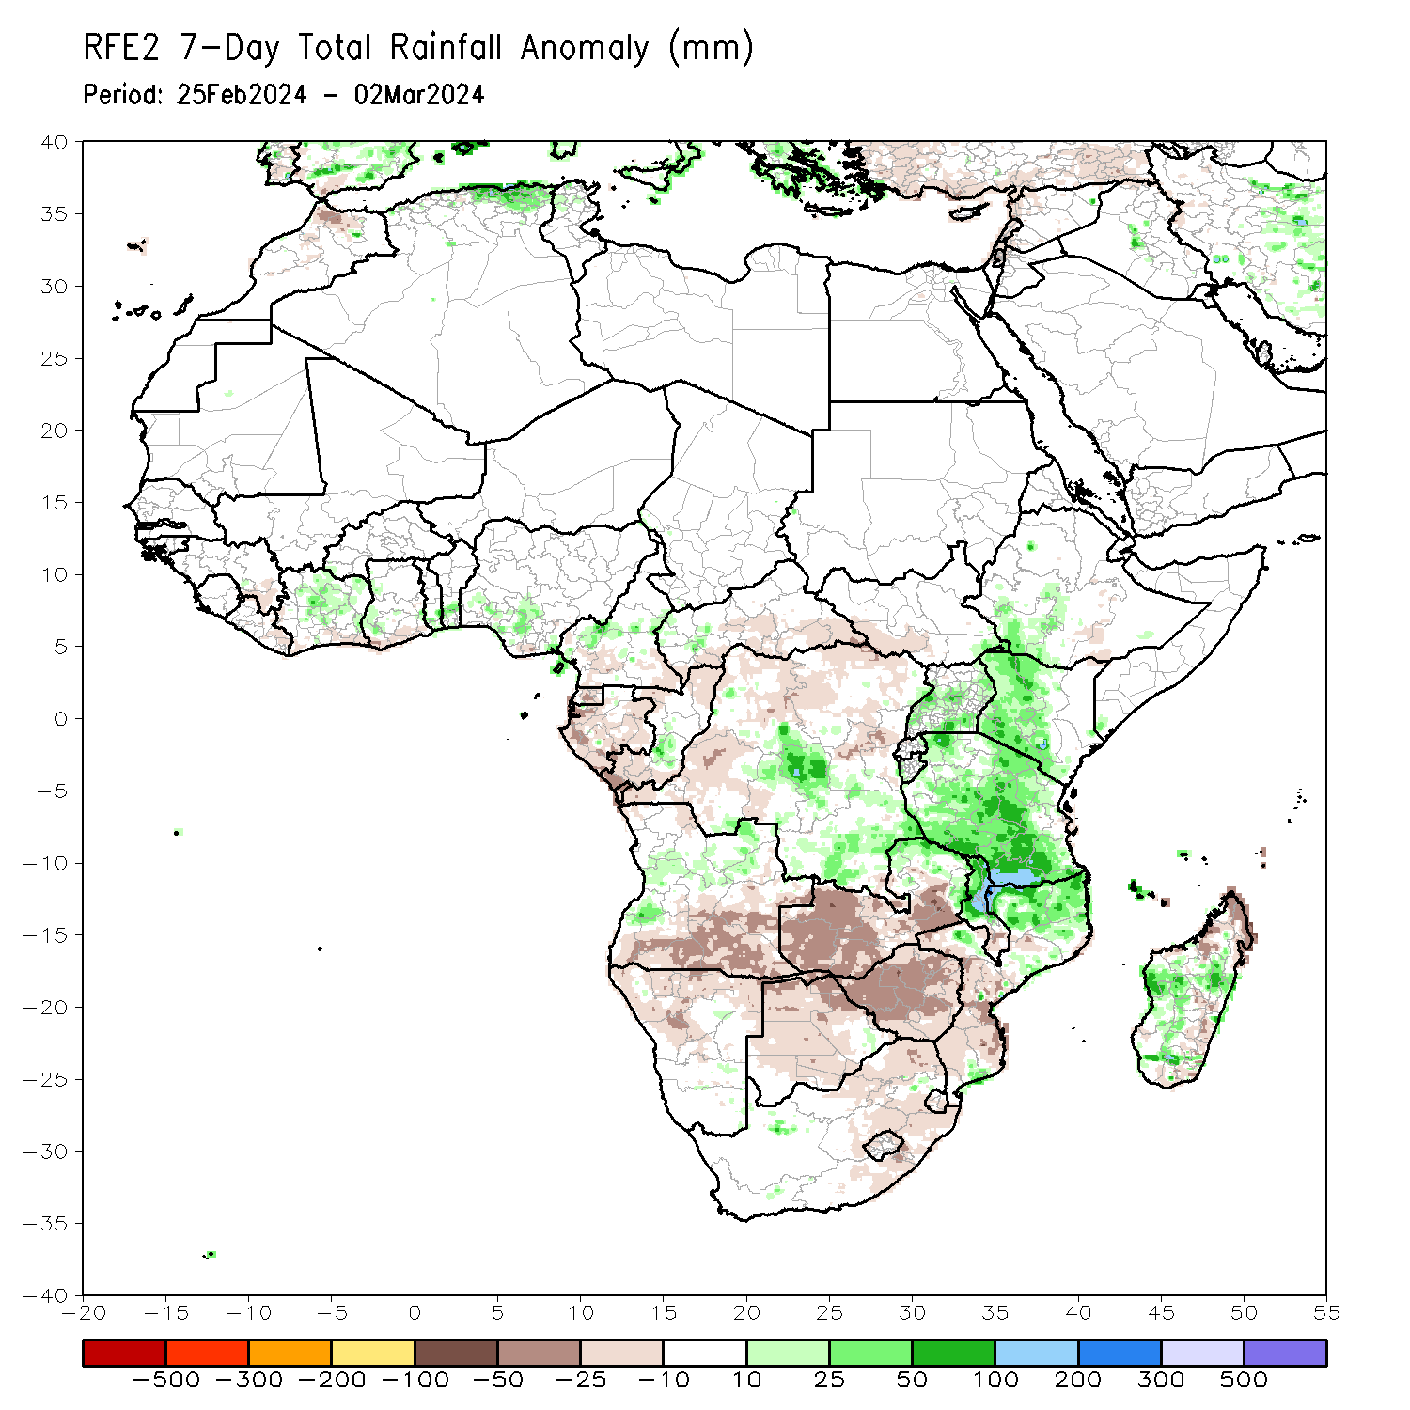
Rainfall Patterns: Last 7 Days
During the past 7 days, in East Africa, rainfall was above-average in southwestern and pockets of central Ethiopia, western, northwestern, southern and western-central Kenya, western, central, southern and eastern Uganda, many parts of Tanzania, western Burundi and eastern Rwanda. Rainfall was below average in pockets of regions in southern Ethiopia. In central Africa, rainfall was above-average in central and southeastern DRC, pockets of northwestern CAR and central Congo, and western-central and eastern Cameroon. Rainfall was below-average in southern and southeastern CAR, northwestern, northern, northeastern and southwestern DRC, northern and southern Congo, southern Cameroon, and many parts of Equatorial Guinea and Gabon. In West Africa, rainfall was above-average in central and northern Cote d’Ivoire, western Ghana, southern parts of Togo and Benin, and southwestern Nigeria. Rainfall was below-average in southeastern Guinea, eastern Liberia, and pockets of southeastern Cote d’Ivoire and southern Ghana. In southern Africa, rainfall was above-average in western-central and northeastern Angola, northern and central Malawi, northern Mozambique, pockets of northern and eastern Zambia, and western and central-eastern Madagascar. Rainfall was below-average across southern and eastern Angola, northwestern and northern Namibia, many parts of Botswana, Zimbabwe, Lesotho and Eswatini, western, central and southern Zambia, western and central Mozambique, southern Malawi, northern, central and eastern South Africa, and northern and southeastern Madagascar.

Slide 7
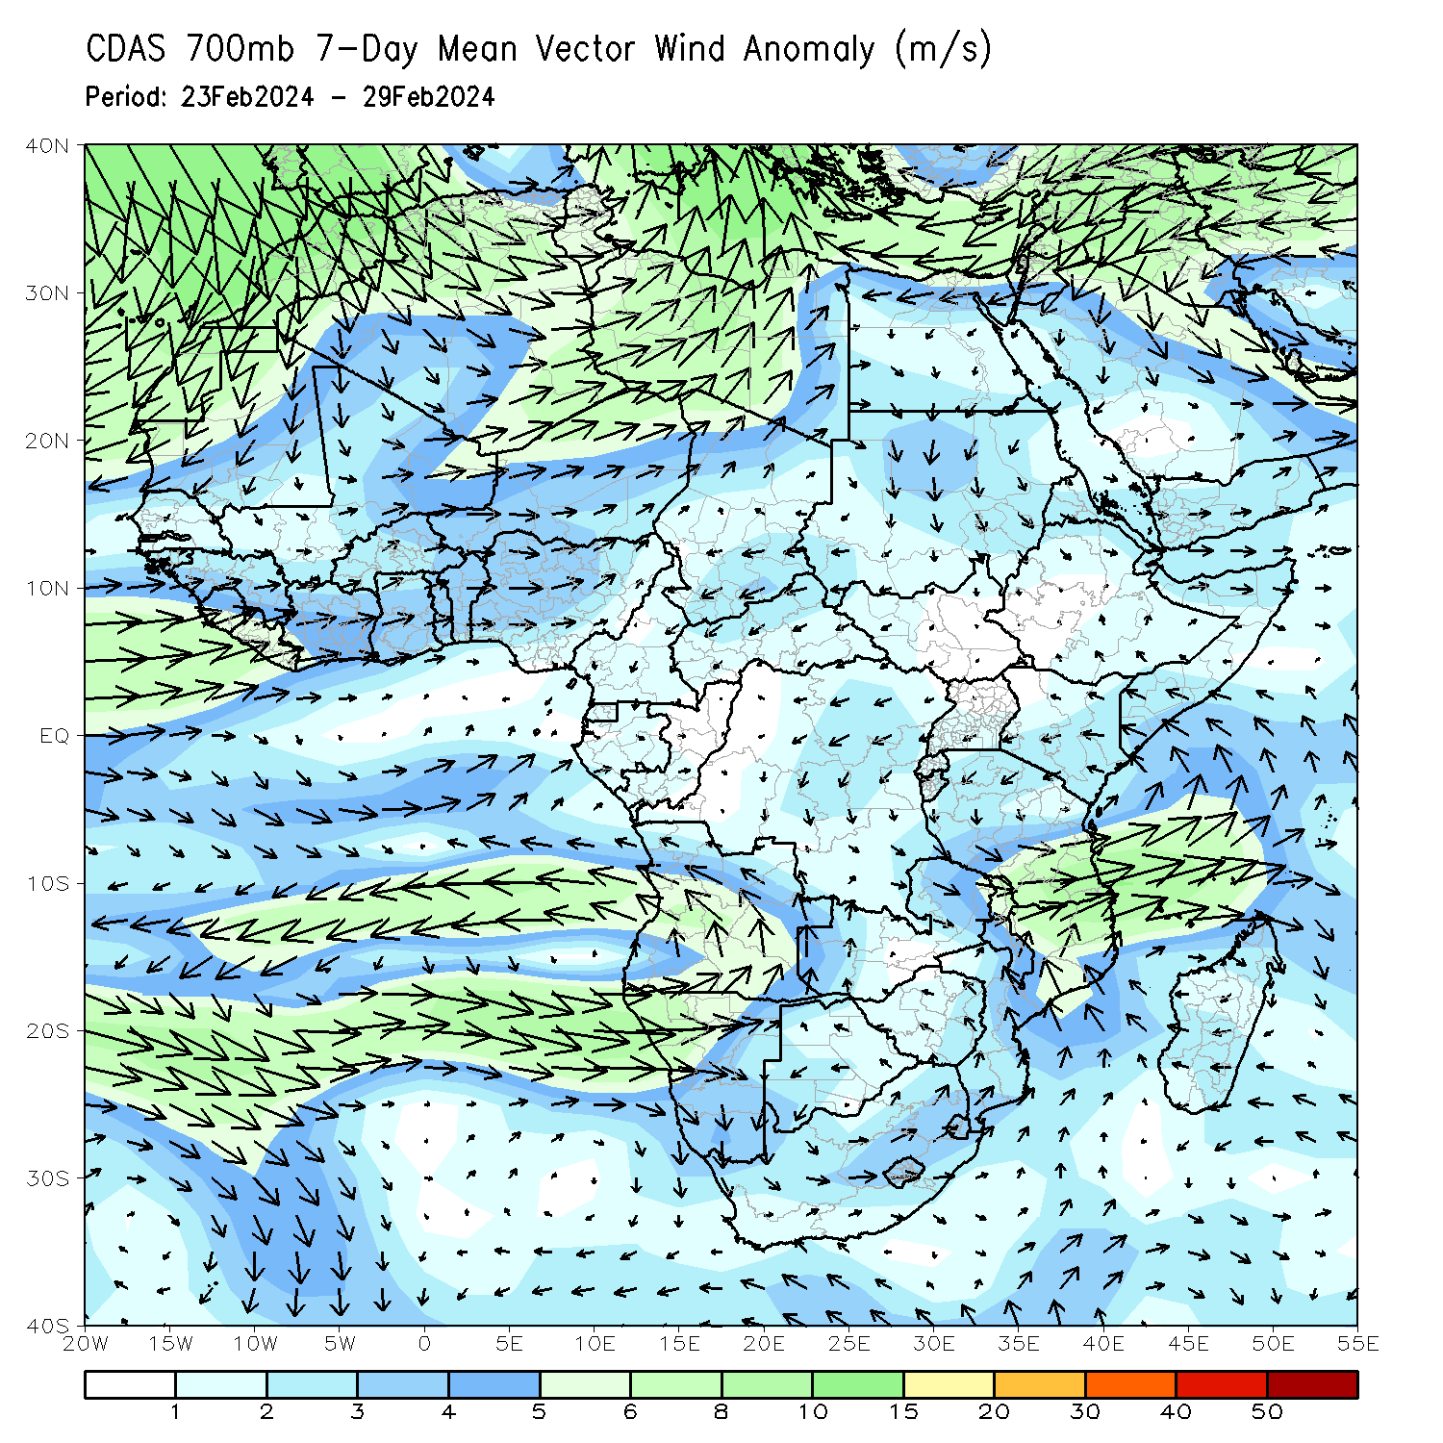
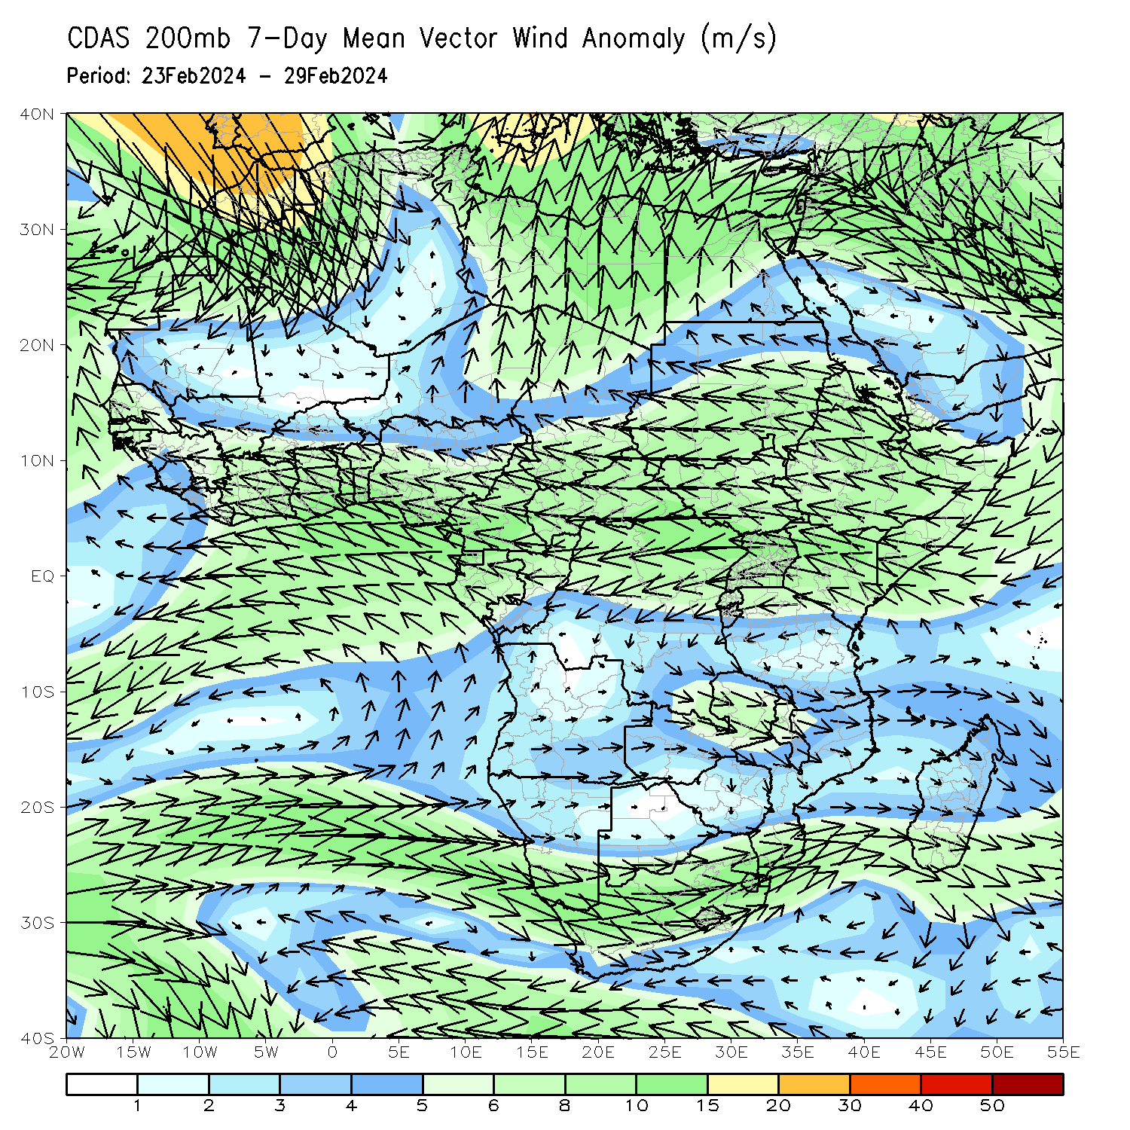
Atmospheric Circulation: Last 7 Days
At 700-hPa level (left panel), anomalous lower-level cyclonic trough may have contributed to the observed above-average rainfall in many parts of northern Mozambique and Malawi and many parts of Tanzania. An area of anti-cyclonic circulation at 700hPa (left panel) was observed across Angola and Namibia that may have contributed to the observed below-average rainfall in southern and eastern Angola and northern Namibia.

Slide 8
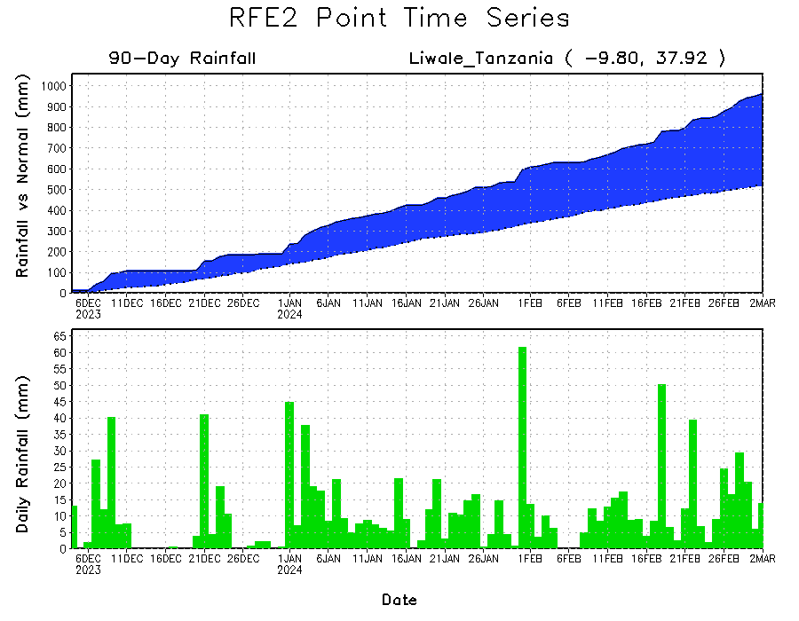
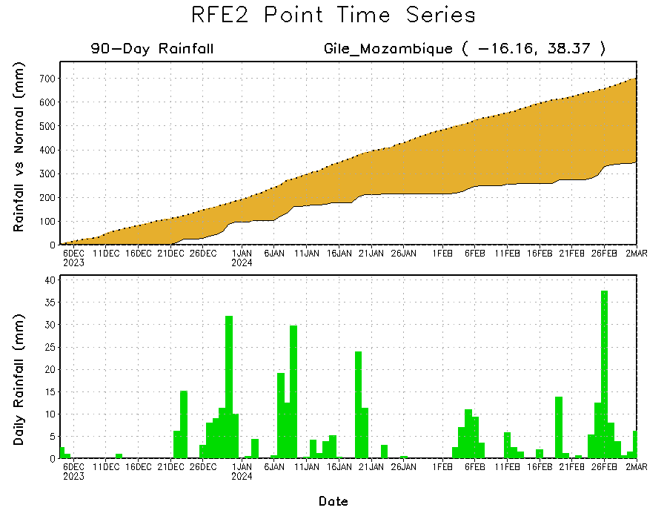
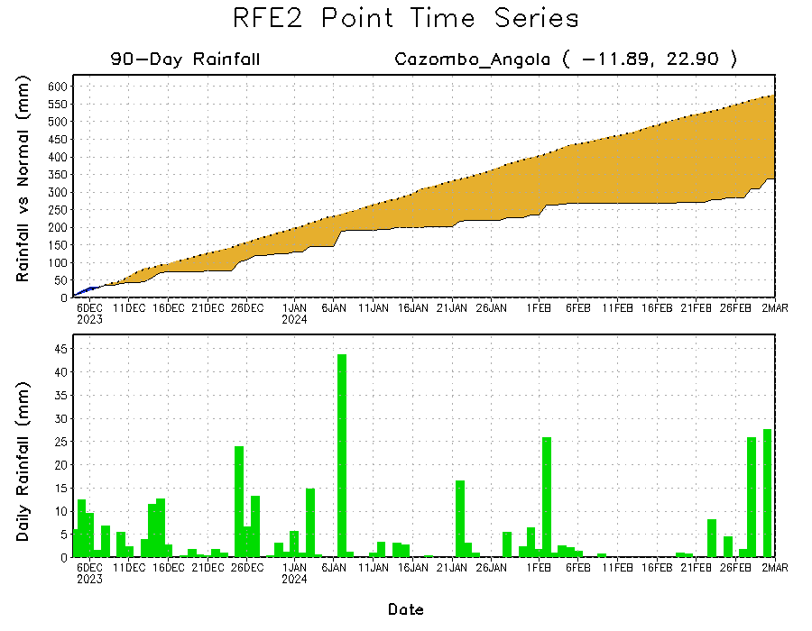
Rainfall Evolution
Daily evolution in rainfall at selected locations over the past 90 days shows growing deficits over parts of eastern Angola (bottom left) and central-eastern Mozambique (bottom right). Conversely, rainfall surpluses persist in central, southern and eastern Tanzania due to heavy and above-average rainfall during last 2 months (top right).

Slide 9
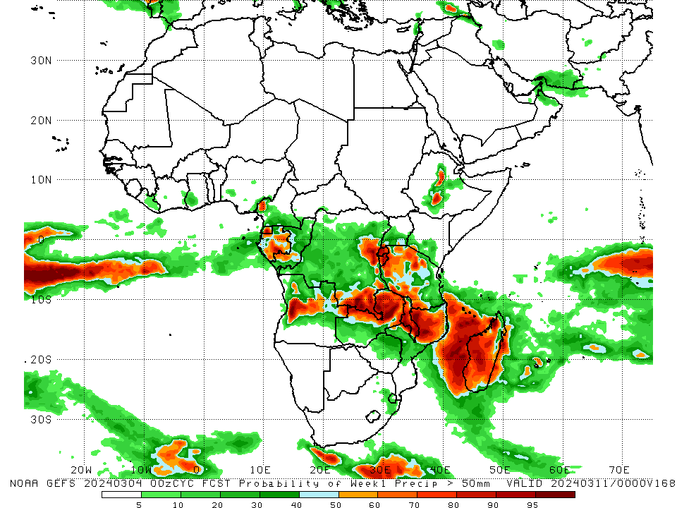
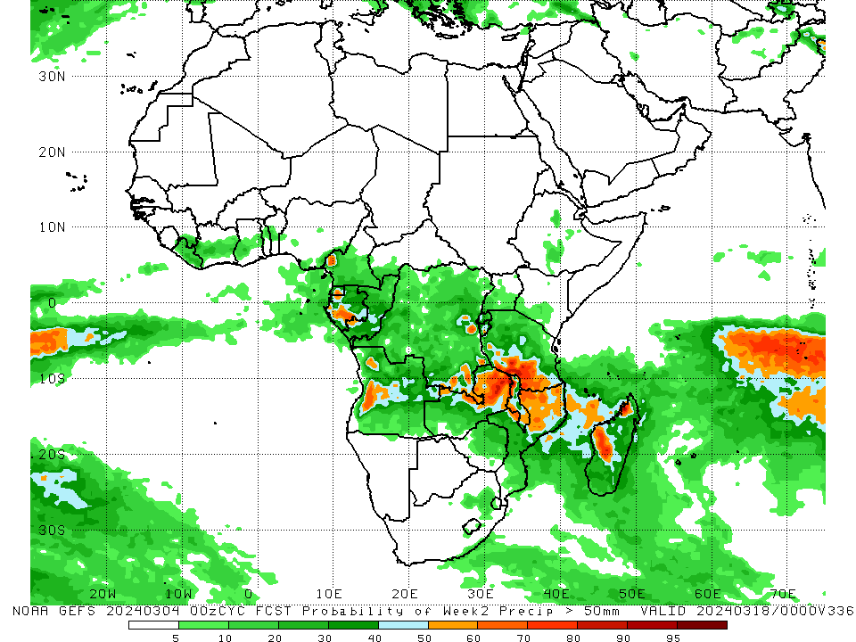
NCEP GEFS Model Forecasts Non-Bias Corrected Probability of precipitation exceedance
Week-1, Valid: 05 Mar – 11 Mar 2024
Week-2, Valid: 12 – 18 Mar 2024
For week-1 (left panel) the NCEP GEFS indicates a moderate to high chance (over 70%) for rainfall to exceed 50 mm over western-central Angola, northern and eastern Zambia, Malawi, northern Mozambique, Rwanda, Burundi, western and southwestern Tanzania, some regions in eastern and southeastern DRC, western, central, southwestern, northwestern and eastern Madagascar, Equatorial Guinea, southern Gabon, and some parts of central Ethiopia. For week-2 (right panel), NCEP GEFS indicates a moderate to high chance (over 70%) for rainfall to exceed 50 mm over northern Zambia, southwestern Tanzania, western Malawi, and some region western-central and pockets of northwestern Madagascar.
Notes:
9

Slide 10
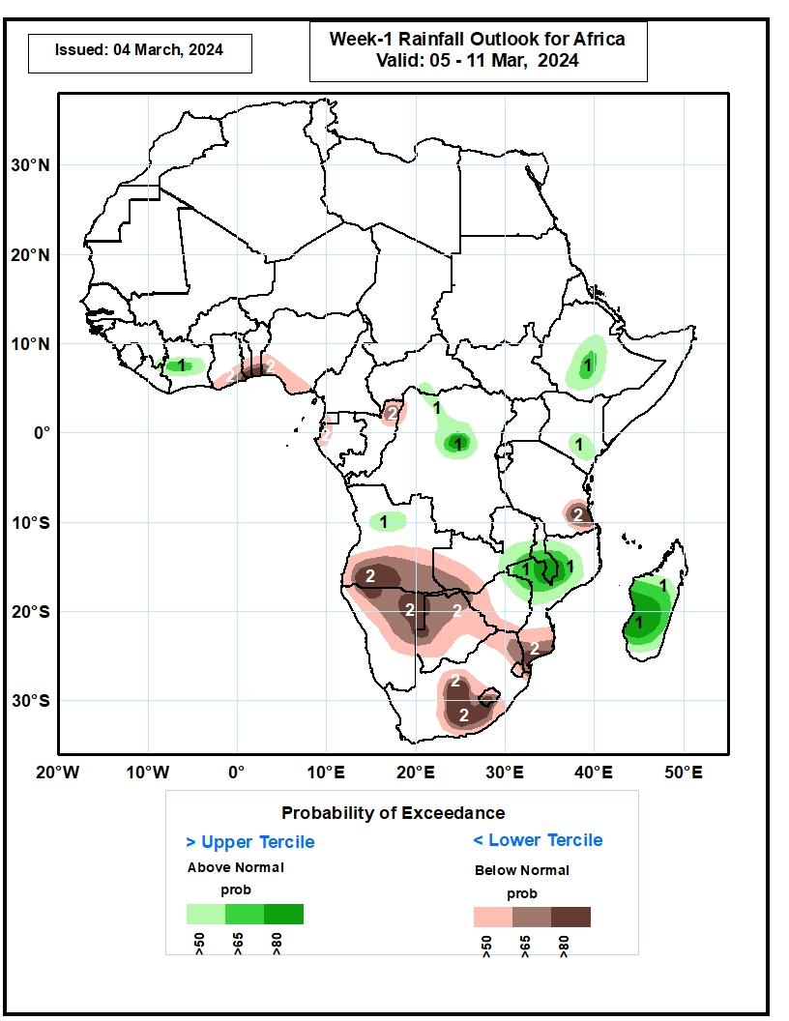
Week-1 Precipitation Outlooks
05 Feb – 11 Mar 2024
The probabilistic forecasts call for above 50% chance for weekly rainfall to be above-normal (above the upper tercile) over central Cote d’Ivoire, south-central CAR, northern and central parts of DR Congo, central and southern parts of Ethiopia, southeastern Kenya, northern part of Angola, eastern Zambia, central and southern Malawi, northern and central parts of Mozambique, and much of Madagascar. There is above 80% chance for above-normal rainfall over central part of DR Congo, southern Malawi, central part of Mozambique, and western and central parts of Madagascar.
The probabilistic forecasts call for above 50% chance for weekly total rainfall to be below-normal (below the lower tercile) over southern Ghana, southern Togo, southern Benin, southern Nigeria, much of Equatorial Guinea, western Gabon, northern Congo, southeastern Tanzania, central and southern Angola, western Zambia, northern and central parts of Namibia, much of Botswana, western and southern parts of Zimbabwe, southern Mozambique, northern and central parts of South Africa, Lesotho, and Eswatini. There is above 80% chance for below-normal rainfall over southern Togo, southern Benin, southeastern part of Tanzania, southwestern Angola, northern and eastern parts of Namibia, southern part of Mozambique, central parts of South Africa, and western Lesotho.
Notes:
10

Slide 11
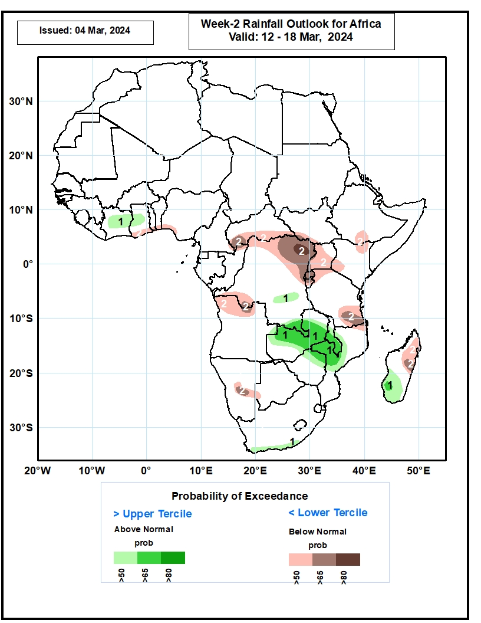
Week-2 Precipitation Outlooks
12 – 18 Mar 2024
The probabilistic forecasts call for above 50% chance for weekly rainfall to be above-normal (above the upper tercile) over northern and central parts of Cote d’Ivoire, central part of Ghana, southern part of DR Congo, northern and central parts of Zambia, central and southern Malawi, northern and central parts of Mozambique, northern Zimbabwe, southern South Africa, and southern Madagascar. There is above 65% chance for above-normal rainfall over southern part of DR Congo, northern and central parts of Zambia, central and southern Malawi, western Mozambique, northeastern Zimbabwe, and southern Madagascar.
The probabilistic forecasts call for above 50% chance for weekly total rainfall to be below-normal (below the lower tercile) over southern Ghana, southern Togo, southern Benin, southwestern Nigeria, southern CAR, northern, eastern and western parts of DR Congo, southwestern South Sudan, much of Uganda, Rwanda, Burundi, south-central Ethiopia, southwestern and northeastern Kenya, northwestern and southern parts of Tanzania, northern Angola, northeastern Mozambique, northern and central parts of Madagascar, and central part of Namibia. There is above 80% chance for below-normal rainfall over northeastern DR Congo.
Notes:
11

Slide 12
Summary
Over the past 30 days, in East Africa, rainfall was above-average in southwestern and some parts of Ethiopia, pockets of southeastern South Sudan, western, northern, central, eastern and southeastern Uganda, northwestern, western, central and southern Kenya, and western, central, southern and northern Tanzania. Rainfall was below-average in western South Sudan, some parts of central-southern Ethiopia, Rwanda, Burundi, and some regions in western and eastern Tanzania. In Central Africa, rainfall was above-average over southwestern and central DRC, southern parts of Gabon and Congo. Rainfall was below-average in central, western and southern Cameroon, Equatorial Guinea, western and northern Gabon, northern Congo, western, southern and eastern CAR, and northern, eastern and southern DRC. In West Africa, rainfall above-average in southern prats of Toga and Benin, and southwestern Nigeria. Rainfall was below-average in eastern Guinea, Liberia, many parts of Cote d’Ivoire and Ghana, central Togo, and southeastern Nigeria. In southern Africa, rainfall was above-average in western and northern Angola, some parts of northern Zambia and northern Mozambique, northern and central Malawi, and many parts of Madagascar. Rainfall was below-average in central, southeastern and eastern Angola, northern, eastern, western and southern Namibia, many parts of Botswana, Zimbabwe, Lesotho and Eswatini, western, central, southern and eastern Zambia, western and central Mozambique, and many parts of northern, western, central and eastern South Africa.
During the past 7 days, in East Africa, rainfall was above-average in southwestern and pockets of central Ethiopia, western, northwestern, southern and western-central Kenya, western, central, southern and eastern Uganda, many parts of Tanzania, western Burundi and eastern Rwanda. Rainfall was below average in pockets of regions in southern Ethiopia. In central Africa, rainfall was above-average in central and southeastern DRC, pockets of northwestern CAR and central Congo, and western-central and eastern Cameroon. Rainfall was below-average in southern and southeastern CAR, northwestern, northern, northeastern and southwestern DRC, northern and southern Congo, southern Cameroon, and many parts of Equatorial Guinea and Gabon. In West Africa, rainfall was above-average in central and northern Cote d’Ivoire, western Ghana, southern parts of Togo and Benin, and southwestern Nigeria. Rainfall was below-average in southeastern Guinea, eastern Liberia, and pockets of southeastern Cote d’Ivoire and southern Ghana. In southern Africa, rainfall was above-average in western-central and northeastern Angola, northern and central Malawi, northern Mozambique, pockets of northern and eastern Zambia, and western and central-eastern Madagascar. Rainfall was below-average across southern and eastern Angola, northwestern and northern Namibia, many parts of Botswana, Zimbabwe, Lesotho and Eswatini, western, central and southern Zambia, western and central Mozambique, southern Malawi, northern, central and eastern South Africa, and northern and southeastern Madagascar.
The Week-1 outlook calls for above-average rainfall in central and southern Uganda, some parts of central and southern Ethiopia, southern Kenya, Rwanda, Burundi, northern, western and central Tanzania, central-northeastern and southern DRC, northern Angola, central and southern Malawi, central parts of Cote d’Ivoire and Ghana, southern Cameroon, northern Gabon and western and southwestern Madagascar. In contrast, there is an increased chance for below-average in many parts of southern Africa, northern DRC, southern Mozambique, southern parts of Togo and Benin, and northern Madagascar. The Week-2 outlook calls for above-normal rainfall in central and southern Cameroon and Congo, central and northern Gabon, Malawi, pockets of northern Mozambique, and southwestern Madagascar. In contrast, there is an increased chance for below-average in many parts of southern Africa, southern Ethiopia, southeastern South Sudan, Uganda, Rwanda, Burundi, western, northern and eastern Tanzania, eastern and southern DRC, northern Madagascar, northern Cote d’Ivoire, and southern Togo and Benin.

