Slide 1
The African Monsoon Recent Evolution and Current Status Include Week-1 and Week-2 Outlooks
Update prepared
08 January 2024
For more information, visit:
http://www.cpc.ncep.noaa.gov/products/Global_Monsoons/African_Monsoons/precip_monitoring.shtml

Slide 2
Outline
Highlights
Recent Evolution and Current Conditions
NCEP GEFS Forecasts
Summary

Slide 3
Highlights: Last 7 Days
During the past 7 days, in East Africa, rainfall was above-average in pockets of southwestern Ethiopia, eastern and central Uganda, southern and much of western Kenya, and northern, eastern, and southern Tanzania. Below-average rainfall was observed over parts of west-central Tanzania and southern Burundi. In central Africa, above-average rainfall was observed over parts of southeastern DRC. Rainfall was below-average over much of central and southern DRC, central and parts of southern Congo, central and southern Gabon, and parts of southern Equatorial Guinea. In West Africa, rainfall was above normal in southern Cote d’Ivoire and southern Ghana. In southern Africa, rainfall was above-average over parts of central and northeastern Angola, northern and parts of far eastern Zambia, northern and parts of central Malawi, northern Mozambique, north-central and parts of east-central Namibia, south-central Botswana, south-central South Africa, and southern Madagascar. Below-average rainfall was observed over northern, east-central, southwestern, and southeastern Angola, southern Zambia, central and southern Mozambique, Zimbabwe, northern and eastern Botswana, northwestern, northeastern, and parts of central Namibia, parts of central and eastern South Africa, Comoros, and northern and west-central Madagascar.
The Week-1 outlook calls for above-average rainfall in coastal areas of Sierra Leone, Liberia, and southwestern Cote d’Ivoire, southwestern Kenya, Rwanda, Burundi, east-central and parts of southeastern DRC, much of northern and central Tanzania, Zambia, Malawi, southeastern Angola, Zimbabwe, northern and western Mozambique, northern and eastern Botswana, eastern South Africa, Lesotho, Eswatini, Comoros, and northern and west-central Madagascar. In contrast, there is an increased chance for below-average rainfall across Equatorial Guinea, Gabon, central and southern Congo, western DRC, northern and western Angola, much of eastern Mozambique, and southern and much of eastern Madagascar. The Week-2 outlook calls for above-normal rainfall in southern Kenya, eastern Tanzania, eastern Burundi, parts of southern Zambia, central Malawi, west-central Mozambique, northern Zimbabwe, southeastern South Africa, Comoros, and northern Madagascar. In contrast, there is an increased chance for below-average rainfall in southern Cameroon, Gabon, Congo, much of western and southern DRC, southern Uganda, western Tanzania, northern, western, and southern Angola, western Burundi, parts of northern, eastern, and southern Mozambique, northern and central Namibia, parts of eastern and western Botswana, southwestern Zimbabwe, Lesotho, Eswatini, eastern and parts of central South Africa, and parts of central and southern Madagascar.

Slide 4
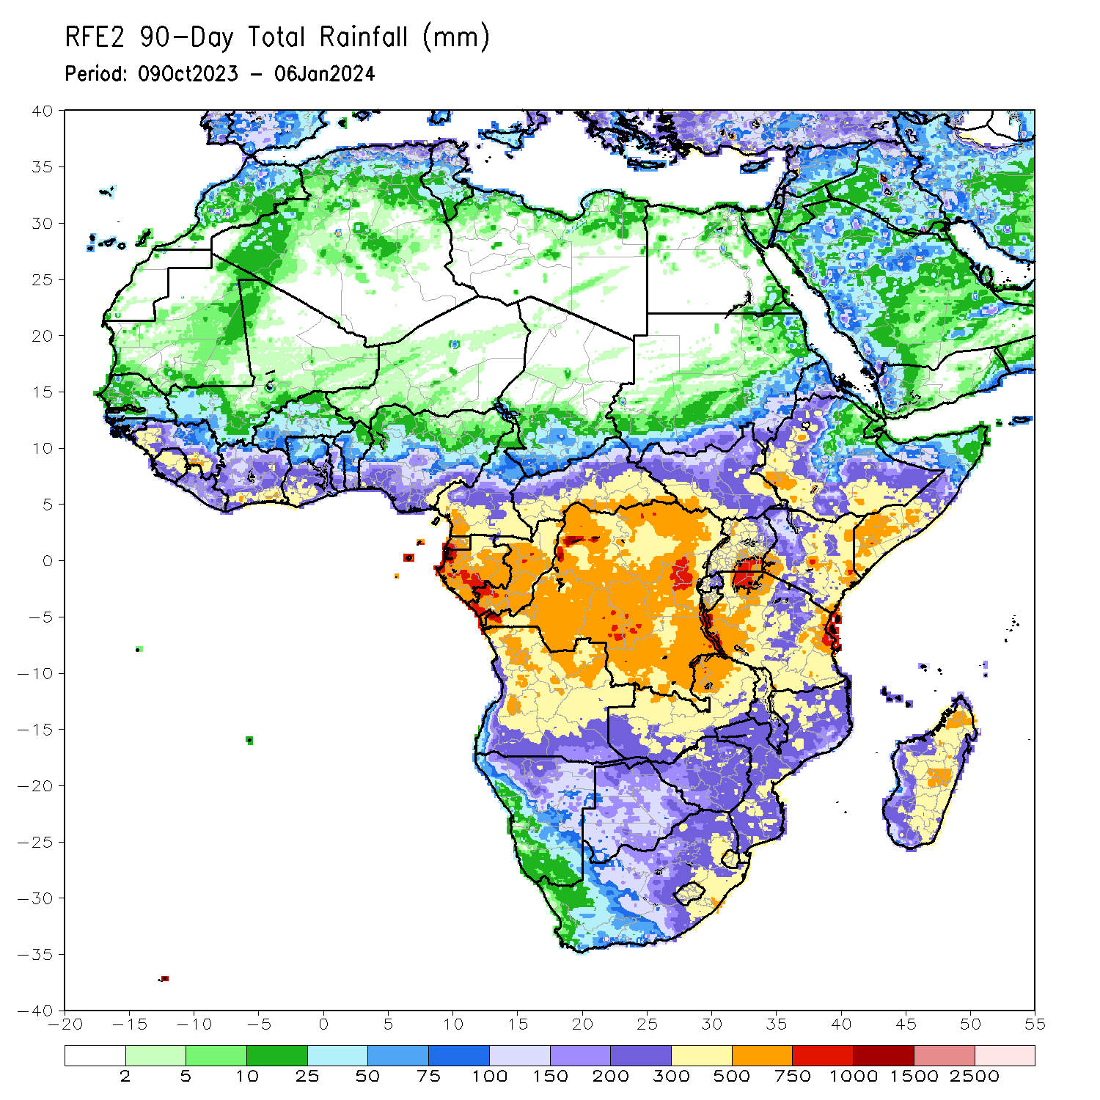
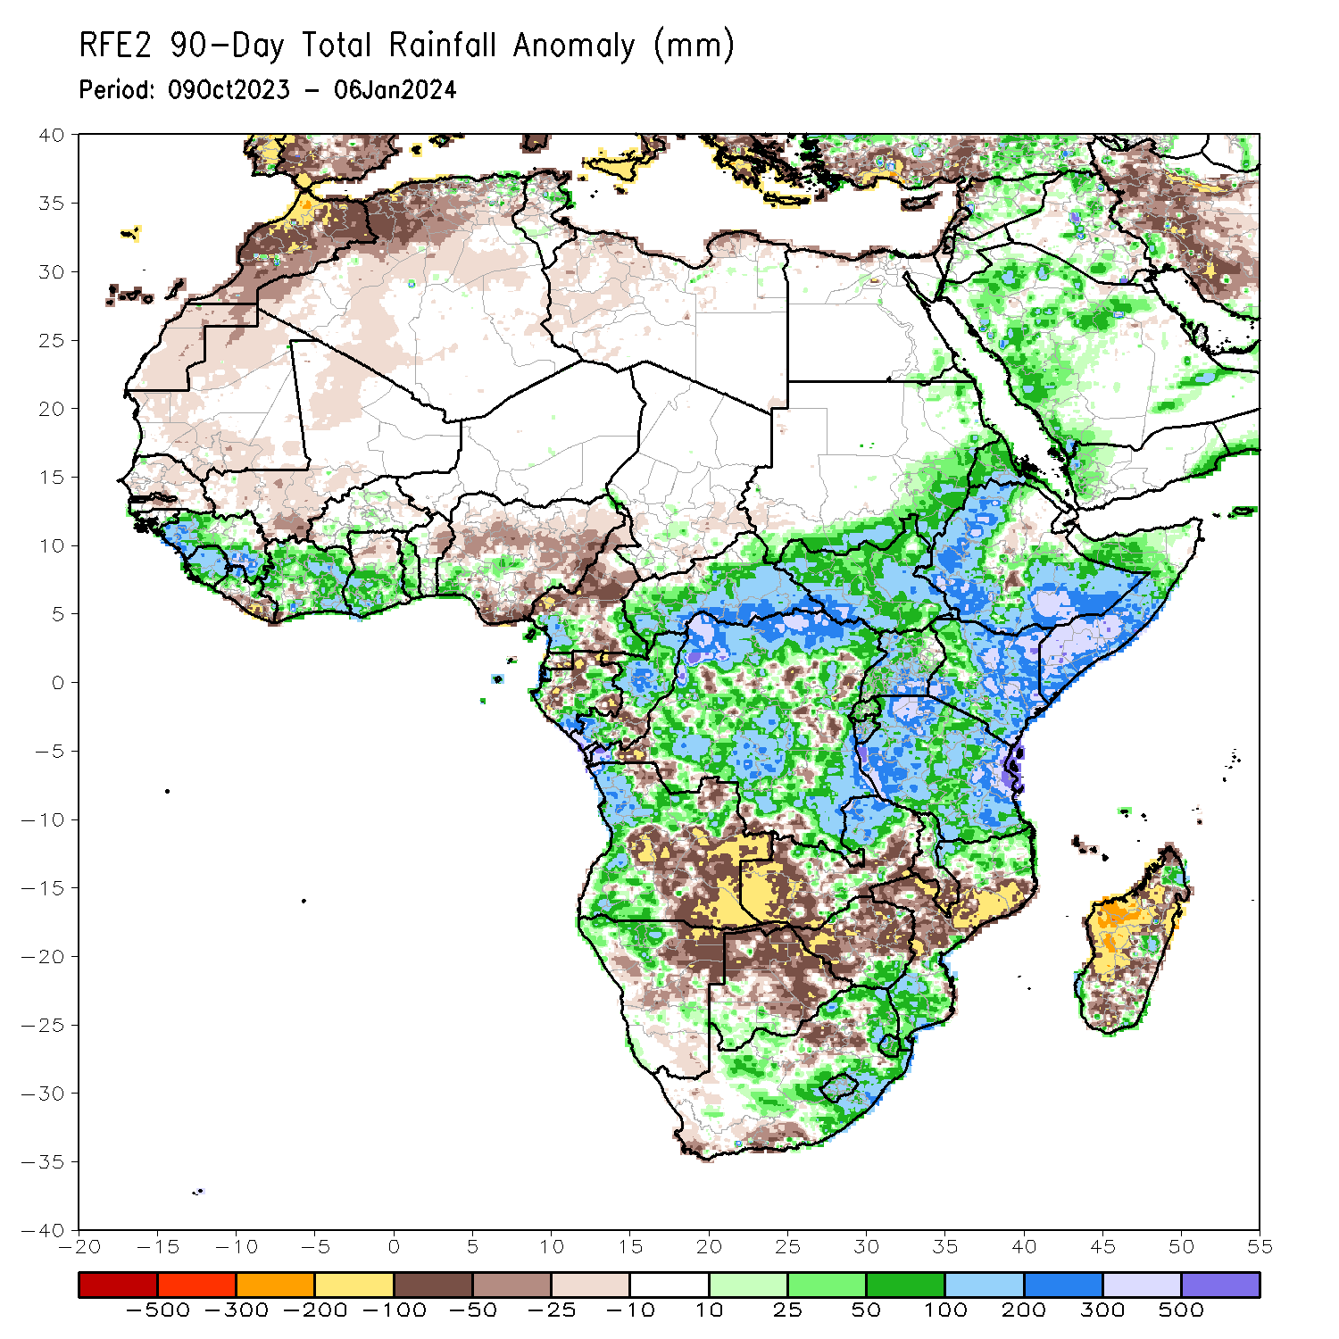
Rainfall Patterns: Last 90 Days
Over the past 90 days, in East Africa, above-average rainfall was observed in many parts of southern and eastern Sudan, South Sudan, Kenya, Tanzania, Burundi, Rwanda, Uganda, western and central Eritrea, northern, western, and southern Ethiopia, and southern, central, and western Somalia. Rainfall was below-average over parts of central Ethiopia. In Central Africa, rainfall was above-average in many parts of CAR, most of DRC, most of Congo, east-central, western, and south-central Gabon, western and northern Equatorial Guinea, and pockets of southwestern and southeastern Cameroon. Rainfall was below-average over northern, central, and south-central Cameroon, southern Equatorial Guinea, northern, west-central, and southeastern Gabon, south-central and northwestern Congo, southeastern Chad, north-central CAR, and pockets of southwestern, central, and eastern DRC. In West Africa, rainfall was above-average over southern Guinea-Bissau, western and southeastern Guinea, Sierra Leone, western and northern Liberia, many parts of Cote d’Ivoire and Togo, southern Benin, central and southern Ghana, southern Burkina Faso, and southwestern Nigeria. Below-average rainfall was observed over central Senegal, Gambia, south-central and northern Mauritania, western Mali, western Burkina Faso, far southwestern Cote d’Ivoire, south-central and southeastern Liberia, and central, eastern, and south-central Nigeria. In southern Africa, above-average rainfall was observed over western and much of northern Angola, northwestern Namibia, northeastern and parts of central Zambia, southeastern and northwestern Zimbabwe, southwestern Botswana, southern and northern Mozambique, eastern and parts of central South Africa, Eswatini, Lesotho, northern and parts of central Malawi, and pockets of northern, east-central, southeastern, and southwestern Madagascar. Below-average rainfall was observed over much of eastern and parts of central Angola, northeastern Namibia, western and southeastern Zambia, much of central and northern Botswana, much of western, northern, central, and eastern Zimbabwe, southwestern and parts of north-central South Africa, central Mozambique, southern Malawi, Comoros, and western, southern, central, and eastern Madagascar.
Notes:
4

Slide 5
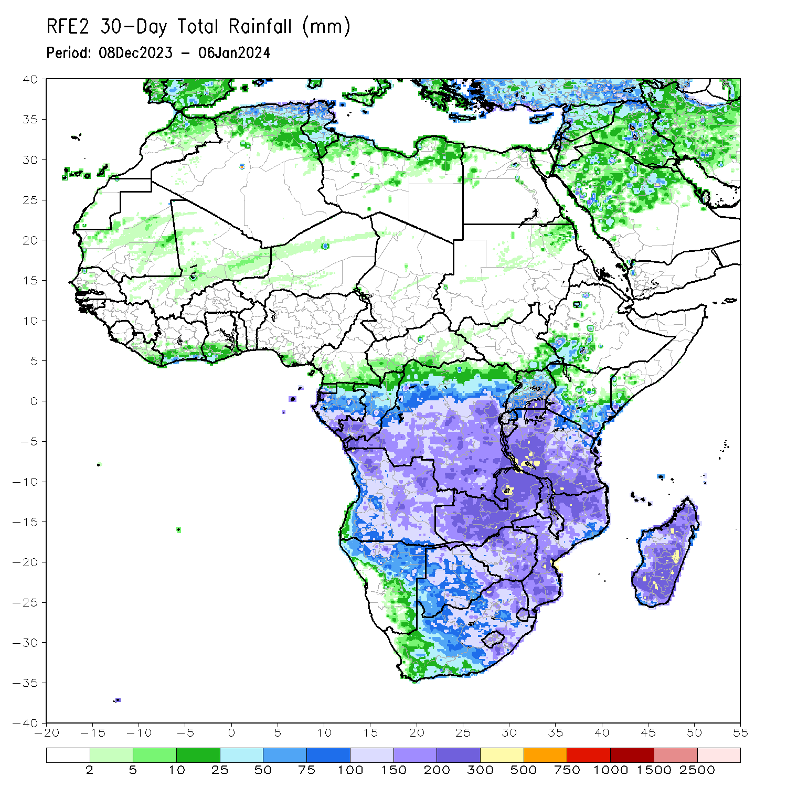
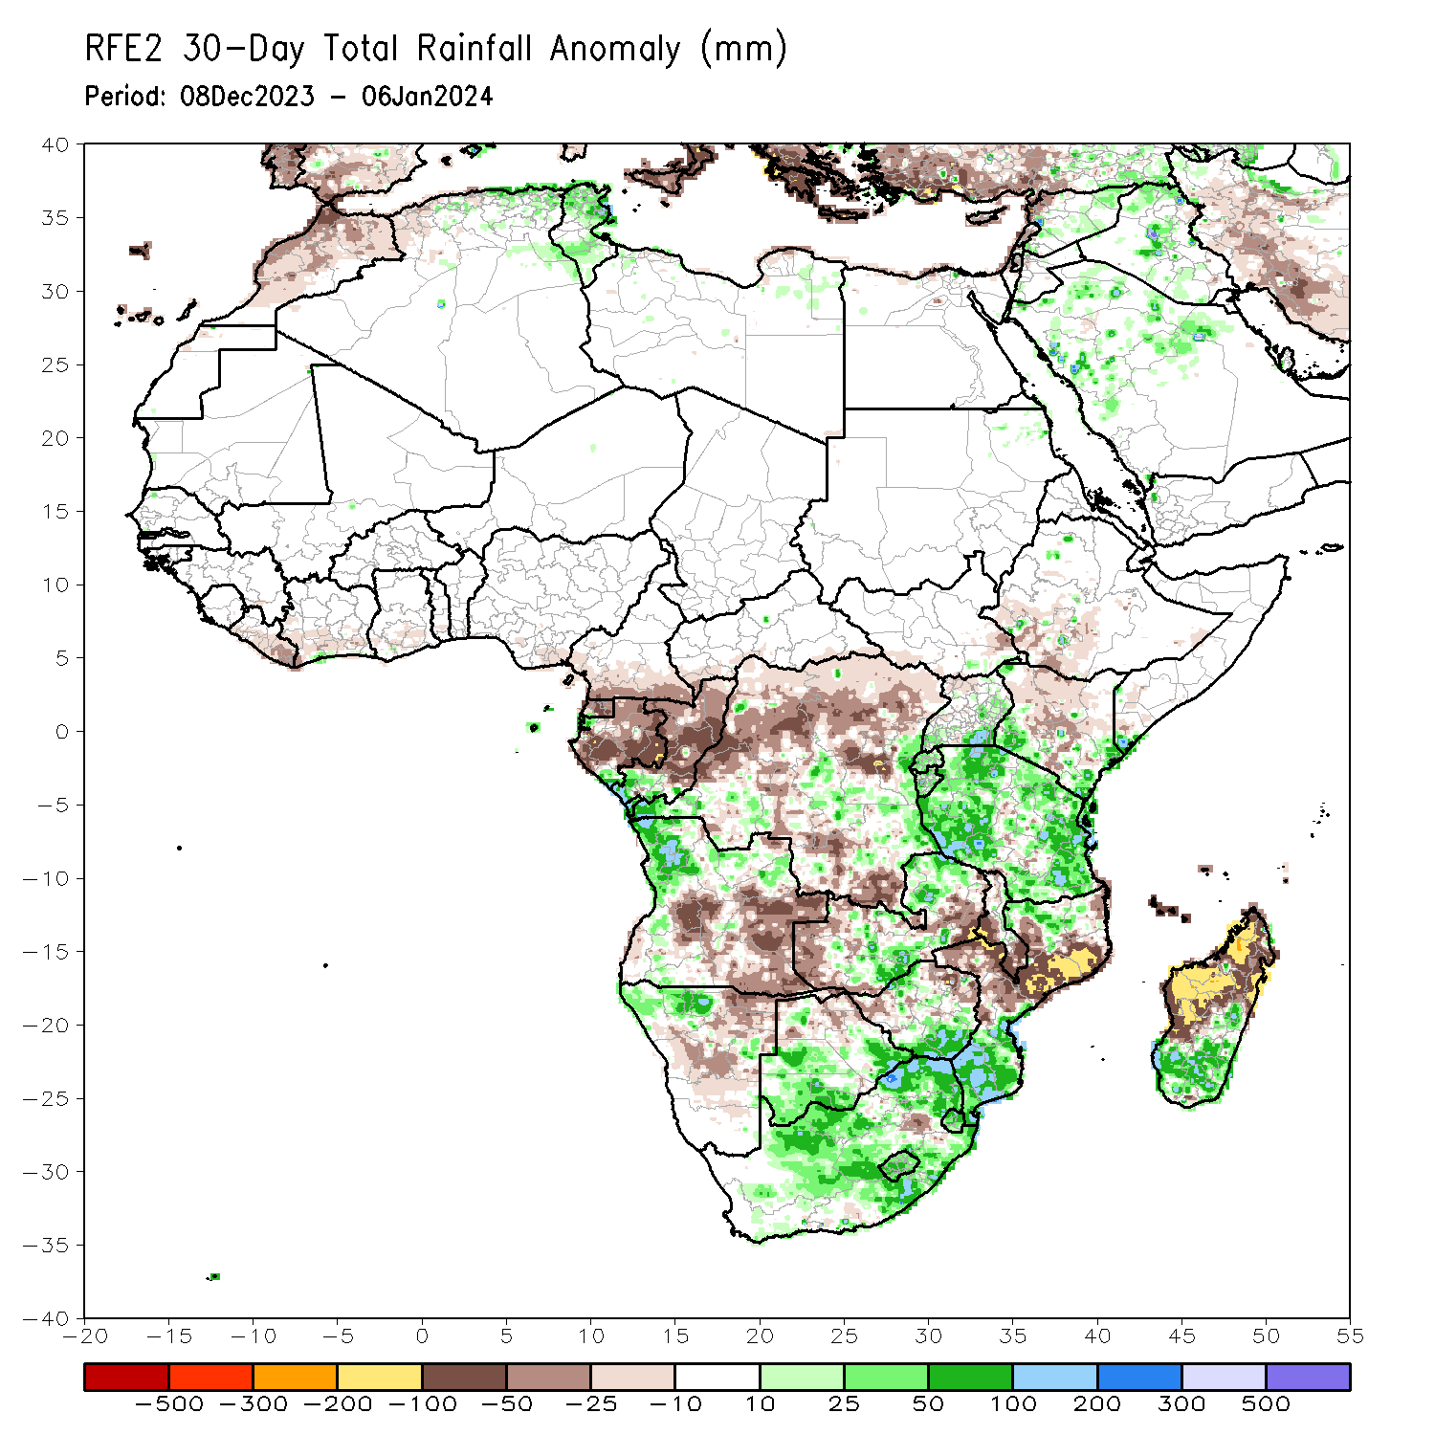
Rainfall Patterns: Last 30 Days
Over the past 30 days, in East Africa, above-average rainfall was observed in many parts of Tanzania, parts of east-central and southern Uganda, southwestern and southeastern Kenya, Burundi, Rwanda, and far southeastern Somalia. Rainfall was below-average over southwestern Ethiopia, northern, central, and south-central Kenya, southeastern and southwestern South Sudan, and parts of northwestern Uganda. In Central Africa, rainfall was above-average across southwestern and east-central DRC, southwestern Gabon, and southern Congo. Below-average rainfall was observed in central and eastern Equatorial Guinea, western, central, northern, and eastern Gabon, parts of northern and central Congo, much of southeastern and northern DRC, southwestern CAR, and southern Cameroon. In West Africa, rainfall was below-average from coastal areas of Liberia to southern Nigeria. In southern Africa, above-average rainfall was observed in western and northern Angola, northwestern Namibia, south-central and northeastern Zambia, southern and parts of northern Mozambique, southern and northwestern Zimbabwe, southern Botswana, Lesotho, Eswatini, eastern and central South Africa, and southern and east-central Madagascar. Below-average rainfall was observed in central and eastern Angola, western and southeastern Zambia, western and northeastern Zimbabwe, northern Botswana, northeastern and central Namibia, central and northeastern Mozambique, southern and west-central Malawi, Comoros, and west-central and northern Madagascar.
Notes:
5

Slide 6
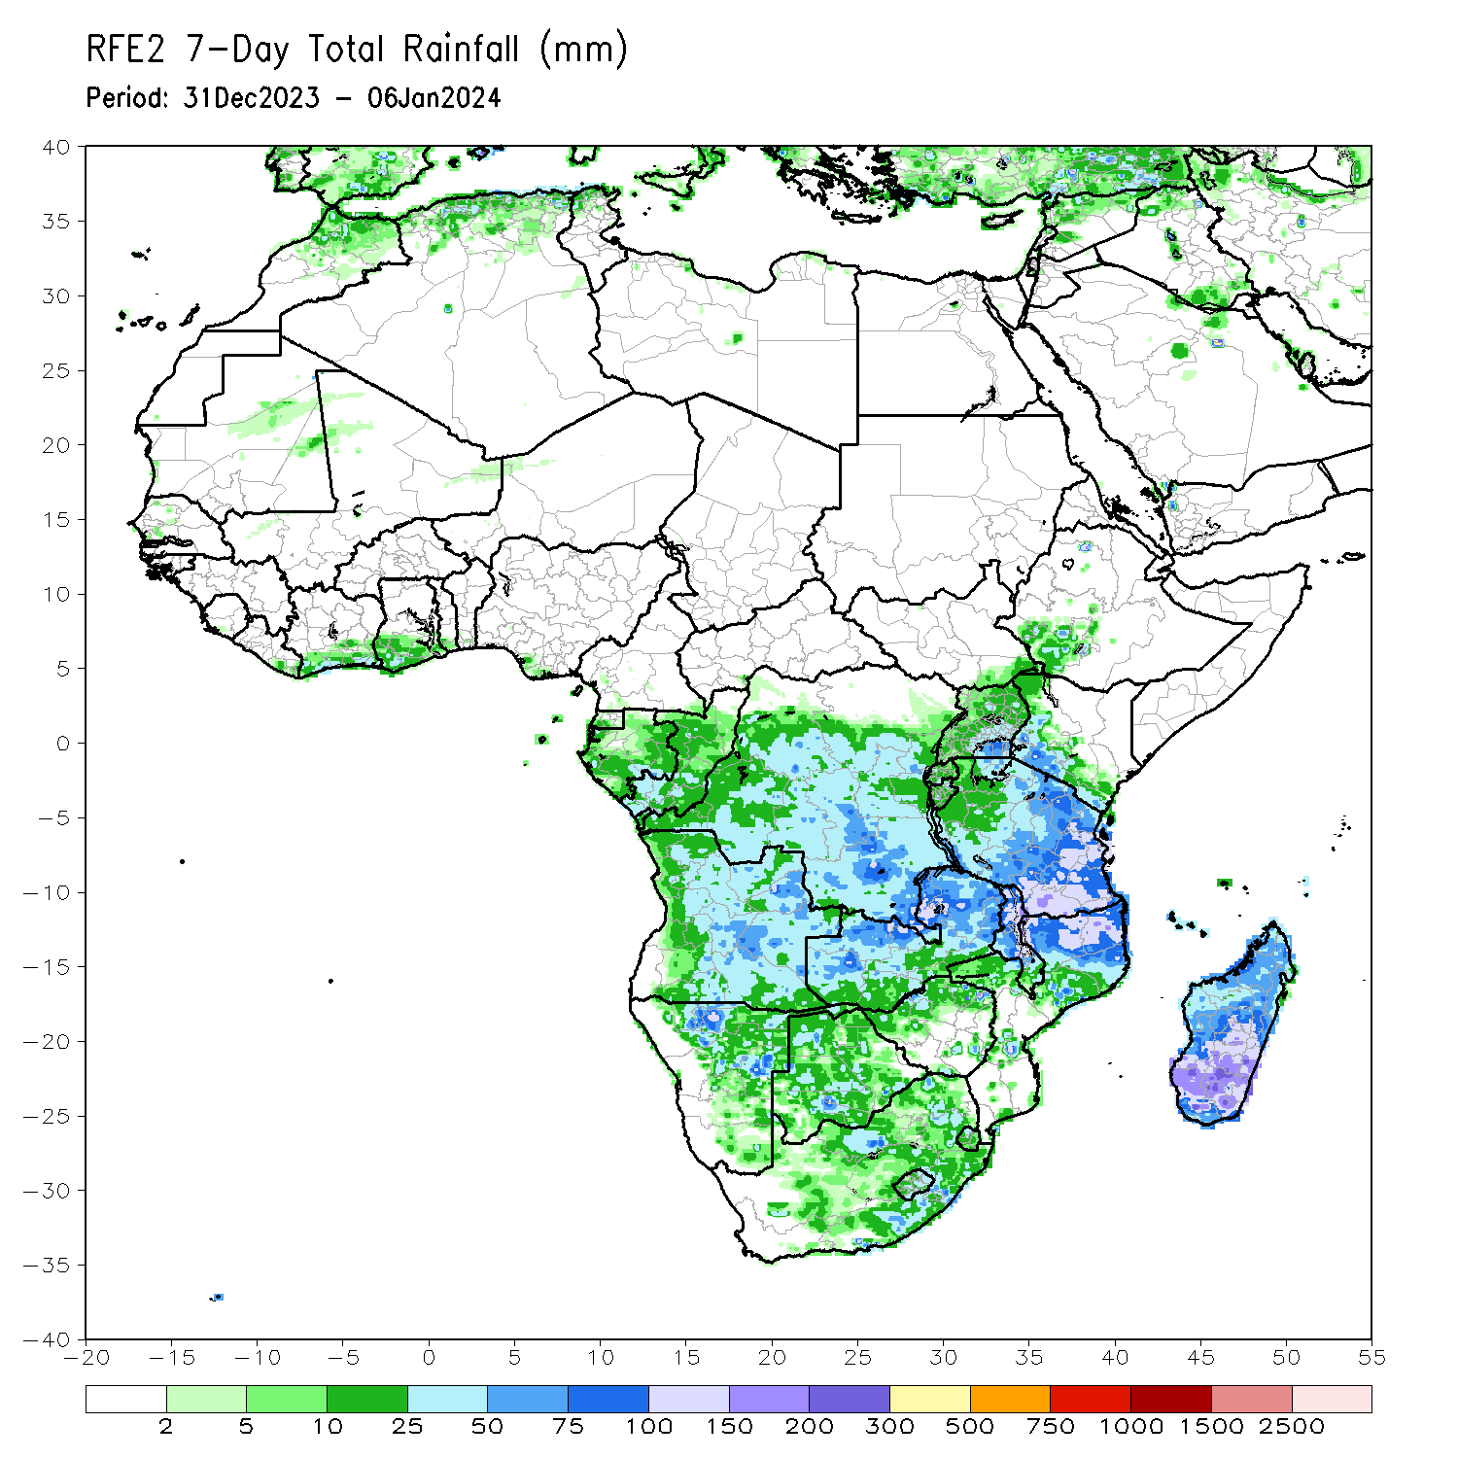
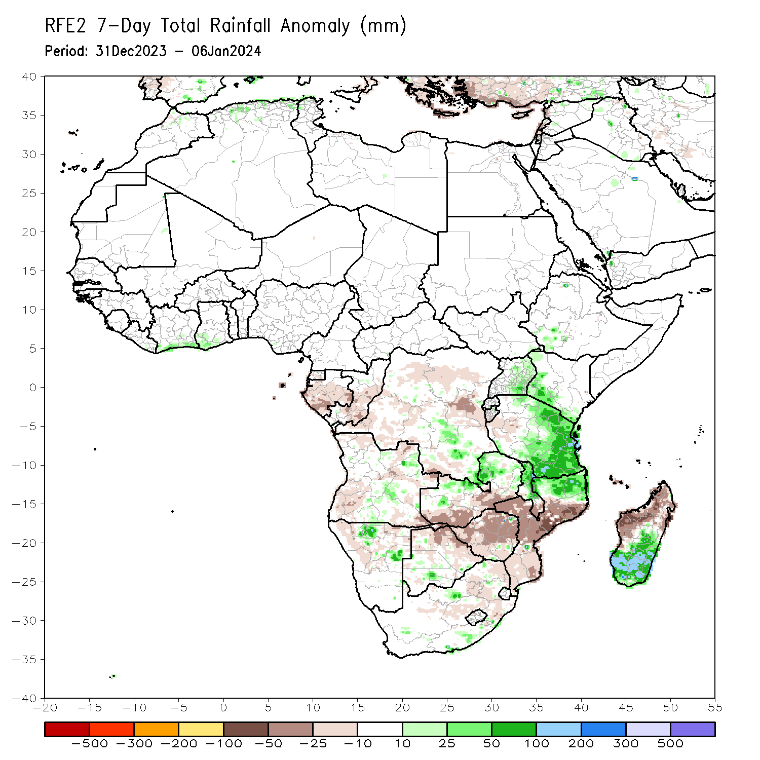
Rainfall Patterns: Last 7 Days
During the past 7 days, in East Africa, rainfall was above-average in pockets of southwestern Ethiopia, eastern and central Uganda, southern and much of western Kenya, and northern, eastern, and southern Tanzania. Below-average rainfall was observed over parts of west-central Tanzania and southern Burundi. In central Africa, above-average rainfall was observed over parts of southeastern DRC. Rainfall was below-average over much of central and southern DRC, central and parts of southern Congo, central and southern Gabon, and parts of southern Equatorial Guinea. In West Africa, rainfall was above normal in southern Cote d’Ivoire and southern Ghana. In southern Africa, rainfall was above-average over parts of central and northeastern Angola, northern and parts of far eastern Zambia, northern and parts of central Malawi, northern Mozambique, north-central and parts of east-central Namibia, south-central Botswana, south-central South Africa, and southern Madagascar. Below-average rainfall was observed over northern, east-central, southwestern, and southeastern Angola, southern Zambia, central and southern Mozambique, Zimbabwe, northern and eastern Botswana, northwestern, northeastern, and parts of central Namibia, parts of central and eastern South Africa, Comoros, and northern and west-central Madagascar.

Slide 7
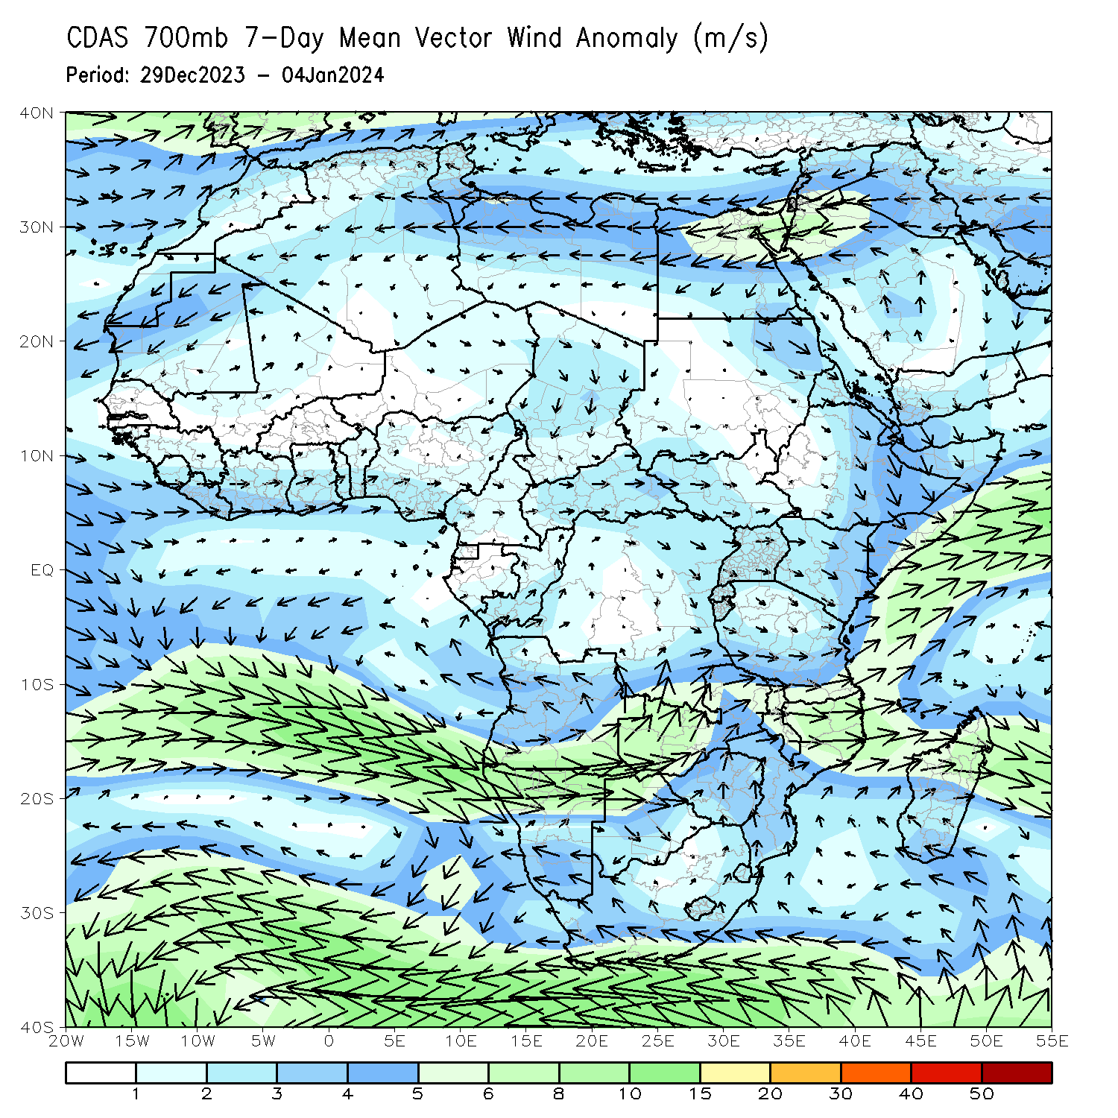
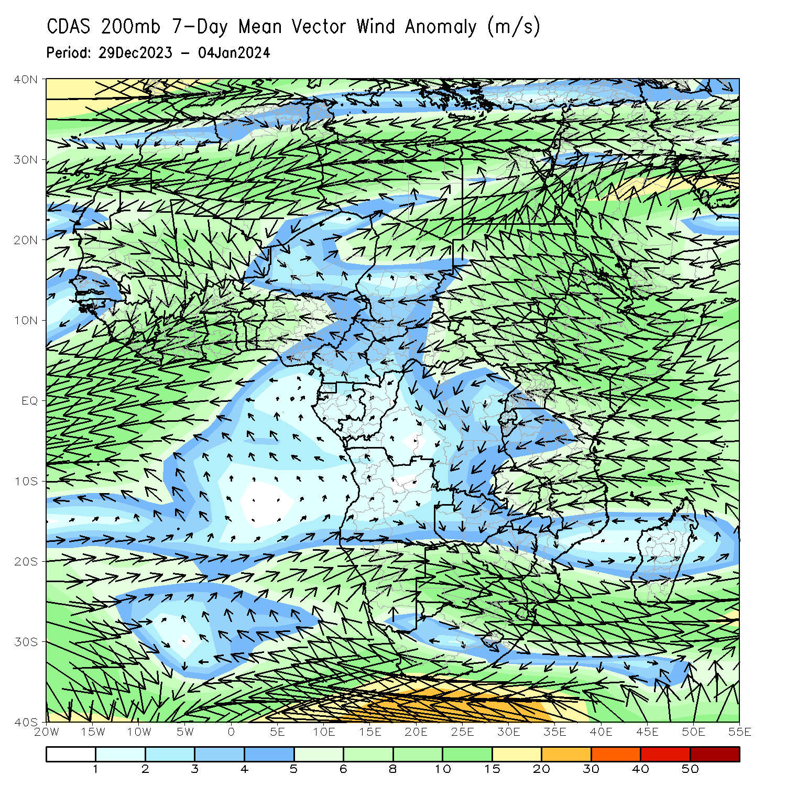
Atmospheric Circulation: Last 7 Days
At 700-hPa level (left panel), the anomalous lower-level convergence near Tanzania/northern Mozambique may have contributed to the observed above-average rainfall in the region. At 200-hPa level (right panel), anomalous upper-level convergence near Zimbabwe/central Mozambique may have contributed to the observed below-average rainfall in that region.

Slide 8
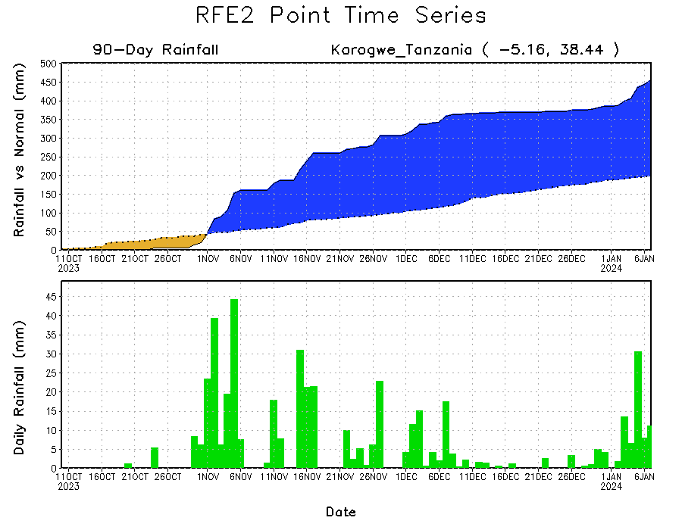
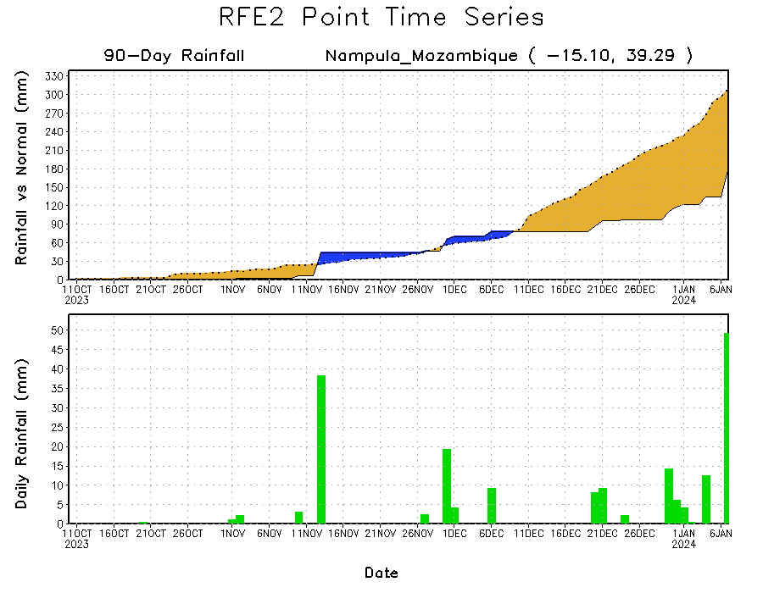
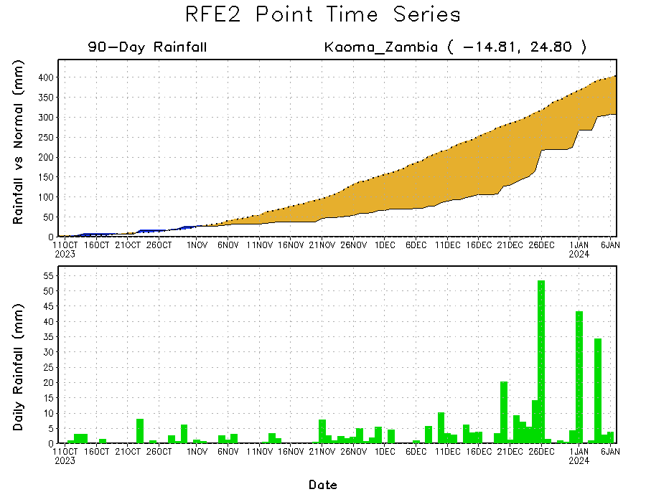
Rainfall Evolution
Daily evolution of rainfall over the last 90 days at selected locations shows a continuing deficits over parts of western Zambia (bottom left) and northeastern Mozambique (bottom right). Seasonal total rainfall remained much above-average over northeastern Tanzania due to the recent moderate rainfall (top right).

Slide 9
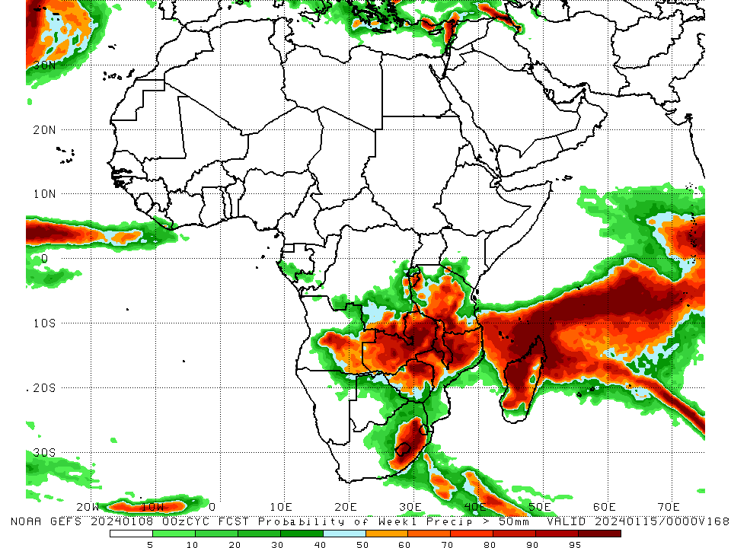
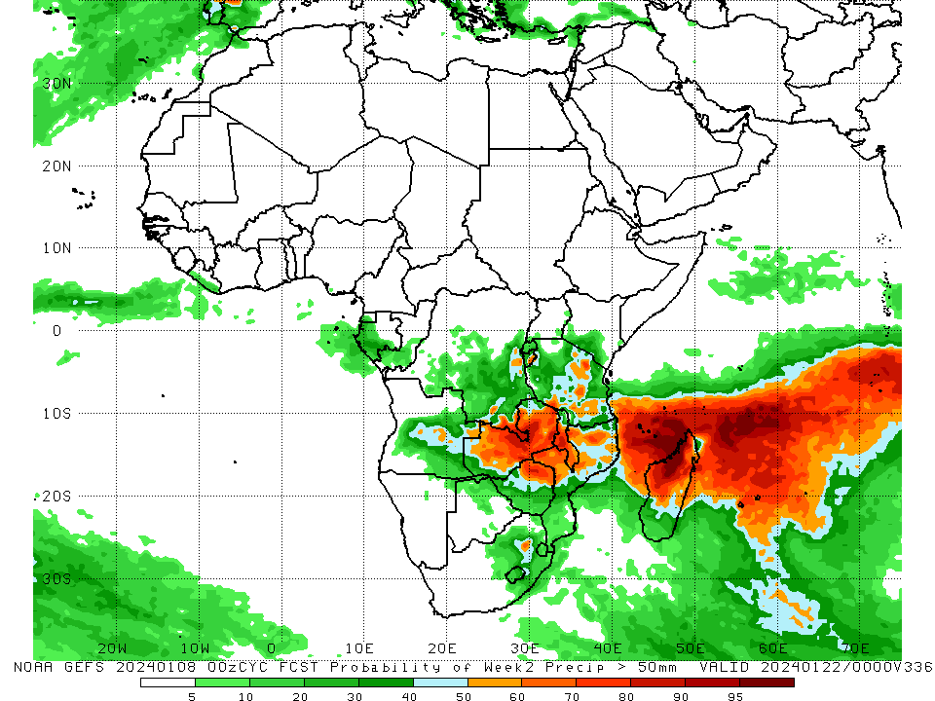
NCEP GEFS Model Forecasts Non-Bias Corrected Probability of precipitation exceedance
Week-1, Valid: 09 – 15 Jan 2024
Week-2, Valid: 16 – 22 Jan 2024
For week-1 (left panel) the GEFS forecasts indicate a moderate to high chance (over 70%) for rainfall to exceed 50 mm over Burundi, central and southwestern Tanzania, southeastern DRC, central and parts of southeastern Angola, much of Zambia, northern and west-central Mozambique, northeastern and parts of central Zimbabwe, western Eswatini, Lesotho, southeastern South Africa, Malawi, northern, west-central, and parts of southern Madagascar, and Comoros. For week-2 (right panel), the GEFS forecasts indicate a moderate to high chance (over 70%) for rainfall to exceed 50 mm over a small area of northeastern and southwestern Tanzania, central and eastern Zambia, northeastern Zimbabwe, parts of northern and northwestern Mozambique, central Malawi, northern and parts of central Madagascar, and Comoros.
Notes:
9

Slide 10
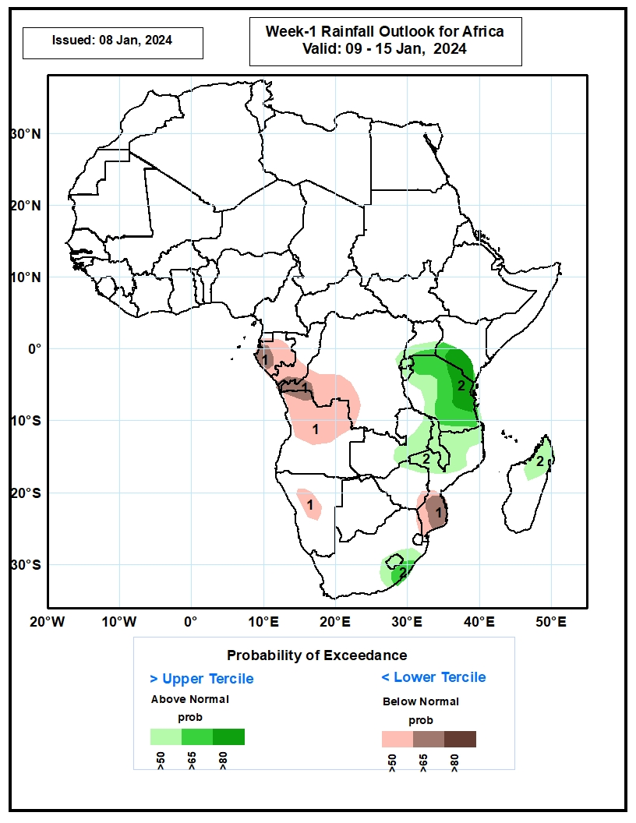
Week-1 Precipitation Outlooks
03 – 09 Jan 2024
1. The probabilistic forecasts call for above 50% chance for weekly total rainfall to be below-normal (below the lower tercile) over Equatorial Guinea, Gabon, southern Congo, western DRC, northern Angola, central Namibia, and southern Mozambique. There is above 65% chance for below-normal rainfall over parts of southern Mozambique.
2. The probabilistic forecasts call for above 50% chance for weekly rainfall to be above-normal (above the upper tercile) over southern Uganda, southern Kenya, much of Tanzania, eastern Zambia, Malawi, northern Mozambique, eastern South Africa, and northern Madagascar. There is above 65% chance for above-normal rainfall over eastern Tanzania and southern Kenya.
Notes:
10

Slide 11
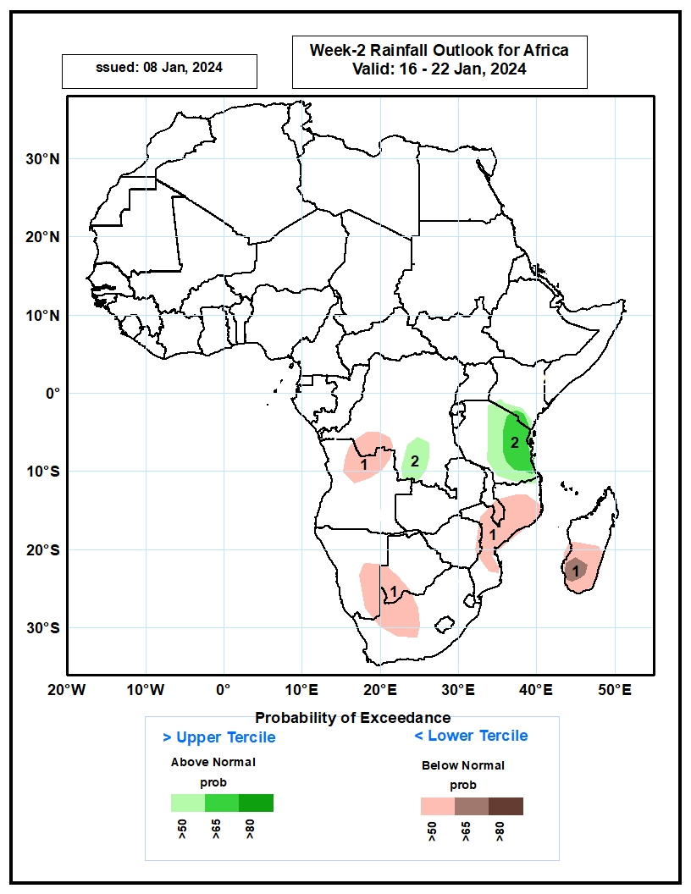
Week-2 Precipitation Outlooks
10 – 16 Jan 2024
1. The probabilistic forecasts call for above 50% chance for weekly total rainfall to be below-normal (below the lower tercile) over southwestern DRC, northern Angola, southeastern Namibia, western Botswana, northwestern South Africa, Mozambique and southern Madagascar. There is above 65% chance for below-normal rainfall over pockets of southern Madagascar.
2. The probabilistic forecasts call for above 50% chance for weekly rainfall to be above-normal (above the upper tercile) over eastern Tanzania and part of southern DRC.
Notes:
11

Slide 12
Summary
Over the past 30 days, in East Africa, above-average rainfall was observed in many parts of Tanzania, parts of east-central and southern Uganda, southwestern and southeastern Kenya, Burundi, Rwanda, and far southeastern Somalia. Rainfall was below-average over southwestern Ethiopia, northern, central, and south-central Kenya, southeastern and southwestern South Sudan, and parts of northwestern Uganda. In Central Africa, rainfall was above-average across southwestern and east-central DRC, southwestern Gabon, and southern Congo. Below-average rainfall was observed in central and eastern Equatorial Guinea, western, central, northern, and eastern Gabon, parts of northern and central Congo, much of southeastern and northern DRC, southwestern CAR, and southern Cameroon. In West Africa, rainfall was below-average from coastal areas of Liberia to southern Nigeria. In southern Africa, above-average rainfall was observed in western and northern Angola, northwestern Namibia, south-central and northeastern Zambia, southern and parts of northern Mozambique, southern and northwestern Zimbabwe, southern Botswana, Lesotho, Eswatini, eastern and central South Africa, and southern and east-central Madagascar. Below-average rainfall was observed in central and eastern Angola, western and southeastern Zambia, western and northeastern Zimbabwe, northern Botswana, northeastern and central Namibia, central and northeastern Mozambique, southern and west-central Malawi, Comoros, and west-central and northern Madagascar.
During the past 7 days, in East Africa, rainfall was above-average in pockets of southwestern Ethiopia, eastern and central Uganda, southern and much of western Kenya, and northern, eastern, and southern Tanzania. Below-average rainfall was observed over parts of west-central Tanzania and southern Burundi. In central Africa, above-average rainfall was observed over parts of southeastern DRC. Rainfall was below-average over much of central and southern DRC, central and parts of southern Congo, central and southern Gabon, and parts of southern Equatorial Guinea. In West Africa, rainfall was above normal in southern Cote d’Ivoire and southern Ghana. In southern Africa, rainfall was above-average over parts of central and northeastern Angola, northern and parts of far eastern Zambia, northern and parts of central Malawi, northern Mozambique, north-central and parts of east-central Namibia, south-central Botswana, south-central South Africa, and southern Madagascar. Below-average rainfall was observed over northern, east-central, southwestern, and southeastern Angola, southern Zambia, central and southern Mozambique, Zimbabwe, northern and eastern Botswana, northwestern, northeastern, and parts of central Namibia, parts of central and eastern South Africa, Comoros, and northern and west-central Madagascar.
The Week-1 outlook calls for above-average rainfall in coastal areas of Sierra Leone, Liberia, and southwestern Cote d’Ivoire, southwestern Kenya, Rwanda, Burundi, east-central and parts of southeastern DRC, much of northern and central Tanzania, Zambia, Malawi, southeastern Angola, Zimbabwe, northern and western Mozambique, northern and eastern Botswana, eastern South Africa, Lesotho, Eswatini, Comoros, and northern and west-central Madagascar. In contrast, there is an increased chance for below-average rainfall across Equatorial Guinea, Gabon, central and southern Congo, western DRC, northern and western Angola, much of eastern Mozambique, and southern and much of eastern Madagascar. The Week-2 outlook calls for above-normal rainfall in southern Kenya, eastern Tanzania, eastern Burundi, parts of southern Zambia, central Malawi, west-central Mozambique, northern Zimbabwe, southeastern South Africa, Comoros, and northern Madagascar. In contrast, there is an increased chance for below-average rainfall in southern Cameroon, Gabon, Congo, much of western and southern DRC, southern Uganda, western Tanzania, northern, western, and southern Angola, western Burundi, parts of northern, eastern, and southern Mozambique, northern and central Namibia, parts of eastern and western Botswana, southwestern Zimbabwe, Lesotho, Eswatini, eastern and parts of central South Africa, and parts of central and southern Madagascar.

