Slide 1
The African Monsoon Recent Evolution and Current Status Include Week-1 and Week-2 Outlooks
Update prepared
20 November 2023
For more information, visit:
http://www.cpc.ncep.noaa.gov/products/Global_Monsoons/African_Monsoons/precip_monitoring.shtml

Slide 2
Outline
Highlights
Recent Evolution and Current Conditions
NCEP GEFS Forecasts
Summary

Slide 3
Highlights: Last 7 Days
During the past 7 days, in East Africa, rainfall was above-average over west-central and southern Ethiopia, northwestern and southern Somalia, northern, central, and southwestern South Sudan, parts of southern Sudan, northwestern, central, and southern Uganda, eastern, parts of central, and parts of southwestern Kenya, northern, eastern, western, and southern Tanzania, southwestern and northeastern Rwanda, and Burundi. Anomalies in excess of 100 mm or more were observed in parts of southern and west-central Ethiopia, southern Somalia, northeastern Kenya, parts of southwestern and southeastern South Sudan, and northeastern Tanzania. In central Africa, above-average rainfall was observed over southern and eastern CAR, southwestern, southeastern, and west-central Chad, northern, much of central, and parts of southeastern DRC, northern and southwestern Congo, western and central Gabon, Equatorial Guinea, and central and southwestern Cameroon. Anomalies in excess of 100 mm or more were observed in parts of north-central, northeastern, and south-central DRC. Rainfall was below-average over parts of west-central, far southeastern, and southwestern DRC, southeastern Gabon, and southeastern Congo. In West Africa, above-average rainfall was observed over parts of southeastern Guinea-Conakry, southern Cote d’Ivoire, southwestern parts of Ghana, and over south-central and southeastern Nigeria. Rainfall was slightly below average in eastern Sierra Leone and eastern Liberia. In southern Africa, rainfall was above-average over parts of northwestern and northeastern Angola, northeastern Zambia, northern Mozambique, parts of central Namibia, parts of northeastern South Africa, western Eswatini, and parts of central and northern Madagascar. Central and southern Angola, western and central Zambia, central and southern Mozambique, Zimbabwe, northern, eastern, and parts of southern Botswana, northeastern Namibia, much of eastern and southern South Africa, Lesotho, and western and southern Madagascar received below average rainfall.
Week-1 forecasts show enhanced probabilities for above average rainfall (exceeding 50mm) over Central Africa, southern Somalia, parts of northern and western Angola, central and southern Uganda, central and southern Kenya, much of northern, eastern, and western Tanzania, Rwanda, Burundi, and northeastern and northwestern Zambia. Rainfall is expected to be below-normal in Sierra Leone, western Liberia, southern Ethiopia, and much of southern Africa (from southwestern Angola to northeastern South Africa and eastward towards the coast, as well as Madagascar). The Week-2 outlook calls for above-normal rainfall in most of Central Africa, southwestern Angola, northern and central Namibia, western and parts of southern Botswana, north-central and southeastern South Africa, eastern Lesotho, western Eswatini, coastal portions of southern Somalia, and along the coastal portions of the Gulf of Guinea region. Rainfall is expected to be below-normal in northwestern Angola, Zambia, Zimbabwe, Mozambique, Malawi, southern Tanzania, Madagascar, southeastern DRC, and parts of southwestern and central Ethiopia.

Slide 4
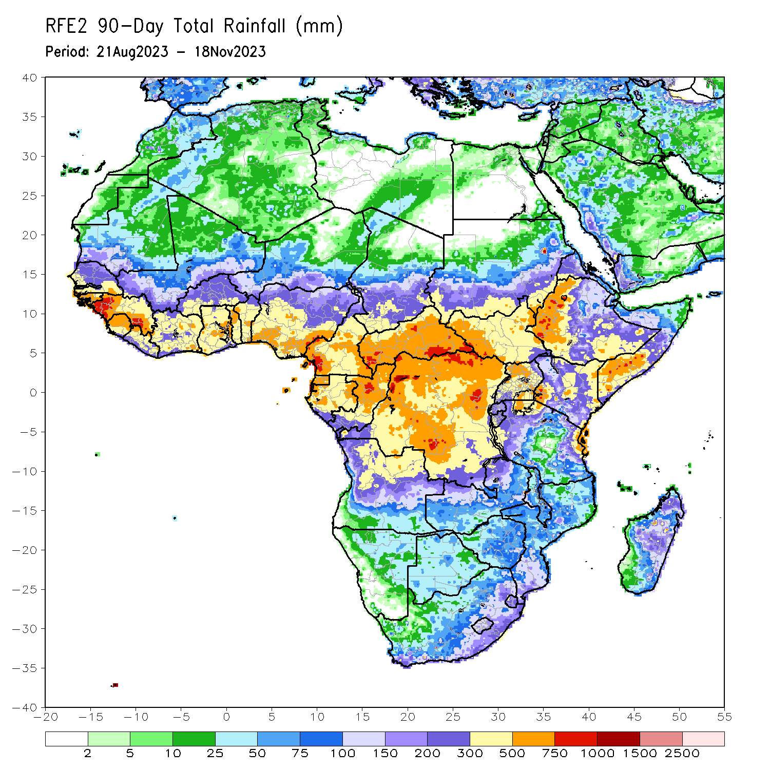
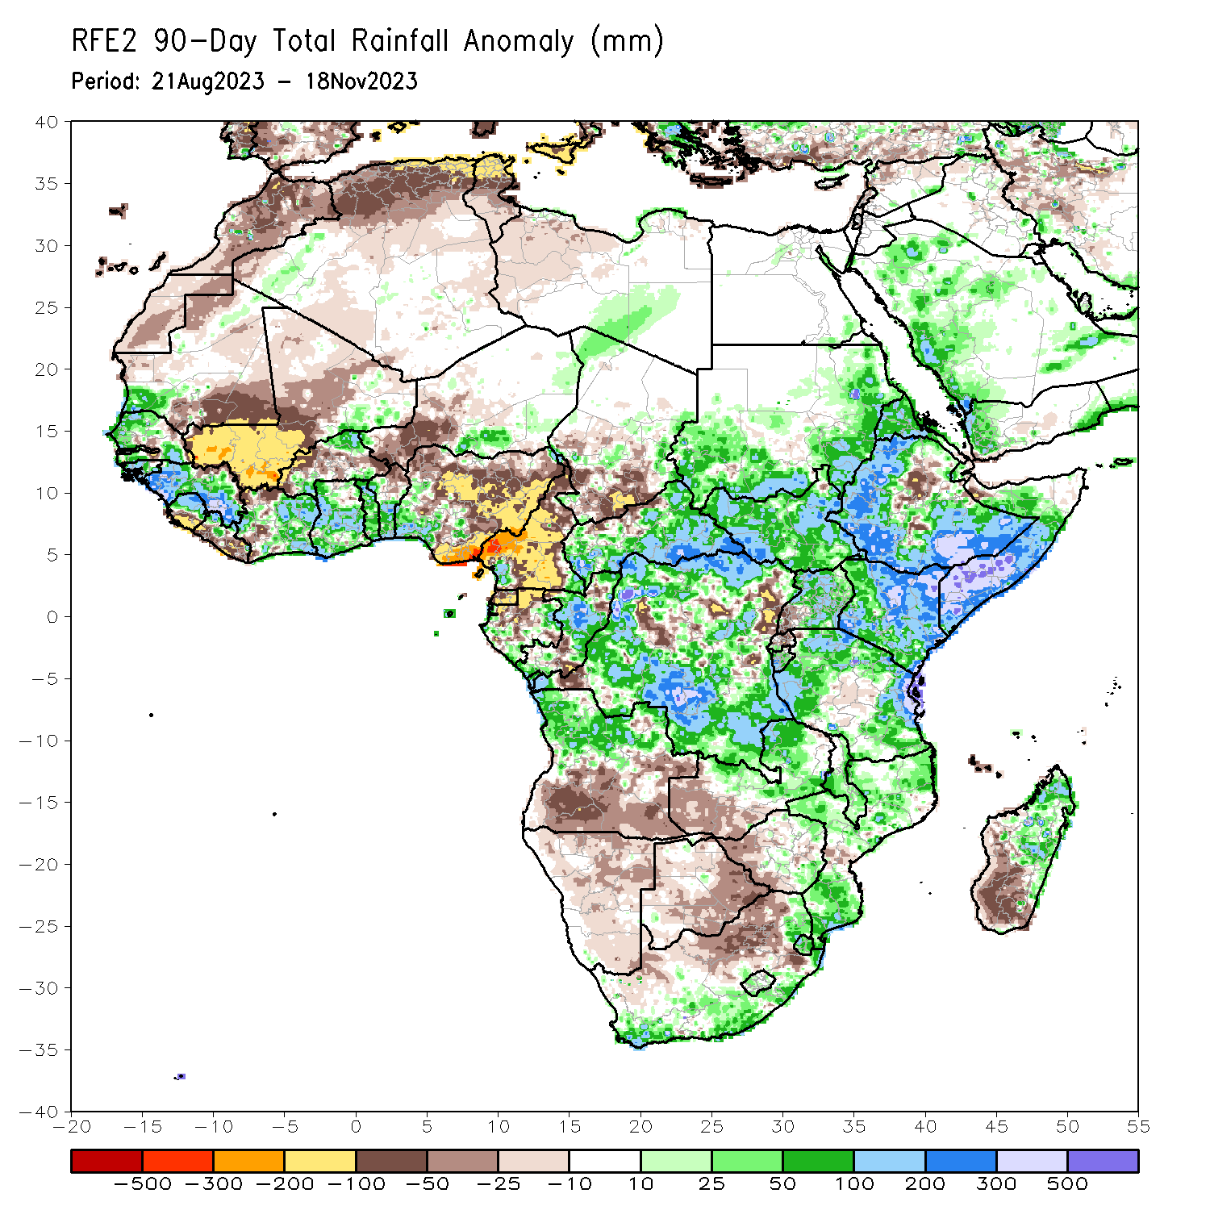
Rainfall Patterns: Last 90 Days
Over the past 90 days, in East Africa, above-average rainfall was observed over eastern and southern Sudan, western, northern, and southern Ethiopia, most of South Sudan, much of northern, eastern, and central Uganda, western and central Eritrea, western Djibouti, parts of northern, southern, and central Somalia, Kenya, Burundi, and northern, western, and eastern Tanzania. Rainfall was below-average over central Rift Valley and its escarpments in Ethiopia, over parts of northern Somalia, southwestern Uganda, central and eastern Rwanda, northern Burundi, and northwestern and central Tanzania. In Central Africa, rainfall was above-average over many parts of CAR, eastern and parts of central Chad, much of central, southwestern, and far northern Congo, parts of western and northeastern Gabon, far southwestern and southeastern Cameroon, and northern, western, and much of southern DRC. Rainfall was below-average over much of Cameroon, Equatorial Guinea, northern and central Gabon, parts of northern and southeastern Congo, parts of central, northeastern, and southwestern DRC, northern borders of CAR, and central and much of southern Chad. In southern Africa, above-average rainfall was observed over southern and eastern South Africa, Lesotho, Eswatini, southern, parts of central, and northern Mozambique, much of northern Angola, northern and central Zambia, central and eastern Zimbabwe, northeastern, central, and southern Malawi, and parts of central, eastern, and northern Madagascar. Below-average rainfall was observed over parts of central and southern Angola, Namibia, Botswana, northern South Africa, western Zimbabwe, western Zambia, and southwestern Madagascar. In West Africa, rainfall was above-average over southwestern Mauritania, much of Senegal, western Gambia, Guinea-Bissau, western and southern Guinea, northern and central Sierra Leone, northwestern Liberia, eastern Mali, southern and northeastern Burkina Faso, much of Cote d’Ivoire, much of Ghana, Togo, Benin, parts of northwestern, southeastern, and eastern Niger, and southwestern and far northeastern Nigeria. Below-average rainfall was observed over most parts of Mali, southern Sierra Leone, southern Liberia, northwestern Cote d’Ivoire, northeastern Guinea, central Senegal, eastern Gambia, northern Benin, western and central Burkina Faso, parts of southwestern and central Niger, southeastern central, and northwestern Mauritania, and central, northern, and eastern Nigeria.
Notes:
4

Slide 5
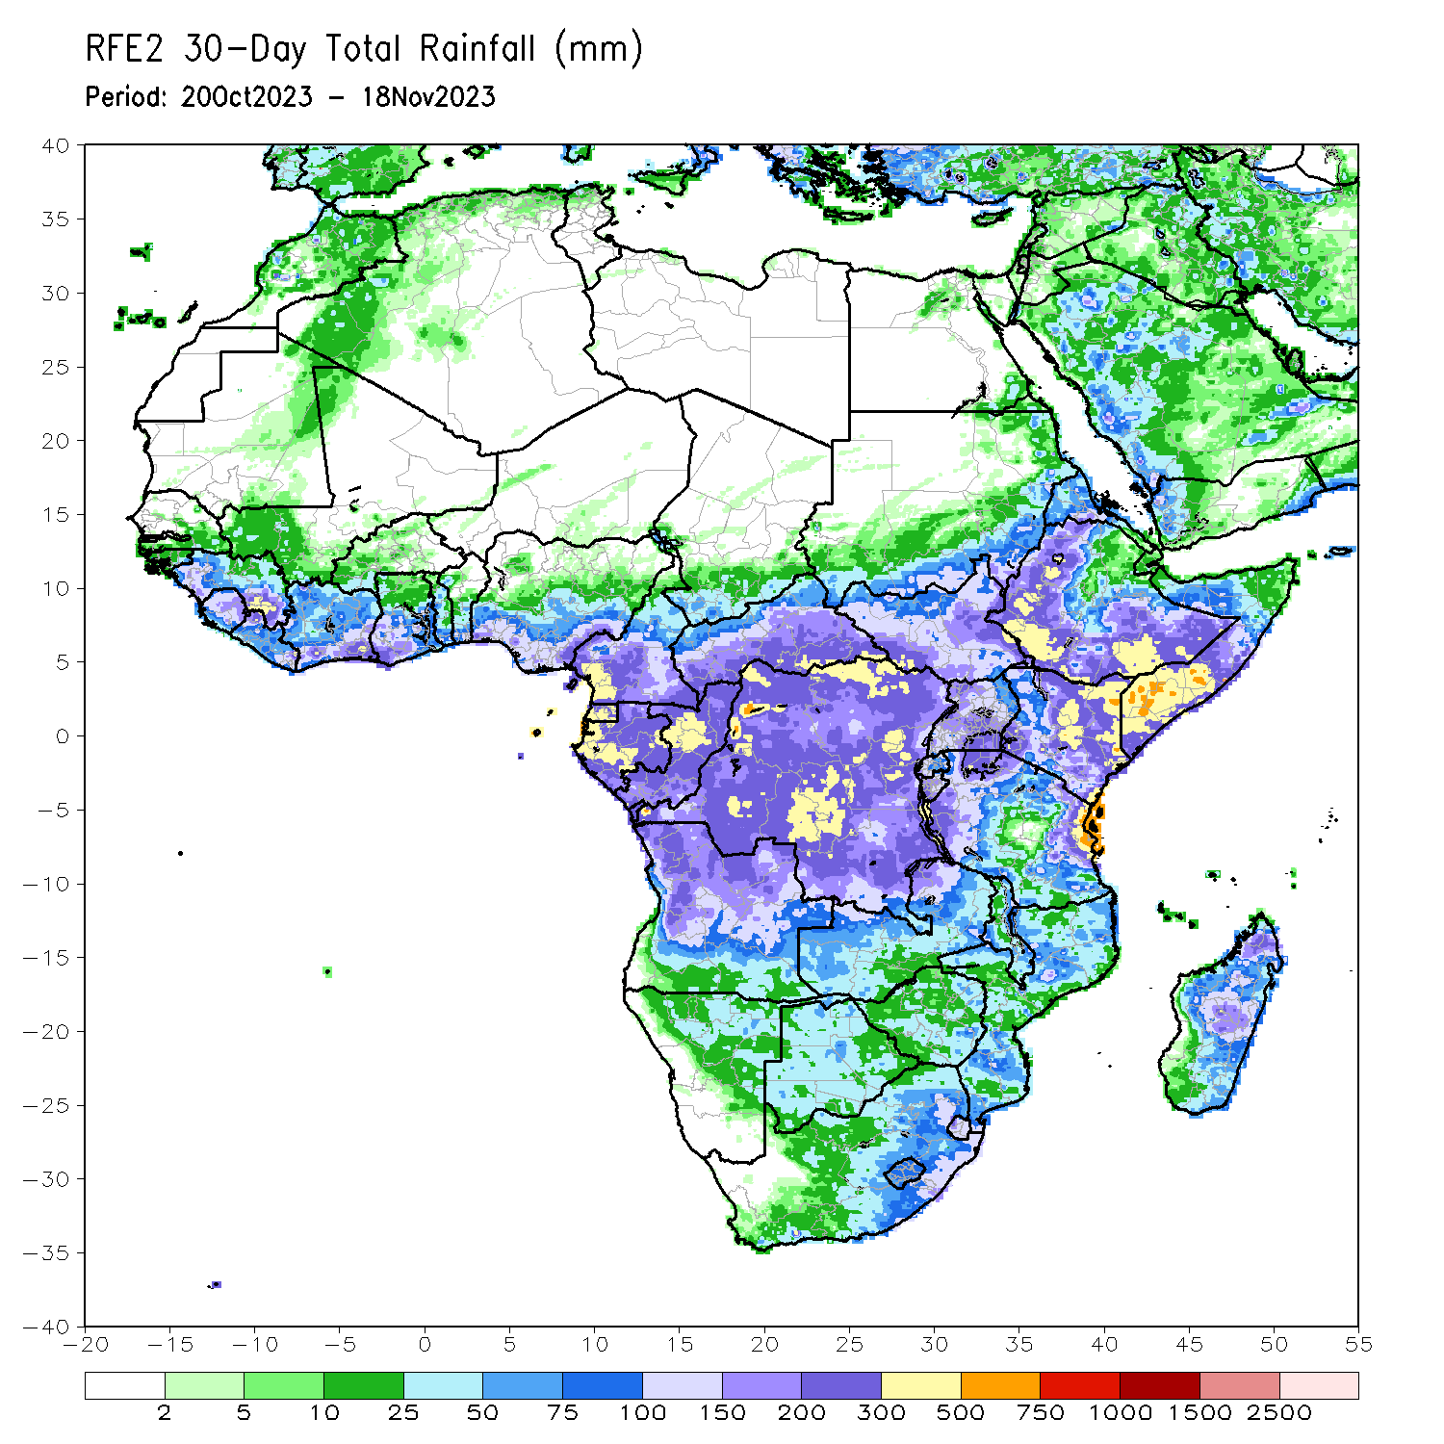
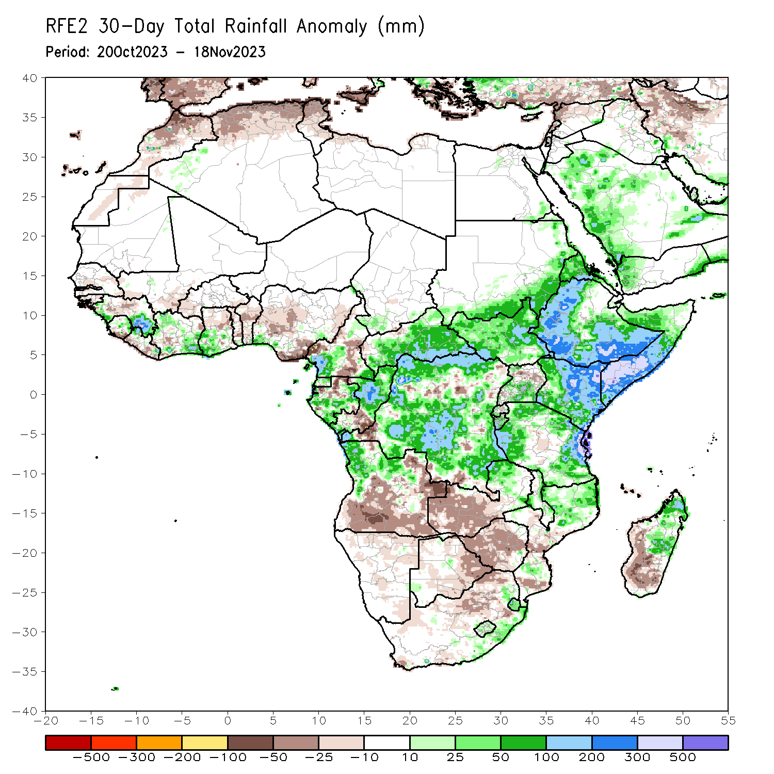
Rainfall Patterns: Last 30 Days
Over the past 30 days, in East Africa, above-average rainfall was observed over southern and eastern Sudan, South Sudan, western and central Eritrea, northern, western, and southern Ethiopia, northwestern, central, and southeastern Uganda, most of Kenya, southern, central, and northwestern Somalia, Burundi, western Rwanda, and parts of northern, western, and eastern Tanzania. Rainfall anomalies exceeded their long-term 30-day averages by more than 300mm in southern Somalia, northeastern and southeastern Kenya, parts of southern and western Ethiopia, and parts of northeastern Tanzania. Rainfall was below-average in parts of central Tanzania, parts of central Uganda, and central Rwanda. In Central Africa, rainfall was above-average over parts of southwestern and southeastern Cameroon, northern, central, and southwestern Congo, CAR excluding its northern borders, central and southern Gabon, Equatorial Guinea, and most of DRC excluding isolated pockets in the northeast, southwest, central, and southeast regions. Below-average rainfall was observed over much of south-central and west-central Cameroon, northern Gabon, and southeastern Congo. In West Africa, rainfall was above-average over western and southeastern Guinea-Conakry, eastern Sierra Leone, northwestern and northeastern Liberia, much of Cote d’Ivoire, southwestern Ghana, and southwestern and far northeastern Nigeria. Below-average rainfall was observed over central Senegal, Gambia, Guinea-Bissau, central Guinea-Conakry, southern Mali, western and southern Burkina Faso, southern Sierra Leone, coastal areas of Liberia, most of Togo and Benin, and over central and south-central Nigeria. In southern Africa, above-average rainfall was observed over much of northern Angola, northeastern Zambia, parts of northern and central Malawi, northern and south-central Mozambique, Lesotho, Eswatini, southeastern South Africa, and northeastern and central Madagascar. Rainfall was below-average over southern and eastern Angola, northern and eastern Namibia, eastern and southern Botswana, northern and southwestern South Africa, western and central Zimbabwe, western and central Zambia, and west-central and southern Madagascar.
Notes:
5

Slide 6
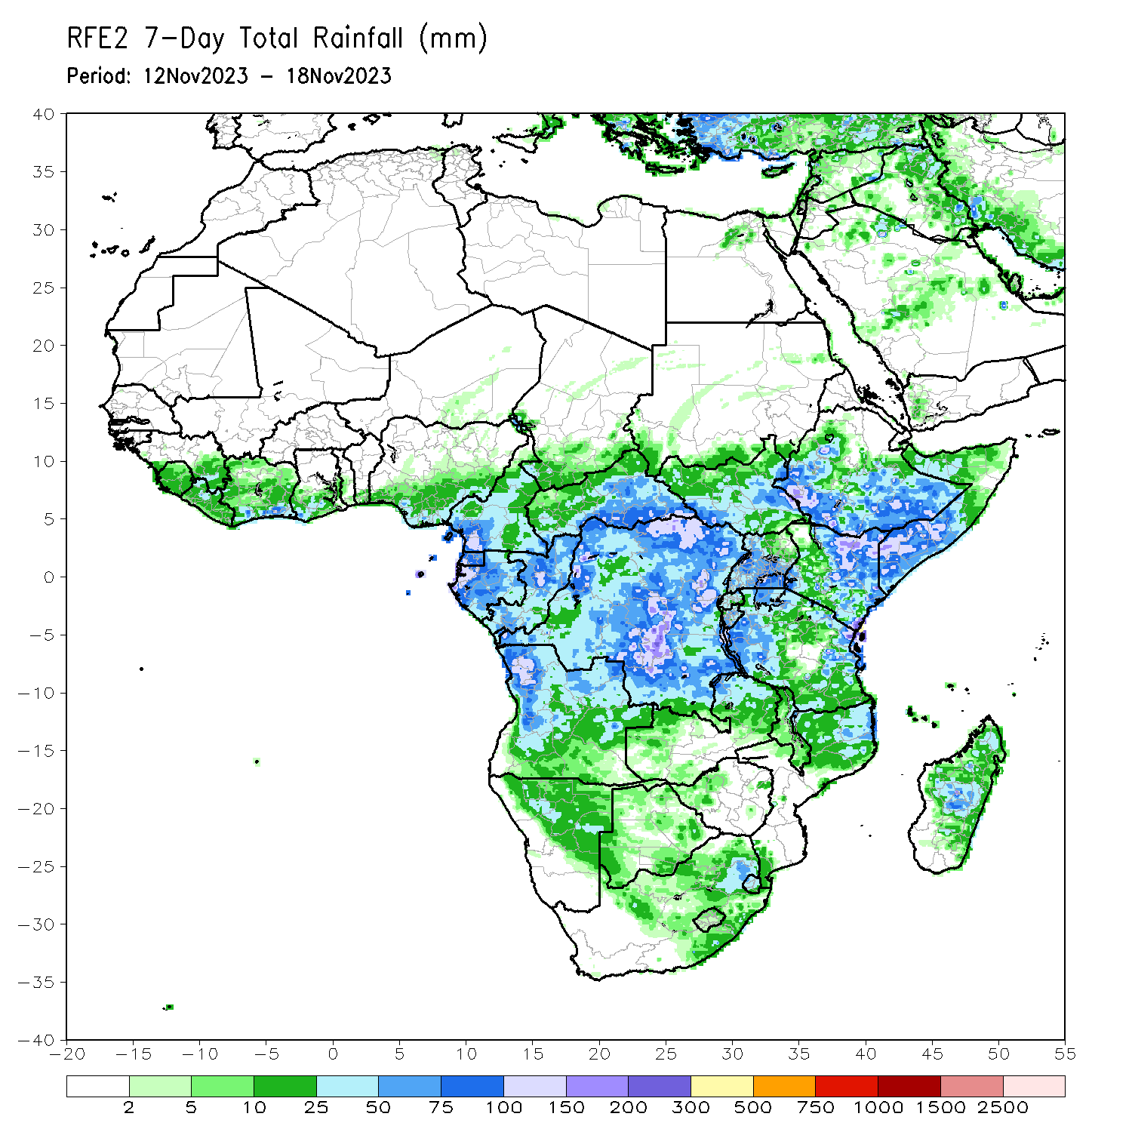
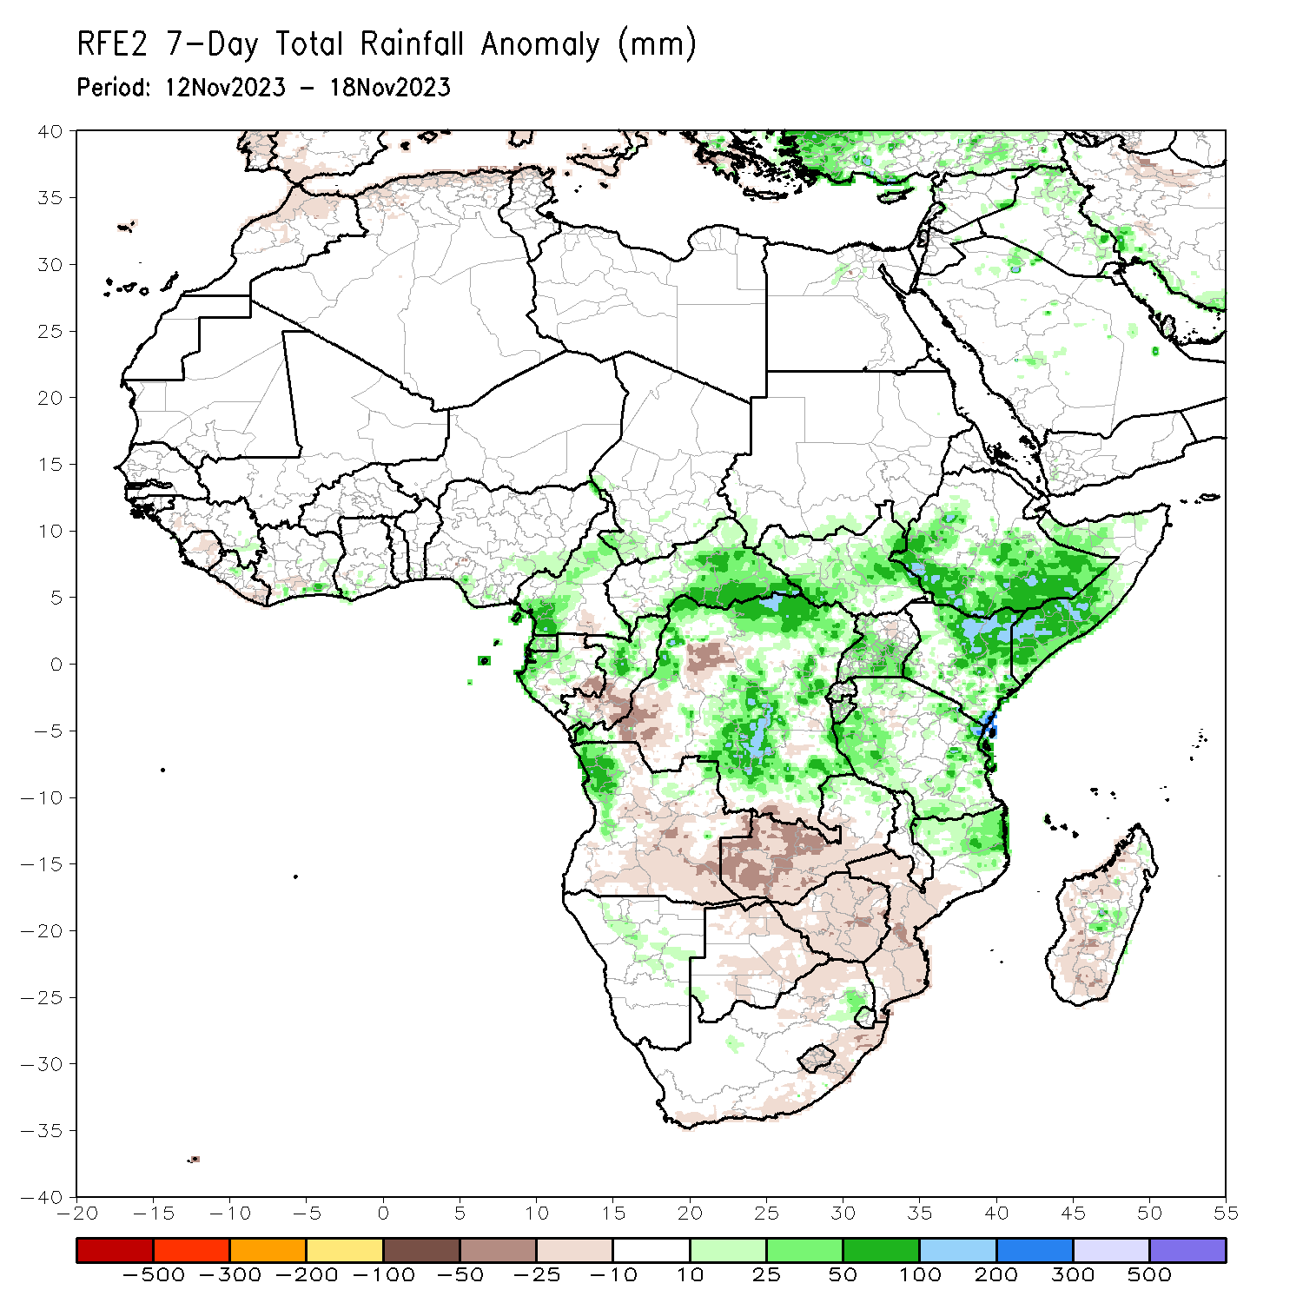
Rainfall Patterns: Last 7 Days
During the past 7 days, in East Africa, rainfall was above-average over west-central and southern Ethiopia, northwestern and southern Somalia, northern, central, and southwestern South Sudan, parts of southern Sudan, northwestern, central, and southern Uganda, eastern, parts of central, and parts of southwestern Kenya, northern, eastern, western, and southern Tanzania, southwestern and northeastern Rwanda, and Burundi. Anomalies in excess of 100 mm or more were observed in parts of southern and west-central Ethiopia, southern Somalia, northeastern Kenya, parts of southwestern and southeastern South Sudan, and northeastern Tanzania. In central Africa, above-average rainfall was observed over southern and eastern CAR, southwestern, southeastern, and west-central Chad, northern, much of central, and parts of southeastern DRC, northern and southwestern Congo, western and central Gabon, Equatorial Guinea, and central and southwestern Cameroon. Anomalies in excess of 100 mm or more were observed in parts of north-central, northeastern, and south-central DRC. Rainfall was below-average over parts of west-central, far southeastern, and southwestern DRC, southeastern Gabon, and southeastern Congo. In West Africa, above-average rainfall was observed over parts of southeastern Guinea-Conakry, southern Cote d’Ivoire, southwestern parts of Ghana, and over south-central and southeastern Nigeria. Rainfall was slightly below average in eastern Sierra Leone and eastern Liberia. In southern Africa, rainfall was above-average over parts of northwestern and northeastern Angola, northeastern Zambia, northern Mozambique, parts of central Namibia, parts of northeastern South Africa, western Eswatini, and parts of central and northern Madagascar. Central and southern Angola, western and central Zambia, central and southern Mozambique, Zimbabwe, northern, eastern, and parts of southern Botswana, northeastern Namibia, much of eastern and southern South Africa, Lesotho, and western and southern Madagascar received below average rainfall.

Slide 7
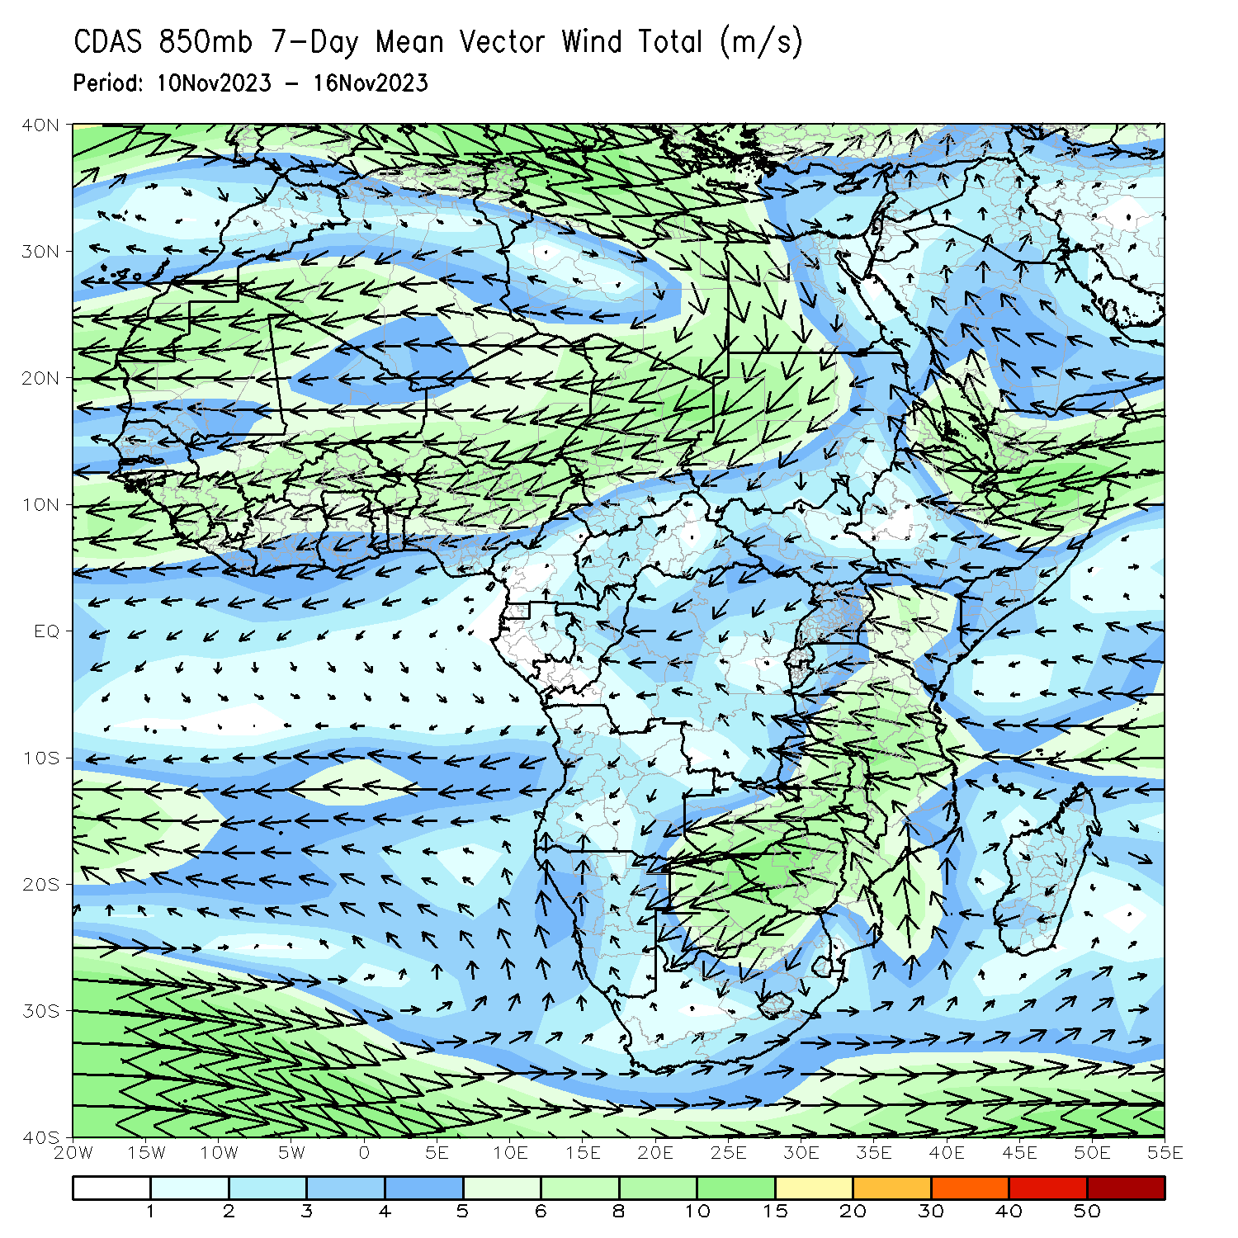
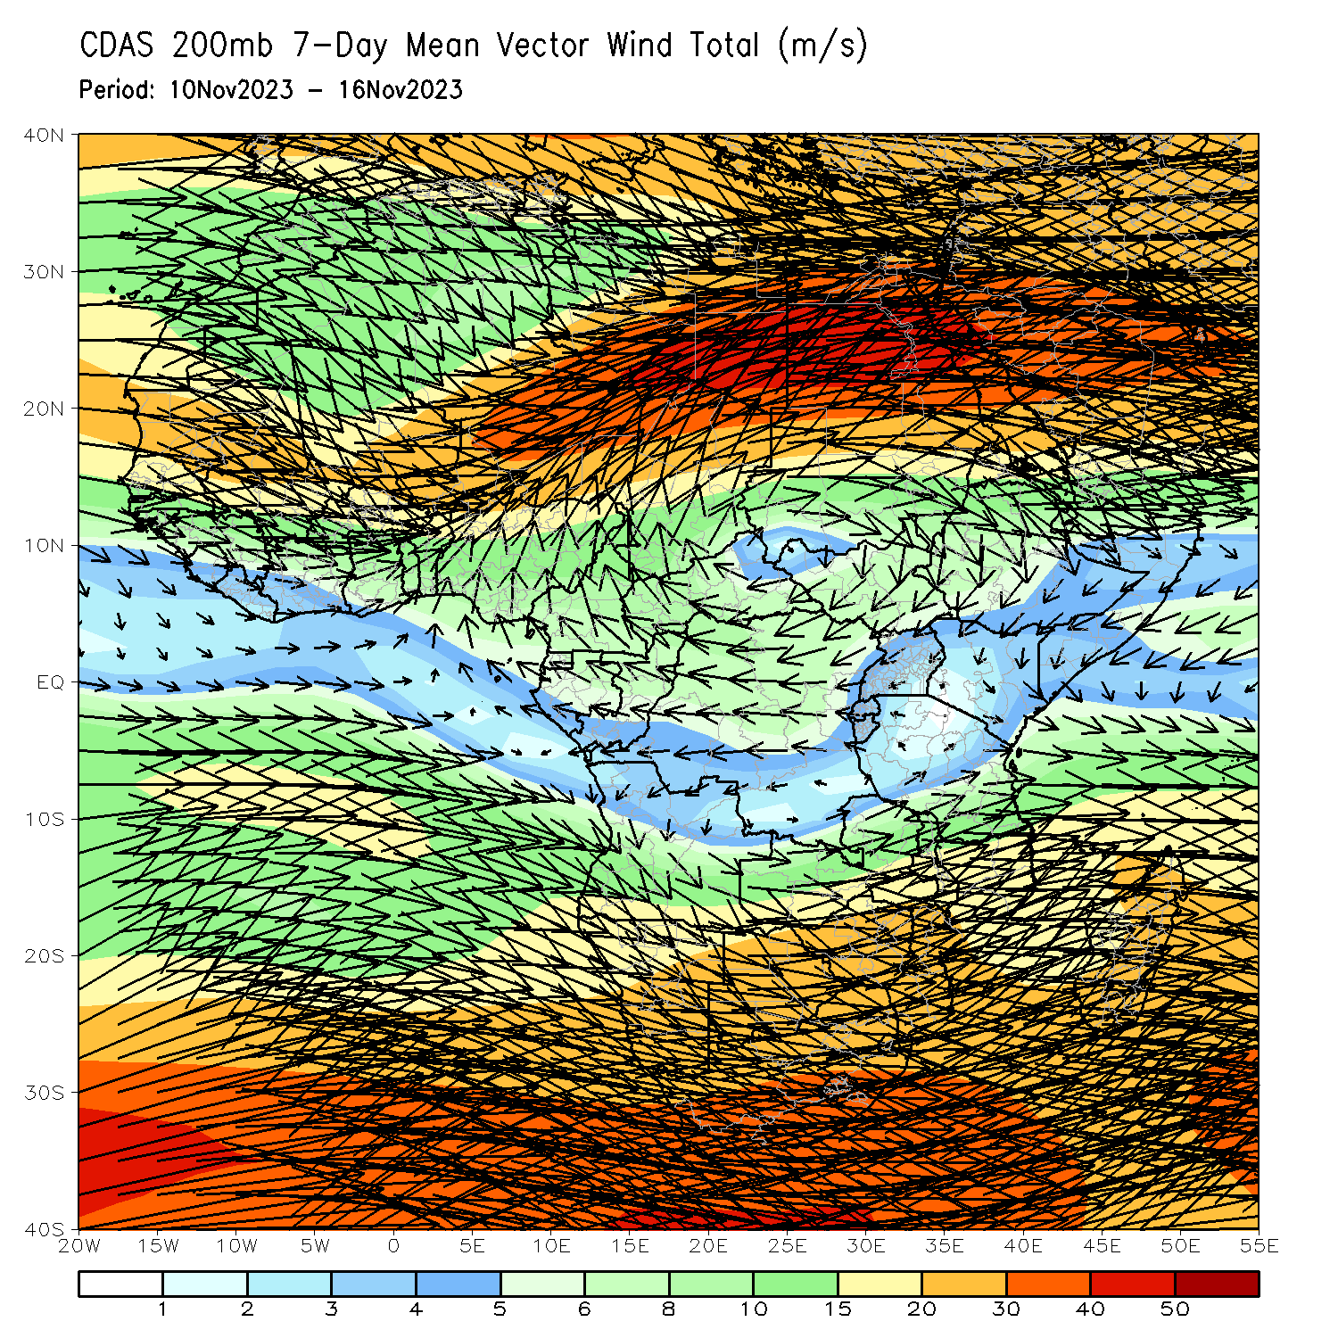
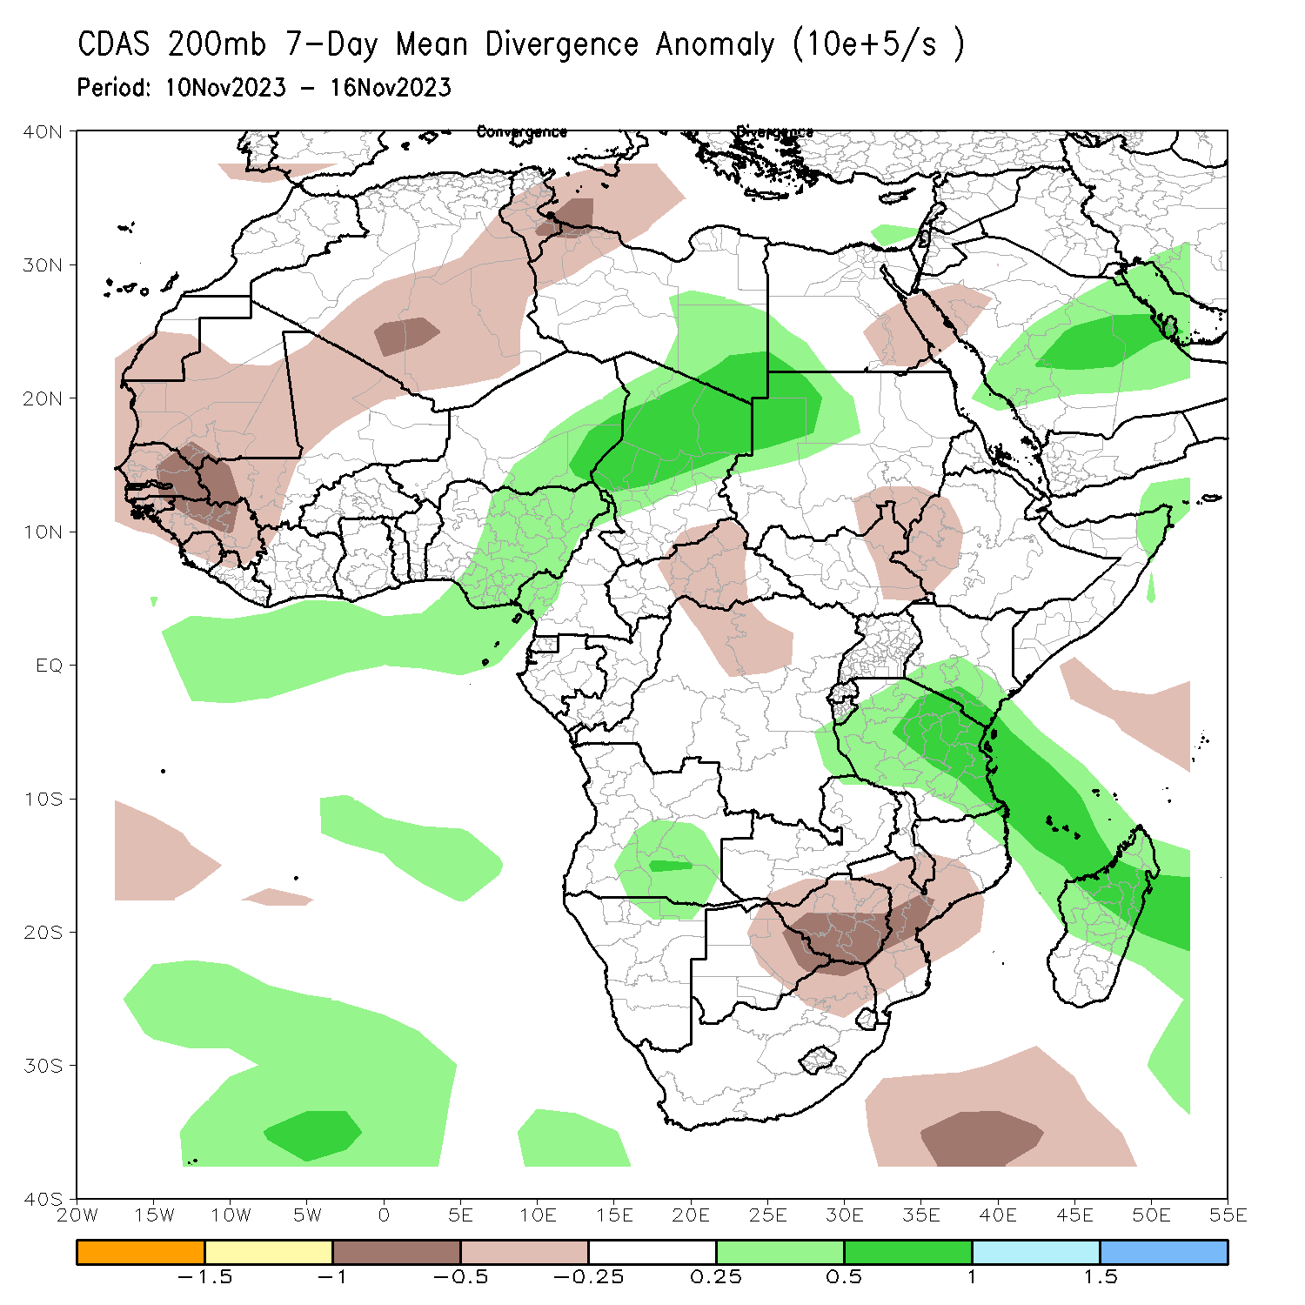
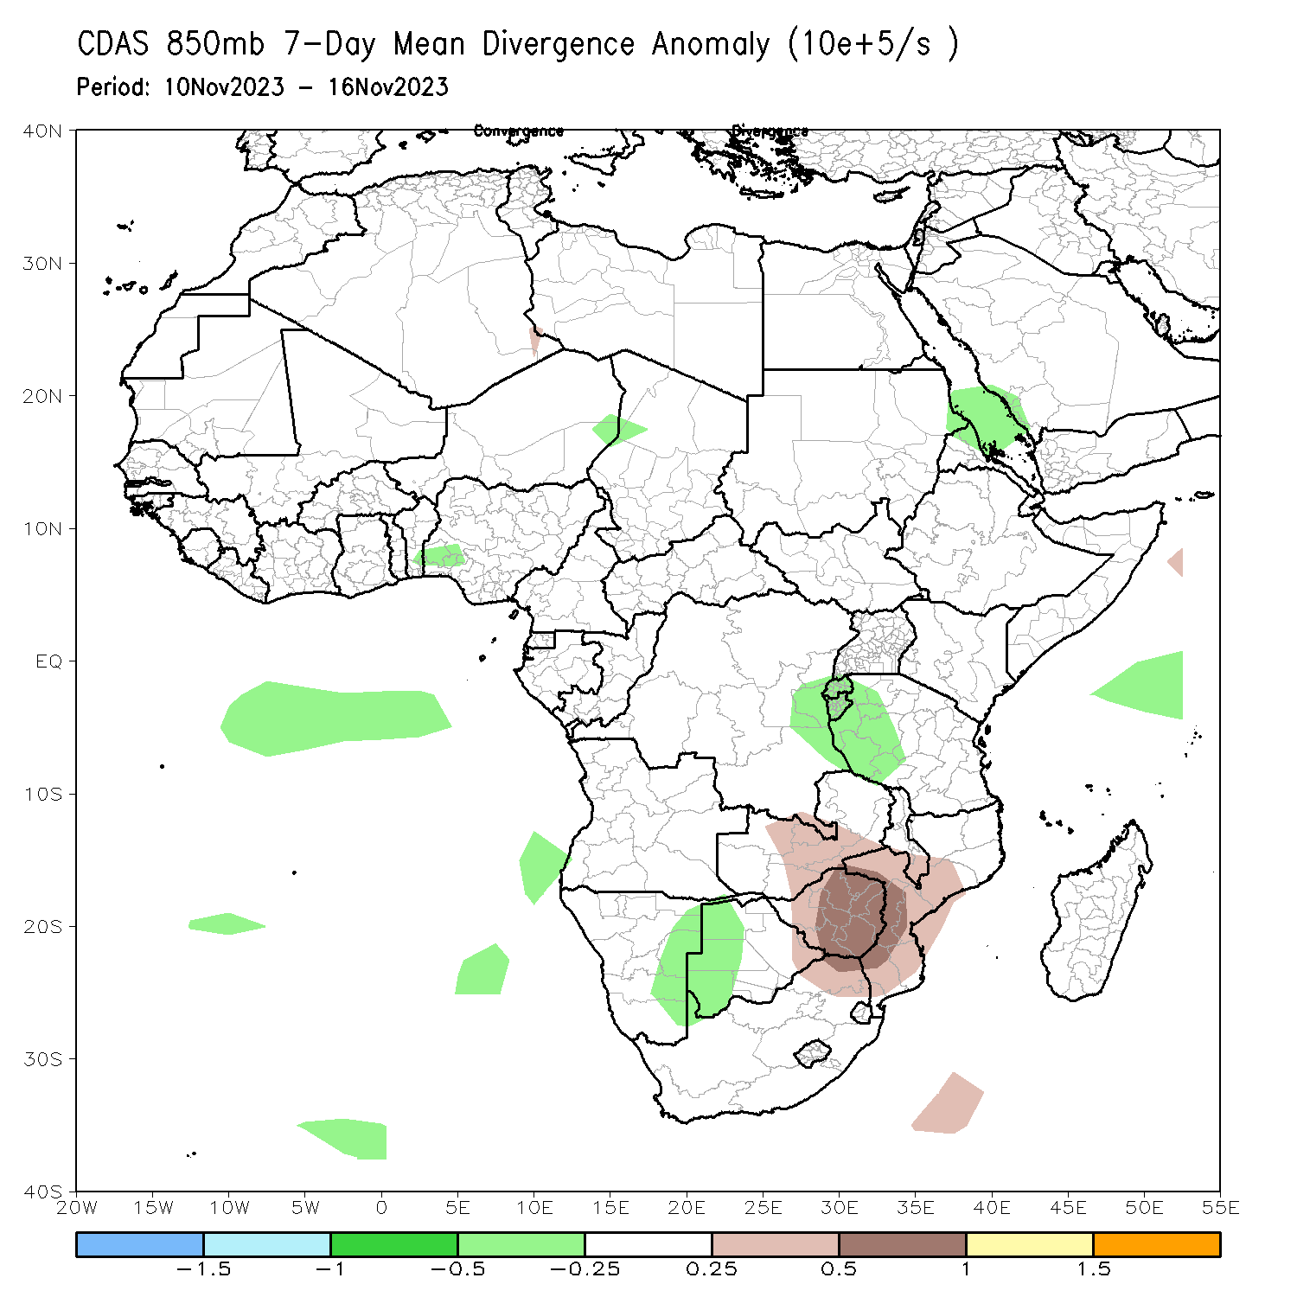
Atmospheric Circulation: Last 7 Days
At 850-hPa level (left panel), anomalous onshore flow in eastern Africa led to enhanced precipitation. At 200-hPa, upper-level divergence (top-right) contributed to the below average precipitation from Zambia to Mozambique.

Slide 8
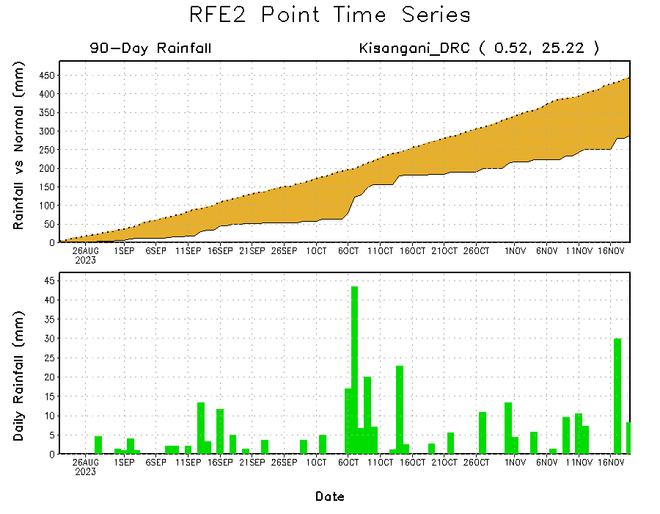
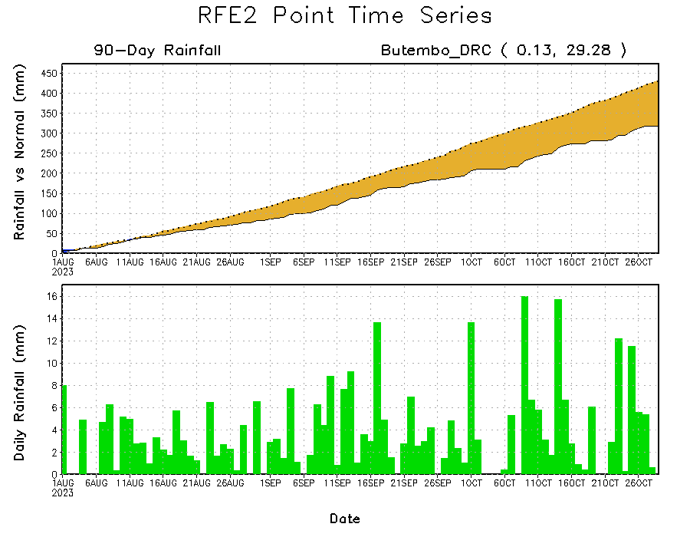
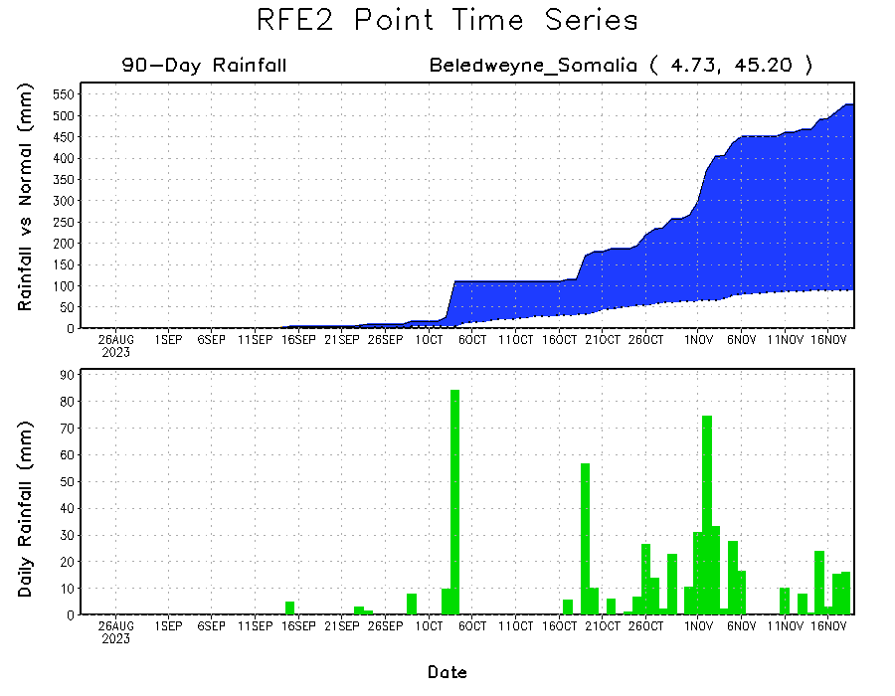
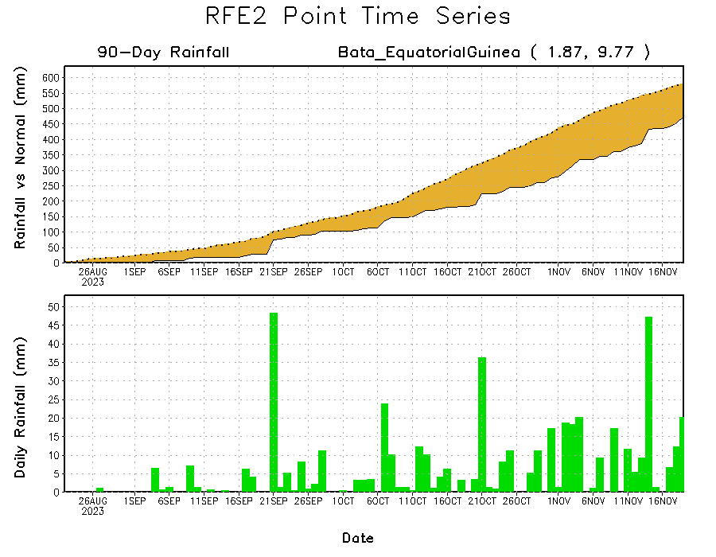
Rainfall Evolution
Daily evolution of rainfall over the last 90 days at selected locations shows light rainfall increased moisture deficits over parts of Equatorial Guinea (bottom left). Seasonal total rainfall remained below-average over northeastern DRC due to the recent below average rainfall (top right). The recent heavy rainfall also increased surpluses early in the rainfall season over southern Somalia (bottom right).

Slide 9
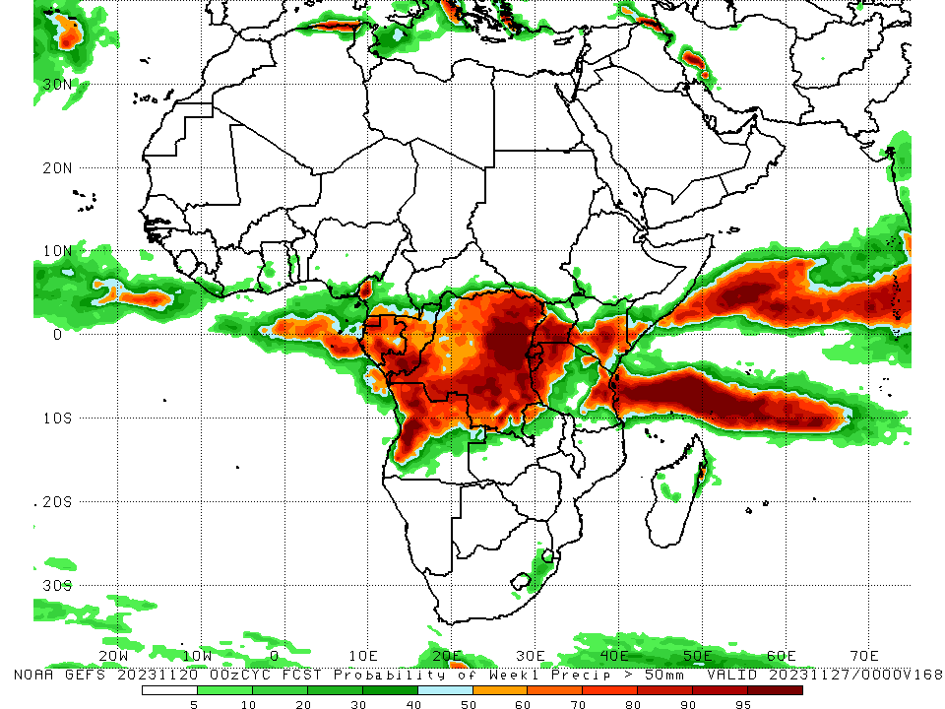
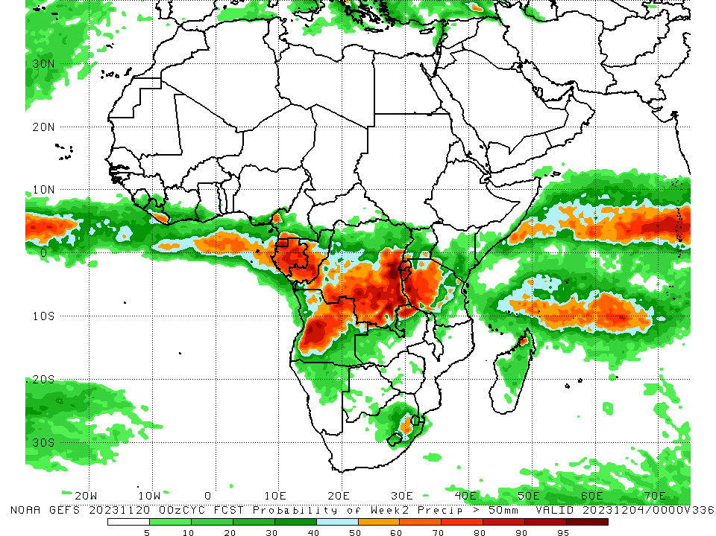
NCEP GEFS Model Forecasts Non-Bias Corrected Probability of precipitation exceedance
Week-1, Valid: 21 – 27 Nov 2023
Week-2, Valid: 28 Nov – 04 Dec 2023
For Week-1 (left-panel), there is moderate to high chance (over 70%) for rainfall to exceed 50 mm over central Kenya, central and southern Uganda, Rwanda, Burundi, eastern and southern DRC, western and eastern Tanzania, parts of northern and western Angola, southern Congo, south-central and northern Gabon, Equatorial Guinea, parts of southern Somalia, northeastern Zambia, and southwestern Cameroon. For week-2 (right panel), the GEFS model predicts a continuation of moderate to high chance (over 70%) for rainfall to exceed 50 mm over Equatorial Guinea, Gabon, southern Congo, parts of southwestern Cameroon, southern and east-central DRC, western Rwanda, Burundi, northeastern and central Angola, northeastern Zambia, western Tanzania, and parts of northwestern Madagascar.
Notes:
9

Slide 10
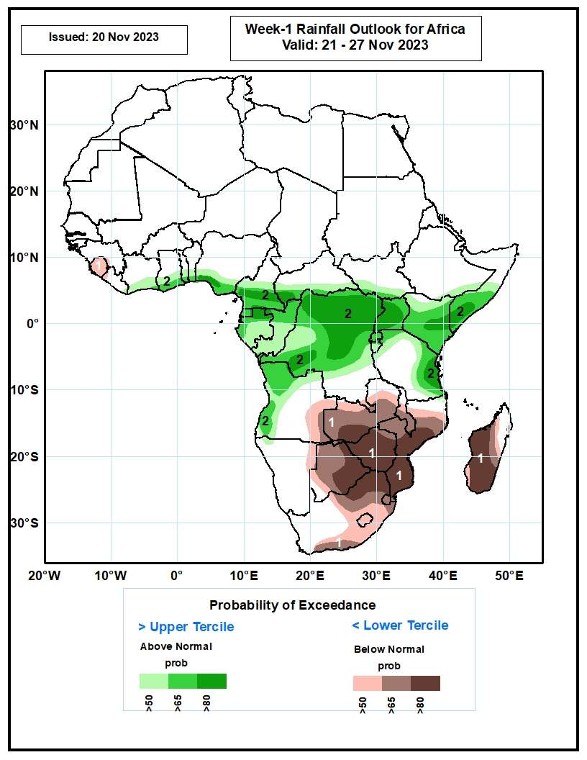
Week-1 Precipitation Outlooks
The probabilistic forecasts call for above 50% chance for weekly total rainfall to be below-average (below the lower tercile) over Sierra Leone, eastern Angola, northeastern Namibia, much of Zambia, Botswana, Zimbabwe, Malawi, Mozambique, Lesotho, Eswatini, northern and central South Africa, and much of Madagascar. There is above 80% chance for below-average rainfall over southern Zambia, eastern Botswana, much of Zimbabwe, central and southern Mozambique, northern South Africa, and central and southern Madagascar.
The probabilistic forecasts call for above 50% chance for weekly rainfall to be above-average (above the upper tercile) over southern parts of Cote d’Ivoire, Ghana, Togo, Benin and Nigeria, central and southern part of Cameroon, southern CAR and South Sudan, Equatorial Guinea, Gabon, Congo, most of DR Congo, northern and western Angola, Uganda, Rwanda, Burundi, Kenya, southeastern Ethiopia, central and southern Somalia, and northern and eastern parts of Tanzania. There is above 80% chance for above-average rainfall over southwestern Nigeria, southern Cameroon, southwestern CAR, northern Gabon, northern and central parts of DR Congo, much of Uganda, central Kenya, southern Somalia, and eastern Tanzania.
21 – 27 Nov 2023
Notes:
10

Slide 11
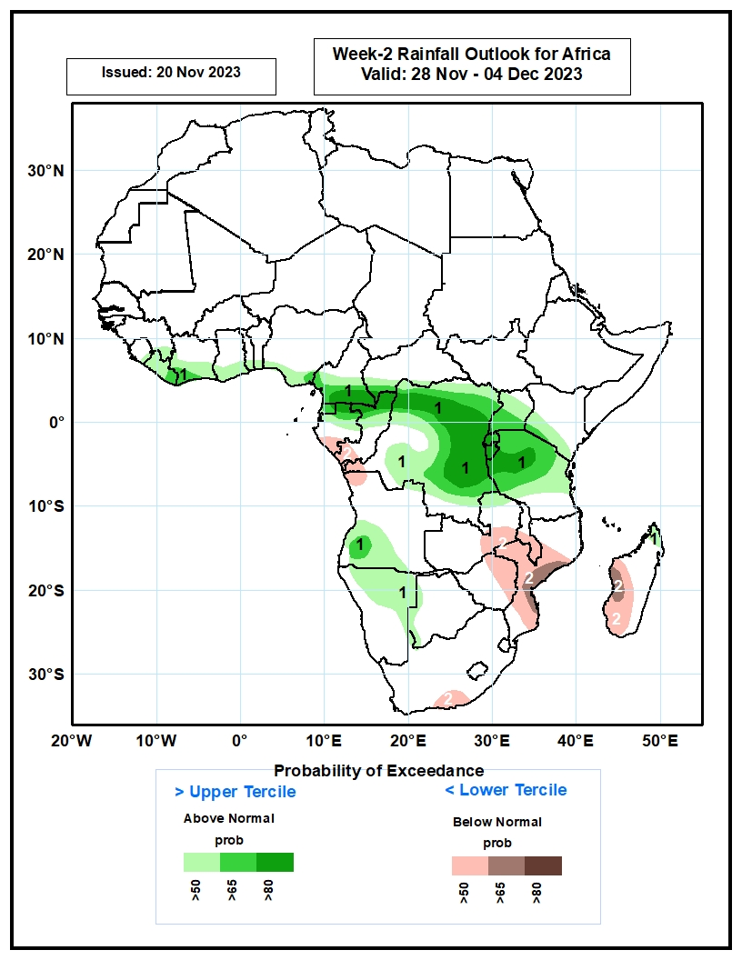
Week-2 Precipitation Outlooks
28 Nov – 04 Dec 2023
The probabilistic forecasts call for above 50% chance for weekly rainfall to be above-average (above the upper tercile) over southeastern Guinea, eastern Sierra Leone, Liberia, southern Cote d’Ivoire, Ghana, Togo, Benin, Nigeria and Cameroon, southwestern CAR, Equatorial Guinea, northern Gabon and Congo, much of DR Congo and Uganda, Rwanda, Burundi, southern Kenya, northern and central Tanzania, western and southern Angola, northern and eastern Namibia, western Botswana, and northern Madagascar. There is above 80% chance for above-average rainfall over southern Cameroon, southwestern CAR, northern Gabon and Congo, northern and eastern parts of DR Congo, Rwanda, Burundi, and central Tanzania.
The probabilistic forecasts call for above 50% chance for weekly total rainfall to be below-average (below the lower tercile) over southern Gabon, southern Congo, western DR Congo, northwestern Angola, southeastern Zambia, central and southern Malawi, eastern Zimbabwe, central and southern Mozambique, south-central South Africa, and western and central part of Madagascar. There is above 65% chance for below-average rainfall over central Mozambique, and west-central Madagascar.
Notes:
11

Slide 12
Summary
Over the past 30 days, in East Africa, above-average rainfall was observed over southern and eastern Sudan, South Sudan, western and central Eritrea, northern, western, and southern Ethiopia, northwestern, central, and southeastern Uganda, most of Kenya, southern, central, and northwestern Somalia, Burundi, western Rwanda, and parts of northern, western, and eastern Tanzania. Rainfall anomalies exceeded their long-term 30-day averages by more than 300mm in southern Somalia, northeastern and southeastern Kenya, parts of southern and western Ethiopia, and parts of northeastern Tanzania. Rainfall was below-average in parts of central Tanzania, parts of central Uganda, and central Rwanda. In Central Africa, rainfall was above-average over parts of southwestern and southeastern Cameroon, northern, central, and southwestern Congo, CAR excluding its northern borders, central and southern Gabon, Equatorial Guinea, and most of DRC excluding isolated pockets in the northeast, southwest, central, and southeast regions. Below-average rainfall was observed over much of south-central and west-central Cameroon, northern Gabon, and southeastern Congo. In West Africa, rainfall was above-average over western and southeastern Guinea-Conakry, eastern Sierra Leone, northwestern and northeastern Liberia, much of Cote d’Ivoire, southwestern Ghana, and southwestern and far northeastern Nigeria. Below-average rainfall was observed over central Senegal, Gambia, Guinea-Bissau, central Guinea-Conakry, southern Mali, western and southern Burkina Faso, southern Sierra Leone, coastal areas of Liberia, most of Togo and Benin, and over central and south-central Nigeria. In southern Africa, above-average rainfall was observed over much of northern Angola, northeastern Zambia, parts of northern and central Malawi, northern and south-central Mozambique, Lesotho, Eswatini, southeastern South Africa, and northeastern and central Madagascar. Rainfall was below-average over southern and eastern Angola, northern and eastern Namibia, eastern and southern Botswana, northern and southwestern South Africa, western and central Zimbabwe, western and central Zambia, and west-central and southern Madagascar.
During the past 7 days, in East Africa, rainfall was above-average over west-central and southern Ethiopia, northwestern and southern Somalia, northern, central, and southwestern South Sudan, parts of southern Sudan, northwestern, central, and southern Uganda, eastern, parts of central, and parts of southwestern Kenya, northern, eastern, western, and southern Tanzania, southwestern and northeastern Rwanda, and Burundi. Anomalies in excess of 100 mm or more were observed in parts of southern and west-central Ethiopia, southern Somalia, northeastern Kenya, parts of southwestern and southeastern South Sudan, and northeastern Tanzania. In central Africa, above-average rainfall was observed over southern and eastern CAR, southwestern, southeastern, and west-central Chad, northern, much of central, and parts of southeastern DRC, northern and southwestern Congo, western and central Gabon, Equatorial Guinea, and central and southwestern Cameroon. Anomalies in excess of 100 mm or more were observed in parts of north-central, northeastern, and south-central DRC. Rainfall was below-average over parts of west-central, far southeastern, and southwestern DRC, southeastern Gabon, and southeastern Congo. In West Africa, above-average rainfall was observed over parts of southeastern Guinea-Conakry, southern Cote d’Ivoire, southwestern parts of Ghana, and over south-central and southeastern Nigeria. Rainfall was slightly below average in eastern Sierra Leone and eastern Liberia. In southern Africa, rainfall was above-average over parts of northwestern and northeastern Angola, northeastern Zambia, northern Mozambique, parts of central Namibia, parts of northeastern South Africa, western Eswatini, and parts of central and northern Madagascar. Central and southern Angola, western and central Zambia, central and southern Mozambique, Zimbabwe, northern, eastern, and parts of southern Botswana, northeastern Namibia, much of eastern and southern South Africa, Lesotho, and western and southern Madagascar received below average rainfall.
For Week-1 (left-panel), there is moderate to high chance (over 70%) for rainfall to exceed 50 mm over central Kenya, central and southern Uganda, Rwanda, Burundi, eastern and southern DRC, western and eastern Tanzania, parts of northern and western Angola, southern Congo, south-central and northern Gabon, Equatorial Guinea, parts of southern Somalia, northeastern Zambia, and southwestern Cameroon. For week-2 (right panel), the GEFS model predicts a continuation of moderate to high chance (over 70%) for rainfall to exceed 50 mm over Equatorial Guinea, Gabon, southern Congo, parts of southwestern Cameroon, southern and east-central DRC, western Rwanda, Burundi, northeastern and central Angola, northeastern Zambia, western Tanzania, and parts of northwestern Madagascar.

