Slide 1
The African Monsoon Recent Evolution and Current Status Include Week-1 and Week-2 Outlooks
Update prepared
06 November 2023
For more information, visit:
http://www.cpc.ncep.noaa.gov/products/Global_Monsoons/African_Monsoons/precip_monitoring.shtml

Slide 2
Outline
Highlights
Recent Evolution and Current Conditions
NCEP GEFS Forecasts
Summary

Slide 3
Highlights: Last & Upcoming 7 Days
During the past 7 days, rainfall has expanded and intensified across eastern and southern Africa and diminished over West Africa. In East Africa, rainfall was above-average over parts of western and southeastern Ethiopia, parts of eastern Sudan, much of South Sudan, northern and southern Uganda, eastern half of Kenya, much of Somalia, Burundi, and parts of northwestern and southeastern Tanzania. In central Africa, above-average rainfall was observed over central and southern CAR, much of DRC, Equatorial Guinea, central Congo, and southwestern Cameroon. Rainfall was below-average over parts of northwestern Gabon, parts of southern Congo and a few areas in eastern DRC. In West Africa, above-average rainfall was observed over parts of southern and eastern Nigeria and in isolated areas over Guinea-Bissau, Guinea Conakry, Senegal, and bordering areas of Cote d’Ivoire and Ghana. Climatologically dry conditions persisted over much of the remaining areas in West Africa. In southern Africa, rainfall was above-average over parts of northern and eastern Angola, western Botswana, southern Zimbabwe, northern and central Zambia, central and northeastern South Africa, the Kingdom of Eswatini, southern and central Mozambique, and northeastern Madagascar. Rainfall was below-average over southern and northeastern Angola and southwestern Madagascar.
Week-1 forecasts indicate rainfall intensification over Kenya, persistence of wetter than average conditions extending from Central Africa to western Ethiopia, and a slight decline over central parts of Somalia and much of southern Africa. The Week-1 outlook calls for above-normal rainfall over southern Cote d’Ivoire, southern Nigeria, much of Cameroon, northern Gabon, northern Congo, northern DRC, southern CAR, southern South Sudan, Uganda, Rwanda, Burundi, southern and eastern Kenya, southwestern Ethiopia, southern Somalia, parts of Angola, central Mozambique, and northeastern Madagascar. Rainfall is expected to be below-normal across the far western Gulf of Guinea region and coastal areas of Gabon, Congo and DRC. The Week-2 outlook calls for above-normal rainfall over portion of the Gulf of Guinea region, parts of central Africa, southeastern Ethiopia, eastern Kenya and southern Somalia. Rainfall is expected to be below-normal over northeastern Namibia, southwestern Botswana, and central parts of South Africa.

Slide 4
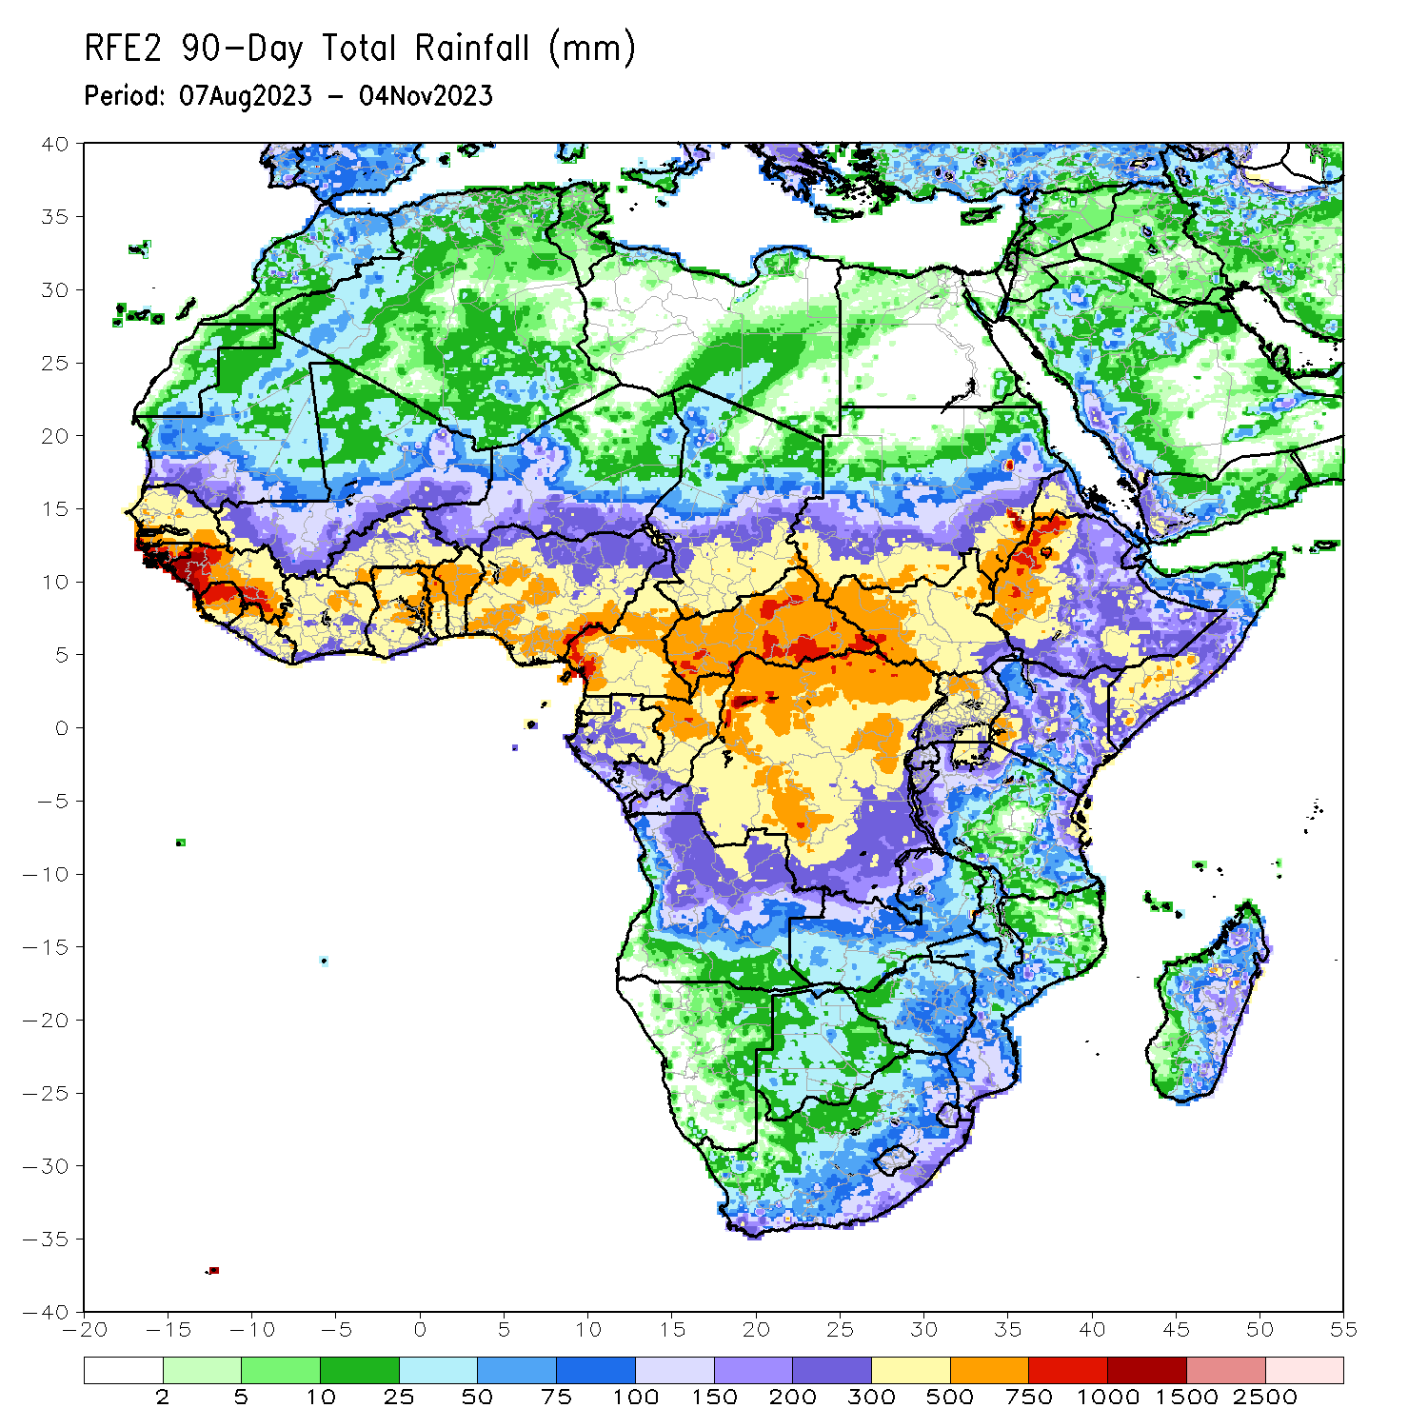
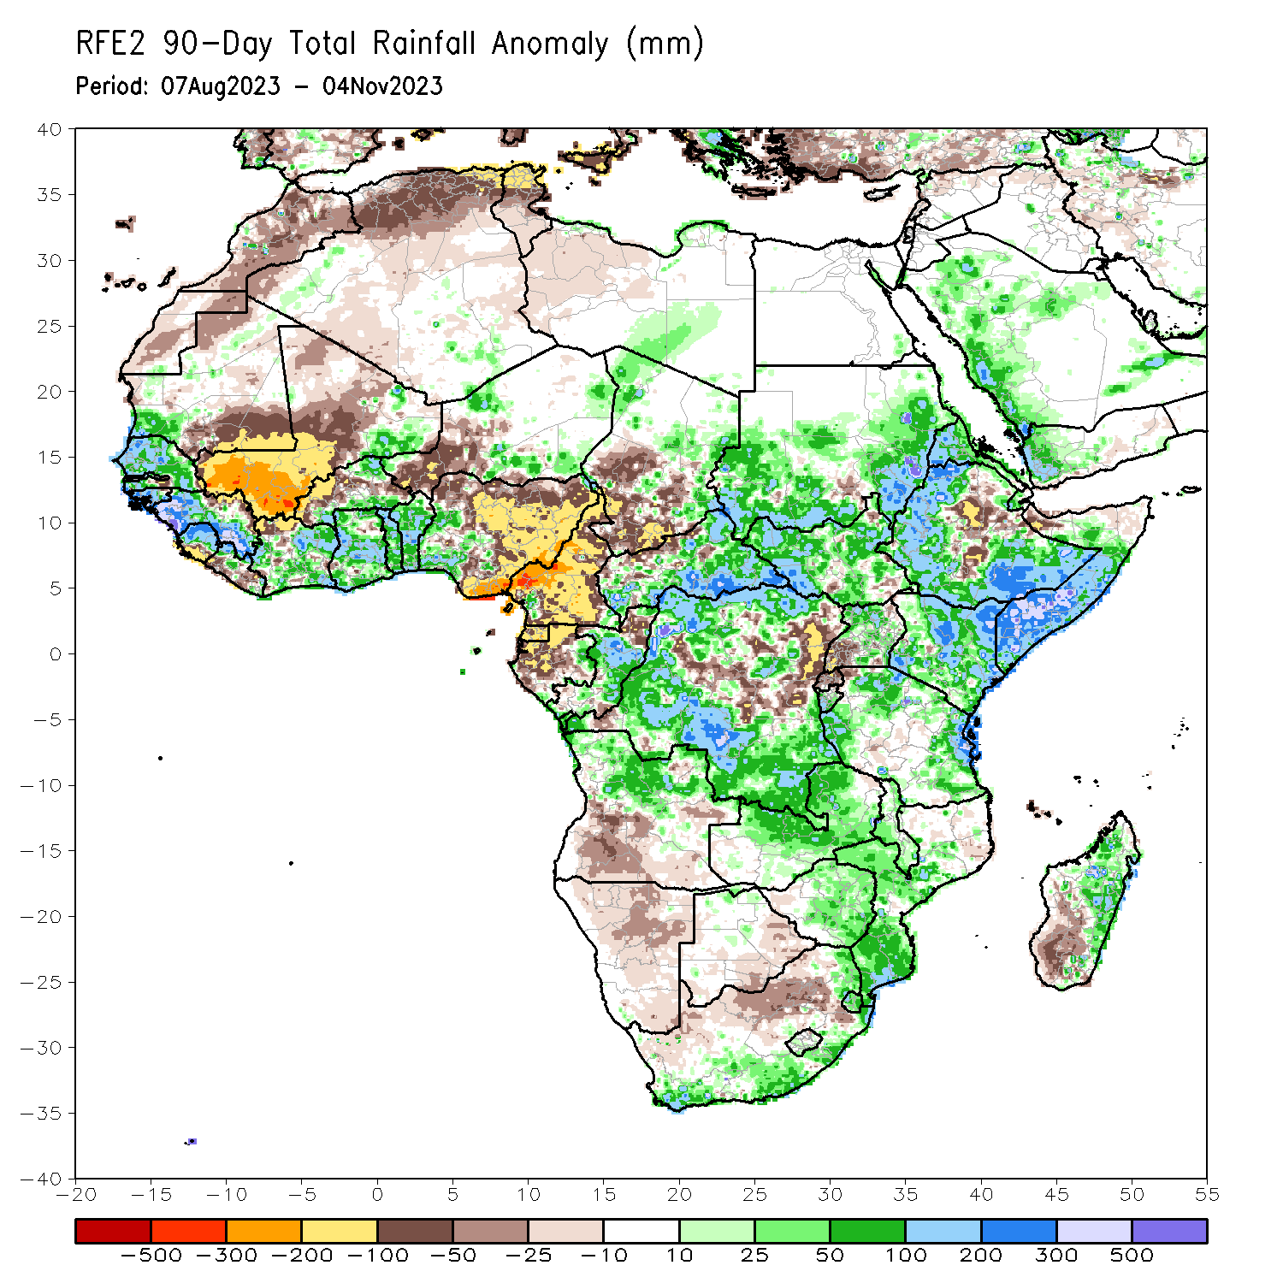
Rainfall Patterns: Last 90 Days
Over the past 90 days, in East Africa, above-average rainfall was observed over many parts of Sudan, western, northern, southern and southeastern Ethiopia, most of western and northeastern South Sudan, much of northern and central Uganda, Eritrea, Djibouti, southern and central Somalia, parts of southwestern, southeastern, central, and northern Kenya, Burundi, and parts of north-central and eastern Tanzania. Rainfall was below-average over isolated areas in southeastern Sudan and central and southeastern South Sudan, along the main Rift Valley and its escarpments in Ethiopia, over parts of northern Somalia, at isolated pockets in central Kenya, over southwestern Uganda, Rwanda, northern Burundi, and northwestern Tanzania. In southern Africa, above-average rainfall was observed over southern and eastern South Africa, Eswatini, southern and central Mozambique, much of northern Angola, northern and central Zambia, central and eastern Zimbabwe, central and southern Malawi, western parts of Botswana, and parts of eastern and central Madagascar. Below-average rainfall was observed over northern South Africa, parts of central and southern Angola, Namibia, southern and eastern parts of Botswana, and southwestern Madagascar. In Central Africa, rainfall was above-average over many parts of CAR, eastern and northwestern Chad, much of central and far northern Congo, northeastern Gabon, far southeastern Cameroon, and northern, western, and much of southern DRC. Rainfall was below-average over much of Cameroon, Equatorial Guinea, most of Gabon, parts of northern Congo, parts of central and northeastern DRC, northern borders of CAR, and central and southwestern Chad. In West Africa, rainfall was above-average over much of Senegal, southwestern Mauritania, Gambia, Guinea-Bissau, western and southern Guinea, northern and central Sierra Leone, eastern and northwestern Liberia, eastern Mali, much of Cote d’Ivoire, southern and northeastern Burkina Faso, much of Ghana, Togo, Benin, parts of northwestern and southeastern, and eastern Niger, and western Nigeria. Below-average rainfall was observed over western, central, and northern Mali, northeastern Guinea, southern Sierra Leone, southwestern Liberia, northwestern Cote d’Ivoire, western and central Burkina Faso, parts of southwestern and central Niger, southeastern and parts of northeastern Mauritania, and central, northern, and eastern Nigeria.
Notes:
4

Slide 5
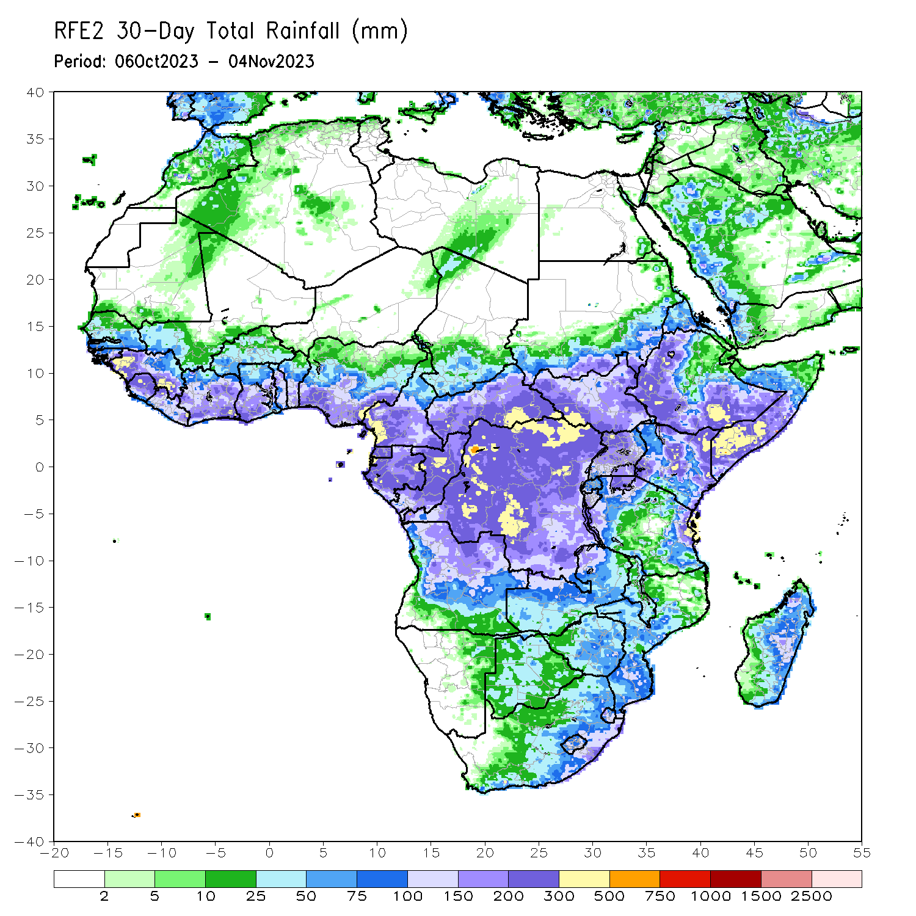
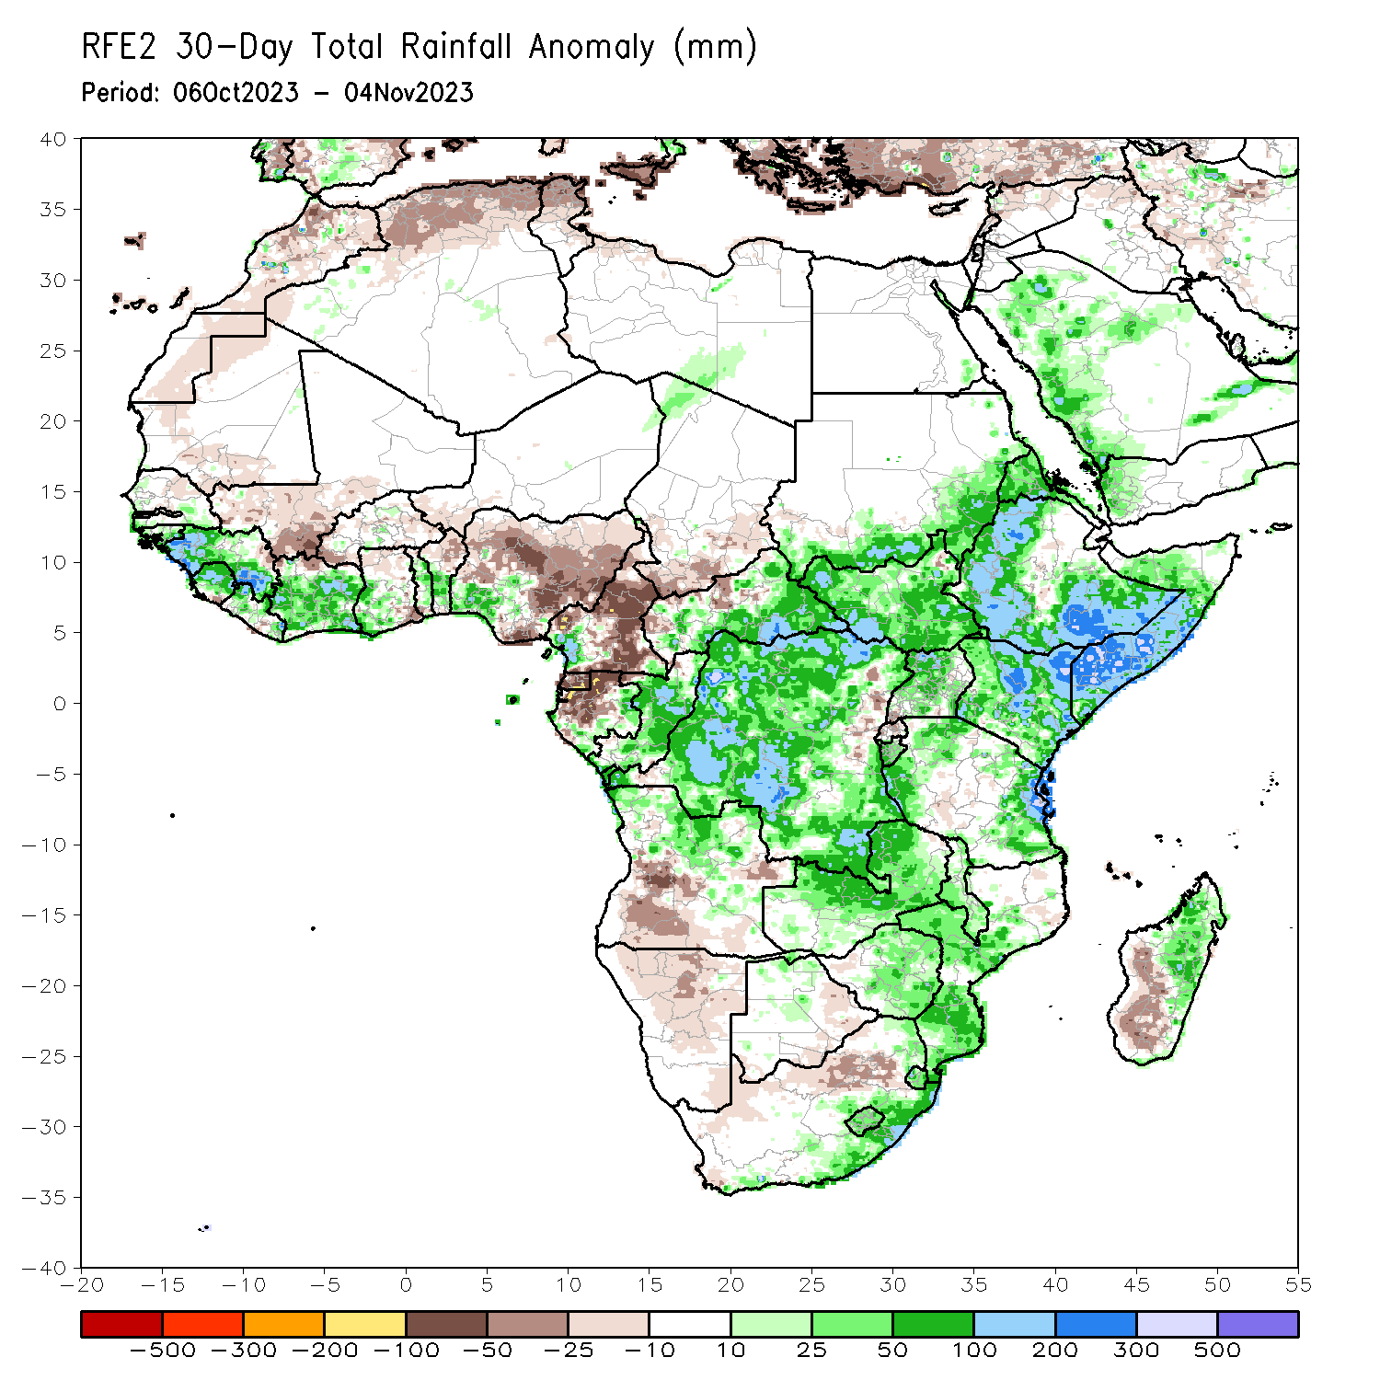
Rainfall Patterns: Last 30 Days
OOver the past 30 days, in East Africa, above-average rainfall was observed over southern and eastern Sudan, most of western, southern and eastern South Sudan, most of Eritrea (except southern Red Sea coast), northern, western and southeastern Ethiopia, northern and central Uganda, most of Kenya, southern and central Somalia, Burundi, and parts of northern, western and eastern Tanzania. Rainfall was below-average in parts of the main Rift Valley and its escarpments in Ethiopia, parts of southern Uganda, Rwanda, and parts of northeastern South Sudan. In Central Africa, rainfall was above-average over much of Congo, parts of western Cameroon, parts of western, isolated areas in central Chad, parts of southern and eastern Gabon, eastern, southern, and western CAR, and southern, northern, western, and central DRC. Below-average rainfall was observed over much of Cameroon, Equatorial Guinea, northern, central, and western Gabon, northwestern border regions of Congo, southern and eastern Chad, northern and parts of central CAR, and east-central DRC. In West Africa, rainfall was above-average over pockets of northern and southern Senegal, Guinea, Guinea-Bissau, northern and central Sierra Leone, northwestern and parts of central and eastern Liberia, much of Cote d’Ivoire, parts of central and southern Burkina Faso, southwestern Ghana, Togo, most of Benin, parts of southwestern Nigeria, isolated areas in northeastern Niger, and a few localities in southwestern and northeastern Mauritania. Below-average rainfall was observed over south-central Mauritania, southwestern and central Mali, parts of southeastern Sierra Leone, parts of northern Cote d’Ivoire, southern Burkina Faso, southwestern Niger, parts of northern and southeastern Ghana, and southeastern coastal, eastern, and northern Nigeria. In southern Africa, above-average rainfall was observed over much of northern Angola, northern and central Zambia, central-north Botswana, eastern and central Zimbabwe, Malawi, central and southern Mozambique, Lesotho, Eswatini, southern South Africa, and parts of eastern and northeastern Madagascar. Rainfall was below-average over southern and eastern Angola, western Zambia, northern and eastern Namibia, eastern Botswana, northern South Africa, and parts of central and southern Madagascar.
Notes:
5

Slide 6
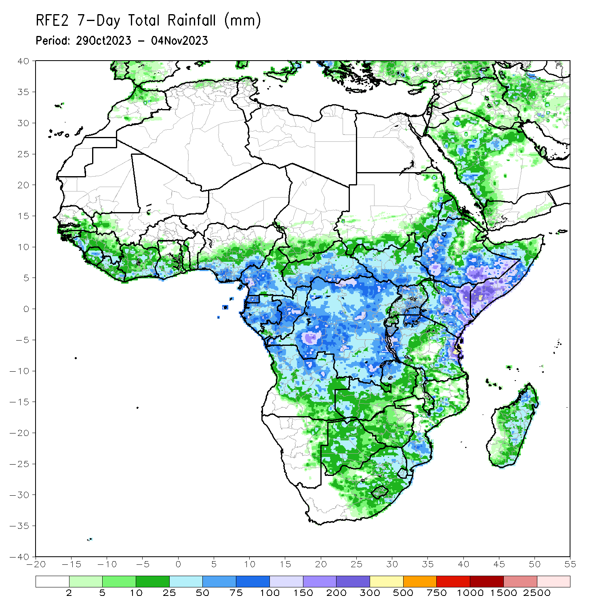
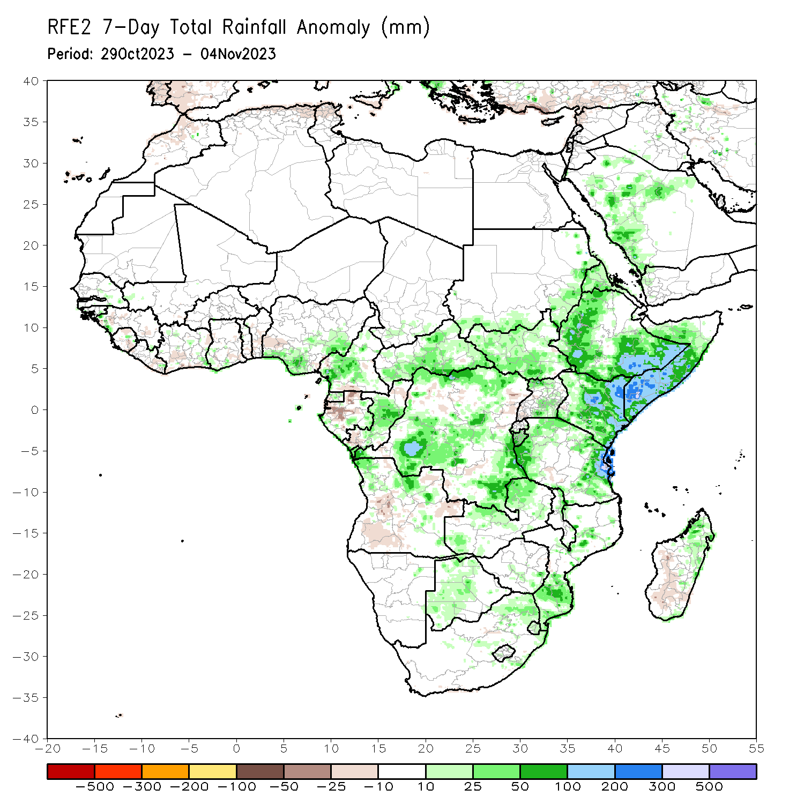
Rainfall Patterns: Last 7 Days
During the past 7 days, rainfall has expanded and intensified across eastern and southern Africa and diminished over West Africa. In East Africa, rainfall was above-average over parts of western and southeastern Ethiopia, parts of eastern Sudan, much of South Sudan, northern and southern Uganda, eastern half of Kenya, much of Somalia, Burundi, and parts of northwestern and southeastern Tanzania. In central Africa, above-average rainfall was observed over central and southern CAR, much of DRC, Equatorial Guinea, central Congo, and southwestern Cameroon. Rainfall was below-average over parts of northwestern Gabon, parts of southern Congo and a few areas in eastern DRC. In West Africa, above-average rainfall was observed over parts of southern and eastern Nigeria and in isolated areas over Guinea-Bissau, Guinea Conakry, Senegal, and bordering areas of Cote D’Ivoire and Ghana. Climatologically dry conditions persisted over much of the remaining areas in West Africa. In southern Africa, rainfall was above-average over parts of northern and eastern Angola, western Botswana, southern Zimbabwe, northern and central Zambia, central and northeastern South Africa, the Kingdom of Eswatini, southern and central Mozambique, and northeastern Madagascar. Rainfall was below-average over southern Angola and northeastern Angola and southwestern Madagascar.

Slide 7
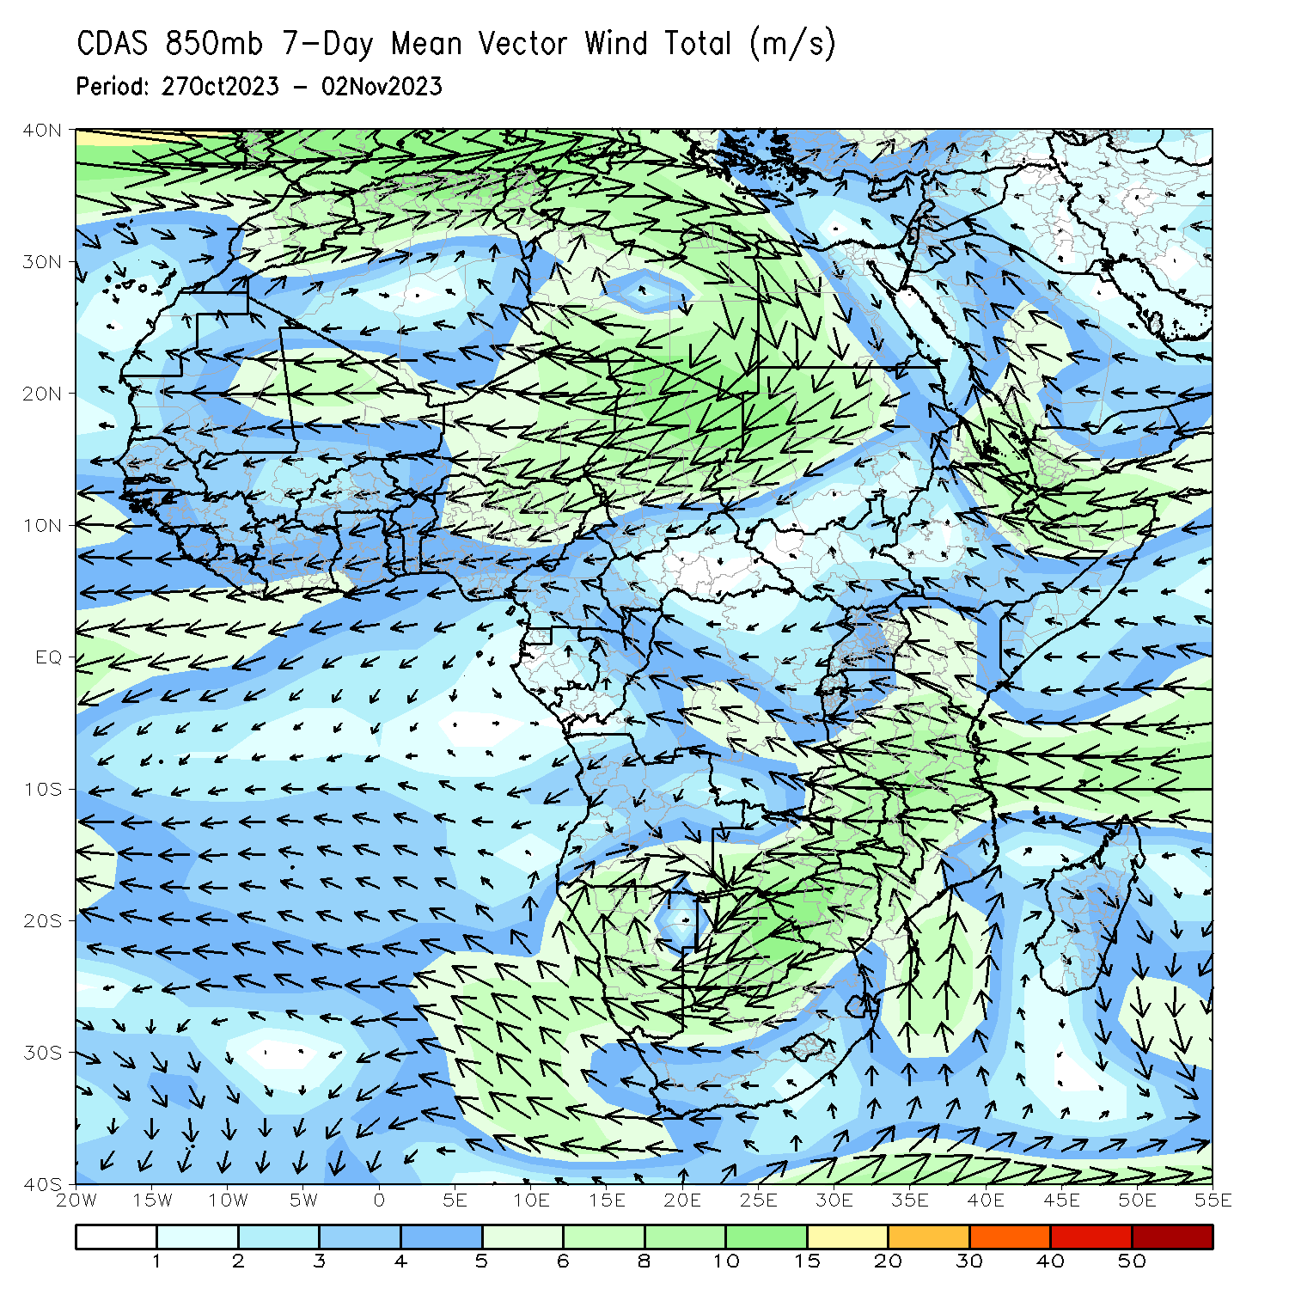
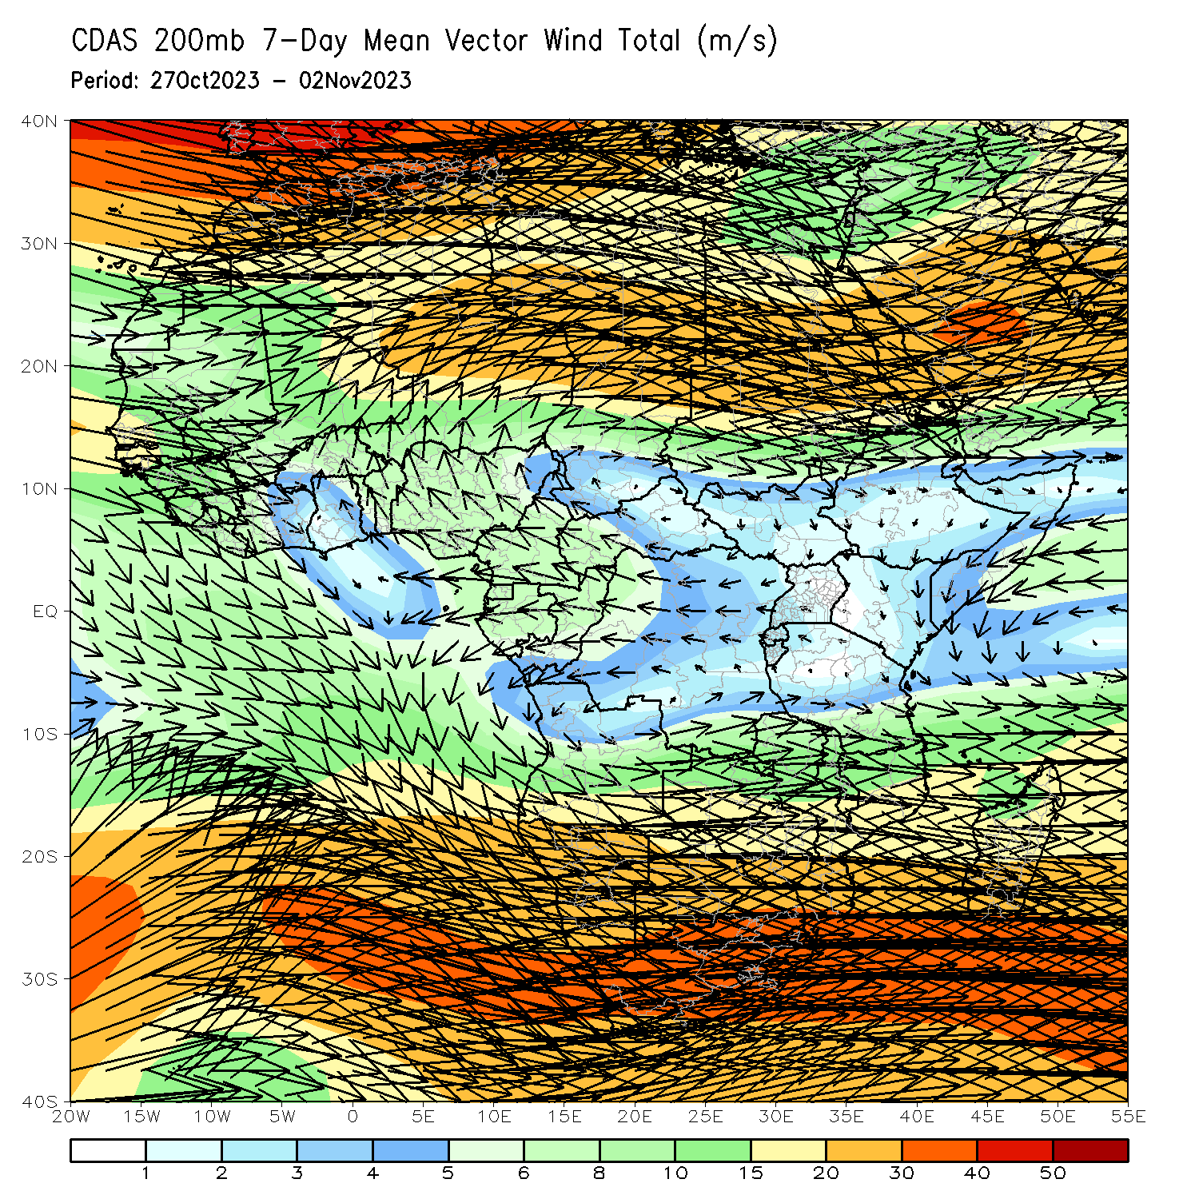
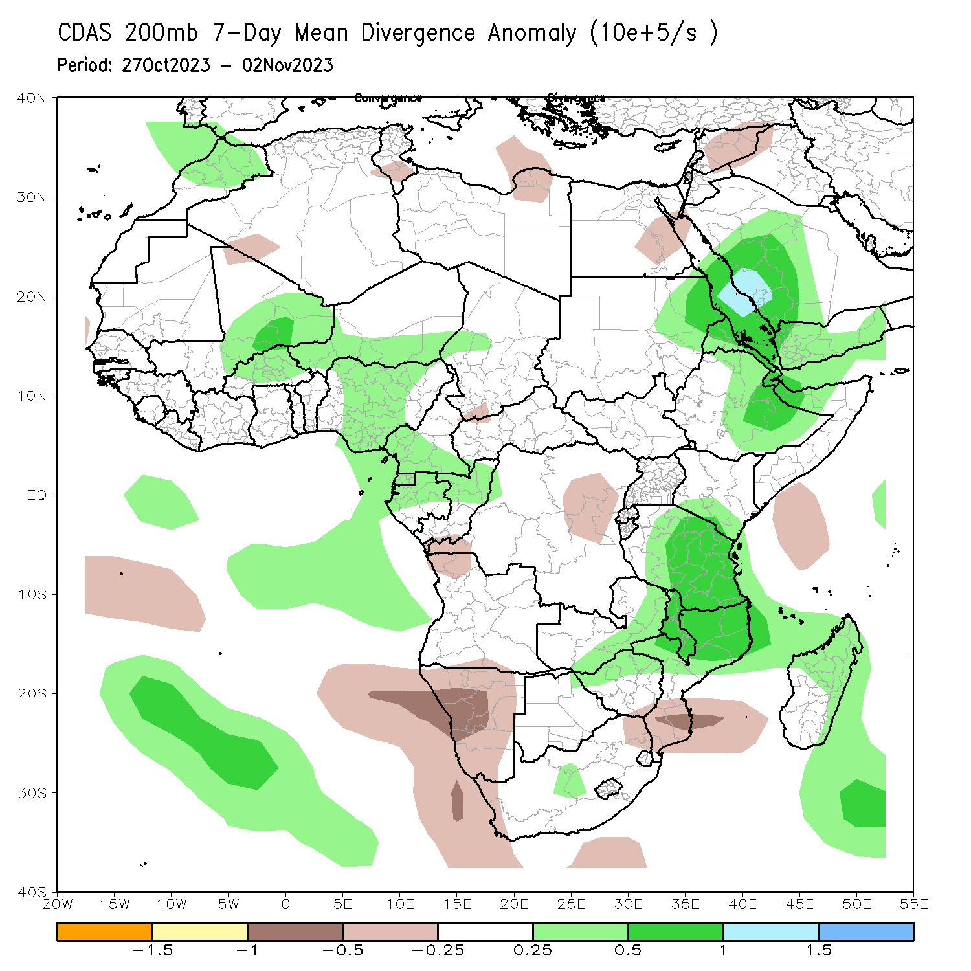
Atmospheric Circulation: Last 7 Days
At 850-hPa level (left panel), perturbation in the easterlies in the equatorial eastern Africa and a pronounced trough in the easterlies over Ethiopia (east of the trough line) favored enhanced rainfall in the region. At 200-hPa, the trough in the westerlies (right-top) and an upper-level divergence (right-bottom) contributed to the above average precipitation covering parts of Sudan, Ethiopia, Kenya, Somalia, and eastern Tanzania. Lower-tropospheric cyclonic circulation contributed to the expansion of rainfall activities into southern Africa.

Slide 8
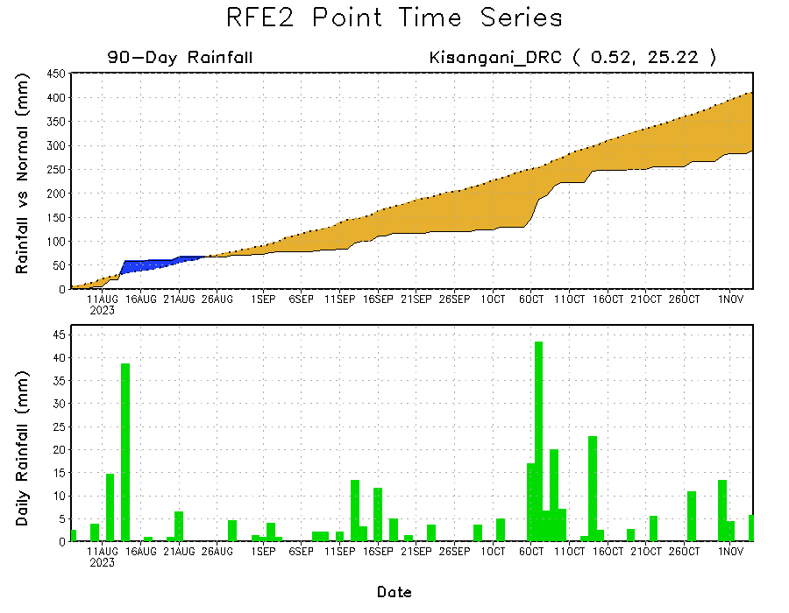
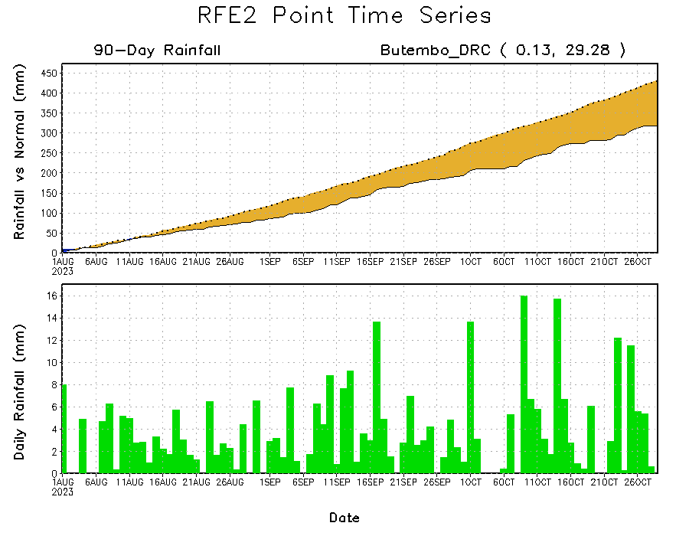
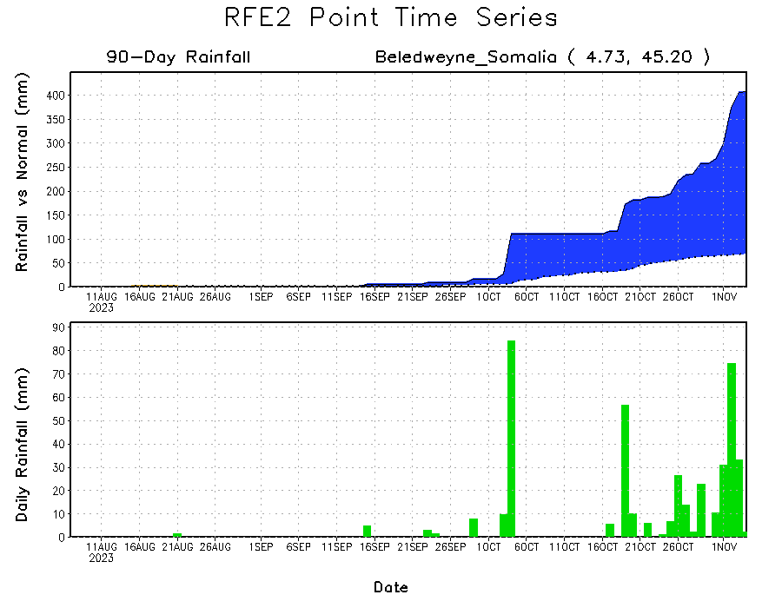
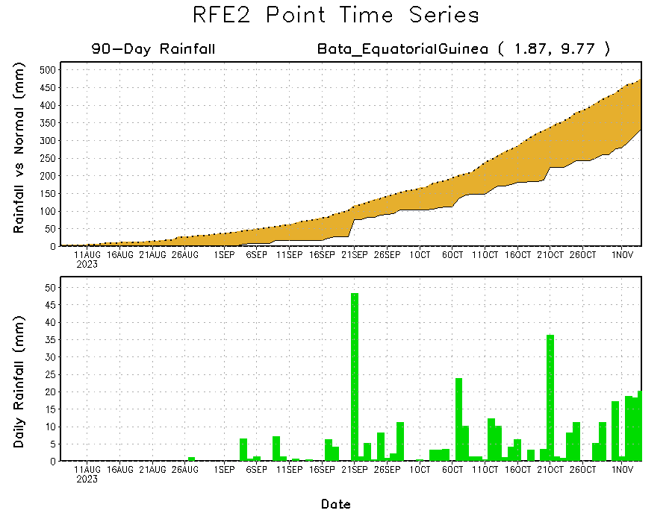
Rainfall Evolution
Daily evolution of rainfall over the last 90 days at selected locations shows light rainfall increased moisture deficits over parts of Equatorial Guinea (bottom left). Seasonal total rainfall remained below-average over northeastern DRC due to the recent below average rainfall (top right). The recent heavy rainfall also increased surpluses early in the rainfall season over southern Somalia (bottom right).

Slide 9
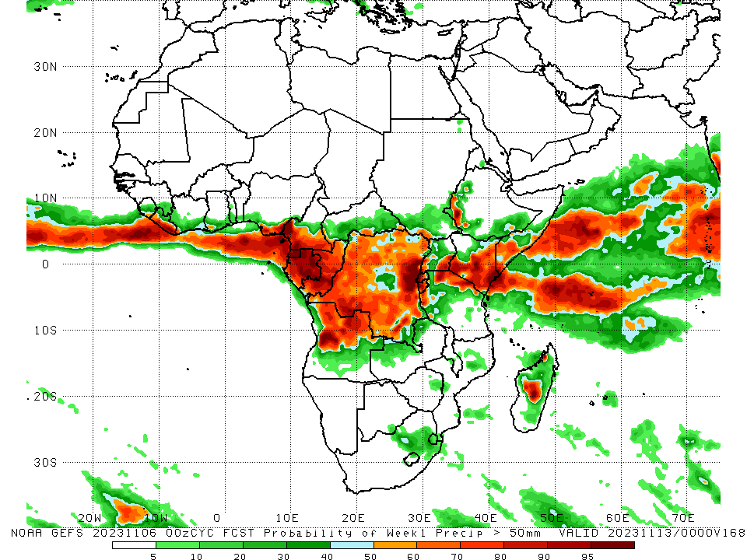
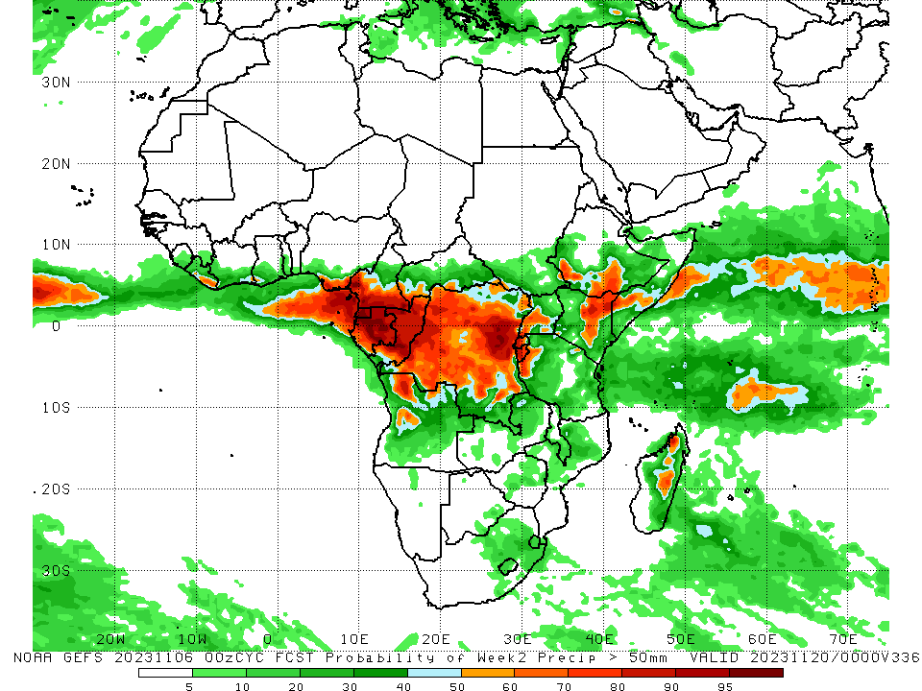
NCEP GEFS Model Forecasts Non-Bias Corrected Probability of precipitation exceedance
Week-1, Valid: 07 – 13 Nov 2023
Week-2, Valid: 14 – 20 Nov 2023
The GEFS forecasts indicate rainfall intensification over Kenya, persistence of wetter than average conditions extending from Central Africa to western Ethiopia, and slight decline over central parts of Somalia and much of southern Africa. For Week-1 (left-panel), there is moderate to high chance (over 70%) for rainfall to exceed 50 mm over Liberia and the eastern Gulf of Guinea region (southeastern Nigeria, southern Cameroon to Gabon), Congo, northern Angola, southern and eastern DRC, Rwanda, Burundi, southeastern Uganda, northern Tanzania, southern and eastern Kenya, southwestern Ethiopia, and southern Somalia. For week-2 (right panel), the GEFS forecasts indicate a moderate to high chance (over 70%) for rainfall to exceed 50 mm over coastal Nigeria, southwestern Cameroon, Equatorial Guinea, much of Gabon, central and parts of northern Congo, western and northeastern DRC, Rwanda, Burundi, western Uganda, northwestern Tanzania, northeastern Kenya, parts of southern Somalia, southwestern Ethiopia, and parts of central and northeastern Madagascar.
Notes:
9

Slide 10
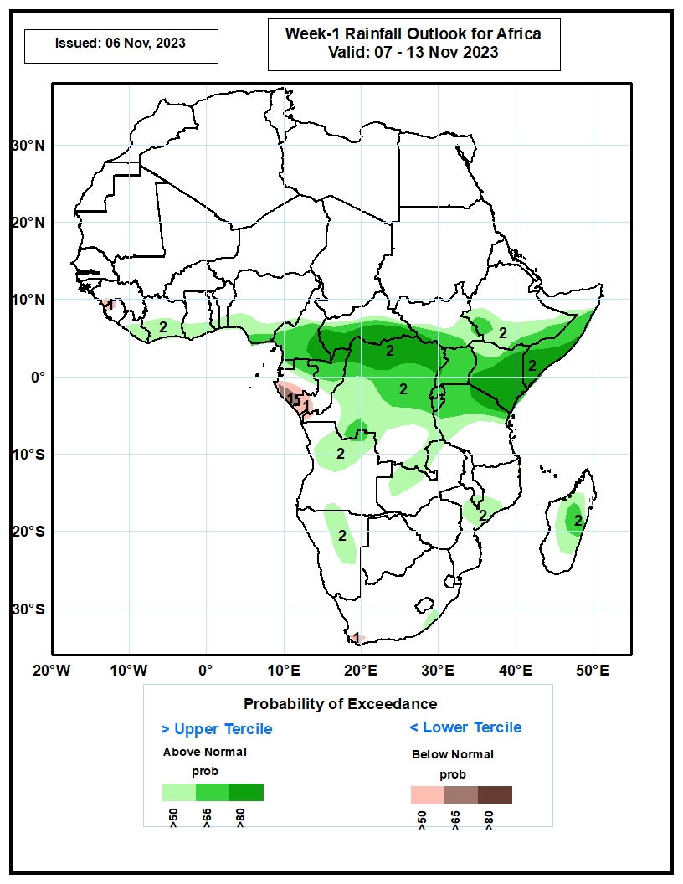
Week-1 Precipitation Outlooks
7 – 13 Nov 2023
The forecasts call for above 50% chance for weekly total rainfall to be below-average (below the lower tercile) over parts of Guinea-Conakry, Sierra Leone, Gabon, Congo-Brazzaville, and southern South Africa. There is above 65% chance for below-average rainfall over southern Gabon.
The probabilistic forecasts call for above 50% chance for weekly rainfall to be above-average (above the upper tercile) over the Gulf of Guinea region, Central Africa, equatorial East Africa, parts of Angola, Zambia, Namibia, Mozambique, and central Madagascar. There is above 80% chance for above-average rainfall over southern CAR, northern DRC, southwestern Ethiopia, Kenya, and southern Somalia.
Notes:
10

Slide 11
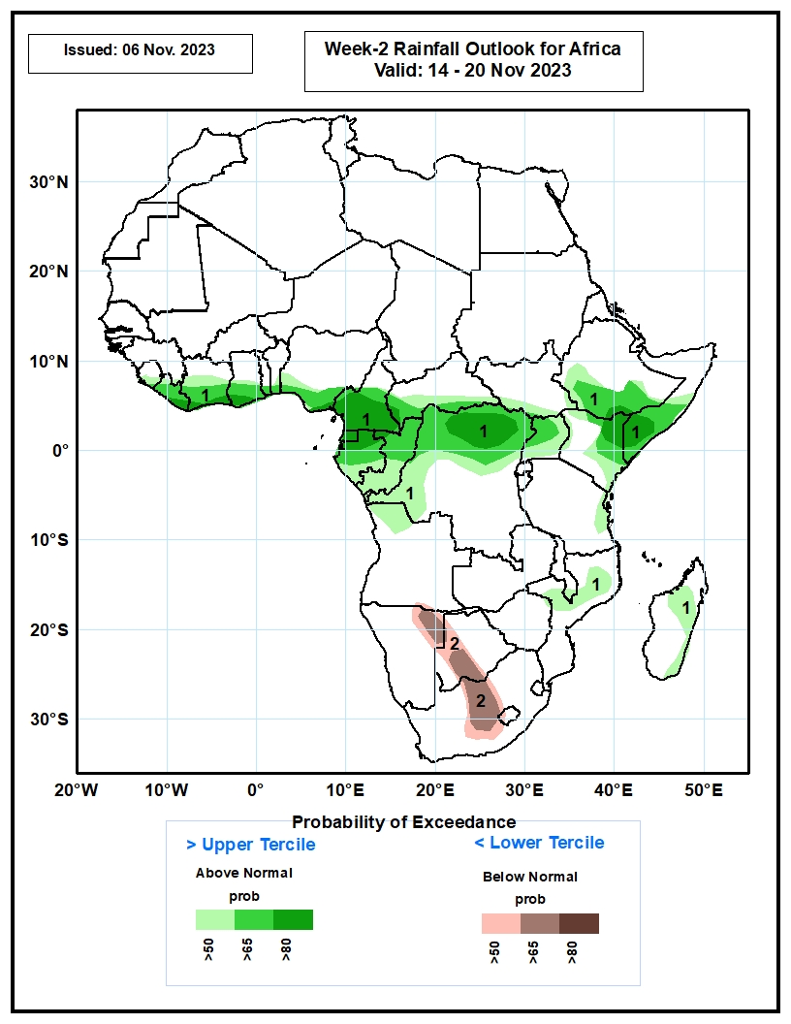
Week-2 Precipitation Outlooks
14 – 20 Nov 2023
The forecasts call for above 50% chance for weekly total rainfall to be above-average (above the upper tercile) over the Gulf of Guinea, parts of Central Africa, equatorial East Africa, northern Mozambque, and central Madagascar. There is above 80% chance above-average rainfall over Cameroon, northern DRC, northern Kenya, and southern Somalia.
The probabilistic forecasts call for above 50% chance for weekly rainfall to be below-average (below the lower tercile) over northeastern Namibia, western Botswana, and central South Africa. There is above 65% chance for below-average rainfall over northeastern Namibia, southern Botswana, and central South Africa.
Notes:
11

Slide 12
Summary
Over the past 30 days, in East Africa, above-average rainfall was observed over southern and eastern Sudan, most of western, southern and eastern South Sudan, most of Eritrea (except southern Red Sea coast), northern, western and southeastern Ethiopia, northern and central Uganda, most of Kenya, southern and central Somalia, Burundi, and parts of northern, western and eastern Tanzania. Rainfall was below-average in parts of the main Rift Valley and its escarpments in Ethiopia, parts of southern Uganda, Rwanda, and parts of northeastern South Sudan. In Central Africa, rainfall was above-average over much of Congo, parts of western Cameroon, parts of western, isolated areas in central Chad, parts of southern and eastern Gabon, eastern, southern, and western CAR, and southern, northern, western, and central DRC. Below-average rainfall was observed over much of Cameroon, Equatorial Guinea, northern, central, and western Gabon, northwestern border regions of Congo, southern and eastern Chad, northern and parts of central CAR, and east-central DRC. In West Africa, rainfall was above-average over pockets of northern and southern Senegal, Guinea, Guinea-Bissau, northern and central Sierra Leone, northwestern and parts of central and eastern Liberia, much of Cote d’Ivoire, parts of central and southern Burkina Faso, southwestern Ghana, Togo, most of Benin, parts of southwestern Nigeria, isolated areas in northeastern Niger, and a few localities in southwestern and northeastern Mauritania. Below-average rainfall was observed over south-central Mauritania, southwestern and central Mali, parts of southeastern Sierra Leone, parts of northern Cote d’Ivoire, southern Burkina Faso, southwestern Niger, parts of northern and southeastern Ghana, and southeastern coastal, eastern, and northern Nigeria. In southern Africa, above-average rainfall was observed over much of northern Angola, northern and central Zambia, central-north Botswana, eastern and central Zimbabwe, Malawi, central and southern Mozambique, Lesotho, Eswatini, southern South Africa, and parts of eastern and northeastern Madagascar. Rainfall was below-average over southern and eastern Angola, western Zambia, northern and eastern Namibia, eastern Botswana, northern South Africa, and parts of central and southern Madagascar.
During the past 7 days, rainfall has expanded and intensified across eastern and southern Africa and diminished over West Africa. In East Africa, rainfall was above-average over parts of western and southeastern Ethiopia, parts of eastern Sudan, much of South Sudan, northern and southern Uganda, eastern half of Kenya, much of Somalia, Burundi, and parts of northwestern and southeastern Tanzania. In central Africa, above-average rainfall was observed over central and southern CAR, much of DRC, Equatorial Guinea, central Congo, and southwestern Cameroon. Rainfall was below-average over parts of northwestern Gabon, parts of southern Congo and a few areas in eastern DRC. In West Africa, above-average rainfall was observed over parts of southern and eastern Nigeria and in isolated areas over Guinea-Bissau, Guinea Conakry, Senegal, and bordering areas of Cote d’Ivoire and Ghana. Climatologically dry conditions persisted over much of the remaining areas in West Africa. In southern Africa, rainfall was above-average over parts of northern and eastern Angola, western Botswana, southern Zimbabwe, northern and central Zambia, central and northeastern South Africa, the Kingdom of Eswatini, southern and central Mozambique, and northeastern Madagascar. Rainfall was below-average over southern and northeastern Angola and southwestern Madagascar.
Week-1 forecasts indicate rainfall intensification over Kenya, persistence of wetter than average conditions extending from Central Africa to western Ethiopia, and a slight decline over central parts of Somalia and much of southern Africa. The Week-1 outlook calls for above-normal rainfall over southern Cote d’Ivoire, southern Nigeria, much of Cameroon, northern Gabon, northern Congo, northern DRC, southern CAR, southern South Sudan, Uganda, Rwanda, Burundi, southern and eastern Kenya, southwestern Ethiopia, southern Somalia, parts of Angola, central Mozambique, and northeastern Madagascar. Rainfall is expected to be below-normal across the far western Gulf of Guinea region and coastal areas of Gabon, Congo and DRC. The Week-2 outlook calls for above-normal rainfall over portion of the Gulf of Guinea region, parts of central Africa, southeastern Ethiopia, eastern Kenya and southern Somalia. Rainfall is expected to be below-normal over northeastern Namibia, southwestern Botswana, and central parts of South Africa.

