Slide 1
The African Monsoon Recent Evolution and Current Status Include Week-1 and Week-2 Outlooks
Update prepared
10 October 2023
For more information, visit:
http://www.cpc.ncep.noaa.gov/products/Global_Monsoons/African_Monsoons/precip_monitoring.shtml

Slide 2
Outline
Highlights
Recent Evolution and Current Conditions
NCEP GEFS Forecasts
Summary

Slide 3
Highlights: Last 7 Days
During the past 7 days, in East Africa, rainfall was above-average over southwestern and south-central Sudan, western and parts of northeastern South Sudan, parts of west-central and southern Ethiopia, pockets of northeastern and southeastern Kenya, parts of southern and central Somalia, parts of northeastern Tanzania, and northwestern Uganda. Below-average rainfall was observed over parts of southeastern Sudan, southern, central, and parts of northern South Sudan, western Kenya, northern Tanzania, Rwanda, Burundi, much of western and central Ethiopia, northwestern Somalia, and southern and eastern Uganda. In central Africa, above-average rainfall was observed over pockets of northern, southeastern, and southwestern Cameroon, most of CAR, northern and eastern Congo, western Equatorial Guinea, western Gabon, parts of northwestern and southern Chad, and northern and western DRC. Rainfall was below-average over many parts of central Cameroon, parts of central CAR, west-central Congo, northern and eastern Gabon, central and eastern Equatorial Guinea, and parts of central and eastern DRC. In West Africa, above-average rainfall was observed over southwestern Mauritania, much of Senegal, eastern portions of The Gambia, Guinea-Bissau, Guinea, northern Sierra Leone, Liberia, Cote d’Ivoire, parts of central and western Burkina Faso, northern, central, and southwestern Ghana, most of Togo, central and southern Benin, southwestern Nigeria, and parts of northeastern Niger. Rainfall was below-average over southwestern Mali and northern, central, and eastern Nigeria. In southern Africa, rainfall was above-average over parts of southern (coastal) South Africa. Rainfall was below-average over southern and western Eswatini and southeastern South Africa.
The Week-1 outlook calls for above-normal rainfall in much of the central and eastern Gulf of Guinea region (from Liberia to Cameroon and Gabon), most of central Africa, much of eastern Africa, the central parts of southern Africa, and northern Madagascar. In contrast, there is an increased chance for below-normal rainfall over the western parts of the Gulf of Guinea region (Senegal to Sierra Leone), central and southern Somalia, coastal Kenya, northeastern Tanzania, and northwestern Angola. For Week-2, there is an increased chance for above-normal rainfall across western (Guinea to Liberia) and eastern (Cameroon to Congo) parts of the Gulf of Guinea region, parts of northern and southern DRC, Ethiopia, parts of western Eritrea, and northern and western Somalia. In contrast, there is an increased chance for below-normal rainfall from central Cameroon to northwestern South Sudan, southern Uganda, southwestern and central Kenya, east-central DRC, Rwanda, Burundi, northern Tanzania, parts of eastern South Africa, and western Eswatini.

Slide 4
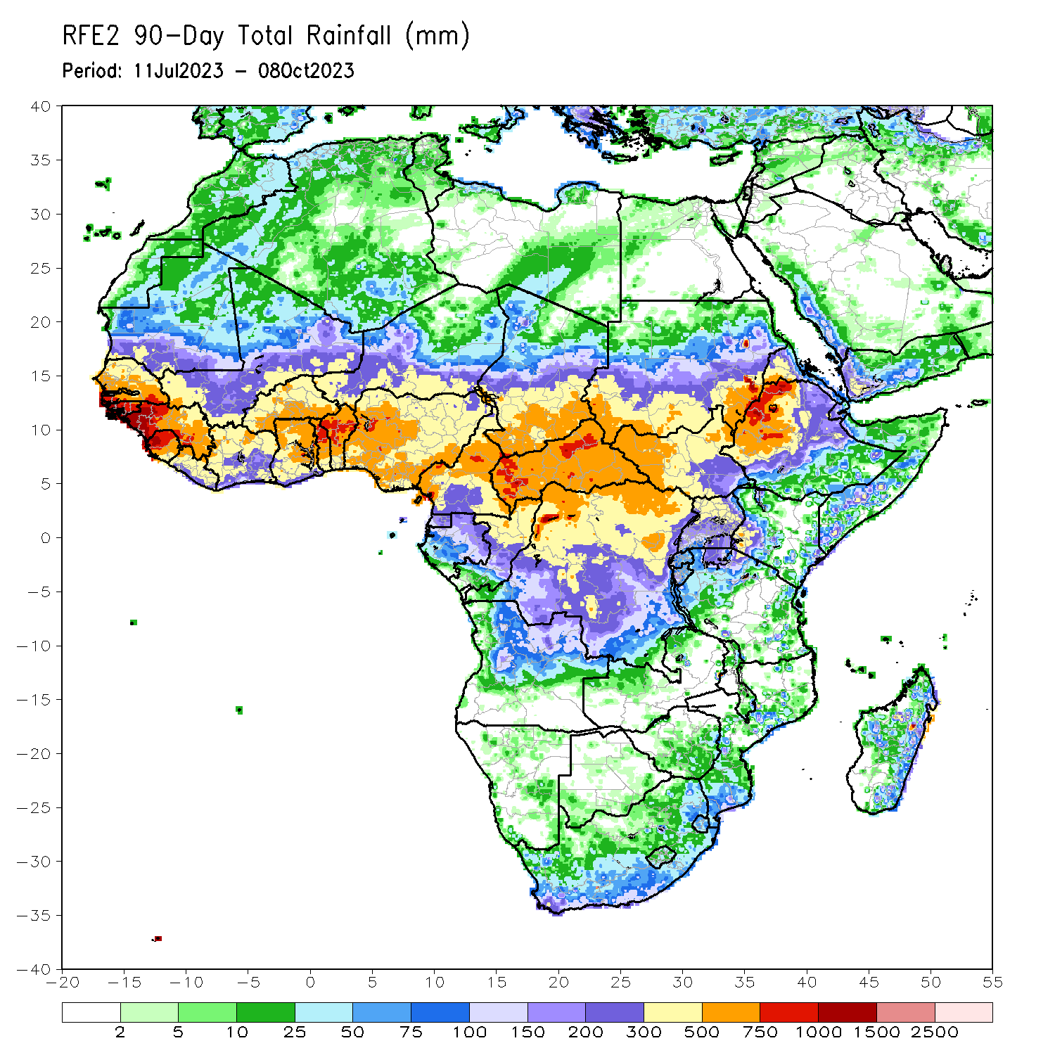
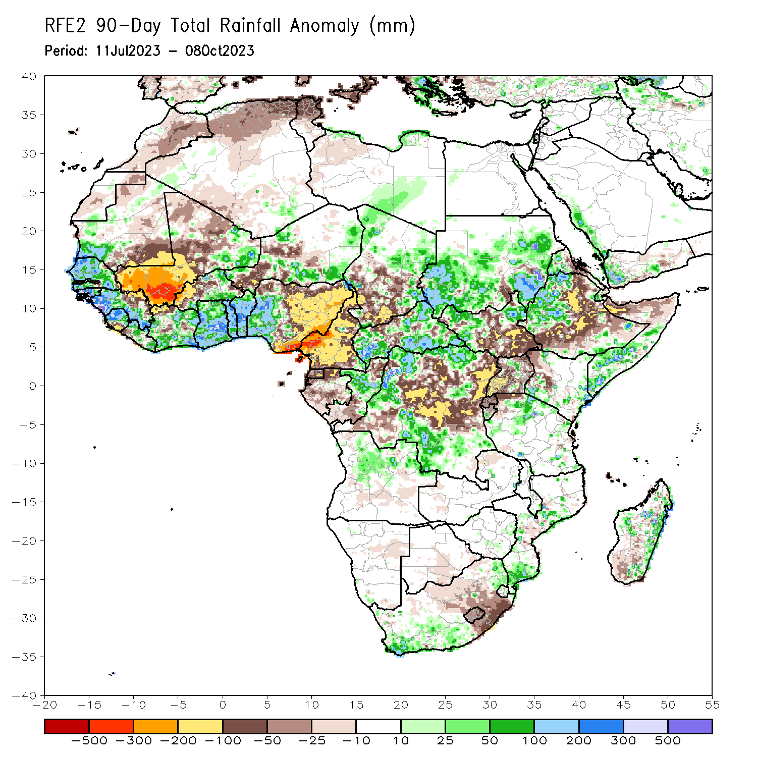
Rainfall Patterns: Last 90 Days
Over the past 90 days, in East Africa, above-average rainfall was observed over many parts of Sudan, western and parts of far southern Ethiopia, most of western and northeastern South Sudan, a part of north-central Uganda, western Eritrea, western Djibouti, parts of southern and central Somalia, parts of northern Tanzania, southern Burundi, and southwestern and eastern Kenya. Rainfall was below-average over central and southeastern South Sudan, a part of south-central Sudan, eastern, central, and southern Ethiopia, parts of northern Somalia, pockets of west-central and northwestern Kenya, Rwanda, northern Burundi, northwestern Tanzania, central Eritrea, and most of Uganda. In southern Africa, above-average rainfall was observed over south-central, southwestern, and northeastern South Africa, northern and eastern Eswatini, southern and parts of central Mozambique, parts of northern Angola, and parts of eastern and central Madagascar. Below-average rainfall was observed over southeastern and parts of central South Africa, Lesotho, and pockets of southwestern and central Madagascar. In Central Africa, rainfall was above-average over many parts of CAR, eastern and northwestern Chad, parts of central Congo, and northern, west-central, south-central, and southeastern DRC. Rainfall was below-average over much of Cameroon, Equatorial Guinea, Gabon, northern and southern Congo, parts of central, northeastern, and southwestern DRC, pockets of central CAR, and central and southwestern Chad. In West Africa, rainfall was above-average over much of Senegal, southwestern Mauritania, The Gambia, Guinea-Bissau, western and southern Guinea, northern and central Sierra Leone, eastern and northwestern Liberia, eastern Mali, much of Cote d’Ivoire, southern and northeastern Burkina Faso, much of Ghana, Togo, Benin, parts of northwestern and southeastern Niger, and western Nigeria. Below-average rainfall was observed over western, central, and northern Mali, much of eastern Guinea, southern Sierra Leone, southwestern Liberia, northwestern Cote d’Ivoire, western and central Burkina Faso, parts of southwestern and central Niger, southeastern Mauritania, and central, northern, and eastern Nigeria.
Notes:
4

Slide 5
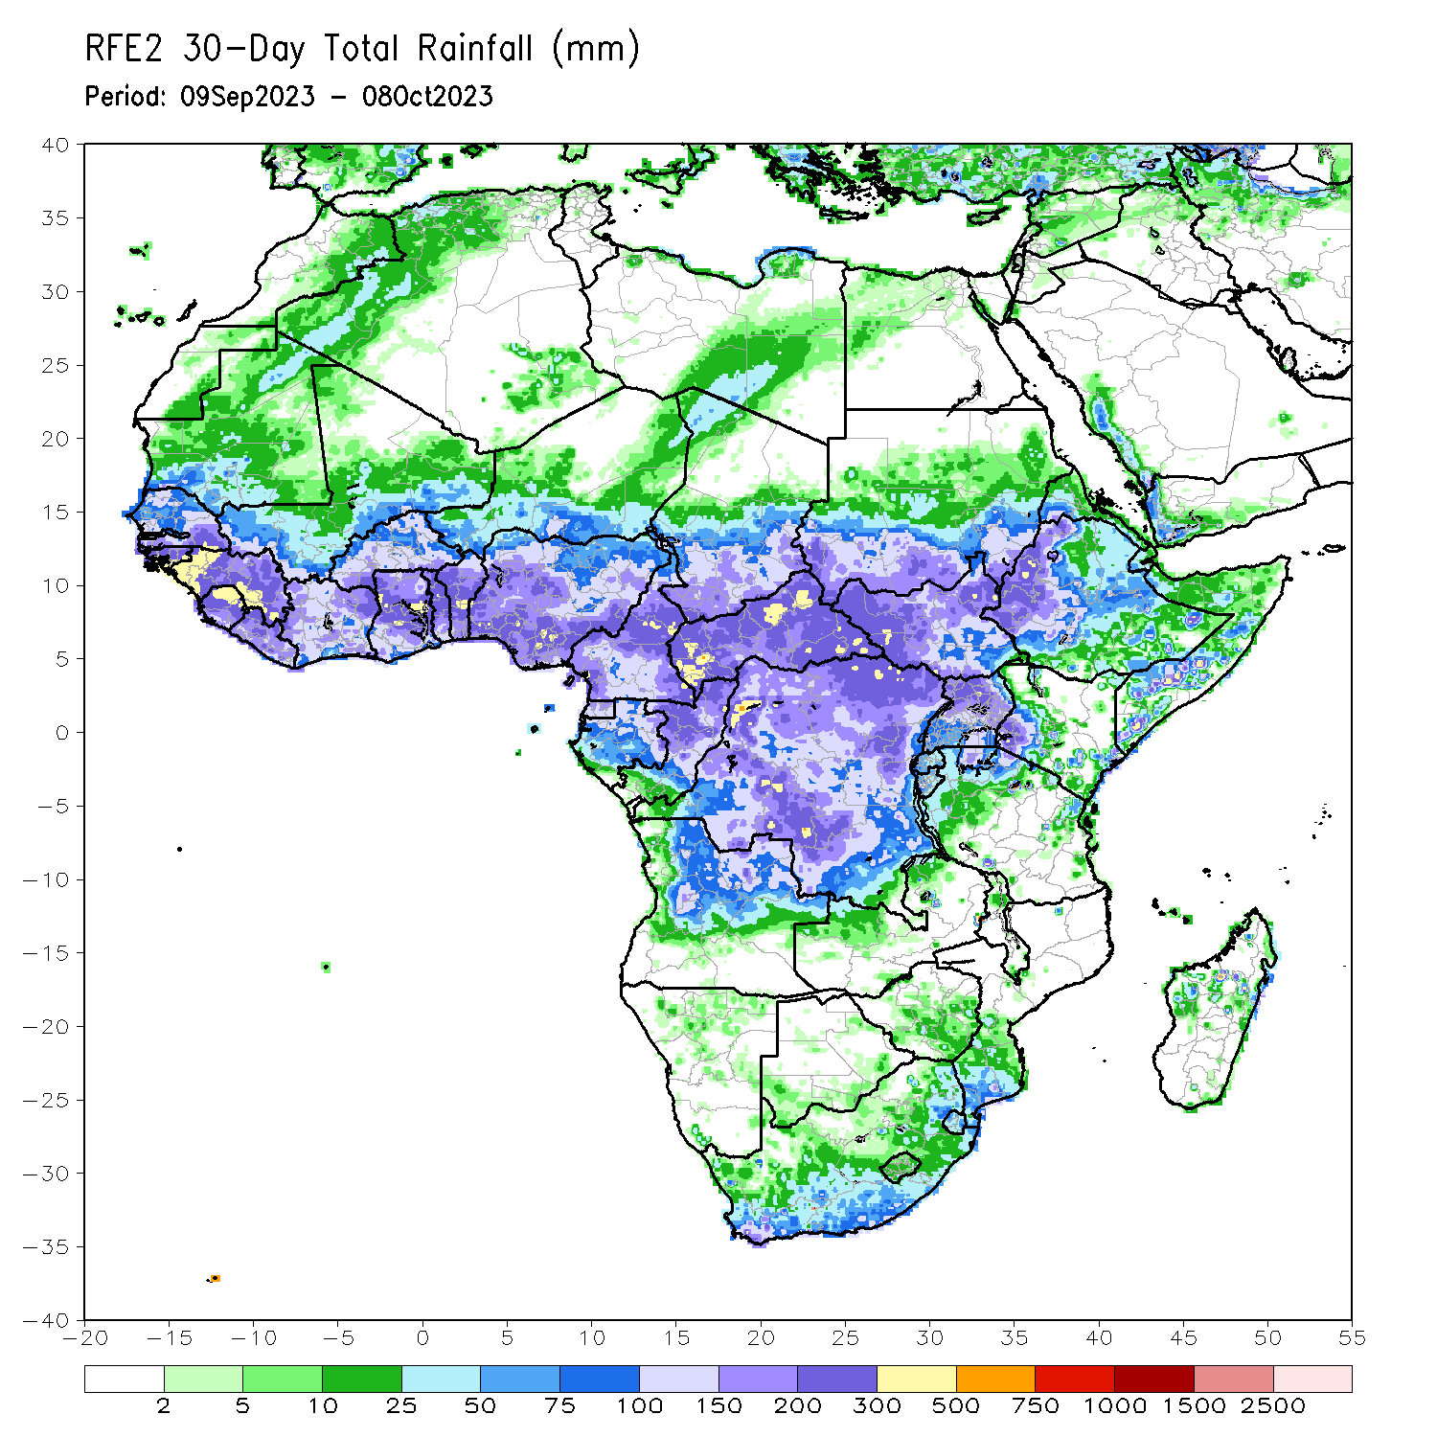
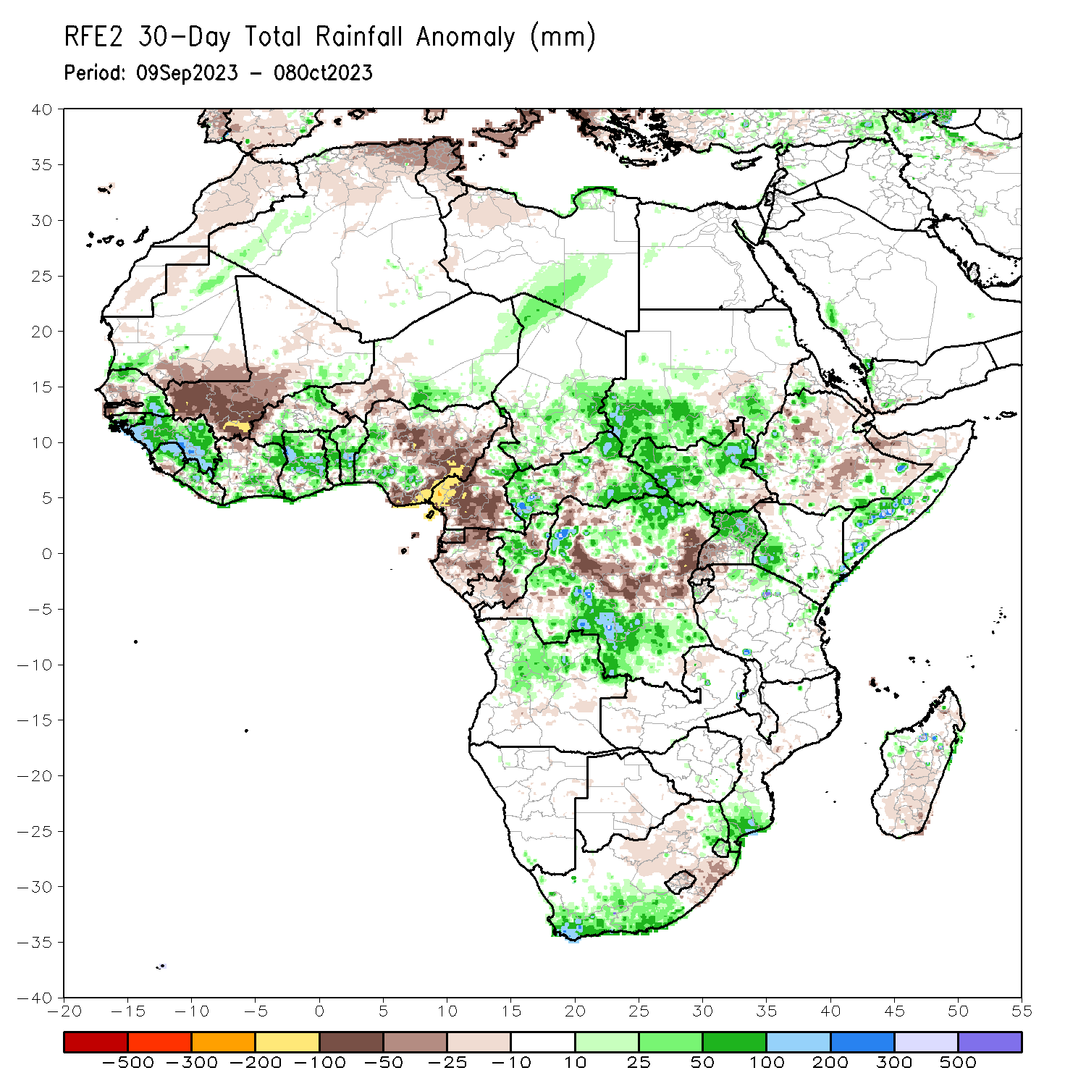
Rainfall Patterns: Last 30 Days
Over the past 30 days, in East Africa, above-average rainfall was observed over many parts of southern Sudan, most of northern and southern South Sudan, southwestern Eritrea, western Djibouti, pockets of northern, western, and south-central Ethiopia, northern and eastern Uganda, southwestern and southeastern Kenya, parts of southern and central Somalia, western Burundi, and parts of northern Tanzania. Rainfall was below-average over much of central and southern Ethiopia, southwestern Uganda, Rwanda, northern Somalia, eastern Djibouti, pockets of south-central Sudan, and parts of northeastern and southeastern South Sudan. In Central Africa, rainfall was above-average over central Congo, east-central Cameroon, parts of central, southeastern, southwestern, and northwestern Chad, much of CAR, and southeastern, south-central, west-central, and northeastern DRC. Below-average rainfall was observed over much of Cameroon, Equatorial Guinea, Gabon, parts of northern and southern Congo, pockets of south-central Chad, central CAR, and southwestern, central, and northwestern DRC. In West Africa, rainfall was above-average over pockets of northern and southeastern Senegal, Guinea, Guinea-Bissau, northern and central Sierra Leone, Liberia, northeastern, central, and southern Cote d’Ivoire, northeastern and much of southern Burkina Faso, southeastern Mali, Ghana, Togo, most of Benin, parts of western and north-central Nigeria, south-central and northeastern Niger, and southwestern Mauritania. Below-average rainfall was observed over southeastern Mauritania, southwestern and central Mali, pockets of central Senegal, The Gambia, southern Sierra Leone, northwestern Cote d’Ivoire, western and central Burkina Faso, western Niger, and central, northwestern, and eastern Nigeria.
Notes:
5

Slide 6
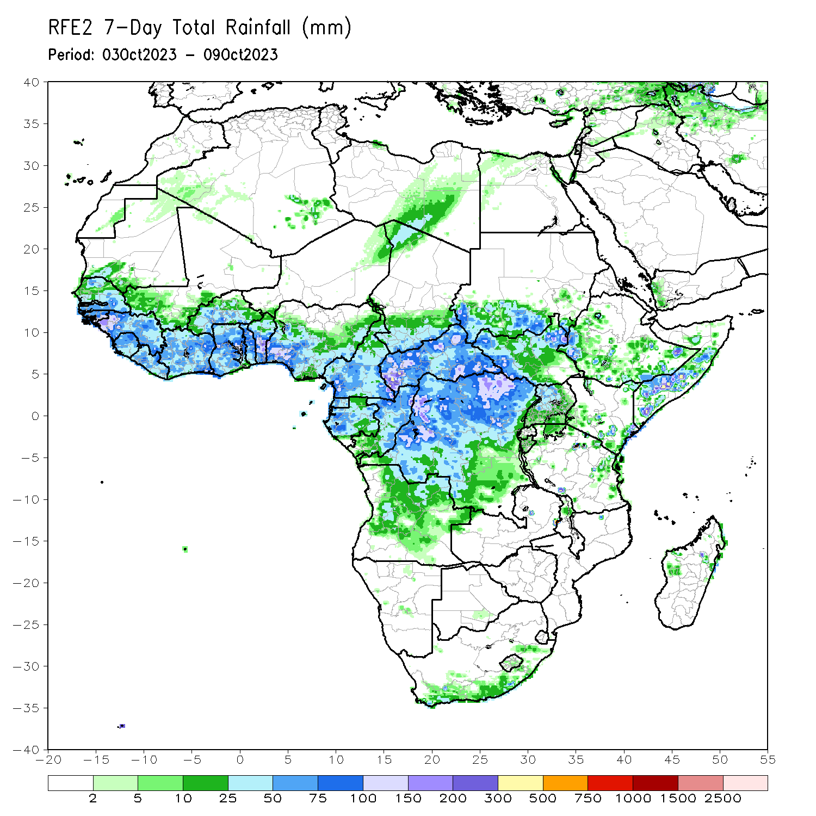
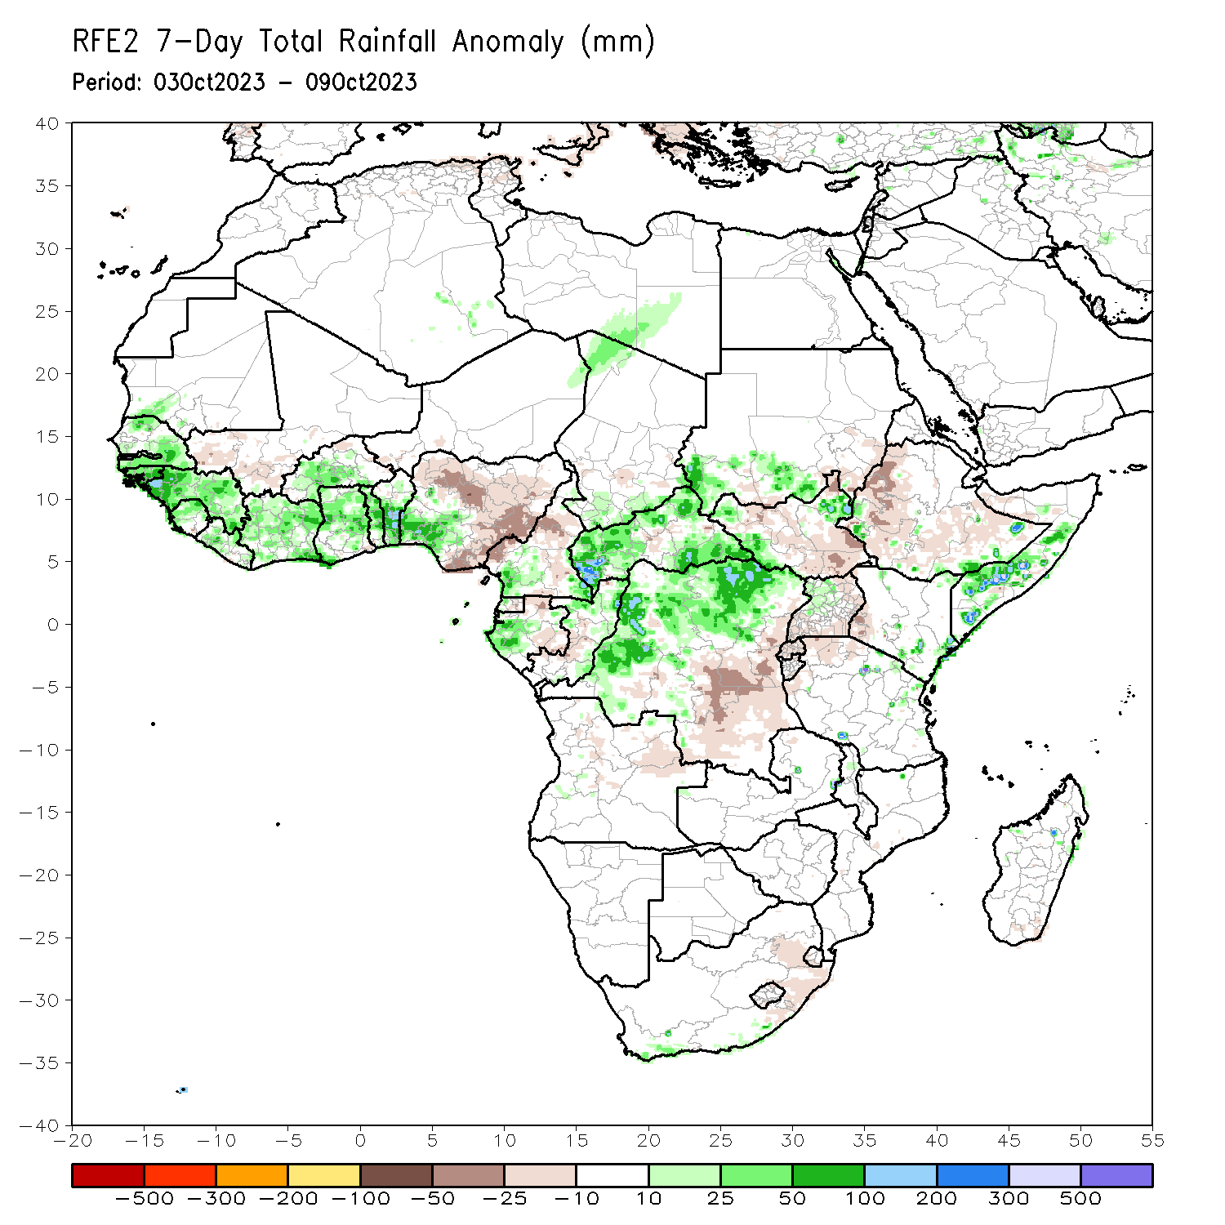
Rainfall Patterns: Last 7 Days
During the past 7 days, in East Africa, rainfall was above-average over southwestern and south-central Sudan, western and parts of northeastern South Sudan, parts of west-central and southern Ethiopia, pockets of northeastern and southeastern Kenya, parts of southern and central Somalia, parts of northeastern Tanzania, and northwestern Uganda. Below-average rainfall was observed over parts of southeastern Sudan, southern, central, and parts of northern South Sudan, western Kenya, northern Tanzania, Rwanda, Burundi, much of western and central Ethiopia, northwestern Somalia, and southern and eastern Uganda. In central Africa, above-average rainfall was observed over pockets of northern, southeastern, and southwestern Cameroon, most of CAR, northern and eastern Congo, western Equatorial Guinea, western Gabon, parts of northwestern and southern Chad, and northern and western DRC. Rainfall was below-average over many parts of central Cameroon, parts of central CAR, west-central Congo, northern and eastern Gabon, central and eastern Equatorial Guinea, and parts of central and eastern DRC. In West Africa, above-average rainfall was observed over southwestern Mauritania, much of Senegal, eastern portions of The Gambia, Guinea-Bissau, Guinea, northern Sierra Leone, Liberia, Cote d’Ivoire, parts of central and western Burkina Faso, northern, central, and southwestern Ghana, most of Togo, central and southern Benin, southwestern Nigeria, and parts of northeastern Niger. Rainfall was below-average over southwestern Mali and northern, central, and eastern Nigeria. In southern Africa, rainfall was above-average over parts of southern (coastal) South Africa. Rainfall was below-average over southern and western Eswatini and southeastern South Africa.

Slide 7
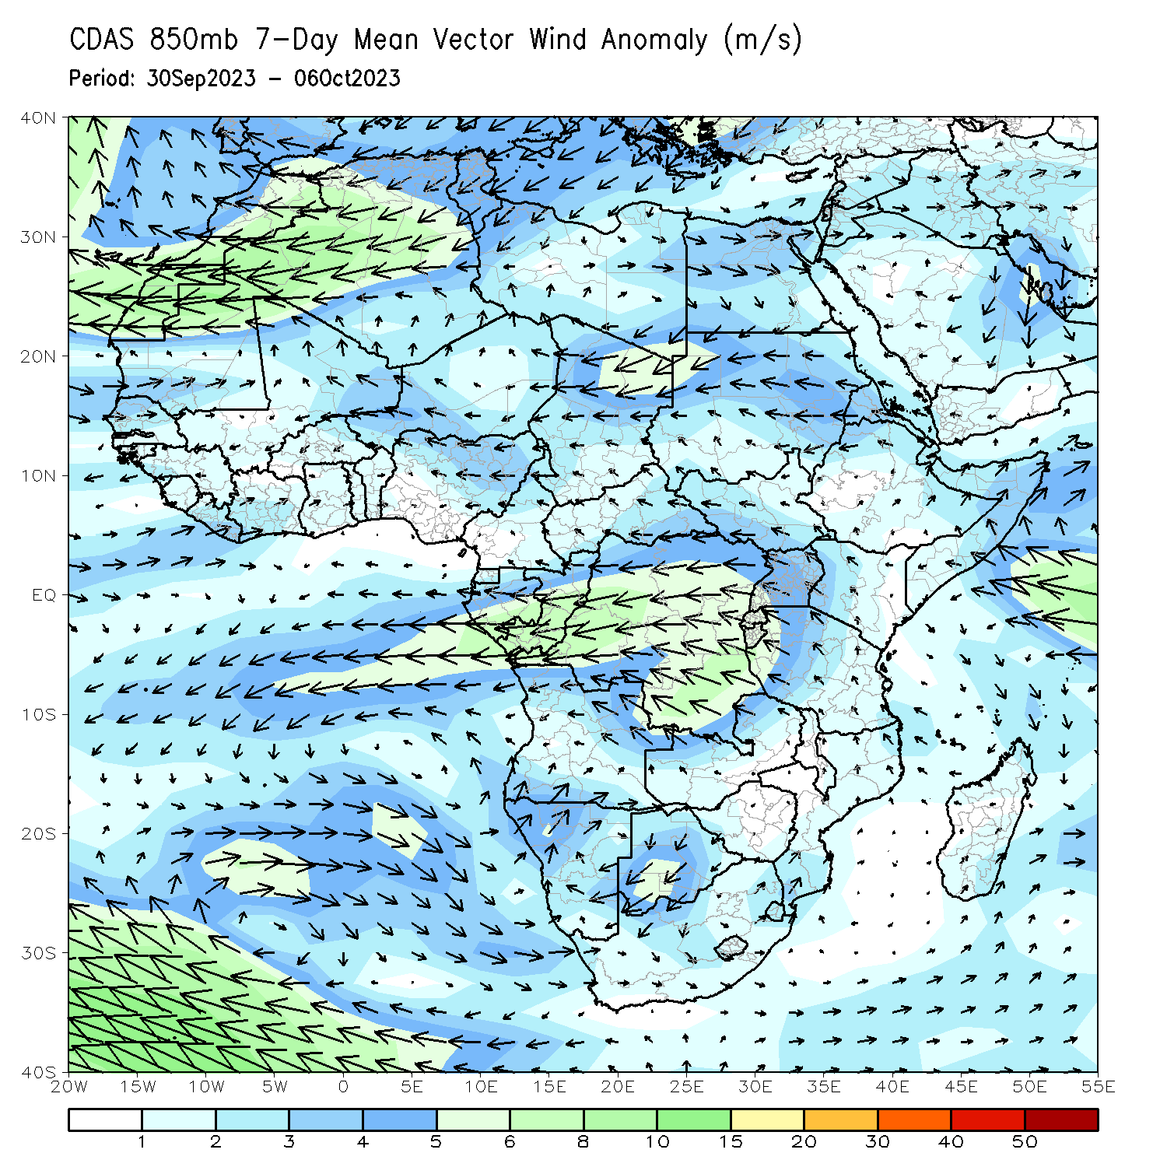
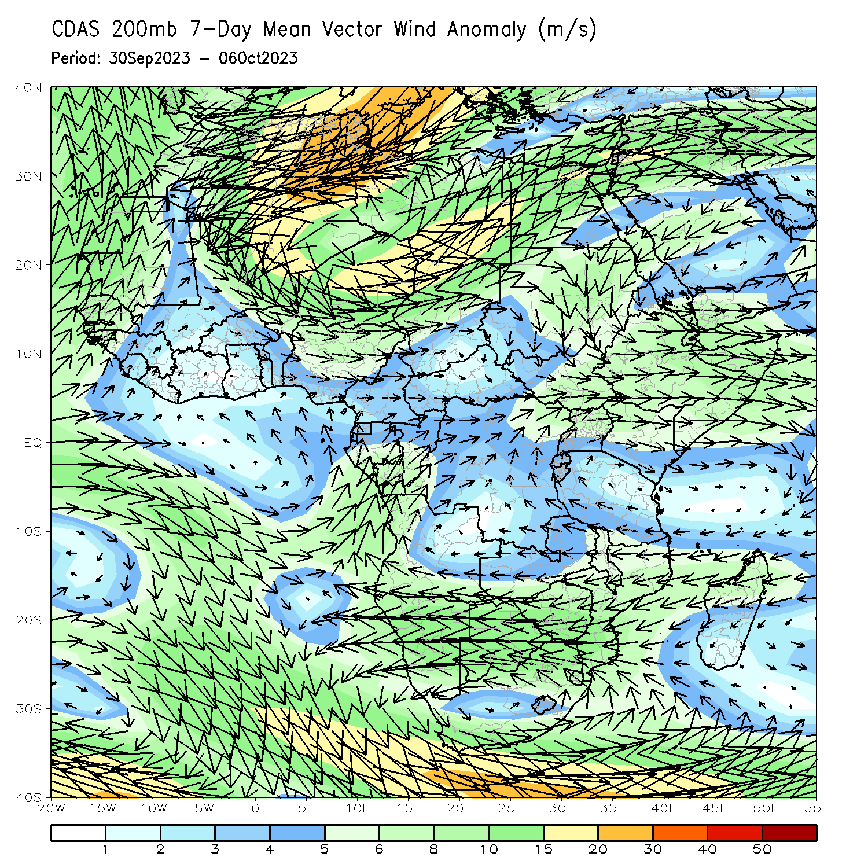
Atmospheric Circulation: Last 7 Days
At 850-hPa level (left panel), anomalous onshore flow was observed over the western and central Gulf of Guinea region, which may have contributed to the observed below-average rainfall in the region. In contrast, anomalous lower-level divergence was present across much of eastern Africa, while upper level convergence was present across much of eastern Africa and southeastern Nigeria. This likely contributed to the below average rainfall for these regions.

Slide 8
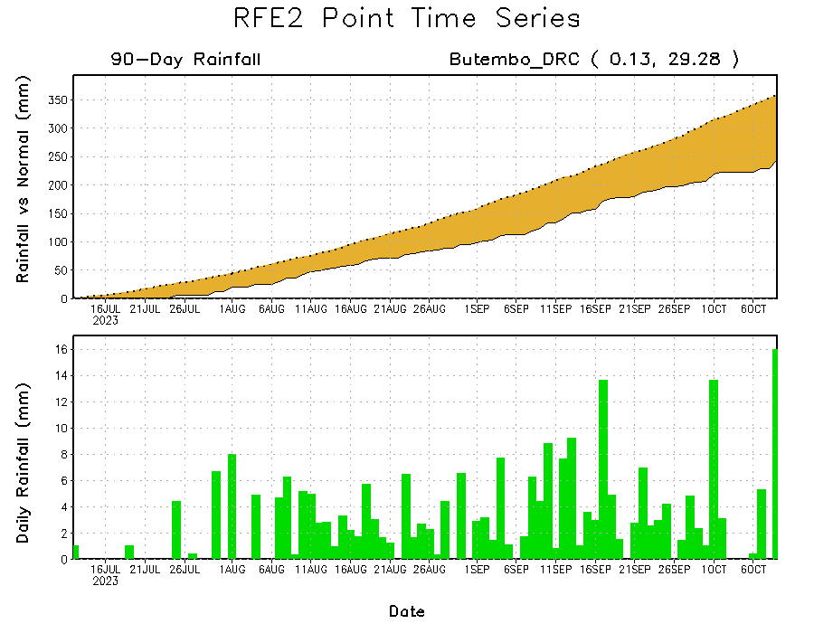
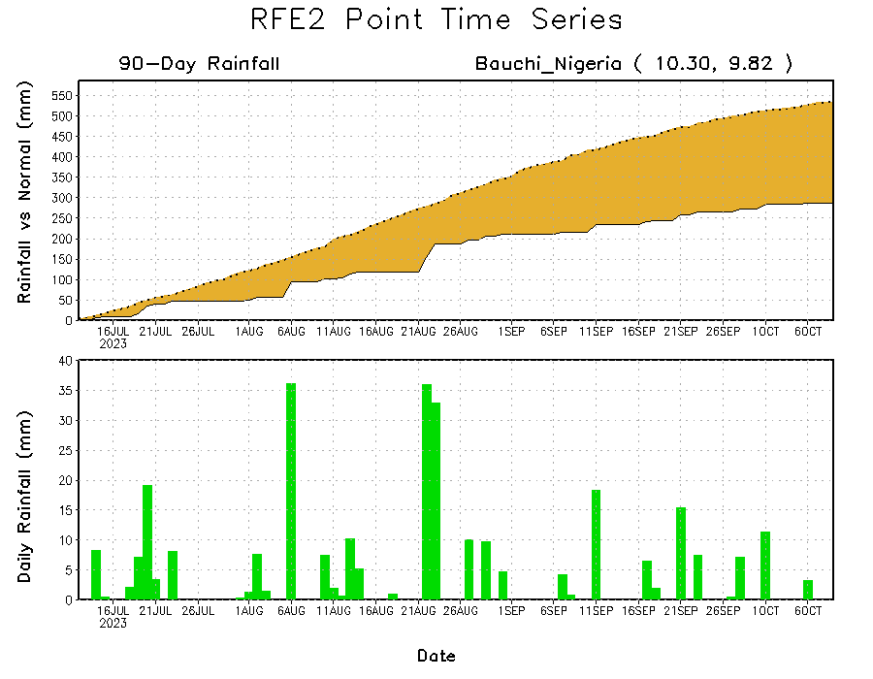
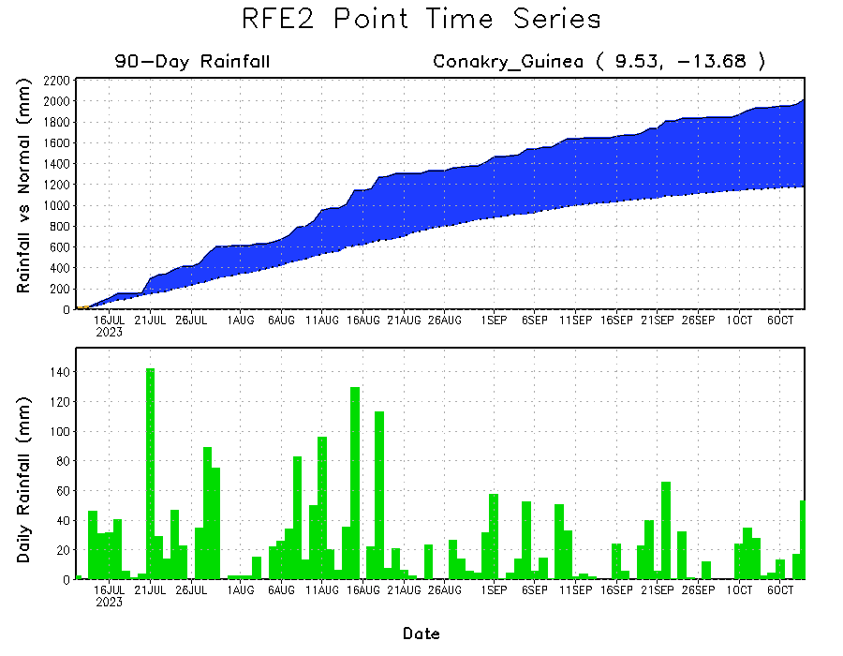
Rainfall Evolution
Daily evolution of rainfall over the last 90 days at selected locations shows light rainfall sustained moisture surpluses over parts of Guinea (bottom left). Seasonal total rainfall remained below-average over northeastern DRC (top right) and eastern Nigeria (bottom right).

Slide 9
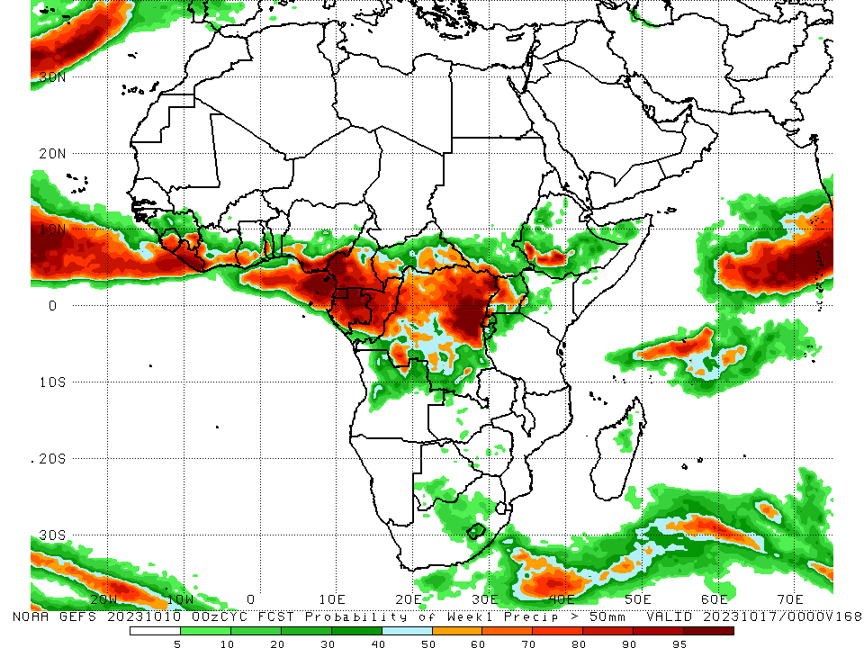
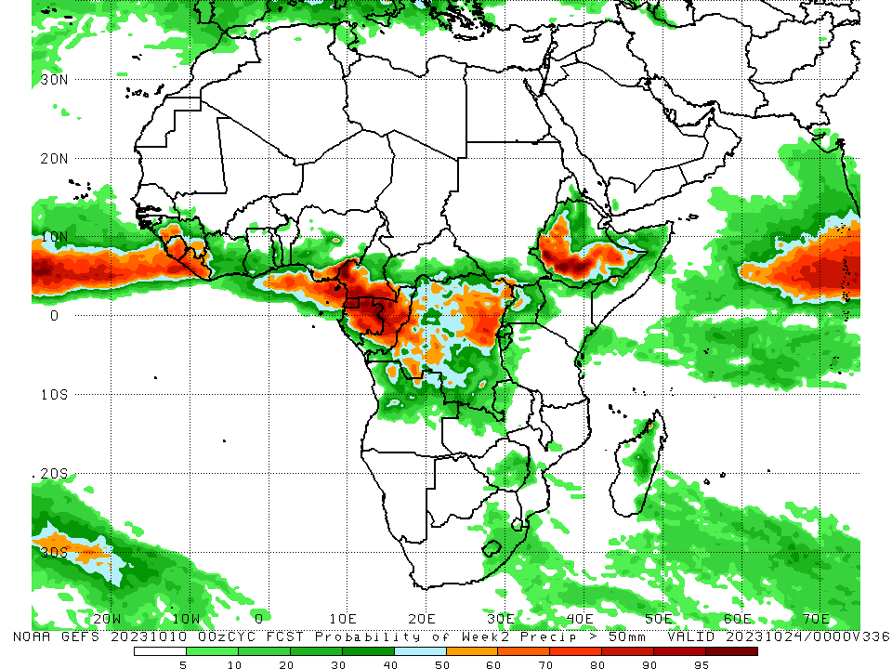
NCEP GEFS Model Forecasts Non-Bias Corrected Probability of precipitation exceedance
Week-1, Valid: 11 – 17 Oct 2023
Week-2, Valid: 18 – 24 Oct 2023
For week-1 (left panel) the GEFS forecasts indicate a moderate to high chance (over 70%) for rainfall to exceed 50 mm over the Gulf of Guinea region (southern Sierra Leone, southeastern Guinea, Liberia, southwestern and southeastern Cote d’Ivoire, southwestern Ghana, southern Togo, southern Nigeria, central and southern Cameroon, Equatorial Guinea, most of Gabon), most of Congo, western CAR, parts of northern, central, and southwestern DRC, and parts of southwestern Ethiopia. For week-2 (right panel), the GEFS forecasts indicate a moderate to high chance (over 70%) for rainfall to exceed 50 mm over eastern and western parts of the Gulf of Guinea region (southern Sierra Leone, Liberia, southern Nigeria, southern Cameroon, Equatorial Guinea, much of Gabon), central Congo, parts of western CAR, west-central and northeastern DRC, and much of western and southern Ethiopia.
Notes:
9

Slide 10
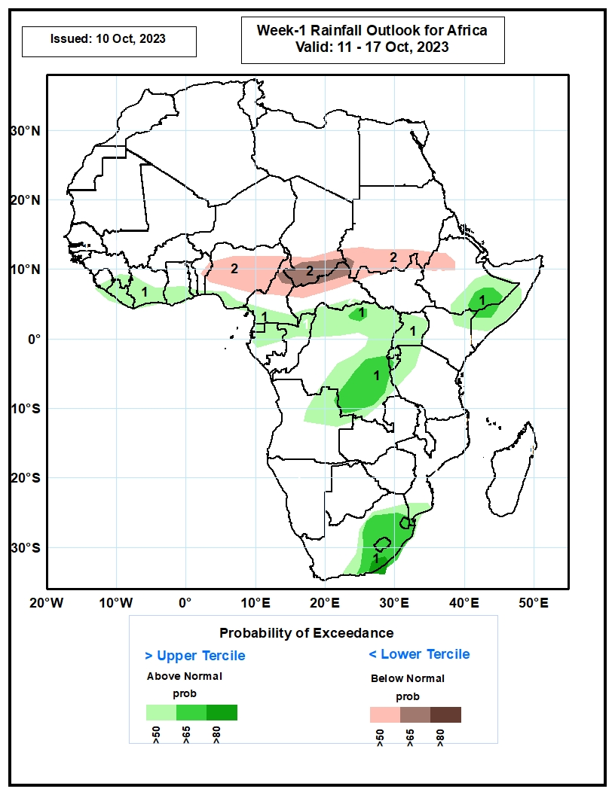
Week-1 Precipitation Outlooks
11 – 17 Oct 2023
The probabilistic forecasts call for above 50% chance for weekly rainfall to be above-normal (above the upper tercile) along the Gulf of Guinea coast, parts of Central Africa, including the Lake Victoria region, southeastern Ethiopia, southern Somalia, and the eastern portion of South Africa, including Lesotho and Eswatini. There is above 65% chance for the rainfall to be above-normal over part of southeastern Ethiopia, southeastern DRC, eastern South Africa, Lesotho and Eswatini.
The forecasts call for above 50% chance for weekly total rainfall to be below-normal (below the lower tercile) across parts of Nigeria, northern Cameroon, southern Chad, northern CAR, southern Sudan and parts of northern South Sudan and western Ethiopia. There is above 65% chance for rainfall to be below-normal over parts of southern Chad and northern CAR.
Notes:
10

Slide 11
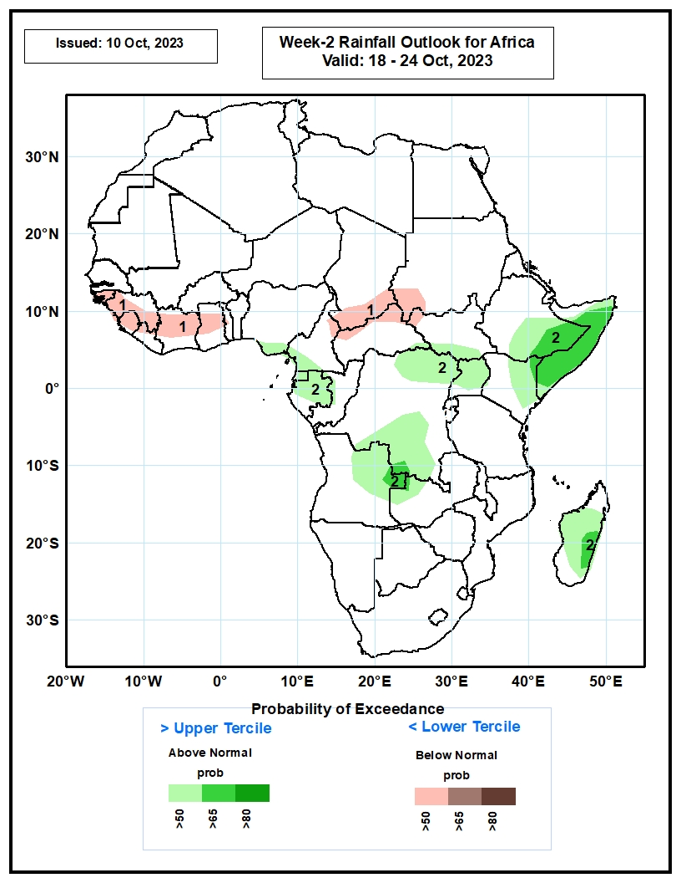
Week-2 Precipitation Outlooks
18 – 24 Oct 2023
The probabilistic forecasts call for above 50% chance for weekly rainfall to be below-normal (below the lower tercile) over Guinea-Bissau, parts of Guinea, Sierra Leone, parts of Cote d’Ivoire and Ghana, and southern Chad, northern CAR and western Sudan.
The forecasts call for above 50% chance for weekly total rainfall to be above-normal (above the upper tercile) southeastern Nigeria, Equatorial Guinea, Gabon, northeastern Angola, parts of southern and northeastern DRC, Uganda, southeastern Ethiopia, eastern Kenya and Somalia, and eastern Madagascar. There is above 65% chance for rainfall to be above-normal over southeastern Ethiopia, Somalia and eastern Madagascar.
Notes:
11

Slide 12
Summary
Over the past 30 days, in East Africa, above-average rainfall was observed over many parts of southern Sudan, most of northern and southern South Sudan, southwestern Eritrea, western Djibouti, pockets of northern, western, and south-central Ethiopia, northern and eastern Uganda, southwestern and southeastern Kenya, parts of southern and central Somalia, western Burundi, and parts of northern Tanzania. Rainfall was below-average over much of central and southern Ethiopia, southwestern Uganda, Rwanda, northern Somalia, eastern Djibouti, pockets of south-central Sudan, and parts of northeastern and southeastern South Sudan. In Central Africa, rainfall was above-average over central Congo, east-central Cameroon, parts of central, southeastern, southwestern, and northwestern Chad, much of CAR, and southeastern, south-central, west-central, and northeastern DRC. Below-average rainfall was observed over much of Cameroon, Equatorial Guinea, Gabon, parts of northern and southern Congo, pockets of south-central Chad, central CAR, and southwestern, central, and northwestern DRC. In West Africa, rainfall was above-average over pockets of northern and southeastern Senegal, Guinea, Guinea-Bissau, northern and central Sierra Leone, Liberia, northeastern, central, and southern Cote d’Ivoire, northeastern and much of southern Burkina Faso, southeastern Mali, Ghana, Togo, most of Benin, parts of western and north-central Nigeria, south-central and northeastern Niger, and southwestern Mauritania. Below-average rainfall was observed over southeastern Mauritania, southwestern and central Mali, pockets of central Senegal, The Gambia, southern Sierra Leone, northwestern Cote d’Ivoire, western and central Burkina Faso, western Niger, and central, northwestern, and eastern Nigeria.
During the past 7 days, in East Africa, rainfall was above-average over southwestern and south-central Sudan, western and parts of northeastern South Sudan, parts of west-central and southern Ethiopia, pockets of northeastern and southeastern Kenya, parts of southern and central Somalia, parts of northeastern Tanzania, and northwestern Uganda. Below-average rainfall was observed over parts of southeastern Sudan, southern, central, and parts of northern South Sudan, western Kenya, northern Tanzania, Rwanda, Burundi, much of western and central Ethiopia, northwestern Somalia, and southern and eastern Uganda. In central Africa, above-average rainfall was observed over pockets of northern, southeastern, and southwestern Cameroon, most of CAR, northern and eastern Congo, western Equatorial Guinea, western Gabon, parts of northwestern and southern Chad, and northern and western DRC. Rainfall was below-average over many parts of central Cameroon, parts of central CAR, west-central Congo, northern and eastern Gabon, central and eastern Equatorial Guinea, and parts of central and eastern DRC. In West Africa, above-average rainfall was observed over southwestern Mauritania, much of Senegal, eastern portions of The Gambia, Guinea-Bissau, Guinea, northern Sierra Leone, Liberia, Cote d’Ivoire, parts of central and western Burkina Faso, northern, central, and southwestern Ghana, most of Togo, central and southern Benin, southwestern Nigeria, and parts of northeastern Niger. Rainfall was below-average over southwestern Mali and northern, central, and eastern Nigeria. In southern Africa, rainfall was above-average over parts of southern (coastal) South Africa. Rainfall was below-average over southern and western Eswatini and southeastern South Africa.
The Week-1 outlook calls for above-normal rainfall in much of the central and eastern Gulf of Guinea region (from Liberia to Cameroon and Gabon), most of central Africa, much of eastern Africa, the central parts of southern Africa, and northern Madagascar. In contrast, there is an increased chance for below-normal rainfall over the western parts of the Gulf of Guinea region (Senegal to Sierra Leone), central and southern Somalia, coastal Kenya, northeastern Tanzania, and northwestern Angola. For Week-2, there is an increased chance for above-normal rainfall across western (Guinea to Liberia) and eastern (Cameroon to Congo) parts of the Gulf of Guinea region, parts of northern and southern DRC, Ethiopia, parts of western Eritrea, and northern and western Somalia. In contrast, there is an increased chance for below-normal rainfall from central Cameroon to northwestern South Sudan, southern Uganda, southwestern and central Kenya, east-central DRC, Rwanda, Burundi, northern Tanzania, parts of eastern South Africa, and western Eswatini.

