Slide 1
The African Monsoon Recent Evolution and Current Status Include Week-1 and Week-2 Outlooks
Update prepared
02 October 2023
For more information, visit:
http://www.cpc.ncep.noaa.gov/products/Global_Monsoons/African_Monsoons/precip_monitoring.shtml

Slide 2
Outline
Highlights
Recent Evolution and Current Conditions
NCEP GEFS Forecasts
Summary

Slide 3
Highlights: Last 7 Days
During the past 7 days, in East Africa, rainfall was above-average over most of southern Sudan, western and east-central South Sudan, parts of western, central, and eastern Ethiopia, pockets of southwestern and southeastern Kenya, parts of southern Somalia, and northeastern Tanzania. Below-average rainfall was observed over parts of southeastern Sudan, central and northeastern South Sudan, and southwestern Uganda. In central Africa, above-average rainfall was observed over pockets of northern Cameroon, western, north-central, and southeastern CAR, central Congo, northern Gabon, southeastern Chad, and northeastern, parts of northwestern, and southeastern DRC. Rainfall was below-average over many parts of central and southern Cameroon, south-central CAR, southern Congo, western Gabon, Equatorial Guinea, southwestern Chad, and parts of northwestern and central DRC. In West Africa, above-average rainfall was observed over much of Guinea-Bissau, western and parts of southeastern Guinea, eastern Liberia, southwestern Cote d’Ivoire, eastern Burkina Faso, northeastern Nigeria, and southeastern Niger. Rainfall was below-average over many parts of Senegal, southwestern Mali, western and central Sierra Leone, western and central Liberia, northern and central Cote d’Ivoire, Ghana, northern and southern Togo, most of Benin, western Burkina Faso, and southern and parts of central Nigeria. In southern Africa, rainfall was above-average over much of southern and eastern South Africa, Eswatini, southern Mozambique, parts of northern Angola, and northwestern Zambia.
The Week-1 outlook calls for above-normal rainfall in much of the Gulf of Guinea region (from Guinea to Nigeria), Cameroon, Equatorial Guinea, Gabon, Congo, southern Chad, western CAR, northwestern DRC, southeastern South Africa, and southeastern Kenya. In contrast, there is an increased chance for below-normal rainfall over parts of central, southern, and eastern Africa (South Sudan, Ethiopia, northern Somalia, Uganda, eastern DRC, Rwanda, Burundi, southwestern Kenya, northern Tanzania, Eswatini, and southeastern South Africa). For Week-2, there is an increased chance for above-normal rainfall across parts of the Gulf of Guinea region (from southern Cote d’Ivoire to southern Nigeria), central Africa (southern Cameroon, northern Gabon, northern Congo, eastern CAR, northern and eastern DRC), and parts of eastern Africa (southern South Sudan, central and southern Ethiopia, northern Somalia). In contrast, there is an increased chance for below-normal rainfall over western Gabon, southern Congo, southwestern DRC, northwestern Angola, the Lake Victoria region, parts of eastern Tanzania, northeastern Madagascar, and central Somalia.

Slide 4
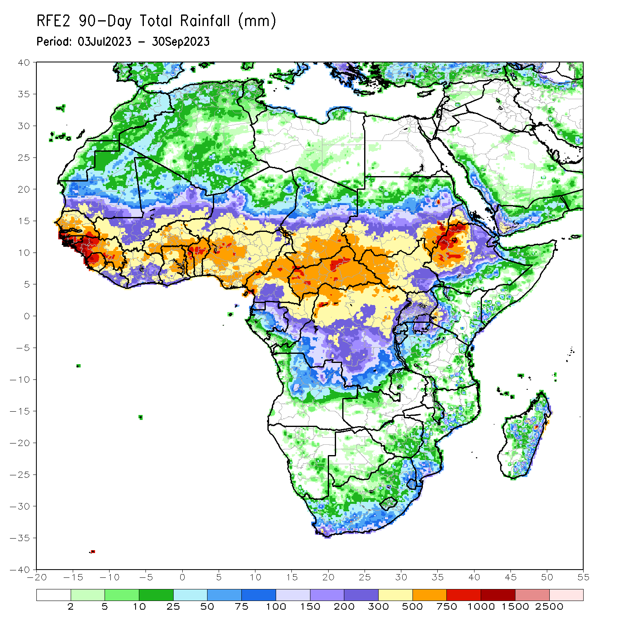
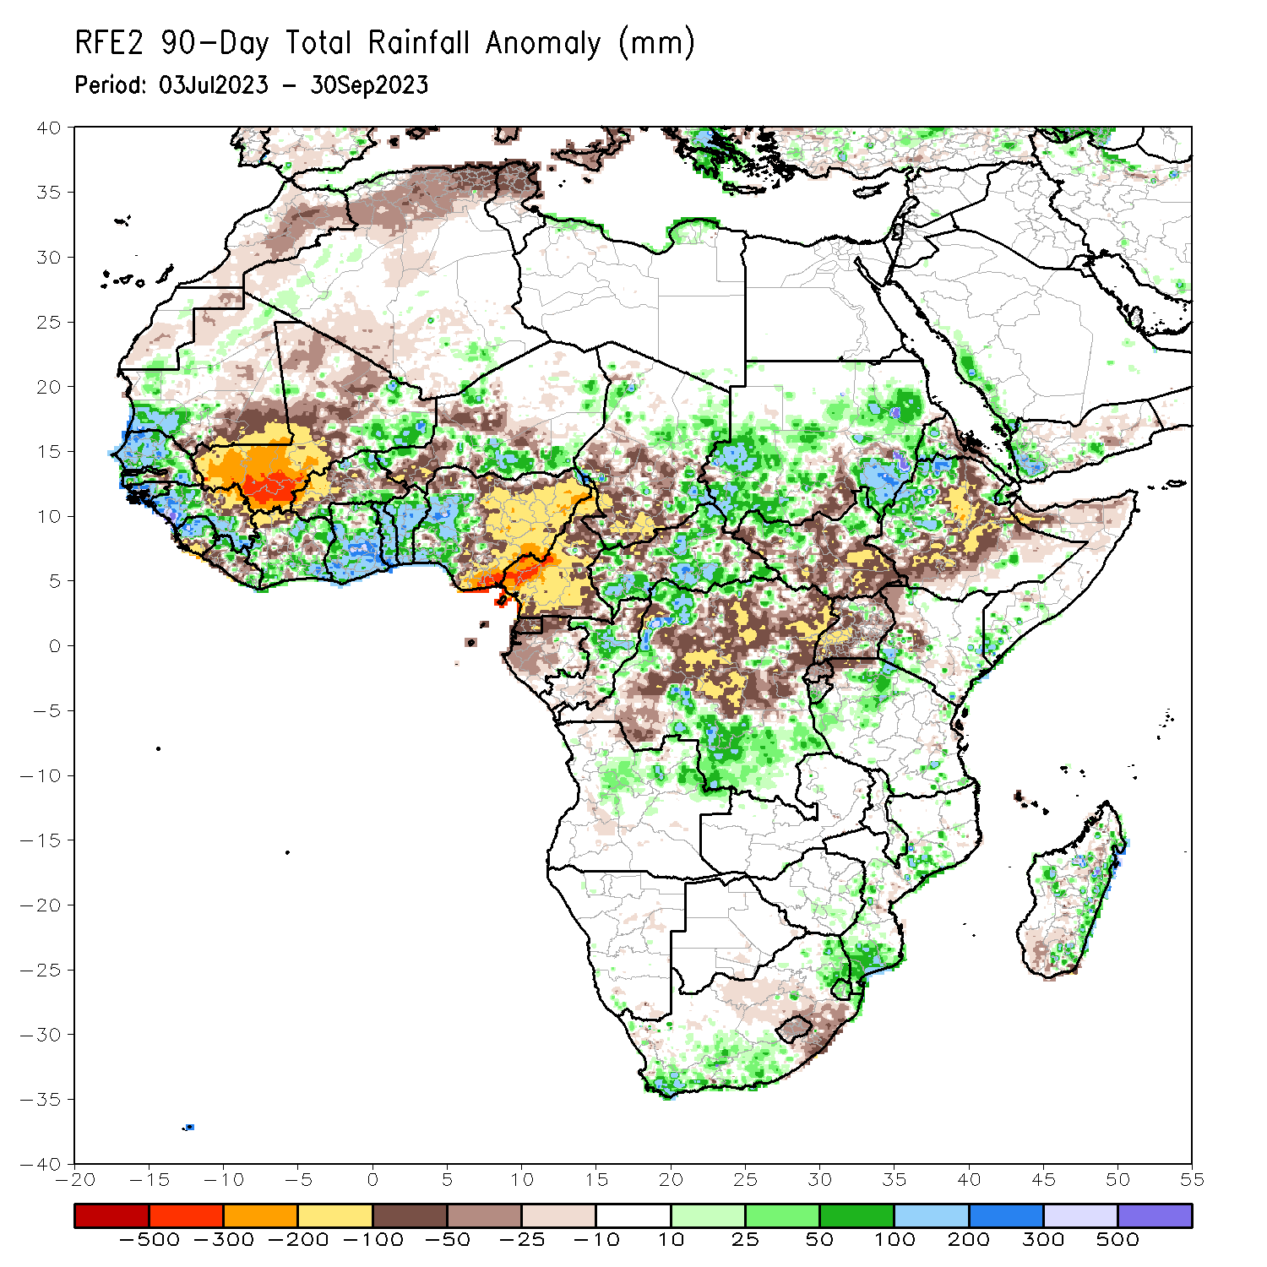
Rainfall Patterns: Last 90 Days
Over the past 90 days, in East Africa, above-average rainfall was observed over many parts of Sudan, western Ethiopia, northwestern and northeastern South Sudan, north-central Uganda, western Eritrea, parts of southern Somalia, parts of northern Tanzania, southern Burundi, and southwestern and southeastern Kenya. Rainfall was below-average over many parts of South Sudan, south-central Sudan, eastern, central, and southern Ethiopia, parts of northern Somalia, pockets of west-central and northwestern Kenya, Rwanda, northern Burundi, northwestern Tanzania, central Eritrea, and most of Uganda. In southern Africa, above-average rainfall was observed over south-central, southwestern, and eastern South Africa, Eswatini, southern Mozambique, parts of northern Angola, and parts of eastern and central Madagascar. Below-average rainfall was observed over southeastern and parts of central South Africa, Lesotho, and pockets of southwestern Madagascar. In Central Africa, rainfall was above-average over many parts of CAR, eastern Chad, parts of central Congo, and northwestern, south-central, and southeastern DRC. Rainfall was below-average over much of Cameroon, Equatorial Guinea, Gabon, northern and southern Congo, parts of central, northeastern, and southwestern DRC, pockets of central CAR, and central and southwestern Chad. In West Africa, rainfall was above-average over much of Senegal, southwestern Mauritania, The Gambia, Guinea-Bissau, western and southern Guinea, northern and central Sierra Leone, eastern and northwestern Liberia, eastern Mali, much of Cote d’Ivoire, southern and northeastern Burkina Faso, much of Ghana, Togo, Benin, parts of northwestern and southeastern Niger, and western Nigeria. Below-average rainfall was observed over western, central and northern Mali, much of western Guinea, southern Sierra Leone, most of coastal and central Liberia, northwestern Cote d’Ivoire, western and central Burkina Faso, parts of southwestern and central Niger, and central, northern, and eastern Nigeria.
Notes:
‹#›

Slide 5
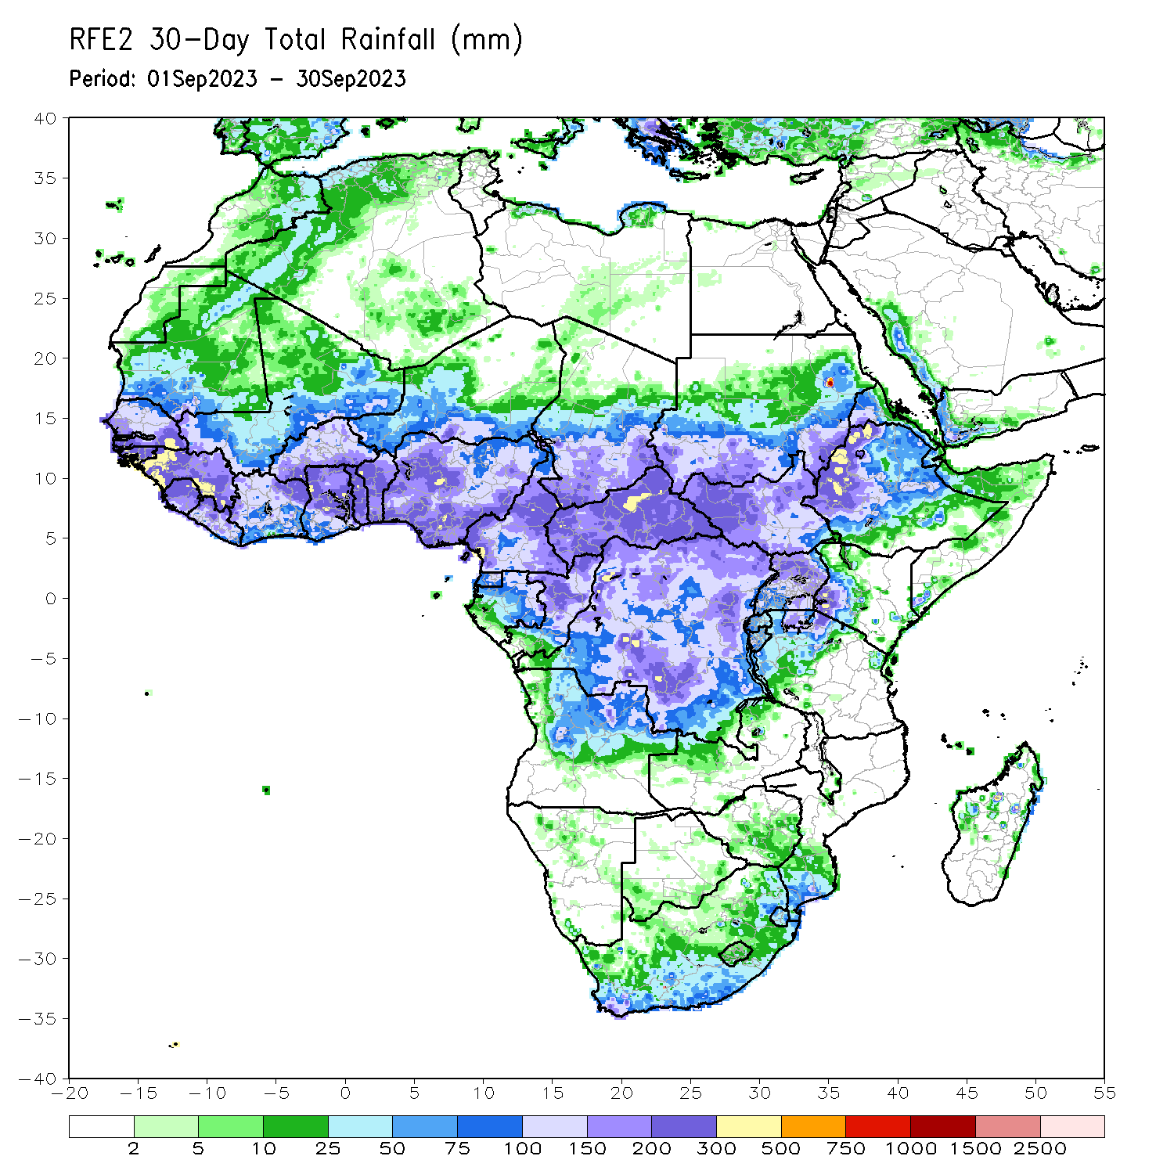
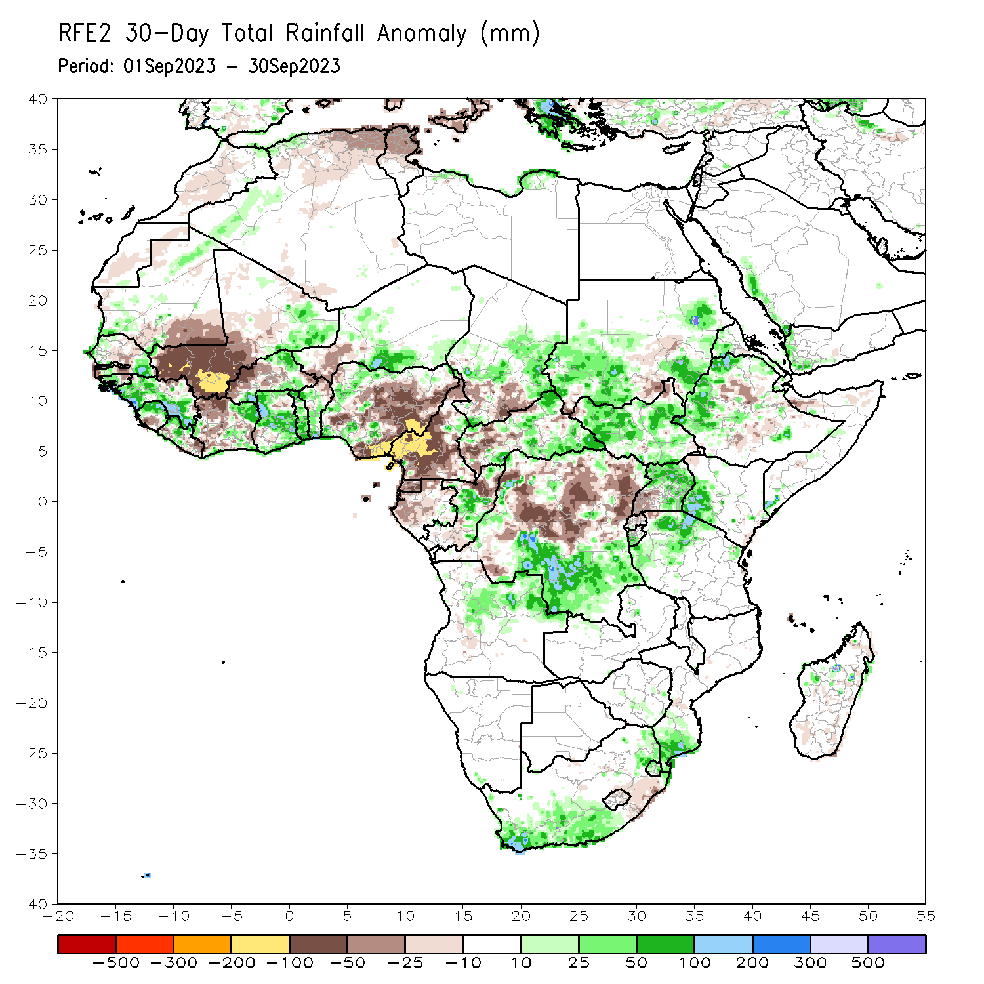
Rainfall Patterns: Last 30 Days
Over the past 30 days, in East Africa, above-average rainfall was observed over many parts of Sudan, South Sudan, western Eritrea, pockets of northern and western Ethiopia, northern and eastern Uganda, southwestern Kenya, parts of southern Somalia, Burundi, and much of northern Tanzania. Rainfall was below-average over central and southern Ethiopia, southwestern Uganda, and pockets of south-central and southwestern Sudan. In Central Africa, rainfall was above-average over central Congo, parts of central and eastern Chad, southern and northeastern CAR, and southeastern and south-central DRC. Below-average rainfall was observed over much of Cameroon, Equatorial guinea, northern and western Gabon, parts of northern Congo, pockets of south-central and southwestern Chad, parts of western CAR, and western, and central and northeastern DRC. In West Africa, rainfall was above-average over pockets of western and southeastern Senegal, southern and western Guinea, western Guinea-Bissau, northern Sierra Leone, northwestern and central Liberia, northeastern and southern Cote d’Ivoire, northeastern and much of southern Burkina Faso, eastern Mali, Ghana, Togo, central and southern Benin, western and parts of northern Nigeria, and south-central Niger. Below-average rainfall was observed over southeastern Mauritania, western and central Mali, pockets of central Senegal, western portions of The Gambia, eastern Guinea-Bissau, eastern Liberia, southern Sierra Leone, much of western Cote d’Ivoire, western and central Burkina Faso, western Niger, northeastern Benin, and central and eastern Nigeria.
Notes:
‹#›

Slide 6
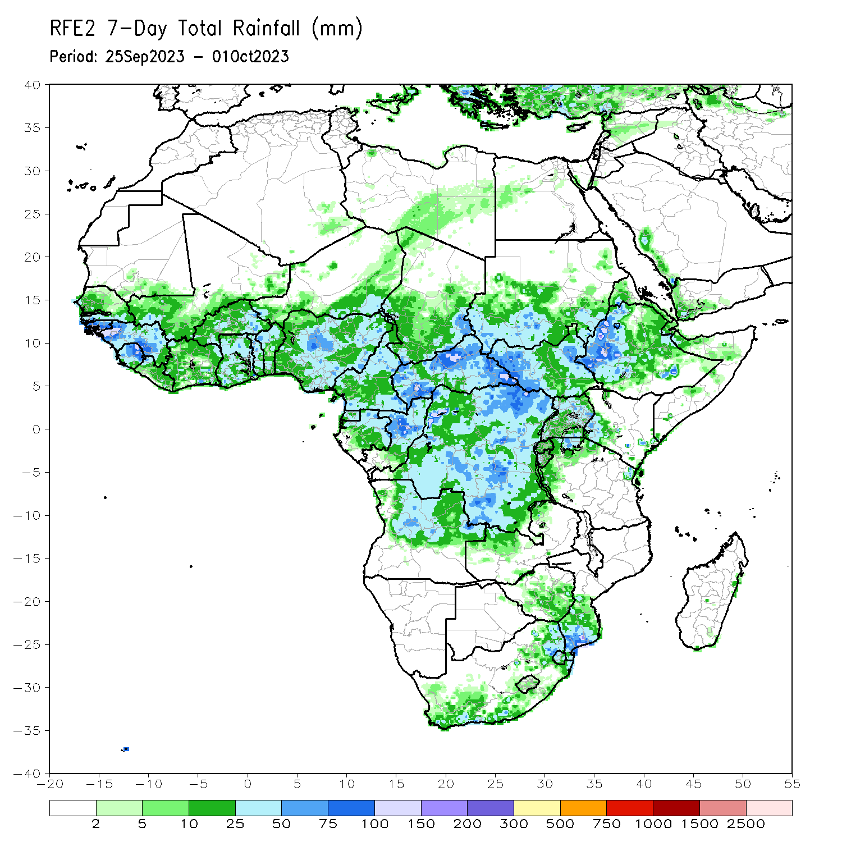
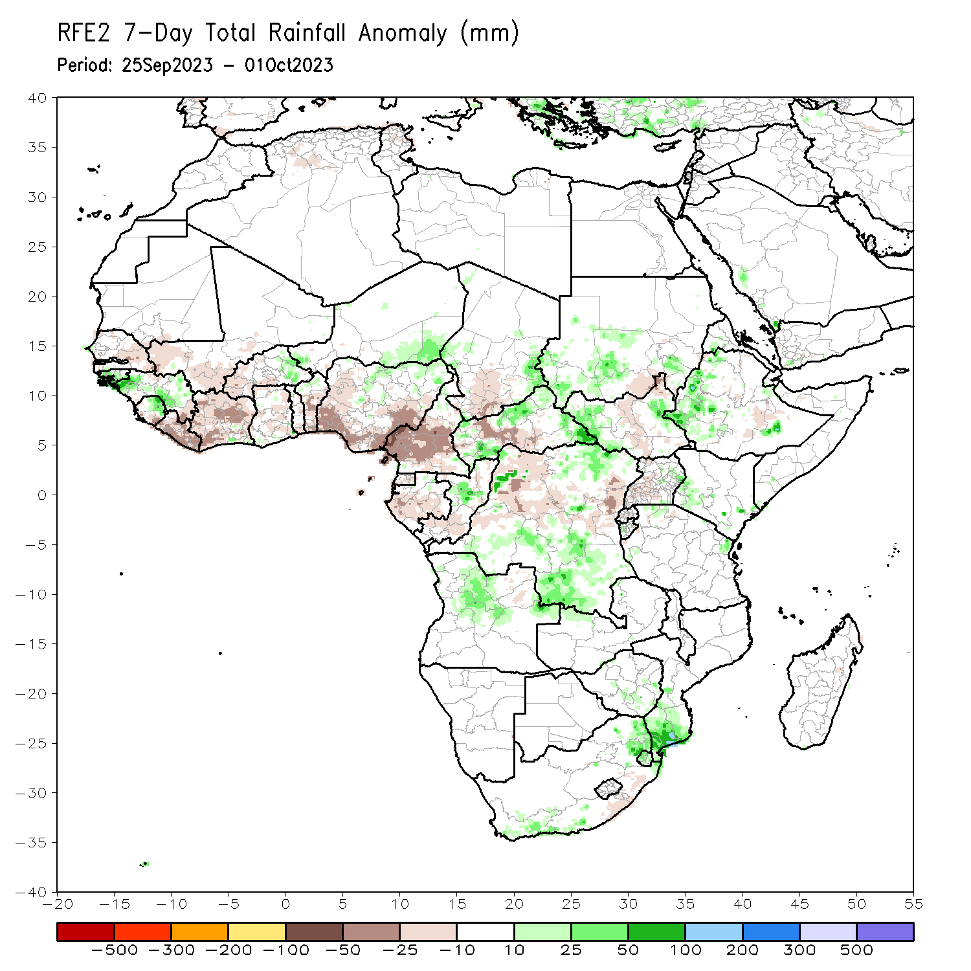
Rainfall Patterns: Last 7 Days
During the past 7 days, in East Africa, rainfall was above-average over most of southern Sudan, western and east-central South Sudan, parts of western, central, and eastern Ethiopia, pockets of southwestern and southeastern Kenya, parts of southern Somalia, and northeastern Tanzania. Below-average rainfall was observed over parts of southeastern Sudan, central and northeastern South Sudan, and southwestern Uganda. In central Africa, above-average rainfall was observed over pockets of northern Cameroon, western, north-central, and southeastern CAR, central Congo, northern Gabon, southeastern Chad, and northeastern, parts of northwestern, and southeastern DRC. Rainfall was below-average over many parts of central and southern Cameroon, south-central CAR, southern Congo, western Gabon, Equatorial Guinea, southwestern Chad, and parts of northwestern and central DRC. In West Africa, above-average rainfall was observed over much of Guinea-Bissau, western and parts of southeastern Guinea, eastern Liberia, southwestern Cote d’Ivoire, eastern Burkina Faso, northeastern Nigeria, and southeastern Niger. Rainfall was below-average over many parts of Senegal, southwestern Mali, western and central Sierra Leone, western and central Liberia, northern and central Cote d’Ivoire, Ghana, northern and southern Togo, most of Benin, western Burkina Faso, and southern and parts of central Nigeria. In southern Africa, rainfall was above-average over much of southern and eastern South Africa, Eswatini, southern Mozambique, parts of northern Angola, and northwestern Zambia.

Slide 7
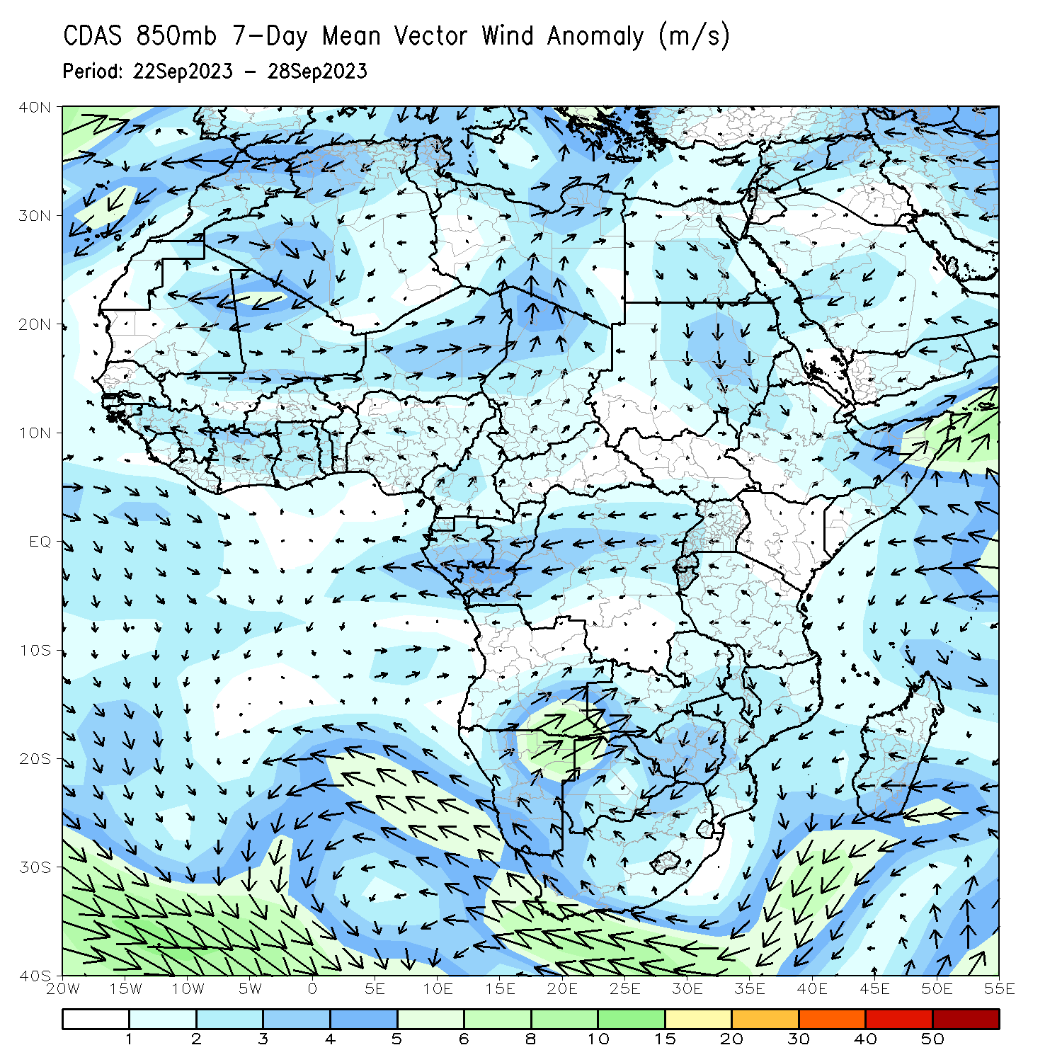
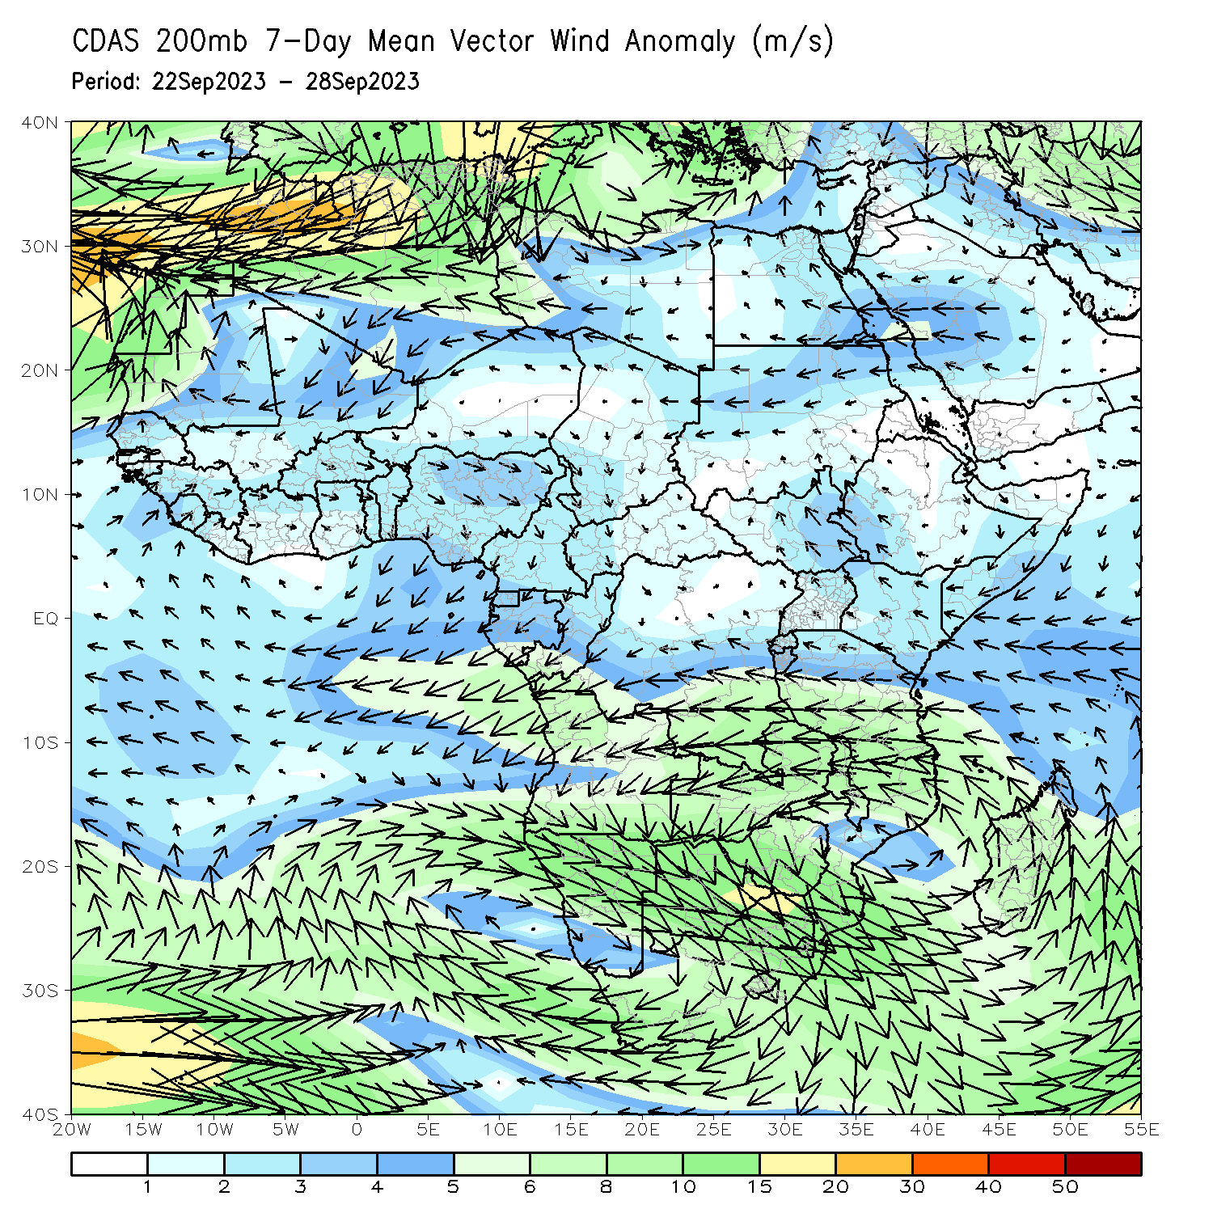
Atmospheric Circulation: Last 7 Days
At 850-hPa level (left panel), anomalous offshore flow was observed over most of the Gulf of Guinea region, which may have contributed to the observed below-average rainfall in the region. In contrast, anomalous lower-level convergence was present across southeastern DRC, which likely contributed to the above average rainfall for the region. Upper-level convergence across the western Gulf of Guinea region helped contribute to the below normal rainfall across the region.

Slide 8
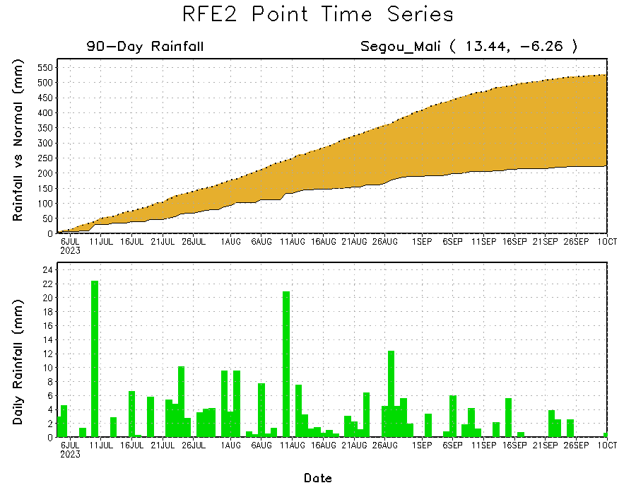
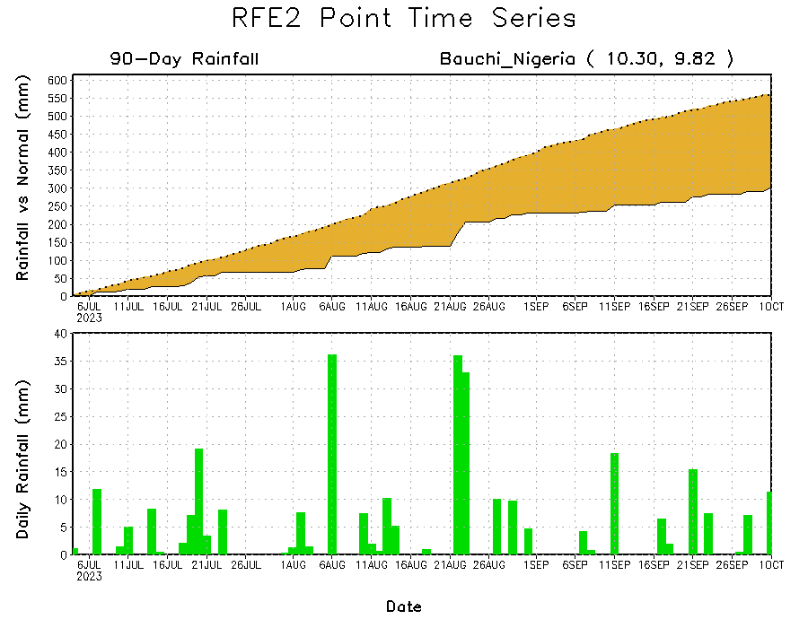
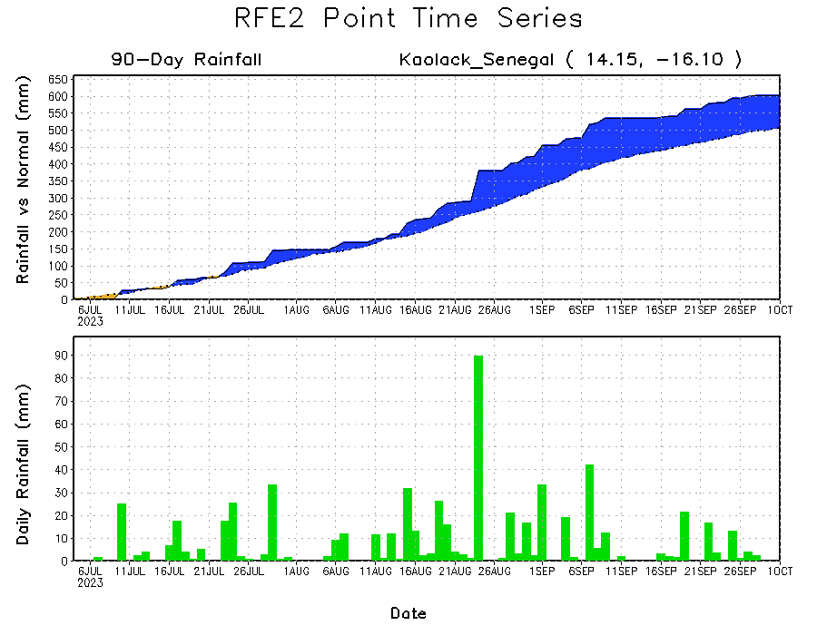
Rainfall Evolution
Daily evolution of rainfall over the last 90 days at selected locations shows light rainfall sustained moisture surpluses over parts of Senegal (bottom left). Seasonal total rainfall remained below-average over western Mali (top right) and eastern Nigeria (bottom right).

Slide 9
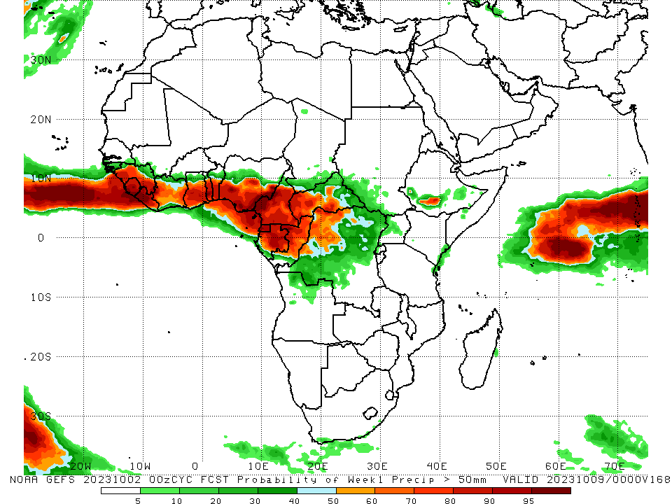
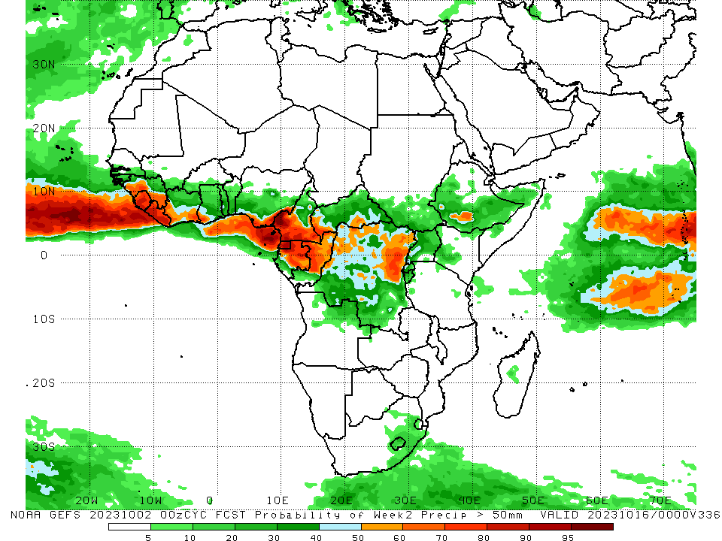
NCEP GEFS Model Forecasts Non-Bias Corrected Probability of precipitation exceedance
Week-1, Valid: 03 – 09 Oct 2023
Week-2, Valid: 10 – 16 Oct 2023
For week-1 (left panel) the GEFS forecasts indicate a moderate to high chance (over 70%) for rainfall to exceed 50 mm over the Gulf of Guinea region, central and southern Cameroon, Equatorial Guinea, most of Gabon, most of Congo, western and parts of central CAR, parts of northeastern DRC, and parts of south-central Ethiopia. For week-2 (right panel), the GEFS forecasts indicate a moderate to high chance (over 70%) for rainfall to exceed 50 mm over eastern and western parts of the Gulf of Guinea region, southern Cameroon, Equatorial Guinea, central Congo, parts of western CAR, and east-central DRC.
Notes:
‹#›

Slide 10
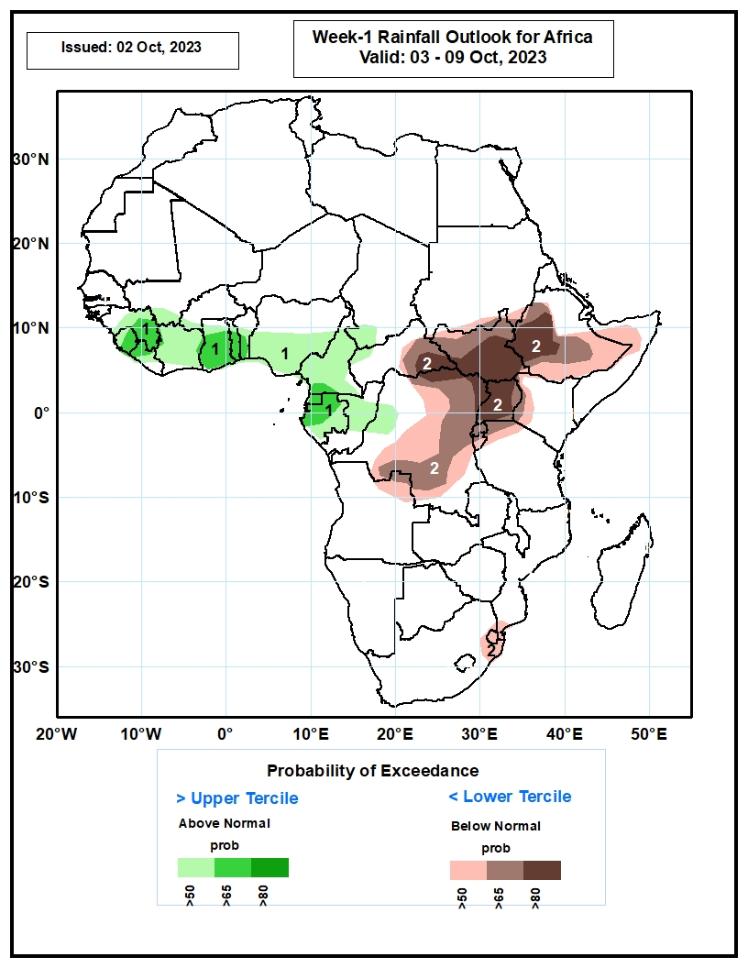
Week-1 Precipitation Outlooks
03 – 09 Oct 2023
The probabilistic forecasts call for above 50% chance for weekly rainfall to be above-normal (above the upper tercile) across the Gulf of Guinea region and the neighboring areas of Central Africa. There is above 65% chance for rainfall to be above-normal over eastern Guinea, Sierra Leone, Ghana, Togo, Benin, Equatorial Guinea and western Gabon.
The forecasts call for above 50% chance for weekly total rainfall to be below-normal (below the lower tercile) over southern and eastern DRC, eastern CAR, South Sudan, Rwanda, Burundi, Uganda, western and southern Ethiopia, western Kenya, and the far eastern South Africa and Eswatini. There is above 80% chance for rainfall to be below-normal in the Lake Victoria region, including parts of South Sudan and southwestern Ethiopia.
Notes:
‹#›

Slide 11
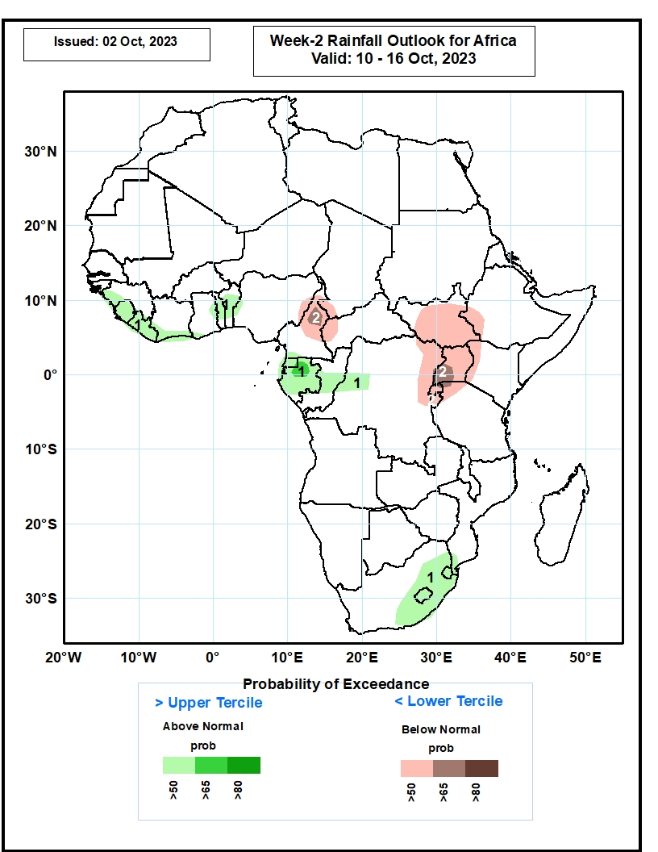
Week-2 Precipitation Outlooks
10 – 16 Oct 2023
The probabilistic forecasts call for above 50% chance for weekly rainfall to be above-normal (above the upper tercile) over western Guinea, Sierra Leone, Liberia, coastal Cote d’Ivoire, Togo, Benin, Equatorial Guinea, Gabon, central Congo, part of western DRC, eastern South Africa, Lesotho and Eswatini. There is above 65% chance for rainfall to be above-normal over pocket of northern Gabon.
The forecasts call for above 50% chance for weekly total rainfall to be below-normal (below the lower tercile) over northern Cameroon, western CAR, South Sudan, southwestern Ethiopia, northeastern DRC, Rwanda, Burundi, and Uganda.
Notes:
‹#›

Slide 12
Summary
Over the past 30 days, in East Africa, above-average rainfall was observed over many parts of Sudan, South Sudan, western Eritrea, pockets of northern and western Ethiopia, northern and eastern Uganda, southwestern Kenya, parts of southern Somalia, Burundi, and much of northern Tanzania. Rainfall was below-average over central and southern Ethiopia, southwestern Uganda, and pockets of south-central and southwestern Sudan. In Central Africa, rainfall was above-average over central Congo, parts of central and eastern Chad, southern and northeastern CAR, and southeastern and south-central DRC. Below-average rainfall was observed over much of Cameroon, Equatorial guinea, northern and western Gabon, parts of northern Congo, pockets of south-central and southwestern Chad, parts of western CAR, and western, and central and northeastern DRC. In West Africa, rainfall was above-average over pockets of western and southeastern Senegal, southern and western Guinea, western Guinea-Bissau, northern Sierra Leone, northwestern and central Liberia, northeastern and southern Cote d’Ivoire, northeastern and much of southern Burkina Faso, eastern Mali, Ghana, Togo, central and southern Benin, western and parts of northern Nigeria, and south-central Niger. Below-average rainfall was observed over southeastern Mauritania, western and central Mali, pockets of central Senegal, western portions of The Gambia, eastern Guinea-Bissau, eastern Liberia, southern Sierra Leone, much of western Cote d’Ivoire, western and central Burkina Faso, western Niger, northeastern Benin, and central and eastern Nigeria.
During the past 7 days, in East Africa, rainfall was above-average over most of southern Sudan, western and east-central South Sudan, parts of western, central, and eastern Ethiopia, pockets of southwestern and southeastern Kenya, parts of southern Somalia, and northeastern Tanzania. Below-average rainfall was observed over parts of southeastern Sudan, central and northeastern South Sudan, and southwestern Uganda. In central Africa, above-average rainfall was observed over pockets of northern Cameroon, western, north-central, and southeastern CAR, central Congo, northern Gabon, southeastern Chad, and northeastern, parts of northwestern, and southeastern DRC. Rainfall was below-average over many parts of central and southern Cameroon, south-central CAR, southern Congo, western Gabon, Equatorial Guinea, southwestern Chad, and parts of northwestern and central DRC. In West Africa, above-average rainfall was observed over much of Guinea-Bissau, western and parts of southeastern Guinea, eastern Liberia, southwestern Cote d’Ivoire, eastern Burkina Faso, northeastern Nigeria, and southeastern Niger. Rainfall was below-average over many parts of Senegal, southwestern Mali, western and central Sierra Leone, western and central Liberia, northern and central Cote d’Ivoire, Ghana, northern and southern Togo, most of Benin, western Burkina Faso, and southern and parts of central Nigeria. In southern Africa, rainfall was above-average over much of southern and eastern South Africa, Eswatini, southern Mozambique, parts of northern Angola, and northwestern Zambia.
The Week-1 outlook calls for above-normal rainfall in much of the Gulf of Guinea region (from Guinea to Nigeria), Cameroon, Equatorial Guinea, Gabon, Congo, southern Chad, western CAR, northwestern DRC, southeastern South Africa, and southeastern Kenya. In contrast, there is an increased chance for below-normal rainfall over parts of central, southern, and eastern Africa (South Sudan, Ethiopia, northern Somalia, Uganda, eastern DRC, Rwanda, Burundi, southwestern Kenya, northern Tanzania, Eswatini, and southeastern South Africa). For Week-2, there is an increased chance for above-normal rainfall across parts of the Gulf of Guinea region (from southern Cote d’Ivoire to southern Nigeria), central Africa (southern Cameroon, northern Gabon, northern Congo, eastern CAR, northern and eastern DRC), and parts of eastern Africa (southern South Sudan, central and southern Ethiopia, northern Somalia). In contrast, there is an increased chance for below-normal rainfall over western Gabon, southern Congo, southwestern DRC, northwestern Angola, the Lake Victoria region, parts of eastern Tanzania, northeastern Madagascar, and central Somalia.

