Slide 1
The African Monsoon Recent Evolution and Current Status Include Week-1 and Week-2 Outlooks
Update prepared
25 September 2023
For more information, visit:
http://www.cpc.ncep.noaa.gov/products/Global_Monsoons/African_Monsoons/precip_monitoring.shtml

Slide 2
Outline
Highlights
Recent Evolution and Current Conditions
NCEP GEFS Forecasts
Summary

Slide 3
Highlights: Last 7 Days
During the past 7 days, in East Africa, rainfall was above-average over eastern Sudan, parts of western and eastern Ethiopia, Uganda, and pockets of southern Kenya and northern Tanzania. Below-average rainfall was observed over parts of southern Sudan. In central Africa, above-average rainfall was observed over pockets of Cameroon, CAR, Congo and DRC. Rainfall was below-average over many parts of Cameroon and CAR, northern Congo, and much of DRC. In West Africa, above-average rainfall was observed over southeastern Senegal, much of Guinea, Sierra Leone, Liberia, southeastern Cote d’Ivoire, pockets of Burkina Faso and Ghana. Rainfall was below-average over many parts of Senegal, western Mali, Cote d’Ivoire, parts of Ghana, southern Benin and much of Nigeria. In southern Africa, rainfall was above-average over the southern portion of South Africa.
The Week-1 outlook calls for above-normal rainfall in southeastern Burkina Faso, northern Ghana, Togo, and Benin, much of Nigeria, southern Chad, northern CAR, northern South Sudan western Ethiopia, northeastern Angola, and southern DRC. In contrast, there is an increased chance for below-normal rainfall over southern Senegal, western Guinea, and pockets of Gabon and Congo. For week-2, there is an increased chance for above-normal rainfall across southern Senegal, Guinea-Bissau, Guinea, southern Mali, northern Cote d’Ivoire, Burkina Faso, central and northern Ghana, Togo, Benin, parts of Nigeria, southern Cameroon and northern Gabon. In contrast, there is an increased chance for below-normal rainfall over eastern CAR, southern and eastern DRC, Rwanda, Burundi, northwestern Tanzania, Uganda, eastern South Sudan, and western Ethiopia.

Slide 4
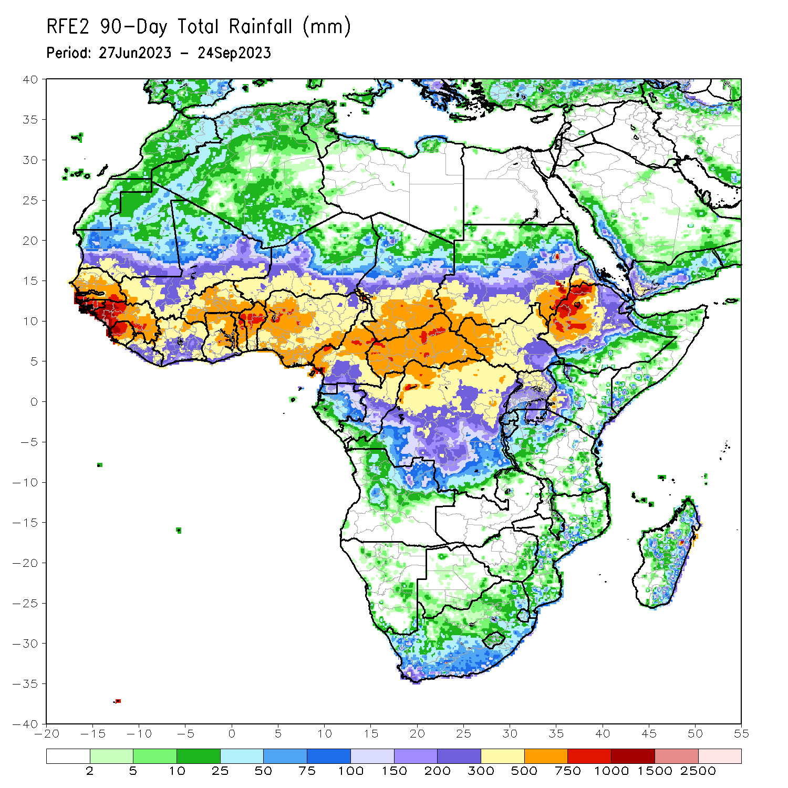
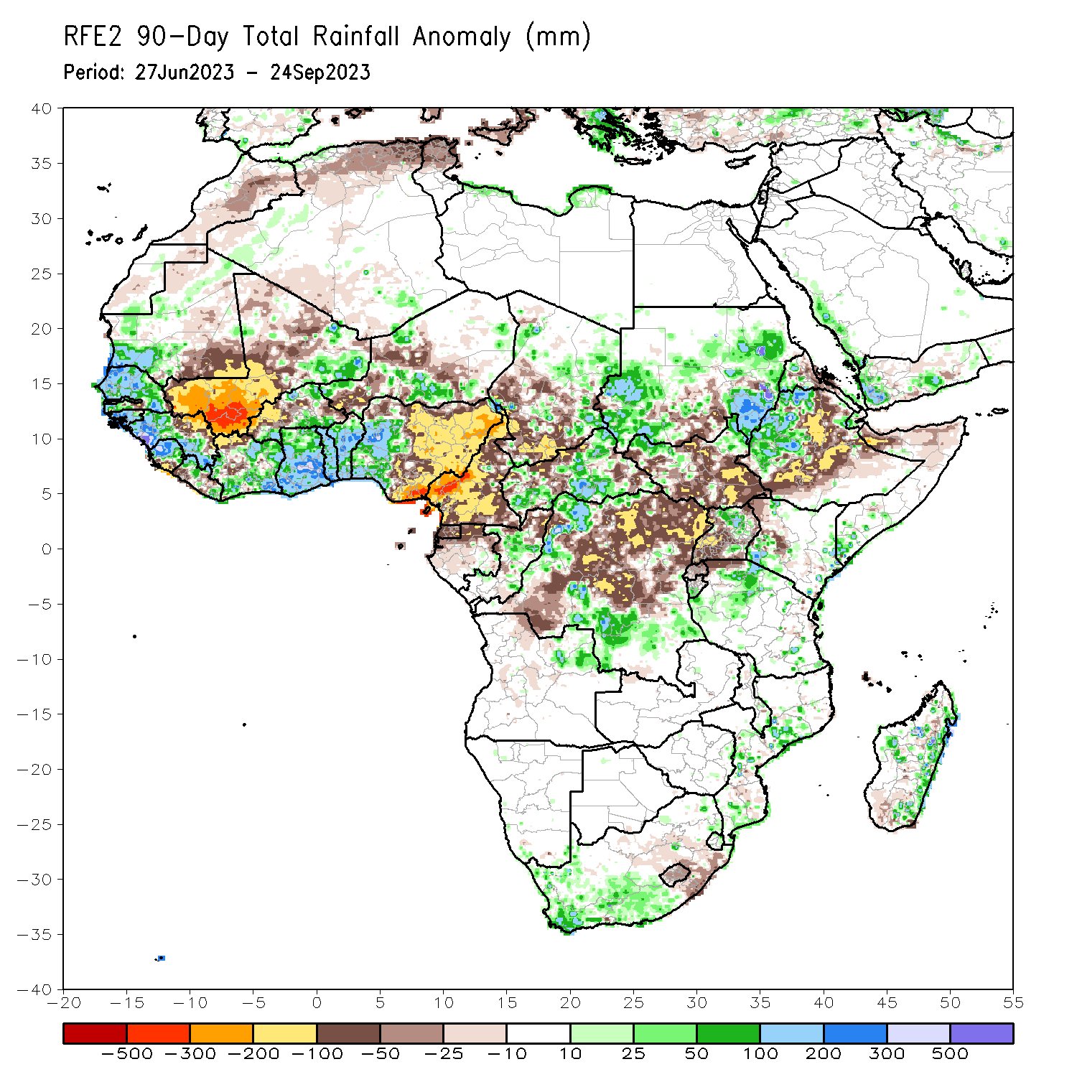
Rainfall Patterns: Last 90 Days
Over the past 90 days, in East Africa, above-average rainfall was observed over many parts of Sudan, western Ethiopia, the far northern South Sudan, northern Uganda, and southwestern Kenya. Rainfall was below-average over many parts of South Sudan, central Sudan, eastern and southern Ethiopia, parts of northern Somalia, pockets of western Kenya, and southern Uganda. In southern Africa, above-average rainfall was observed over the western portion of South Africa, and parts of Madagascar. Below-average rainfall was observed over eastern South Africa, Lesotho, and pockets of Madagascar. In Central Africa, rainfall was above-average over many parts of CAR, pockets of Chad, parts of Congo, and western and southern DRC. Rainfall was below-average over much of Cameroon, Equatorial Guinea, northern Gabon, parts of central, northeastern and eastern DRC, and pockets of CAR, and Chad. In West Africa, rainfall was above-average over much of Senegal, southern Mauritania, Guinea-Bissau, Guinea, Sierra Leone, Liberia, northeastern Mali, much of Cote d’Ivoire, pockets of Burkina Faso, much of Ghana, Togo, Benin, parts of Niger, and western Nigeria. Below-average rainfall was observed over western, central and northern Mali, coastal Liberia, pockets of Burkina Faso, parts of Niger, and central and eastern Nigeria.
Notes:
4

Slide 5
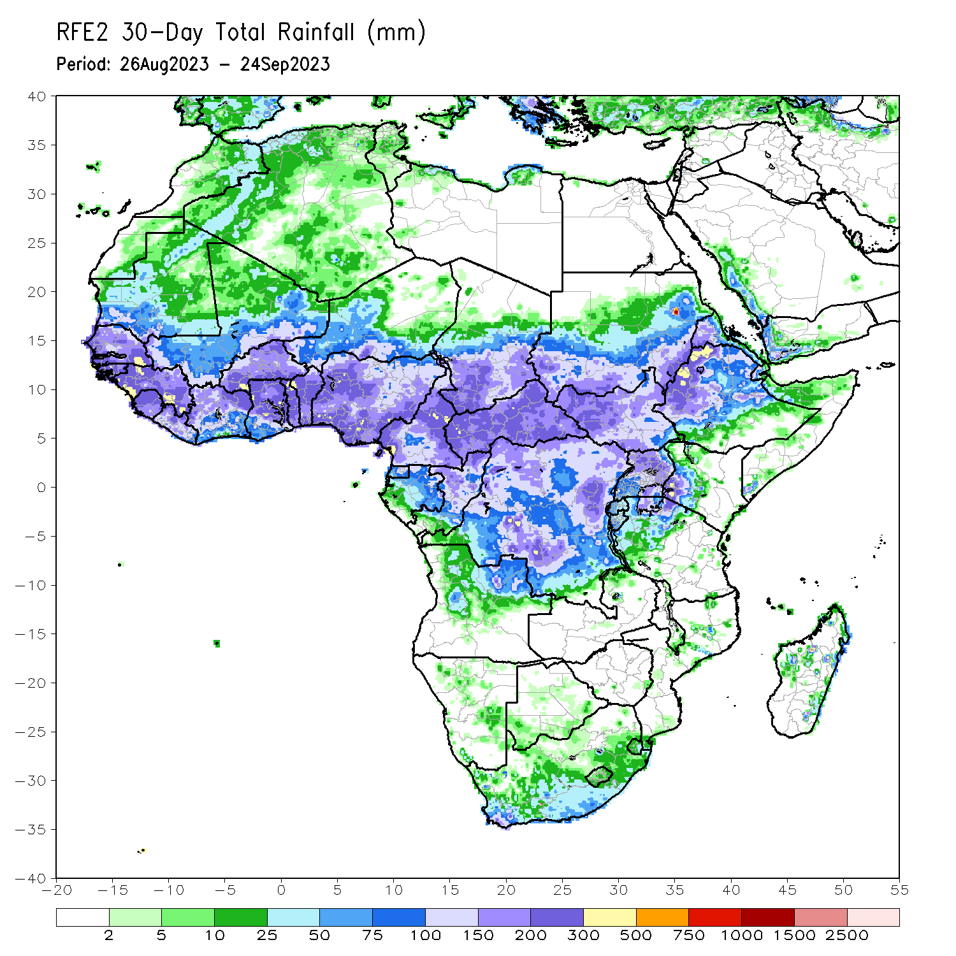
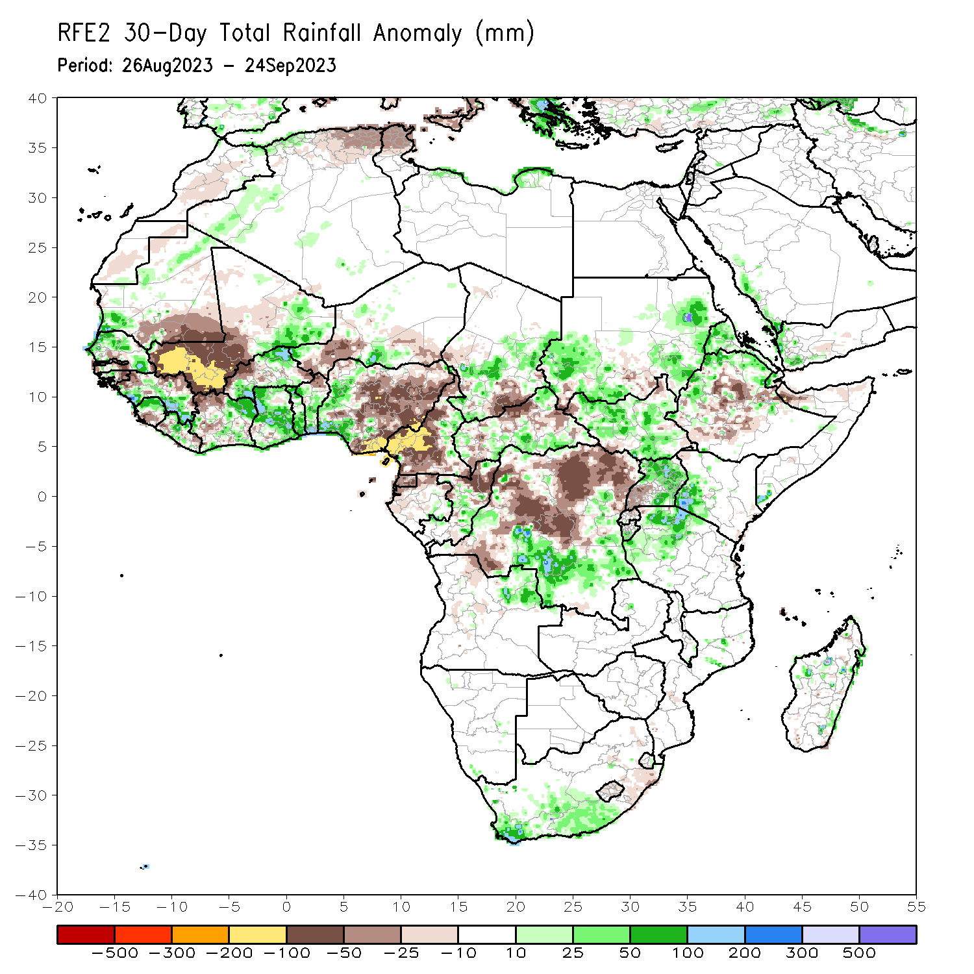
Rainfall Patterns: Last 30 Days
Over the past 30 days, in East Africa, above-average rainfall was observed over many parts of Sudan, South Sudan and Eritrea, and pockets of northern and western Ethiopia, Uganda and western Kenya and northwestern Tanzania. Rainfall was below-average over central and southern Ethiopia, southwestern Uganda, and pockets of Sudan. In Central Africa, rainfall was above-average over central Congo, parts of Chad and CAR, southern and eastern DRC. Below-average rainfall was observed over much of Cameroon, Equatorial guinea, northern Gabon, northern Congo, pockets of Chad and CAR, and western, central and northern DRC. In West Africa, rainfall was above-average over pockets of over pockets of Senegal, southern Guinea, northern Sierra Leone, northern Liberia, northwestern Cote d’Ivoire, northern Burkina Faso, northeastern Mali, Ghana, Togo, Benin, western Nigeria and pockets of Niger. Below-average rainfall was observed over southern Mauritania, western and central Mali, pockets of Senegal, Liberia and Sierra Leone, parts of Cote d’Ivoire, western Burkina Faso, western Niger, and central and eastern Nigeria.
Notes:
5

Slide 6
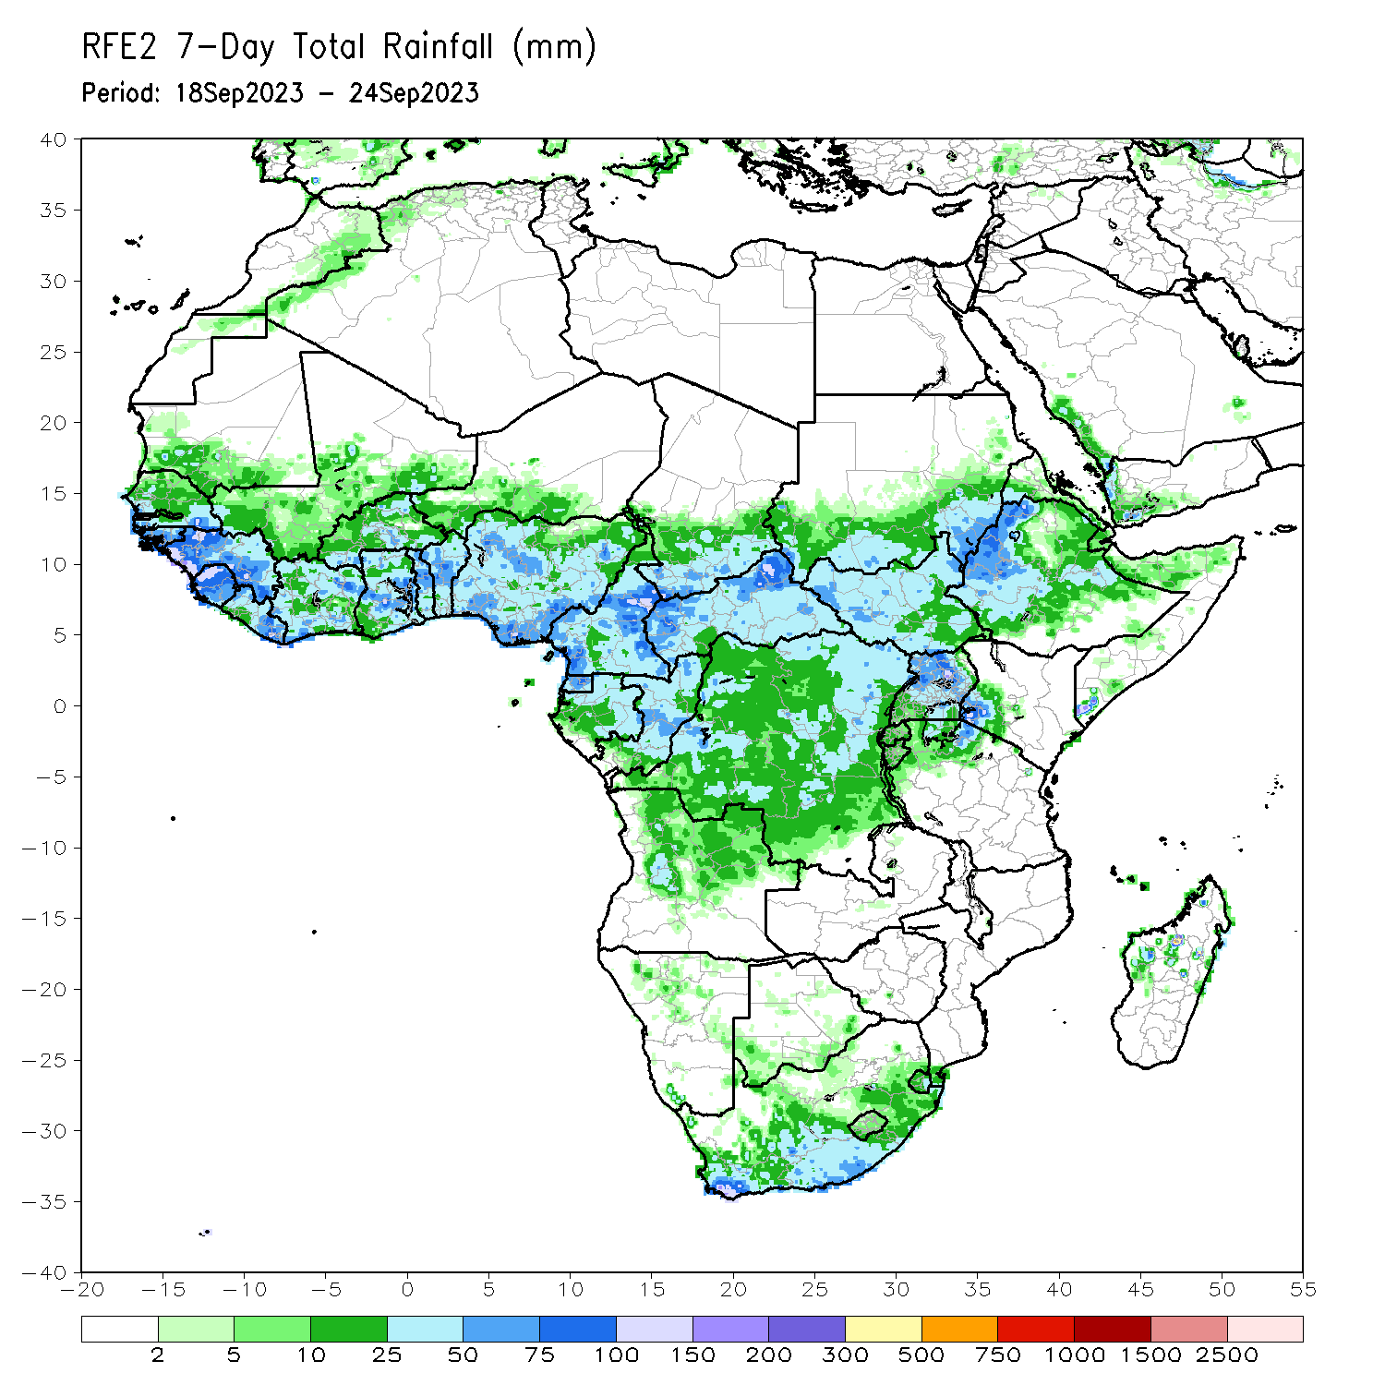
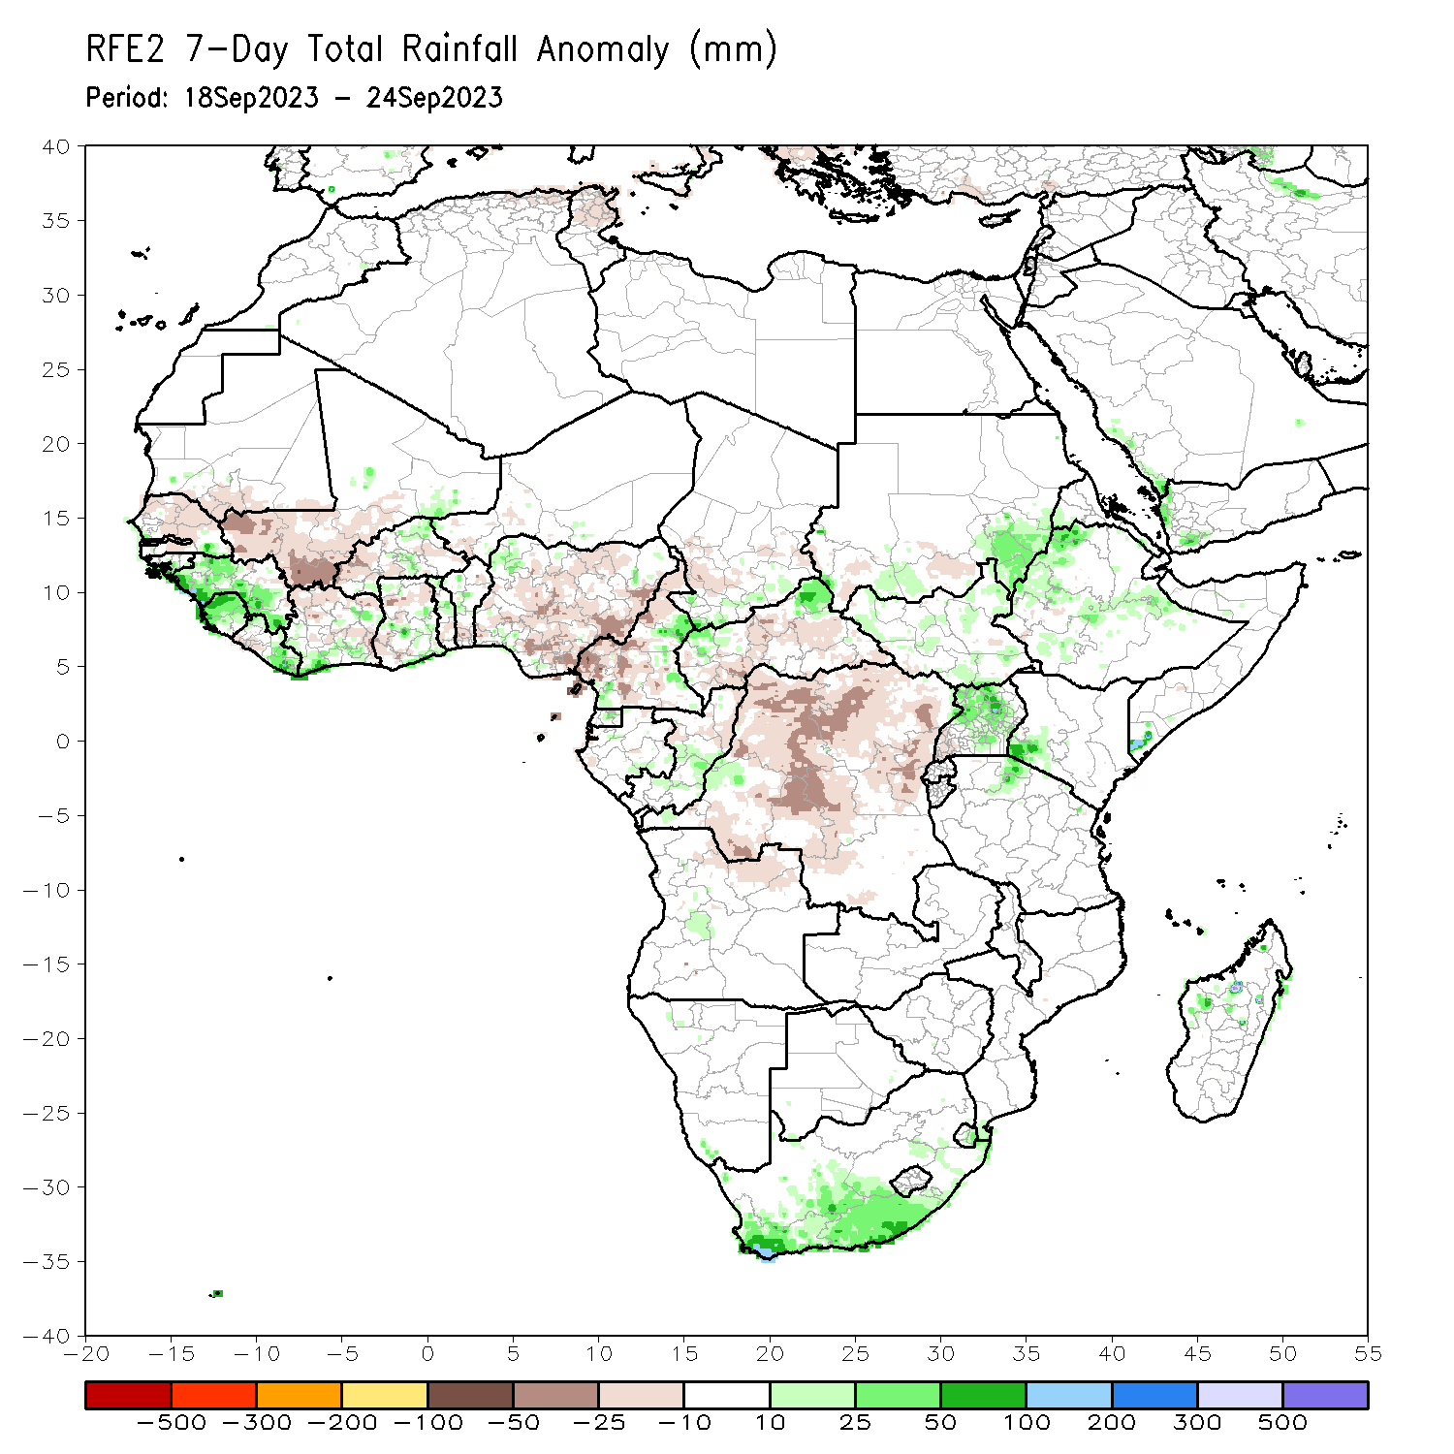
Rainfall Patterns: Last 7 Days
During the past 7 days, in East Africa, rainfall was above-average over eastern Sudan, parts of western and eastern Ethiopia, Uganda, and pockets of southern Kenya and northern Tanzania. Below-average rainfall was observed over parts of southern Sudan. In central Africa, above-average rainfall was observed over pockets of Cameroon, CAR, Congo and DRC. Rainfall was below-average over many parts of Cameroon and CAR, northern Congo, and much of DRC. In West Africa, above-average rainfall was observed over southeastern Senegal, much of Guinea, Sierra Leone, Liberia, southeastern Cote d’Ivoire, pockets of Burkina Faso and Ghana. Rainfall was below-average over many parts of Senegal, western Mali, Cote d’Ivoire, parts of Ghana, southern Benin and much of Nigeria. In southern Africa, rainfall was above-average over the southern portion of South Africa.

Slide 7
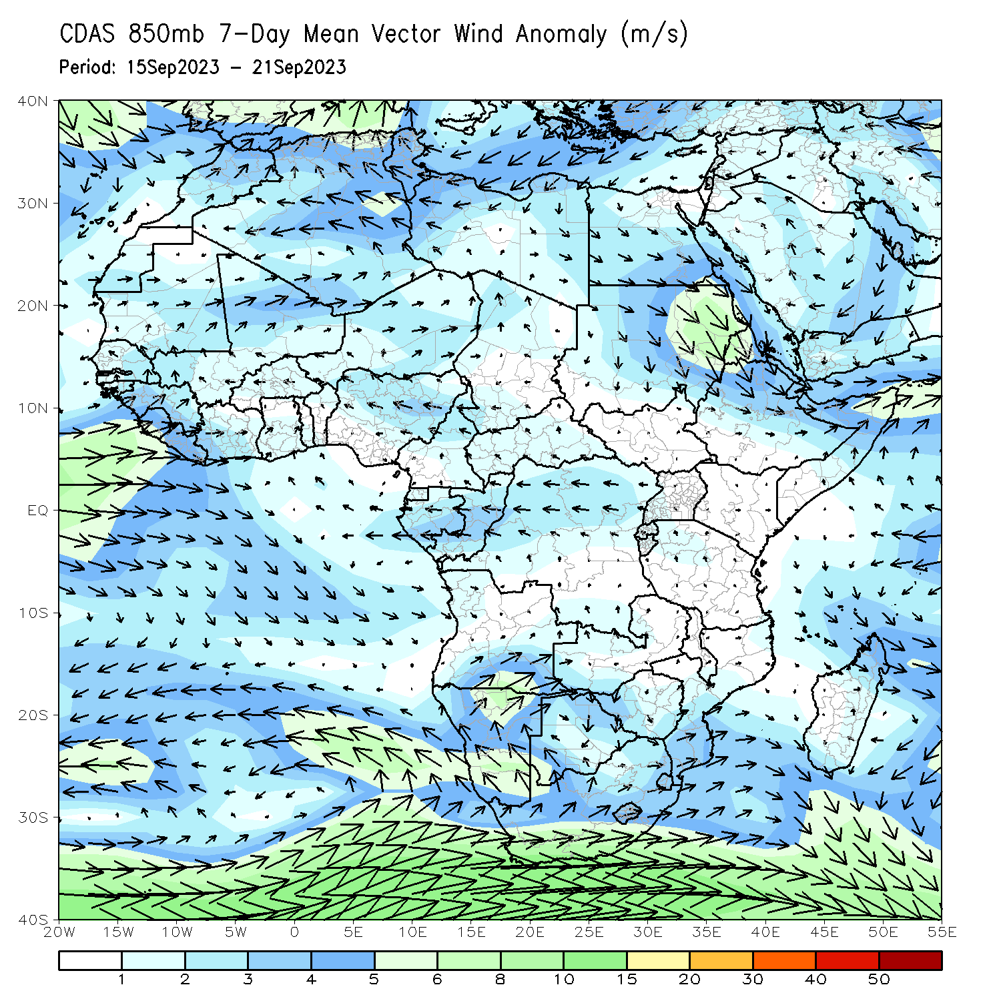
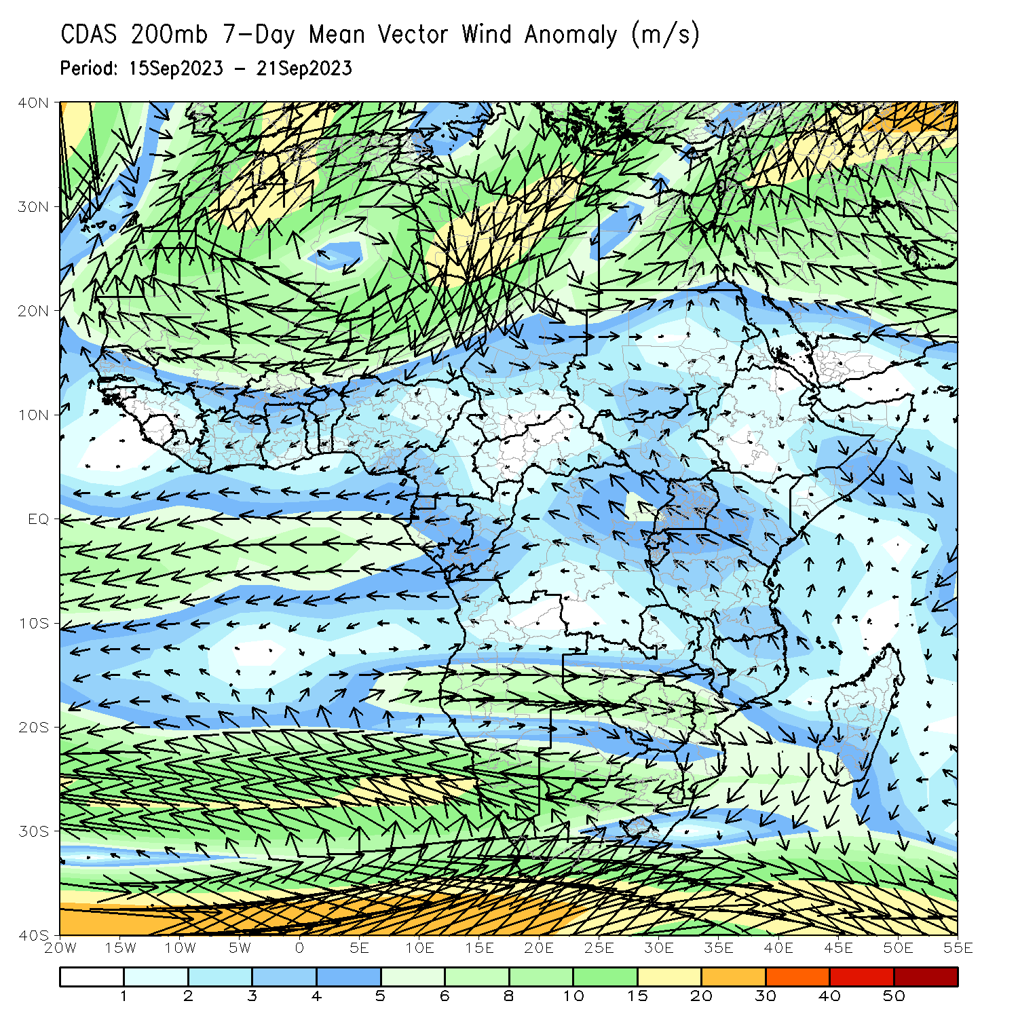
Atmospheric Circulation: Last 7 Days
At 850-hPa level (left panel), anomalous onshore flow was observed over the far western gulf of Guinea region, which may have contributed to the observed above-average rainfall in the region. In contrast, the lower-level anomalies were easterly across equatorial Africa.

Slide 8
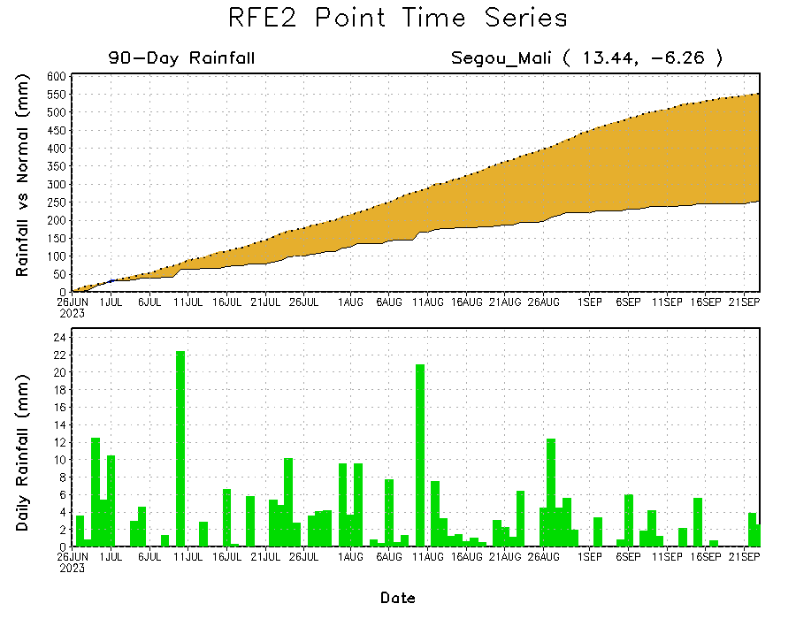
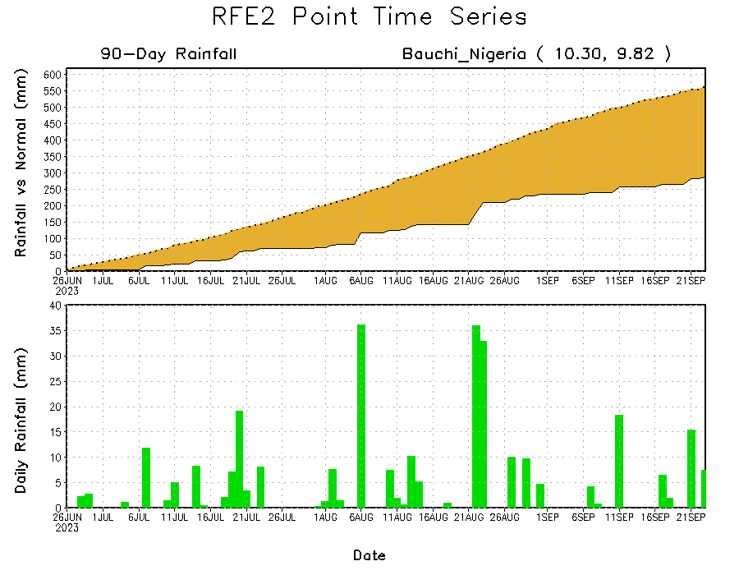
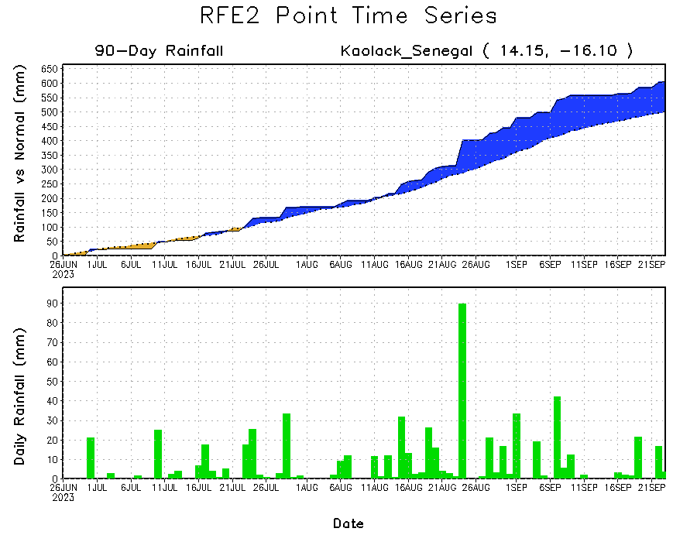
Rainfall Evolution
Daily evolution of rainfall over the last 90 days at selected locations shows moderate to heavy rainfall sustained moisture surpluses over parts of Senegal (bottom left). Seasonal total rainfall remained below-average over western Mali (top right) and eastern Nigeria (bottom right).

Slide 9
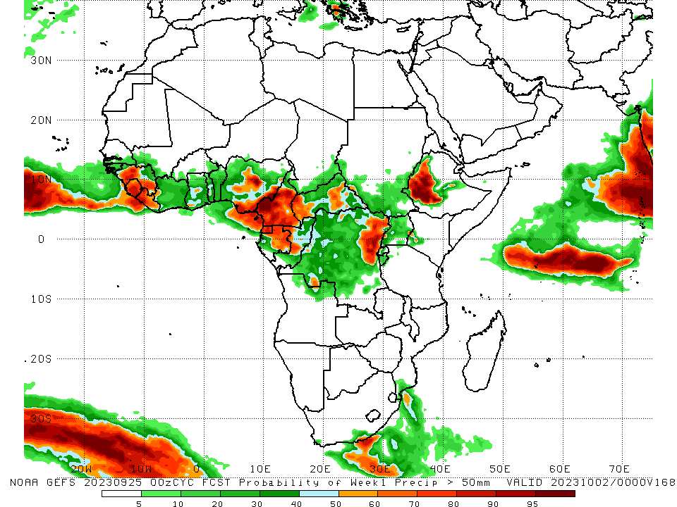
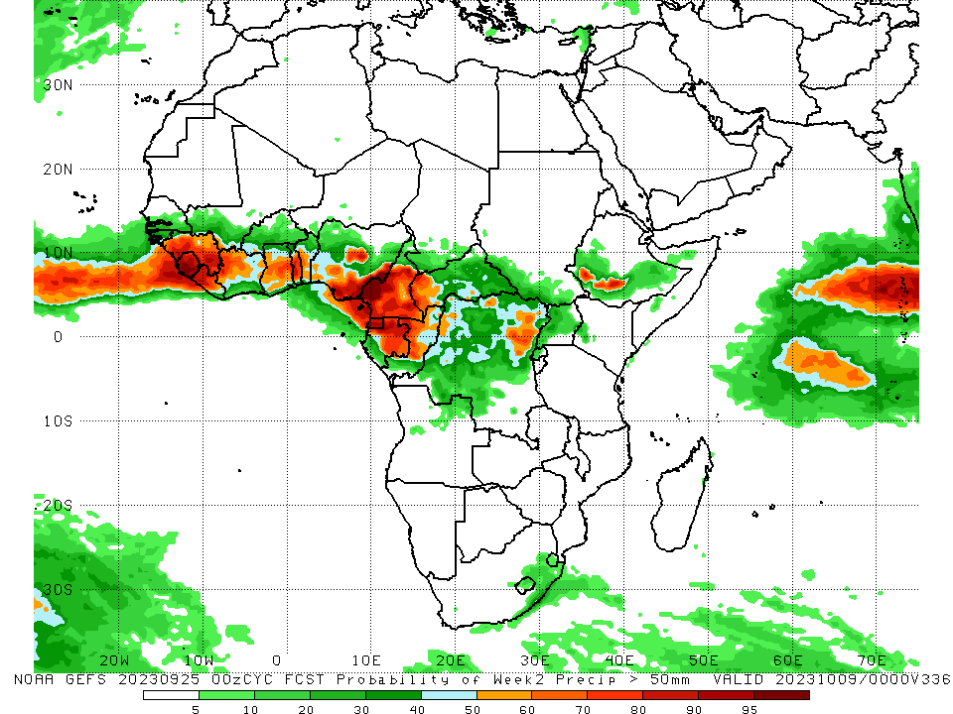
NCEP GEFS Model Forecasts Non-Bias Corrected Probability of precipitation exceedance
Week-1, Valid: 26 Sep – 02 Oct 2023
Week-2, Valid: 03 – 09 Oct 2023
For week-1 (left panel) and week-2 (right panel), the GEFS forecasts indicate a moderate to high chance (over 70%) for rainfall to exceed 50 mm over parts of the Gulf of Guinea region and Central Africa, and southwestern Ethiopia.
Notes:
9

Slide 10
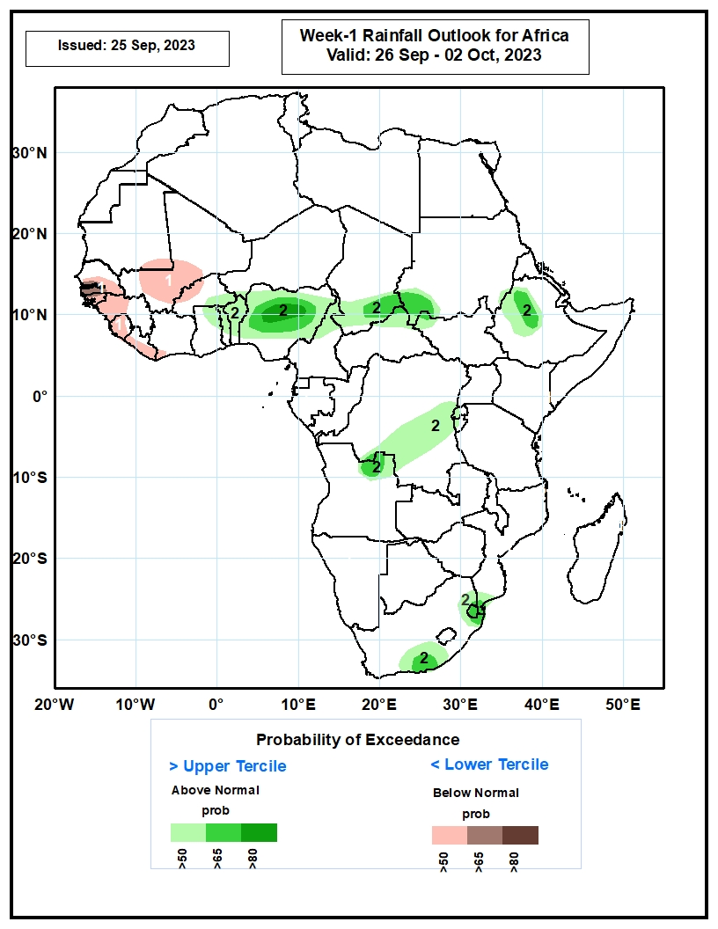
Week-1 Precipitation Outlooks
26 Sep – 02 Oct 2023
The probabilistic forecasts call for above 50% chance for weekly total rainfall to be below-normal (below the lower tercile) over southern Senegal, much of The Gambia, Guinea-Bissau, Sierra Leone and Liberia, western Guinea-Conakry, central and southern parts of Mali, western Burkina Faso, and southwestern Cote d’Ivoire. The probabilistic forecasts call for above 65% chance for weekly rainfall to be below-normal over southwestern Senegal and much of The Gambia.
The probabilistic forecasts call for above 50% chance for weekly rainfall to be above-normal (above the upper tercile) over southeastern Burkina Faso, northern Ghana, northern and central parts of Togo and Benin, much of Nigeria, northern Cameroon, southern Chad, southwestern Sudan, western Ethiopia, central part of DR Congo, western parts of Rwanda and Burundi, northern part of Angola, eastern and southern parts of South Africa, and southern Mozambique. The probabilistic forecasts call for above 80% chance for weekly rainfall to be above-normal in central part of Nigeria.
Notes:
10

Slide 11
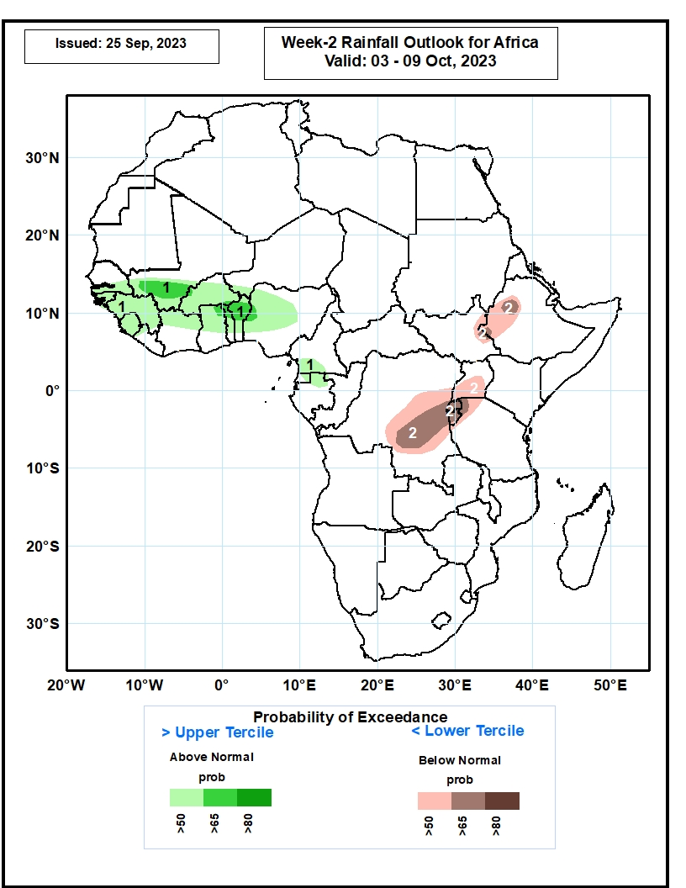
Week-2 Precipitation Outlooks
03 – 09 Oct 2023
The probabilistic forecasts call for above 50% chance for weekly rainfall to be above-normal (above the upper tercile) over southern Senegal, much of the Gambia, Guinea-Bissau, Guinea-Conakry, Sierra Leone, and Burkina Faso, southern Mali, northern Cote d’Ivoire, northern and central parts of Ghana, Togo and Benin, western and central parts of Nigeria, southern Cameroon, and northern part of Gabon. The probabilistic forecasts call for above 65% chance for weekly rainfall to be above-normal in southern Mali, northeastern Ghana, northern Togo and Benin, and west-central Nigeria.
The probabilistic forecasts call for above 50% chance for weekly total rainfall to be below-normal (below the lower tercile) over eastern South Sudan, western Ethiopia, central and southern parts of DR Congo, much of Rwanda and Burundi, northwestern Tanzania, and central and southern parts of Uganda. The probabilistic forecasts call for above 65% chance for weekly rainfall to be below-normal over central DR Congo, much of Rwanda and Burundi, and northwestern Tanzania.
Notes:
11

Slide 12
Summary
Over the past 30 days, in East Africa, above-average rainfall was observed over many parts of Sudan, South Sudan and Eritrea, and pockets of northern and western Ethiopia, Uganda and western Kenya and northwestern Tanzania. Rainfall was below-average over central and southern Ethiopia, southwestern Uganda, and pockets of Sudan. In Central Africa, rainfall was above-average over central Congo, parts of Chad and CAR, southern and eastern DRC. Below-average rainfall was observed over much of Cameroon, Equatorial guinea, northern Gabon, northern Congo, pockets of Chad and CAR, and western, central and northern DRC. In West Africa, rainfall was above-average over pockets of over pockets of Senegal, southern Guinea, northern Sierra Leone, northern Liberia, northwestern Cote d’Ivoire, northern Burkina Faso, northeastern Mali, Ghana, Togo, Benin, western Nigeria and pockets of Niger. Below-average rainfall was observed over southern Mauritania, western and central Mali, pockets of Senegal, Liberia and Sierra Leone, parts of Cote d’Ivoire, western Burkina Faso, western Niger, and central and eastern Nigeria.
During the past 7 days, in East Africa, rainfall was above-average over eastern Sudan, parts of western and eastern Ethiopia, Uganda, and pockets of southern Kenya and northern Tanzania. Below-average rainfall was observed over parts of southern Sudan. In central Africa, above-average rainfall was observed over pockets of Cameroon, CAR, Congo and DRC. Rainfall was below-average over many parts of Cameroon and CAR, northern Congo, and much of DRC. In West Africa, above-average rainfall was observed over southeastern Senegal, much of Guinea, Sierra Leone, Liberia, southeastern Cote d’Ivoire, pockets of Burkina Faso and Ghana. Rainfall was below-average over many parts of Senegal, western Mali, Cote d’Ivoire, parts of Ghana, southern Benin and much of Nigeria. In southern Africa, rainfall was above-average over the southern portion of South Africa.
The Week-1 outlook calls for above-normal rainfall in southeastern Burkina Faso, northern Ghana, Togo, and Benin, much of Nigeria, southern Chad, northern CAR, northern South Sudan western Ethiopia, northeastern Angola, and southern DRC. In contrast, there is an increased chance for below-normal rainfall over southern Senegal, western Guinea, and pockets of Gabon and Congo. For week-2, there is an increased chance for above-normal rainfall across southern Senegal, Guinea-Bissau, Guinea, southern Mali, northern Cote d’Ivoire, Burkina Faso, central and northern Ghana, Togo, Benin, parts of Nigeria, southern Cameroon and northern Gabon. In contrast, there is an increased chance for below-normal rainfall over eastern CAR, southern and eastern DRC, Rwanda, Burundi, northwestern Tanzania, Uganda, eastern South Sudan, and western Ethiopia.

