Slide 1
The African Monsoon Recent Evolution and Current Status Include Week-1 and Week-2 Outlooks
Update prepared
18 September 2023
For more information, visit:
http://www.cpc.ncep.noaa.gov/products/Global_Monsoons/African_Monsoons/precip_monitoring.shtml

Slide 2
Outline
Highlights
Recent Evolution and Current Conditions
NCEP GEFS Forecasts
Summary

Slide 3
Highlights: Last 7 Days
During the past 7 days, in East Africa, rainfall was above-average over southern Sudan, west-central and eastern South Sudan, parts of central Ethiopia, northern and eastern Uganda, southwestern Kenya, and northern Tanzania. Below-average rainfall was observed over parts of southeastern Sudan, north-central South Sudan, and northern and east-central Ethiopia. In Central Africa, rainfall was above-average over parts of central Cameroon, southwestern and east-central Chad, parts of south-central CAR, parts of central and northern Congo, and northwestern and east-central DRC. Below-average rainfall was observed over much of southern Cameroon, southeastern Chad, northwestern Congo, northeastern and central DRC, northern Gabon. Equatorial Guinea, and western and eastern CAR. In West Africa, above-average rainfall was observed over northern and southeastern Senegal, central and eastern Guinea, central and northern Mauritania, northern Sierra Leone, northwestern Liberia, west-central and southeastern Cote d’Ivoire, much of Ghana, Togo, central and southern Benin, south-central Niger, eastern Burkina Faso, and west-central and southwestern Nigeria. Rainfall was below-average over southeastern Mauritania, southwestern Mali, Burkina Faso, southwestern Senegal, western Guinea, Guinea-Bissau, southern Sierra Leone, most of Liberia, north-central Cote d’Ivoire, northern Benin, southwestern Niger, northern and western Burkina Faso, The Gambia, and central and southeastern Nigeria.
The Week-1 outlook calls for above-normal rainfall in the western Gulf of Guinea region, as well as much of central and eastern Africa. This includes primarily western and southern Guinea, Liberia, western Cote d’Ivoire, Sierra Leone, western CAR, Equatorial Guinea, Gabon, Congo, much of DRC, eastern South Sudan, and western and central Ethiopia. In contrast, there is an increased chance for below-normal rainfall across parts of Senegal, south-central Mali, western Burkina Faso, central and eastern portions of the Gulf of Guinea, and northern Cameroon. For week-2, there is an increased chance for above-normal rainfall across central Nigeria, southern Chad, eastern CAR, northeastern DRC, South Sudan, southern Sudan, and western and central Ethiopia. In contrast, there is an increased chance for below-normal rainfall in Equatorial Guinea, Gabon, and most of the Gulf of Guinea region.

Slide 4
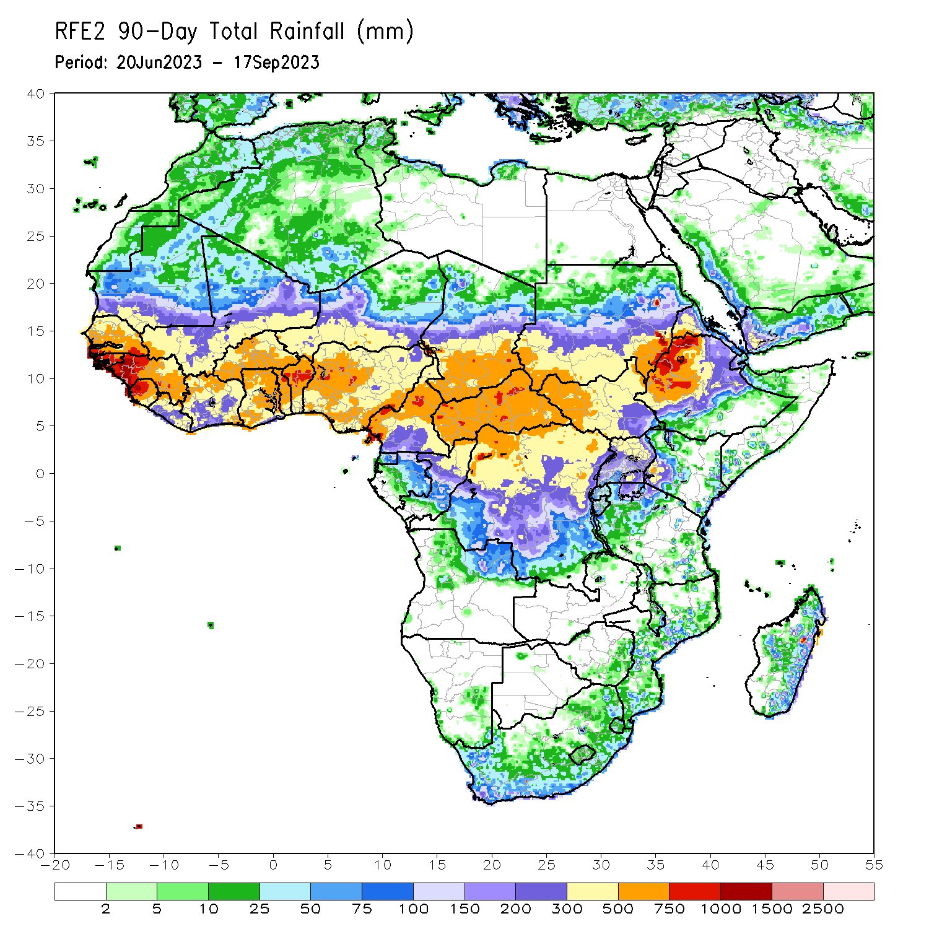
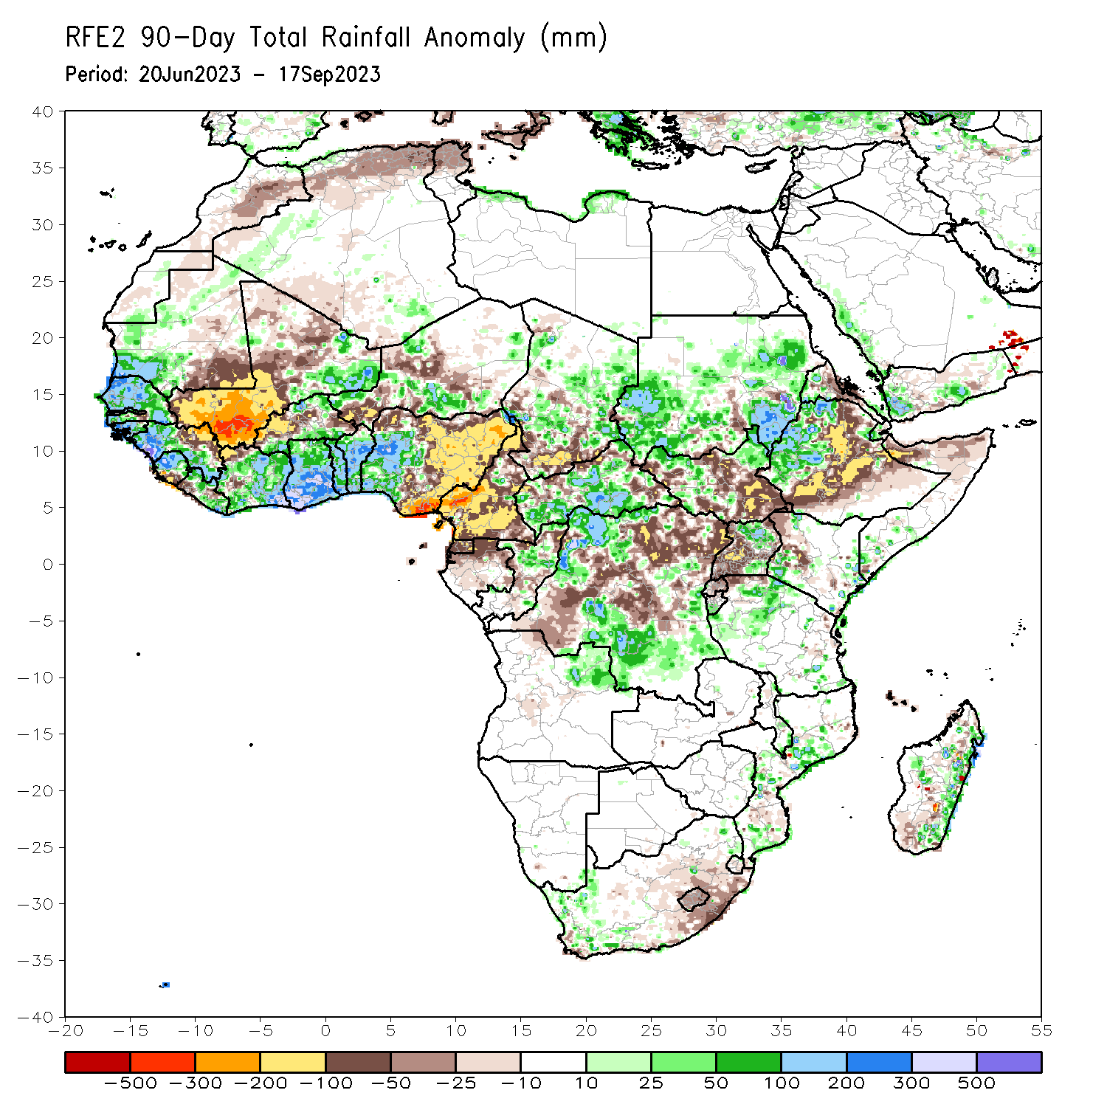
Rainfall Patterns: Last 90 Days
Over the past 90 days, in East Africa, above-average rainfall was observed over many parts of Sudan, western Ethiopia, western Eritrea, northeastern and northwestern South Sudan, Djibouti, northern and southeastern Uganda, parts of southwestern Kenya, southern Burundi, and parts of northern Tanzania. Rainfall was below-average over north-central and southeastern South Sudan, eastern, central, and southern Ethiopia, parts of northern Somalia, parts of western Kenya, eastern Rwanda, and western Uganda. In southern Africa, above-average rainfall was observed over the western portion of South Africa, eastern Madagascar, central and southern Mozambique, and northeastern Angola. Below-average rainfall was observed over pockets of eastern South Africa, Lesotho, and southern Madagascar. In Central Africa, rainfall was above-average over far northern Cameroon, many parts of CAR, eastern and central Chad, parts of northern Congo, and northwestern and south-central DRC. Rainfall was below-average over most of Cameroon, Equatorial Guinea, northern Gabon, most of central and northeastern DRC, southwestern Chad, and parts of northern and southeastern CAR. In West Africa, rainfall was above-average over much of Senegal, southwestern and central Mauritania, The Gambia, Guinea-Bissau, western and southern Guinea, northern Sierra Leone, eastern and northwestern Liberia, eastern Mali, much of Cote d’Ivoire, pockets of northern and southern Burkina Faso, much of Ghana, Togo, Benin, parts of western and southern Niger, and western and central Nigeria. Below-average rainfall was observed over western, central, and northern Mali, southwestern and central Liberia, central Burkina Faso, southern Sierra Leone, parts of western Cote d’Ivoire, southeastern Mauritania, parts of southwestern and central Niger, northeastern Guinea, and eastern, northern, and central Nigeria.
Notes:
4

Slide 5
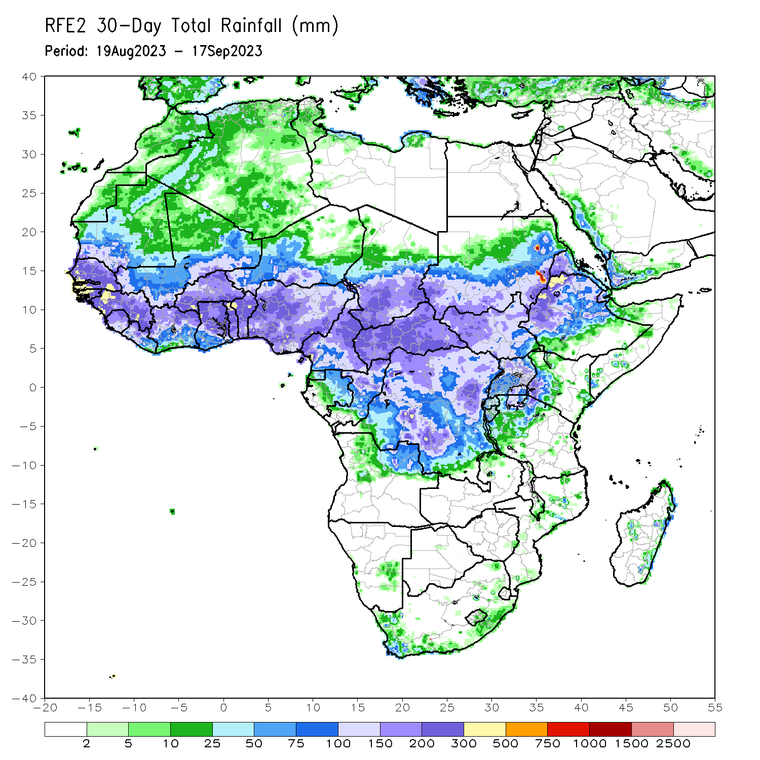
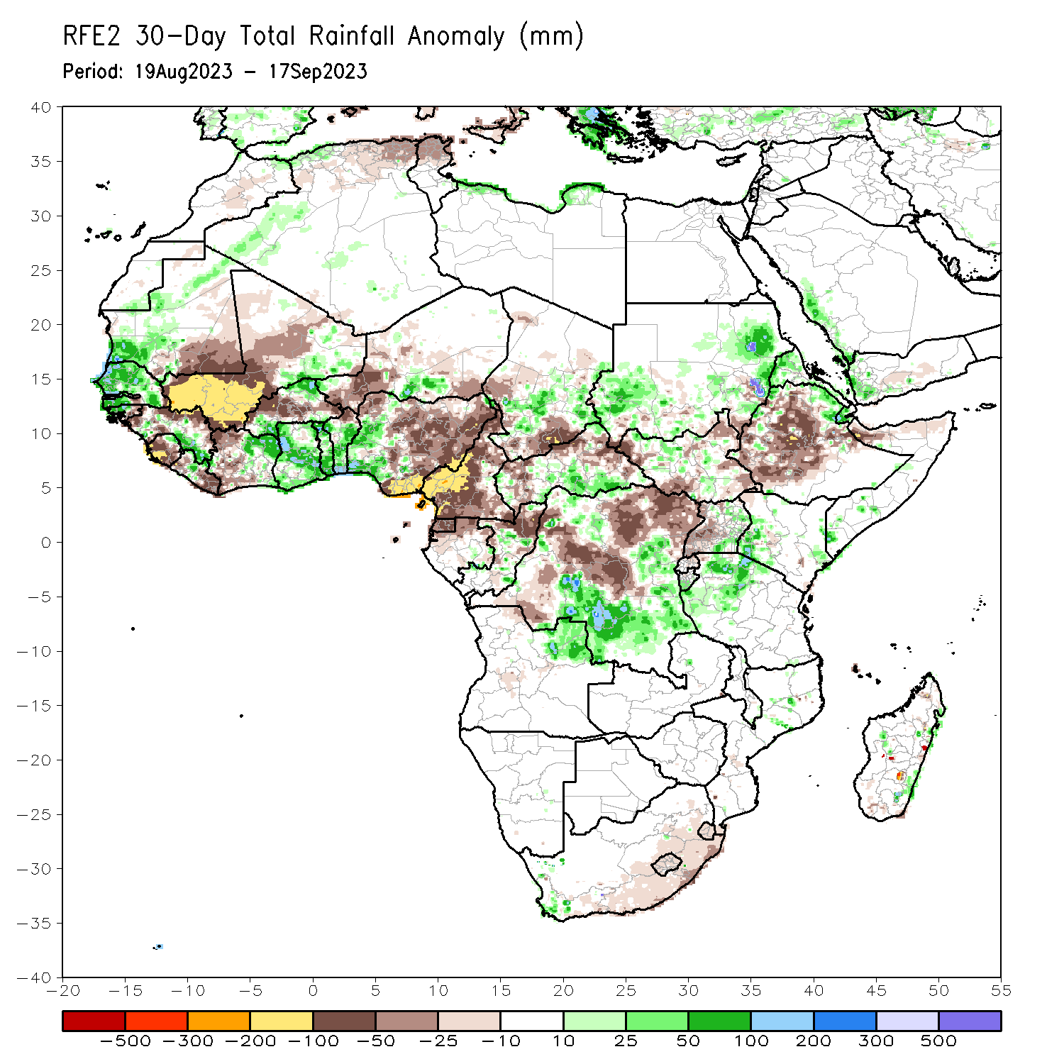
Rainfall Patterns: Last 30 Days
Over the past 30 days, in East Africa, above-average rainfall was observed over many parts of eastern and southwestern Sudan, Eritrea, pockets of northern Ethiopia, southeastern and southwestern Kenya, northern Tanzania, eastern Uganda, and southern Burundi. Rainfall was below-average over southeastern Sudan, northwestern, northeastern, southeastern, and southwestern South Sudan, central and southern Ethiopia, eastern Rwanda, western Uganda, northern Somalia, and parts of northwestern Kenya. In Southern Africa, rainfall was above average over parts of eastern Madagascar and below average over northeastern Angola, much of southern South Africa, Lesotho, and Eswatini. In Central Africa, rainfall was above-average over central Congo, south-central CAR, pockets of southeastern and southwestern Chad, and northwestern, east-central, and south-central DRC. Below-average rainfall was observed over much of Cameroon, central and southwestern Chad, Equatorial Guinea, northern Gabon, northern Congo, and central, southwestern, and northeastern DRC. In West Africa, rainfall was above-average over pockets of southwestern and central Mauritania, Senegal, southeastern Guinea, western Guinea-Bissau, northern Sierra Leone, northeastern and southern Burkina Faso, eastern Cote d’Ivoire, south-central and parts of western Niger, Ghana, Togo, central and southern Benin, central Liberia, The Gambia, and parts of western Nigeria. Below-average rainfall was observed over much of Mali, northern Guinea, western and central Burkina Faso, most of central and southern Niger, central and southern Sierra Leone, western and eastern Liberia, western Cote d’Ivoire, eastern Guinea-Bissau, northern Benin, southeastern Mauritania, and northern, central, and eastern Nigeria.
Notes:
5

Slide 6
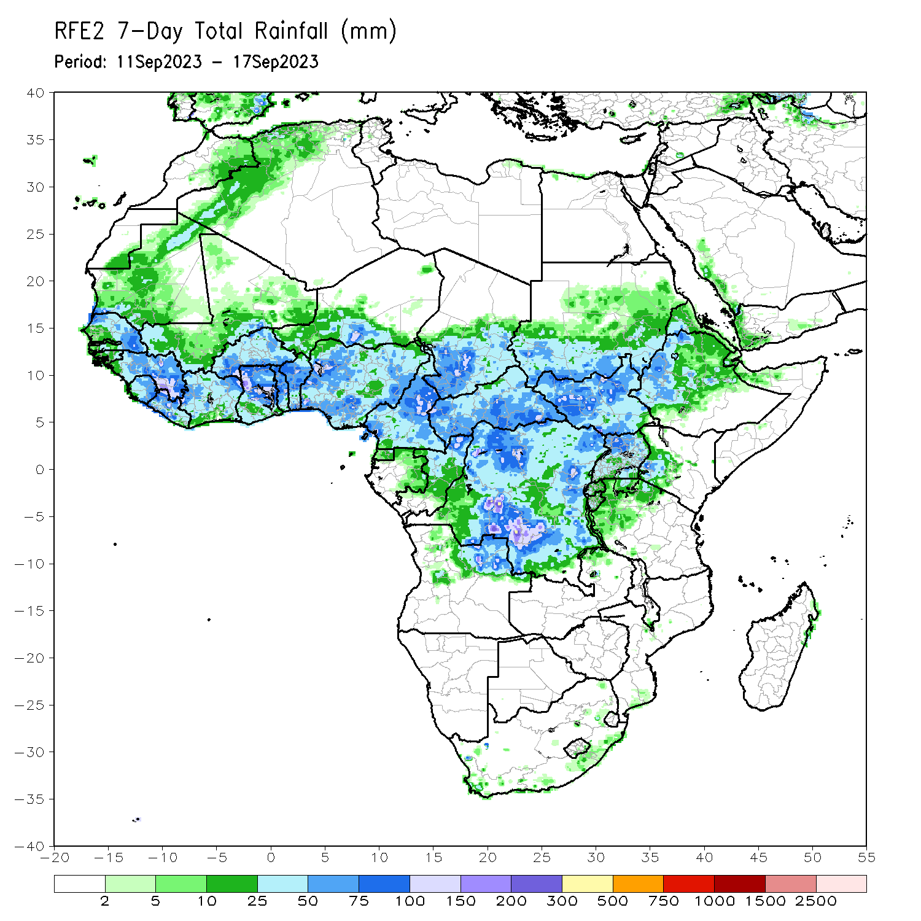
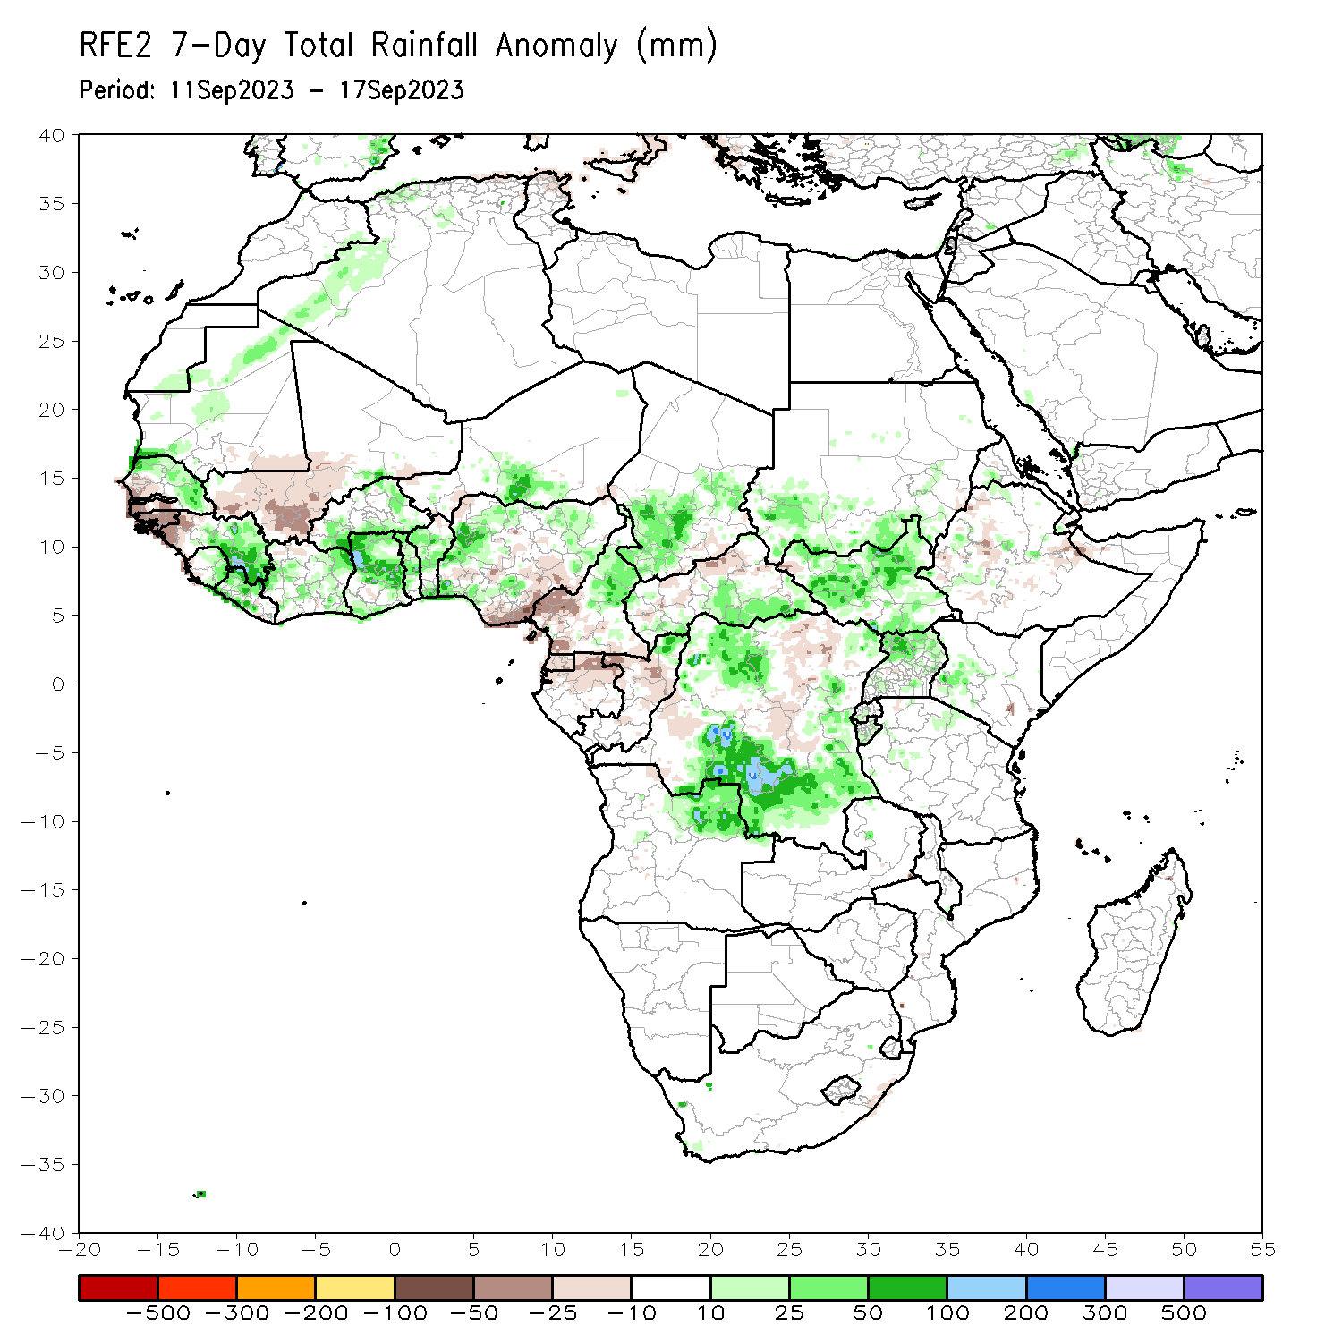
Rainfall Patterns: Last 7 Days
During the past 7 days, in East Africa, rainfall was above-average over southern Sudan, west-central and eastern South Sudan, parts of central Ethiopia, northern and eastern Uganda, southwestern Kenya, and northern Tanzania. Below-average rainfall was observed over parts of southeastern Sudan, north-central South Sudan, and northern and east-central Ethiopia. In Central Africa, rainfall was above-average over parts of central Cameroon, southwestern and east-central Chad, parts of south-central CAR, parts of central and northern Congo, and northwestern and east-central DRC. Below-average rainfall was observed over much of southern Cameroon, southeastern Chad, northwestern Congo, northeastern and central DRC, northern Gabon. Equatorial Guinea, and western and eastern CAR. In West Africa, above-average rainfall was observed over northern and southeastern Senegal, central and eastern Guinea, central and northern Mauritania, northern Sierra Leone, northwestern Liberia, west-central and southeastern Cote d’Ivoire, much of Ghana, Togo, central and southern Benin, south-central Niger, eastern Burkina Faso, and west-central and southwestern Nigeria. Rainfall was below-average over southeastern Mauritania, southwestern Mali, Burkina Faso, southwestern Senegal, western Guinea, Guinea-Bissau, southern Sierra Leone, most of Liberia, north-central Cote d’Ivoire, northern Benin, southwestern Niger, northern and western Burkina Faso, The Gambia, and central and southeastern Nigeria.

Slide 7
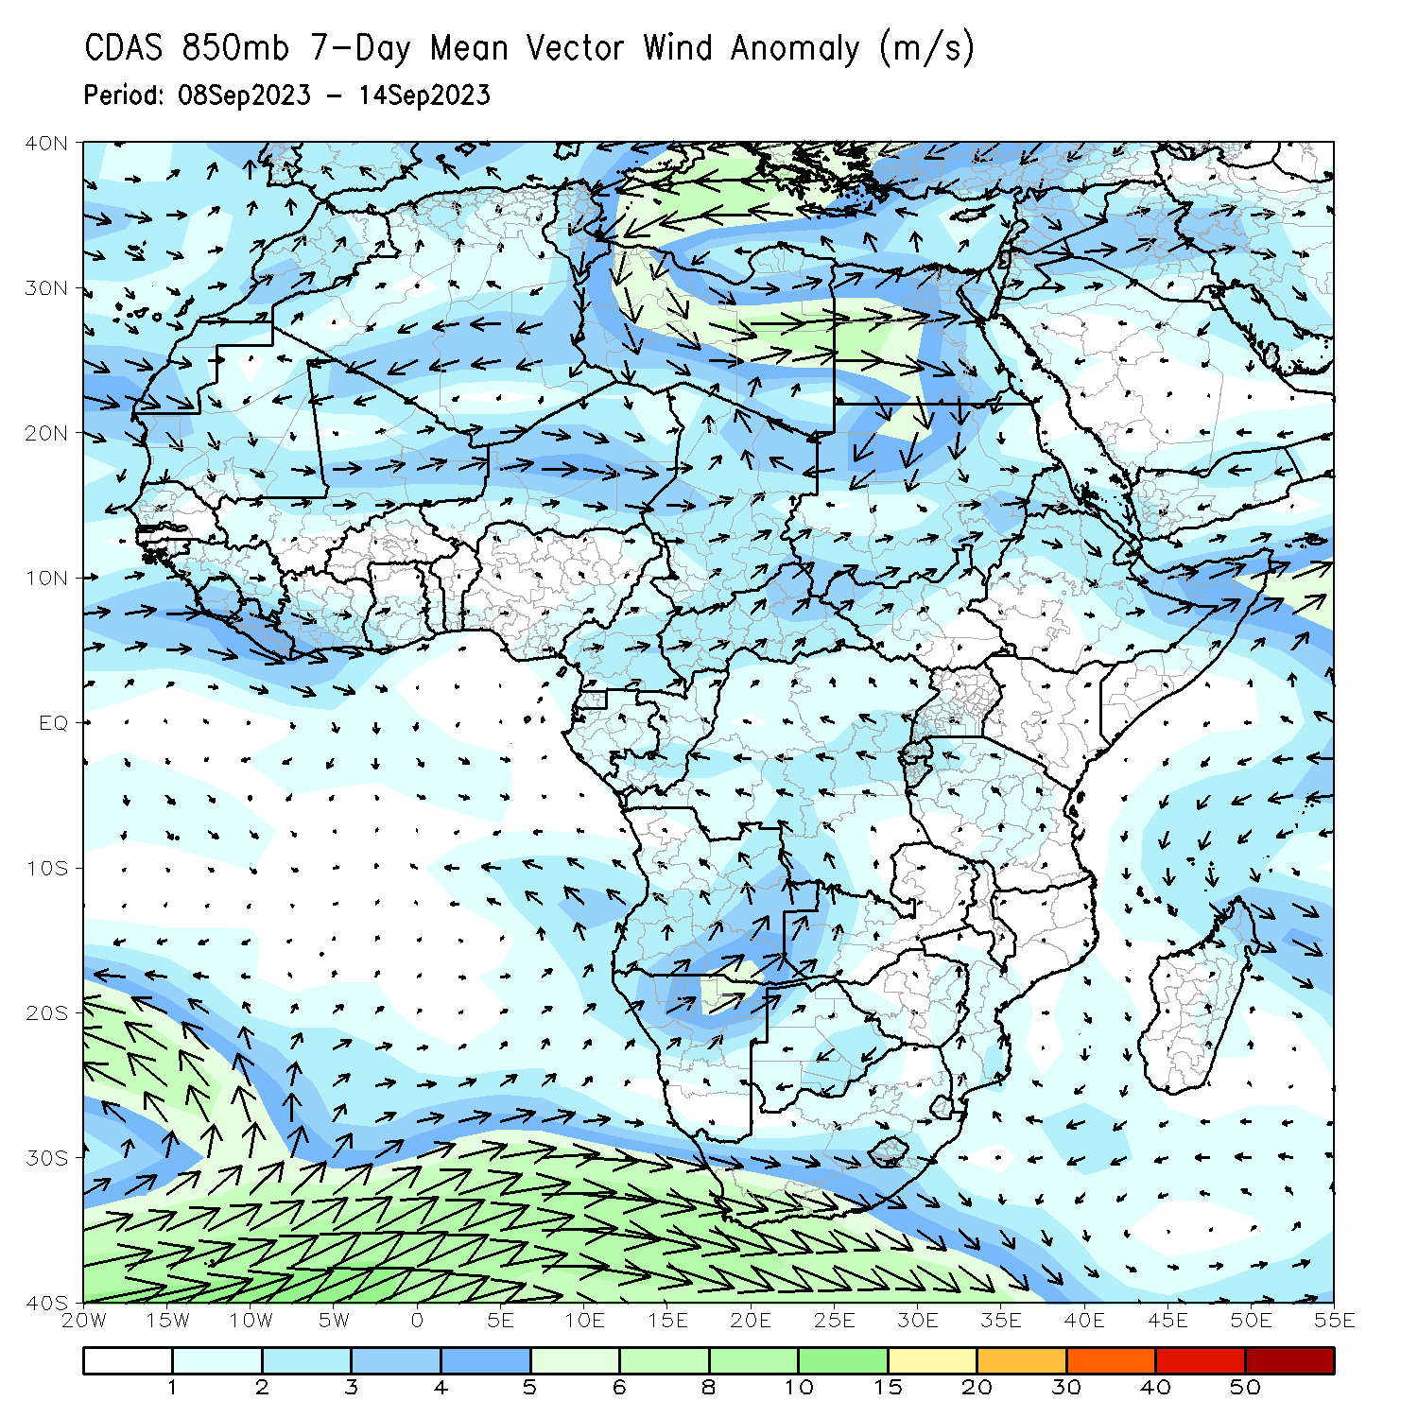
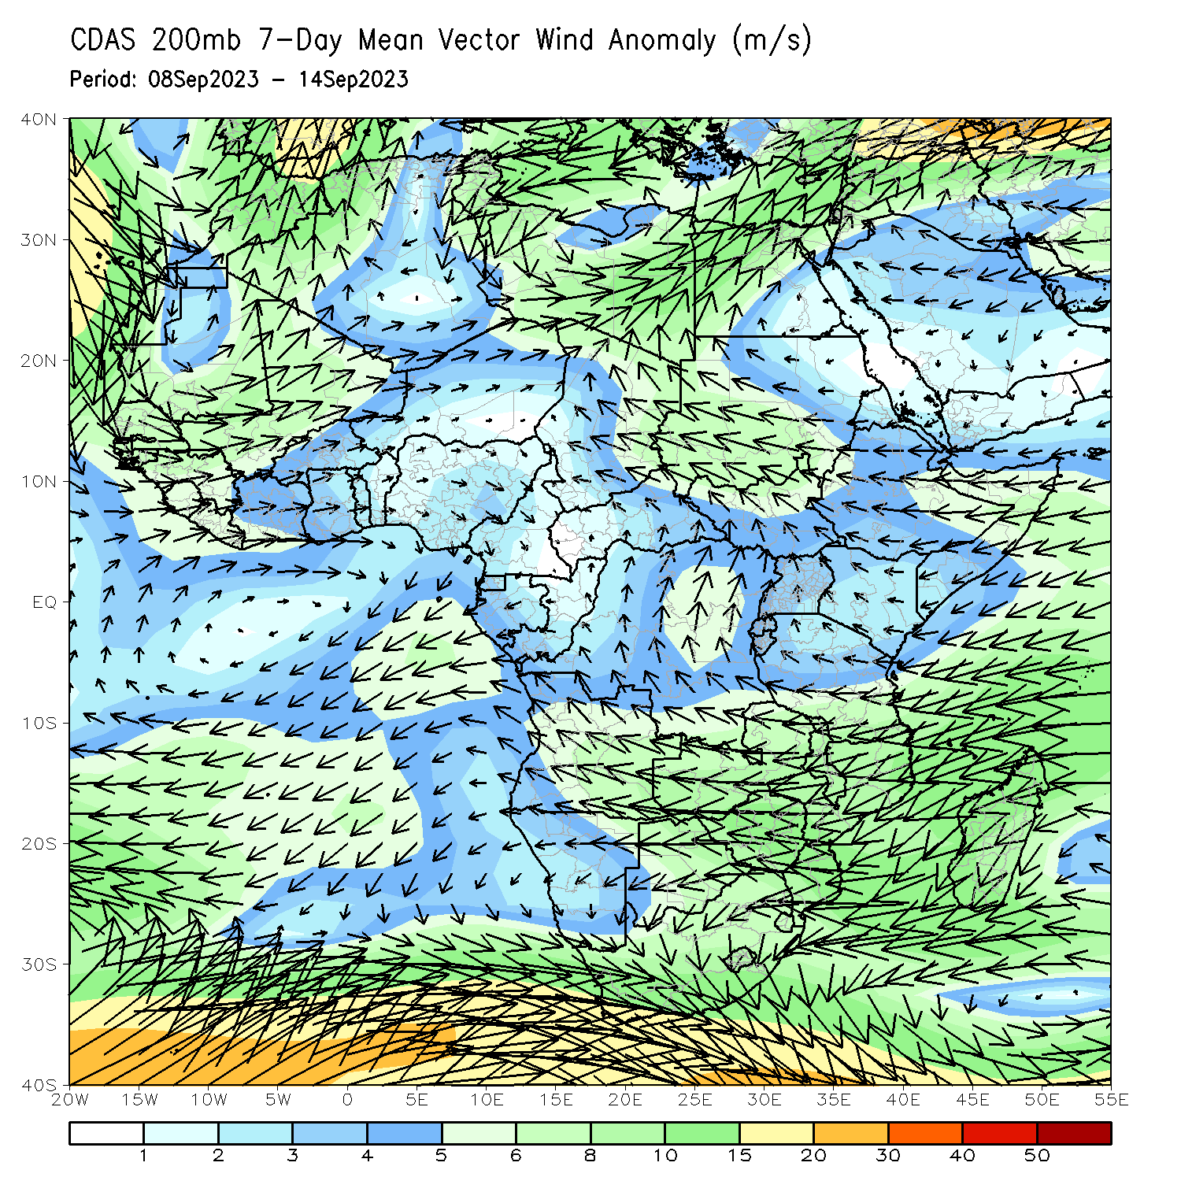
Atmospheric Circulation: Last 7 Days
At 850-hPa level (left panel), anomalous onshore flow and convergence was observed in Liberia, Sierra Leone, and Guinea. Lower-level convergence was also observed in southeastern Sudan, northeastern Angola, and south-central DRC. In contrast, the upper-level winds led to anomalous convergence in parts of Senegal, Guinea-Bissau, The Gambia, and Guinea, likely suppressing rainfall in that region.

Slide 8
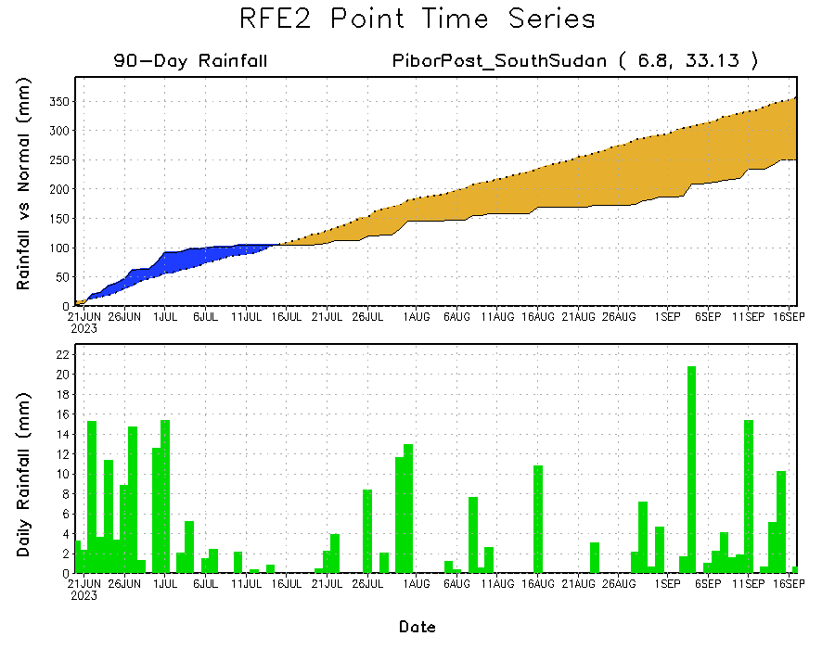
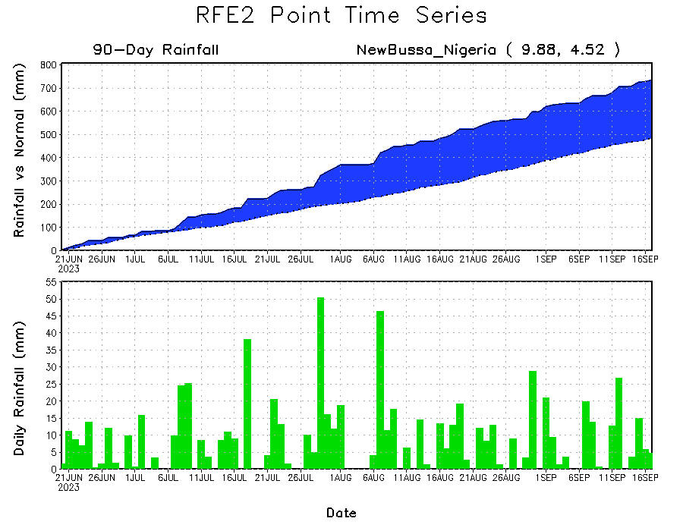
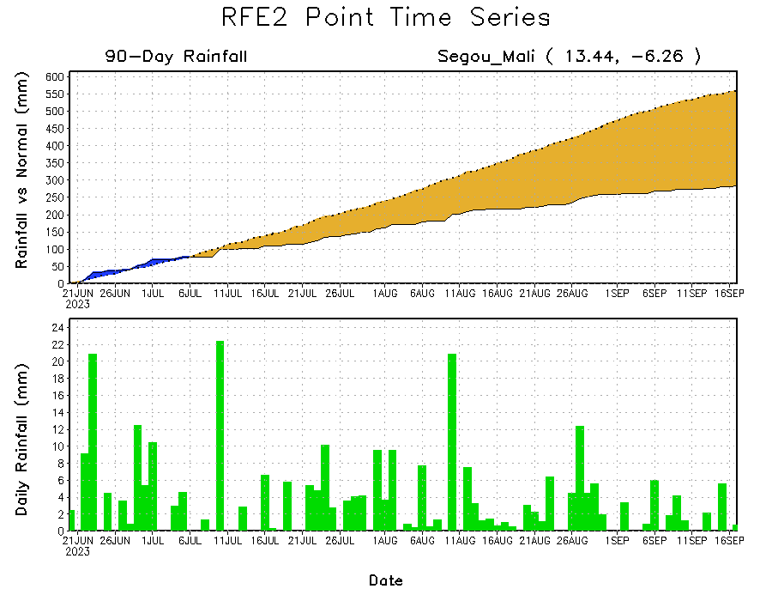
Rainfall Evolution
Daily evolution of rainfall over the last 90 days at selected locations shows moderate rainfall sustained moisture surpluses over parts of western Nigeria (bottom right). Light rainfall since early September increased seasonal deficits over southwestern Mali (bottom left). Near-normal rainfall has kept seasonal rainfall deficits steady over the last few weeks in eastern South Sudan (top right).

Slide 9
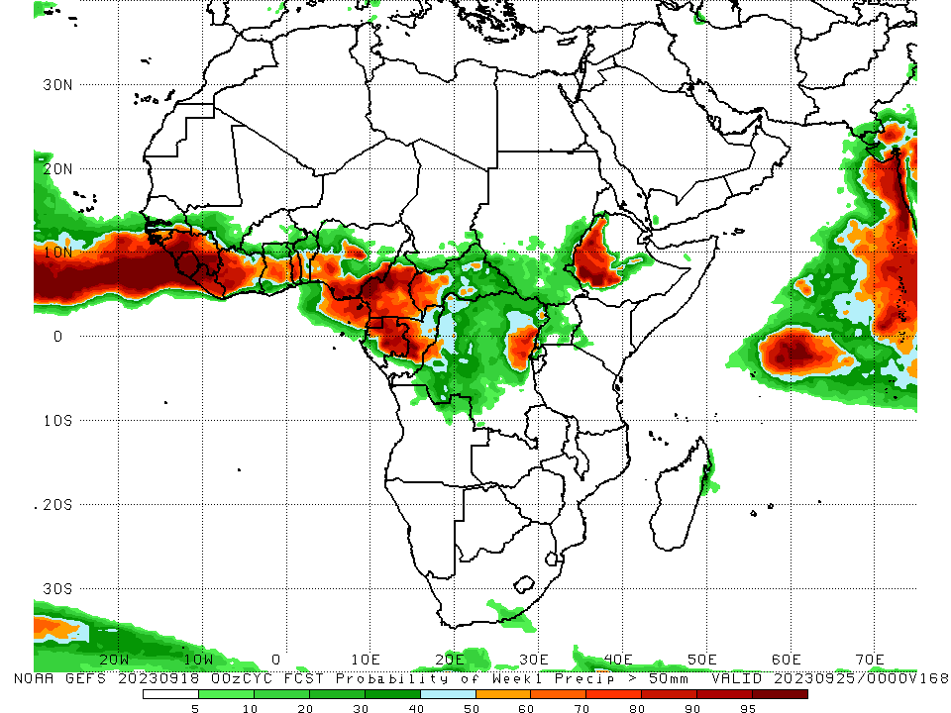
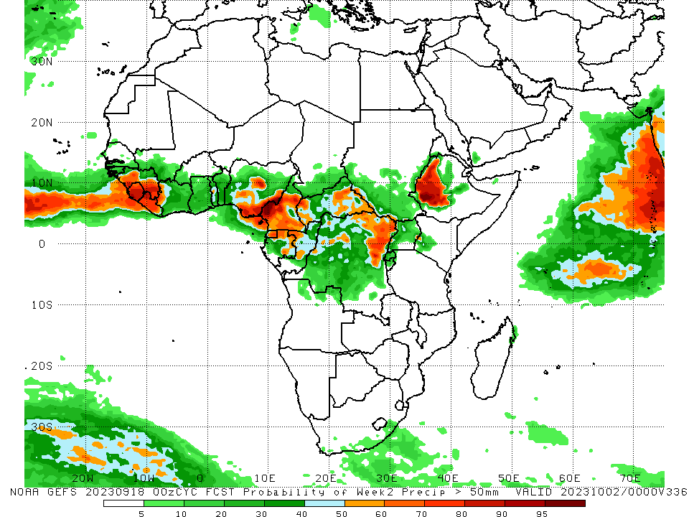
NCEP GEFS Model Forecasts Non-Bias Corrected Probability of precipitation exceedance
Week-1, Valid: 19 – 25 Sep 2023
Week-2, Valid: 26 Sep – 02 Oct 2023
For week-1 (left panel) the GEFS forecast indicates a moderate to high chance (over 70%) for rainfall to exceed 50 mm over much of the Gulf of Guinea region, parts of Central Africa (primarily Cameroon and parts of CAR and DRC), and western Ethiopia. For week-1 (left panel) the GEFS forecast indicates a moderate to high chance (over 70%) for rainfall to exceed 50 mm over much of the western and eastern Gulf of Guinea region, parts of Central Africa (primarily Cameroon and parts of CAR and DRC), and western Ethiopia.
Notes:
9

Slide 10
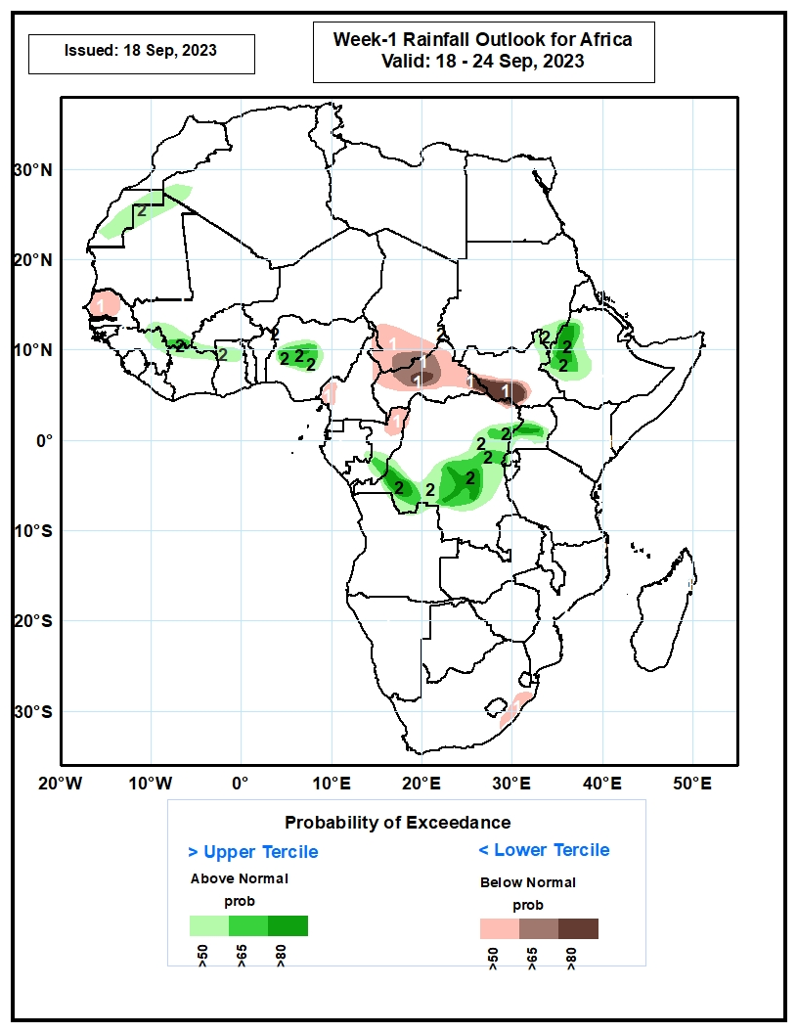
Week-1 Precipitation Outlooks
18 – 24 September 2023
The probabilistic forecasts call for above 50% chance for weekly total rainfall to be below-normal (below the lower tercile) over western and northern Senegal, southern Chad, northern and eastern CAR, southwest South Sudan, northern Congo, southwest Cameroon, and eastern South Africa. There is above 80% chance for rainfall to be below-normal over pockets of western and eastern CAR and southwest South Sudan.
The probabilistic forecasts call for above 50% chance for weekly rainfall to be above-normal (above the upper tercile) over eastern Western Sahara, northeast Mauritania, southern parts of Mali and Burkina Faso, northern parts of Cote d’Ivoire and Ghana, western-central Nigeria, central Congo, southern and eastern DRC, central Uganda, pockets of northeast South Sudan and southeast Sudan, and western Ethiopia. The probabilistic forecasts call for above 80% chance for weekly rainfall to be above-normal in western Ethiopia, southern DRC, central Uganda, and pockets of central Nigeria.
Notes:
10

Slide 11
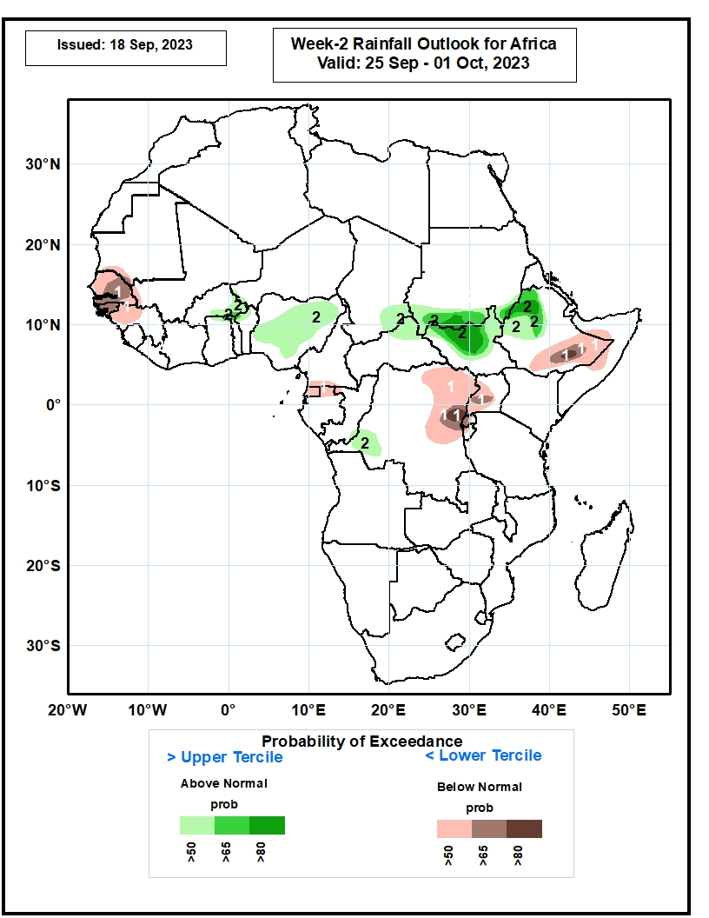
Week-2 Precipitation Outlooks
25 September – 01 October 2023
The probabilistic forecasts call for above 50% chance for weekly rainfall to be below-normal (below the lower tercile) over Senegal, Guinea-Bissau, western and northwest Guinea, Equatorial Guinea, northern Gabon, northeast and eastern DRC, western parts of Uganda, Rwanda and Burundi, southeast Ethiopia, and pockets of western Somalia. The probabilistic forecasts call for above 80% chance for weekly rainfall to be below-normal over pockets of eastern DRC and southeast Ethiopia.
The probabilistic forecasts call for above 50% chance for weekly total rainfall to be above-normal (above the upper tercile) over eastern Burkina Faso, central and northeast Nigeria, southeast Chad, southern Sudan, northern and central South Sudan, western and northwest Ethiopia, and southwest DRC. The probabilistic forecasts call for above 80% chance for weekly rainfall to be above-normal in western Ethiopia, northern South Sudan, and pockets of southern Sudan.
Notes:
11

Slide 12
Summary
Over the past 30 days, in East Africa, above-average rainfall was observed over many parts of eastern and southwestern Sudan, Eritrea, pockets of northern Ethiopia, southeastern and southwestern Kenya, northern Tanzania, eastern Uganda, and southern Burundi. Rainfall was below-average over southeastern Sudan, northwestern, northeastern, southeastern, and southwestern South Sudan, central and southern Ethiopia, eastern Rwanda, western Uganda, northern Somalia, and parts of northwestern Kenya. In Southern Africa, rainfall was above average over parts of eastern Madagascar and below average over northeastern Angola, much of southern South Africa, Lesotho, and Eswatini. In Central Africa, rainfall was above-average over central Congo, south-central CAR, pockets of southeastern and southwestern Chad, and northwestern, east-central, and south-central DRC. Below-average rainfall was observed over much of Cameroon, central and southwestern Chad, Equatorial Guinea, northern Gabon, northern Congo, and central, southwestern, and northeastern DRC. In West Africa, rainfall was above-average over pockets of southwestern and central Mauritania, Senegal, southeastern Guinea, western Guinea-Bissau, northern Sierra Leone, northeastern and southern Burkina Faso, eastern Cote d’Ivoire, south-central and parts of western Niger, Ghana, Togo, central and southern Benin, central Liberia, The Gambia, and parts of western Nigeria. Below-average rainfall was observed over much of Mali, northern Guinea, western and central Burkina Faso, most of central and southern Niger, central and southern Sierra Leone, western and eastern Liberia, western Cote d’Ivoire, eastern Guinea-Bissau, northern Benin, southeastern Mauritania, and northern, central, and eastern Nigeria.
During the past 7 days, in East Africa, rainfall was above-average over southern Sudan, west-central and eastern South Sudan, parts of central Ethiopia, northern and eastern Uganda, southwestern Kenya, and northern Tanzania. Below-average rainfall was observed over parts of southeastern Sudan, north-central South Sudan, and northern and east-central Ethiopia. In Central Africa, rainfall was above-average over parts of central Cameroon, southwestern and east-central Chad, parts of south-central CAR, parts of central and northern Congo, and northwestern and east-central DRC. Below-average rainfall was observed over much of southern Cameroon, southeastern Chad, northwestern Congo, northeastern and central DRC, northern Gabon. Equatorial Guinea, and western and eastern CAR. In West Africa, above-average rainfall was observed over northern and southeastern Senegal, central and eastern Guinea, central and northern Mauritania, northern Sierra Leone, northwestern Liberia, west-central and southeastern Cote d’Ivoire, much of Ghana, Togo, central and southern Benin, south-central Niger, eastern Burkina Faso, and west-central and southwestern Nigeria. Rainfall was below-average over southeastern Mauritania, southwestern Mali, Burkina Faso, southwestern Senegal, western Guinea, Guinea-Bissau, southern Sierra Leone, most of Liberia, north-central Cote d’Ivoire, northern Benin, southwestern Niger, northern and western Burkina Faso, The Gambia, and central and southeastern Nigeria.
The Week-1 outlook calls for above-normal rainfall in the western Gulf of Guinea region, as well as much of central and eastern Africa. This includes primarily western and southern Guinea, Liberia, western Cote d’Ivoire, Sierra Leone, western CAR, Equatorial Guinea, Gabon, Congo, much of DRC, eastern South Sudan, and western and central Ethiopia. In contrast, there is an increased chance for below-normal rainfall across parts of Senegal, south-central Mali, western Burkina Faso, central and eastern portions of the Gulf of Guinea, and northern Cameroon. For week-2, there is an increased chance for above-normal rainfall across central Nigeria, southern Chad, eastern CAR, northeastern DRC, South Sudan, southern Sudan, and western and central Ethiopia. In contrast, there is an increased chance for below-normal rainfall in Equatorial Guinea, Gabon, and most of the Gulf of Guinea region.

