Slide 1
The African Monsoon Recent Evolution and Current Status Include Week-1 and Week-2 Outlooks
Update prepared
31 July 2023
For more information, visit:
http://www.cpc.ncep.noaa.gov/products/Global_Monsoons/African_Monsoons/precip_monitoring.shtml

Slide 2
Outline
Highlights
Recent Evolution and Current Conditions
NCEP GEFS Forecasts
Summary

Slide 3
Highlights: Last 7 Days
During the past 7 days, in East Africa, rainfall was above-average over pockets of Sudan, northern South Sudan and southwestern Ethiopia. Below-average rainfall was observed over southern South Sudan, northern and eastern Ethiopia, and much of Eritrea. In Central Africa, rainfall was above-average over part of western Cameroon, pockets of southern Chad, western CAR, and northern Congo, and pockets of northwestern and northeastern DRC. Below-average rainfall was observed over pockets of Cameroon, southwestern Chad, central and eastern CAR, and northcentral DRC. In West Africa, above-average rainfall was observed over southern Mauritania, western Senegal, western Guinea, Sierra Leone, pockets of Mali, and pockets of Ghana and Nigeria. Rainfall was below-average over eastern Senegal, southwestern Mali, western Burkina Faso, parts of Togo and Benin, and many parts of Nigeria.
The Week-1 outlook calls for above-normal rainfall over eastern Mali, southern Niger, central Chad, parts of Sudan and western Ethiopia. In contrast, there is an increased chance for below-normal rainfall over much of Senegal, northern Cote d’Ivoire, northern Ghana, Togo, northern Benin, much of Nigeria, Cameroon, southern Chad, central CAR, parts of central and eastern DRC and northeastern Ethiopia. For week-2, there is an increased chance for above-normal rainfall across the eastern portions of the Gulf of Guinea region and the neighboring areas of Central Africa, and parts of Mali. In contrast, there is an increased chance for below-normal rainfall over parts of eastern Ethiopia and western Kenya.

Slide 4
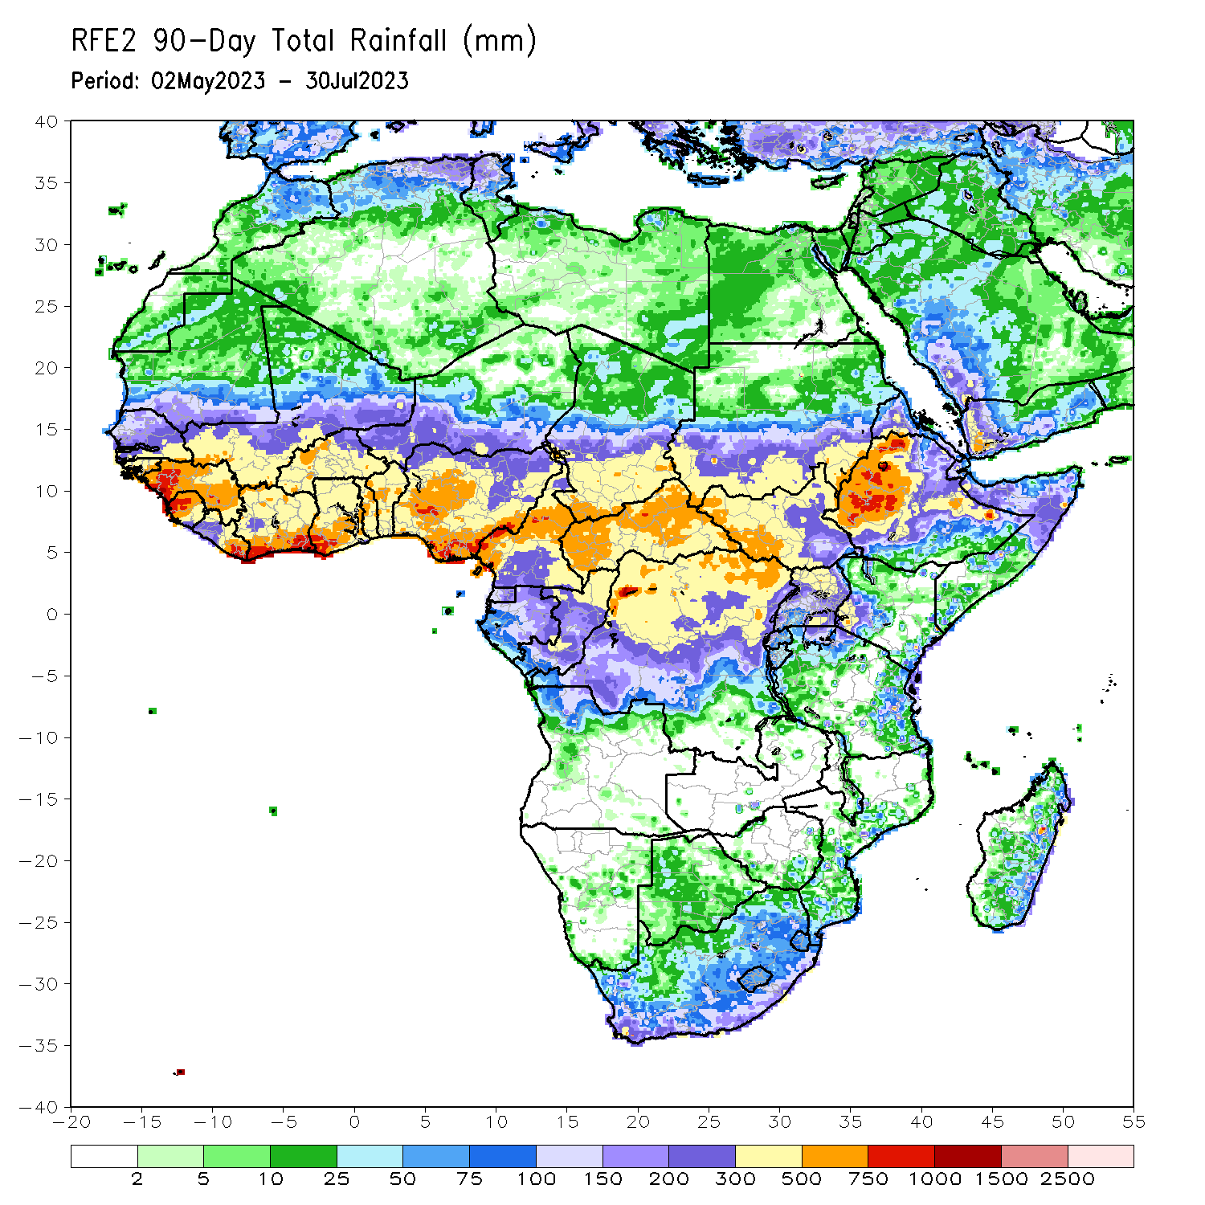
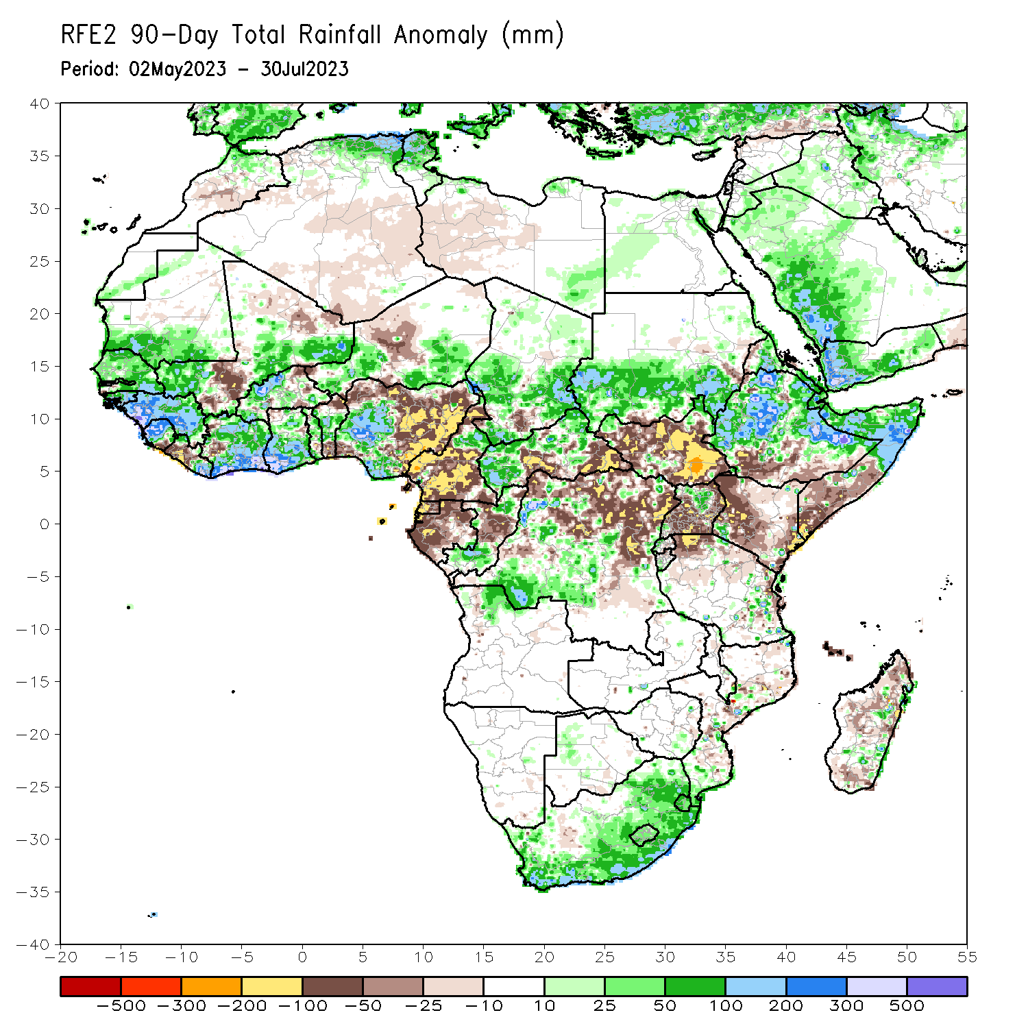
Rainfall Patterns: Last 90 Days
Over the past 90 days, in East Africa, above-average rainfall was observed over southern and eastern Sudan, much of Eritrea, Ethiopia, northern and central Somalia, part of southwestern Kenya, Djibouti, and northern Uganda. Rainfall was below-average over much of South Sudan, southern Somalia, much of Kenya, and central and southern Uganda. In southern Africa, above-average rainfall was observed over many parts of South Africa, including Lesotho and Eswatini. Below-average rainfall was observed over pocket of western South Africa. In Central Africa, rainfall was above-average over part of northern Cameroon, many parts of CAR, the far southern and northern Congo, southern Chad, and parts of central and western DRC. Rainfall was below-average over central and southern Cameroon, Equatorial Guinea, Gabon, central Congo, pockets of Chad and CAR, and parts of northern and eastern DRC. In West Africa, rainfall was above-average over much of Senegal, southern Mauritania, Guinea-Bissau, Guinea, Sierra Leone, eastern Liberia, southwestern and eastern Mali, much of Cote d’Ivoire, parts of Burkina Faso, much of Ghana, northern Togo, northern Benin, western and southern Niger, and western southern Nigeria. Below-average rainfall was observed over western Liberia, parts of southern Mali, pockets of Cote d’Ivoire and Burkina Faso, southern Benin, northern and eastern Nigeria.
Notes:
4

Slide 5
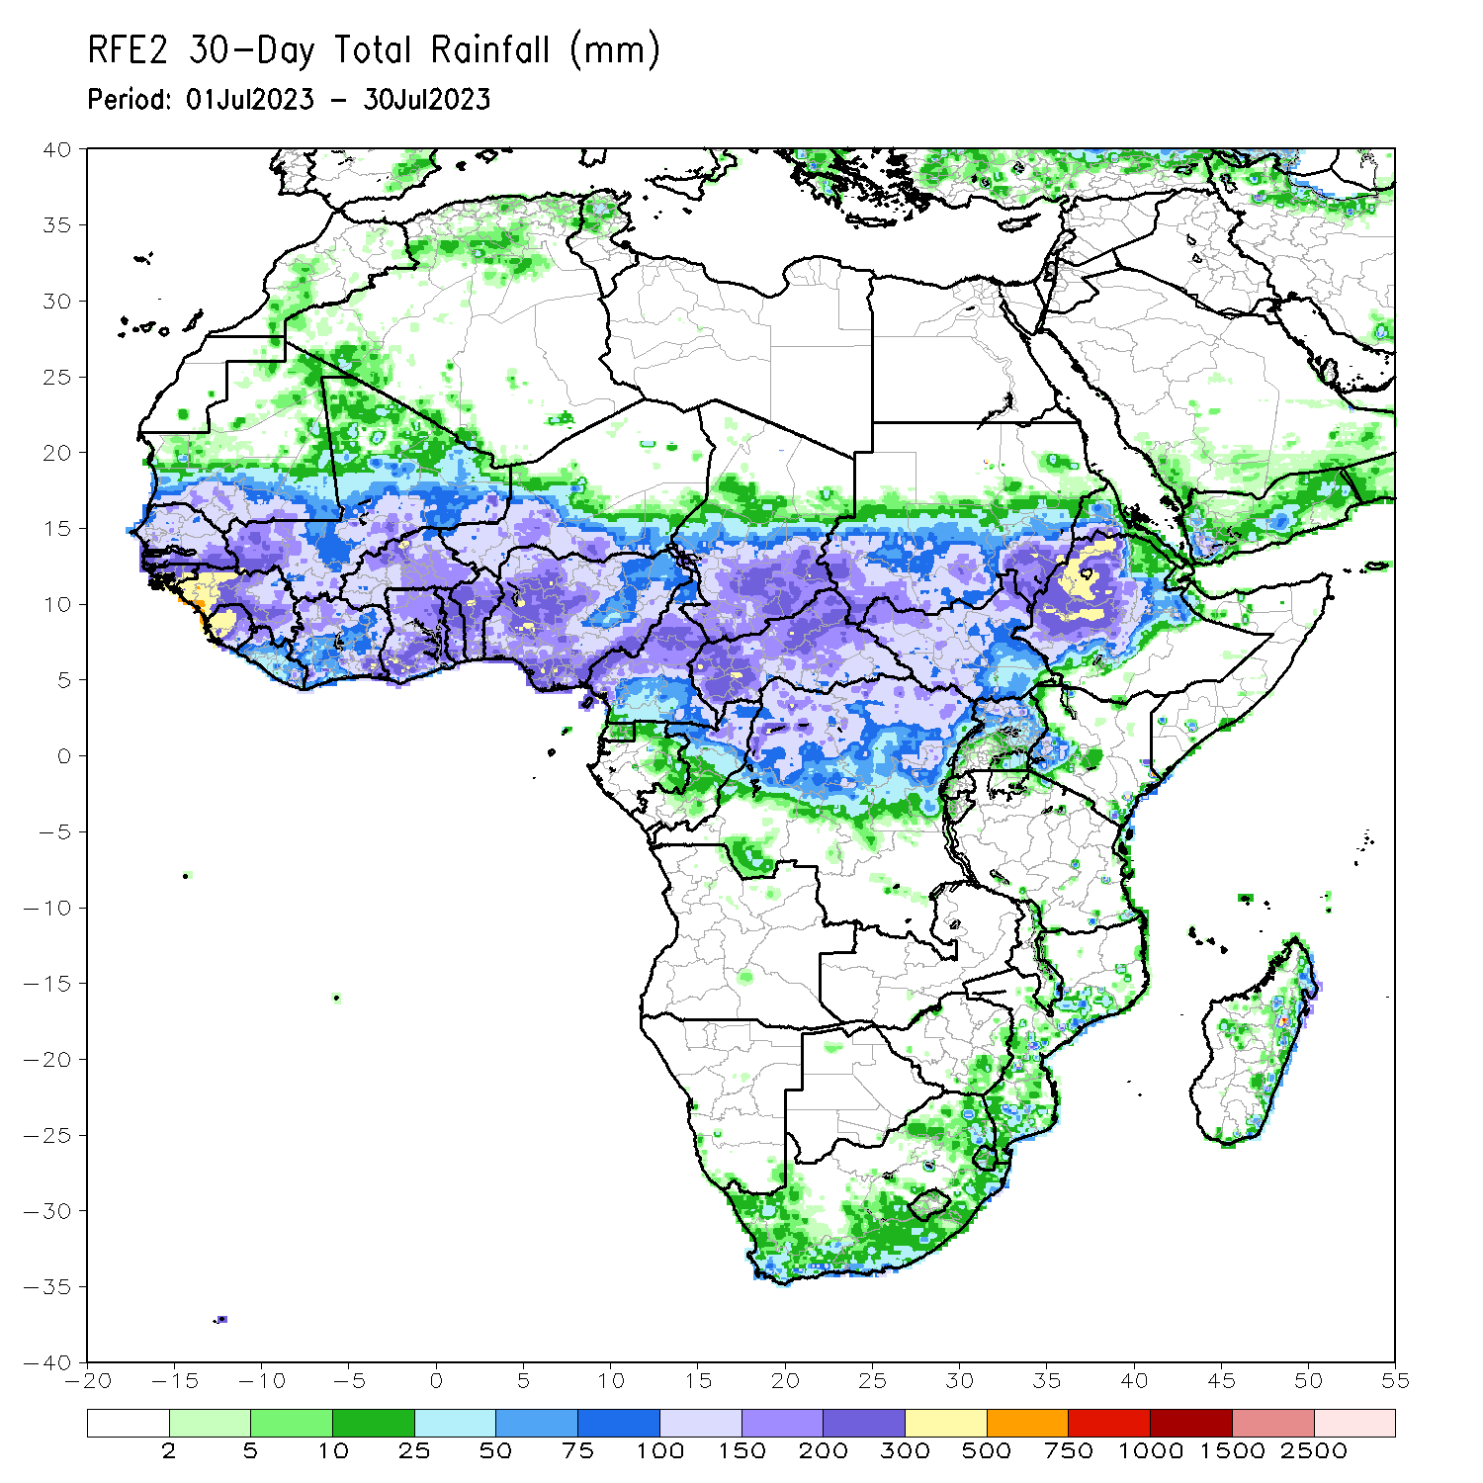
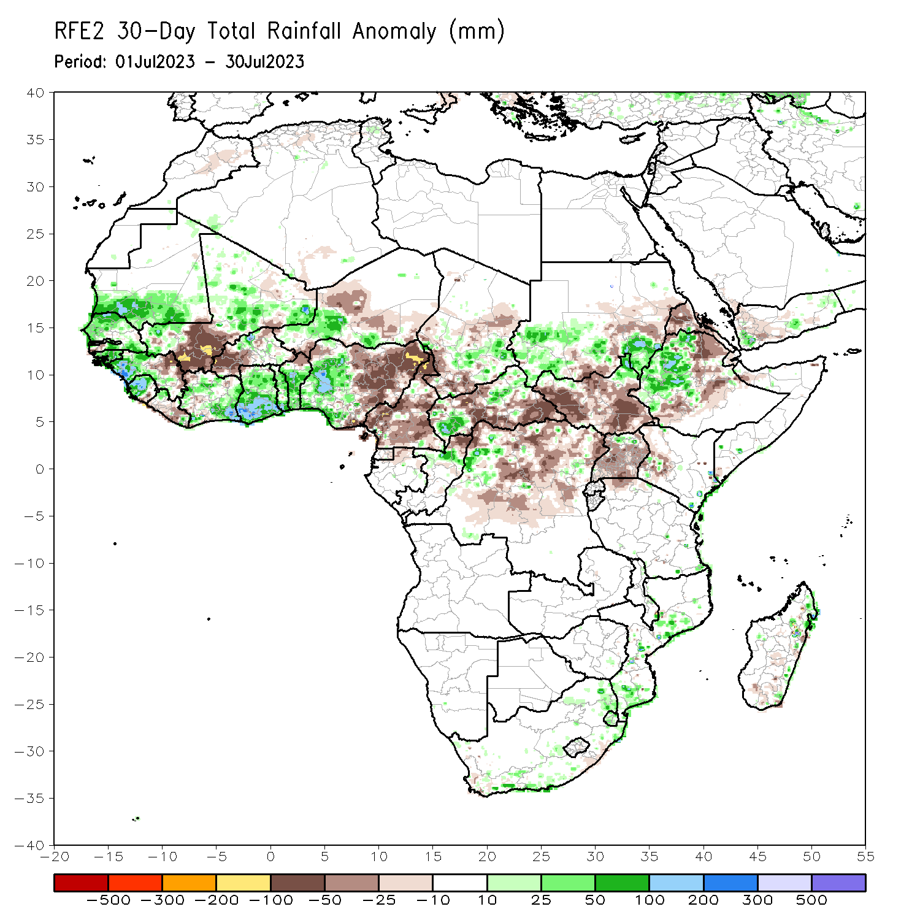
Rainfall Patterns: Last 30 Days
Over the past 30 days, in East Africa, above-average rainfall was observed over parts of southern and eastern Sudan, western Ethiopia and the far northern Uganda. Rainfall was below-average over much of South Sudan, pockets of Sudan, Eritrea, eastern and southern Ethiopia, and southern Uganda. In Central Africa, rainfall was above-average over pockets of Congo and CCAR, and northwestern DRC. Below-average rainfall was observed over much of Cameroon, central and eastern CAR, portions of Chad, and central and eastern DRC. In West Africa, rainfall was above-average over southern Mauritania, much of Senegal, Guinea-Bissau, western Guinea, Sierra Leone, the far western and eastern Mali, southeastern Cote d’Ivoire, much of Ghana, pockets of eastern Burkina Faso, western Niger, Togo, Benin, and western Nigeria. Below-average rainfall was observed over Liberia, southern and central Mali, pockets of Cote d’Ivoire, western Burkina Faso, and eastern Nigeria.
Notes:
5

Slide 6
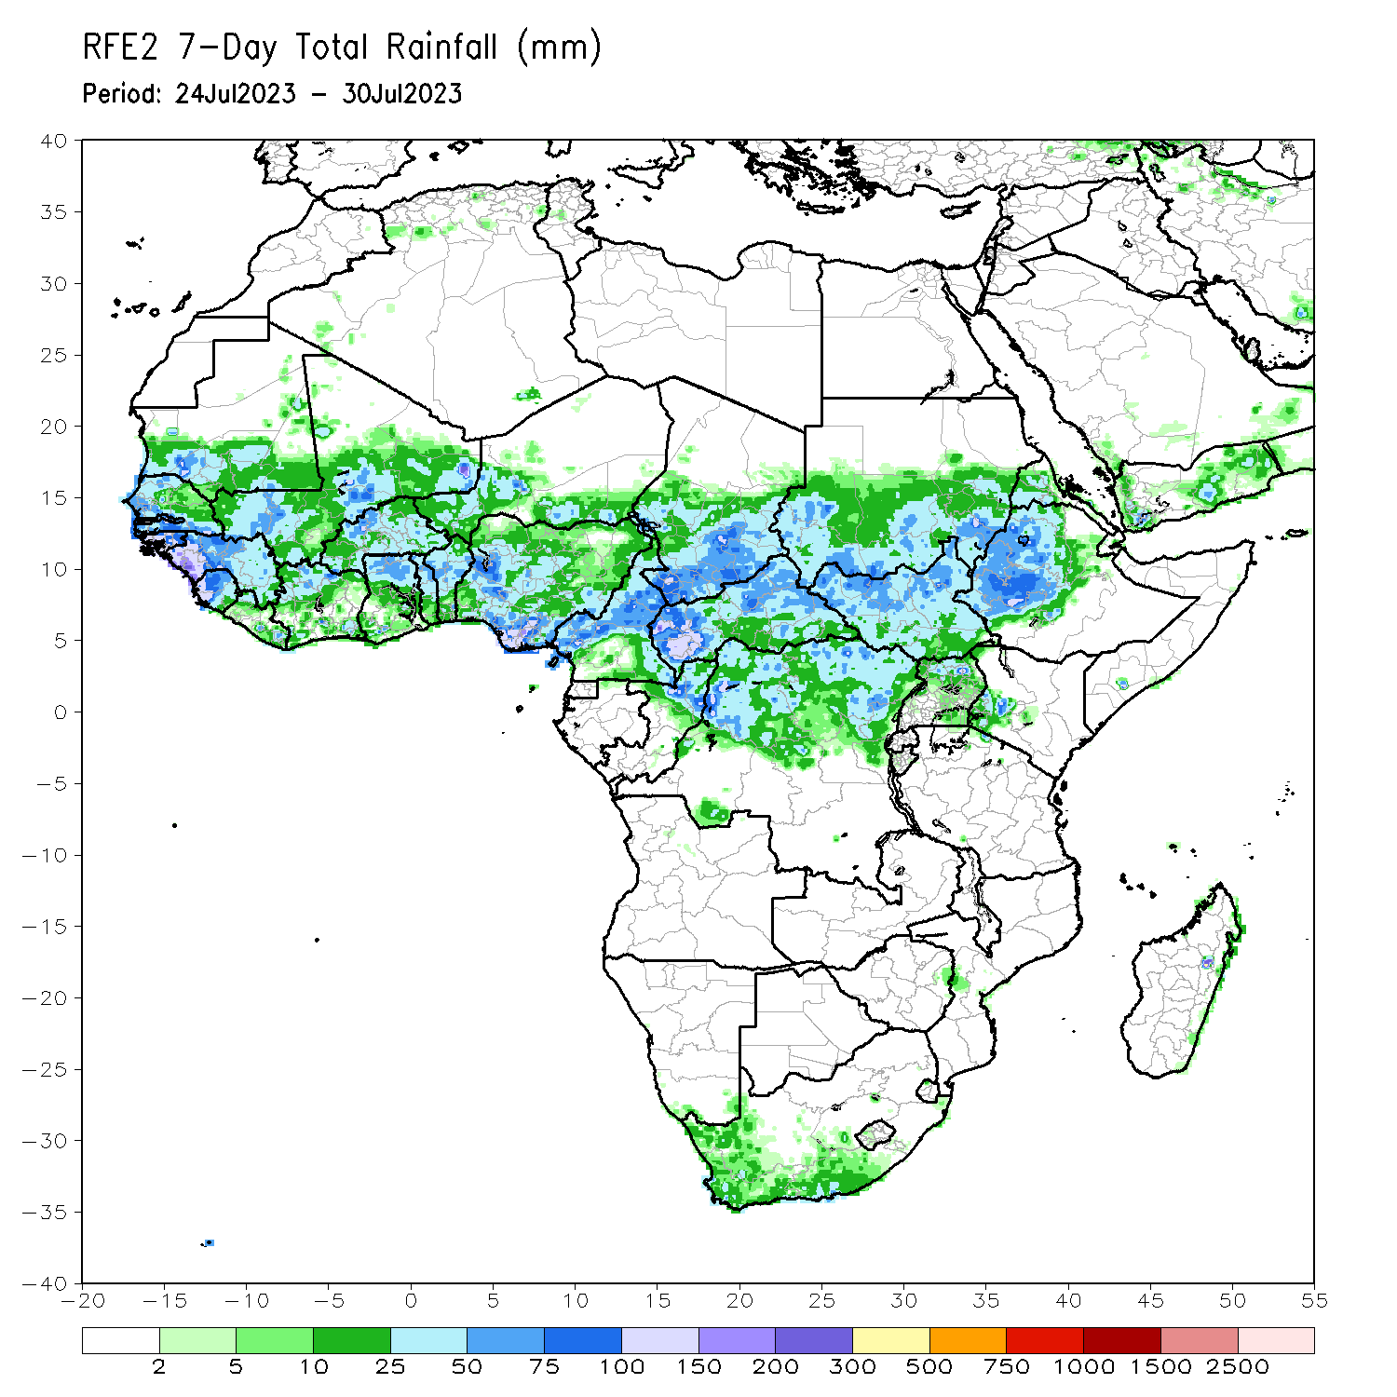
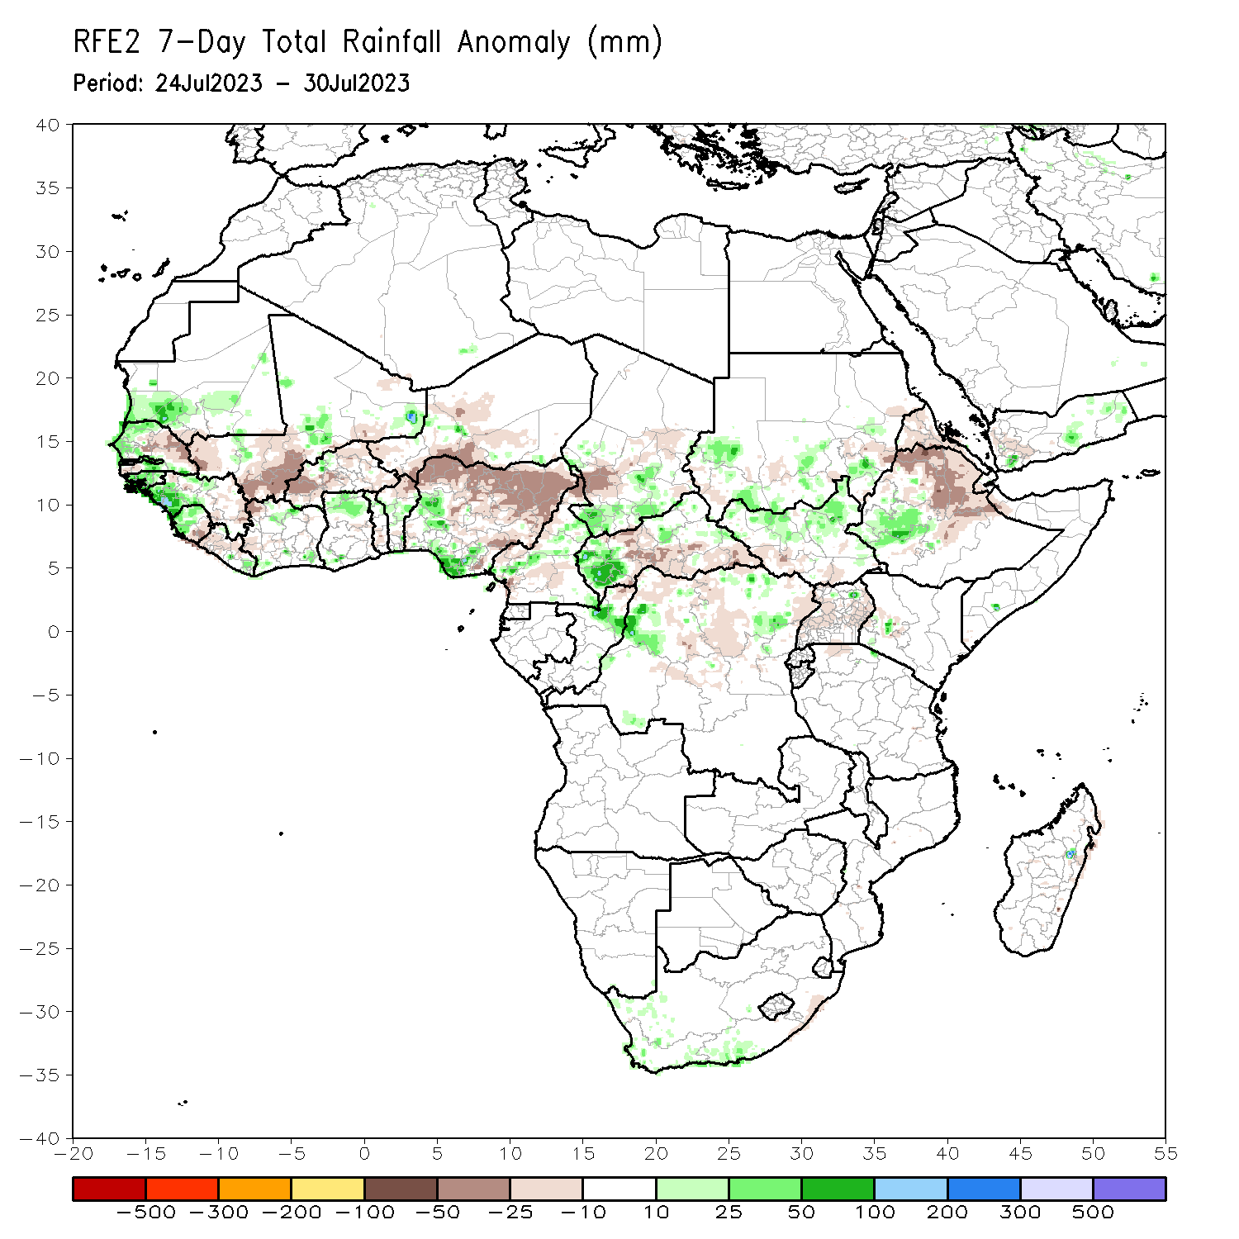
Rainfall Patterns: Last 7 Days
During the past 7 days, in East Africa, rainfall was above-average over pockets of Sudan, northern South Sudan and southwestern Ethiopia. Below-average rainfall was observed over southern South Sudan, northern and eastern Ethiopia, and much of Eritrea. In Central Africa, rainfall was above-average over part of western Cameroon, pockets of southern Chad, western CAR, and northern Congo, and pockets of northwestern and northeastern DRC. Below-average rainfall was observed over pockets of Cameroon, southwestern Chad, central and eastern CAR, and northcentral DRC. In West Africa, above-average rainfall was observed over southern Mauritania, western Senegal, western Guinea, Sierra Leone, pockets of Mali, and pockets of Ghana and Nigeria. Rainfall was below-average over eastern Senegal, southwestern Mali, western Burkina Faso, parts of Togo and Benin, and many parts of Nigeria.

Slide 7
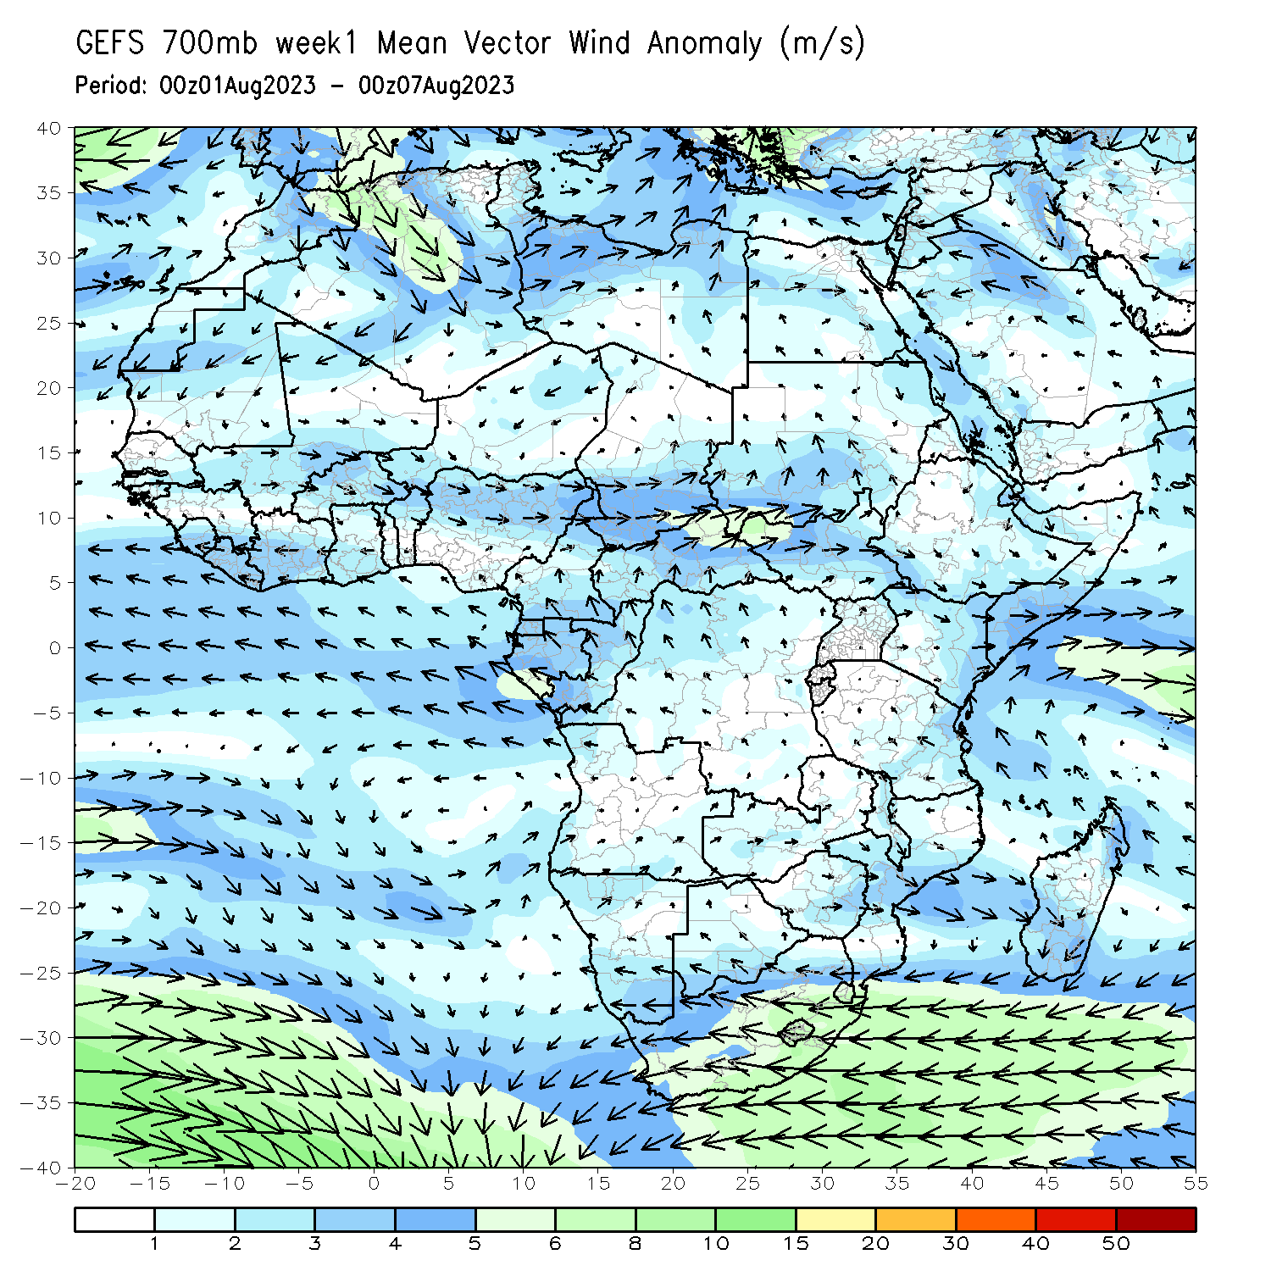
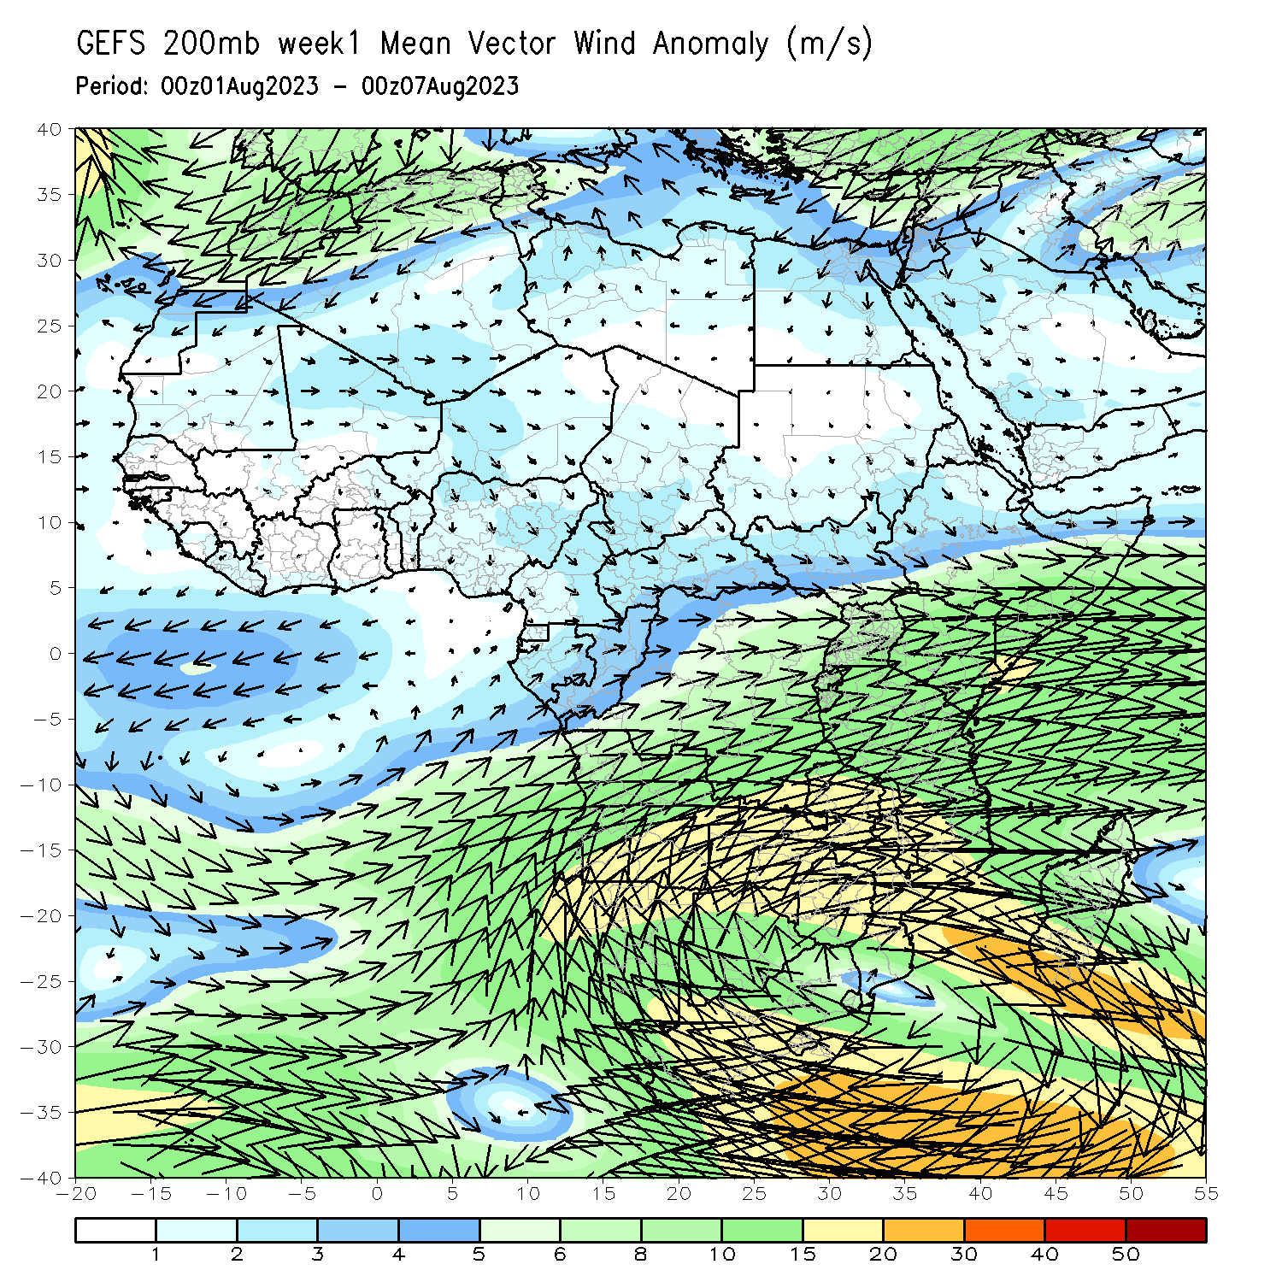
Atmospheric Circulation: Last 7 Days
At 700-hPa level (left panel), anomalous anti-cyclonic shear may have contributed to the observed below-average rainfall over parts the Gulf of guinea region.

Slide 8
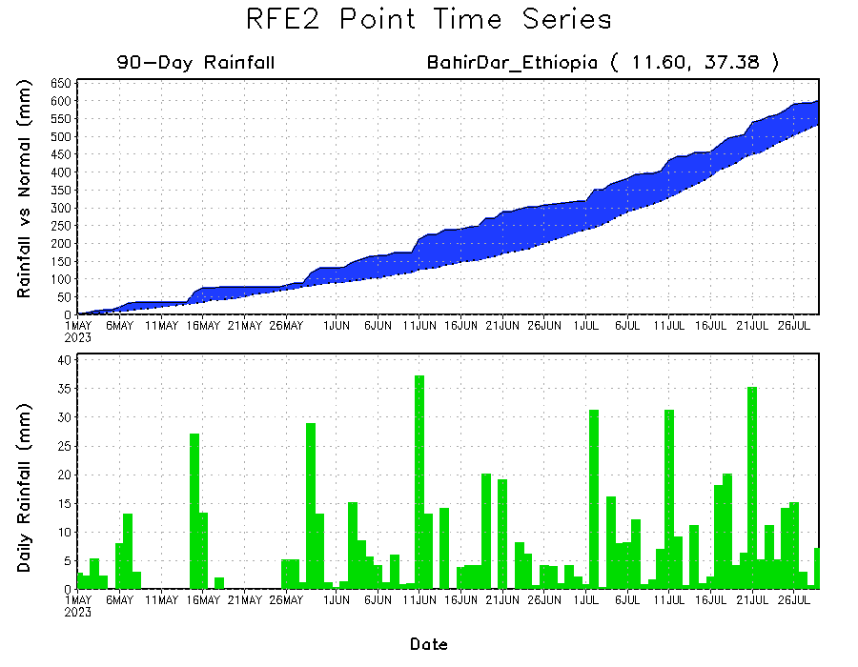
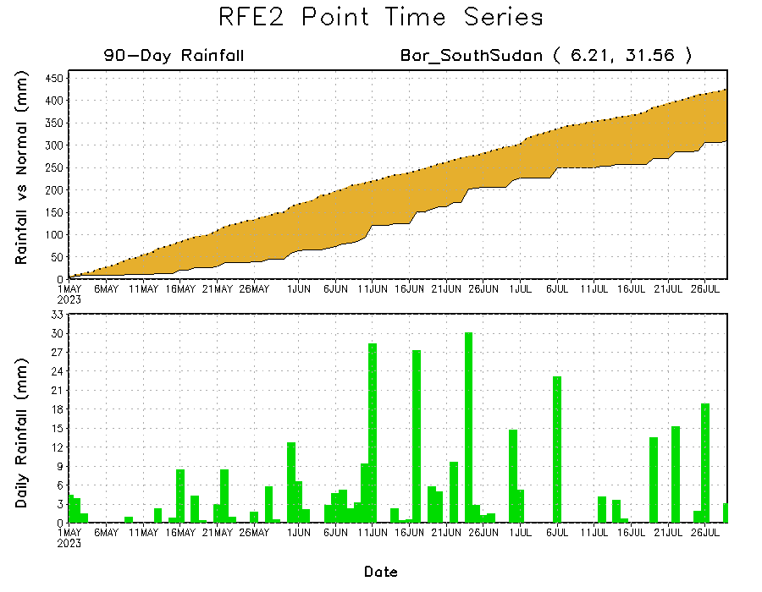
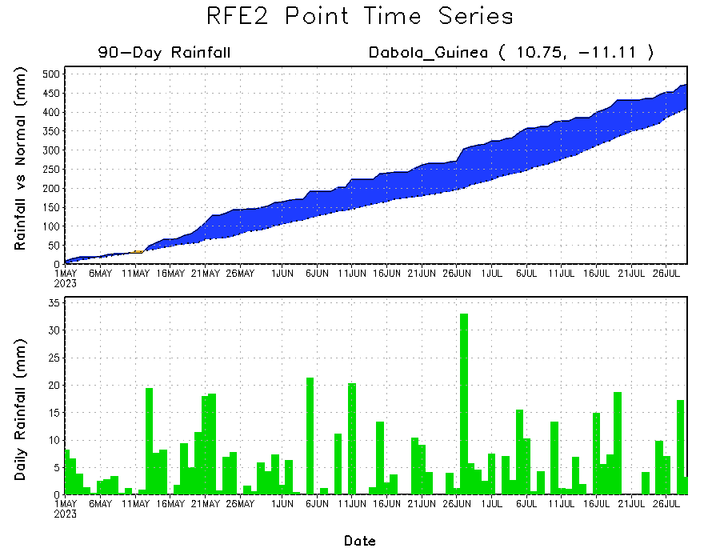
Rainfall Evolution
Daily evolution of rainfall over the last 90 days at selected locations shows moderate to heavy rainfall sustained moisture surpluses over parts of Guinea (bottom left) and western Ethiopia (top right). Seasonal total rainfall remained below-average over parts of South Sudan (bottom right).

Slide 9
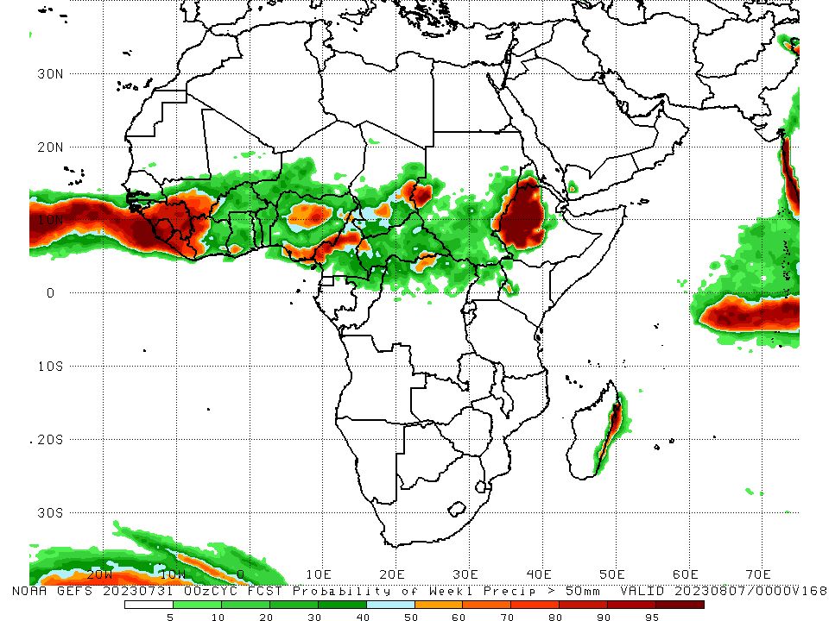
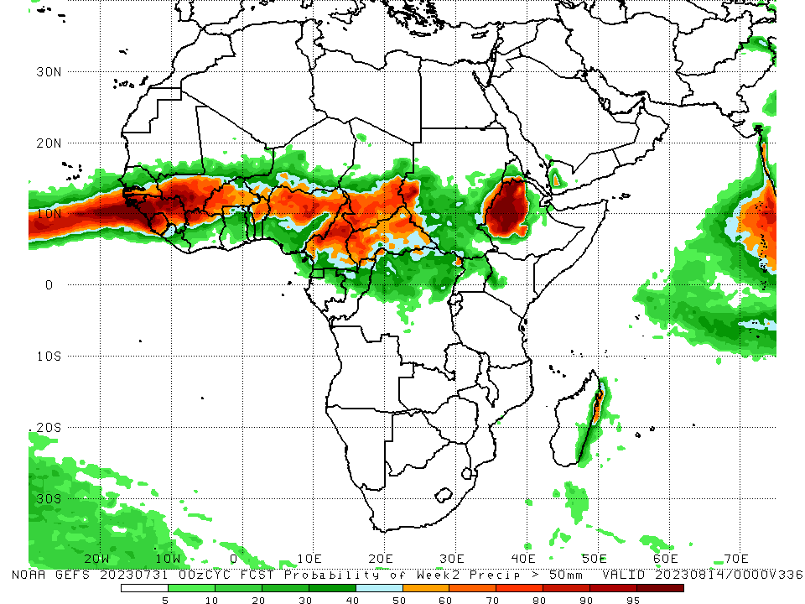
NCEP GEFS Model Forecasts Non-Bias Corrected Probability of precipitation exceedance
Week-1, Valid: 01 – 07 August 2023
Week-2, Valid: 08 – 14 August 2023
For week-1 (left panel), the GEFS forecasts indicate a moderate to high chance (over 70%) for rainfall to exceed 50 mm over much of Guinea, Sierra Leone, Liberia, southwestern Mali, western Cote d’Ivoire, parts of Nigeria and Cameroon, southern chad and western Ethiopia. For week-2 (right panel), there is a high chance for the weekly total rainfall to exceed 50mm over the far western and eastern Gulf of Guinea, and much of the Sahel region, and western Ethiopia.
Notes:
9

Slide 10
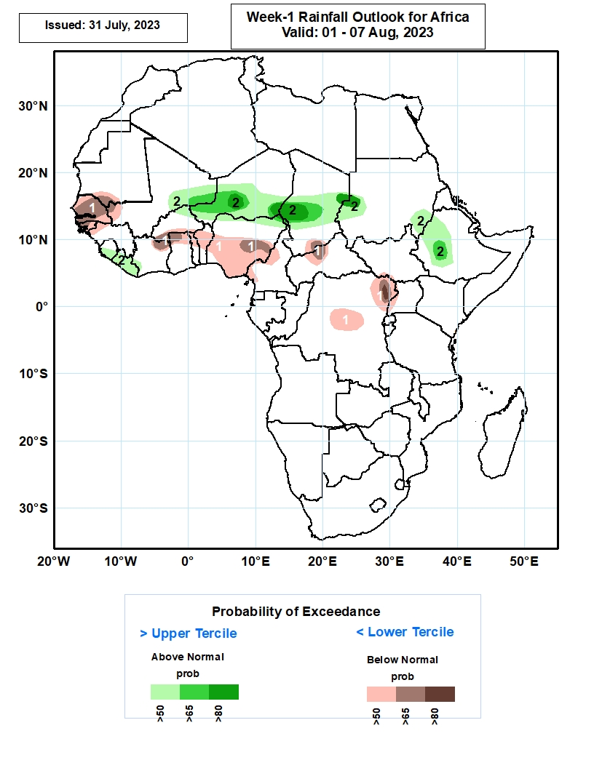
Week-1 Precipitation Outlooks
01 – 07 August 2023
The probabilistic forecasts call for above 50% chance for weekly rainfall to be above-normal (above the upper tercile) over western Guinea-Conakry, much of Sierra Leone, central and eastern parts of Mali, northern and eastern parts of Cote d’Ivoire, much of Ghana, Togo, Benin, Nigeria, Cameroon and CAR, northern Gabon and Congo, northern and northwestern parts of DR Congo, east-central Chad, and central parts of Sudan. There is above 65% chance for rainfall to be above-normal over southern Cameroon, northern Gabon and Congo, and eastern CAR.
The forecasts call for above 50% chance for weekly total rainfall to be below-normal (below the lower tercile) over central and eastern parts of Ethiopia, much of Djibouti, northwestern Somalia, southeastern Uganda, and southwestern Kenya. There is above 65% chance for rainfall to be below-normal over central and eastern parts of Ethiopia.
Notes:
10

Slide 11
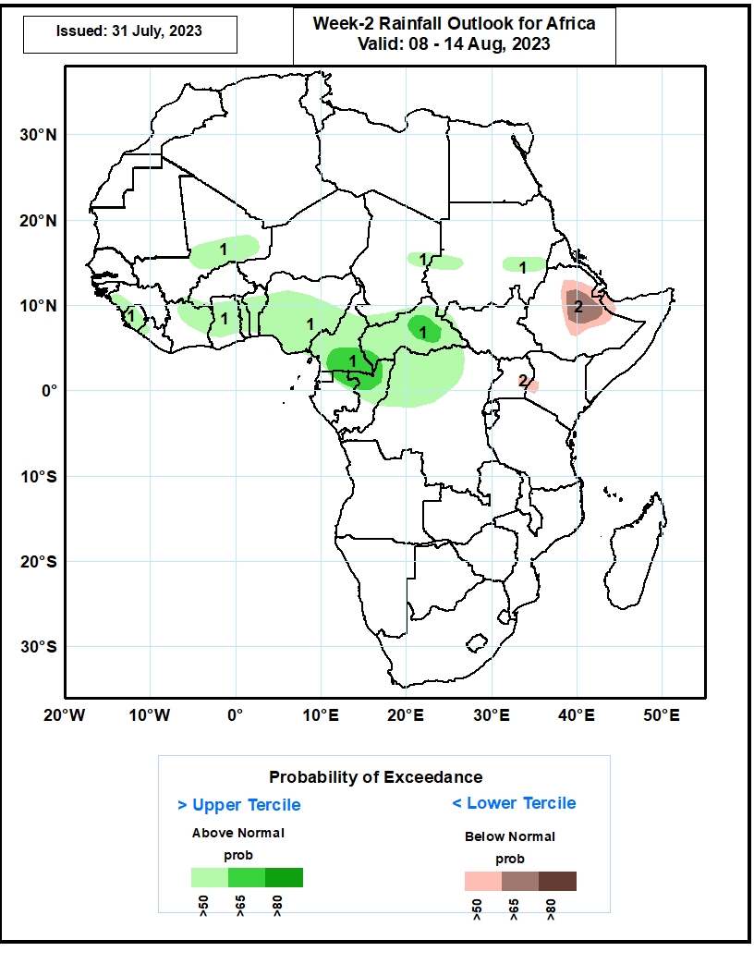
Week-2 Precipitation Outlooks
08 – 14 August 2023
The forecasts call for above 50% chance for weekly total rainfall to be below-normal (below the lower tercile) over south-central Mauritania, much of Senegal and Guinea-Bissau, western Guinea-Conakry, southwestern Mali, northeastern Cote d’Ivoire, northern Ghana, Togo and Benin, central and southern parts of Nigeria, western part of Cameroon, south-central Chad, north-central CAR, central and northeastern parts of DR Congo. There is above 65% chance for rainfall to be below-normal over much of Senegal, south-central Mauritania, western Guinea-Bissau, northeastern Cote d’Ivoire, northern Ghana, east-central Nigeria, south-central Chad, north-central CAR, and northeastern DR Congo.
The probabilistic forecasts call for above 50% chance for weekly rainfall to be above-normal (above the upper tercile) over much of Sierra Leone and Liberia, eastern Mali, central and southern parts of Niger and Chad, west-central and southeastern Sudan, and western Ethiopia. There is above 80% chance for rainfall to be above-normal over central and southeastern Niger, and central parts of Chad.
Notes:
11

Slide 12
Summary
Over the past 30 days, in East Africa, above-average rainfall was observed over parts of southern and eastern Sudan, western Ethiopia and the far northern Uganda. Rainfall was below-average over much of South Sudan, pockets of Sudan, Eritrea, eastern and southern Ethiopia, and southern Uganda. In Central Africa, rainfall was above-average over pockets of Congo and CCAR, and northwestern DRC. Below-average rainfall was observed over much of Cameroon, central and eastern CAR, portions of Chad, and central and eastern DRC. In West Africa, rainfall was above-average over southern Mauritania, much of Senegal, Guinea-Bissau, western Guinea, Sierra Leone, the far western and eastern Mali, southeastern Cote d’Ivoire, much of Ghana, pockets of eastern Burkina Faso, western Niger, Togo, Benin, and western Nigeria. Below-average rainfall was observed over Liberia, southern and central Mali, pockets of Cote d’Ivoire, western Burkina Faso, and eastern Nigeria.
During the past 7 days, in East Africa, rainfall was above-average over pockets of Sudan, northern South Sudan and southwestern Ethiopia. Below-average rainfall was observed over southern South Sudan, northern and eastern Ethiopia, and much of Eritrea. In Central Africa, rainfall was above-average over part of western Cameroon, pockets of southern Chad, western CAR, and northern Congo, and pockets of northwestern and northeastern DRC. Below-average rainfall was observed over pockets of Cameroon, southwestern Chad, central and eastern CAR, and northcentral DRC. In West Africa, above-average rainfall was observed over southern Mauritania, western Senegal, western Guinea, Sierra Leone, pockets of Mali, and pockets of Ghana and Nigeria. Rainfall was below-average over eastern Senegal, southwestern Mali, western Burkina Faso, parts of Togo and Benin, and many parts of Nigeria.
The Week-1 outlook calls for above-normal rainfall over eastern Mali, southern Niger, central Chad, parts of Sudan and western Ethiopia. In contrast, there is an increased chance for below-normal rainfall over much of Senegal, northern Cote d’Ivoire, northern Ghana, Togo, northern Benin, much of Nigeria, Cameroon, southern Chad, central CAR, parts of central and eastern DRC and northeastern Ethiopia. For week-2, there is an increased chance for above-normal rainfall across the eastern portions of the Gulf of Guinea region and the neighboring areas of Central Africa, and parts of Mali. In contrast, there is an increased chance for below-normal rainfall over parts of eastern Ethiopia and western Kenya.

