Slide 1
The African Monsoon Recent Evolution and Current Status Include Week-1 and Week-2 Outlooks
Update prepared
10 July 2023
For more information, visit:
http://www.cpc.ncep.noaa.gov/products/Global_Monsoons/African_Monsoons/precip_monitoring.shtml

Slide 2
Outline
Highlights
Recent Evolution and Current Conditions
NCEP GEFS Forecasts
Summary

Slide 3
Highlights: Last 7 Days
During the past 7 days, in East Africa, rainfall was above-average over southeastern and southwestern Sudan, western and northern Ethiopia, northeastern South Sudan, northern and eastern Uganda, and southwestern Kenya. Rainfall was below average over most of northern, eastern, and western South Sudan and in south-central Sudan. In Central Africa, rainfall was above-average over parts of north-central Cameroon, parts of central CAR, southeastern Chad, and parts of northeastern and northwestern DRC. Below-average rainfall was observed over northern and parts of central Cameroon, southeastern CAR, north-central DRC, and southwestern Chad. In West Africa, above-average rainfall was observed over western and central Guinea, northern Senegal, southwestern Mauritania, northern and central Sierra Leone, central and eastern Cote d’Ivoire, parts of central Nigeria, southern Ghana, Togo, Benin, eastern Mali, and south-central Niger. Rainfall was below-average over parts of southern Sierra Leone, southwestern Cote d’Ivoire, Liberia, eastern Guinea, Burkina Faso, south-central and southwestern Mali, southwestern Senegal, southeastern Mauritania, and most of northeastern and south-central Nigeria.
The Week-1 outlook calls for above-normal rainfall over much of the Gulf of Guinea region, including central and southern Senegal, Guinea-Bissau, Guinea, Sierra Leone, Liberia, Cote d’Ivoire, Ghana, Togo, Benin, central and southern Nigeria, southern Cameroon, and northern Gabon. Rainfall is also expected to be above average in northwestern Ethiopia. In contrast, there is an increased chance for below-normal rainfall over much of the Sahel regions, including south-central Mali, Burkina Faso, southern Niger, northern Nigeria, northern Cameroon, southern Chad, southern Sudan, northern South Sudan, north-central Ethiopia, and western Eritrea. For week-2, there is an increased chance for above-normal rainfall over southeastern Guinea, southern Sierra Leone, Liberia, and parts of southern Cote d’Ivoire. In contrast, there is an increased chance for below-normal rainfall over much of coastal Guinea and Guinea-Bissau, central and southern Nigeria, central and southern Cameroon, CAR, northern DRC, South Sudan, northern and central Uganda, parts of western Kenya, and parts of western and central Ethiopia.

Slide 4
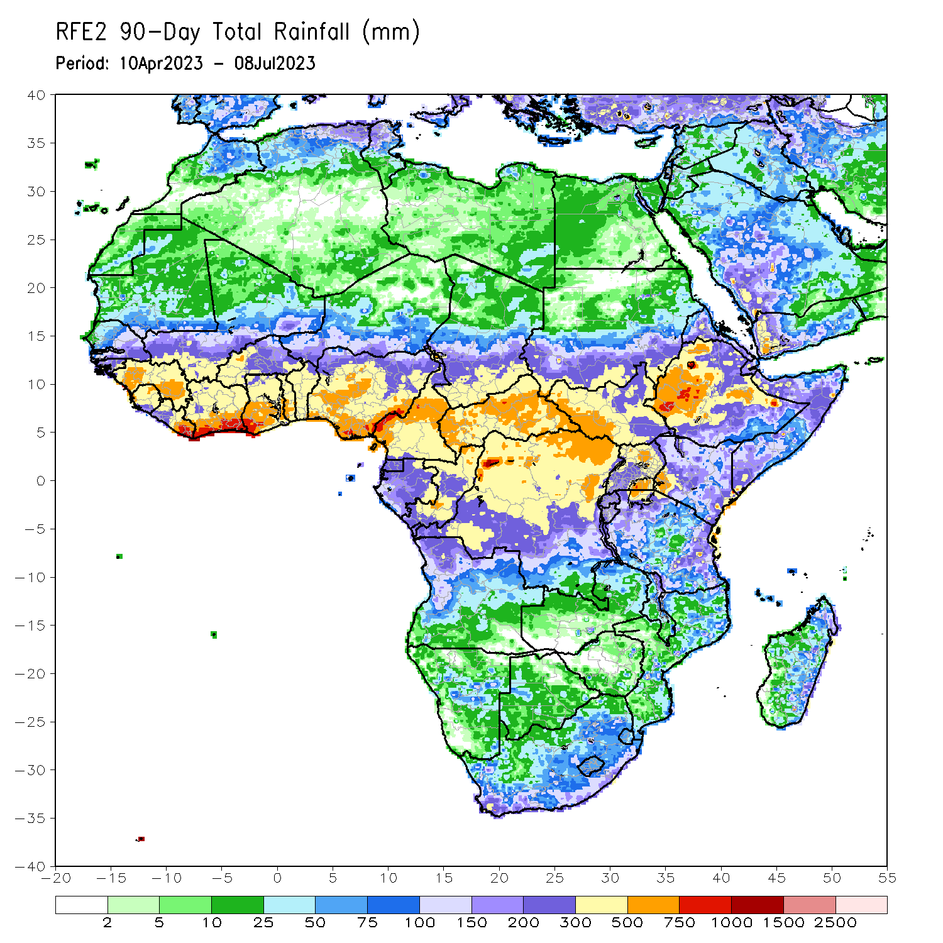
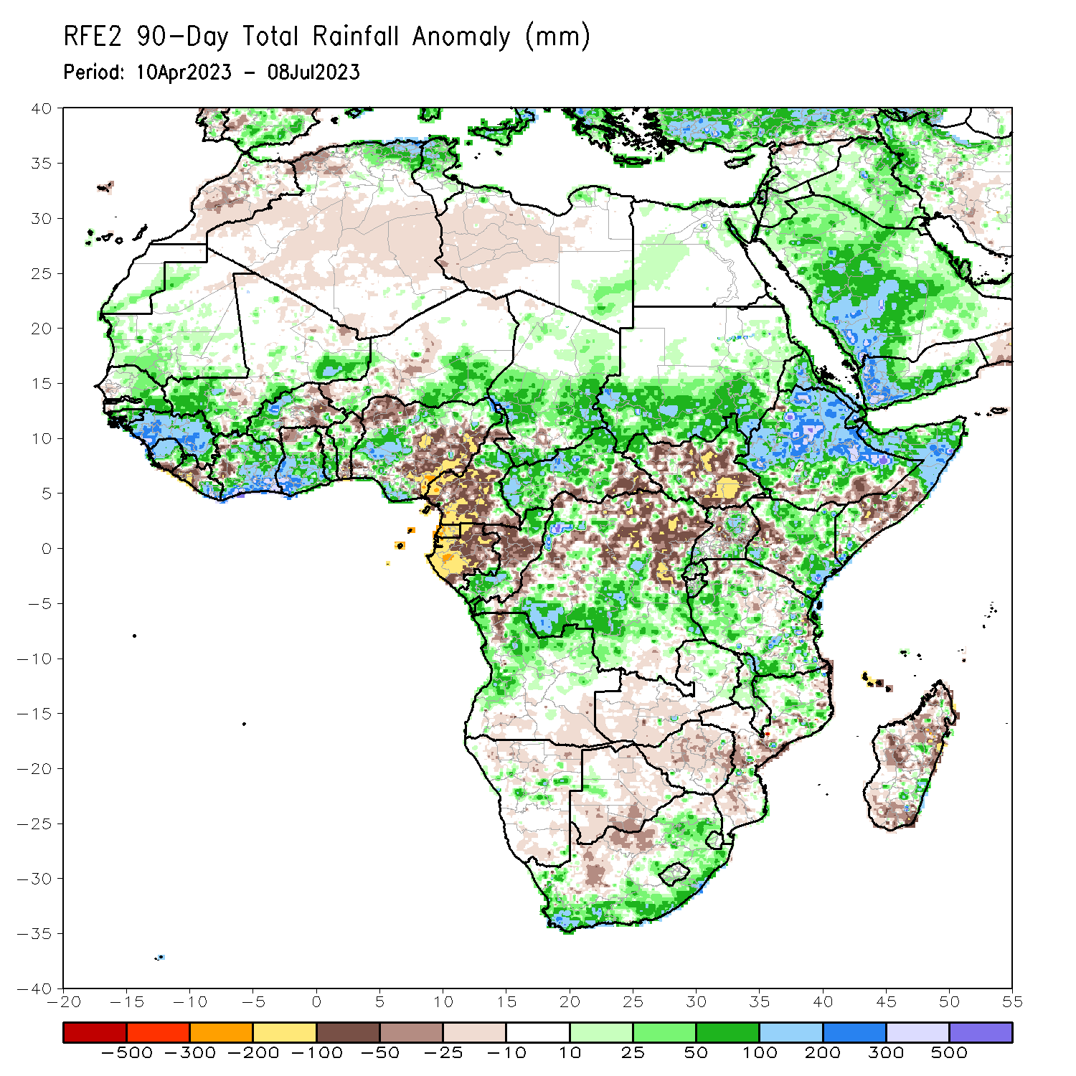
Rainfall Patterns: Last 90 Days
Over the past 90 days, in East Africa, above-average rainfall was observed over much of Eritrea, Ethiopia (outside of southern portions), northern and parts of far southern Somalia, northern, southwestern, and eastern Kenya, Djibouti, central, northwestern, and southern Uganda, most of Tanzania, Burundi, Rwanda, southern and eastern Sudan, and far northwestern and northeastern South Sudan. Rainfall was below-average over much of central South Sudan, parts of central and southern Somalia, parts of western Kenya, northern and parts of central Uganda, and southern Ethiopia. In southern Africa, above-average rainfall was observed over central and northern Angola, eastern Zambia, parts of eastern, western, and southern South Africa, Lesotho, Eswatini, northern and central Malawi, northern Mozambique, parts of central Namibia, and parts of central and southeastern Madagascar. Below-average rainfall was observed over the southern portion of Angola, western and southern Zambia, northern and southern Namibia, most of Botswana, northern South Africa, Zimbabwe, southern and central Mozambique, and parts of northern, central, and southern Madagascar. In Central Africa, rainfall was above-average over parts of eastern and far northern Cameroon, western, central, and northeastern CAR, southern and northern Congo, much of southern and central Chad, and southern, parts of central, and parts of northwestern DRC. Rainfall was below-average over parts of central and southwestern Cameroon, Equatorial Guinea, much of Gabon, central Congo, parts of southeastern CAR, and parts of central and northeastern DRC. In West Africa, rainfall was above-average over parts of eastern and southern Senegal, much of Guinea, Guinea-Bissau, northern and central Sierra Leone, northwestern and eastern Liberia, most of Cote d’Ivoire, southern Mali, western Burkina Faso, central and southern Ghana, Togo, central and northwestern Benin, southeastern Niger, and southwestern and northeastern Nigeria. Below-average rainfall was observed over parts of eastern Burkina Faso, northwestern and southeastern Nigeria, northeastern and southern Benin, northwestern Ghana, west-central Cote d’Ivoire, central Liberia, and southern Sierra Leone.
Notes:
4

Slide 5
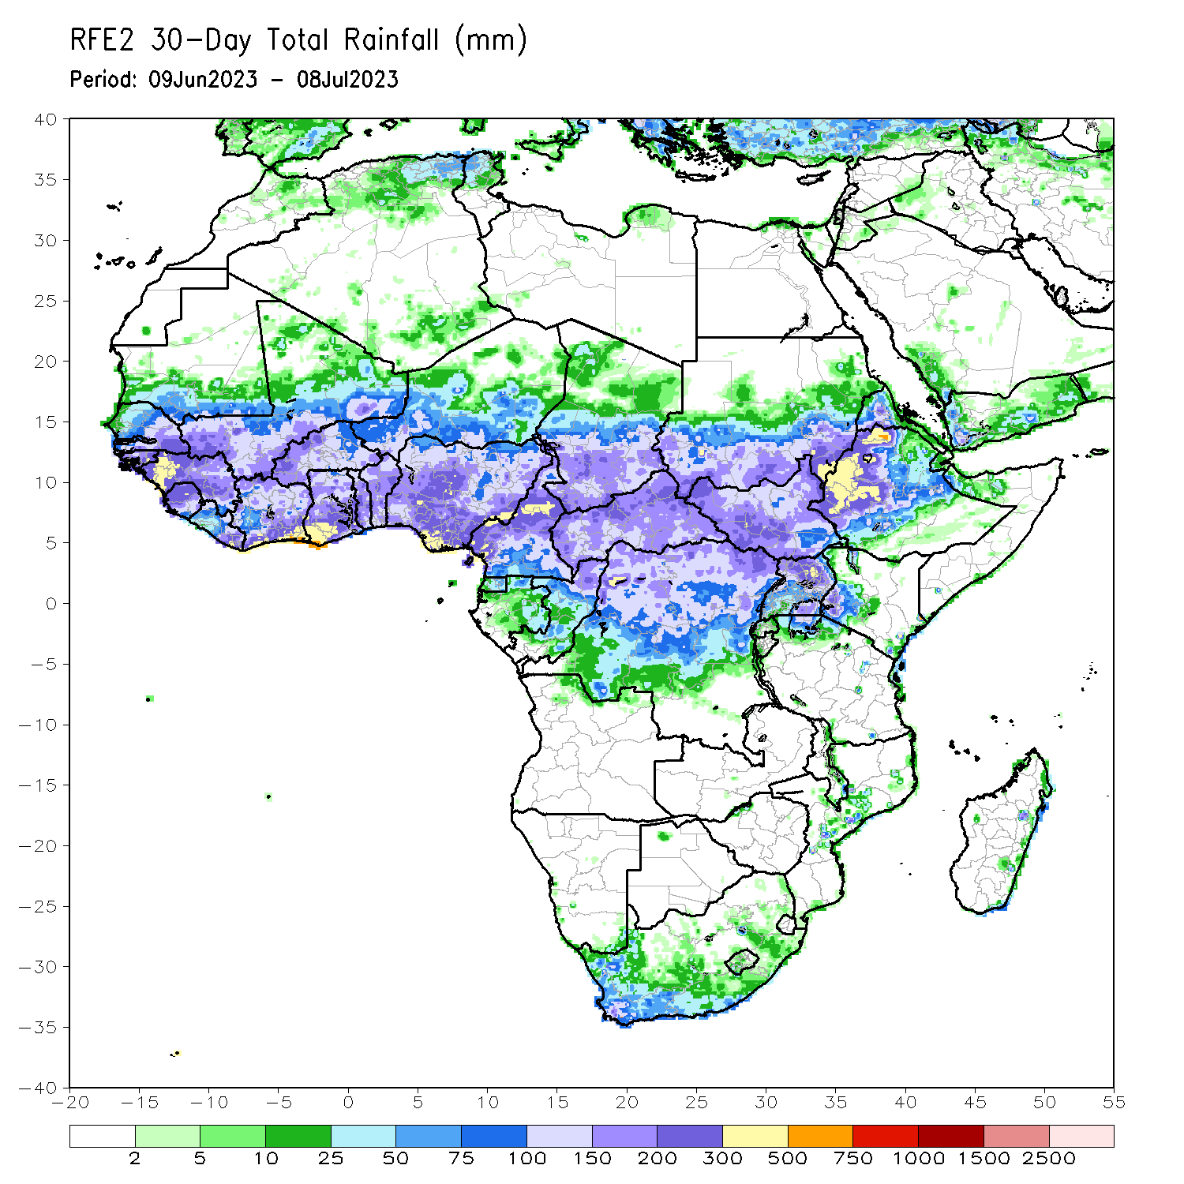
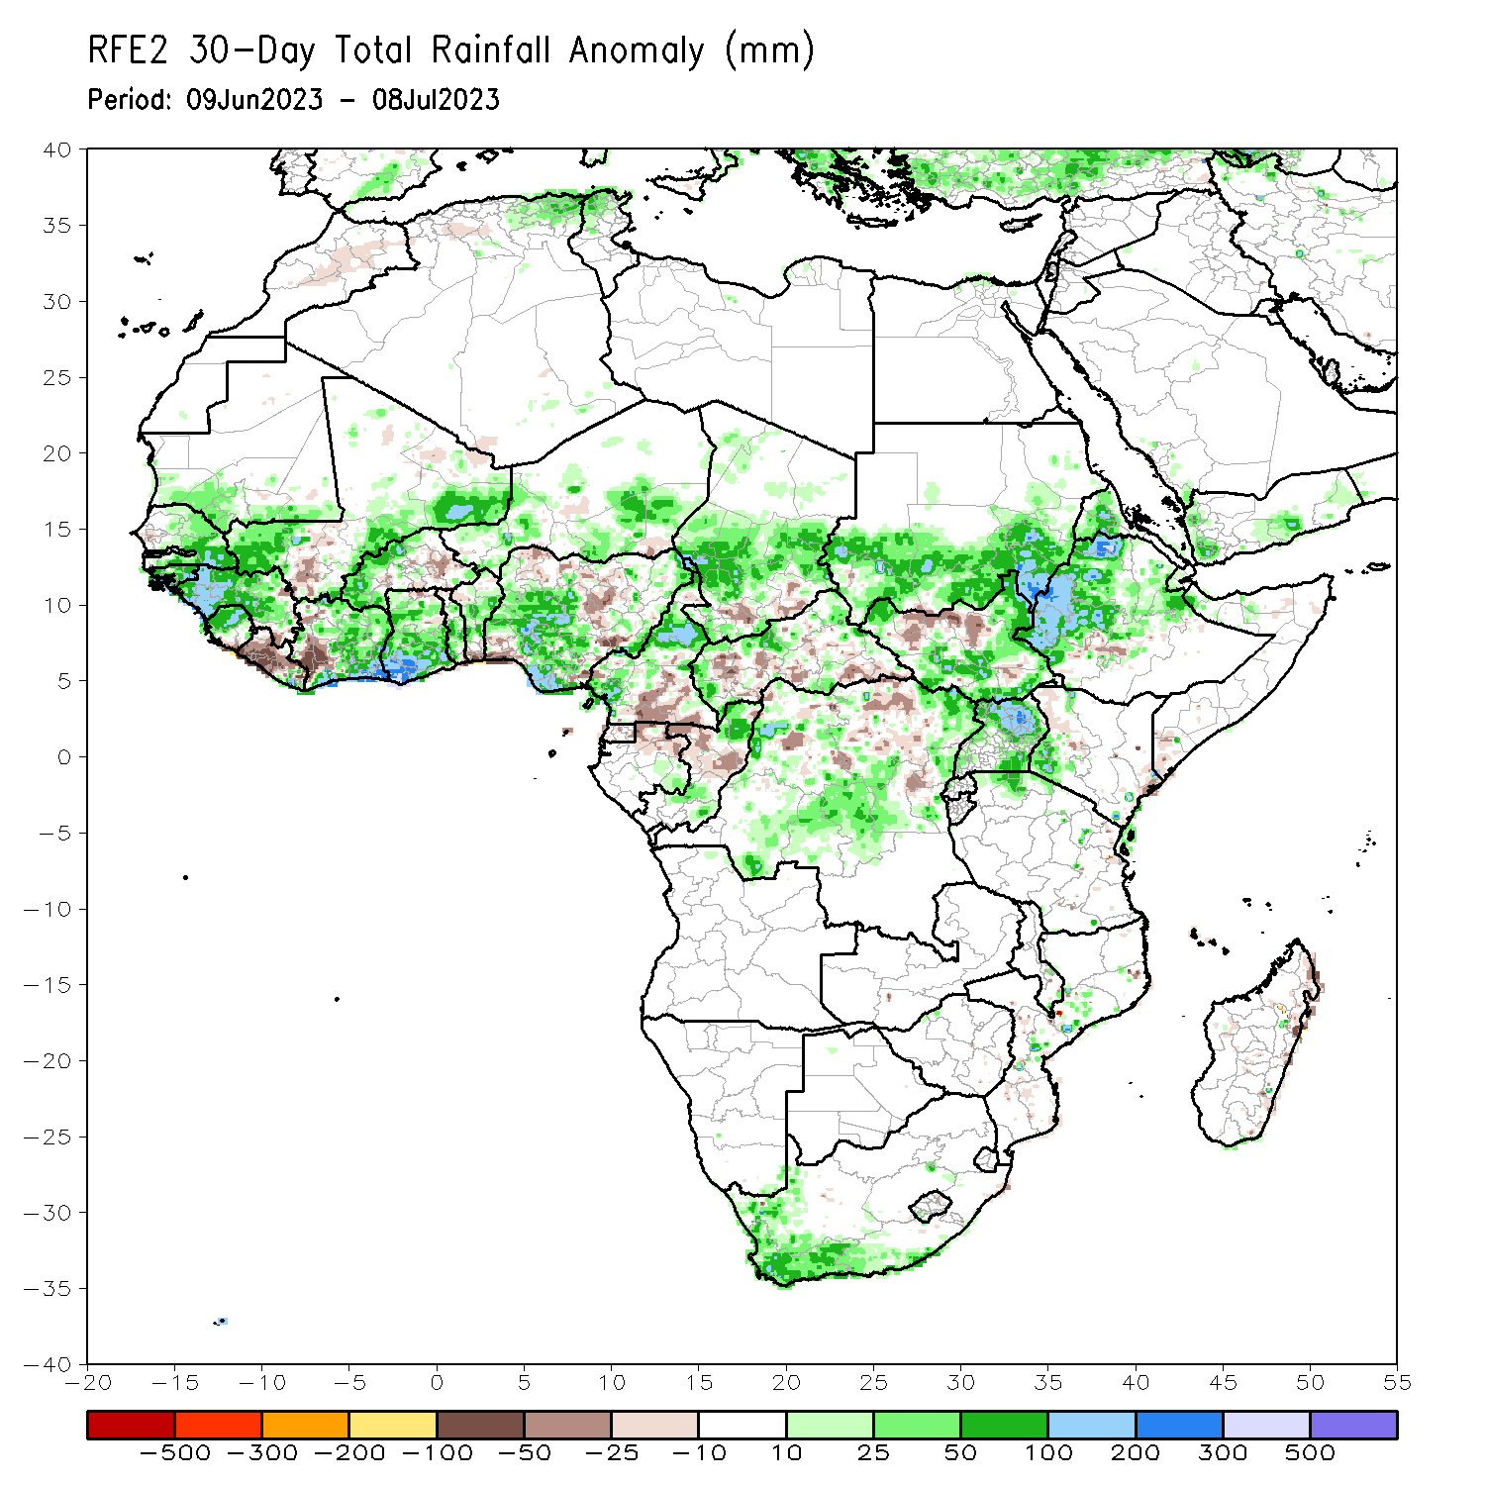
Rainfall Patterns: Last 30 Days
Over the past 30 days, in East Africa, above-average rainfall was observed over southern Sudan, central, western, and northern Ethiopia, western Eritrea, Djibouti, southern, eastern, and western South Sudan, southwestern Kenya, and northern and eastern Uganda. Rainfall was below-average over north-central South Sudan. In southern Africa, rainfall was above-average over the southern and western portions of South Africa. In Central Africa, rainfall was above-average over northern, eastern, and western Cameroon, southeastern Gabon, southern and northern Congo, parts of western and northern CAR, central and southwestern Chad, and northeastern, northwestern, and central DRC. Below-average rainfall was observed over pockets of southern Cameroon, northern Gabon, pockets of central and northern DRC, pockets of south-central Chad, central Congo, and parts of central and southeastern CAR. In West Africa, rainfall was above-average over southern and eastern Senegal, much of Guinea, Guinea-Bissau, southeastern and southwestern Mali, northern Sierra Leone, eastern Liberia, southern, eastern, and northern Cote d’Ivoire, western and northern Burkina Faso, most of Ghana, southern, central, and eastern Nigeria, central and southern Togo, central Benin, and much of southern Niger. Below-average rainfall was observed over western Liberia, west-central Cote d’Ivoire, eastern Burkina Faso, northern Togo, southern Benin, northeastern Ghana, coastal Sierra Leone, southeastern Guinea, south-central Mali, and parts of northwestern, southwestern, and central Nigeria.
Notes:
5

Slide 6
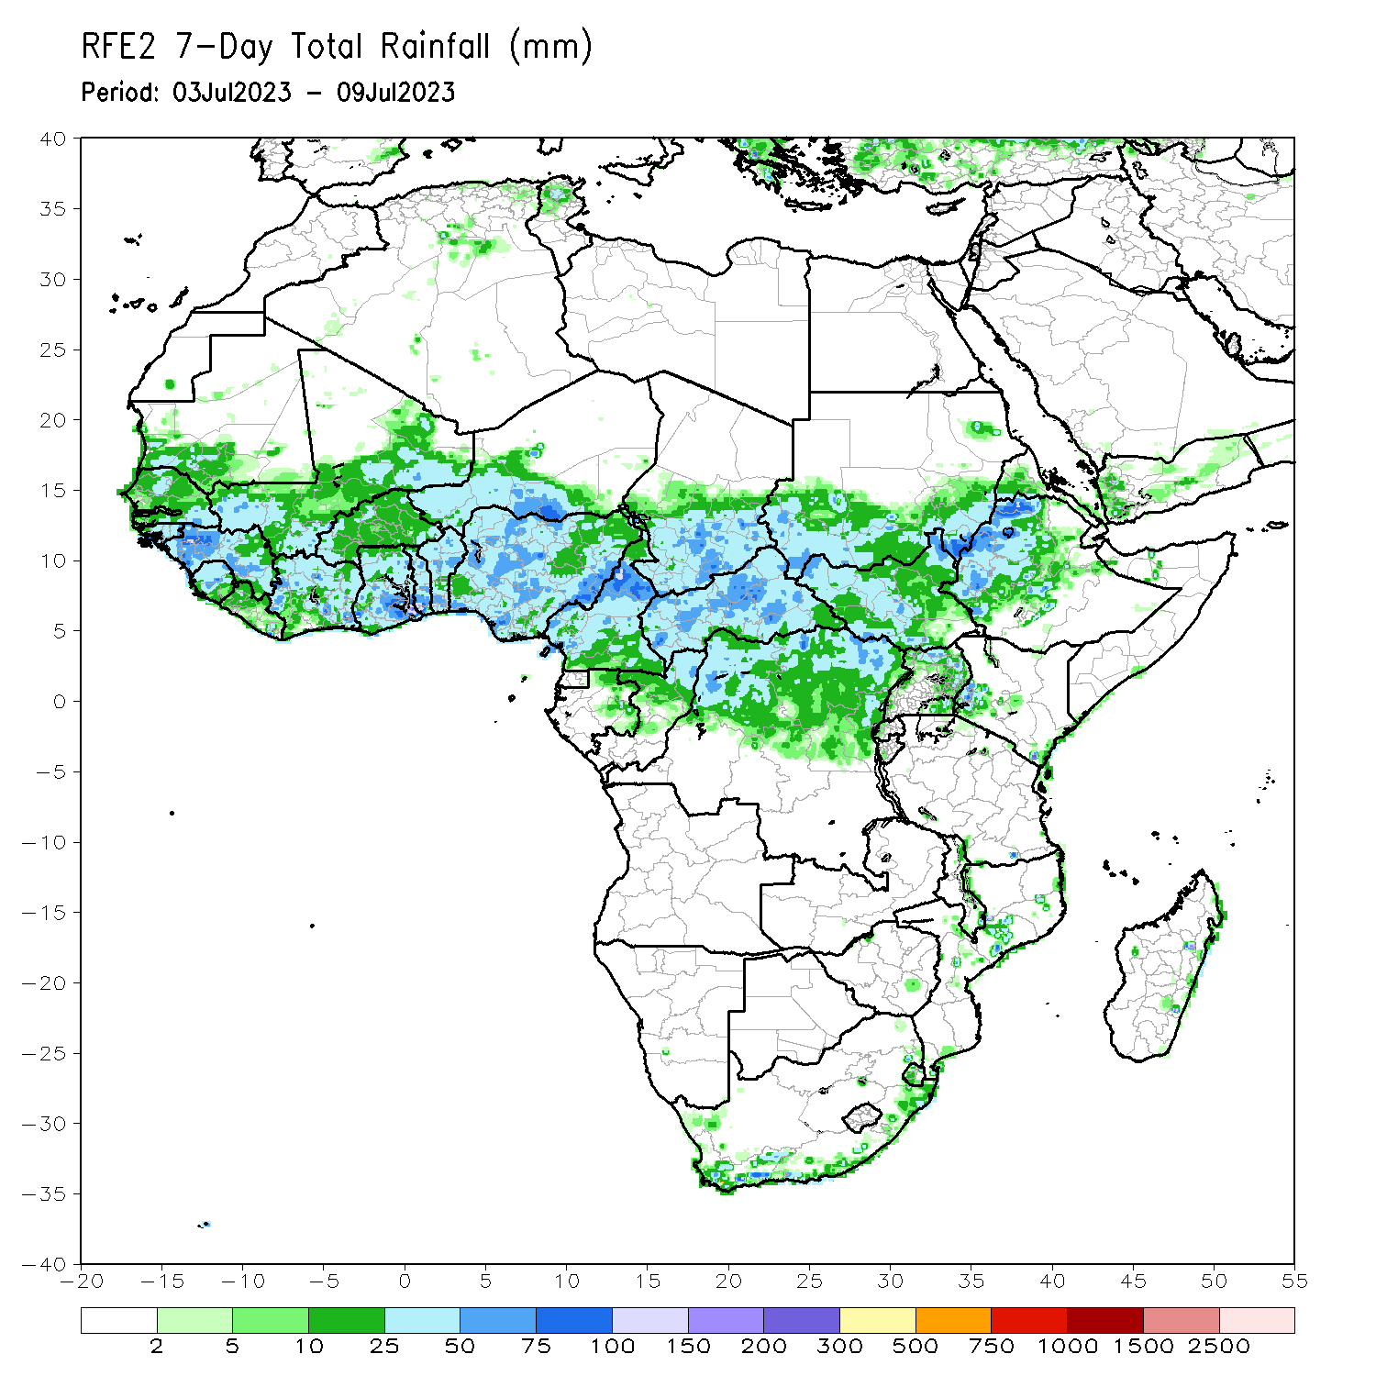
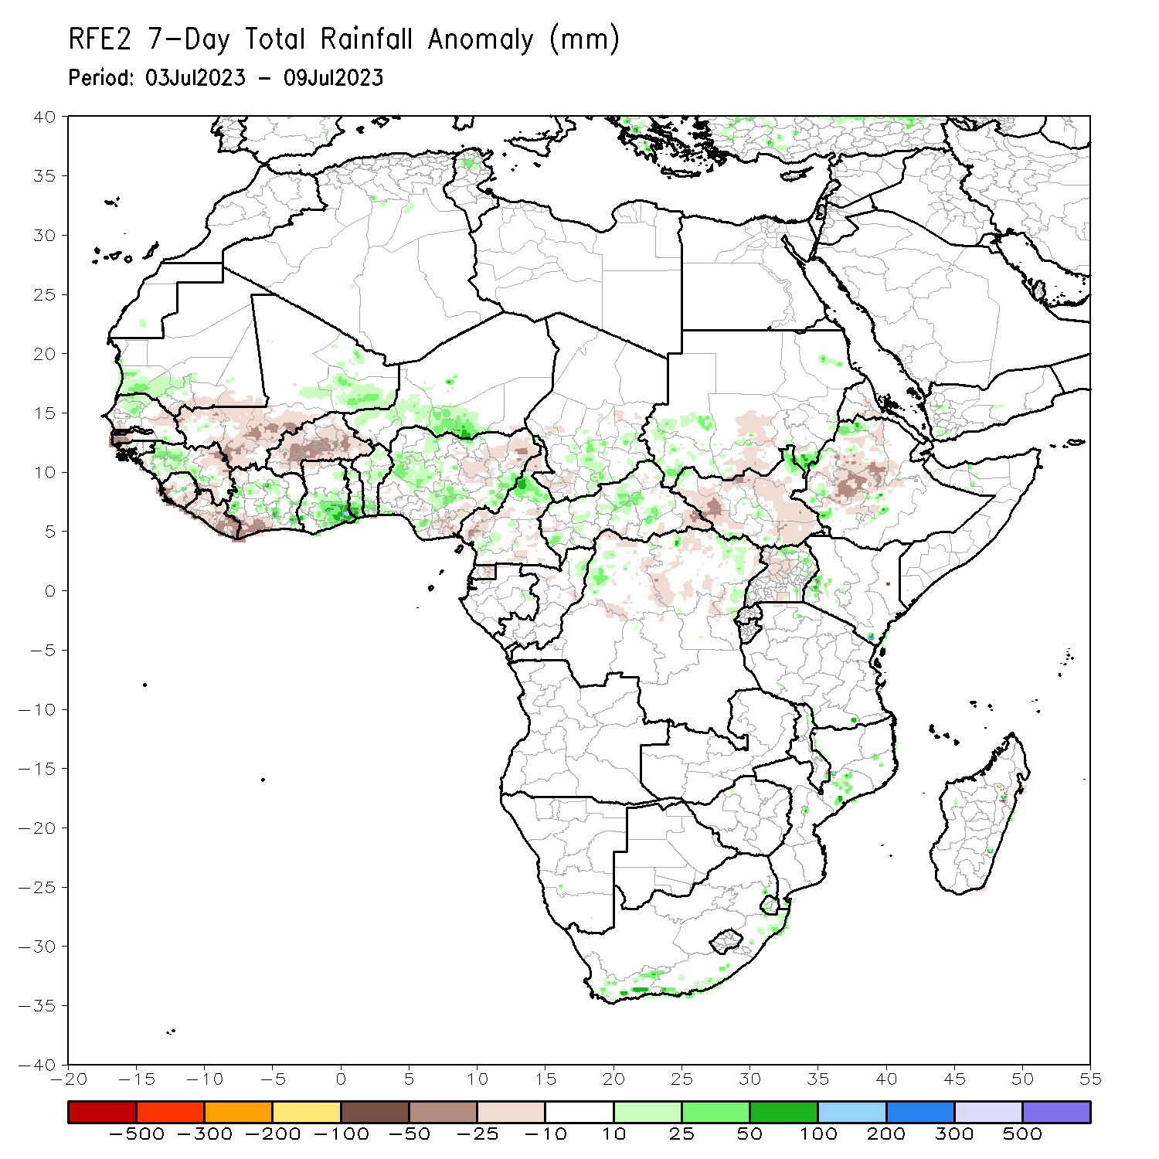
Rainfall Patterns: Last 7 Days
During the past 7 days, in East Africa, rainfall was above-average over southeastern and southwestern Sudan, western and northern Ethiopia, northeastern South Sudan, northern and eastern Uganda, and southwestern Kenya. Rainfall was below average over most of northern, eastern, and western South Sudan and in south-central Sudan. In Central Africa, rainfall was above-average over parts of north-central Cameroon, parts of central CAR, southeastern Chad, and parts of northeastern and northwestern DRC. Below-average rainfall was observed over northern and parts of central Cameroon, southeastern CAR, north-central DRC, and southwestern Chad. In West Africa, above-average rainfall was observed over western and central Guinea, northern Senegal, southwestern Mauritania, northern and central Sierra Leone, central and eastern Cote d’Ivoire, parts of central Nigeria, southern Ghana, Togo, Benin, eastern Mali, and south-central Niger. Rainfall was below-average over parts of southern Sierra Leone, southwestern Cote d’Ivoire, Liberia, eastern Guinea, Burkina Faso, south-central and southwestern Mali, southwestern Senegal, southeastern Mauritania, and most of northeastern and south-central Nigeria.

Slide 7
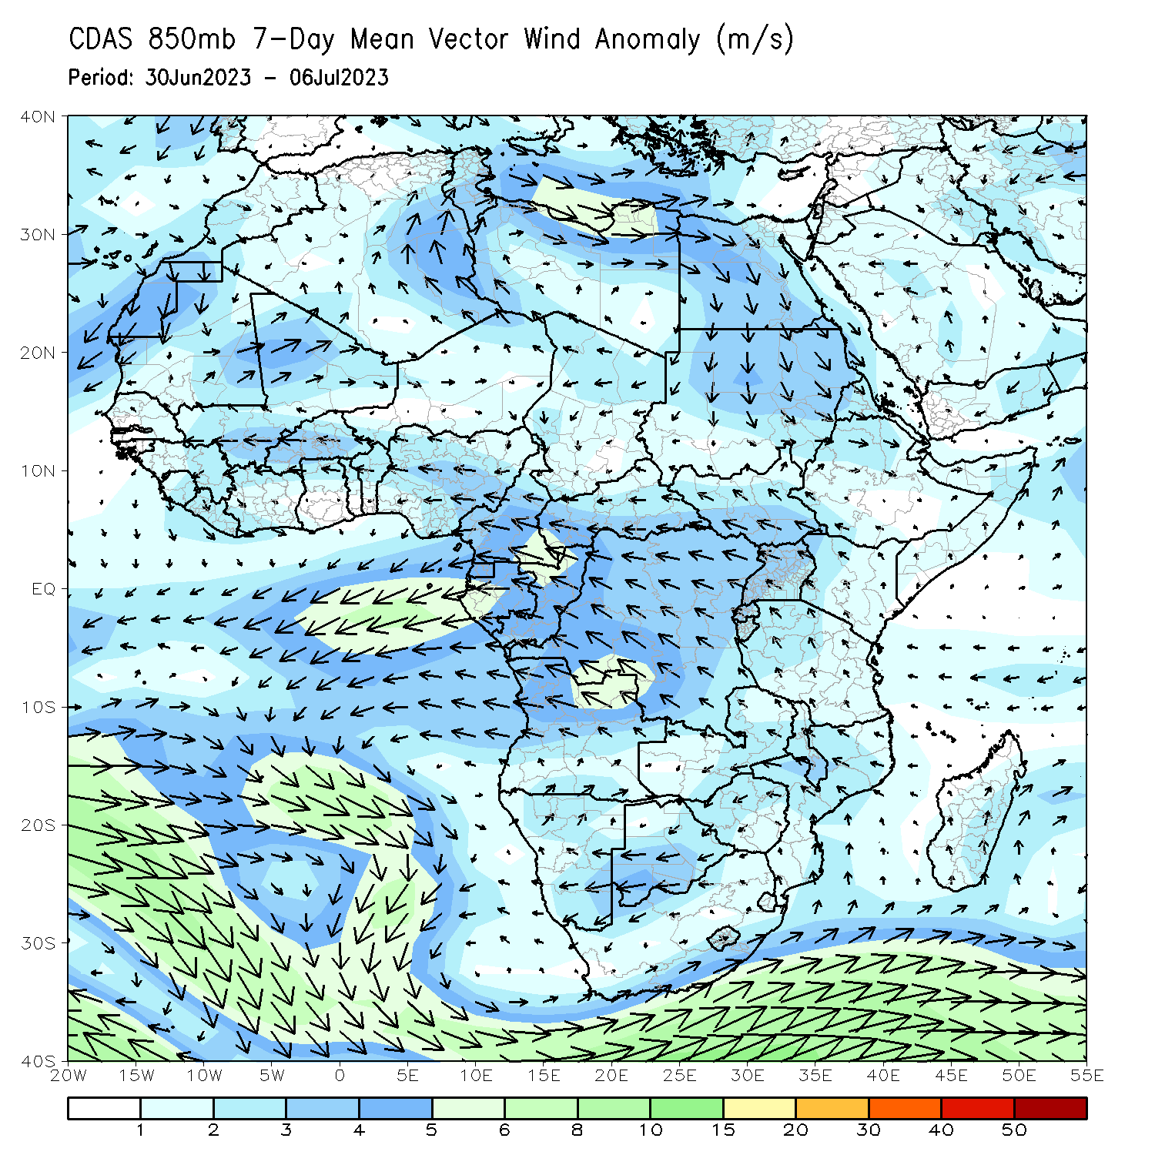
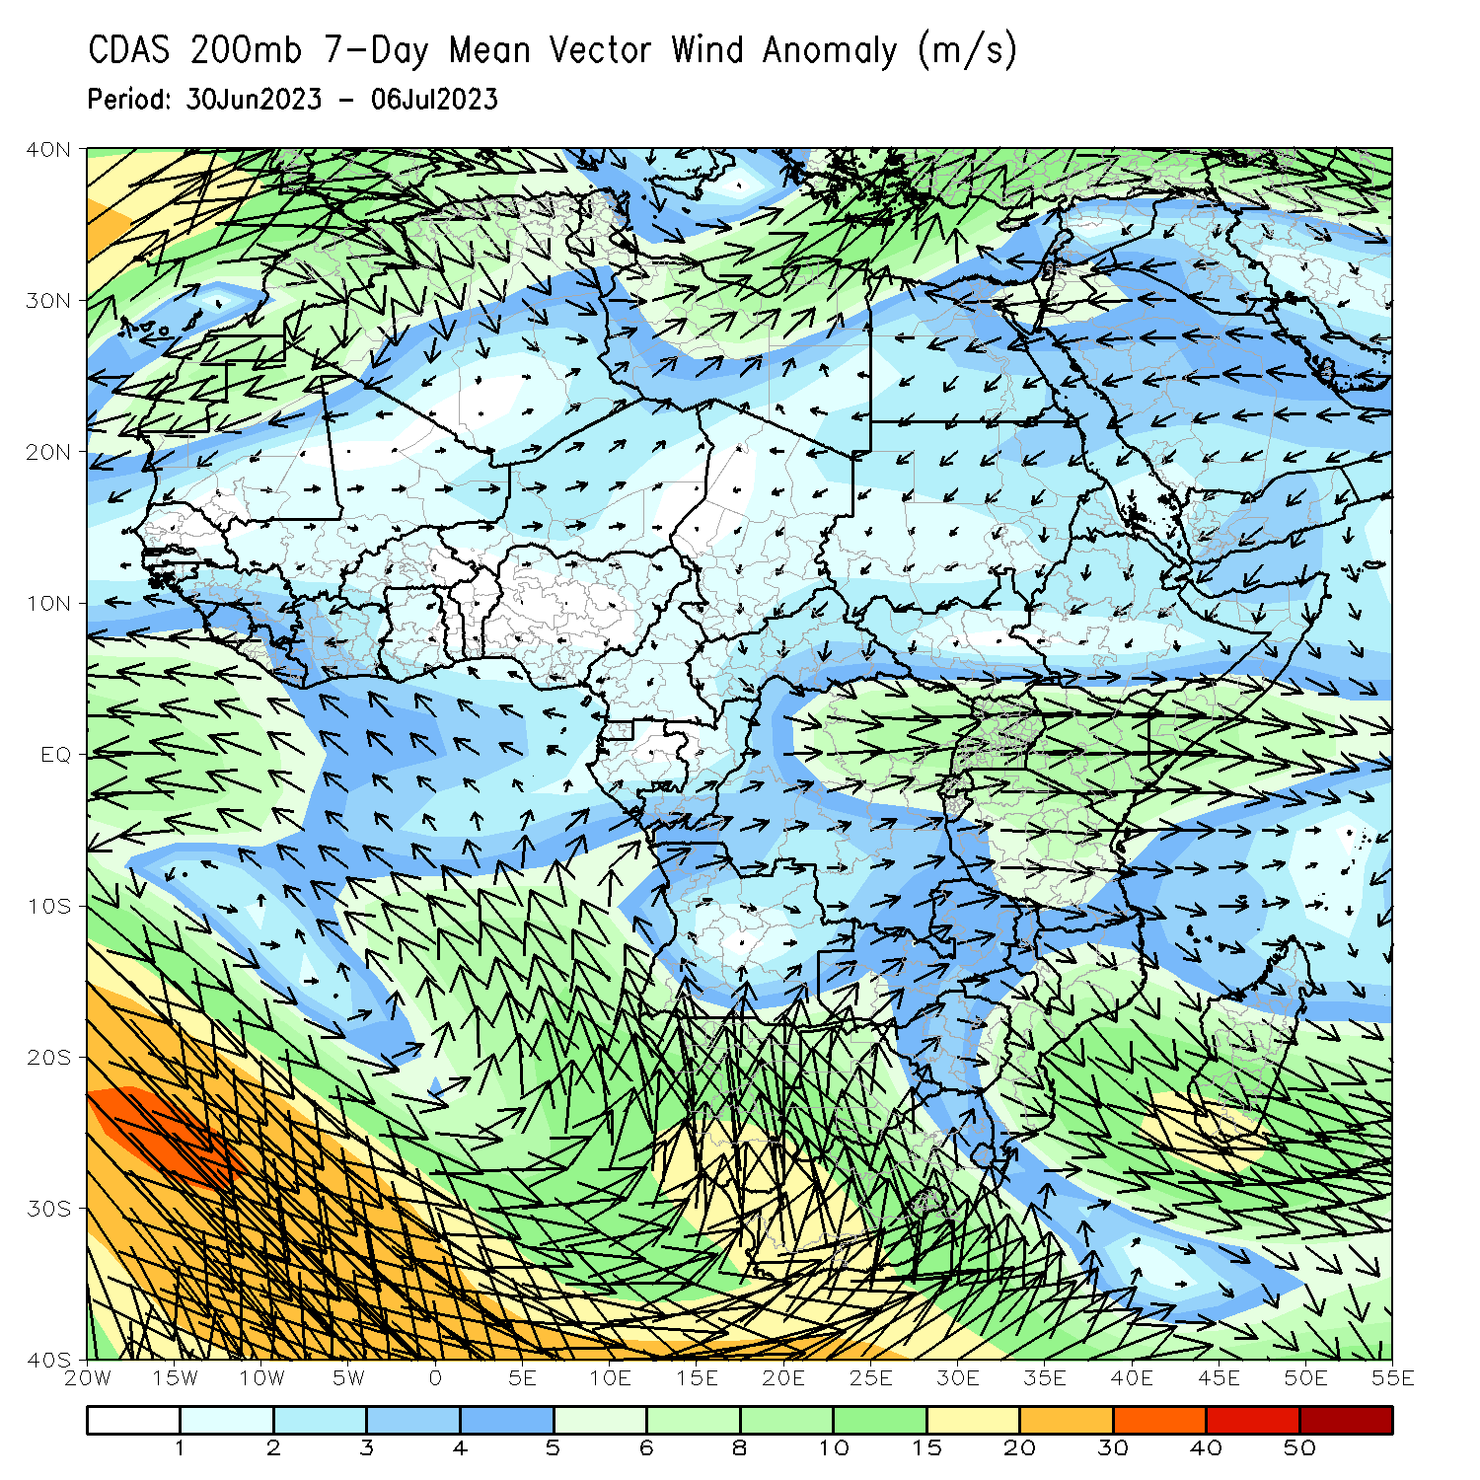
Atmospheric Circulation: Last 7 Days
At 850-hPa (left panel), anomalous lower-level divergence in southern Mali and Burkina Faso, as well as the off-shore flow near Liberia may have contributed to the observed below-average rainfall in the region. At 200-hPa (right panel), anomalous confluence near South Sudan and Ethiopia may have contributed to below-average rainfall.

Slide 8
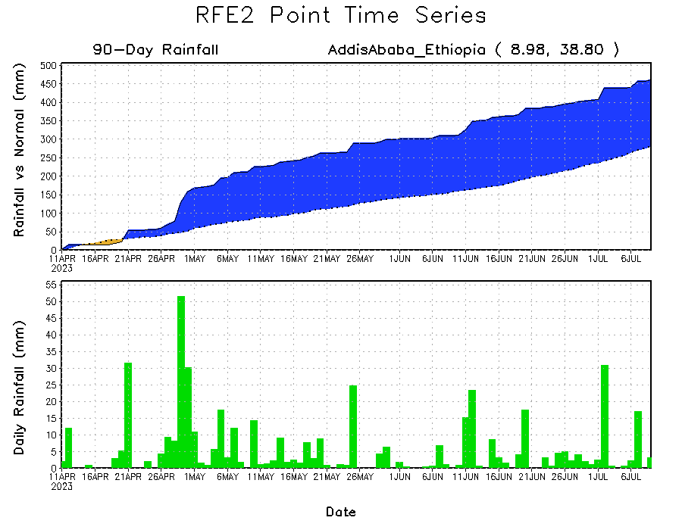
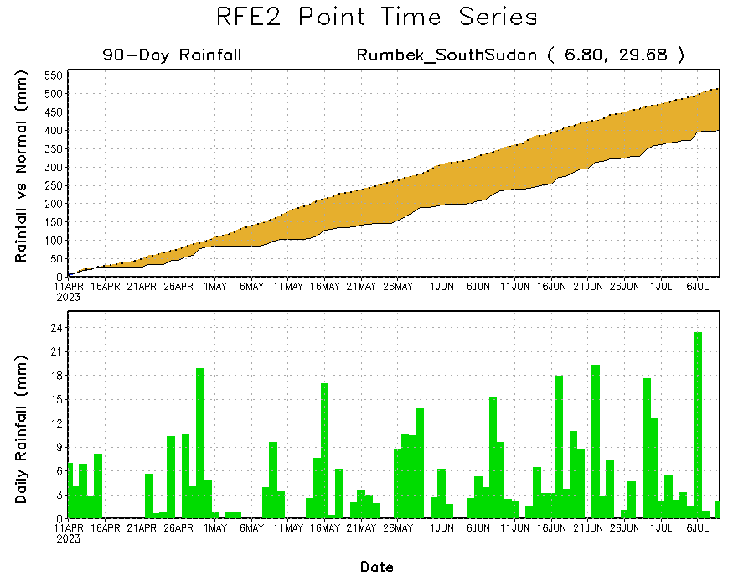
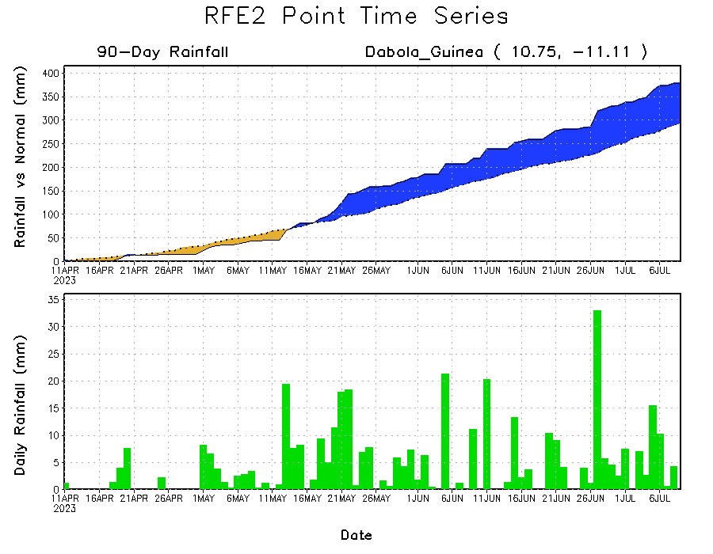
Rainfall Evolution
Daily evolution of rainfall over the last 90 days at selected locations shows light to moderate rainfall maintained moisture surpluses over parts of Guinea (bottom left), and light rain maintained surpluses in central Ethiopia (top right). Seasonal total rainfall remained below-average over parts of South Sudan (bottom right) despite heavier rainfall around 06 July.

Slide 9
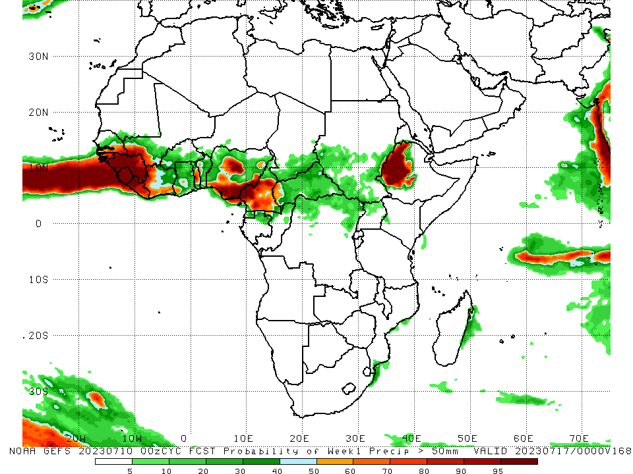
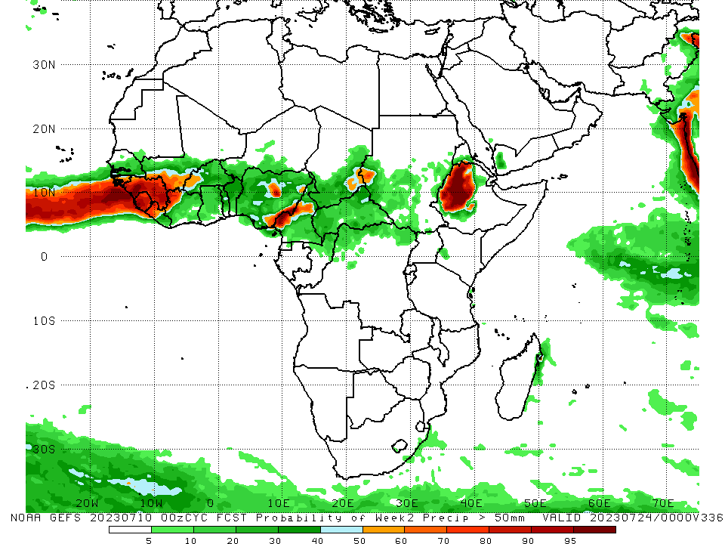
NCEP GEFS Model Forecasts Non-Bias Corrected Probability of precipitation exceedance
Week-1, Valid: 11 June – 17 July 2023
Week-2, Valid: 18 – 24 July 2023
For week-1 (left panel), the GEFS forecasts indicate a moderate to high chance (over 70%) for rainfall to exceed 50 mm over much of southeastern Senegal, Guinea, Guinea-Bissau, southwestern Mali, Sierra Leone, western and central Liberia, northwestern Cote d’Ivoire, parts of central Togo, parts of central, south-central, and southeastern Nigeria, central and southern Cameroon, and western Ethiopia. For week-2 (right panel), the GEFS forecasts indicate a moderate to high chance (over 70%) for rainfall to exceed 50 mm over much of Guinea, southern Guinea-Bissau, northwestern Cote d’Ivoire, Sierra Leone, western Liberia. Parts of southwestern Mali, parts of central and southeastern Nigeria, west-central Cameroon, a small part of southwestern Sudan, and western Ethiopia.
Notes:
9

Slide 10
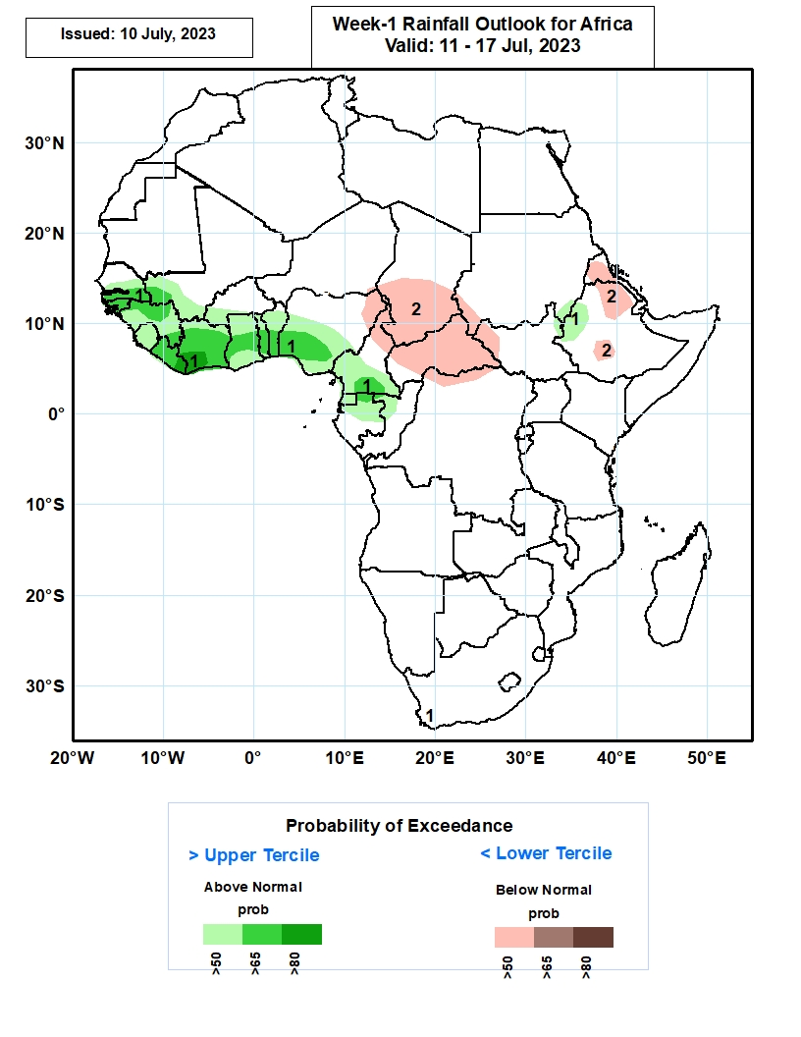
Week-1 Precipitation Outlooks
11 – 17 July 2023
1. The probabilistic forecasts call for above 50% chance for weekly rainfall to be above-normal (above the upper tercile) over along the Gulf of Guinea coast, including southern Senegal, and the far western Ethiopia. There is above 65% chance for rainfall to be above-normal over parts of southern Senegal, Guinea-Bissau, southwestern Mali, northern Guinea, Liberia, Cote d’Ivoire, central Ghana, southern Togo, southern Benin and southern Cameroon.
2. The forecasts call for above 50% chance for weekly total rainfall to be below-normal (below the lower tercile) over northeastern Nigeria, southern Chad, northern Cameroon, CAR, southwestern Sudan, western South Sudan, Eritrea, and parts of northeastern and southern Ethiopia.
Notes:
10

Slide 11
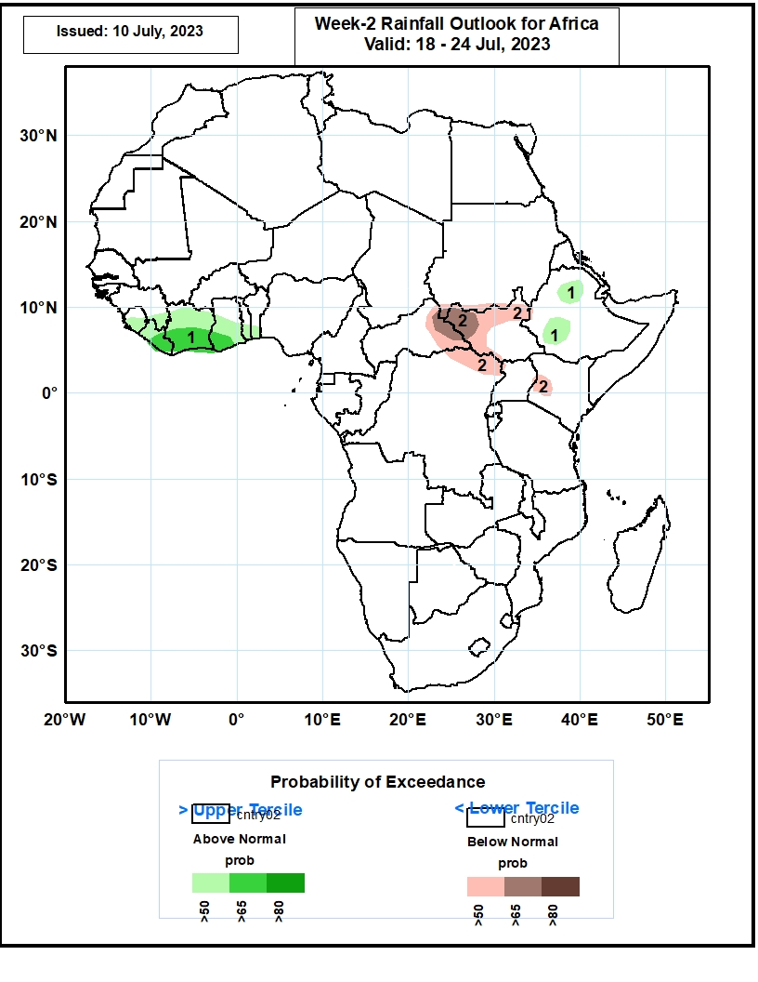
Week-2 Precipitation Outlooks
18 – 24 July 2023
1. The consolidated probabilistic forecasts call for above 50% chance for weekly rainfall to be above-normal (above the upper tercile) over parts of the Gulf of Guinea region, and pockets of northern and southwestern Ethiopia. There is above 65% chance for rainfall to be above-normal over eastern Liberia, southern Cote d’Ivoire and southwestern Ghana.
2. The forecasts call for above 50% chance for weekly total rainfall to be below-normal (below the lower tercile) over eastern CAR, northern and western South Sudan, northern DRC, and pocket of western Kenya. There is above 65% chance for rainfall to be below-normal across eastern CAR and western South Sudan.
Notes:
11

Slide 12
Summary
Over the past 30 days, in East Africa, above-average rainfall was observed over southern Sudan, central, western, and northern Ethiopia, western Eritrea, Djibouti, southern, eastern, and western South Sudan, southwestern Kenya, and northern and eastern Uganda. Rainfall was below-average over north-central South Sudan. In southern Africa, rainfall was above-average over the southern and western portions of South Africa. In Central Africa, rainfall was above-average over northern, eastern, and western Cameroon, southeastern Gabon, southern and northern Congo, parts of western and northern CAR, central and southwestern Chad, and northeastern, northwestern, and central DRC. Below-average rainfall was observed over pockets of southern Cameroon, northern Gabon, pockets of central and northern DRC, pockets of south-central Chad, central Congo, and parts of central and southeastern CAR. In West Africa, rainfall was above-average over southern and eastern Senegal, much of Guinea, Guinea-Bissau, southeastern and southwestern Mali, northern Sierra Leone, eastern Liberia, southern, eastern, and northern Cote d’Ivoire, western and northern Burkina Faso, most of Ghana, southern, central, and eastern Nigeria, central and southern Togo, central Benin, and much of southern Niger. Below-average rainfall was observed over western Liberia, west-central Cote d’Ivoire, eastern Burkina Faso, northern Togo, southern Benin, northeastern Ghana, coastal Sierra Leone, southeastern Guinea, south-central Mali, and parts of northwestern, southwestern, and central Nigeria.
During the past 7 days, in East Africa, rainfall was above-average over southeastern and southwestern Sudan, western and northern Ethiopia, northeastern South Sudan, northern and eastern Uganda, and southwestern Kenya. Rainfall was below average over most of northern, eastern, and western South Sudan and in south-central Sudan. In Central Africa, rainfall was above-average over parts of north-central Cameroon, parts of central CAR, southeastern Chad, and parts of northeastern and northwestern DRC. Below-average rainfall was observed over northern and parts of central Cameroon, southeastern CAR, north-central DRC, and southwestern Chad. In West Africa, above-average rainfall was observed over western and central Guinea, northern Senegal, southwestern Mauritania, northern and central Sierra Leone, central and eastern Cote d’Ivoire, parts of central Nigeria, southern Ghana, Togo, Benin, eastern Mali, and south-central Niger. Rainfall was below-average over parts of southern Sierra Leone, southwestern Cote d’Ivoire, Liberia, eastern Guinea, Burkina Faso, south-central and southwestern Mali, southwestern Senegal, southeastern Mauritania, and most of northeastern and south-central Nigeria.
The Week-1 outlook calls for above-normal rainfall over much of the Gulf of Guinea region, including central and southern Senegal, Guinea-Bissau, Guinea, Sierra Leone, Liberia, Cote d’Ivoire, Ghana, Togo, Benin, central and southern Nigeria, southern Cameroon, and northern Gabon. Rainfall is also expected to be above average in northwestern Ethiopia. In contrast, there is an increased chance for below-normal rainfall over much of the Sahel regions, including south-central Mali, Burkina Faso, southern Niger, northern Nigeria, northern Cameroon, southern Chad, southern Sudan, northern South Sudan, north-central Ethiopia, and western Eritrea. For week-2, there is an increased chance for above-normal rainfall over southeastern Guinea, southern Sierra Leone, Liberia, and parts of southern Cote d’Ivoire. In contrast, there is an increased chance for below-normal rainfall over much of coastal Guinea and Guinea-Bissau, central and southern Nigeria, central and southern Cameroon, CAR, northern DRC, South Sudan, northern and central Uganda, parts of western Kenya, and parts of western and central Ethiopia.

