Slide 1
The African Monsoon Recent Evolution and Current Status Include Week-1 and Week-2 Outlooks
Update prepared
26 June 2023
For more information, visit:
http://www.cpc.ncep.noaa.gov/products/Global_Monsoons/African_Monsoons/precip_monitoring.shtml

Slide 2
Outline
Highlights
Recent Evolution and Current Conditions
NCEP GEFS Forecasts
Summary

Slide 3
Highlights: Last 7 Days
During the past 7 days, in East Africa, rainfall was above-average over southern and eastern Sudan, pockets of Ethiopia, and portions of South Sudan and Uganda. In Central Africa, rainfall was above-average over western and northern Cameroon, northern Congo, western CAR, and parts of central and northern DRC. Below-average rainfall was observed over pockets of central Cameroon, central Congo, and eastern CAR. In West Africa, above-average rainfall was observed over western Guinea, Sierra Leone, eastern Liberia, Cote d’Ivoire, western and northern Burkina Faso, southern Ghana, southeastern Mali, northern Benin, and central and southern Nigeria. Rainfall was below-average over western Mali, parts of eastern Guinea, eastern Burkina Faso, southern Benin and parts of northern and eastern Nigeria.
The Week-1 outlook calls for above-normal rainfall over Guinea, southern Mali, southeastern Nigeria, southern Cameroon, northern Congo, northern DRC, parts of southern Sudan and northern South Sudan, western and central Ethiopia, and southern South Africa. In contrast, there is an increased chance for below-normal rainfall over much of Cote d’Ivoire, southern Burkina Faso, Ghana, Togo Benin, northern Nigeria, southern Niger, northern Cameroon, southern Chad, northern CAR and northeastern Ethiopia. For week-2, there is an increased chance for above-normal rainfall over eastern Nigeria, Cameroon, southern CAR, northern DRC, southwestern South Sudan and western Ethiopia. In contrast, there is an increased chance for below-normal rainfall over much of Liberia and northwestern Cote d’Ivoire.

Slide 4
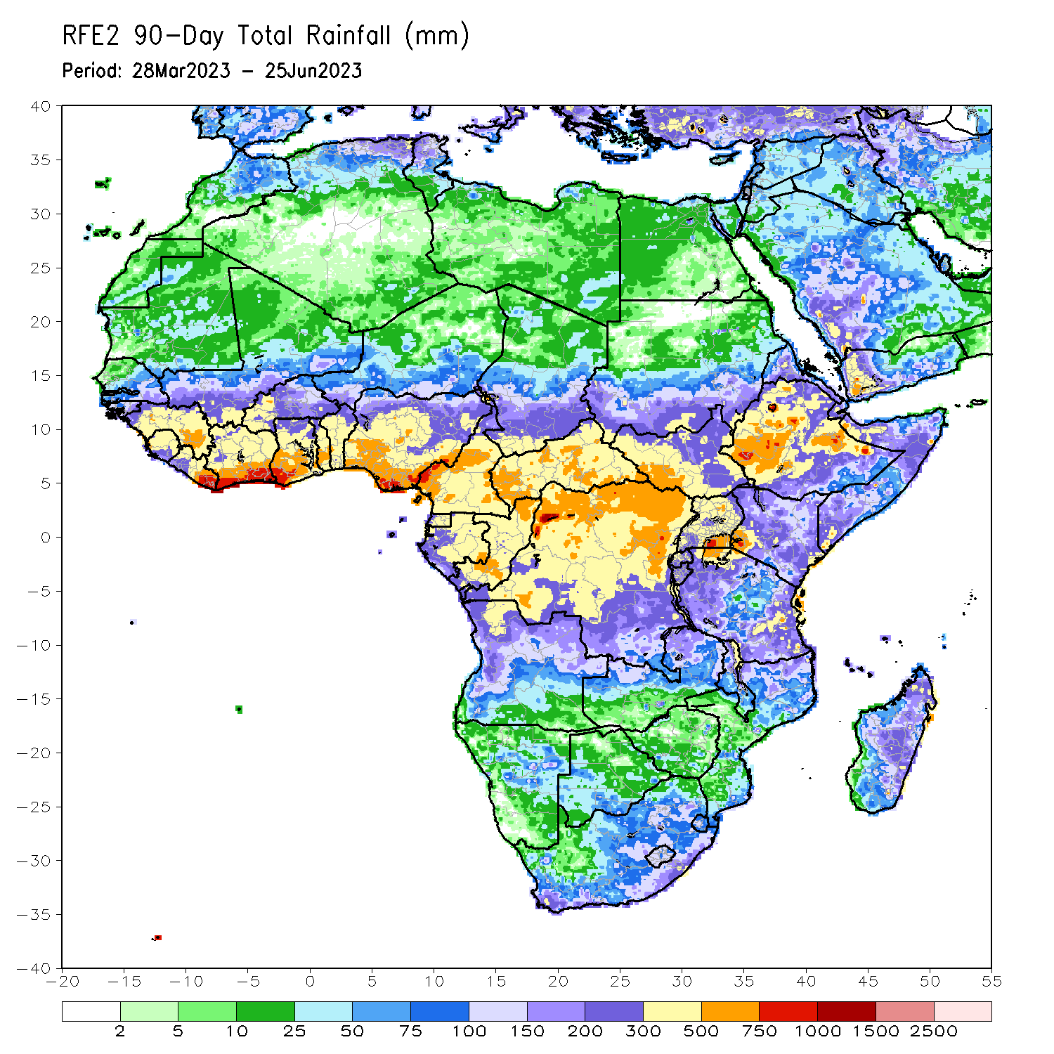
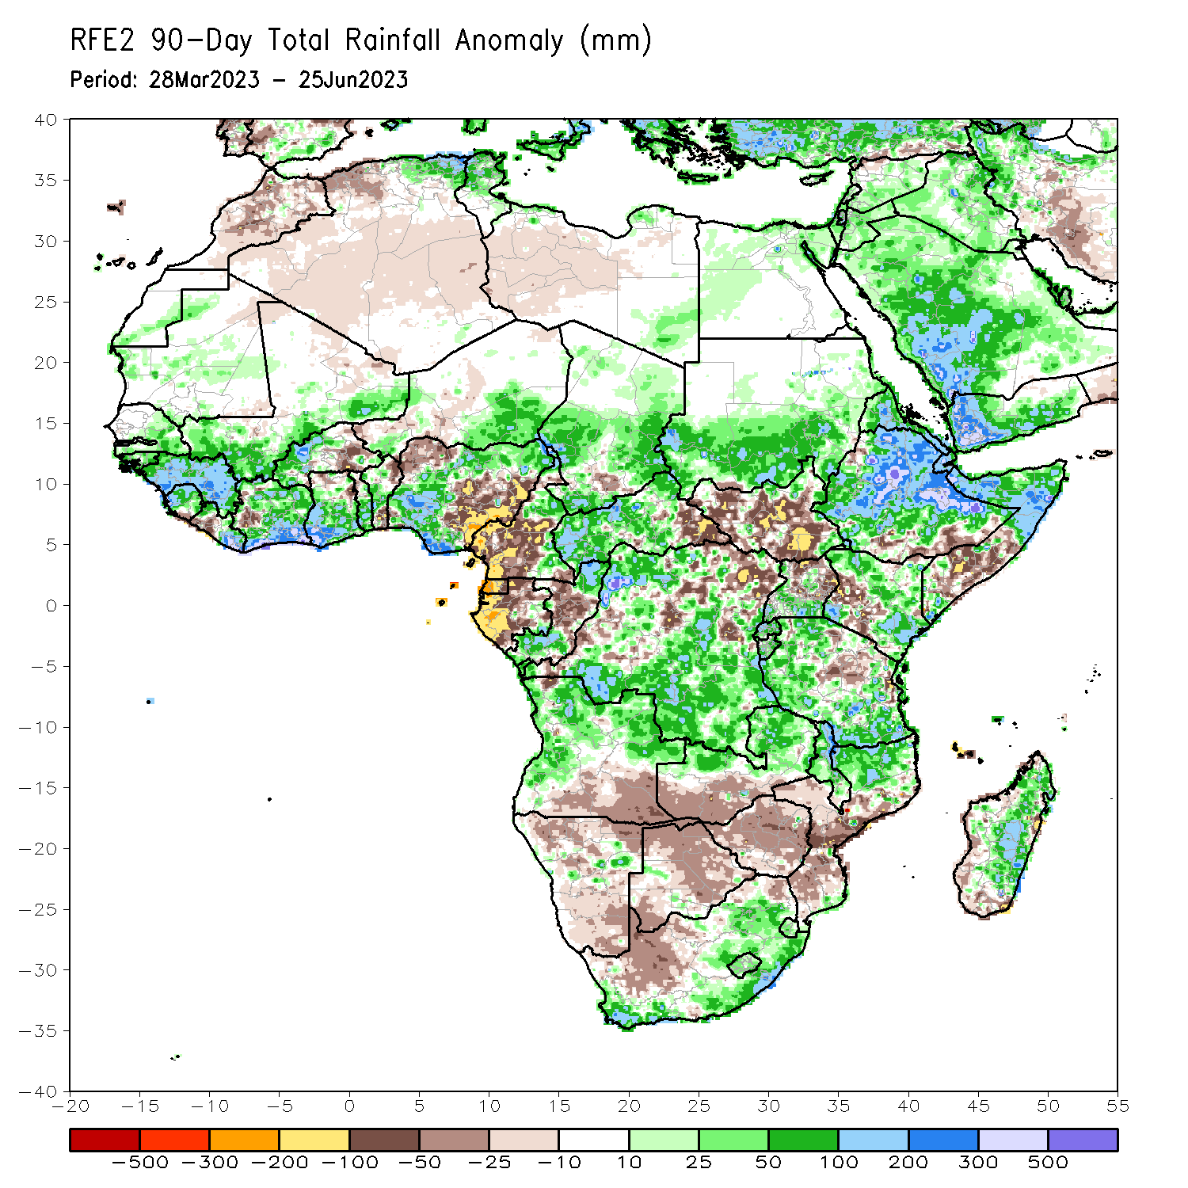
Rainfall Patterns: Last 90 Days
Over the past 90 days, in East Africa, above-average rainfall was observed over much of Eritrea, Ethiopia, northern and central Somalia, central and eastern Kenya, Djibouti, central and southern Uganda, Tanzania, Burundi and Rwanda. Rainfall was below-average over much of South Sudan, parts of southern Somalia, western Kenya and northern Uganda. In southern Africa, above-average rainfall was observed over central and northern Angola, northern and eastern Zambia, parts of eastern and southern South Africa, Lesotho, Eswatini, Malawi, northern Mozambique, and much of Madagascar. Below-average rainfall was observed over the southern portion of Angola, western and southern Zambia, much of Namibia and Botswana, western South Africa, Zimbabwe, Malawi, and southern Mozambique. In Central Africa, rainfall was above-average over parts of eastern Cameroon, western and central CAR, the far southern and northern Congo, and many parts of DRC. Rainfall was below-average over many parts of Cameroon, Equatorial Guinea, much of Gabon, parts of eastern CAR, and parts of central and eastern DRC. In West Africa, rainfall was above-average over parts of eastern and southern Senegal, much of Guinea, Sierra Leone, Liberia, Cote d’Ivoire, southwestern Mali, western Burkina Faso, central and southern Ghana, Togo, Benin, and western and northern Nigeria. Below-average rainfall was observed over parts of eastern Burkina Faso, and northwestern and eastern Nigeria.
Notes:
4

Slide 5
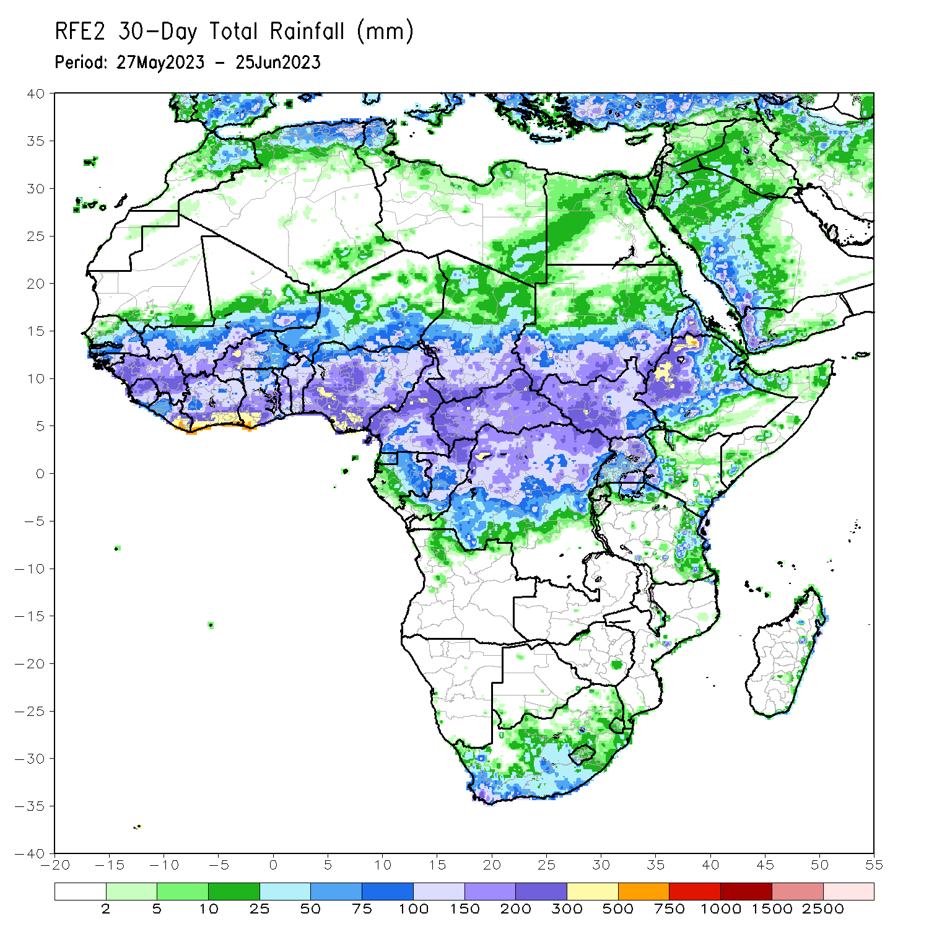
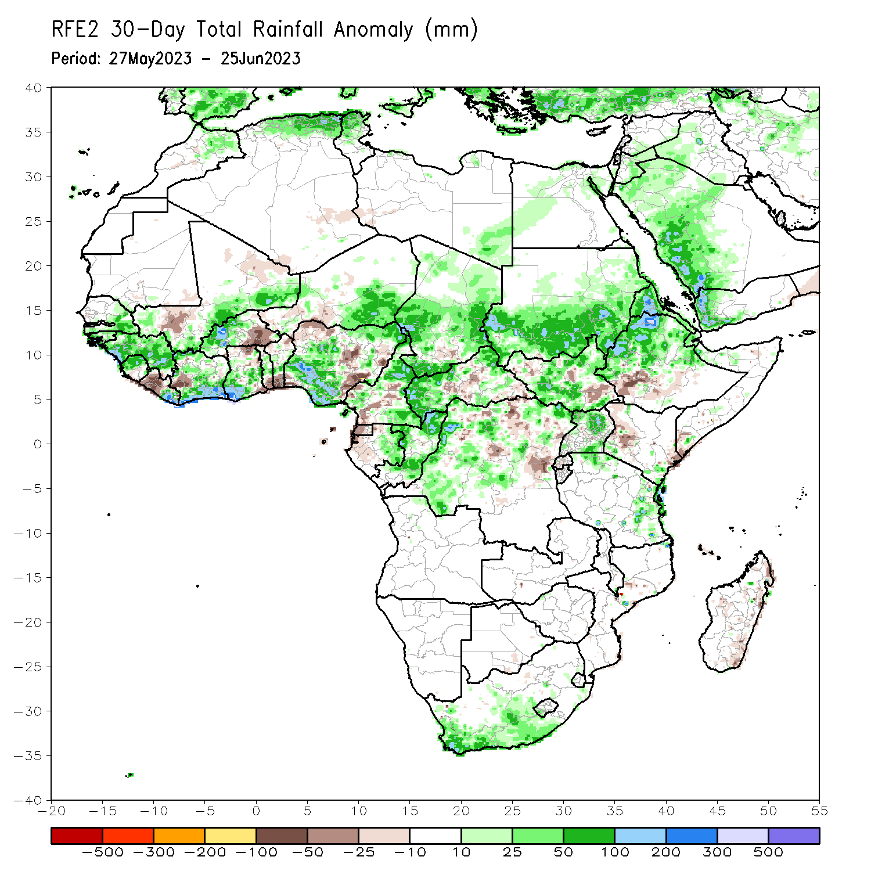
Rainfall Patterns: Last 30 Days
Over the past 30 days, in East Africa, above-average rainfall was observed over southern Sudan, central and northern Ethiopia, Eritrea, Djibouti, and parts of South Sudan and Uganda. Rainfall was below-average over southeastern South Sudan, southwestern Ethiopia and pockets of Kenya. In southern Africa, rainfall was above-average over the southern portion of South Africa. In Central Africa, rainfall was above-average over parts of Cameroon, eastern Gabon, southern and northern Congo, parts of CAR and DRC. Below-average rainfall was observed over pockets of central Cameroon, Equatorial Guinea, western Gabon, pockets of central and northern DRC, and parts of central CAR. In West Africa, rainfall was above-average over southern and eastern Senegal, much of Guinea, southeastern Mali, Sierra Leone, eastern Liberia, southern Cote d’Ivoire, western Burkina Faso, southern Ghana, and central and southern and central Nigeria, and southeastern Niger. Below-average rainfall was observed over western Liberia, eastern Burkina Faso, southern Togo, southern Benin, and parts of eastern Nigeria.
Notes:
5

Slide 6
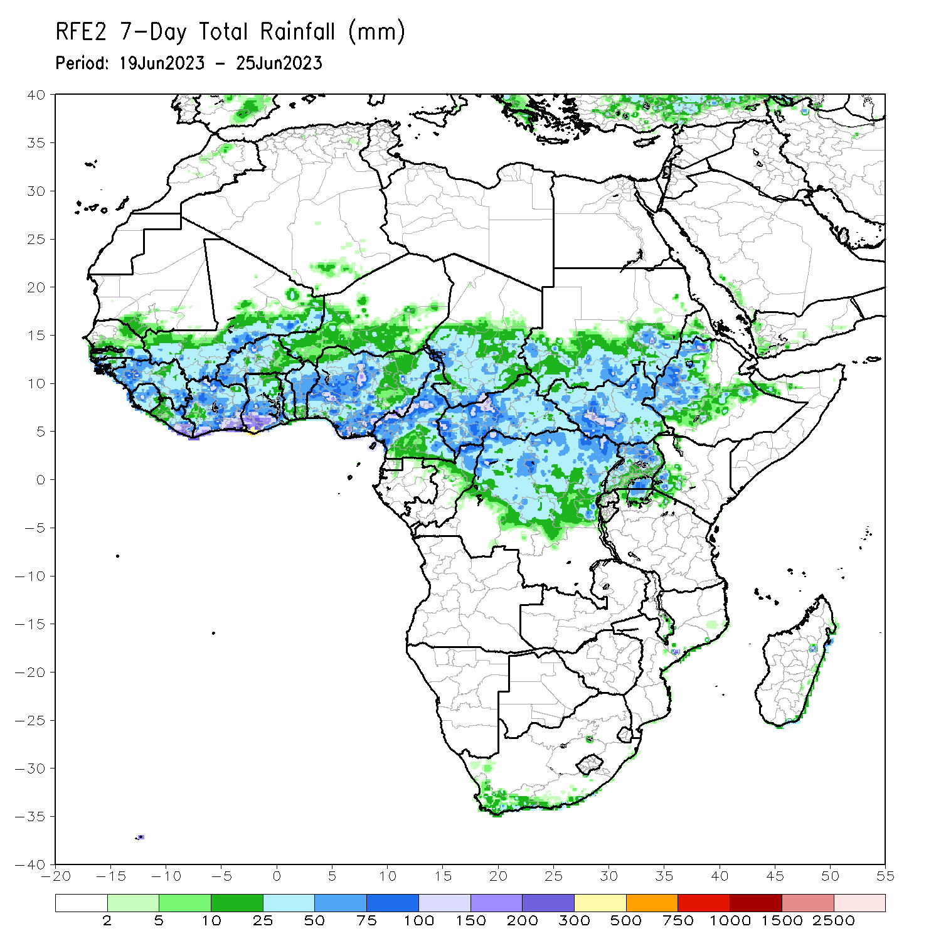
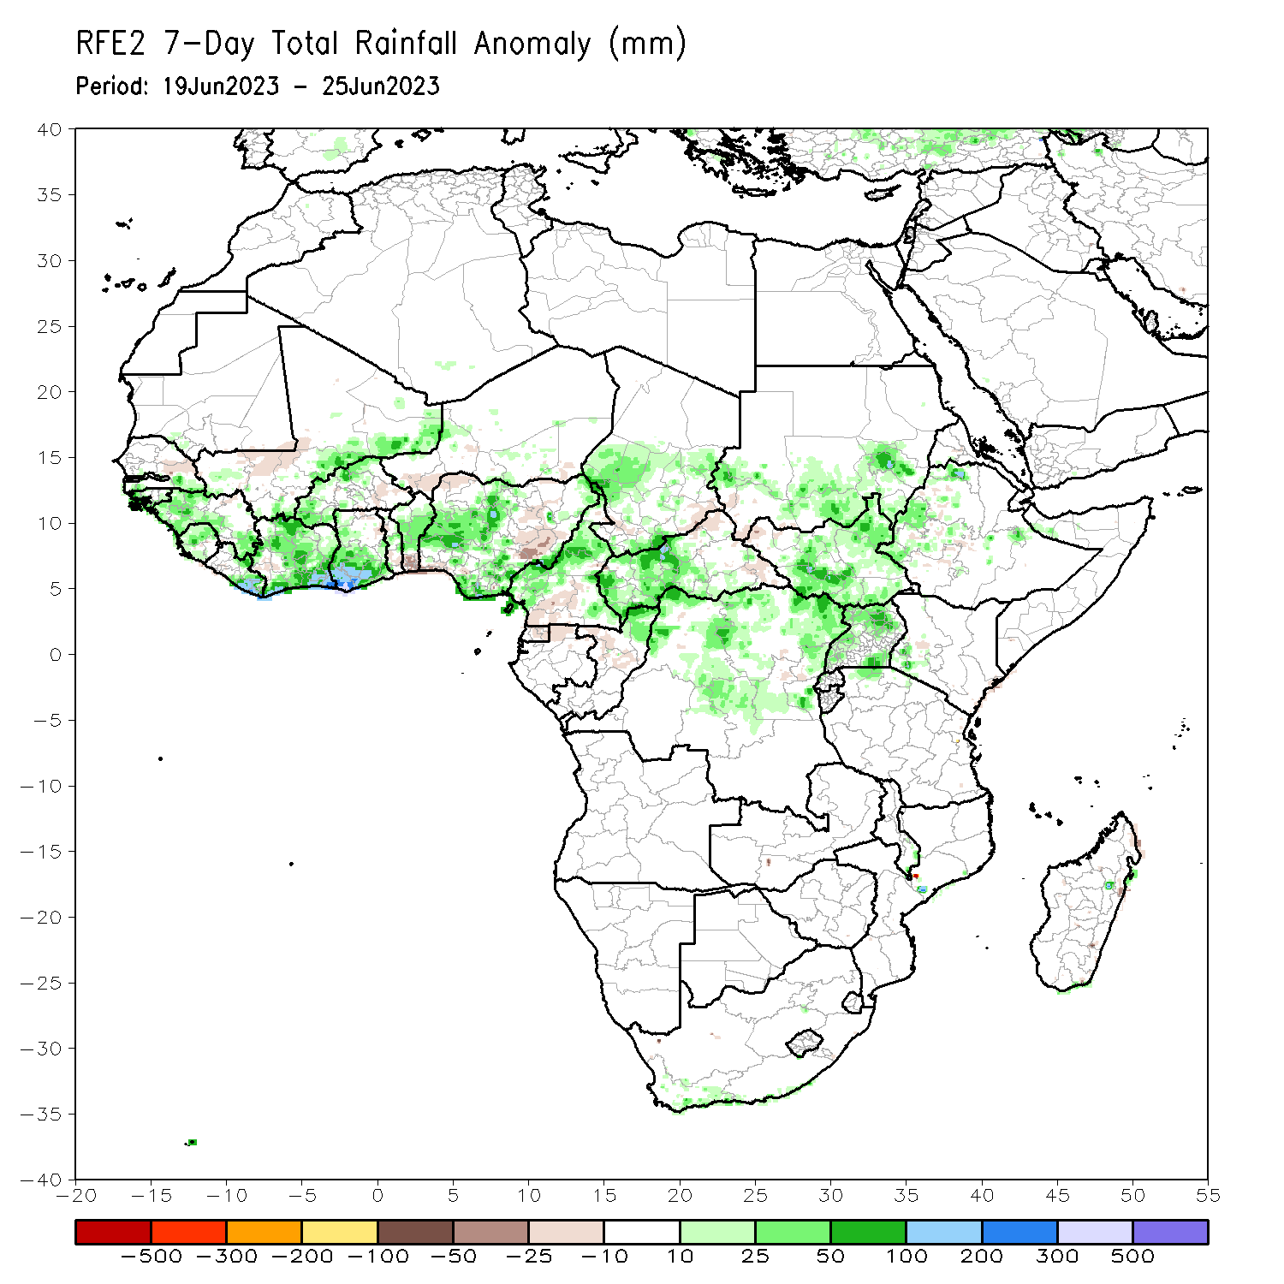
Rainfall Patterns: Last 7 Days
During the past 7 days, in East Africa, rainfall was above-average over southern and eastern Sudan, pockets of Ethiopia, and portions of South Sudan and Uganda. In Central Africa, rainfall was above-average over western and northern Cameroon, northern Congo, western CAR, and parts of central and northern DRC. Below-average rainfall was observed over pockets of central Cameroon, central Congo, and eastern CAR. In West Africa, above-average rainfall was observed over western Guinea, Sierra Leone, eastern Liberia, Cote d’Ivoire, western and northern Burkina Faso, southern Ghana, southeastern Mali, northern Benin, and central and southern Nigeria. Rainfall was below-average over western Mali, parts of eastern Guinea, eastern Burkina Faso, southern Benin and parts of northern and eastern Nigeria.

Slide 7
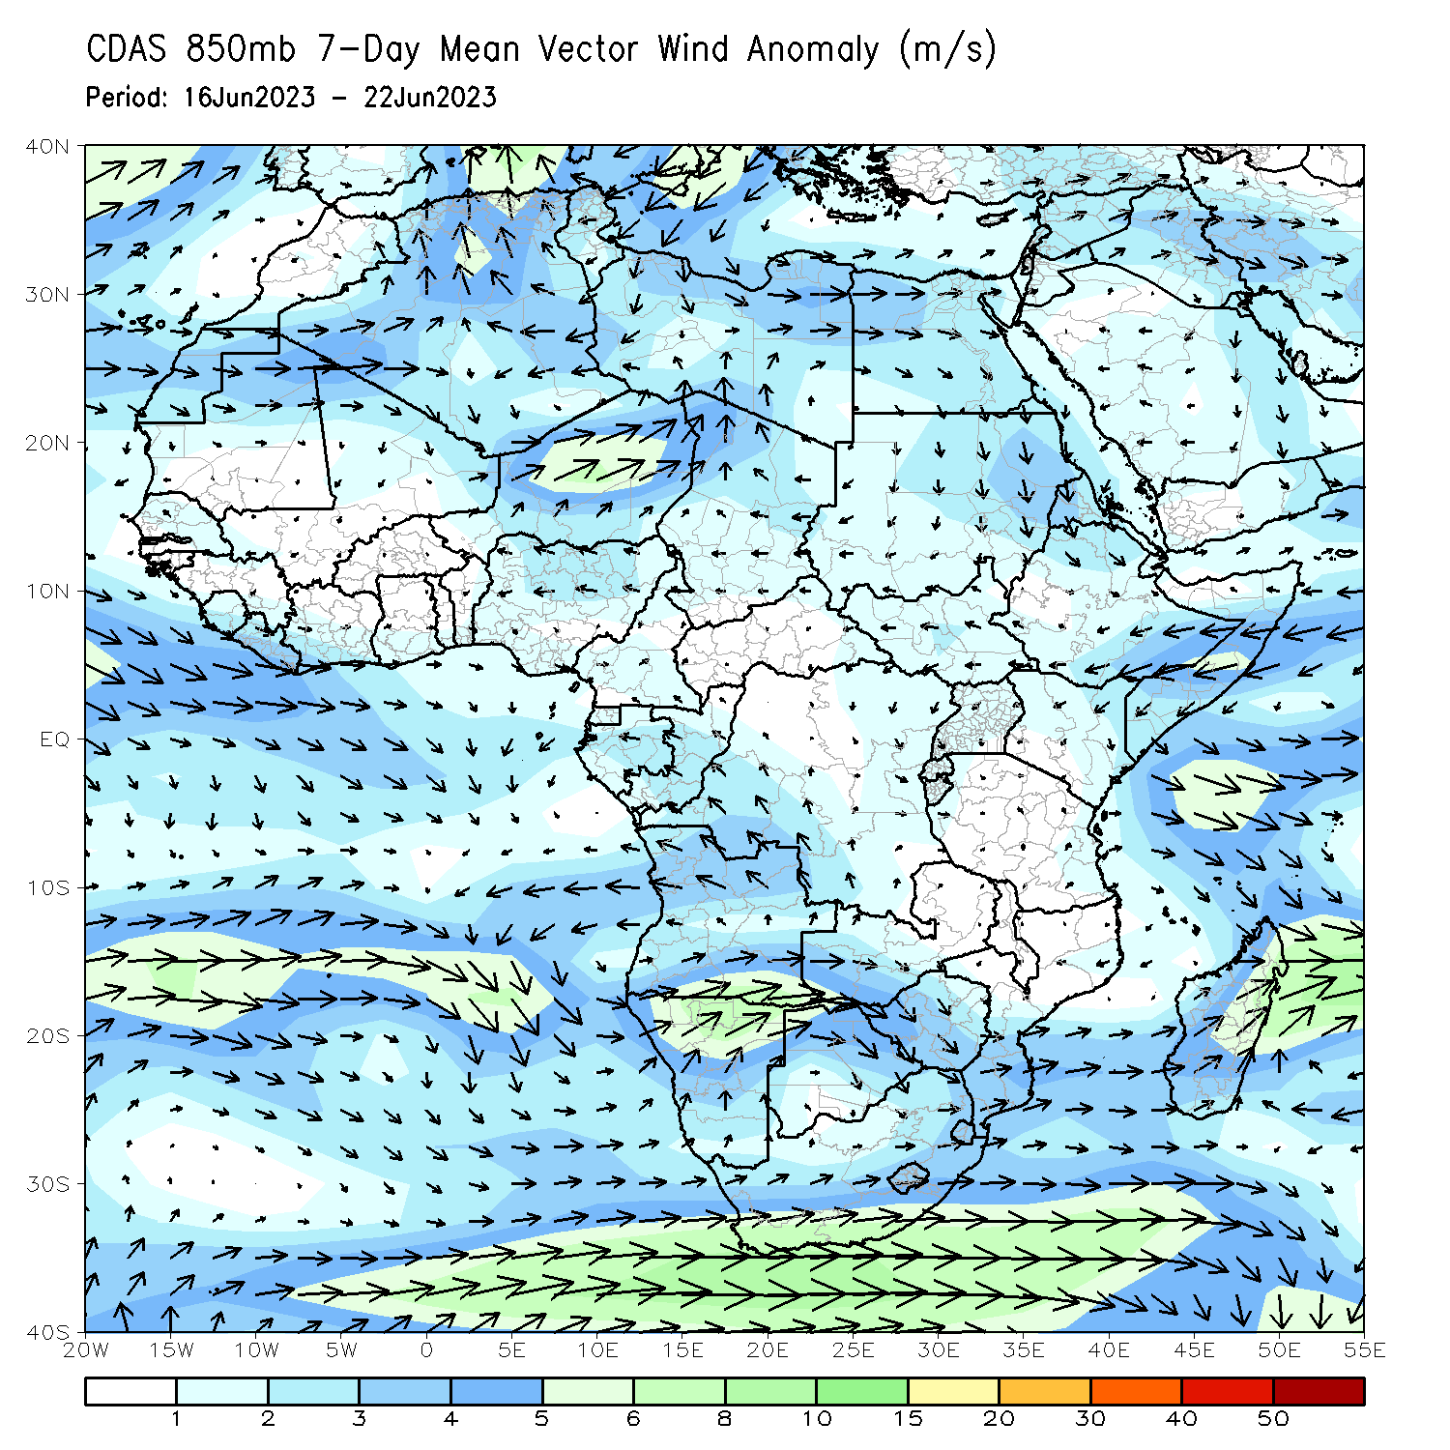
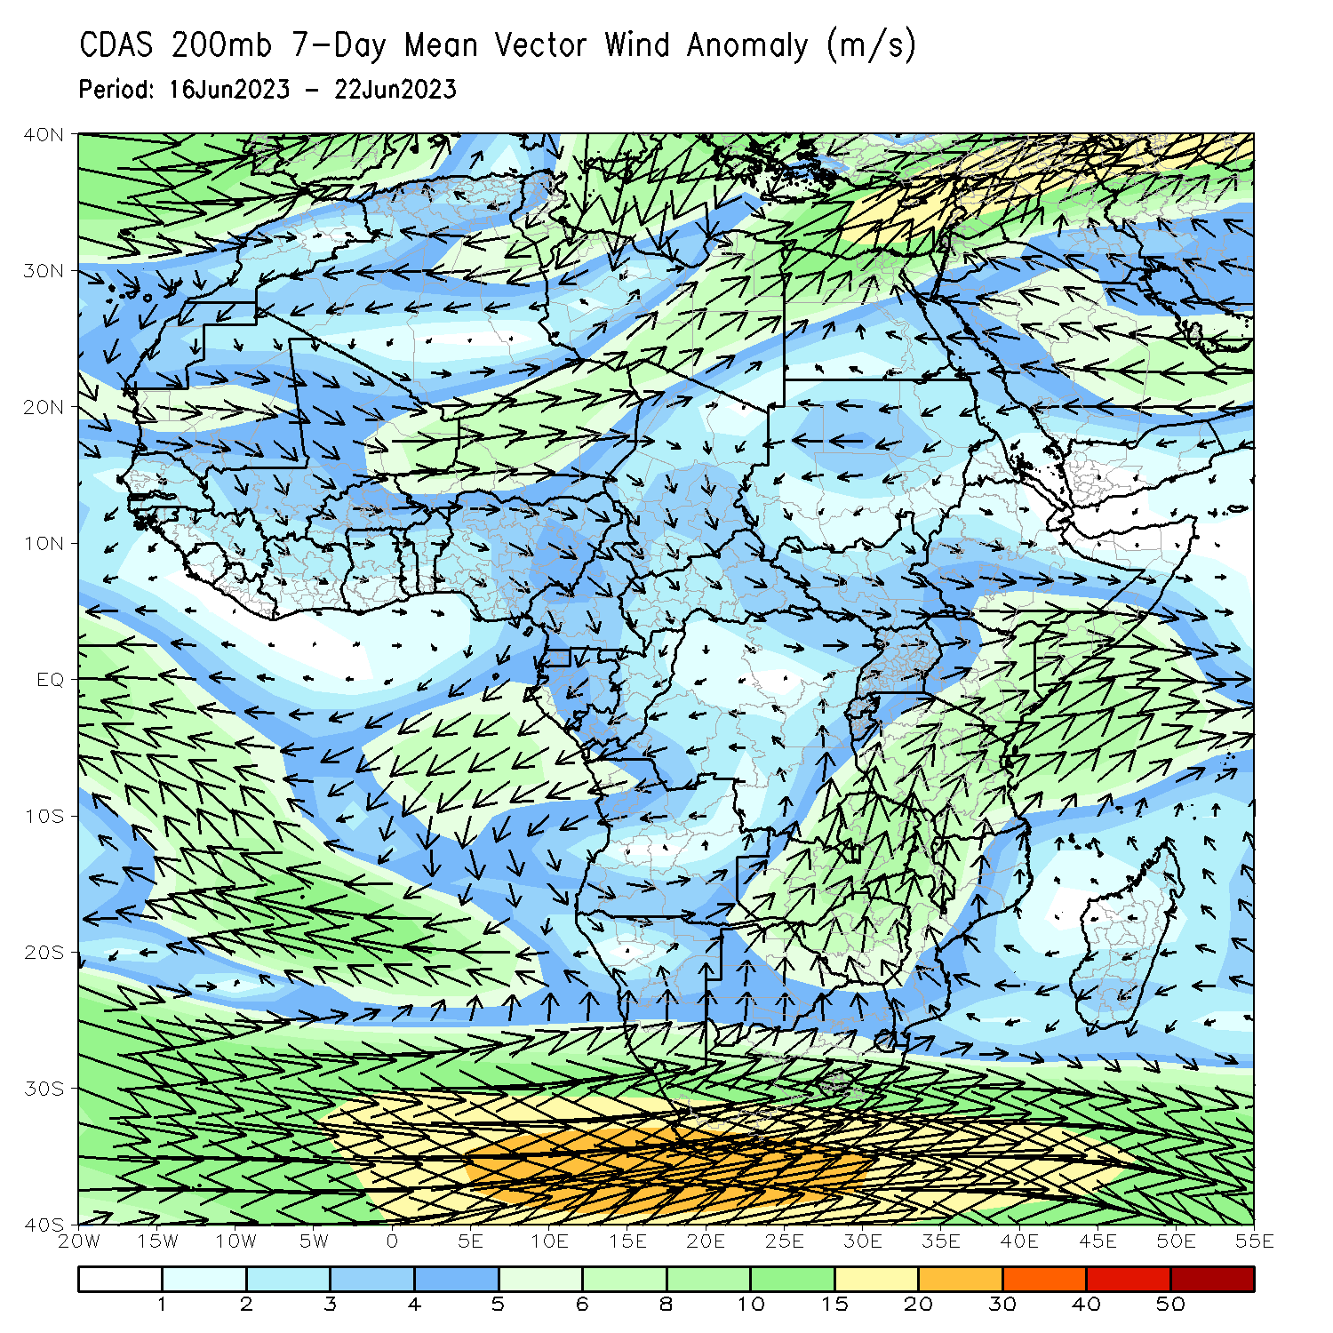
Atmospheric Circulation: Last 7 Days
At 850-hPa level (left panel), anomalous lower-level convergence between westerlies and easterlies in the Gulf of Guinea may have contributed to the observed above-average rainfall in the region.

Slide 8
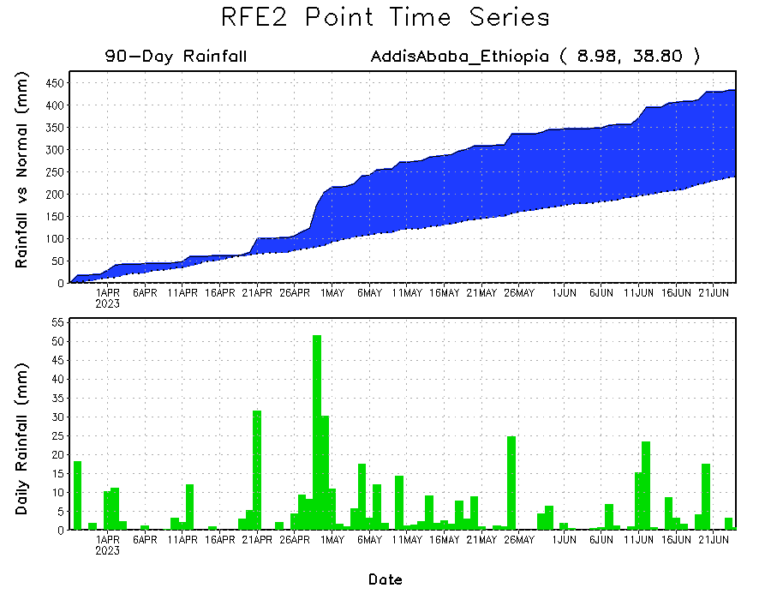
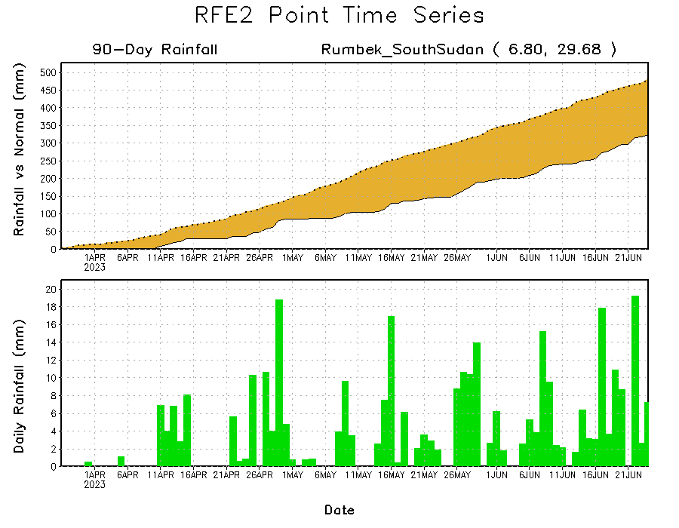
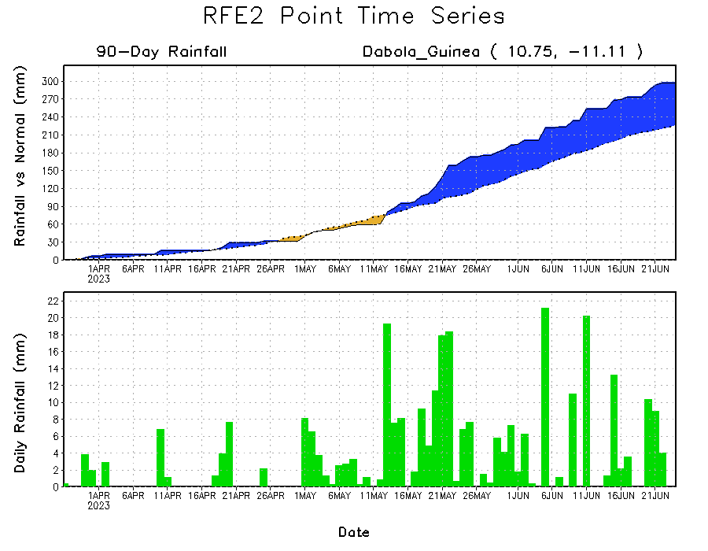
Rainfall Evolution
Daily evolution of rainfall over the last 90 days at selected locations shows moderate to local heavy rainfall sustained moisture surpluses over parts of Guinea (bottom left) and Ethiopia (top right). Seasonal total rainfall remained below-average over parts of South Sudan (bottom right).

Slide 9
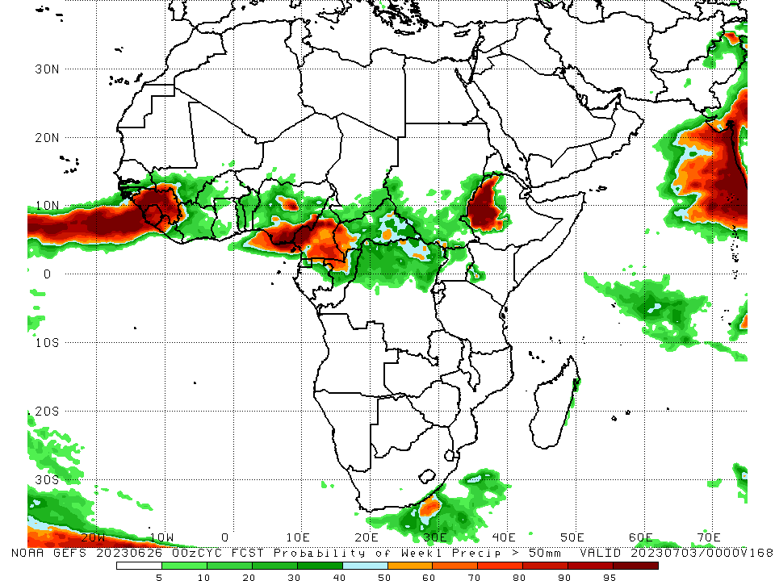
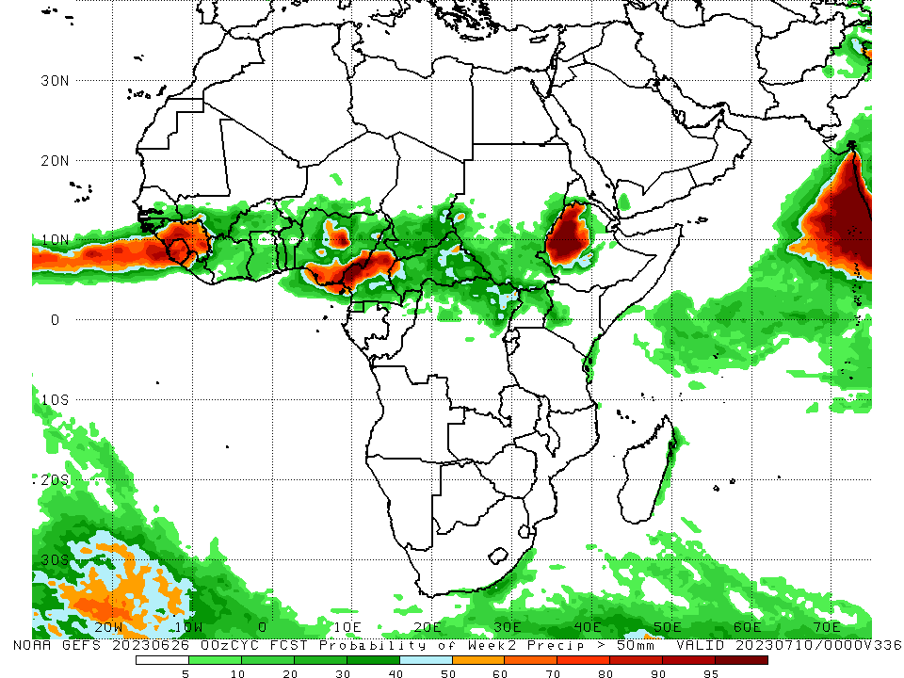
NCEP GEFS Model Forecasts Non-Bias Corrected Probability of precipitation exceedance
Week-1, Valid: 27 June – 03 July 2023
Week-2, Valid: 04 – 10 July 2023
For week-1 (left panel) and week-2 (right panel), the GEFS forecasts indicate a moderate to high chance (over 70%) for rainfall to exceed 50 mm over much of Guinea, Sierra Leone, western Liberia, central and southeastern Nigeria, Cameroon, and western Ethiopia.
Notes:
9

Slide 10
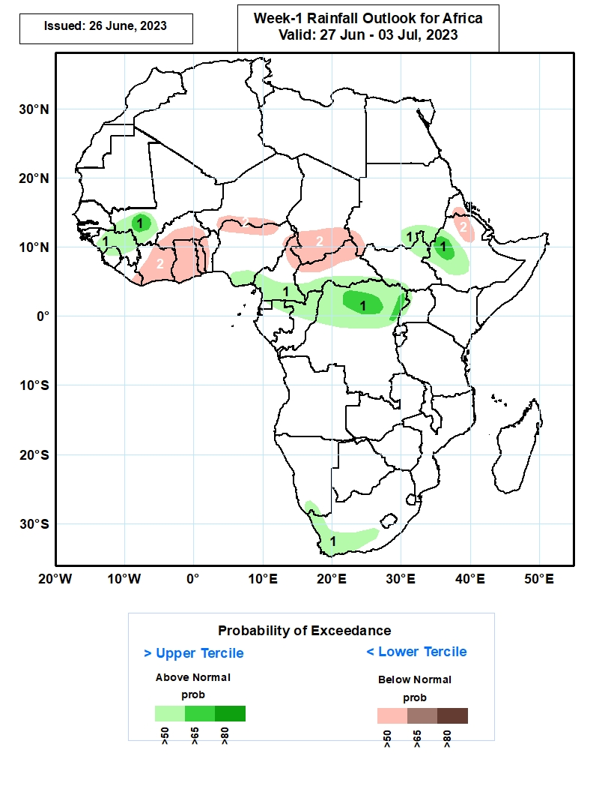
Week-1 Precipitation Outlooks
27 June – 03 July 2023
The probabilistic forecasts call for above 50% chance for weekly rainfall to be above-normal (above the upper tercile) over southern Mali, much of Guinea, northern Sierra Leone, southern Nigeria and Cameroon, northern parts of Gabon and Congo, southern CAR, northern and central portions of DR Congo, northeastern and southwestern South Sudan, southeastern Sudan, western and central parts of Ethiopia, southern Namibia, and western and southern parts of South Africa. In particular, there is an above 65% chance for rainfall to be above-normal over southern Mali, northern and eastern parts of DR Congo, and western Ethiopia.
The forecasts call for above 50% chance for weekly total rainfall to be below-normal (below the lower tercile) over eastern Liberia, much of Cote d’Ivoire, Ghana and Togo, central and southern parts of Burkina Faso, western Benin, southern Niger, northern Nigeria and Cameroon, southern Chad, northern CAR, north-central Ethiopia, and southern parts of Eritrea.
Notes:
10

Slide 11
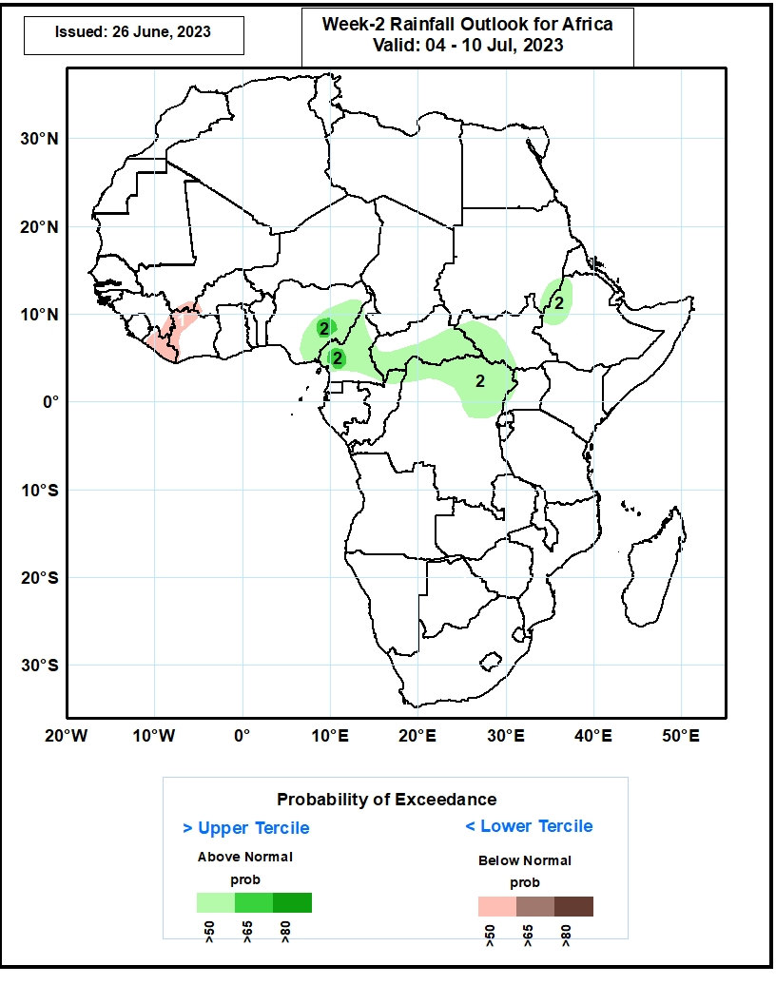
Week-2 Precipitation Outlooks
04 – 10 July 2023
The forecasts call for above 50% chance for weekly total rainfall to be below-normal (below the lower tercile) over eastern Guinea, western and northern parts of Cote d’Ivoire, and much of Liberia.
The probabilistic forecasts call for above 50% chance for weekly rainfall to be above-normal (above the upper tercile) over central and eastern parts of Nigeria, much of Cameroon, central and southern portions of CAR, western South Sudan, southeastern Sudan, western Ethiopia, northern Congo, and northern and eastern portions of DR Congo. In particular, there is an above 65% chance for rainfall to be above-normal over central Nigeria and southwestern Cameroon
Notes:
11

Slide 12
Summary
Over the past 30 days, in East Africa, above-average rainfall was observed over southern Sudan, central and northern Ethiopia, Eritrea, Djibouti, and parts of South Sudan and Uganda. Rainfall was below-average over southeastern South Sudan, southwestern Ethiopia and pockets of Kenya. In southern Africa, rainfall was above-average over the southern portion of South Africa. In Central Africa, rainfall was above-average over parts of Cameroon, eastern Gabon, southern and northern Congo, parts of CAR and DRC. Below-average rainfall was observed over pockets of central Cameroon, Equatorial Guinea, western Gabon, pockets of central and northern DRC, and parts of central CAR. In West Africa, rainfall was above-average over southern and eastern Senegal, much of Guinea, southeastern Mali, Sierra Leone, eastern Liberia, southern Cote d’Ivoire, western Burkina Faso, southern Ghana, and central and southern and central Nigeria, and southeastern Niger. Below-average rainfall was observed over western Liberia, eastern Burkina Faso, southern Togo, southern Benin, and parts of eastern Nigeria.
During the past 7 days, in East Africa, rainfall was above-average over southern and eastern Sudan, pockets of Ethiopia, and portions of South Sudan and Uganda. In Central Africa, rainfall was above-average over western and northern Cameroon, northern Congo, western CAR, and parts of central and northern DRC. Below-average rainfall was observed over pockets of central Cameroon, central Congo, and eastern CAR. In West Africa, above-average rainfall was observed over western Guinea, Sierra Leone, eastern Liberia, Cote d’Ivoire, western and northern Burkina Faso, southern Ghana, southeastern Mali, northern Benin, and central and southern Nigeria. Rainfall was below-average over western Mali, parts of eastern Guinea, eastern Burkina Faso, southern Benin and parts of northern and eastern Nigeria.
The Week-1 outlook calls for above-normal rainfall over Guinea, southern Mali, southeastern Nigeria, southern Cameroon, northern Congo, northern DRC, parts of southern Sudan and northern South Sudan, western and central Ethiopia, and southern South Africa. In contrast, there is an increased chance for below-normal rainfall over much of Cote d’Ivoire, southern Burkina Faso, Ghana, Togo Benin, northern Nigeria, southern Niger, northern Cameroon, southern Chad, northern CAR and northeastern Ethiopia. For week-2, there is an increased chance for above-normal rainfall over eastern Nigeria, Cameroon, southern CAR, northern DRC, southwestern South Sudan and western Ethiopia. In contrast, there is an increased chance for below-normal rainfall over much of Liberia and northwestern Cote d’Ivoire.

