Slide 1
The African Monsoon Recent Evolution and Current Status Include Week-1 and Week-2 Outlooks
Update prepared
08 May 2023
For more information, visit:
http://www.cpc.ncep.noaa.gov/products/Global_Monsoons/African_Monsoons/precip_monitoring.shtml

Slide 2
Outline
Highlights
Recent Evolution and Current Conditions
NCEP GEFS Forecasts
Summary

Slide 3
Highlights: Last 7 Days
During the past 7 days, in East Africa, rainfall was above-average over much of Ethiopia, northern Somalia, Rwanda, Burundi and western Tanzania. Below-average rainfall was observed over much of South Sudan, northern Uganda, central and eastern Kenya and southern Somalia. In Central Africa, rainfall was above-average over parts of central CAR, and parts of central and eastern DRC. Below-average rainfall was observed over much of Cameroon, Equatorial Guinea, Gabon, Congo, the far eastern CAR, and parts of western DRC. In West Africa, above-average rainfall was observed over parts of Guinea, parts of Burkina Faso, and pockets of Ghana and western Nigeria. Below average rainfall was observed over parts of Liberia, southern and western Cote d’Ivoire, central Ghana and many parts of Nigeria.
The Week-1 outlook calls for below-normal rainfall over southern Mali, western Burkina Faso, northern Cote d’Ivoire, southern and southeastern portions of Nigeria, western Cameroon, southeastern Uganda, southern Kenya, northern and eastern portions of Tanzania, eastern Ethiopia, and northern and central parts of Somalia. In contrast, there is an increased chance for above-normal rainfall over eastern and southern parts of Gabon, central Congo, western and central parts of DR Congo, southwestern South Sudan, central Ethiopia, and coastal South Africa. The Week-2 outlook suggests above-normal rainfall over southeastern Liberia, southern Cote d’Ivoire and Ghana, and northern Nigeria. In contrast, northeastern DR Congo, much of Uganda and Rwanda, western Kenya, and northern portions of Tanzania. In particular, there is above 80% chance for rainfall to be below-normal over southeastern Uganda, southwestern Kenya, northern Tanzania.

Slide 4
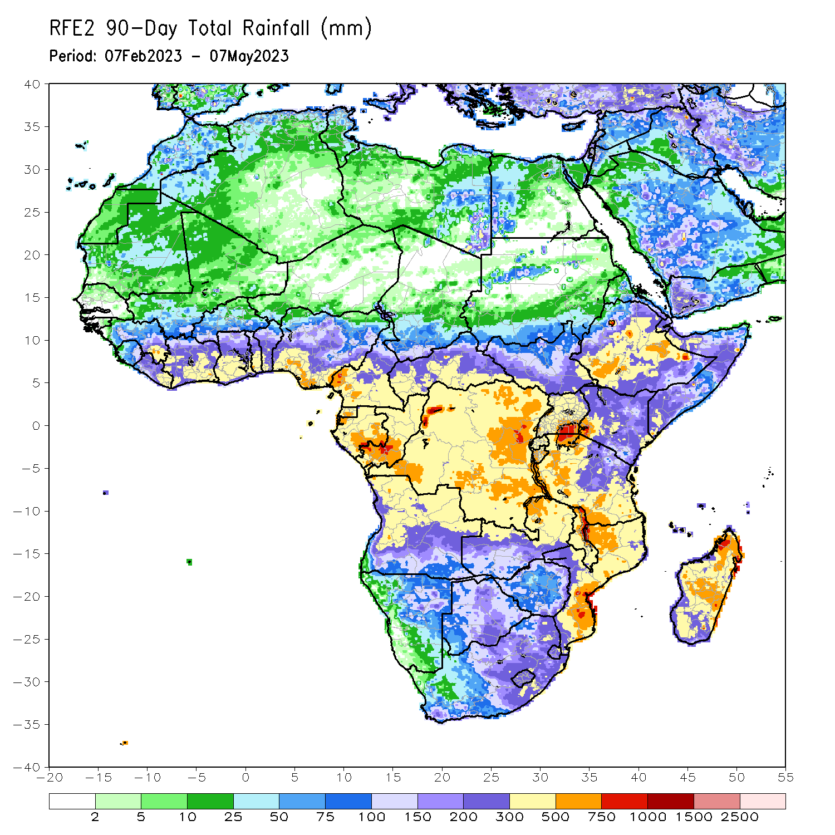
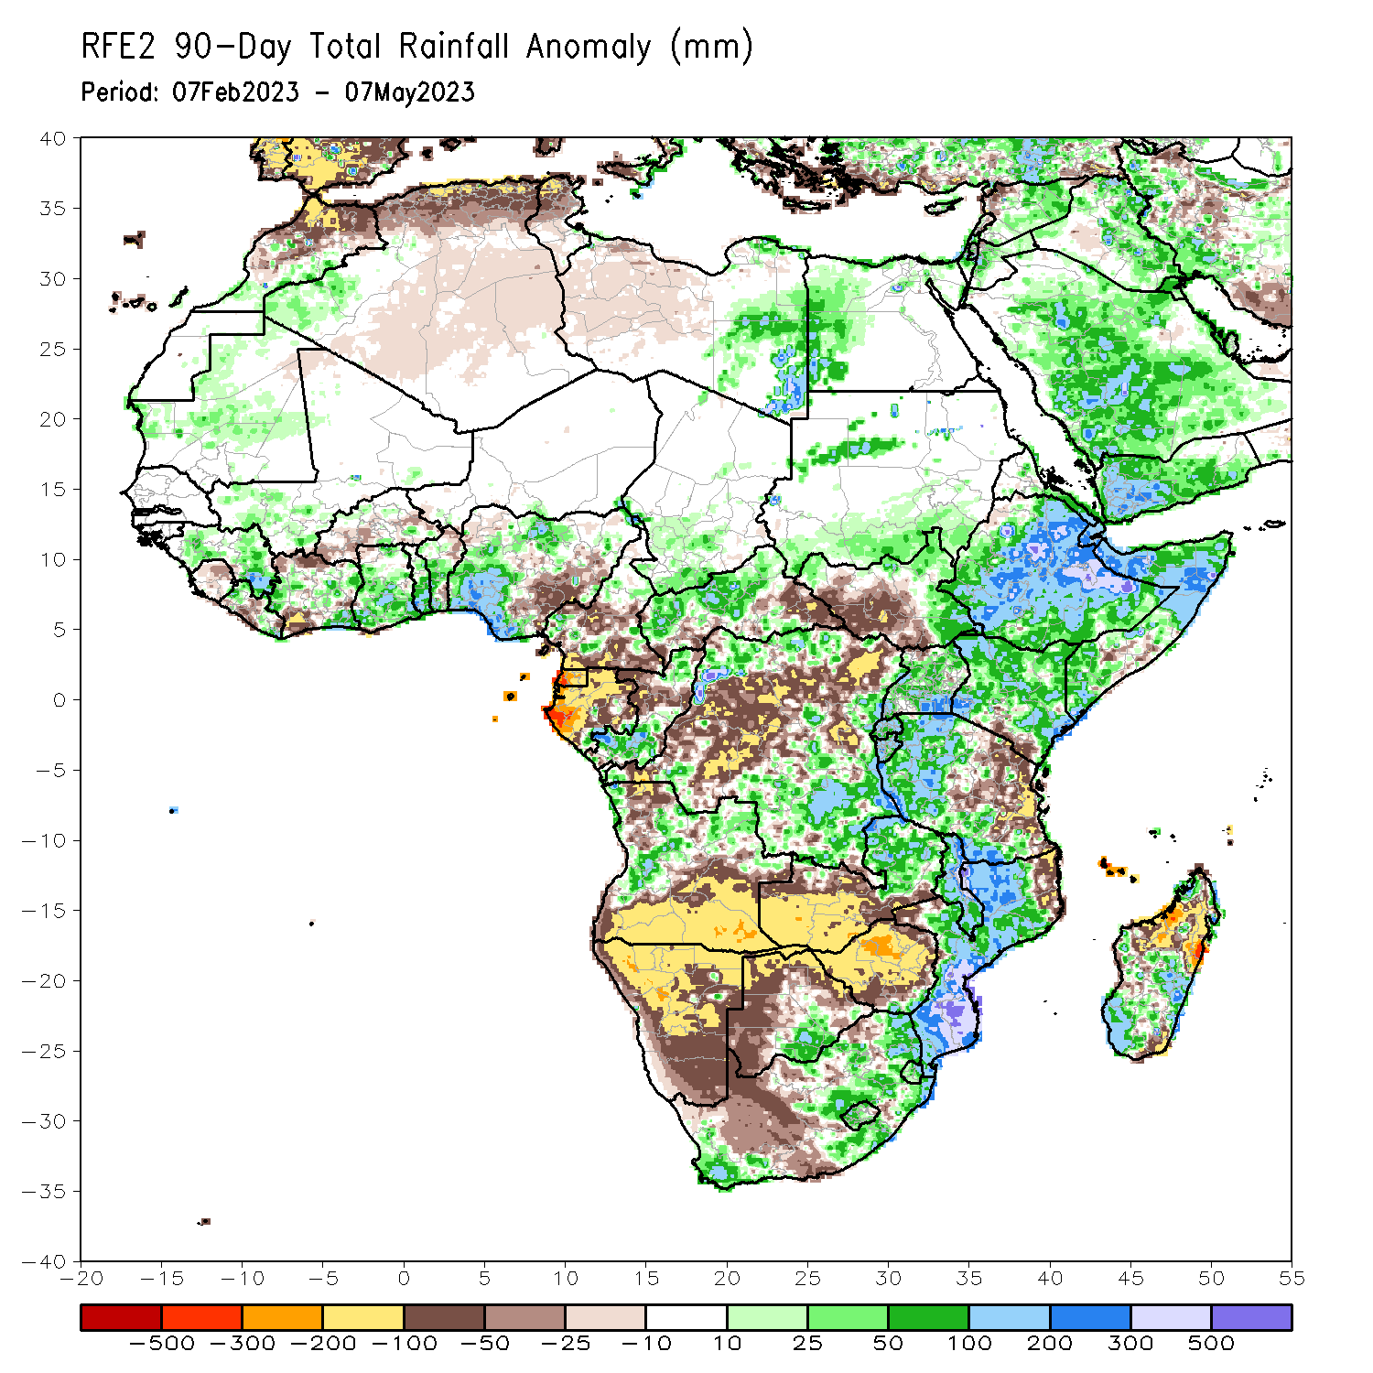
Rainfall Patterns: Last 90 Days
Over the past 90 days, in East Africa, above-average rainfall was observed over much Ethiopia, many parts of Somalia, Djibouti, parts of Eritrea, Kenya, Uganda, western Tanzania, Burundi, Rwanda, and northern and southeastern South Sudan. Rainfall was below-average over southwestern South Sudan, the far southern Kenya and eastern Tanzania. In southern Africa, above-average rainfall was observed over parts of northern Angola, eastern Zambia, the far southern Botswana, eastern South Africa, Lesotho, Eswatini, much of Mozambique, and central and southern Madagascar. Below-average rainfall was observed over southern Angola, western Zambia, much of Namibia, western and northern Botswana, western South Africa, Zimbabwe, pockets of northeastern Mozambique and northern Madagascar. In Central Africa, rainfall was above-average over parts of western and northern Cameroon, western and central CAR, much of Congo, and the far northern and southern DRC. In West Africa, rainfall was above-average over much of Guinea, western Liberia, parts of Cote d’Ivoire, Ghana, Togo, Benin, and southwestern and northern Nigeria. Below-average rainfall was observed over parts of Sierra Leone, central Liberia, southwestern Cote d’Ivoire, parts of Burkina Faso and southeastern Nigeria.
Notes:
4

Slide 5
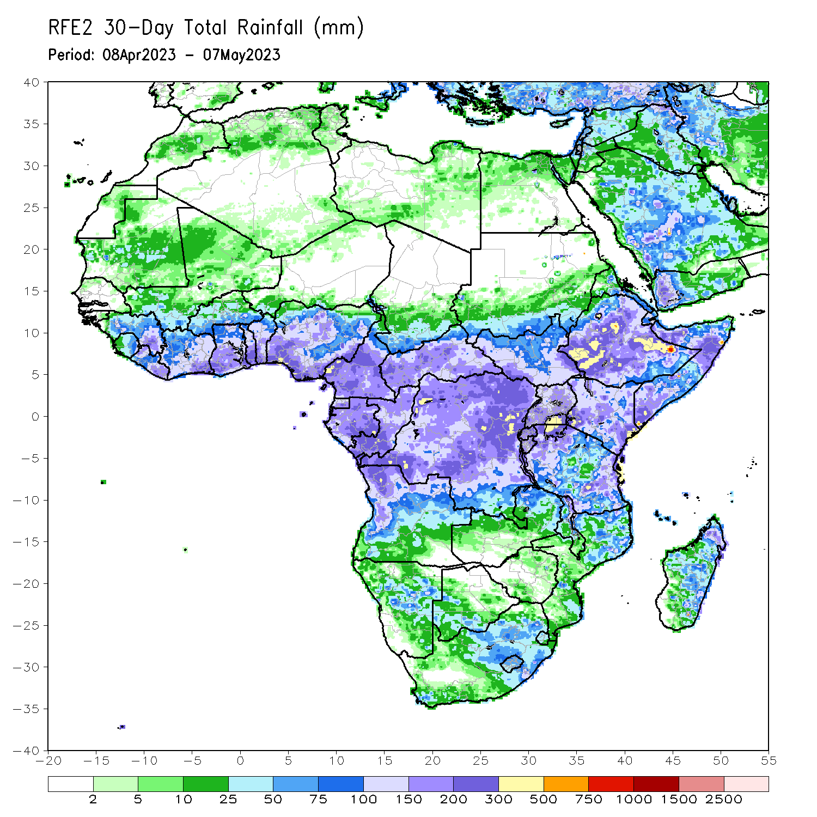
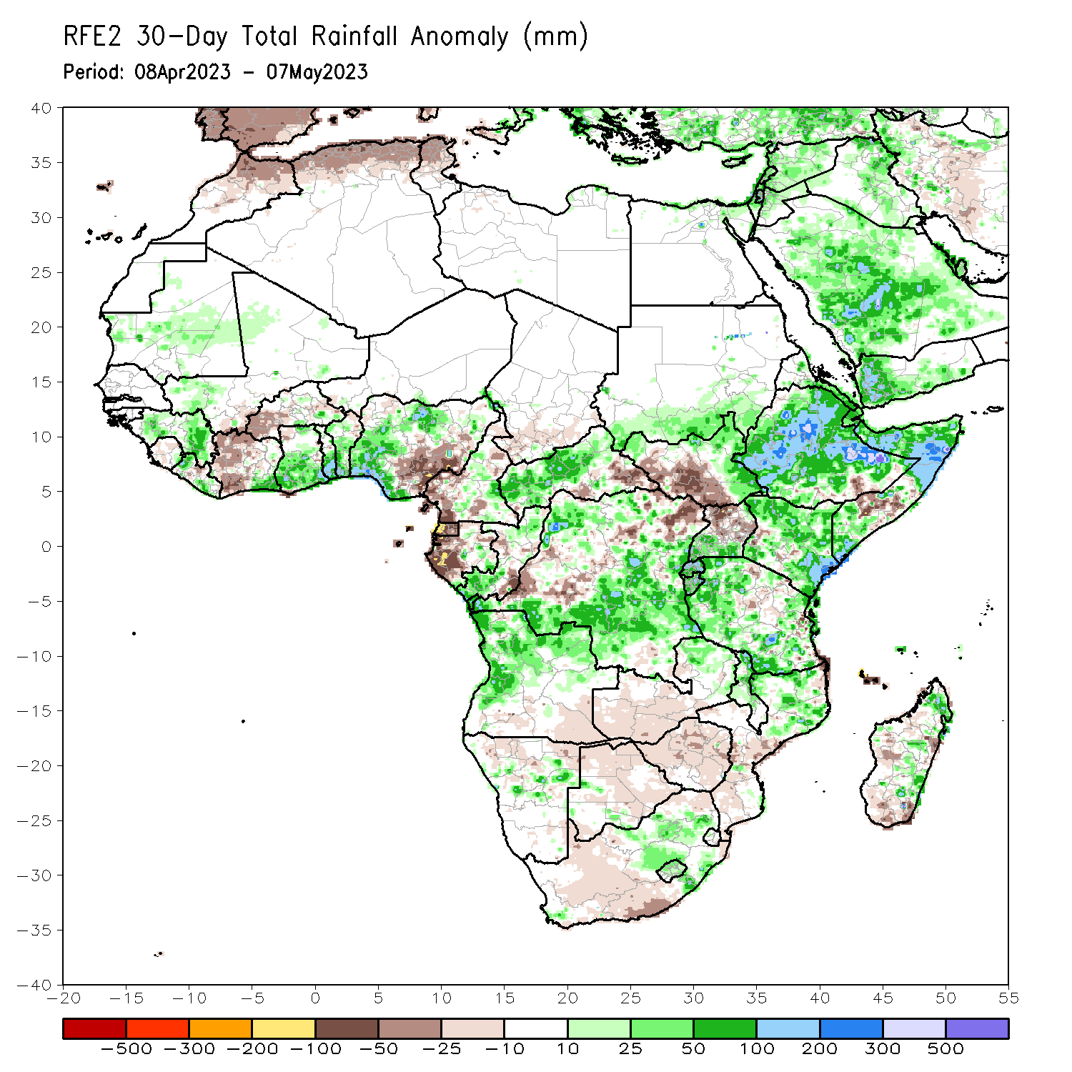
Rainfall Patterns: Last 30 Days
Over the past 30 days, in East Africa, above-average rainfall was observed over much Ethiopia, Djibouti, many parts of Somalia, pockets of Eritrea, Kenya, southern Uganda, many parts Tanzania, Burundi, Rwanda, and northern and eastern South Sudan. Rainfall was below-average over the southern portion of South Sudan, pockets of southeastern Ethiopia and central Somalia and central Tanzania. In southern Africa, above-average rainfall was observed over parts of western and northern Angola, northeastern Zambia, northern Mozambique and eastern Madagascar. Below-average rainfall was observed over southern Angola, southern and western Zambia, much of Namibia, Botswana, Zimbabwe, South Africa, Lesotho, Eswatini, and central and southern Mozambique and western Madagascar. In Central Africa, rainfall was above-average over pockets of Cameroon, western and central CAR, the far southern and northern Congo, and many parts of DRC. Below-average rainfall was observed over southwestern Cameroon, Gabon, parts of western and northern DRC, and eastern CAR. In West Africa, rainfall was above-average over parts of Guinea and Liberia, southeastern Cote d’Ivoire, Ghana, Togo, Benin and western and northern Nigeria. Below-average rainfall was observed over western and central Cote d’Ivoire and southeastern Nigeria.
Notes:
5

Slide 6
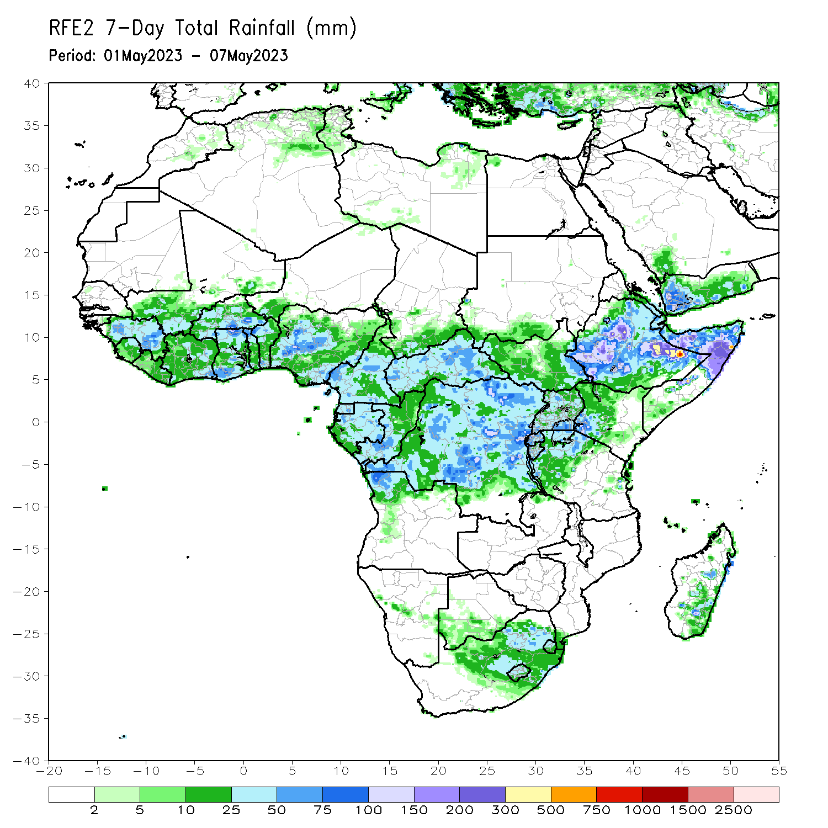
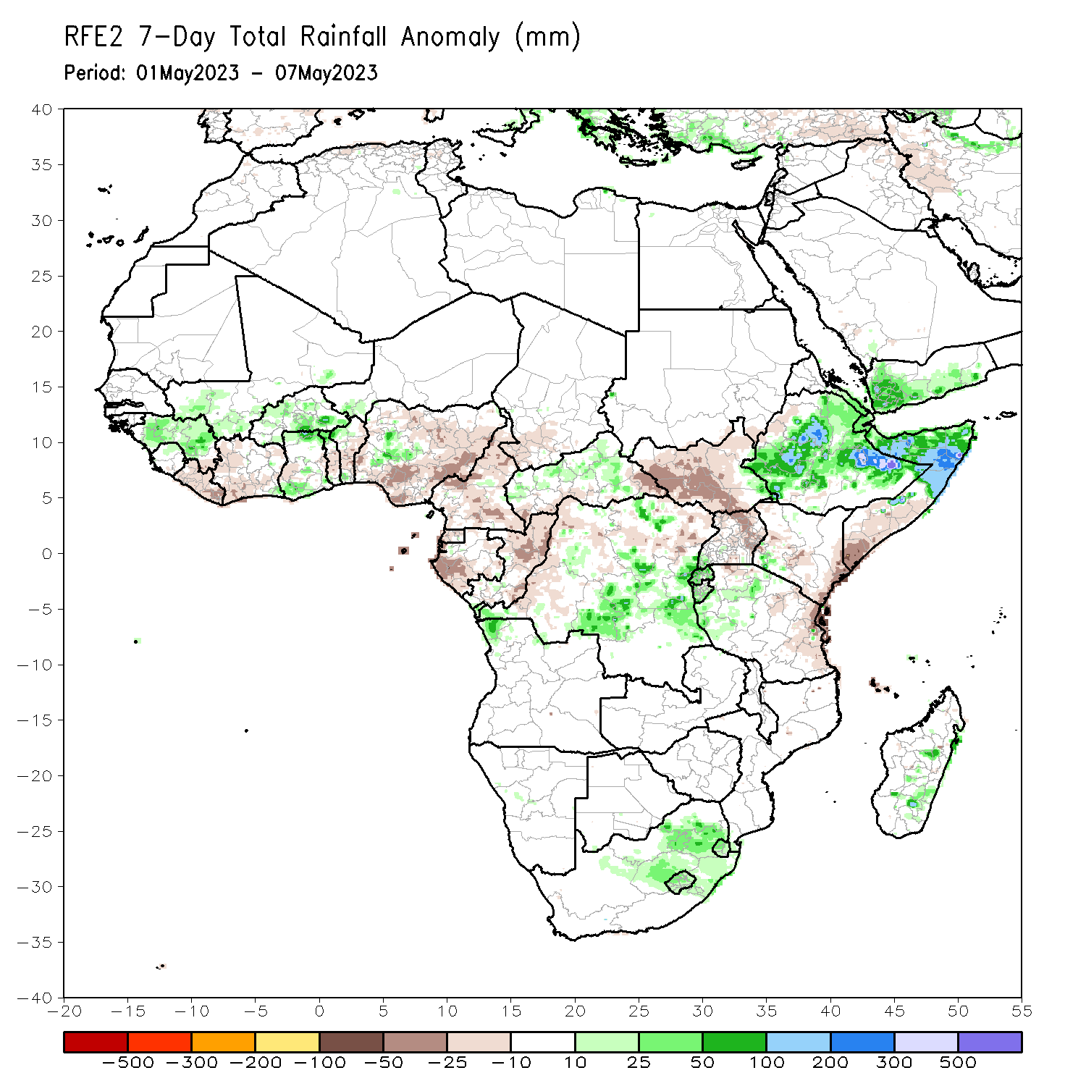
Rainfall Patterns: Last 7 Days
During the past 7 days, in East Africa, rainfall was above-average over much of Ethiopia, northern Somalia, Rwanda, Burundi and western Tanzania. Below-average rainfall was observed over much of South Sudan, northern Uganda, central and eastern Kenya and southern Somalia. In Central Africa, rainfall was above-average over parts of central CAR, and parts of central and eastern DRC. Below-average rainfall was observed over much of Cameroon, Equatorial Guinea, Gabon, Congo, the far eastern CAR, and parts of western DRC. In West Africa, above-average rainfall was observed over parts of Guinea, parts of Burkina Faso, and pockets of Ghana and western Nigeria. Below average rainfall was observed over parts of Liberia, southern and western Cote d’Ivoire, central Ghana and many parts of Nigeria.

Slide 7
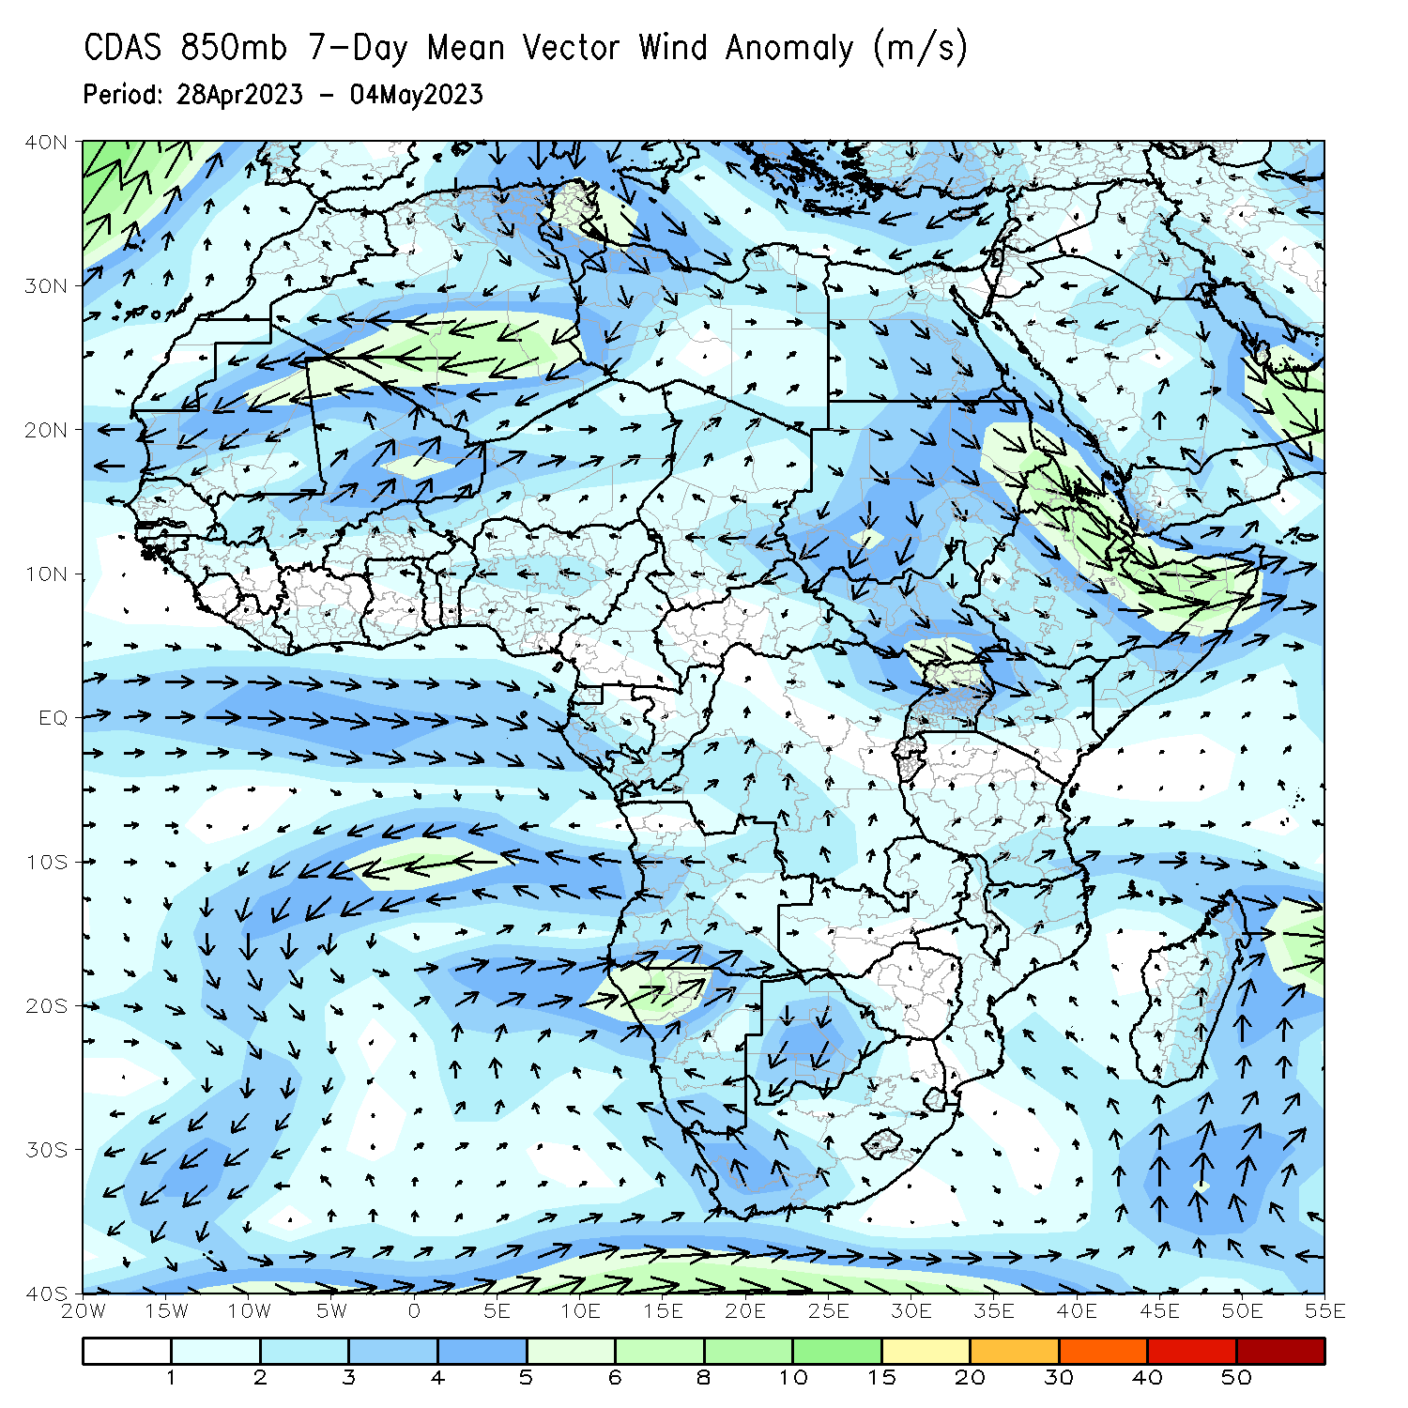
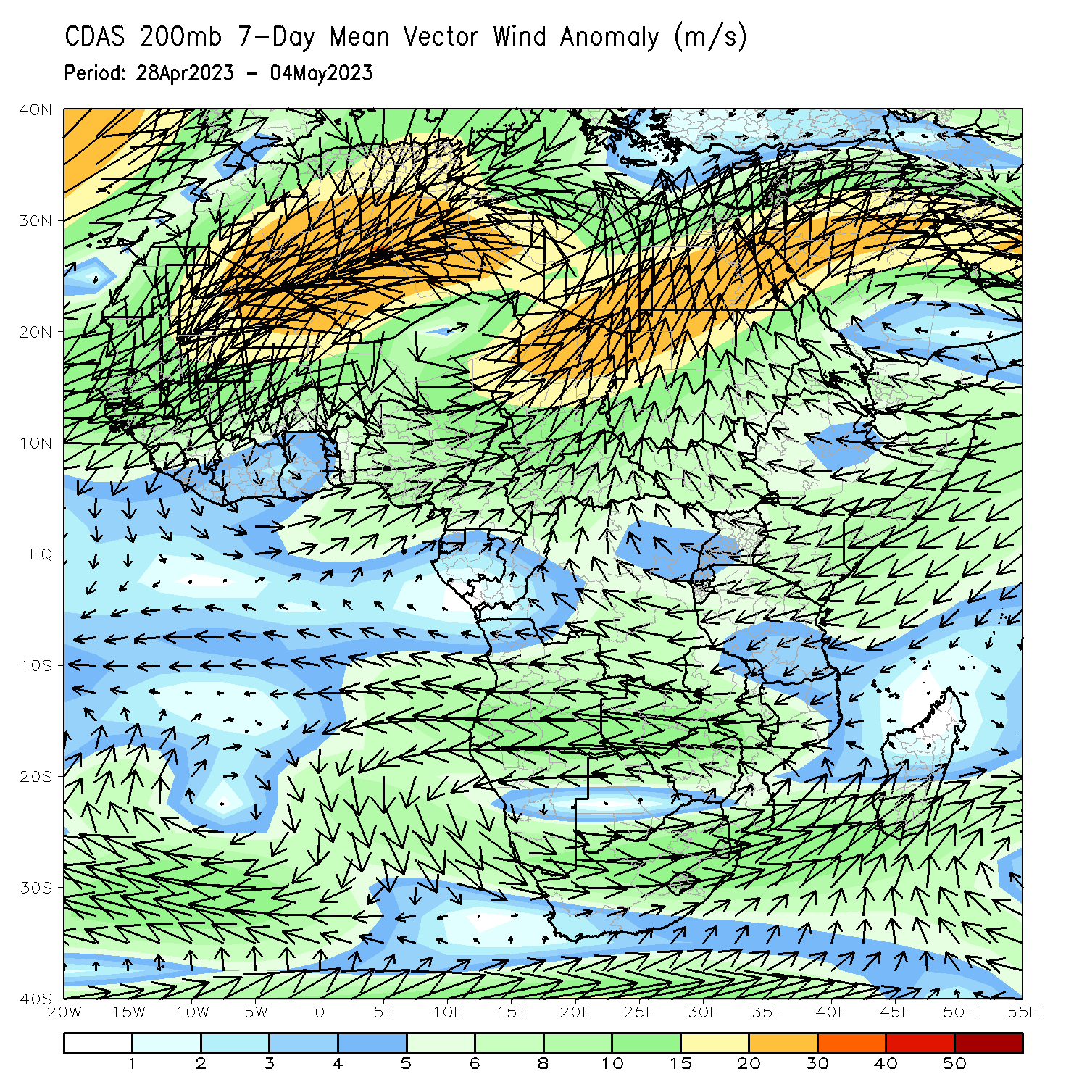
Atmospheric Circulation: Last 7 Days
At 850-hPa level (left panel), an area of anomalous lower-level cyclonic and upper-level anti-cyclonic flow in the Gulf of Aden region may have contributed to the observed above-average rainfall in the Greater Horn of Africa.

Slide 8
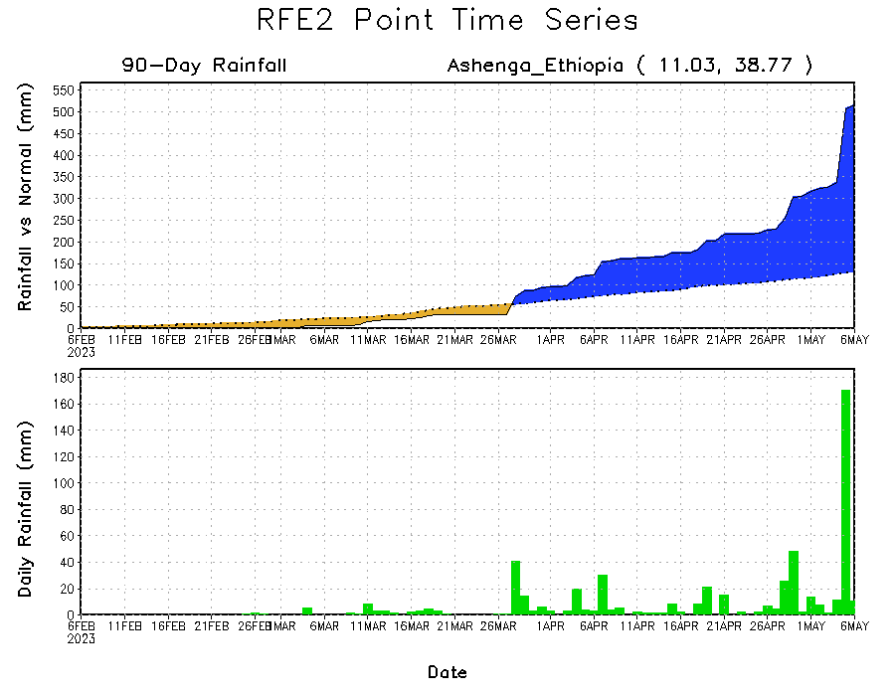
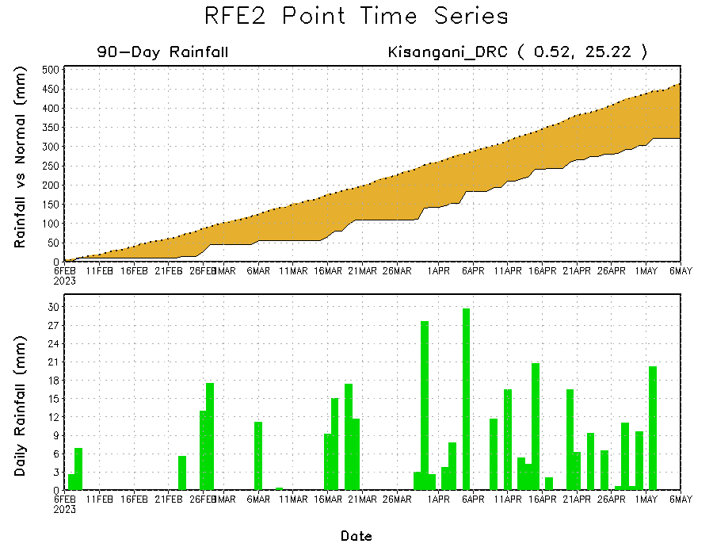
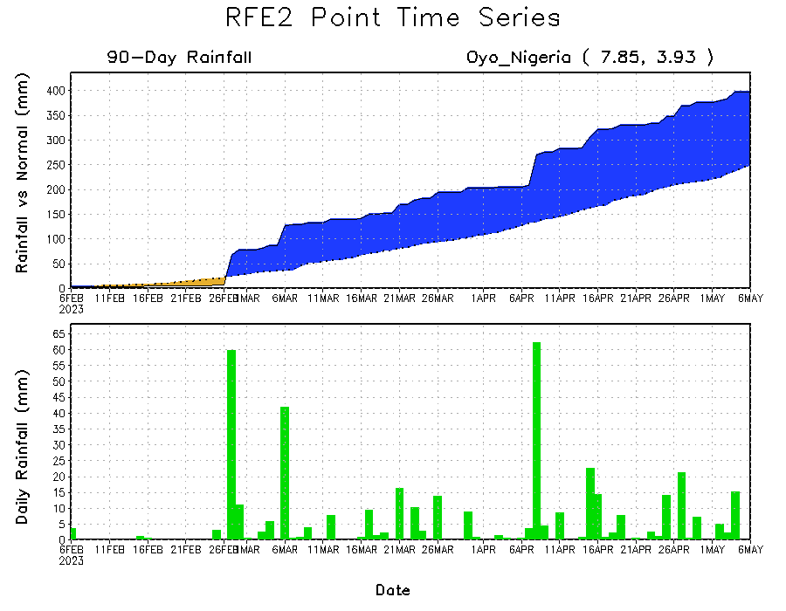
Rainfall Evolution
Daily evolution of rainfall over the last 90 days at selected locations shows that moderate to heavy rains sustained rainfall surpluses over parts of southern Nigeria (bottom left) and Ethiopia (top right). The seasonal total rainfall remained below-average over parts of central DRC (bottom right).

Slide 9
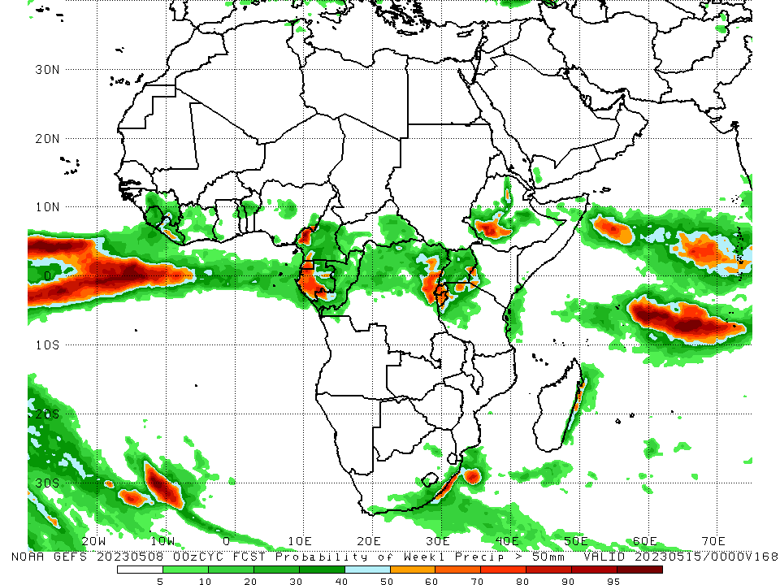
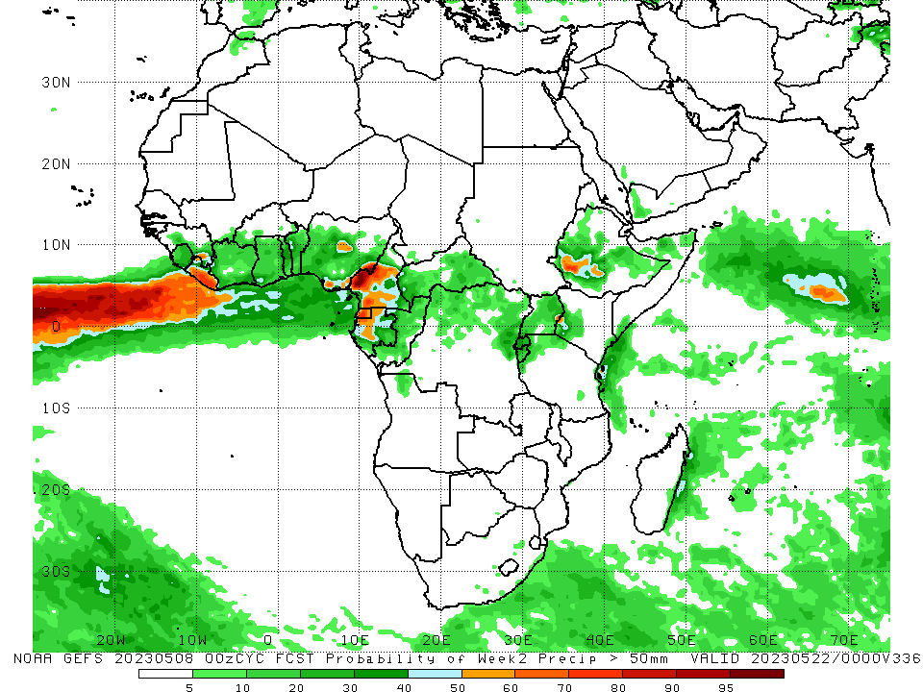
NCEP GEFS Model Forecasts Non-Bias Corrected Probability of precipitation exceedance
Week-1, Valid: 09 – 15 May 2023
Week-2, Valid: 16 – 22 May 2023
For week-1 (left panel), the GEFS forecasts indicate a moderate to high chance (over 70%) for rainfall to exceed 50 mm over parts of southern Liberia and western Cameroon, Equatorial Guinea, western Gabon, northeastern DRC, Rwanda, Burundi, northwestern Tanzania, and southwestern Ethiopia (left panel). For week-2, there is a moderate to high chance for weekly rainfall to exceed 50mm over much of Liberia, Cameroon, Equatorial Guinea, western Gabon and southwestern Ethiopia (right panel).
Notes:
9

Slide 10
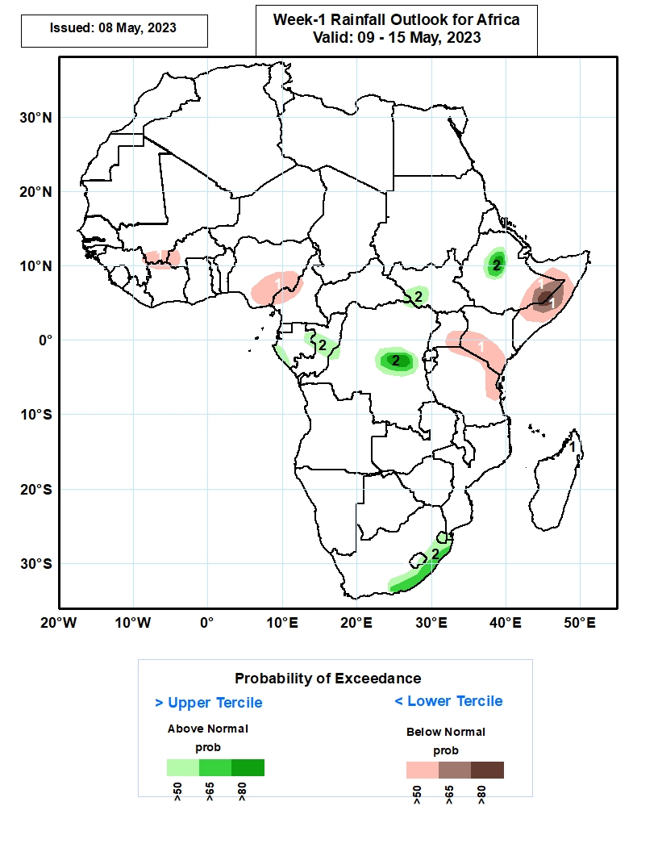
Week-1 Precipitation Outlooks
09 – 15 May 2023
The forecasts call for above 50% chance for weekly total rainfall to be below-normal (below the lower tercile) over southern Mali, western Burkina Faso, northern Cote d’Ivoire, southern and southeastern portions of Nigeria, western Cameroon, southeastern Uganda, southern Kenya, northern and eastern portions of Tanzania, eastern Ethiopia, and northern and central parts of Somalia. In particular, there is above 80% chance for rainfall to be below-normal over eastern Ethiopia, and central Somalia.
The probabilistic forecasts call for above 50% chance for weekly rainfall to be above-normal (above the upper tercile) over eastern and southern parts of Gabon, central Congo, western and central parts of DR Congo, southwestern South Sudan, central Ethiopia, southern South Africa and much of Lesotho and Eswatini. In particular, there is above 80% chance for rainfall to be above-normal over central Ethiopia and DR Congo.
Notes:
10

Slide 11
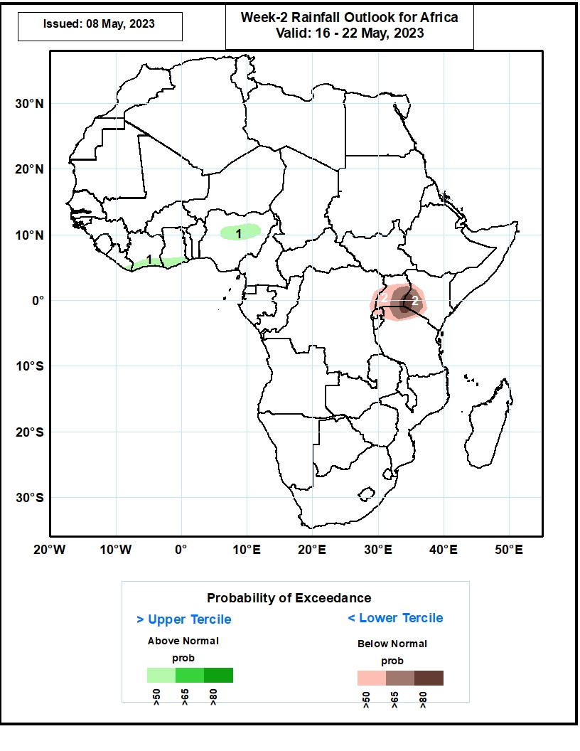
Week-2 Precipitation Outlooks
16 – 22 May 2023
The probabilistic forecasts call for above 50% chance for weekly rainfall to be above-normal (above the upper tercile) over southeastern Liberia, southern Cote d’Ivoire and Ghana, and northern Nigeria.
The forecasts call for above 50% chance for weekly total rainfall to be below-normal (below the lower tercile) over northeastern DR Congo, much of Uganda and Rwanda, western Kenya, and northern portions of Tanzania. In particular, there is above 80% chance for rainfall to be below-normal over southeastern Uganda, southwestern Kenya, northern Tanzania.
Notes:
11

Slide 12
Summary
Over the past 30 days, in East Africa, above-average rainfall was observed over much Ethiopia, Djibouti, many parts of Somalia, pockets of Eritrea, Kenya, southern Uganda, many parts Tanzania, Burundi, Rwanda, and northern and eastern South Sudan. Rainfall was below-average over the southern portion of South Sudan, pockets of southeastern Ethiopia and central Somalia and central Tanzania. In southern Africa, above-average rainfall was observed over parts of western and northern Angola, northeastern Zambia, northern Mozambique and eastern Madagascar. Below-average rainfall was observed over southern Angola, southern and western Zambia, much of Namibia, Botswana, Zimbabwe, South Africa, Lesotho, Eswatini, and central and southern Mozambique and western Madagascar. In Central Africa, rainfall was above-average over pockets of Cameroon, western and central CAR, the far southern and northern Congo, and many parts of DRC. Below-average rainfall was observed over southwestern Cameroon, Gabon, parts of western and northern DRC, and eastern CAR. In West Africa, rainfall was above-average over parts of Guinea and Liberia, southeastern Cote d’Ivoire, Ghana, Togo, Benin and western and northern Nigeria. Below-average rainfall was observed over western and central Cote d’Ivoire and southeastern Nigeria.
During the past 7 days, in East Africa, rainfall was above-average over much of Ethiopia, northern Somalia, Rwanda, Burundi and western Tanzania. Below-average rainfall was observed over much of South Sudan, northern Uganda, central and eastern Kenya and southern Somalia. In Central Africa, rainfall was above-average over parts of central CAR, and parts of central and eastern DRC. Below-average rainfall was observed over much of Cameroon, Equatorial Guinea, Gabon, Congo, the far eastern CAR, and parts of western DRC. In West Africa, above-average rainfall was observed over parts of Guinea, parts of Burkina Faso, and pockets of Ghana and western Nigeria. Below average rainfall was observed over parts of Liberia, southern and western Cote d’Ivoire, central Ghana and many parts of Nigeria.
The Week-1 outlook calls for below-normal rainfall over southern Mali, western Burkina Faso, northern Cote d’Ivoire, southern and southeastern portions of Nigeria, western Cameroon, southeastern Uganda, southern Kenya, northern and eastern portions of Tanzania, eastern Ethiopia, and northern and central parts of Somalia. In contrast, there is an increased chance for above-normal rainfall over eastern and southern parts of Gabon, central Congo, western and central parts of DR Congo, southwestern South Sudan, central Ethiopia, and coastal South Africa. The Week-2 outlook suggests above-normal rainfall over southeastern Liberia, southern Cote d’Ivoire and Ghana, and northern Nigeria. In contrast, northeastern DR Congo, much of Uganda and Rwanda, western Kenya, and northern portions of Tanzania. In particular, there is above 80% chance for rainfall to be below-normal over southeastern Uganda, southwestern Kenya, northern Tanzania.

