Slide 1
The African Monsoon Recent Evolution and Current Status Include Week-1 and Week-2 Outlooks
Update prepared
24 April 2023
For more information, visit:
http://www.cpc.ncep.noaa.gov/products/Global_Monsoons/African_Monsoons/precip_monitoring.shtml

Slide 2
Outline
Highlights
Recent Evolution and Current Conditions
NCEP GEFS Forecasts
Summary

Slide 3
Highlights: Last 7 Days
During the past 7 days, in East Africa, rainfall was above-average over northeastern and parts of south-central and southwestern Ethiopia, southwestern Somalia, Djibouti, central and eastern Eritrea, eastern Rwanda, eastern Kenya, eastern and southern Tanzania, and the Lake Victoria region. Below-average rainfall was observed across south-central and northwestern Kenya, parts of southern and central South Sudan, northern and central Uganda, parts of southwestern and southeastern Ethiopia, parts of north-central and western Tanzania, northern and central Burundi, and some areas of central Somalia. In Central Africa, rainfall was above-average over western CAR, most of Cameroon, most of Congo, eastern and southern Gabon, and northwestern and south-central DRC. Below-average rainfall was observed over parts of eastern and central DRC, Equatorial Guinea, and western Gabon. In West Africa, above-average rainfall was observed over central Cote d’Ivoire, eastern Sierra Leone, west-central Ghana, southeastern Guinea, central Togo, central Benin, east-central Nigeria, and northwestern Liberia. Below average rainfall was observed over northern Cote d’Ivoire, northern Ghana, southwestern Burkina Faso, south-central Nigeria, and Sao Tome and Principe. In southern Africa, rainfall was above-average over northern Mozambique, northern Malawi, pockets of northern and central Angola, parts of central Namibia, pockets of southwestern South Africa, and pockets of northern and eastern Madagascar. In contrast, rainfall was below-average over Lesotho, western Eswatini, from north-central to southeastern South Africa, pockets of northern Madagascar, parts of northern Zimbabwe, and pockets of northwestern Angola.
The Week-1 outlook calls for above-average rainfall primarily over much of the Gulf of Guinea region, as well as central and western Africa. This includes regions from Liberia to central and southern Nigeria, southern Cameroon, Equatorial Guinea, Gabon, much of CAR, South Sudan, much of DRC, Lesotho, Sao Tome and Principe, northern Madagascar, Ethiopia, Uganda, Kenya, Tanzania, parts of Somalia, Rwanda, and Burundi. Anomalies could exceed 50mm from southwestern Ethiopia to central Tanzania. In contrast, there is an increased chance for below-average rainfall over southern Guinea, Sierra Leone, central Angola, southeastern DRC, coastal Mozambique, and central and southern Madagascar. The Week-2 outlook suggests above-average rainfall over primarily central and western Africa. This includes parts of CAR, central and southern Congo, DRC, northern Angola, Rwanda, Burundi, parts of Uganda, northern and western Tanzania, western Kenya, central and southwestern Ethiopia, northern Somalia, coastal Ghana/Togo/Benin/Nigeria, eastern Sierra Leone, and southeastern Guinea. Below-average rainfall is likely over parts of central Nigeria/Cameroon, western Equatorial Guinea, western Gabon, eastern Tanzania, the Lake Victoria region, northeastern Mozambique, Comoros, and eastern Madagascar.

Slide 4
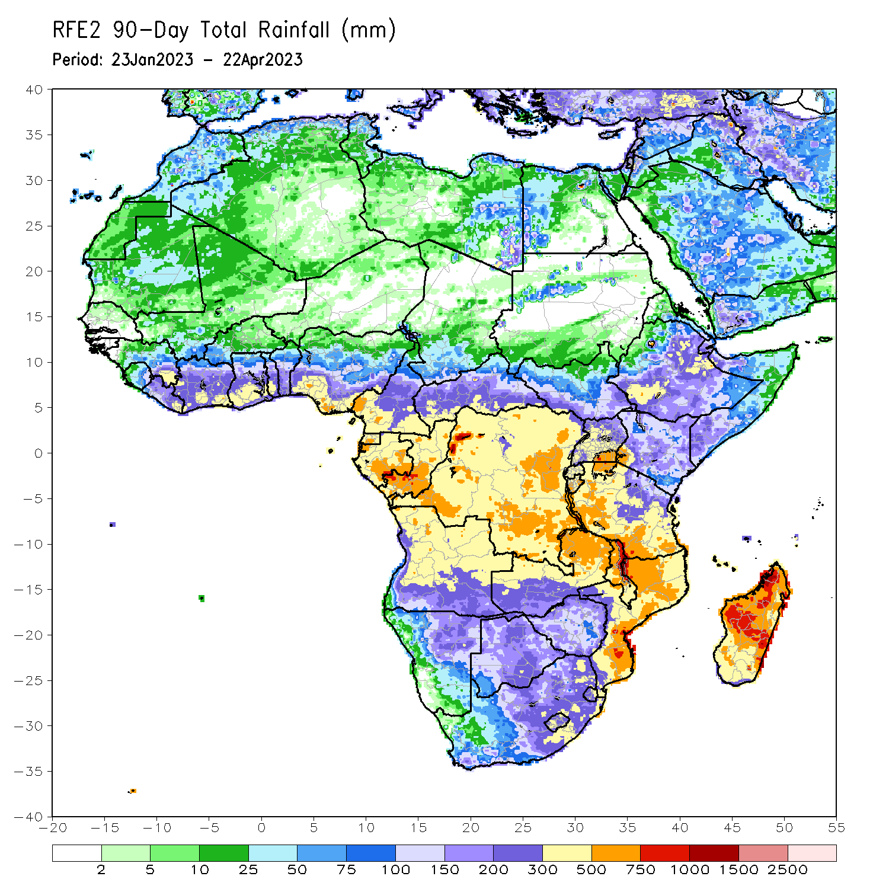
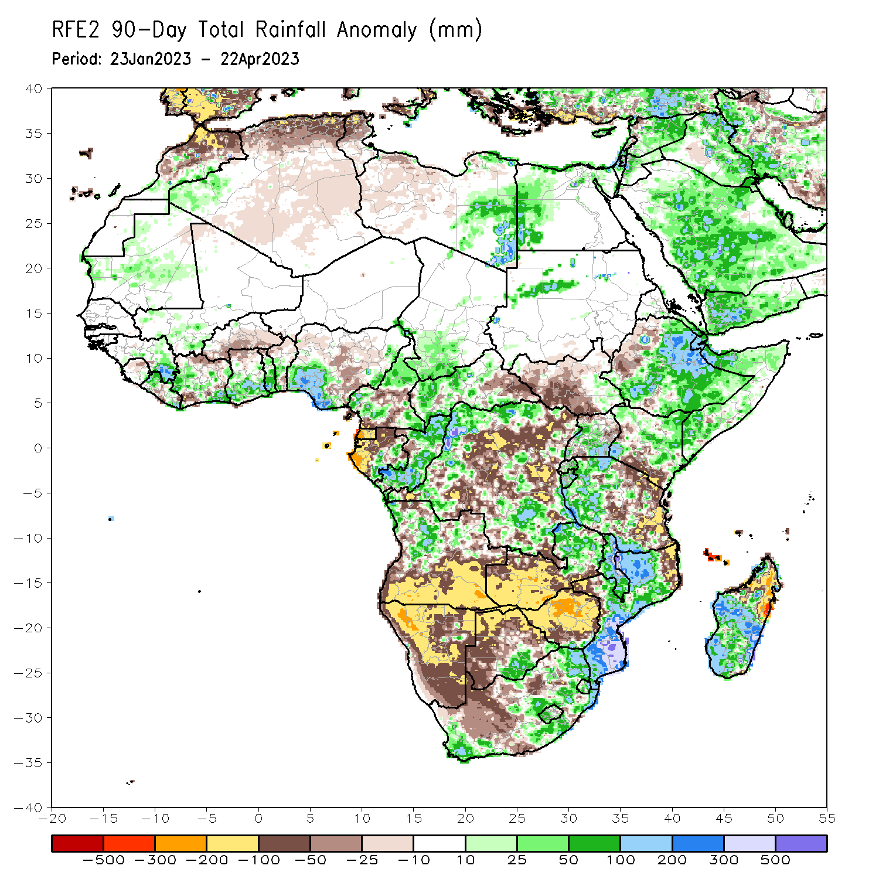
Rainfall Patterns: Last 90 Days
Over the past 90 days, in East Africa, above-average rainfall was observed over parts of central, central, eastern, and southern Ethiopia, many parts of Somalia, Djibouti, eastern Eritrea, northern, central, southwestern, and eastern Kenya, central and southeastern Uganda, western Tanzania, Burundi, Rwanda, southeastern South Sudan, and parts of northwestern Sudan. Rainfall was below-average over parts of west-central and northwestern Ethiopia, southwestern, northwestern, and east-central Uganda, most of western and central South Sudan, southern Kenya, and eastern and pockets of central Tanzania. In southern Africa, above-average rainfall was observed over parts of northwestern, central, and southern Mozambique, much of Malawi, eastern Zambia, pockets of central and northern Angola, south-central Botswana, southern Zimbabwe, eastern, southern, and parts of central South Africa, western Lesotho, most of Eswatini, and parts of western, central, and southern Madagascar. Below-average rainfall was observed over west-central, southern, and eastern Angola, most of Namibia, western, northern, and central Botswana, much of northern and central Zimbabwe, southern and western Zambia, northeastern and west-central Mozambique, northeastern and coastal northwestern Madagascar, parts of northern and west-central South Africa, and Comoros. In Central Africa, rainfall was above-average over much of Congo, parts of western, eastern, and northern DRC, north-central, western, and southeastern Cameroon, southwestern Chad, pockets of southern and eastern Gabon, and northern and southern CAR. Rainfall was below-average over southern Cameroon, western and northern Gabon, Equatorial Guinea, Sao Tome and Principe, east-central CAR, and portions of central and southern DRC. In West Africa, rainfall was above-average over parts of eastern Guinea, southeastern and northwestern Liberia, southeastern and parts of central Cote d’Ivoire, southern parts of Ghana, central and southern Togo, central and southwestern Benin, parts of southern and eastern Nigeria, central Mauritania, and southwestern Mali. In contrast, below-average rainfall was observed over northern Sierra Leone, northeastern and central Liberia, northern, east-central, and southwestern Cote d’Ivoire, northern Ghana, northern and southeastern Benin, northern Togo, central Nigeria, and southern Burkina Faso.
Notes:
‹#›

Slide 5
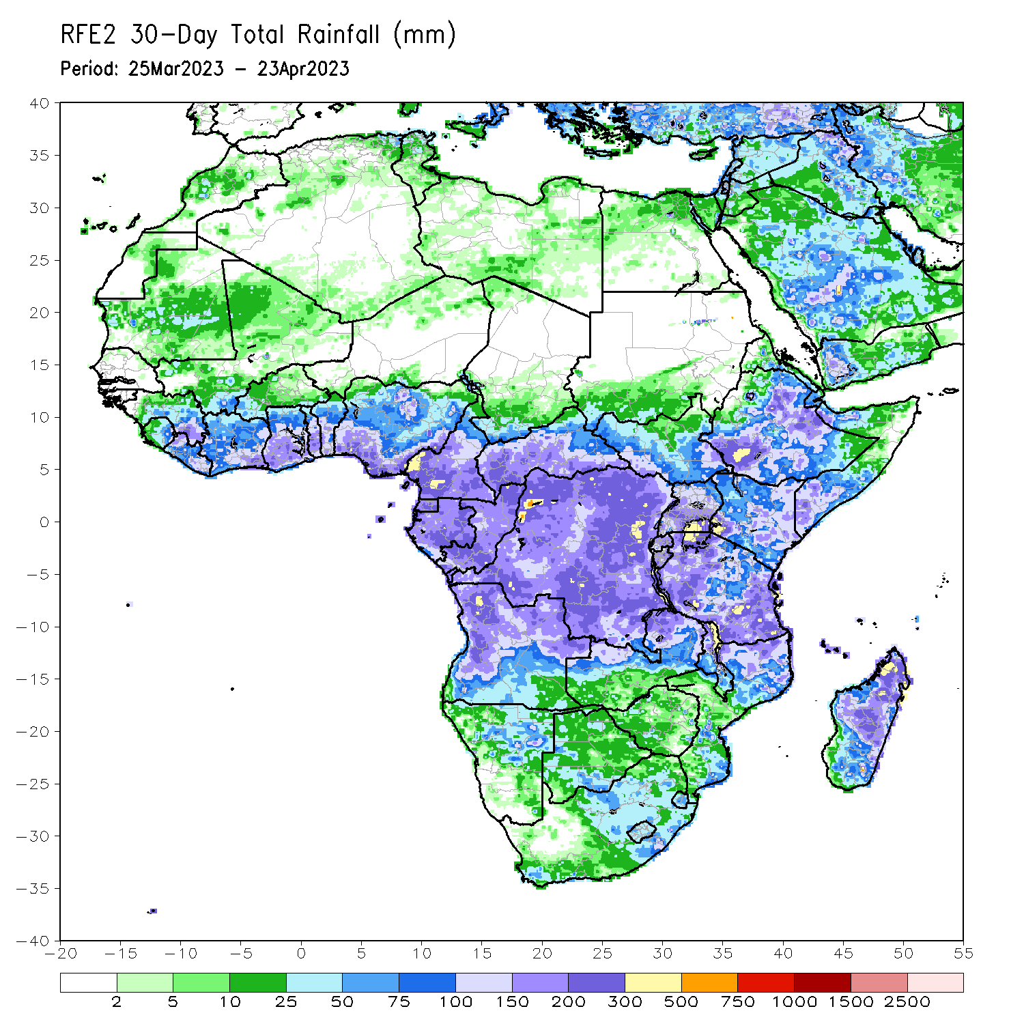
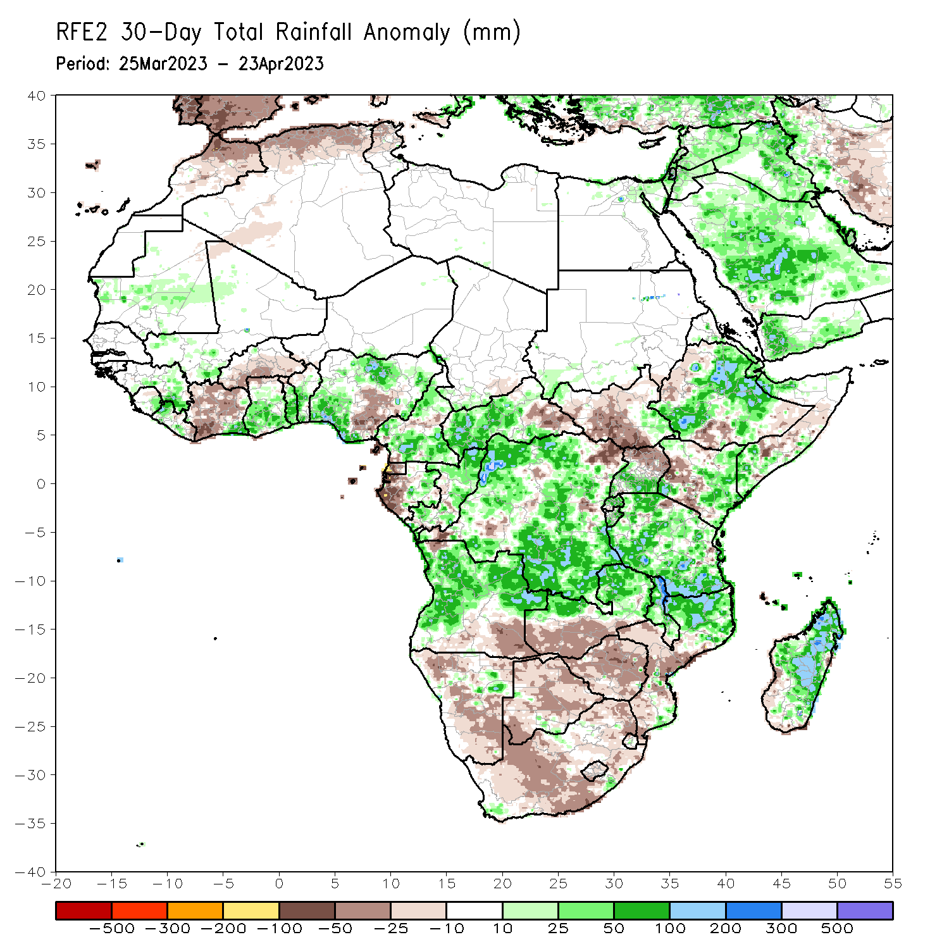
Rainfall Patterns: Last 30 Days
Over the past 30 days, in East Africa, above-average rainfall was observed over central, southwestern, and northeastern Ethiopia, southern and northwestern Somalia, Djibouti, eastern Eritrea, southwestern and eastern Kenya, most of Tanzania, Rwanda, Burundi, southern Uganda, southeastern and northwestern South Sudan, and southwestern Sudan. Rainfall was below-average over west-central and south-central Kenya, a small area of northeastern Tanzania, central South Sudan, west-central Somalia, and northwestern, south-central, and southeastern Ethiopia. In southern Africa, above-average rainfall was observed over northern and pockets of southeastern Mozambique, most of Malawi, northern and eastern Zambia, most of northern, western, and east-central Angola, pockets of northeastern Namibia, eastern Comoros, and most of central and northern Madagascar. Below-average rainfall was observed over much of northern, central, and southern Namibia, southern and northwestern Angola, southern Zambia, most of Zimbabwe and Botswana, most of South Africa, Lesotho, northern Eswatini, western Comoros, and parts of southern and southwestern Madagascar. In Central Africa, rainfall was above-average over most of Congo, northern, southern, and western Cameroon, southwestern Chad, central and eastern Gabon, parts of central and western CAR, and most of DRC. Rainfall was below-average over pockets of northeastern and southwestern DRC, Equatorial Guinea, western Gabon, parts of central Cameroon, Sao Tome and Principe, and east-central CAR. In West Africa, rainfall was above-average over eastern Guinea, northwestern and south-central Liberia, southeastern Cote d’Ivoire, central and southern Ghana, central and southern Togo, central and southern Benin, southwestern, north-central, and parts of eastern Nigeria, southwestern Mali, and central Mauritania. Rainfall was below-average in eastern Liberia, parts of northern Ghana, northern Benin, northern Togo, western, central, and northern Cote d’Ivoire, south-central Nigeria, and central and southern Burkina Faso.
Notes:
‹#›

Slide 6
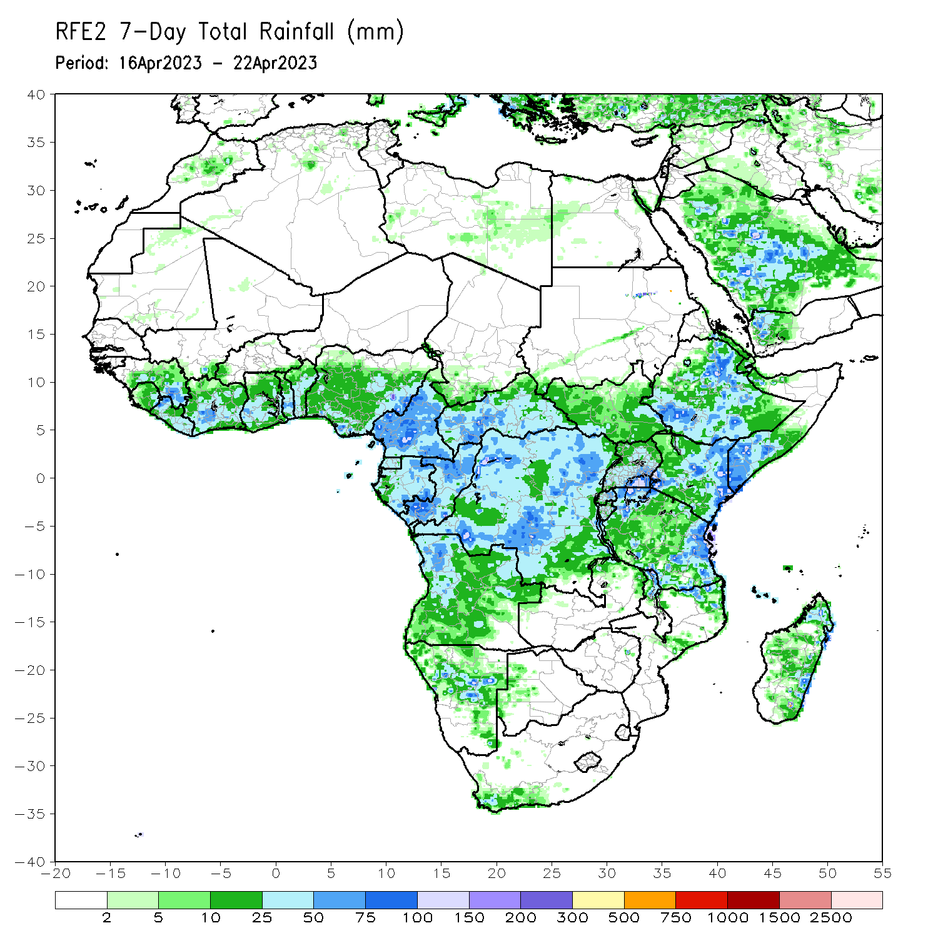
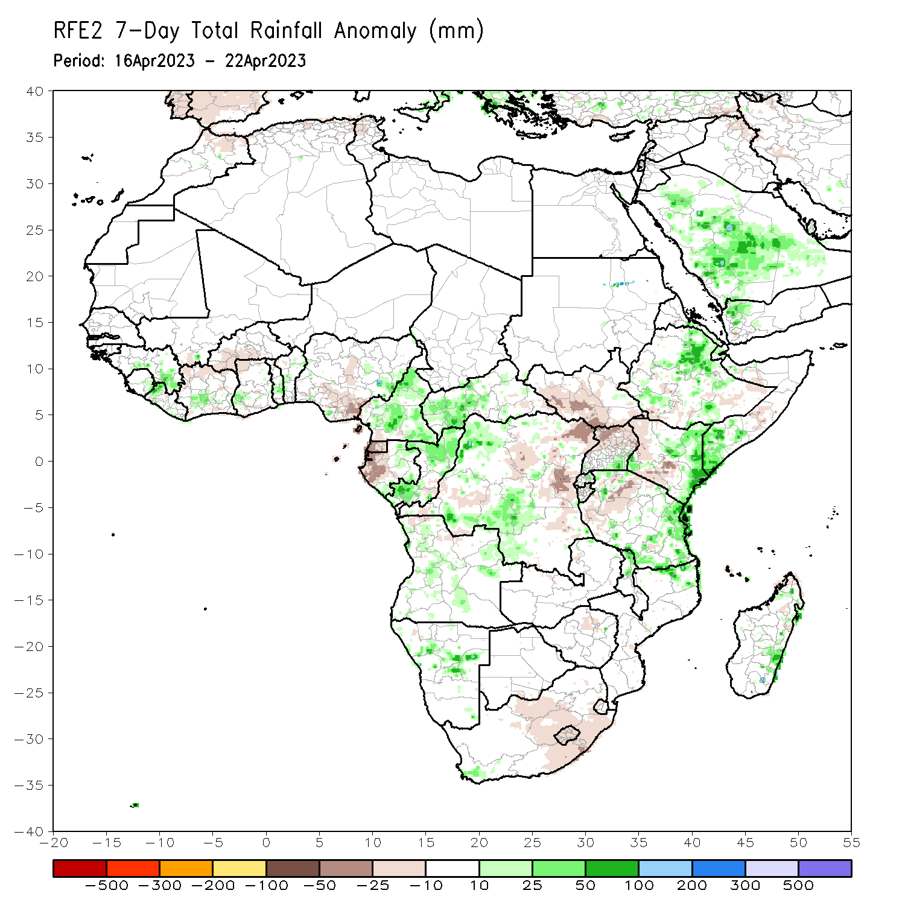
Rainfall Patterns: Last 7 Days
During the past 7 days, in East Africa, rainfall was above-average over northeastern and parts of south-central and southwestern Ethiopia, southwestern Somalia, Djibouti, central and eastern Eritrea, eastern Rwanda, eastern Kenya, eastern and southern Tanzania, and the Lake Victoria region. Below-average rainfall was observed across south-central and northwestern Kenya, parts of southern and central South Sudan, northern and central Uganda, parts of southwestern and southeastern Ethiopia, parts of north-central and western Tanzania, northern and central Burundi, and some areas of central Somalia. In Central Africa, rainfall was above-average over western CAR, most of Cameroon, most of Congo, eastern and southern Gabon, and northwestern and south-central DRC. Below-average rainfall was observed over parts of eastern and central DRC, Equatorial Guinea, and western Gabon. In West Africa, above-average rainfall was observed over central Cote d’Ivoire, eastern Sierra Leone, west-central Ghana, southeastern Guinea, central Togo, central Benin, east-central Nigeria, and northwestern Liberia. Below average rainfall was observed over northern Cote d’Ivoire, northern Ghana, southwestern Burkina Faso, south-central Nigeria, and Sao Tome and Principe. In southern Africa, rainfall was above-average over northern Mozambique, northern Malawi, pockets of northern and central Angola, parts of central Namibia, pockets of southwestern South Africa, and pockets of northern and eastern Madagascar. In contrast, rainfall was below-average over Lesotho, western Eswatini, from north-central to southeastern South Africa, pockets of northern Madagascar, parts of northern Zimbabwe, and pockets of northwestern Angola.

Slide 7
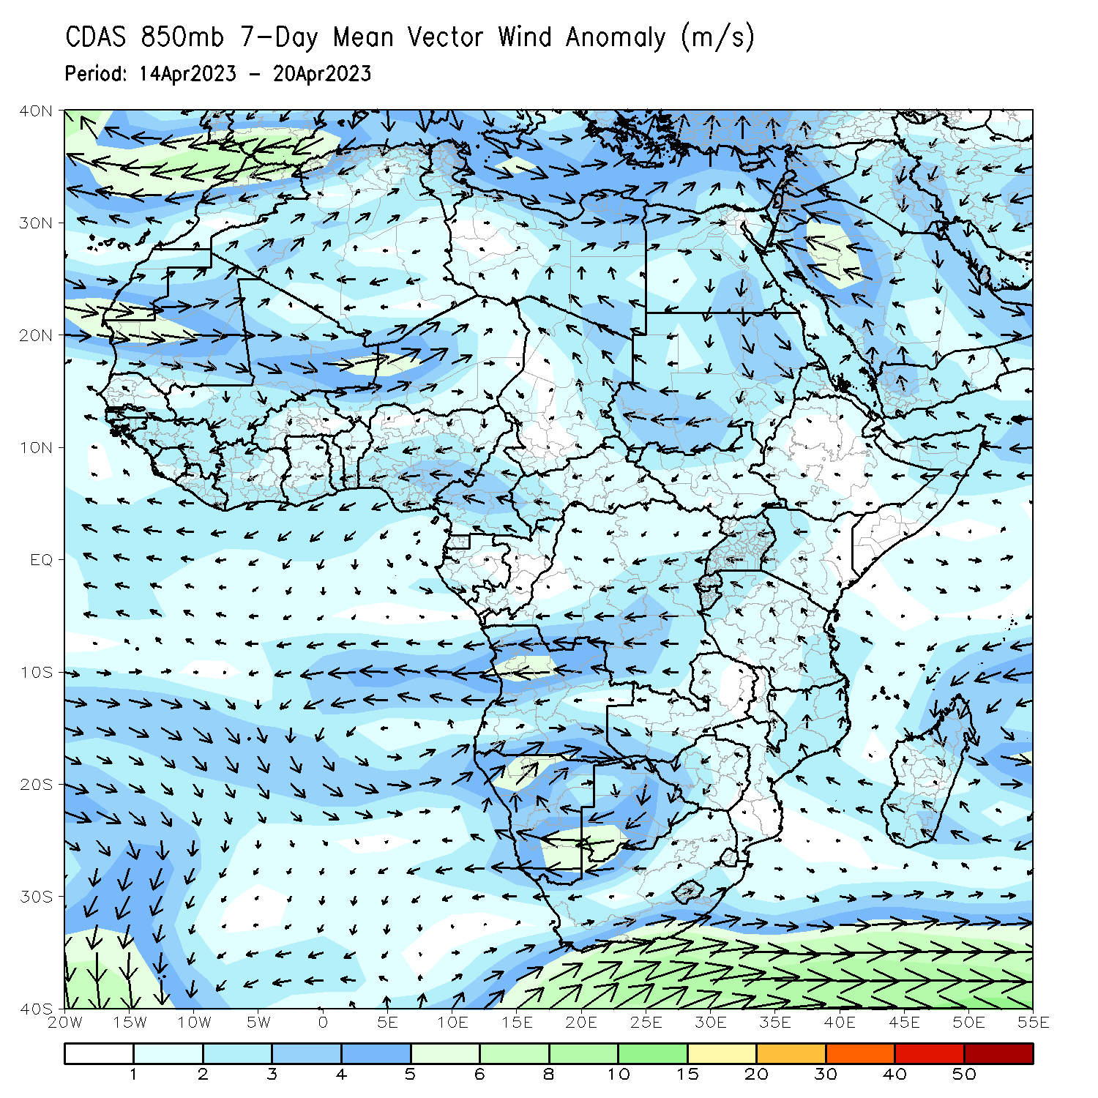
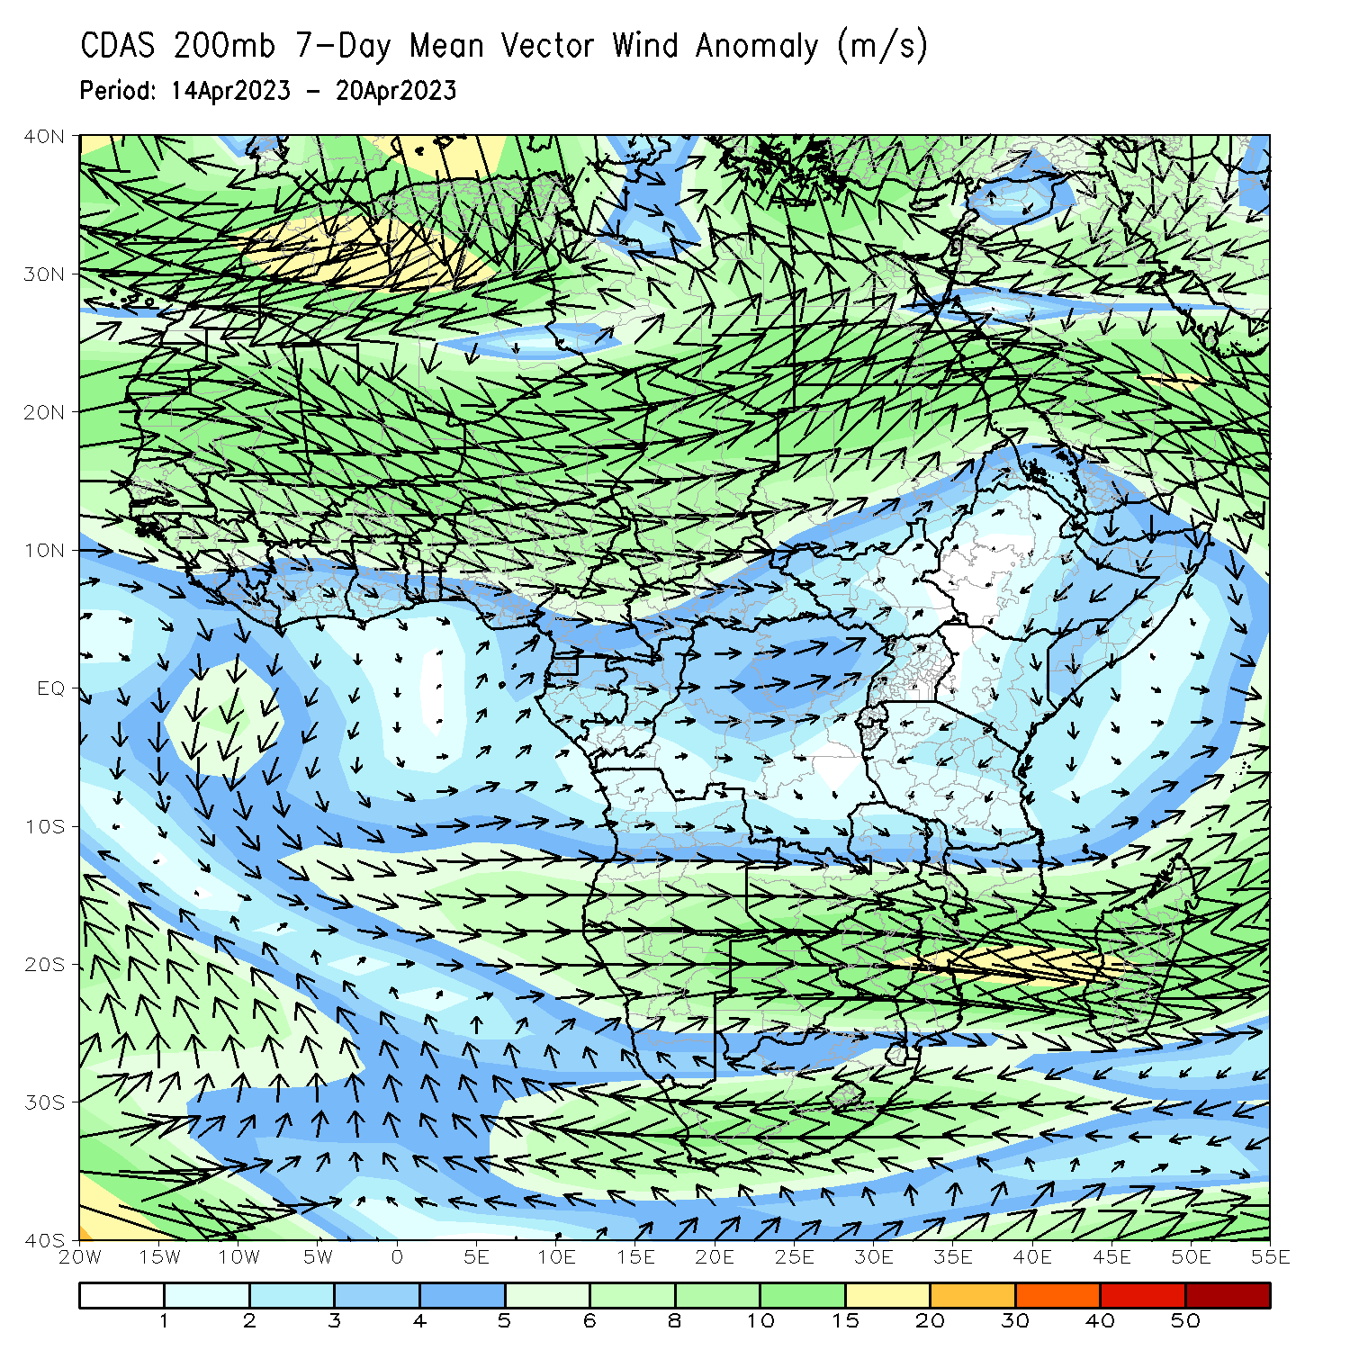
Atmospheric Circulation: Last 7 Days
At 850-hPa level (left panel), confluence/convergence was observed in Cameroon, CAR, and Congo (associated with anomalous cyclonic flow), contributing to above normal rainfall. Upper-level divergence was present at 200-hPa (right panel) from eastern Kenya to eastern Tanzania, also contributing to the above normal rainfall in that region.

Slide 8
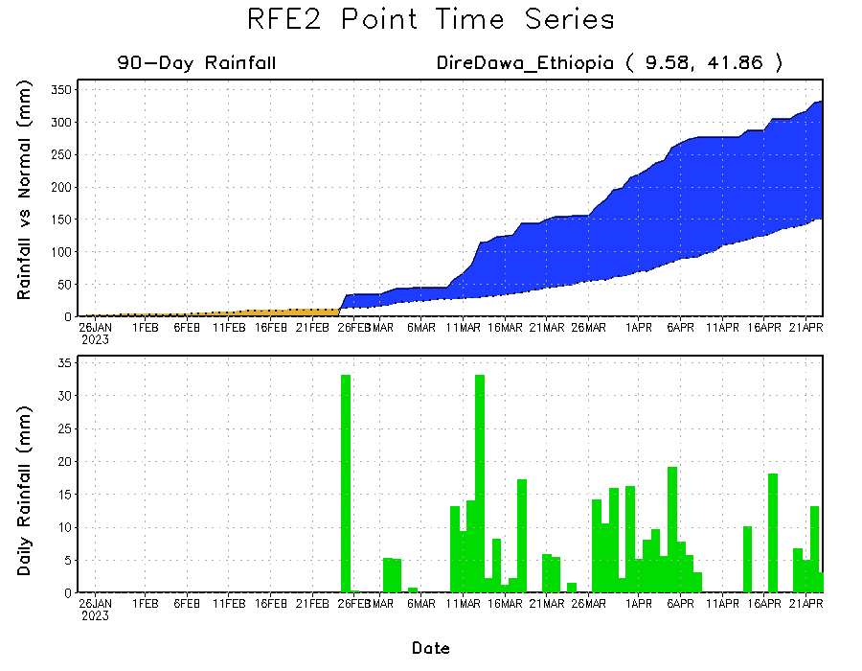
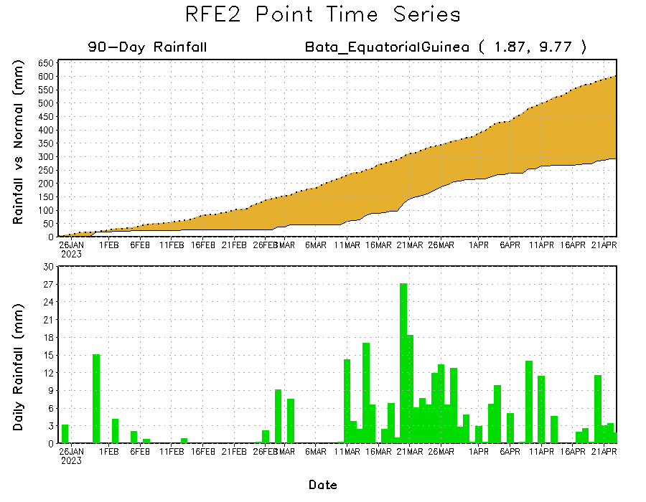
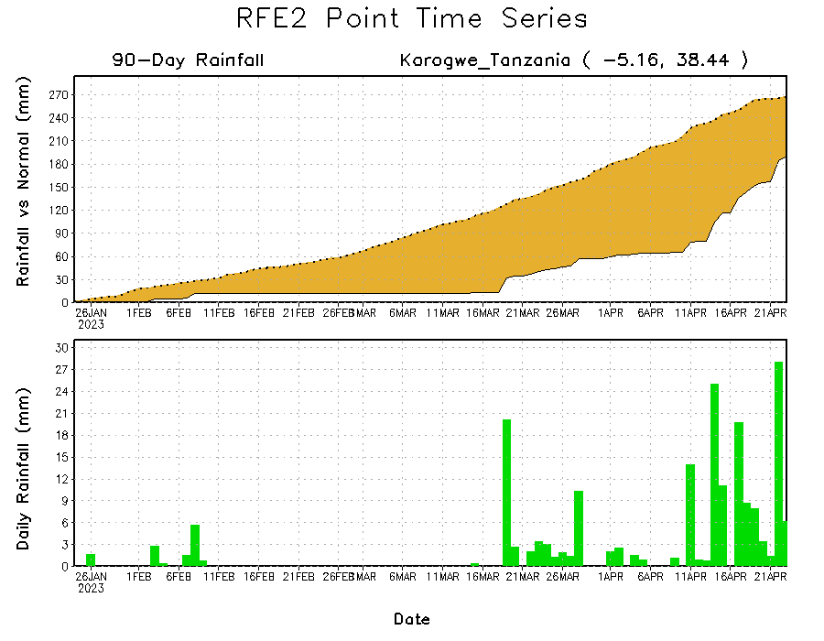
Rainfall Evolution
Daily evolution of rainfall over the last 90 days at selected locations shows slightly decreased rainfall deficits over parts of northeastern Tanzania (bottom left) and increasing rainfall deficits over Equatoria Guinea (bottom right). Near-normal rainfall also resulted in continuing moisture surpluses over parts of eastern and northeastern Ethiopia (top right).

Slide 9
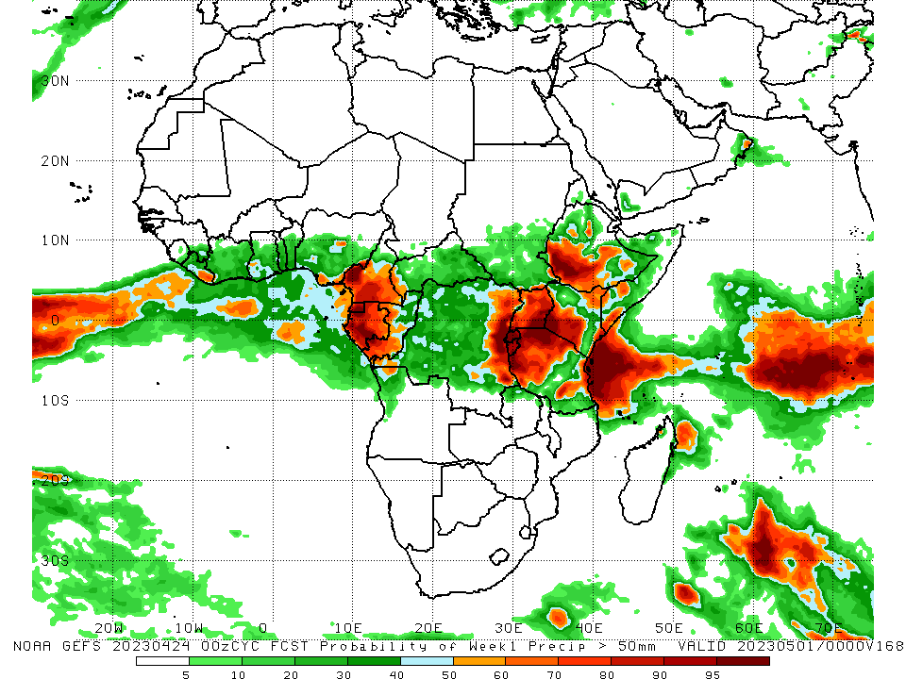
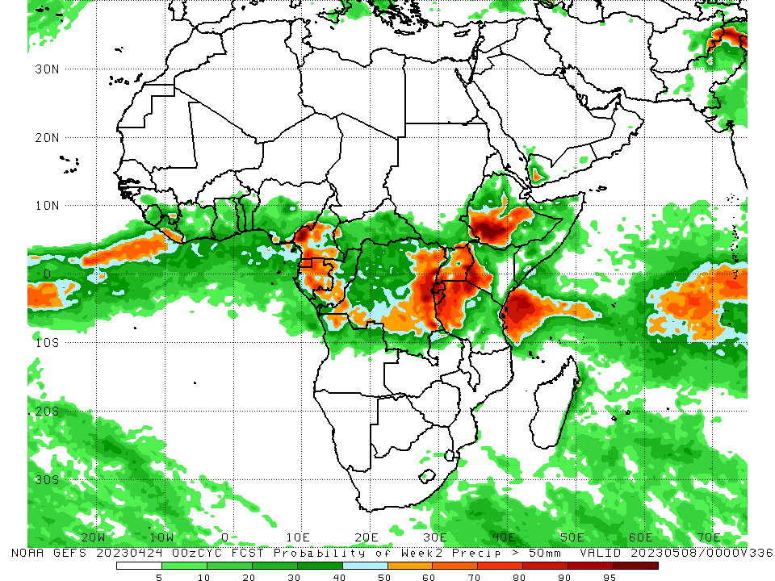
NCEP GEFS Model Forecasts Non-Bias Corrected Probability of precipitation exceedance
Week-1, Valid: 25 Apr – 01 May 2023
Week-2, Valid: 02 May – 08 May 2023
For week-1 (left panel), the GEFS forecasts indicate a moderate to high chance (over 70%) for rainfall to exceed 50 mm over southeastern Liberia, Equatorial Guinea, much of western and central Gabon, southwestern and west-central Congo, west-central and parts of southern Cameroon, eastern DRC, Burundi, Rwanda, northern, west-central, east-central, and south-central Tanzania (east of the higher elevations), the Lake Victoria region, southwestern and coastal Kenya, most of Uganda, south-central and southwestern Ethiopia, parts of southern Somalia, and along the Jos Plateau (as well as southeastern parts) of Nigeria. For week-2 (right panel), the GEFS forecasts indicate a moderate to high chance (over 70%) for rainfall to exceed 50 mm over central and eastern Equatorial Guinea, northern and south-central Gabon, parts of southern Congo along the border of Gabon), west-central and southwestern Cameroon, eastern DRC, southwestern and eastern Uganda, Rwanda, Burundi, northwestern Tanzania, southwestern Kenya, southwestern and east-central Ethiopia, and southeastern Nigeria.
Notes:
‹#›

Slide 10
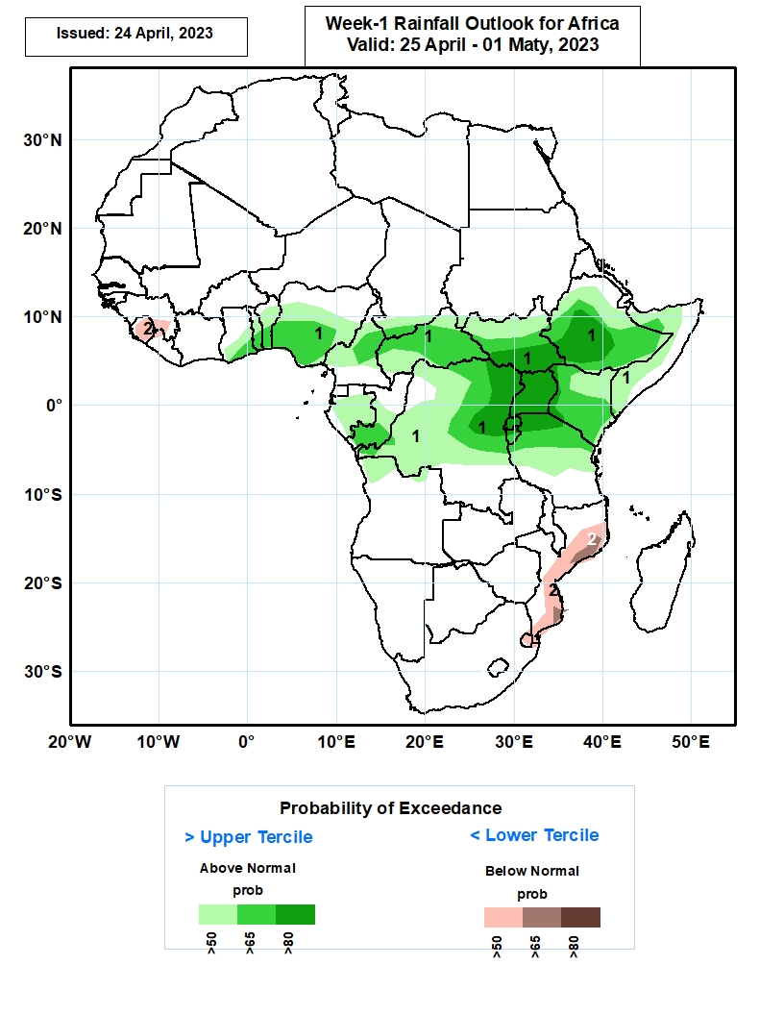
Week-1 Precipitation Outlooks
25 Apr – 01 May 2023
Increased rainfall activity expected across central and eastern Africa. As a result, coastal areas of Ghana, Togo and Benin, southern half of Nigeria, northern half of Cameroon, CAR, Gabon, Congo, DRC, northern Tanzania, Burundi, Rwanda, Uganda, Kenya, South Sudan, and much of Ethiopia and neighboring Somalia are predicted to have above 50% chance for wetter than normal rainfall (above the upper tercile). In particular, there is an increased probability exceeding 80% for rainfall to be above normal over eastern DRC, Rwanda, Uganda, southern South Sudan and southwestern Ethiopia.
The consolidated probabilistic forecasts suggest above 50% chance for weekly total rainfall to be drier than normal (below the lower tercile) over Sierra Leone and surrounding areas, and coastal areas of Mozambique.
Notes:
‹#›

Slide 11
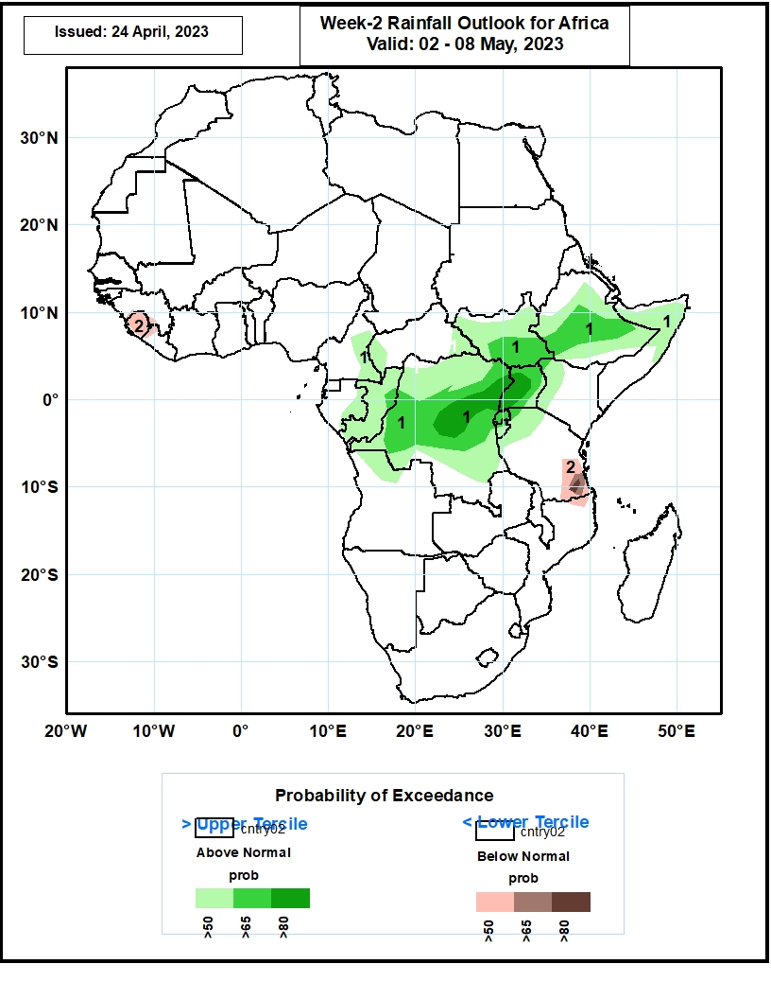
Week-2 Precipitation Outlooks
02 May – 08 May 2023
The consolidated probabilistic forecasts indicate a continuation of increased rainfall activity from central to eastern Africa. Accordingly, the forecasts suggest above 50% chance for weekly total rainfall to be wetter than normal (above the upper tercile) from Congo Brazzaville through DRC, Burundi, Rwanda, Uganda, south Sudan, Ethiopia, and northern Somalia. In particular, the forecasts suggest enhanced probability exceeding 80% for rainfall to be above normal across central DRC, and western Uganda. Enhanced chance of rainfall (>60%) also expected across southern parts of South Sudan extending to Ethiopia.
The consolidated probabilistic forecasts suggest above 50% chance for weekly total rainfall to be drier than normal (below the lower tercile) over Sierra Leone, and coastal areas of southeastern Tanzania.
Notes:
‹#›

Slide 12
Summary
Over the past 30 days, in East Africa, above-average rainfall was observed over central, southwestern, and northeastern Ethiopia, southern and northwestern Somalia, Djibouti, eastern Eritrea, southwestern and eastern Kenya, most of Tanzania, Rwanda, Burundi, southern Uganda, southeastern and northwestern South Sudan, and southwestern Sudan. Rainfall was below-average over west-central and south-central Kenya, a small area of northeastern Tanzania, central South Sudan, west-central Somalia, and northwestern, south-central, and southeastern Ethiopia. In southern Africa, above-average rainfall was observed over northern and pockets of southeastern Mozambique, most of Malawi, northern and eastern Zambia, most of northern, western, and east-central Angola, pockets of northeastern Namibia, eastern Comoros, and most of central and northern Madagascar. Below-average rainfall was observed over much of northern, central, and southern Namibia, southern and northwestern Angola, southern Zambia, most of Zimbabwe and Botswana, most of South Africa, Lesotho, northern Eswatini, western Comoros, and parts of southern and southwestern Madagascar. In Central Africa, rainfall was above-average over most of Congo, northern, southern, and western Cameroon, southwestern Chad, central and eastern Gabon, parts of central and western CAR, and most of DRC. Rainfall was below-average over pockets of northeastern and southwestern DRC, Equatorial Guinea, western Gabon, parts of central Cameroon, Sao Tome and Principe, and east-central CAR. In West Africa, rainfall was above-average over eastern Guinea, northwestern and south-central Liberia, southeastern Cote d’Ivoire, central and southern Ghana, central and southern Togo, central and southern Benin, southwestern, north-central, and parts of eastern Nigeria, southwestern Mali, and central Mauritania. Rainfall was below-average in eastern Liberia, parts of northern Ghana, northern Benin, northern Togo, western, central, and northern Cote d’Ivoire, south-central Nigeria, and central and southern Burkina Faso.
During the past 7 days, in East Africa, rainfall was above-average over northeastern and parts of south-central and southwestern Ethiopia, southwestern Somalia, Djibouti, central and eastern Eritrea, eastern Rwanda, eastern Kenya, eastern and southern Tanzania, and the Lake Victoria region. Below-average rainfall was observed across south-central and northwestern Kenya, parts of southern and central South Sudan, northern and central Uganda, parts of southwestern and southeastern Ethiopia, parts of north-central and western Tanzania, northern and central Burundi, and some areas of central Somalia. In Central Africa, rainfall was above-average over western CAR, most of Cameroon, most of Congo, eastern and southern Gabon, and northwestern and south-central DRC. Below-average rainfall was observed over parts of eastern and central DRC, Equatorial Guinea, and western Gabon. In West Africa, above-average rainfall was observed over central Cote d’Ivoire, eastern Sierra Leone, west-central Ghana, southeastern Guinea, central Togo, central Benin, east-central Nigeria, and northwestern Liberia. Below average rainfall was observed over northern Cote d’Ivoire, northern Ghana, southwestern Burkina Faso, south-central Nigeria, and Sao Tome and Principe. In southern Africa, rainfall was above-average over northern Mozambique, northern Malawi, pockets of northern and central Angola, parts of central Namibia, pockets of southwestern South Africa, and pockets of northern and eastern Madagascar. In contrast, rainfall was below-average over Lesotho, western Eswatini, from north-central to southeastern South Africa, pockets of northern Madagascar, parts of northern Zimbabwe, and pockets of northwestern Angola.
The Week-1 outlook calls for above-average rainfall primarily over much of the Gulf of Guinea region, as well as central and western Africa. This includes regions from Liberia to central and southern Nigeria, southern Cameroon, Equatorial Guinea, Gabon, much of CAR, South Sudan, much of DRC, Lesotho, Sao Tome and Principe, northern Madagascar, Ethiopia, Uganda, Kenya, Tanzania, parts of Somalia, Rwanda, and Burundi. Anomalies could exceed 50mm from southwestern Ethiopia to central Tanzania. In contrast, there is an increased chance for below-average rainfall over southern Guinea, Sierra Leone, central Angola, southeastern DRC, coastal Mozambique, and central and southern Madagascar. The Week-2 outlook suggests above-average rainfall over primarily central and western Africa. This includes parts of CAR, central and southern Congo, DRC, northern Angola, Rwanda, Burundi, parts of Uganda, northern and western Tanzania, western Kenya, central and southwestern Ethiopia, northern Somalia, coastal Ghana/Togo/Benin/Nigeria, eastern Sierra Leone, and southeastern Guinea. Below-average rainfall is likely over parts of central Nigeria/Cameroon, western Equatorial Guinea, western Gabon, eastern Tanzania, the Lake Victoria region, northeastern Mozambique, Comoros, and eastern Madagascar.

