Slide 1
The African Monsoon Recent Evolution and Current Status Include Week-1 and Week-2 Outlooks
Update prepared
17 April 2023
For more information, visit:
http://www.cpc.ncep.noaa.gov/products/Global_Monsoons/African_Monsoons/precip_monitoring.shtml

Slide 2
Outline
Highlights
Recent Evolution and Current Conditions
NCEP GEFS Forecasts
Summary

Slide 3
Highlights: Last 7 Days
During the past 7 days, in East Africa, rainfall was above-average over southwestern and north-central Ethiopia, parts of southeastern Somalia, Djibouti, central Eritrea, eastern Rwanda, eastern Burundi, parts central Kenya, west-central and east-central South Sudan, and central, western, and southern Tanzania. Below-average rainfall was observed across southeastern and western Kenya, parts of southern South Sudan, northern, central, and eastern Uganda, south-central and northeastern Ethiopia, parts of northern and east-central Tanzania, Djibouti, and some areas of southern and northwestern Somalia. In Central Africa, rainfall was above-average over most of CAR, pockets of central Cameroon, northern and east-central Congo, and northwestern, southwestern, east-central, and southeastern DRC. Below-average rainfall was observed over parts of northeastern and west-central DRC, Equatorial Guinea, Gabon, parts of southern and western Congo, and pockets of western and south-central Cameroon. In West Africa, above-average rainfall was observed over southeastern Cote d’Ivoire, eastern Sierra Leone, central Ghana, eastern Guinea, central and southern Togo, southern Benin, southwestern and northeastern Nigeria, southwestern Mali, central Mauritania, and most of Liberia. Below average rainfall was observed over southwestern, central, and northeastern Cote d’Ivoire, northern Ghana, southern Burkina Faso, and central and southeastern Nigeria. In southern Africa, rainfall was above-average over northern and southeastern Mozambique, northern and central Malawi, eastern Zambia, much of western and northern Angola, parts of east-central Namibia, pockets of southeastern and north-central South Africa, eastern Lesotho, pockets of west-central and south-central Botswana, and northern and west-central Madagascar. In contrast, rainfall was below-average over central Namibia, eastern Lesotho, and coastal east-central and southern Madagascar.
The Week-1 outlook calls for above-average rainfall over central Ethiopia, northeastern and south-central Kenya, western, southern, and eastern Tanzania, central Uganda, parts of central CAR, Liberia, southeastern Guinea, southern Sierra Leone, west-central Cameroon, southern and eastern DRC, Rwanda, Burundi, northern and eastern parts of Zambia, northern Mozambique, most of northern Angola, northern and central Malawi, and coastal northeastern Madagascar. In contrast, there is an increased chance for below-average rainfall over northern Cote d’Ivoire, northern and southern Ghana, northern and southern Togo, northern and southern Benin, southern Nigeria, southwestern Cameroon, northern and southern Congo, northeastern Gabon, west-central and southeastern Ethiopia, central South Sudan, central and southeastern Somalia, southeastern Uganda, Lesotho, Eswatini, much of central and southeastern South Africa, and northern Madagascar. The Week-2 outlook suggests above-average rainfall over central Togo and Benin, central and southern Nigeria, and most of Central and Western Africa – especially the region from eastern DRC to western Ethiopia. Below-average rainfall is likely over southern Guinea, Sierra Leone, and coastal Mozambique.

Slide 4
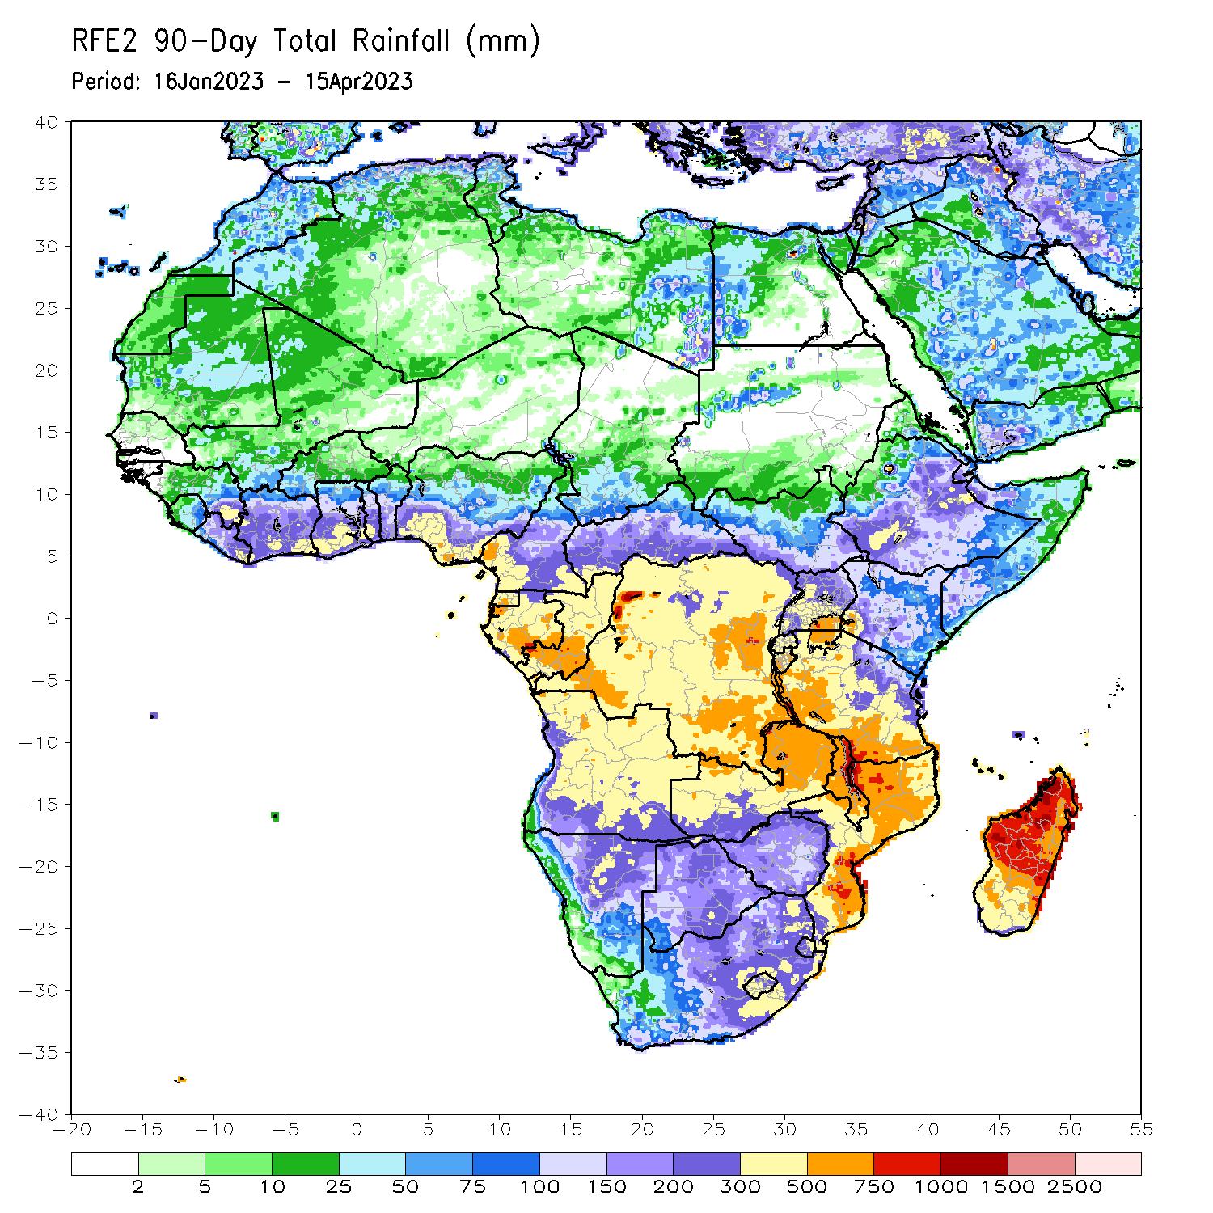
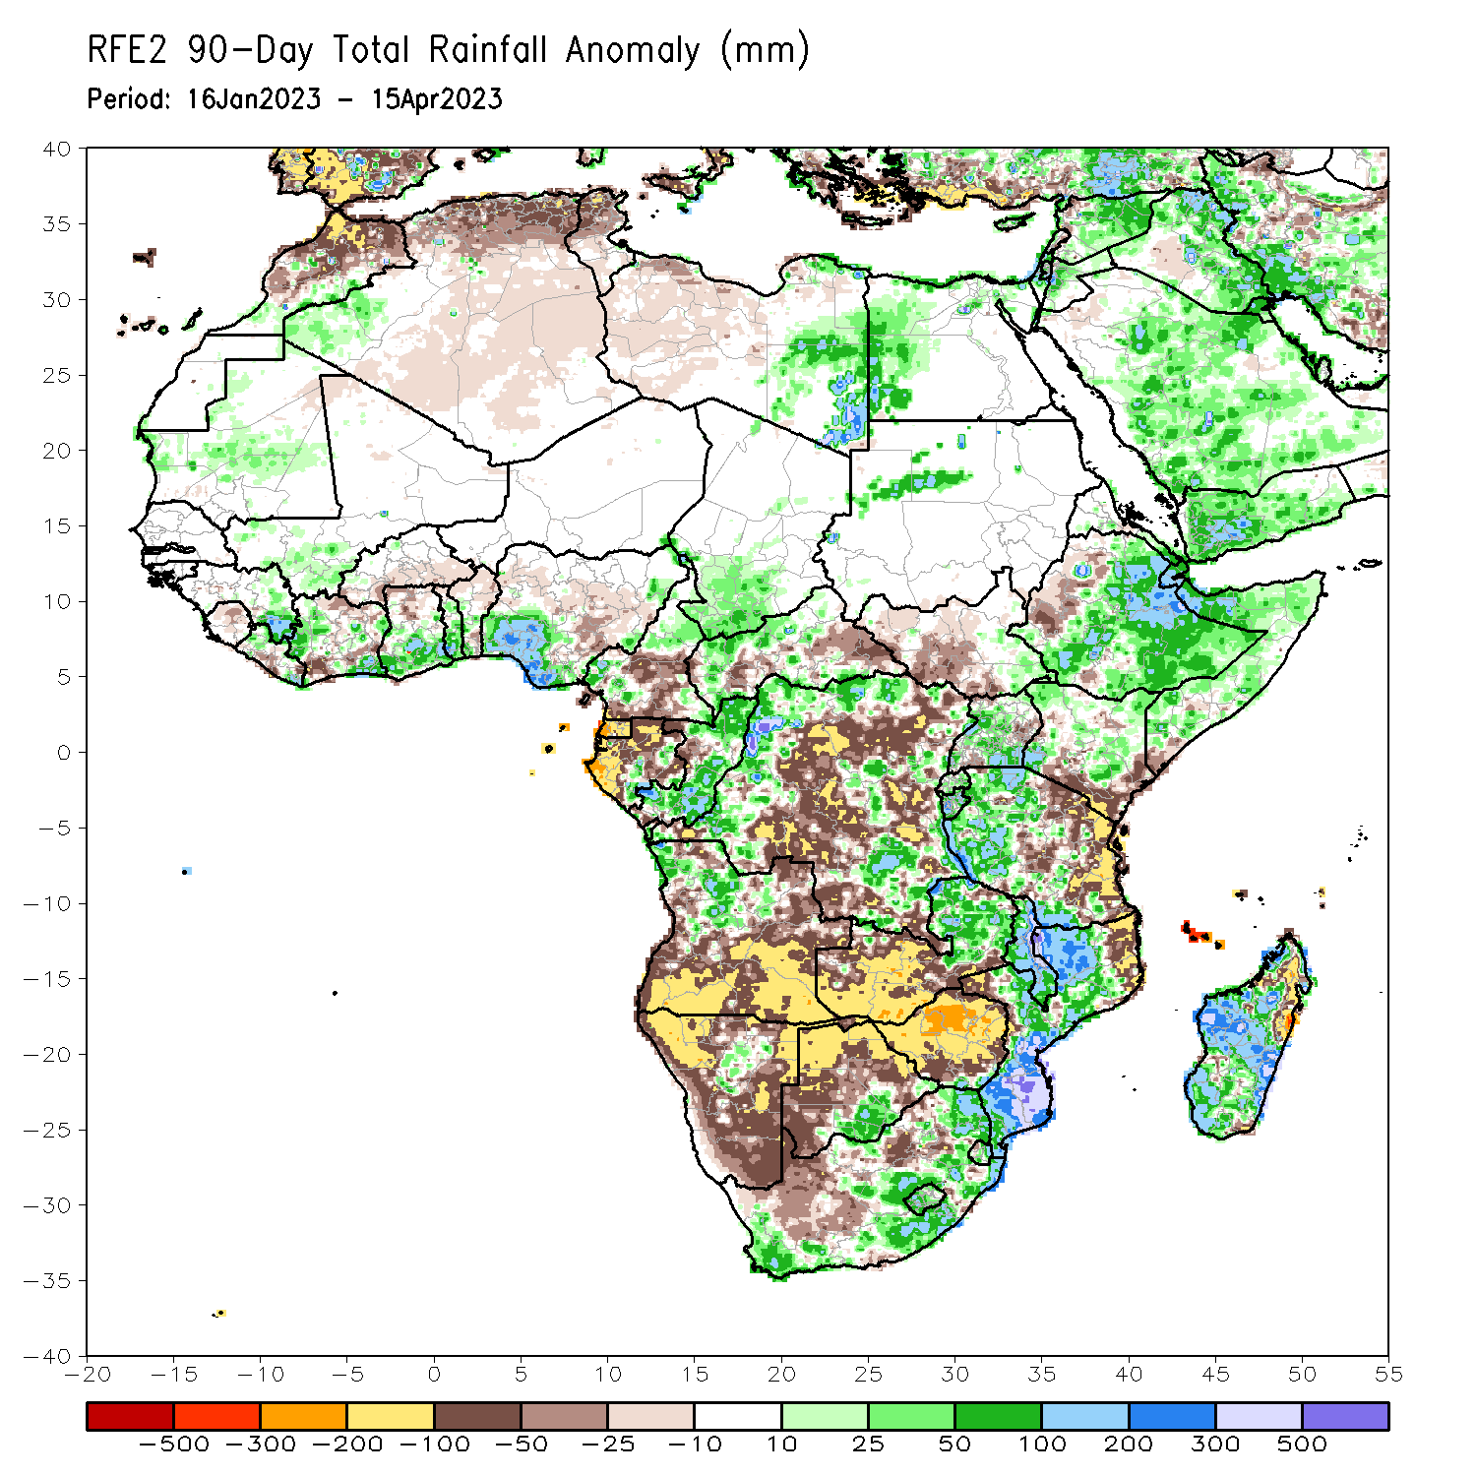
Rainfall Patterns: Last 90 Days
Over the past 90 days, in East Africa, above-average rainfall was observed over parts of central, central, eastern, and southern Ethiopia, many parts of Somalia, Djibouti, eastern Eritrea, northern, central, and southwestern Kenya, northeastern, central, and southeastern Uganda, western Tanzania, Burundi, Rwanda, southeastern South Sudan, and parts of northwestern Sudan. Rainfall was below-average over parts of west-central Ethiopia, southwestern, northwestern, and east-central Uganda, most of western and central South Sudan, southern Kenya, southeastern Somalia, and eastern and parts of central Tanzania. In southern Africa, above-average rainfall was observed over parts of northwestern, central, and southern Mozambique, much of Malawi, eastern Zambia, pockets of central and northwestern Angola, pockets of north-central Namibia, south-central Botswana, southern Zimbabwe, eastern, southern, and parts of central South Africa, Lesotho, eastern Eswatini, and parts of western, central, and southern Madagascar. Below-average rainfall was observed over west-central, southern, and eastern Angola, western, northern, eastern, and southern Namibia, western, northern, and central Botswana, much of northern and central Zimbabwe, southern and western Zambia, northeastern and west-central Mozambique, northeastern and a small portion of southeastern Madagascar, parts of northern South Africa, northwestern Eswatini, and Comoros. In Central Africa, rainfall was above-average over much of Congo, parts of western, eastern, and northern DRC, north-central, western, and southeastern Cameroon, southwestern Chad, pockets of southern and eastern Gabon, and northern and southern CAR. Rainfall was below-average over southern Cameroon, western and northern Gabon, Equatorial Guinea, Sao Tome and Principe, central CAR, and portions of central and southern DRC. In West Africa, rainfall was above-average over parts of eastern Guinea, southeastern and northwestern Liberia, southeastern and parts of central Cote d’Ivoire, southern parts of Ghana, central and southern Togo, central and southwestern Benin, parts of southern and eastern Nigeria, central Mauritania, and southwestern Mali. In contrast, below-average rainfall was observed over northern Sierra Leone, northeastern and central Liberia, northern, east-central, and southwestern Cote d’Ivoire, northern Ghana, northern and southeastern Benin, northern Togo, central Nigeria, and southern Burkina Faso.
Notes:
‹#›

Slide 5
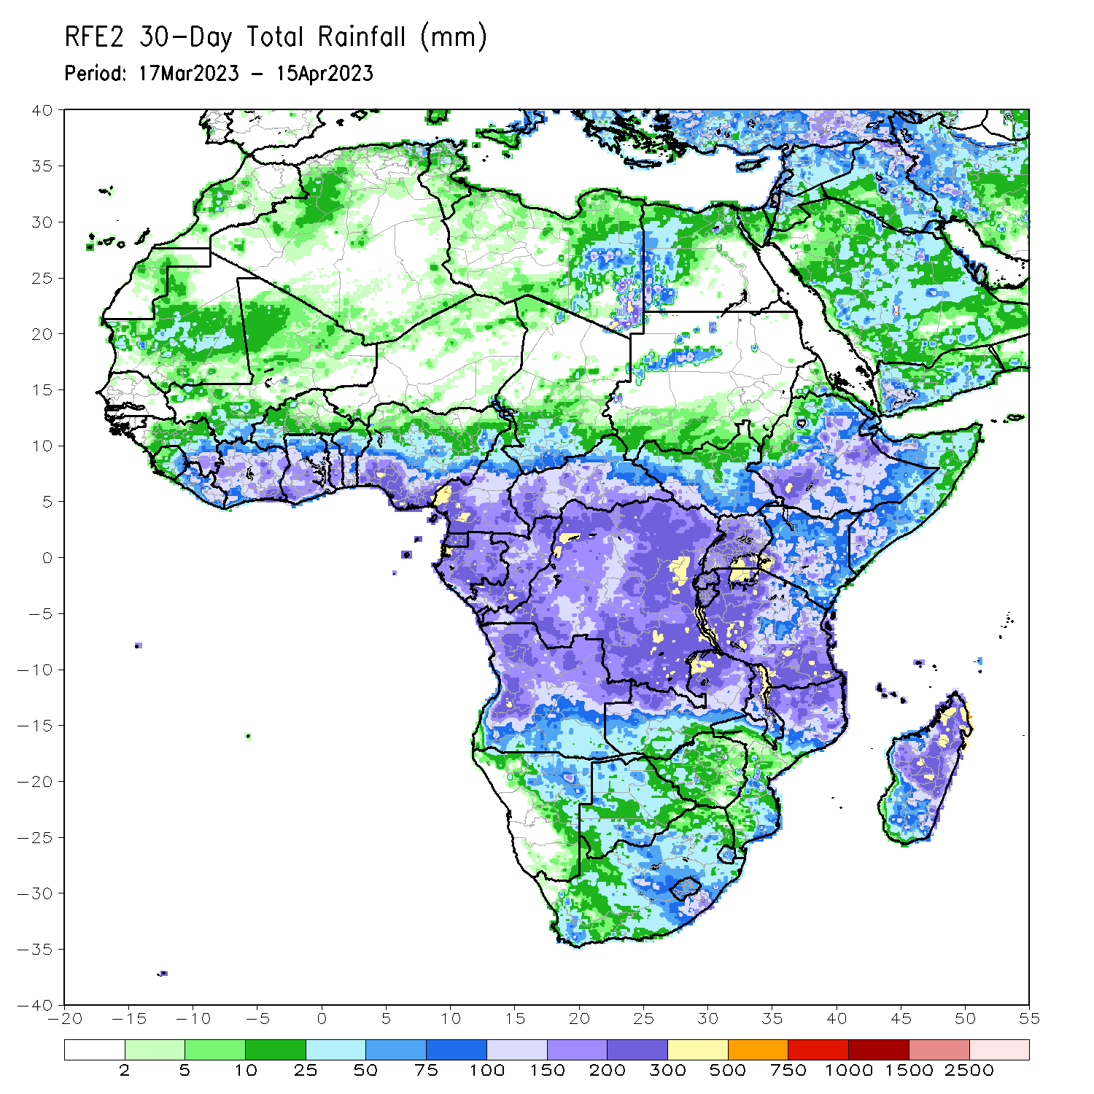
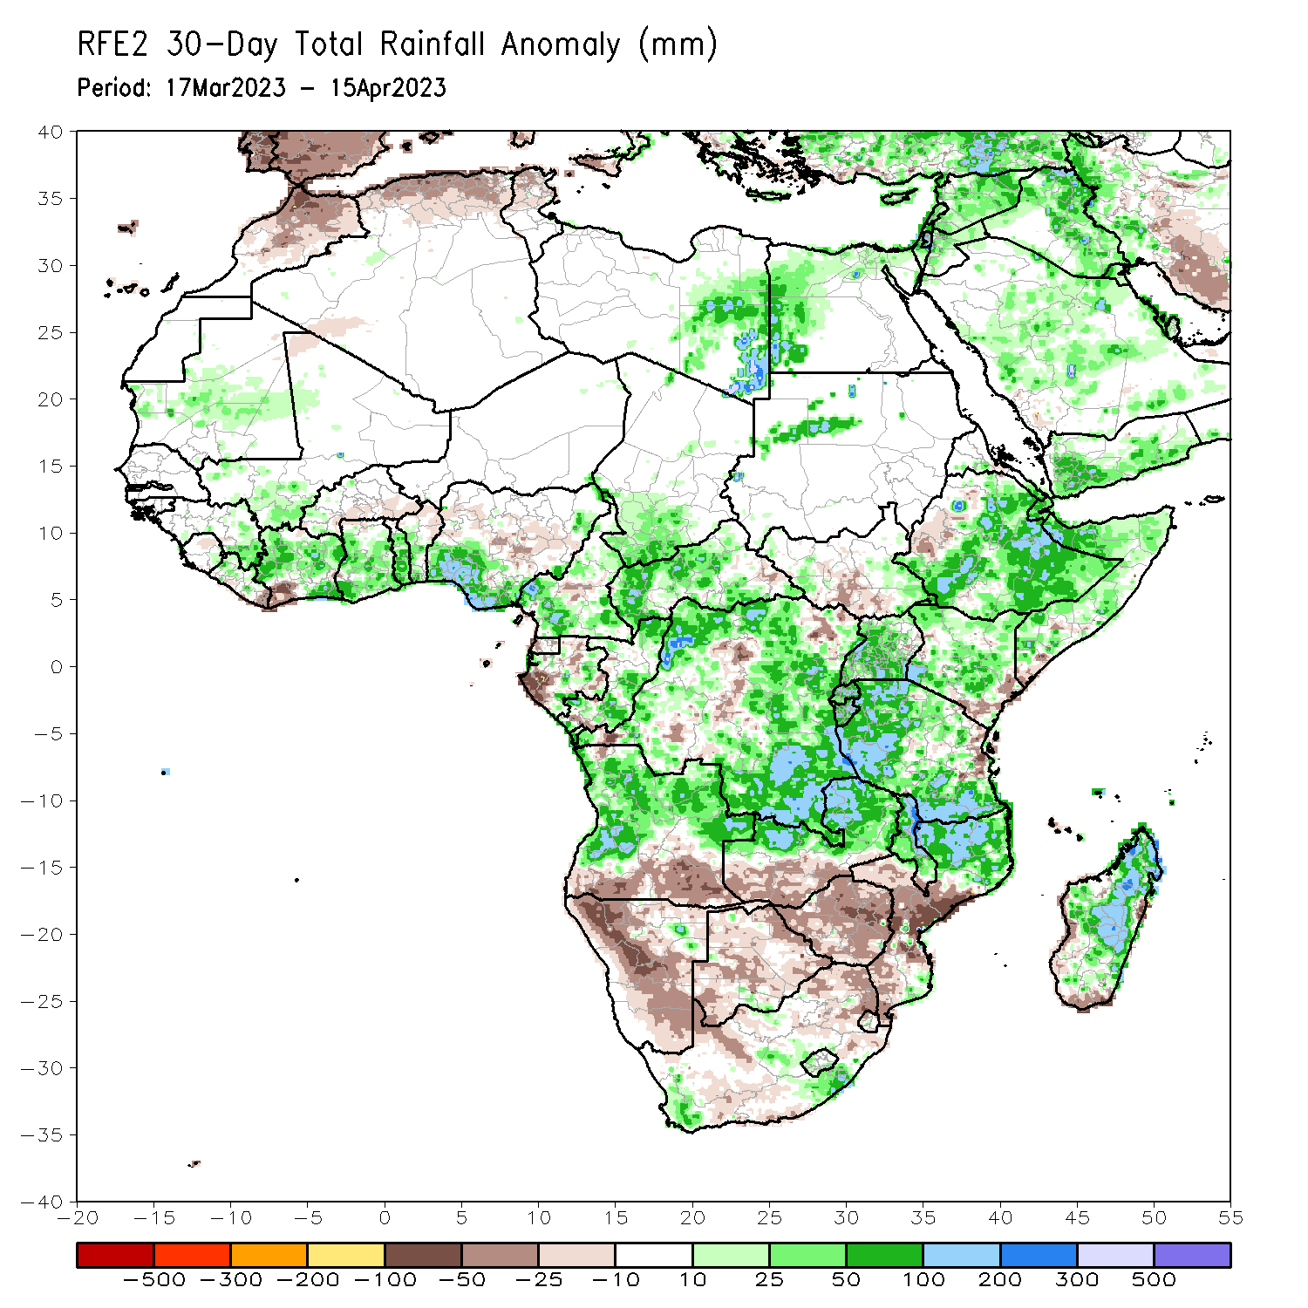
Rainfall Patterns: Last 30 Days
Over the past 30 days, in East Africa, above-average rainfall was observed over central, southern, and eastern Ethiopia, much of Somalia, Djibouti, eastern Eritrea, southwestern, northern, and central Kenya, western, southern, and much of northern Tanzania, Rwanda, Burundi, most of Uganda, southeastern and southwestern South Sudan, and pockets of northwestern Sudan. Rainfall was below-average over southeastern Kenya, northeastern Tanzania, pockets of south-central South Sudan, southeastern Somalia, and parts of west-central Ethiopia. In southern Africa, above-average rainfall was observed over northern and pockets of southeastern Mozambique, most of Malawi, northern and eastern Zambia, most of northern, western, and east-central Angola, southwestern and southeastern South Africa, western Lesotho, and most of central and northern Madagascar. Below-average rainfall was observed over much of Namibia, southern Angola, southern Zambia, most of Zimbabwe and Botswana, northern and eastern South Africa, northern and southern Eswatini, western Comoros, and parts of southern and west-central Madagascar. In Central Africa, rainfall was above-average over northern and southern Congo, northern, southern, and western Cameroon, southwestern Chad, central Gabon, parts of central, northern, western, and southern CAR, and most of northern, southern, western, and eastern DRC. Rainfall was below-average over parts of central and northeastern DRC, western Equatorial Guinea, western and north-central Gabon, parts of central Cameroon, and east-central CAR. In West Africa, rainfall was above-average over eastern Guinea, northern Liberia, northern, central, and southeastern Cote d’Ivoire, central and southern Ghana, central and southern Togo, central and southern Benin, southern and parts of eastern Nigeria, southwestern Mali, central Mauritania, and western Burkina Faso. Rainfall was below-average in eastern Liberia, parts of northern Ghana, northern Benin, southwestern Cote d’Ivoire, and central Nigeria.
Notes:
‹#›

Slide 6
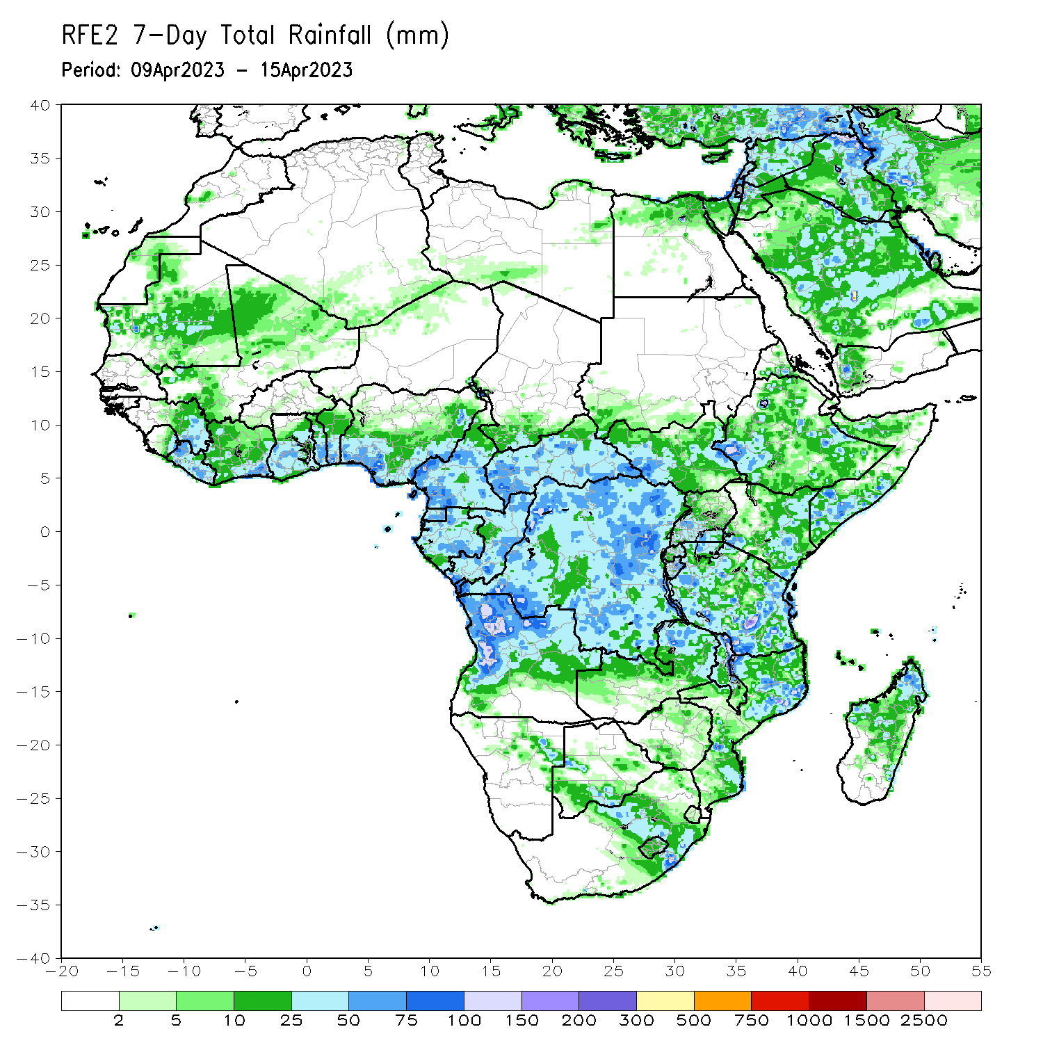
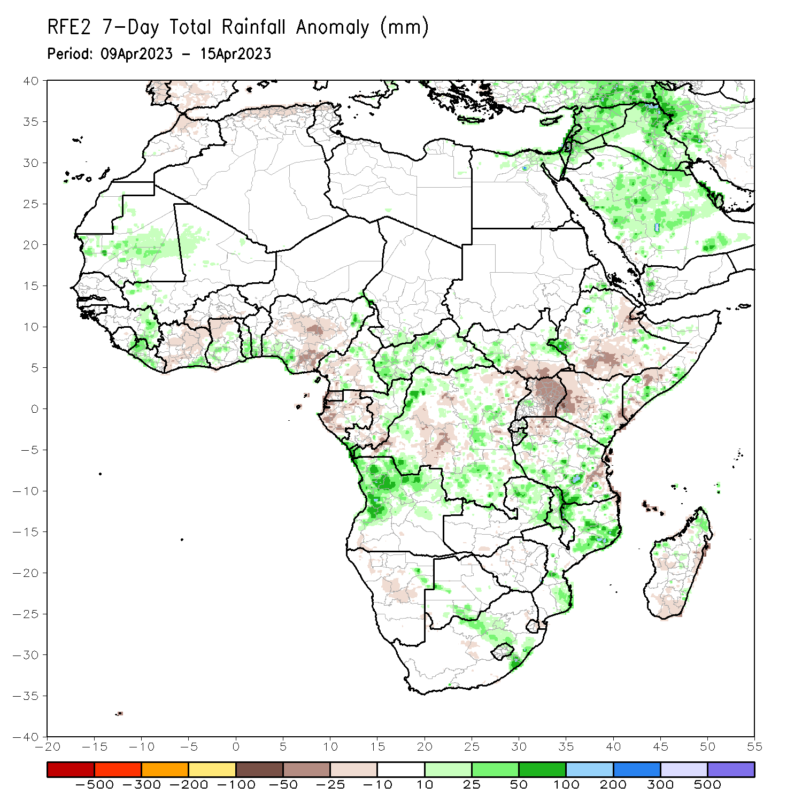
Rainfall Patterns: Last 7 Days
During the past 7 days, in East Africa, rainfall was above-average over southwestern and north-central Ethiopia, parts of southeastern Somalia, Djibouti, central Eritrea, eastern Rwanda, eastern Burundi, parts central Kenya, west-central and east-central South Sudan, and central, western, and southern Tanzania. Below-average rainfall was observed across southeastern and western Kenya, parts of southern South Sudan, northern, central, and eastern Uganda, south-central and northeastern Ethiopia, parts of northern and east-central Tanzania, Djibouti, and some areas of southern and northwestern Somalia. In Central Africa, rainfall was above-average over most of CAR, pockets of central Cameroon, northern and east-central Congo, and northwestern, southwestern, east-central, and southeastern DRC. Below-average rainfall was observed over parts of northeastern and west-central DRC, Equatorial Guinea, Gabon, parts of southern and western Congo, and pockets of western and south-central Cameroon. In West Africa, above-average rainfall was observed over southeastern Cote d’Ivoire, eastern Sierra Leone, central Ghana, eastern Guinea, central and southern Togo, southern Benin, southwestern and northeastern Nigeria, southwestern Mali, central Mauritania, and most of Liberia. Below average rainfall was observed over southwestern, central, and northeastern Cote d’Ivoire, northern Ghana, southern Burkina Faso, and central and southeastern Nigeria. In southern Africa, rainfall was above-average over northern and southeastern Mozambique, northern and central Malawi, eastern Zambia, much of western and northern Angola, parts of east-central Namibia, pockets of southeastern and north-central South Africa, eastern Lesotho, pockets of west-central and south-central Botswana, and northern and west-central Madagascar. In contrast, rainfall was below-average over central Namibia, eastern Lesotho, and coastal east-central and southern Madagascar.

Slide 7
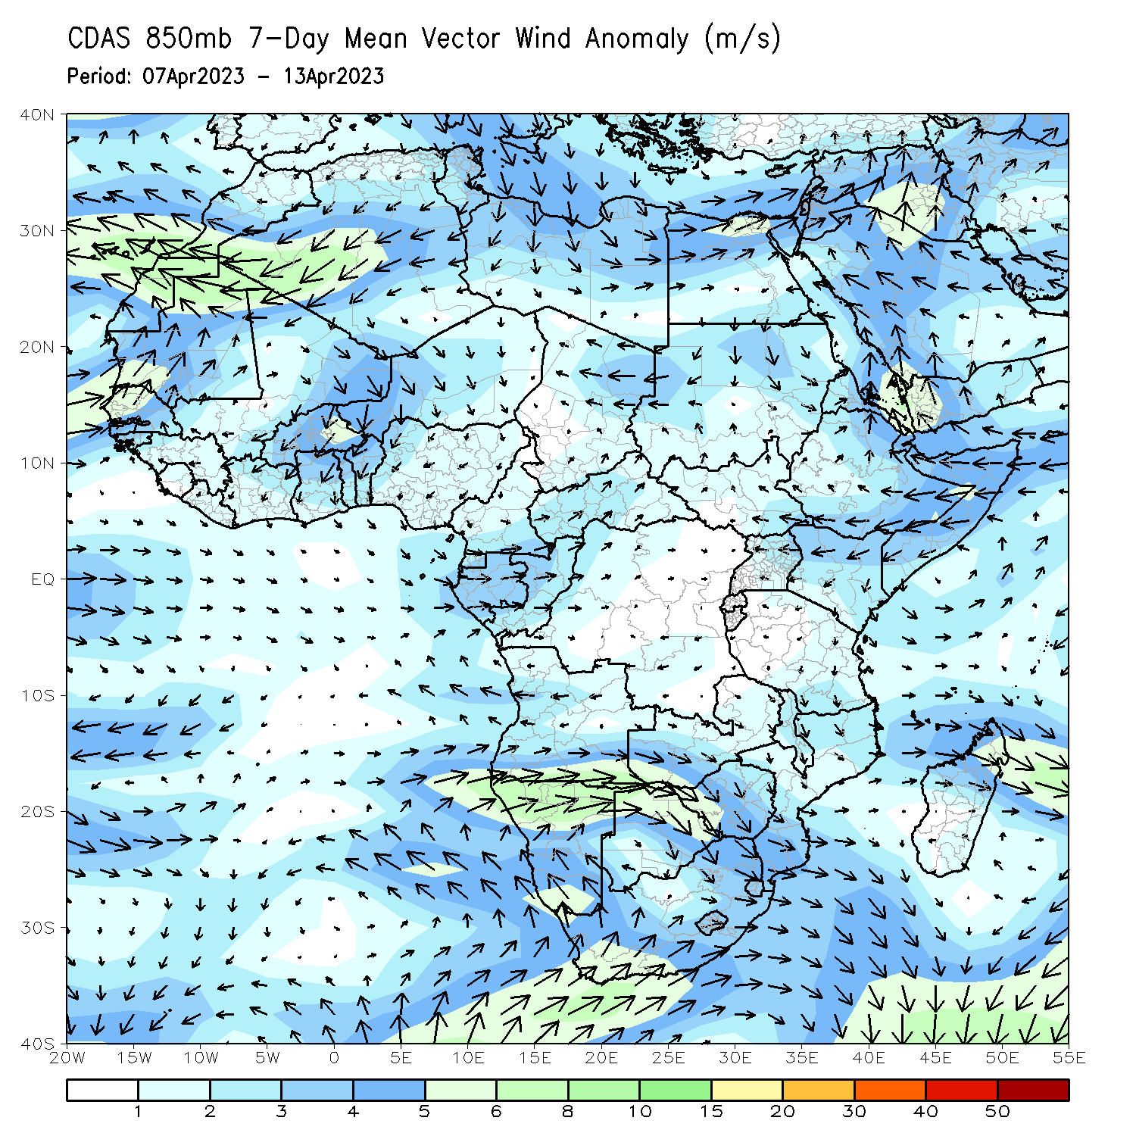
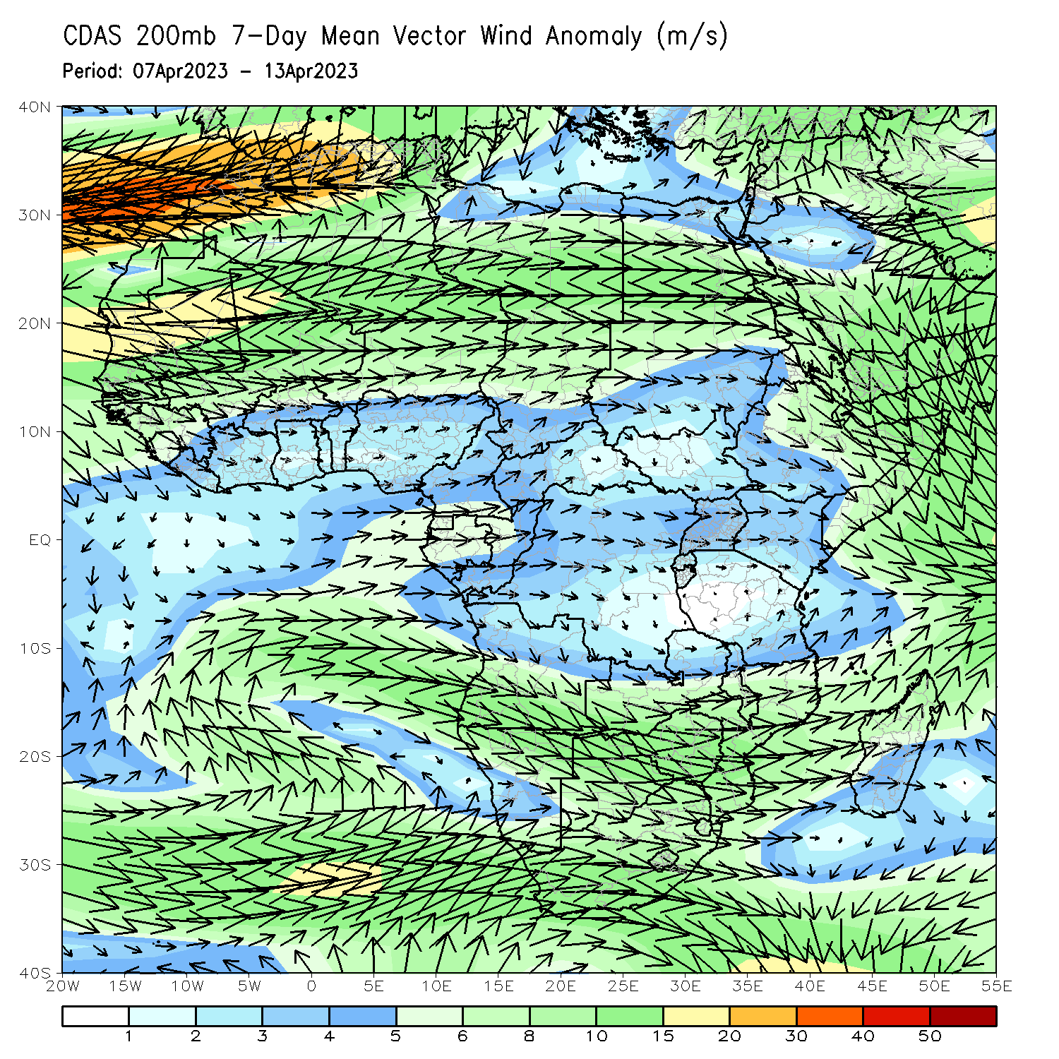
Atmospheric Circulation: Last 7 Days
At 850-hPa level (left panel), confluence/convergence was observed in northern Angola and from CAR to west-central Ethiopia, contributing to above normal rainfall. Upper-level divergence was present at 200-hPa (right panel) across northern Angola, also contributing to the above normal rainfall in that region.

Slide 8
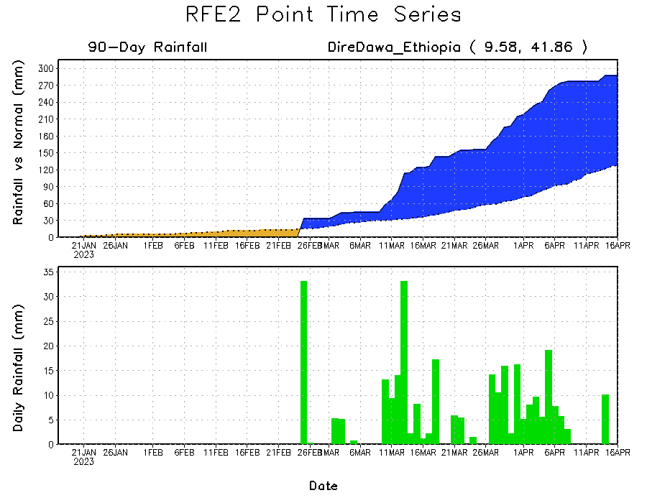
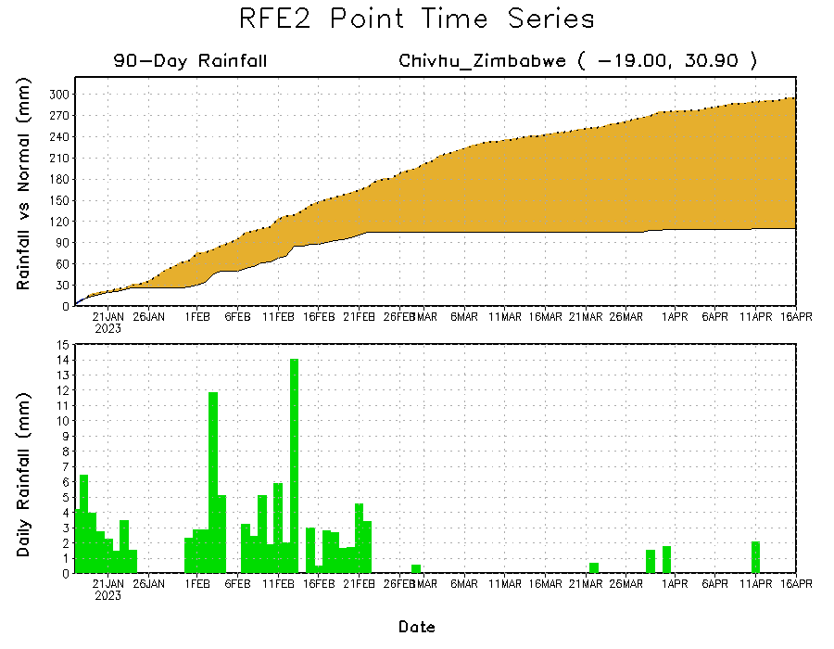
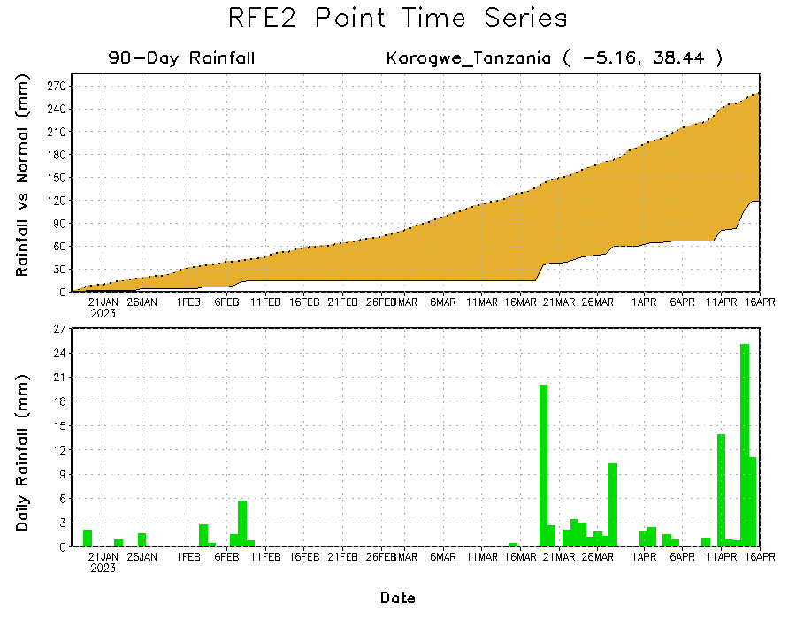
Rainfall Evolution
Daily evolution of rainfall over the last 90 days at selected locations shows slightly decreased rainfall deficits over parts of northeastern Tanzania (bottom left) and increasing rainfall deficits over central Zimbabwe (bottom right). Near-normal rainfall also resulted in continuing moisture surpluses over parts of eastern and northeastern Ethiopia (top right).

Slide 9
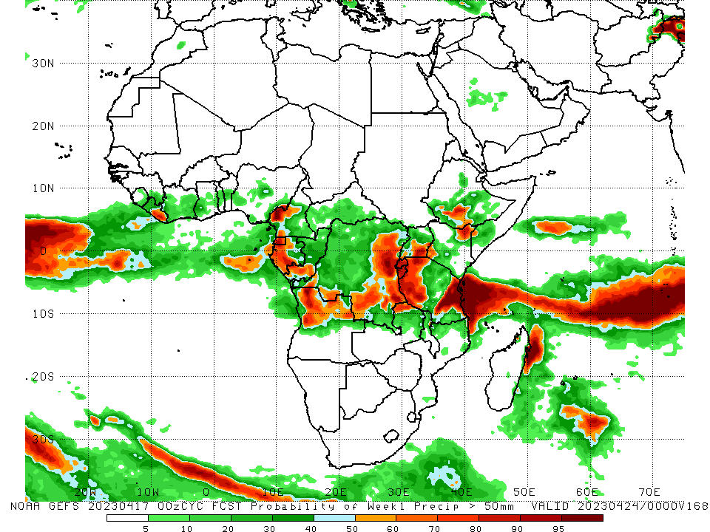
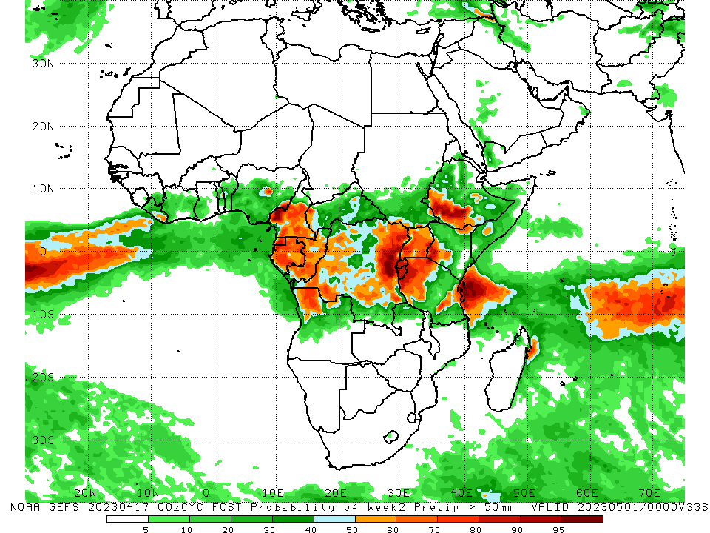
NCEP GEFS Model Forecasts Non-Bias Corrected Probability of precipitation exceedance
Week-1, Valid: 18 – 24 April 2023
Week-2, Valid: 25 Apr – 01 May 2023
For week-1 (left panel), the GEFS forecasts indicate a moderate to high chance (over 70%) for rainfall to exceed 50 mm over southeastern Liberia, Equatorial Guinea, much of western Gabon, southern Congo, west-central Cameroon, southeastern, east-central, and some portions of southwestern DRC, Burundi, Rwanda, western, eastern, and south-central Tanzania (east of the higher elevations), the Lake Victoria region, northwestern Kenya, south-central Ethiopia, northern Angola, northeastern Zambia, and northeastern Madagascar. For week-2 (right panel), the GEFS forecasts indicate a moderate to high chance (over 70%) for rainfall to exceed 50 mm over Equatorial Guinea, western, northern, and southern Gabon, southern Congo, pockets of central and southwestern Cameroon, southwestern and eastern DRC, western and southeastern Uganda, Rwanda, Burundi, northwestern, northeastern, and south-central Tanzania (east of the higher elevations), southwestern Kenya, southeastern Ethiopia, northwestern Angola, and along the Jos Plateau of Nigeria.
Notes:
‹#›

Slide 10
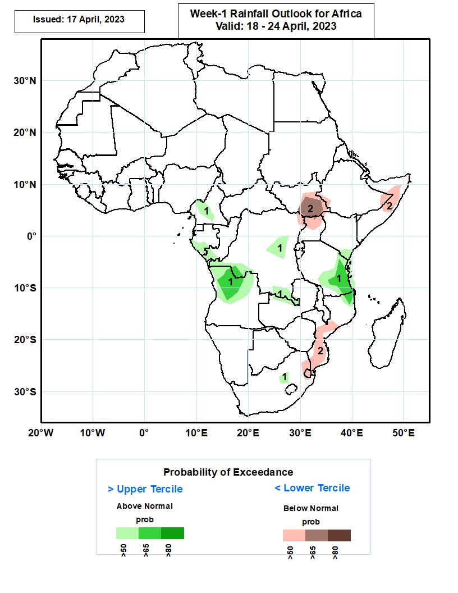
Week-1 Precipitation Outlooks
18 Apr – 24 Apr 2023
The wet conditions that covered much of central, western and eastern Africa is forecasted to weaken in the coming week. As a result, a few areas in Cameroon, coastal areas from Gabon to DRC, northern Angola, a few areas of central and southern DRC, eastern Tanzania and southeastern Kenya, and isolated areas in South Africa are predicted to have above 50% chance for weekly rainfall to be wetter than normal (above the upper tercile). In particular, there is an enhanced probability exceeding 80% for rainfall to be above normal over southeastern Tanzania and northern Angola.
The consolidated probabilistic forecasts suggest above 50% chance for weekly total rainfall to be drier than normal (below the lower tercile) over parts of South Sudan, north-central Somalia and southern Mozambique.
Notes:
‹#›

Slide 11
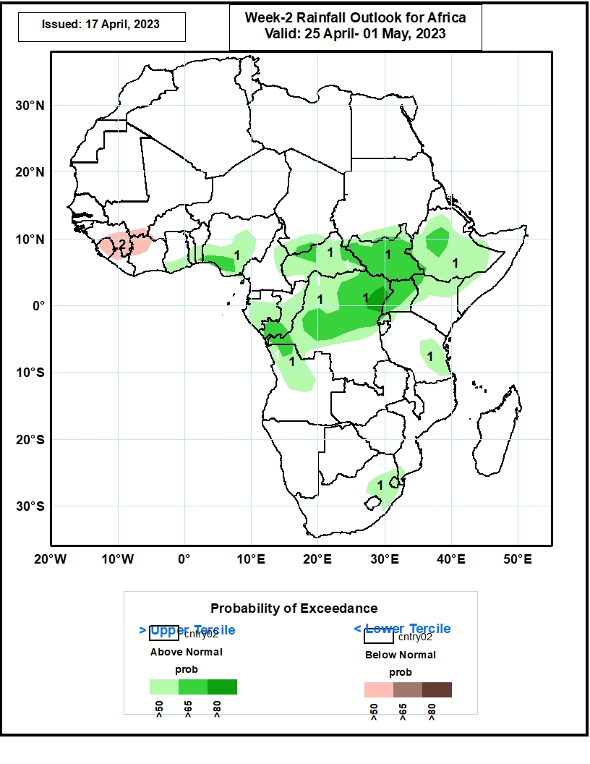
Week-2 Precipitation Outlooks
25 Apr – 01 May 2023
The consolidated probabilistic forecasts indicate a general increase in rainfall activity from central to eastern Africa. Accordingly, the forecasts indicate above 50% chance for weekly total rainfall to be wetter than normal (above the upper tercile) from the Gulf of Guinea extending to central and eastern Africa. In particular, the forecasts suggest enhanced probability exceeding 80% for rainfall to be above normal over the coastal areas of Congo-Brazzaville, much of central and northern DRC, and northern Ethiopia.
The forecasts indicate above 50% chance for weekly rainfall to be below-normal (below the lower tercile) over Guinea, Sierra Leone, and northern Ivory Coast.
Notes:
‹#›

Slide 12
Summary
Over the past 30 days, in East Africa, above-average rainfall was observed over central, southern, and eastern Ethiopia, much of Somalia, Djibouti, eastern Eritrea, southwestern, northern, and central Kenya, western, southern, and much of northern Tanzania, Rwanda, Burundi, most of Uganda, southeastern and southwestern South Sudan, and pockets of northwestern Sudan. Rainfall was below-average over southeastern Kenya, northeastern Tanzania, pockets of south-central South Sudan, southeastern Somalia, and parts of west-central Ethiopia. In southern Africa, above-average rainfall was observed over northern and pockets of southeastern Mozambique, most of Malawi, northern and eastern Zambia, most of northern, western, and east-central Angola, southwestern and southeastern South Africa, western Lesotho, and most of central and northern Madagascar. Below-average rainfall was observed over much of Namibia, southern Angola, southern Zambia, most of Zimbabwe and Botswana, northern and eastern South Africa, northern and southern Eswatini, western Comoros, and parts of southern and west-central Madagascar. In Central Africa, rainfall was above-average over northern and southern Congo, northern, southern, and western Cameroon, southwestern Chad, central Gabon, parts of central, northern, western, and southern CAR, and most of northern, southern, western, and eastern DRC. Rainfall was below-average over parts of central and northeastern DRC, western Equatorial Guinea, western and north-central Gabon, parts of central Cameroon, and east-central CAR. In West Africa, rainfall was above-average over eastern Guinea, northern Liberia, northern, central, and southeastern Cote d’Ivoire, central and southern Ghana, central and southern Togo, central and southern Benin, southern and parts of eastern Nigeria, southwestern Mali, central Mauritania, and western Burkina Faso. Rainfall was below-average in eastern Liberia, parts of northern Ghana, northern Benin, southwestern Cote d’Ivoire, and central Nigeria.
During the past 7 days, in East Africa, rainfall was above-average over southwestern and north-central Ethiopia, parts of southeastern Somalia, Djibouti, central Eritrea, eastern Rwanda, eastern Burundi, parts central Kenya, west-central and east-central South Sudan, and central, western, and southern Tanzania. Below-average rainfall was observed across southeastern and western Kenya, parts of southern South Sudan, northern, central, and eastern Uganda, south-central and northeastern Ethiopia, parts of northern and east-central Tanzania, Djibouti, and some areas of southern and northwestern Somalia. In Central Africa, rainfall was above-average over most of CAR, pockets of central Cameroon, northern and east-central Congo, and northwestern, southwestern, east-central, and southeastern DRC. Below-average rainfall was observed over parts of northeastern and west-central DRC, Equatorial Guinea, Gabon, parts of southern and western Congo, and pockets of western and south-central Cameroon. In West Africa, above-average rainfall was observed over southeastern Cote d’Ivoire, eastern Sierra Leone, central Ghana, eastern Guinea, central and southern Togo, southern Benin, southwestern and northeastern Nigeria, southwestern Mali, central Mauritania, and most of Liberia. Below average rainfall was observed over southwestern, central, and northeastern Cote d’Ivoire, northern Ghana, southern Burkina Faso, and central and southeastern Nigeria. In southern Africa, rainfall was above-average over northern and southeastern Mozambique, northern and central Malawi, eastern Zambia, much of western and northern Angola, parts of east-central Namibia, pockets of southeastern and north-central South Africa, eastern Lesotho, pockets of west-central and south-central Botswana, and northern and west-central Madagascar. In contrast, rainfall was below-average over central Namibia, eastern Lesotho, and coastal east-central and southern Madagascar.
The Week-1 outlook calls for above-average rainfall over central Ethiopia, northeastern and south-central Kenya, western, southern, and eastern Tanzania, central Uganda, parts of central CAR, Liberia, southeastern Guinea, southern Sierra Leone, west-central Cameroon, southern and eastern DRC, Rwanda, Burundi, northern and eastern parts of Zambia, northern Mozambique, most of northern Angola, northern and central Malawi, and coastal northeastern Madagascar. In contrast, there is an increased chance for below-average rainfall over northern Cote d’Ivoire, northern and southern Ghana, northern and southern Togo, northern and southern Benin, southern Nigeria, southwestern Cameroon, northern and southern Congo, northeastern Gabon, west-central and southeastern Ethiopia, central South Sudan, central and southeastern Somalia, southeastern Uganda, Lesotho, Eswatini, much of central and southeastern South Africa, and northern Madagascar. The Week-2 outlook suggests above-average rainfall over central Togo and Benin, central and southern Nigeria, and most of Central and Western Africa – especially the region from eastern DRC to western Ethiopia. Below-average rainfall is likely over southern Guinea, Sierra Leone, and coastal Mozambique.

