Slide 1
The African Monsoon Recent Evolution and Current Status Include Week-1 and Week-2 Outlooks
Update prepared
10 April 2023
For more information, visit:
http://www.cpc.ncep.noaa.gov/products/Global_Monsoons/African_Monsoons/precip_monitoring.shtml

Slide 2
Outline
Highlights
Recent Evolution and Current Conditions
NCEP GEFS Forecasts
Summary

Slide 3
Highlights: Last 7 Days
During the past 7 days, in East Africa, rainfall was above-average over southwestern, central, and eastern Ethiopia, parts of southwestern and northwestern Somalia, Djibouti, eastern Eritrea, southern Uganda, Rwanda, Burundi, parts of western and central Kenya, and western, northern, and southern Tanzania. Below-average rainfall was observed across southeastern Kenya, parts of southern South Sudan, northern Uganda, south-central Ethiopia, parts of east-central Tanzania, and some areas of southern Somalia. In Central Africa, rainfall was above-average over parts of southeastern CAR, southern and central Cameroon, northern Congo, most of northern, eastern, and southern DRC, and most of Gabon. Below-average rainfall was observed over parts of northeastern and west-central DRC, northern and eastern CAR, western Equatorial Guinea, southern Congo, and pockets of western Cameroon. In West Africa, above-average rainfall was observed over southeastern Cote d’Ivoire, northern and southern Ghana, southeastern Guinea, southern Togo, southern Benin, southwestern and south-central Nigeria, southwestern Mali, most of Liberia, and western Burkina Faso. Below average rainfall was observed over southwestern and central Cote d’Ivoire, central Ghana, parts of northern Benin, and southeastern Nigeria. In southern Africa, rainfall was above-average over pockets of northern Mozambique, northern Malawi, northern Zambia, western and northern Angola, parts of east-central Namibia, pockets of southeastern and north-central South Africa, Lesotho, and most of Madagascar. In contrast, rainfall was below-average over central and southern and eastern Mozambique, central and southern Zimbabwe, northeastern and northwestern South Africa, southeastern Angola, southwestern Zambia, northern and eastern Botswana, central and northern Namibia, and coastal northeastern Madagascar.
The Week-1 outlook calls for an increased chance for above-average rainfall over central Ethiopia, eastern Kenya, western and southern Tanzania, northern Congo, southern CAR, southwestern and southeastern South Sudan, northern Liberia, southeastern Guinea, central Mauritania, west-central Cameroon, northern, central, and southeastern DRC, northern, central, and eastern parts of Zambia, most of Mozambique, most of northern Angola, Malawi, and northern Madagascar. In contrast, there is an increased chance for below-average rainfall over most of the Gulf of Guinea region, central Cameroon, western and southern Gabon, western Equatorial Guinea, southwestern DRC, western Burundi, south-central South Sudan, southern Ethiopia, central and southern Somalia, southwestern Zambia, southern and northwestern Angola, most of Namibia, northern and southern Botswana, Uganda, southwestern Kenya, parts of northern and east-central Tanzania, Comoros, Lesotho, western Eswatini, much of South Africa, and eastern coastal Madagascar. The Week-2 outlook suggests an increased chance for above-average rainfall over the Gulf of Guinea region, central and southern Cameroon, CAR, Equatorial Guinea, western Gabon, southwestern Congo, northwestern and southeastern DRC, northern and central Ethiopia, central Eritrea, northwestern Somalia, southern Tanzania, northern Angola, northern Zambia, southern Malawi, northern Mozambique, Comoros, and northeastern Madagascar. Below-average rainfall is likely over much of central Africa (especially eastern DRC, Uganda, Rwanda, Burundi, northern Tanzania, southern Kenya, and central/southern Somalia), as well as southwestern Ethiopia, coastal eastern Mozambique, and coastal eastern Madagascar.

Slide 4
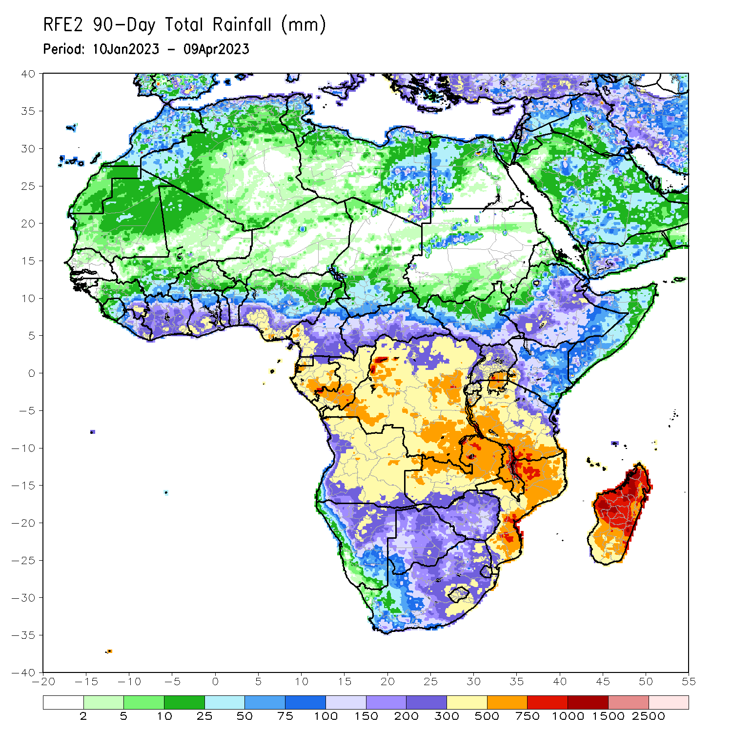
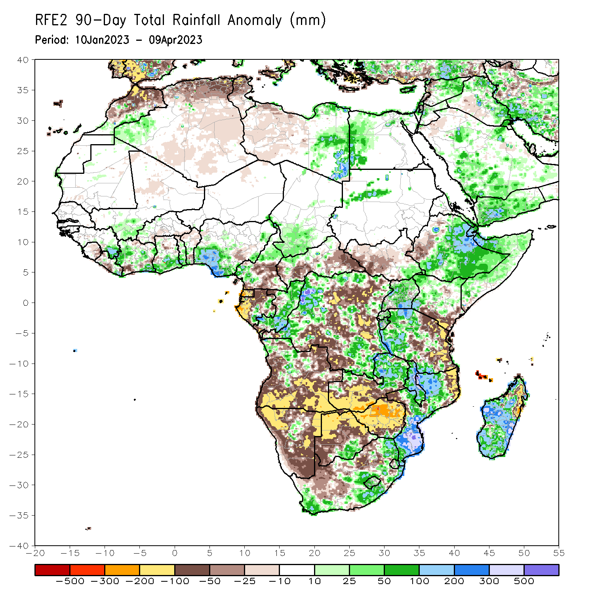
Rainfall Patterns: Last 90 Days
Over the past 90 days, in East Africa, above-average rainfall was observed over parts of central, central, eastern, and southern Ethiopia, many parts of Somalia, Djibouti, eastern Eritrea, northern and western Kenya, northern, central and southeastern Uganda, western Tanzania, Burundi, Rwanda, southeastern South Sudan, and parts of northwestern Sudan. Rainfall was below-average over parts of west-central Ethiopia, southwestern Uganda, must of western and central South Sudan, southern Kenya, and eastern and parts of central Tanzania.. In southern Africa, above-average rainfall was observed over parts of northwestern, central, and southern Mozambique, much of Malawi, northern and eastern Zambia, pockets of central and northwestern Angola, pockets of central Namibia, south-central Botswana, southern Zimbabwe, eastern and southern South Africa, western and central Lesotho, eastern Eswatini, and parts of western, central, southern and southeastern Madagascar. Below-average rainfall was observed over western, southern and eastern Angola, western, northern, eastern, and southern Namibia, western, northern, and eastern Botswana, much of northern and central Zimbabwe, southern Zambia, northeastern and west-central Mozambique, northeastern Madagascar, northern South Africa, eastern Lesotho, western Eswatini, and Comoros. In Central Africa, rainfall was above-average over much of Congo, parts of western, eastern, and northern DRC, north-central and western Cameroon, southern Chad, parts of southern and eastern Gabon, and northern CAR. Rainfall was below-average over southern Cameroon, western and northern Gabon, Equatorial Guinea, southern and eastern CAR, and portions of central and southern DRC. In West Africa, rainfall was above-average over parts of southeastern Guinea and Liberia, southeastern and central Cote d’Ivoire, southern parts of Ghana, central and southern Togo, central Benin, parts of southern and central Nigeria, western Burkina Faso, and southwestern Mali. In contrast, below-average rainfall was observed over eastern Sierra Leone, western and central Liberia, northern and southwestern Cote d’Ivoire, northern Ghana, northern and southern Benin, northern Togo, northern Mali, and southern Burkina Faso.
Notes:
‹#›

Slide 5
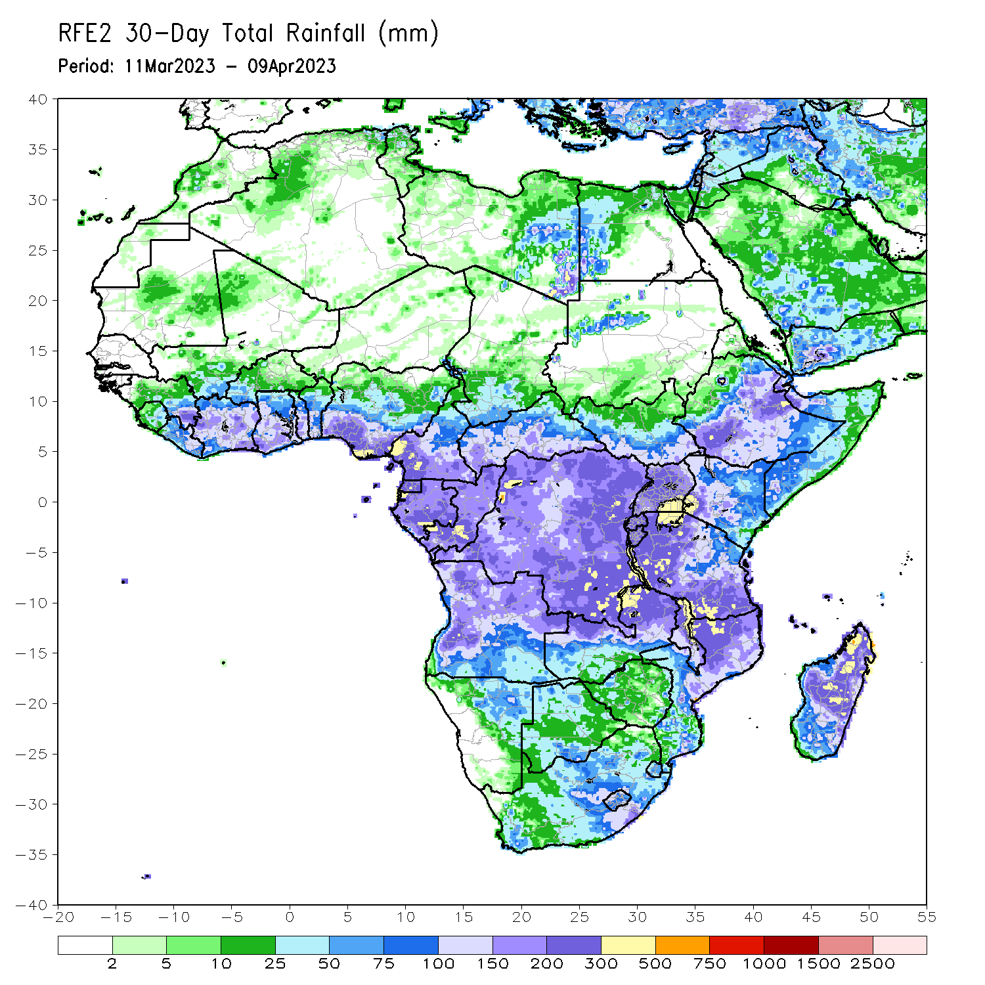
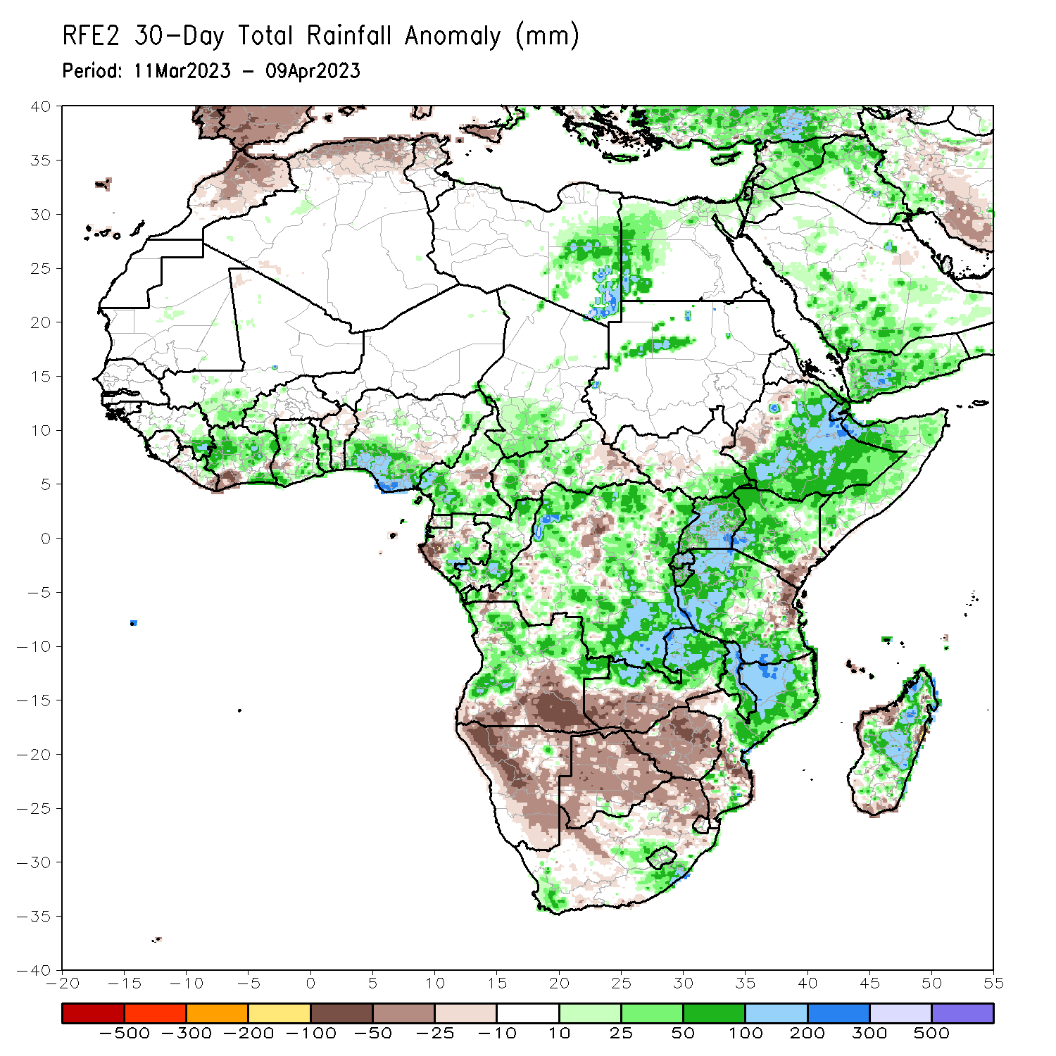
Rainfall Patterns: Last 30 Days
Over the past 30 days, in East Africa, above-average rainfall was observed over central, southern, and eastern Ethiopia, much of Somalia, Djibouti, eastern Eritrea, western, northern, and central Kenya, western and southern Tanzania, Rwanda, Burundi, Uganda, southern South Sudan, and pockets of northwestern Sudan. Rainfall was below-average over southeastern Kenya, northeastern Tanzania, pockets of central South Sudan, and parts of western Ethiopia. In southern Africa, above-average rainfall was observed over northern, central, and pockets of southern Mozambique, Malawi, northern and eastern Zambia, most of northern and western Angola, southwestern and southeastern South Africa, Lesotho, and most of central and northern Madagascar. Below-average rainfall was observed over much of Namibia, southern Angola, southern Zambia, most of Zimbabwe and Botswana, northern and eastern South Africa, northern and southern Eswatini, western Comoros, and parts of southern and northwestern Madagascar. In Central Africa, rainfall was above-average over most of Congo, northern, southern, and western Cameroon, southern Chad, southern Gabon, northern parts of central, northern, and southern CAR, and northern, southern, western, and eastern DRC. Rainfall was below-average over parts of central DRC, western Equatorial Guinea, western and central Gabon, parts of central Cameroon, and eastern CAR. In West Africa, rainfall was above-average over pockets of southeastern Guinea, north-central Liberia, northern, central, and southeastern Cote d’Ivoire, central and southern Ghana, Togo, central and southern Benin, southern and eastern Nigeria, southwestern Mali, and western Burkina Faso. Rainfall was below-average in southeastern Liberia, parts of west-central Ghana, and northern Benin.
Notes:
‹#›

Slide 6
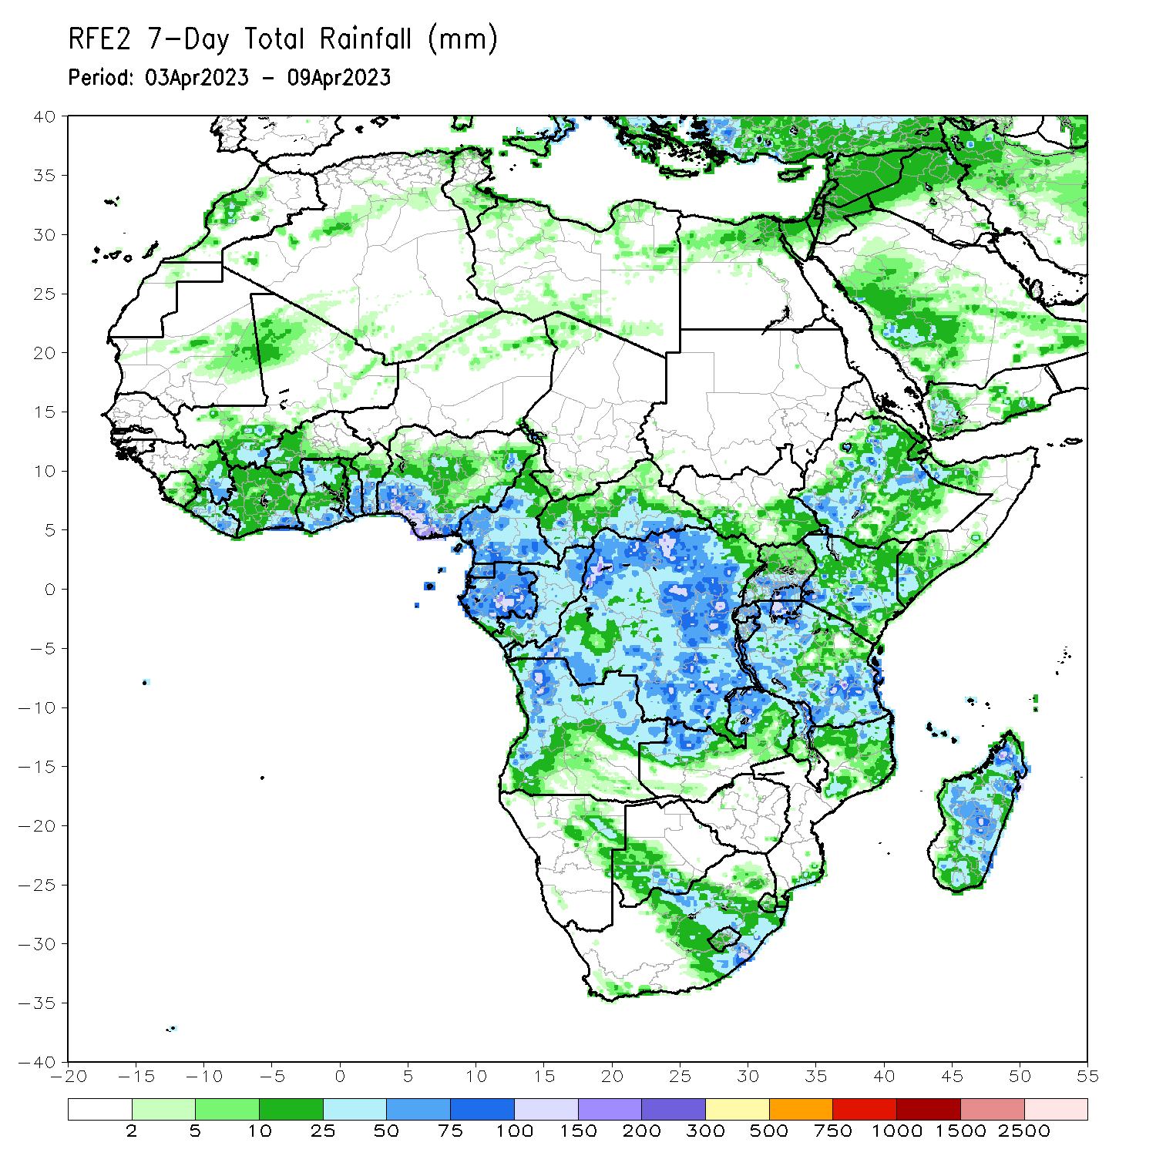
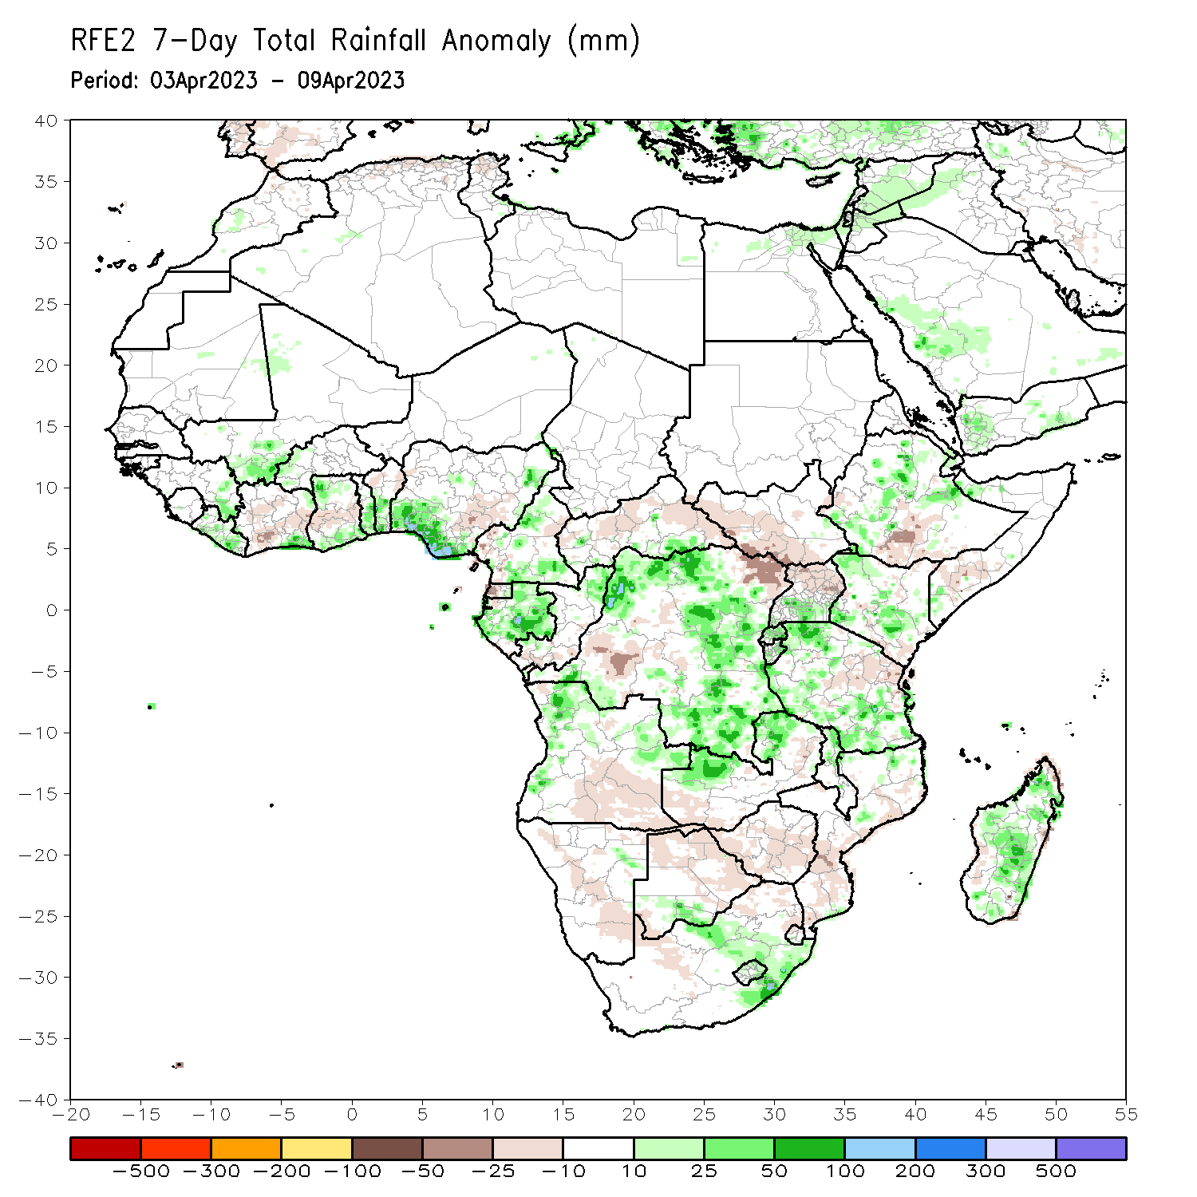
Rainfall Patterns: Last 7 Days
During the past 7 days, in East Africa, rainfall was above-average over southwestern, central, and eastern Ethiopia, parts of southwestern and northwestern Somalia, Djibouti, eastern Eritrea, southern Uganda, Rwanda, Burundi, parts of western and central Kenya, and western, northern, and southern Tanzania. Below-average rainfall was observed across southeastern Kenya, parts of southern South Sudan, northern Uganda, south-central Ethiopia, parts of east-central Tanzania, and some areas of southern Somalia. In Central Africa, rainfall was above-average over parts of southeastern CAR, southern and central Cameroon, northern Congo, most of northern, eastern, and southern DRC, and most of Gabon. Below-average rainfall was observed over parts of northeastern and west-central DRC, northern and eastern CAR, western Equatorial Guinea, southern Congo, and pockets of western Cameroon. In West Africa, above-average rainfall was observed over southeastern Cote d’Ivoire, northern and southern Ghana, southeastern Guinea, southern Togo, southern Benin, southwestern and south-central Nigeria, southwestern Mali, most of Liberia, and western Burkina Faso. Below average rainfall was observed over southwestern and central Cote d’Ivoire, central Ghana, parts of northern Benin, and southeastern Nigeria. In southern Africa, rainfall was above-average over pockets of northern Mozambique, northern Malawi, northern Zambia, western and northern Angola, parts of east-central Namibia, pockets of southeastern and north-central South Africa, Lesotho, and most of Madagascar. In contrast, rainfall was below-average over central and southern and eastern Mozambique, central and southern Zimbabwe, northeastern and northwestern South Africa, southeastern Angola, southwestern Zambia, northern and eastern Botswana, central and northern Namibia, and coastal northeastern Madagascar.

Slide 7
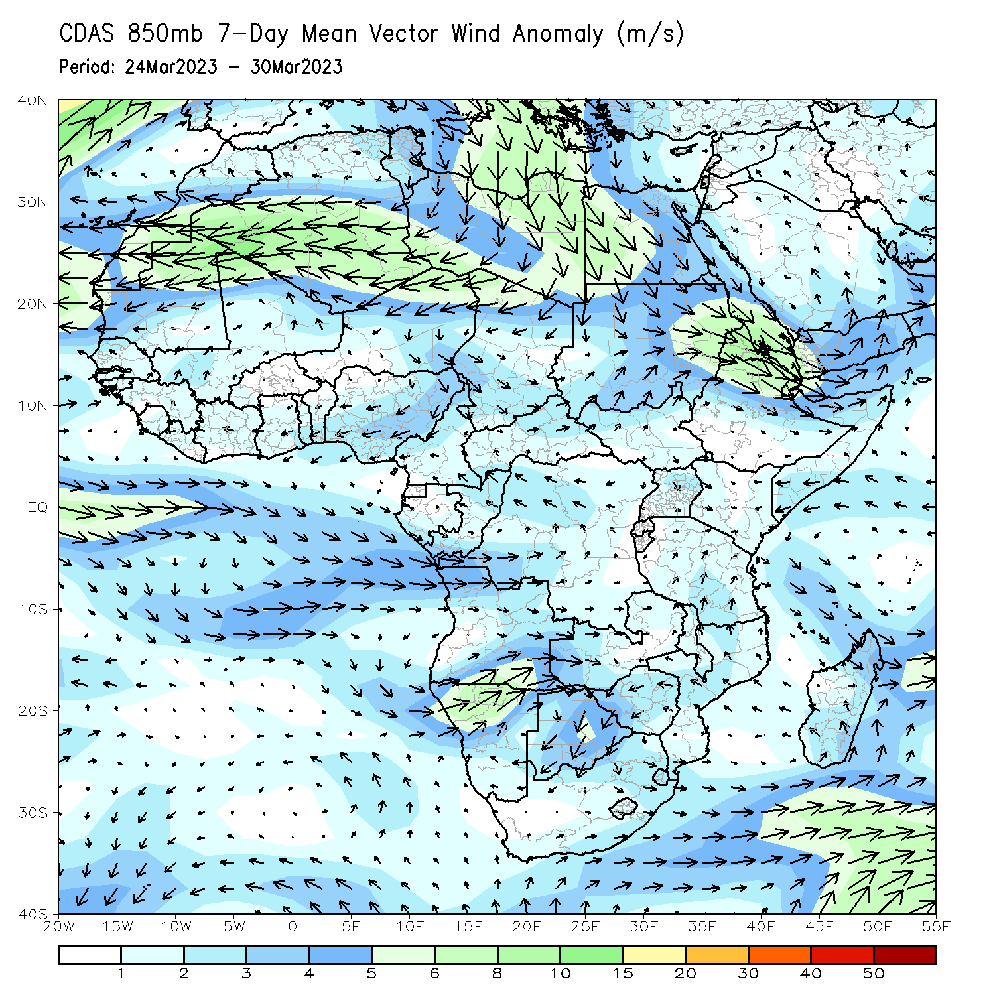
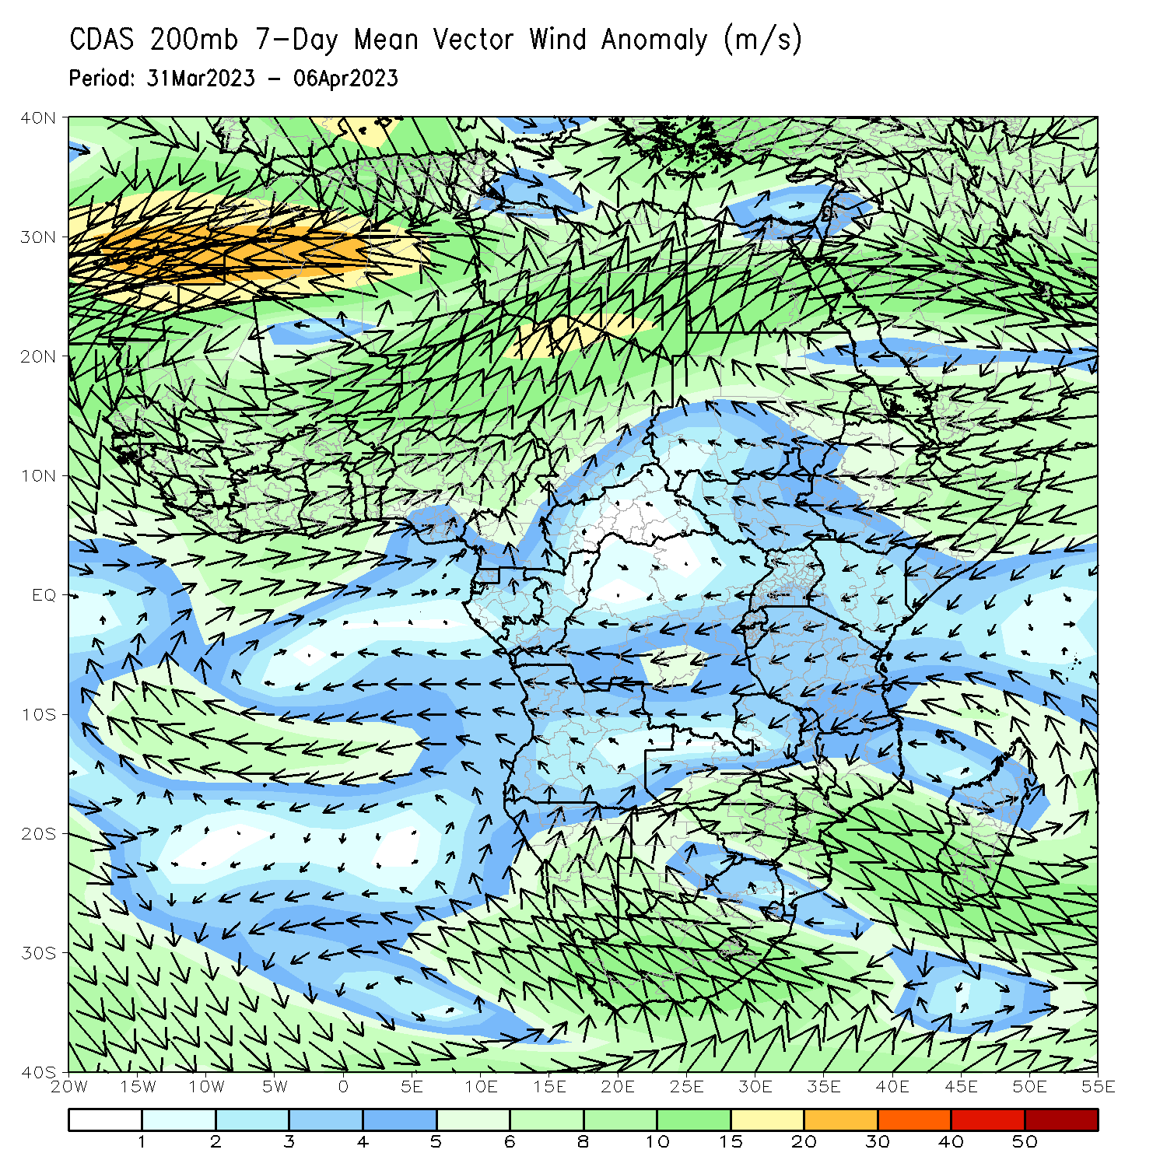
Atmospheric Circulation: Last 7 Days
At 850-hPa level (left panel), confluence/convergence was observed from northern/eastern DRC to southern Tanzania, contributing to above normal rainfall. Anomalous low-level convergence across northern Ethiopia and southern Nigeria may have contributed to the observed above-average rainfall across the region. Upper-level divergence was present at 200-hPa (right panel) across southern Nigeria and northern/eastern DRC as well.

Slide 8
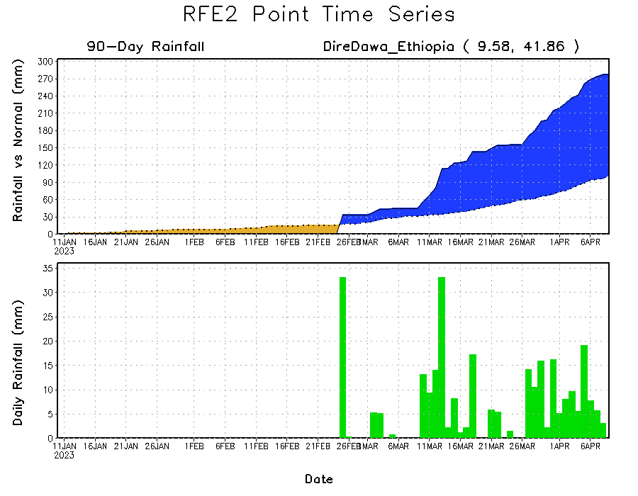
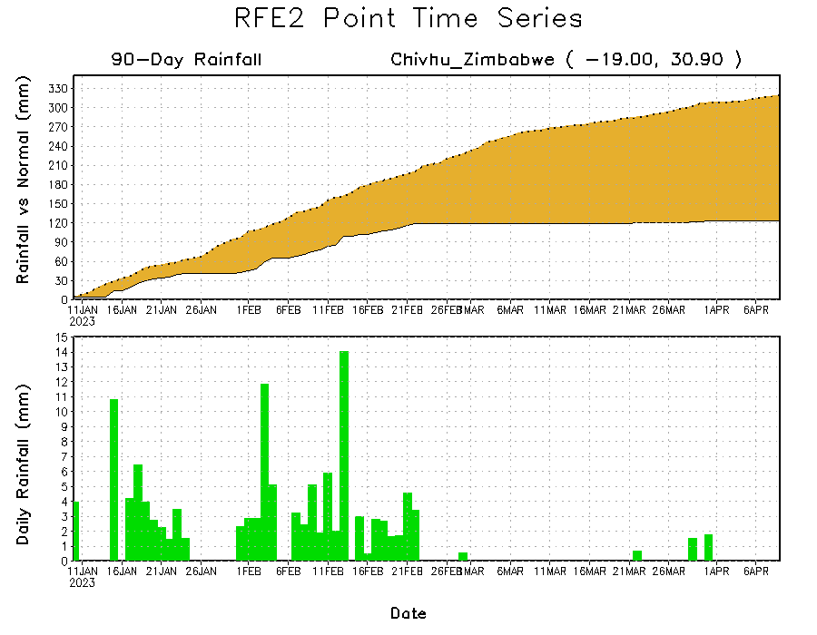
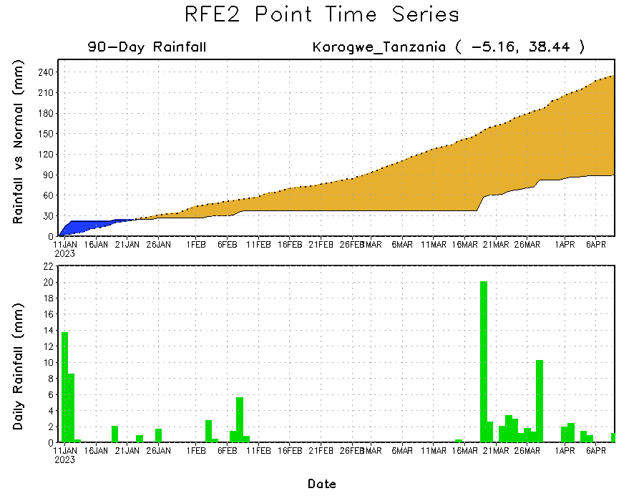
Rainfall Evolution
Daily evolution of rainfall over the last 90 days at selected locations shows worsening moisture deficits over parts of northeastern Tanzania (bottom left) and central Zimbabwe (bottom right). Moderate to locally heavy rainfall also resulted in increasing moisture surpluses over parts of eastern and northeastern Ethiopia (top right).

Slide 9
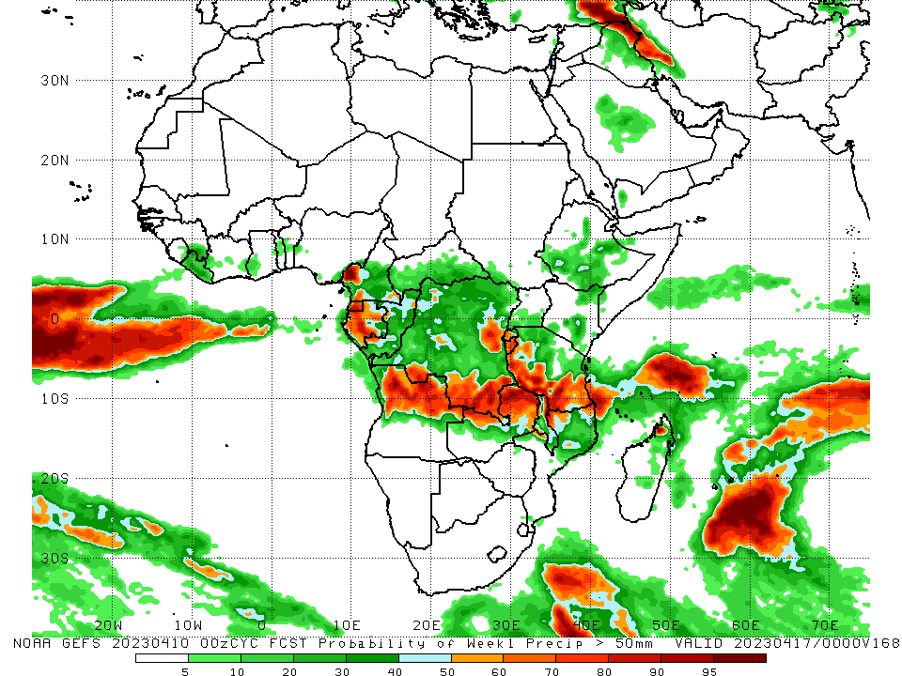
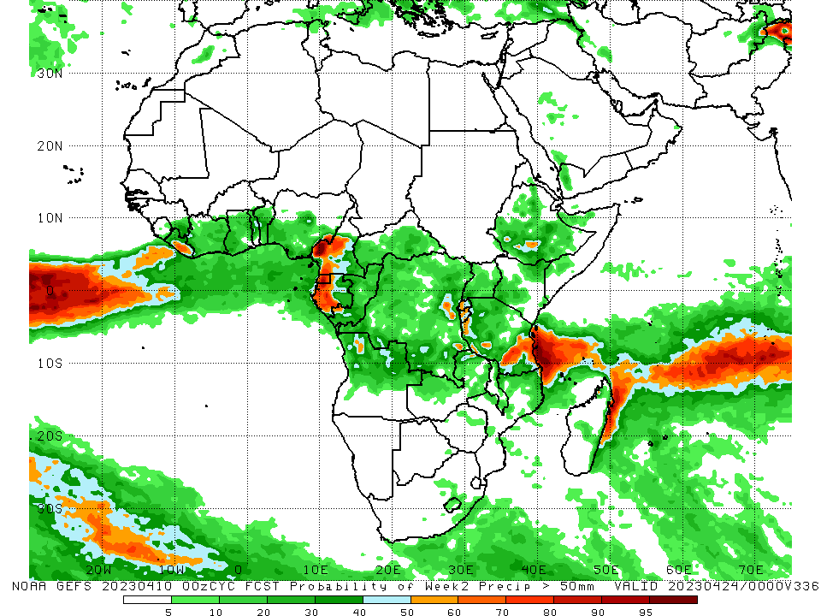
NCEP GEFS Model Forecasts Non-Bias Corrected Probability of precipitation exceedance
Week-1, Valid: 11 – 17 April 2023
Week-2, Valid: 18 – 24 Apr 2023
For week-1 (left panel), the GEFS forecasts indicate a moderate to high chance (over 70%) for rainfall to exceed 50 mm over Equatorial Guinea, much of western and central Gabon, west-central Cameroon, southeastern and east-central DRC, Burundi, southern and west-central Tanzania, northern Angola, northern Zambia, northeastern Malawi, northwestern Mozambique, and northwestern Madagascar. For week-2 (right panel), the GEFS forecasts indicate a moderate to high chance (over 70%) for rainfall to exceed 50 mm over Equatorial Guinea, western Gabon, pockets of west-central and southwestern Cameroon, south-central and southeastern Tanzania, and a small area of south-central Liberia.
Notes:
‹#›

Slide 10
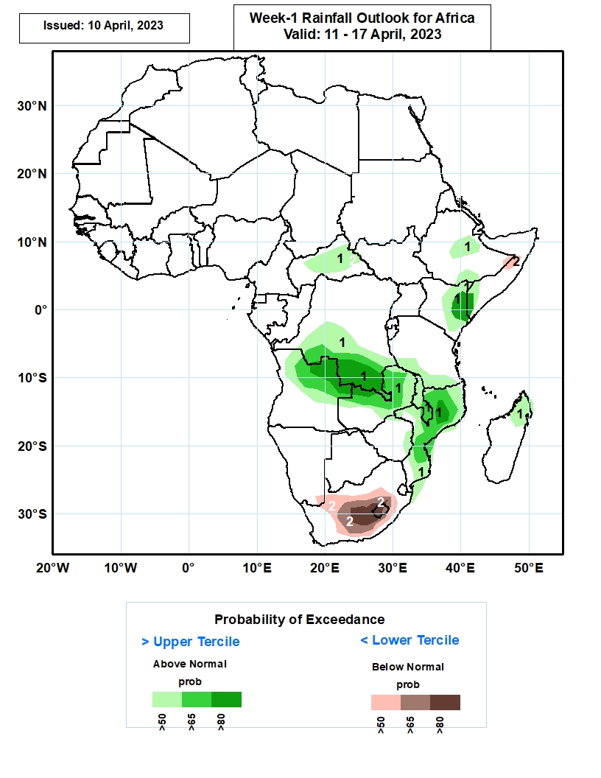
Week-1 Precipitation Outlooks
11 Apr – 17 Apr 2023
The forecasts suggest above 50% chance for weekly rainfall to be above-normal (above the upper tercile) over eastern and southern Ethiopia, eastern Kenya and bordering southern Somalia, CAR, northeastern Angola, southern DRC, northern Zambia, Malawi, Mozambique, and northern Madagascar. In particular, there is enhanced probabilities exceeding 80% for rainfall to be above-normal over southern DRC and bordering Angola and Zambia, and northern Mozambique.
The consolidated probabilistic forecasts suggest above 50% chance for weekly total rainfall to be below-normal (below the lower tercile) over parts of South Africa and Lesotho.
Notes:
‹#›

Slide 11
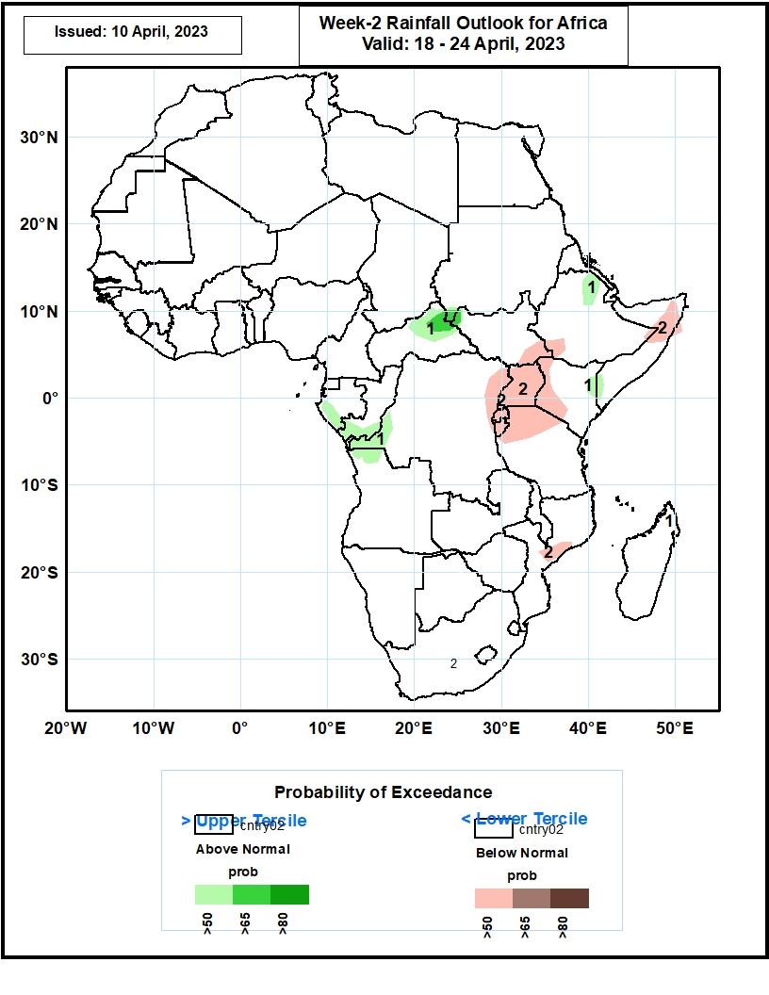
Week-2 Precipitation Outlooks
18 – 24 Apr 2023
The consolidated probabilistic forecasts indicate a general reduction in rainfall coverage but suggest above 50% chance for weekly total rainfall to be above-normal (above the upper tercile) over coastal
DRC, Congo-Brazzaville, coastal areas of Gabon, northeastern Central African Republic, northeastern Ethiopia, eastern Kenya, and bordering southern Somalia.
The forecasts indicate above 50% chance for weekly rainfall to be below-normal (below the lower tercile) over Uganda, cross-border regions of Karamoja, eastern DRC, western Kenya, northern Tanzania, Burundi and Rwanda.
Notes:
‹#›

Slide 12
Summary
Over the past 30 days, in East Africa, above-average rainfall was observed over central, southern, and eastern Ethiopia, much of Somalia, Djibouti, eastern Eritrea, western, northern, and central Kenya, western and southern Tanzania, Rwanda, Burundi, Uganda, southern South Sudan, and pockets of northwestern Sudan. Rainfall was below-average over southeastern Kenya, northeastern Tanzania, pockets of central South Sudan, and parts of western Ethiopia. In southern Africa, above-average rainfall was observed over northern, central, and pockets of southern Mozambique, Malawi, northern and eastern Zambia, most of northern and western Angola, southwestern and southeastern South Africa, Lesotho, and most of central and northern Madagascar. Below-average rainfall was observed over much of Namibia, southern Angola, southern Zambia, most of Zimbabwe and Botswana, northern and eastern South Africa, northern and southern Eswatini, western Comoros, and parts of southern and northwestern Madagascar. In Central Africa, rainfall was above-average over most of Congo, northern, southern, and western Cameroon, southern Chad, southern Gabon, northern parts of central, northern, and southern CAR, and northern, southern, western, and eastern DRC. Rainfall was below-average over parts of central DRC, western Equatorial Guinea, western and central Gabon, parts of central Cameroon, and eastern CAR. In West Africa, rainfall was above-average over pockets of southeastern Guinea, north-central Liberia, northern, central, and southeastern Cote d’Ivoire, central and southern Ghana, Togo, central and southern Benin, southern and eastern Nigeria, southwestern Mali, and western Burkina Faso. Rainfall was below-average in southeastern Liberia, parts of west-central Ghana, and northern Benin.
During the past 7 days, in East Africa, rainfall was above-average over southwestern, central, and eastern Ethiopia, parts of southwestern and northwestern Somalia, Djibouti, eastern Eritrea, southern Uganda, Rwanda, Burundi, parts of western and central Kenya, and western, northern, and southern Tanzania. Below-average rainfall was observed across southeastern Kenya, parts of southern South Sudan, northern Uganda, south-central Ethiopia, parts of east-central Tanzania, and some areas of southern Somalia. In Central Africa, rainfall was above-average over parts of southeastern CAR, southern and central Cameroon, northern Congo, most of northern, eastern, and southern DRC, and most of Gabon. Below-average rainfall was observed over parts of northeastern and west-central DRC, northern and eastern CAR, western Equatorial Guinea, southern Congo, and pockets of western Cameroon. In West Africa, above-average rainfall was observed over southeastern Cote d’Ivoire, northern and southern Ghana, southeastern Guinea, southern Togo, southern Benin, southwestern and south-central Nigeria, southwestern Mali, most of Liberia, and western Burkina Faso. Below average rainfall was observed over southwestern and central Cote d’Ivoire, central Ghana, parts of northern Benin, and southeastern Nigeria. In southern Africa, rainfall was above-average over pockets of northern Mozambique, northern Malawi, northern Zambia, western and northern Angola, parts of east-central Namibia, pockets of southeastern and north-central South Africa, Lesotho, and most of Madagascar. In contrast, rainfall was below-average over central and southern and eastern Mozambique, central and southern Zimbabwe, northeastern and northwestern South Africa, southeastern Angola, southwestern Zambia, northern and eastern Botswana, central and northern Namibia, and coastal northeastern Madagascar.
The Week-1 outlook calls for an increased chance for above-average rainfall over central Ethiopia, eastern Kenya, western and southern Tanzania, northern Congo, southern CAR, southwestern and southeastern South Sudan, northern Liberia, southeastern Guinea, central Mauritania, west-central Cameroon, northern, central, and southeastern DRC, northern, central, and eastern parts of Zambia, most of Mozambique, most of northern Angola, Malawi, and northern Madagascar. In contrast, there is an increased chance for below-average rainfall over most of the Gulf of Guinea region, central Cameroon, western and southern Gabon, western Equatorial Guinea, southwestern DRC, western Burundi, south-central South Sudan, southern Ethiopia, central and southern Somalia, southwestern Zambia, southern and northwestern Angola, most of Namibia, northern and southern Botswana, Uganda, southwestern Kenya, parts of northern and east-central Tanzania, Comoros, Lesotho, western Eswatini, much of South Africa, and eastern coastal Madagascar. The Week-2 outlook suggests an increased chance for above-average rainfall over the Gulf of Guinea region, central and southern Cameroon, CAR, Equatorial Guinea, western Gabon, southwestern Congo, northwestern and southeastern DRC, northern and central Ethiopia, central Eritrea, northwestern Somalia, southern Tanzania, northern Angola, northern Zambia, southern Malawi, northern Mozambique, Comoros, and northeastern Madagascar. Below-average rainfall is likely over much of central Africa (especially eastern DRC, Uganda, Rwanda, Burundi, northern Tanzania, southern Kenya, and central/southern Somalia), as well as southwestern Ethiopia, coastal eastern Mozambique, and coastal eastern Madagascar.

