Slide 1
The African Monsoon Recent Evolution and Current Status Include Week-1 and Week-2 Outlooks
Update prepared
13 March 2023
For more information, visit:
http://www.cpc.ncep.noaa.gov/products/Global_Monsoons/African_Monsoons/precip_monitoring.shtml

Slide 2
Outline
Highlights
Recent Evolution and Current Conditions
NCEP GEFS Forecasts
Summary

Slide 3
Highlights: Last 7 Days
During the past 7 days, in East Africa, rainfall was above-average over pockets of northeast and central Ethiopia and pockets of southern and western Tanzania, southern Rwanda, and northern Burundi. Below-average rainfall was observed across Uganda, eastern, northern and southwest Tanzania, southern Kenya, pockets of southwest Ethiopia and western and southern South Sudan. In Central Africa, rainfall was above-average over northwest CAR, western and central Cameroon, southeast Gabon, central and southern Congo, and pockets of northwest and northeast DRC. Below-average rainfall was observed across Equatorial Guinea, western and northern Gabon, southern CAR, and parts of western, central, southern and eastern DRC. In West Africa, above-average rainfall was observed over southeast Cote d’Ivoire, southern Ghana, southeast Guinea, and southwest, southern and southeast Nigeria. Below average rainfall was observed over central Liberia and pockets of southwest Cote d’Ivoire. In southern Africa, rainfall was above-average over northwest and central Mozambique, parts of northern and central Malawi, northeast, central and western-central Angola, pockets of central and southern Botswana, parts of central and southeast South Africa, and southern and southeast Madagascar. In contrast, rainfall was below-average over northwest, southwest and southeast Angola, northern and central Namibia, western, central and southern Zambia, many parts of Zimbabwe, pockets of western and eastern Botswana, parts of northeast South Africa, northern parts of Lesotho and Eswatini, northeast and southern Mozambique, southern Malawi, and northern, central and eastern Madagascar.
Week-1 outlook calls for an increased chance for above-average rainfall over central and southern Ethiopia, Uganda, Rwanda, Burundi, parts of northwest, western, central and southern Tanzania, many parts of DRC, northeast and southwest Kenya, northeast Angola, northern Zambia, Malawi, northwest and central Mozambique, and parts of central and southern Madagascar. In contrast, there is an increased chance for below-average rainfall over southern Angola, northern, central and eastern Namibia, Botswana, southern Zambia, western Zimbabwe, western, northern, central and eastern South Africa, Lesotho, Eswatini, northern Madagascar, eastern Tanzania, southeast Kenya, Equatorial Guinea, western and southern Gabon, southeast Cameroon, and southern parts of Cote d’Ivoire, Ghana and Togo. Week-2 outlook suggests an increased chance for above-average rainfall over Gulf of Guinea coast regions, central Congo, western and central CAR, western, central and eastern DRC, Uganda, Rwanda, Burundi, western and northern parts Tanzania and Kenya, central and southern Ethiopia, southern paths of South Sudan and Somalia, northern Angola, and central Madagascar, while below-average rainfall is likely over southern Angola, Namibia, Botswana, South Africa, Lesotho, Eswatini, Zimbabwe, southern and northern parts of Zambia and Mozambique, and Malawi.

Slide 4
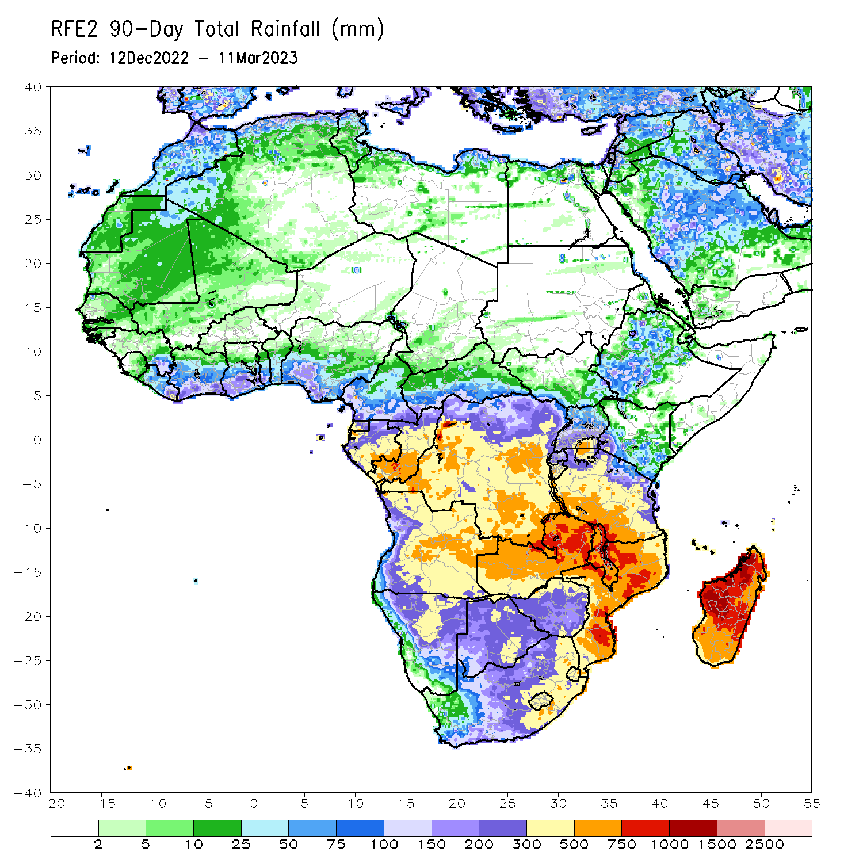
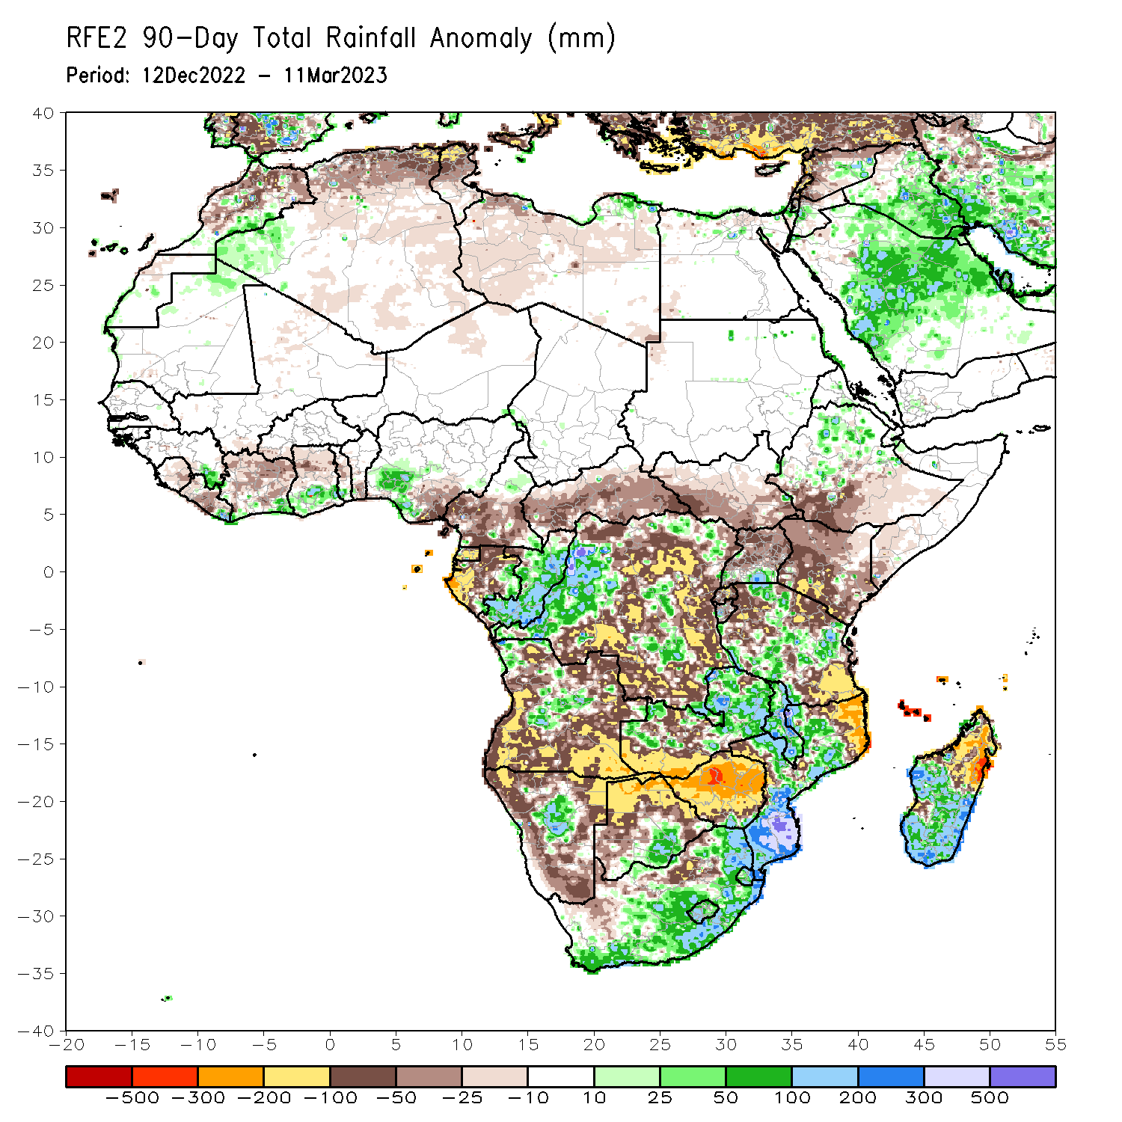
Rainfall Patterns: Last 90 Days
days Over the past 90 days, in East Africa, above-average rainfall was observed over parts of central and northern Ethiopia, pockets of southern Uganda, and parts of northern, southwest, central and eastern Tanzania. Rainfall was below-average over parts of southern and eastern Ethiopia, many parts of Kenya and South Sudan, Rwanda, eastern Burundi, southern Somalia, northwest, northeast and southeast Tanzania, and central, northern and eastern Uganda. In southern Africa, above-average rainfall was observed over parts of northwest, central and southern Mozambique, much of Malawi, many parts of central and northern Zambia, pockets of central Angola and Namibia, southern Botswana, northern, central and eastern South Africa, Lesotho, Eswatini, and parts of western, central, southern and southeast Madagascar. Below-average rainfall was observed over western, southern and eastern Angola, western, northern, eastern and southern Namibia, western, northern and eastern Botswana, much of Zimbabwe, southern Zambia, northeast Mozambique, northern and northeast Madagascar, and pockets of western South Africa. In Central Africa, rainfall was above-average over many parts of Congo, parts western and central DRC, and pockets of central Cameroon and eastern Gabon. Rainfall was below-average over western and central Cameroon, western, northern and southern Gabon, Equatorial Guinea, CAR, and portions of northwest, north-central, eastern, and southern DRC. In West Africa, rainfall was above-average over parts of southeast Guinea, Liberia and Cote d’Ivoire, southern parts of Ghana and Togo, pockets of southwest Nigeria, and northern Mauritania. In contrast, below-average rainfall was observed over Sierra Leone, western and central Liberia, northern, central and eastern parts of Cote d’Ivoire and Ghana, central Toga, southern Benin, and southeast Nigeria.
Notes:
4

Slide 5
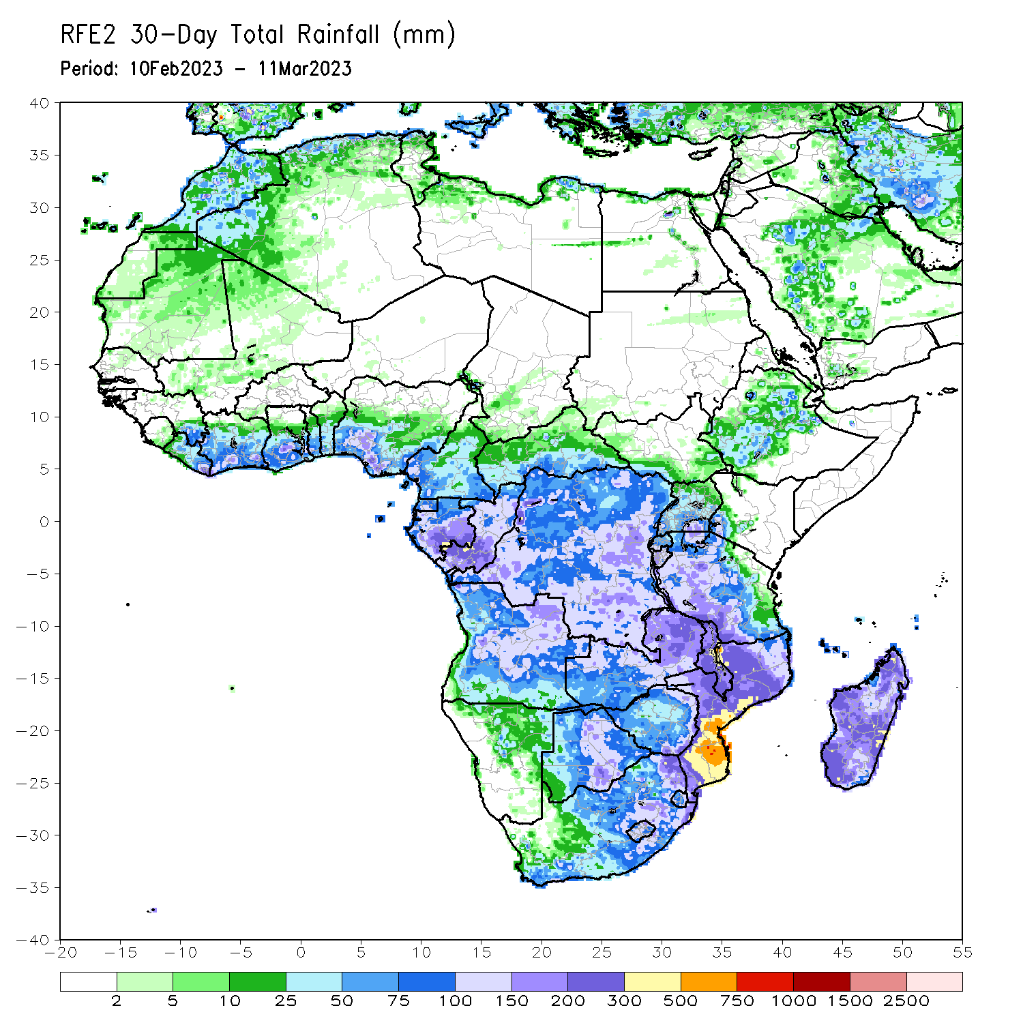
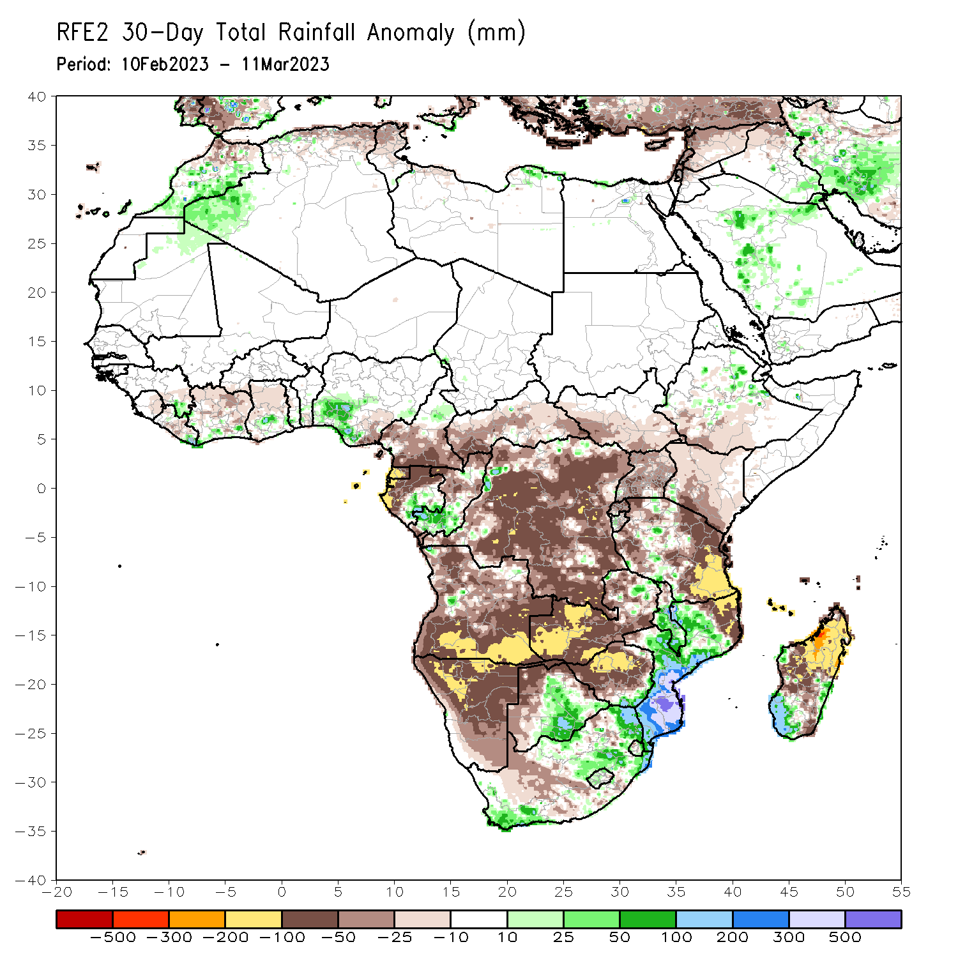
Rainfall Patterns: Last 30 Days
Over the past 30 days, in East Africa, above-average rainfall was observed over pockets of central, southern, and northern Tanzania, pockets of northeast Ethiopia, and western Burundi. Rainfall was below-average over southern Ethiopia, many parts of Kenya and Uganda, western, southern and southeast South Sudan, Rwanda, and eastern Burundi, western, northeast, eastern and southeast Tanzania. In southern Africa, above-average rainfall was observed over northwest, central and southern parts of Mozambique, central and southern Malawi, parts of central and southern Botswana, many parts of central, northern and southeast South Africa, eastern Eswatini, western Lesotho, and parts of southwest and eastern Madagascar. Below-average rainfall was observed over much of Angola and Namibia, western, southern, central and northwest Zambia, western, central and northern Zimbabwe, western and northern Botswana, northeast Mozambique, northern Malawi, southwest South Africa, and northern, western, central, and southeast Madagascar. In Central Africa, rainfall was above-average over southern Congo, and pockets of southeast Gabon, northwest DRC and central Cameroon. Rainfall was below-average over many parts of DRC and CAR, Equatorial Guinea, western and northern Gabon, parts of central and northern Congo, and western and southern Cameroon. In West Africa, rainfall was above-average over pockets of southeastern Guinea and Liberia, southern parts of Cote d’Ivoire, Ghana and Togo, and parts of southwest Nigeria. Rainfall was below-average in eastern Sierra Leone, central Liberia, northern, central and eastern parts of Cote d’Ivoire, central Ghana, and southeast Nigeria.
Notes:
5

Slide 6
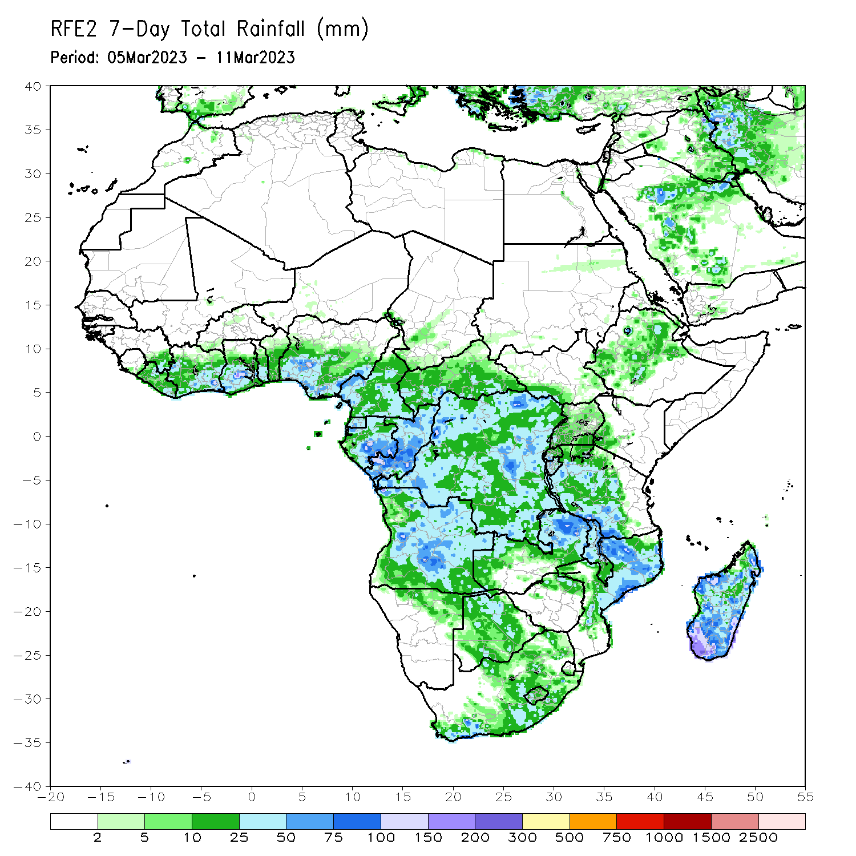
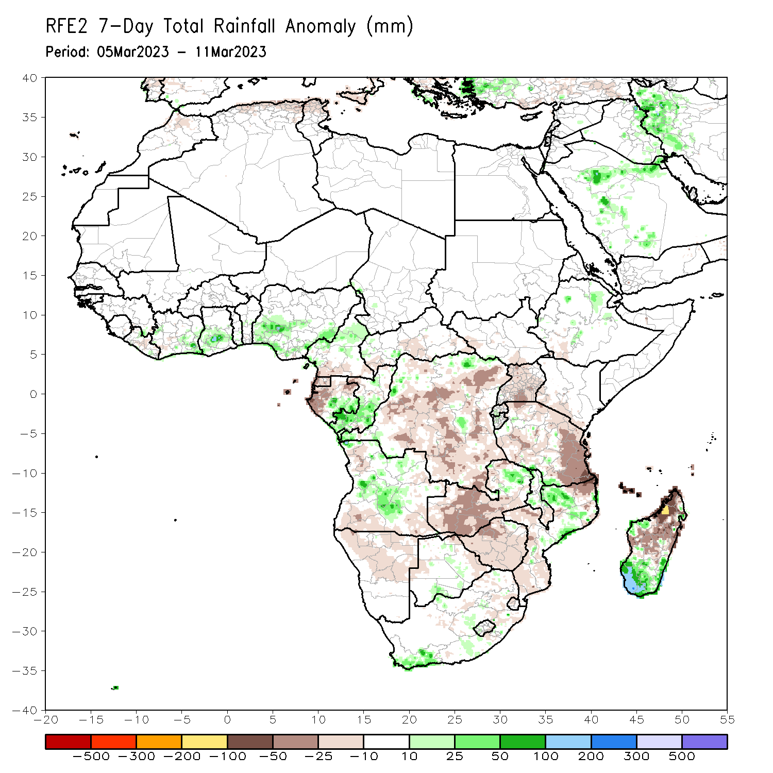
Rainfall Patterns: Last 7 Days
During the past 7 days, in East Africa, rainfall was above-average over pockets of northeast and central Ethiopia and pockets of southern and western Tanzania, southern Rwanda, and northern Burundi. Below-average rainfall was observed across Uganda, eastern, northern and southwest Tanzania, southern Kenya, pockets of southwest Ethiopia and western and southern South Sudan. In Central Africa, rainfall was above-average over northwest CAR, western and central Cameroon, southeast Gabon, central and southern Congo, and pockets of northwest and northeast DRC. Below-average rainfall was observed across Equatorial Guinea, western and northern Gabon, southern CAR, and parts of western, central, southern and eastern DRC. In West Africa, above-average rainfall was observed over southeast Cote d’Ivoire, southern Ghana, southeast Guinea, and southwest, southern and southeast Nigeria. Below average rainfall was observed over central Liberia and pockets of southwest Cote d’Ivoire. In southern Africa, rainfall was above-average over northwest and central Mozambique, parts of northern and central Malawi, northeast, central and western-central Angola, pockets of central and southern Botswana, parts of central and southeast South Africa, and southern and southeast Madagascar. In contrast, rainfall was below-average over northwest, southwest and southeast Angola, northern and central Namibia, western, central and southern Zambia, many parts of Zimbabwe, pockets of western and eastern Botswana, parts of northeast South Africa, northern parts of Lesotho and Eswatini, northeast and southern Mozambique, southern Malawi, and northern, central and eastern Madagascar.

Slide 7
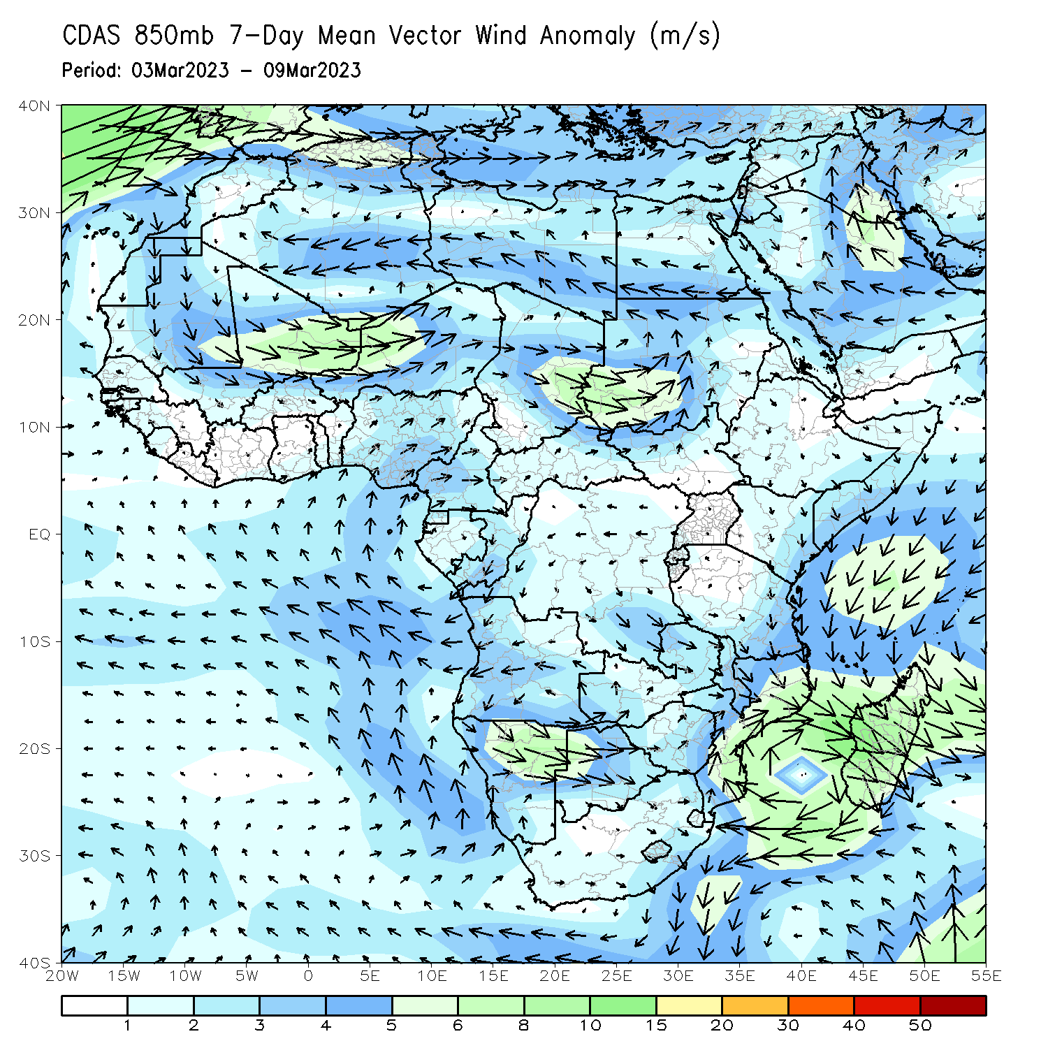
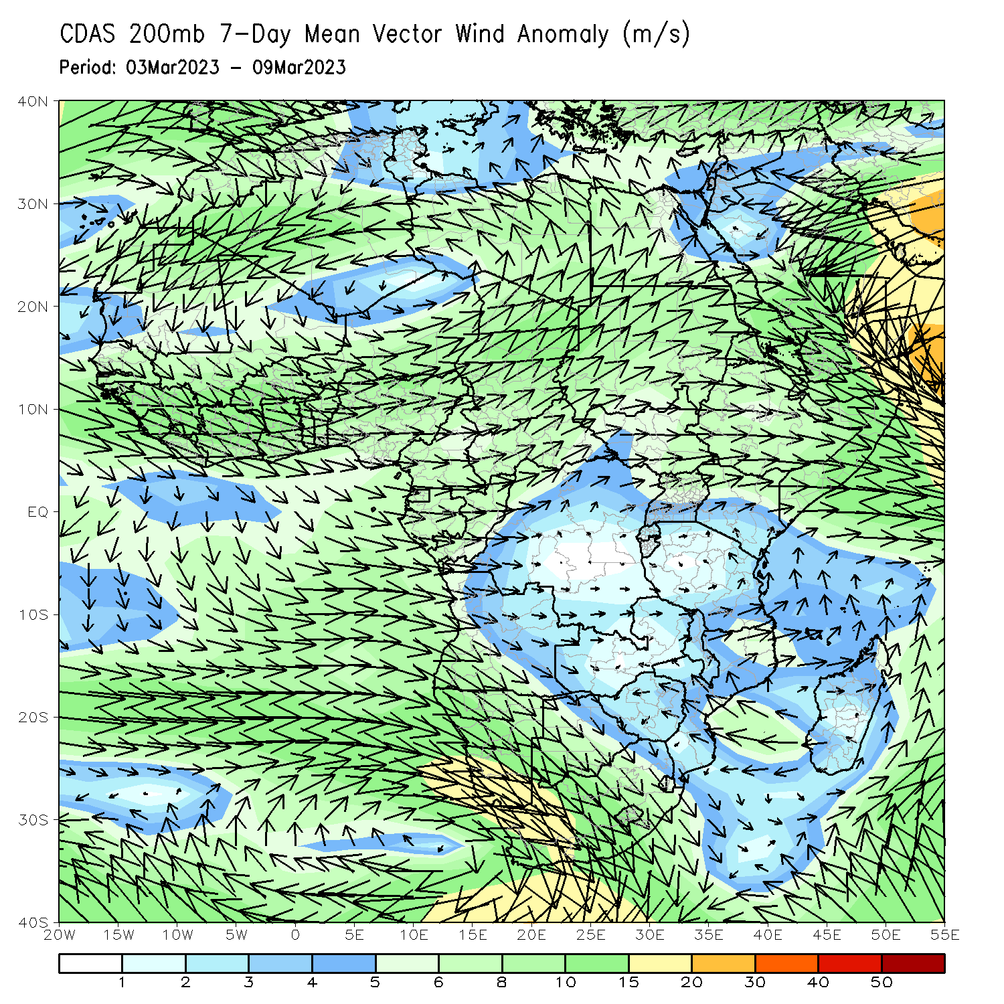
Atmospheric Circulation: Last 7 Days
At 850-hPa level (left panel), wind anomalies were cyclonic across central Mozambique, Mozambique Channel, and southern and central Madagascar, and anomalous wind convergence across central and northern Mozambique may have contributed to the observed above-average rainfall across central and northern Mozambique and western and southern Madagascar.

Slide 8
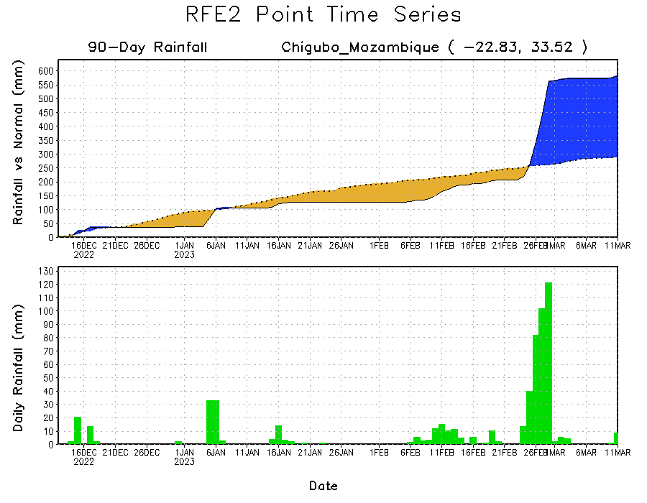
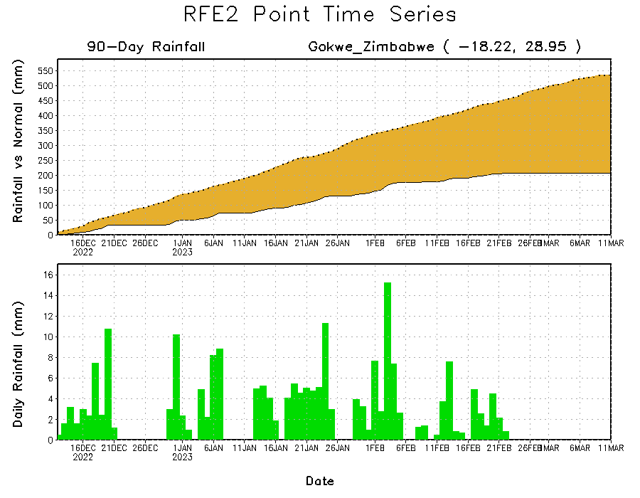
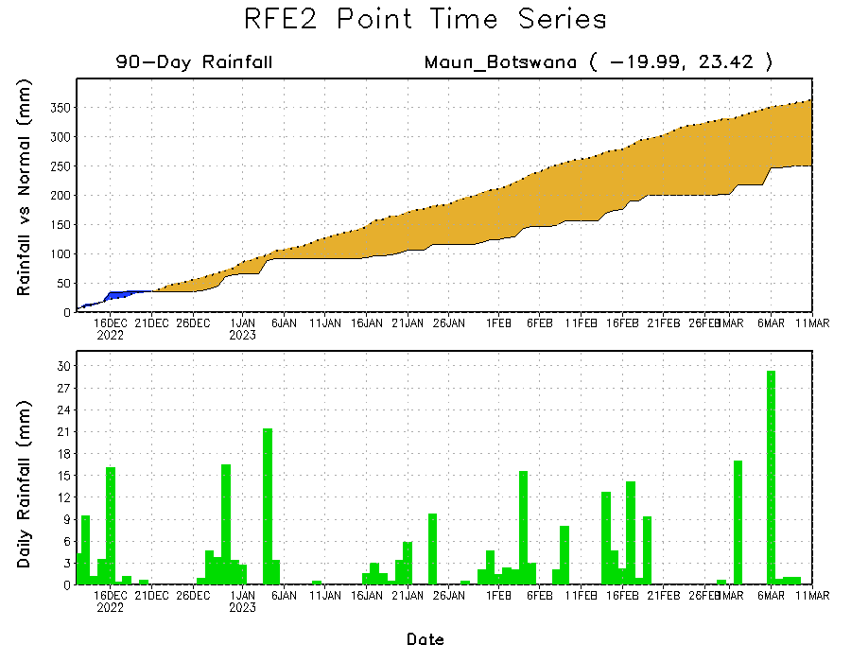
Rainfall Evolution
Daily evolution of rainfall over the last 90 days at selected locations shows worsening moisture deficits over parts of northern Botswana (bottom left) and central Zimbabwe (bottom right). Total rainfall transitioned from a seasonal deficit to a seasonal surplus in southeast Mozambique due to TC Freddy’s landfall (top right).

Slide 9
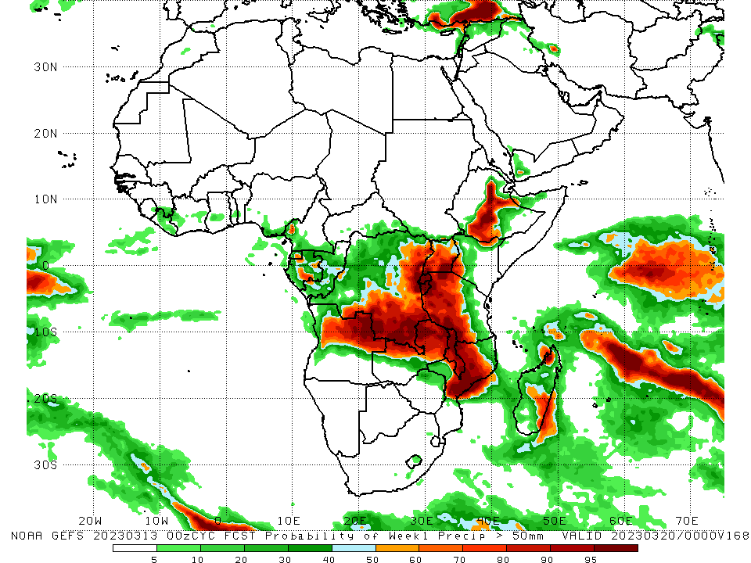
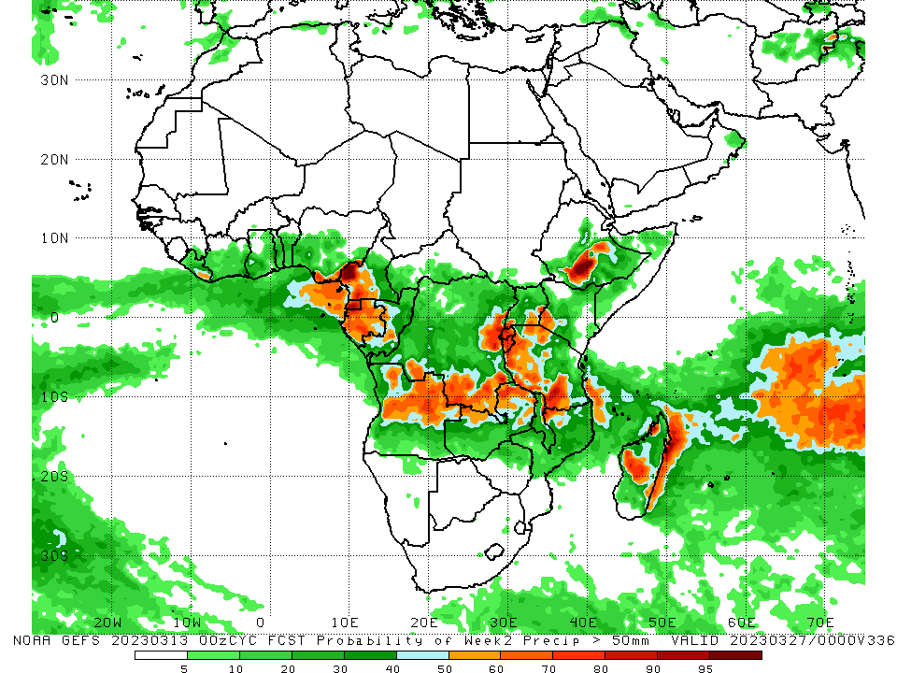
NCEP GEFS Model Forecasts Non-Bias Corrected Probability of precipitation exceedance
Week-1, Valid: 14 Mar – 20 Mar 2023
Week-2, Valid: 21 – 27 Mar 2023
For week-1 (left panel), the NCEP GEFS forecasts indicate a moderate to high chance (over 70%) for rainfall to exceed 50 mm over parts of central and northeast Angola, northern, central, and eastern Zambia, central and northwest Mozambique, Malawi, southern and eastern DRC, Rwanda, Burundi, many parts of Uganda, parts of northwest, western, central and southwest Tanzania, central and southern Ethiopia, and pockets of northwest and southeast Madagascar. For week-2 (right panel), the NCEP GEFS forecasts indicate a moderate to high chance (over 70%) for rainfall to exceed 50 mm over Equatorial Guinea, western and northern Gabon, western Cameroon, pockets of eastern and southern DRC, Rwanda, Burundi, parts of western and southwest Tanzania, and pockets of southern Ethiopia and central Madagascar.
Notes:
9

Slide 10
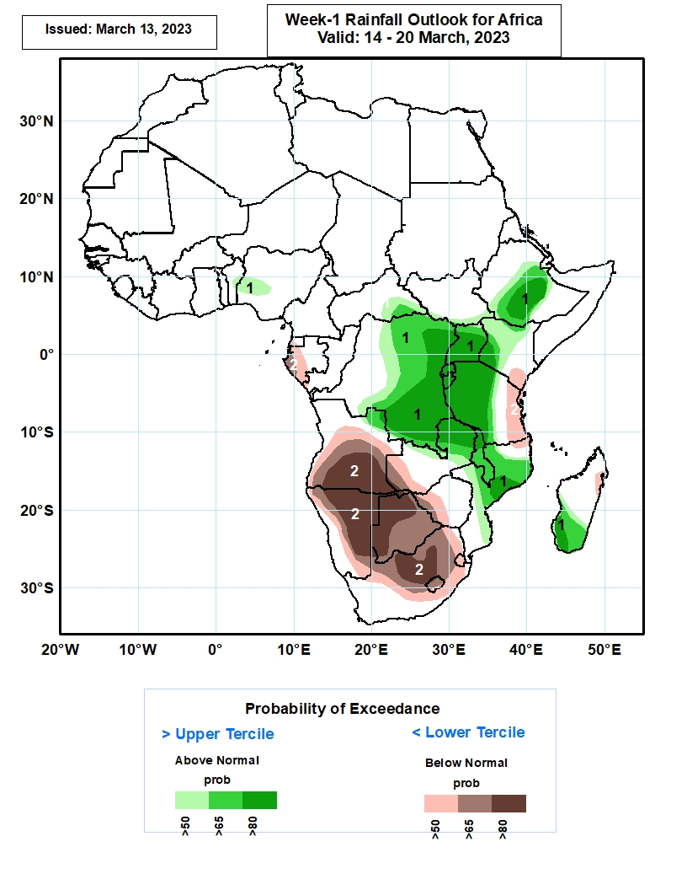
Week-1 Precipitation Outlooks
14 Mar – 20 Mar 2023
The forecasts suggest above 50% chance for weekly rainfall to be above-normal (above the upper tercile) over western Nigeria, southeastern CAR, central and eastern parts of DR Congo, much of Rwanda, Burundi and Uganda, central portions of Ethiopia, western and central parts of Kenya and Tanzania, northern Angola and Zambia, much of Malawi, northern and central parts of Mozambique, and southern Madagascar. In particular, there is above 80% chance for rainfall to be above-normal over central Ethiopia, central and eastern parts of DR Congo, much of Uganda, Rwanda and Burundi, southwestern Kenya, western and central parts of Tanzania, northern Zambia and Malawi, central Mozambique, and southwestern Madagascar.
The consolidated probabilistic forecasts suggest above 50% chance for weekly total rainfall to be below-normal (below the lower tercile) over western Equatorial Guinea and Gabon, central and southern parts of Angola, western Zambia, much of Namibia and Botswana, western Zimbabwe, central and eastern South Africa, much of Lesotho and Eswatini, southeastern Kenya, eastern Tanzania, and northeastern Madagascar. In particular, there is above 80% chance for rainfall to be below normal over southern Angola, central and eastern parts of Namibia, western and northern parts of Botswana, and central parts of South Africa.
Notes:
10

Slide 11
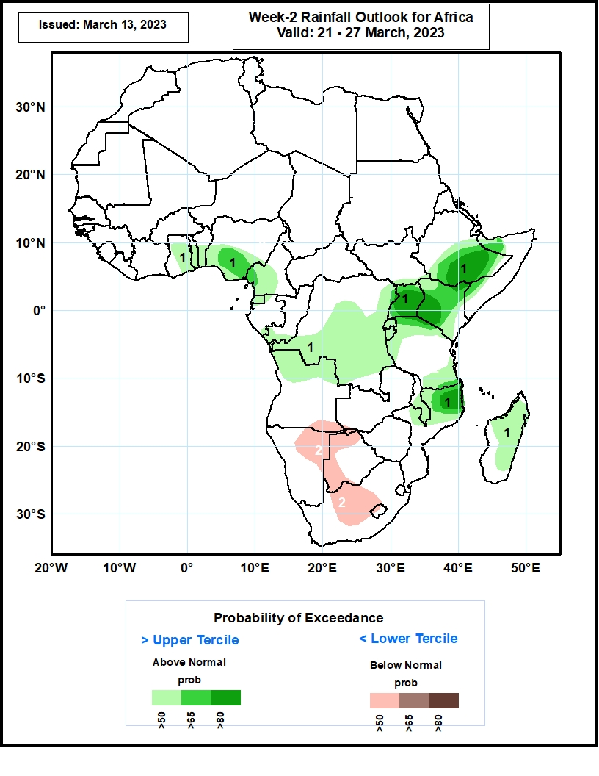
Week-2 Precipitation Outlooks
21 – 27 Mar 2023
The forecasts suggest above 50% chance for weekly rainfall to be above-normal (above the upper tercile) over central and southern parts of Ghana, Togo, Benin and Nigeria, western and central parts of Cameroon, much of Equatorial Guinea, southern Congo, central and southern parts of DR Congo, much of Uganda, Kenya, Rwanda and Burundi, central and eastern Ethiopia, northern and southern parts of Tanzania, central and southern Malawi, northern Mozambique, and much of Madagascar. In particular, there is an above 80% chance for rainfall to be above-normal over central and eastern Ethiopia, much of Uganda, western Kenya, and northern Mozambique.
The consolidated probabilistic forecasts suggest above 50% chance for weekly total rainfall to be below-normal (below the lower tercile) over southeastern Angola, northern and eastern parts of Namibia, northern and western parts of Botswana, and central parts of South Africa.
Notes:
11

Slide 12
Summary
Over the past 30 days, in East Africa, above-average rainfall was observed over pockets of central, western, and northern Tanzania, pockets of northeast Ethiopia, and western Burundi. Rainfall was below-average over southern Ethiopia, many parts of Kenya and Uganda, western, southern and southeast South Sudan, Rwanda, and eastern Burundi, western, northeast, eastern and southeast Tanzania. In southern Africa, above-average rainfall was observed over northwest, central and southern parts of Mozambique, central and southern Malawi, parts of central and southern Botswana, many parts of central, northern and southeast South Africa, eastern Eswatini, western Lesotho, and parts of southwest and eastern Madagascar. Below-average rainfall was observed over much of Angola and Namibia, western, southern, central and northwest Zambia, western, central and northern Zimbabwe, western and northern Botswana, northeast Mozambique, northern Malawi, southwest South Africa, and northern, western, central, and southeast Madagascar. In Central Africa, rainfall was above-average over southern Congo, and pockets of southeast Gabon, northwest DRC and central Cameroon. Rainfall was below-average over many parts of DRC and CAR, Equatorial Guinea, western and northern Gabon, parts of central and northern Congo, and western and southern Cameroon. In West Africa, rainfall was above-average over pockets of southeastern Guinea and Liberia, southern parts of Cote d’Ivoire, Ghana and Togo, and parts of southwest Nigeria. Rainfall was below-average in eastern Sierra Leone, central Liberia, northern, central and eastern parts of Cote d’Ivoire, central Ghana, and southeast Nigeria.
During the past 7 days, in East Africa, rainfall was above-average over pockets of northeast and central Ethiopia and pockets of southern and western Tanzania, southern Rwanda, and northern Burundi. Below-average rainfall was observed across Uganda, eastern, northern and southwest Tanzania, southern Kenya, pockets of southwest Ethiopia and western and southern South Sudan. In Central Africa, rainfall was above-average over northwest CAR, western and central Cameroon, southeast Gabon, central and southern Congo, and pockets of northwest and northeast DRC. Below-average rainfall was observed across Equatorial Guinea, western and northern Gabon, southern CAR, and parts of western, central, southern and eastern DRC. In West Africa, above-average rainfall was observed over southeast Cote d’Ivoire, southern Ghana, southeast Guinea, and southwest, southern and southeast Nigeria. Below average rainfall was observed over central Liberia and pockets of southwest Cote d’Ivoire. In southern Africa, rainfall was above-average over northwest and central Mozambique, parts of northern and central Malawi, northeast, central and western-central Angola, pockets of central and southern Botswana, parts of central and southeast South Africa, and southern and southeast Madagascar. In contrast, rainfall was below-average over northwest, southwest and southeast Angola, northern and central Namibia, western, central and southern Zambia, many parts of Zimbabwe, pockets of western and eastern Botswana, parts of northeast South Africa, northern parts of Lesotho and Eswatini, northeast and southern Mozambique, southern Malawi, and northern, central and eastern Madagascar.
Week-1 outlook calls for an increased chance for above-average rainfall over central and southern Ethiopia, Uganda, Rwanda, Burundi, parts of northwest, western, central and southern Tanzania, many parts of DRC, northeast and southwest Kenya, northeast Angola, northern Zambia, Malawi, northwest and central Mozambique, and parts of central and southern Madagascar. In contrast, there is an increased chance for below-average rainfall over southern Angola, northern, central and eastern Namibia, Botswana, southern Zambia, western Zimbabwe, western, northern, central and eastern South Africa, Lesotho, Eswatini, northern Madagascar, eastern Mozambique, southeast Kenya, Equatorial Guinea, western and southern Gabon, southeast Cameroon, and southern parts of Cote d’Ivoire, Ghana and Togo. Week-2 outlook suggests an increased chance for above-average rainfall over Gulf of Guinea coast regions, central Congo, western and central CAR, western, central and eastern DRC, Uganda, Rwanda, Burundi, western and northern parts Tanzania and Kenya, central and southern Ethiopia, southern paths of South Sudan and Somalia, northern Angola, and central Madagascar, while below-average rainfall is likely over southern Angola, Namibia, Botswana, South Africa, Lesotho, Eswatini, Zimbabwe, southern and northern parts of Zambia and Mozambique, and Malawi.

