Slide 1
The African Monsoon Recent Evolution and Current Status Include Week-1 and Week-2 Outlooks
Update prepared
06 March 2023
For more information, visit:
http://www.cpc.ncep.noaa.gov/products/Global_Monsoons/African_Monsoons/precip_monitoring.shtml

Slide 2
Outline
Highlights
Recent Evolution and Current Conditions
NCEP GEFS Forecasts
Summary

Slide 3
Highlights: Last 7 Days
During the past 7 days, in East Africa, rainfall was above-average over southwest and central Ethiopia, parts of central, western and northwest Tanzania, eastern Burundi, central and southeast Uganda, and pockets of southwest Kenya. Below-average rainfall was observed across northeast, eastern and southeast Tanzania, Rwanda, southern Kenya, pockets of western South Sudan and southern Ethiopia. In Central Africa, rainfall was above-average over southeast CAR, western Cameroon, and parts of northern and northeast DRC. Below-average rainfall was observed across Equatorial Guinea, many parts of Gabon and Congo, southeast Cameroon, western CAR, and parts of western, central and southeast DRC. In West Africa, above-average rainfall was observed over southeast Liberia, parts of southwest and central Cote d’Ivoire, pockets of southeast Ghana, parts of southern Togo and Benin, and southwest Nigeria. Below average rainfall was observed over southwest Ghana and southeast Nigeria. In southern Africa, rainfall was above-average over central and southern Mozambique, southern Malawi, western and southern Madagascar, pockets of southern Botswana, southeast Zimbabwe, northwestern Zambia and central Angola, and southeast and western South Africa. In contrast, rainfall was below-average over northwest, southern and southeast Angola, northern Namibia, western and southern Zambia, many parts of Zimbabwe, northern and eastern Botswana, parts of northwest and eastern South Africa, northeast Mozambique, and northwest and northern Madagascar.
Week-1 outlook calls for an increased chance for above-average rainfall over Gulf of Guinea coast regions, central and northern Congo, southwest CAR, western and central DRC, northeast Angola, central Mozambique, and southern Malawi. In contrast, there is an increased chance for below-average rainfall over southern Angola, western and southern Zambia, northern Namibia, Botswana, western Zimbabwe, eastern and northern South Africa, Lesotho, Eswatini, Uganda, southern parts of Kenya, northern, eastern and southern Tanzania and northern Madagascar. Week-2 outlook suggests an increased chance for above-average rainfall over Gulf of Guinea coast regions, central Congo, southern CAR, many parts of DRC, Uganda, Rwanda, Burundi, western Tanzania, northeast Angola, many parts of Ethiopia, Zambia, Malawi, and northern Mozambique, while below-average rainfall is likely over southeast Kenya, western Angola, southern parts of Botswana, South Africa, Zimbabwe and Mozambique, Eswatini, and many parts of Madagascar.

Slide 4
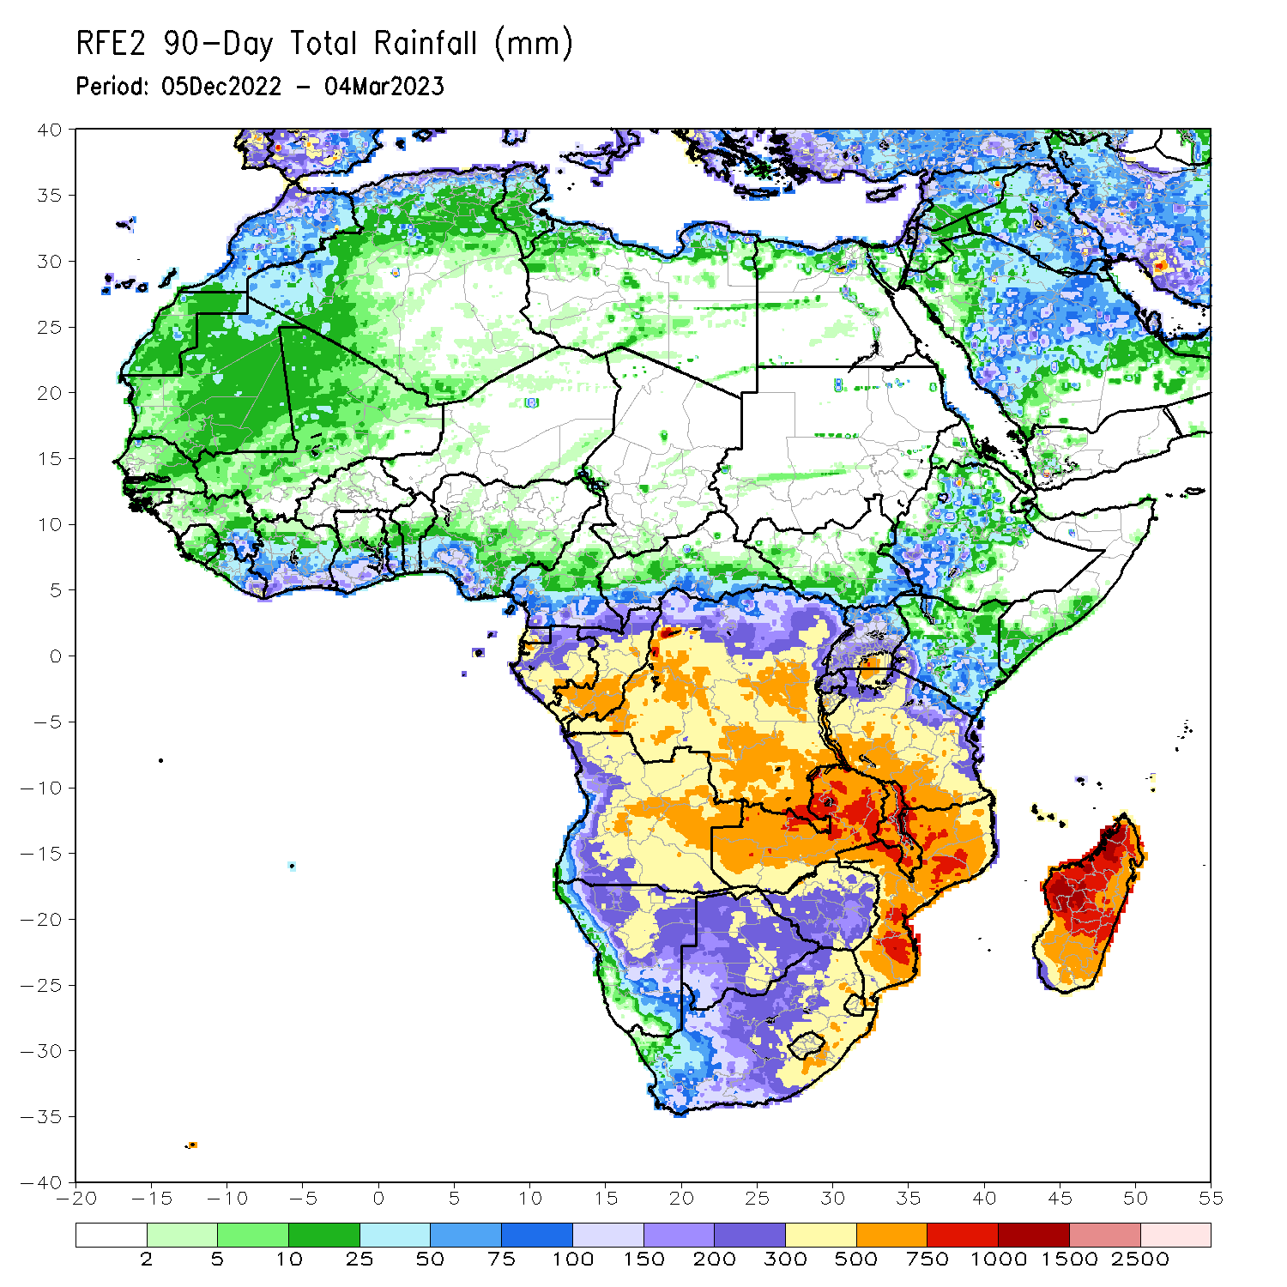
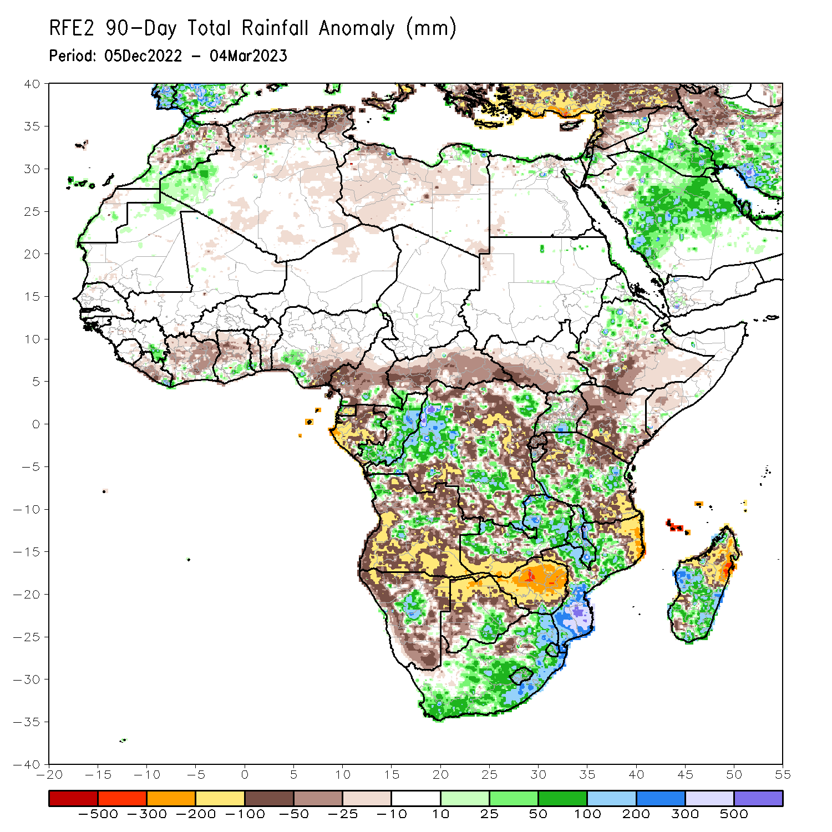
Rainfall Patterns: Last 90 Days
Over the past 90 days, in East Africa, above-average rainfall was observed over parts of southwest and northern Ethiopia, pockets of east-central Kenya and southeast South Sudan, pockets of western and southeast Uganda, and parts of northeast, central and southwest Tanzania. Rainfall was below-average over southern and central Ethiopia, many parts of Kenya, Rwanda, eastern Burundi, southern Somalia, southwest South Sudan, northeast Uganda, and northwest, northeast and southeast Tanzania. In southern Africa, above-average rainfall was observed over parts of central and southern Mozambique, much of Malawi, many parts of central and northern Zambia, pockets of central Angola and Namibia, southern Botswana, northern, central and eastern South Africa, Lesotho, Eswatini, and parts of western, central and southeast Madagascar. Below-average rainfall was observed over southwest, southern and northeast Angola, western, northern, eastern and southern Namibia, western, northern and eastern Botswana, much of Zimbabwe, southern Zambia, northeast Mozambique, northern and northeast Madagascar, and pockets of western South Africa. In Central Africa, rainfall was above-average over many parts of Congo, parts western and central DRC, and southeast Cameroon. Rainfall was below-average over western and central Cameroon, western, northern and southern Gabon, Equatorial Guinea, and portions of northwest, north-central, eastern, and southern DRC. In West Africa, rainfall was above-average over parts of southeast Guinea, southeastern Liberia, southern parts of Cote d’Ivoire, Ghana and Togo, and pockets of southern Nigeria. In contrast, below-average rainfall was observed over western and central Liberia, northern and central parts of Cote d’Ivoire and Ghana, central Togo, central and southern Benin, and most of southeast Nigeria.
Notes:
4

Slide 5
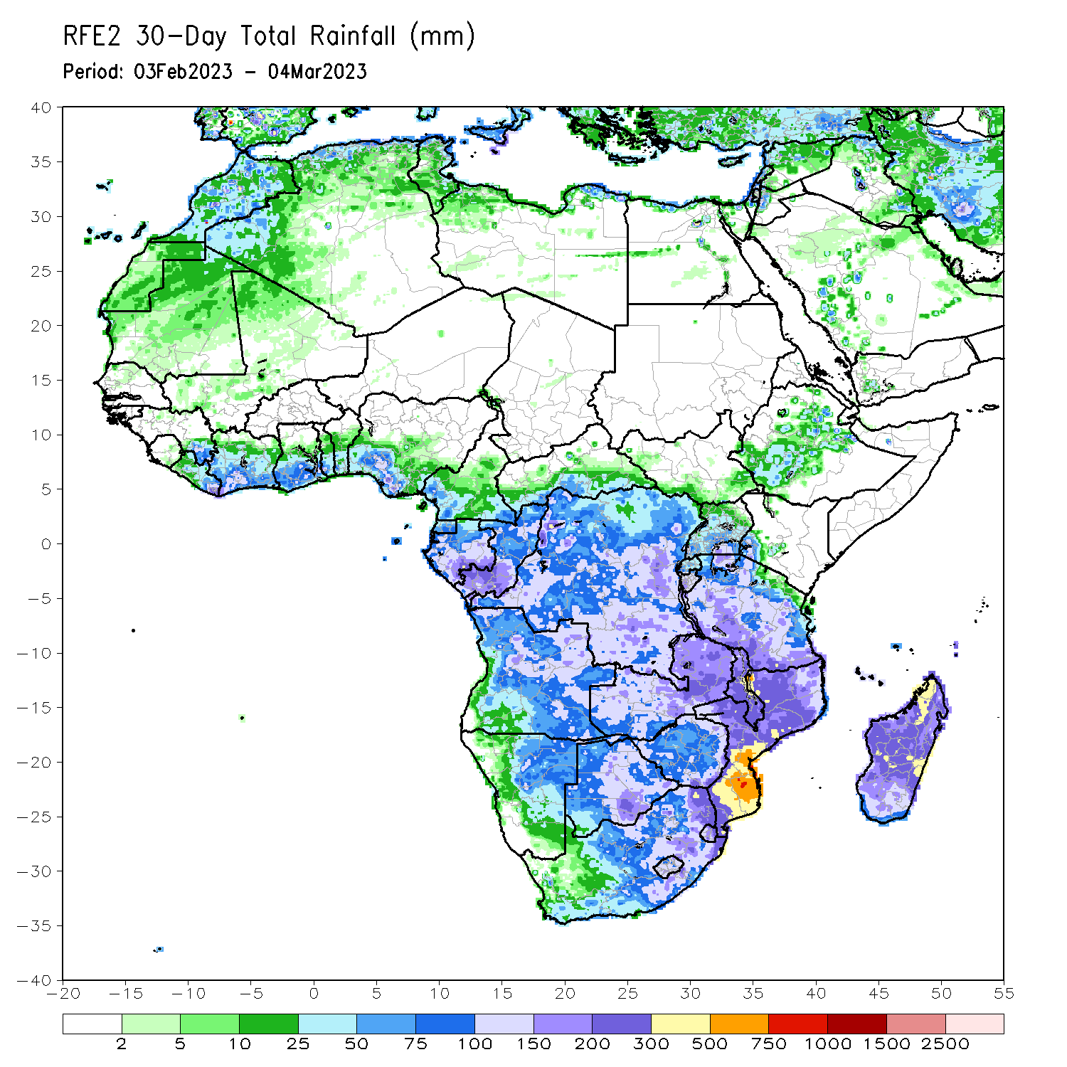
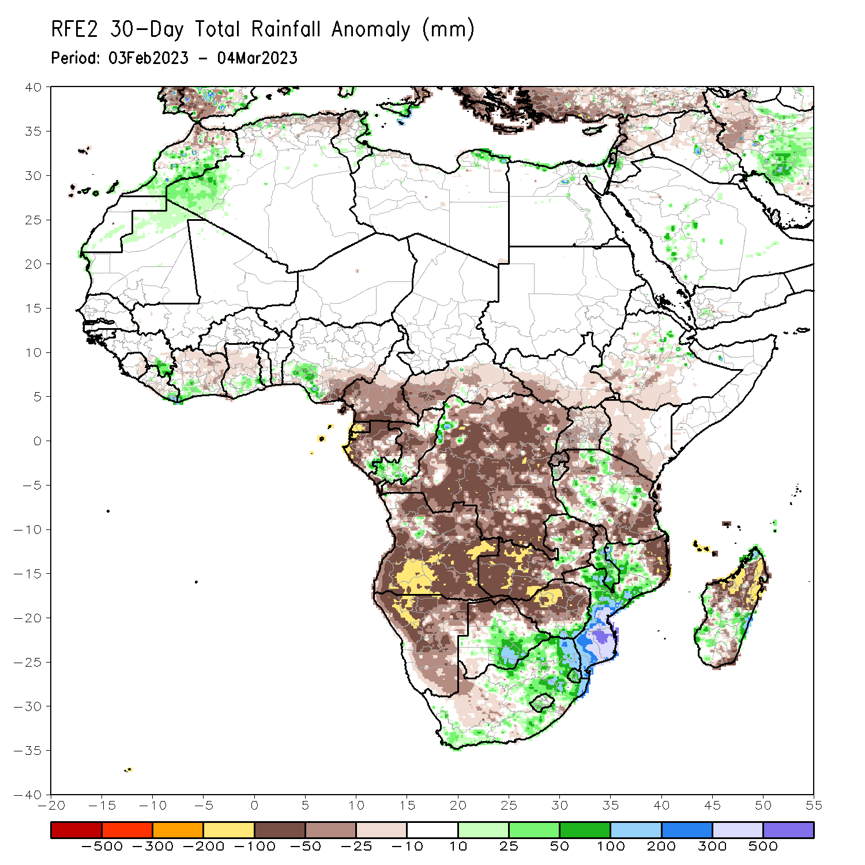
Rainfall Patterns: Last 30 Days
Over the past 30 days, in East Africa, above-average rainfall was observed over pockets of east-central, west-central and northern Tanzania, pockets of northeast Ethiopia, and western Burundi. Rainfall was below-average over southwestern Ethiopia, northwest, central and southeast Kenya, southern South Sudan, many parts of Uganda, Rwanda, northwest, northeast and southern Tanzania. In southern Africa, above-average rainfall was observed over central and southern parts of Mozambique and Malawi, southern Botswana, many parts of central, northern and eastern South Africa, Eswatini, southern Lesotho, and parts of southwest and central-east Madagascar. Below-average rainfall was observed over much of Angola and Namibia, western, southern, eastern and northern Zambia, western, central and northern Zimbabwe, northern Botswana, northeast Mozambique, northern Malawi, northern, and southeast Madagascar. In Central Africa, rainfall was above-average over southern Congo, pockets of southeast Gabon and northwest DRC. Rainfall was below-average over many parts of DRC and Gabon, Equatorial Guinea, central and southern Cameroon, western, central and eastern CAR, and central Congo. In West Africa, rainfall was above-average over pockets of southeastern Guinea, southeastern Liberia, southwest Cote d’Ivoire, southern Ghana, and parts of southern Nigeria. Rainfall was below-average in central Liberia, northern, central and southeast Cote d’Ivoire, central Ghana, and southeast Nigeria.
Notes:
5

Slide 6
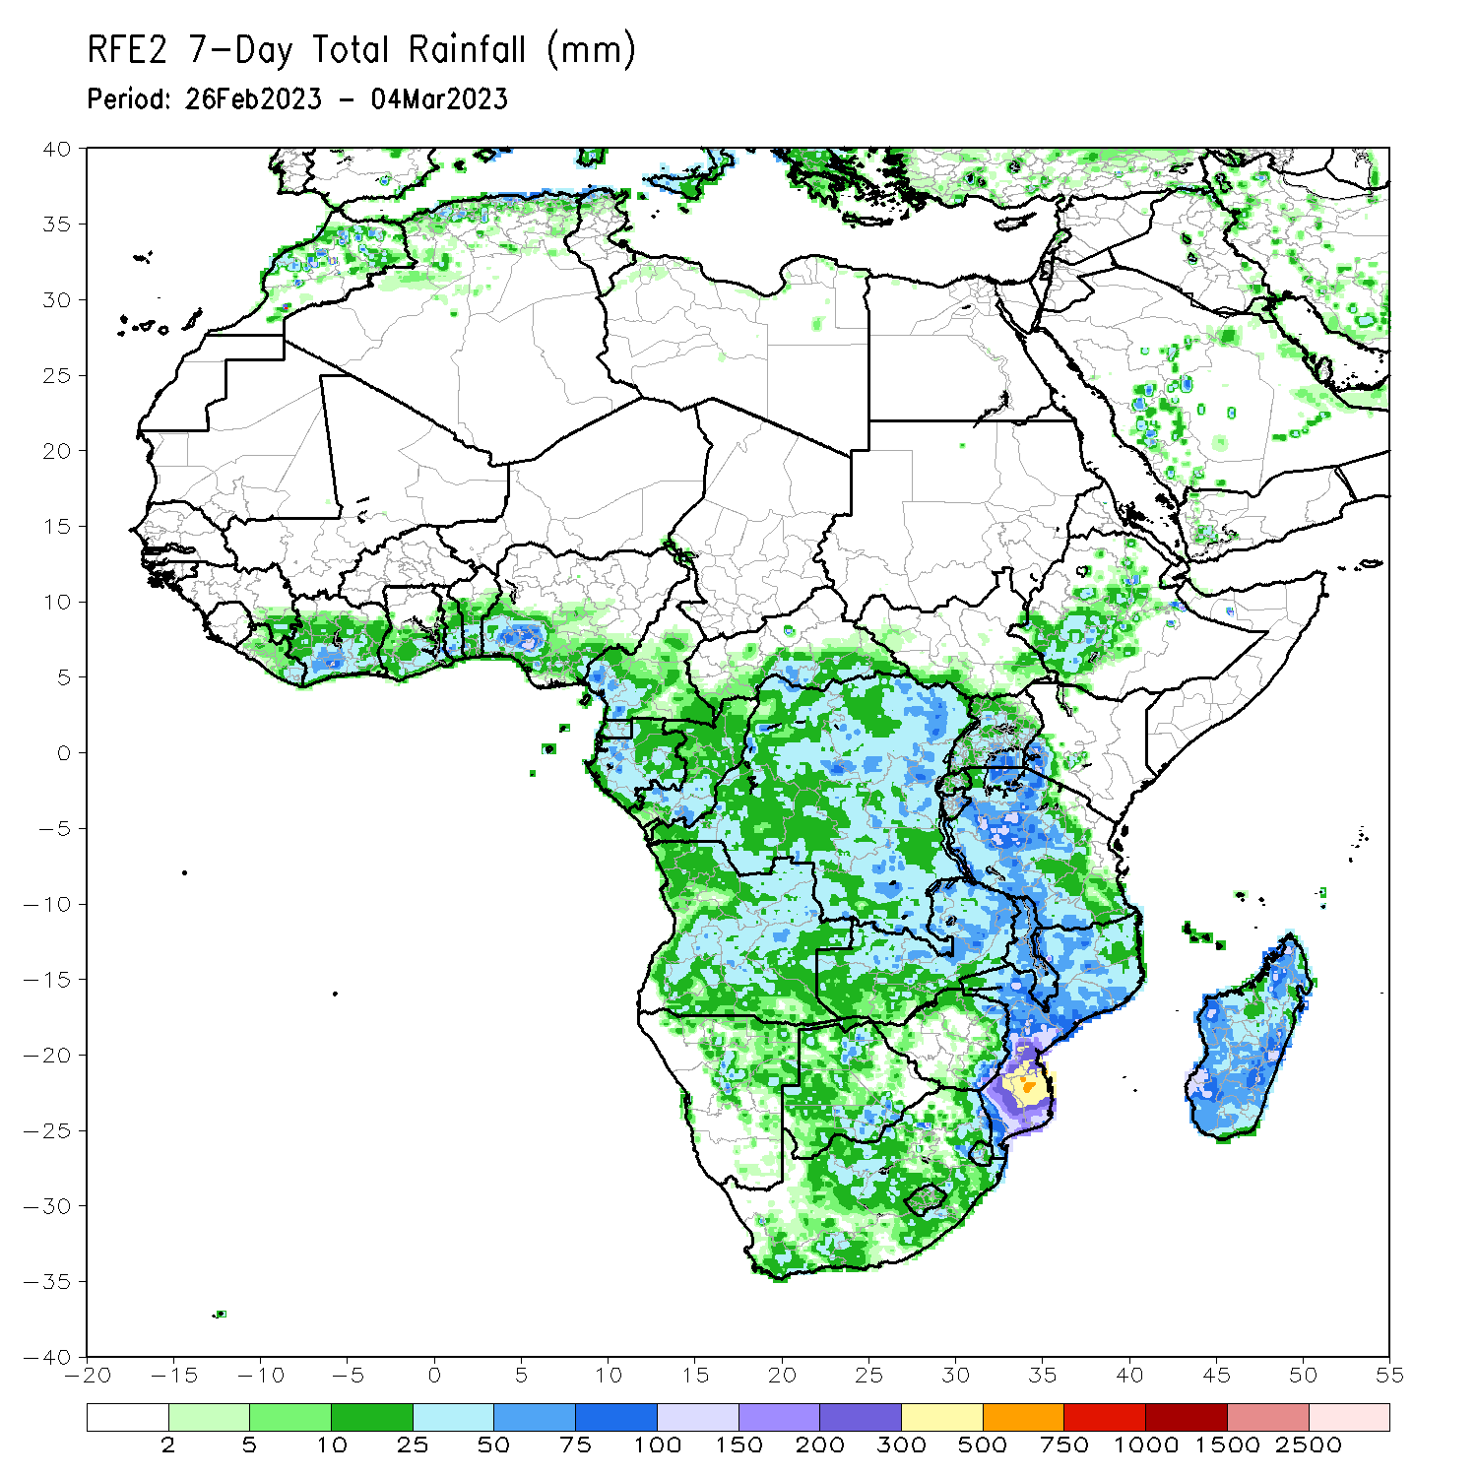
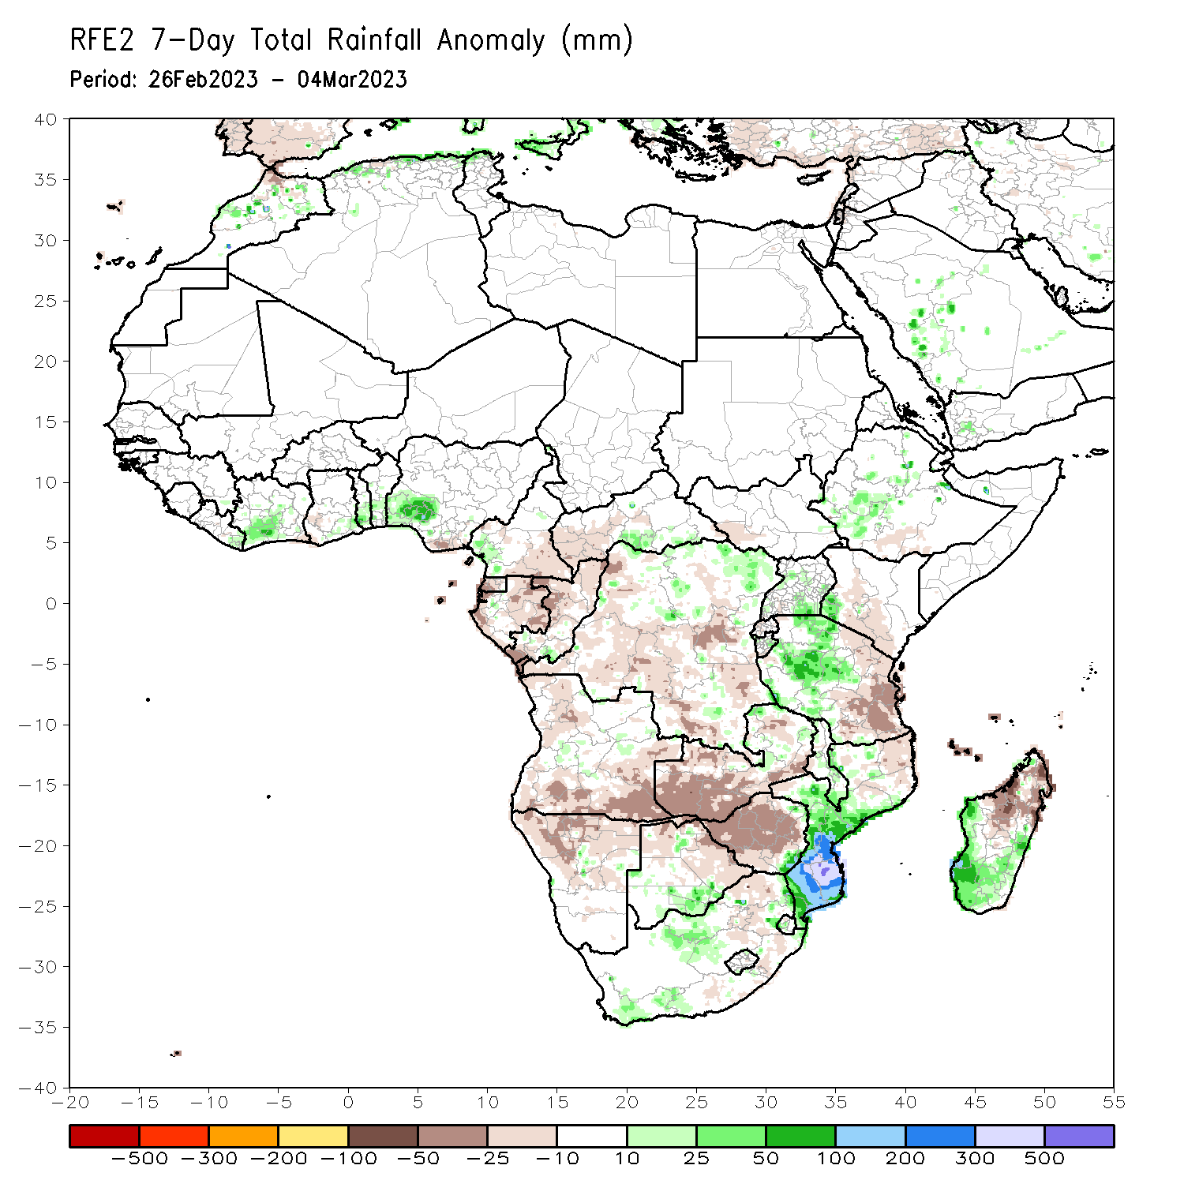
Rainfall Patterns: Last 7 Days
During the past 7 days, in East Africa, rainfall was above-average over southwest and central Ethiopia, parts of central, western and northwest Tanzania, eastern Burundi, central and southeast Uganda, and pockets of southwest Kenya. Below-average rainfall was observed across northeast, eastern and southeast Tanzania, Rwanda, southern Kenya, pockets of western South Sudan and southern Ethiopia. In Central Africa, rainfall was above-average over southeast CAR, western Cameroon, and parts of northern and northeast DRC. Below-average rainfall was observed across Equatorial Guinea, many parts of Gabon and Congo, southeast Cameroon, western CAR, and parts of western, central and southeast DRC. In West Africa, above-average rainfall was observed over southeast Liberia, parts of southwest and central Cote d’Ivoire, pockets of southeast Ghana, parts of southern Togo and Benin, and southwest Nigeria. Below average rainfall was observed over southwest Ghana and southeast Nigeria. In southern Africa, rainfall was above-average over central and southern Mozambique, southern Malawi, western and southern Madagascar, pockets of southern Botswana, southeast Zimbabwe, northwestern Zambia and central Angola, and southeast and western South Africa. In contrast, rainfall was below-average over northwest, southern and southeast Angola, northern Namibia, western and southern Zambia, many parts of Zimbabwe, northern and eastern Botswana, parts of northwest and eastern South Africa, northeast Mozambique, and northwest and northern Madagascar.

Slide 7
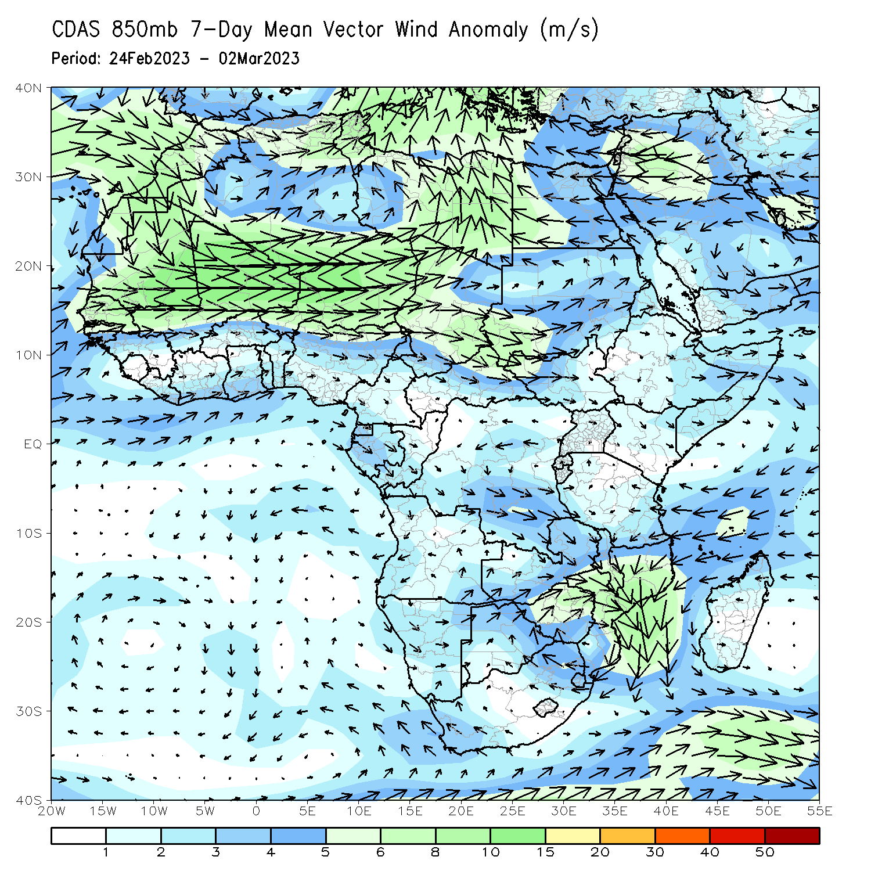
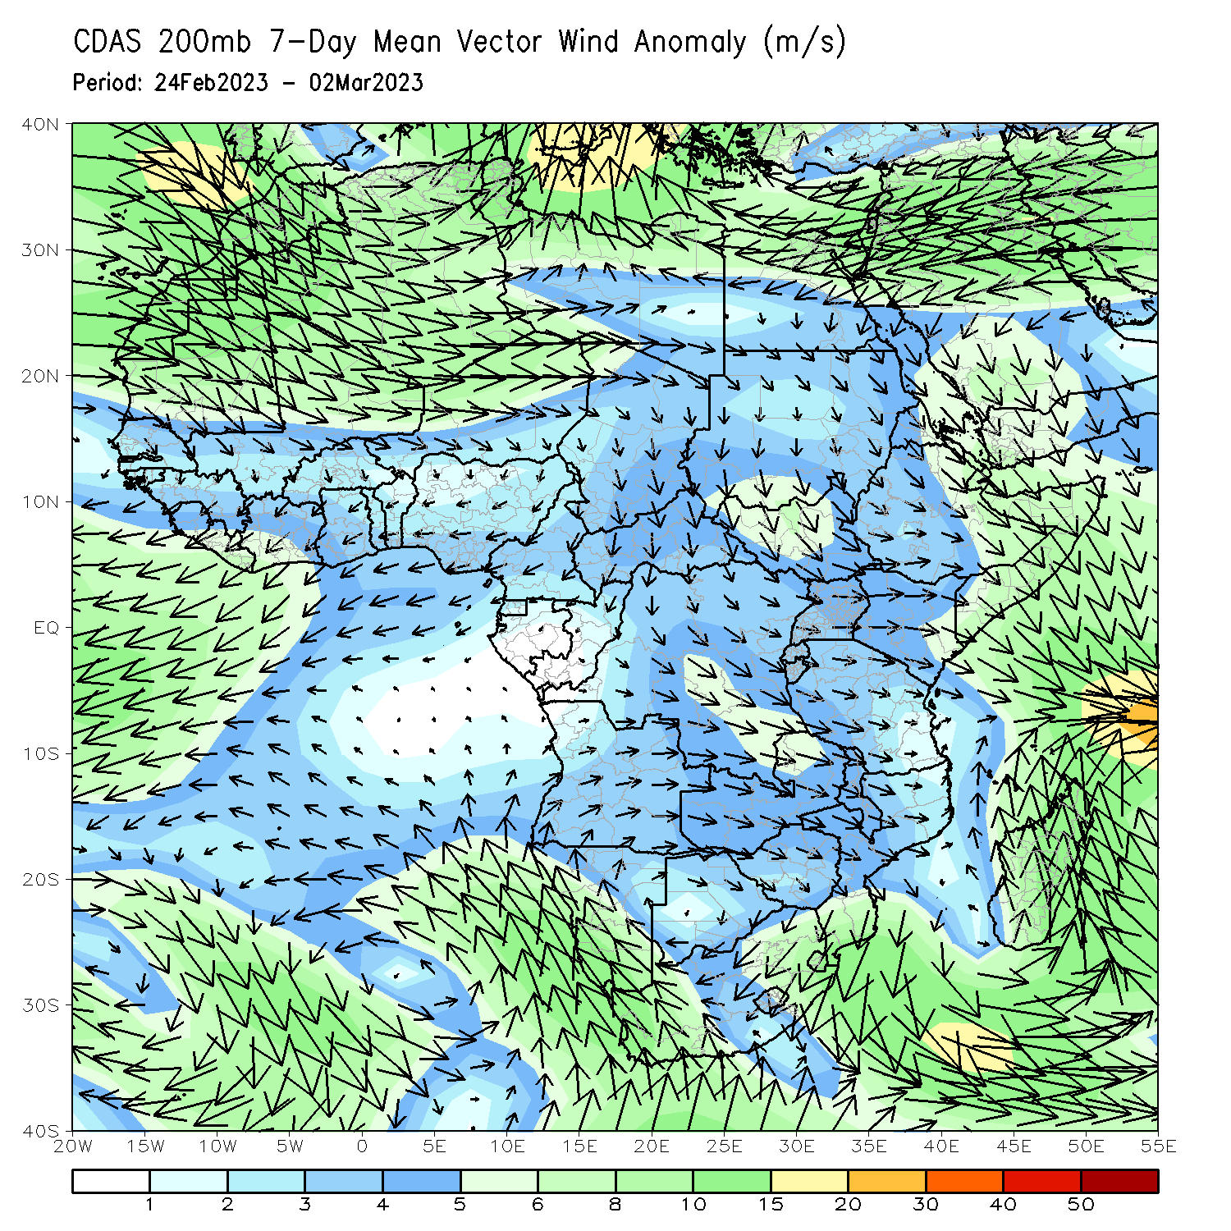
Atmospheric Circulation: Last 7 Days
At 850-hPa level (left panel), wind anomalies were cyclonic across Mozambique, Zimbabwe, Malawi and eastern Zambia and anomalous wind convergence across central and Southern Mozambique may have contributed to the observed above-average rainfall across central and Southern Mozambique.

Slide 8
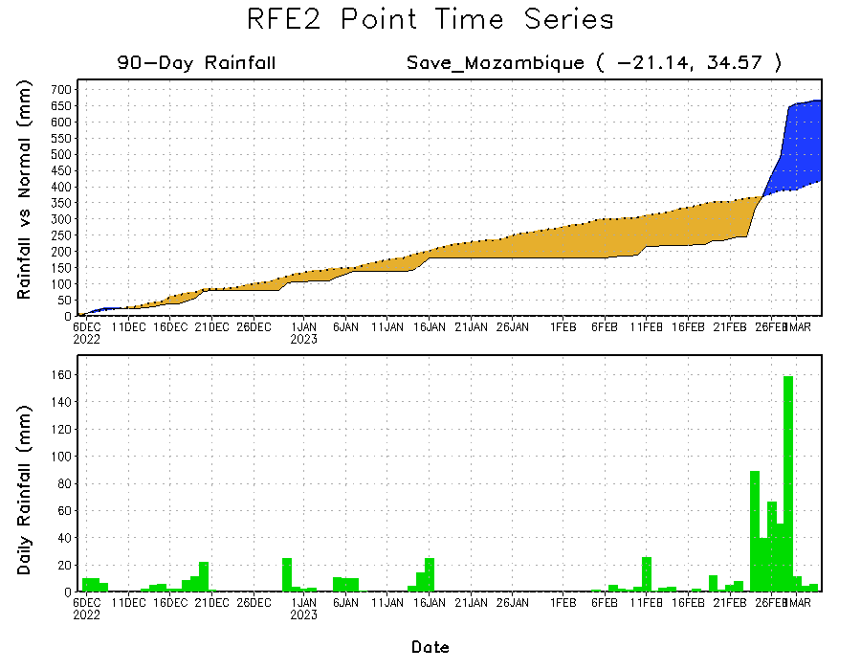
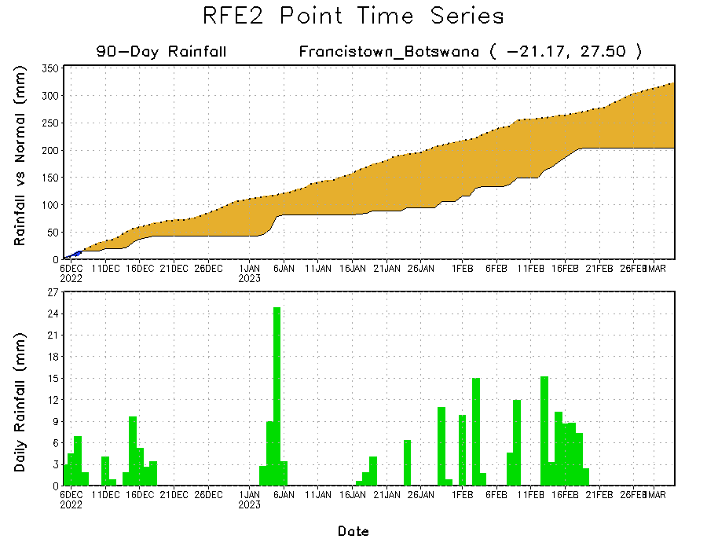
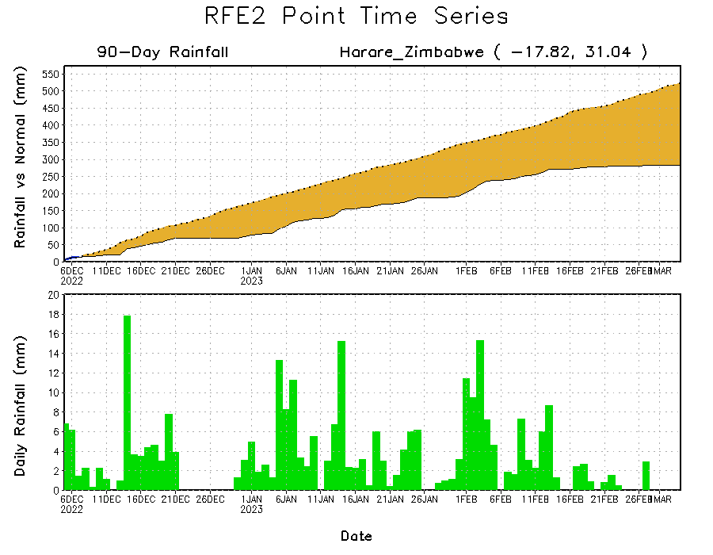
Rainfall Evolution
Daily evolution of rainfall over the last 90 days at selected locations shows worsening moisture deficits over parts of northern Botswana (bottom left) and central Zimbabwe (bottom right). Total rainfall transitioned from a seasonal deficit to a seasonal surplus in central Mozambique due to TC Freddy’s landfall (top right).

Slide 9
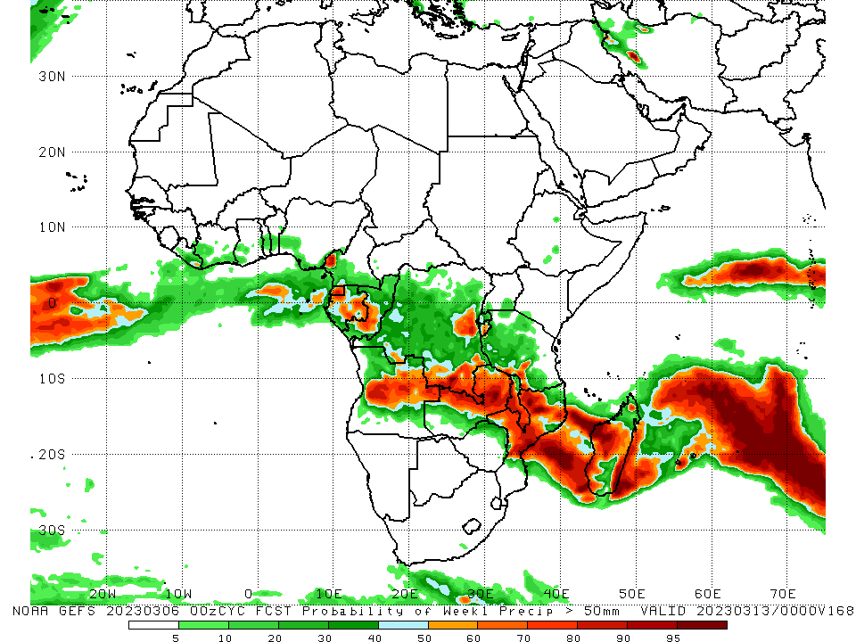
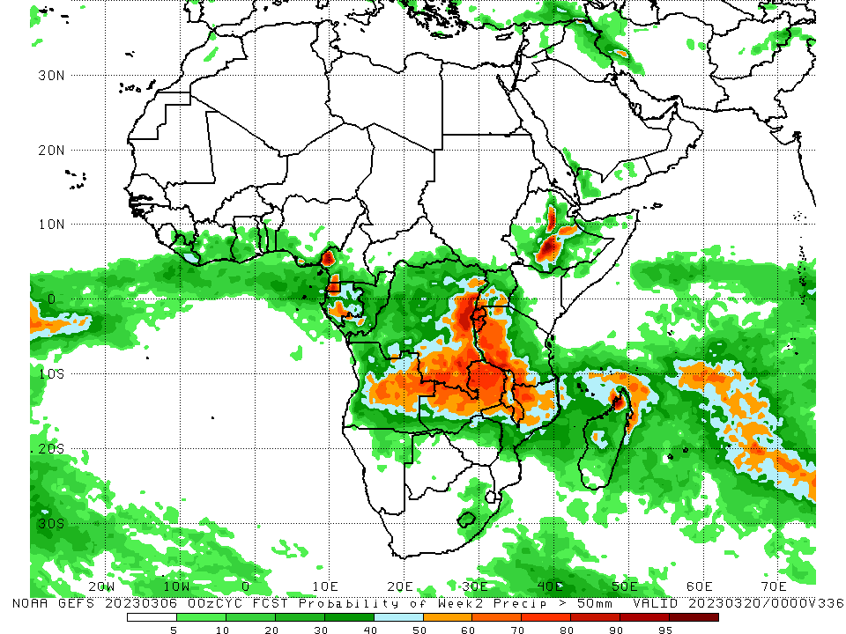
NCEP GEFS Model Forecasts Non-Bias Corrected Probability of precipitation exceedance
Week-1, Valid: 07 Mar – 13 Mar 2023
Week-2, Valid: 14 – 20 Mar 2023
For week-1 (left panel), the NCEP GEFS forecasts indicate a moderate to high chance (over 70%) for rainfall to exceed 50 mm over central and eastern Angola, northern and eastern Zambia, central and northwest Mozambique, central and southern Malawi, western, southwest and eastern Madagascar, southern and pockets of eastern DRC, Equatorial Guinea, eastern Gabon, western Congo, and pockets of southwest Cameroon. For week-2 (right panel), the NCEP GEFS forecasts indicate a moderate to high chance (over 70%) for rainfall to exceed 50 mm over Equatorial Guinea, pockets of southwest Cameroon, central Ethiopia, eastern Angola, eastern and southern DRC, Rwanda, Burundi, western Tanzania, northwest, northern and eastern Zambia, northern and southern Malawi, and northwest parts of Mozambique and Madagascar.
Notes:
9

Slide 10
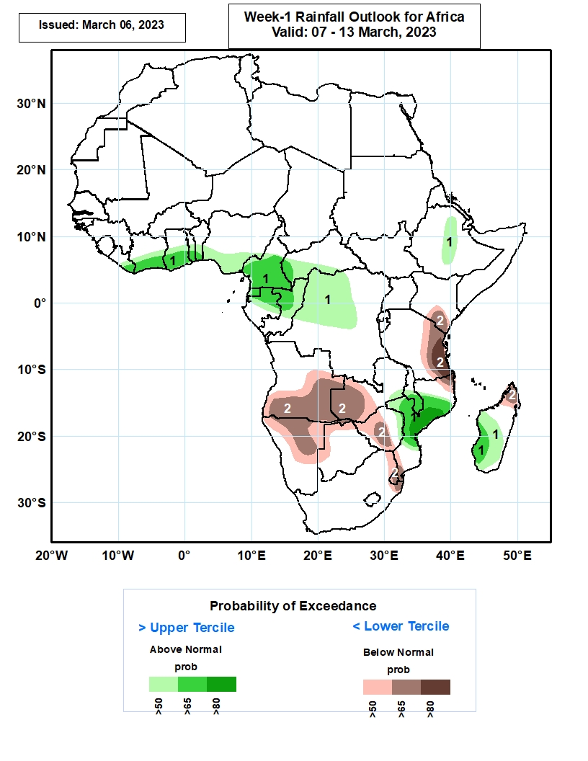
Week-1 Precipitation Outlooks
07 Mar – 13 Mar 2023
The forecasts suggest above 50% chance for weekly rainfall to be above-normal (above the upper tercile) over eastern Liberia, southern Cote d’Ivoire, central and southern parts of Ghana, Togo, Benin and Cameroon, southern Nigeria, western and southern parts of CAR, much of Equatorial Guinea, northern Gabon, northern and central Congo, western and central parts of DR Congo, central Ethiopia, southern Malawi, northern and central portions of Mozambique, central and southern parts of Madagascar. In particular, there is above 80% chance for rainfall to be above-normal over central Mozambique, this is associated with TC Freddy forecasted to make landfall in Mozambique in the next 120 hours (5 days).
The consolidated probabilistic forecasts suggest above 50% chance for weekly total rainfall to be below-normal (below the lower tercile) over central and southern parts of Angola, northern and central Namibia, western Zambia, northern portions of Botswana, western and central Zimbabwe, northern South Africa, much of Eswatini, southern Kenya, eastern Tanzania, northeastern Mozambique, and northern Madagascar. In particular, there is above 80% chance for rainfall to be below normal over eastern Tanzania.
Notes:
10

Slide 11
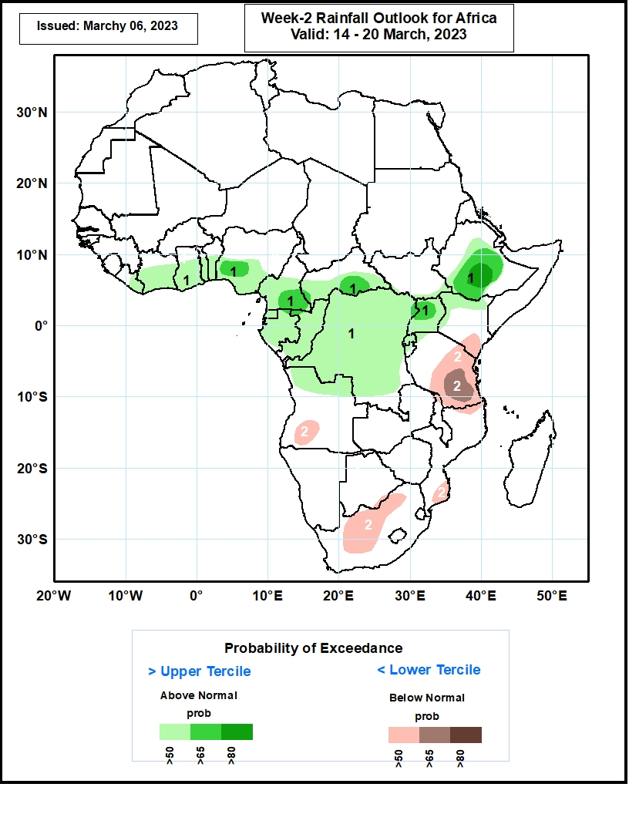
Week-2 Precipitation Outlooks
14 – 20 Mar 2023
The forecasts suggest above 50% chance for weekly rainfall to be above-normal (above the upper tercile) over eastern Liberia, central and southern Cote d’Ivoire, Ghana, Togo, Benin, Cameroon and CAR, southern Nigeria, much of Equatorial Guinea, Gabon, Congo, DR Congo, Uganda and Rwanda, central portions of Ethiopia, northern and western parts of Kenya. In particular, there is above 80% chance for rainfall to be above-normal over central Ethiopia.
The consolidated probabilistic forecasts suggest above 50% chance for weekly total rainfall to be below-normal (below the lower tercile) over southwestern Angola, southeastern Kenya, central and eastern parts of Tanzania, northern and central parts of South Africa, northern and southern parts of Mozambique. In particular, there is above 65% chance for rainfall to be below normal over southern Tanzania.
Notes:
11

Slide 12
Summary
Over the past 30 days, in East Africa, above-average rainfall was observed over pockets of east-central, west-central and northern Tanzania, pockets of northeast Ethiopia, and western Burundi. Rainfall was below-average over southwestern Ethiopia, northwest, central and southeast Kenya, southern South Sudan, many parts of Uganda, Rwanda, northwest, northeast and southern Tanzania. In southern Africa, above-average rainfall was observed over central and southern parts of Mozambique and Malawi, southern Botswana, many parts of central, northern and eastern South Africa, Eswatini, southern Lesotho, and parts of southwest and central-east Madagascar. Below-average rainfall was observed over much of Angola and Namibia, western, southern, eastern and northern Zambia, western, central and northern Zimbabwe, northern Botswana, northeast Mozambique, northern Malawi, northern, and southeast Madagascar. In Central Africa, rainfall was above-average over southern Congo, pockets of southeast Gabon and northwest DRC. Rainfall was below-average over many parts of DRC and Gabon, Equatorial Guinea, central and southern Cameroon, western, central and eastern CAR, and central Congo. In West Africa, rainfall was above-average over pockets of southeastern Guinea, southeastern Liberia, southwest Cote d’Ivoire, southern Ghana, and parts of southern Nigeria. Rainfall was below-average in central Liberia, northern, central and southeast Cote d’Ivoire, central Ghana, and southeast Nigeria.
During the past 7 days, in East Africa, rainfall was above-average over southwest and central Ethiopia, parts of central, western and northwest Tanzania, eastern Burundi, central and southeast Uganda, and pockets of southwest Kenya. Below-average rainfall was observed across northeast, eastern and southeast Tanzania, Rwanda, southern Kenya, pockets of western South Sudan and southern Ethiopia. In Central Africa, rainfall was above-average over southeast CAR, western Cameroon, and parts of northern and northeast DRC. Below-average rainfall was observed across Equatorial Guinea, many parts of Gabon and Congo, southeast Cameroon, western CAR, and parts of western, central and southeast DRC. In West Africa, above-average rainfall was observed over southeast Liberia, parts of southwest and central Cote d’Ivoire, pockets of southeast Ghana, parts of southern Togo and Benin, and southwest Nigeria. Below average rainfall was observed over southwest Ghana and southeast Nigeria. In southern Africa, rainfall was above-average over central and southern Mozambique, southern Malawi, western and southern Madagascar, pockets of southern Botswana, southeast Zimbabwe, northwestern Zambia and central Angola, and southeast and western South Africa. In contrast, rainfall was below-average over northwest, southern and southeast Angola, northern Namibia, western and southern Zambia, many parts of Zimbabwe, northern and eastern Botswana, parts of northwest and eastern South Africa, northeast Mozambique, and northwest and northern Madagascar.
Week-1 outlook calls for an increased chance for above-average rainfall over Gulf of Guinea coast regions, central and northern Congo, southwest CAR, western and central DRC, northeast Angola, central Mozambique, and southern Malawi. In contrast, there is an increased chance for below-average rainfall over southern Angola, western and southern Zambia, northern Namibia, Botswana, western Zimbabwe, eastern and northern South Africa, Lesotho, Eswatini, Uganda, southern parts of Kenya, northern, eastern and southern Tanzania and northern Madagascar. Week-2 outlook suggests an increased chance for above-average rainfall over Gulf of Guinea coast regions, central Congo, southern CAR, many parts of DRC, Uganda, Rwanda, Burundi, western Tanzania, northeast Angola, many parts of Ethiopia, Zambia, Malawi, and northern Mozambique, while below-average rainfall is likely over southeast Kenya, western Angola, southern parts of Botswana, South Africa, Zimbabwe and Mozambique, Eswatini, and many parts of Madagascar.

