Slide 1
The African Monsoon Recent Evolution and Current Status Include Week-1 and Week-2 Outlooks
Update prepared by Justin Hicks
06 February 2023
For more information, visit:
http://www.cpc.ncep.noaa.gov/products/Global_Monsoons/African_Monsoons/precip_monitoring.shtml

Slide 2
Outline
Highlights
Recent Evolution and Current Conditions
NCEP GEFS Forecasts
Summary

Slide 3
Highlights: Last 7 Days
During the past 7 days, in East Africa, rainfall was above-average over pockets of western and eastern Tanzania. Below-average rainfall was observed over parts of central and southern Tanzania. In Central Africa, rainfall was above-average over Equatorial Guinea, Gabon, southern Congo, and parts of southern and eastern DRC. Below-average rainfall was observed over western and northern DRC. In West Africa, above-average rainfall was observed along the costal areas of Cote d’Ivoire and Ghana. In southern Africa, rainfall was above-average over northwestern and the far southern Angola, northeastern Namibia, pockets of Botswana, eastern South Africa, and many parts of Madagascar. In contrast, rainfall was below-average over southwestern and eastern Angola, Zambia, Malawi, Mozambique, and the far western and northern Madagascar.
Model forecasts call for an increased chance for week-1 rainfall to be below-normal across southern Nigeria, southern Cameroon, Equatorial Guinea, Gabon, Congo, much of DRC, Angola, northwestern Namibia and northern Madagascar. In contrast, there is an increased chance for week-1 rainfall to be above-normal across eastern Namibia, much of Botswana and Zimbabwe, South Africa, Lesotho, Eswatini, southern Zambia, southern Malawi, and much of Mozambique. For week-2, model forecasts indicate an increased chance for below-normal rainfall along the Gulf of Guinea coast and the neighboring areas of Central Africa, parts of equatorial East Africa, northern and western Angola, and parts of Namibia and South Africa. In contrast, there is an increased chance for week-2 rainfall to be above-normal over pockets of Angola, southern Zambia, northeastern Namibia, Botswana, Zambia, Malawi, parts of Mozambique, and western Madagascar.

Slide 4
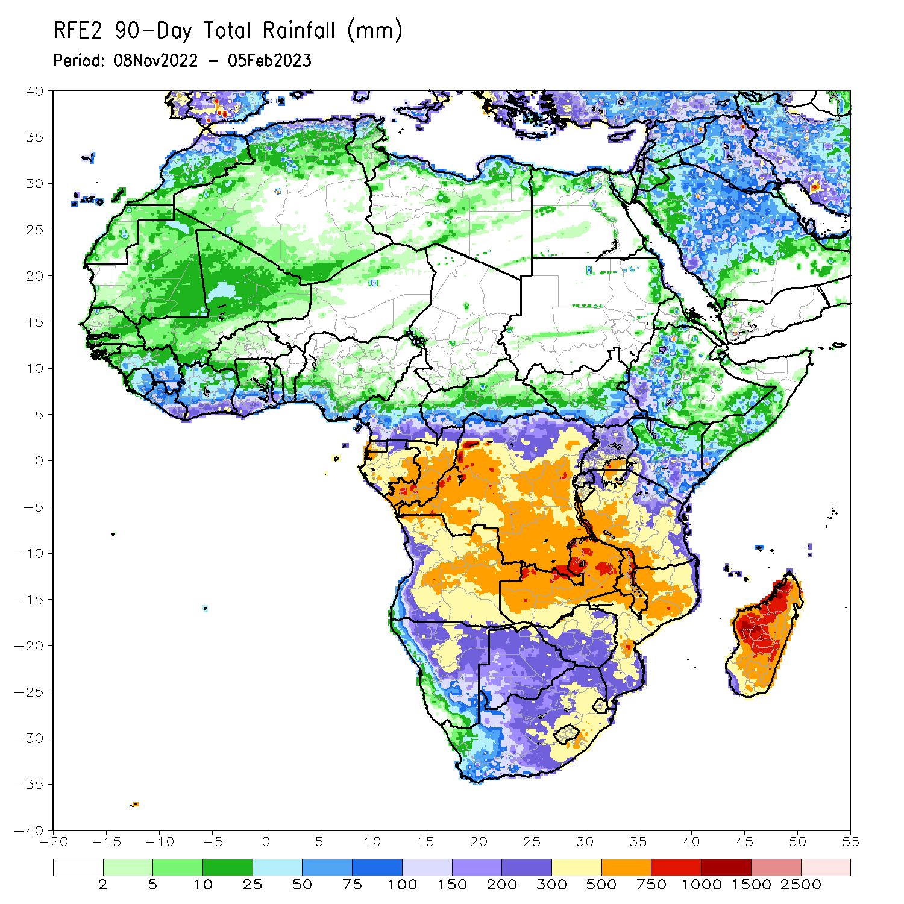
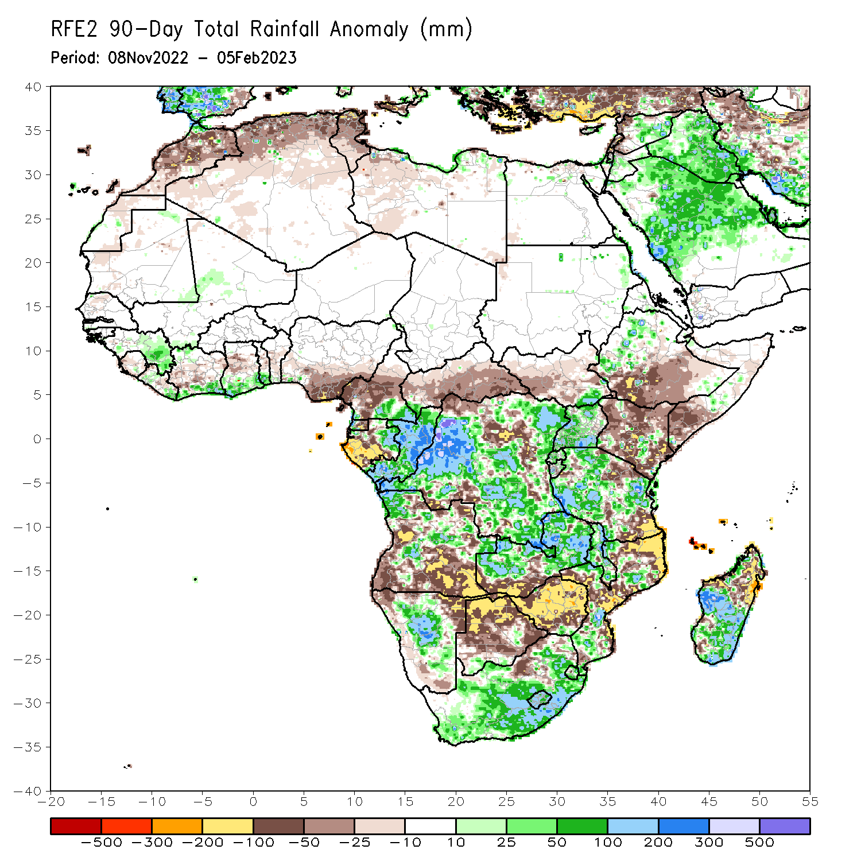
Rainfall Patterns: Last 90 Days
Over the past 90 days, in East Africa, above-average rainfall was observed over parts of western Ethiopia, and much of Uganda and Tanzania. Rainfall was below-average over southern Ethiopia, much of Kenya, southern Somalia, and pockets of Tanzania. In southern Africa, above-average rainfall was observed over parts of central and northern Angola, much of Zambia, Namibia, much of South Africa, Lesotho, Eswatini, Malawi, parts of Mozambique, and southern Madagascar. Below-average rainfall was observed over southern Angola, much of Botswana and Zimbabwe, pockets of Mozambique, and northern Madagascar. In Central Africa, rainfall was above-average over southeastern Cameroon, eastern Gabon, Congo, and much of DRC. Rainfall was below-average over western and central Cameroon, western Gabon, Equatorial Guinea, and portions of northeastern and southwestern DRC. In West Africa, rainfall was above-average over parts of eastern Guinea, and coastal Cote d’Ivoire and Ghana. In contrast, below-average rainfall was observed over southern Nigeria.
Notes:
4

Slide 5
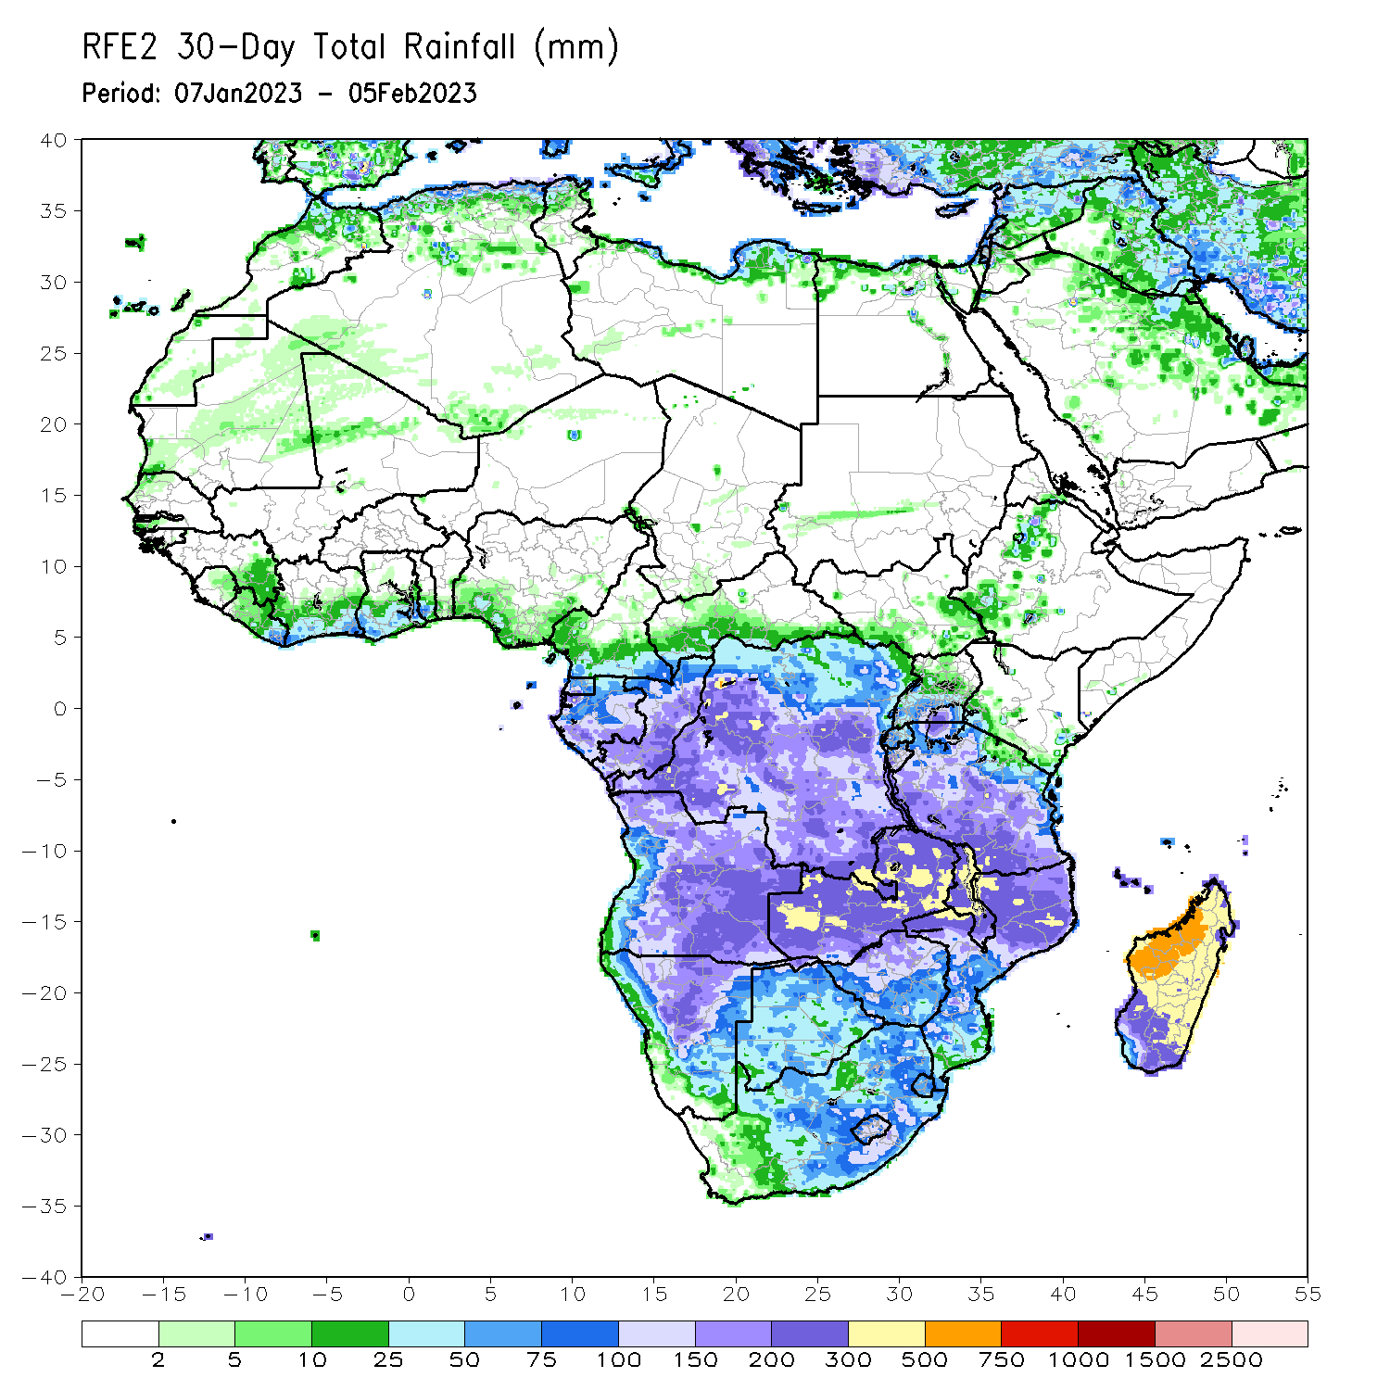
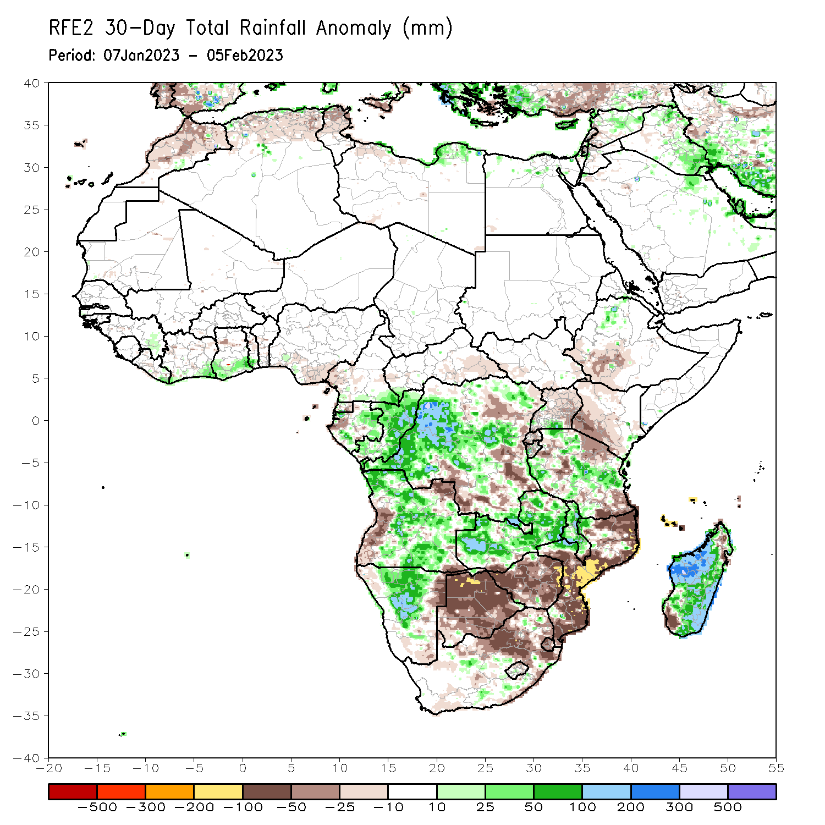
Rainfall Patterns: Last 30 Days
Over the past 30 days, in East Africa, above-average rainfall was observed over pockets of northwestern Ethiopia, and many parts of Tanzania. Rainfall was below-average over southwestern Ethiopia, Kenya, and pockets of Tanzania. In southern Africa, above-average rainfall was observed over many parts of Angola, much of Zambia, Namibia, Malawi, and much of Madagascar. Below-average rainfall was observed over western and the far northern Angola, much of Botswana and Zimbabwe, and northern South Africa, and much of Mozambique. In Central Africa, rainfall was above-average over Congo, many parts of DRC. Rainfall was below-average over parts of southern and eastern DRC. In West Africa, rainfall was above-average along coastal Cote d’Ivoire and Ghana.
Notes:
5

Slide 6
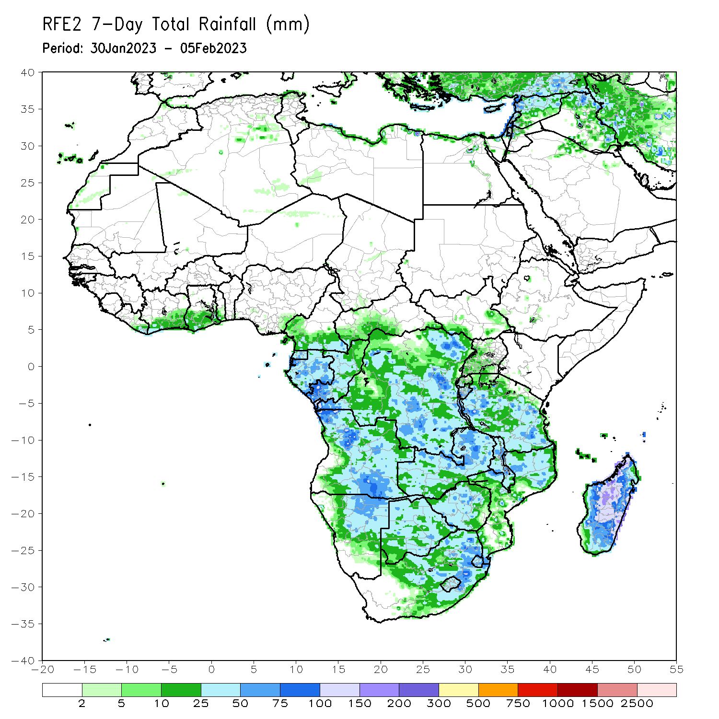
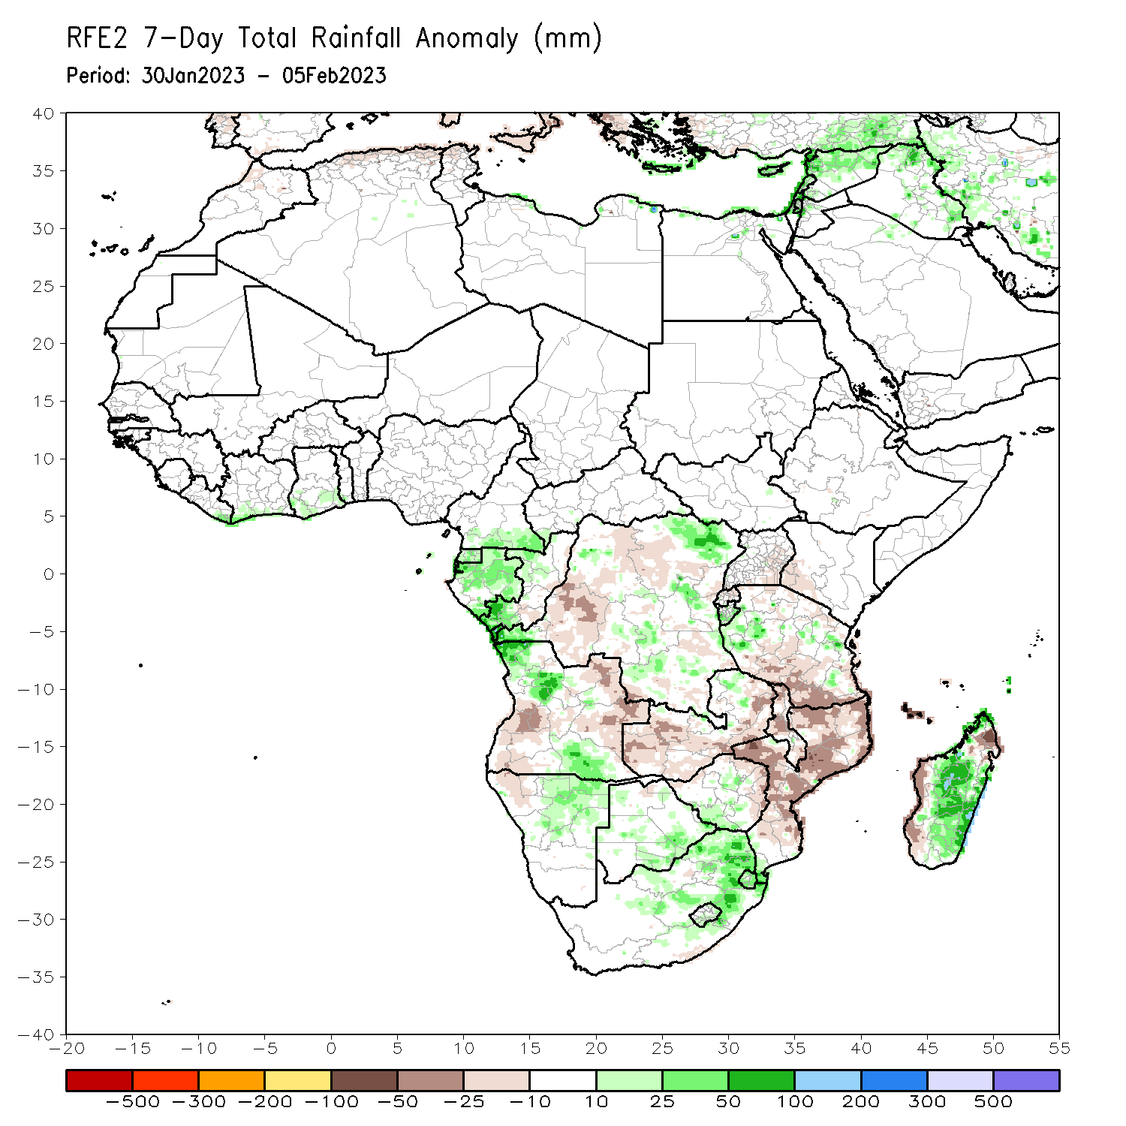
Rainfall Patterns: Last 7 Days
During the past 7 days, in East Africa, rainfall was above-average over pockets of western and eastern Tanzania. Below-average rainfall was observed over parts of central and southern Tanzania. In Central Africa, rainfall was above-average over Equatorial Guinea, Gabon, southern Congo, and parts of southern and eastern DRC. Below-average rainfall was observed over western and northern DRC. In West Africa, above-average rainfall was observed along the costal areas of Cote d’Ivoire and Ghana. In southern Africa, rainfall was above-average over northwestern and the far southern Angola, northeastern Namibia, pockets of Botswana, eastern South Africa, and many parts of Madagascar. In contrast, rainfall was below-average over southwestern and eastern Angola, Zambia, Malawi, Mozambique, and the far western and northern Madagascar.

Slide 7
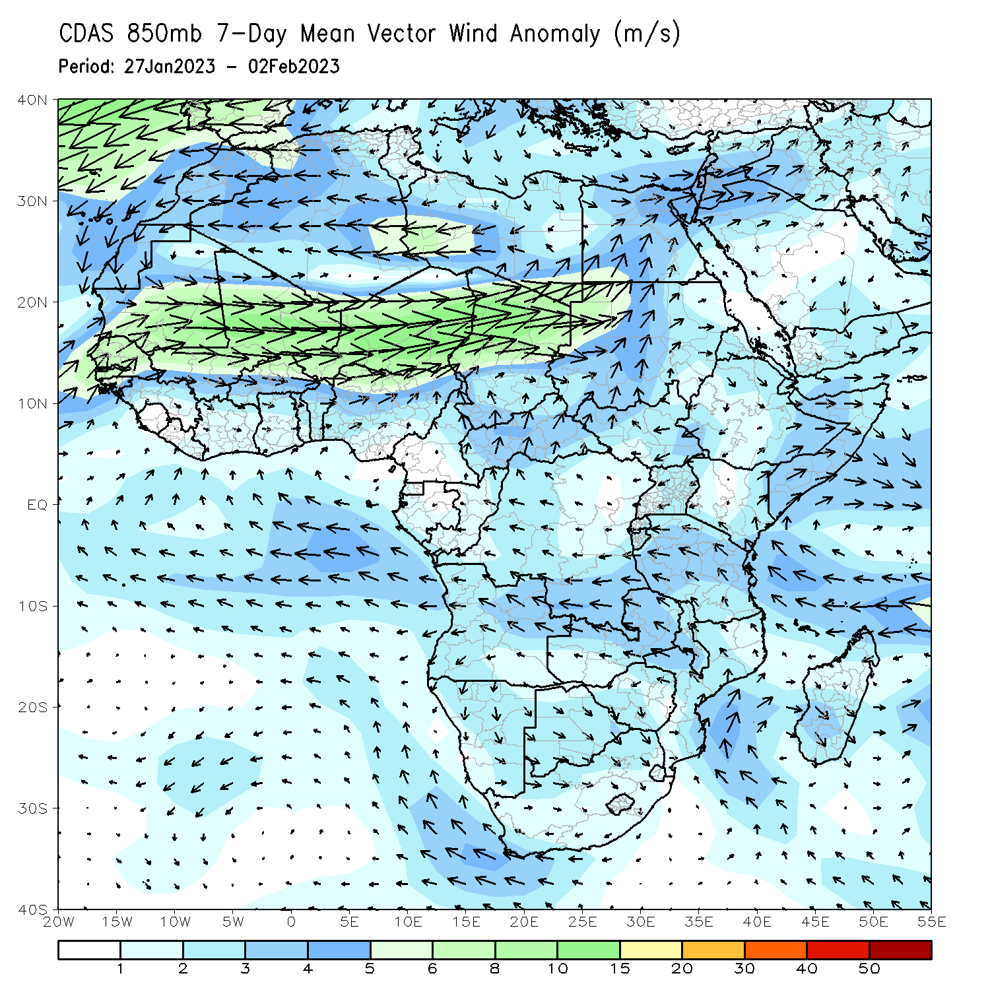
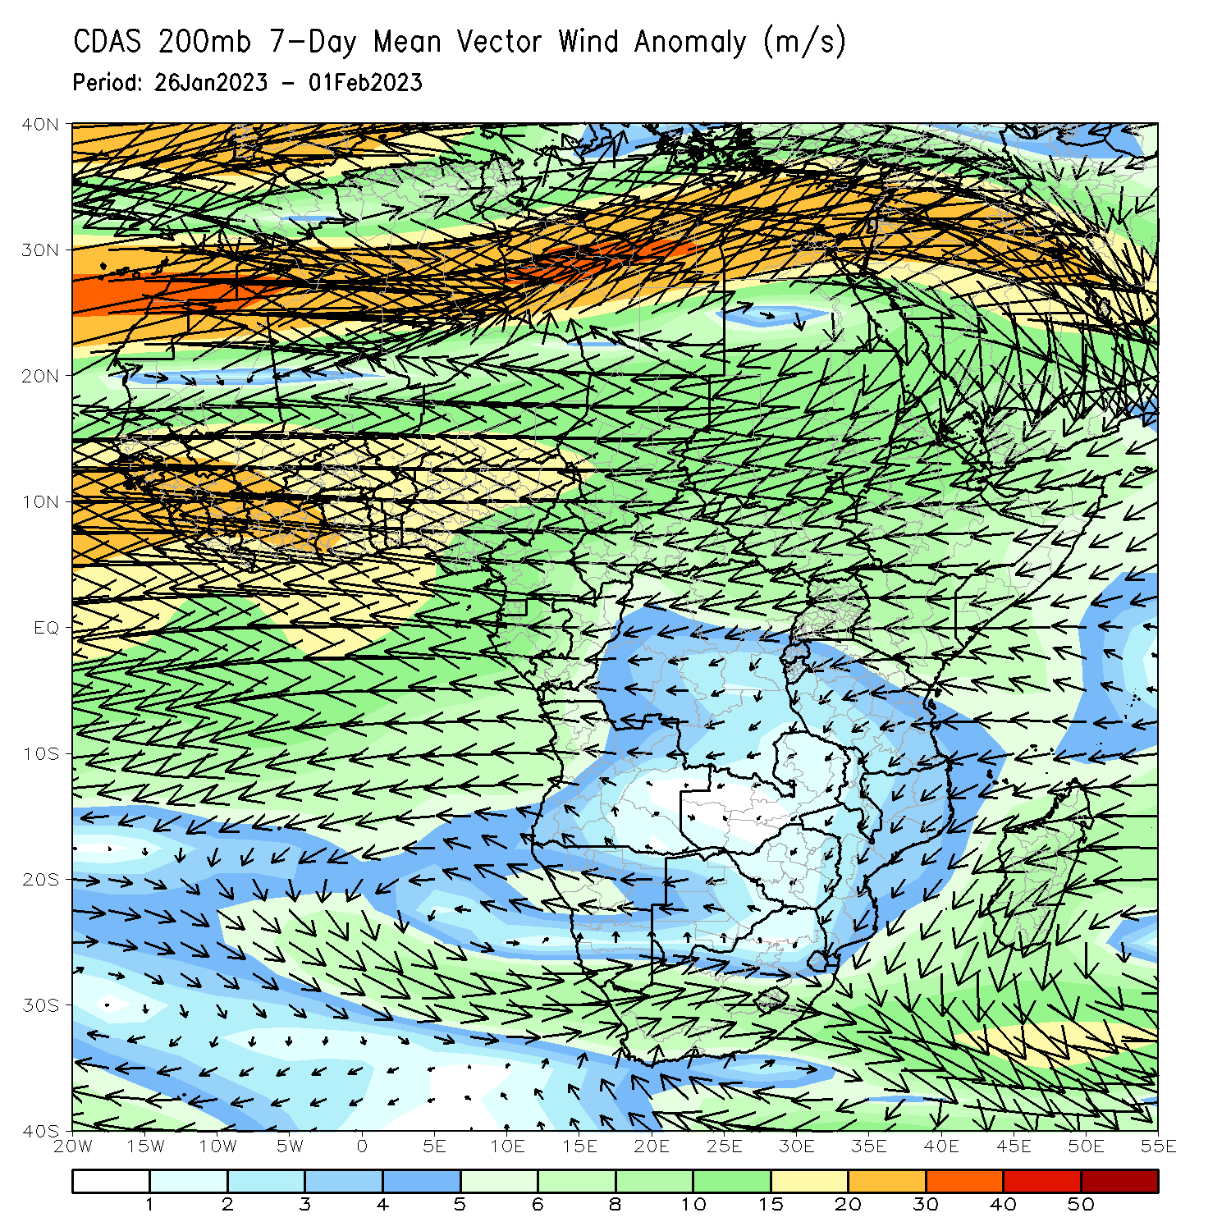
Atmospheric Circulation: Last 7 Days
Lower-level (850-hPa) wind anomalies were anti-cyclonic across southern Africa, and cyclonic in the Mozambique Channel and the neighboring areas.

Slide 8
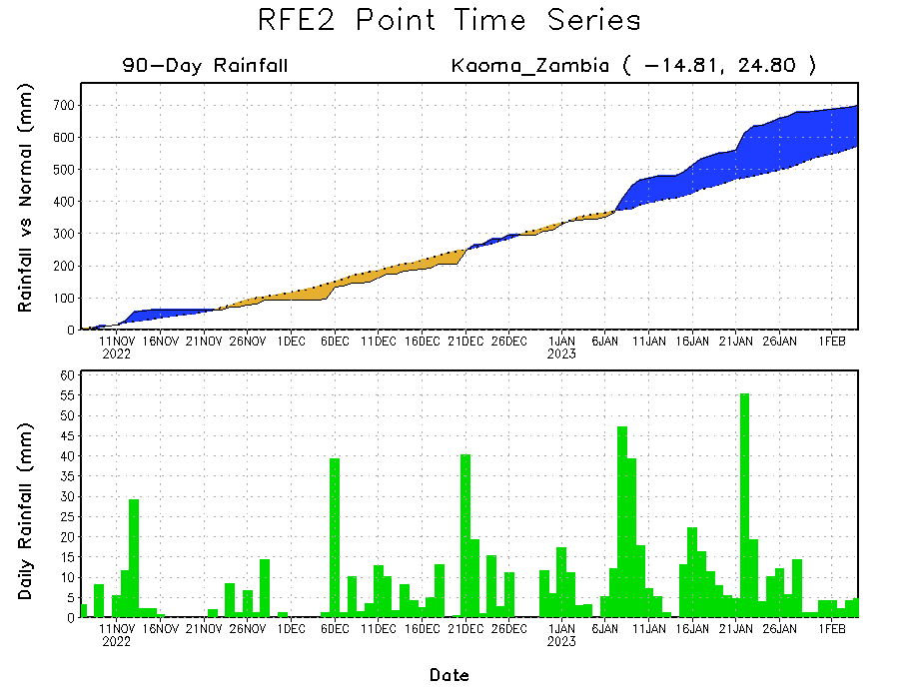
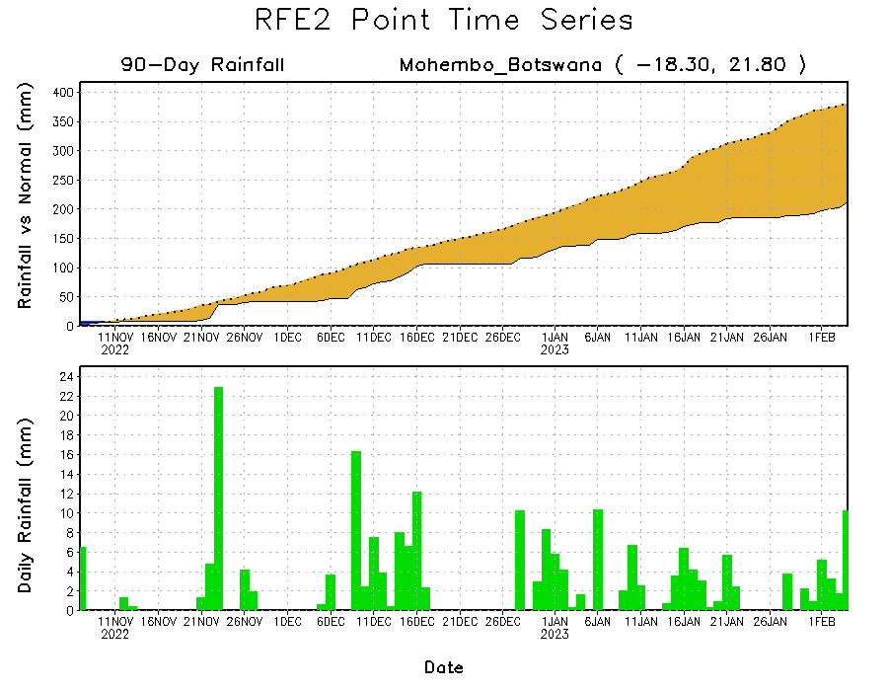
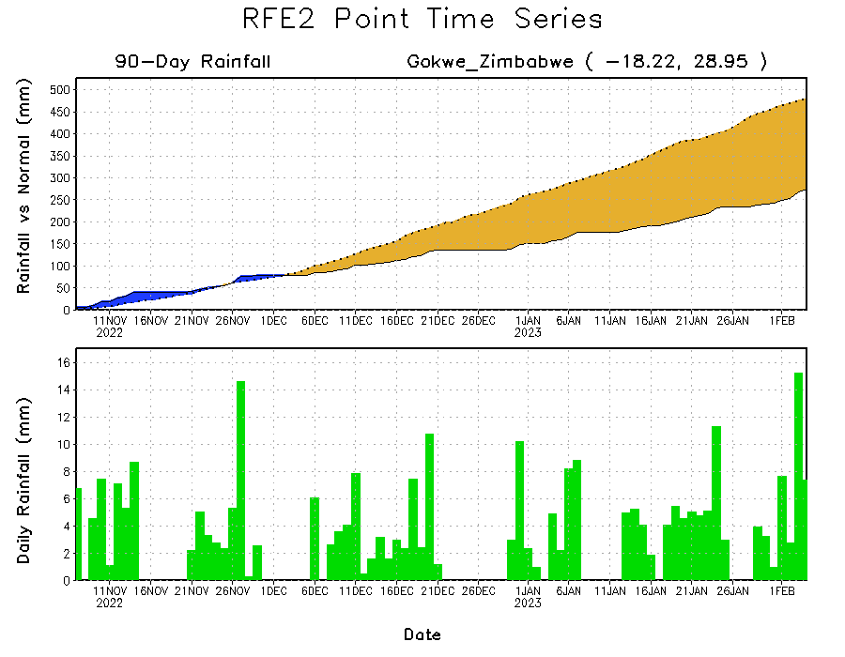
Rainfall Evolution
Daily evolution of rainfall over the last 90 days at selected locations shows worsening moisture deficits over parts of northern Botswana (bottom left) and central Zimbabwe (bottom right). Seasonal total rainfall remained above-average over western Zambia (top right).

Slide 9
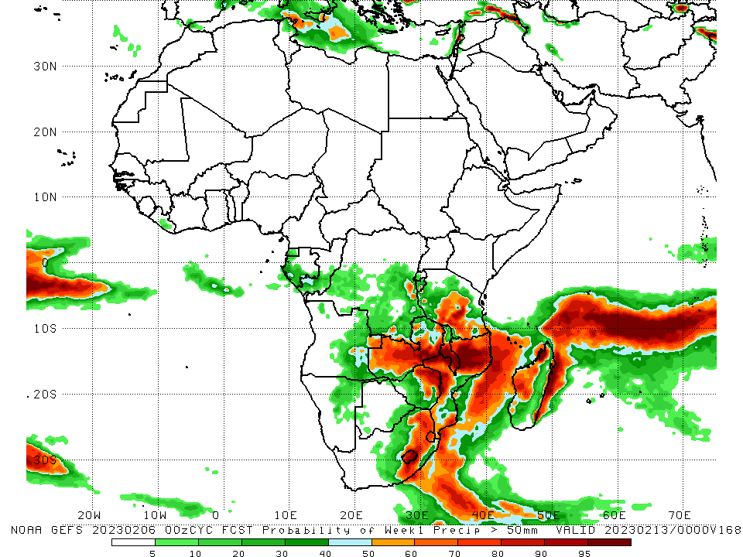
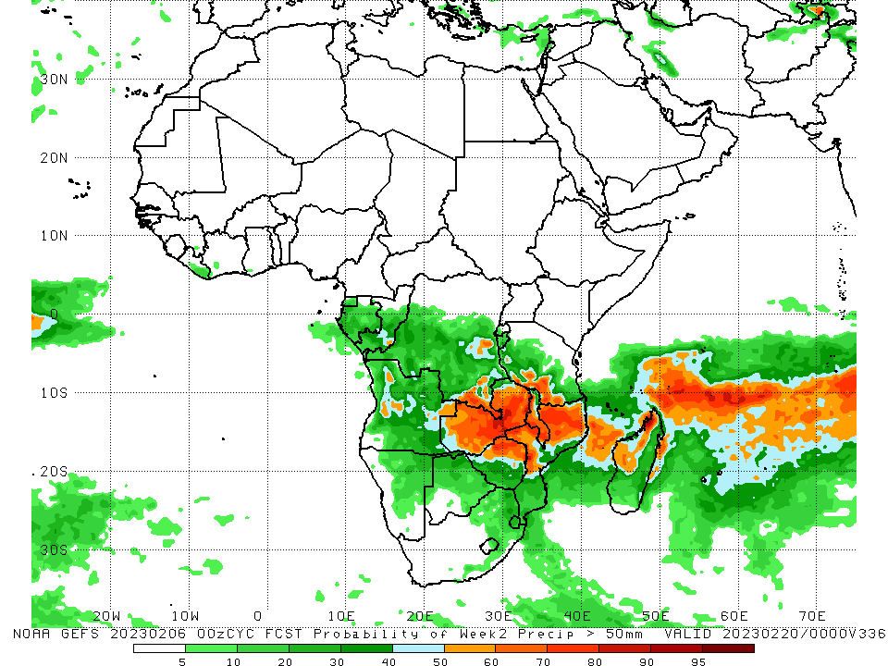
NCEP GEFS Model Forecasts Non-Bias Corrected Probability of precipitation exceedance
Week-1, Valid: 07 – 13 Feb 2023
Week-2, Valid: 14 – 20 Feb 2023
For week-1 (left panel), the GEFS forecasts indicate a moderate to high chance (over 70%) for rainfall to exceed 50 mm over southern Tanzania, Zambia, Malawi, eastern Zimbabwe,, eastern South Africa, Lesotho, Eswatini, and parts of Mozambique and Madagascar. For week-2 (right panel), there is a moderate to high chance for rainfall to exceed 50mm across much of Zambia, northern Zimbabwe, the far southern Tanzania, Malawi, northern Mozambique, and northwestern Madagascar.
Notes:
9

Slide 10
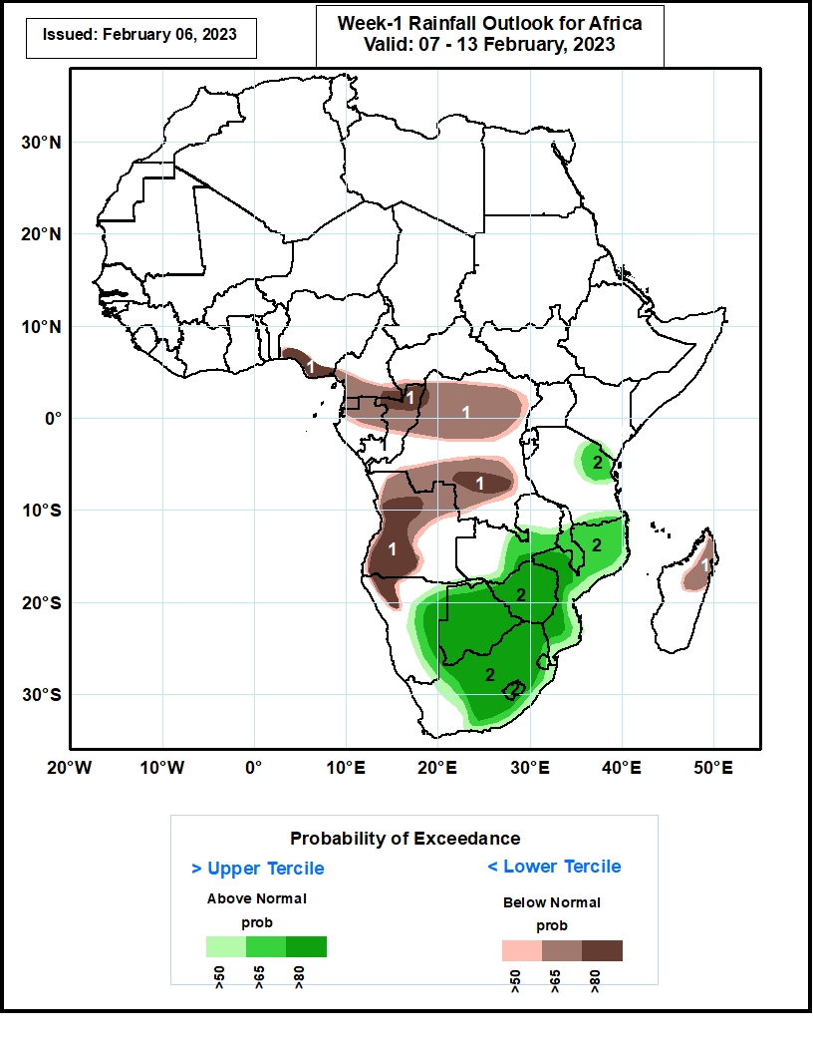
Week-1 Precipitation Outlooks
07 – 13 Feb 2023
The consolidated probabilistic forecasts suggest above 50% chance for weekly total rainfall to be below-normal (below the lower tercile) over southern Nigeria and Cameroon, much of Equatorial Guinea, northern Gabon, northern and central parts of Congo, northern and southern portions of DR Congo, western and central Angola, northwestern Namibia, and northern parts of Madagascar. In particular, there is above 80% chance for rainfall to be below normal over southeastern Cameroon, northern Congo, southern DR Congo, western and central parts of Angola and northwestern Namibia.
The forecasts suggest above 50% chance for weekly rainfall to be above-normal (above the upper tercile) over northeastern and southern Tanzania, central and southern parts of Zambia and Malawi, much of Mozambique, Zimbabwe and Botswana, eastern Namibia, central and eastern South Africa, and much of Lesotho and Eswatini. In particular, there is above 80% chance for rainfall to be above-normal over western and southern Mozambique, much of Botswana and Zimbabwe, eastern Namibia, central and eastern South Africa, and much of Lesotho.
Notes:
10

Slide 11
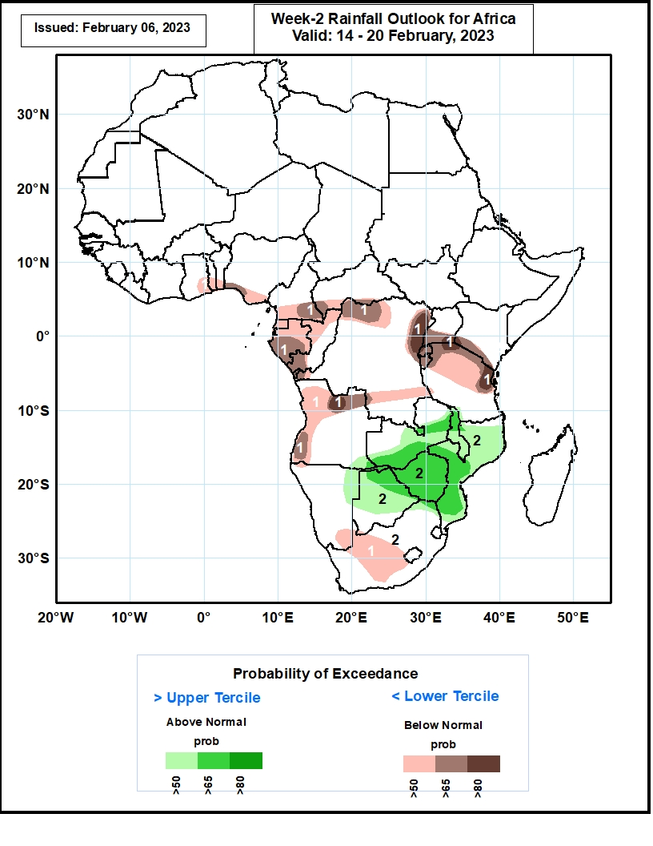
Week-2 Precipitation Outlooks
14 – 20 Feb 2023
The consolidated probabilistic forecasts suggest above 50% chance for weekly total rainfall to be below-normal (below the lower tercile) over southeastern Ghana, southern Togo, Benin, Nigeria and Cameroon, southwestern CAR, much of Equatorial Guinea and Gabon, western Congo, northern and southern portions of DR Congo, western and northern portions of Angola, southern Uganda and Kenya, northern Tanzania, much of Rwanda and Burundi, southeastern Namibia, and central parts of South Africa. In particular, there is above 80% chance for rainfall to be below normal over northeastern DR Congo, southeastern Uganda, southwestern Kenya, northeastern Tanzania, and north-central Angola.
The forecasts suggest above 50% chance for weekly rainfall to be above-normal (above the upper tercile) over central and southern parts of Zambia, much of Malawi, Mozambique and Zimbabwe, southeastern Angola, northeastern Namibia, northern and central parts of Botswana, and northern parts of South Africa. In particular, there is above 65% chance for rainfall to be above-normal over central and southern parts of Zambia, northern Malawi and Botswana, much of Zimbabwe, central and southern parts of Mozambique.
Notes:
11

Slide 12
Summary
Over the past 30 days, in East Africa, above-average rainfall was observed over pockets of northwestern Ethiopia, and many parts of Tanzania. Rainfall was below-average over southwestern Ethiopia, Kenya, and pockets of Tanzania. In southern Africa, above-average rainfall was observed over many parts of Angola, much of Zambia, Namibia, Malawi, and much of Madagascar. Below-average rainfall was observed over western and the far northern Angola, much of Botswana and Zimbabwe, and northern South Africa, and much of Mozambique. In Central Africa, rainfall was above-average over Congo, many parts of DRC. Rainfall was below-average over parts of southern and eastern DRC. In West Africa, rainfall was above-average along coastal Cote d’Ivoire and Ghana.
During the past 7 days, in East Africa, rainfall was above-average over pockets of western and eastern Tanzania. Below-average rainfall was observed over parts of central and southern Tanzania. In Central Africa, rainfall was above-average over Equatorial Guinea, Gabon, southern Congo, and parts of southern and eastern DRC. Below-average rainfall was observed over western and northern DRC. In West Africa, above-average rainfall was observed along the costal areas of Cote d’Ivoire and Ghana. In southern Africa, rainfall was above-average over northwestern and the far southern Angola, northeastern Namibia, pockets of Botswana, eastern South Africa, and many parts of Madagascar. In contrast, rainfall was below-average over southwestern and eastern Angola, Zambia, Malawi, Mozambique, and the far western and northern Madagascar.
Model forecasts call for an increased chance for week-1 rainfall to be below-normal across southern Nigeria, southern Cameroon, Equatorial Guinea, Gabon, Congo, much of DRC, Angola, northwestern Namibia and northern Madagascar. In contrast, there is an increased chance for week-1 rainfall to be above-normal across eastern Namibia, much of Botswana and Zimbabwe, South Africa, Lesotho, Eswatini, southern Zambia, southern Malawi, and much of Mozambique. For week-2, model forecasts indicate an increased chance for below-normal rainfall along the Gulf of Guinea coast and the neighboring areas of Central Africa, parts of equatorial East Africa, northern and western Angola, and parts of Namibia and South Africa. In contrast, there is an increased chance for week-2 rainfall to be above-normal over pockets of Angola, southern Zambia, northeastern Namibia, Botswana, Zambia, Malawi, parts of Mozambique, and western Madagascar.

