Slide 1
The African Monsoon Recent Evolution and Current Status Include Week-1 and Week-2 Outlooks
Update prepared by
03 January 2023
For more information, visit:
http://www.cpc.ncep.noaa.gov/products/Global_Monsoons/African_Monsoons/precip_monitoring.shtml

Slide 2
Outline
Highlights
Recent Evolution and Current Conditions
NCEP GEFS Forecasts
Summary

Slide 3
Highlights: Last 7 Days
During the past 7 days, in East Africa, rainfall was above-average over pockets of northern and central Ethiopia, southwest Kenya, southern Uganda, and northern, southern, and eastern Tanzania. Below-average rainfall was observed over pockets of central Kenya and far southwestern Ethiopia. In Central Africa, rainfall was above-average over southwestern parts of Congo and southern DRC. Below-average rainfall was observed over southern and eastern Gabon and central DRC. In West Africa, above-average rainfall was observed over pockets of eastern Senegal. In southern Africa, rainfall was above-average over pockets of central, eastern, and northern Angola, central and eastern Namibia, western Lesotho, and central and eastern South Africa, northern Malawi, central Mozambique, northern and eastern Zambia, central and western Botswana, and pockets of western and northern Madagascar. In contrast, rainfall was below-average over southeastern Angola, northeast Namibia along the Caprivi Strip, southern Zambia, northern, northeastern and eastern Botswana, western, Zimbabwe, northeastern South Africa, southern and western Mozambique, and eastern and southwestern Madagascar.
Week-1 outlook calls for above-average rainfall over central and southern Congo, southern and western Gabon, Equatorial Guinea, central and southeastern DRC, western Tanzania, Zambia, Zimbabwe, Malawi, northern and southern Mozambique, northern, central, and southeastern Angola, eastern Botswana, northeastern Namibia, eastern South Africa, Eswatini, and southern Madagascar. In contrast, below-average rainfall is expected over northeastern and southeastern Tanzania, southeast Angola, portions of central Namibia, portions of central South Africa, Lesotho, and northern Madagascar. Week-2 outlook suggests an increased chance for above-average rainfall over southern and western Gabon, southern Congo, western and portions of eastern DRC, Rwanda, Burundi, northern Angola, northern and central Mozambique, central Zambia, Malawi, Tanzania, portions of central and southern Madagascar, and southern Kenya, while below-average rainfall is likely over northern and eastern Madagascar, northeastern Namibia, northern Botswana, western and southern Zimbabwe, northern South Africa, southeastern Angola, southwestern Zambia, and along the Gulf of Guinea between Liberia and Nigeria.

Slide 4
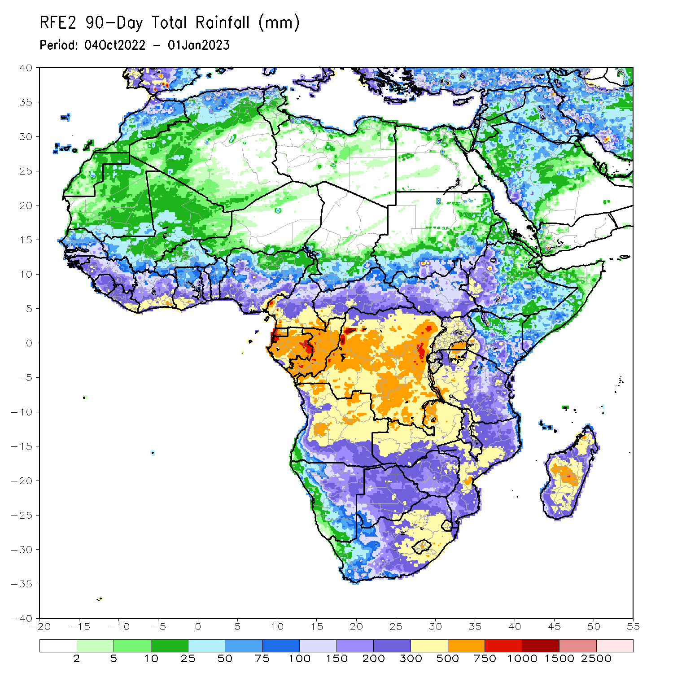
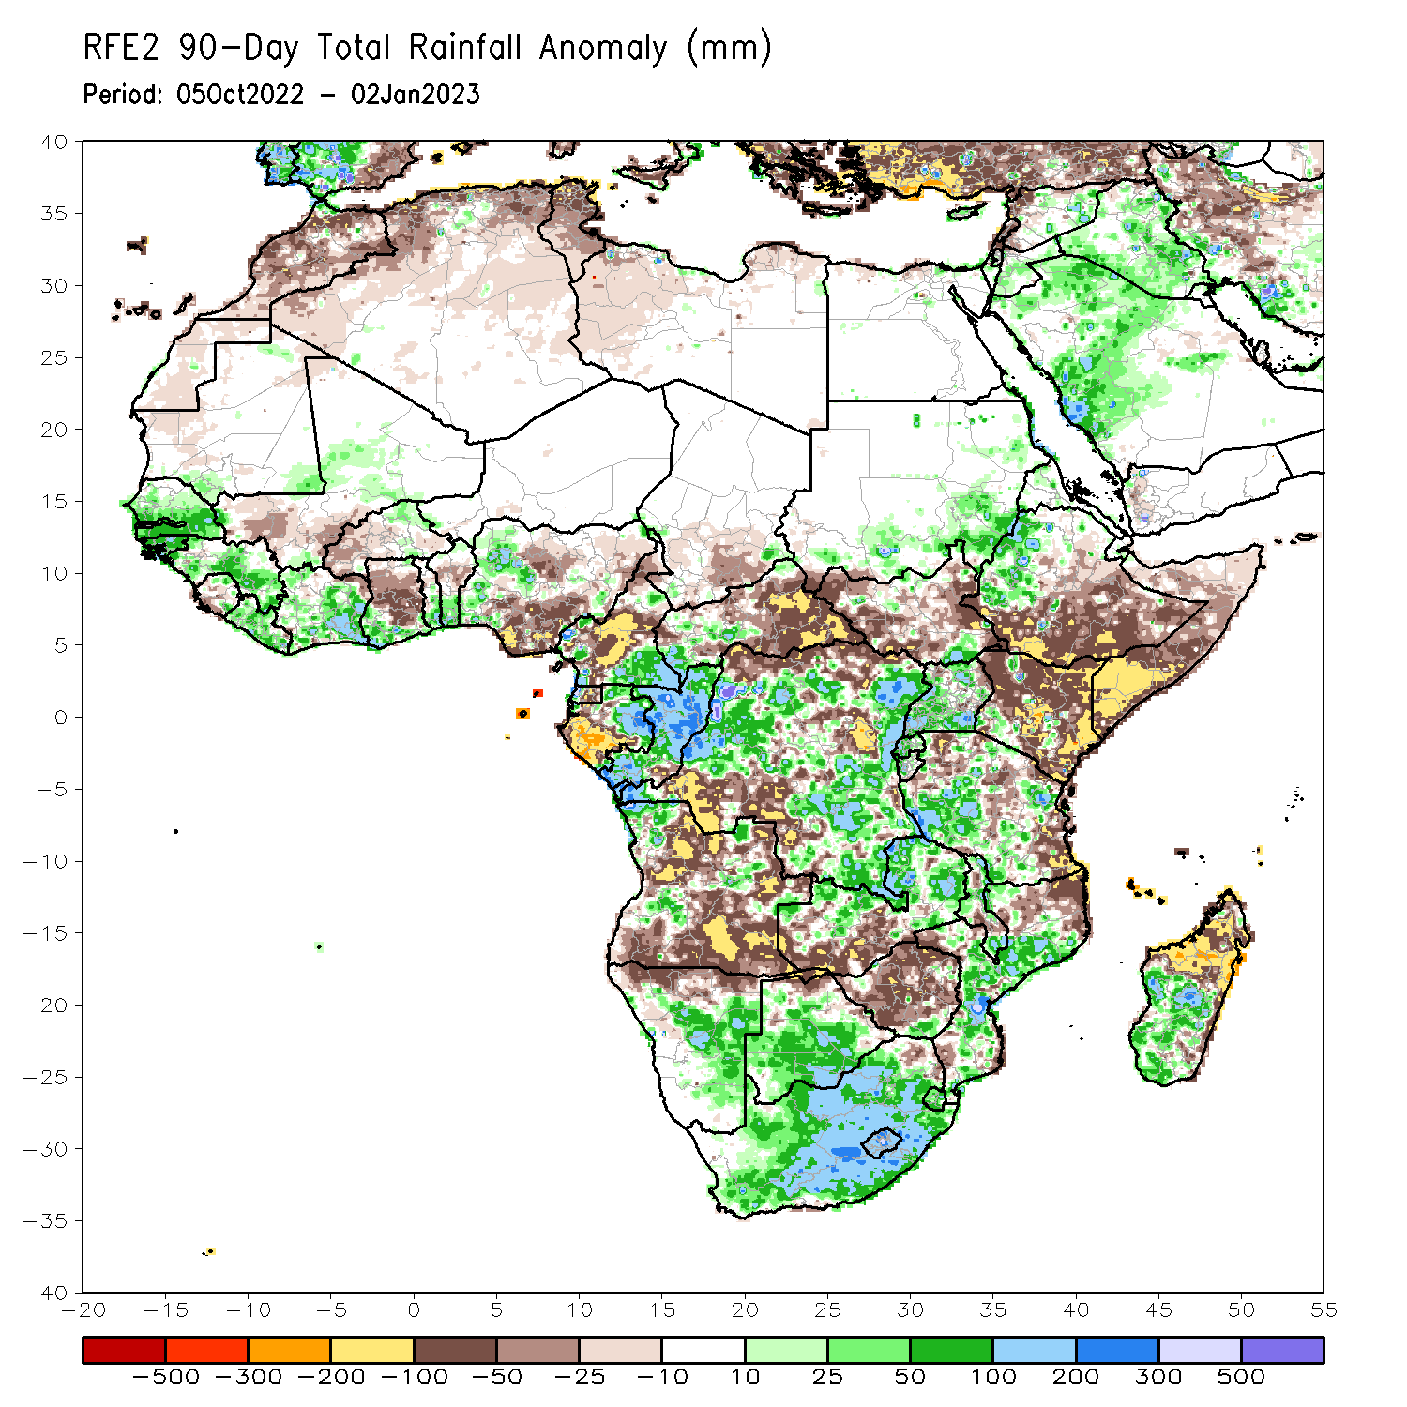
Rainfall Patterns: Last 90 Days
Over the past 90 days, in East Africa, above-average rainfall was observed over the southern and southeastern parts of Sudan, pockets of western and southeastern South Sudan, western Ethiopia, northern and western Eritrea, many parts of Uganda, Rwanda, western Burundi, and pockets of southwest and southern Tanzania. Rainfall was below-average over southern, central, and eastern Ethiopia, throughout much of Somalia, much of Kenya, northwest, southwest, central, and eastern South Sudan, and northern and eastern Tanzania. In southern Africa, above-average rainfall was observed over central and southern Botswana, South Africa, Lesotho, Eswatini, southern Zimbabwe, eastern and northern Zambia, central and southern Mozambique, northwest and portions of central Angola, central and eastern Namibia, and southwest and central parts of Madagascar. Below-average rainfall was observed over many parts of Angola, southwestern Zambia, northern Namibia, central and northern Zimbabwe, northeastern Mozambique, central Malawi, and northern Madagascar. In Central Africa, rainfall was above-average over southeast Cameroon, western CAR, eastern and northern Gabon, much of Congo, and parts of western and eastern DRC. Rainfall was below-average over northern and central Cameroon, southwestern Gabon, eastern CAR, southern Chad, and parts of northern, central and southwestern DRC. In West Africa, rainfall was above-average over southern Mauritania, southern and eastern Senegal, Gambia, Guinea-Bissau, Guinea, Liberia, Cote D’Ivoire, southern parts of Ghana and Togo, southern and northern Benin, northern Burkina Faso, central Mali, and western Nigeria. In contrast, below-average rainfall was observed over northern and western Mauritania, southwestern Mali, western and central Sierra Leone, central and northern Ghana, western Burkina Faso, and southern, central, and eastern Nigeria.
Notes:
‹#›

Slide 5
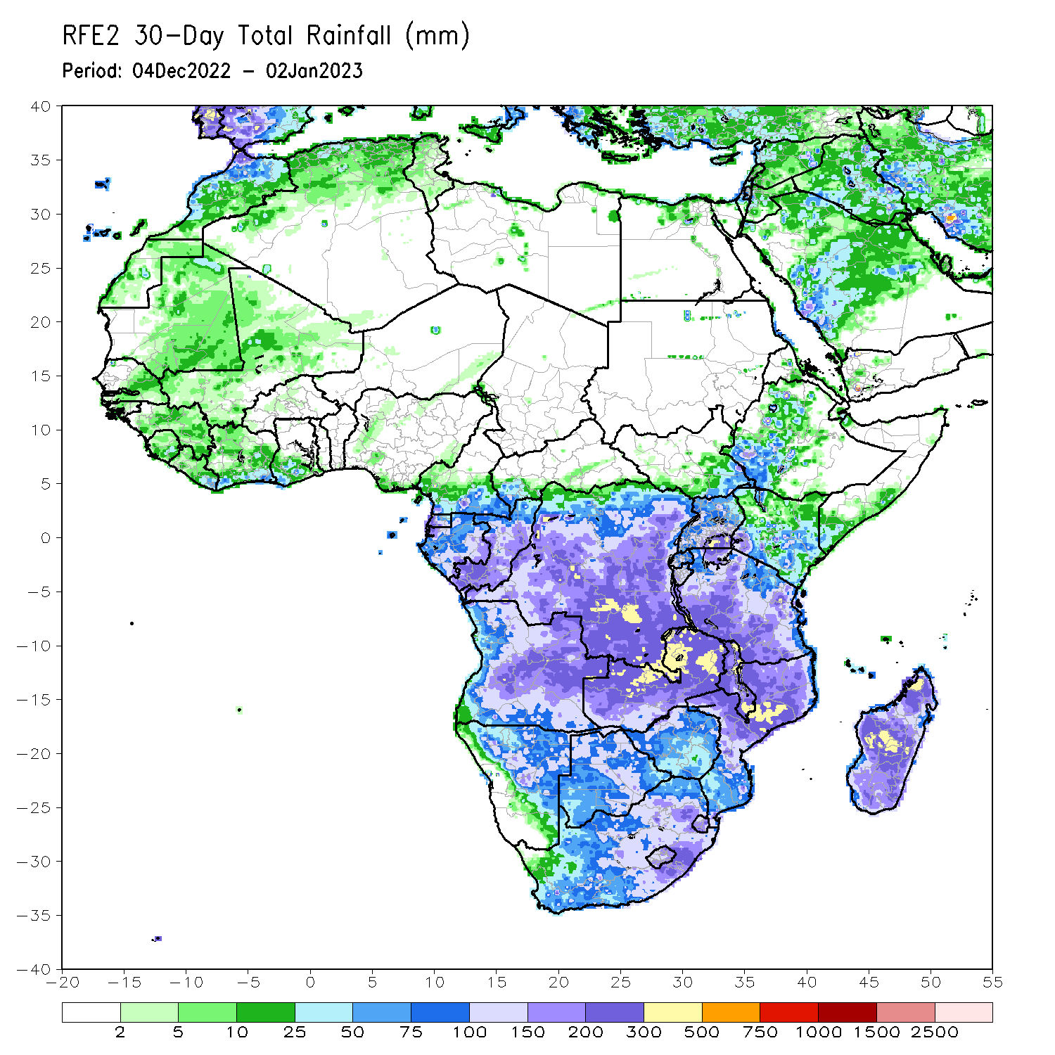
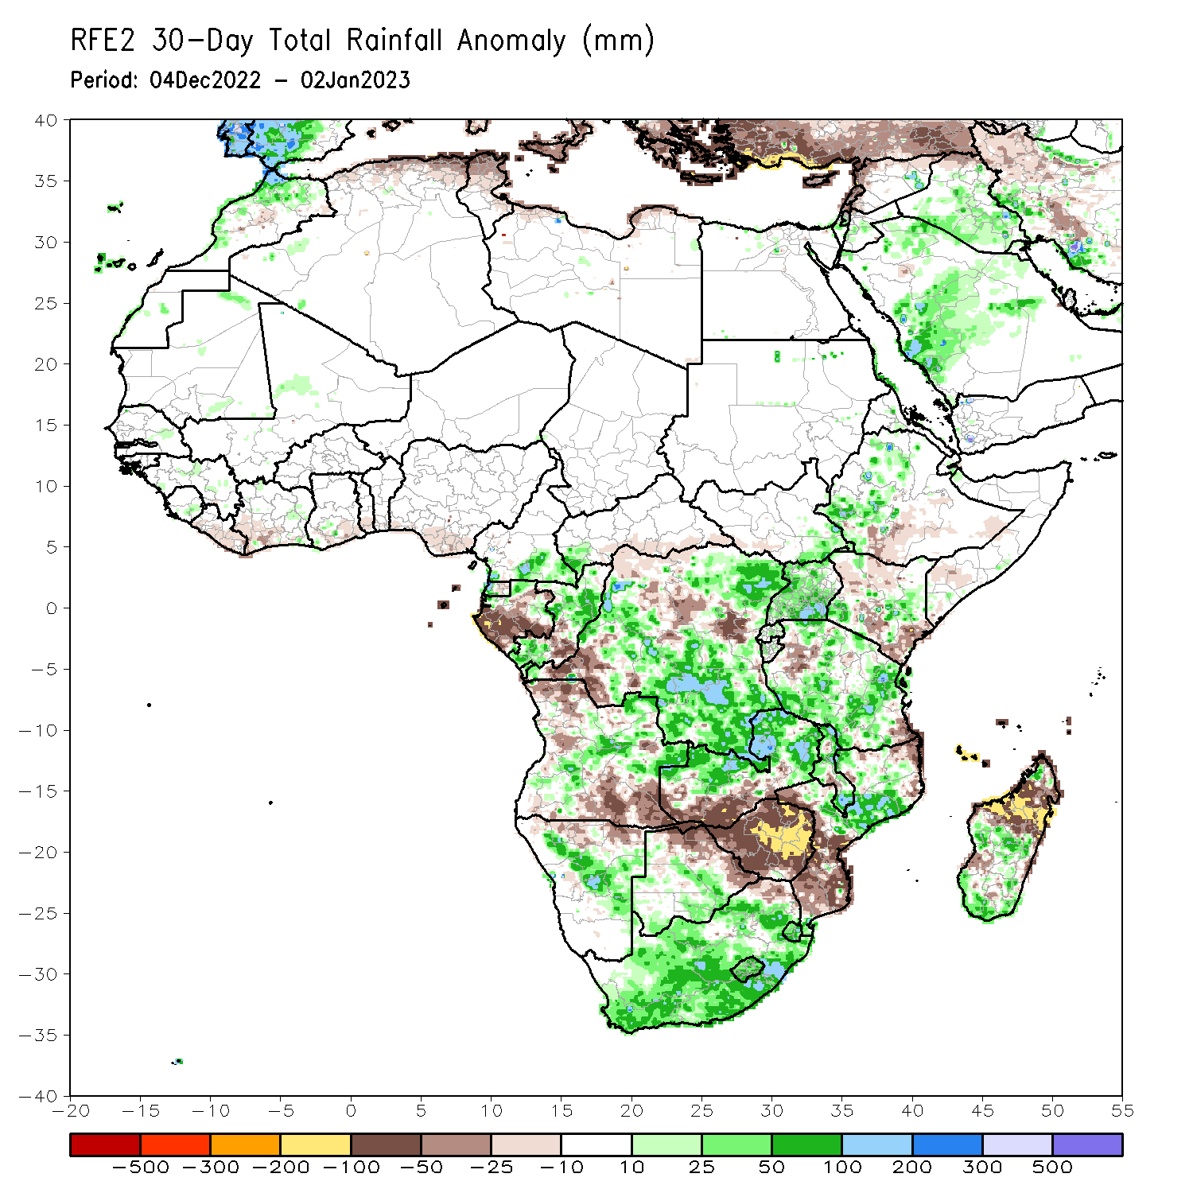
Rainfall Patterns: Last 30 Days
During the past 30 days, in East Africa, above-average rainfall was observed over Uganda, pockets of central Kenya, western Ethiopia, central and northern Tanzania, Rwanda, Burundi, and southeastern South Sudan. Rainfall was below-average over southern and southeastern Ethiopia, southern Somalia, northern and southern Kenya, and parts of northwestern and southeastern Tanzania. In Central Africa, rainfall was above-average over northeastern Gabon, western Equatorial Guinea, southeastern Cameroon, southwestern CAR, northern and southwestern Congo, and southern and eastern DRC. Rainfall was below-average over western and southern Gabon, eastern Equatorial Guinea, southern CAR, pockets of central Congo, and pockets of central and southwestern DRC. In West Africa, rainfall was above-average over pockets of Liberia, southern Sierra Leone, eastern Cote d’Ivoire, southwestern parts of Ghana, and pockets of central Mali. In contrast, below-average rainfall was observed over southern Nigeria, Liberia, southwestern Cote d’Ivoire, southeastern Ghana, and southern Togo. In southern Africa, above-average rainfall was observed over central and northeastern Angola, South Africa, Lesotho, Eswatini, central Namibia, central and northern Mozambique, northern and southern Malawi, northern and central Zambia, southern Botswana, and southern Madagascar. Below normal precipitation was observed over southern and northwestern Angola, northern Namibia, southwestern Zambia, central parts of Malawi, southern and northeastern Mozambique, most of Zimbabwe, northern and eastern Botswana, and northwest and central Madagascar.
Notes:
‹#›

Slide 6
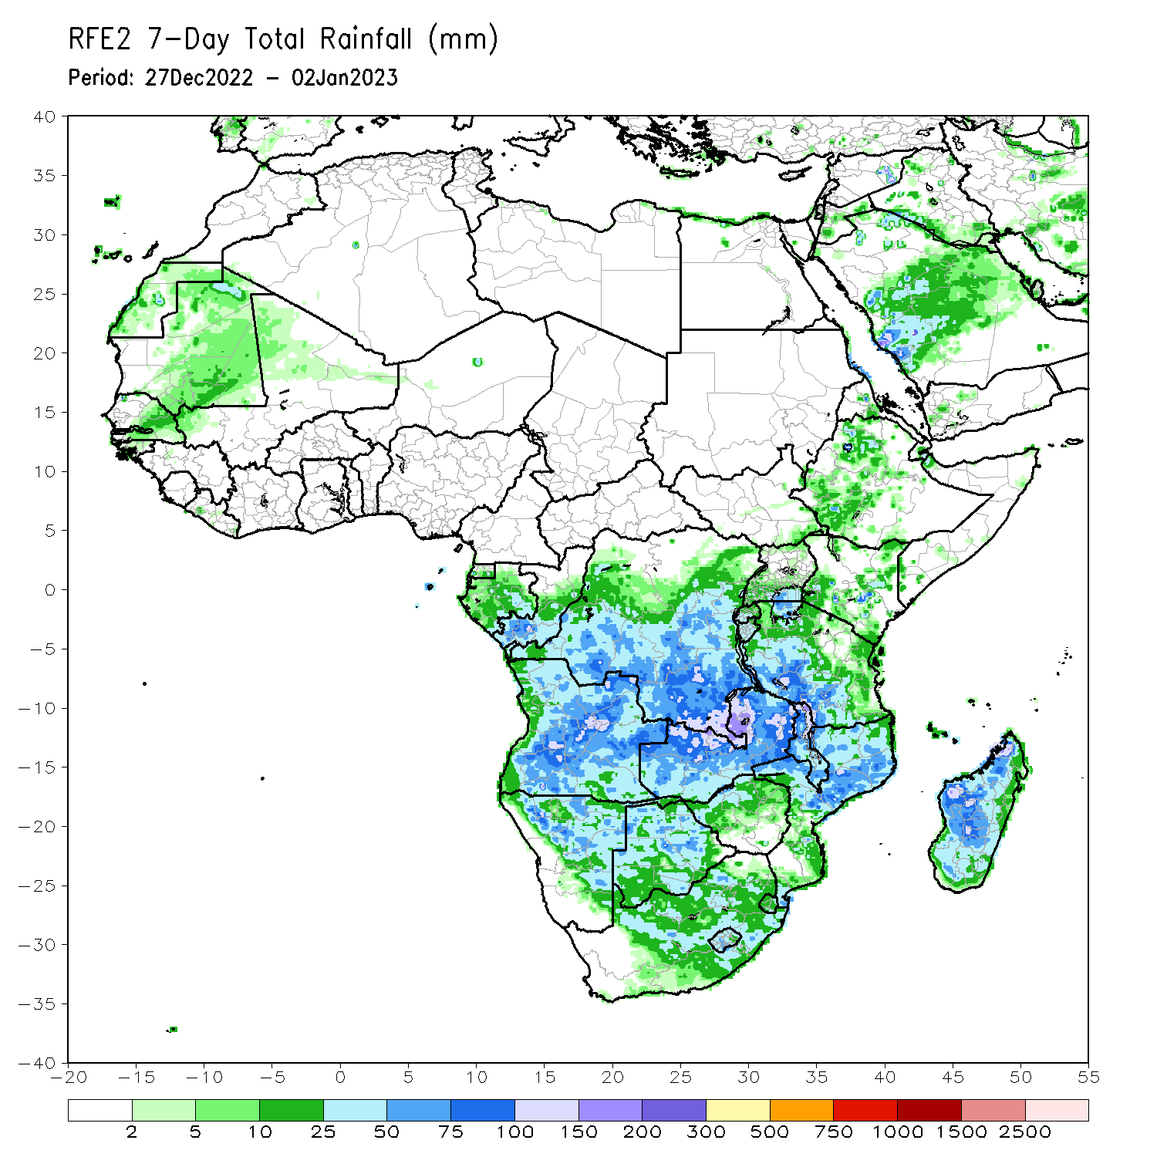
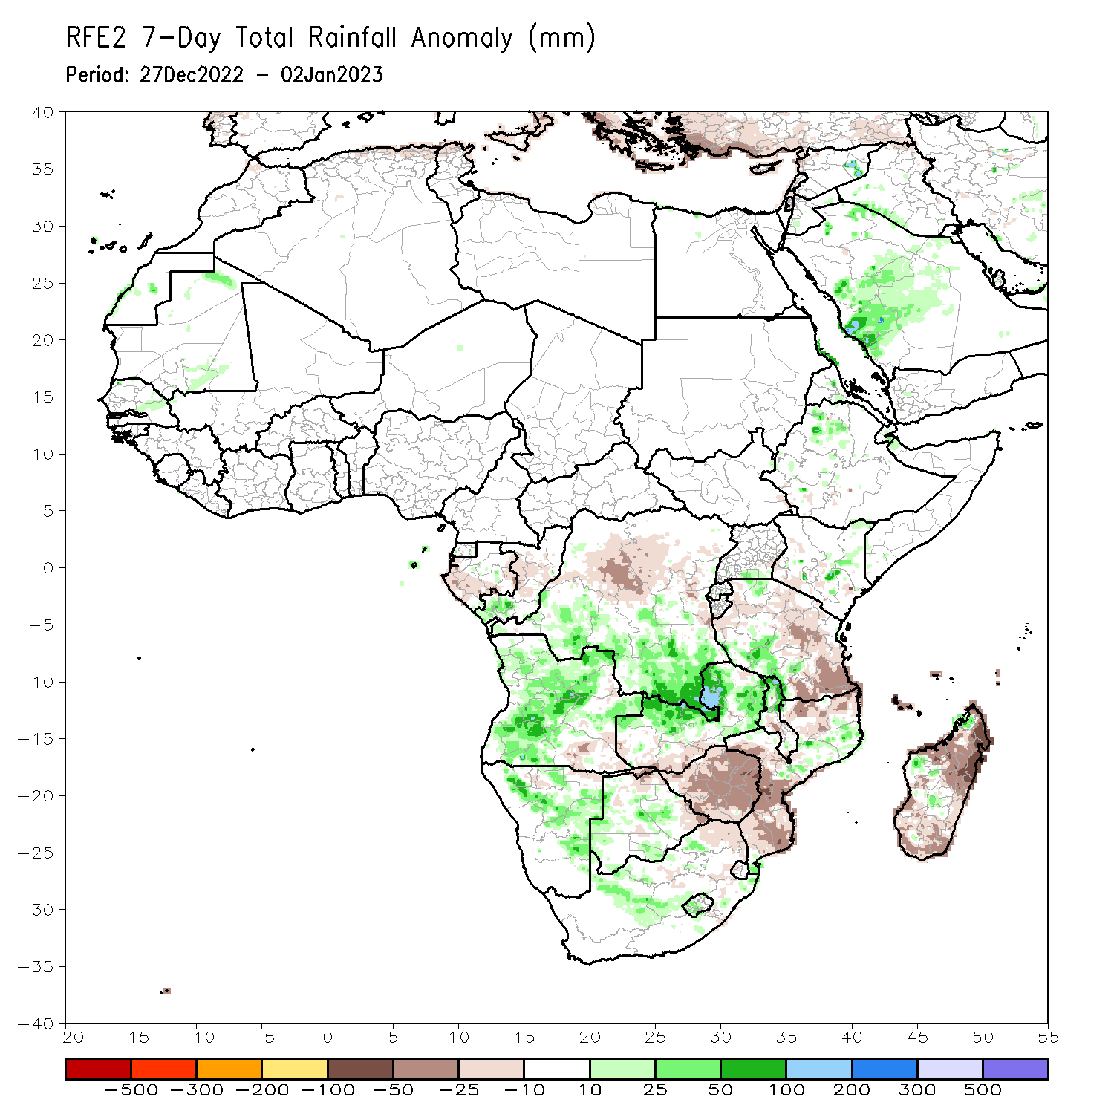
Rainfall Patterns: Last 7 Days
During the past 7 days, in East Africa, rainfall was above-average over pockets of northern and central Ethiopia, southwest Kenya, southern Uganda, and northern, southern, and eastern Tanzania. Below-average rainfall was observed over pockets of central Kenya and far southwestern Ethiopia. In Central Africa, rainfall was above-average over southwestern parts of Congo and southern DRC. Below-average rainfall was observed over southern and eastern Gabon and central DRC. In West Africa, above-average rainfall was observed over pockets of eastern Senegal. In southern Africa, rainfall was above-average over pockets of central, eastern, and northern Angola, central and eastern Namibia, western Lesotho, and central and eastern South Africa, northern Malawi, central Mozambique, northern and eastern Zambia, central and western Botswana, and pockets of western and northern Madagascar. In contrast, rainfall was below-average over southeastern Angola, northeast Namibia along the Caprivi Strip, southern Zambia, northern, northeastern and eastern Botswana, western, Zimbabwe, northeastern South Africa, southern and western Mozambique, and eastern and southwestern Madagascar.

Slide 7
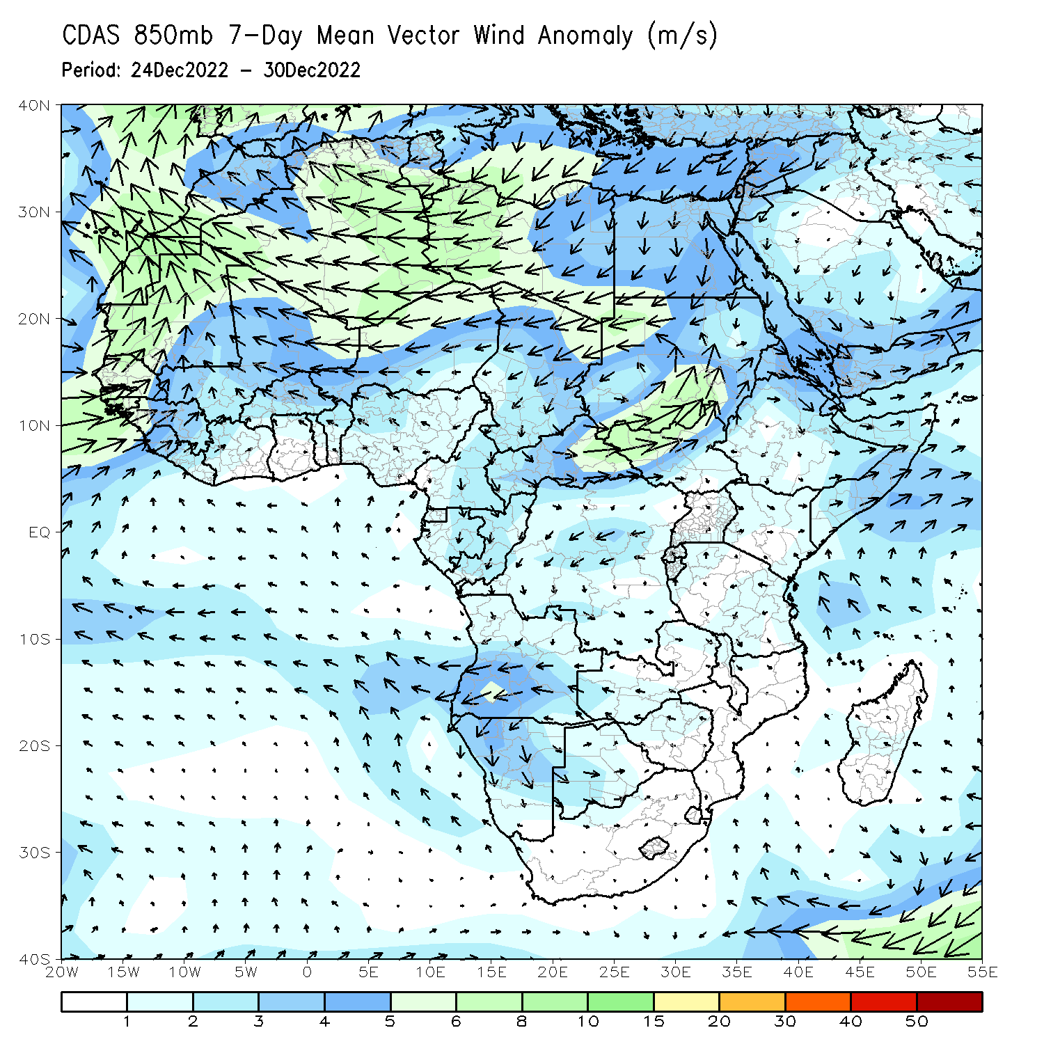
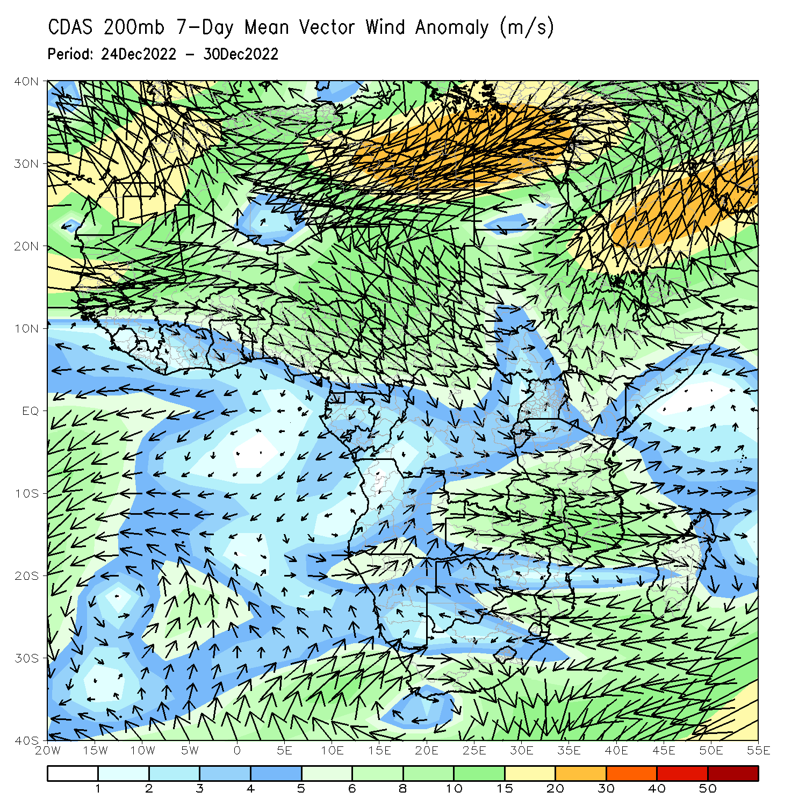
Atmospheric Circulation: Last 7 Days
At 850-hPa level (left panel), anomalous wind convergence may have contributed to the observed rainfall increases across Angola, Mozambique, and DRC. Anomalous upper level divergence at 200-hPa (right panel) in the same region complemented the lower level dynamics.

Slide 8
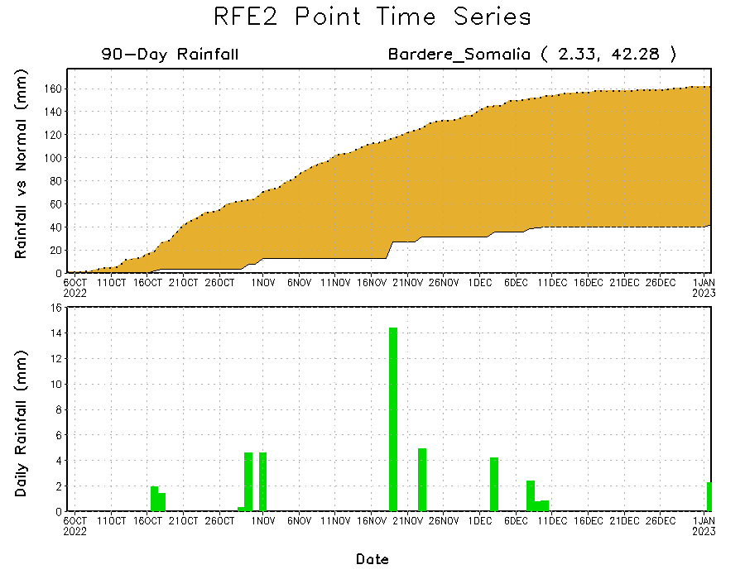
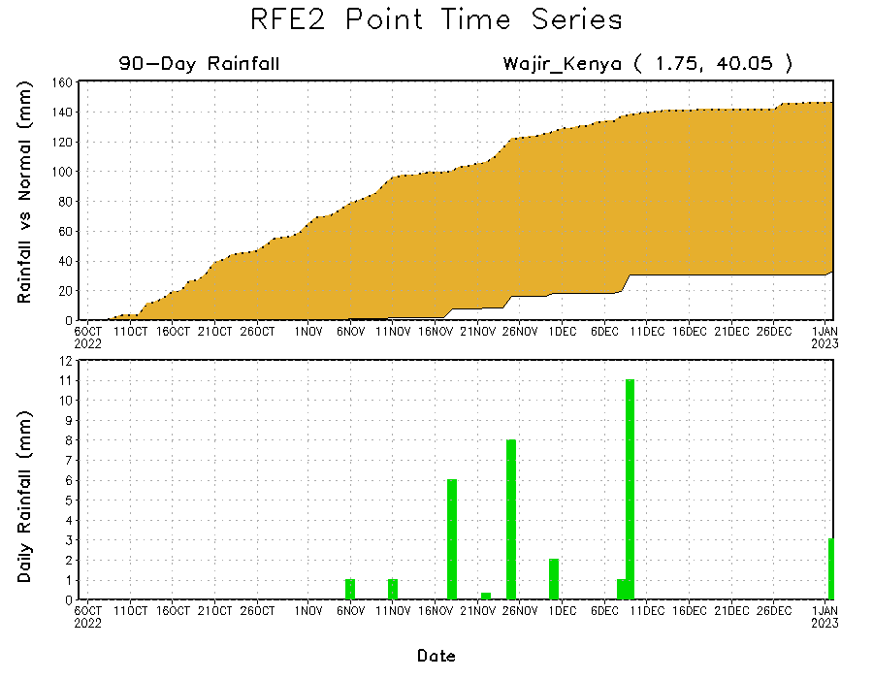
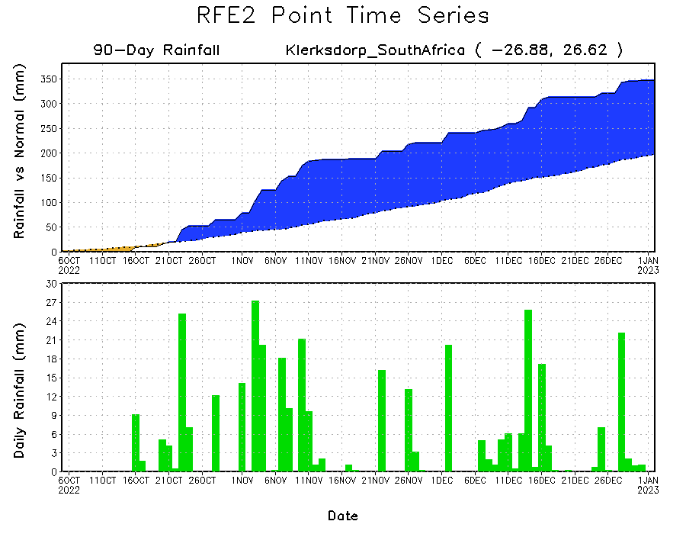
Rainfall Evolution
Daily evolution of rainfall over the last 90 days at selected locations shows continuing moisture surpluses over parts of South Africa (bottom left). Rainfall deficits continue over eastern Kenya (bottom right) and southern Somalia (top right).

Slide 9
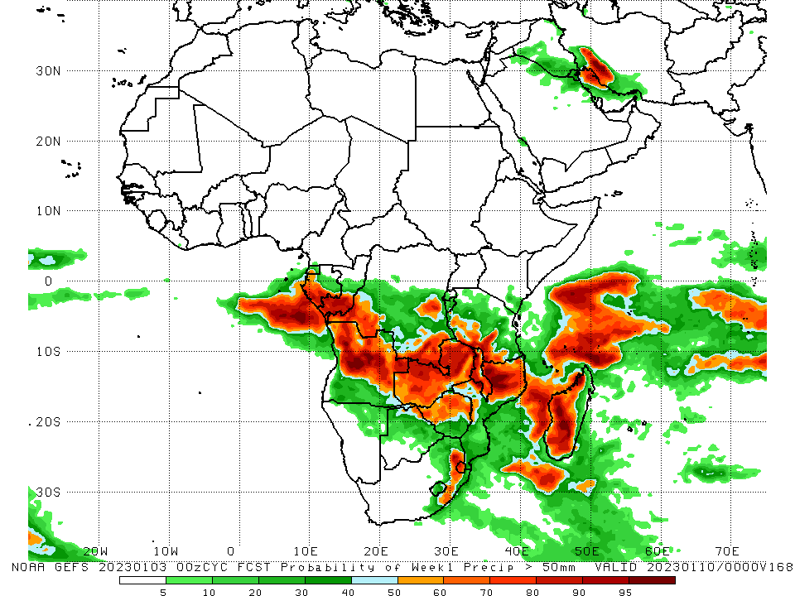
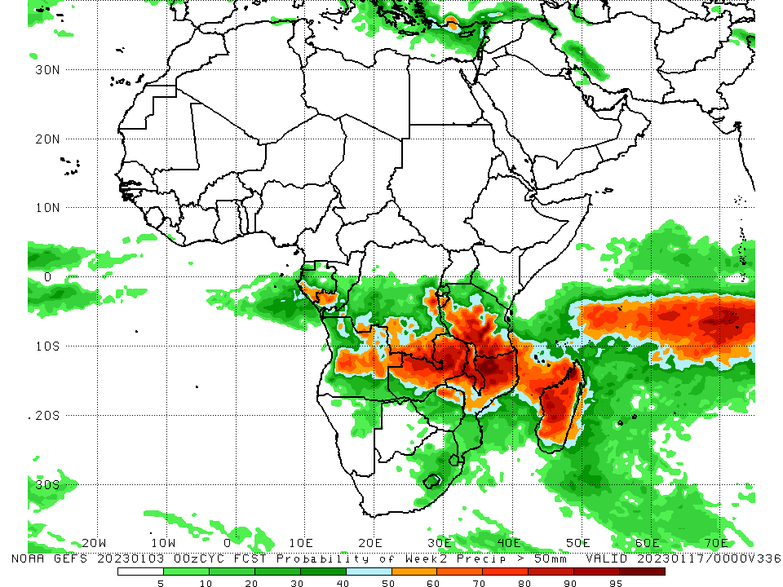
NCEP GEFS Model Forecasts Non-Bias Corrected Probability of precipitation exceedance
Week-1, Valid: 04 – 10 Jan 2023
Week-2, Valid: 11 – 17 Jan 2023
For week-1 (left panel), the NCEP GEFS forecasts indicate a moderate to high chance (over 70%) for rainfall to exceed 50 mm over southern parts of Gabon and Congo, southern and eastern DRC, southwestern Tanzania, Malawi, parts of northern Mozambique, northern and central Angola, central and northern Zambia, parts of northern Zimbabwe, western Madagascar, eastern South Africa, and Eswatini. For week-2 (right panel), the NCEP GEFS forecasts indicate a moderate to high chance (over 70%) for rainfall to exceed 50 mm over southern parts of Congo, southeastern and parts of eastern DRC, portions of central Angola, northern and central Zambia, northern parts of Zimbabwe, northern Mozambique, central and southern Tanzania, Malawi, and central and western parts of Madagascar.
Notes:
‹#›

Slide 10
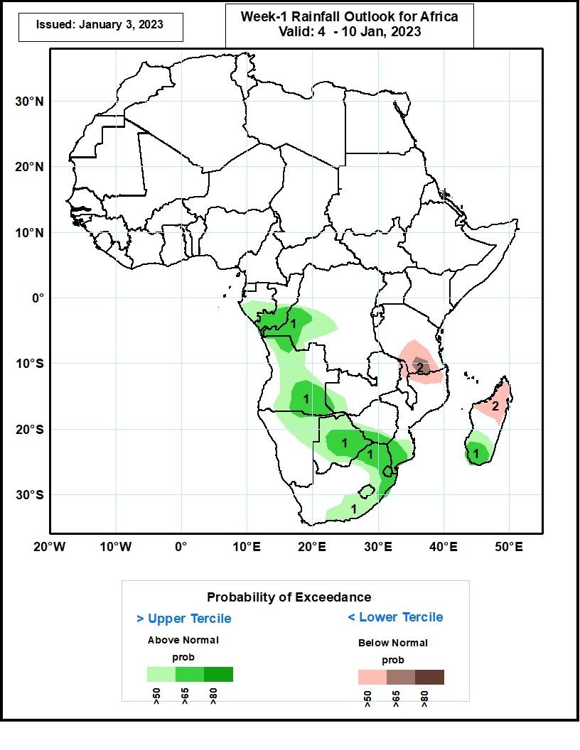
Week-1 Precipitation Outlooks
04 – 10 Jan, 2023
The forecasts suggest above 50% chance for weekly rainfall to be above-normal (above the upper tercile) over southern Congo, southern Gabon, western parts of DRC, northwestern, central, and southern parts of Angola, southwestern parts of Zambia, northeastern parts of Namibia, most of Botswana, southern Zimbabwe, southern and eastern parts of South Africa, Lesotho, Eswatini, and southern Madagascar. In particular, there is above 65% chance for rainfall to be above-normal over southern Congo, western DRC, northwestern and southeastern Angola, far western Zambia, central and eastern Botswana, southern Zimbabwe, eastern South Africa, Eswatini, southern Mozambique, and southern Madagascar.
The consolidated probabilistic forecasts suggest above 50% chance for weekly total rainfall to be below-normal (below the lower tercile) over southern Tanzania, northern Malawi, northern Mozambique, and northern Madagascar. In particular, there is above 65% chance for rainfall to be below-normal over southern Tanzania.
Notes:
‹#›

Slide 11
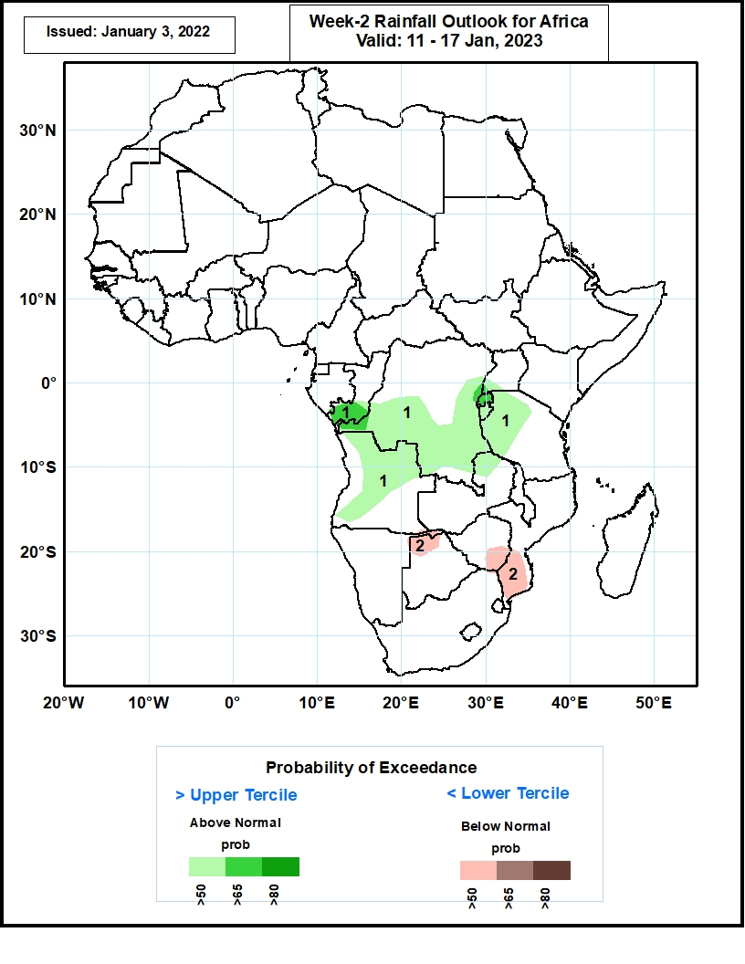
Week-2 Precipitation Outlooks
11 – 17 Jan, 2023
The forecasts suggest above 50% chance for weekly rainfall to be above-normal (above the upper tercile) over much of southern Congo, central and southern DRC, southwestern Uganda, Rwanda, Burundi, western Tanzania, northeastern Zambia, and northern and central Angola. In particular, there is above 65% chance for rainfall to be above-normal over southern Congo, Rwanda, and the area that borders Rwanda, including far southwestern Uganda and east-central DRC.
The consolidated probabilistic forecasts suggest above 50% chance for weekly total rainfall to be below-normal (below the lower tercile) over northern Botswana, the Caprivi Strip of Namibia, southern Zimbabwe, and southern Mozambique.
Notes:
‹#›

Slide 12
Summary
During the past 30 days, in East Africa, above-average rainfall was observed over Uganda, pockets of central Kenya, western Ethiopia, central and northern Tanzania, Rwanda, Burundi, and southeastern South Sudan. Rainfall was below-average over southern and southeastern Ethiopia, southern Somalia, northern and southern Kenya, and parts of northwestern and southeastern Tanzania. In Central Africa, rainfall was above-average over northeastern Gabon, western Equatorial Guinea, southeastern Cameroon, southwestern CAR, northern and southwestern Congo, and southern and eastern DRC. Rainfall was below-average over western and southern Gabon, eastern Equatorial Guinea, southern CAR, pockets of central Congo, and pockets of central and southwestern DRC. In West Africa, rainfall was above-average over pockets of Liberia, southern Sierra Leone, eastern Cote d’Ivoire, southwestern parts of Ghana, and pockets of central Mali. In contrast, below-average rainfall was observed over southern Nigeria, Liberia, southwestern Cote d’Ivoire, southeastern Ghana, and southern Togo. In southern Africa, above-average rainfall was observed over central and northeastern Angola, South Africa, Lesotho, Eswatini, central Namibia, central and northern Mozambique, northern and southern Malawi, northern and central Zambia, southern Botswana, and southern Madagascar. Below normal precipitation was observed over southern and northwestern Angola, northern Namibia, southwestern Zambia, central parts of Malawi, southern and northeastern Mozambique, most of Zimbabwe, northern and eastern Botswana, and northwest and central Madagascar.
During the past 7 days, in East Africa, rainfall was above-average over pockets of northern and central Ethiopia, southwest Kenya, southern Uganda, and northern, southern, and eastern Tanzania. Below-average rainfall was observed over pockets of central Kenya and far southwestern Ethiopia. In Central Africa, rainfall was above-average over southwestern parts of Congo and southern DRC. Below-average rainfall was observed over southern and eastern Gabon and central DRC. In West Africa, above-average rainfall was observed over pockets of eastern Senegal. In southern Africa, rainfall was above-average over pockets of central, eastern, and northern Angola, central and eastern Namibia, western Lesotho, and central and eastern South Africa, northern Malawi, central Mozambique, northern and eastern Zambia, central and western Botswana, and pockets of western and northern Madagascar. In contrast, rainfall was below-average over southeastern Angola, northeast Namibia along the Caprivi Strip, southern Zambia, northern, northeastern and eastern Botswana, western, Zimbabwe, northeastern South Africa, southern and western Mozambique, and eastern and southwestern Madagascar.
Week-1 outlook calls for above-average rainfall over central and southern Congo, southern and western Gabon, Equatorial Guinea, central and southeastern DRC, western Tanzania, Zambia, Zimbabwe, Malawi, northern and southern Mozambique, northern, central, and southeastern Angola, eastern Botswana, northeastern Namibia, eastern South Africa, Eswatini, and southern Madagascar. In contrast, below-average rainfall is expected over northeastern and southeastern Tanzania, southeast Angola, portions of central Namibia, portions of central South Africa, Lesotho, and northern Madagascar. Week-2 outlook suggests an increased chance for above-average rainfall over southern and western Gabon, southern Congo, western and portions of eastern DRC, Rwanda, Burundi, northern Angola, northern and central Mozambique, central Zambia, Malawi, Tanzania, portions of central and southern Madagascar, and southern Kenya, while below-average rainfall is likely over northern and eastern Madagascar, northeastern Namibia, northern Botswana, western and southern Zimbabwe, northern South Africa, southeastern Angola, southwestern Zambia, and along the Gulf of Guinea between Liberia and Nigeria.

