Slide 1
The African Monsoon Recent Evolution and Current Status Include Week-1 and Week-2 Outlooks
Update prepared by
12 December 2022
For more information, visit:
http://www.cpc.ncep.noaa.gov/products/Global_Monsoons/African_Monsoons/precip_monitoring.shtml

Slide 2
Outline
Highlights
Recent Evolution and Current Conditions
NCEP GEFS Forecasts
Summary

Slide 3
Highlights: Last 7 Days
During the past 7 days, in East Africa, rainfall was above-average over pockets of southwest, central and eastern Kenya, southwest Ethiopia, much of Uganda, and southeast South Sudan. Below-average rainfall was observed over pockets of central Ethiopia and southwest Somalia, and much of Tanzania. In Central Africa, rainfall was above-average over northern Congo, southeast Cameroon, and pockets of central, northeast and southeast DRC. Below-average rainfall was observed over Gabon, Equatorial Guinea, central Congo, and southwest and central DRC. In West Africa, above-average rainfall was observed over eastern parts of Sierra Leone and Guinea, and central Cote D’Ivoire. In southern Africa, rainfall was above-average over pockets of southeast Angola, western Zambia, northwest Botswana, pockets of central Mozambique, southern Malawi and western Madagascar, and western and eastern South Africa. In contrast, rainfall was below-average over western, southern, northern and northeast Angola, northern Namibia, southern and eastern Zambia, Zimbabwe, southern Mozambique, pockets of central South Africa, and northwest and southeast parts of Madagascar.
Week-1 outlook calls for an increased chance for above-average rainfall over Equatorial Guinea, Gabon, Congo, much of DRC, southern Cameroon, central and southern Uganda, Rwanda, Burundi, western Tanzania, northern, eastern and southern Angola, northeast Namibia, western and southern Botswana, western, northern, central, and eastern South Africa, Lesotho, and pockets of central and southeast Madagascar. In contrast, there is an increased chance for below-average rainfall over Zambia, western and southern Zimbabwe, northeast Botswana, Malawi, western Angola, Kenya, southern, central, eastern and northern parts of Tanzania, Mozambique, southern Somalia, northern Madagascar, and Gulf of Guinea coast. Week-2 outlook suggests an increased chance for above-average rainfall over Tanzania, Rwanda, Burundi, southern Kenya, many parts of DRC, Zambia, Malawi, northern Mozambique, southeast Angola, and western and southern Madagascar, while below-average rainfall is likely over the western, northern and southwest Angola, northern Namibia, much of Botswana and Zimbabwe, central and northern South Africa, Lesotho, Eswatini, southern Mozambique, southern Gabon and Congo.

Slide 4
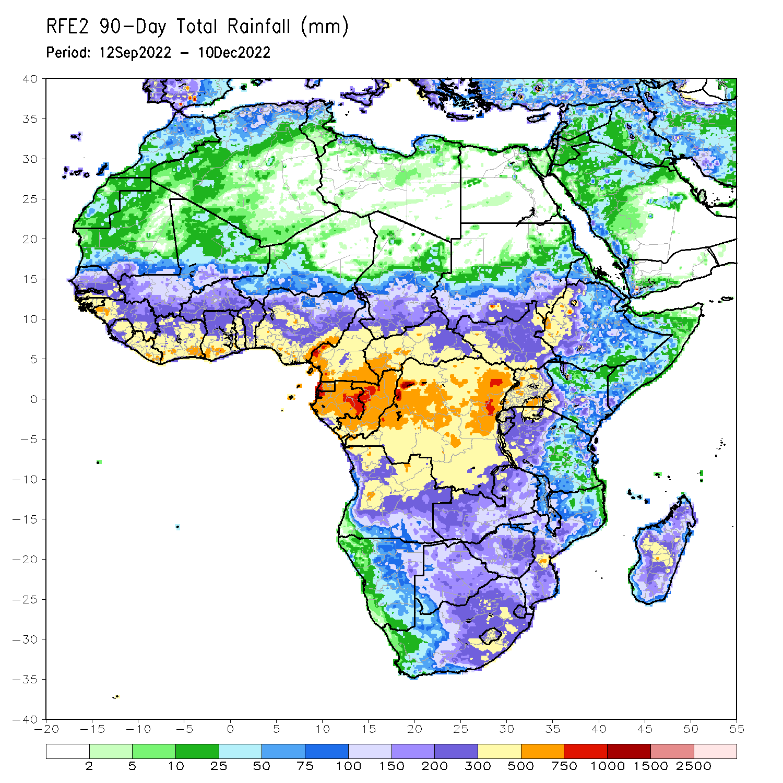
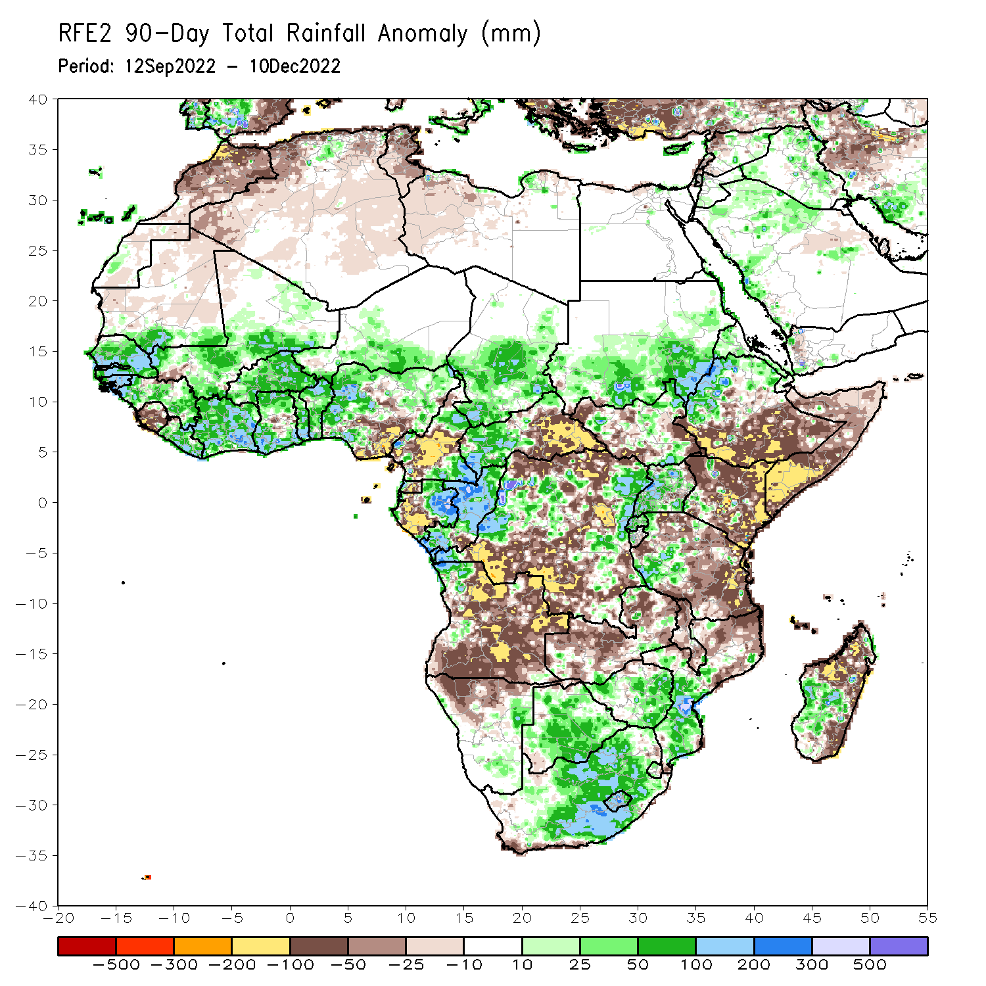
Rainfall Patterns: Last 90 Days
Over the past 90 days, in East Africa, above-average rainfall was observed over the southern and central parts of Sudan, pockets of central, northeast and southeast South Sudan, western and northern Ethiopia, Eritrea, Djibouti, much of Uganda, Rwanda, and southwest Tanzania. Rainfall was below-average over southern and eastern Ethiopia, throughout much of Somalia, much of Kenya, and central, southern, northeast and eastern Tanzania. In southern Africa, above-average rainfall was observed over Zimbabwe, Botswana, eastern Namibia, northwest Angola, western, central and eastern South Africa, Lesotho, southern Mozambique, and central and southwest Madagascar. Below-average rainfall was observed over many parts of Angola, northern Namibia, western, central and northern Zambia, southeast South Africa, northern Mozambique, Malawi, and northern and the far eastern Madagascar. In Central Africa, rainfall was above-average over southeast and northeast Cameroon, southern and central Chad, western CAR, eastern Gabon, much of Congo, and parts of western and eastern DRC. Rainfall was below-average over western Cameroon, western Gabon, Equatorial Guinea, eastern CAR, and portions of northern, central and southern DRC. In West Africa, rainfall was above-average over southern Mauritania, Senegal, Gambia, Guinea-Bissau, Guinea, Liberia, Cote D’Ivoire, portions of Ghana, Togo, Benin, Burkina Faso, eastern and southern portions of Mali, southern Niger, and western and northern Nigeria. In contrast, below-average rainfall was observed over northern Mauritania, Sierra Leone, central Ghana, and parts of central and southeastern Nigeria.
Notes:
4

Slide 5
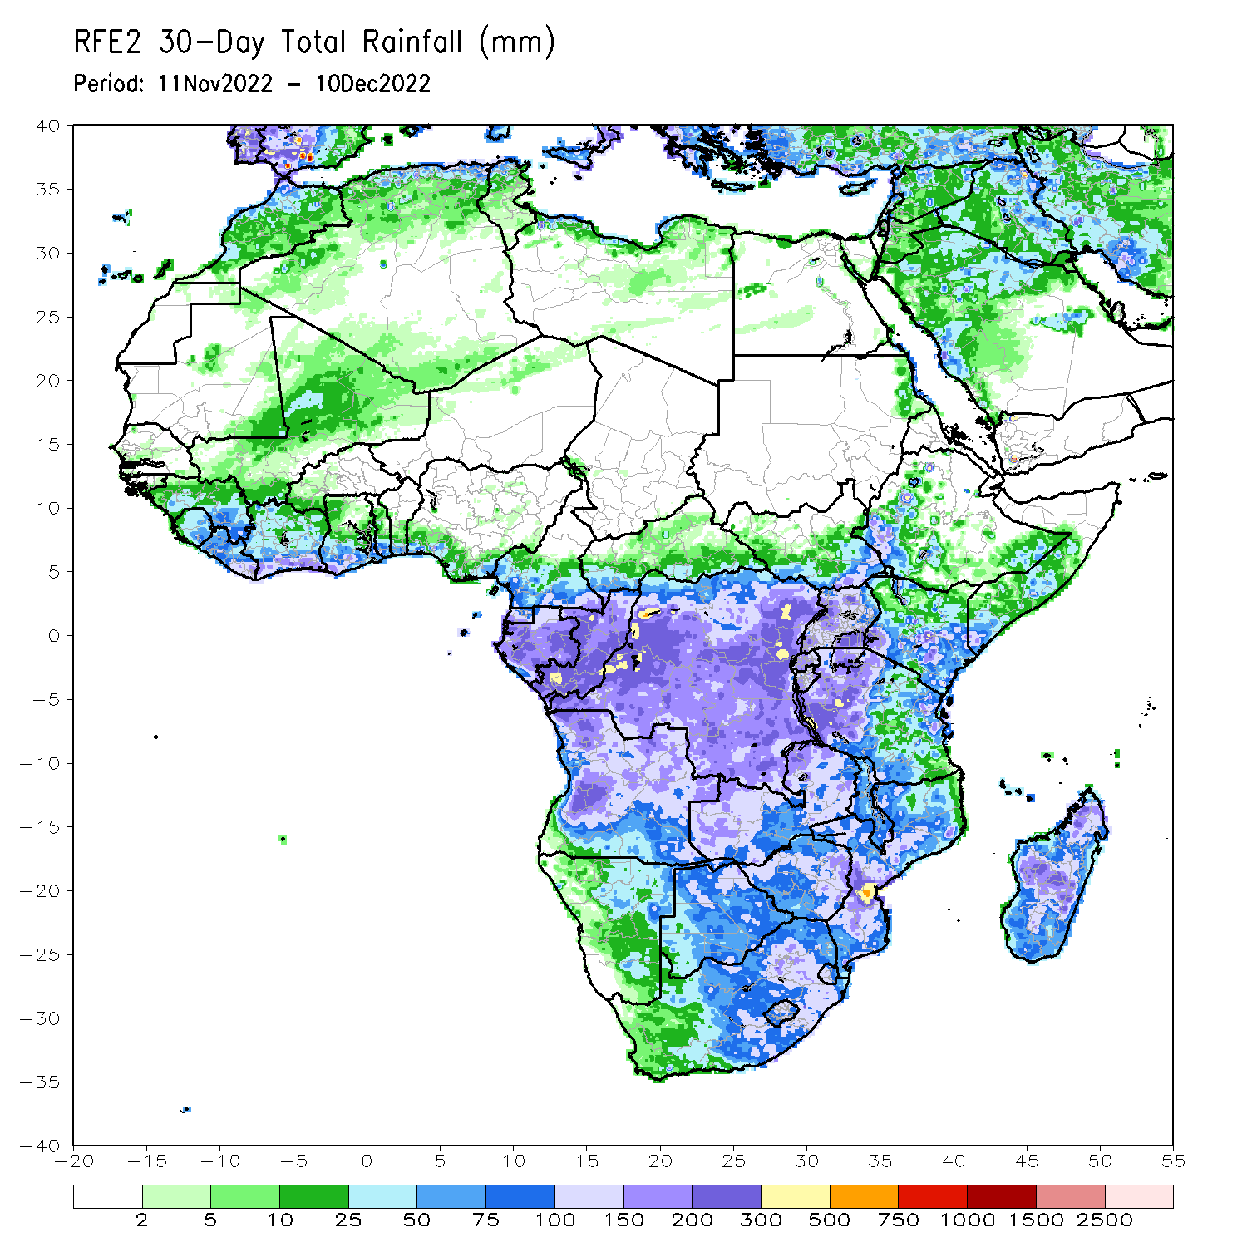
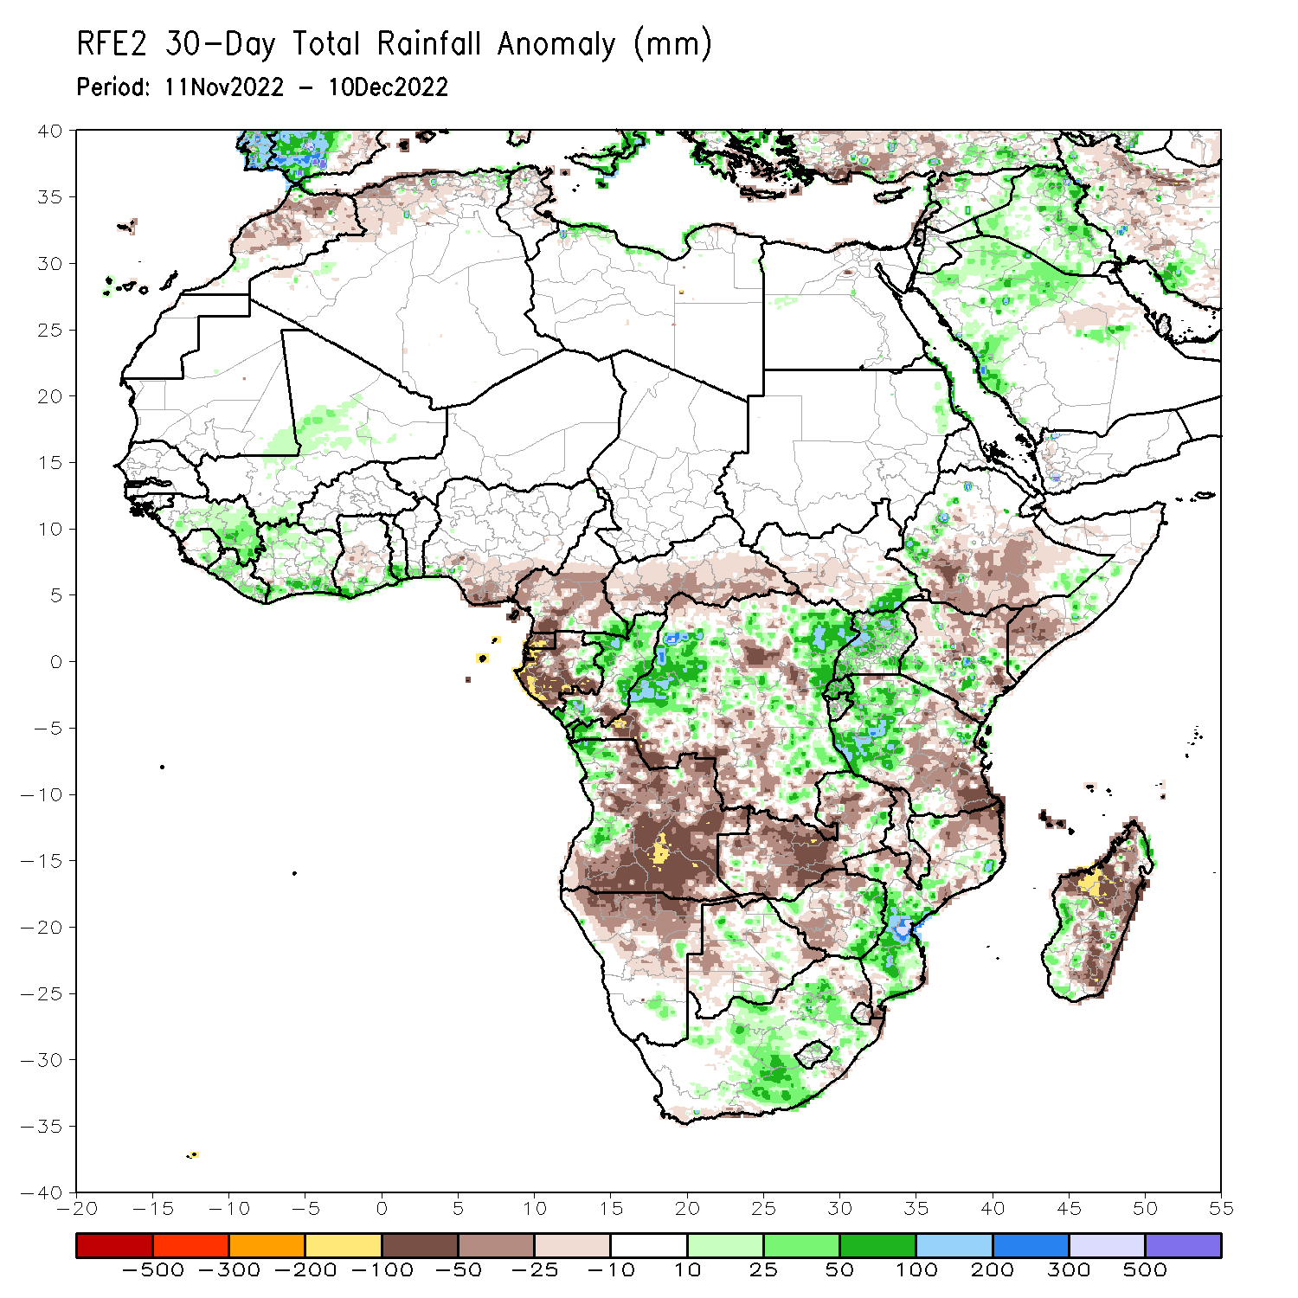
Rainfall Patterns: Last 30 Days
During the past 30 days, in East Africa, above-average rainfall was observed over Uganda, pockets of southwest and central Kenya, central Somalia and southwest Ethiopia, western Tanzania, Rwanda, Burundi, and southeast South Sudan. Rainfall was below-average over southwest and southern South Sudan, central and southern Ethiopia, southern Somalia, northern and southeast Kenya, and parts of central and southeast Tanzania. In Central Africa, rainfall was above-average over northeast Gabon, many parts of Congo, and parts of western and eastern DRC. Rainfall was below-average over western, southern, and northwest Gabon, Equatorial Guinea, western and central Cameroon, CAR, and parts of central and southwestern DRC. In West Africa, rainfall was above-average over central and eastern Senegal, Liberia, Cote d’Ivoire, southern parts of Ghana, Togo and Benin, eastern Sierra Leone, and pockets of central Mali. In contrast, below-average rainfall was observed over much southern Nigeria and central Ghana. In southern Africa, above-average rainfall was observed over northwestern Angola, southeast Namibia, pockets of central and eastern Botswana, eastern Zimbabwe, western, central and eastern South Africa, Lesotho, southern Mozambique, and southwest Madagascar. Below normal precipitation was observed over many parts of Angola, northern Namibia, much of Zambia, Malawi, northern Mozambique and northern, central and eastern Madagascar.
Notes:
5

Slide 6
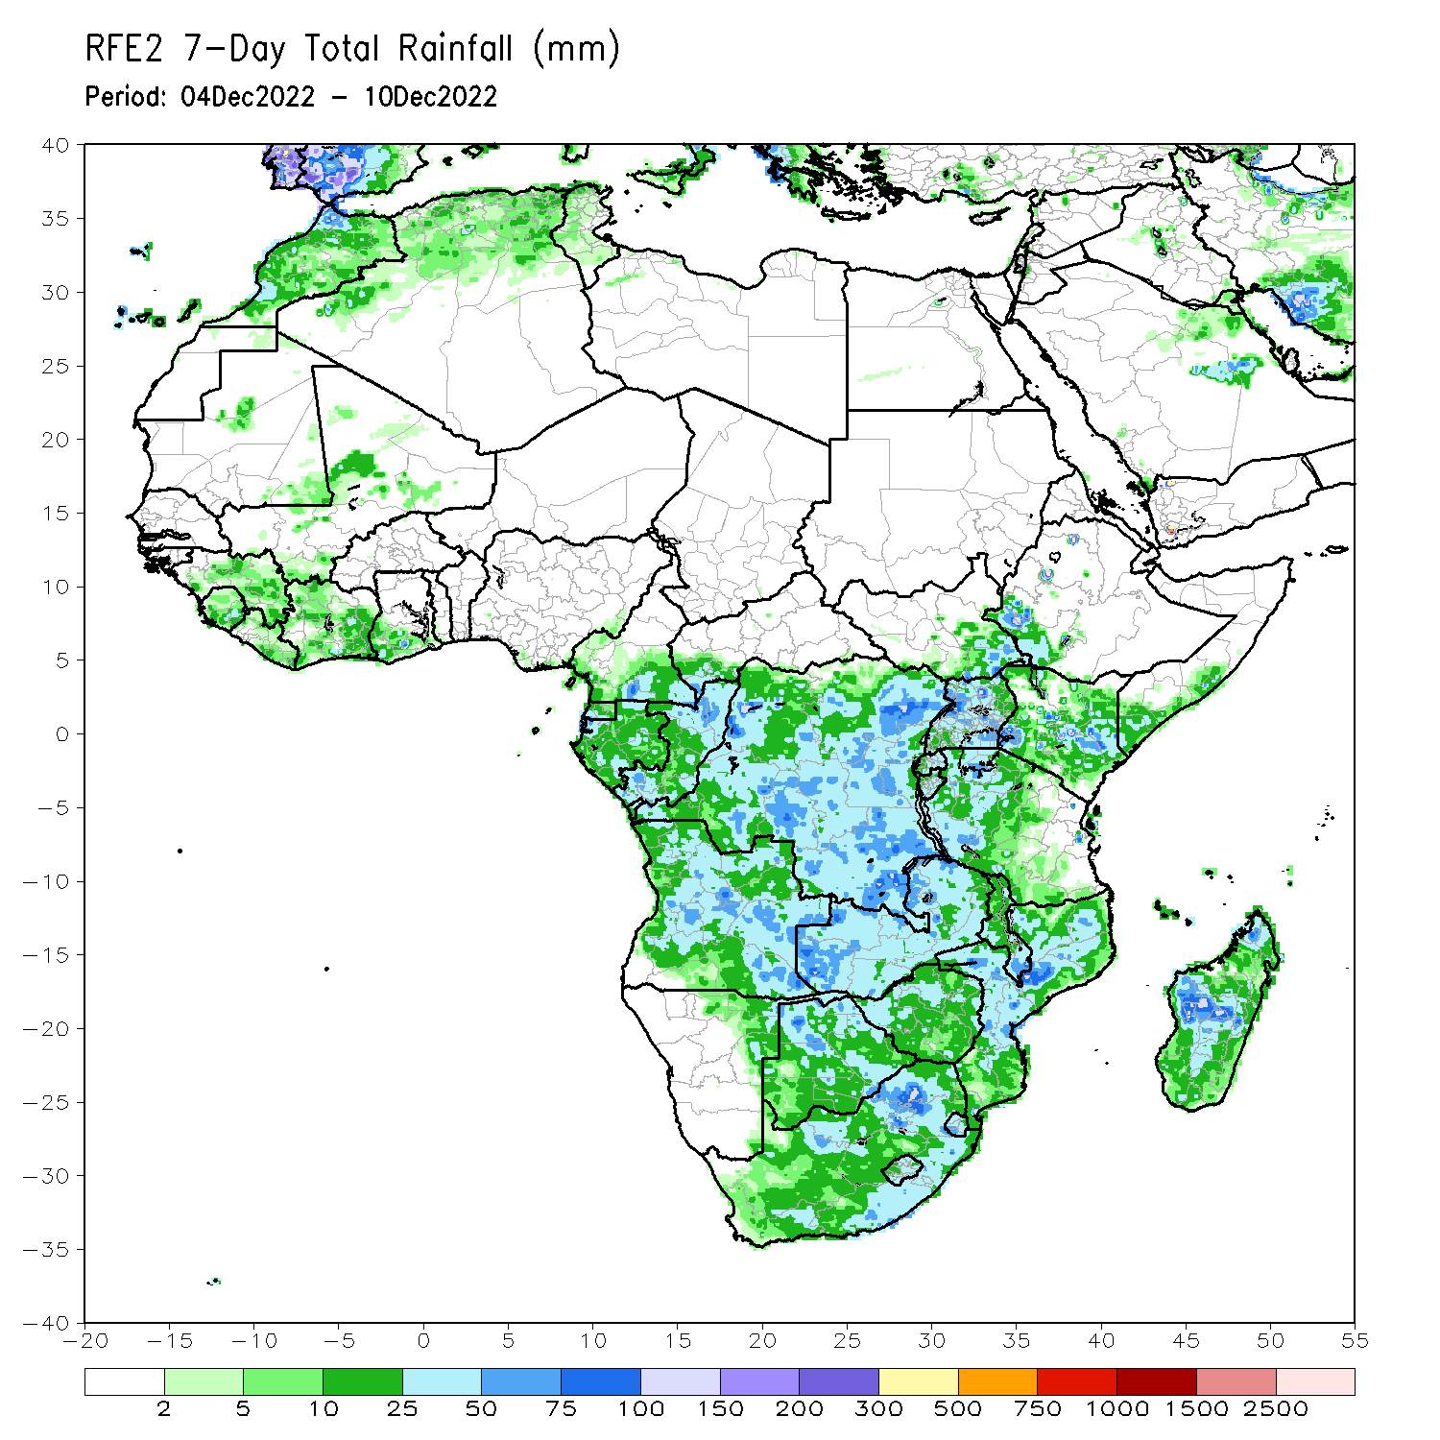
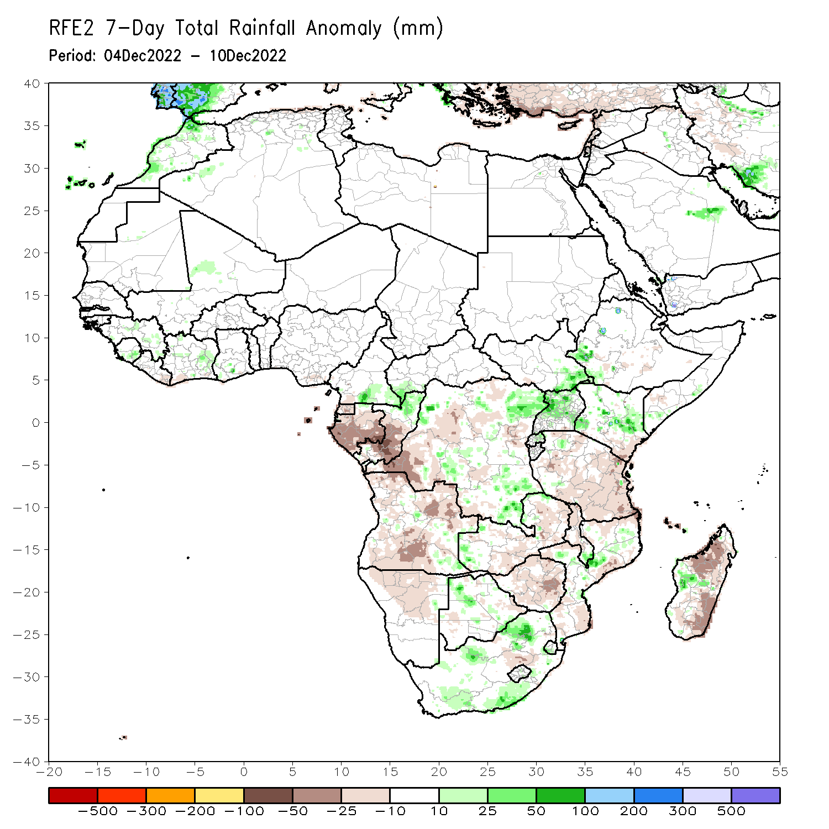
Rainfall Patterns: Last 7 Days
During the past 7 days, in East Africa, rainfall was above-average over pockets of southwest, central and eastern Kenya, southwest Ethiopia, much of Uganda, and southeast South Sudan. Below-average rainfall was observed over pockets of central Ethiopia and southwest Somalia, and much of Tanzania. In Central Africa, rainfall was above-average over northern Congo, southeast Cameroon, and pockets of central, northeast and southeast DRC. Below-average rainfall was observed over Gabon, Equatorial Guinea, central Congo, and southwest and central DRC. In West Africa, above-average rainfall was observed over eastern parts of Sierra Leone and Guinea, and central Cote D’Ivoire. In southern Africa, rainfall was above-average over pockets of southeast Angola, western Zambia, northwest Botswana, pockets of central Mozambique, southern Malawi and western Madagascar, and western and eastern South Africa. In contrast, rainfall was below-average over western, southern, northern and northeast Angola, northern Namibia, southern and eastern Zambia, Zimbabwe, southern Mozambique, pockets of central South Africa, and northwest and southeast parts of Madagascar.

Slide 7
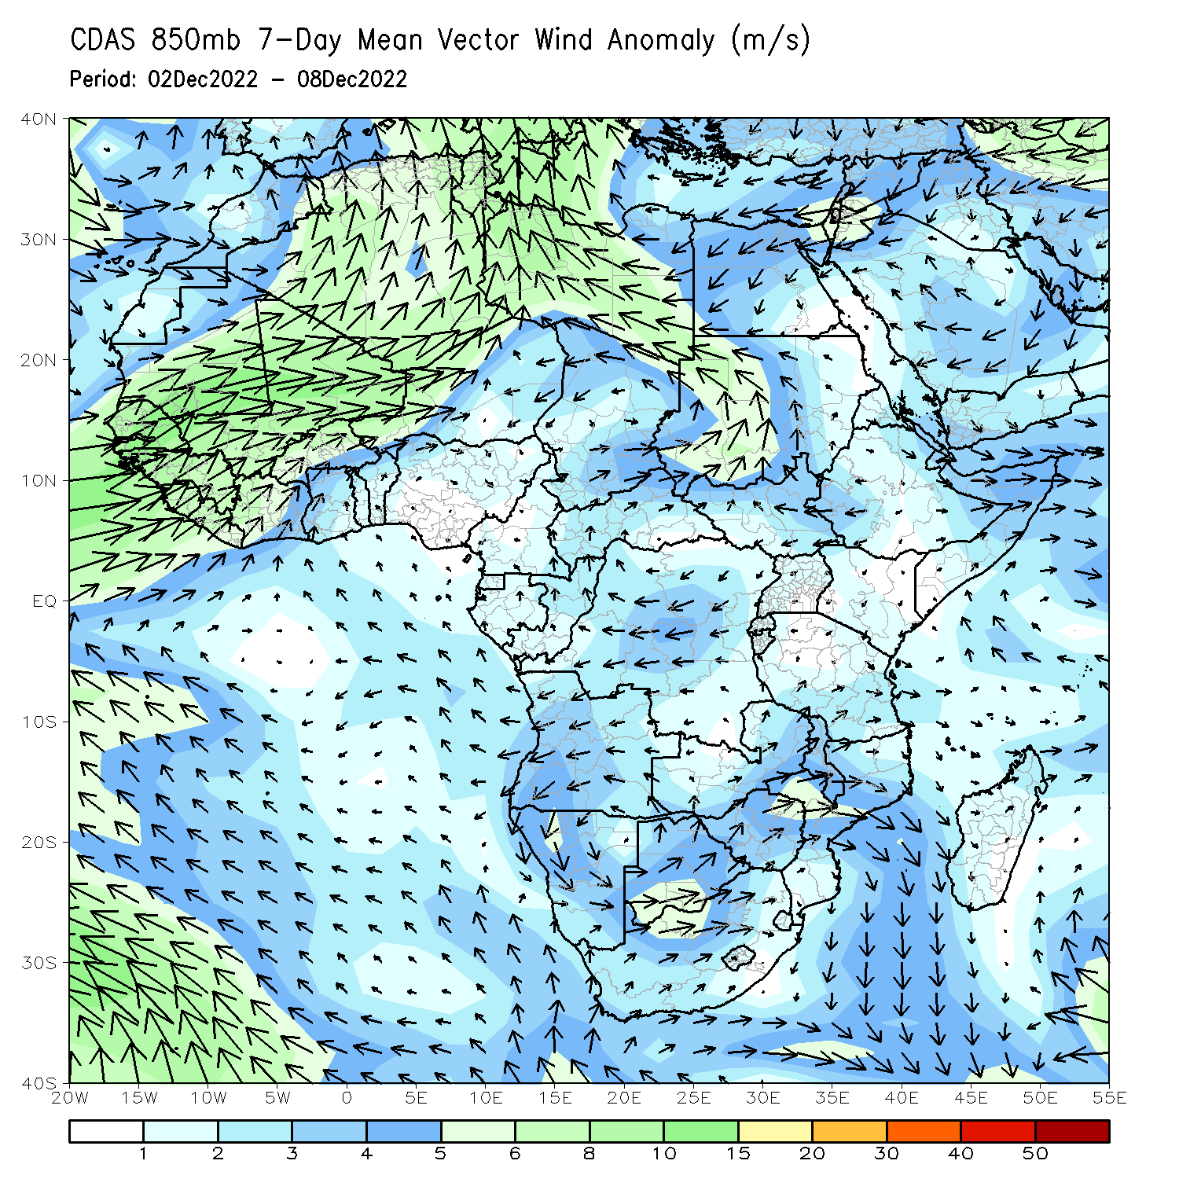
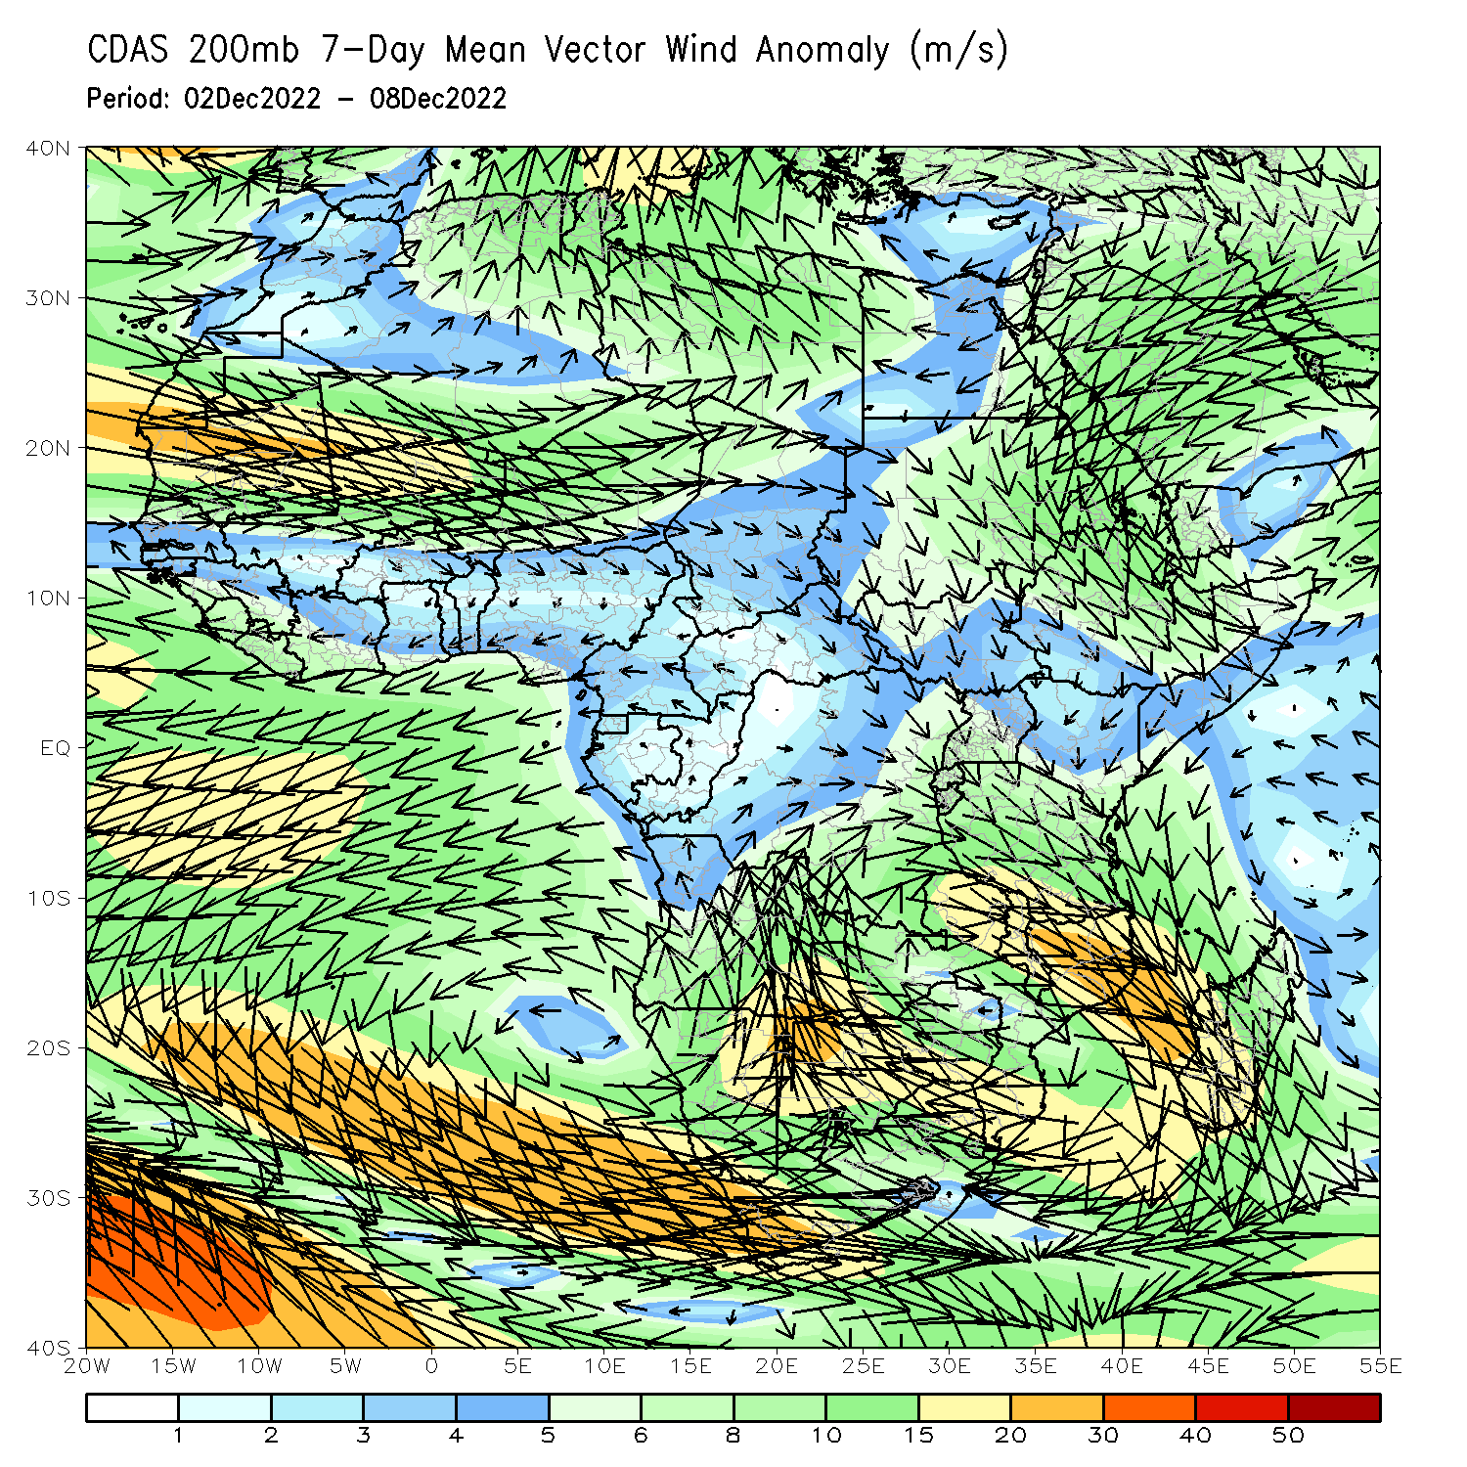
Atmospheric Circulation: Last 7 Days
At 850-hPa level (right panel), the wind anomalies were anti-cyclonic in the western portion of Southern Africa.

Slide 8
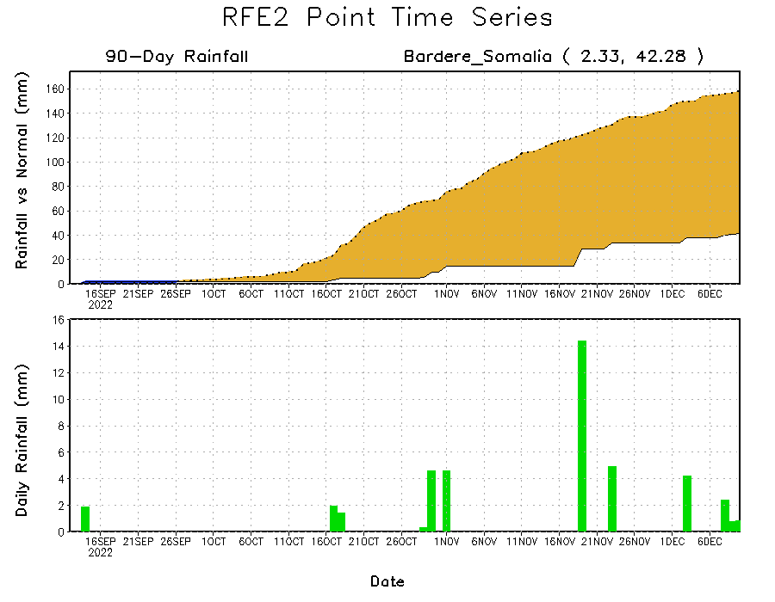
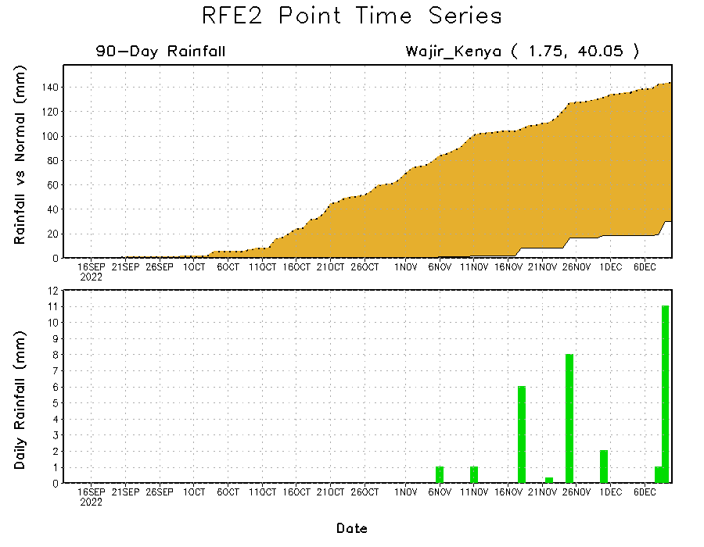
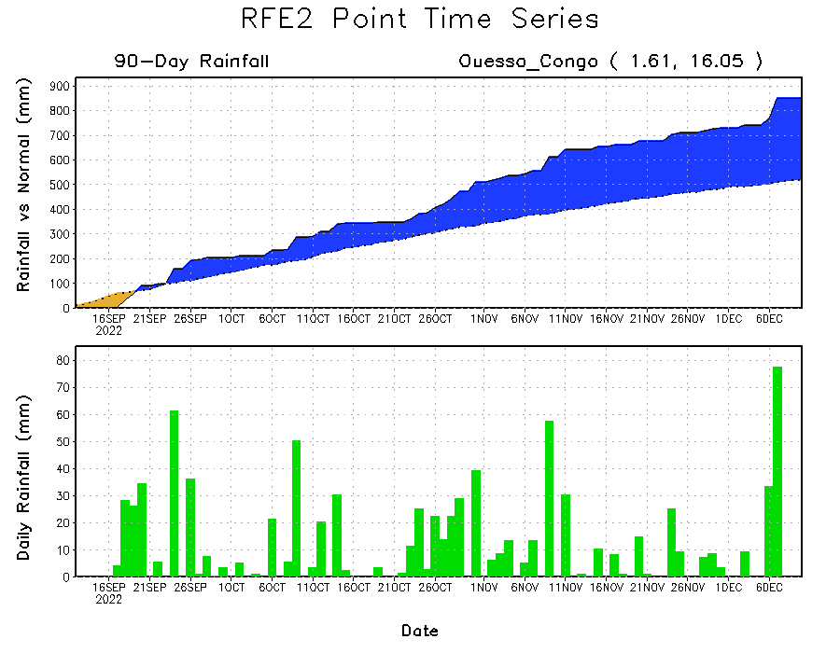
Rainfall Evolution
Daily evolution of rainfall over the last 90 days at selected locations shows continuing moisture surpluses over parts of Congo (bottom left). Rainfall deficits continue over eastern Kenya (bottom right) and southern Somalia (top right).

Slide 9
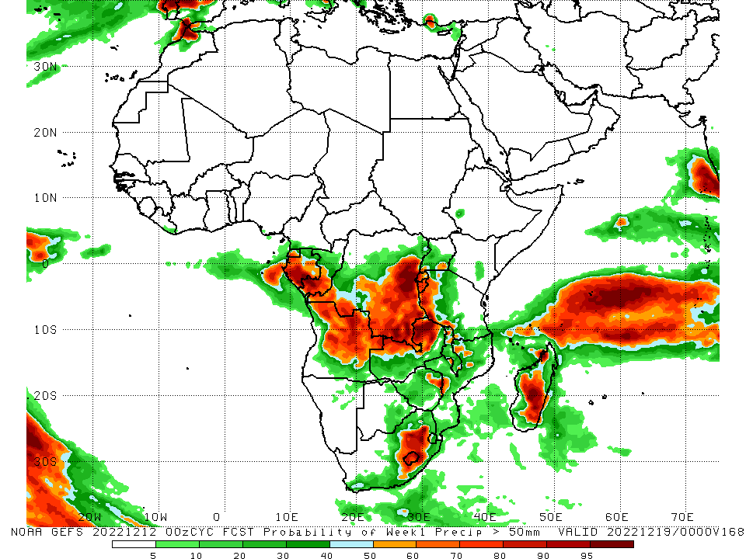
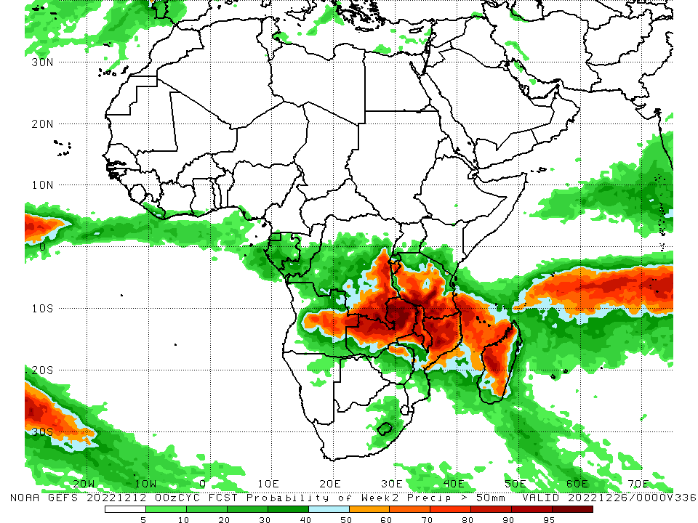
NCEP GEFS Model Forecasts Non-Bias Corrected Probability of precipitation exceedance
Week-1, Valid: 13 – 19 Dec 2022
Week-2, Valid: 20 – 26 Dec 2022
For week-1 (left panel), the NCEP GEFS forecasts indicate a moderate to high chance (over 70%) for rainfall to exceed 50 mm over southern parts of Equatorial Guinea, Gabon and Congo, northern, central ad eastern Angola, eastern and southern DRC, Rwanda, Burundi, western Tanzania, northwest and northern Zambia, central South Africa, Lesotho, and central and southeast Madagascar. For week-2 (right panel), the NCEP GEFS forecasts indicate a moderate to high chance (over 70%) for rainfall to exceed 50 mm over southeast DRC, Burundi, central, southern and southeast Tanzania, eastern Angola, northwest, central and northern Zambia, Malawi, northern Mozambique, and western and central Madagascar.
Notes:
9

Slide 10
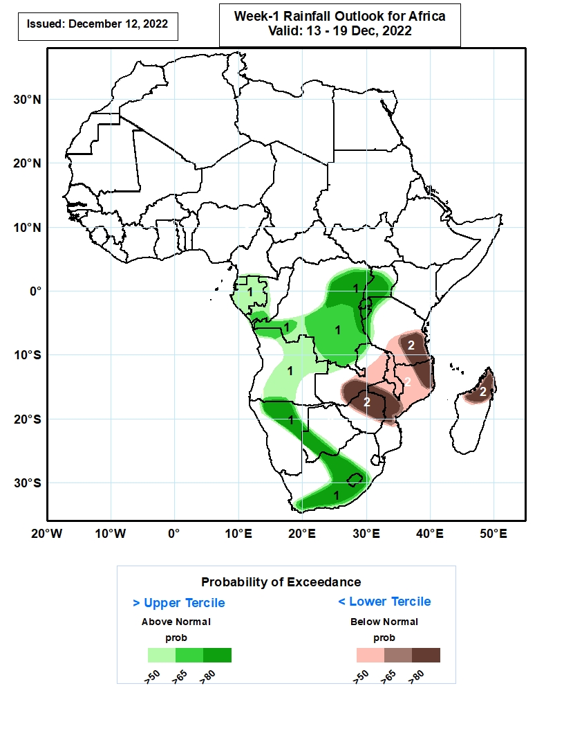
Week-1 Precipitation Outlooks
13 – 19 Dec, 2022
The forecasts suggest above 50% chance for weekly rainfall to be above-normal (above the upper tercile) over southern Cameroon, much of Equatorial Guinea and Gabon, western Congo, central and southern portions of DR Congo, much of Uganda, Rwanda and Burundi, northern Tanzania, much of Angola, northern and eastern portions of Namibia, southwestern Botswana, central and western parts of South Africa, and much of Lesotho. In particular, there is above 80% chance for rainfall to be above-normal over northeastern DR Congo, western and central parts of Uganda, much of Rwanda and Burundi, northern and eastern portions of Namibia, southwestern Botswana, central and western parts of South Africa, and much of Lesotho.
The consolidated probabilistic forecasts suggest above 50% chance for weekly total rainfall to be below-normal (below the lower tercile) over central and southern portions of Tanzania and Zambia, much of Malawi, northern and central parts of Zimbabwe and Mozambique, and northern portions of Madagascar. In particular, there is above 80% chance for rainfall to be below normal over southern Tanzania, northeastern and central parts of Mozambique, southern Zambia, northern and central parts of Zimbabwe, and northern Madagascar.
Notes:
10

Slide 11
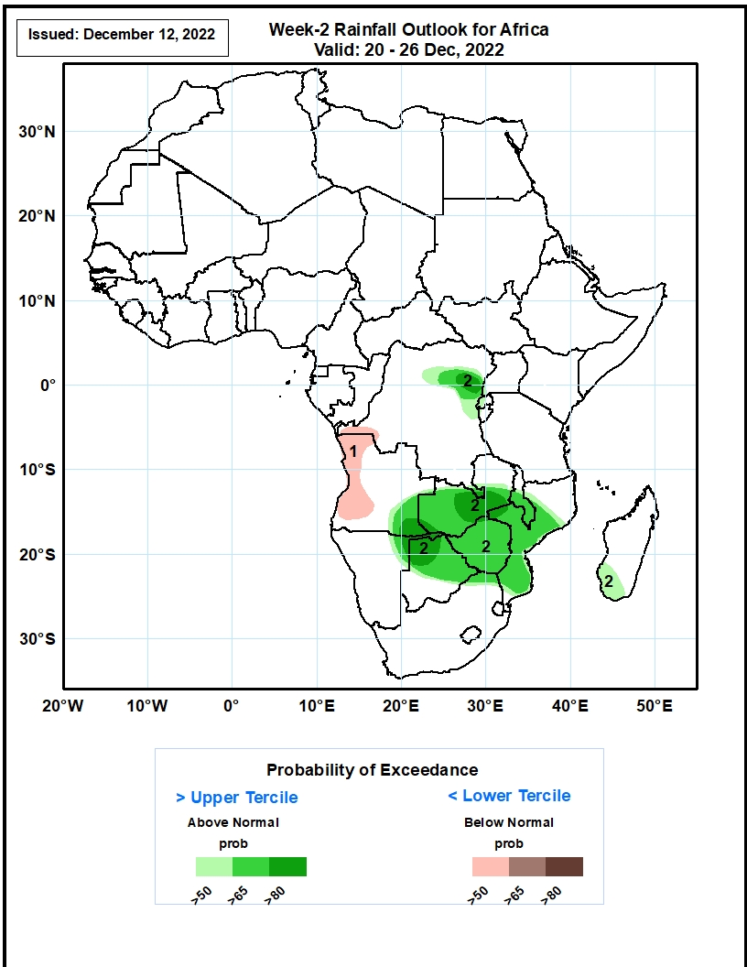
Week-2 Precipitation Outlooks
20 – 26 Dec, 2022
The consolidated probabilistic forecasts suggest above 50% chance for weekly total rainfall to be below-normal (below the lower tercile) over western parts of DR Congo and Angola.
The forecasts suggest above 50% chance for weekly rainfall to be above-normal (above the upper tercile) over northern DR Congo, eastern parts of Angola, much of Zambia and Zimbabwe, southern Malawi, central and southern parts of Mozambique, northeastern Namibia, northern and central parts of Botswana, northern South Africa and southwestern part of Madagascar. In particular, there is above 80% chance for rainfall to be above-normal over northeastern DR Congo, central parts of Zambia, southeastern Angola, northeastern Namibia, and northern Botswana.
Notes:
11

Slide 12
Summary
During the past 30 days, in East Africa, above-average rainfall was observed over Uganda, pockets of southwest and central Kenya, central Somalia and southwest Ethiopia, western Tanzania, Rwanda, Burundi, and southeast South Sudan. Rainfall was below-average over southwest and southern South Sudan, central and southern Ethiopia, southern Somalia, northern and southeast Kenya, and parts of central and southeast Tanzania. In Central Africa, rainfall was above-average over northeast Gabon, many parts of Congo, and parts of western and eastern DRC. Rainfall was below-average over western, southern, and northwest Gabon, Equatorial Guinea, western and central Cameroon, CAR, and parts of central and southwestern DRC. In West Africa, rainfall was above-average over central and eastern Senegal, Liberia, Cote d’Ivoire, southern parts of Ghana, Togo and Benin, eastern Sierra Leone, and pockets of central Mali. In contrast, below-average rainfall was observed over much southern Nigeria and central Ghana. In southern Africa, above-average rainfall was observed over northwestern Angola, southeast Namibia, pockets of central and eastern Botswana, eastern Zimbabwe, western, central and eastern South Africa, Lesotho, southern Mozambique, and southwest Madagascar. Below normal precipitation was observed over many parts of Angola, northern Namibia, much of Zambia, Malawi, northern Mozambique and northern, central and eastern Madagascar.
During the past 7 days, in East Africa, rainfall was above-average over pockets of southwest, central and eastern Kenya, southwest Ethiopia, much of Uganda, and southeast South Sudan. Below-average rainfall was observed over pockets of central Ethiopia and southwest Somalia, and much of Tanzania. In Central Africa, rainfall was above-average over northern Congo, southeast Cameroon, and pockets of central, northeast and southeast DRC. Below-average rainfall was observed over Gabon, Equatorial Guinea, central Congo, and southwest and central DRC. In West Africa, above-average rainfall was observed over eastern parts of Sierra Leone and Guinea, and central Cote D’Ivoire. In southern Africa, rainfall was above-average over pockets of southeast Angola, western Zambia, northwest Botswana, pockets of central Mozambique, southern Malawi and western Madagascar, and western and eastern South Africa. In contrast, rainfall was below-average over western, southern, northern and northeast Angola, northern Namibia, southern and eastern Zambia, Zimbabwe, southern Mozambique, pockets of central South Africa, and northwest and southeast parts of Madagascar.
Week-1 outlook calls for an increased chance for above-average rainfall over Equatorial Guinea, Gabon, Congo, much of DRC, southern Cameroon, central and southern Uganda, Rwanda, Burundi, western Tanzania, northern, eastern and southern Angola, northeast Namibia, western and southern Botswana, western, northern, central, and eastern South Africa, Lesotho, and pockets of central and southeast Madagascar. In contrast, there is an increased chance for below-average rainfall over Zambia, western and southern Zimbabwe, northeast Botswana, Malawi, western Angola, Kenya, southern, central, eastern and northern parts of Tanzania, Mozambique, southern Somalia, northern Madagascar, and Gulf of Guinea coast. Week-2 outlook suggests an increased chance for above-average rainfall over Tanzania, Rwanda, Burundi, southern Kenya, many parts of DRC, Zambia, Malawi, northern Mozambique, southeast Angola, and western and southern Madagascar, while below-average rainfall is likely over the western, northern and southwest Angola, northern Namibia, much of Botswana and Zimbabwe, central and northern South Africa, Lesotho, Eswatini, southern Mozambique, southern Gabon and Congo.

