Slide 1
The African Monsoon Recent Evolution and Current Status Include Week-1 and Week-2 Outlooks
Update prepared by
05 December 2022
For more information, visit:
http://www.cpc.ncep.noaa.gov/products/Global_Monsoons/African_Monsoons/precip_monitoring.shtml

Slide 2
Outline
Highlights
Recent Evolution and Current Conditions
NCEP GEFS Forecasts
Summary

Slide 3
Highlights: Last 7 Days
During the past 7 days, in East Africa, rainfall was above-average over pockets of southeast Kenya and western Tanzania. Below-average rainfall was observed over parts of southern Ethiopia, southwest and central Kenya, southern Somalia and central and southeast Tanzania. In Central Africa, rainfall was above-average over northeast Gabon, southern and central Congo, and western, northern and eastern parts of DRC. Below-average rainfall was observed over western and central Gabon, western and northern Equatorial Guinea, and pockets of central and southern DRC. In West Africa, above-average rainfall was observed along the Gulf of Guinea coast. In southern Africa, rainfall was above-average over northwest Angola, southeast Namibia, eastern parts of Zimbabwe and Zambia, western and southern Mozambique, central South Africa and southeast Madagascar. In contrast, rainfall was below-average over southern and eastern Angola, western and southern Zambia, northern and eastern Botswana, western Zimbabwe, northern Mozambique, northeast South Africa, Eswatini, and western and central parts of Madagascar.
Week-1 outlook calls for an increased chance for above-average rainfall over Equatorial Guinea, Gabon, southern Cameroon, northern Angola, northern and eastern DRC, central and northern South Africa, and Eswatini. In contrast, there is an increased chance for below-average rainfall over southern and eastern Angola, southern DRC, Zambia, northern and eastern Zimbabwe, southern and eastern Tanzania, Malawi, Mozambique, Madagascar, and parts of central and southern Ethiopia. Week-2 outlook suggests an increased chance for above-average rainfall Equatorial Guinea, Gabon, Congo, southern Cameroon, western and northern Angola, many parts of DRC, central and northern parts of South Africa, Lesotho, Eswatini, northeast Namibia, and southern and eastern Botswana, western Zimbabwe, while below-average rainfall is likely over many parts of Zambia, Malawi, southwest Tanzania, northern Mozambique, southern and eastern Tanzania, eastern Kenya, Liberia, and central and northern parts of Madagascar.

Slide 4
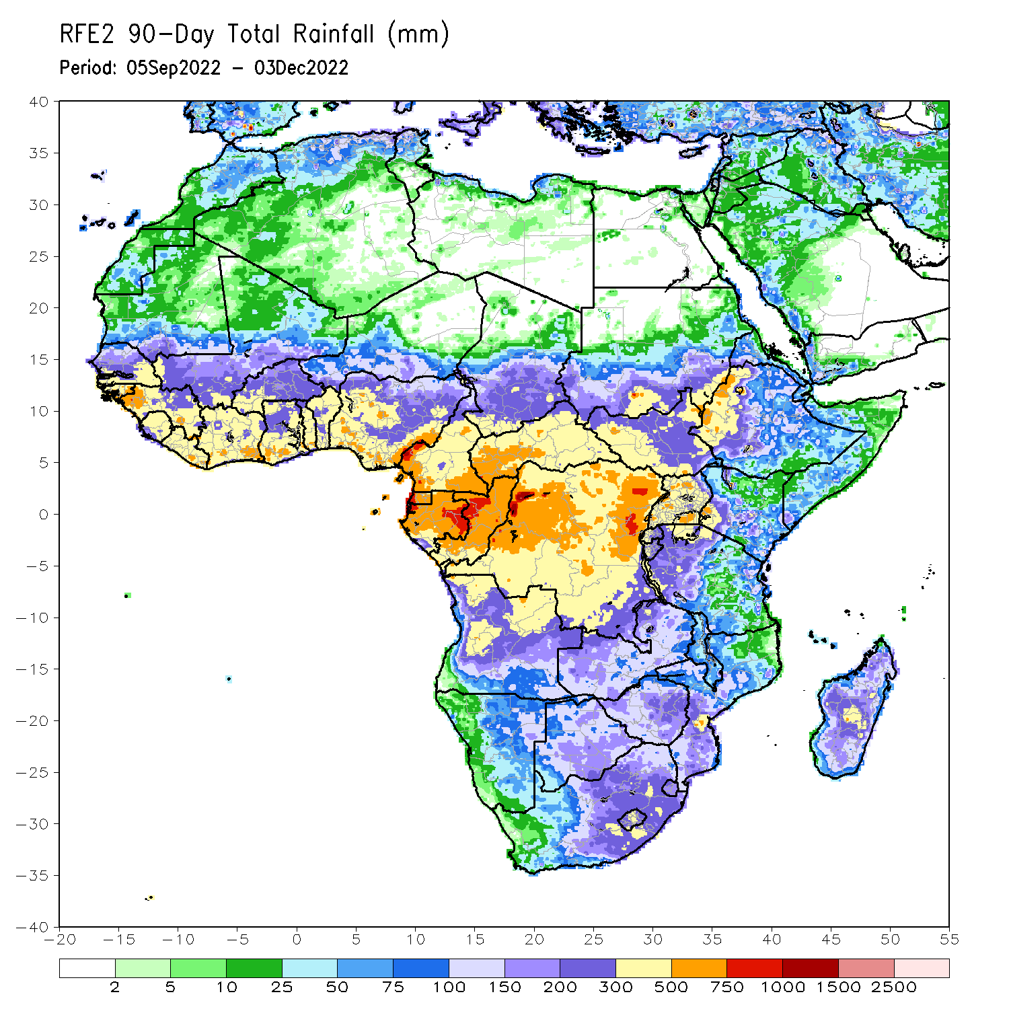
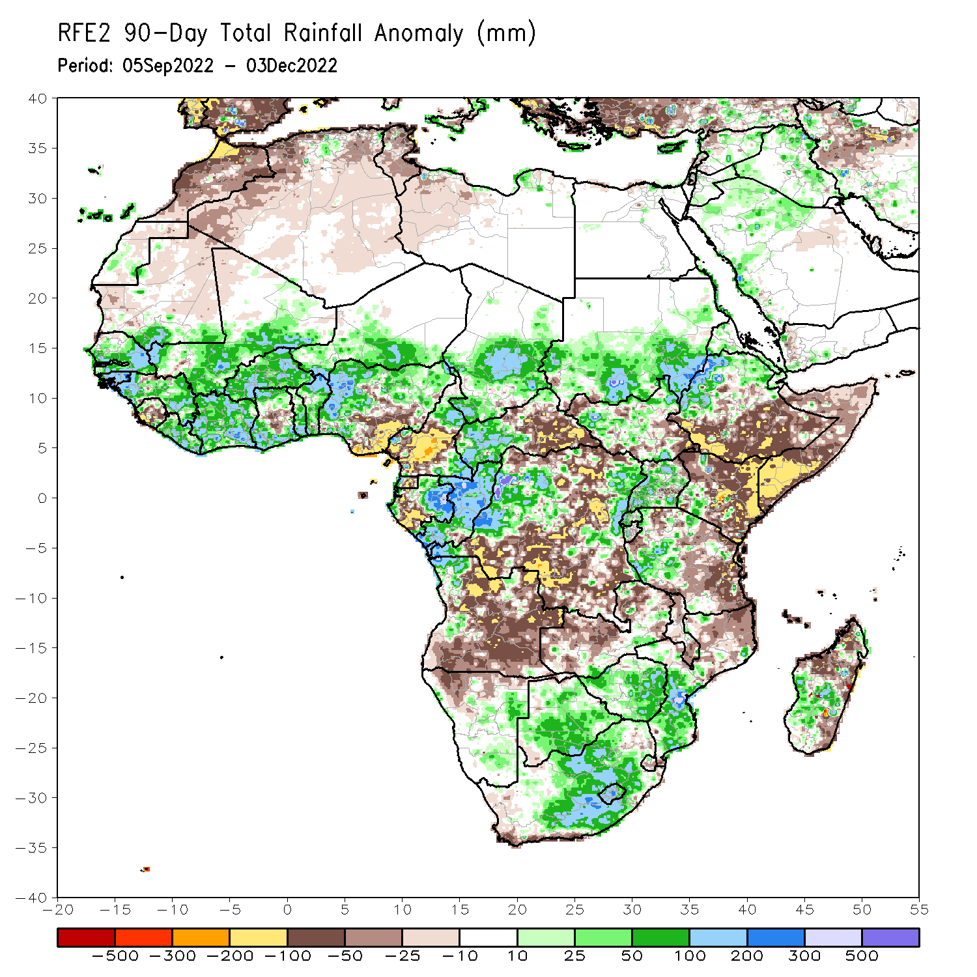
Rainfall Patterns: Last 90 Days
Over the past 90 days, in East Africa, above-average rainfall was observed over the southern and central parts of Sudan, many parts of central and northern South Sudan, northwest and northern Ethiopia, Eritrea, Djibouti, Uganda, Rwanda, southwest Tanzania, and southwest Kenya. Rainfall was below-average over southern and southeastern Ethiopia, throughout much of Somalia, central, northern, and eastern Kenya, and central and eastern Tanzania. In southern Africa, above-average rainfall was observed over Zimbabwe, Botswana, eastern Namibia, northwest Angola, western, central and eastern South Africa, Lesotho, southern Mozambique, and central and southwest Madagascar. Below-average rainfall was observed over many parts of Angola, northern Namibia, western, central and northern Zambia, southwest South Africa, northern Mozambique, Malawi, and northern and the far eastern Madagascar. In Central Africa, rainfall was above-average over northern Cameroon, southern and central Chad, western CAR, eastern Gabon, much of Congo, and parts of western and eastern DRC. Rainfall was below-average over western Cameroon, western Gabon, Equatorial Guinea, eastern CAR, and portions of northern, central and southern DRC. In West Africa, rainfall was above-average over southern Mauritania, many parts of Senegal, Gambia, Guinea-Bissau, Guinea, Liberia, Cote D’Ivoire, portions of Ghana, Togo, Benin, Burkina Faso, eastern and southern portions of Mali, southern Niger, and western and northern Nigeria. In contrast, below-average rainfall was observed over northern Mauritania, Sierra Leone, central Ghana, and parts of central and southeastern Nigeria.
Notes:
4

Slide 5
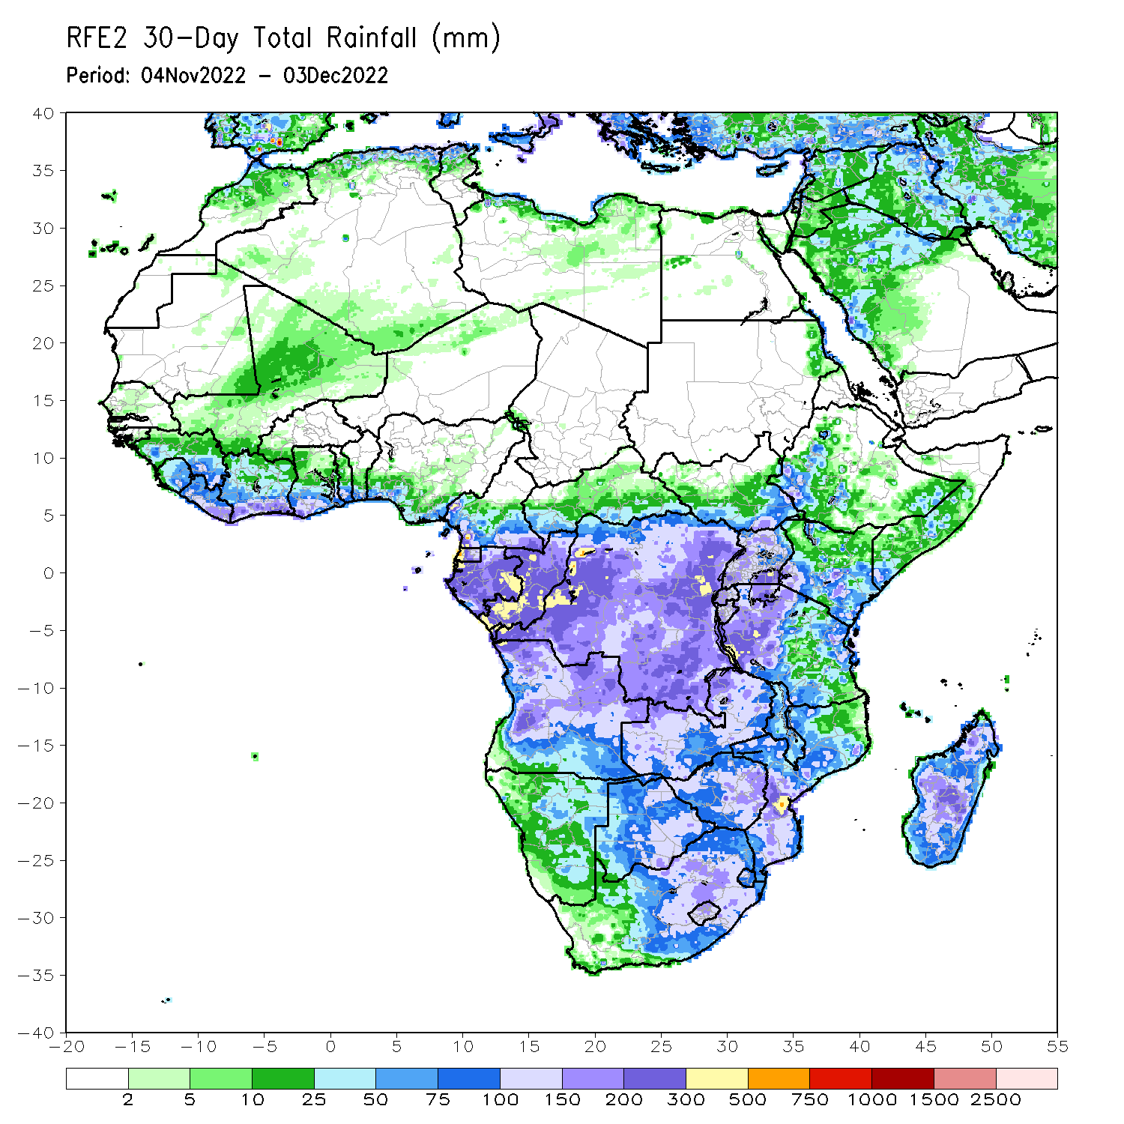
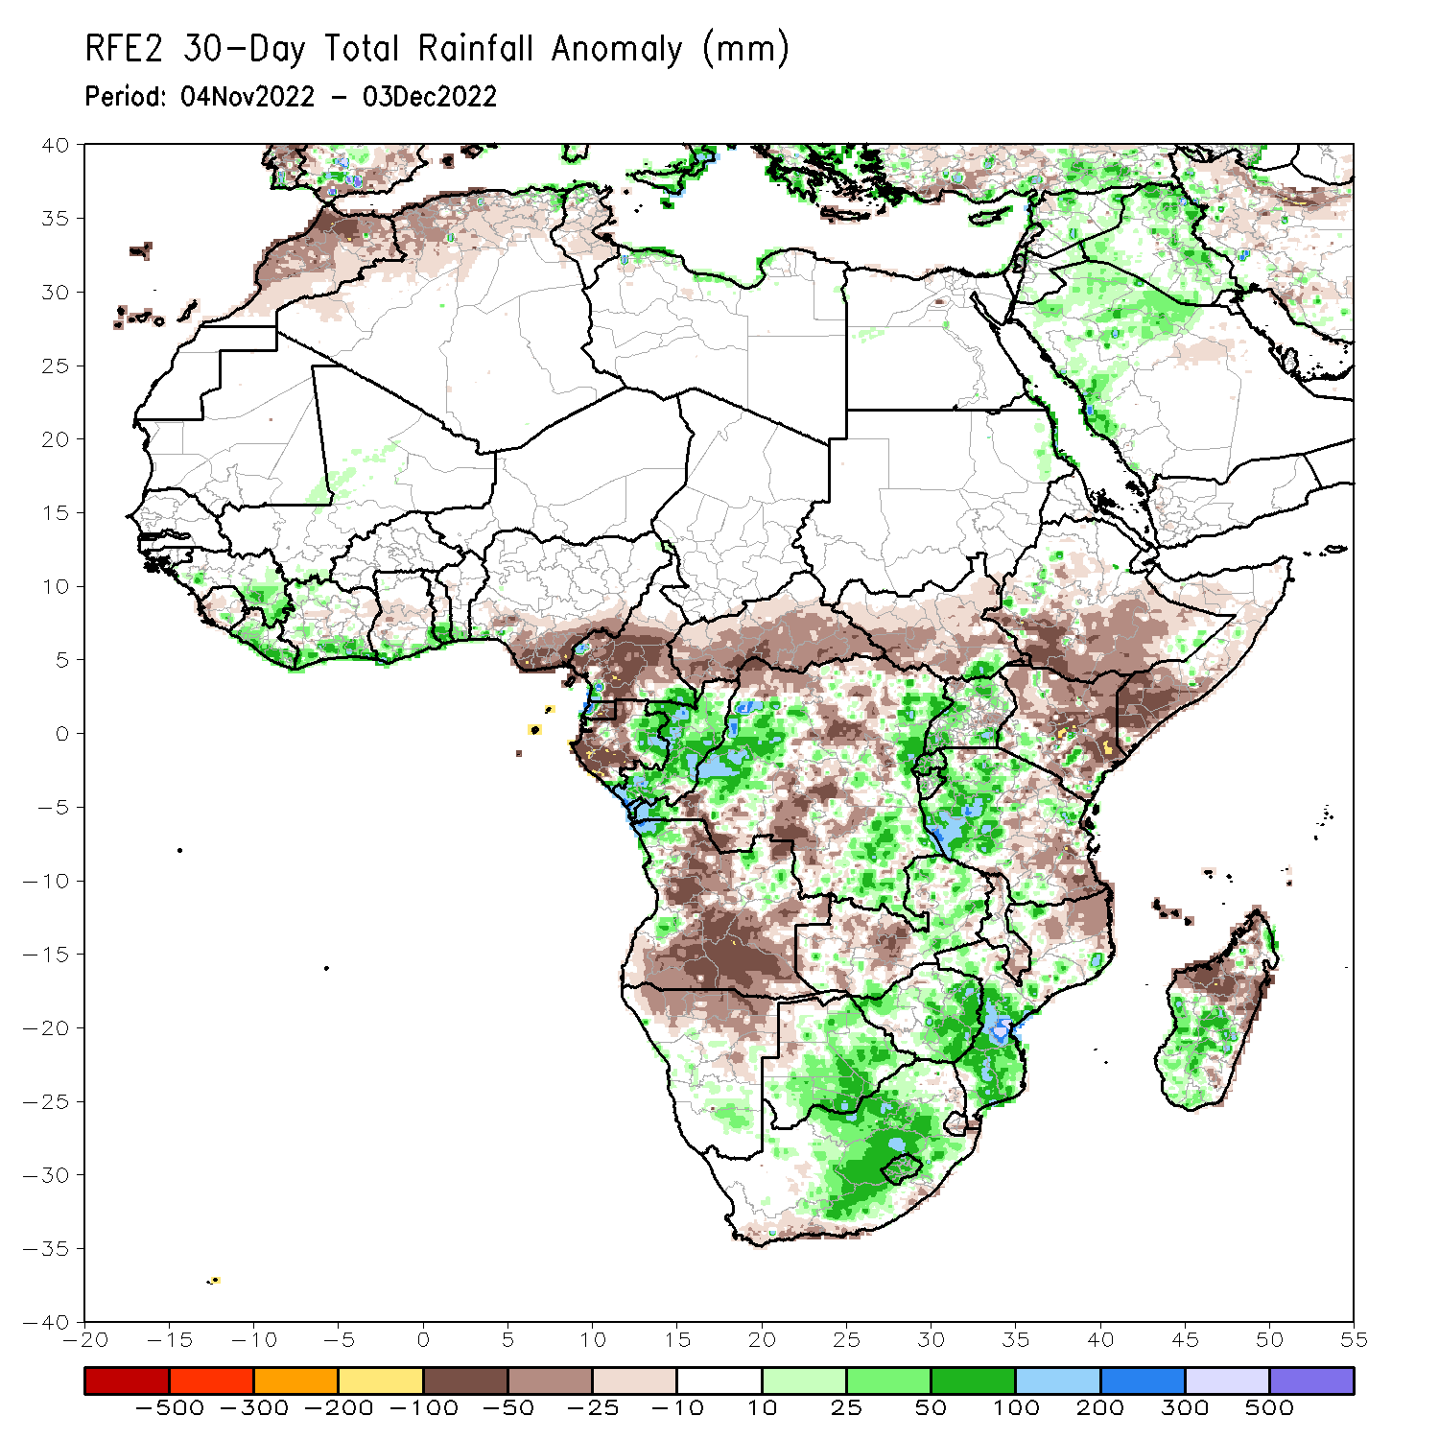
Rainfall Patterns: Last 30 Days
During the past 30 days, in East Africa, above-average rainfall was observed over parts of Uganda, pockets of southern Kenya, western Tanzania, Rwanda and Burundi. Rainfall was below-average over much of South Sudan, central and southern Ethiopia, Somalia, many parts of Kenya, and parts of southern and eastern Tanzania. In Central Africa, rainfall was above-average over northeast Gabon, much of Congo, and parts of western and eastern DRC. Rainfall was below-average over western and northwest Gabon, central and eastern Equatorial Guinea, western and central Cameroon, CAR, and parts of northern, central and southwestern DRC. In West Africa, rainfall was above-average along coastal regions of Cote d’Ivoire, Ghana, Togo and Benin, Liberia, and eastern Guinea. In contrast, below-average rainfall was observed over much southern Nigeria and western Sierra Leone. In southern Africa, above-average rainfall was observed over northwestern Angola, southeast Namibia, central, eastern and southern Botswana, eastern Zambia, Zimbabwe, western, central and eastern South Africa, Lesotho, southern Mozambique, and central and southwest Madagascar. Below normal precipitation was observed over many parts of Angola, northern Namibia, western Zambia, Malawi, northern Mozambique and the far northern Madagascar.
Notes:
5

Slide 6
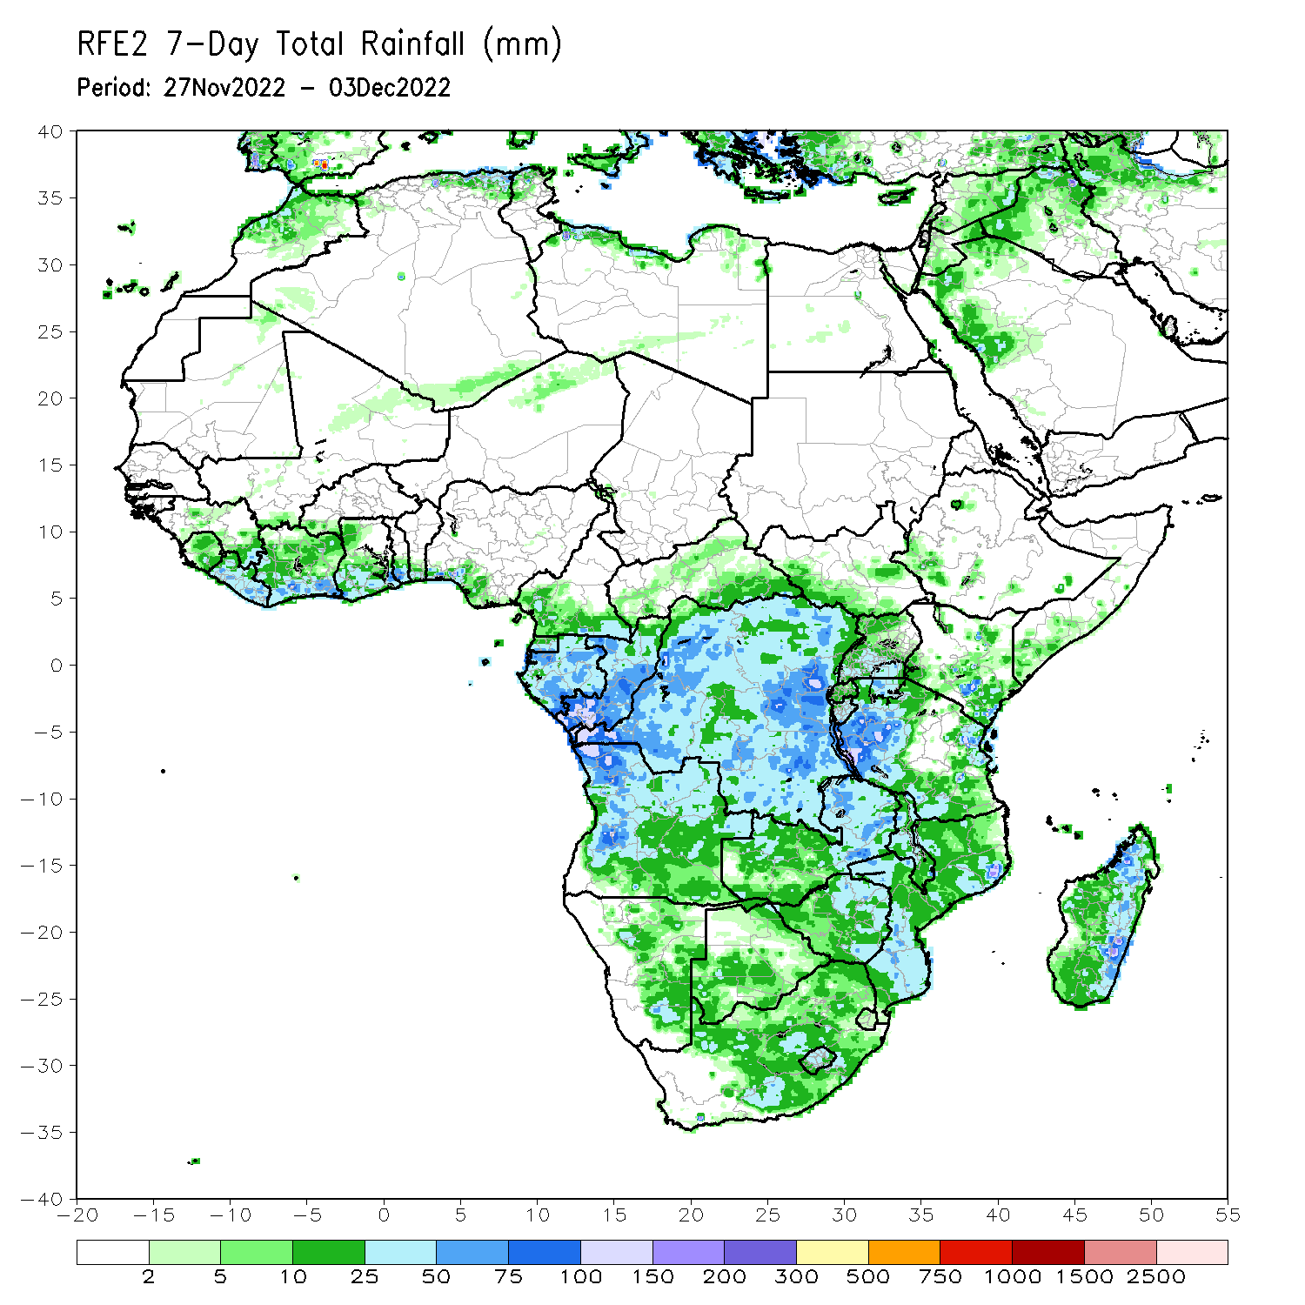
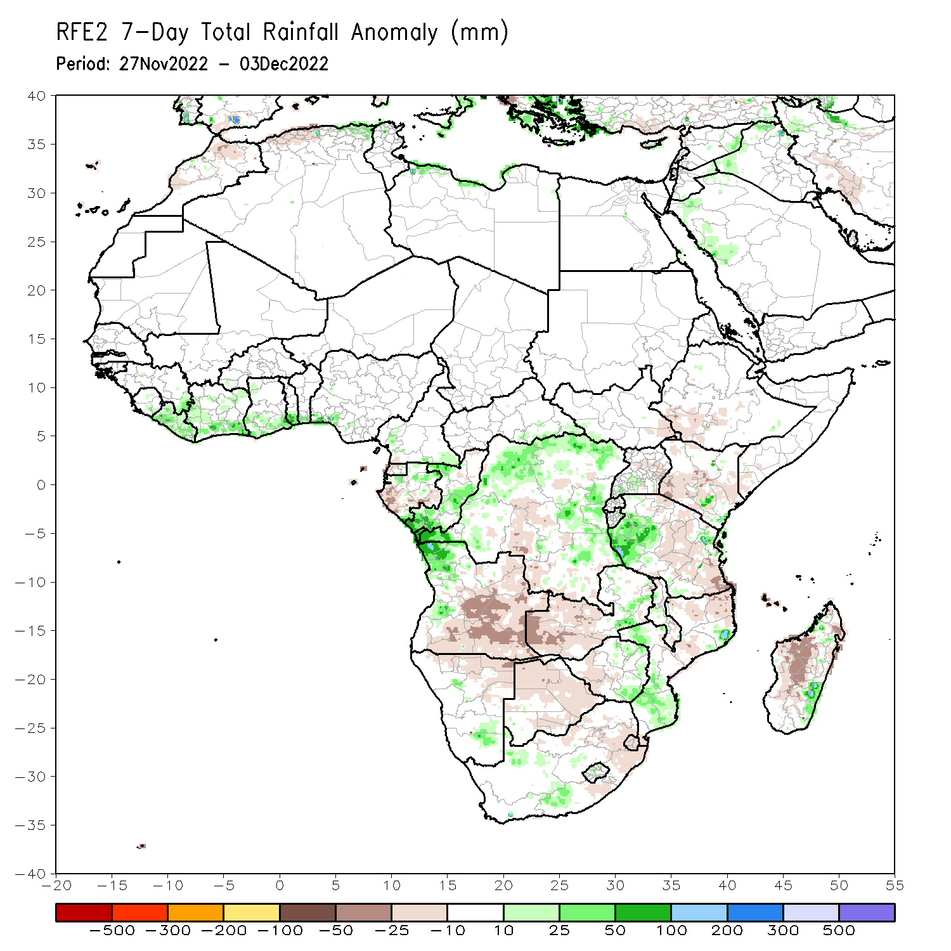
Rainfall Patterns: Last 7 Days
During the past 7 days, in East Africa, rainfall was above-average over pockets of southeast Kenya and western Tanzania. Below-average rainfall was observed over parts of southern Ethiopia, southwest and central Kenya, southern Somalia and central and southeast Tanzania. In Central Africa, rainfall was above-average over northeast Gabon, southern and central Congo, and western, northern and eastern parts of DRC. Below-average rainfall was observed over western and central Gabon, western and northern Equatorial Guinea, and pockets of central and southern DRC. In West Africa, above-average rainfall was observed along the Gulf of Guinea coast. In southern Africa, rainfall was above-average over northwest Angola, southeast Namibia, eastern parts of Zimbabwe and Zambia, western and southern Mozambique, central South Africa and southeast Madagascar. In contrast, rainfall was below-average over southern and eastern Angola, western and southern Zambia, northern and eastern Botswana, western Zimbabwe, northern Mozambique, northeast South Africa, Swaziland, and western and central parts of Madagascar.

Slide 7
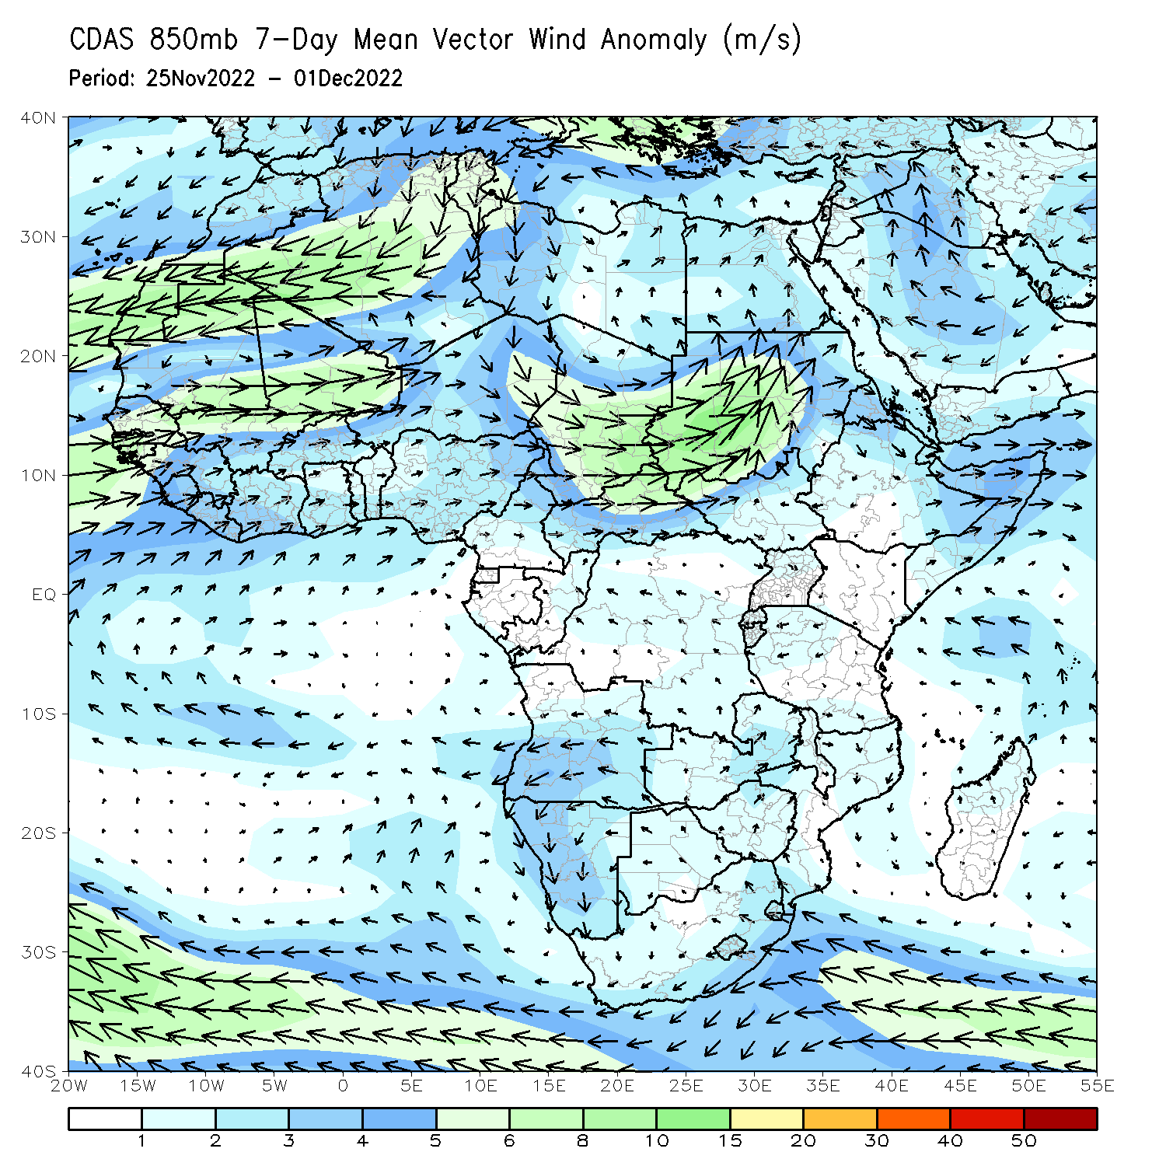
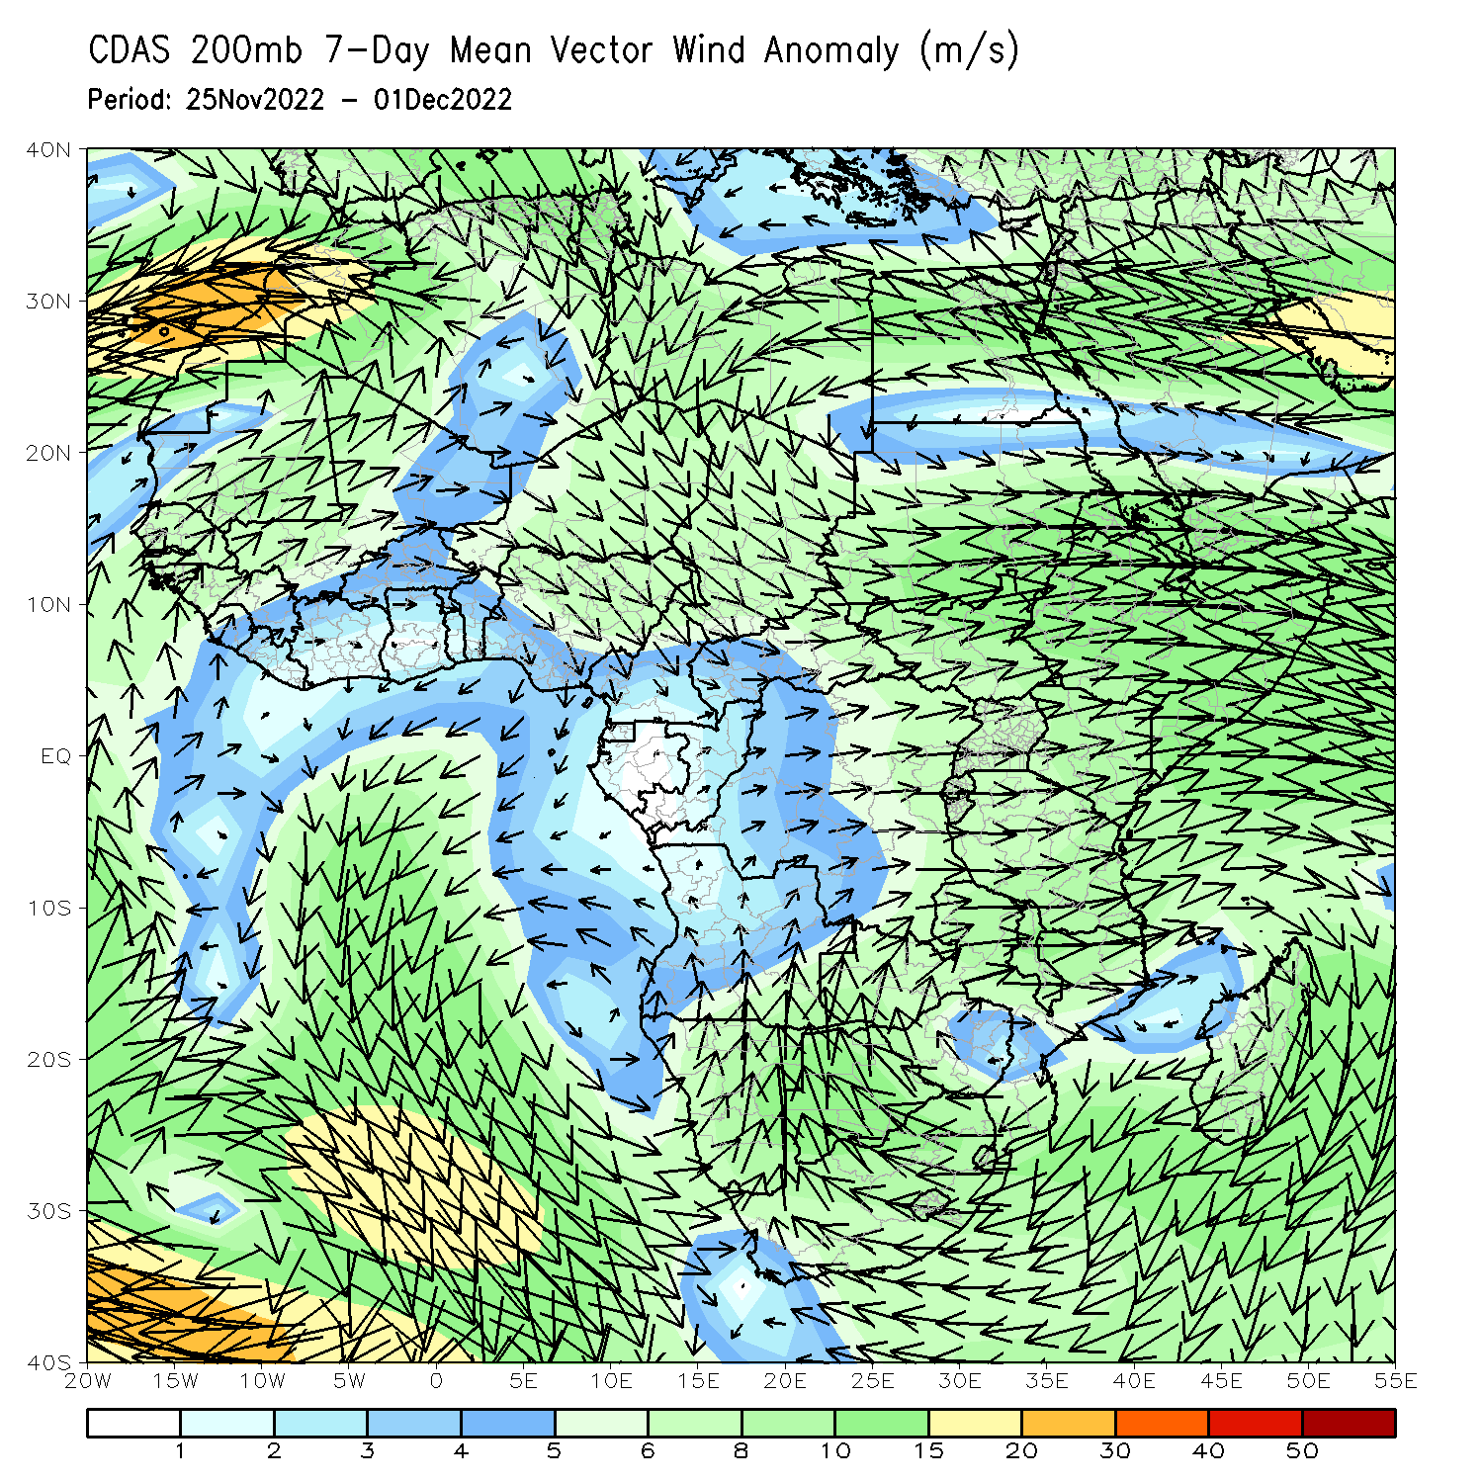
Atmospheric Circulation: Last 7 Days
At 850-hPa level (right panel), the wind anomalies were anti-cyclonic in the western portion of Southern Africa.

Slide 8
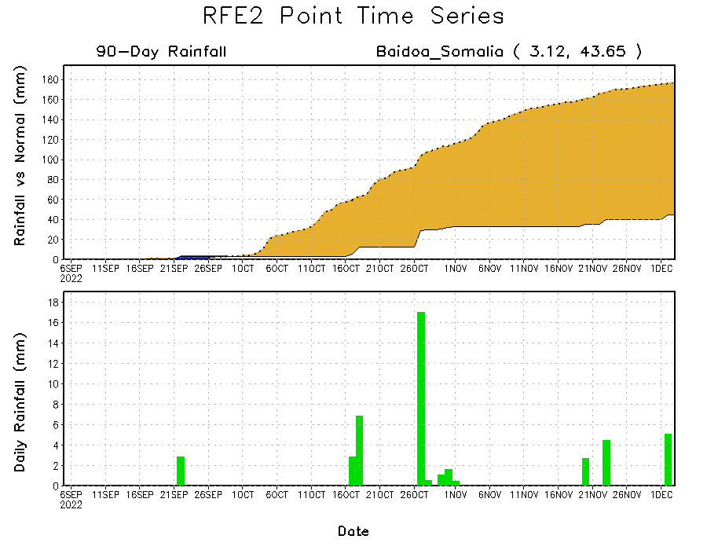
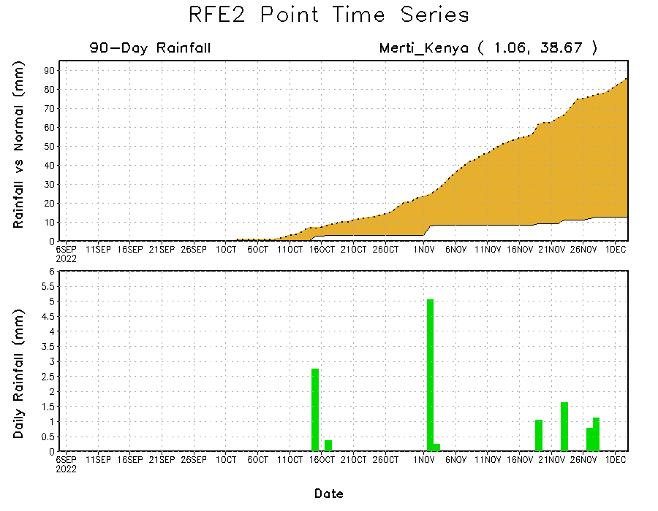
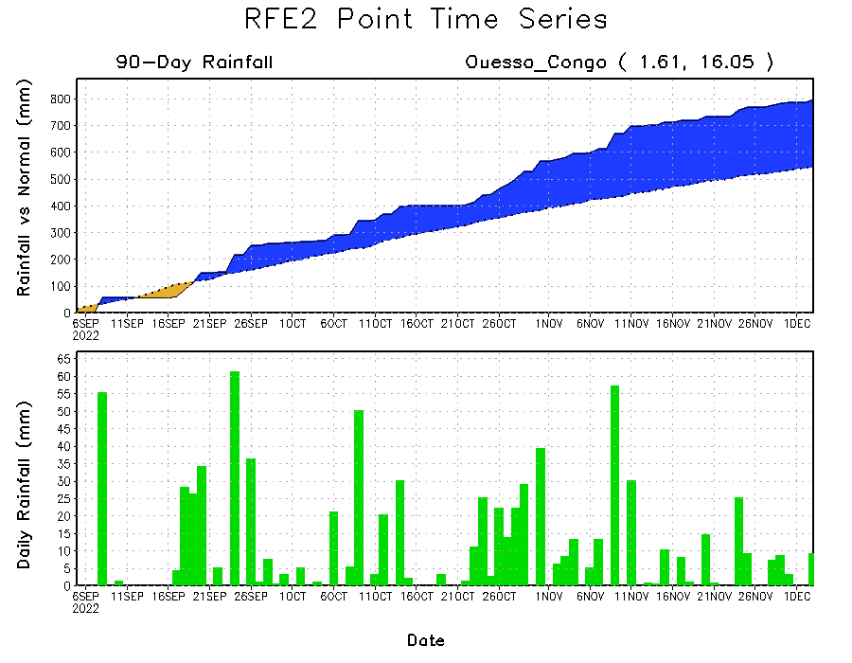
Rainfall Evolution
Daily evolution of rainfall over the last 90 days at selected locations shows continuing moisture surpluses over parts of Congo (bottom left). Rainfall deficits continue over eastern Kenya (bottom right) and southern Somalia (top right).

Slide 9
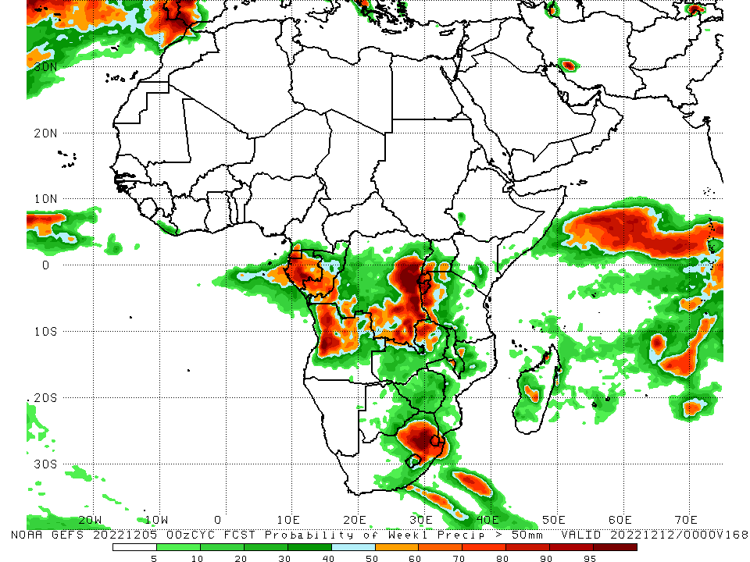
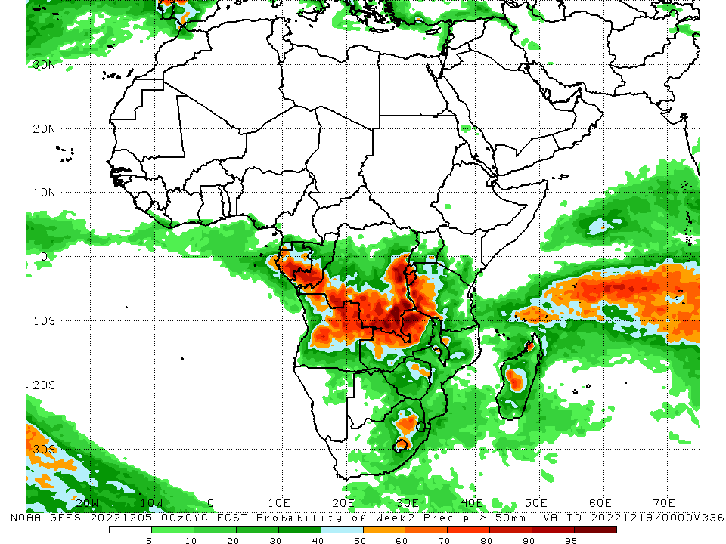
NCEP GEFS Model Forecasts Non-Bias Corrected Probability of precipitation exceedance
Week-1, Valid: 06 – 12 Dec 2022
Week-2, Valid: 13 – 19 Dec 2022
For week-1 (left panel), the NCEP GEFS forecasts indicate a moderate to high chance (over 70%) for rainfall to exceed 50 mm over Equatorial Guinea, Gabon, southern Congo, northwest and western Angola, eastern and southern DRC, Rwanda, Burundi, western Tanzania, northwest Zambia, northern South Africa and Eswatini. For week-2 (right panel), the NCEP GEFS forecasts indicate a moderate to high chance (over 70%) for rainfall to exceed 50 mm over southern parts of Gabon and Congo, southern and eastern DRC, Rwanda, Burundi, western Tanzania, central and eastern Angola, northern and northwest Zambia, and pockets of central Madagascar.
Notes:
9

Slide 10
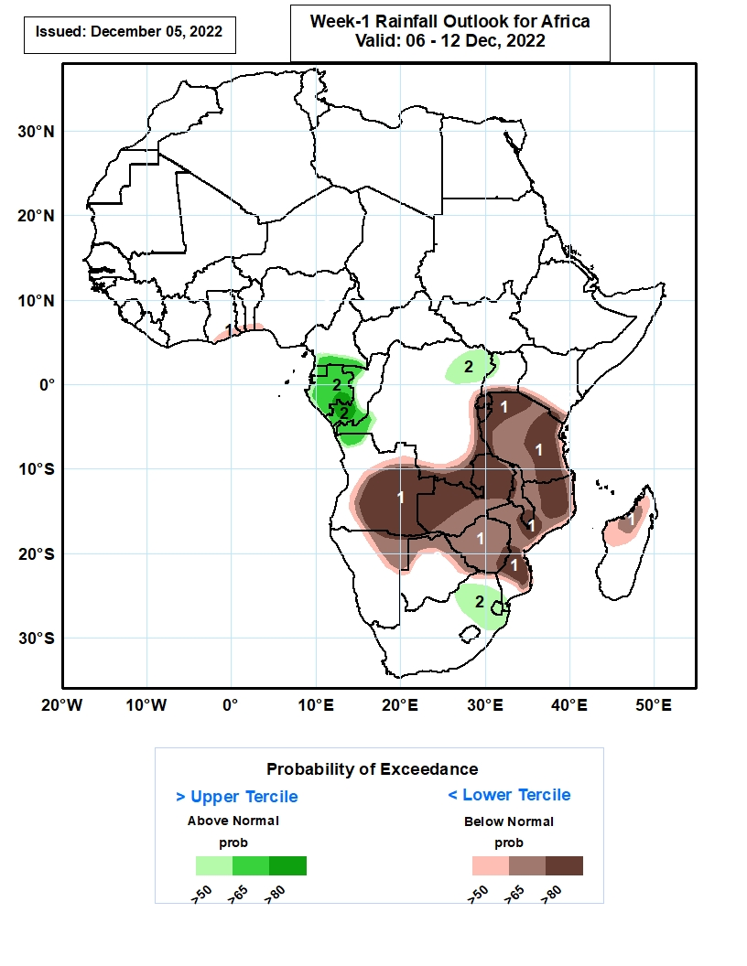
Week-1 Precipitation Outlooks
06 – 12 Dec, 2022
The consolidated probabilistic forecasts suggest above 50% chance for weekly total rainfall to be below-normal (below the lower tercile) over southern parts of Ghana, Togo and Benin, southwestern Nigeria, central and eastern Angola, southern DR Congo, Uganda and Kenya, much of Rwanda, Burundi, Tanzania, Zambia, Malawi, Mozambique and Zimbabwe, northeastern Namibia, northern portions of Botswana, northern and western parts of Madagascar. In particular, there is above 80% chance for rainfall to be below normal over central and eastern Angola, eastern and southern parts of DR Congo, much of Rwanda, Burundi and Zambia, northern and eastern portions of Tanzania, southern Malawi, northern and southern parts of Mozambique.
The forecasts suggest above 50% chance for weekly rainfall to be above-normal (above the upper tercile) over southern Cameroon, much of Equatorial Guinea and Gabon, southern Congo, northeastern and western portions of DR Congo, northwestern Uganda and Angola, northern South Africa and much of Eswatini. In particular, there is above 80% chance for rainfall to be above-normal over southern parts of Gabon and Congo.
Notes:
10

Slide 11
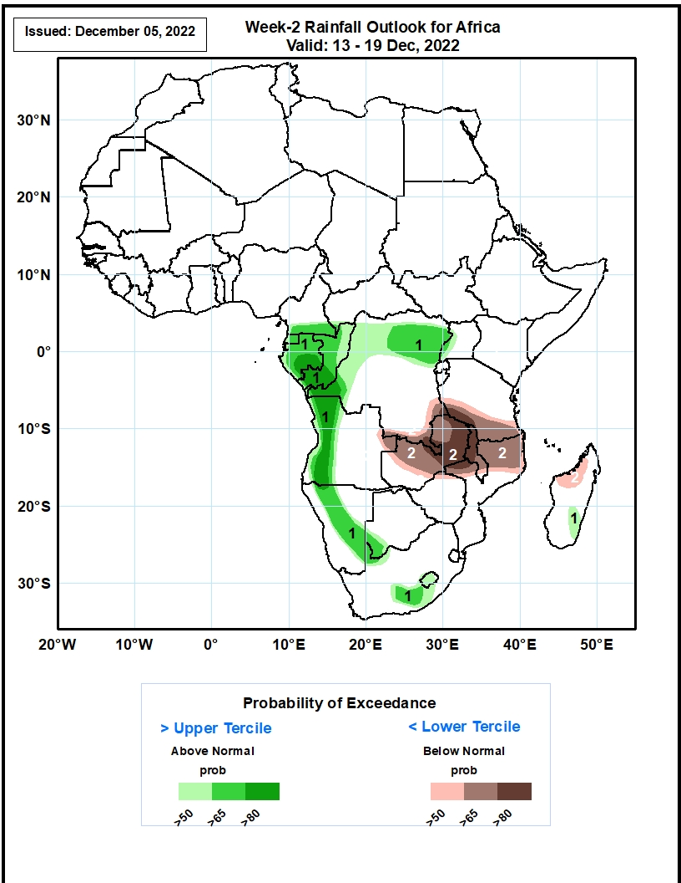
Week-2 Precipitation Outlooks
13 – 19 Dec, 2022
The forecasts suggest above 50% chance for weekly rainfall to be above-normal (above the upper tercile) over southern Cameroon, much of Equatorial Guinea, Gabon and Congo, northern and western portions of DR Congo, western Uganda and Angola, central and eastern parts of Namibia, southwestern Botswana, south-central portions of South Africa, much of Lesotho and southeastern Madagascar. In particular, there is above 80% chance for rainfall to be above-normal over southern parts of Gabon and Congo, western DR Congo and Angola.
The consolidated probabilistic forecasts suggest above 50% chance for weekly total rainfall to be below-normal (below the lower tercile) over eastern and southern parts of DR Congo, eastern Angola, much of Zambia and Malawi, southern Tanzania, northern Mozambique and northwestern portions of Madagascar. In particular, there is above 80% chance for rainfall to be below normal over northern Zambia, southwestern Tanzania, northern and central parts of Malawi.
Notes:
11

Slide 12
Summary
During the past 30 days, in East Africa, above-average rainfall was observed over parts of Uganda, pockets of southern Kenya, western Tanzania, Rwanda and Burundi. Rainfall was below-average over much of South Sudan, central and southern Ethiopia, Somalia, many parts of Kenya, and parts of southern and eastern Tanzania. In Central Africa, rainfall was above-average over northeast Gabon, much of Congo, and parts of western and eastern DRC. Rainfall was below-average over western and northwest Gabon, central and eastern Equatorial Guinea, western and central Cameroon, CAR, and parts of northern, central and southwestern DRC. In West Africa, rainfall was above-average along coastal regions of Cote d’Ivoire, Ghana, Togo and Benin, Liberia, and eastern Guinea. In contrast, below-average rainfall was observed over much southern Nigeria and western Sierra Leone. In southern Africa, above-average rainfall was observed over northwestern Angola, southeast Namibia, central, eastern and southern Botswana, eastern Zambia, Zimbabwe, western, central and eastern South Africa, Lesotho, southern Mozambique, and central and southwest Madagascar. Below normal precipitation was observed over many parts of Angola, northern Namibia, western Zambia, Malawi, northern Mozambique and the far northern Madagascar.
During the past 7 days, in East Africa, rainfall was above-average over pockets of southeast Kenya and western Tanzania. Below-average rainfall was observed over parts of southern Ethiopia, southwest and central Kenya, southern Somalia and central and southeast Tanzania. In Central Africa, rainfall was above-average over northeast Gabon, southern and central Congo, and western, northern and eastern parts of DRC. Below-average rainfall was observed over western and central Gabon, western and northern Equatorial Guinea, and pockets of central and southern DRC. In West Africa, above-average rainfall was observed along the Gulf of Guinea coast. In southern Africa, rainfall was above-average over northwest Angola, southeast Namibia, eastern parts of Zimbabwe and Zambia, western and southern Mozambique, central South Africa and southeast Madagascar. In contrast, rainfall was below-average over southern and eastern Angola, western and southern Zambia, northern and eastern Botswana, western Zimbabwe, northern Mozambique, northeast South Africa, Swaziland, and western and central parts of Madagascar.
Week-1 outlook calls for an increased chance for above-average rainfall over Equatorial Guinea, Gabon, southern Cameroon, northern Angola, northern and eastern DRC, central and northern South Africa, and Eswatini. In contrast, there is an increased chance for below-average rainfall over southern and eastern Angola, southern DRC, Zambia, northern and eastern Zimbabwe, southern and eastern Tanzania, Malawi, Mozambique, Madagascar, and parts of central and southern Ethiopia. Week-2 outlook suggests an increased chance for above-average rainfall Equatorial Guinea, Gabon, Congo, southern Cameroon, western and northern Angola, many parts of DRC, central and northern parts of South Africa, Lesotho, Eswatini, northeast Namibia, and southern and eastern Botswana, western Zimbabwe, while below-average rainfall is likely over many parts of Zambia, Malawi, southwest Tanzania, northern Mozambique, southern and eastern Tanzania, eastern Kenya, Liberia, and central and northern parts of Madagascar.

