Slide 1
The African Monsoon Recent Evolution and Current Status Include Week-1 and Week-2 Outlooks
Update prepared by
31 October 2022
For more information, visit:
http://www.cpc.ncep.noaa.gov/products/Global_Monsoons/African_Monsoons/precip_monitoring.shtml

Slide 2
Outline
Highlights
Recent Evolution and Current Conditions
NCEP GEFS Forecasts
Summary

Slide 3
Highlights: Last 7 Days
During the past 7 days, in East Africa, rainfall was above-average over pockets of western and southern Ethiopia. Below-average rainfall was observed over parts of South Sudan, southern Somalia, and Kenya. In Central Africa, rainfall was above-average over southern Cameroon, and parts of Gabon and Congo, and pockets of DRC. Below-average rainfall was observed over northern Cameroon, much of CAR, pockets of northeastern DRC, and a small portion of central Gabon. In West Africa, above-average rainfall was observed over the far western portion of the Gulf of Guinea region. Rainfall was below-average over the central and eastern portions of the Gulf of Guinea region. In southern Africa, rainfall was above average in pockets of Angola, northern South Africa and eastern Madagascar. In contrast, rainfall was below average in northeastern Angola.
Week-1 outlooks call for an increased chance for above-normal rainfall over Gabon, southern Congo, eastern South Africa, Lesotho, Eswatini, southern Mozambique and central Madagascar. In contrast, there is an increased chance for below-normal rainfall over Gabon, southern Congo, eastern South Africa, Lesotho, Eswatini, southern Mozambique and central Madagascar. Week-2 outlooks call for an increased chance for above-normal rainfall over eastern Angola, western Zambia, eastern Zimbabwe, eastern South Africa, Lesotho, Eswatini, southern Mozambique, and southern Madagascar. In contrast, there is an increased chance for below-normal rainfall over Sierra Leone, southern Cameroon, southern CAR, northwestern DRC, southern Uganda, northwestern Tanzania, and central Tanzania.

Slide 4
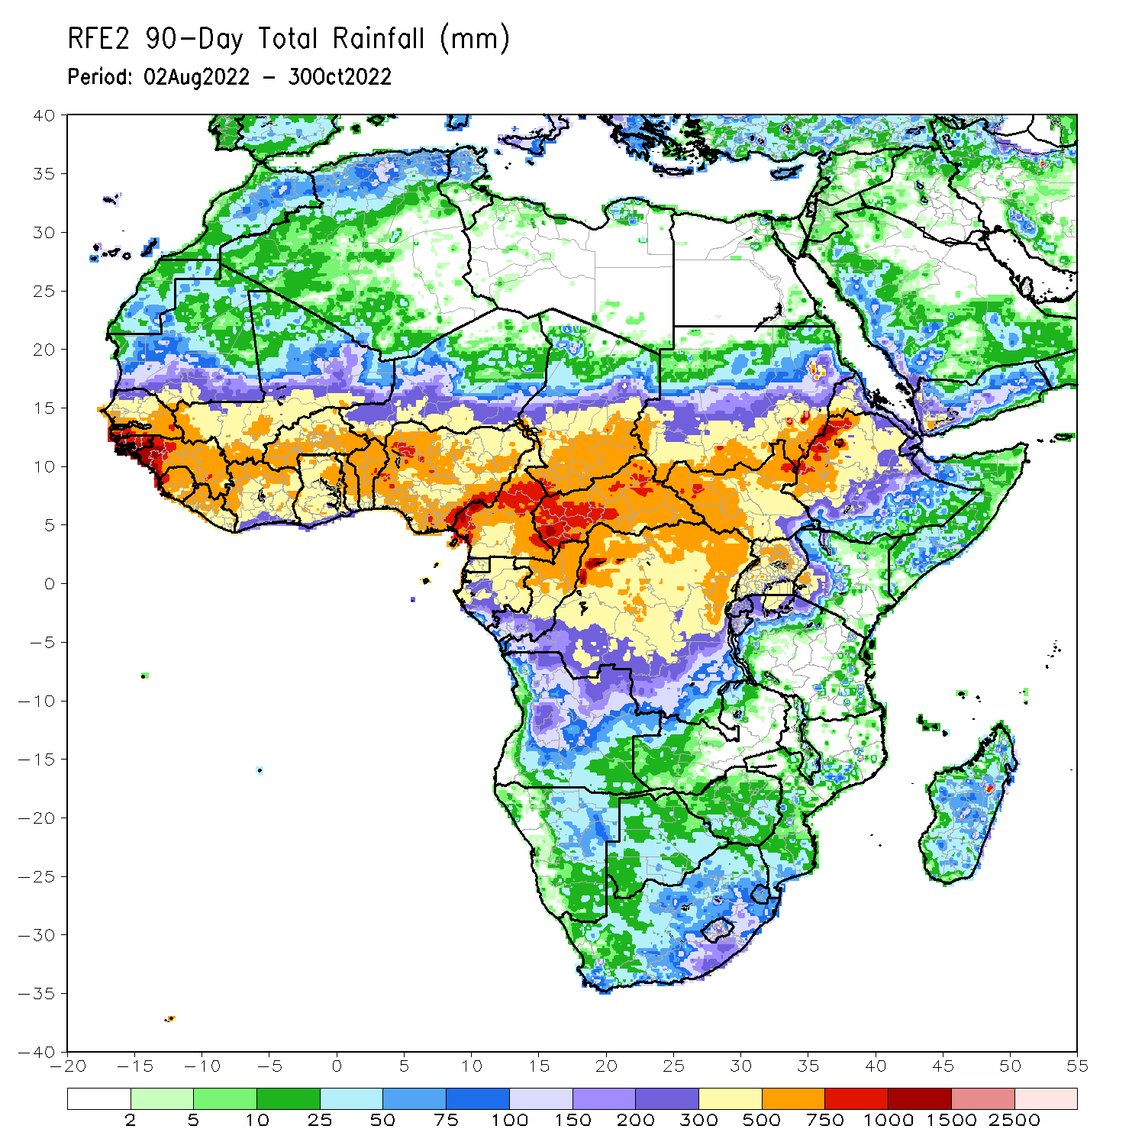
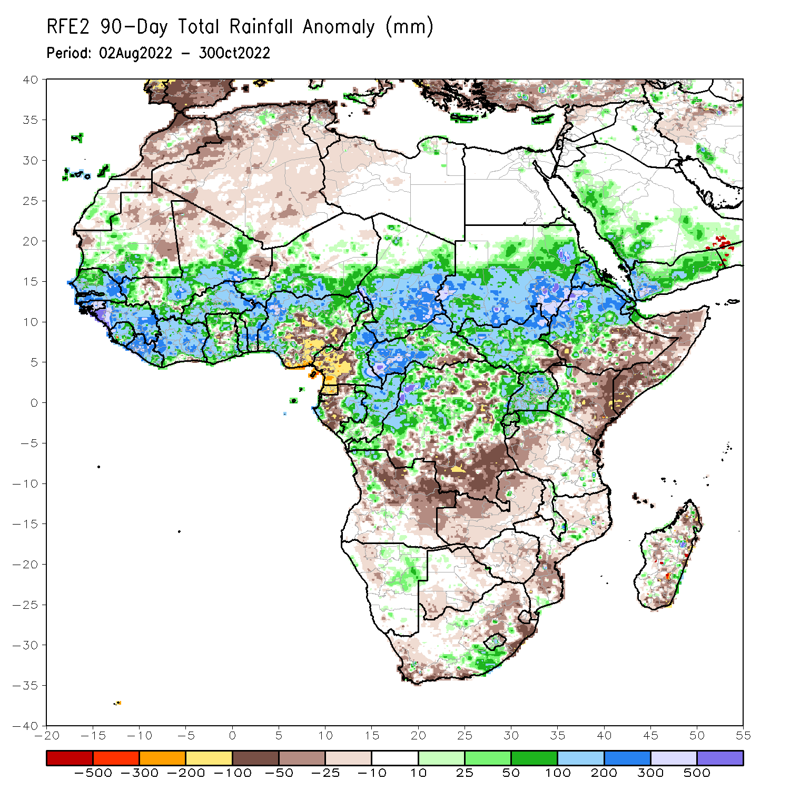
Rainfall Patterns: Last 90 Days
Over the past 90 days, in East Africa, above-average rainfall was observed over southern and central parts of Sudan, much of South Sudan, central and northern Ethiopia, Eritrea, Djibouti, Uganda, Rwanda, Burundi, northern Tanzania, and western Kenya. Rainfall was below-average over pockets of southern and southeastern Ethiopia, throughout much of Somalia, central and eastern Kenya, and western Tanzania. In southern Africa, above-average rainfall was observed over pockets of southern South Africa and northeastern Namibia. Below-average rainfall was observed over much of Angola, pockets of southwestern and northeastern South Africa, Lesotho, Eswatini, Botswana, southern Mozambique, Zimbabwe, Zambia, and southern, central, and northern Madagascar. In Central Africa, rainfall was above-average over northern and eastern Cameroon, southern and central Chad, CAR, much of Congo, and many parts of DRC. Rainfall was below-average over western Cameroon, pockets of northern and western Gabon, Equatorial Guinea, and parts of DRC. In West Africa, rainfall was above-average over southern Mauritania, Senegal, Gambia, Guinea-Bissau, Guinea, Sierra Leone, Liberia, much of Cote D’Ivoire, throughout most of Ghana, Togo, Benin, Burkina Faso, eastern and southern portions of Mali, southern Niger, and western and northern Nigeria. In contrast, below-average rainfall was observed over eastern and northern Mauritania, western and northern pockets of Mali, and parts of central and southeastern Nigeria.
Notes:
4

Slide 5
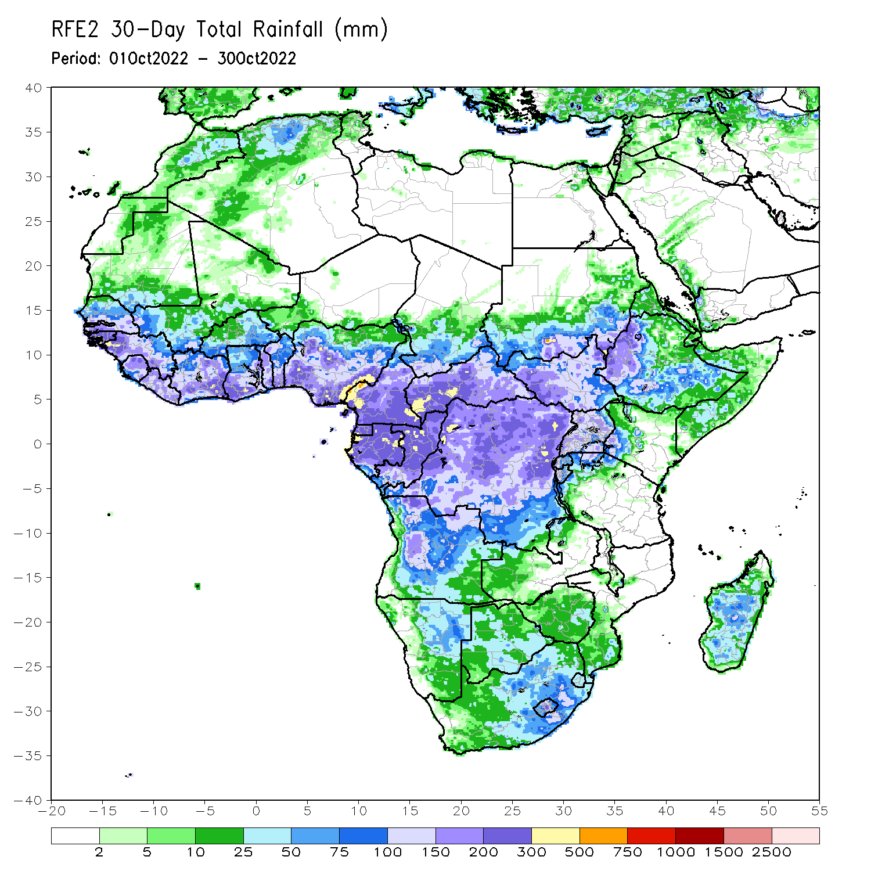
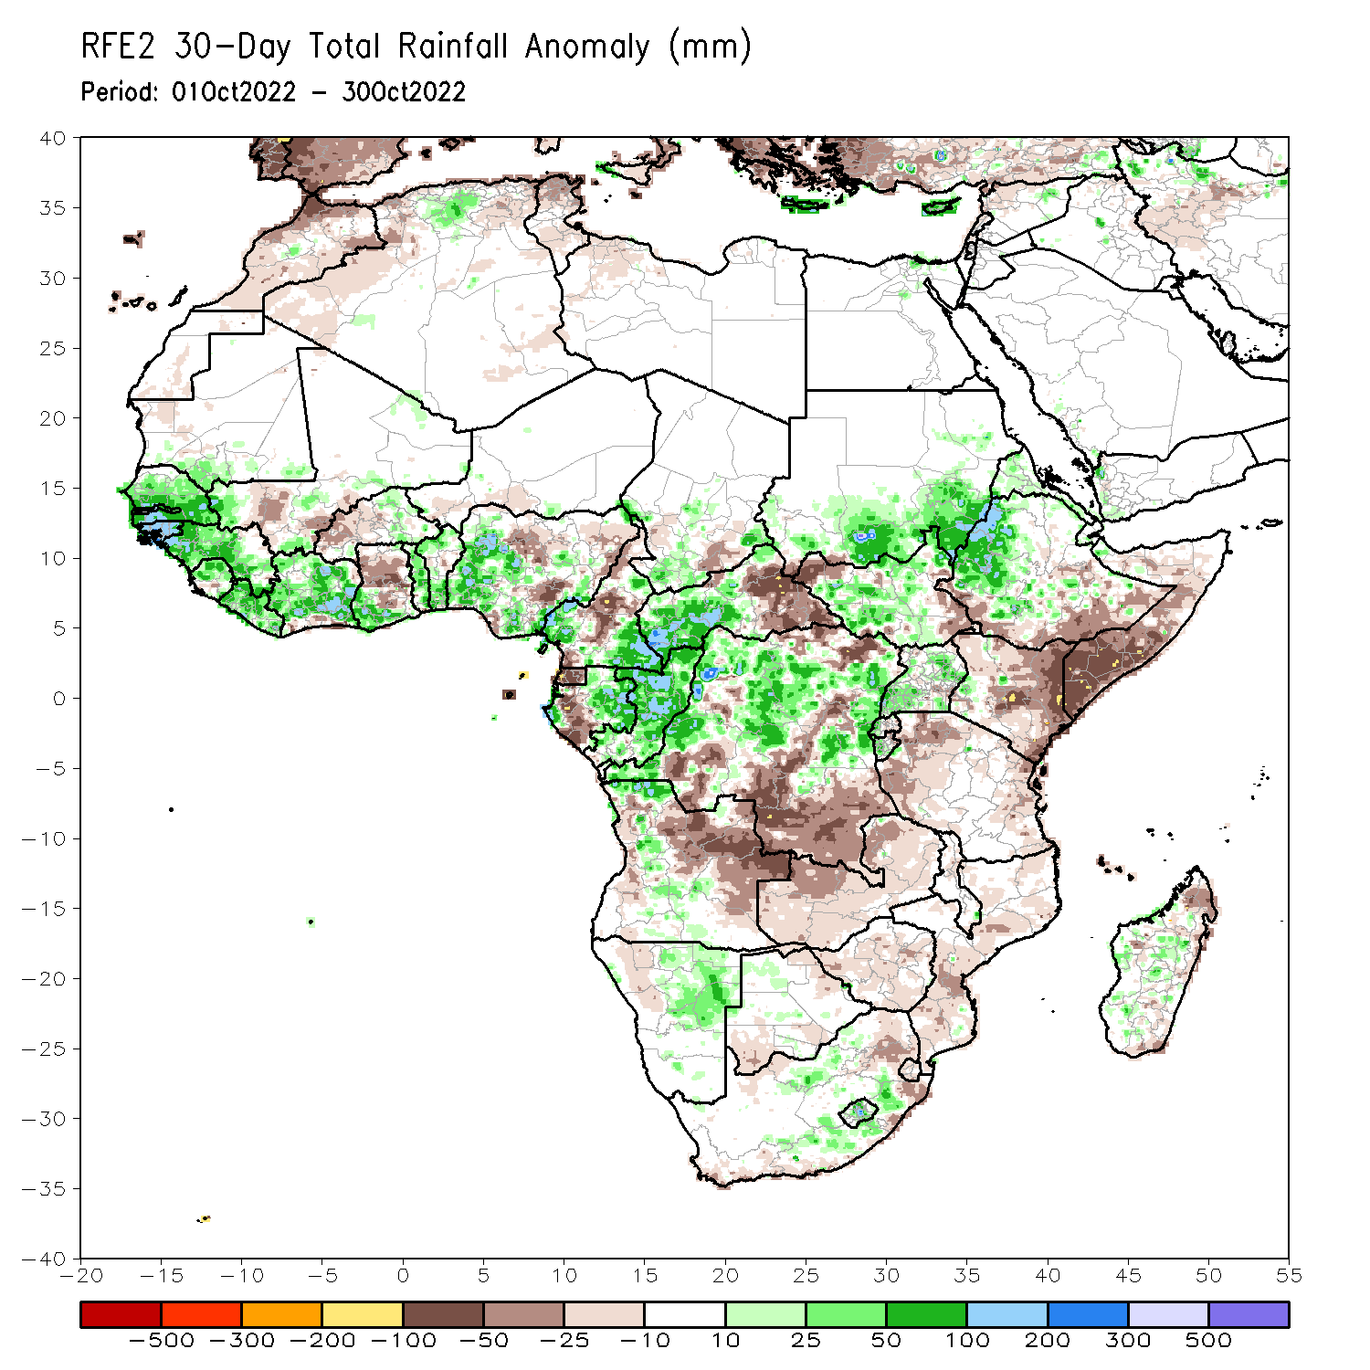
Rainfall Patterns: Last 30 Days
During the past 30 days, in East Africa, above-average rainfall was observed over southern and eastern Sudan, parts of South Sudan, western Ethiopia, and Uganda. Rainfall was below-average over pockets of southern Ethiopia and most of Somalia, Kenya and Tanzania. In Central Africa, rainfall was above-average over parts of western and eastern Cameroon, much of Congo, western and central CAR, and parts of DRC. Rainfall was below-average over Equatorial Guinea, and northwestern Cameroon, and pockets of central and southern DRC. In West Africa, rainfall was above-average over Senegal, Guinea-Bissau, Guinea, Sierra Leone, Liberia, Cote d’Ivoire, most of southwestern Ghana, Togo, and western and southern Nigeria. In contrast, central Ghana, coastal Cote D’Ivoire, and central and eastern Nigeria received below-average rainfall. In southern Africa, above-average rainfall was observed over northwestern Angola, parts of southern South Africa and northeastern Namibia. Below normal precipitation was observed in central and eastern Angola, northern and eastern South Africa, northern Lesotho, Swaziland, Zambia, Botswana, Zimbabwe, central and southern Mozambique, and central and eastern Madagascar.
Notes:
5

Slide 6
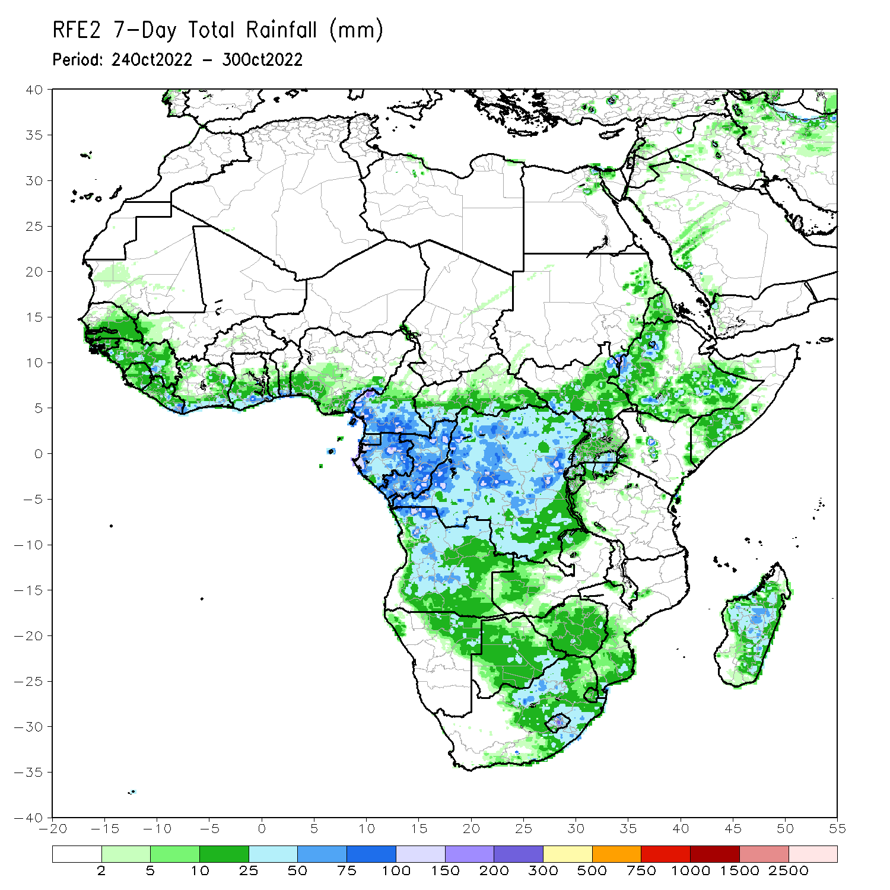
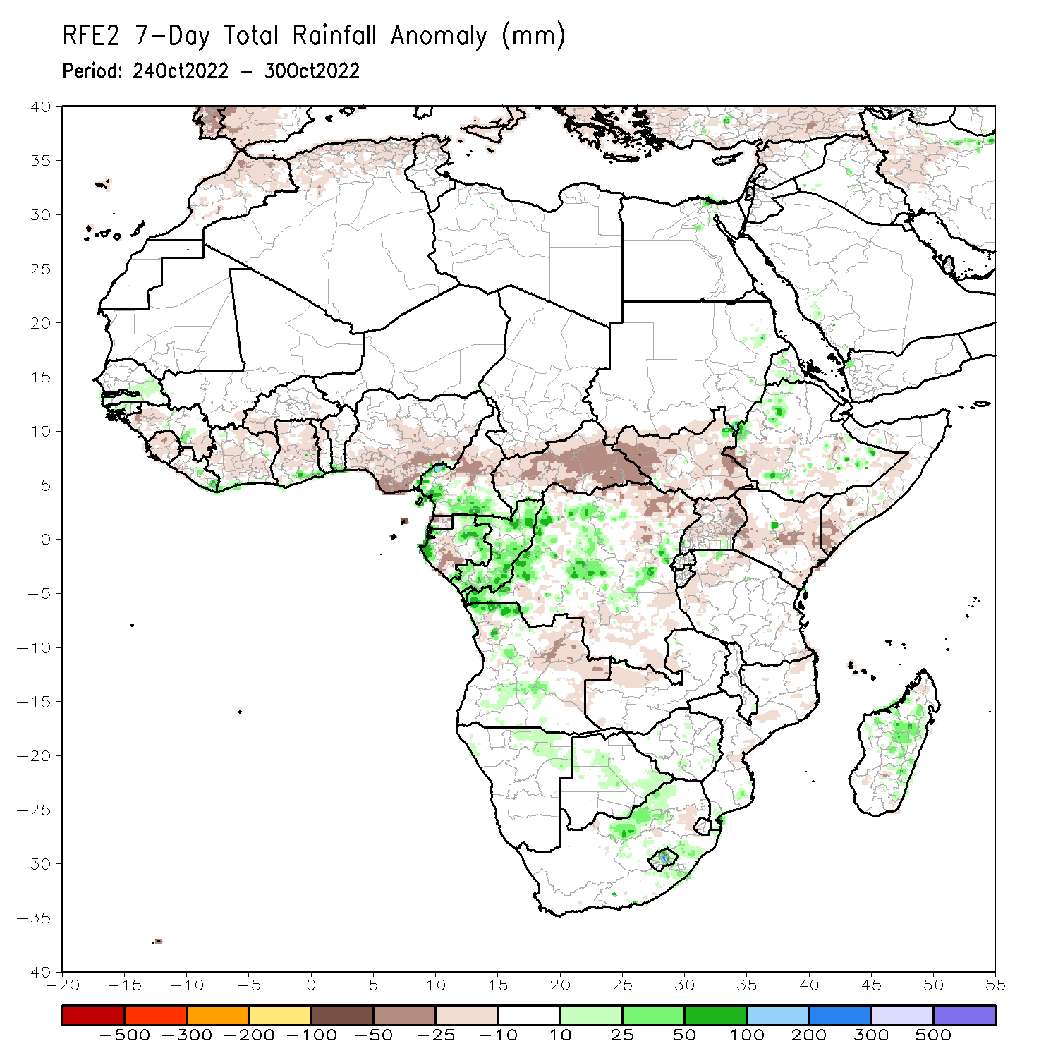
Rainfall Patterns: Last 7 Days
During the past 7 days, in East Africa, rainfall was above-average over pockets of western and southern Ethiopia. Below-average rainfall was observed over parts of South Sudan, southern Somalia, and Kenya. In Central Africa, rainfall was above-average over southern Cameroon, and parts of Gabon and Congo, and pockets of DRC. Below-average rainfall was observed over northern Cameroon, much of CAR, pockets of northeastern DRC, and a small portion of central Gabon. In West Africa, above-average rainfall was observed over the far western portion of the Gulf of Guinea region. Rainfall was below-average over the central and eastern portions of the Gulf of Guinea region. In southern Africa, rainfall was above average in pockets of Angola, northern South Africa and eastern Madagascar. In contrast, rainfall was below average in northeastern Angola.

Slide 7
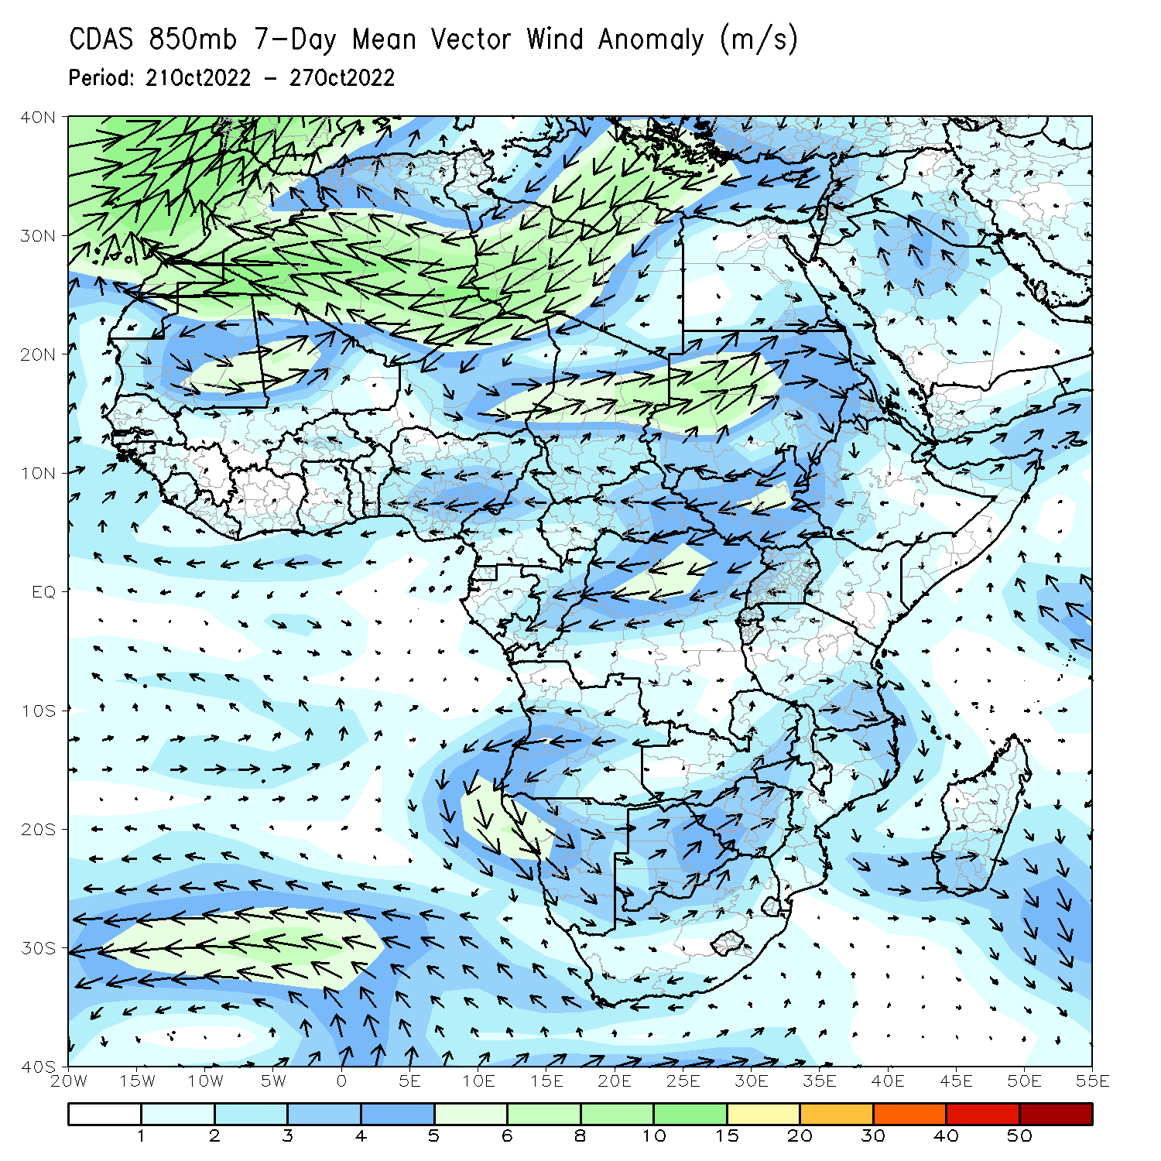
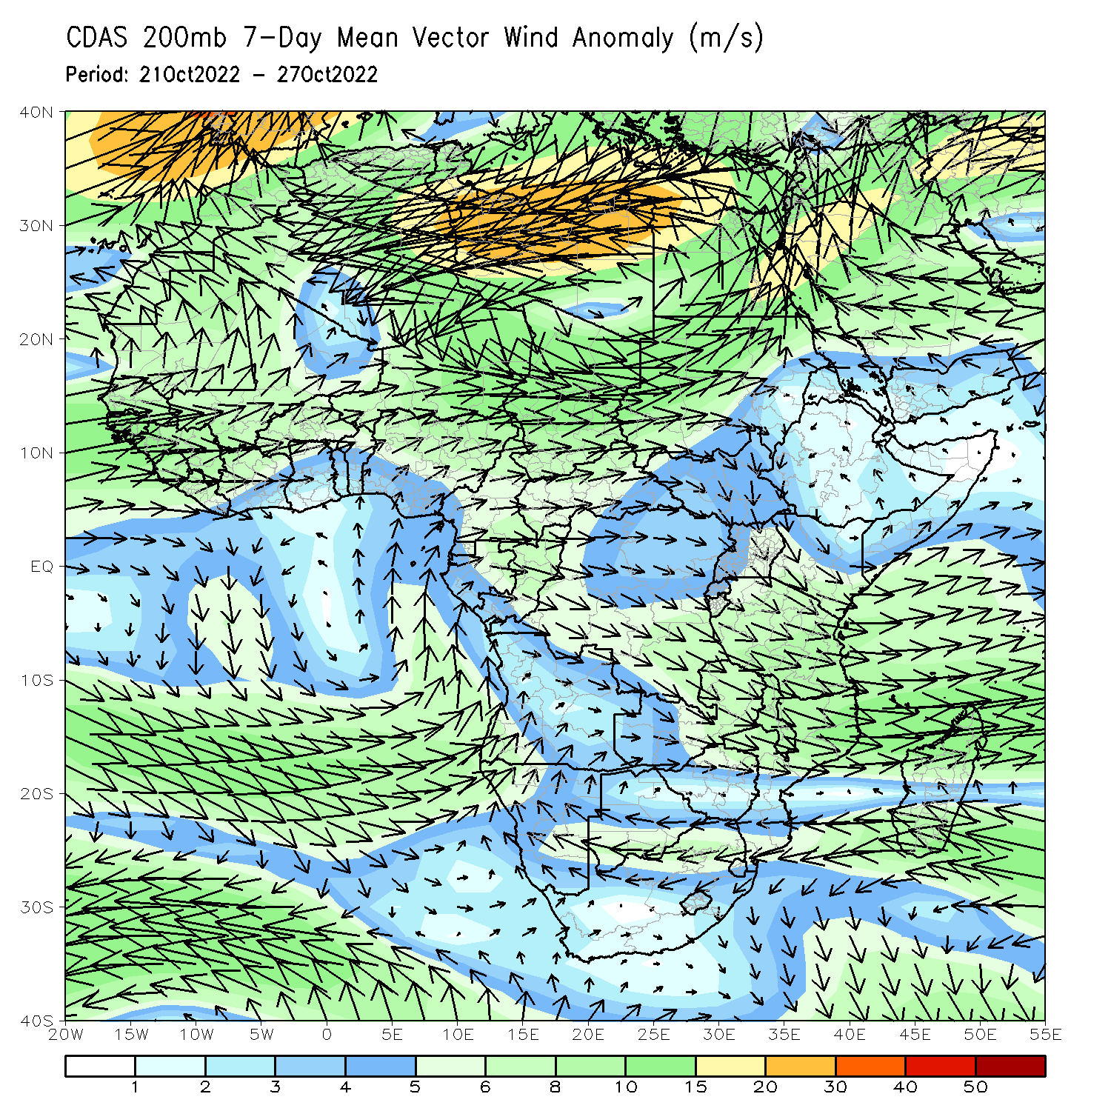
Atmospheric Circulation: Last 7 Days
At 850-hPa level (left panel), anomalous anti-cyclonic flow was observed across the northern portion of Southern Africa.

Slide 8
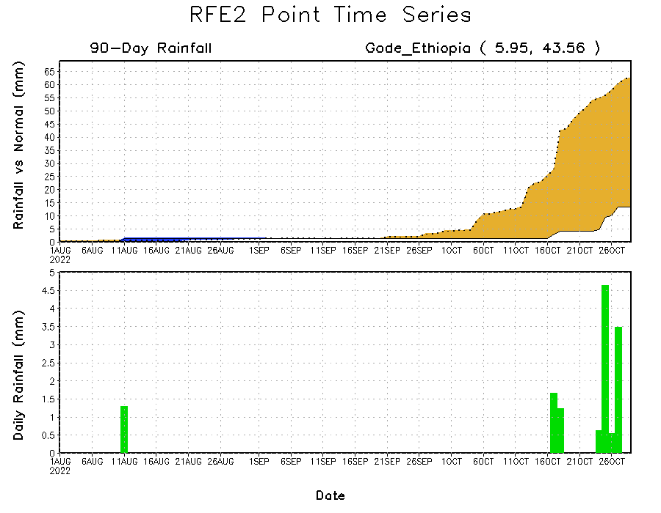
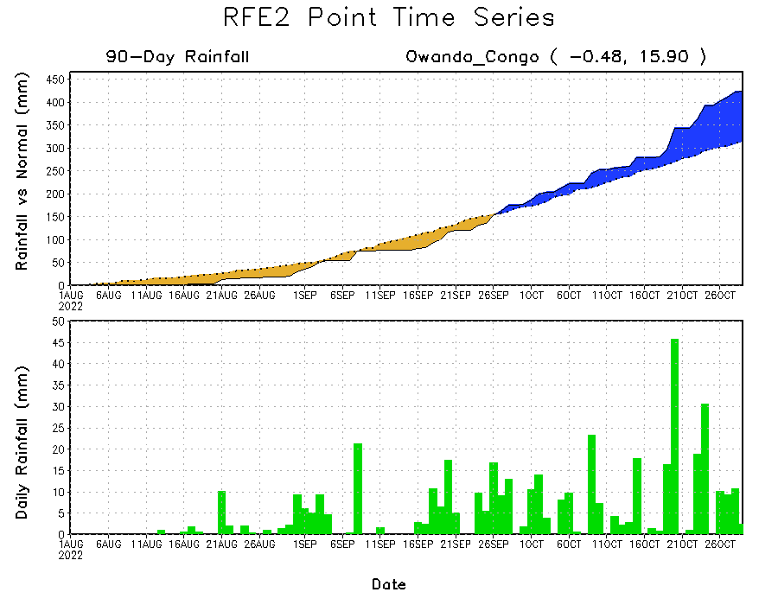
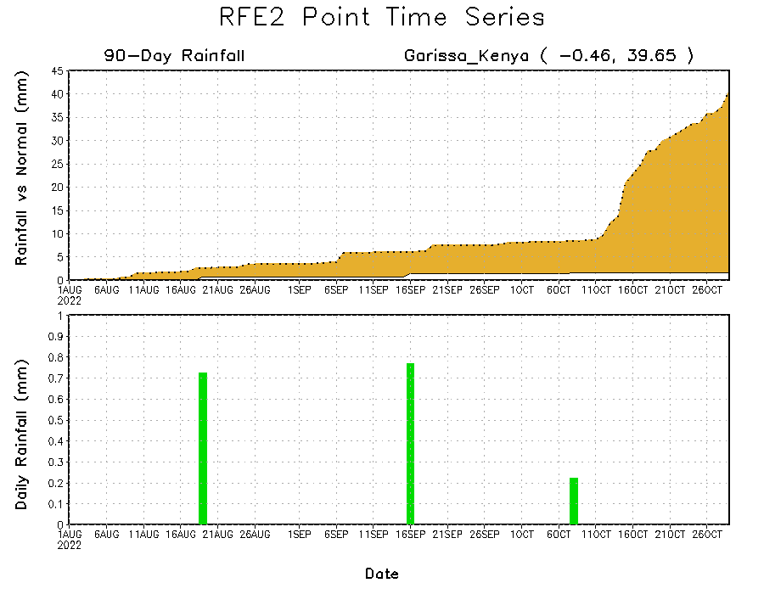
Rainfall Evolution
Daily evolution of rainfall over the last 90 days at selected locations shows continuing moisture surpluses over parts of Congo (bottom left). Rainfall deficits continue in southern Ethiopia (top right) and eastern Kenya (bottom right).

Slide 9
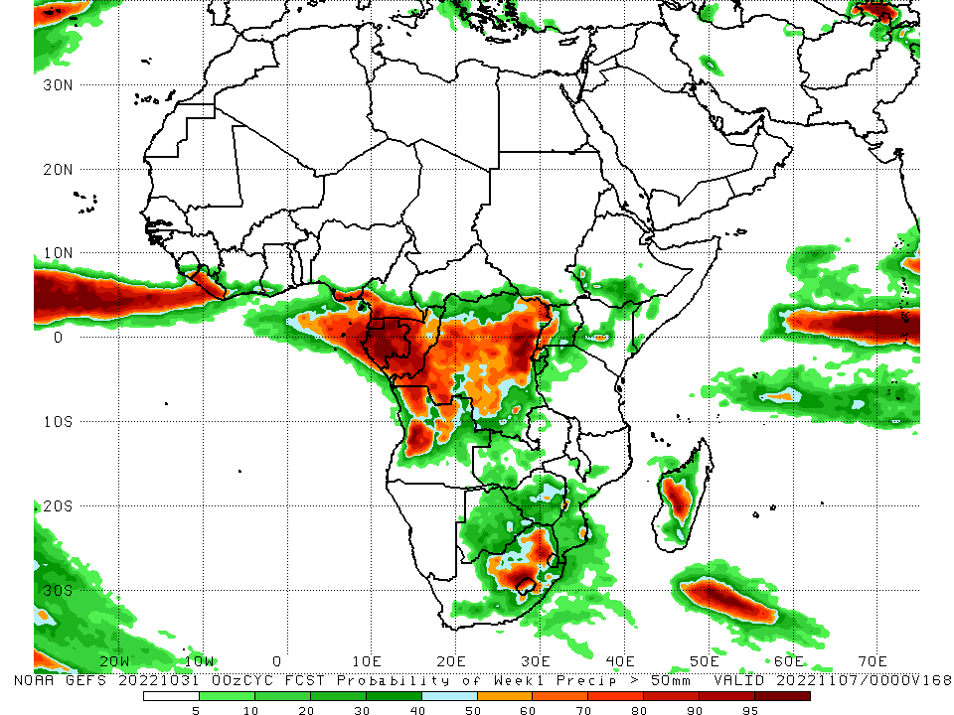
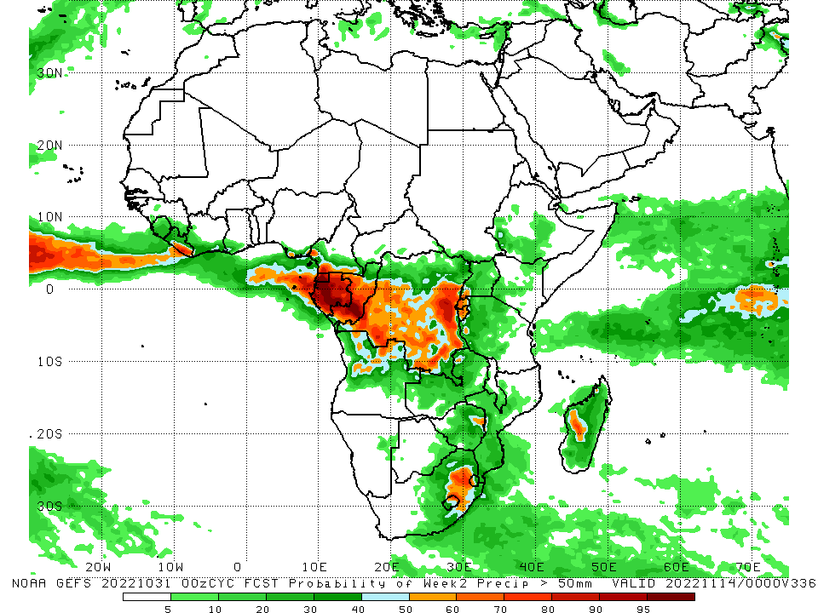
NCEP GEFS Model Forecasts Non-Bias Corrected Probability of precipitation exceedance
Week-1, Valid: 01 – 07 November, 2022
Week-2, Valid: 08 – 14 November, 2022
For week-1 (left panel) and week-2 (right panel), the NCEP GEFS forecasts indicate a moderate to high chance (over 70%) for rainfall to exceed 50 across Equatorial Guinea, Gabon, Congo, northern Angola, DRC, eastern South Africa, and central Madagascar.
Notes:
9

Slide 10
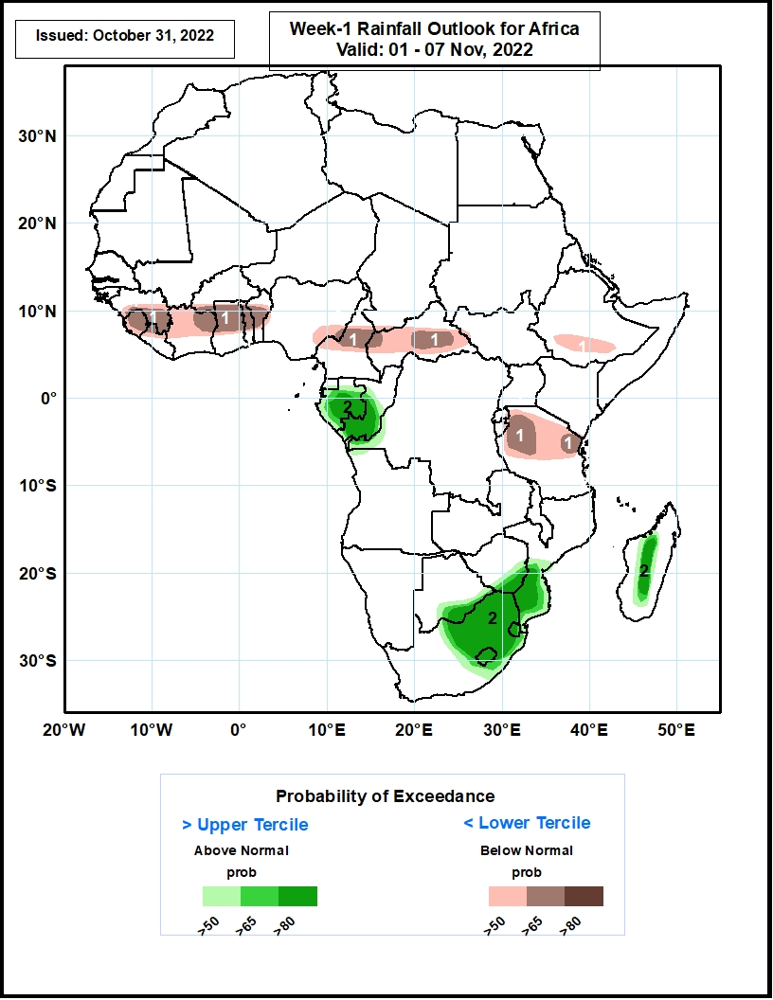
Week-1 Precipitation Outlooks
01 - 07 October, 2022
Model consolidated probabilistic forecasts call for above 50% chance for weekly total rainfall to be below-normal (below the lower tercile) portions of the Gulf of Guinea region, northern Cameroon, CAR, southern Ethiopia and northern Tanzania. In particular, there is above 65% chance for rainfall to be below-normal over Sierra Leone, eastern Guinea, northeastern Cote d’Ivoire, northern Ghana, northern Cameroon, and parts of CAR and Tanzania.
The forecasts also call for above 50% chance for weekly rainfall to be above-normal (above the upper tercile) over Gabon, southern Congo, eastern South Africa, Lesotho, Eswatini, southern Mozambique and central Madagascar. In particular, there is above 65% chance for rainfall to be above-normal over Gabon, southern Congo, and eastern South Africa.
Notes:
10

Slide 11
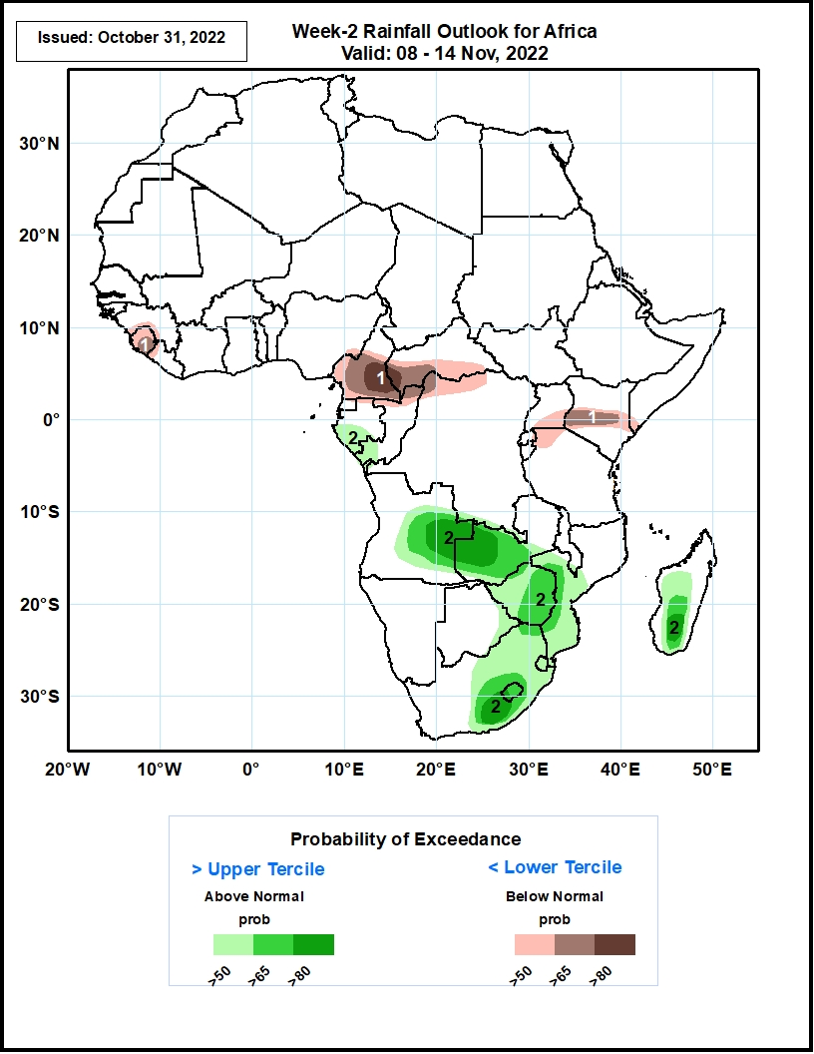
Week-2 Precipitation Outlooks
08 - 14 November, 2022
Model consolidated probabilistic forecasts call for above 50% chance for weekly total rainfall to be below-normal (below the lower tercile) over Sierra Leone, southern Cameroon, southern CAR, northwestern DRC, southern Uganda, northwestern Tanzania, and central Tanzania. In particular, there is above 80% chance for rainfall to be below-normal over southeastern Cameroon.
The forecasts also call for above 50% chance for weekly rainfall to be above-normal (above the upper tercile) over eastern Angola, western Zambia, eastern Zimbabwe, eastern South Africa, Lesotho, Eswatini, southern Mozambique, and southern Madagascar. In particular, there is above 65% chance for rainfall to be above-normal over eastern Angola, western Zambia, eastern South Africa and southern Madagascar.
Notes:
11

Slide 12
Summary
During the past 30 days, in East Africa, above-average rainfall was observed over southern and eastern Sudan, parts of South Sudan, western Ethiopia, and Uganda. Rainfall was below-average over pockets of southern Ethiopia and most of Somalia, Kenya and Tanzania. In Central Africa, rainfall was above-average over parts of western and eastern Cameroon, much of Congo, western and central CAR, and parts of DRC. Rainfall was below-average over Equatorial Guinea, and northwestern Cameroon, and pockets of central and southern DRC. In West Africa, rainfall was above-average over Senegal, Guinea-Bissau, Guinea, Sierra Leone, Liberia, Cote d’Ivoire, most of southwestern Ghana, Togo, and western and southern Nigeria. In contrast, central Ghana, coastal Cote D’Ivoire, and central and eastern Nigeria received below-average rainfall. In southern Africa, above-average rainfall was observed over northwestern Angola, parts of southern South Africa and northeastern Namibia. Below normal precipitation was observed in central and eastern Angola, northern and eastern South Africa, northern Lesotho, Swaziland, Zambia, Botswana, Zimbabwe, central and southern Mozambique, and central and eastern Madagascar.
During the past 7 days, in East Africa, rainfall was above-average over pockets of western and southern Ethiopia. Below-average rainfall was observed over parts of South Sudan, southern Somalia, and Kenya. In Central Africa, rainfall was above-average over southern Cameroon, and parts of Gabon and Congo, and pockets of DRC. Below-average rainfall was observed over northern Cameroon, much of CAR, pockets of northeastern DRC, and a small portion of central Gabon. In West Africa, above-average rainfall was observed over the far western portion of the Gulf of Guinea region. Rainfall was below-average over the central and eastern portions of the Gulf of Guinea region. In southern Africa, rainfall was above average in pockets of Angola, northern South Africa and eastern Madagascar. In contrast, rainfall was below average in northeastern Angola.
Week-1 outlooks call for an increased chance for above-normal rainfall over Gabon, southern Congo, eastern South Africa, Lesotho, Eswatini, southern Mozambique and central Madagascar. In contrast, there is an increased chance for below-normal rainfall over Gabon, southern Congo, eastern South Africa, Lesotho, Eswatini, southern Mozambique and central Madagascar. Week-2 outlooks call for an increased chance for above-normal rainfall over eastern Angola, western Zambia, eastern Zimbabwe, eastern South Africa, Lesotho, Eswatini, southern Mozambique, and southern Madagascar. In contrast, there is an increased chance for below-normal rainfall over Sierra Leone, southern Cameroon, southern CAR, northwestern DRC, southern Uganda, northwestern Tanzania, and central Tanzania.

