Slide 1
The African Monsoon Recent Evolution and Current Status Include Week-1 and Week-2 Outlooks
Update prepared by
24 October 2022
For more information, visit:
http://www.cpc.ncep.noaa.gov/products/Global_Monsoons/African_Monsoons/precip_monitoring.shtml

Slide 2
Outline
Highlights
Recent Evolution and Current Conditions
NCEP GEFS Forecasts
Summary

Slide 3
Highlights: Last 7 Days
During the past 7 days, in East Africa, rainfall was above-average over western Ethiopia, northern and central South Sudan, southeastern portions of Sudan, and southwestern and eastern Uganda, western Rwanda, and Burundi. Below-average rainfall was observed over pockets of southern Ethiopia, southwestern South Sudan, southern Somalia, and eastern Kenya. In Central Africa, rainfall was above-average over eastern Cameroon, southwestern Chad, western and central CAR, central portions of Congo, eastern DRC, and a small portion of central Gabon. Below-average rainfall was observed over a portion of northeastern CAR, central Cameroon, northern, southern, and central DRC, Equatorial Guinea, western Gabon, northern and southern Congo, northeastern Angola, and northern Zambia. In West Africa, above-average rainfall was observed over southwestern Nigeria, southern Benin, southern Togo, southwestern Ghana, southern Cote D’Ivoire, eastern Liberia, western Guinea, northeastern Sierra Leone, Guinea-Bissau, and central and southern Senegal. In contrast, eastern Guinea, western and southern Sierra Leone, northern Cote D’Ivoire, northern Ghana, western Burkina Faso, northern and central Togo/Benin, and small portions of north-central and southern and central Nigeria received below-average rainfall. In southern Africa, rainfall was above average in pockets of eastern and southern South Africa, central and western Madagascar, central and eastern Namibia, and pockets of northern and southern Botswana. In contrast, rainfall was below average in northeastern Madagascar, Zimbabwe, and southern Mozambique.
Week-1 outlooks call for an increased chance for above-average rainfall across much of the Gulf of Guinea coast, northwestern DRC, western and southern Ethiopia, Gabon, Equatorial Guinea, Congo, western Somalia, portions of central Angola, eastern South Africa, Swaziland, and western and central Madagascar. In contrast, there is an increased chance for below-average rainfall near the Lake Victoria region, Burundi, Rwanda, southern Somalia, Kenya, eastern and western Tanzania, northeastern DRC, eastern Madagascar, southeastern and western Guinea, Sierra Leone, northern Cote D’Ivoire, northern Ghana, northern Togo/Benin, northern and central Cameroon, CAR, South Sudan, central and southern South Africa, and Lesotho. Week-2 outlooks call for an increased chance for above-average rainfall in Gabon, Congo, western and southern DRC, eastern Angola, eastern Zimbabwe, Zambia, northeastern Namibia, central and western Madagascar, Botswana, Zimbabwe, southern Mozambique, central and eastern South Africa, Lesotho, and Swaziland. In contrast, there is an increased chance for below-average rainfall across the Gulf of Guinea coast, central and southern Cameroon, central and southern CAR, southern and western Ethiopia, southern Somalia, the Lake Victoria region, Rwanda, Burundi, Tanzania, Kenya, and eastern Madagascar.

Slide 4
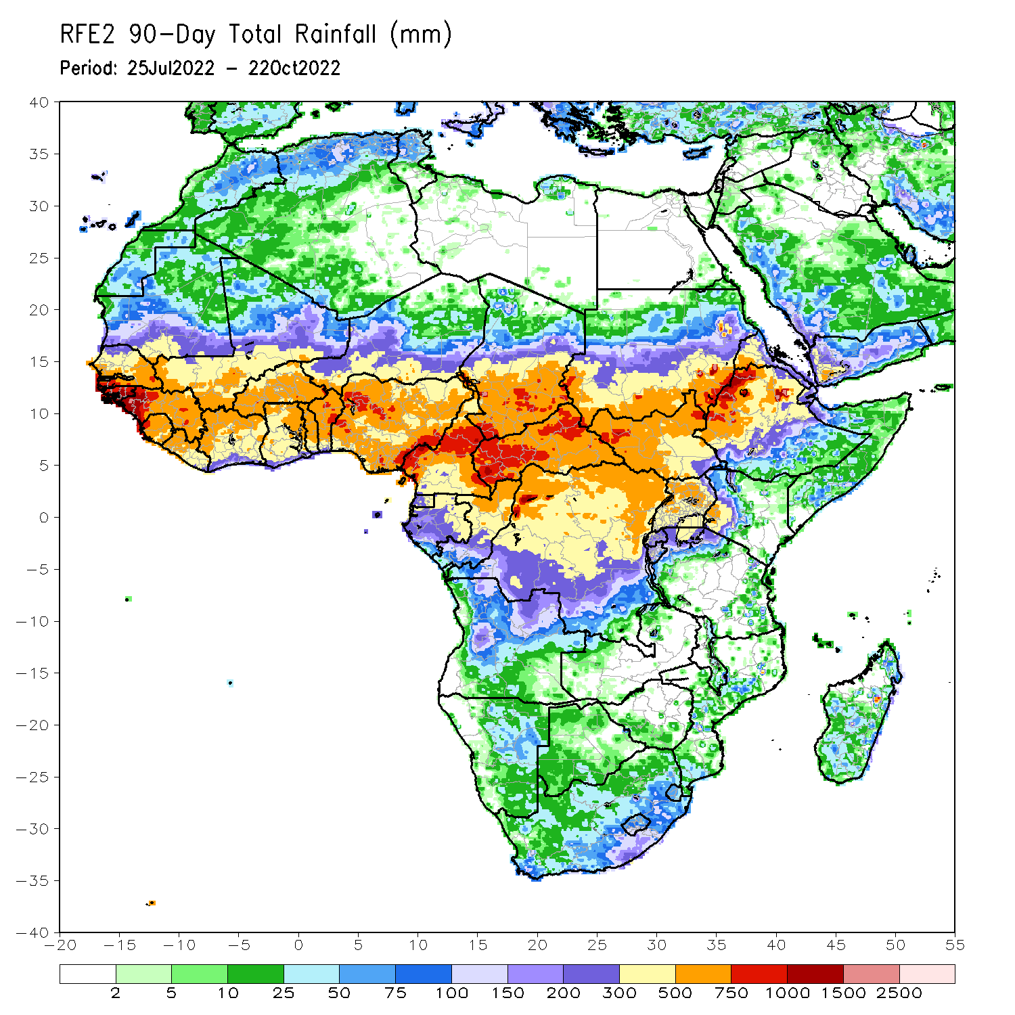
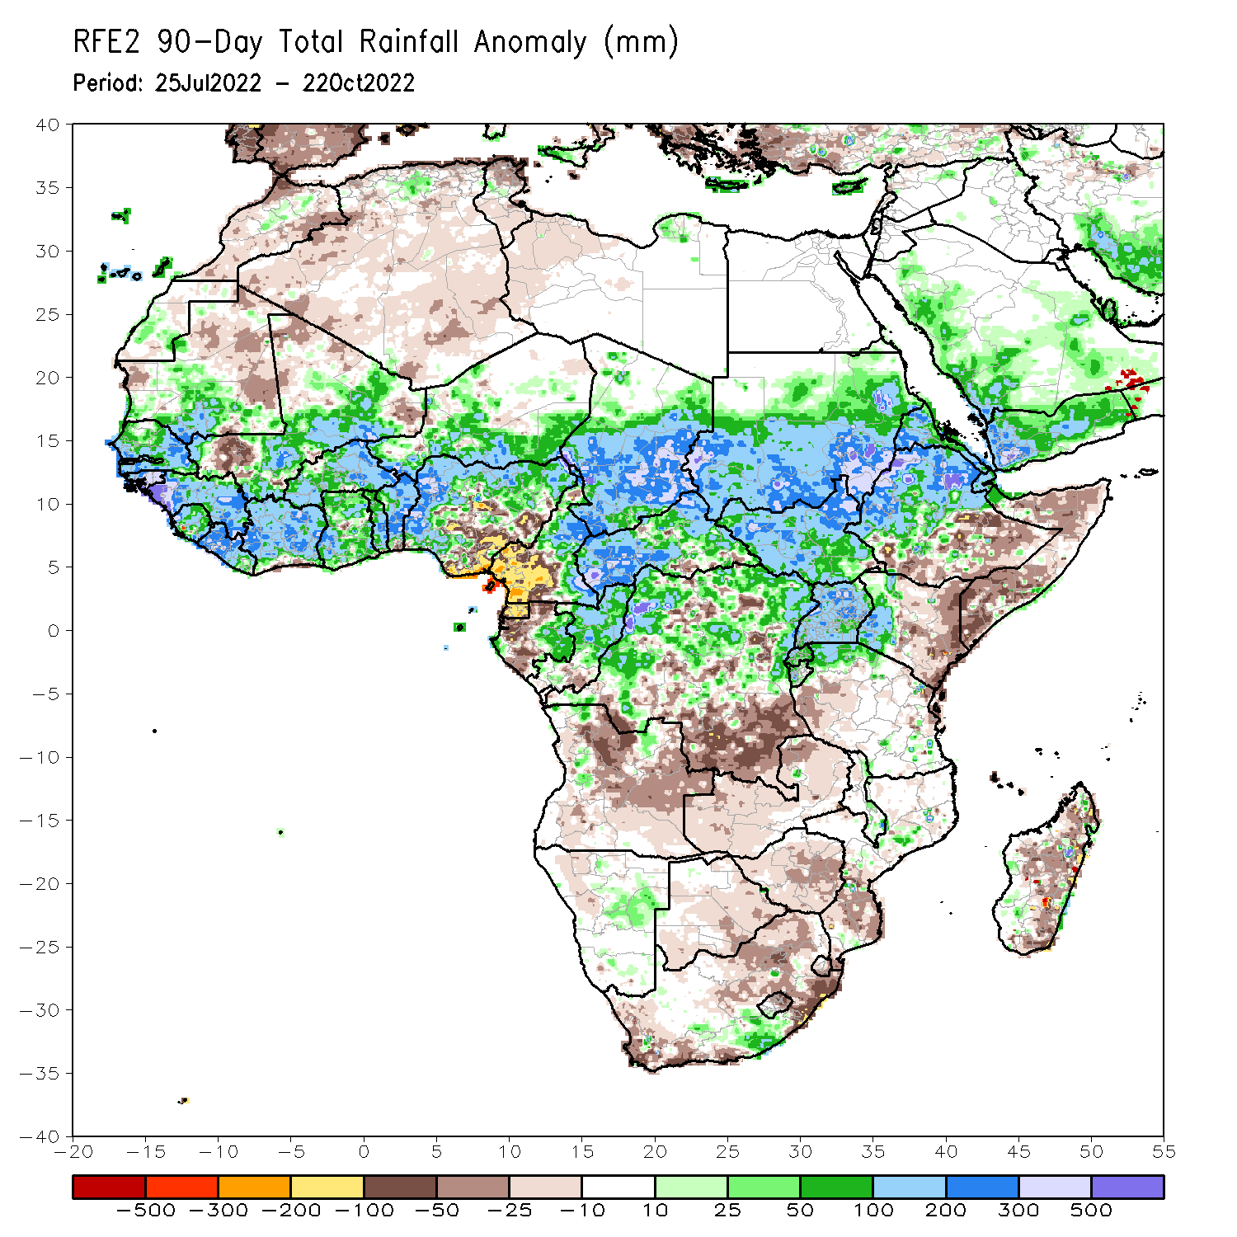
Rainfall Patterns: Last 90 Days
Over the past 90 days, in East Africa, above-average rainfall was observed over southern and central parts of Sudan, much of South Sudan, northern Ethiopia, Eritrea, Djibouti, Uganda, Rwanda, western Burundi, northern Tanzania, and western Kenya. Rainfall was below-average over pockets of southern and central Ethiopia, throughout much of Somalia, eastern Kenya, and western Tanzania. In southern Africa, above-average rainfall was observed over pockets of southern South Africa, pockets of central Mozambique, northeastern Namibia, southern Malawi, and pockets of eastern and western Madagascar. Below-average rainfall was observed over pockets of southwestern and northeastern South Africa, Lesotho, Botswana, southern Mozambique, Zimbabwe, Zambia, and southern, central, and northern Madagascar. In Central Africa, rainfall was above-average over northern and eastern Cameroon, southern and central Chad, CAR, northern and central Congo, and northern, western and northeastern parts of DRC. Rainfall was below-average over western Cameroon, pockets of northern and western Gabon, Equatorial Guinea, parts of southeast DRC, and most of Angola. In West Africa, rainfall was above-average over southern Mauritania, Senegal, Gambia, Guinea-Bissau, Guinea, Sierra Leone, Liberia, much of Cote D’Ivoire, throughout most of Ghana, Togo, central and northern parts of Benin, Burkina Faso, eastern and southern portions of Mali, southern Niger, and western and northern Nigeria. In contrast, below-average rainfall was observed over eastern Mauritania, western and northern parts of Mali, parts of central and southeastern Nigeria, southern Benin, and southern Cote D’Ivoire.
Notes:
4

Slide 5
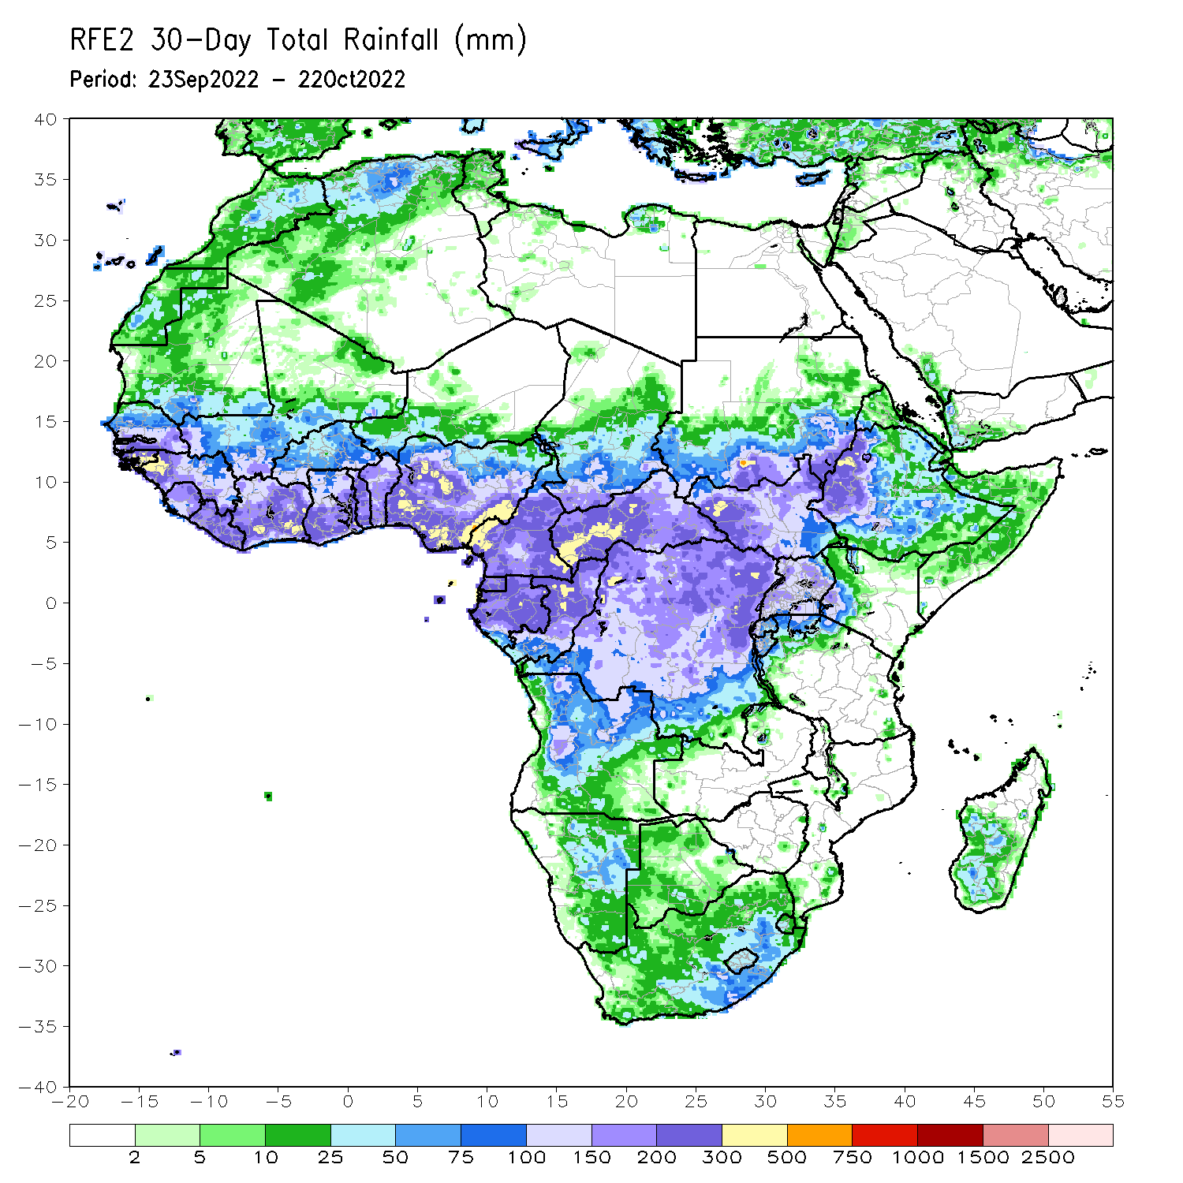
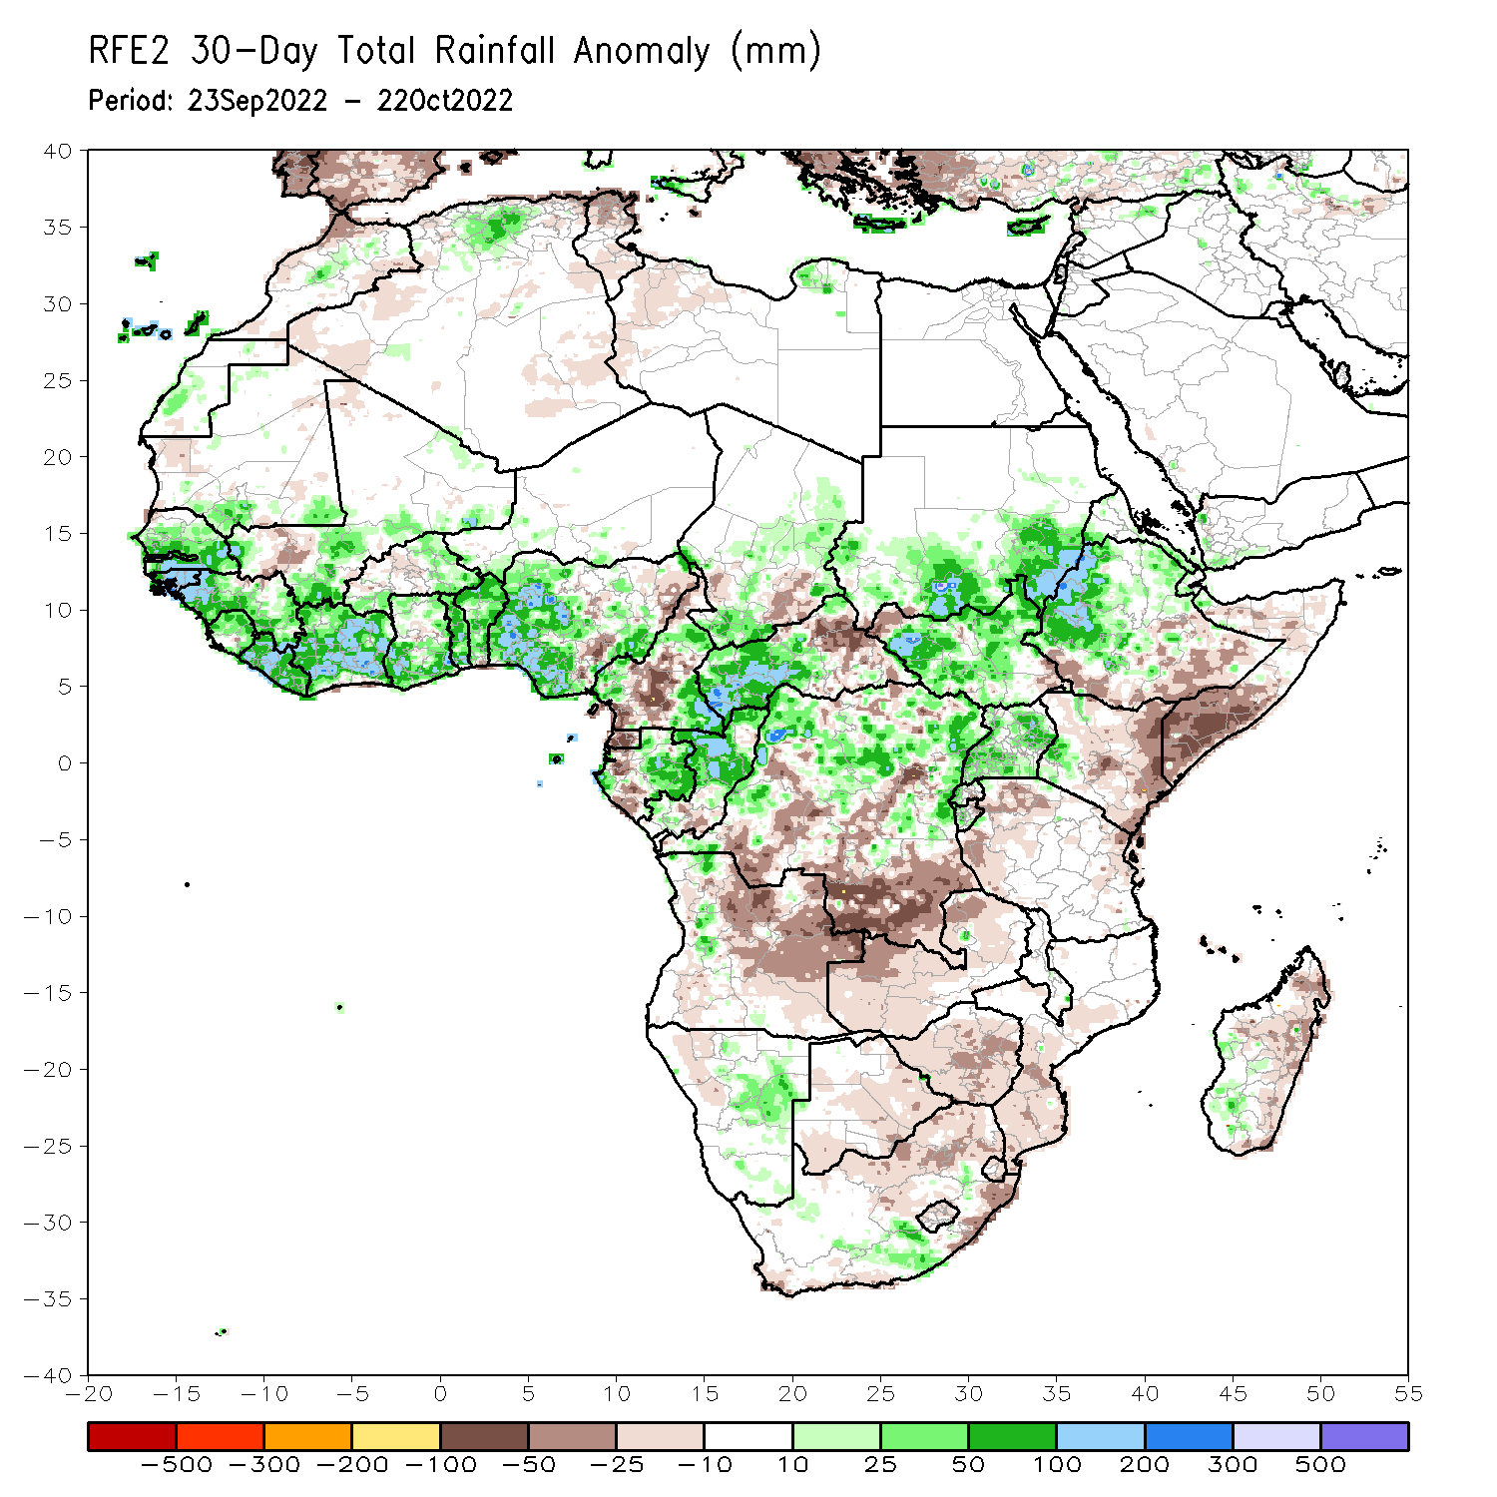
Rainfall Patterns: Last 30 Days
During the past 30 days, in East Africa, above-average rainfall was observed over southern and central Sudan, the western, central, and northeastern parts of South Sudan, eastern Eritrea, northern and western Ethiopia, and in Uganda and the Lake Victoria region. Rainfall was below-average over pockets of southern Ethiopia and most of Somalia. In Central Africa, rainfall was above-average over parts of northwestern and eastern Cameroon, northern and central Congo, western and northern CAR, southwestern and central Chad, and northern, western, and parts of eastern DRC. Rainfall was below-average over Equatorial Guinea, southern, central, and northern Cameroon, most of Angola, and pockets of central and southern DRC. In West Africa, rainfall was above-average over Senegal, Guinea-Bissau, Guinea, northern and southern Sierra Leone, Liberia, Burkina Faso, most of southern Ghana, parts of southern Niger, Togo, northern and central Benin, and western and southeastern Nigeria. In contrast, central Ghana, coastal Cote D’Ivoire, southern Benin, and central and eastern Nigeria received below-average rainfall. In southern Africa, above-average rainfall was observed over parts of southern South Africa, northeastern Namibia, and western Madagascar. Below normal precipitation was observed in northern and eastern South Africa, northern Lesotho, Swaziland, Zambia, Botswana, Zimbabwe, central and southern Mozambique, and central and eastern Madagascar.
Notes:
5

Slide 6
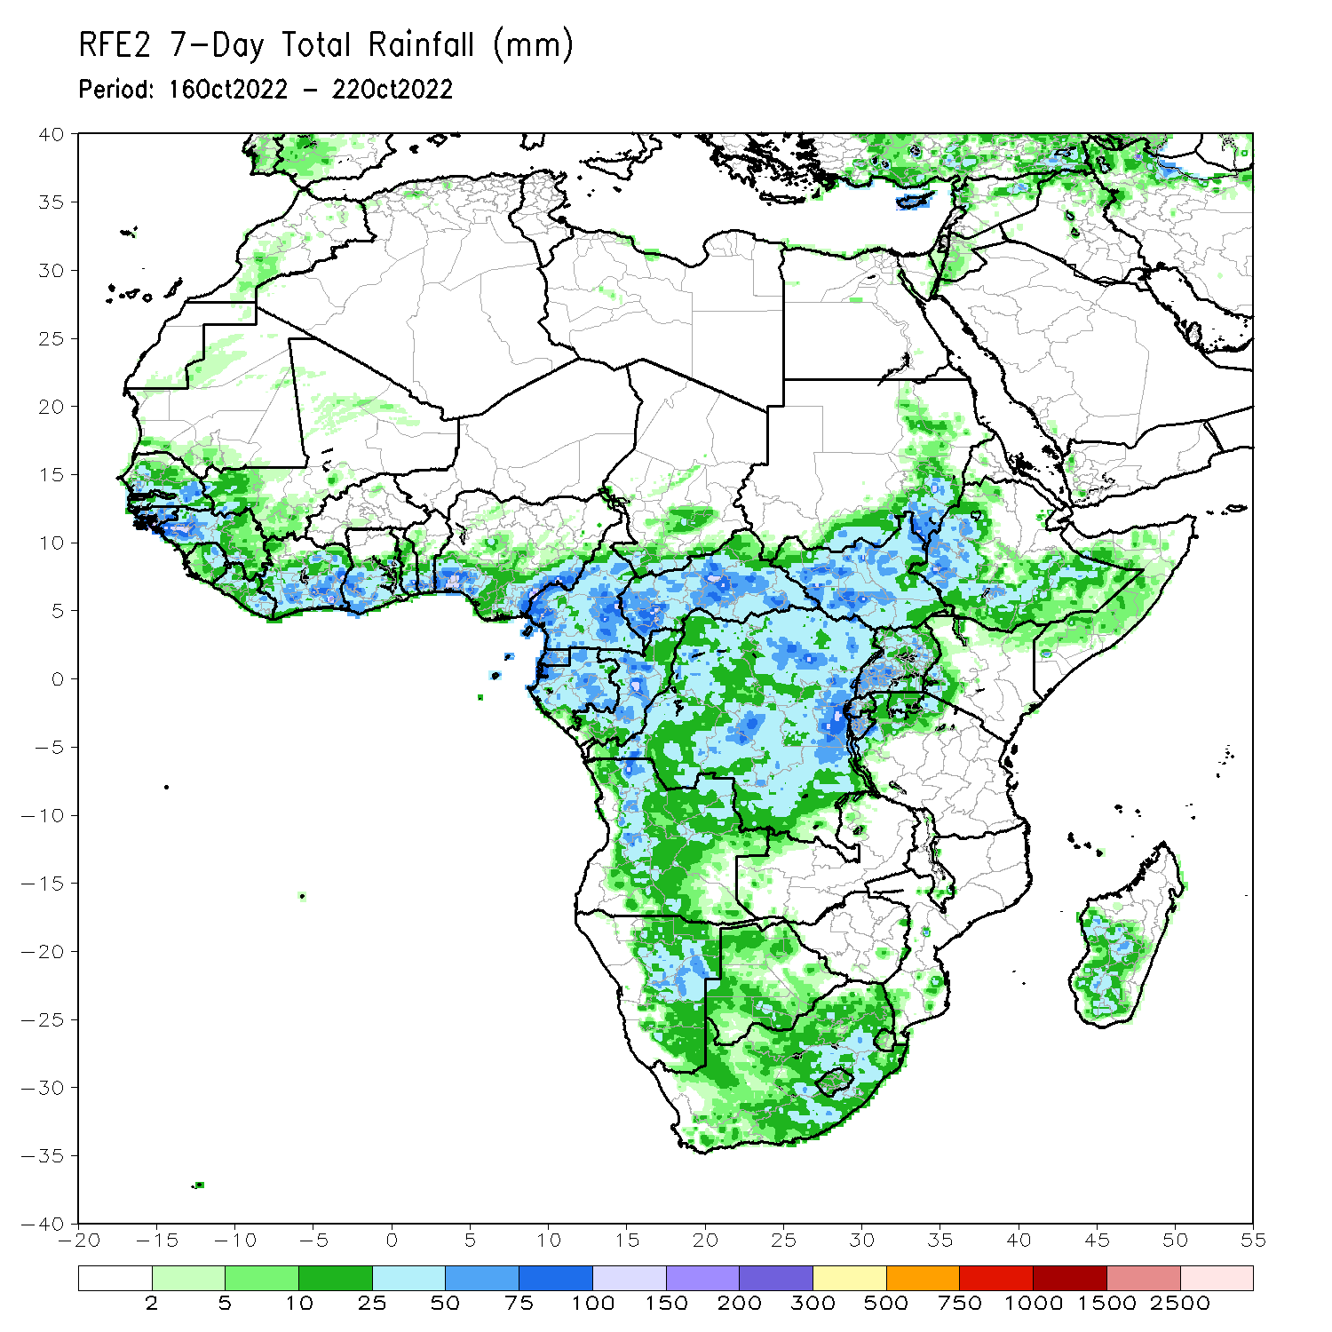
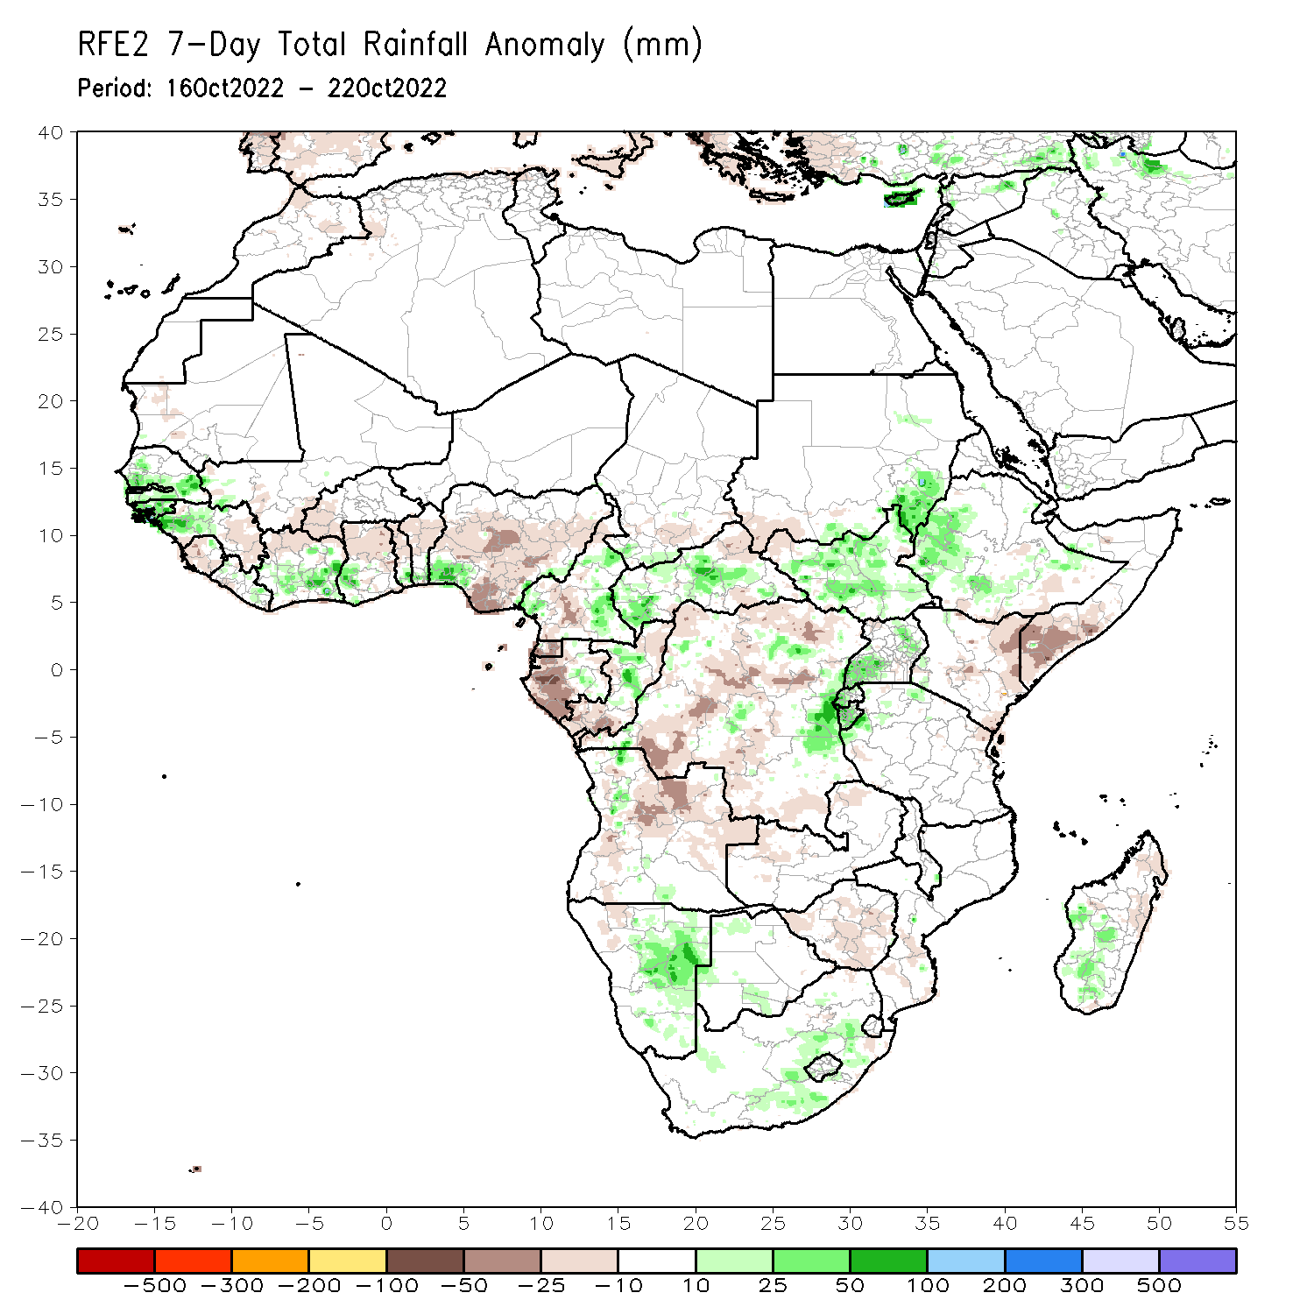
Rainfall Patterns: Last 7 Days
During the past 7 days, in East Africa, rainfall was above-average over western Ethiopia, northern and central South Sudan, southeastern portions of Sudan, and southwestern and eastern Uganda, western Rwanda, and Burundi. Below-average rainfall was observed over pockets of southern Ethiopia, southwestern South Sudan, southern Somalia, and eastern Kenya. In Central Africa, rainfall was above-average over eastern Cameroon, southwestern Chad, western and central CAR, central portions of Congo, eastern DRC, and a small portion of central Gabon. Below-average rainfall was observed over a portion of northeastern CAR, central Cameroon, northern, southern, and central DRC, Equatorial Guinea, western Gabon, northern and southern Congo, northeastern Angola, and northern Zambia. In West Africa, above-average rainfall was observed over southwestern Nigeria, southern Benin, southern Togo, southwestern Ghana, southern Cote D’Ivoire, eastern Liberia, western Guinea, northeastern Sierra Leone, Guinea-Bissau, and central and southern Senegal. In contrast, eastern Guinea, western and southern Sierra Leone, northern Cote D’Ivoire, northern Ghana, western Burkina Faso, northern and central Togo/Benin, and small portions of north-central and southern and central Nigeria received below-average rainfall. In southern Africa, rainfall was above average in pockets of eastern and southern South Africa, central and western Madagascar, central and eastern Namibia, and pockets of northern and southern Botswana. In contrast, rainfall was below average in northeastern Madagascar, Zimbabwe, and southern Mozambique.

Slide 7
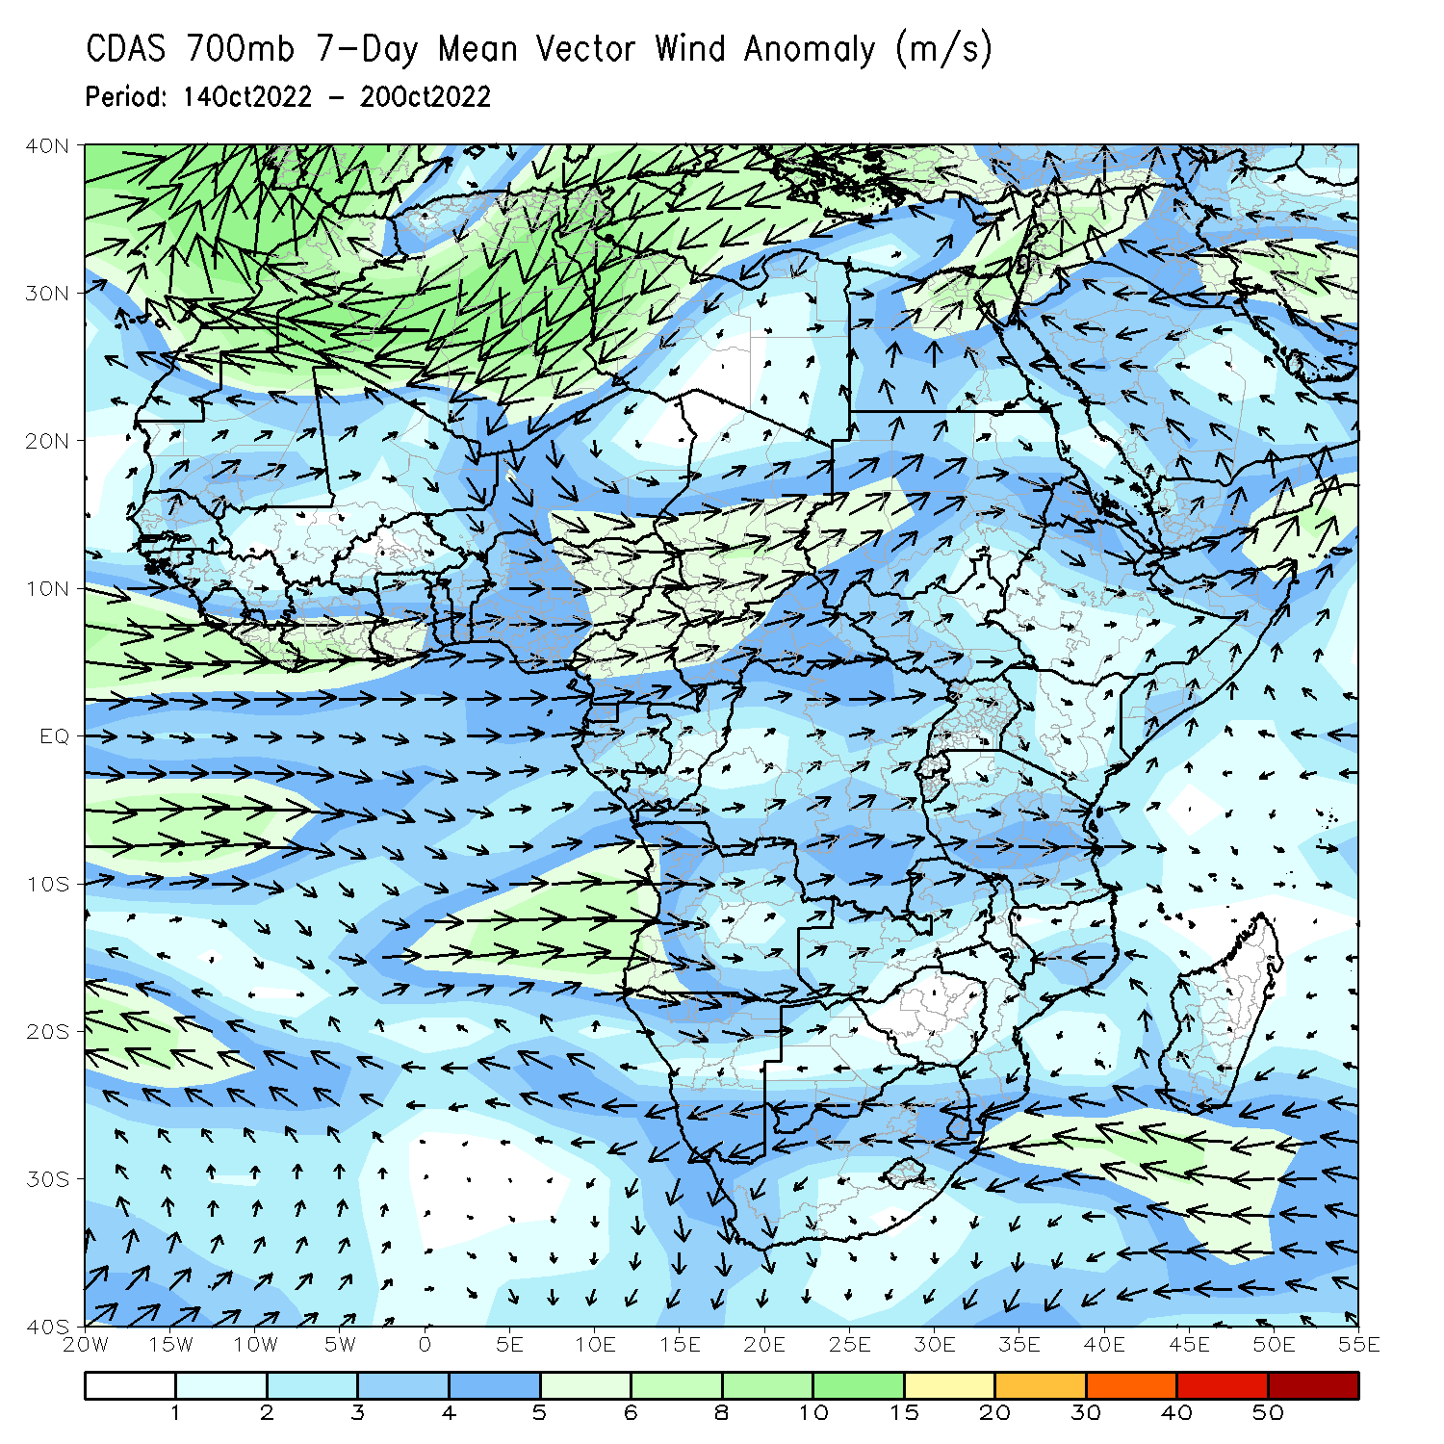
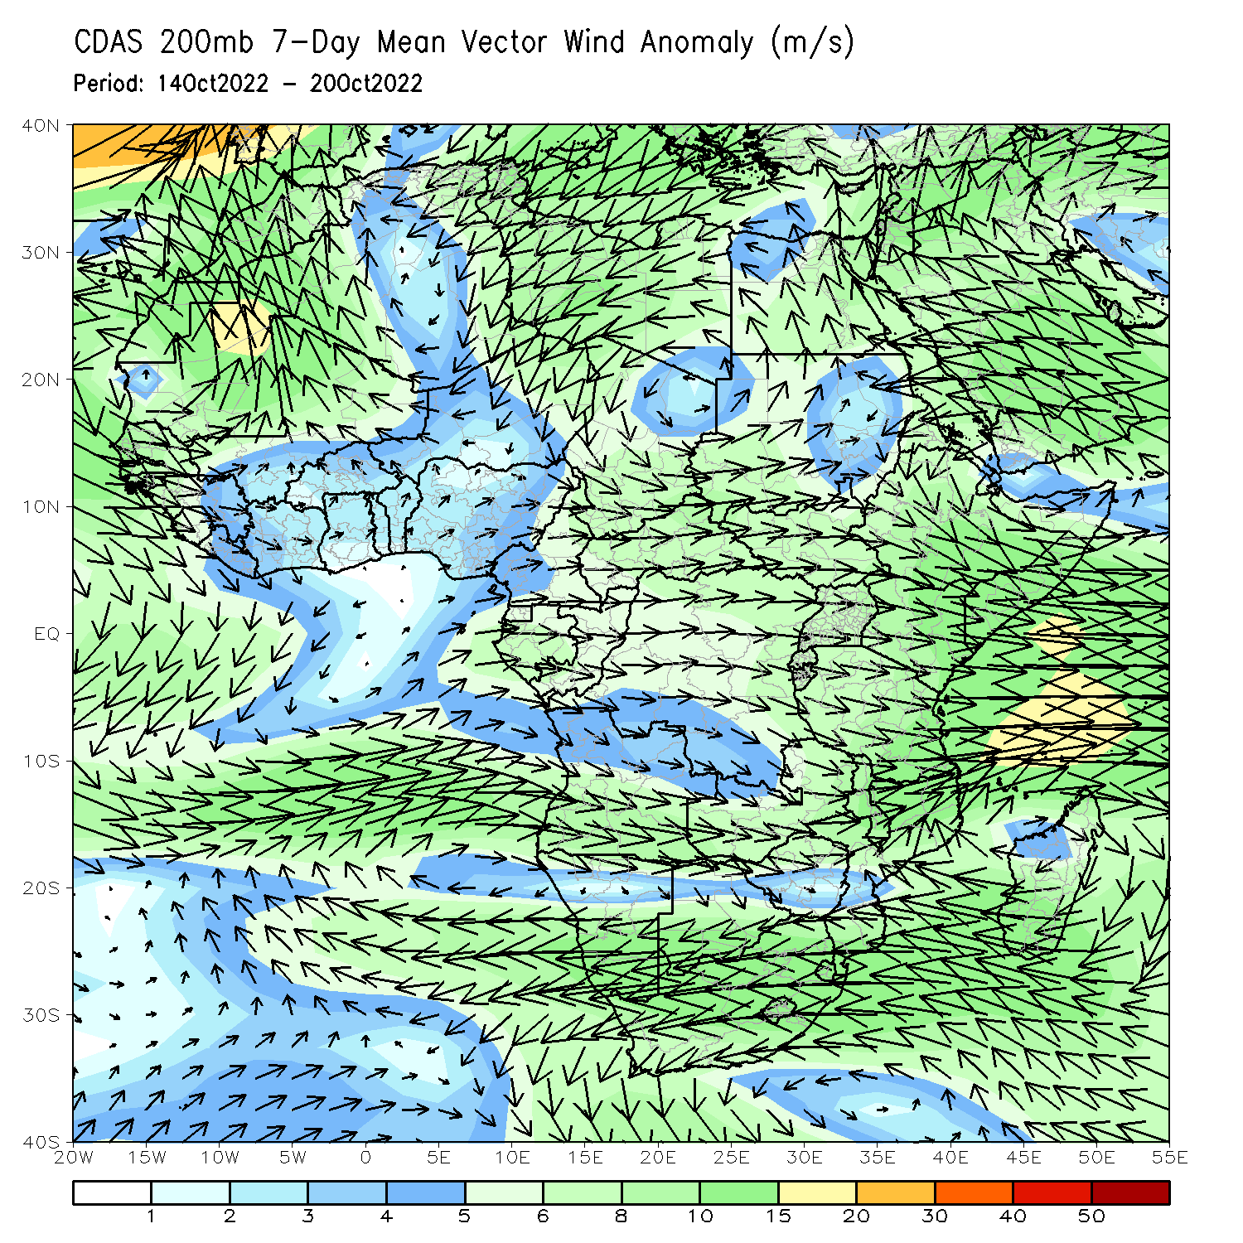
Atmospheric Circulation: Last 7 Days
At 700-hPa level (left panel), anomalous westerly flow was observed across much of the Gulf of Guinea coast .

Slide 8
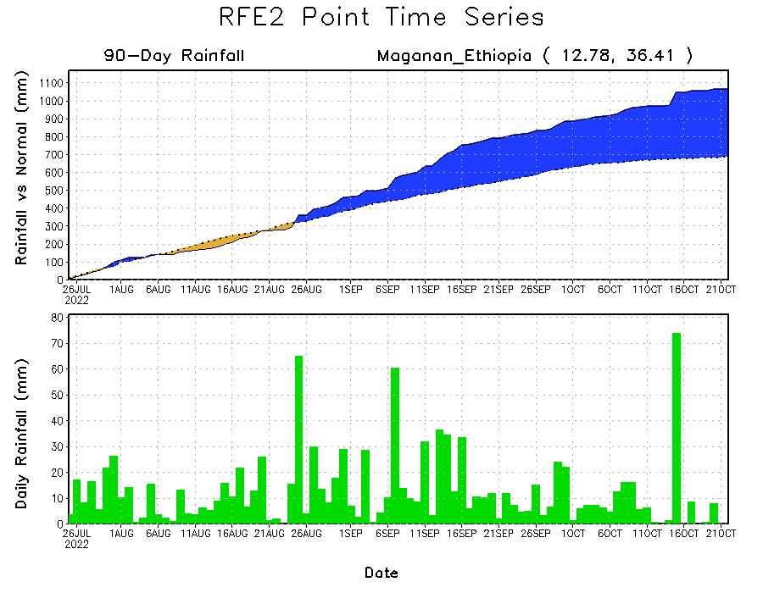
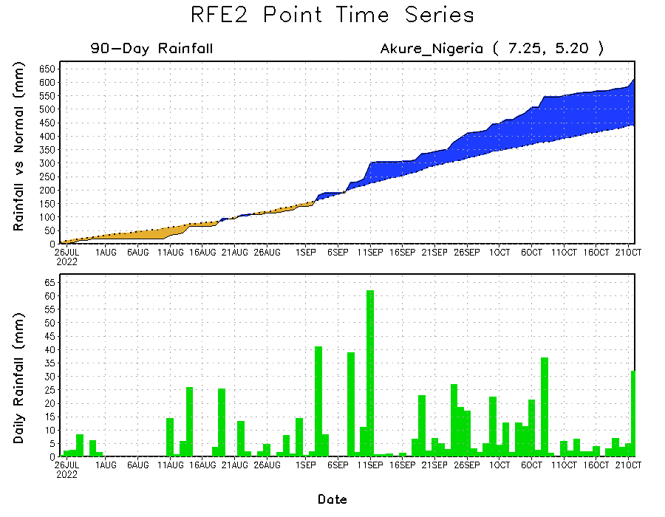
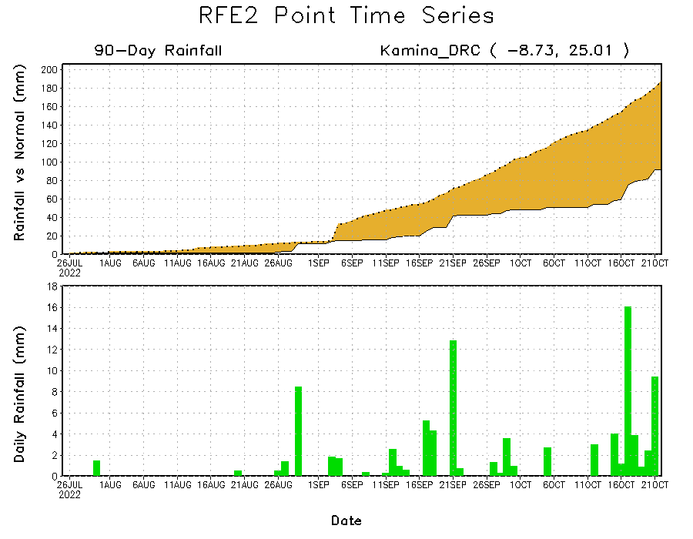
Rainfall Evolution
Daily evolution of rainfall over the last 90 days at selected locations shows continuing moisture surpluses over parts of western and southern Nigeria (bottom left), which have recently led to catastrophic flooding. Rainfall deficits continue in southern DRC (bottom right), and consistent heavy rains have led to significant moisture surpluses over parts of western Ethiopia (top right).

Slide 9
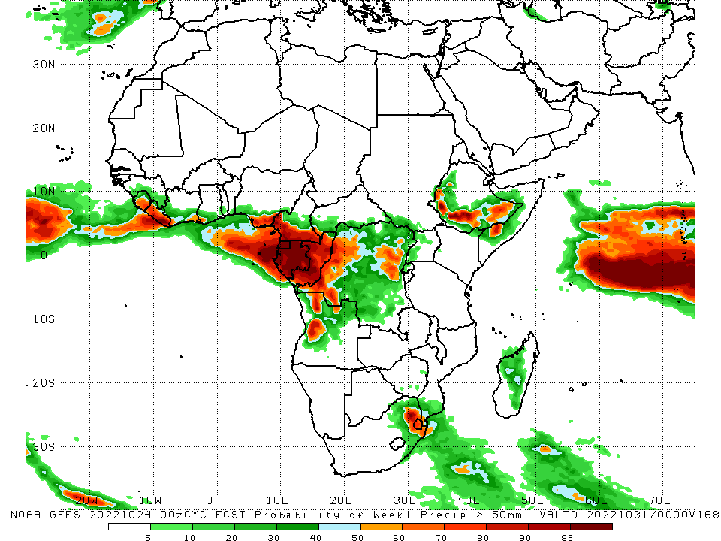
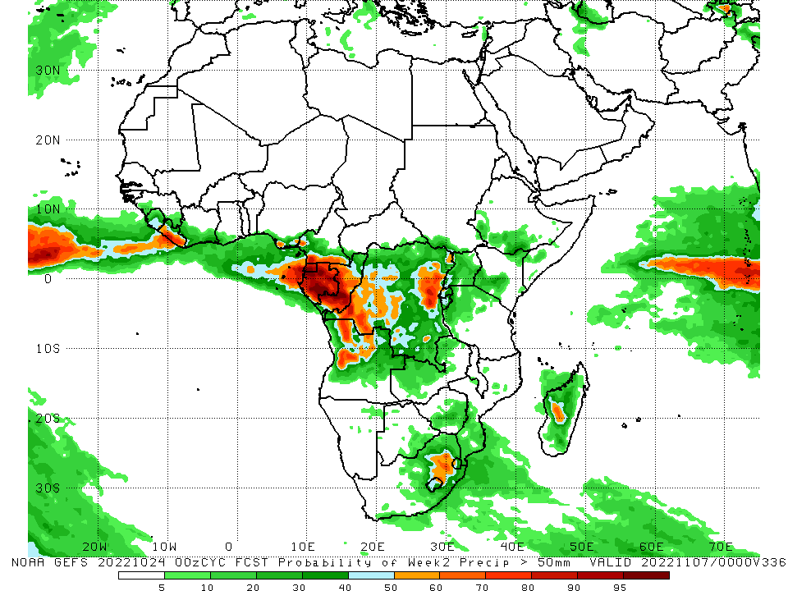
NCEP GEFS Model Forecasts Non-Bias Corrected Probability of precipitation exceedance
Week-1, Valid: 25 – 31 October, 2022
Week-2, Valid: 01 – 07 November, 2022
For week-1 (left panel) the NCEP GEFS indicates a moderate to high chance (over 70%) for rainfall to exceed 50 mm over much of Sierra Leone, Liberia, southern Nigeria, southern Cameroon, Equatorial Guinea, Gabon, Congo, western and portions of northeastern DRC, parts of southern and western Ethiopia, a small portion of southern Somalia, eastern South Africa, and Swaziland. For week-2 (right panel), NCEP GEFS indicates a moderate to high chance (over 70%) for rainfall to exceed 50 mm over Liberia, Equatorial Guinea, Gabon, and parts of central and southern Congo, northern Angola, and portions of northeastern DRC.
Notes:
9

Slide 10
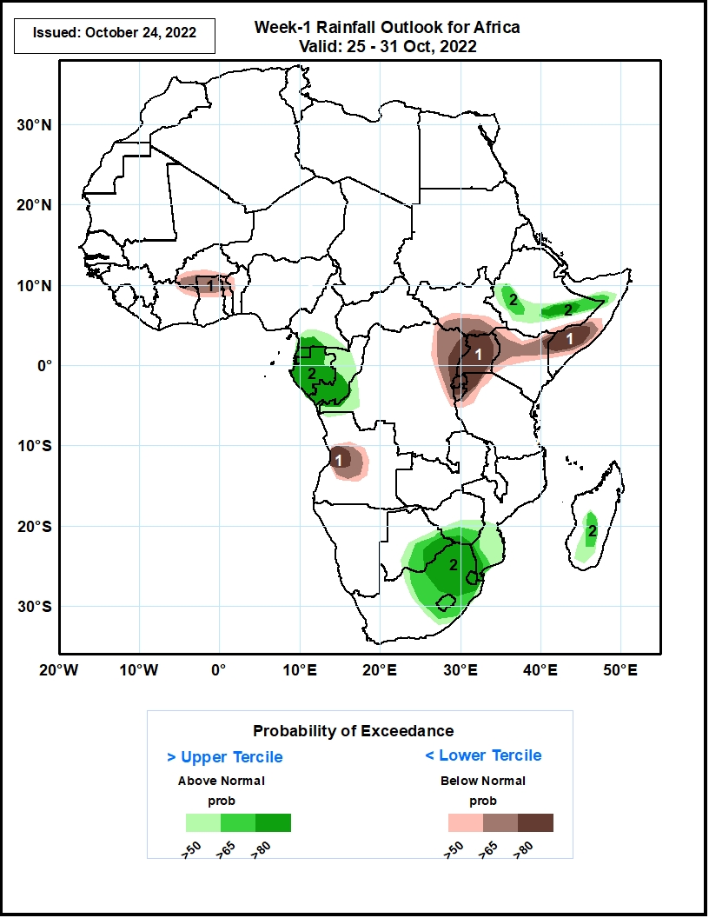
Week-1 Precipitation Outlooks
25 - 31 October, 2022
The consolidated probabilistic forecasts suggest above 50% chance for weekly total rainfall to be below-normal (below the lower tercile) over parts of northern Ghana, northeastern Cote d’Ivoire, northern Togo, central Angola, eastern DRC, southern South Sudan, Uganda, Rwanda, Burundi, northwestern Tanzania, northern Kenya and southern Somalia. In particular, there is above 80% chance for rainfall to be below normal over near Lake Victoria and parts of southern Somalia.
The forecasts suggest above 50% chance for weekly rainfall to be above-normal (above the upper tercile) over Equatorial Guinea, Gabon, Congo, eastern Botswana, southern Zimbabwe, eastern South Africa, Lesotho, Eswatini, southern Mozambique, central Madagascar and parts of southern Ethiopia. In particular, there is above 65% chance for rainfall to be above-normal over Equatorial Guinea, Gabon, southern Congo, eastern South Africa, Eswatini, and pockets of southeastern Ethiopia.
Notes:
10

Slide 11
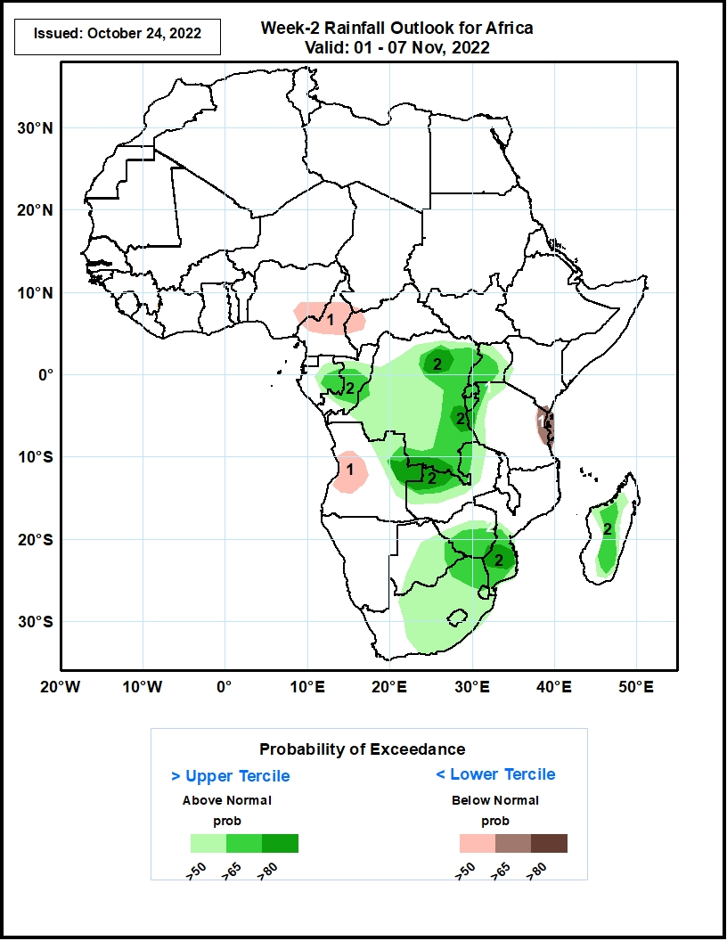
Week-2 Precipitation Outlooks
01 - 07 November, 2022
The consolidated probabilistic forecasts suggest above 50% chance for weekly total rainfall to be below-normal (below the lower tercile) over eastern Nigeria, northern Cameroon, western CAR, western Angola, and coastal Tanzania. In particular, there is above 65% chance for rainfall to be below-normal along the Tanzania coast.
The forecasts suggest above 50% chance for weekly rainfall to be above-normal (above the upper tercile) over portions of Central and Southern Africa. In particular, there is above 80% chance for rainfall to be above-normal over pockets of eastern DRC, eastern Angola,, northwestern Zambia, and southern Mozambique.
Notes:
11

Slide 12
Summary
During the past 30 days, in East Africa, above-average rainfall was observed over southern and central Sudan, the western, central, and northeastern parts of South Sudan, eastern Eritrea, northern and western Ethiopia, and in Uganda and the Lake Victoria region. Rainfall was below-average over pockets of southern Ethiopia and most of Somalia. In Central Africa, rainfall was above-average over parts of northwestern and eastern Cameroon, northern and central Congo, western and northern CAR, southwestern and central Chad, and northern, western, and parts of eastern DRC. Rainfall was below-average over Equatorial Guinea, southern, central, and northern Cameroon, most of Angola, and pockets of central and southern DRC. In West Africa, rainfall was above-average over Senegal, Guinea-Bissau, Guinea, northern and southern Sierra Leone, Liberia, Burkina Faso, most of southern Ghana, parts of southern Niger, Togo, northern and central Benin, and western and southeastern Nigeria. In contrast, central Ghana, coastal Cote D’Ivoire, southern Benin, and central and eastern Nigeria received below-average rainfall. In southern Africa, above-average rainfall was observed over parts of southern South Africa, northeastern Namibia, and western Madagascar. Below normal precipitation was observed in northern and eastern South Africa, northern Lesotho, Swaziland, Zambia, Botswana, Zimbabwe, central and southern Mozambique, and central and eastern Madagascar.
During the past 7 days, in East Africa, rainfall was above-average over western Ethiopia, northern and central South Sudan, southeastern portions of Sudan, and southwestern and eastern Uganda, western Rwanda, and Burundi. Below-average rainfall was observed over pockets of southern Ethiopia, southwestern South Sudan, southern Somalia, and eastern Kenya. In Central Africa, rainfall was above-average over eastern Cameroon, southwestern Chad, western and central CAR, central portions of Congo, eastern DRC, and a small portion of central Gabon. Below-average rainfall was observed over a portion of northeastern CAR, central Cameroon, northern, southern, and central DRC, Equatorial Guinea, western Gabon, northern and southern Congo, northeastern Angola, and northern Zambia. In West Africa, above-average rainfall was observed over southwestern Nigeria, southern Benin, southern Togo, southwestern Ghana, southern Cote D’Ivoire, eastern Liberia, western Guinea, northeastern Sierra Leone, Guinea-Bissau, and central and southern Senegal. In contrast, eastern Guinea, western and southern Sierra Leone, northern Cote D’Ivoire, northern Ghana, western Burkina Faso, northern and central Togo/Benin, and small portions of north-central and southern and central Nigeria received below-average rainfall. In southern Africa, rainfall was above average in pockets of eastern and southern South Africa, central and western Madagascar, central and eastern Namibia, and pockets of northern and southern Botswana. In contrast, rainfall was below average in northeastern Madagascar, Zimbabwe, and southern Mozambique.
Week-1 outlooks call for an increased chance for above-average rainfall across much of the Gulf of Guinea coast, northwestern DRC, western and southern Ethiopia, Gabon, Equatorial Guinea, Congo, western Somalia, portions of central Angola, eastern South Africa, Swaziland, and western and central Madagascar. In contrast, there is an increased chance for below-average rainfall near the Lake Victoria region, Burundi, Rwanda, southern Somalia, Kenya, eastern and western Tanzania, northeastern DRC, eastern Madagascar, southeastern and western Guinea, Sierra Leone, northern Cote D’Ivoire, northern Ghana, northern Togo/Benin, northern and central Cameroon, CAR, South Sudan, central and southern South Africa, and Lesotho. Week-2 outlooks call for an increased chance for above-average rainfall in Gabon, Congo, western and southern DRC, eastern Angola, eastern Zimbabwe, Zambia, northeastern Namibia, central and western Madagascar, Botswana, Zimbabwe, southern Mozambique, central and eastern South Africa, Lesotho, and Swaziland. In contrast, there is an increased chance for below-average rainfall across the Gulf of Guinea coast, central and southern Cameroon, central and southern CAR, southern and western Ethiopia, southern Somalia, the Lake Victoria region, Rwanda, Burundi, Tanzania, Kenya, and eastern Madagascar.

