Slide 1
The African Monsoon Recent Evolution and Current Status Include Week-1 and Week-2 Outlooks
Update prepared by
17 October 2022
For more information, visit:
http://www.cpc.ncep.noaa.gov/products/Global_Monsoons/African_Monsoons/precip_monitoring.shtml

Slide 2
Outline
Highlights
Recent Evolution and Current Conditions
NCEP GEFS Forecasts
Summary

Slide 3
Highlights: Last 7 Days
During the past 7 days, in East Africa, rainfall was above-average over much of western Eritrea, northwestern Ethiopia, northern and western South Sudan, southern portions of Sudan, and western Uganda. Below-average rainfall was observed over pockets of southern Ethiopia, eastern South Sudan, between Rwanda and Burundi, northwestern Tanzania, eastern Kenya, and southern Somalia. In Central Africa, rainfall was above-average over southeastern Cameroon, southeastern Chad, western, central, and southeastern CAR, northern and southern portions of Congo, northern and central DRC, and a small portion of northeastern Angola. Below-average rainfall was observed over a portion of east-central CAR, southern and central Cameroon, much of southern DRC, Equatorial Guinea, northern Gabon, central Cameroon, and central Angola. In West Africa, above-average rainfall was observed over central and southern Nigeria, Benin, Togo, northeastern and southwestern Ghana, most of Cote D’Ivoire, western Liberia, northwestern and southern Guinea, Sierra Leone, Guinea-Bissau, southwestern and northeastern Burkina Faso, central and southeastern and northwestern Senegal, southern Mali, and southwestern Mauritania. In contrast, parts of southwestern Mali, northeastern Guinea, southeastern Liberia, southwestern Cote D’Ivoire, southeastern Ghana, central and southeastern Burkina Faso, and small portions of north-central and southwestern Nigeria received below-average rainfall. In southern Africa, rainfall was above average in pockets of eastern South Africa, Swaziland, and southwestern Madagascar. In contrast, rainfall was below average in central Madagascar.
Week-1 outlooks call for an increased chance for above-average rainfall across much of the Gulf of Guinea coast, portions of western and eastern South Sudan, most of the CAR, western DRC, western and southeastern Ethiopia, Gabon, northern and central Congo, northern Somalia, northwestern Angola, Rwanda, eastern South Africa, and Lesotho. In contrast, there is an increased chance for below-average rainfall near the Lake Victoria region, Burundi, southern Ethiopia, southern Somalia, Kenya, eastern and western Tanzania, eastern DRC, eastern Madagascar, southern Guinea, Sierra Leone, and eastern Liberia. Week-2 outlooks call for an increased chance for above-average rainfall across the Gulf of Guinea region, western Ethiopia, eastern South Africa, central Madagascar, eastern Zimbabwe, and southern Mozambique. In contrast, there is an increased chance for below-average rainfall near southern Guinea, Sierra Leone, northern Cote D’Ivoire , northern Ghana, northern Togo, central Cameroon, CAR, southern South Sudan, southern Ethiopia, southern Somalia, eastern and central DRC, east-central Angola, Uganda, Rwanda, Burundi, Tanzania, Kenya, and northeastern Madagascar.

Slide 4
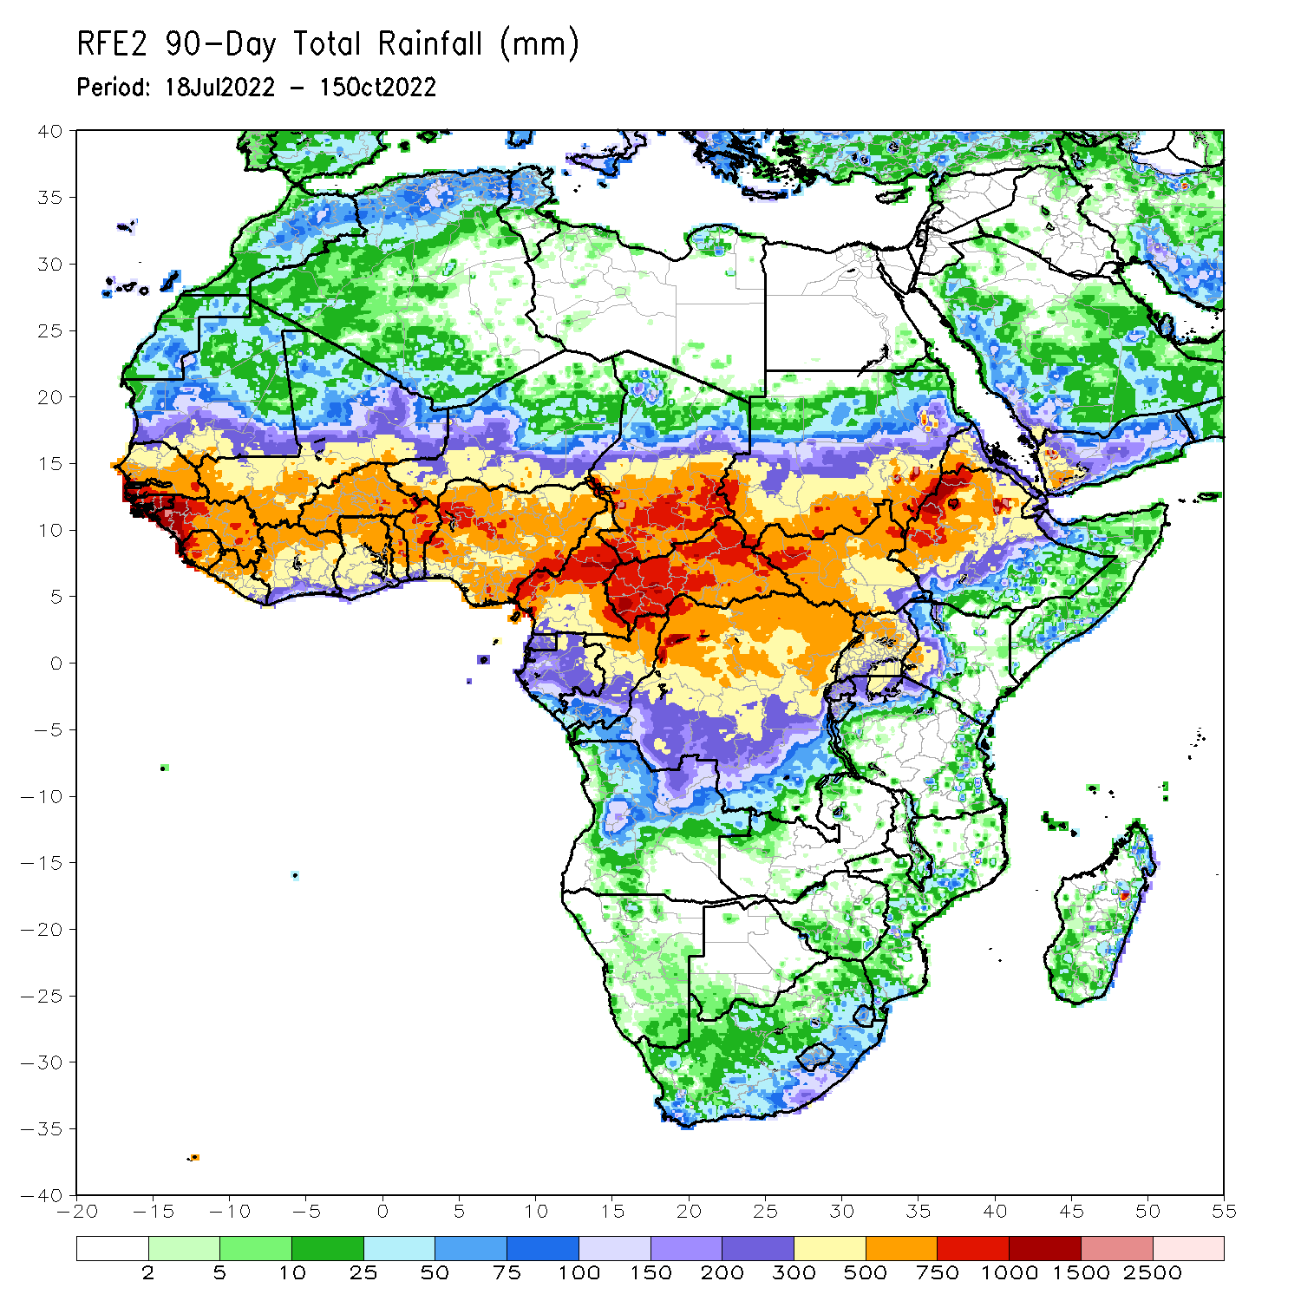
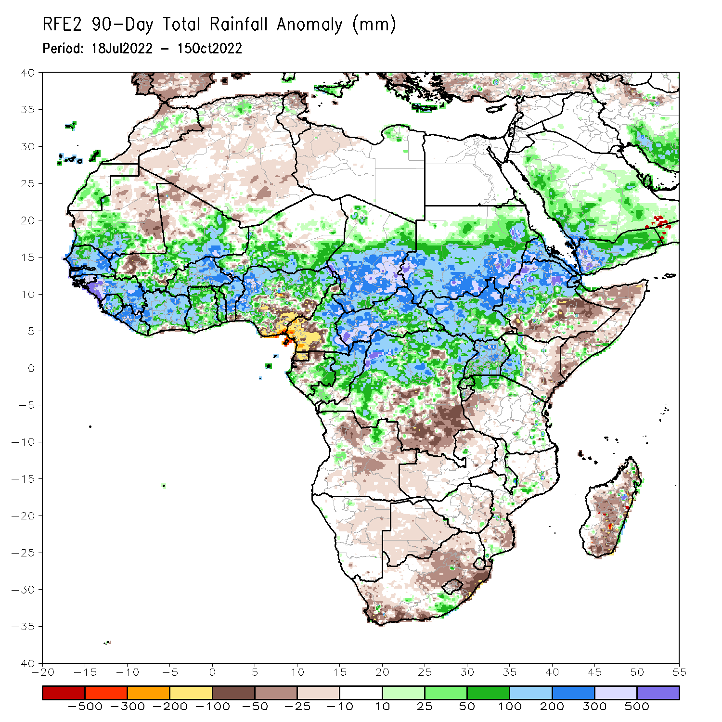
Rainfall Patterns: Last 90 Days
Over the past 90 days, in East Africa, above-average rainfall was observed over southern and central parts of Sudan, much of South Sudan, northern Ethiopia, Eritrea, Djibouti, localized areas in southern Somalia, Uganda, Rwanda, western Burundi, pockets of northwest and eastern Tanzania, and western Kenya. Rainfall was below-average over pockets of southern and central Ethiopia, and throughout much of Somalia. In southern Africa, above-average rainfall was observed over pockets of southern South Africa, central and southern Mozambique, and southern Malawi. Below-average rainfall was observed over pockets of southwestern and northeastern South Africa, Lesotho, and southern, central, and northern Madagascar. In Central Africa, rainfall was above-average over northern and eastern Cameroon, southern and central Chad, CAR, northern and central Congo, and northern, western and northeast parts of DRC. Rainfall was below-average over western Cameroon, pockets of northern and central Gabon, Equatorial Guinea, parts of southeast DRC, and northern and eastern Angola. In West Africa, rainfall was above-average over southern Mauritania, Senegal, Gambia, Guinea-Bissau, Guinea, Sierra Leone, Liberia, much of Cote D’Ivoire, throughout most of Ghana, Togo, central and northern parts of Benin, Burkina Faso, eastern and southern portions of Mali, southern Niger, and western and northern Nigeria. In contrast, below-average rainfall was observed over eastern Mauritania, western and northern parts of Mali, parts of central and southeastern Nigeria, southern Benin, and southern Cote D’Ivoire.
Notes:
‹#›

Slide 5
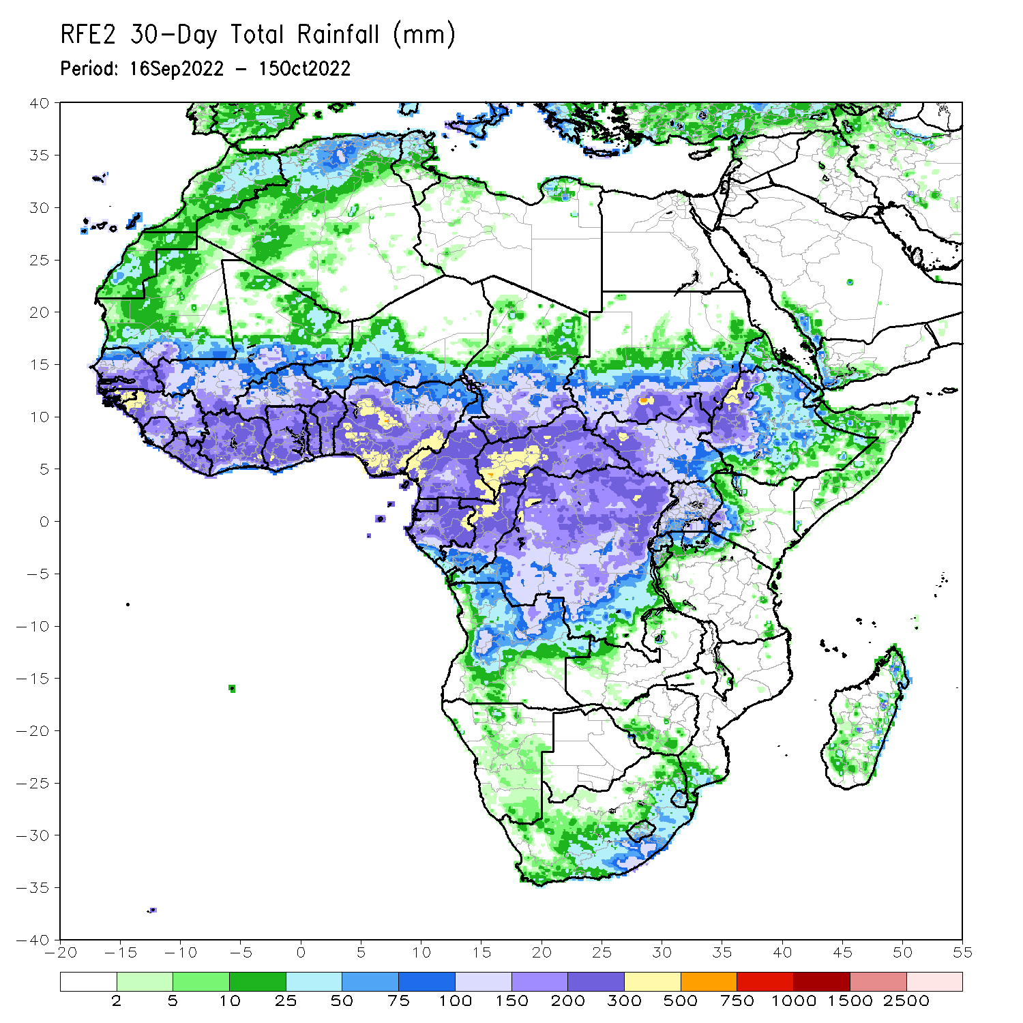
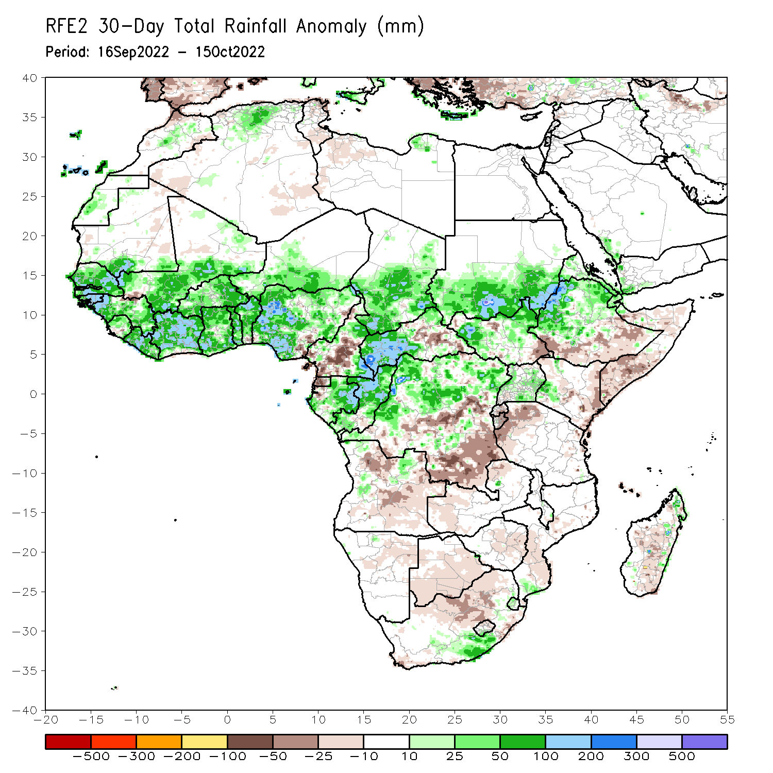
Rainfall Patterns: Last 30 Days
During the past 30 days, in East Africa, above-average rainfall was observed over southern and central Sudan, the western and northeastern parts of South Sudan, Eritrea, northern and central Ethiopia, and in Uganda and the Lake Victoria region. Rainfall was below-average over pockets of southern Ethiopia and most of Somalia. In Central Africa, rainfall was above-average over parts of northern and southeastern Cameroon, northern and central Congo, western and northern CAR, southern and central Chad, and northern and western DRC. Rainfall was below-average over Equatorial Guinea, southern and central Cameroon, northern and central Angola, and pockets of central and southern DRC. In West Africa, rainfall was above-average over Senegal, Guinea-Bissau, Guinea, northern and southern Sierra Leone, Liberia, Burkina Faso, most of Ghana, parts of southern Niger, Togo, northern and central Benin, and northern, western, and eastern Nigeria. In contrast, coastal Sierra Leone, coastal Ghana, southern Benin, and southeastern Nigeria received below-average rainfall. In southern Africa, above-average rainfall was observed over parts of southern South Africa, southern Lesotho, northern Swaziland, and eastern Madagascar. Below normal precipitation was observed in northern and eastern South Africa, northern Lesotho, and central Madagascar.
Notes:
‹#›

Slide 6
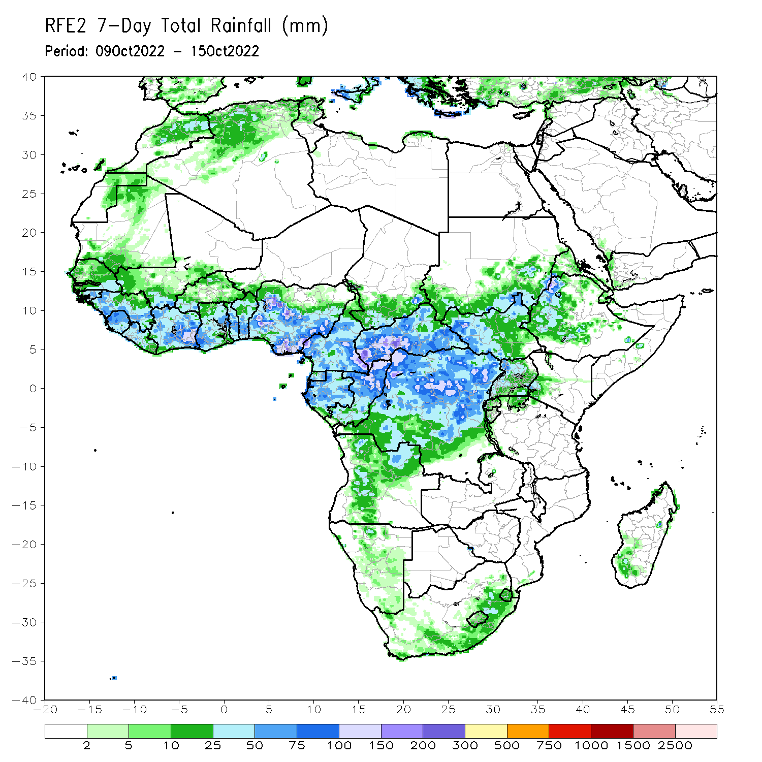
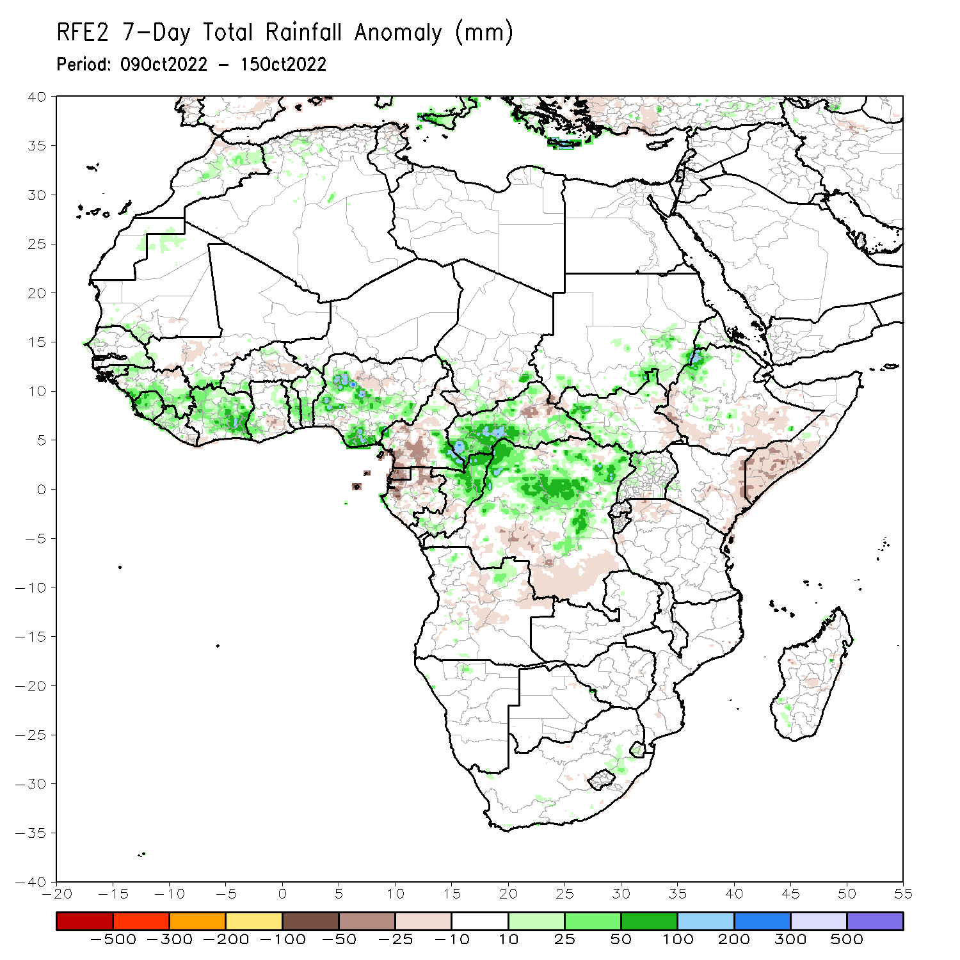
Rainfall Patterns: Last 7 Days
During the past 7 days, in East Africa, rainfall was above-average over much of western Eritrea, northwestern Ethiopia, northern and western South Sudan, southern portions of Sudan, and western Uganda. Below-average rainfall was observed over pockets of southern Ethiopia, eastern South Sudan, between Rwanda and Burundi, northwestern Tanzania, eastern Kenya, and southern Somalia. In Central Africa, rainfall was above-average over southeastern Cameroon, southeastern Chad, western, central, and southeastern CAR, northern and southern portions of Congo, northern and central DRC, and a small portion of northeastern Angola. Below-average rainfall was observed over a portion of east-central CAR, southern and central Cameroon, much of southern DRC, Equatorial Guinea, northern Gabon, central Cameroon, and central Angola. In West Africa, above-average rainfall was observed over central and southern Nigeria, Benin, Togo, northeastern and southwestern Ghana, most of Cote D’Ivoire, western Liberia, northwestern and southern Guinea, Sierra Leone, Guinea-Bissau, southwestern and northeastern Burkina Faso, central and southeastern and northwestern Senegal, southern Mali, and southwestern Mauritania. In contrast, parts of southwestern Mali, northeastern Guinea, southeastern Liberia, southwestern Cote D’Ivoire, southeastern Ghana, central and southeastern Burkina Faso, and small portions of north-central and southwestern Nigeria received below-average rainfall. In southern Africa, rainfall was above average in pockets of eastern South Africa, Swaziland, and southwestern Madagascar. In contrast, rainfall was below average in central Madagascar.

Slide 7
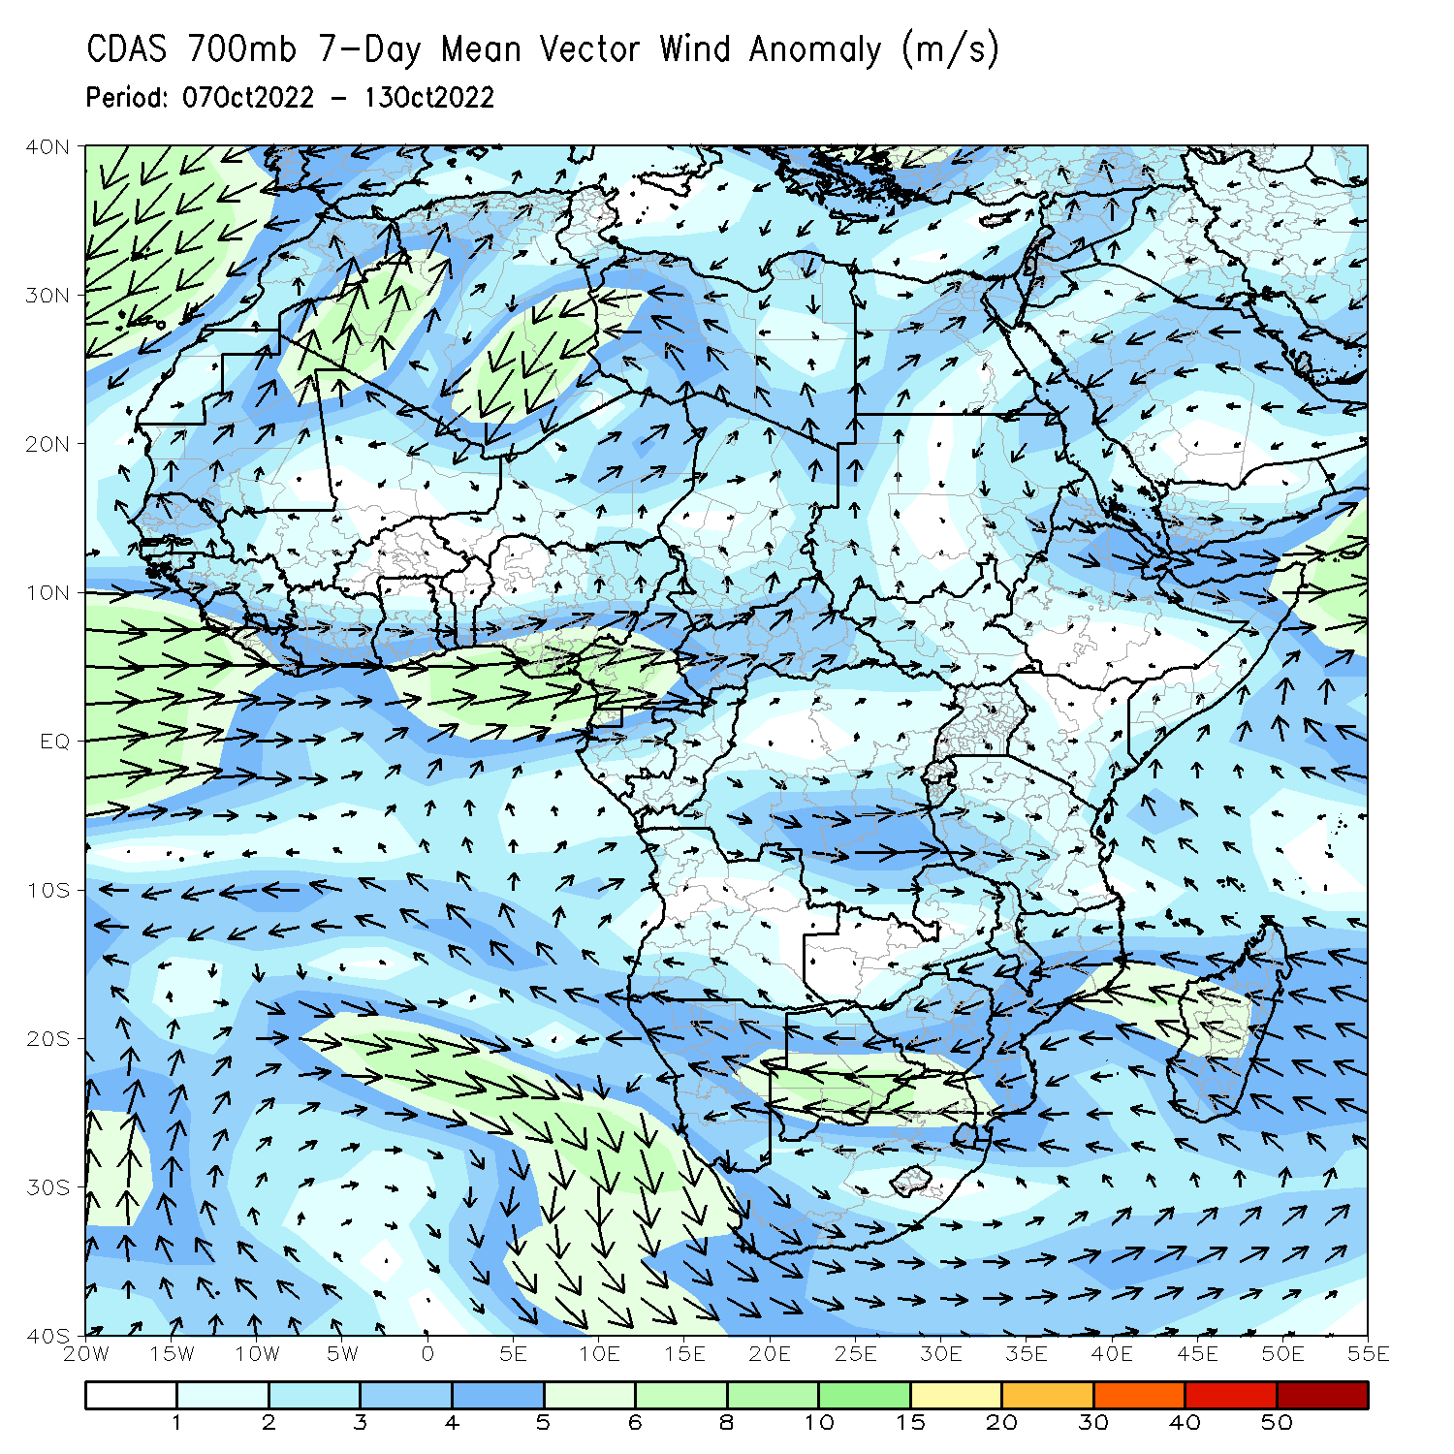
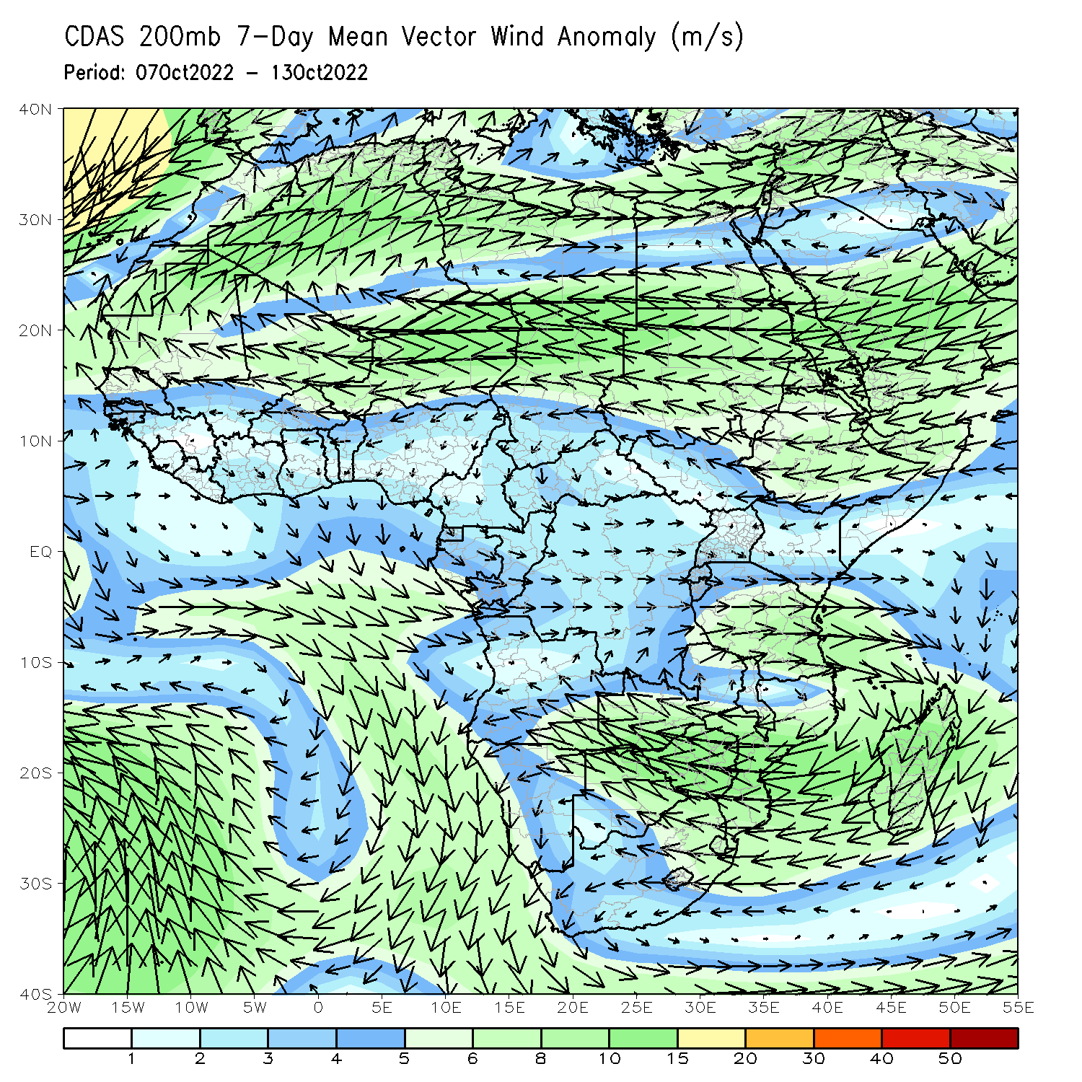
Atmospheric Circulation: Last 7 Days
At 700-hPa level (left panel), anomalous westerly flow was observed across much of the Gulf of Guinea regions.

Slide 8
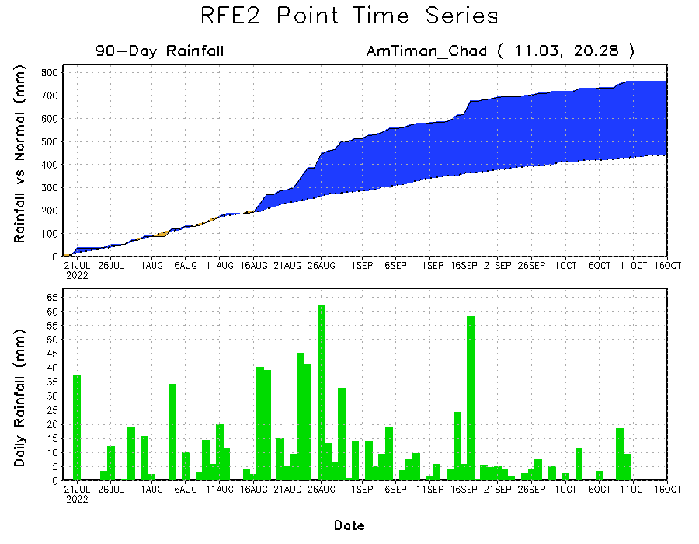
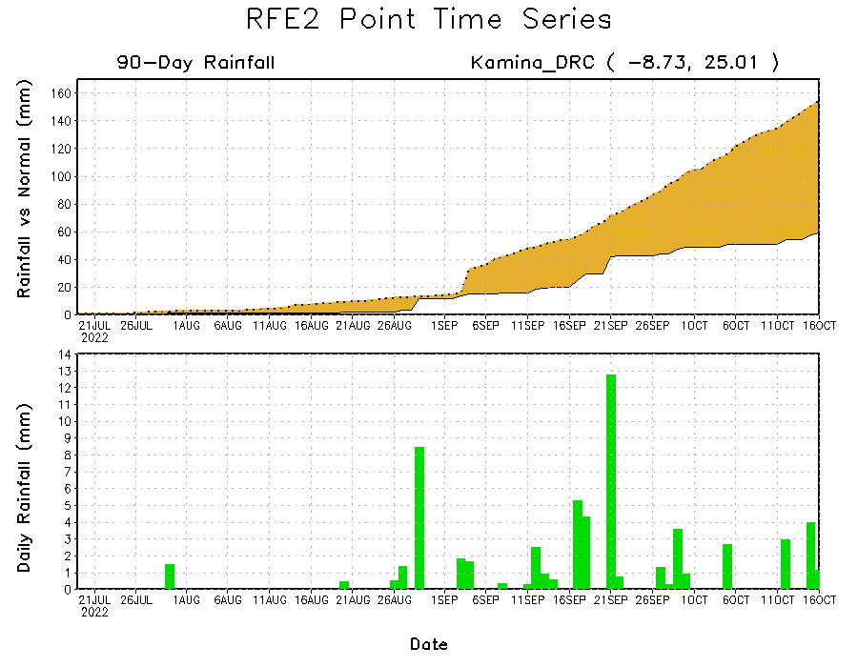
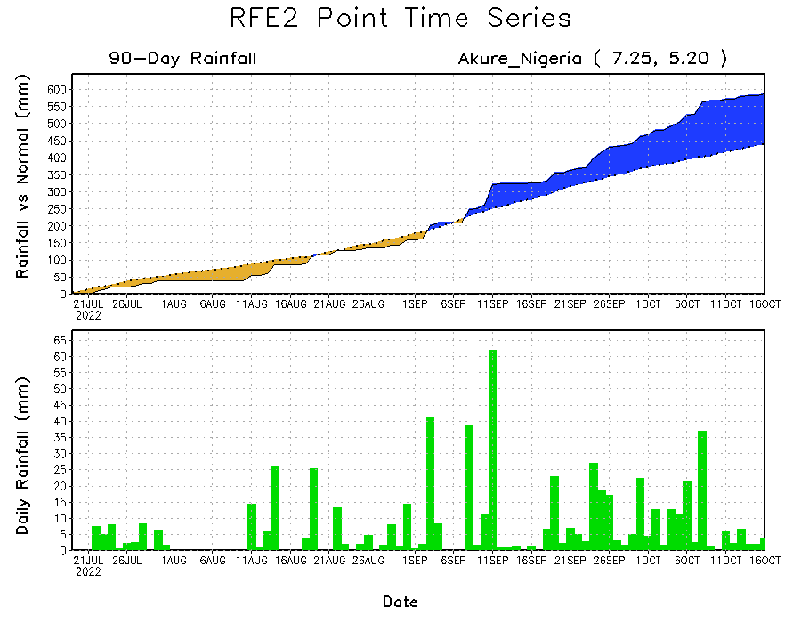
Rainfall Evolution
Daily evolution of rainfall over the last 90 days at selected locations shows continuing moisture surpluses over parts of western and southern Nigeria (bottom left), which have recently led to catastrophic flooding. Rainfall deficits continue in southern DRC (bottom right), and consistent heavy rains have led to significant moisture surpluses over parts of Chad (top right).

Slide 9
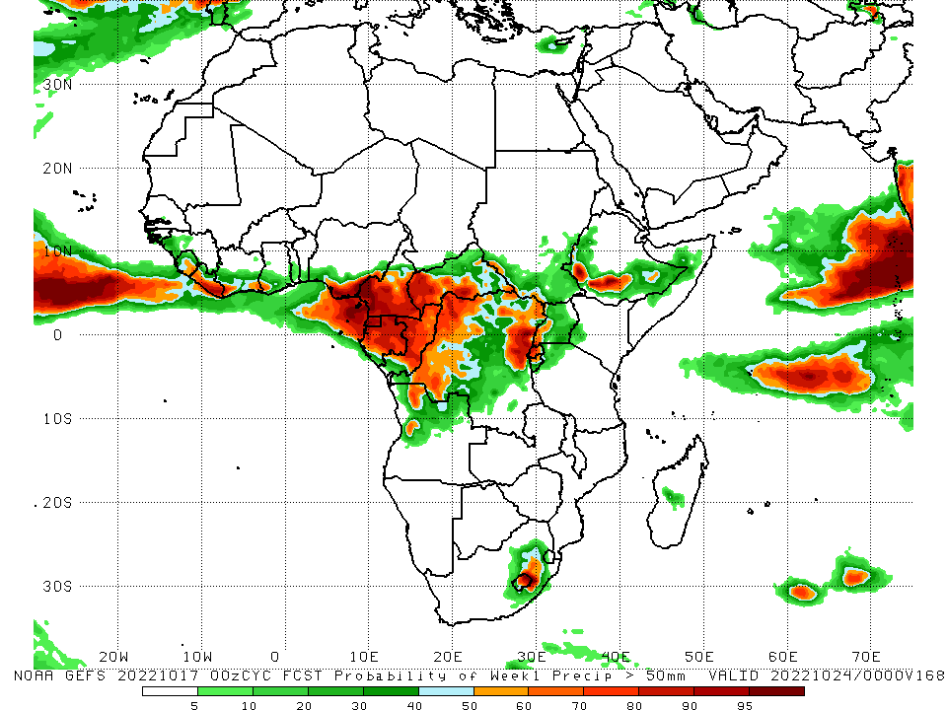
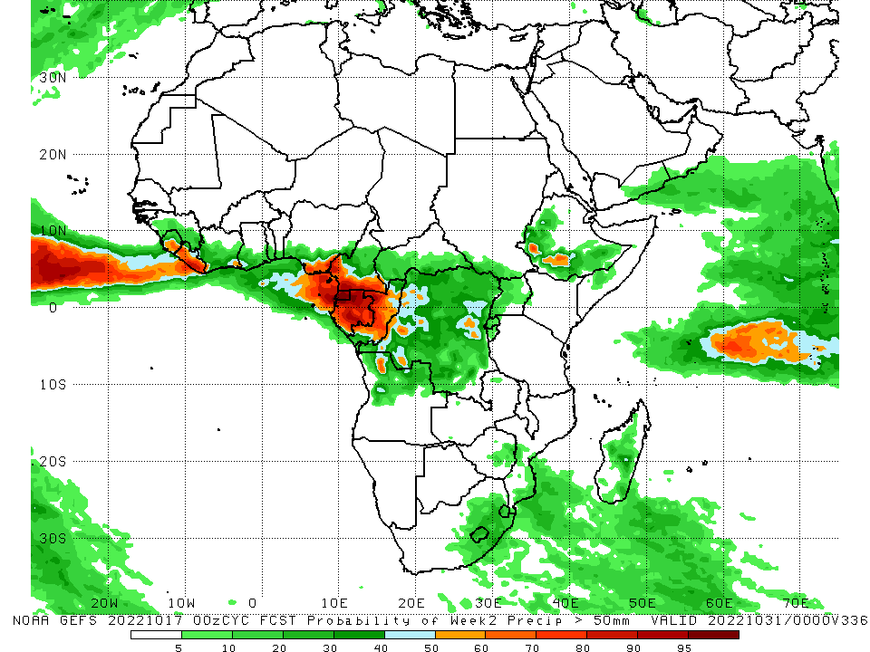
NCEP GEFS Model Forecasts Non-Bias Corrected Probability of precipitation exceedance
Week-1, Valid: 18 – 24 October, 2022
Week-2, Valid: 25 – 31 October, 2022
For week-1 (left panel) the NCEP GEFS indicates a moderate to high chance (over 70%) for rainfall to exceed 50 mm over much of Liberia, southern Nigeria, southern Cameroon, Equatorial Guinea, northern Gabon, Congo, western CAR, northwestern and portions of eastern DRC, parts of southwestern Ethiopia, Rwanda, and eastern Lesotho. For week-2 (right panel), NCEP GEFS indicates a moderate to high chance (over 70%) for rainfall to exceed 50 mm over Liberia, southern Nigeria, southern Cameroon, Equatorial Guinea, most of Gabon, and parts of central Congo.
Notes:
‹#›

Slide 10
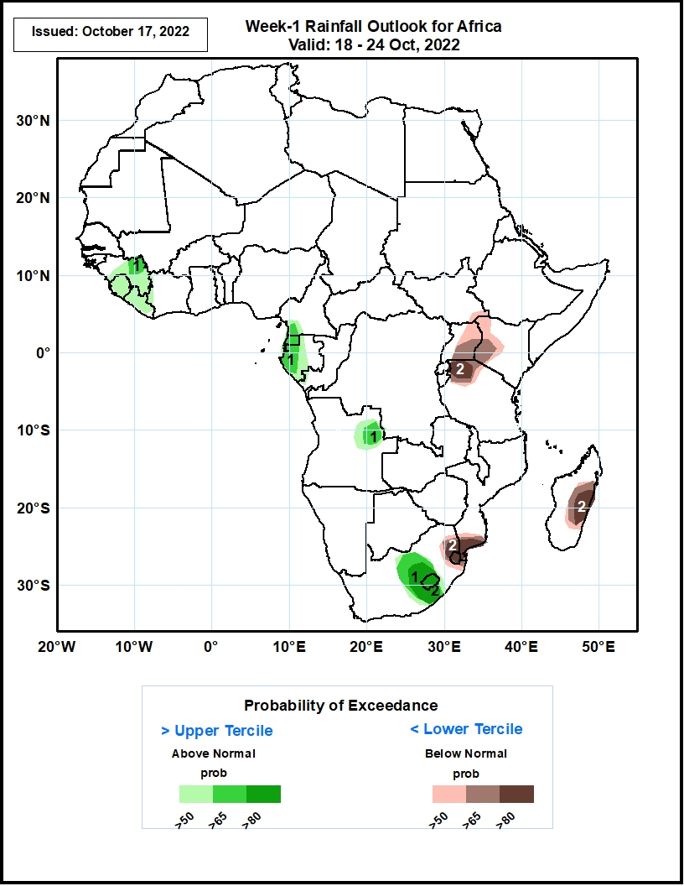
Week-1 Precipitation Outlooks
18 - 24 October, 2022
The consolidated probabilistic forecasts suggest above 50% chance for weekly rainfall to be below-normal (below the lower tercile) over the Lake Victoria region from southeastern South Sudan to northern Tanzania, in eastern Madagascar, and from Swaziland and eastern South Africa to southern Mozambique. In particular, there is above 80% chance for weekly rainfall to be below normal over northern Tanzania, in eastern Madagascar, and from Swaziland to southern Mozambique.
The forecast suggests above 50% chance for weekly total rainfall to be above-normal (above the upper tercile) between central and eastern Guinea and Liberia, between southwestern Cameroon and southern Gabon, in northeastern Angola, and from northern South Africa to Lesotho and southern South Africa. In particular, there is above 80% chance for rainfall to be above-normal from northern South Africa to Lesotho and southern South Africa.
Notes:
‹#›

Slide 11
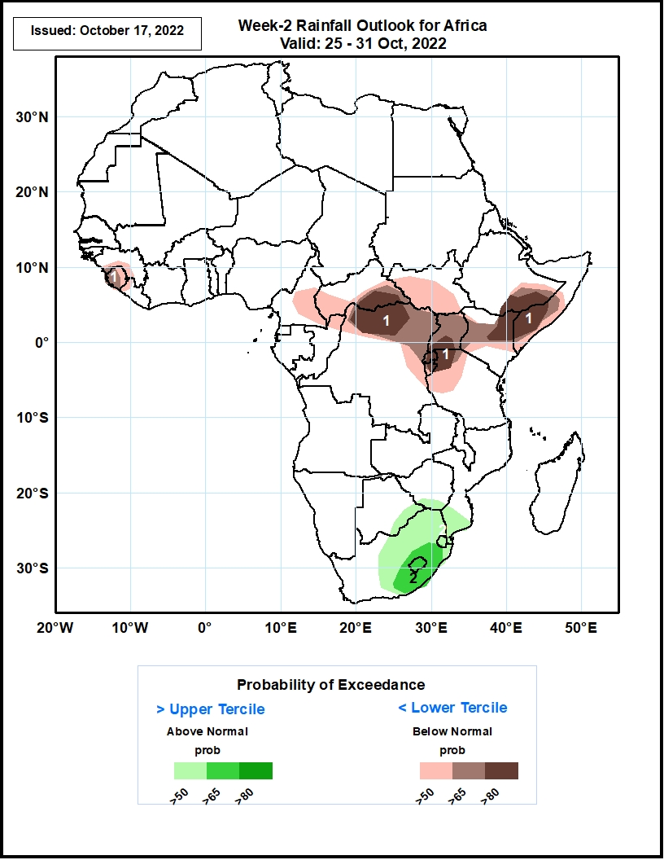
Week-2 Precipitation Outlooks
25 - 31 October, 2022
The consolidated probabilistic forecasts suggest above 50% chance for weekly rainfall to be below-normal (below the lower tercile) around southern Guinea, Sierra Leone, eastern Cameroon, southern CAR, southern South Sudan, northern DRC, around the Lake Victoria region, central Kenya, southern Ethiopia and southern Somalia. In particular, there is above 80% chance for rainfall to be below-normal from southern CAR to northern DRC, around the Lake Victoria region, and near the junction of Ethiopia, Kenya, and Somalia.
The forecast suggests above 50% chance for weekly total rainfall to be above-normal (above the upper tercile) in southern Botswana, southern Zimbabwe, central and eastern South Africa, Lesotho, Swaziland, and southern Mozambique. In particular, there is above 65% chance for rainfall to be above-normal in southeastern South Africa and Lesotho.
Notes:
‹#›

Slide 12
Summary
During the past 30 days, in East Africa, above-average rainfall was observed over southern and central Sudan, the western and northeastern parts of South Sudan, Eritrea, northern and central Ethiopia, and in Uganda and the Lake Victoria region. Rainfall was below-average over pockets of southern Ethiopia and most of Somalia. In Central Africa, rainfall was above-average over parts of northern and southeastern Cameroon, northern and central Congo, western and northern CAR, southern and central Chad, and northern and western DRC. Rainfall was below-average over Equatorial Guinea, southern and central Cameroon, northern and central Angola, and pockets of central and southern DRC. In West Africa, rainfall was above-average over Senegal, Guinea-Bissau, Guinea, northern and southern Sierra Leone, Liberia, Burkina Faso, most of Ghana, parts of southern Niger, Togo, northern and central Benin, and northern, western, and eastern Nigeria. In contrast, coastal Sierra Leone, coastal Ghana, southern Benin, and southeastern Nigeria received below-average rainfall. In southern Africa, above-average rainfall was observed over parts of southern South Africa, southern Lesotho, northern Swaziland, and eastern Madagascar. Below normal precipitation was observed in northern and eastern South Africa, northern Lesotho, and central Madagascar.
During the past 7 days, in East Africa, rainfall was above-average over much of western Eritrea, northwestern Ethiopia, northern and western South Sudan, southern portions of Sudan, and western Uganda. Below-average rainfall was observed over pockets of southern Ethiopia, eastern South Sudan, between Rwanda and Burundi, northwestern Tanzania, eastern Kenya, and southern Somalia. In Central Africa, rainfall was above-average over southeastern Cameroon, southeastern Chad, western, central, and southeastern CAR, northern and southern portions of Congo, northern and central DRC, and a small portion of northeastern Angola. Below-average rainfall was observed over a portion of east-central CAR, southern and central Cameroon, much of southern DRC, Equatorial Guinea, northern Gabon, central Cameroon, and central Angola. In West Africa, above-average rainfall was observed over central and southern Nigeria, Benin, Togo, northeastern and southwestern Ghana, most of Cote D’Ivoire, western Liberia, northwestern and southern Guinea, Sierra Leone, Guinea-Bissau, southwestern and northeastern Burkina Faso, central and southeastern and northwestern Senegal, southern Mali, and southwestern Mauritania. In contrast, parts of southwestern Mali, northeastern Guinea, southeastern Liberia, southwestern Cote D’Ivoire, southeastern Ghana, central and southeastern Burkina Faso, and small portions of north-central and southwestern Nigeria received below-average rainfall. In southern Africa, rainfall was above average in pockets of eastern South Africa, Swaziland, and southwestern Madagascar. In contrast, rainfall was below average in central Madagascar.
Week-1 outlooks call for an increased chance for above-average rainfall across much of the Gulf of Guinea coast, portions of western and eastern South Sudan, most of the CAR, western DRC, western and southeastern Ethiopia, Gabon, northern and central Congo, northern Somalia, northwestern Angola, Rwanda, eastern South Africa, and Lesotho. In contrast, there is an increased chance for below-average rainfall near the Lake Victoria region, Burundi, southern Ethiopia, southern Somalia, Kenya, eastern and western Tanzania, eastern DRC, eastern Madagascar, southern Guinea, Sierra Leone, and eastern Liberia. Week-2 outlooks call for an increased chance for above-average rainfall across the Gulf of Guinea region, western Ethiopia, eastern South Africa, central Madagascar, eastern Zimbabwe, and southern Mozambique. In contrast, there is an increased chance for below-average rainfall near southern Guinea, Sierra Leone, northern Cote D’Ivoire , northern Ghana, northern Togo, central Cameroon, CAR, southern South Sudan, southern Ethiopia, southern Somalia, eastern and central DRC, east-central Angola, Uganda, Rwanda, Burundi, Tanzania, Kenya, and northeastern Madagascar.

