Slide 1
The African Monsoon Recent Evolution and Current Status Include Week-1 and Week-2 Outlooks
Update prepared by
11 October 2022
For more information, visit:
http://www.cpc.ncep.noaa.gov/products/Global_Monsoons/African_Monsoons/precip_monitoring.shtml

Slide 2
Outline
Highlights
Recent Evolution and Current Conditions
NCEP GEFS Forecasts
Summary

Slide 3
Highlights: Last 7 Days
During the past 7 days, in East Africa, rainfall was above-average over much of central and southeastern Eritrea, western and central Ethiopia, eastern, western, and southern South Sudan, southern portions of Sudan, eastern Uganda, and western Kenya. Below-average rainfall was observed over pockets of eastern Ethiopia, northwestern South Sudan, Burundi, northwestern Tanzania, and portions of southern Somalia. In Central Africa, rainfall was above-average over central and southern Cameroon, central and southern Chad, western and central CAR, central and southern Gabon, northern and southern portions of Congo, northwestern, central, and southwestern DRC, and a small portion of west-central Angola. Below-average rainfall was observed over eastern CAR, a small portion of northwestern Cameroon, much of central and southeastern DRC, and Equatorial Guinea. In West Africa, above-average rainfall was observed over western and southern Nigeria, Benin, Togo, northern and southern Ghana, northern and central Cote D’Ivoire, western and central Liberia, northeastern and western Guinea, Sierra Leone, Guinea, Guinea-Bissau, southern and eastern Burkina Faso, and central and southern Senegal. In contrast, southwestern Mali, southern Cote D’Ivoire, central Ghana, and small portions of central Nigeria received below-average rainfall. In southern Africa, rainfall was below average in pockets of southern and eastern South Africa.
Week-1 outlooks call for an increased chance for above-average rainfall across much of the Gulf of Guinea coast, portions of western South Sudan, western CAR, western DRC, western Ethiopia, Gabon, Congo, central South Africa, and Lesotho. In contrast, there is an increased chance for below-average rainfall near the Lake Victoria region, Rwanda, Burundi, southern Ethiopia, southern Somalia, northern and southern Kenya, eastern Tanzania, southern DRC, eastern Madagascar, and northwestern Angola. Week-2 outlooks call for an increased chance for above-average rainfall across southern Nigeria, southern Cameroon, Equatorial Guinea, Gabon, northern Congo, western and central CAR, western DRC, western South Sudan, western and eastern Ethiopia, southeastern South Africa, and Lesotho. In contrast, there is an increased chance for below-average rainfall near most of the Gulf of Guinea coast and Sahel, eastern DRC, the Lake Victoria region, Rwanda, Burundi, eastern Tanzania, Kenya, southern Somalia, and eastern Madagascar.

Slide 4
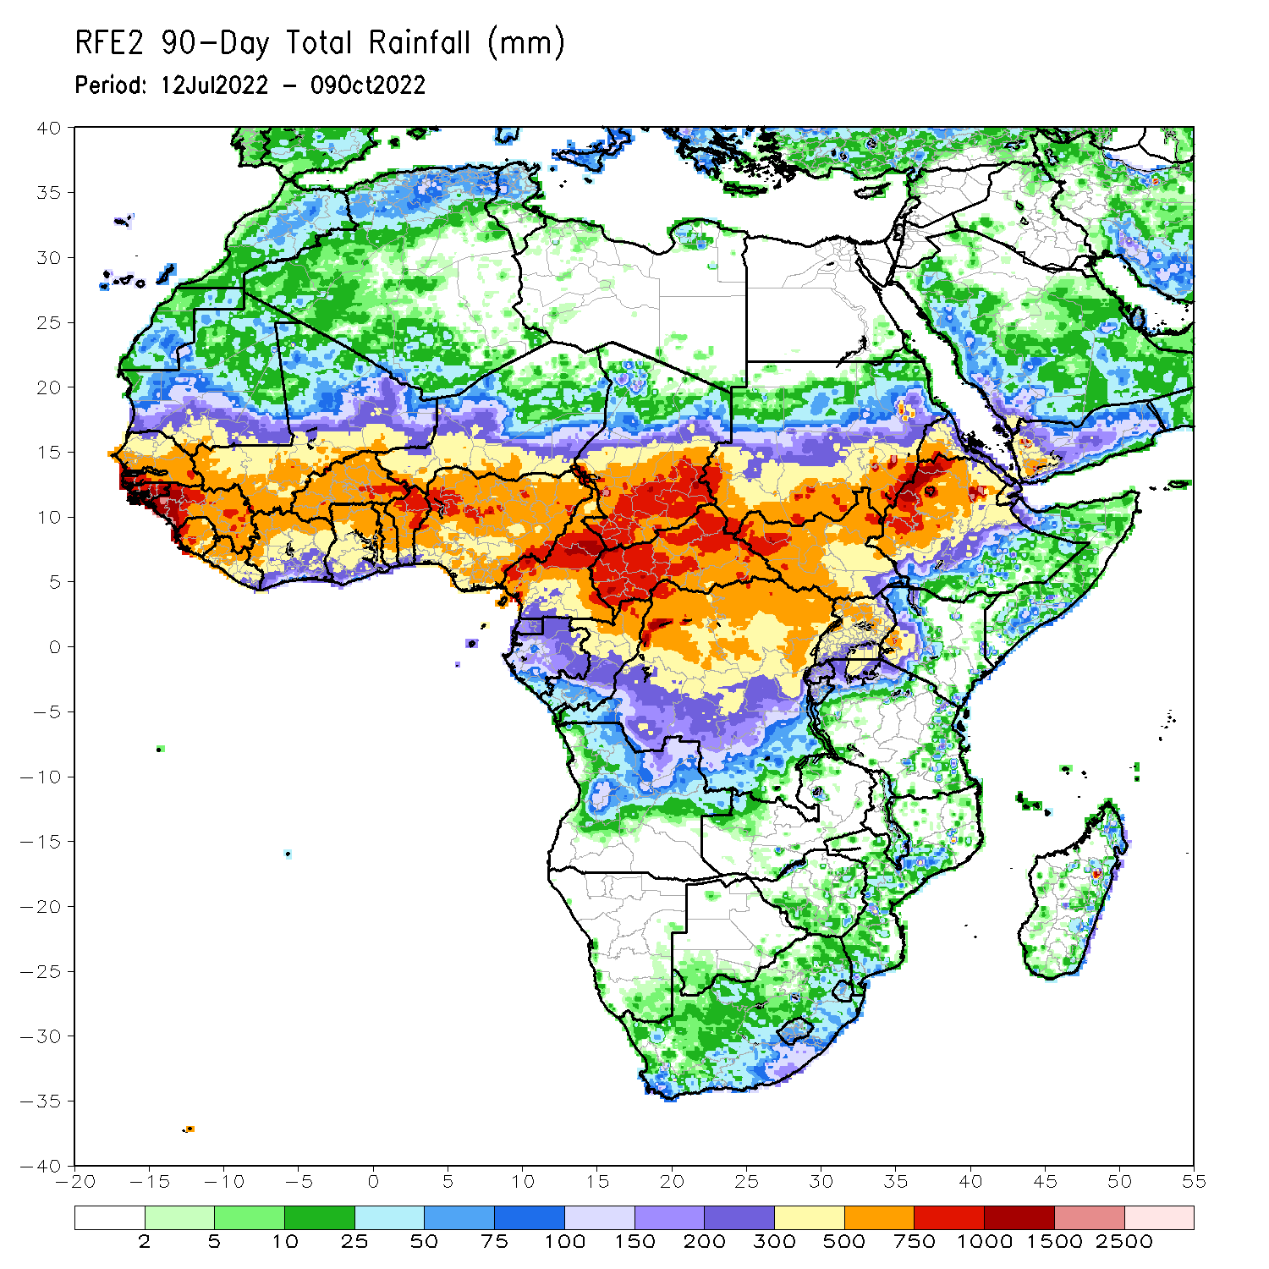
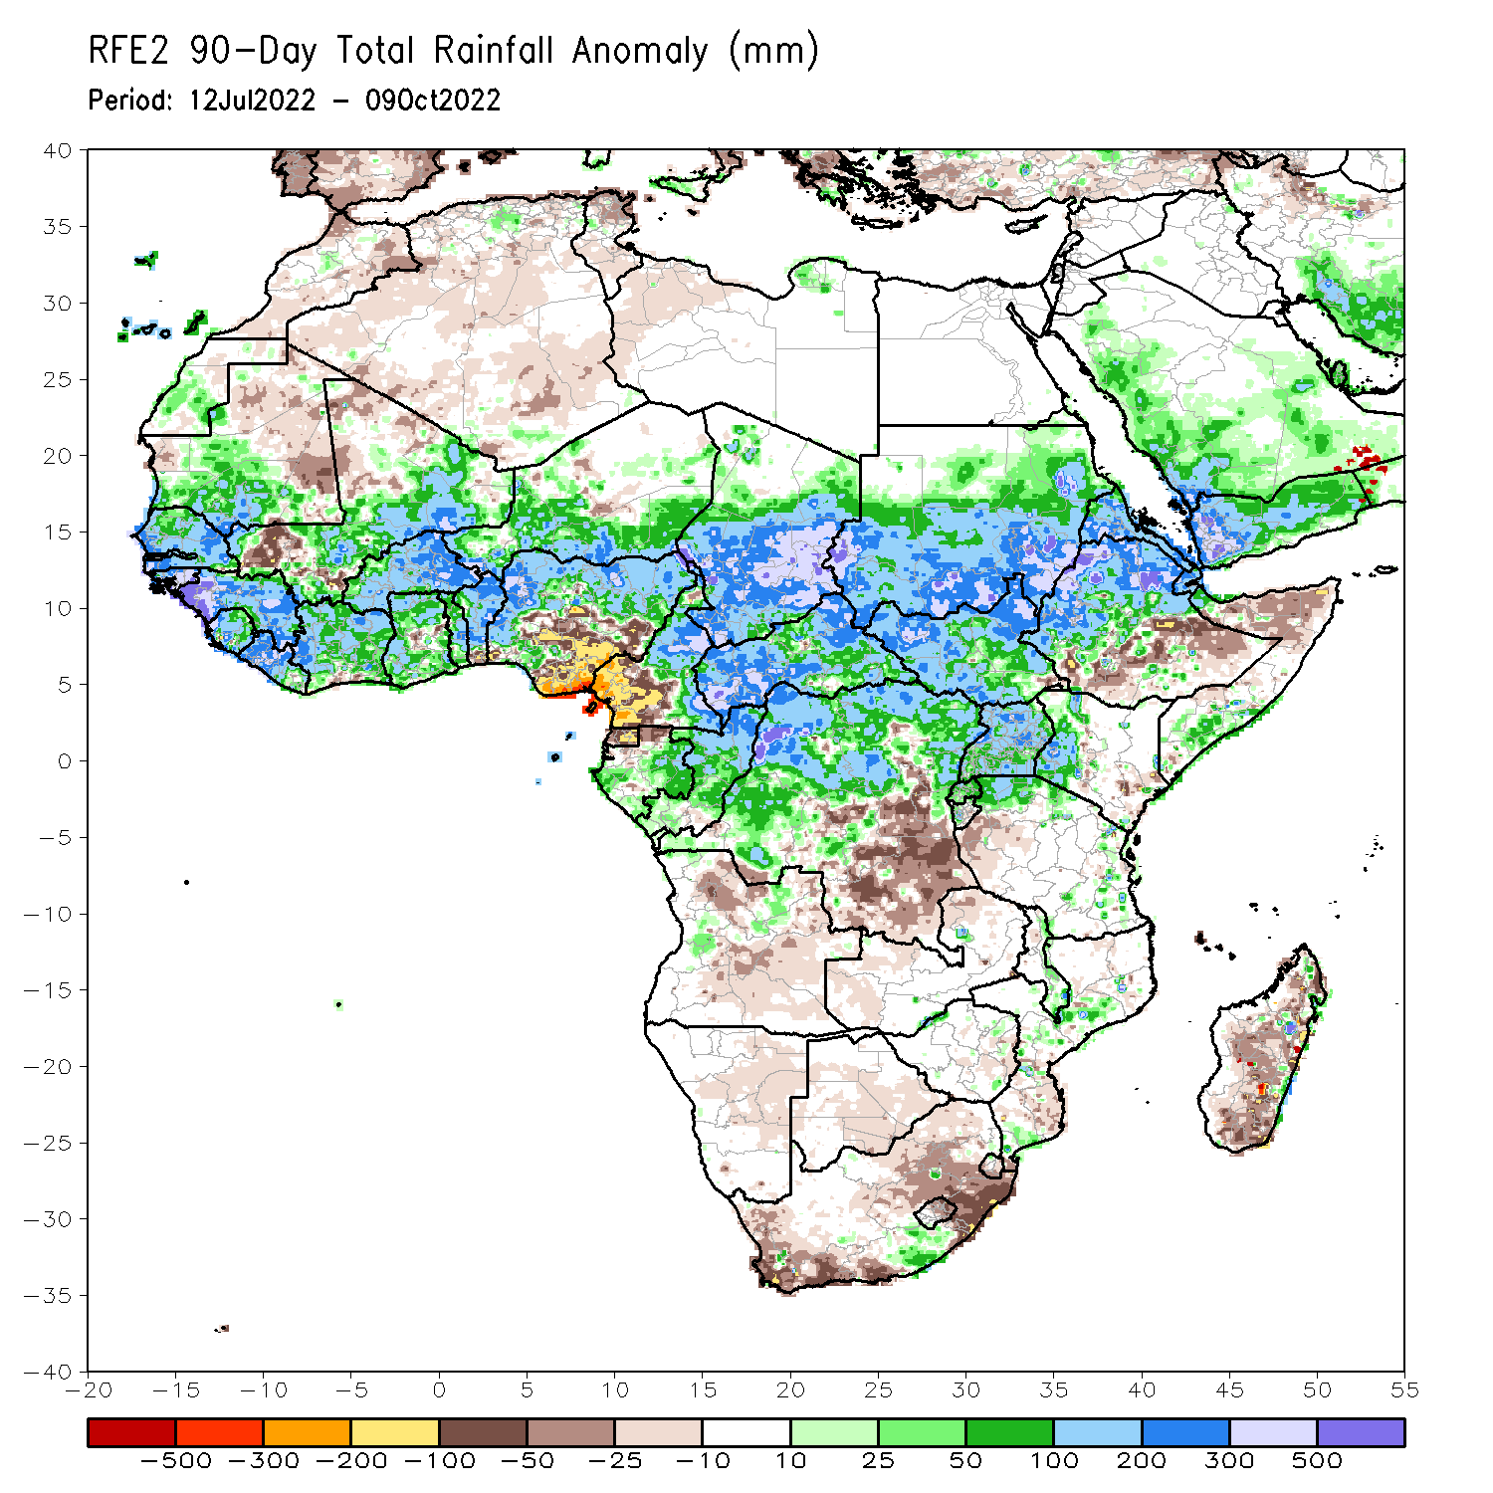
Rainfall Patterns: Last 90 Days
Over the past 90 days, in East Africa, above-average rainfall was observed over southern and central parts of Sudan, much of South Sudan, northern Ethiopia, Eritrea, Djibouti, parts of southern Somalia, Uganda, Rwanda, western Burundi, pockets of northwest and eastern Tanzania, and western Kenya. Rainfall was below-average over pockets of southern and central Ethiopia, and parts of northern Somalia. In southern Africa, above-average rainfall was observed over pockets of southern South Africa, central Mozambique, and southern Malawi. Below-average rainfall was observed over pockets of southwestern and northeastern South Africa, Lesotho, and southern, central, and northern Madagascar. In Central Africa, rainfall was above-average over northern and eastern Cameroon, southern and central Chad, CAR, northern Congo, and northern, western and northeast parts of DRC. Rainfall was below-average over western Cameroon, pockets of northern and central Gabon, Equatorial Guinea, parts of southeast DRC, and northern and eastern Angola. In West Africa, rainfall was above-average over southern Mauritania, Senegal, Gambia, Guinea-Bissau, Guinea, Sierra Leone, western and central Liberia, much of Cote D’Ivoire, western, northern, and southern Ghana, Togo, central and northern parts of Benin, Burkina Faso, eastern and southern portions of Mali, parts of southern Niger, and western and northern Nigeria. In contrast, below-average rainfall was observed over eastern Mauritania, western and northern parts of Mali, parts of central and southeastern Nigeria, and southern Benin.
Notes:
‹#›

Slide 5
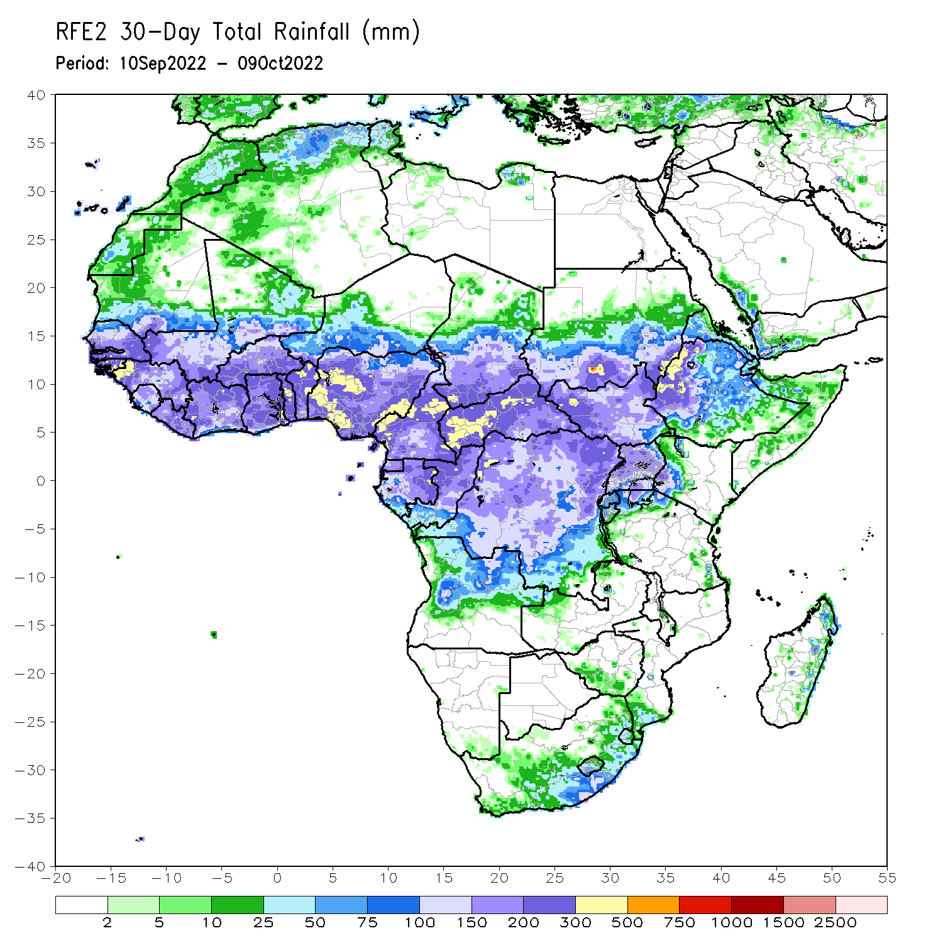
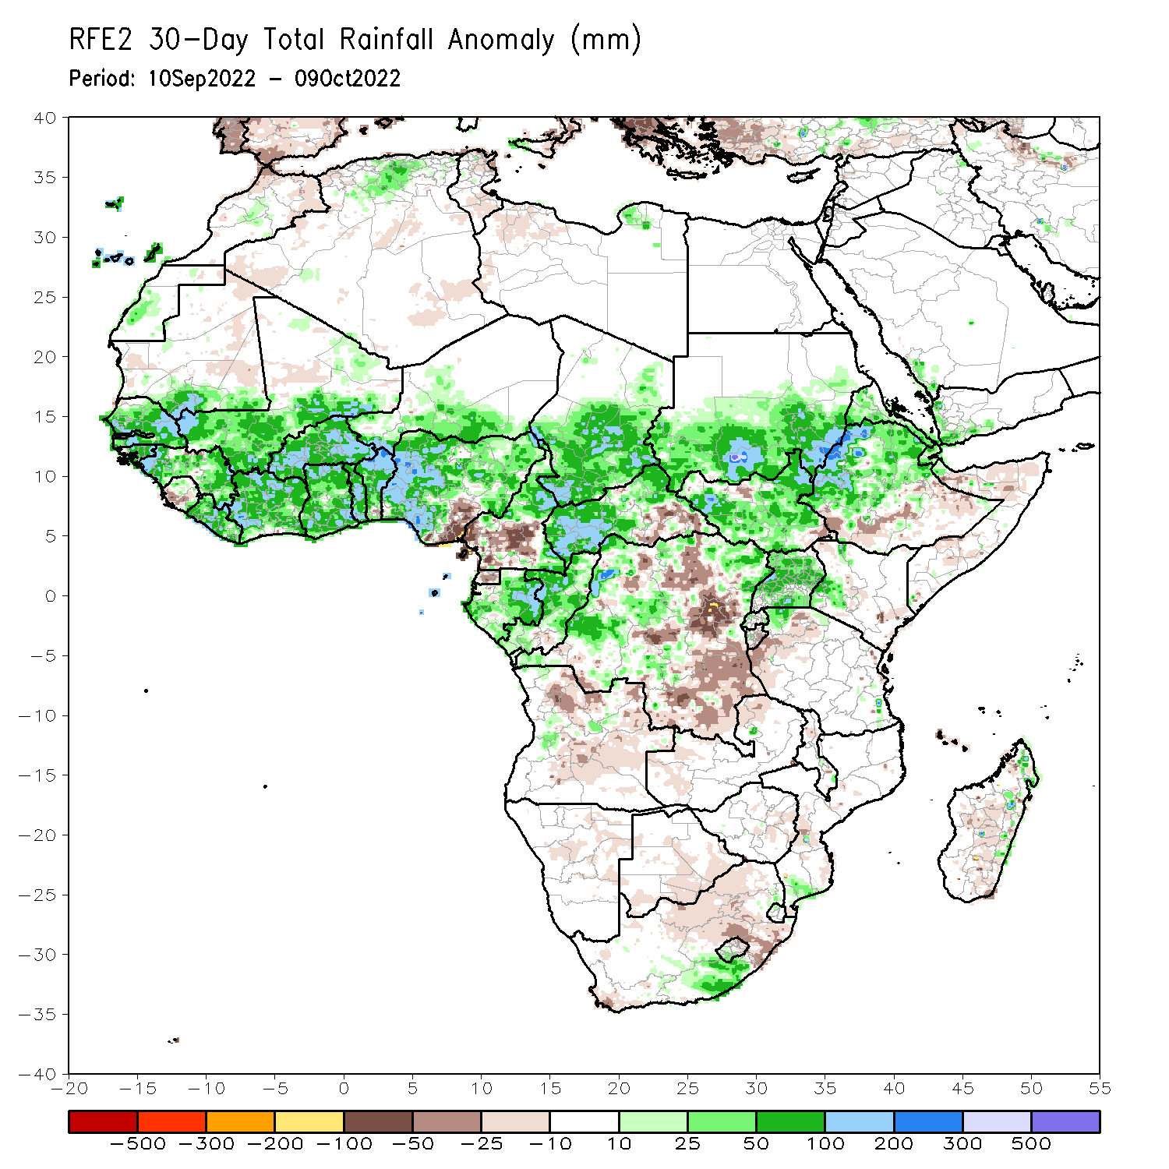
Rainfall Patterns: Last 30 Days
During the past 30 days, in East Africa, above-average rainfall was observed over southern and central Sudan, the western, eastern, and central parts of South Sudan, Eritrea, northern Ethiopia, and in Uganda and the Lake Victoria region. Rainfall was below-average over pockets of central Ethiopia and northern and central Somalia. In Central Africa, rainfall was above-average over parts of northern and central Cameroon, northern and central Congo, western and northern CAR, southern and central Chad, and northern and western DRC. Rainfall was below-average over Equatorial Guinea, southern Cameroon, northern and central Angola, and pockets of central and southern DRC. In West Africa, rainfall was above-average over Senegal, Guinea-Bissau, Guinea, northern and southern Sierra Leone, Liberia, Burkina Faso, most of Ghana, parts of southern Niger, Togo, northern and central Benin, and northern, western, and eastern Nigeria. In contrast, portions of central Mali, coastal Sierra Leone, coastal Ghana, southern Benin, southern Nigeria, and eastern and western Mauritania received below-average rainfall. In southern Africa, above-average rainfall was observed over parts of southern South Africa, southern Lesotho, and eastern Madagascar. Below normal precipitation was observed in northern and eastern South Africa, northern Lesotho, and central Madagascar.
Notes:
‹#›

Slide 6
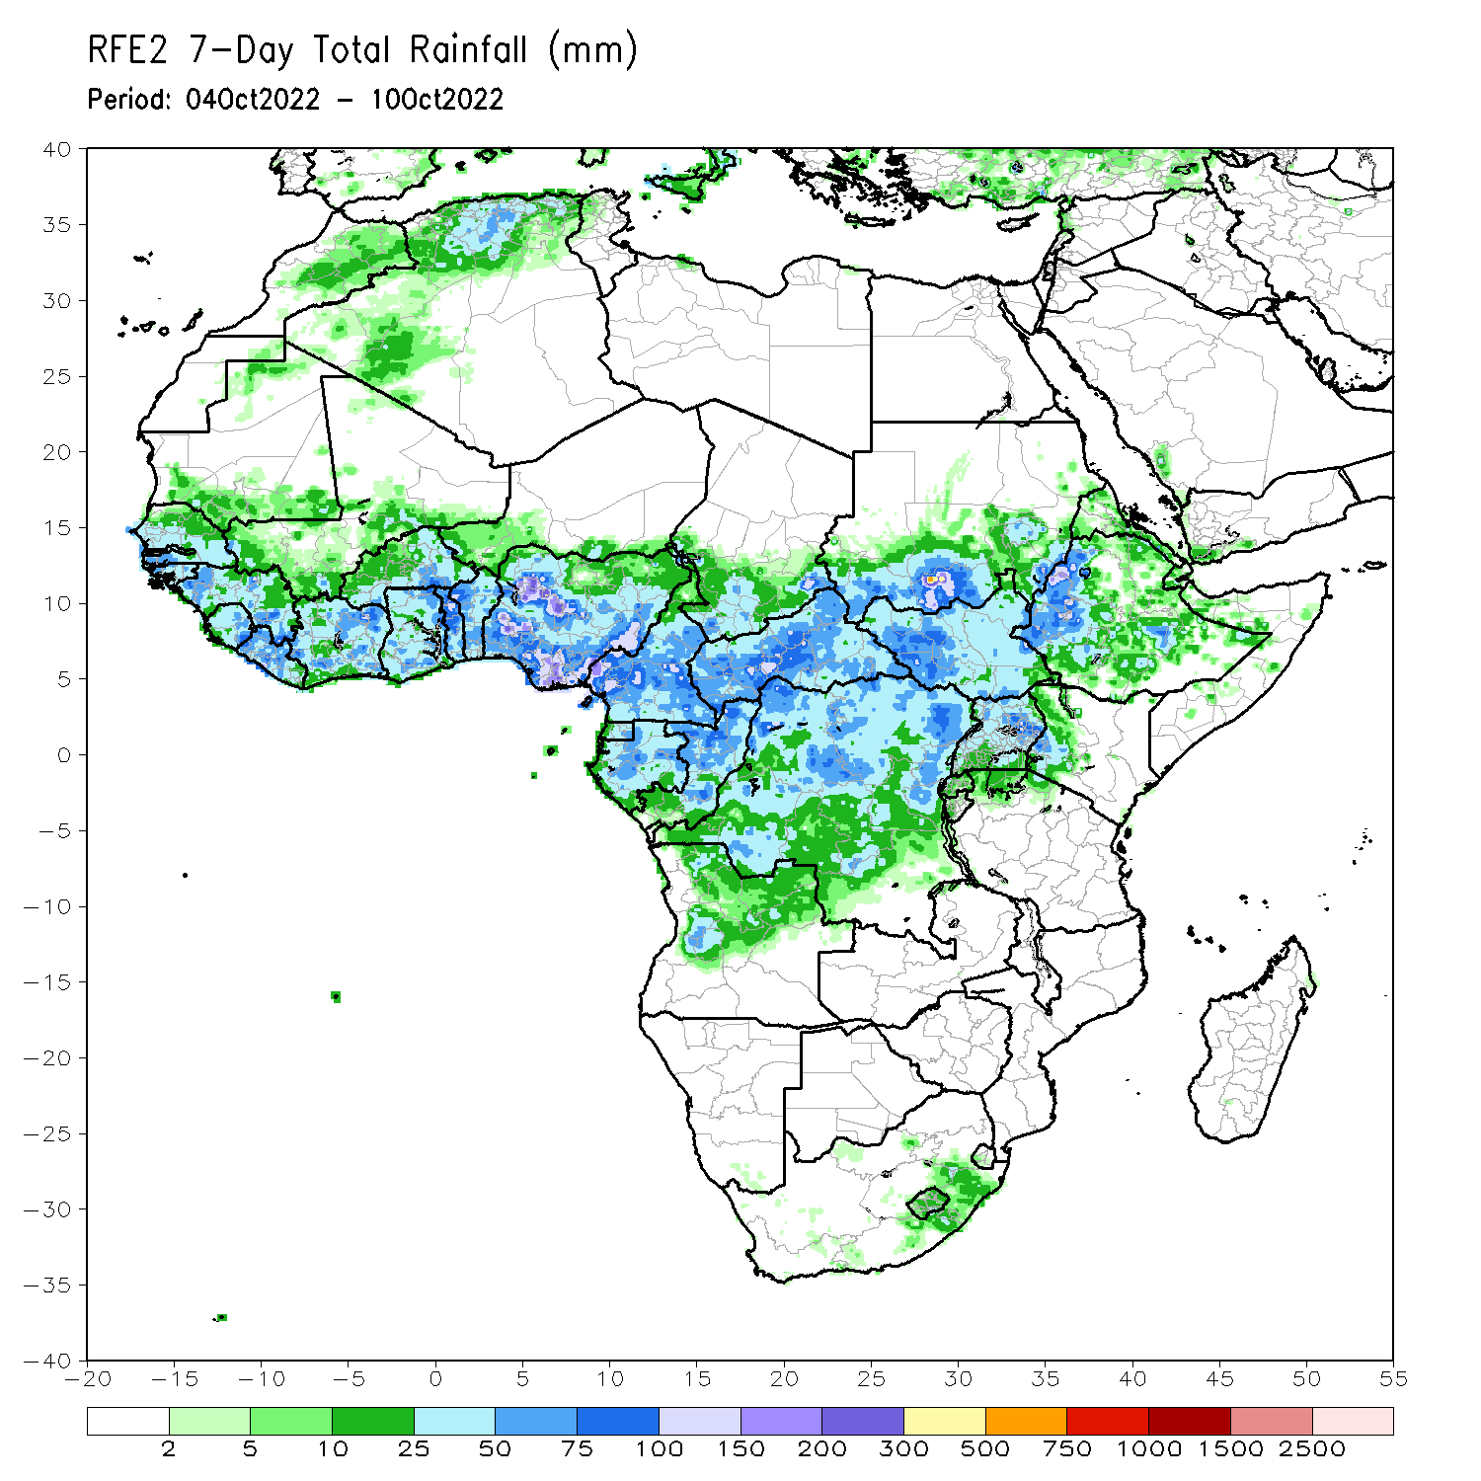
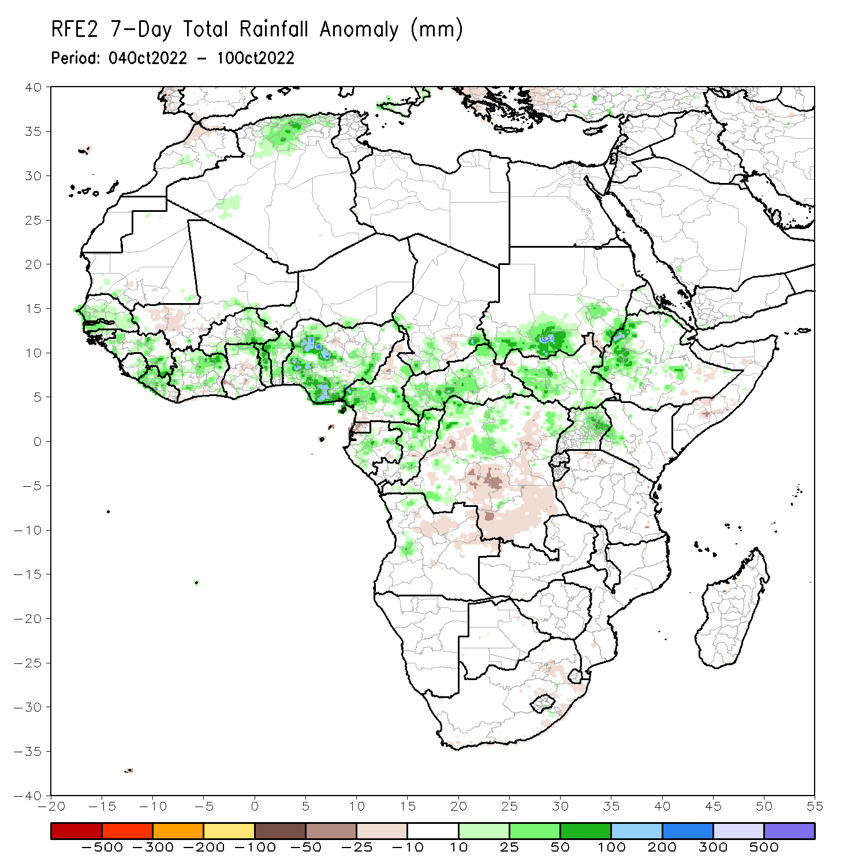
Rainfall Patterns: Last 7 Days
During the past 7 days, in East Africa, rainfall was above-average over much of central and southeastern Eritrea, western and central Ethiopia, eastern, western, and southern South Sudan, southern portions of Sudan, eastern Uganda, and western Kenya. Below-average rainfall was observed over pockets of eastern Ethiopia, northwestern South Sudan, Burundi, northwestern Tanzania, and portions of southern Somalia. In Central Africa, rainfall was above-average over central and southern Cameroon, central and southern Chad, western and central CAR, central and southern Gabon, northern and southern portions of Congo, northwestern, central, and southwestern DRC, and a small portion of west-central Angola. Below-average rainfall was observed over eastern CAR, a small portion of northwestern Cameroon, much of central and southeastern DRC, and Equatorial Guinea. In West Africa, above-average rainfall was observed over western and southern Nigeria, Benin, Togo, northern and southern Ghana, northern and central Cote D’Ivoire, western and central Liberia, northeastern and western Guinea, Sierra Leone, Guinea, Guinea-Bissau, southern and eastern Burkina Faso, and central and southern Senegal. In contrast, southwestern Mali, southern Cote D’Ivoire, central Ghana, and small portions of central Nigeria received below-average rainfall. In southern Africa, rainfall was below average in pockets of southern and eastern South Africa.

Slide 7
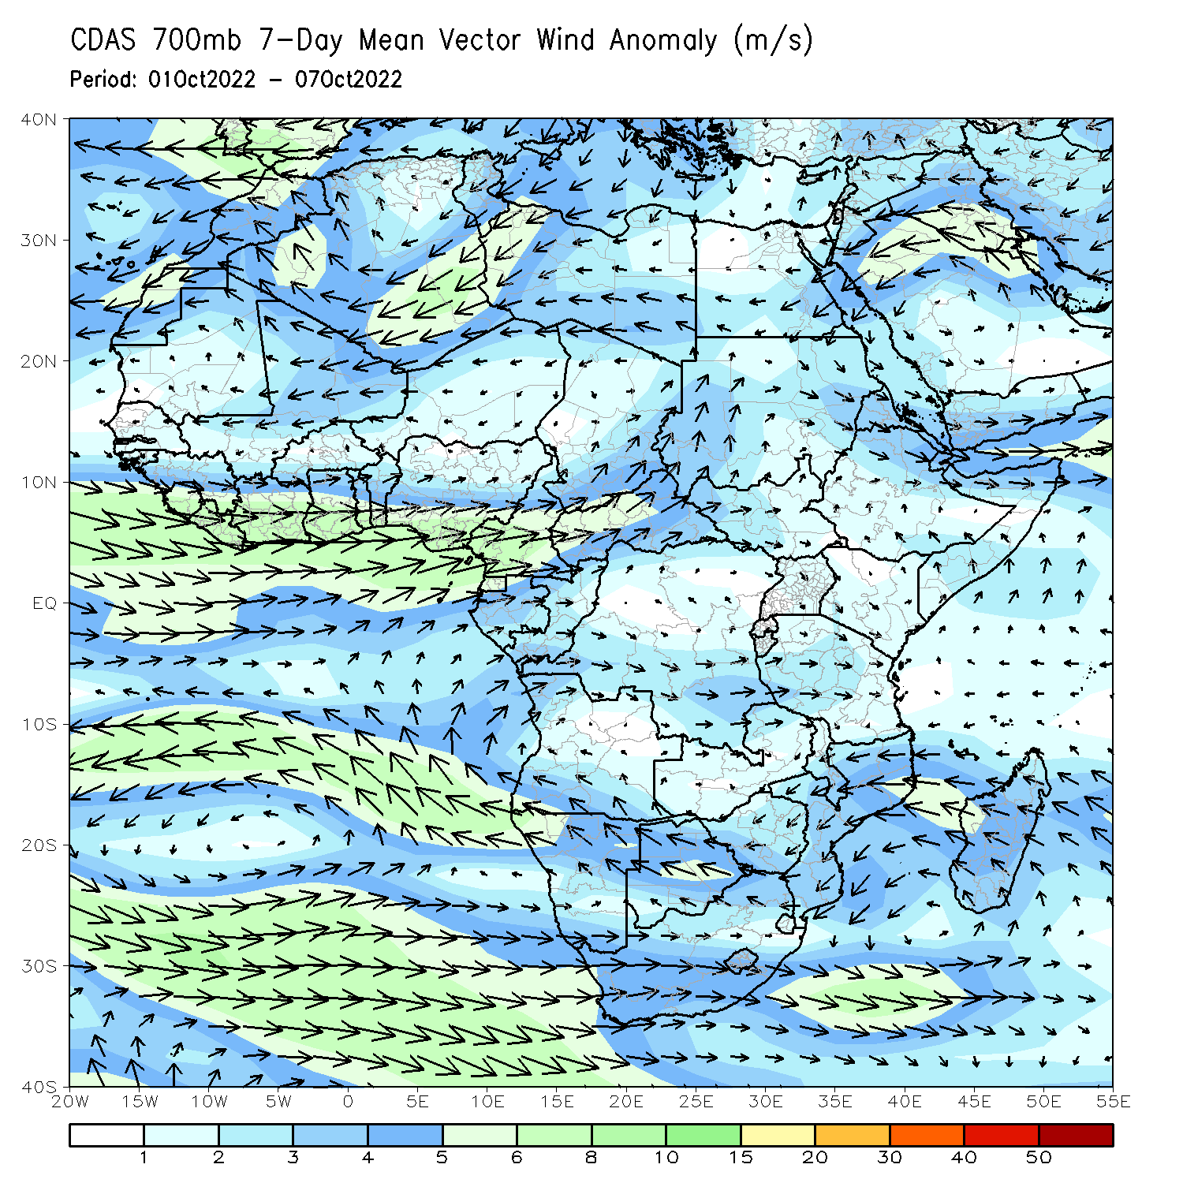
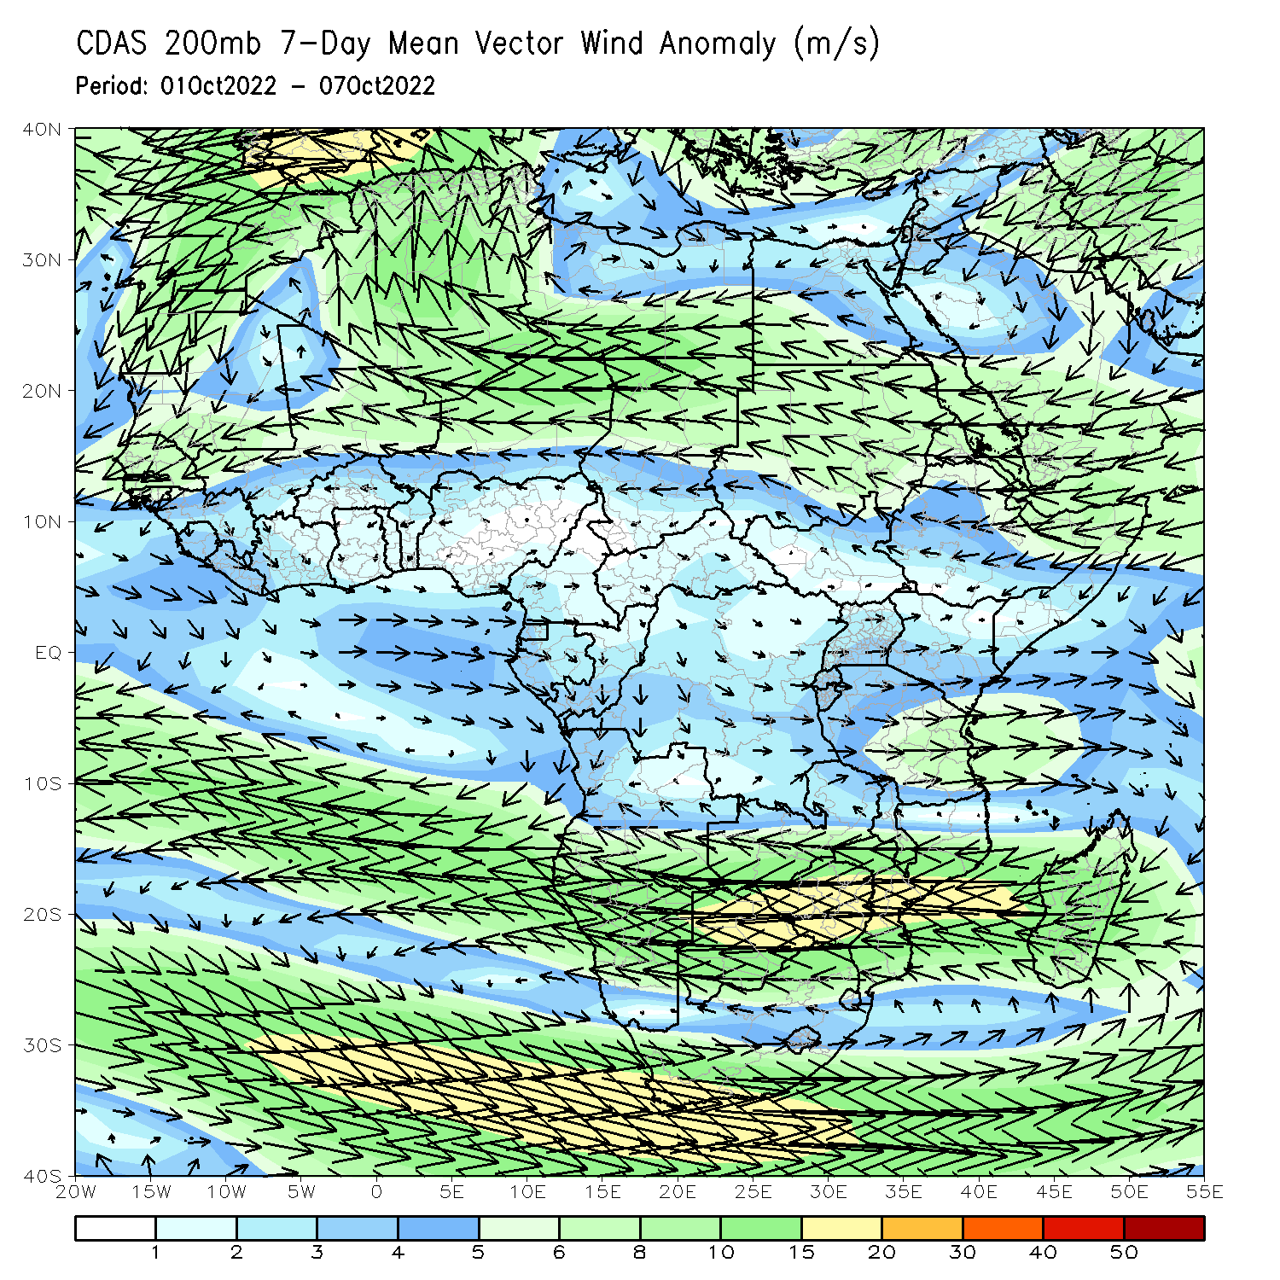
Atmospheric Circulation: Last 7 Days
At 700-hPa level (left panel), anomalous westerly flow was observed across much of the Sahel region and Gulf of Guinea regions.

Slide 8
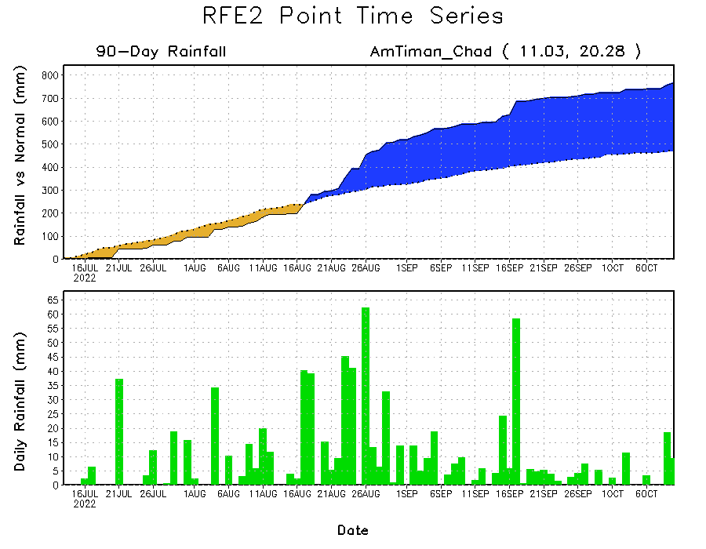
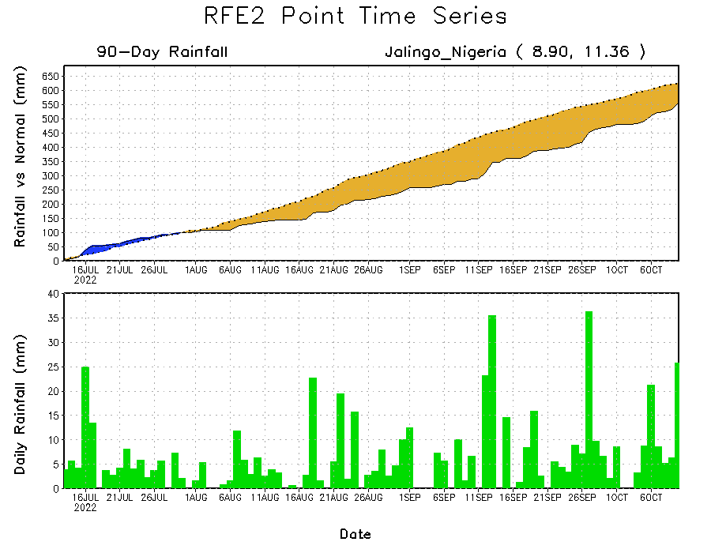
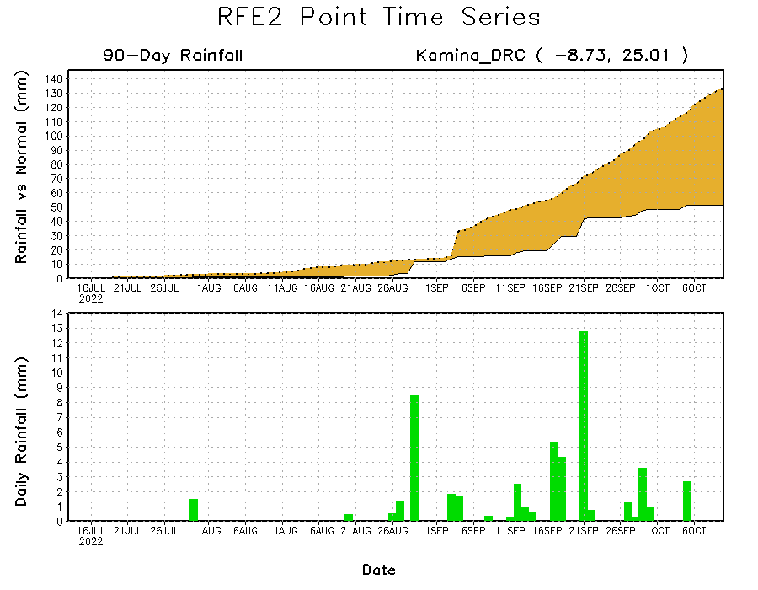
Rainfall Evolution
Daily evolution of rainfall over the last 90 days at selected locations shows continuing moisture deficits over parts of eastern Nigeria (bottom left) and southern DRC (bottom right). Consistent heavy rains have kept significant moisture surpluses over parts of Chad (top right).

Slide 9
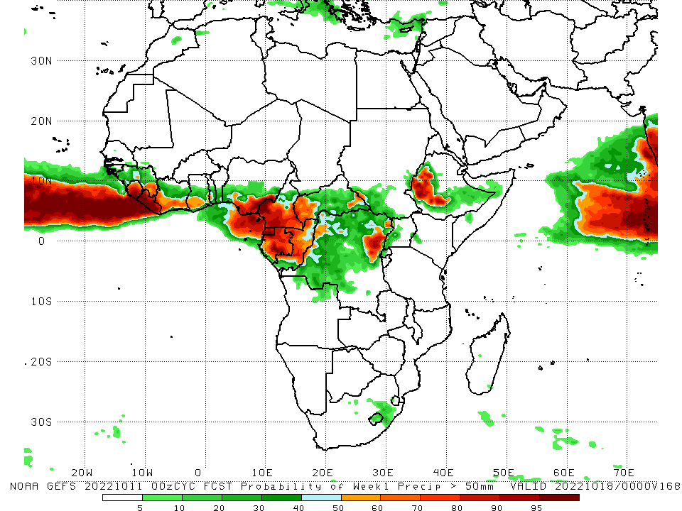
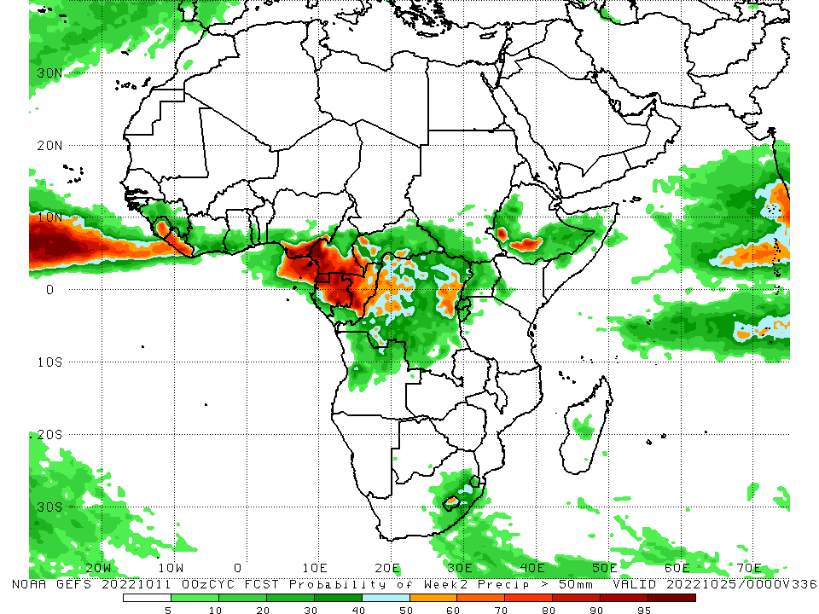
NCEP GEFS Model Forecasts Non-Bias Corrected Probability of precipitation exceedance
Week-1, Valid: 12 – 18 October, 2022
Week-2, Valid: 19 – 25 October, 2022
For week-1 (left panel) the NCEP GEFS indicates a moderate to high chance (over 70%) for rainfall to exceed 50 mm over much of southeastern Guinea, Sierra Leone, Liberia, coastal Cote D’Ivoire, Ghana, and Togo, southern Nigeria, central and southern Cameroon, Equatorial Guinea, Gabon, central Congo, western and eastern CAR, northeastern DRC, and parts of western Ethiopia. For week-2 (right panel), NCEP GEFS indicates a moderate to high chance (over 70%) for rainfall to exceed 50 mm over Sierra Leone, Liberia, southern Nigeria, southern Cameroon, Equatorial Guinea, most of Gabon, and localized areas of western Ethiopia and eastern/western DRC.
Notes:
‹#›

Slide 10
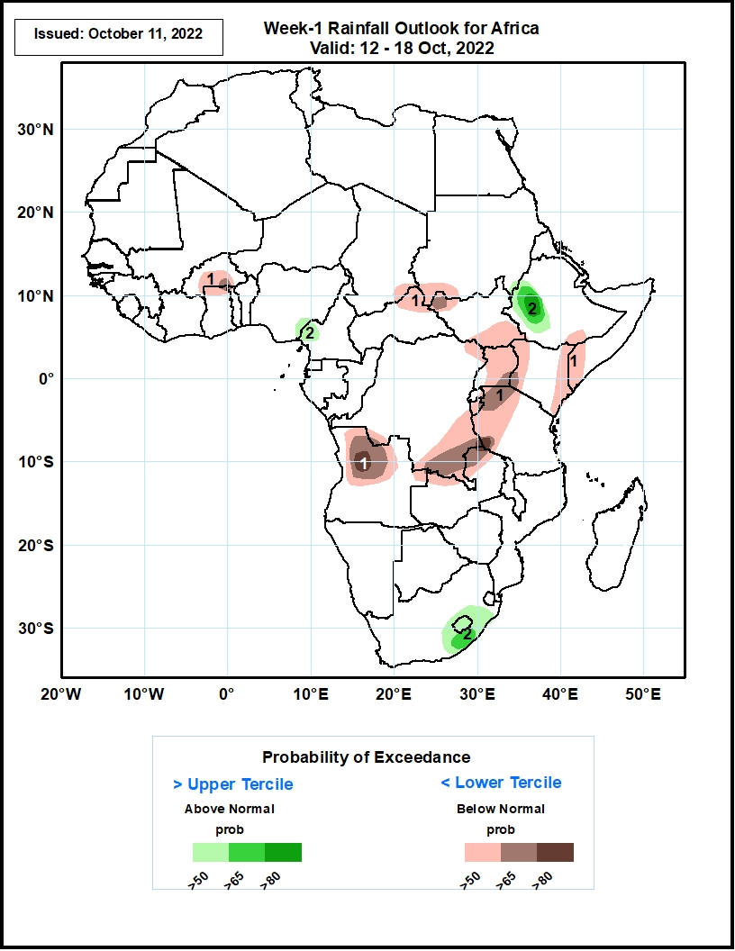
Week-1 Precipitation Outlooks
12 - 18 October, 2022
The consolidated probabilistic forecasts suggest above 50% chance for weekly rainfall to be below-normal (below the lower tercile) over southern Burkina Faso, northern Ghana, between southeastern Chad, northern CAR, southwestern Sudan, and northeastern South Sudan, between southern Somalia and eastern Kenya, from southern South Sudan to southern DRC, and in northern Angola. In particular, there is above 80% chance for weekly rainfall to be below normal over northern Angola and around the junction of DRC, Zambia, and Tanzania.
The forecast suggests above 50% chance for weekly total rainfall to be above-normal (above the upper tercile) between southeastern Nigeria and western Cameroon, eastern Ethiopia, Lesotho, and southeastern South Africa. In particular, there is above 80% chance for rainfall to be above-normal over eastern Ethiopia.
Notes:
‹#›

Slide 11
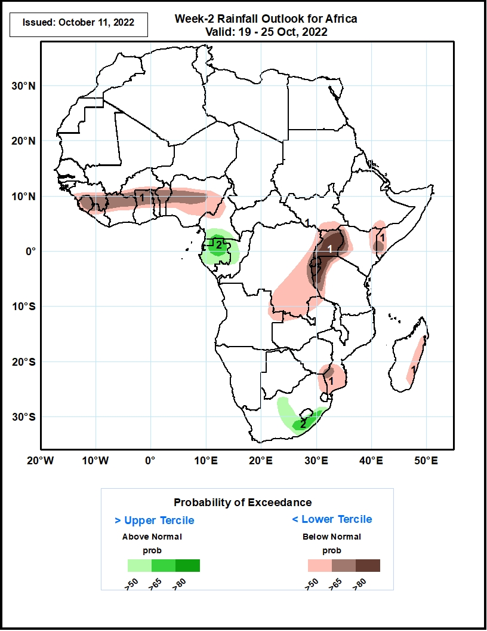
Week-2 Precipitation Outlooks
19 - 25 October, 2022
The consolidated probabilistic forecasts suggest above 50% chance for weekly rainfall to be below-normal (below the lower tercile) around the Gulf of Guinea coast and Sahel (from Sierra Leone east towards central Nigeria), between a small portion of southern Ethiopia and around the border of Kenya and Somalia, from Uganda to southern DRC, southern Mozambique, northwestern South Africa, and southern Zimbabwe. In particular, there is above 80% chance for rainfall to be below-normal in Kenya, Rwanda, Burundi, eastern DRC, northwestern Tanzania, and eastern Madagascar.
The forecast suggests above 50% chance for weekly total rainfall to be above-normal (above the upper tercile) between southern Cameroon and southern Gabon, in portions of central and southeastern South Africa, and southern Lesotho. In particular, there is above 65% chance for rainfall to be above-normal in northern Gabon and in southeastern South Africa.
Notes:
‹#›

Slide 12
Summary
During the past 30 days, in East Africa, above-average rainfall was observed over southern and central Sudan, the western, eastern, and central parts of South Sudan, Eritrea, northern Ethiopia, and in Uganda and the Lake Victoria region. Rainfall was below-average over pockets of central Ethiopia and northern and central Somalia. In Central Africa, rainfall was above-average over parts of northern and central Cameroon, northern and central Congo, western and northern CAR, southern and central Chad, and northern and western DRC. Rainfall was below-average over Equatorial Guinea, southern Cameroon, northern and central Angola, and pockets of central and southern DRC. In West Africa, rainfall was above-average over Senegal, Guinea-Bissau, Guinea, northern and southern Sierra Leone, Liberia, Burkina Faso, most of Ghana, parts of southern Niger, Togo, northern and central Benin, and northern, western, and eastern Nigeria. In contrast, portions of central Mali, coastal Sierra Leone, coastal Ghana, southern Benin, southern Nigeria, and eastern and western Mauritania received below-average rainfall. In southern Africa, above-average rainfall was observed over parts of southern South Africa, southern Lesotho, and eastern Madagascar. Below normal precipitation was observed in northern and eastern South Africa, northern Lesotho, and central Madagascar.
During the past 7 days, in East Africa, rainfall was above-average over much of central and southeastern Eritrea, western and central Ethiopia, eastern, western, and southern South Sudan, southern portions of Sudan, eastern Uganda, and western Kenya. Below-average rainfall was observed over pockets of eastern Ethiopia, northwestern South Sudan, Burundi, northwestern Tanzania, and portions of southern Somalia. In Central Africa, rainfall was above-average over central and southern Cameroon, central and southern Chad, western and central CAR, central and southern Gabon, northern and southern portions of Congo, northwestern, central, and southwestern DRC, and a small portion of west-central Angola. Below-average rainfall was observed over eastern CAR, a small portion of northwestern Cameroon, much of central and southeastern DRC, and Equatorial Guinea. In West Africa, above-average rainfall was observed over western and southern Nigeria, Benin, Togo, northern and southern Ghana, northern and central Cote D’Ivoire, western and central Liberia, northeastern and western Guinea, Sierra Leone, Guinea, Guinea-Bissau, southern and eastern Burkina Faso, and central and southern Senegal. In contrast, southwestern Mali, southern Cote D’Ivoire, central Ghana, and small portions of central Nigeria received below-average rainfall. In southern Africa, rainfall was below average in pockets of southern and eastern South Africa.
Week-1 outlooks call for an increased chance for above-average rainfall across much of the Gulf of Guinea coast, portions of western South Sudan, western CAR, western DRC, western Ethiopia, Gabon, Congo, central South Africa, and Lesotho. In contrast, there is an increased chance for below-average rainfall near the Lake Victoria region, Rwanda, Burundi, southern Ethiopia, southern Somalia, northern and southern Kenya, eastern Tanzania, southern DRC, eastern Madagascar, and northwestern Angola. Week-2 outlooks call for an increased chance for above-average rainfall across southern Nigeria, southern Cameroon, Equatorial Guinea, Gabon, northern Congo, western and central CAR, western DRC, western South Sudan, western and eastern Ethiopia, southeastern South Africa, and Lesotho. In contrast, there is an increased chance for below-average rainfall near most of the Gulf of Guinea coast, eastern DRC, the Lake Victoria region, Rwanda, Burundi, eastern Tanzania, Kenya, southern Somalia, and eastern Madagascar.

