Slide 1
The African Monsoon Recent Evolution and Current Status Include Week-1 and Week-2 Outlooks
Update prepared by
3 October 2022
For more information, visit:
http://www.cpc.ncep.noaa.gov/products/Global_Monsoons/African_Monsoons/precip_monitoring.shtml

Slide 2
Outline
Highlights
Recent Evolution and Current Conditions
NCEP GEFS Forecasts
Summary

Slide 3
Highlights: Last 7 Days
During the past 7 days, in East Africa, rainfall was above-average over much of southeastern Eritrea, northern and central Ethiopia, eastern and western South Sudan, southern portions of Sudan, and near the Lake Victoria region. Below-average rainfall was observed over pockets of southern Ethiopia, southern South Sudan, southwestern Sudan, northern Uganda, Burundi, and western Tanzania. In Central Africa, rainfall was above-average over central and southeastern Cameroon, central and southwestern Chad, western CAR, Equatorial Guinea, Gabon, central and western Congo, western and northeastern DRC, and pockets of central Angola. Below-average rainfall was observed over central and eastern CAR, central and northern Cameroon, southwestern Chad, and much central and southern DRC. In West Africa, above-average rainfall was observed over Nigeria, Benin, Togo, Ghana, Cote D’Ivoire, Liberia, northeastern and western Guinea, Guinea-Bissau, southwestern Niger, southern and eastern Mali, and western and eastern Burkina Faso. In contrast, parts of western and eastern Senegal, northern Guinea, and western Mali received below-average rainfall. In southern Africa, rainfall was above-average in southern portions of South Africa and below average in pockets of northern and eastern South Africa.
Week-1 outlooks call for an increased chance for above-average rainfall across much of the Sahel region and Gulf of Guinea coast, southern Chad, South Sudan, CAR, western and northern DRC, western Ethiopia, northern Uganda, western Kenya, and Congo. In contrast, there is an increased chance for below-average rainfall near the Lake Victoria region, Rwanda, southern Ethiopia, central Somalia, southern Kenya, eastern Tanzania, eastern Madagascar, parts of central Mozambique, southern and northern South Africa, Swaziland, and Lesotho. Week-2 outlooks call for an increased chance for above-average rainfall across the Gulf of Guinea coast extending from Cote D’Ivoire to Nigeria, Senegal, CAR, DRC, Uganda, Rwanda, Burundi, South Sudan, and western Ethiopia. In contrast, there is an increased chance for below-average rainfall near eastern Ethiopia, Somalia, southeastern Madagascar, southern Kenya, and southern Tanzania.

Slide 4
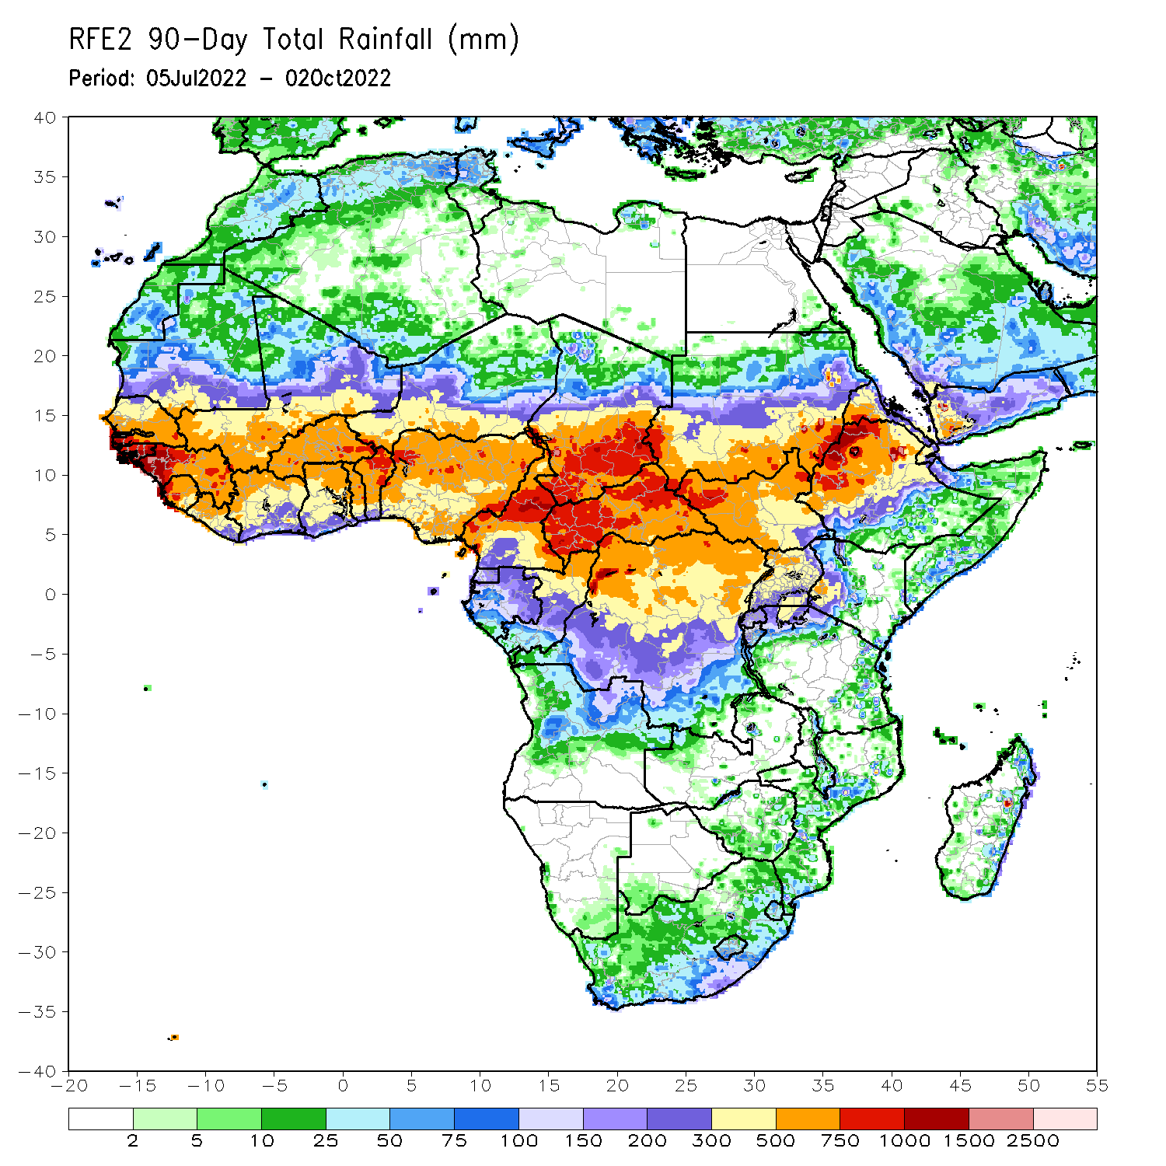
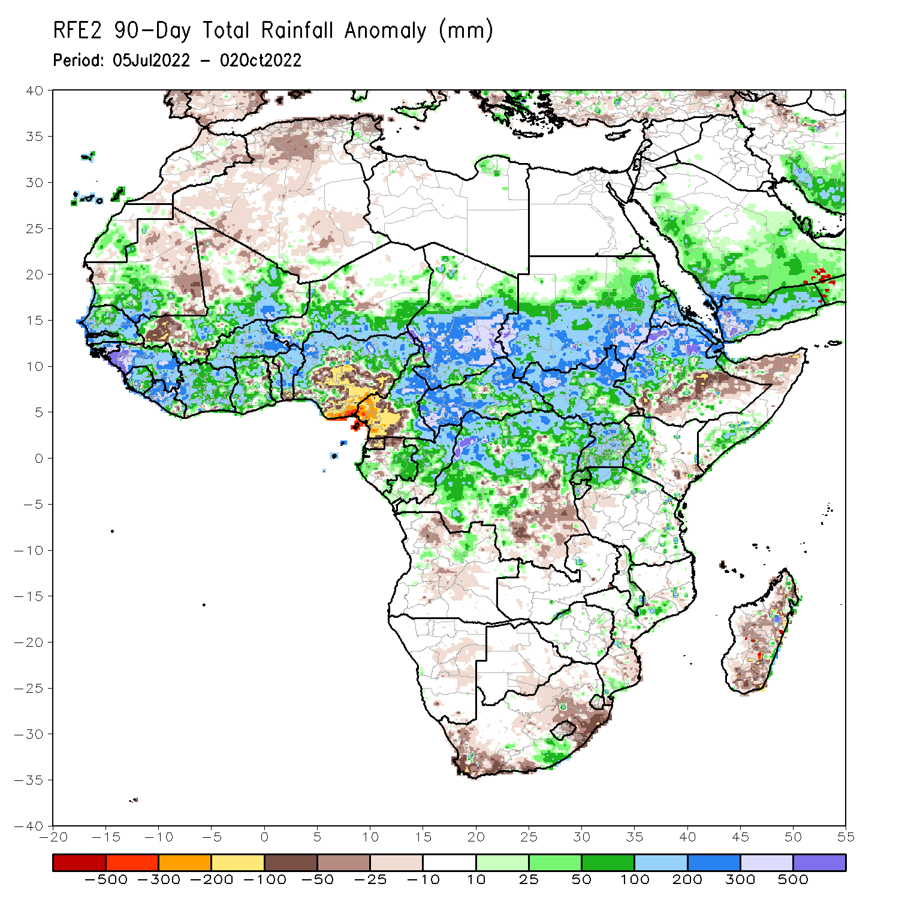
Rainfall Patterns: Last 90 Days
Over the past 90 days, in East Africa, above-average rainfall was observed over southern and central parts of Sudan, much of South Sudan, northern Ethiopia, Eritrea, Djibouti, parts of southern Somalia, Uganda, Rwanda, Burundi, pockets of northwest and eastern Tanzania, and western Kenya. Rainfall was below-average over pockets of southern and central Ethiopia, and parts of northern Somalia. In southern Africa, above-average rainfall was observed over pockets of southern South Africa, central Mozambique, southern Malawi, and eastern Zimbabwe. Below-average rainfall was observed over pockets of southwestern and northeastern South Africa, Lesotho, and southern, central, and northern Madagascar. In Central Africa, rainfall was above-average over northern and eastern Cameroon, southern and central Chad, CAR, northern Congo, and northern, western and northeast parts of DRC. Rainfall was below-average over western Cameroon, pockets of northern and central Gabon, Equatorial Guinea, parts of southeast DRC, and northern Angola. In West Africa, rainfall was above-average over southern Mauritania, Senegal, Gambia, Guinea-Bissau, Guinea, Sierra Leone, western and central Liberia, much of Cote D’Ivoire, western and northern Ghana, central and northern parts of Togo and Benin, Burkina Faso, eastern Mali, and parts of southern Niger and western and northern Nigeria. In contrast, below-average rainfall was observed over eastern Mauritania, western and northern parts of Mali, eastern Liberia, and parts of central and southeastern Nigeria.
Notes:
‹#›

Slide 5
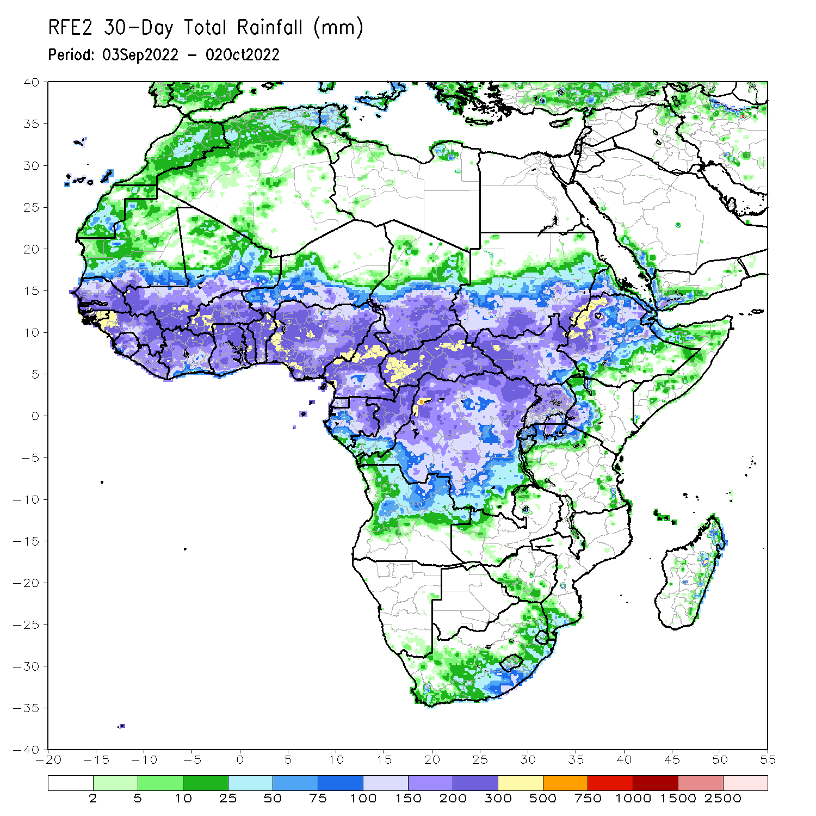
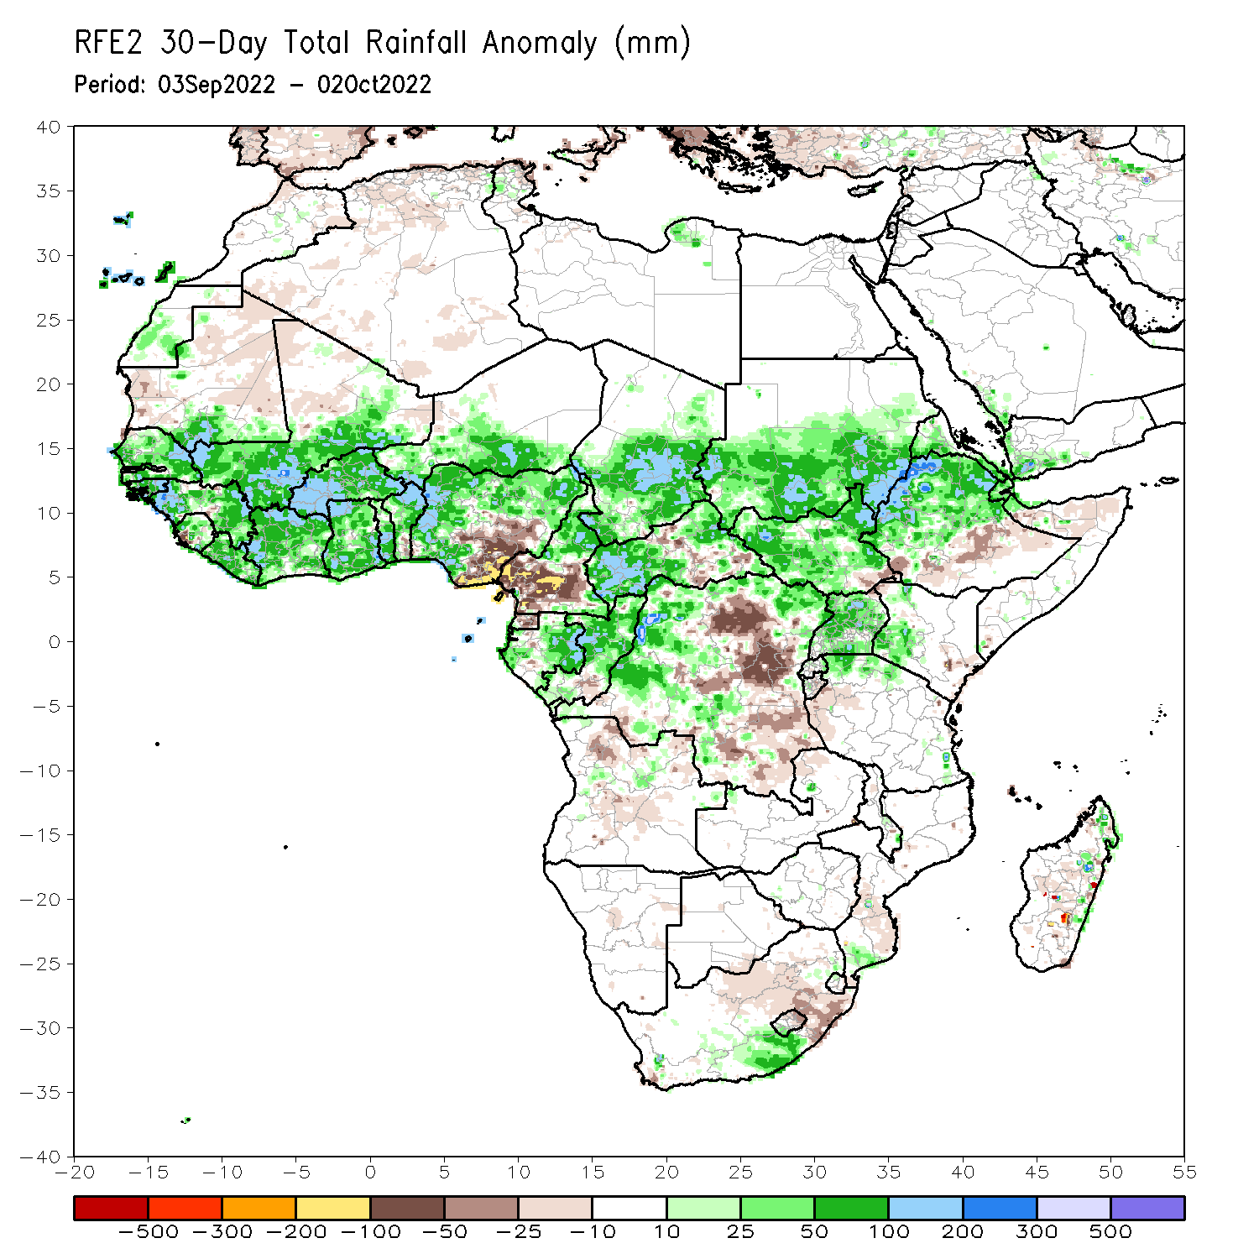
Rainfall Patterns: Last 30 Days
During the past 30 days, in East Africa, above-average rainfall was observed over southern and central Sudan, the western and central parts of South Sudan, Eritrea, and northern Ethiopia. Rainfall was below-average over pockets of central Ethiopia and northern Somalia. In Central Africa, rainfall was above-average over parts of northern and central Cameroon, northern and central Congo, western and northern CAR, southern and central Chad and northern and western DRC. Rainfall was below-average over Equatorial Guinea, southern Cameroon, northern Angola, and pockets of central and southern DRC. In West Africa, rainfall was above-average over Senegal, Guinea-Bissau, Guinea, central and eastern Sierra Leone, Liberia, Burkina Faso, most of Ghana, parts of southern Niger, southern Togo, northern Benin, and northern, western, and eastern Nigeria. In contrast, central and northern Mali, coastal Sierra Leone, Ghana, southern Benin, and southern Nigeria received below-average rainfall. In southern Africa, above-average rainfall was observed over parts of southern South Africa, southern Lesotho, and eastern Madagascar. Below normal precipitation was observed in northern and eastern South Africa, northern Lesotho, and central Madagascar.
Notes:
‹#›

Slide 6
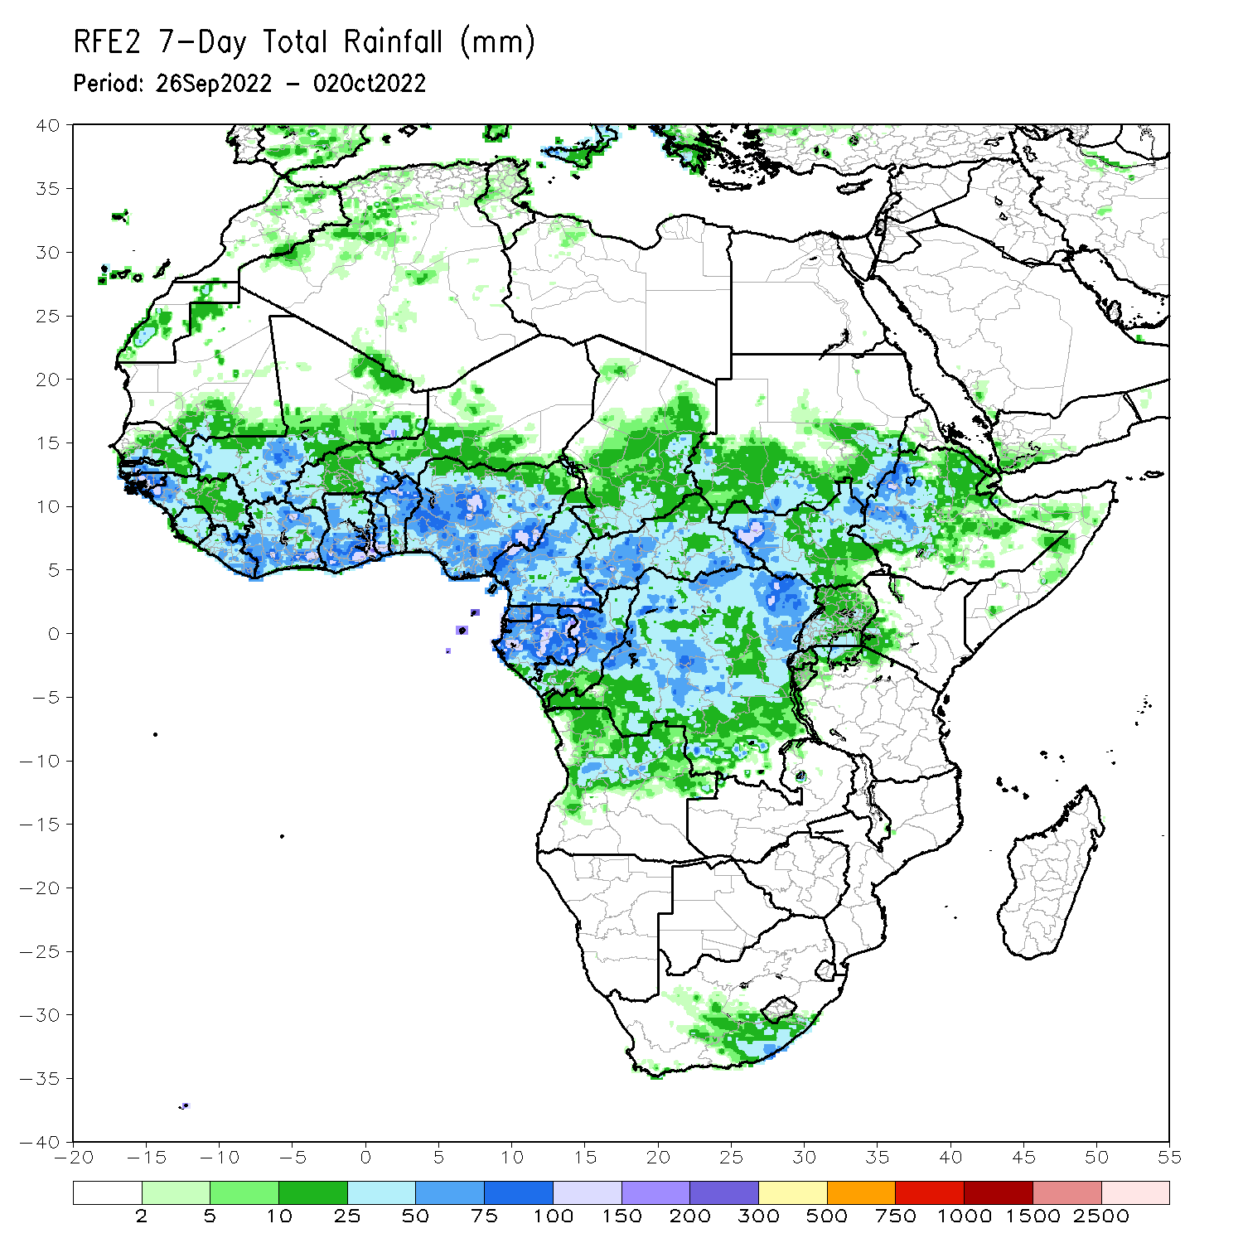
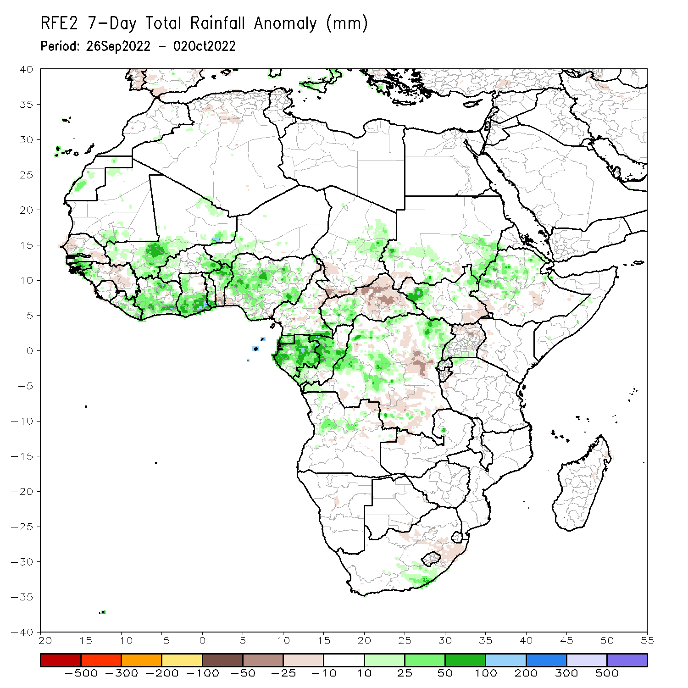
Rainfall Patterns: Last 7 Days
During the past 7 days, in East Africa, rainfall was above-average over southern Sudan, northeastern and western parts of South Sudan, northwest and northern Ethiopia, eastern Eritrea, and pockets of southern Uganda around the Lake Victoria region. Below-average rainfall was observed over pockets of southwest Ethiopia, northern Uganda, and pockets of southwestern South Sudan and western Kenya. In Central Africa, rainfall was above-average over western CAR, central and eastern Chad, pockets of western and northern DRC, central Congo, most of Gabon, and central Angola. Below-average rainfall was observed over pockets of western and central Cameroon, eastern CAR, pockets of southern and central DRC, and pockets of northeastern Angola. In southern Africa, above-average rainfall was observed over southern South Africa and below average rainfall was observed in eastern South Africa. In West Africa, above-average rainfall was observed over southwestern Senegal, Guinea Bissau, western Guinea, southern Mauritania, southern and central Mali, Liberia, Cote D’Ivoire, southern Ghana, eastern and western Burkina Faso, pockets of southern Togo and northern Benin, pockets of southern Niger, and central Nigeria. In contrast, parts of eastern Guinea, northwestern and southeastern Senegal, southern Benin, and southwestern Nigeria received below-average rainfall.

Slide 7
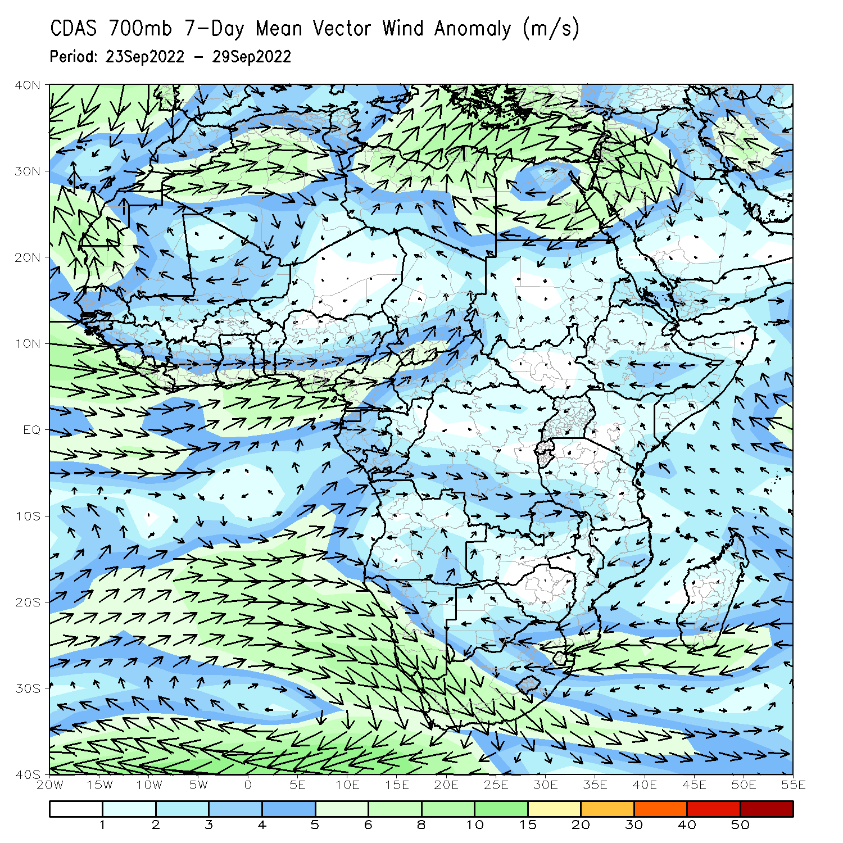
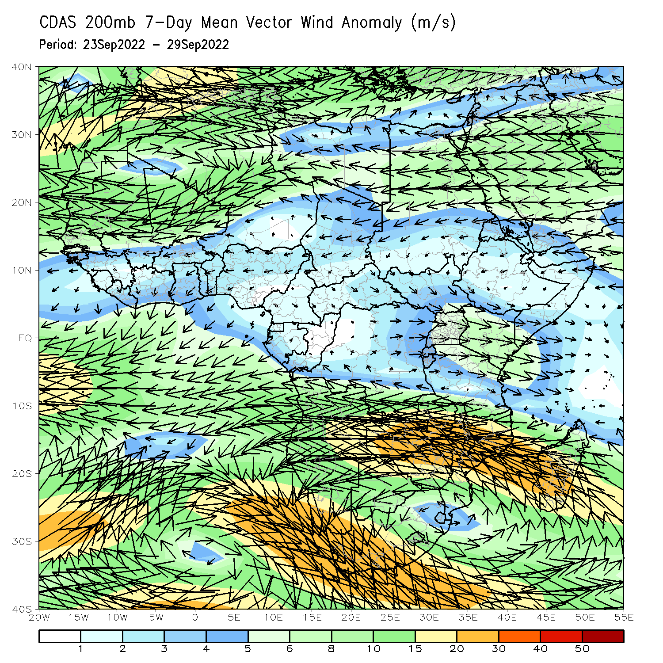
Atmospheric Circulation: Last 7 Days
At 700-hPa level (left panel), anomalous westerly flow was observed across much of the Sahel region and Gulf of Guinea regions.

Slide 8
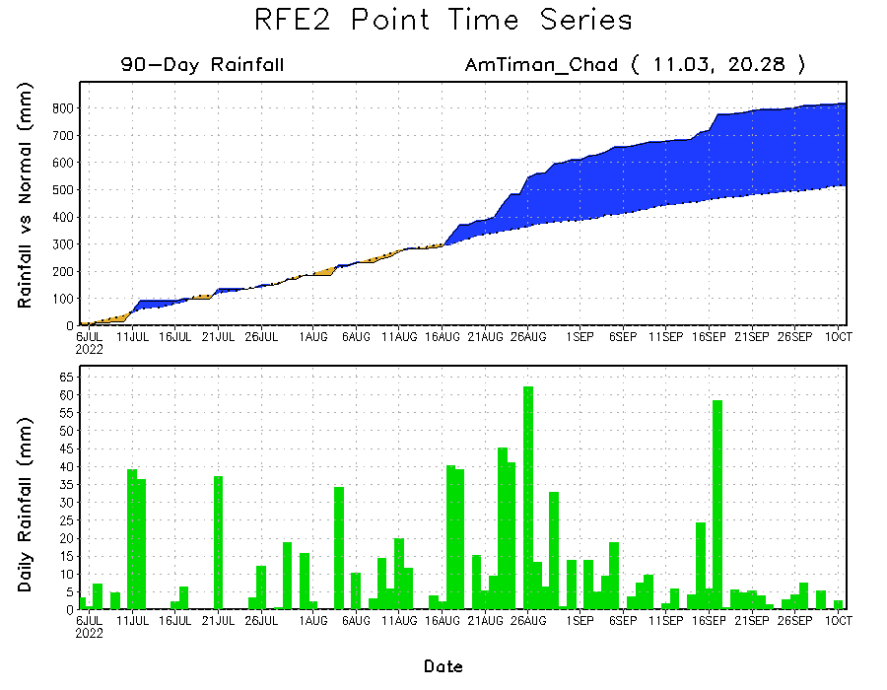
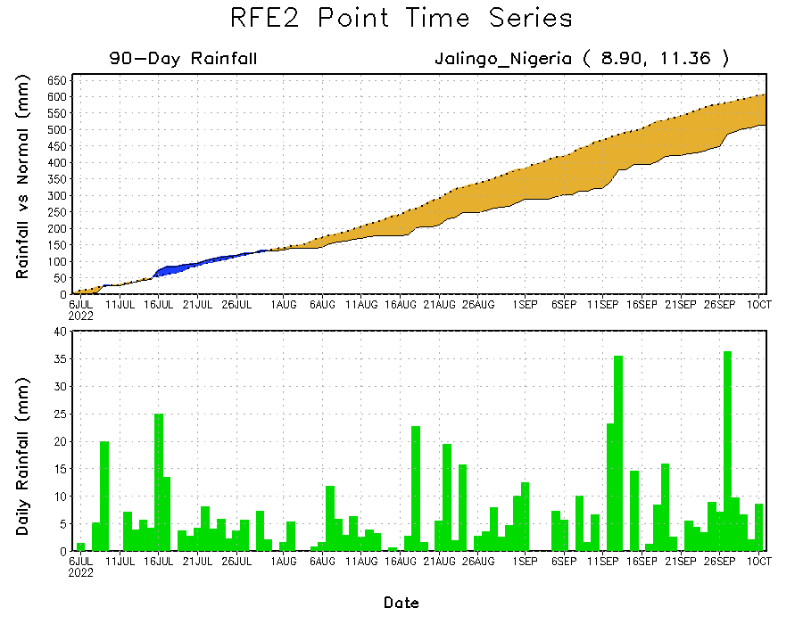
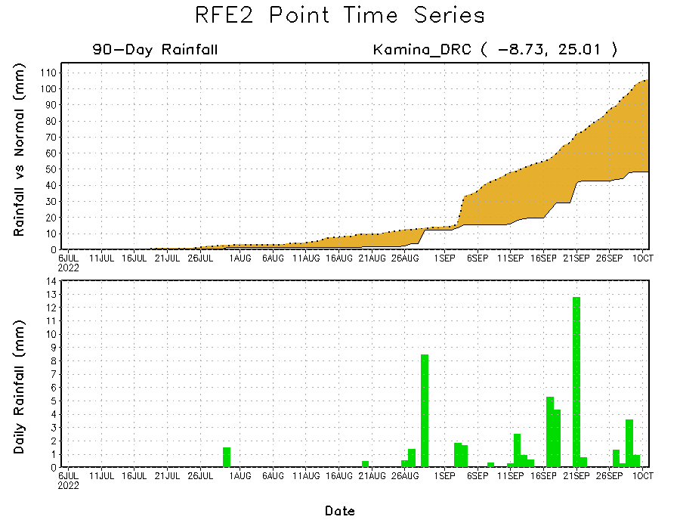
Rainfall Evolution
Daily evolution of rainfall over the last 90 days at selected locations shows continuing moisture deficits over parts of eastern Nigeria (bottom left) and southern South DRC (bottom right). Consistent heavy rains have kept significant moisture surpluses over parts of Chad (top right).

Slide 9
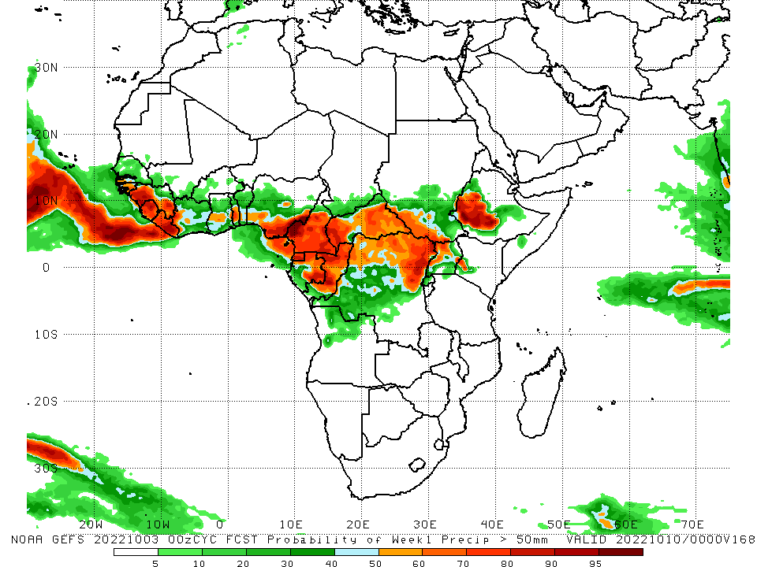
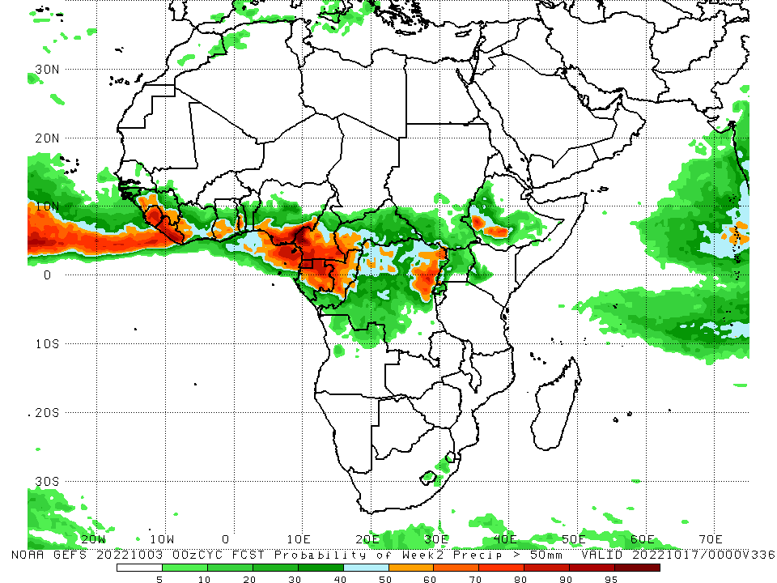
NCEP GEFS Model Forecasts Non-Bias Corrected Probability of precipitation exceedance
Week-1, Valid: 04 – 10 October, 2022
Week-2, Valid: 11 – 17 October, 2022
For week-1 (left panel) the NCEP GEFS indicates a moderate to high chance (over 70%) for rainfall to exceed 50 mm over much of western Guinea, Sierra Leone, Liberia, southern Nigeria, central, southern Cameroon, Equatorial Guinea, central and eastern parts of Gabon, Congo, CAR, northern DRC, and parts of western Ethiopia. For week-2 (right panel), NCEP GEFS indicates a moderate to high chance (over 70%) for rainfall to exceed 50 mm over Sierra Leone, Liberia, southern Nigeria, southern and western Cameroon, Equatorial Guinea, central and northern Gabon, and localized areas of western Ethiopia and eastern DRC.
Notes:
‹#›

Slide 10
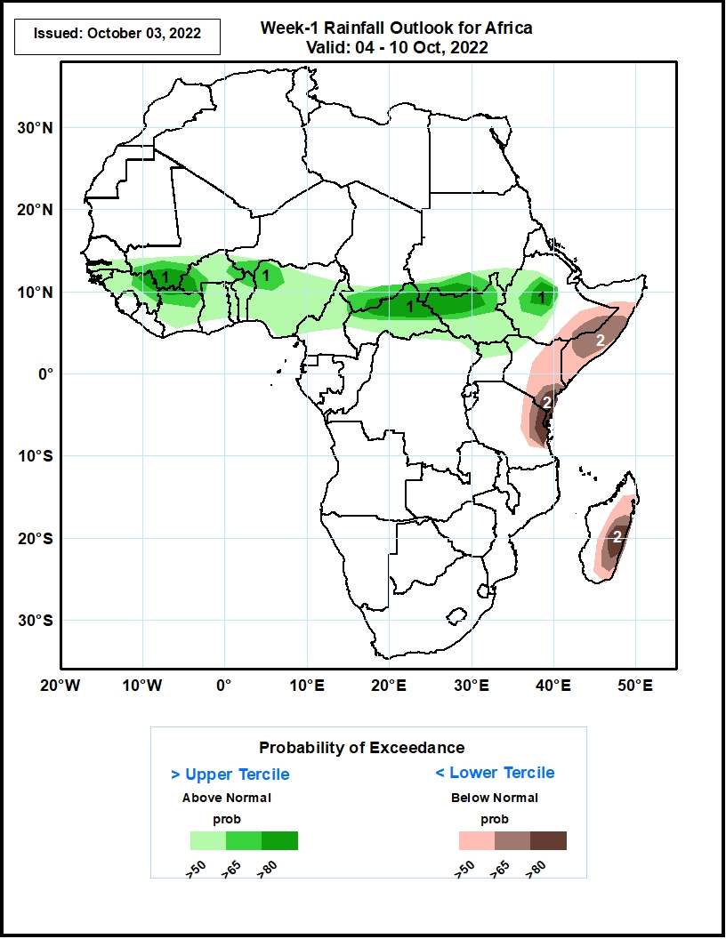
Week-1 Precipitation Outlooks
04 - 10 October, 2022
The consolidated probabilistic forecasts suggest above 50% chance for weekly rainfall to be below-normal (below the lower tercile) over southeastern Ethiopia, central and southern Somalia, eastern and southern Kenya, northeastern Tanzania, and eastern Madagascar. In particular, there is above 80% chance for weekly rainfall to be below normal over southern Kenya, northeastern Tanzania, and eastern Madagascar.
The forecast suggests above 50% chance for weekly total rainfall to be above-normal (above the upper tercile) over southern Senegal, Guinea-Bissau, Guinea, southern Mali, Burkina Faso, Cote d’Ivoire, Ghana, Togo, Benin, CAR, northern Cameroon, South Sudan, Nigeria, southwestern Niger, southern Chad, western Ethiopia, and southern Sudan. In particular, there is above 80% chance for rainfall to be above-normal over western Burkina Faso, southern Mali, northern CAR, northwestern South Sudan, southwestern Sudan, and central Ethiopia.
Notes:
‹#›

Slide 11
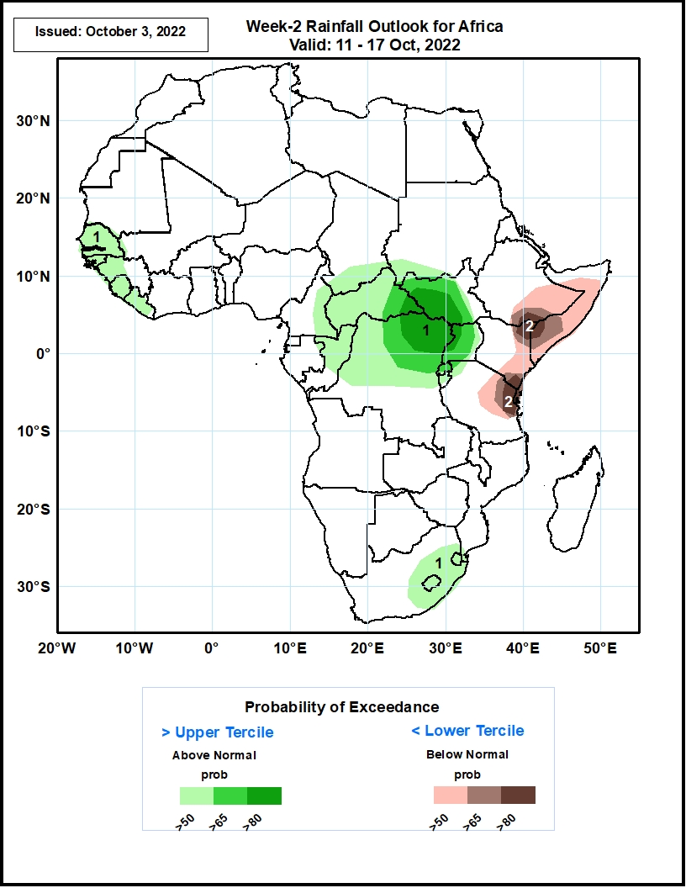
Week-2 Precipitation Outlooks
11 - 17 October, 2022
The consolidated probabilistic forecasts suggest above 50% chance for weekly rainfall to be below-normal (below the lower tercile) over southeastern Ethiopia, central and southern Somalia, eastern Kenya, and northeastern Tanzania. In particular, there is above 80% chance for rainfall to be below-normal at the junction of Ethiopia, Somalia, and Kenya, as well as between southern Kenya and northeastern Tanzania.
The forecast suggests above 50% chance for weekly total rainfall to be above-normal (above the upper tercile) over Senegal, Gambia, Guinea-Bissau, western Guinea, Sierra Leone, Liberia, eastern Cameroon, southern Chad, CAR, northern Congo, northern and central DRC, most of South Sudan, southwestern Sudan, Uganda, Rwanda, Burundi, eastern South Africa, Lesotho, and Swaziland. In particular, there is above 80% chance for rainfall to be above-normal in eastern CAR, southern South Sudan, northern DRC, and western Uganda.
Notes:
‹#›

Slide 12
Summary
During the past 30 days, in East Africa, above-average rainfall was observed over southern and central Sudan, the western and central parts of South Sudan, Eritrea, and northern Ethiopia. Rainfall was below-average over pockets of central Ethiopia and northern Somalia. In Central Africa, rainfall was above-average over parts of northern and central Cameroon, northern and central Congo, western and northern CAR, southern and central Chad and northern and western DRC. Rainfall was below-average over Equatorial Guinea, southern Cameroon, northern Angola, and pockets of central and southern DRC. In West Africa, rainfall was above-average over Senegal, Guinea-Bissau, Guinea, central and eastern Sierra Leone, Liberia, Burkina Faso, most of Ghana, parts of southern Niger, southern Togo, northern Benin, and northern, western, and eastern Nigeria. In contrast, central and northern Mali, coastal Sierra Leone, Ghana, southern Benin, and southern Nigeria received below-average rainfall. In southern Africa, above-average rainfall was observed over parts of southern South Africa, southern Lesotho, and eastern Madagascar. Below normal precipitation was observed in northern and eastern South Africa, northern Lesotho, and central Madagascar.
During the past 7 days, in East Africa, rainfall was above-average over southern Sudan, northeastern and western parts of South Sudan, northwest and northern Ethiopia, eastern Eritrea, and pockets of southern Uganda around the Lake Victoria region. Below-average rainfall was observed over pockets of southwest Ethiopia, northern Uganda, and pockets of southwestern South Sudan and western Kenya. In Central Africa, rainfall was above-average over western CAR, central and eastern Chad, pockets of western and northern DRC, central Congo, most of Gabon, and central Angola. Below-average rainfall was observed over pockets of western and central Cameroon, eastern CAR, pockets of southern and central DRC, and pockets of northeastern Angola. In southern Africa, above-average rainfall was observed over southern South Africa and below average rainfall was observed in eastern South Africa. In West Africa, above-average rainfall was observed over southwestern Senegal, Guinea Bissau, western Guinea, southern Mauritania, southern and central Mali, Liberia, Cote D’Ivoire, southern Ghana, eastern and western Burkina Faso, pockets of southern Togo and northern Benin, pockets of southern Niger, and central Nigeria. In contrast, parts of eastern Guinea, northwestern and southeastern Senegal, southern Benin, and southwestern Nigeria received below-average rainfall.
Week-1 outlooks call for an increased chance for above-average rainfall across much of the Sahel region and Gulf of Guinea coast, southern Chad, South Sudan, CAR, western and northern DRC, western Ethiopia, northern Uganda, western Kenya, and Congo. In contrast, there is an increased chance for below-average rainfall near the Lake Victoria region, Rwanda, southern Ethiopia, central Somalia, southern Kenya, eastern Tanzania, eastern Madagascar, parts of central Mozambique, southern and northern South Africa, Swaziland, and Lesotho. Week-2 outlooks call for an increased chance for above-average rainfall across the Gulf of Guinea coast extending from Cote D’Ivoire to Nigeria, Senegal, CAR, DRC, Uganda, Rwanda, Burundi, South Sudan, and western Ethiopia. In contrast, there is an increased chance for below-average rainfall near eastern Ethiopia, Somalia, southeastern Madagascar, southern Kenya, and southern Tanzania.

