Slide 1
The African Monsoon Recent Evolution and Current Status Include Week-1 and Week-2 Outlooks
Update prepared by
19 September 2022
For more information, visit:
http://www.cpc.ncep.noaa.gov/products/Global_Monsoons/African_Monsoons/precip_monitoring.shtml

Slide 2
Outline
Highlights
Recent Evolution and Current Conditions
NCEP GEFS Forecasts
Summary

Slide 3
Highlights: Last 7 Days
During the past 7 days, in East Africa, rainfall was above-average over much of South Sudan, southern and southeast Sudan, western and northern Ethiopia, pockets of central Eritrea, Uganda, southwest Kenya, and pockets of northwest Tanzania. Below-average rainfall was observed over pockets of central Ethiopia. In Central Africa, rainfall was above-average over CAR, central and southern Chad, pockets of western, southern, and northeast DRC, and central and northern Cameroon. Below-average rainfall was observed over pockets of western and southern Cameroon, northern Gabon, Equatorial Guinea, central Congo, pockets of northwest and central DRC. In southern Africa, below-average rainfall was observed over pockets of northeast South Africa. In West Africa, above-average rainfall was observed over pockets of northeast Senegal, much of Guinea, northern Sierra Leone, northern and central parts of Cote D’Ivoire and Ghana, pockets of southern Mauritania and western Mali, Burkina Faso, Toga, Benin, pockets of southern Niger, and western, northern and eastern Nigeria. In contrast, parts of Guinea Bissau, western Liberia, pockets of southwest Senegal, southern Mali, and southeast regions of Nigeria received below-average rainfall.
Week-1 outlook calls for an increased chance for above-average rainfall over Senegal, Gambia, Guinea Bissau, Guinea, southern Mali, Burkina Faso, northern and eastern Nigeria, northern Cameroon, southern Chad, western and central DRC and eastern South Africa. In contrast, there is an increased chance for below-average rainfall over eastern Sierra Leone, Liberia, southern parts of Cote D’Ivoire and Ghana, southeast part of South Sudan, central Ethiopia, and eastern Uganda. Week-2 outlook suggests an increased chance for above-average rainfall over western and southern parts of Senegal, Gambia, Guinea Bissau, southern Mali, southern Cameroon, parts of northern Gabon and central Congo, western and southern CAR, South Sudan, western Ethiopia, and central, northern, and eastern DRC, while below-average rainfall is likely along Sierra Leone, western Liberia, Equatorial Guinea, and parts of western Gabon.

Slide 4
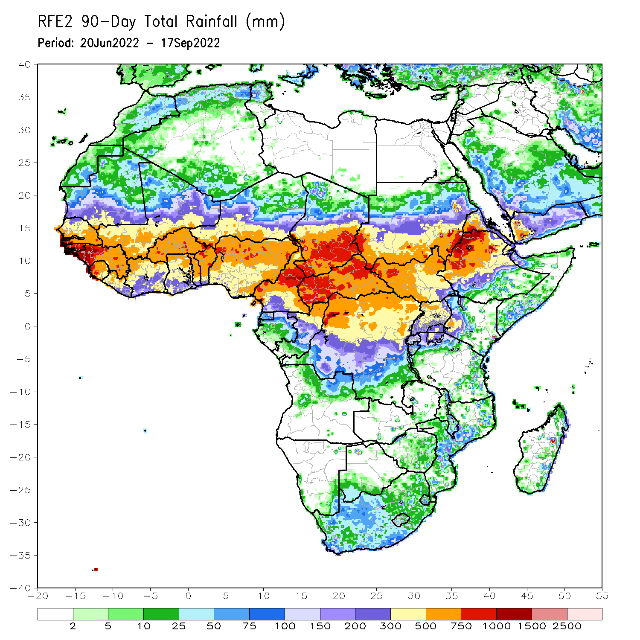
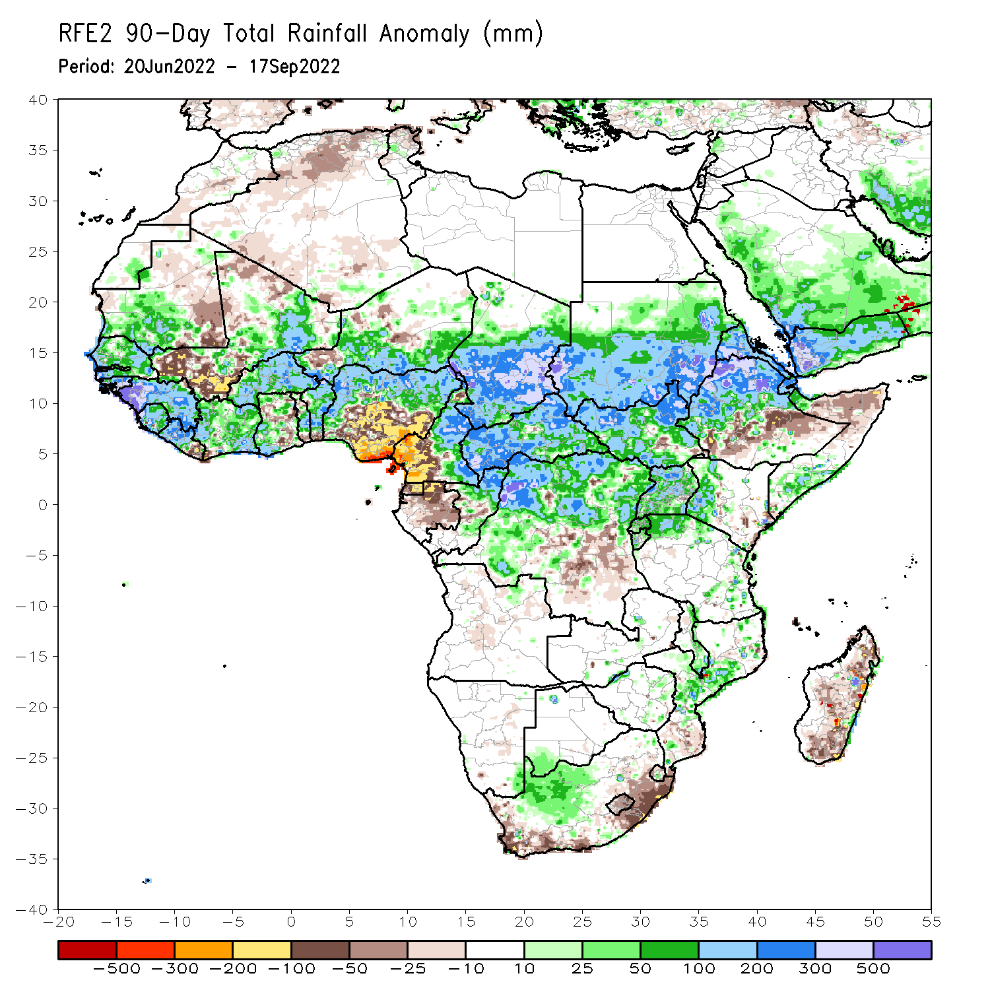
Rainfall Patterns: Last 90 Days
Over the past 90 days, in East Africa, above-average rainfall was observed over southern, central, and eastern parts of Sudan, western, northern, and eastern parts of South Sudan, western and northern Ethiopia, Eritrea, Djibouti, parts of southern Somalia, Uganda, Rwanda, Burundi, pockets of northwest and eastern Tanzania, and western Kenya. Rainfall was below-average over pockets of southern and central Ethiopia, pockets of central South Sudan, and parts of northern Somalia. In southern Africa, above-average rainfall was observed over parts of western South Africa, central Mozambique, southern Malawi, and pockets of southern Botswana and southeast Namibia. Below-average rainfall was observed over pockets of coastal South Africa, Lesotho, and southern, central, and northern Madagascar. In Central Africa, rainfall was above-average over northern and eastern Cameroon, southern, central, and eastern Chad, much of CAR, northern Congo, and northern, northwest, and northeast parts of DRC. Rainfall was below-average over western Cameroon, pockets of northern and central Gabon, Equatorial Guinea, and parts of central DRC. In West Africa, rainfall was above-average over southern Mauritania, Senegal, Gambia, Guinea-Bissau, Guinea, Sierra Leone, western and central Liberia, much of Cote D’Ivoire, parts of southwest Ghana, central and northern parts of Togo and Benin, Burkina Faso, northeastern Mali, and parts of southern Niger and western and northern Nigeria. In contrast, below-average rainfall was observed over southeast Mauritania, western and southern parts of Mali, eastern Liberia, and parts of central and southeast Nigeria.
Notes:
4

Slide 5
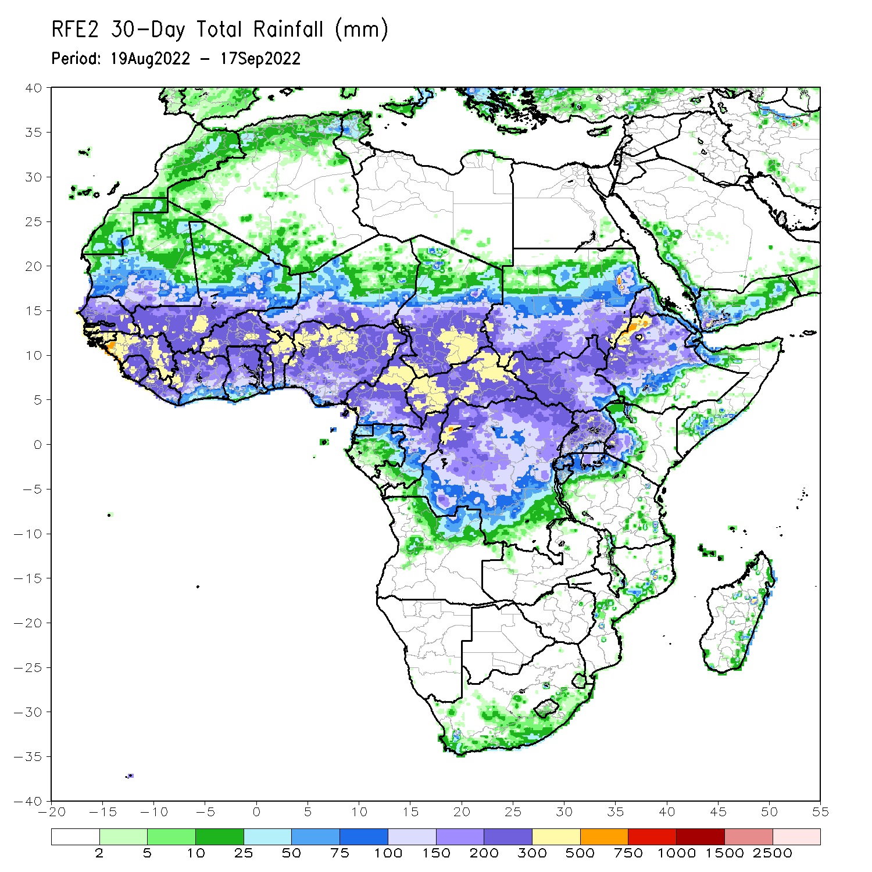
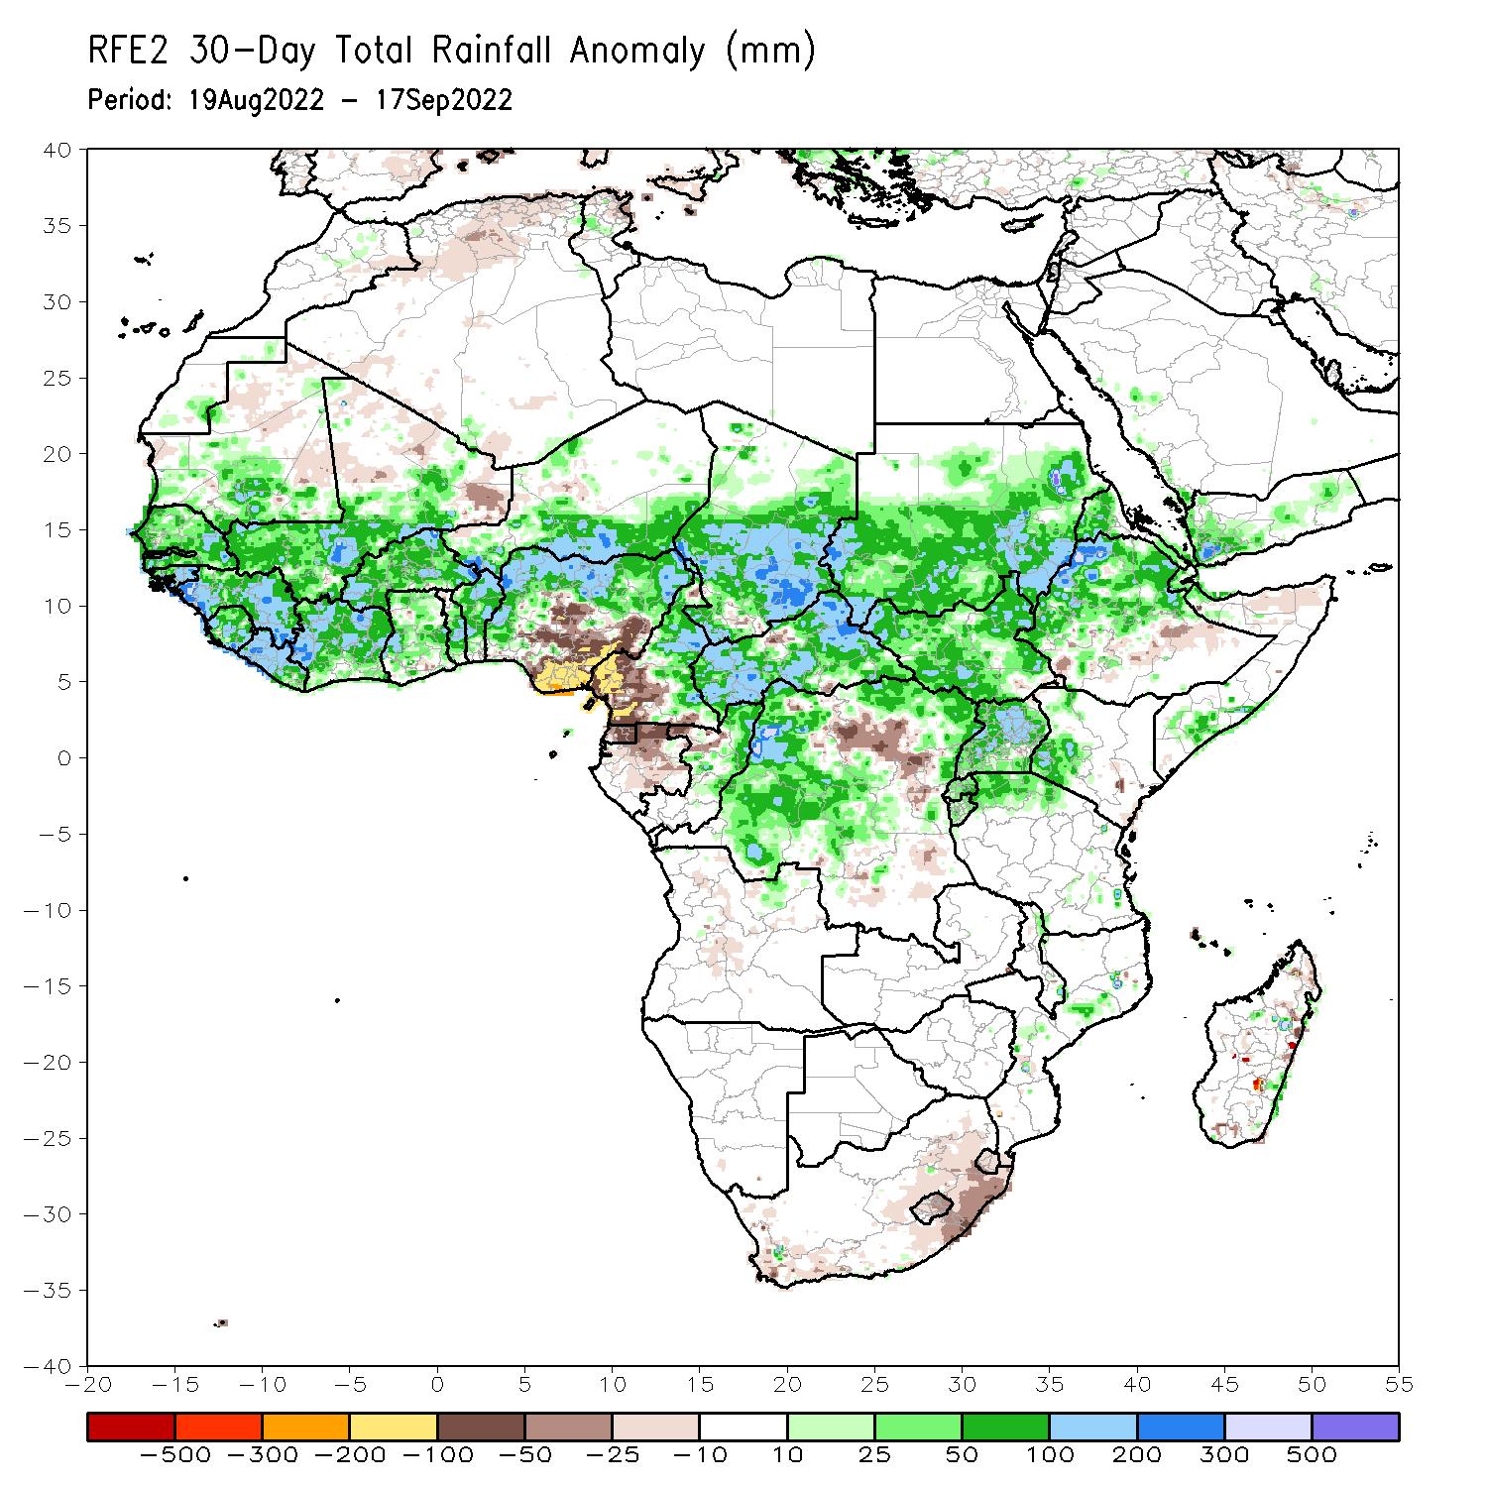
Rainfall Patterns: Last 30 Days
During the past 30 days, in East Africa, above-average rainfall was observed over southern, central, and eastern Sudan, South Sudan, Eritrea, Djibouti, Uganda, western and northern Ethiopia, pockets of western Kenya, Rwanda, Burundi, parts of southern Somalia, and pockets of northwest Tanzania. Rainfall was below-average over pockets of central Ethiopia and northern Somalia. In southern Africa, below-average rainfall was observed over eastern South Africa, Lesotho, and pockets of southern and northern Madagascar. In Central Africa, rainfall was above-average over parts of northern and eastern Cameroon, western, southern, and eastern CAR, western, central and eastern parts of Chad, pockets of western, central, and northeast DRC, and eastern and northern Congo. Rainfall was below-average over Equatorial Guinea, northern Gabon, western Cameroon, and pockets of central DRC and central CAR. In West Africa, rainfall was above-average over southern Mauritania, Senegal, Gambia, Guinea-Bissau, Guinea, Sierra Leone, Liberia, much of Cote D’Ivoire, parts central Ghana and central Togo, central and northern Benin, Burkina Faso, parts of western and southern Mali, southern Niger, and northern and western Nigeria. In contrast, pockets of eastern Mali and parts of central and southeast Nigeria received below-average rainfall.
Notes:
5

Slide 6
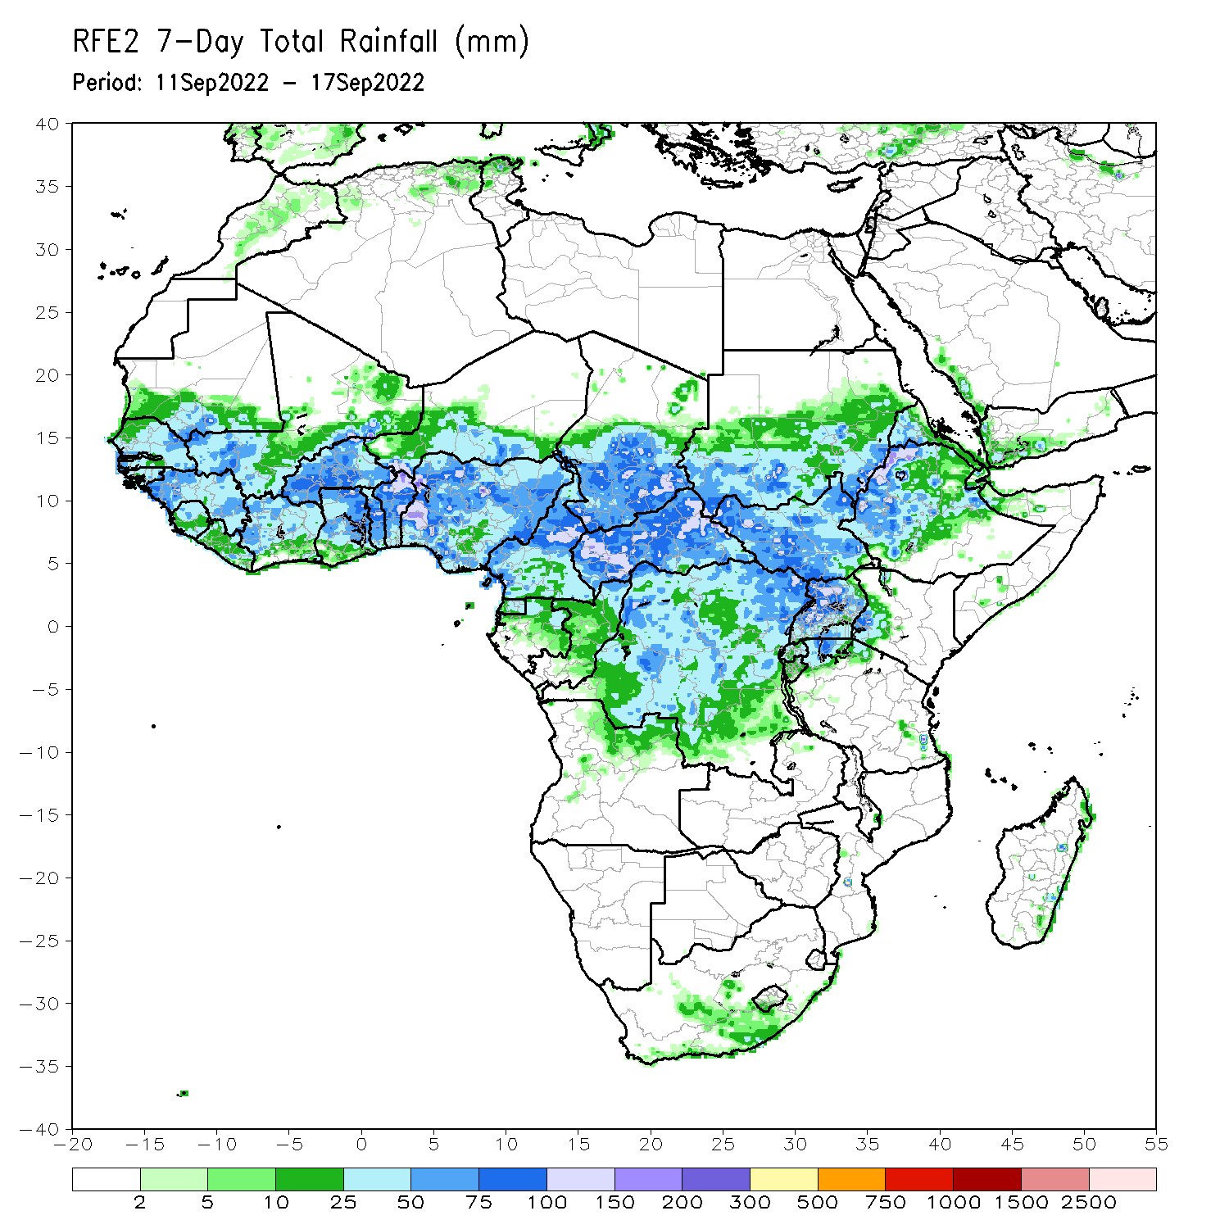
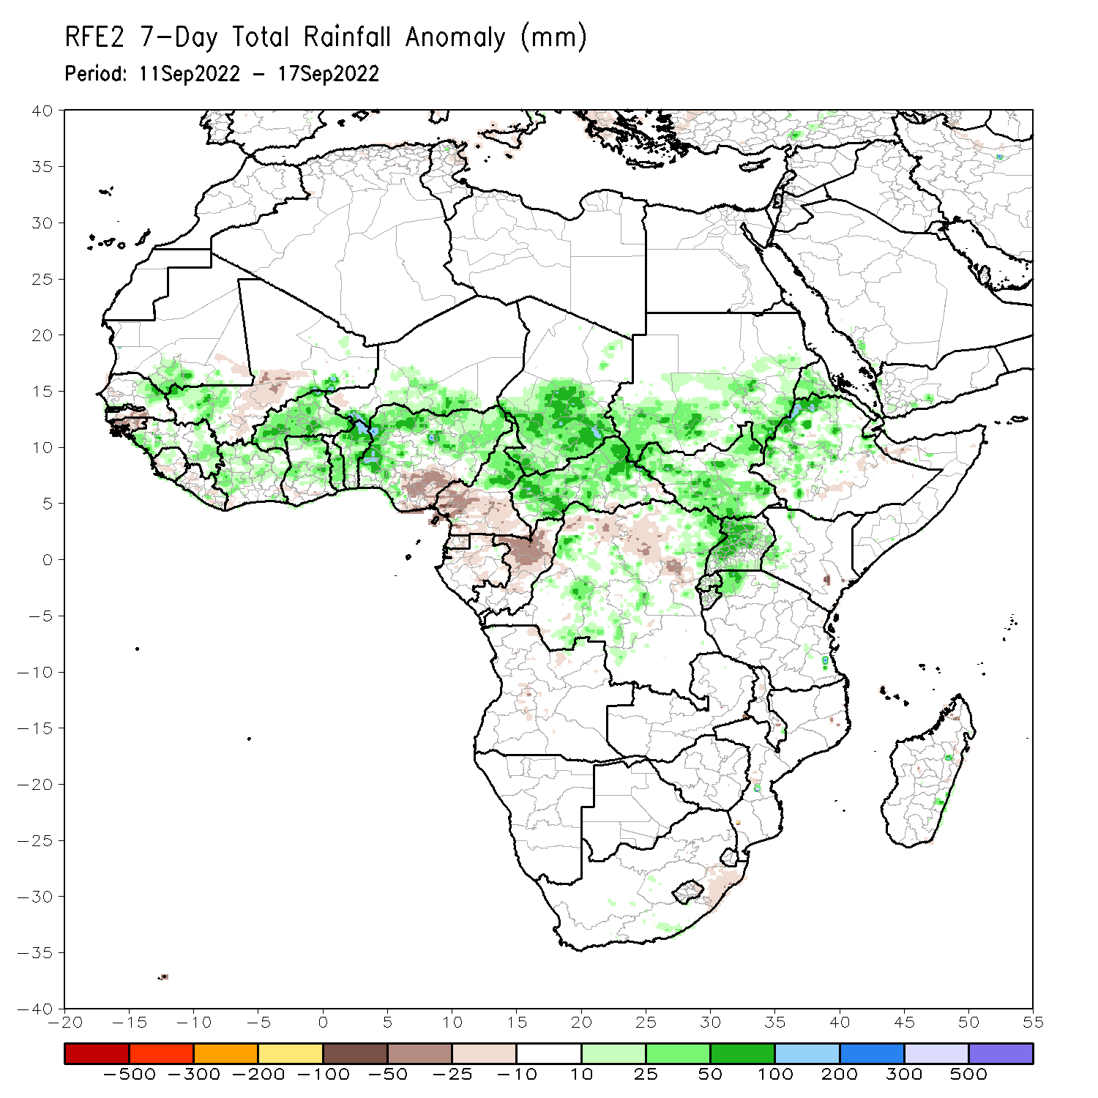
Rainfall Patterns: Last 7 Days
During the past 7 days, in East Africa, rainfall was above-average over much of South Sudan, southern and southeast Sudan, western and northern Ethiopia, pockets of central Eritrea, Uganda, southwest Kenya, and pockets of northwest Tanzania. Below-average rainfall was observed over pockets of central Ethiopia. In Central Africa, rainfall was above-average over CAR, central and southern Chad, pockets of western, southern, and northeast DRC, and central and northern Cameroon. Below-average rainfall was observed over pockets of western and southern Cameroon, northern Gabon, Equatorial Guinea, central Congo, pockets of northwest and central DRC. In southern Africa, below-average rainfall was observed over pockets of northeast South Africa. In West Africa, above-average rainfall was observed over pockets of northeast Senegal, much of Guinea, northern Sierra Leone, northern and central parts of Cote D’Ivoire and Ghana, pockets of southern Mauritania and western Mali, Burkina Faso, Toga, Benin, pockets of southern Niger, and western, northern and eastern Nigeria. In contrast, parts of Guinea Bissau, western Liberia, pockets of southwest Senegal, southern Mali, and southeast regions of Nigeria received below-average rainfall.

Slide 7
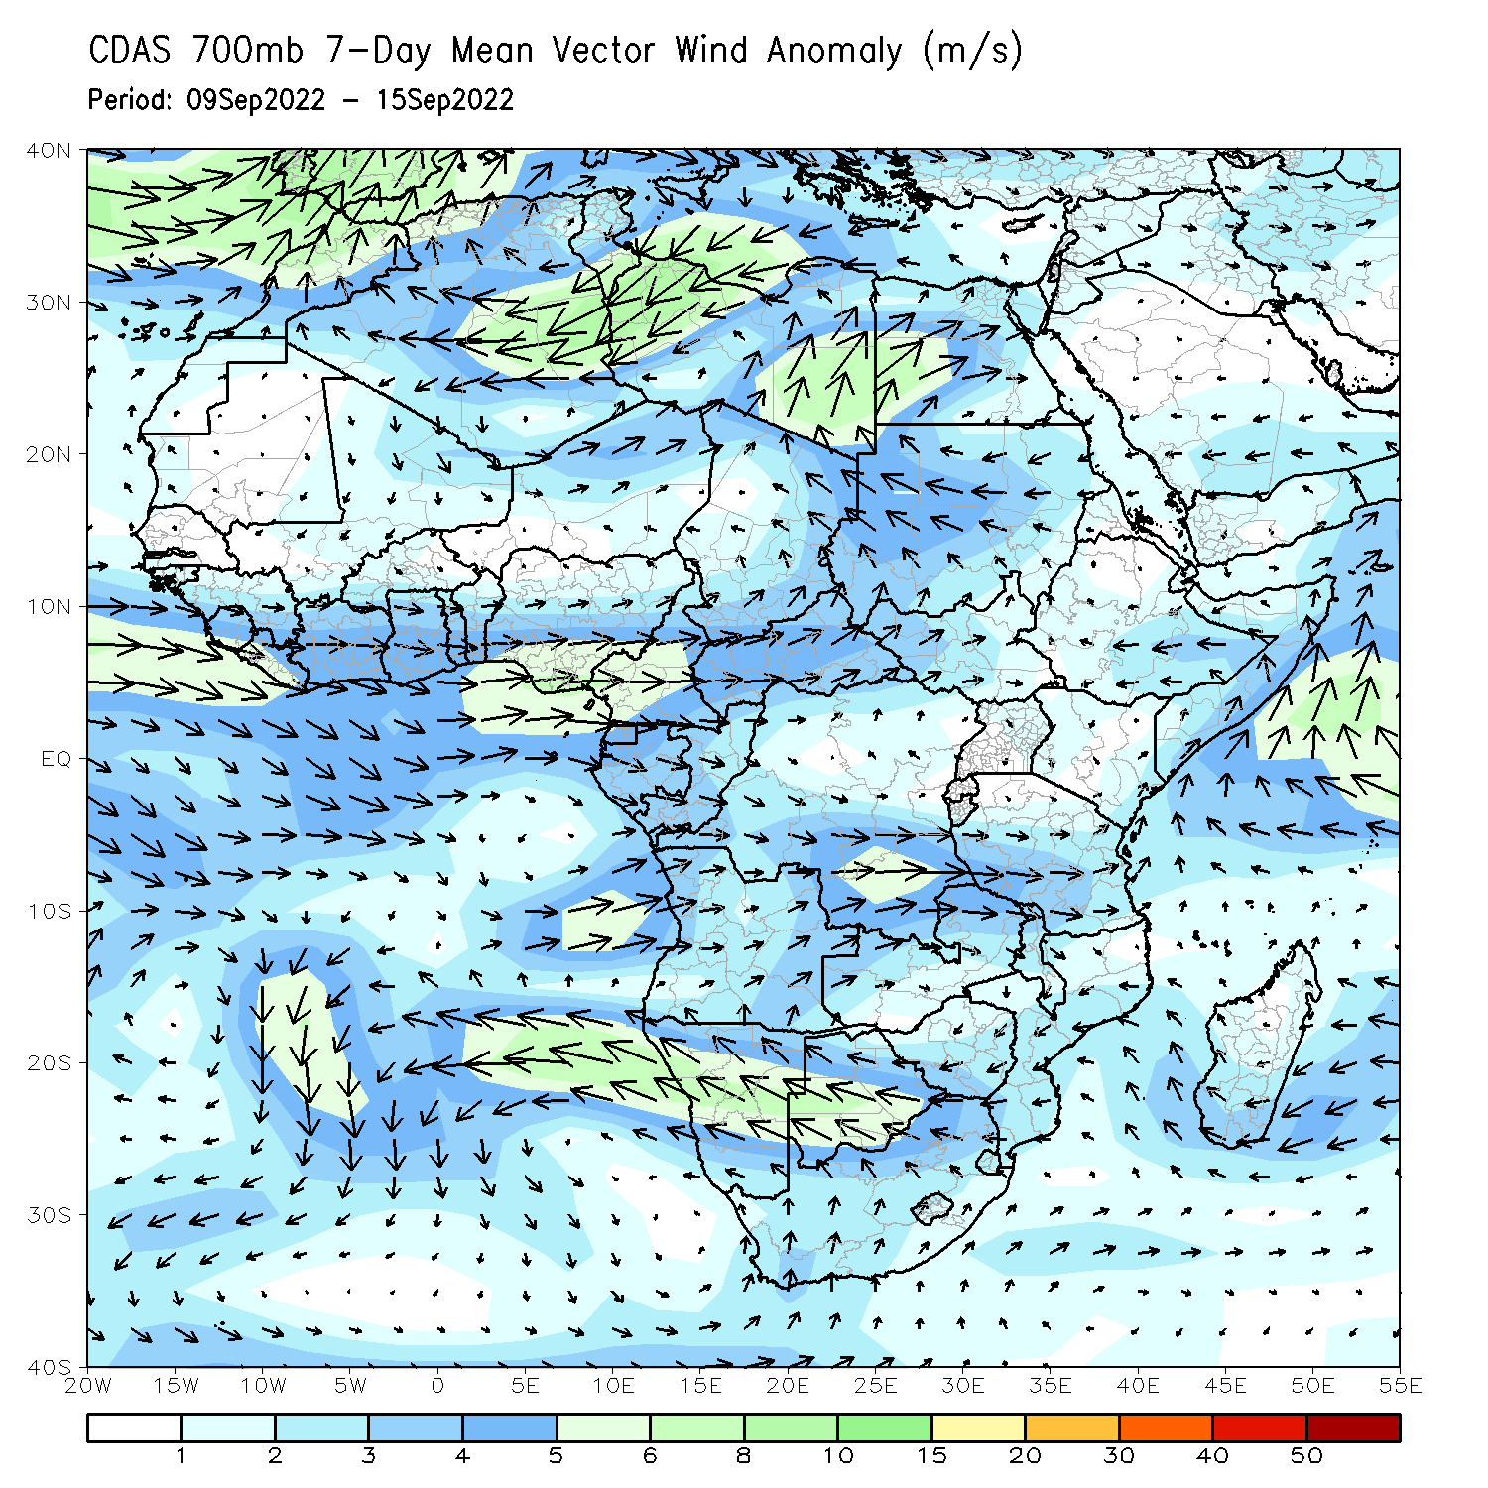
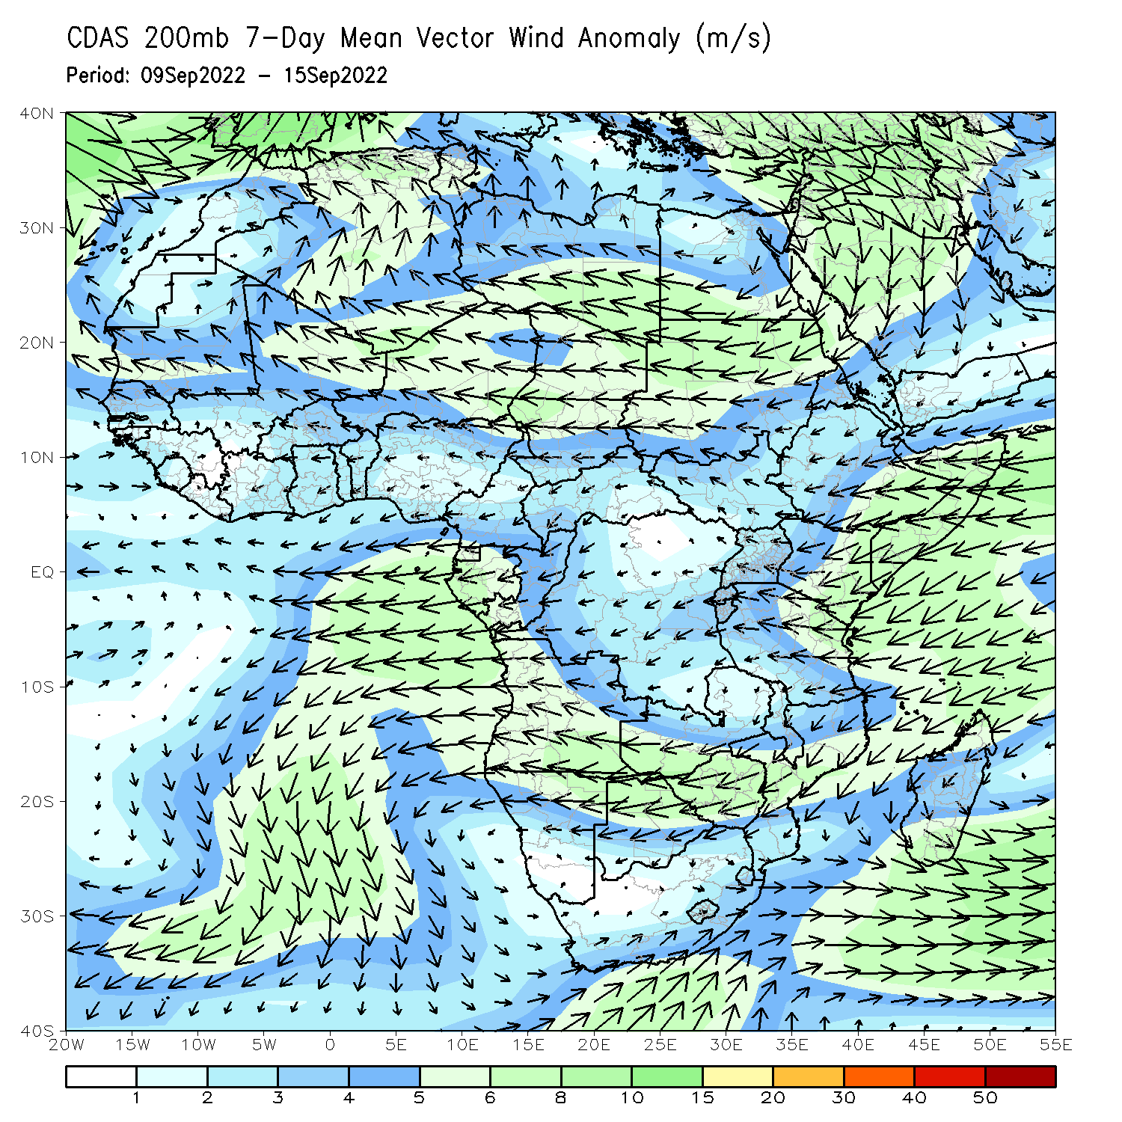
Atmospheric Circulation: Last 7 Days
At 700-hPa level (left panel), anomalous westerly flow was observed across much of the Sahel region and Gulf of Guinea regions . Anomalous wind convergence at 700-hPa level may have contributed to the observed above-average rainfall near Chad/Sudan border.

Slide 8
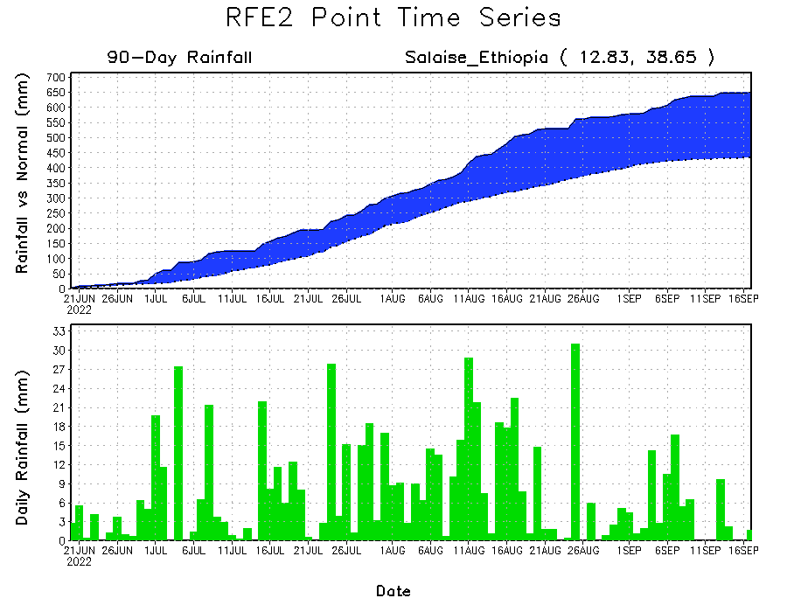
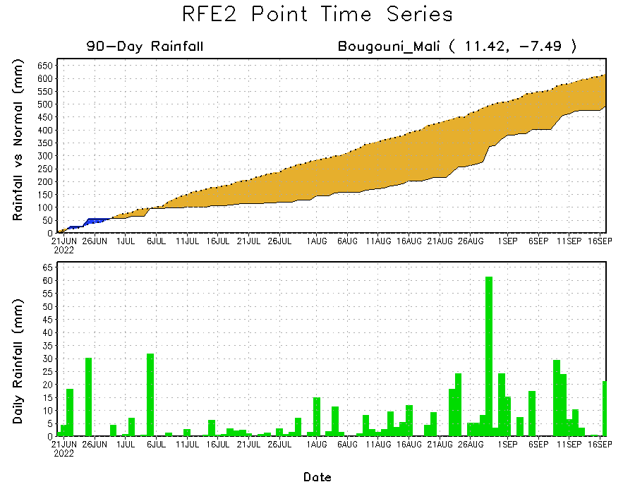
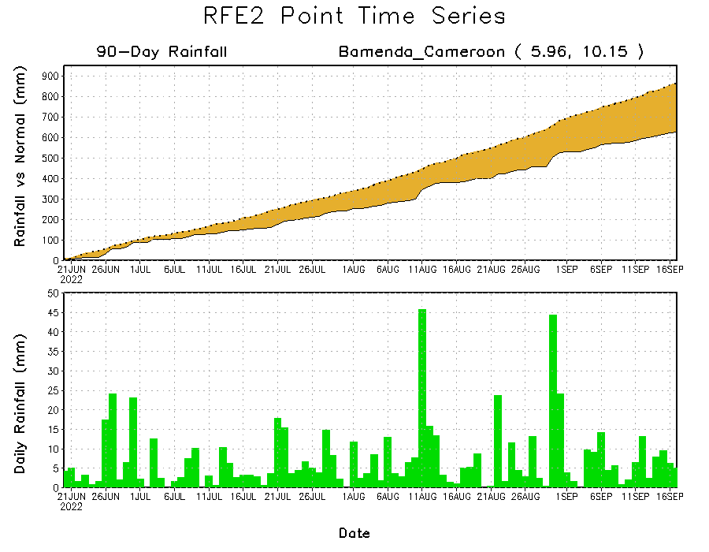
Rainfall Evolution
Daily evolution of rainfall over the last 90 days at selected locations shows increasing moisture deficits over parts of southern Mali (bottom left) and western Cameroon (bottom right). Consistent heavy rains have kept significant moisture surpluses over parts of northern Ethiopia (top right).

Slide 9
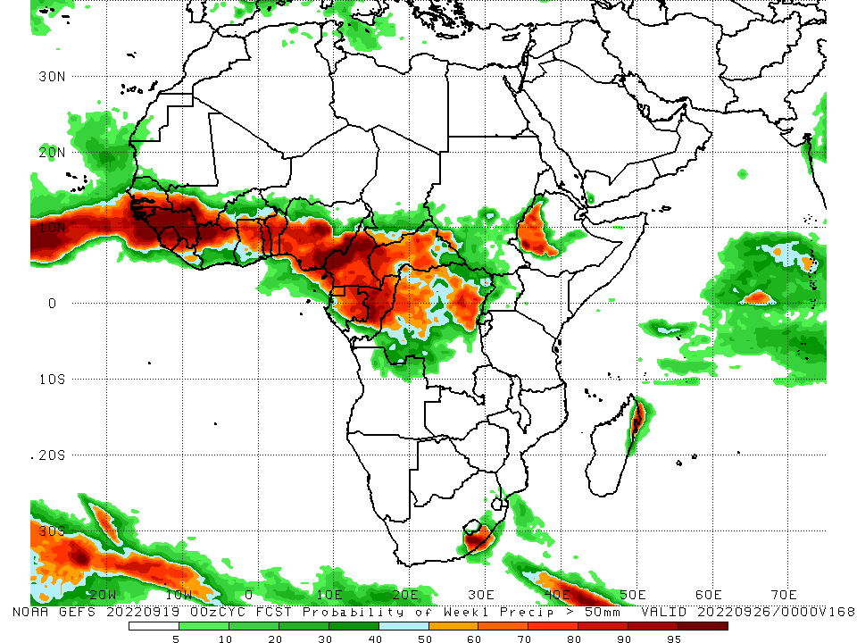
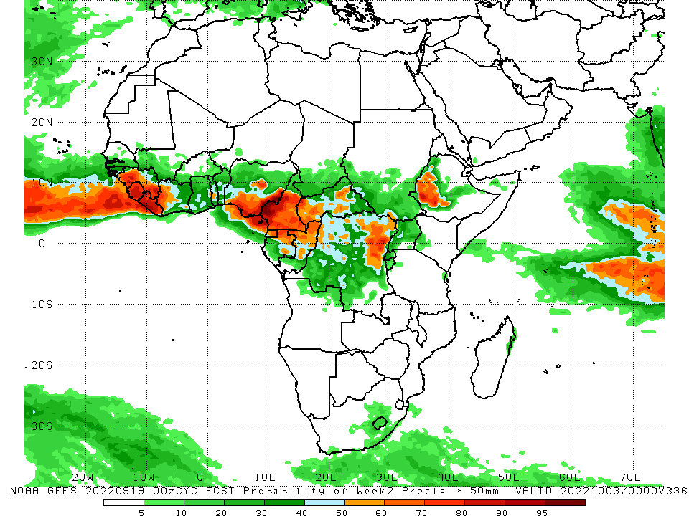
NCEP GEFS Model Forecasts Non-Bias Corrected Probability of precipitation exceedance
Week-1, Valid: 20 – 26 September, 2022
Week-2, Valid: 27 Sep – 03 October, 2022
For week-1 (left panel) the NCEP GEFS indicates a moderate to high chance (over 70%) for rainfall to exceed 50 mm over southern Senegal, Gambia, Guinea Bissau, Guinea, Sierra Leone, western Liberia, northern parts of Cote D’Ivoire and Ghana, southern Mali, western Burkina Faso, Toga, Benin, central and southern Nigeria, much of Cameroon, Equatorial Guinea, central and northern parts of Gabon and Congo, western and central CAR, western and eastern DRC, western Ethiopia and pockets of eastern South Africa. For week-2 (right panel), NCEP GEFS indicates a moderate to high chance (over 70%) for rainfall to exceed 50 mm over western and southern Guinea, Sierra Leone, Liberia, southeast Nigeria, western, southern and eastern Cameroon, Equatorial Guinea, northern parts of Gabon and Congo, eastern DRC, and western Ethiopia.
Notes:
9

Slide 10
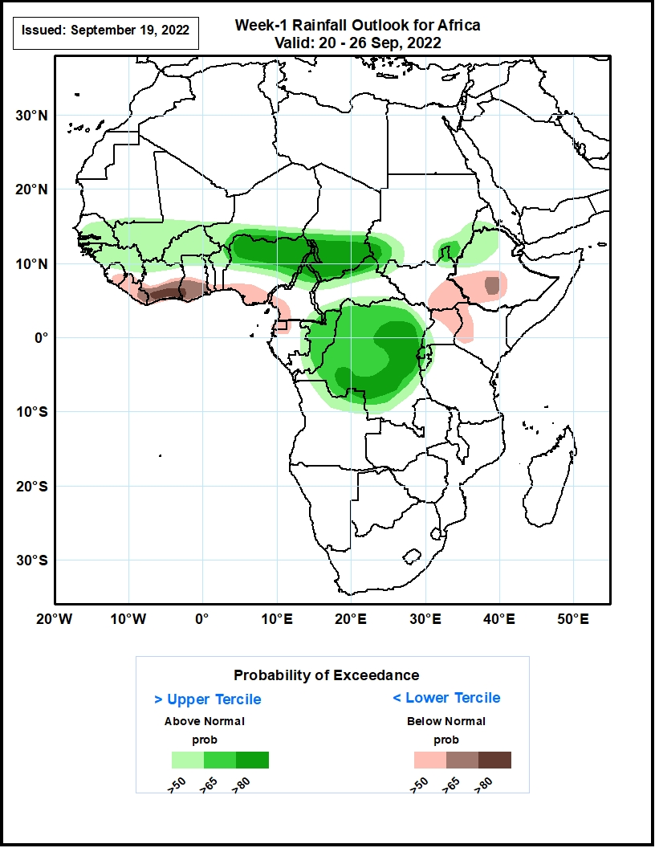
Week-1 Precipitation Outlooks
20 - 26 September, 2022
The consolidated probabilistic forecasts suggest above 50% chance for weekly rainfall to be below-normal (below the lower tercile) over southeastern Sierra Leone, much of Liberia and Equatorial Guinea, southern portions of Cote d’Ivoire, Ghana, Togo, Benin, Nigeria, northwestern Gabon, southeastern South Sudan, southern parts of Ethiopia, northern Uganda and western Kenya. The forecast suggest above 65% chance for the weekly total rainfall to be below-normal over southern parts of Cote d’Ivoire and Ghana.
The forecast suggests above 50% chance for weekly total rainfall to be above-normal (above the upper tercile) over much of Senegal, The Gambia, Guinea-Bissau, Guinea and Burkina Faso, southern parts of Mali, northern parts of Cote d’Ivoire, Ghana, Togo, Benin, southeastern Sudan and northwestern Ethiopia. In particular, there is above 80% chance for rainfall to be above-normal over northern Nigeria and Cameroon, southern parts of Chad, southwestern Sudan, central and southern portions of DR Congo.
Notes:
10

Slide 11
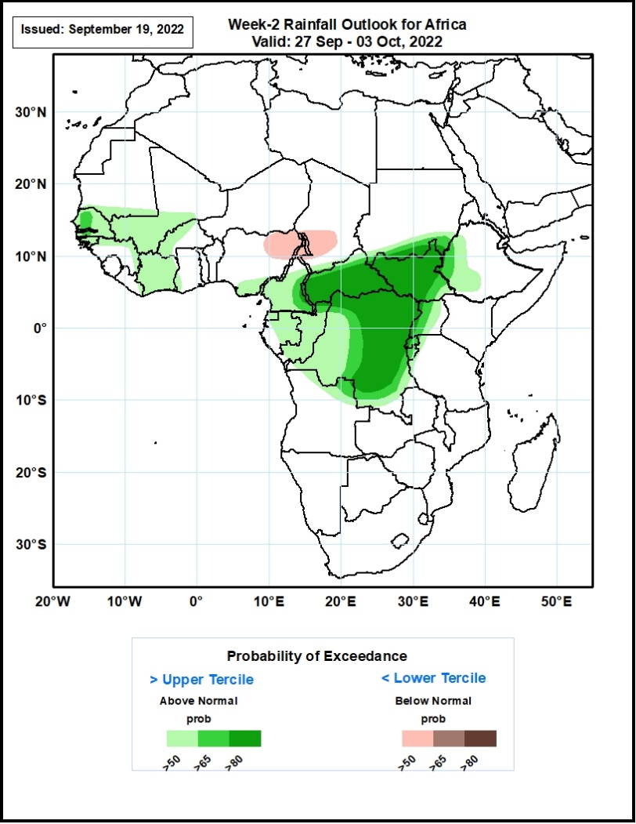
Week-2 Precipitation Outlooks
27 Sep - 03 October, 2022
The consolidated probabilistic forecasts suggest above 50% chance for weekly rainfall to be below-normal (below the lower tercile) over northeastern Nigeria, northern Cameroon and western parts of Chad.
The forecast suggests above 50% chance for weekly total rainfall to be above-normal (above the upper tercile) over much of Senegal, The Gambia, Guinea-Bissau and Cote d’Ivoire, southern parts of Mauritania and Mali, northern parts of Guinea, northwestern Burkina Faso, southeastern Nigeria, middle and southern parts of Cameroon, much of Equatorial Guinea, Gabon, Congo, and western Ethiopia. In particular, there is above 80% chance for rainfall to be above-normal over portions of much of CAR and South Sudan, southern Sudan, central and eastern portions of DR Congo.
Notes:
11

Slide 12
Summary
During the past 30 days, in East Africa, above-average rainfall was observed over southern, central, and eastern Sudan, South Sudan, Eritrea, Djibouti, Uganda, western and northern Ethiopia, pockets of western Kenya, Rwanda, Burundi, parts of southern Somalia, and pockets of northwest Tanzania. Rainfall was below-average over pockets of central Ethiopia and northern Somalia. In southern Africa, below-average rainfall was observed over eastern South Africa, Lesotho, and pockets of southern and northern Madagascar. In Central Africa, rainfall was above-average over parts of northern and eastern Cameroon, western, southern, and eastern CAR, western, central and eastern parts of Chad, pockets of western, central, and northeast DRC, and eastern and northern Congo. Rainfall was below-average over Equatorial Guinea, northern Gabon, western Cameroon, and pockets of central DRC and central CAR. In West Africa, rainfall was above-average over southern Mauritania, Senegal, Gambia, Guinea-Bissau, Guinea, Sierra Leone, Liberia, much of Cote D’Ivoire, parts central Ghana and central Togo, central and northern Benin, Burkina Faso, parts of western and southern Mali, southern Niger, and northern and western Nigeria. In contrast, pockets of eastern Mali and parts of central and southeast Nigeria received below-average rainfall.
During the past 7 days, in East Africa, rainfall was above-average over much of South Sudan, southern and southeast Sudan, western and northern Ethiopia, pockets of central Eritrea, Uganda, southwest Kenya, and pockets of northwest Tanzania. Below-average rainfall was observed over pockets of central Ethiopia. In Central Africa, rainfall was above-average over CAR, central and southern Chad, pockets of western, southern, and northeast DRC, and central and northern Cameroon. Below-average rainfall was observed over pockets of western and southern Cameroon, northern Gabon, Equatorial Guinea, central Congo, pockets of northwest and central DRC. In southern Africa, below-average rainfall was observed over pockets of northeast South Africa. In West Africa, above-average rainfall was observed over pockets of northeast Senegal, much of Guinea, northern Sierra Leone, northern and central parts of Cote D’Ivoire and Ghana, pockets of southern Mauritania and western Mali, Burkina Faso, Toga, Benin, pockets of southern Niger, and western, northern and eastern Nigeria. In contrast, parts of Guinea Bissau, western Liberia, pockets of southwest Senegal, southern Mali, and southeast regions of Nigeria received below-average rainfall.
Week-1 outlook calls for an increased chance for above-average rainfall over Senegal, Gambia, Guinea Bissau, Guinea, southern Mali, Burkina Faso, northern and eastern Nigeria, northern Cameroon, southern Chad, western and central DRC and eastern South Africa. In contrast, there is an increased chance for below-average rainfall over eastern Sierra Leone, Liberia, southern parts of Cote D’Ivoire and Ghana, southeast part of South Sudan, central Ethiopia, and eastern Uganda. Week-2 outlook suggests an increased chance for above-average rainfall over western and southern parts of Senegal, Gambia, Guinea Bissau, southern Mali, southern Cameroon, parts of northern Gabon and central Congo, western and southern CAR, South Sudan, western Ethiopia, and central, northern, and eastern DRC, while below-average rainfall is likely along Sierra Leone, western Liberia, Equatorial Guinea, and parts of western Gabon.

