Slide 1
The African Monsoon Recent Evolution and Current Status Include Week-1 and Week-2 Outlooks
Update prepared by
15 August 2022
For more information, visit:
http://www.cpc.ncep.noaa.gov/products/Global_Monsoons/African_Monsoons/precip_monitoring.shtml

Slide 2
Outline
Highlights
Recent Evolution and Current Conditions
NCEP GEFS Forecasts
Summary

Slide 3
Highlights: Last 7 Days
During the past 7 days, in East Africa, rainfall was above-average over much of South Sudan, southern and eastern Sudan, Eritrea, many parts of Ethiopia and northern Uganda. Below-average rainfall was observed over pockets of northwestern Ethiopia. In Central Africa, rainfall was above-average over northern Cameroon, central Chad, and pockets of northeastern DRC. Below-average rainfall was observed over southern Cameroon, CAR, southern Chad, and parts of northwestern DRC. In West Africa, above-average rainfall was observed over eastern Guinea and Ghana, and southern Nigeria. In contrast, parts of Senegal, central and southern Mali, and pocket areas along the Gulf of Guinea coast received below-average rainfall.
Week-1 and week-2 outlooks call for an increased chance for above-average rainfall across much of the Sahel region, eastern South Sudan, northern Ethiopia, Eritrea, and the Lake Victoria region. In contrast, there is an increased chance for below-average rainfall along the Gulf Guinea coast, and the neighboring areas of Central Africa.

Slide 4
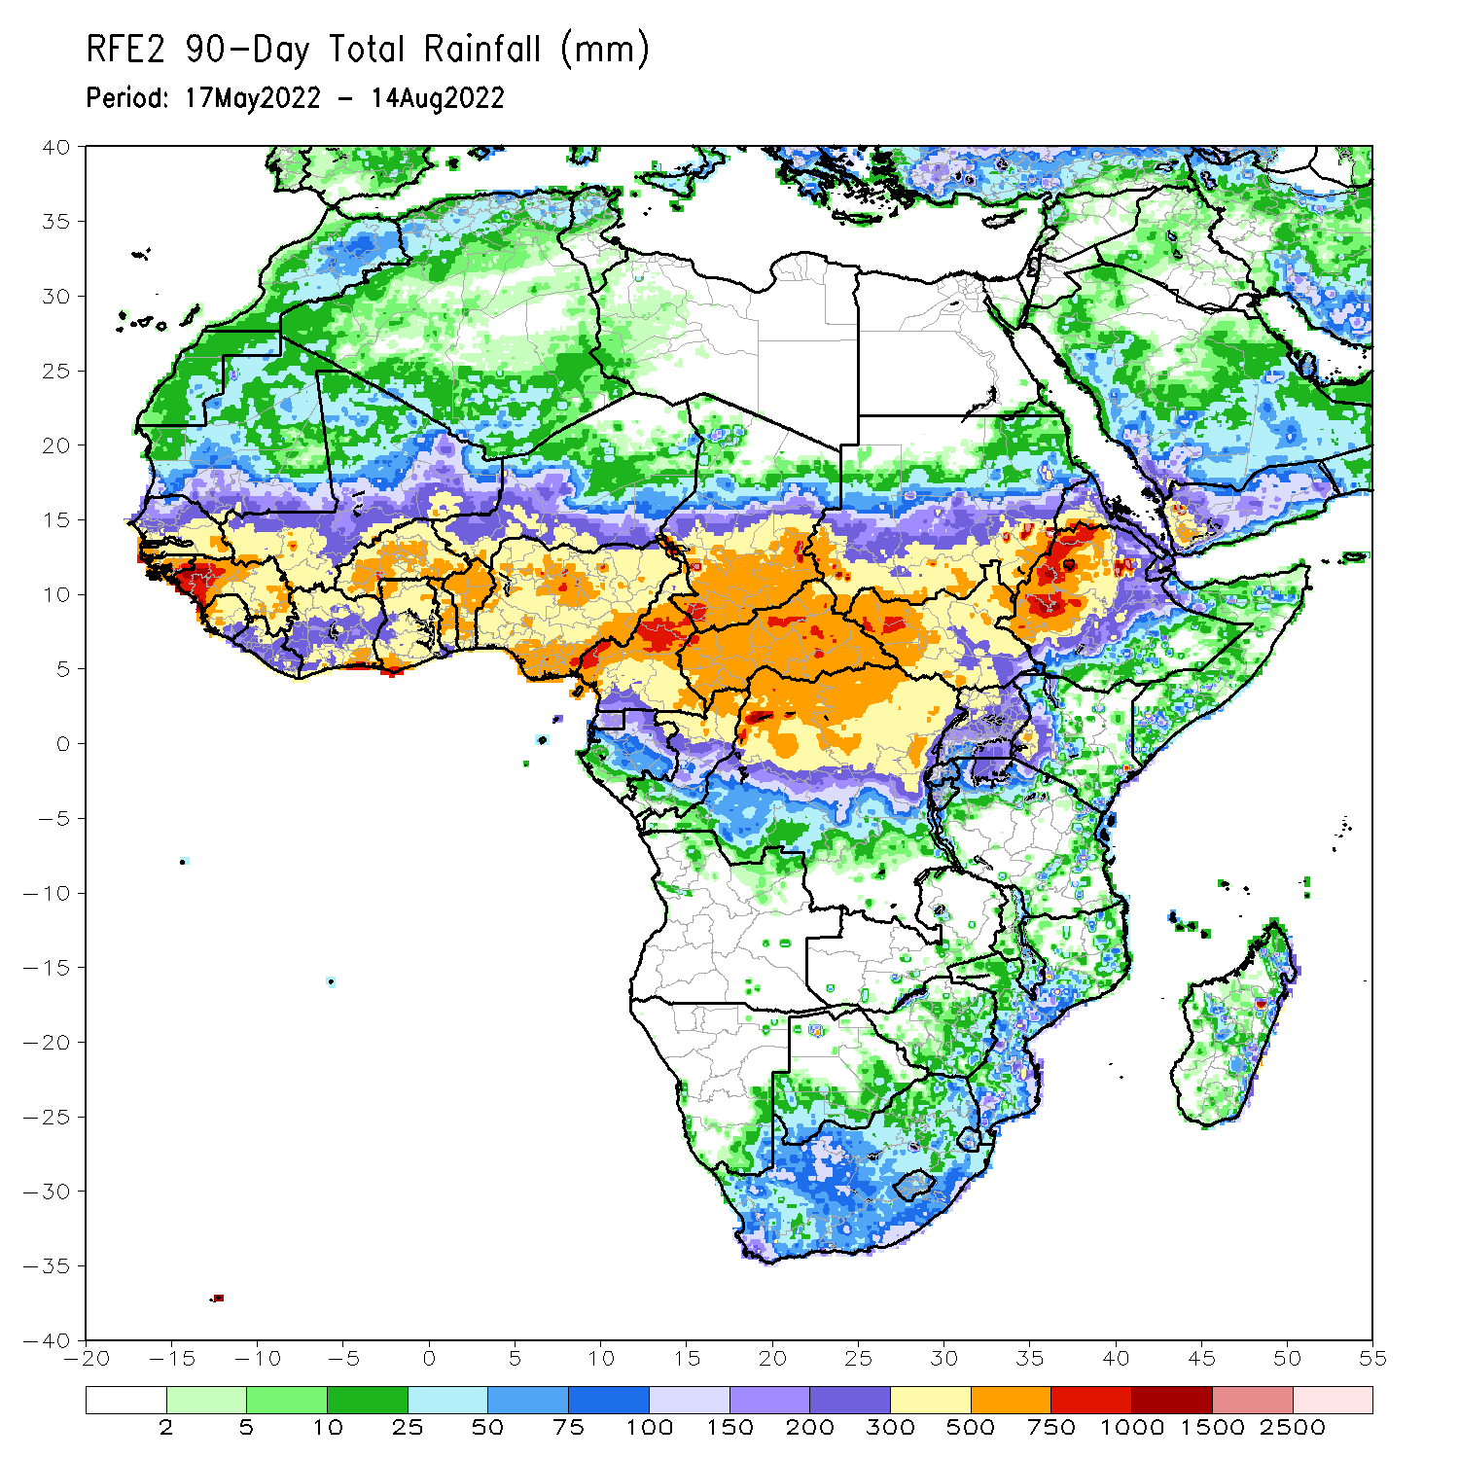
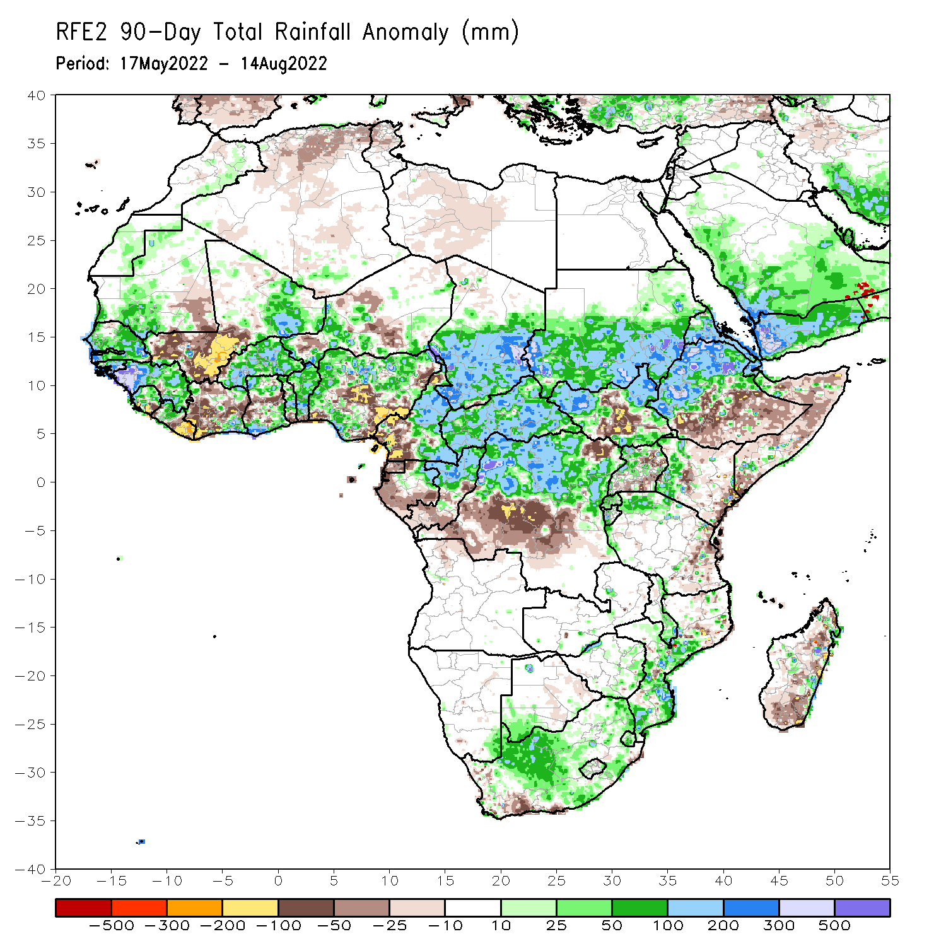
Rainfall Patterns: Last 90 Days
Over the past 90 days, in East Africa, above-average rainfall was observed over southern and eastern Sudan, the western and eastern portions of South Sudan, western and northern Ethiopia, and Eritrea. Rainfall was below-average over southern and eastern Ethiopia, central and southern South Sudan, parts of Kenya, much of Somalia, Uganda, as well as coastal Tanzania. In southern Africa, above-average rainfall was observed over parts of South Africa and Mozambique. Below-average rainfall was observed over pockets of coastal South Africa and much of Madagascar. In Central Africa, rainfall was above-average over central and eastern Cameroon, much of CAR, eastern Gabon, Congo, and northern DRC. Rainfall was below-average over pockets of western Cameroon, parts of central DRC, and parts of western and southern Gabon. In West Africa, rainfall was above-average over southern Mauritania, Senegal, Guinea-Bissau, Guinea, Sierra Leone, western Liberia, eastern northeastern Mali, Burkina Faso, parts of Ghana, Togo, Benin, and parts of Niger and western and northern Nigeria. In contrast, below-average rainfall was observed over western and central Mali, eastern Liberia, parts of Cote D’Ivoire, and parts of central and southern Nigeria.
Notes:
4

Slide 5
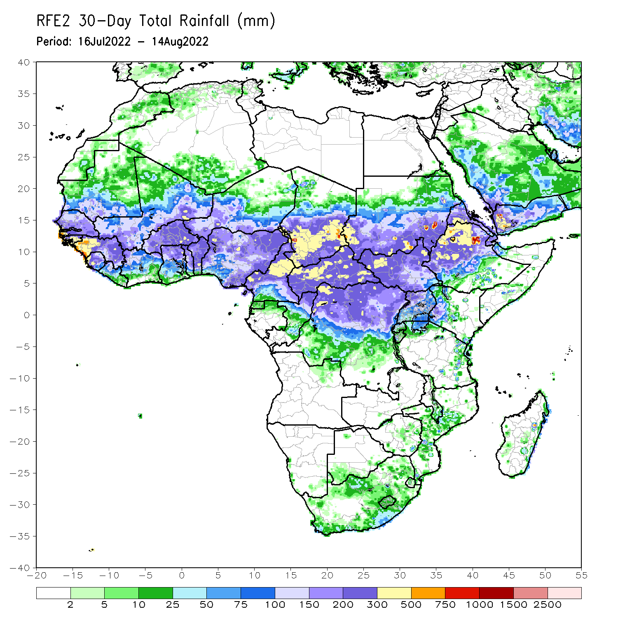
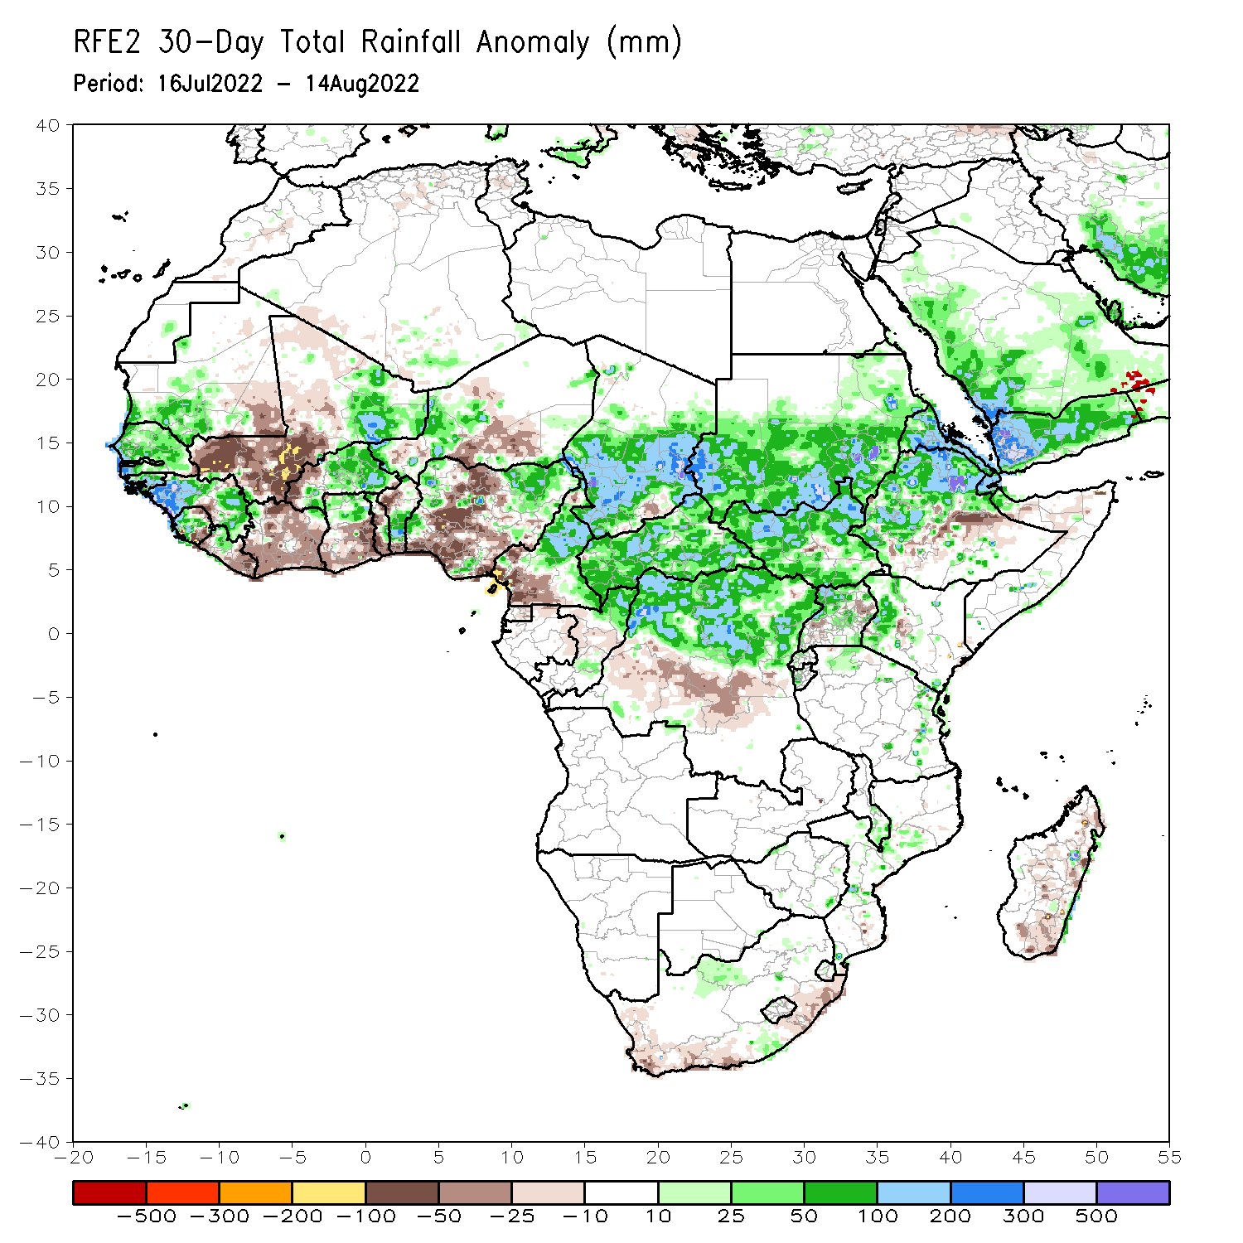
Rainfall Patterns: Last 30 Days
During the past 30 days, in East Africa, above-average rainfall was observed over southern and eastern Sudan, the western and eastern parts of South Sudan, Eritrea, and western and northern Ethiopia. Rainfall was below-average over pockets of central Ethiopia. In Central Africa, rainfall was above-average over parts of northern and eastern Cameroon, northern Congo, much of CAR, southern Chad and northern DRC. Rainfall was below-average over Equatorial Guinea, southern Cameroon, and pockets of central DRC. In West Africa, rainfall was above-average over Senegal, Guinea-Bissau, Guinea, Sierra Leone, western Liberia, Burkina Faso, northern Ghana, parts of Niger and northern Nigeria. In contrast, central and southern Mali, eastern Liberia, Cote d’Ivoire, Ghana, Togo, Benin, and southern Nigeria received below-average rainfall.
Notes:
5

Slide 6
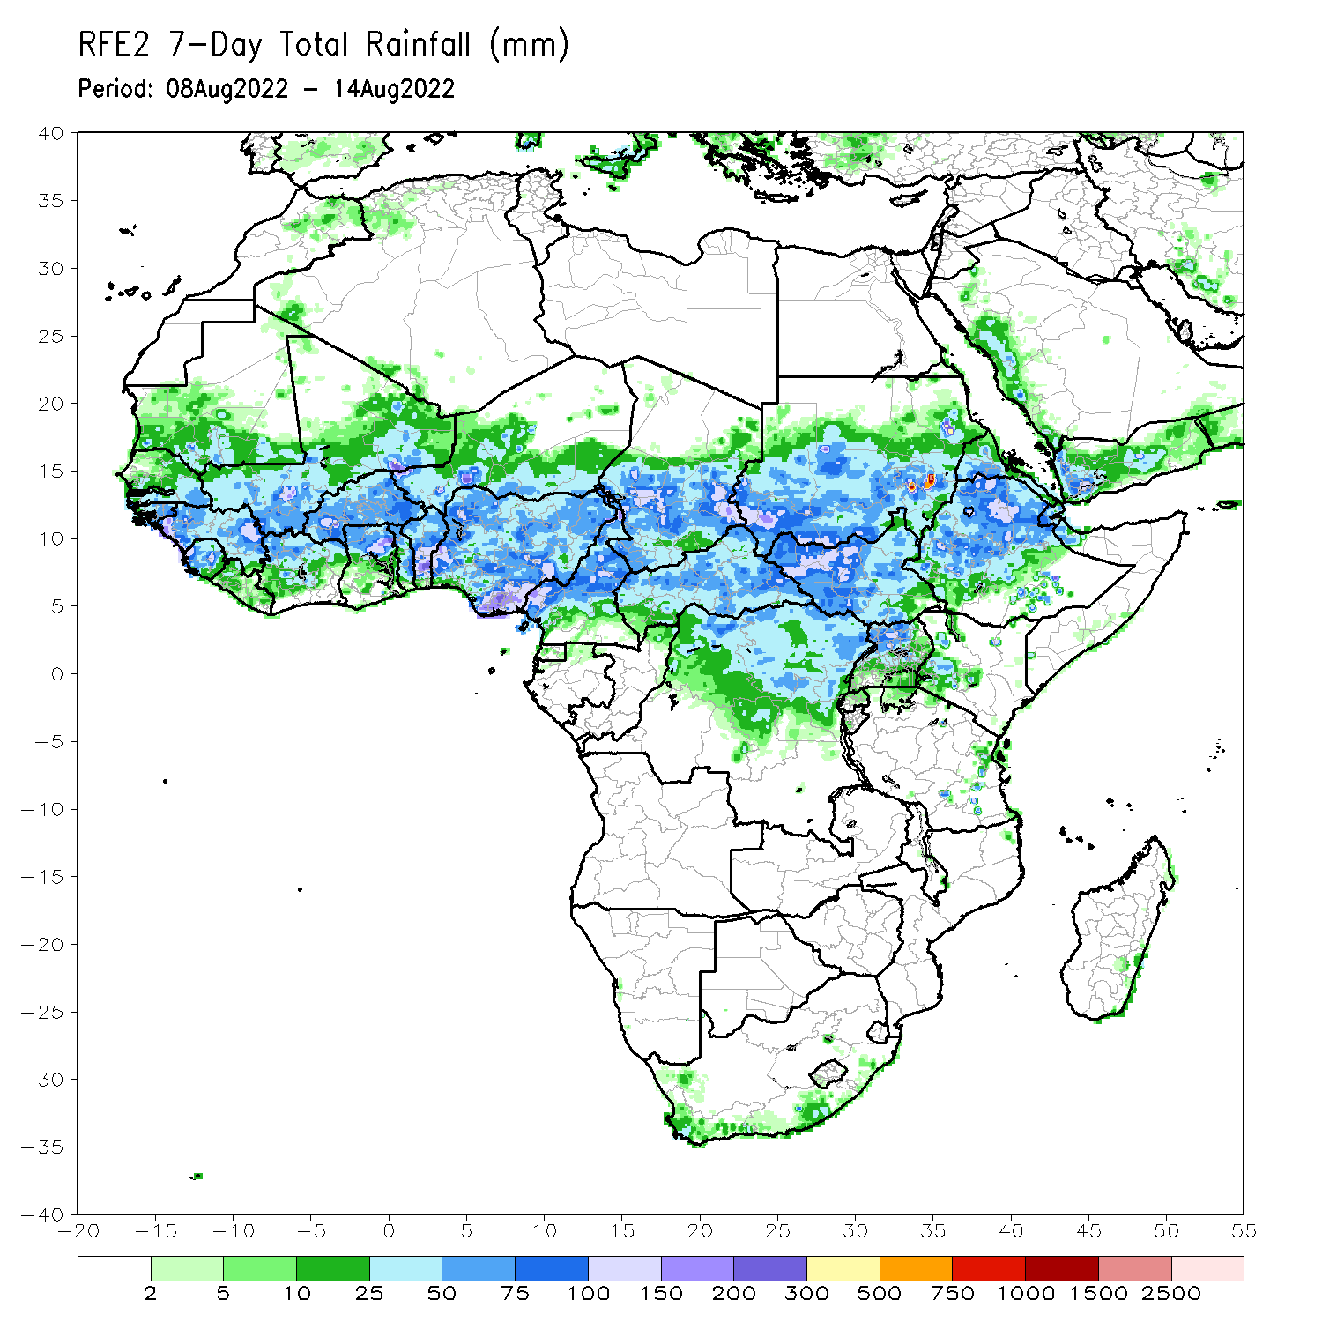
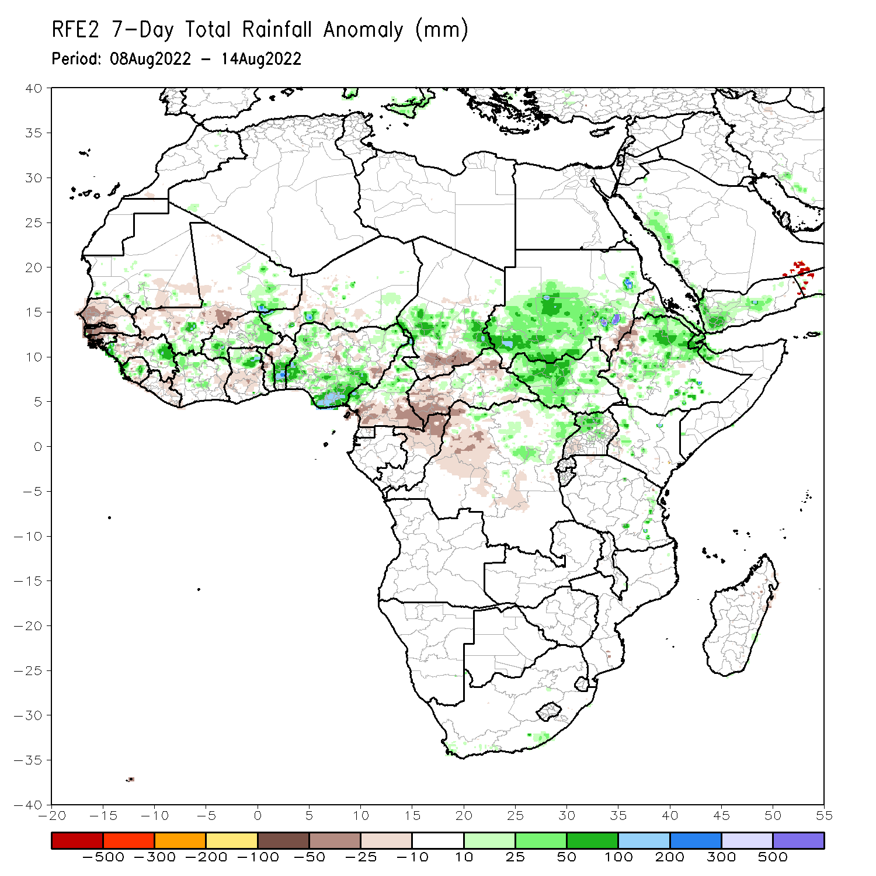
Rainfall Patterns: Last 7 Days
During the past 7 days, in East Africa, rainfall was above-average over much of South Sudan, southern and eastern Sudan, Eritrea, many parts of Ethiopia and northern Uganda. Below-average rainfall was observed over pockets of northwestern Ethiopia. In Central Africa, rainfall was above-average over northern Cameroon, central Chad, and pockets of northeastern DRC. Below-average rainfall was observed over southern Cameroon, CAR, southern Chad, and parts of northwestern DRC. In West Africa, above-average rainfall was observed over eastern Guinea and Ghana, and southern Nigeria. In contrast, parts of Senegal, central and southern Mali, and pocket areas along the Gulf of Guinea coast received below-average rainfall.

Slide 7
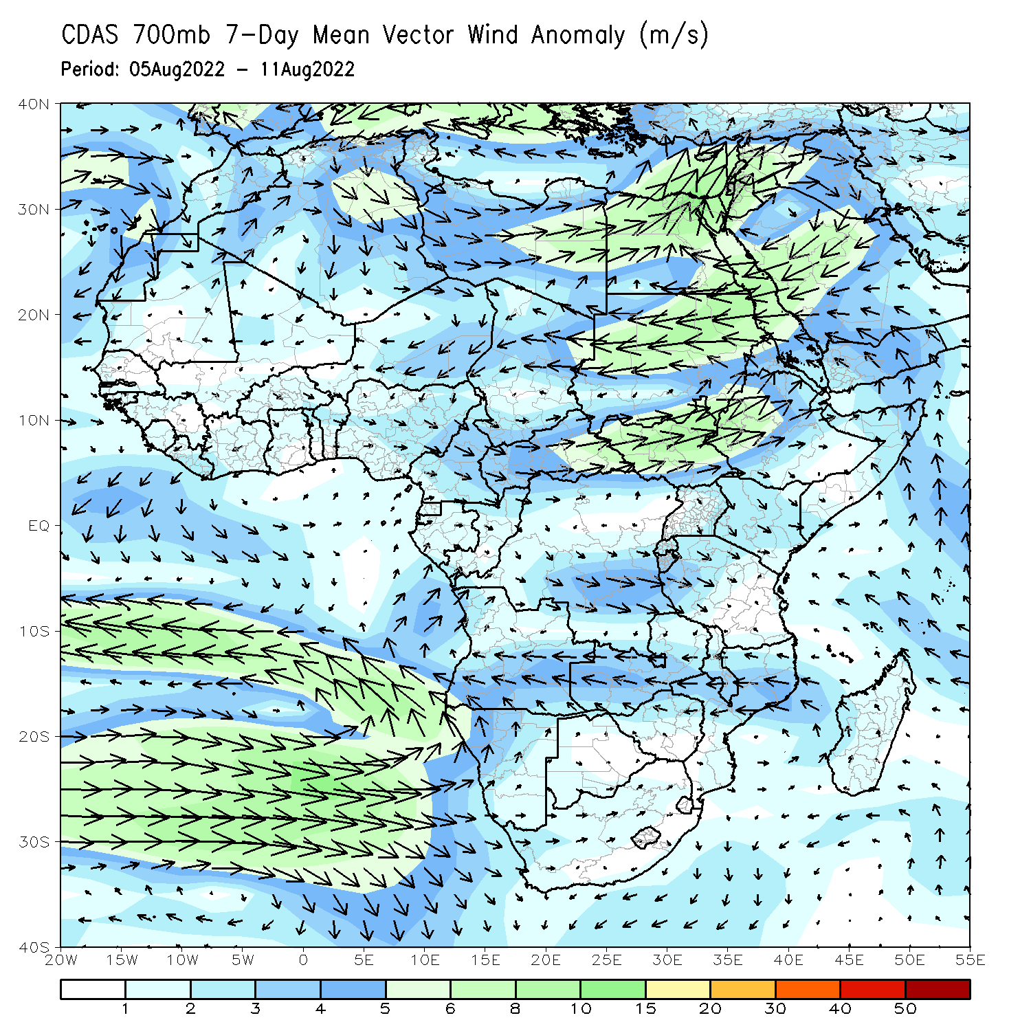
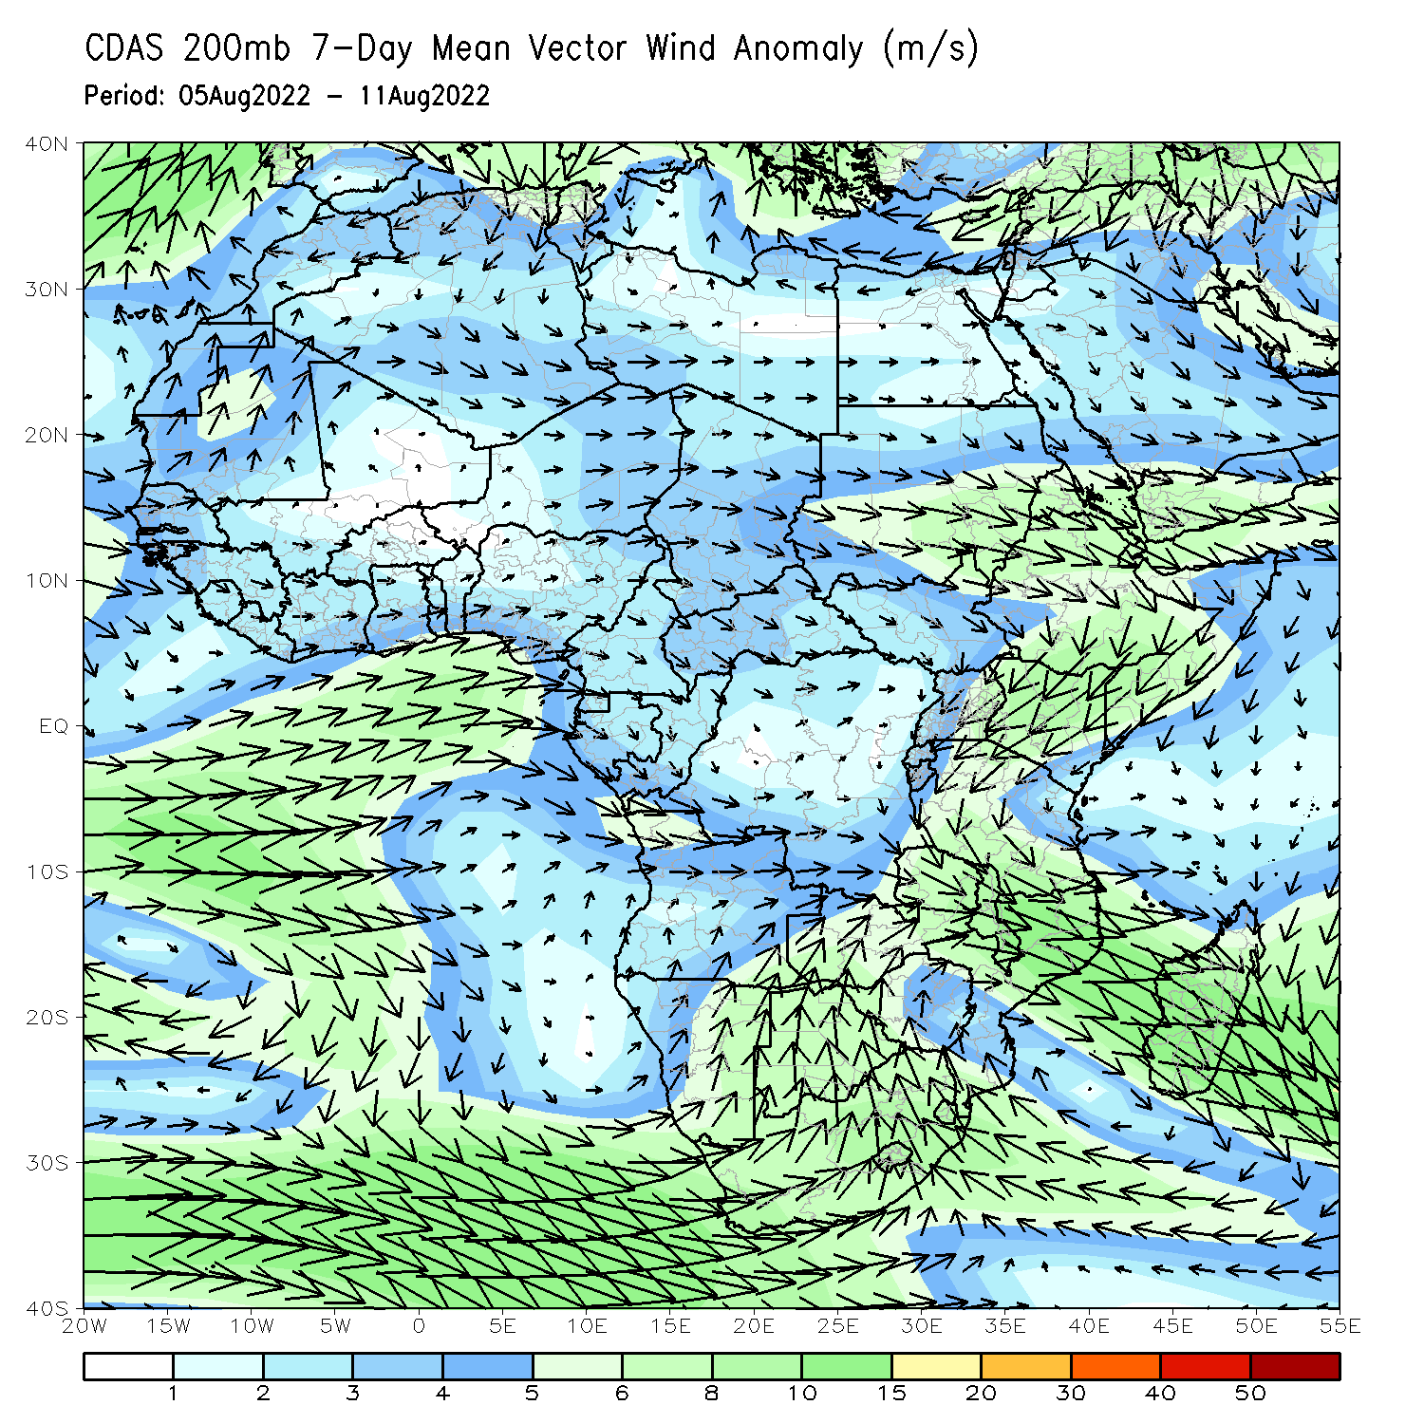
Atmospheric Circulation: Last 7 Days
At 700-hPa level (left panel), a broad area of anomalous cyclonic flow was observed across the eastern portion of the Sahel, including Sudan.

Slide 8
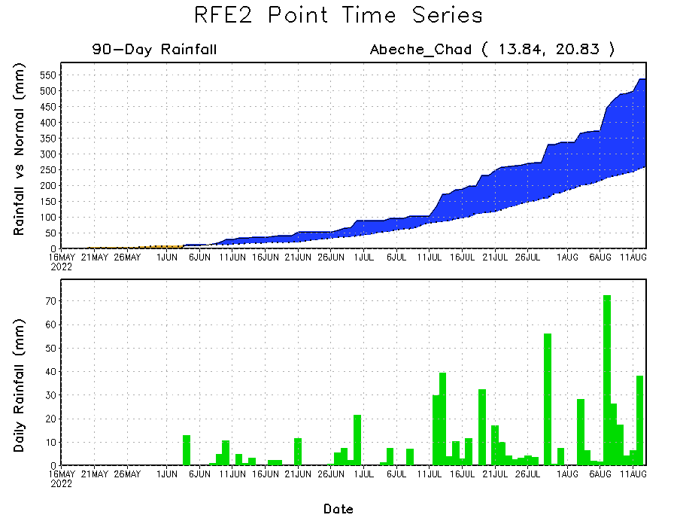
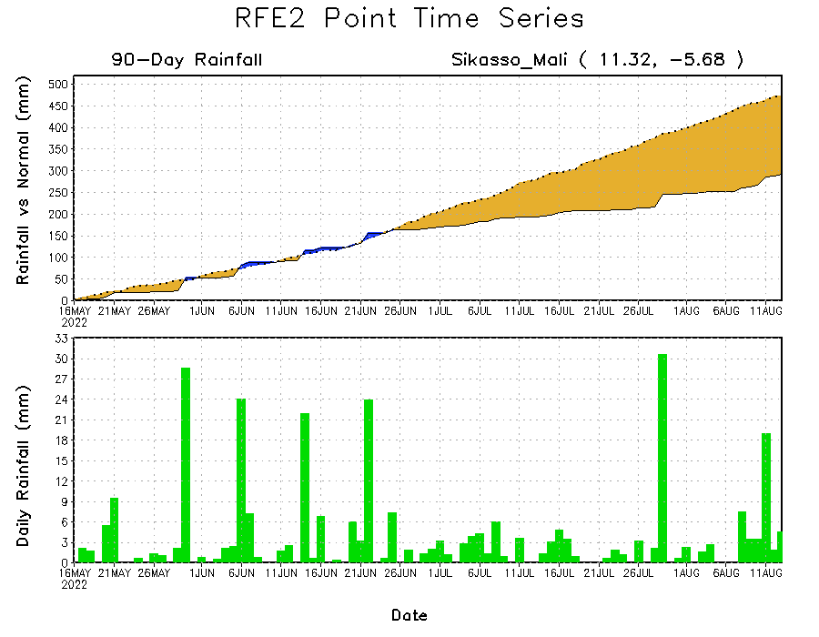
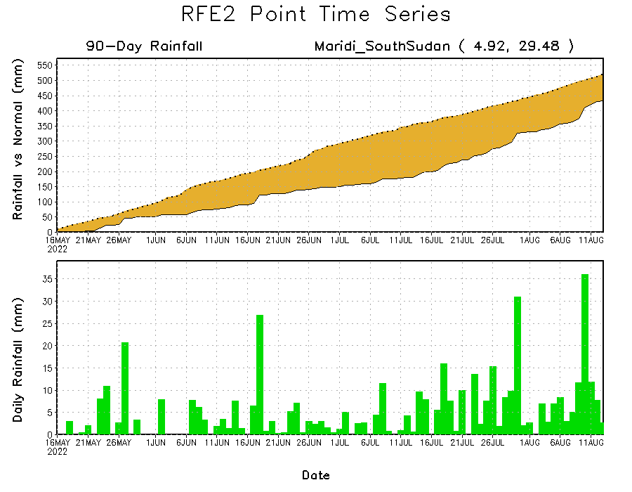
Rainfall Evolution
Daily evolution of rainfall over the last 90 days at selected locations shows increasing moisture deficits over parts of southern Mali (bottom left) and southern South Sudan (bottom right). Consistent heavy rains have kept significant moisture surpluses over parts of Chad (top right).

Slide 9
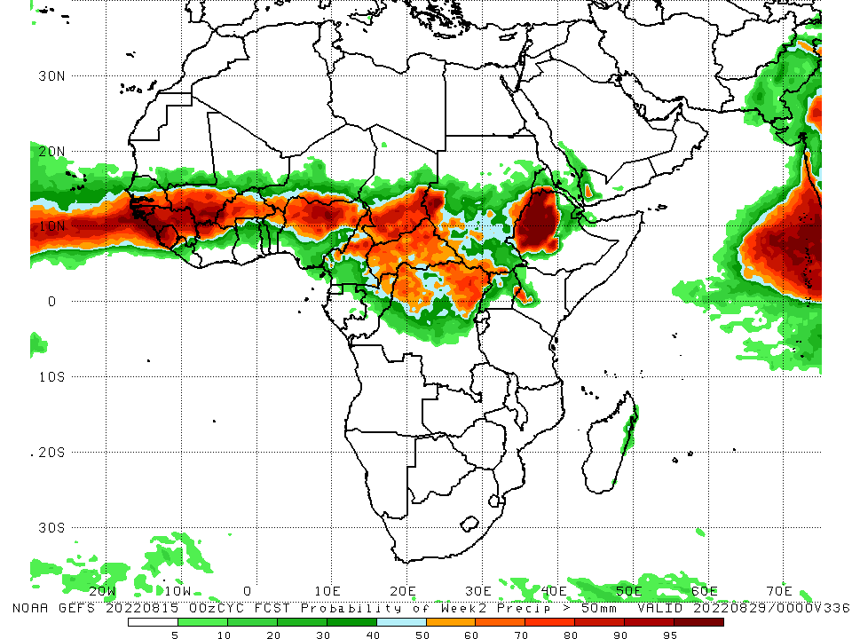
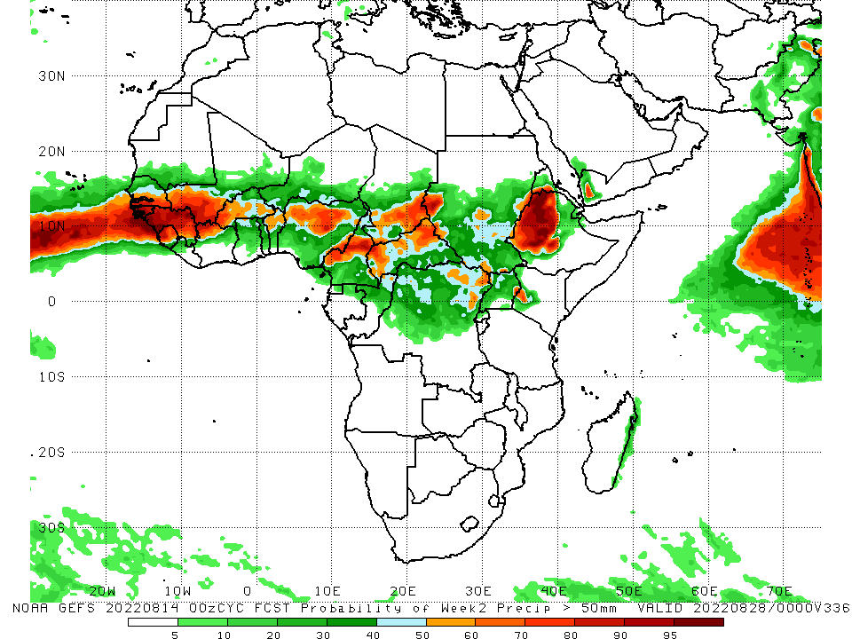
NCEP GEFS Model Forecasts Non-Bias Corrected Probability of precipitation exceedance
Week-1, Valid: 16 – 22 August, 2022
Week-2, Valid: 16 – 22 August, 2022
For week-1 (left panel) and week-2 (right panel) the NCEP GEFS indicates a moderate to high chance (over 70%) for rainfall to exceed 50 mm across the Sahel region, South Sudan, western Ethiopia and the Lake Victoria region.
Notes:
9

Slide 10
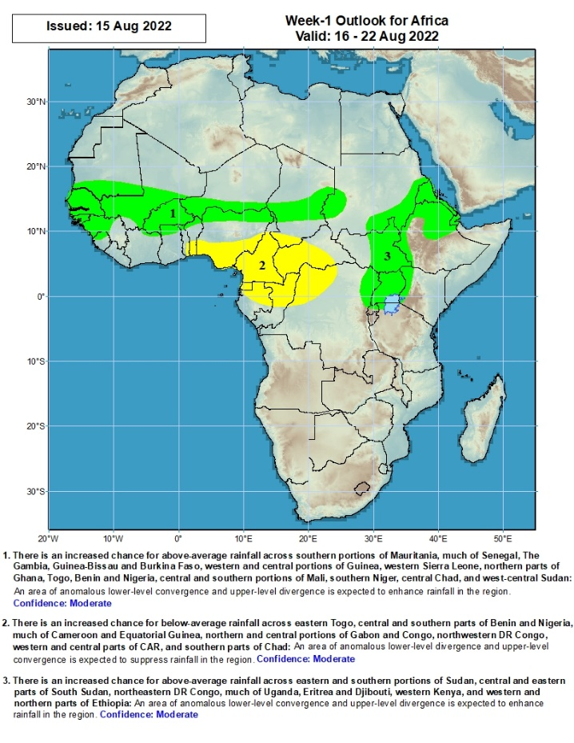
Week-1 Precipitation Outlooks
16 - 22 August, 2022
There is an increased chance for above-average rainfall across much of the Sahel region: An area of anomalous lower-level convergence and upper-level divergence is expected to enhance rainfall in the region. Confidence: Moderate
There is an increased chance for below-average rainfall across the eastern portion of the Gulf of Guinea and the neighboring areas of Central Africa: An area of anomalous lower-level divergence and upper-level convergence is expected to suppress rainfall in the region. Confidence: Moderate
There is an increased chance for above-average rainfall across eastern and southern portions of Sudan, central and eastern parts of South Sudan, northeastern DR Congo, much of Uganda, Eritrea and Djibouti, western Kenya, and western and northern parts of Ethiopia: An area of anomalous lower-level convergence and upper-level divergence is expected to enhance rainfall in the region. Confidence: Moderate
Notes:
10

Slide 11
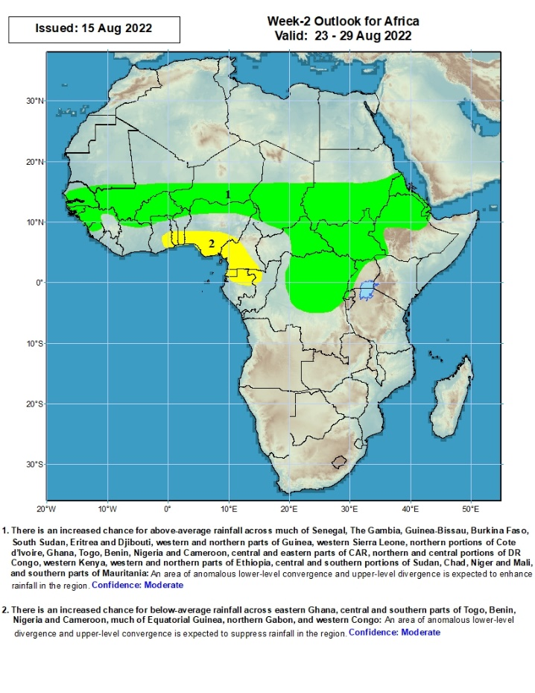
Week-2 Precipitation Outlooks
23 - 29 August, 2022
There is an increased chance for above-average rainfall across much of Sudano-Sahelian region, including northern Ethiopia and Eritrea, and parts of Central Africa and the Lake Victoria region: An area of anomalous lower-level convergence and upper-level divergence is expected to enhance rainfall in the region. Confidence: Moderate
There is an increased chance for below-average rainfall across the eastern portion of the Gulf of Guinea coast: An area of anomalous lower-level divergence and upper-level convergence is expected to suppress rainfall in the region. Confidence: Moderate
Notes:
11

Slide 12
Summary
During the past 30 days, in East Africa, above-average rainfall was observed over southern and eastern Sudan, the western and eastern parts of South Sudan, Eritrea, and western and northern Ethiopia. Rainfall was below-average over pockets of central Ethiopia. In Central Africa, rainfall was above-average over parts of northern and eastern Cameroon, northern Congo, much of CAR, southern Chad and northern DRC. Rainfall was below-average over Equatorial Guinea, southern Cameroon, and pockets of central DRC. In West Africa, rainfall was above-average over Senegal, Guinea-Bissau, Guinea, Sierra Leone, western Liberia, Burkina Faso, northern Ghana, parts of Niger and northern Nigeria. In contrast, central and southern Mali, eastern Liberia, Cote d’Ivoire, Ghana, Togo, Benin, and southern Nigeria received below-average rainfall.
During the past 7 days, in East Africa, rainfall was above-average over much of South Sudan, southern and eastern Sudan, Eritrea, many parts of Ethiopia and northern Uganda. Below-average rainfall was observed over pockets of northwestern Ethiopia. In Central Africa, rainfall was above-average over northern Cameroon, central Chad, and pockets of northeastern DRC. Below-average rainfall was observed over southern Cameroon, CAR, southern Chad, and parts of northwestern DRC. In West Africa, above-average rainfall was observed over eastern Guinea and Ghana, and southern Nigeria. In contrast, parts of Senegal, central and southern Mali, and pocket areas along the Gulf of Guinea coast received below-average rainfall.
Week-1 and week-2 outlooks call for an increased chance for above-average rainfall across much of the Sahel region, eastern South Sudan, northern Ethiopia, Eritrea, and the Lake Victoria region. In contrast, there is an increased chance for below-average rainfall along the Gulf Guinea coast, and the neighboring areas of Central Africa.

