Slide 1
The African Monsoon Recent Evolution and Current Status Include Week-1 and Week-2 Outlooks
Update prepared by
8 August 2022
For more information, visit:
http://www.cpc.ncep.noaa.gov/products/Global_Monsoons/African_Monsoons/precip_monitoring.shtml

Slide 2
Outline
Highlights
Recent Evolution and Current Conditions
NCEP GEFS Forecasts
Summary

Slide 3
Highlights: Last 7 Days
During the past 7 days, in East Africa, rainfall was above-average over the northern part of South Sudan, southern and eastern Sudan, Eritrea, parts of Ethiopia and western Kenya. Below-average rainfall was observed over pockets of South Sudan and Ethiopia. In Central Africa, rainfall was above-average over northern Cameroon, central and southern Chad, many parts of CAR, and pockets of DRC. Below-average rainfall was observed over southern Cameroon, pockets of CAR and parts of northern DRC. In West Africa, above-average rainfall was observed over portions of Senegal, Guinea-Bissau, Guinea, and parts of Burkina Faso. In contrast, parts of central and southern Mali, Sierra Leone, Liberia, Cote d’Ivoire, parts of southern Niger, Togo, Benin, and much of Nigeria received below-average rainfall.
Week-1 and week-2 outlooks call for an increased chance for below-average rainfall over the central and eastern portions of the Gulf of Guinea region and the neighboring areas of Central Africa. In contrast, there is an increased chance for above-average rainfall over eastern Sudan, eastern South Sudan, northern Ethiopia and much of Eritrea.

Slide 4
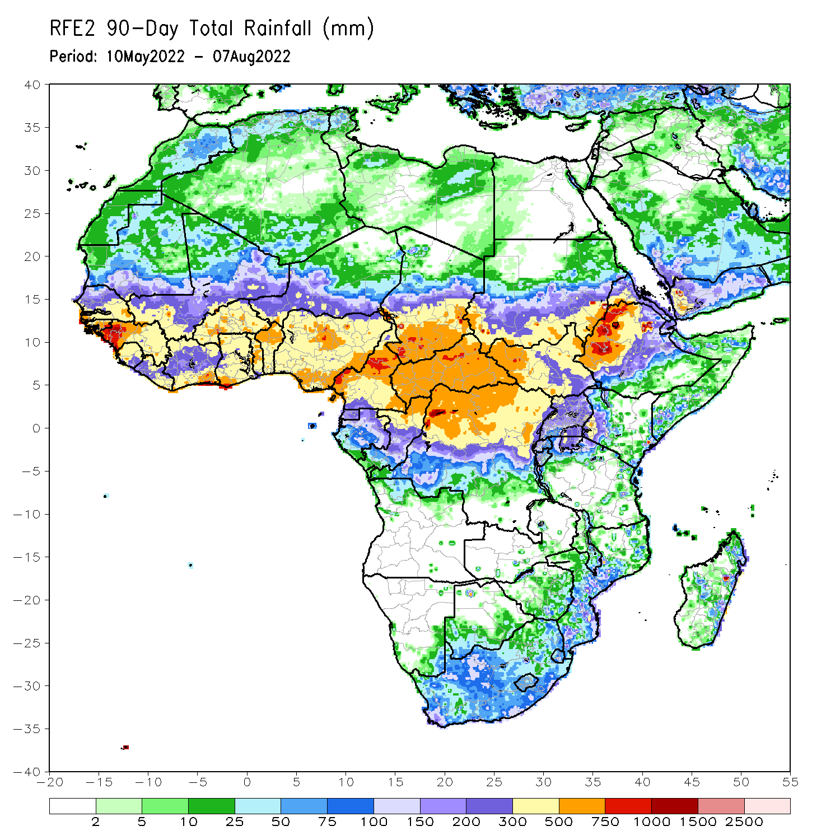
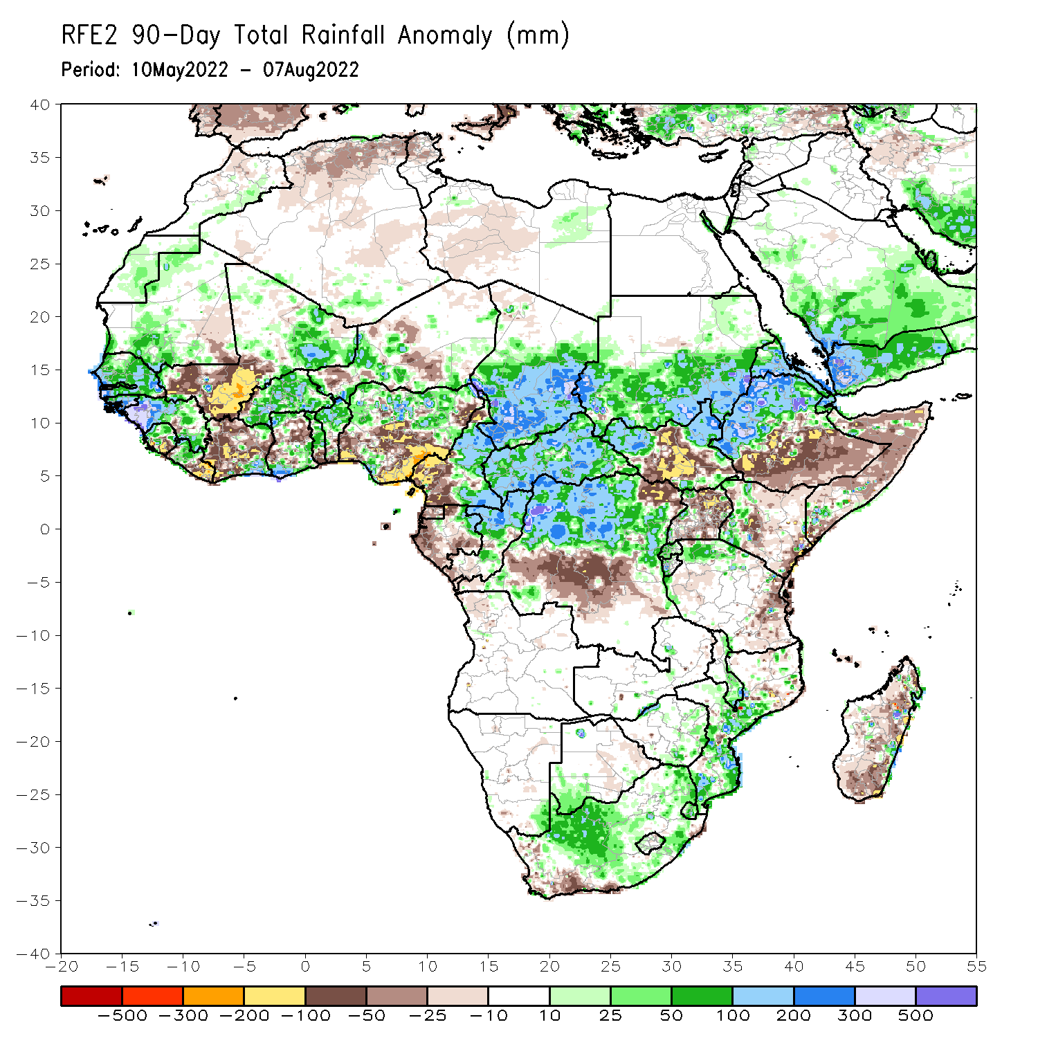
Rainfall Patterns: Last 90 Days
Over the past 90 days, in East Africa, above-average rainfall was observed over southern and eastern Sudan, the western and eastern portions of South Sudan, western Ethiopia, and Eritrea. Rainfall was below-average over southern and eastern Ethiopia, central and southern South Sudan, parts of Kenya, much of Somalia, Uganda, as well as coastal Tanzania. In southern Africa, above-average rainfall was observed over parts of South Africa and Mozambique. Below-average rainfall was observed over pockets of coastal South Africa and much of Madagascar. In Central Africa, rainfall was above-average over central and eastern Cameroon, much of CAR, eastern Gabon, Congo, and northern DRC. Rainfall was below-average over pockets of western Cameroon, parts of central DRC, and pockets of Gabon. In West Africa, rainfall was above-average over southern Mauritania, Senegal, Guinea-Bissau, Guinea, Sierra Leone, western Liberia, eastern Mali, Burkina Faso, parts of Ghana, Togo, Benin, and parts of Niger and western and northern Nigeria. In contrast, below-average rainfall was observed over western and central Mali, eastern Liberia, parts of Cote D’Ivoire, pockets of northeastern Ghana, and parts of central and southern Nigeria.
Notes:
4

Slide 5
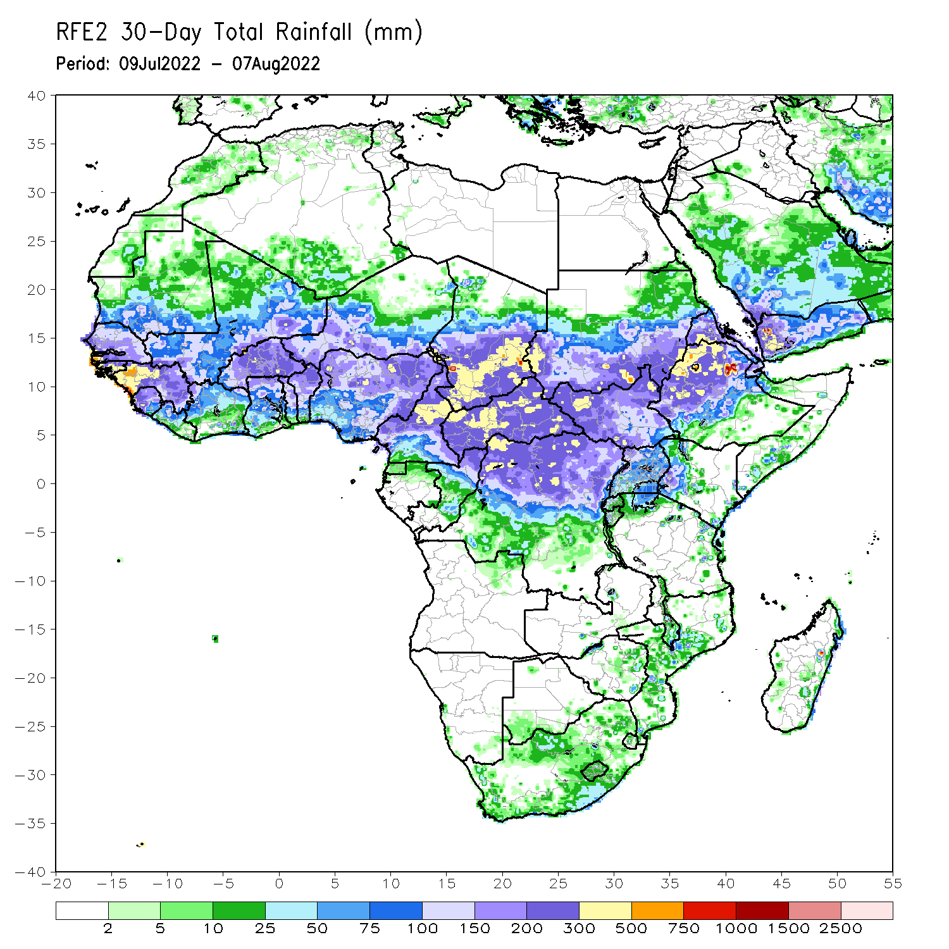
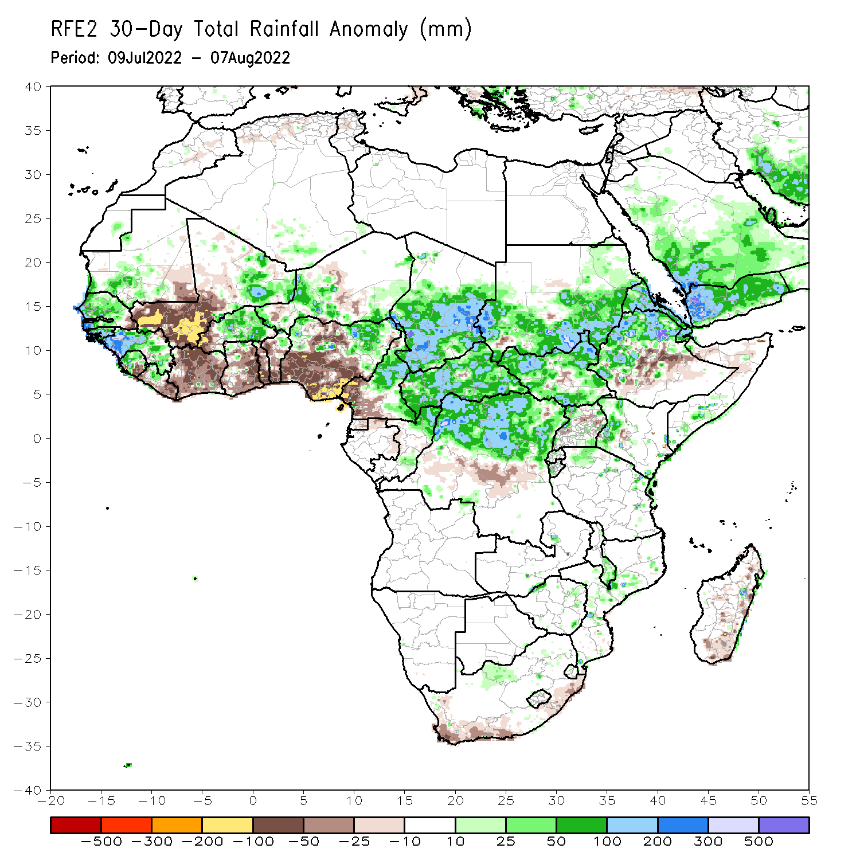
Rainfall Patterns: Last 30 Days
During the past 30 days, in East Africa, above-average rainfall was observed over southern and eastern Sudan, the western and eastern parts of South Sudan, Eritrea, and western and northern Ethiopia. Rainfall was below-average over pockets of central South Sudan, Uganda, and parts of central and southern Ethiopia. In Central Africa, rainfall was above-average over parts of northern and eastern Cameroon, northern Congo, much of CAR, southern Chad and northern DRC. Rainfall was below-average over Equatorial Guinea, southern Cameroon, and pockets of central DRC. In West Africa, rainfall was above-average over Senegal, Guinea-Bissau, Guinea, Sierra Leone, western Liberia, Burkina Faso, parts of Niger and northern Nigeria. In contrast, central and southern Mali, eastern Liberia, Cote d’Ivoire, Ghana, Togo, Benin, pockets of Niger, and southern Nigeria received below-average rainfall.
Notes:
5

Slide 6
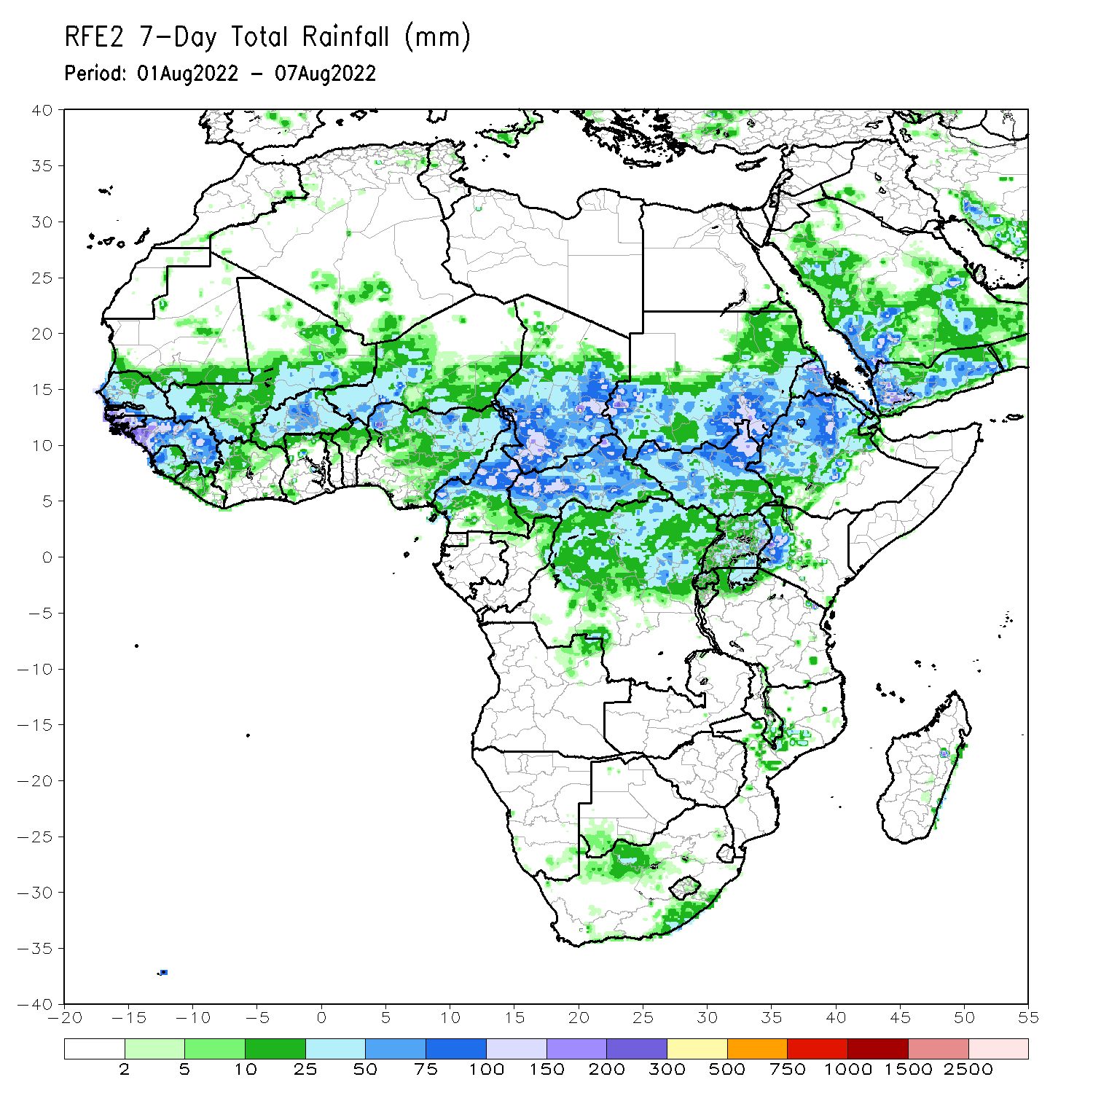
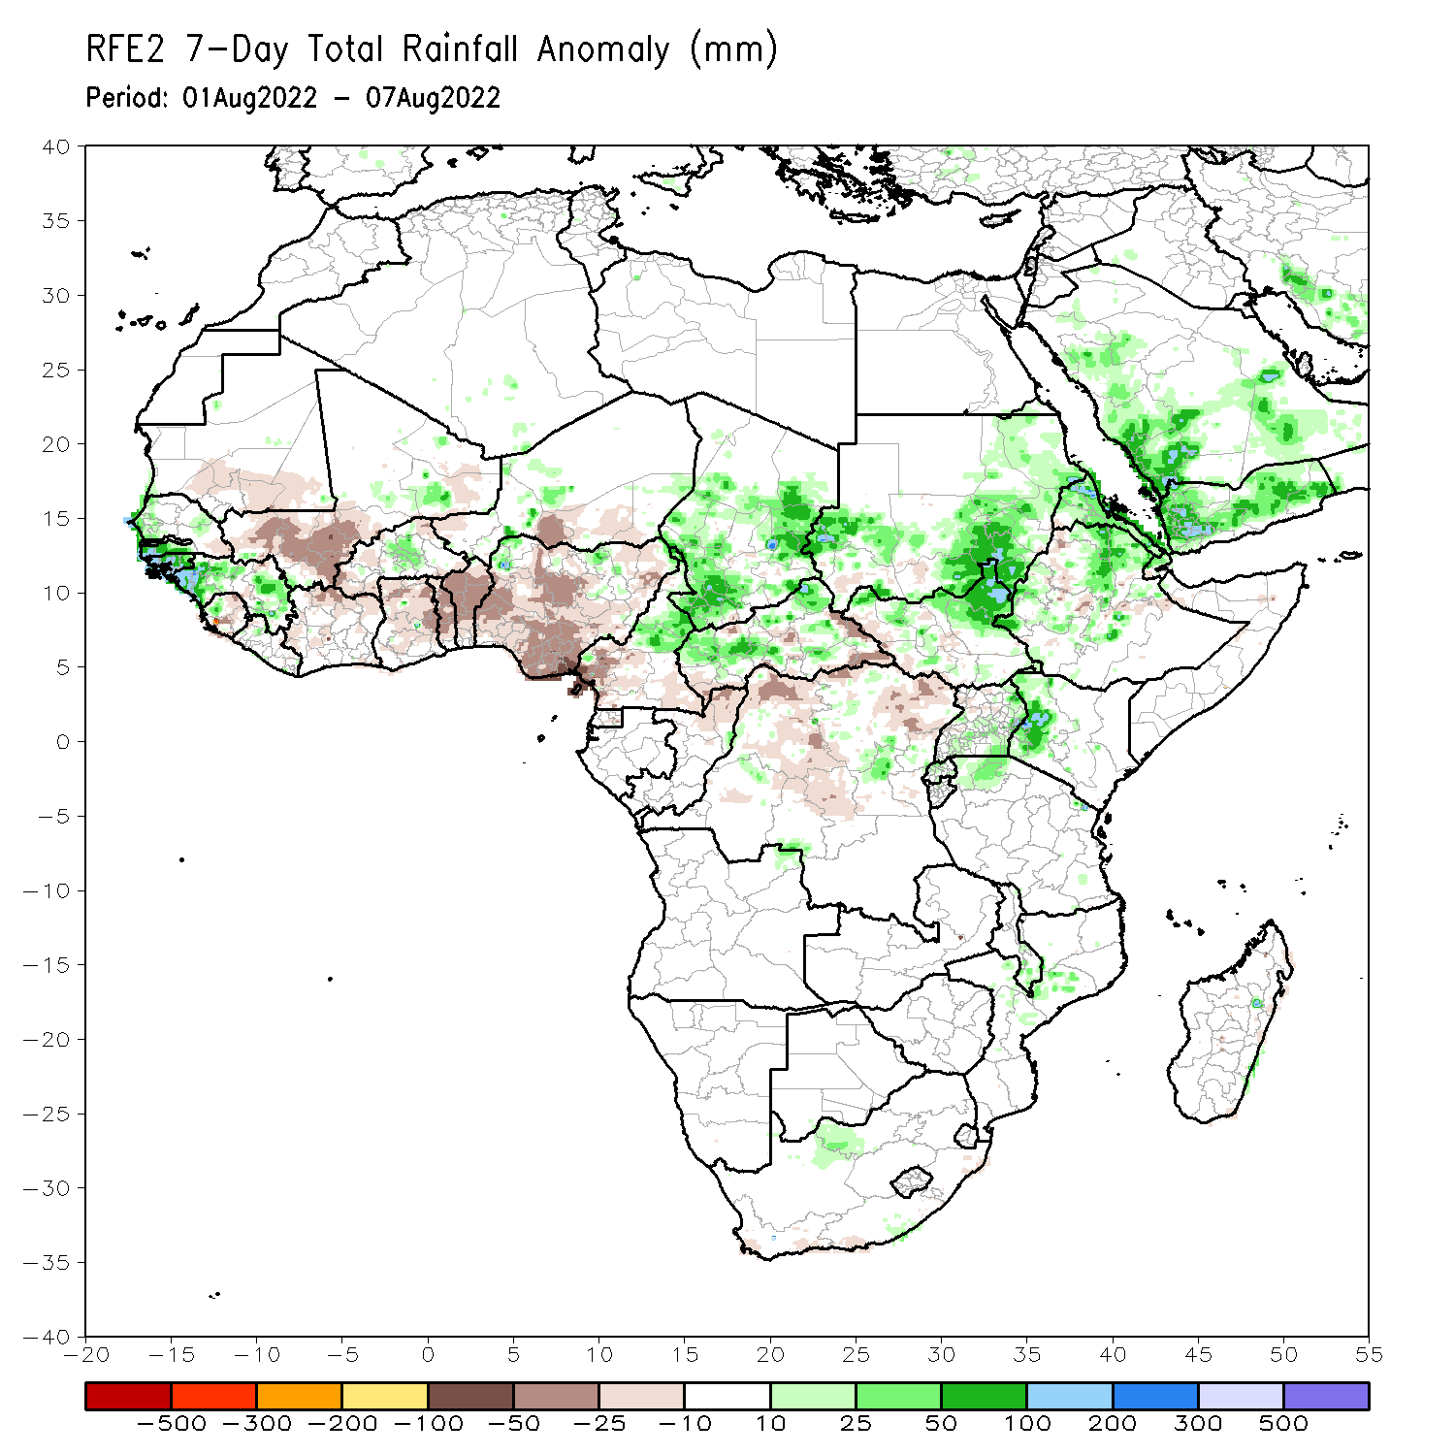
Rainfall Patterns: Last 7 Days
During the past 7 days, in East Africa, rainfall was above-average over the northern part of South Sudan, southern and eastern Sudan, Eritrea, parts of Ethiopia and western Kenya. Below-average rainfall was observed over pockets of South Sudan and Ethiopia. In Central Africa, rainfall was above-average over northern Cameroon, central and southern Chad, many parts of CAR, and pockets of DRC. Below-average rainfall was observed over southern Cameroon, pockets of CAR and parts of northern DRC. In West Africa, above-average rainfall was observed over portions of Senegal, Guinea-Bissau, Guinea, and parts of Burkina Faso. In contrast, parts of central and southern Mali, Sierra Leone, Liberia, Cote d’Ivoire, parts of southern Niger, Togo, Benin, and much of Nigeria received below-average rainfall.

Slide 7
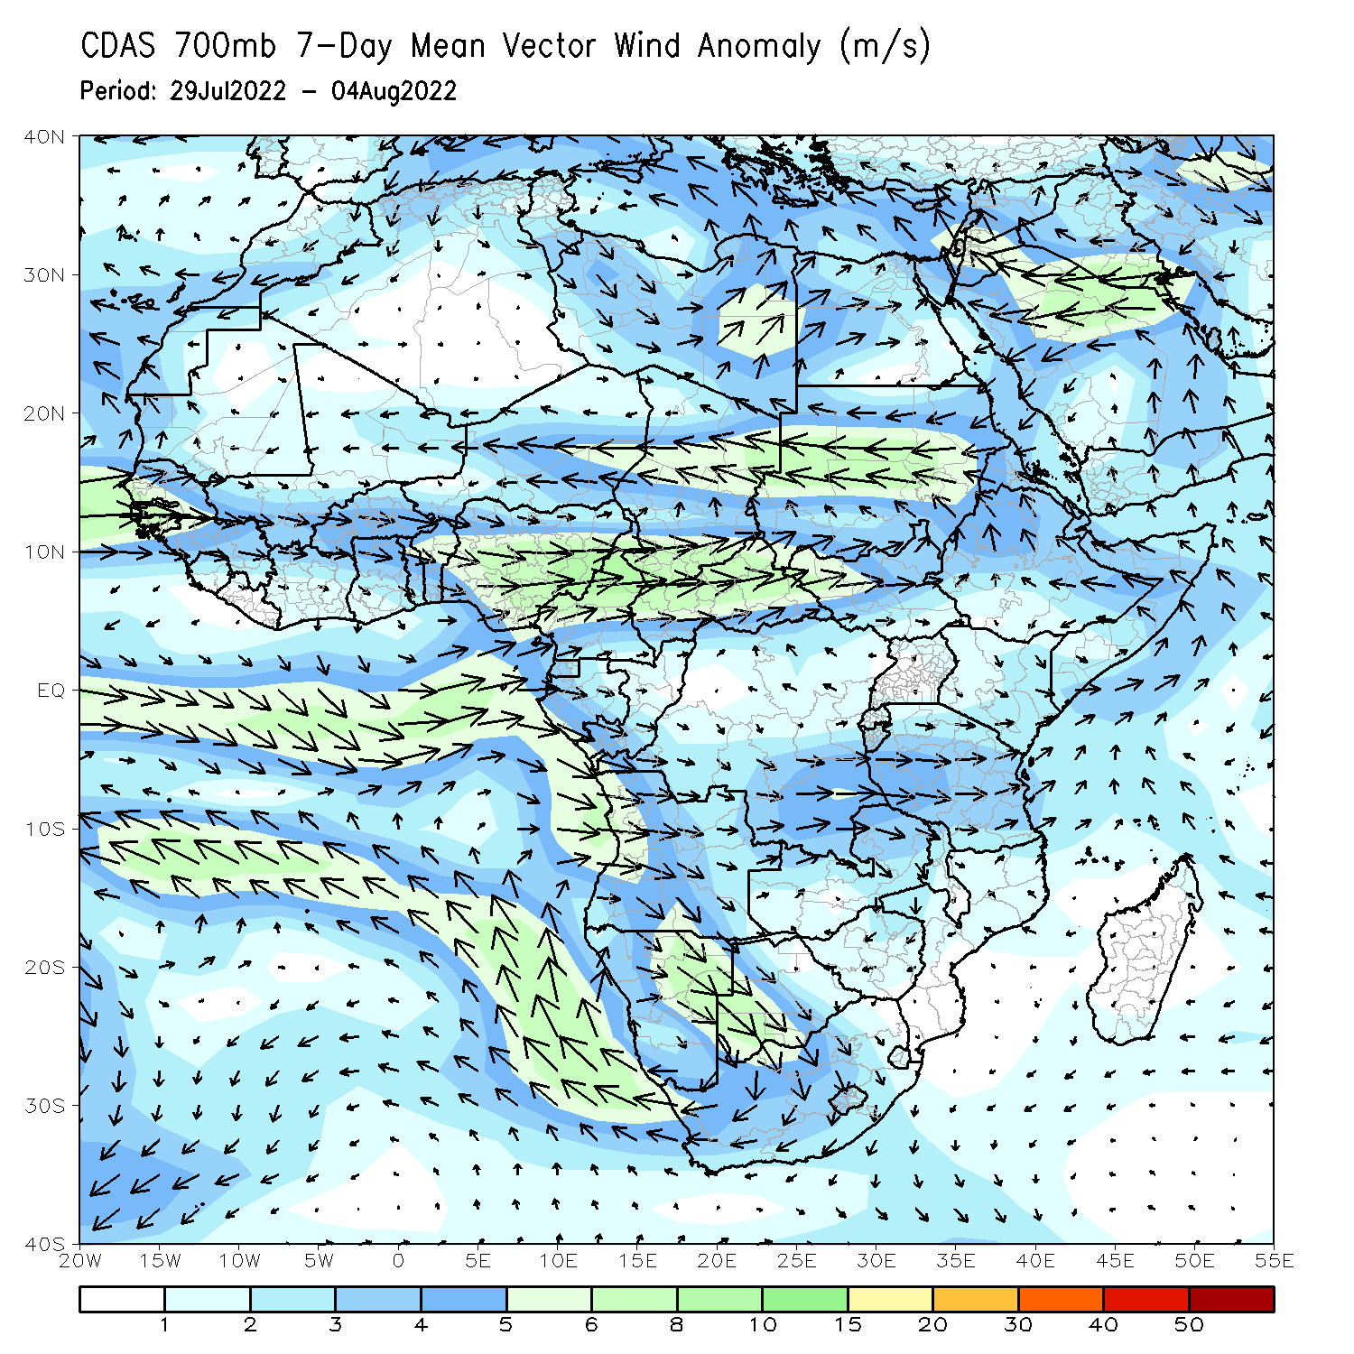
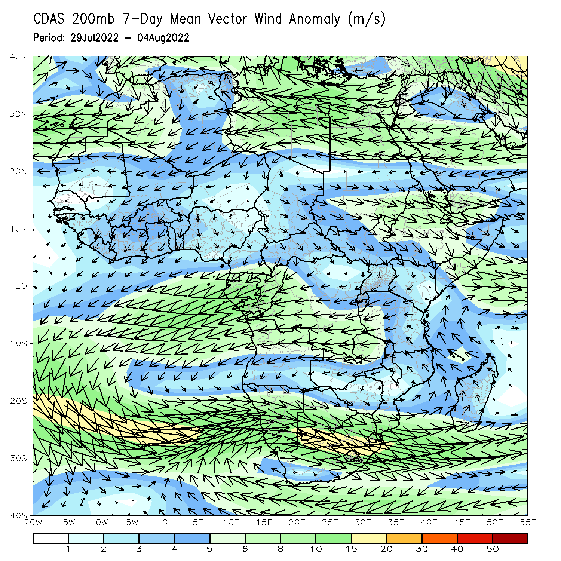
Atmospheric Circulation: Last 7 Days
At 700-hPa level (left panel), a broad area of anomalous cyclonic flow was observed across the Sudano-Sahelian region.

Slide 8
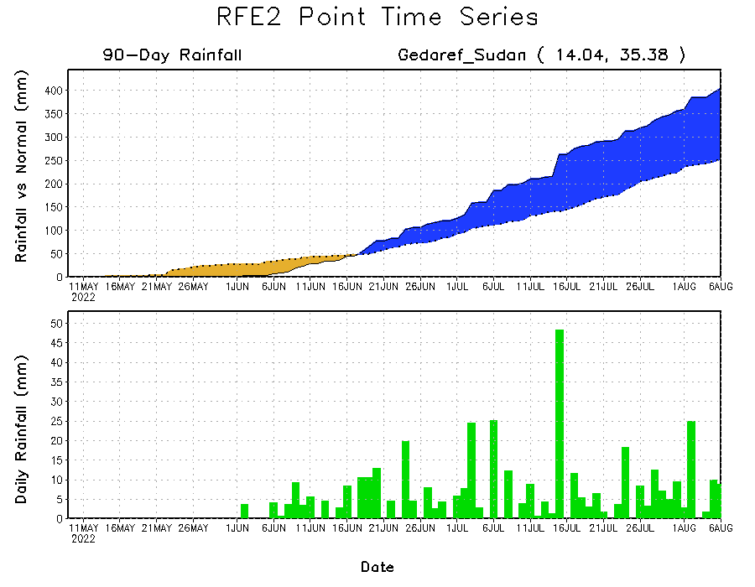
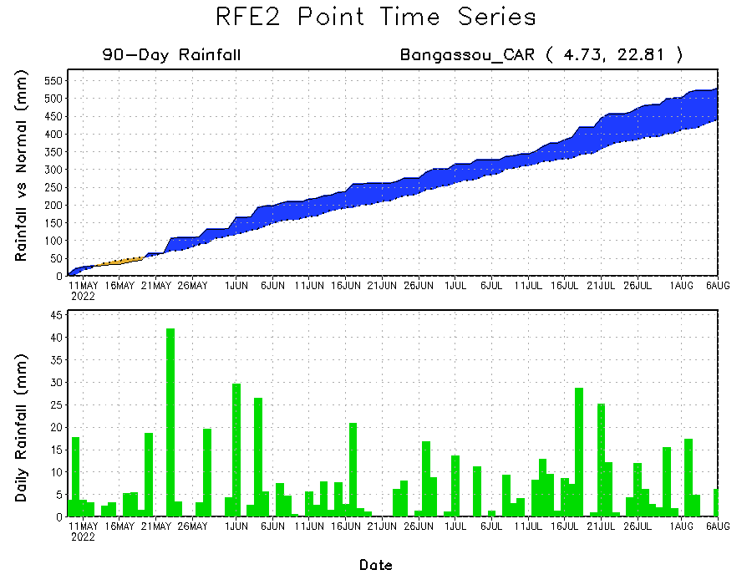
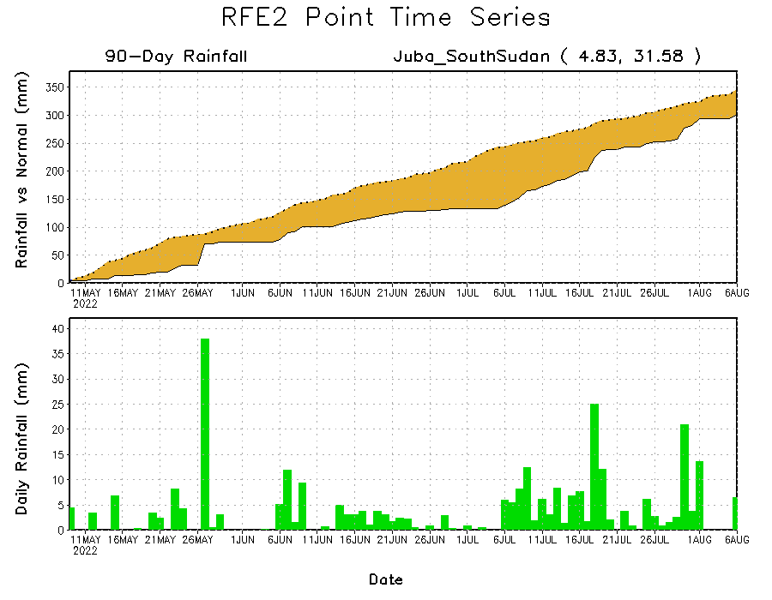
Rainfall Evolution
Daily evolution of rainfall over the last 90 days at selected locations shows increasing moisture deficits over parts of South Sudan (bottom right). Consistent heavy rains have kept significant moisture surpluses over parts of Central African Republic (bottom left) and eastern Sudan (top right).

Slide 9
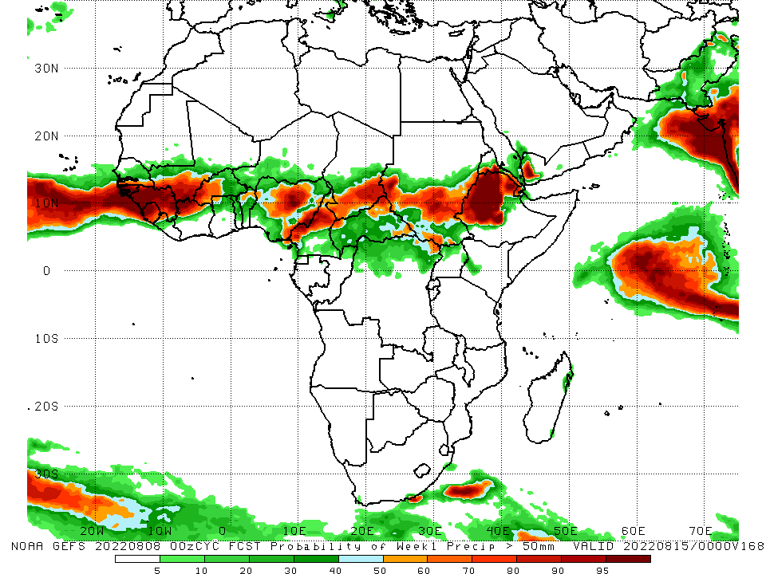
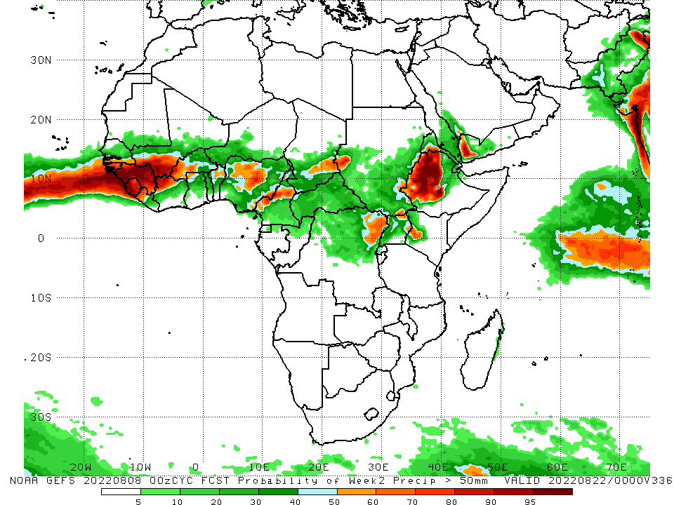
NCEP GEFS Model Forecasts Non-Bias Corrected Probability of precipitation exceedance
Week-1, Valid: 9 – 15 August, 2022
Week-2, Valid: 16 – 22 August, 2022
For week-1 (left panel) and week-2 (right panel) the NCEP GEFS indicates a moderate to high chance (over 70%) for rainfall to exceed 50 mm over the western and eastern portions of the Gulf of Guinea region, parts of central Africa and western Ethiopia.
Notes:
9

Slide 10
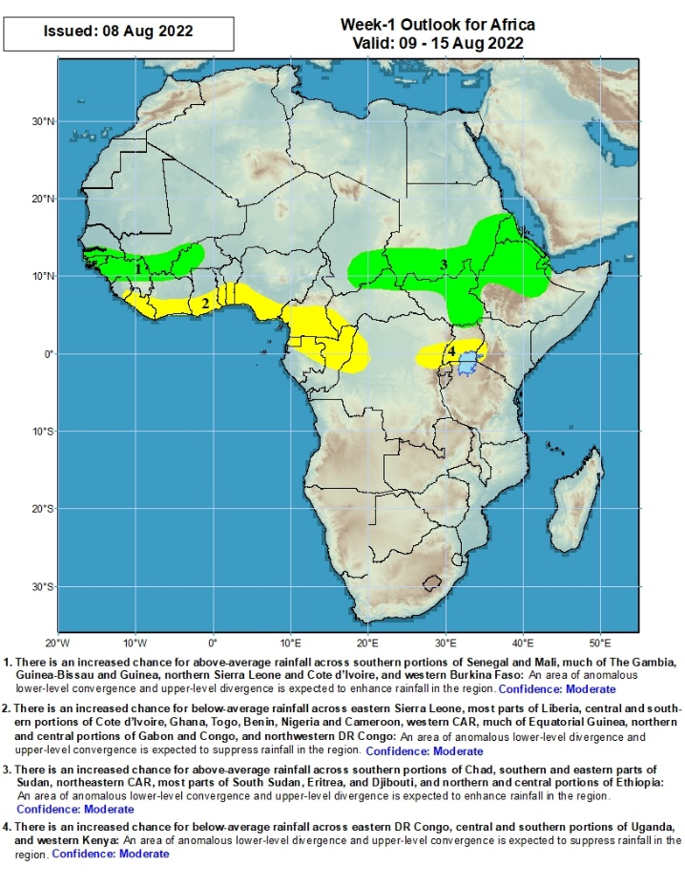
Week-1 Precipitation Outlooks
9 - 15 August, 2022
There is an increased chance for above-average rainfall across southern portions of Senegal and Mali, much of The Gambia, Guinea-Bissau and Guinea, northern Sierra Leone and Cote d’Ivoire, and western Burkina Faso: An area of anomalous lower-level convergence and upper-level divergence is expected to enhance rainfall in the region. Confidence: Moderate
There is an increased chance for below-average rainfall across eastern Sierra Leone, most parts of Liberia, central and southern portions of Cote d’Ivoire, Ghana, Togo, Benin, Nigeria and Cameroon, western CAR, much of Equatorial Guinea, northern and central portions of Gabon and Congo, and northwestern DR Congo: An area of anomalous lower-level divergence and upper-level convergence is expected to suppress rainfall in the region. Confidence: Moderate
There is an increased chance for above-average rainfall across southern portions of Chad, southern and eastern parts of Sudan, northeastern CAR, most parts of South Sudan, Eritrea, and Djibouti, and northern and central portions of Ethiopia: An area of anomalous lower-level convergence and upper-level divergence is expected to enhance rainfall in the region. Confidence: Moderate
There is an increased chance for below-average rainfall across eastern DR Congo, central and southern portions of Uganda, and western Kenya: An area of anomalous lower-level divergence and upper-level convergence is expected to suppress rainfall in the region. Confidence: Moderate
Notes:
10

Slide 11
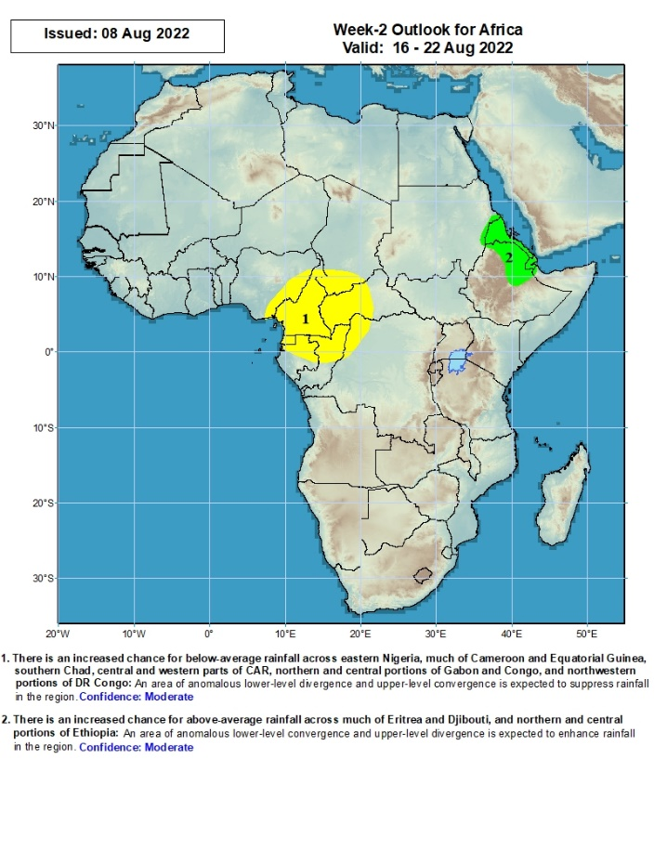
Week-2 Precipitation Outlooks
16 - 22 August, 2022
There is an increased chance for below-average rainfall across eastern Nigeria, much of Cameroon and Equatorial Guinea, southern Chad, central and western parts of CAR, northern and central portions of Gabon and Congo, and northwestern portions of DR Congo: An area of anomalous lower-level divergence and upper-level convergence is expected to suppress rainfall in the region. Confidence: Moderate
There is an increased chance for above-average rainfall across much of Eritrea and Djibouti, and northern and central portions of Ethiopia: An area of anomalous lower-level convergence and upper-level divergence is expected to enhance rainfall in the region. Confidence: Moderate
Notes:
11

Slide 12
Summary
During the past 30 days, in East Africa, above-average rainfall was observed over southern and eastern Sudan, the western and eastern parts of South Sudan, Eritrea, and western and northern Ethiopia. Rainfall was below-average over pockets of central South Sudan, Uganda, and parts of central and southern Ethiopia. In Central Africa, rainfall was above-average over parts of northern and eastern Cameroon, northern Congo, much of CAR, southern Chad and northern DRC. Rainfall was below-average over Equatorial Guinea, southern Cameroon, and pockets of central DRC. In West Africa, rainfall was above-average over Senegal, Guinea-Bissau, Guinea, Sierra Leone, western Liberia, Burkina Faso, parts of Niger and northern Nigeria. In contrast, central and southern Mali, eastern Liberia, Cote d’Ivoire, Ghana, Togo, Benin, pockets of Niger, and southern Nigeria received below-average rainfall.
During the past 7 days, in East Africa, rainfall was above-average over the northern part of South Sudan, southern and eastern Sudan, Eritrea, parts of Ethiopia and western Kenya. Below-average rainfall was observed over pockets of South Sudan and Ethiopia. In Central Africa, rainfall was above-average over northern Cameroon, central and southern Chad, many parts of CAR, and pockets of DRC. Below-average rainfall was observed over southern Cameroon, pockets of CAR and parts of northern DRC. In West Africa, above-average rainfall was observed over portions of Senegal, Guinea-Bissau, Guinea, and parts of Burkina Faso. In contrast, parts of central and southern Mali, Sierra Leone, Liberia, Cote d’Ivoire, parts of southern Niger, Togo, Benin, and much of Nigeria received below-average rainfall.
Week-1 and week-2 outlooks call for an increased chance for below-average rainfall over the central and eastern portions of the Gulf of Guinea region and the neighboring areas of Central Africa. In contrast, there is an increased chance for above-average rainfall over eastern Sudan, eastern South Sudan, northern Ethiopia and much of Eritrea.

