Slide 1
The African Monsoon Recent Evolution and Current Status Include Week-1 and Week-2 Outlooks
Update prepared by
18 July 2022
For more information, visit:
http://www.cpc.ncep.noaa.gov/products/Global_Monsoons/African_Monsoons/precip_monitoring.shtml

Slide 2
Outline
Highlights
Recent Evolution and Current Conditions
NCEP GEFS Forecasts
Summary

Slide 3
Highlights: Last 7 Days
During the past 7 days, in East Africa, rainfall was above-average over parts of of southern and eastern Sudan, western South Sudan and pockets of northwestern Ethiopia. Below-average rainfall was observed over pockets of South Sudan and Ethiopia. In Central Africa, rainfall was above-average over northern Cameroon, Chad, central and eastern CAR, and northern DRC. Below-average rainfall was observed over southern Cameroon, Equatorial Guinea, western CAR, and parts of Congo. In West Africa, above-average rainfall was observed over parts of Guinea, Burkina Faso, and northern Nigeria. Meanwhile, rainfall was below-average over parts of Senegal, southern Mali, eastern Cote d’Ivoire, Ghana, Togo, Benin and southern Nigeria.
Week-1 outlooks call for an increased chance for above-average rainfall over the far western West Africa, and parts of Central Africa, eastern Sudan and western Ethiopia. In contrast, the outlooks call for an increased chance for below-average rainfall along the Gulf of Guinea coast. For week-2, the outlooks call for an increased chance for below-average rainfall over the far western part of the Gulf of Guinea coast, and the Lake Victoria region, while above-average rainfall is likely over eastern Sudan, Eritrea and northern Ethiopia.

Slide 4
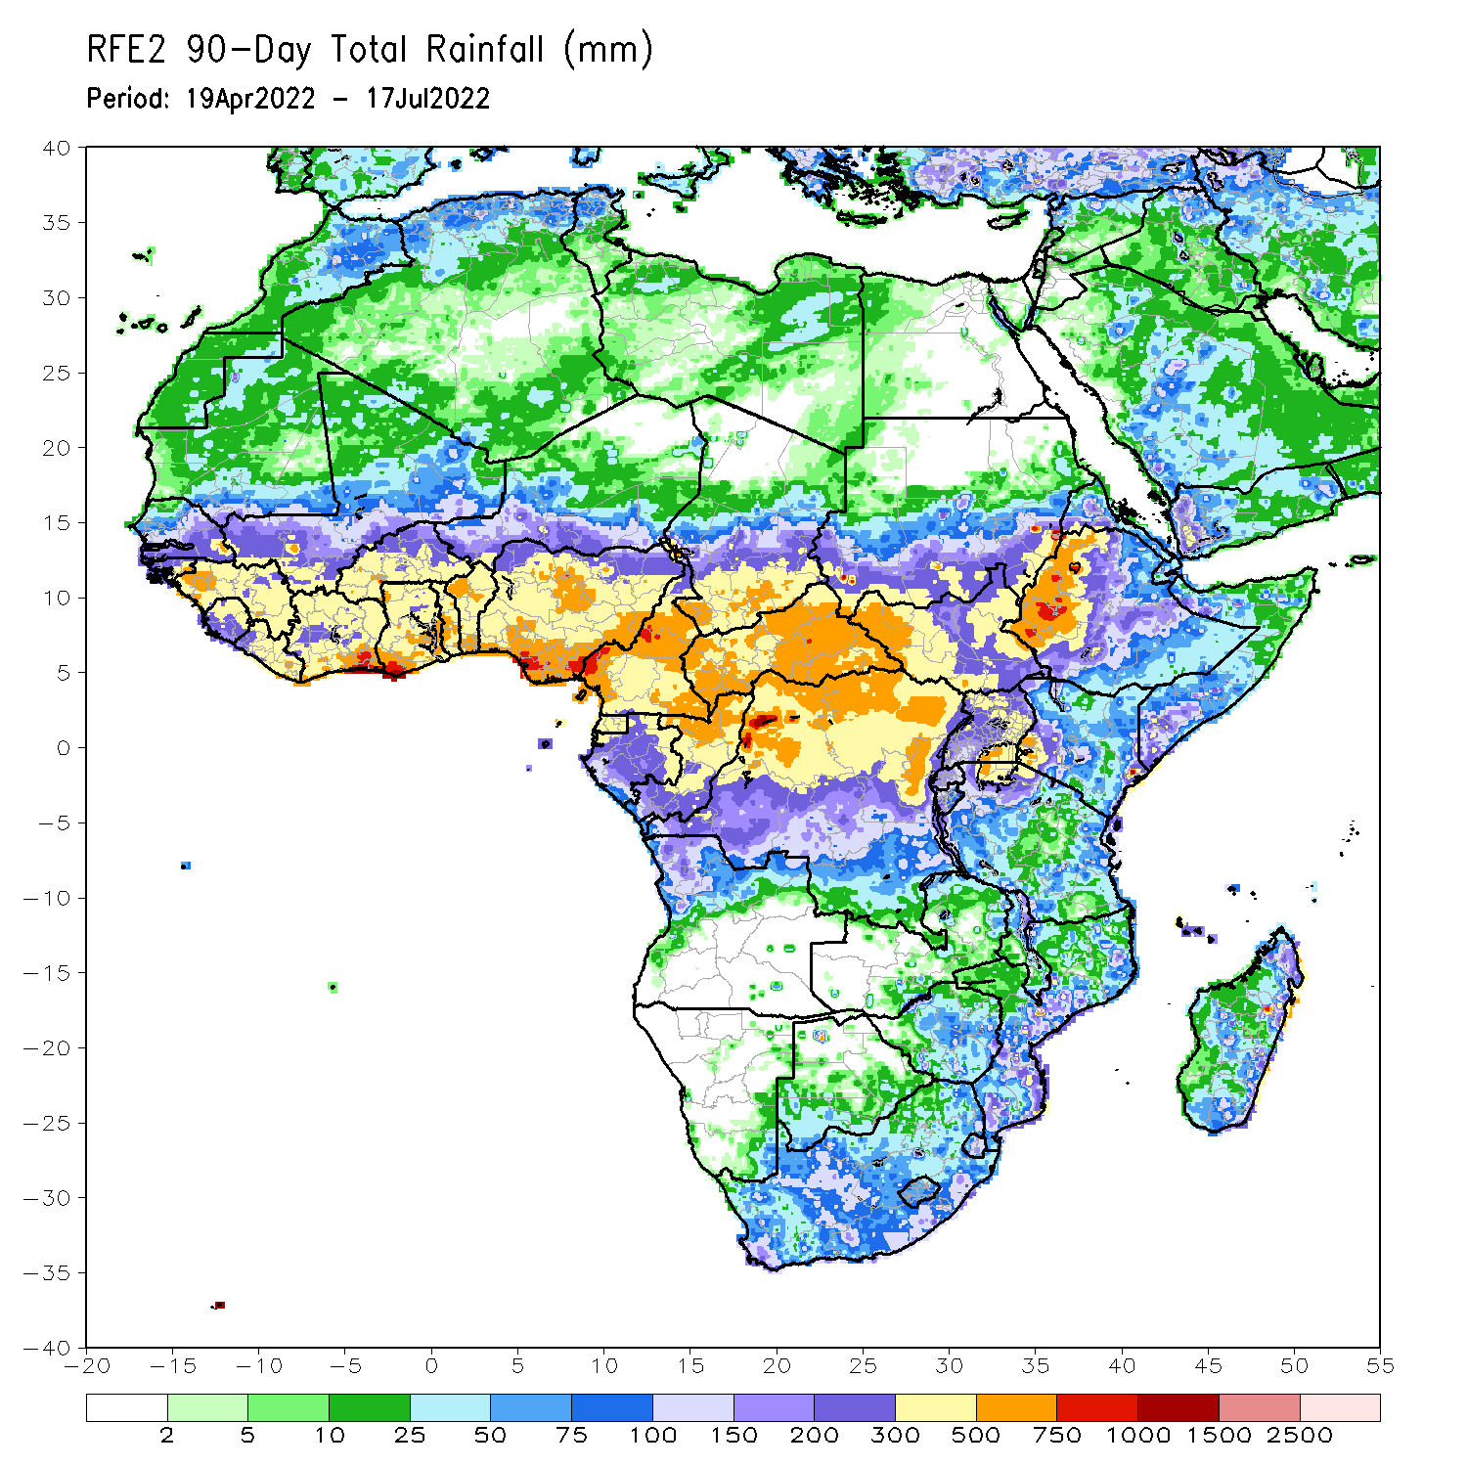
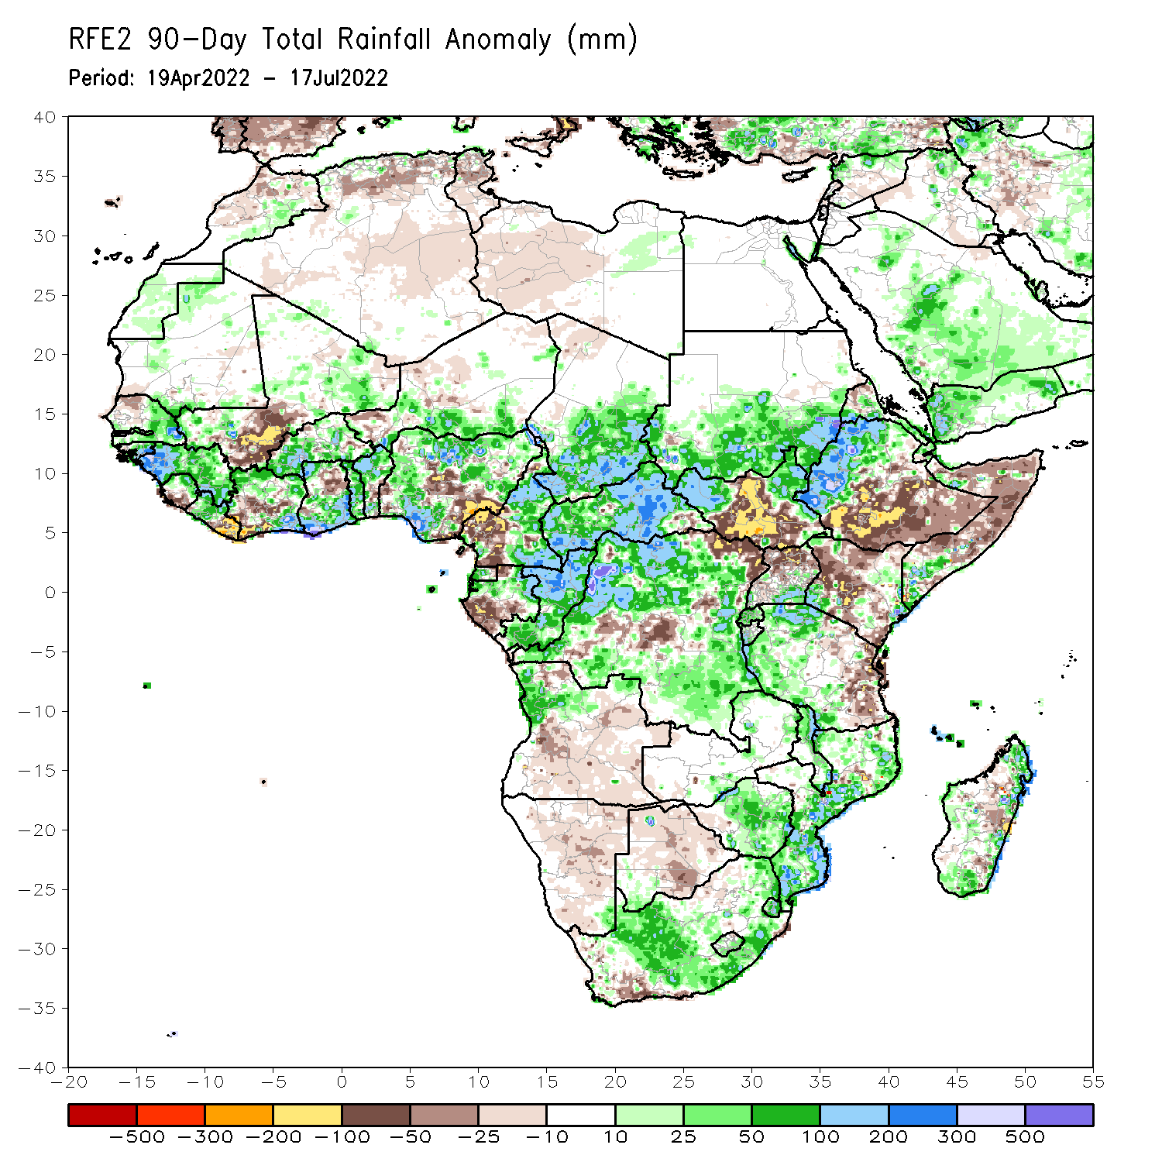
Rainfall Patterns: Last 90 Days
Over the past 90 days, in East Africa, above-average rainfall was observed over southern and eastern Sudan, the western and eastern portions of South Sudan, western Ethiopia, and parts of southern Uganda, western and northern Tanzania and the far southern Somalia. Rainfall was below-average over southern and eastern Ethiopia, central and southern South Sudan, much of Kenya, central and northern Somalia, northern Uganda, as well as pockets of eastern Tanzania. In southern Africa, above-average rainfall was observed over northern Angola, much of Zimbabwe, Malawi, South Africa, Mozambique and pockets of Madagascar. Below-average rainfall was observed over many parts of Angola, much of Namibia, Botswana, the far western South Africa, and pockets of Madagascar. In Central Africa, rainfall was above-average over central and eastern Cameroon, much of CAR, northern Gabon, Congo, and many parts of DRC. Rainfall was below-average over pockets of western Cameroon, parts of central DRC, and southern Gabon. In West Africa, rainfall was above-average over much of the Gulf of Guinea region, as well as eastern and southern Senegal, and the Gambia, while below-average rainfall was observed over pockets of central Mali, eastern Liberia, northeastern Ghana, Cote d’Ivoire and Nigeria.
Notes:
4

Slide 5
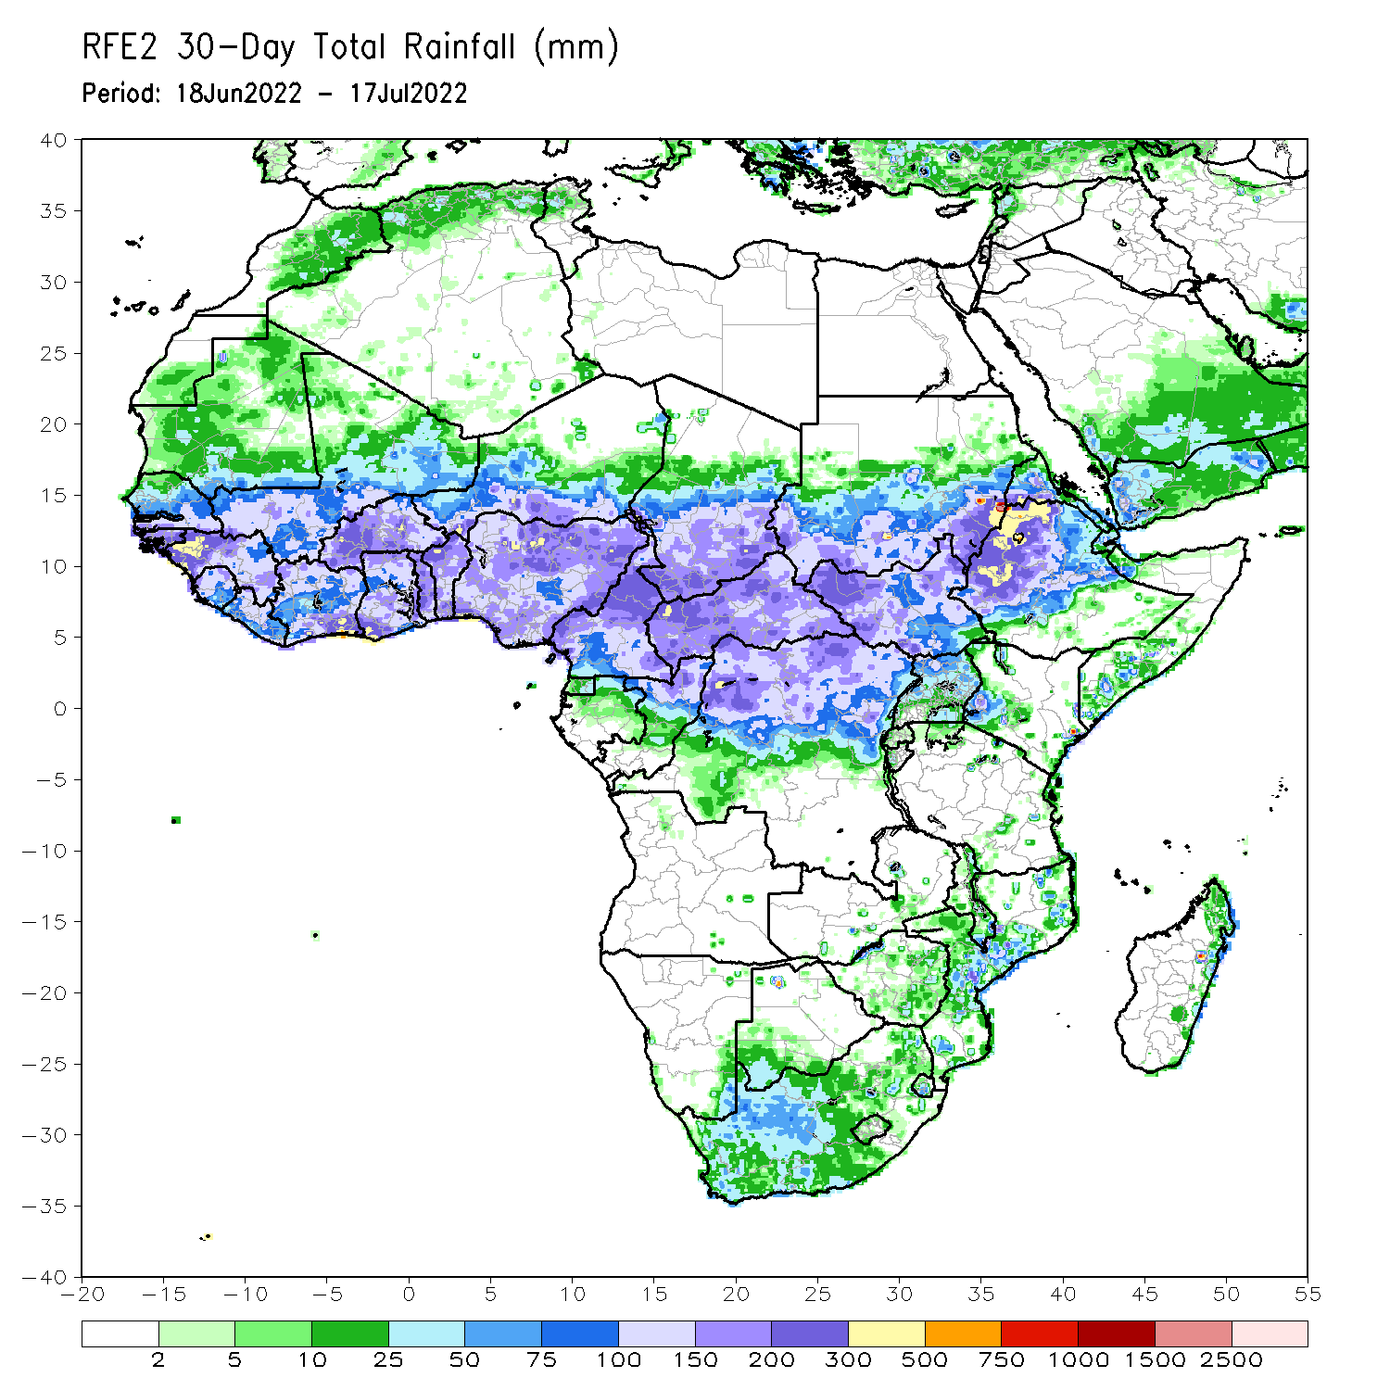
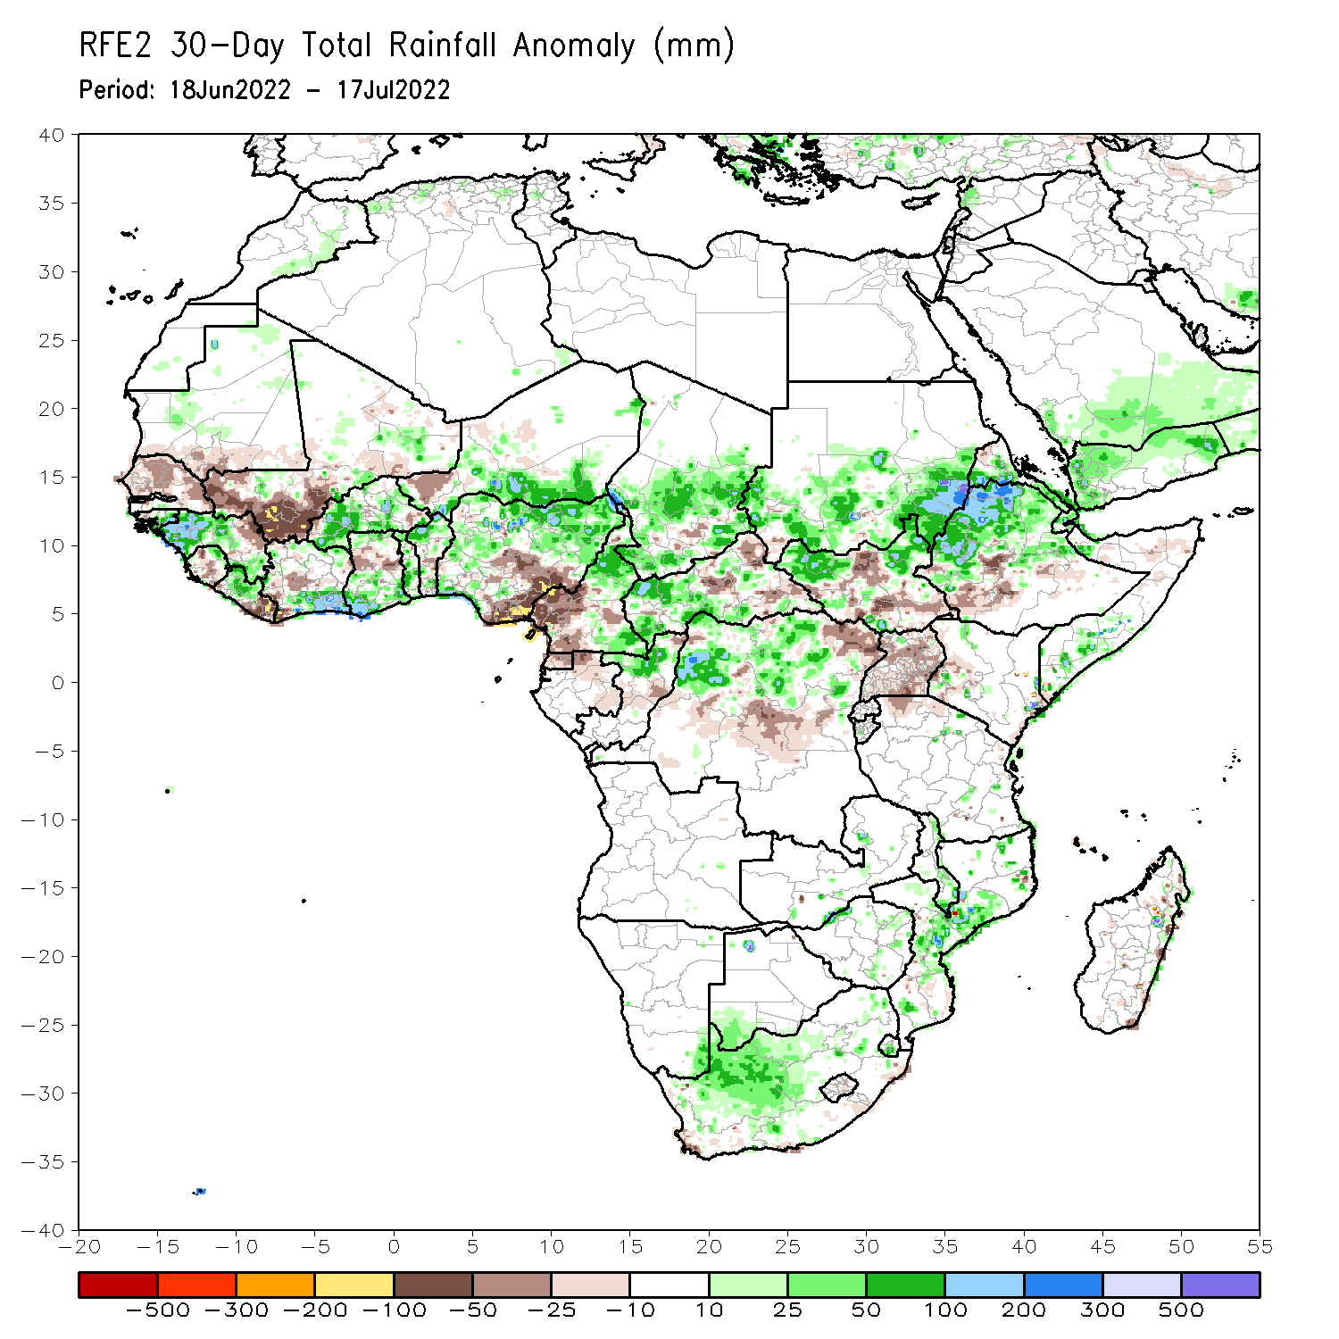
Rainfall Patterns: Last 30 Days
During the past 30 days, in East Africa, above-average rainfall was observed over southern and eastern Sudan, parts of western and eastern South Sudan, and western, central and northern Ethiopia. Rainfall was below-average over the central and southern parts of South Sudan, Uganda, and parts of western Kenya and pockets of southern Ethiopia. In Central Africa, rainfall was above-average over parts of northern and eastern Cameroon, northern Congo, much of CAR and pockets of northern DRC. Rainfall was below-average over Equatorial Guinea, southern Cameroon, and pockets of DRC. In Southern Africa, above-average rainfall was observed over the western portion of South Africa, and pockets of Mozambique. In West Africa, rainfall was above-average over southern Senegal, western Guinea, western Liberia, western Burkina Faso, parts of Cote d’Ivoire, Ghana, Togo, Benin, parts of southern Niger and several portions of Nigeria. In contrast, central and northern Senegal, parts of central and southern Mali, southwestern Cote D’ivoire, western Niger and southeastern Nigeria received below-average rainfall.
Notes:
5

Slide 6
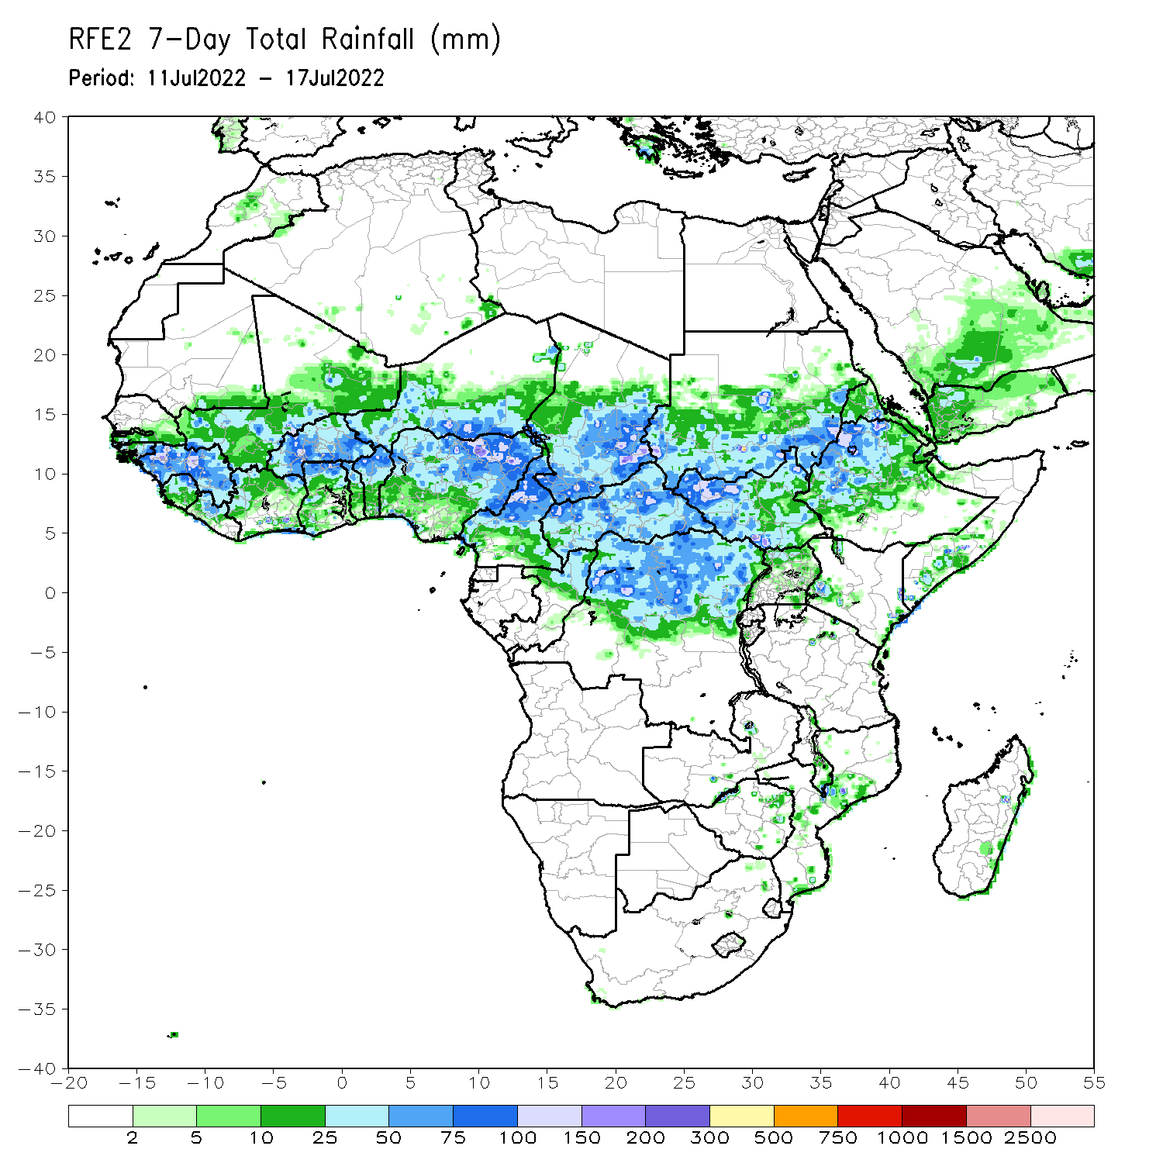
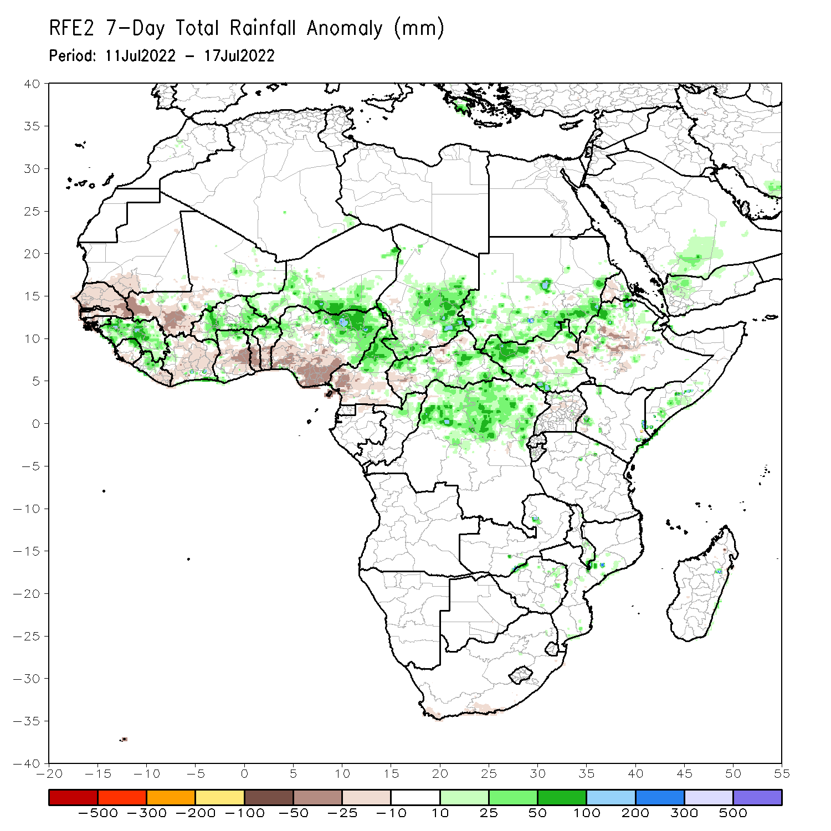
Rainfall Patterns: Last 7 Days
During the past 7 days, in East Africa, rainfall was above-average over parts of of southern and eastern Sudan, western South Sudan and pockets of northwestern Ethiopia. Below-average rainfall was observed over pockets of South Sudan and Ethiopia. In Central Africa, rainfall was above-average over northern Cameroon, Chad, central and eastern CAR, and northern DRC. Below-average rainfall was observed over southern Cameroon, Equatorial Guinea, western CAR, and parts of Congo. In West Africa, above-average rainfall was observed over parts of Guinea, Burkina Faso, and northern Nigeria. Meanwhile, rainfall was below-average over parts of Senegal, southern Mali, eastern Cote d’Ivoire, Ghana, Togo, Benin and southern Nigeria.

Slide 7
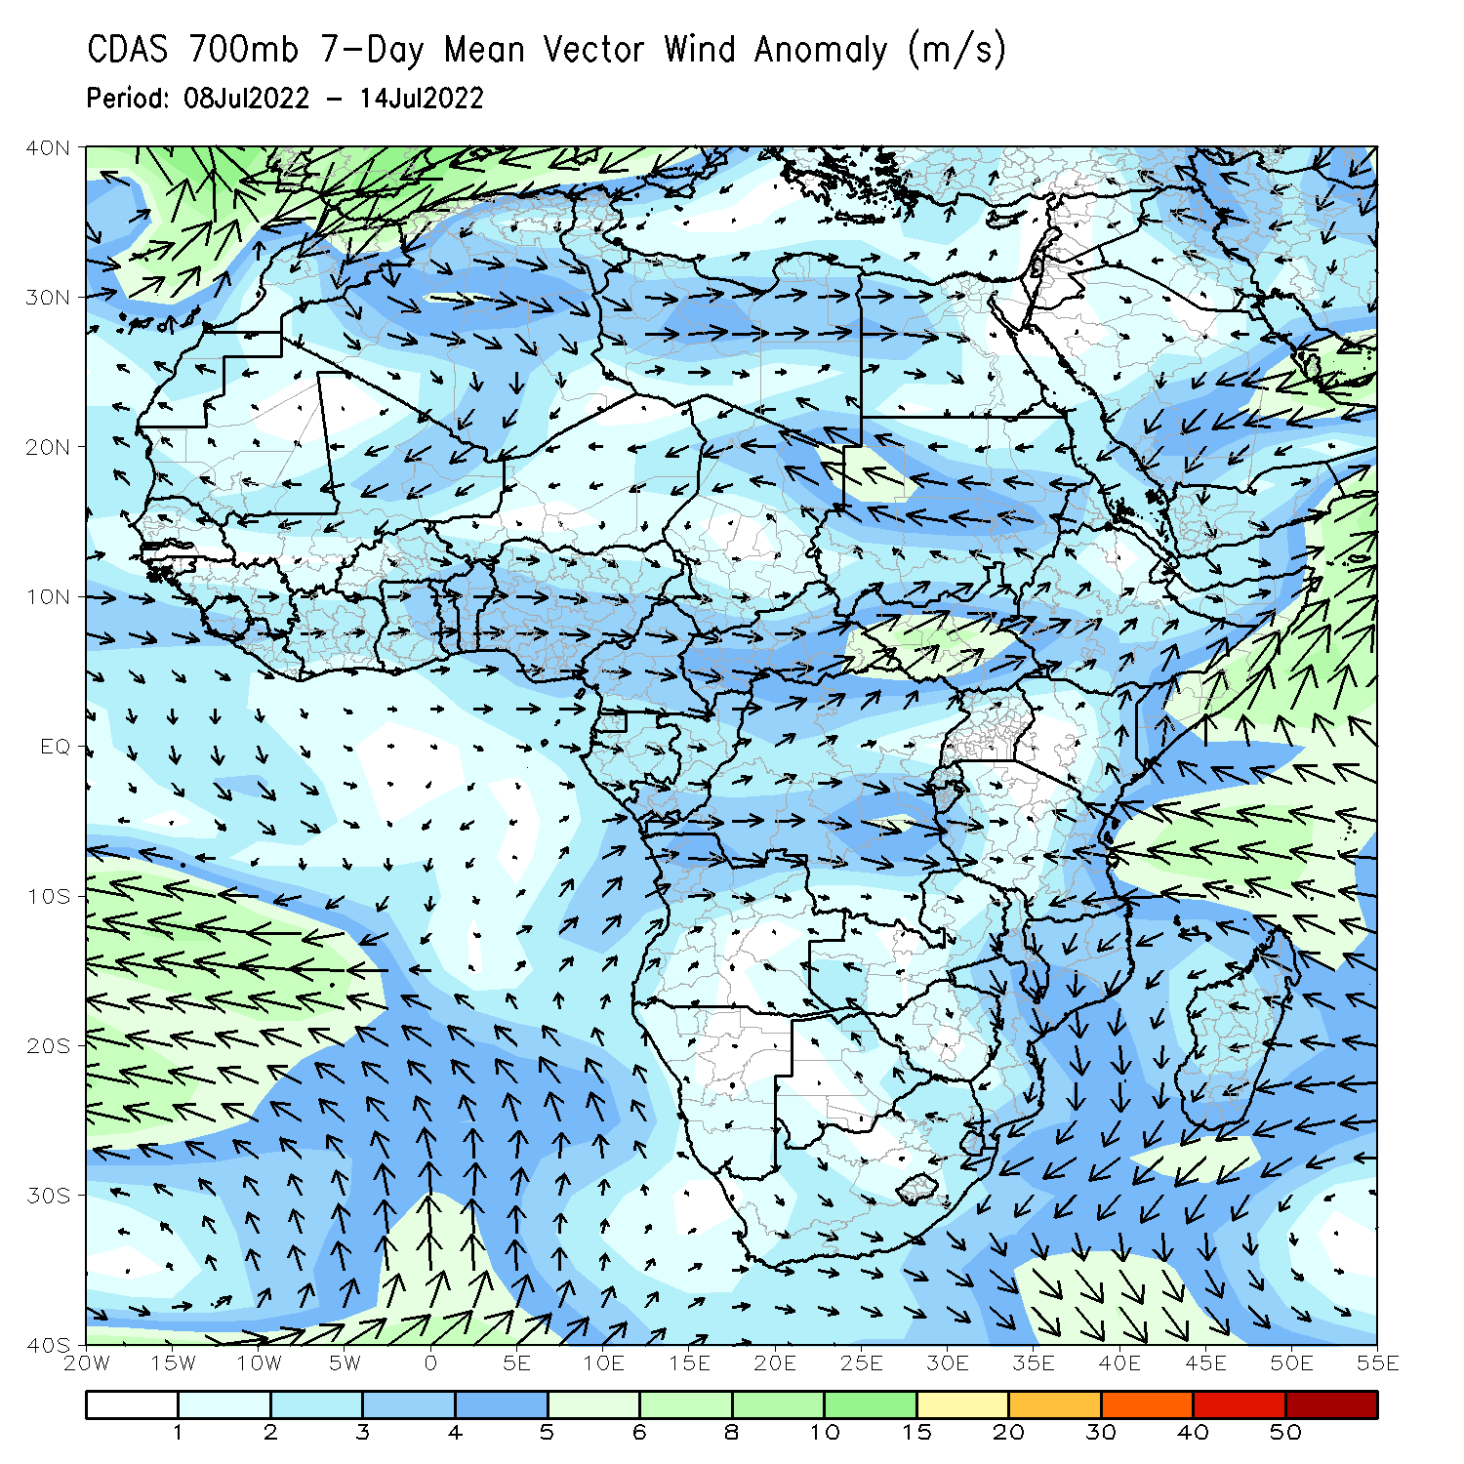
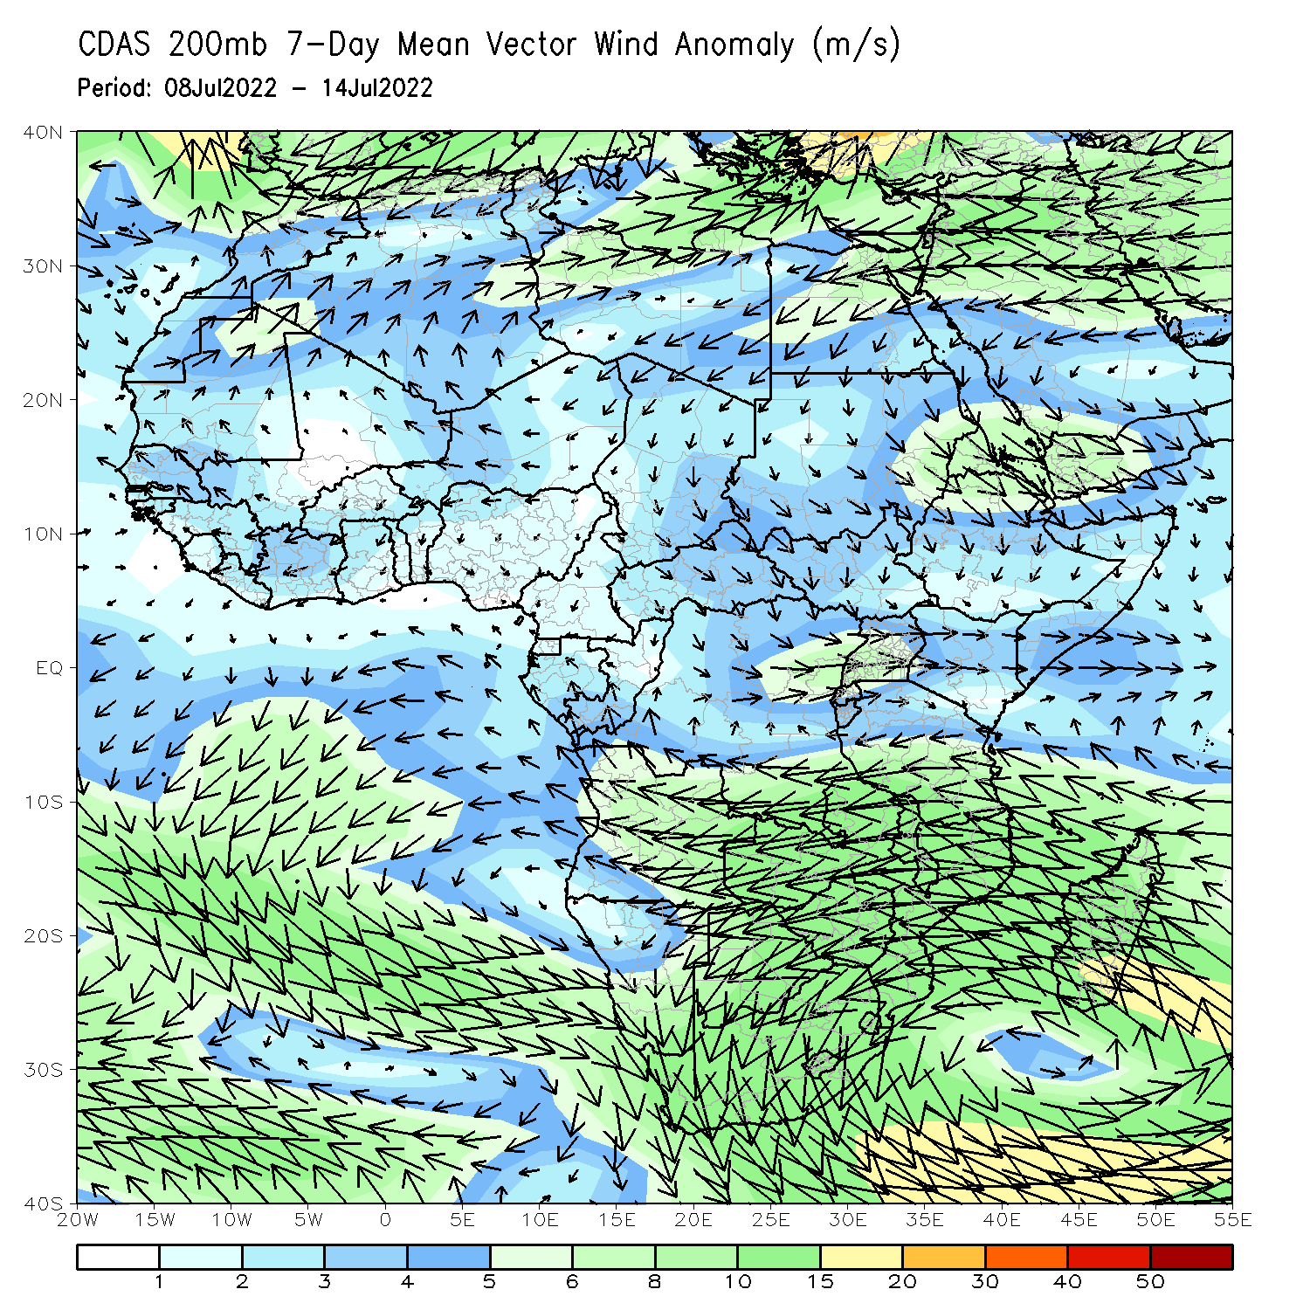
Atmospheric Circulation: Last 7 Days
At 700-hPa level (left panel), anomalous cyclonic shear was observed across Central Africa.

Slide 8
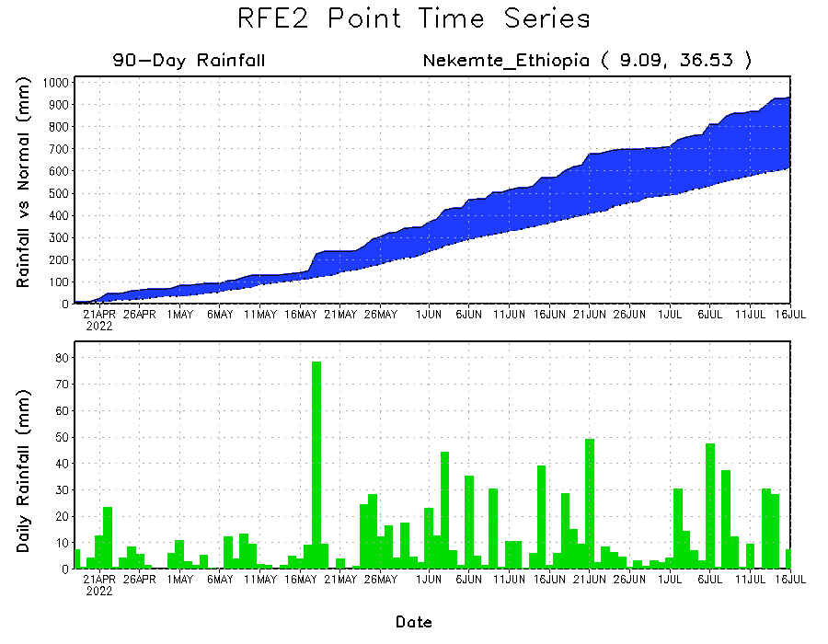
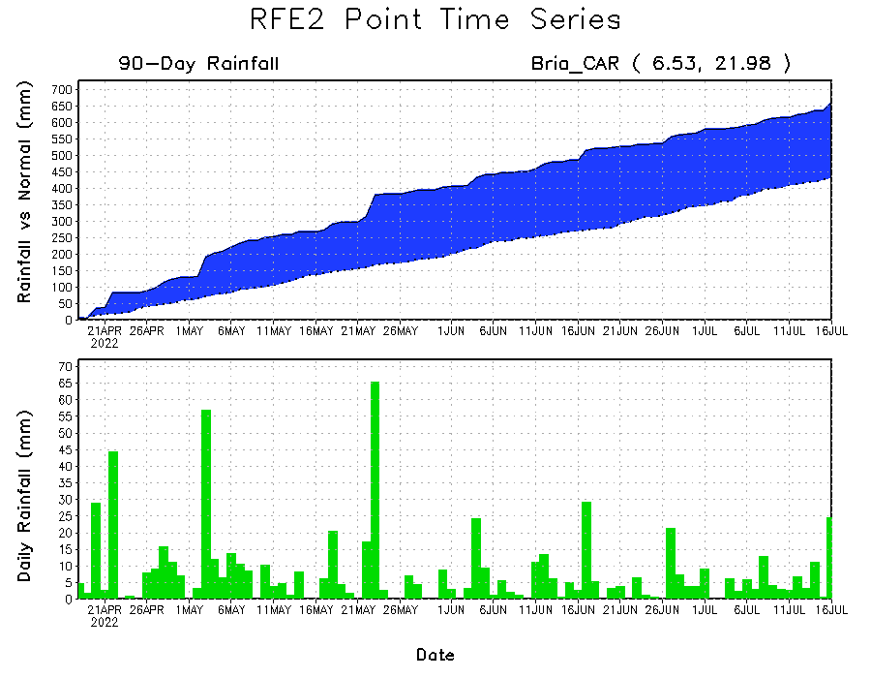
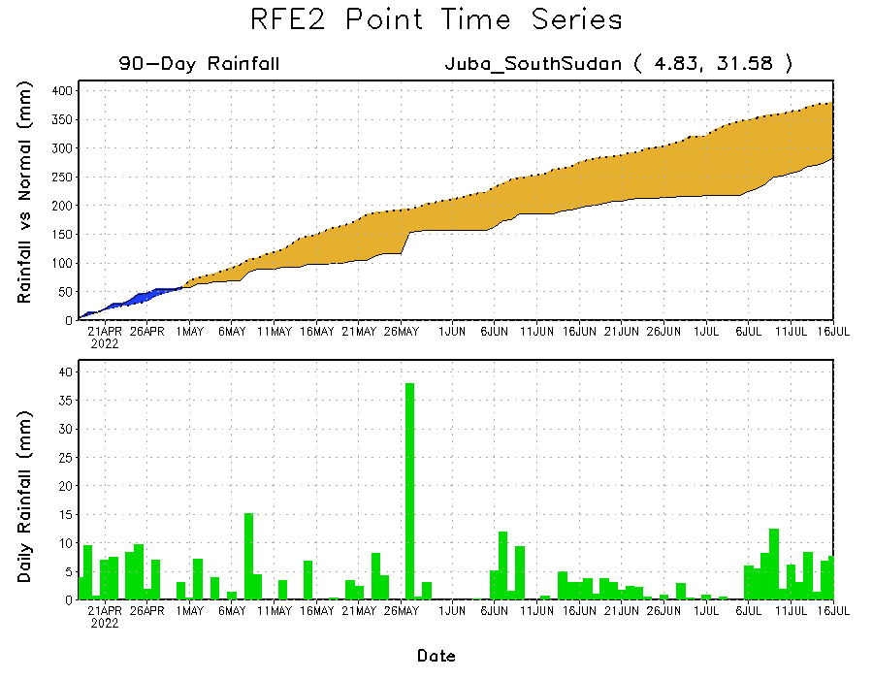
Rainfall Evolution
Daily evolution of rainfall over the last 90 days at selected locations shows increasing moisture deficits over parts of South Sudan (bottom right). Consistent heavy rains have kept significant moisture surpluses over parts of Central African Republic (bottom left) and western Ethiopia (top right).

Slide 9
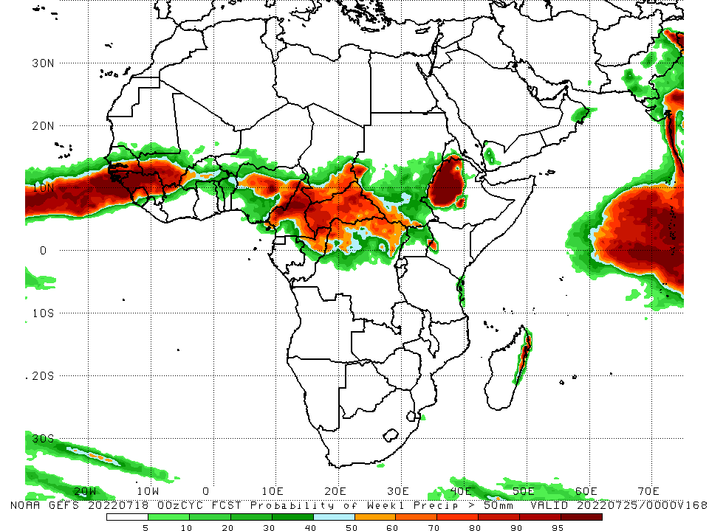
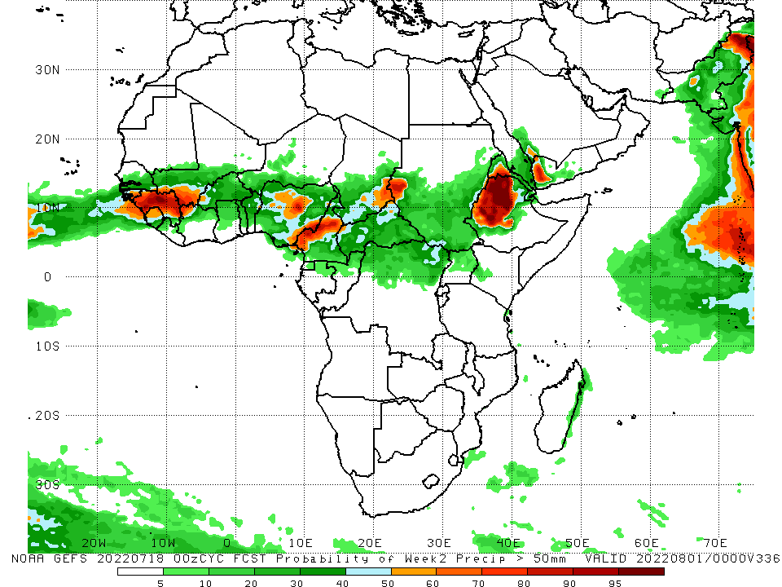
NCEP GEFS Model Forecasts Non-Bias Corrected Probability of precipitation exceedance
Week-1, Valid: 19 - 25 July, 2022
Week-2, Valid: 26 - 31 July, 2022
For week-1 (left panel) and week-2 (right panel) the NCEP GEFS indicates a moderate to high chance (over 70%) for rainfall to exceed 50 mm over Guinea, Sierra Leone, Liberia, southwestern Mali, pockets of Nigeria, Cameroon, CAR, Chad, and western Ethiopia.
Notes:
9

Slide 10
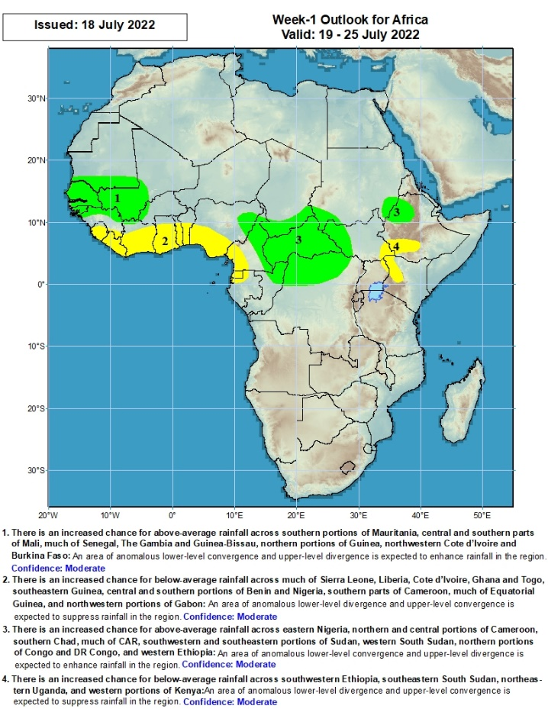
Week-1 Precipitation Outlooks
19 - 25 July, 2022
There is an increased chance for above-average rainfall across southern portions of Mauritania, central and southern parts of Mali, much of Senegal, The Gambia and Guinea-Bissau, northern portions of Guinea, northwestern Cote d’Ivoire and Burkina Faso: An area of anomalous lower-level convergence and upper-level divergence is expected to enhance rainfall in the region. Confidence: Moderate
There is an increased chance for below-average rainfall across much of Sierra Leone, Liberia, Cote d’Ivoire, Ghana and Togo, southeastern Guinea, central and southern portions of Benin and Nigeria, southern parts of Cameroon, much of Equatorial Guinea, and northwestern portions of Gabon: An area of anomalous lower-level divergence and upper-level convergence is expected to suppress rainfall in the region. Confidence: Moderate
There is an increased chance for above-average rainfall across eastern Nigeria, northern and central portions of Cameroon, southern Chad, much of CAR, southwestern and southeastern portions of Sudan, western South Sudan, northern portions of Congo and DR Congo, and western Ethiopia: An area of anomalous lower-level convergence and upper-level divergence is expected to enhance rainfall in the region. Confidence: Moderate
There is an increased chance for below-average rainfall across southwestern Ethiopia, southeastern South Sudan, northeastern Uganda, and western portions of Kenya: An area of anomalous lower-level divergence and upper-level convergence is expected to suppress rainfall in the region. Confidence: Moderate
Notes:
10

Slide 11
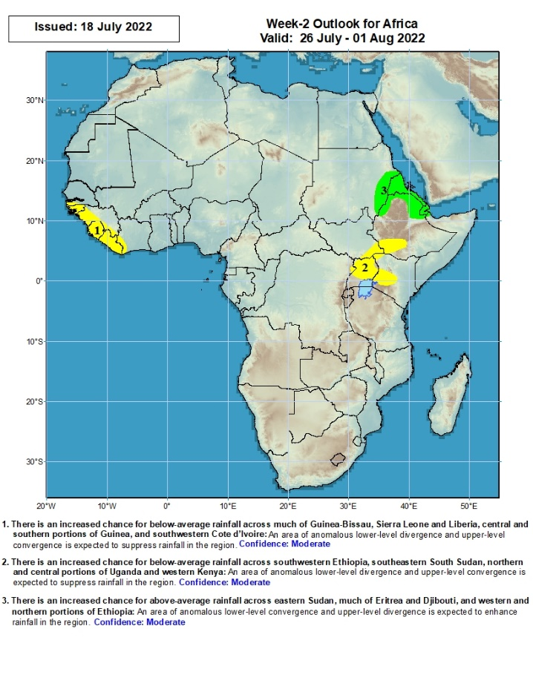
Week-2 Precipitation Outlooks
26 - 31 July, 2022
There is an increased chance for below-average rainfall across much of Guinea-Bissau, Sierra Leone and Liberia, central and southern portions of Guinea, and southwestern Cote d’Ivoire: An area of anomalous lower-level divergence and upper-level convergence is expected to suppress rainfall in the region. Confidence: Moderate
There is an increased chance for below-average rainfall across southwestern Ethiopia, southeastern South Sudan, northern and central portions of Uganda and western Kenya: An area of anomalous lower-level divergence and upper-level convergence is expected to suppress rainfall in the region. Confidence: Moderate
There is an increased chance for above-average rainfall across eastern Sudan, much of Eritrea and Djibouti, and western and northern portions of Ethiopia: An area of anomalous lower-level convergence and upper-level divergence is expected to enhance rainfall in the region. Confidence: Moderate
Notes:
11

Slide 12
Summary
During the past 30 days, in East Africa, above-average rainfall was observed over southern and eastern Sudan, parts of western and eastern South Sudan, and western, central and northern Ethiopia. Rainfall was below-average over the central and southern parts of South Sudan, Uganda, and parts of western Kenya and pockets of southern Ethiopia. In Central Africa, rainfall was above-average over parts of northern and eastern Cameroon, northern Congo, much of CAR and pockets of northern DRC. Rainfall was below-average over Equatorial Guinea, southern Cameroon, and pockets of DRC. In Southern Africa, above-average rainfall was observed over the western portion of South Africa, and pockets of Mozambique. In West Africa, rainfall was above-average over southern Senegal, western Guinea, western Liberia, western Burkina Faso, parts of Cote d’Ivoire, Ghana, Togo, Benin, parts of southern Niger and several portions of Nigeria. In contrast, central and northern Senegal, parts of central and southern Mali, southwestern Cote D’ivoire, western Niger and southeastern Nigeria received below-average rainfall.
During the past 7 days, in East Africa, rainfall was above-average over parts of of southern and eastern Sudan, western South Sudan and pockets of northwestern Ethiopia. Below-average rainfall was observed over pockets of South Sudan and Ethiopia. In Central Africa, rainfall was above-average over northern Cameroon, Chad, central and eastern CAR, and northern DRC. Below-average rainfall was observed over southern Cameroon, Equatorial Guinea, western CAR, and parts of Congo. In West Africa, above-average rainfall was observed over parts of Guinea, Burkina Faso, and northern Nigeria. Meanwhile, rainfall was below-average over parts of Senegal, southern Mali, eastern Cote d’Ivoire, Ghana, Togo, Benin and southern Nigeria.
Week-1 outlooks call for an increased chance for above-average rainfall over the far western West Africa, and parts of Central Africa, eastern Sudan and western Ethiopia. In contrast, the outlooks call for an increased chance for below-average rainfall along the Gulf of Guinea coast. For week-2, the outlooks call for an increased chance for below-average rainfall over the far western part of the Gulf of Guinea coast, and the Lake Victoria region, while above-average rainfall is likely over eastern Sudan, Eritrea and northern Ethiopia.

