Slide 1
The African Monsoon Recent Evolution and Current Status Include Week-1 and Week-2 Outlooks
Update prepared by
5 July 2022
For more information, visit:
http://www.cpc.ncep.noaa.gov/products/Global_Monsoons/African_Monsoons/precip_monitoring.shtml

Slide 2
Outline
Highlights
Recent Evolution and Current Conditions
NCEP GEFS Forecasts
Summary

Slide 3
Highlights: Last 7 Days
During the past 7 days, in East Africa, rainfall was above-average over parts of western Ethiopia, pockets of southern and eastern Sudan and pockets of eastern South Sudan, while below-average rainfall was observed over the southern portion of South Sudan. In Central Africa, rainfall was below-average over pockets of Cameroon, western CAR, and northwestern DRC. In West Africa, above-average rainfall was observed over parts of Guinea, pockets of Mali, southern Cote d’Ivoire, southern Ghana, and northern Nigeria. Meanwhile, rainfall was below-average over pockets of Senegal, Mali, Liberia, Cote d’Ivoire. Burkina Faso, and southern Nigeria.
Week-1 and week-2 outlooks call for an increased chance for above-average rainfall along the Gulf of Guinea coast, and portions of Ethiopia. In contrast, there is an increased chance for below-average rainfall over parts of Central Africa, and in the Lake Victoria region.

Slide 4
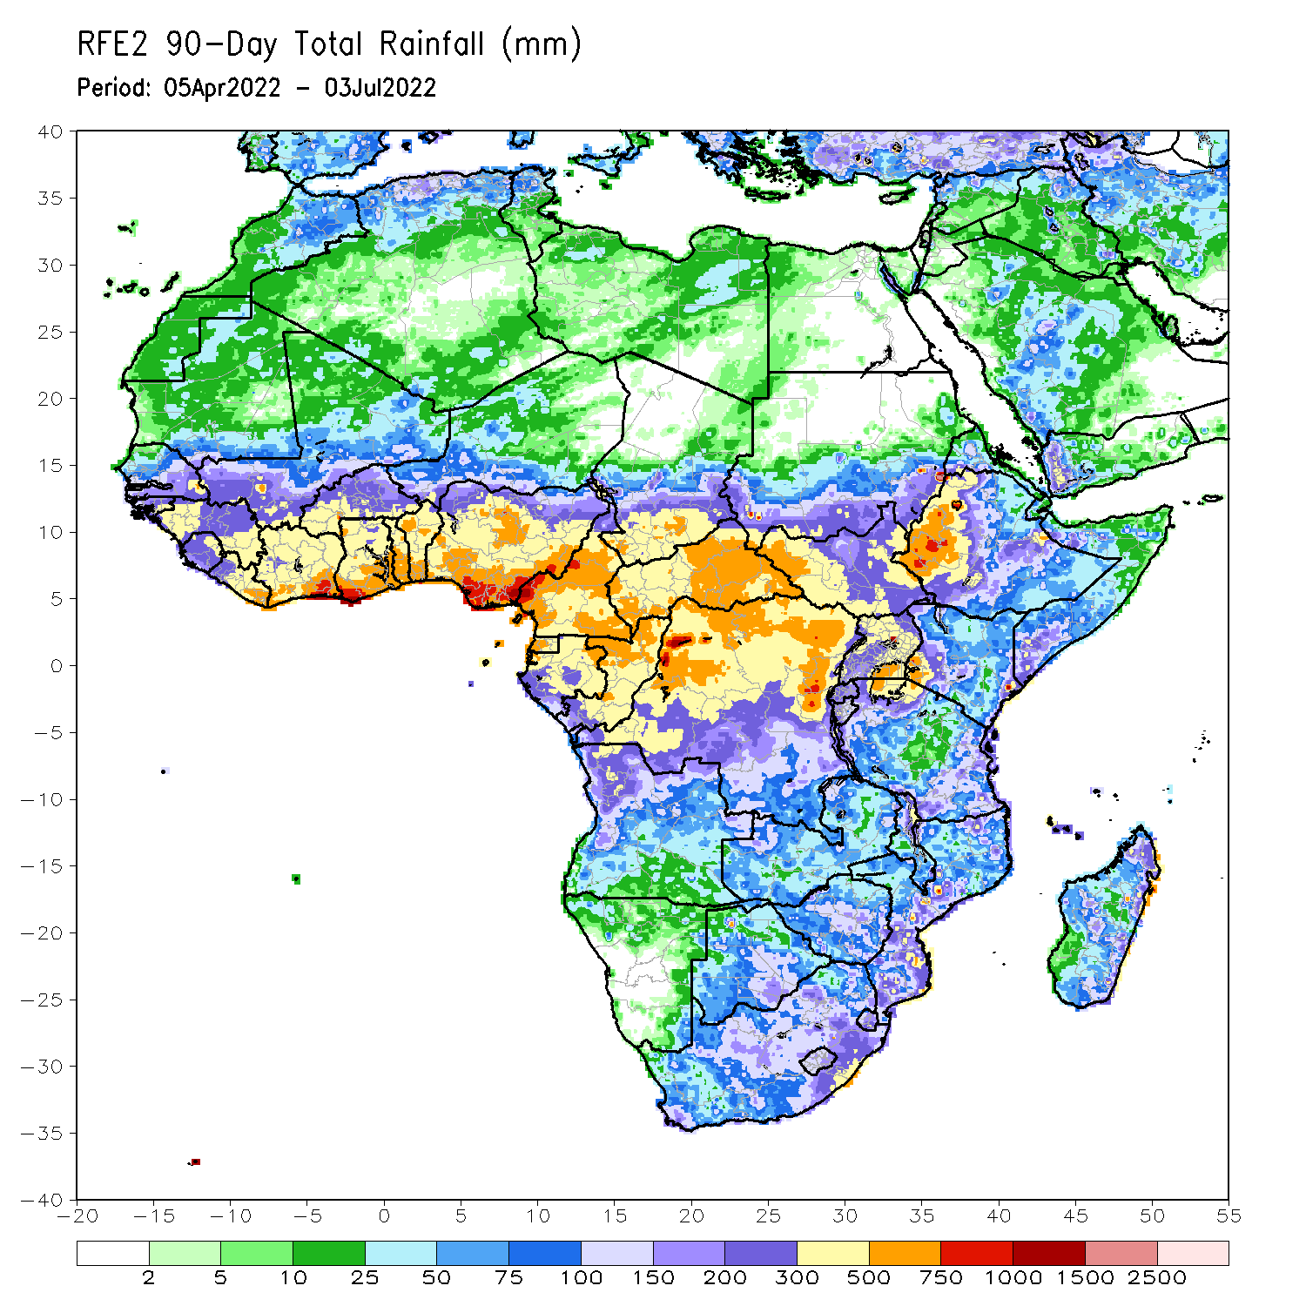
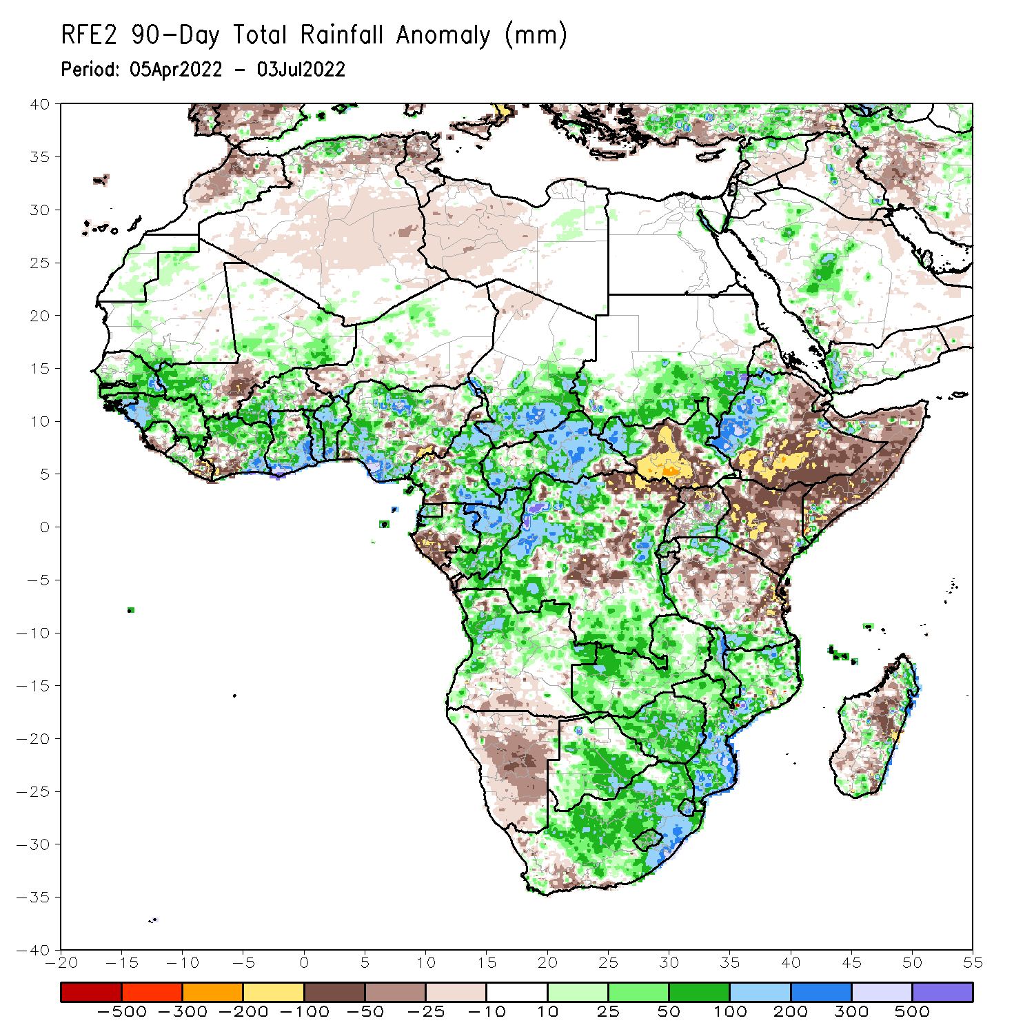
Rainfall Patterns: Last 90 Days
Over the past 90 days, in East Africa, above-average rainfall was observed over southern and eastern Sudan, the western and eastern portions of South Sudan, western Ethiopia, parts of Uganda, and parts of southern and northern Tanzania. Rainfall was below-average over southern and eastern Ethiopia, central and southern South Sudan, Kenya, Somalia, northern Uganda, as well as many parts of Tanzania. In southern Africa, above-average rainfall was observed over portions of Angola, much of Botswana, Zambia, Malawi, much of Mozambique, parts of Madagascar and much of South Africa. Below-average rainfall was observed over parts of southern Angola, much of Namibia, western South Africa, and pockets of Madagascar. In Central Africa, rainfall was above-average over much of CAR, central and northern Gabon, Congo, and over many parts of DRC. Rainfall was below-average over pockets of central and southwestern Cameroon, parts of central and eastern DRC, and southern Gabon. In West Africa, rainfall was above-average over much of the Gulf of Guinea region, as well as Senegal and the Gambia, while below-average rainfall was observed over pockets of central Mali, Cote d’Ivoire and Nigeria.
Notes:
4

Slide 5
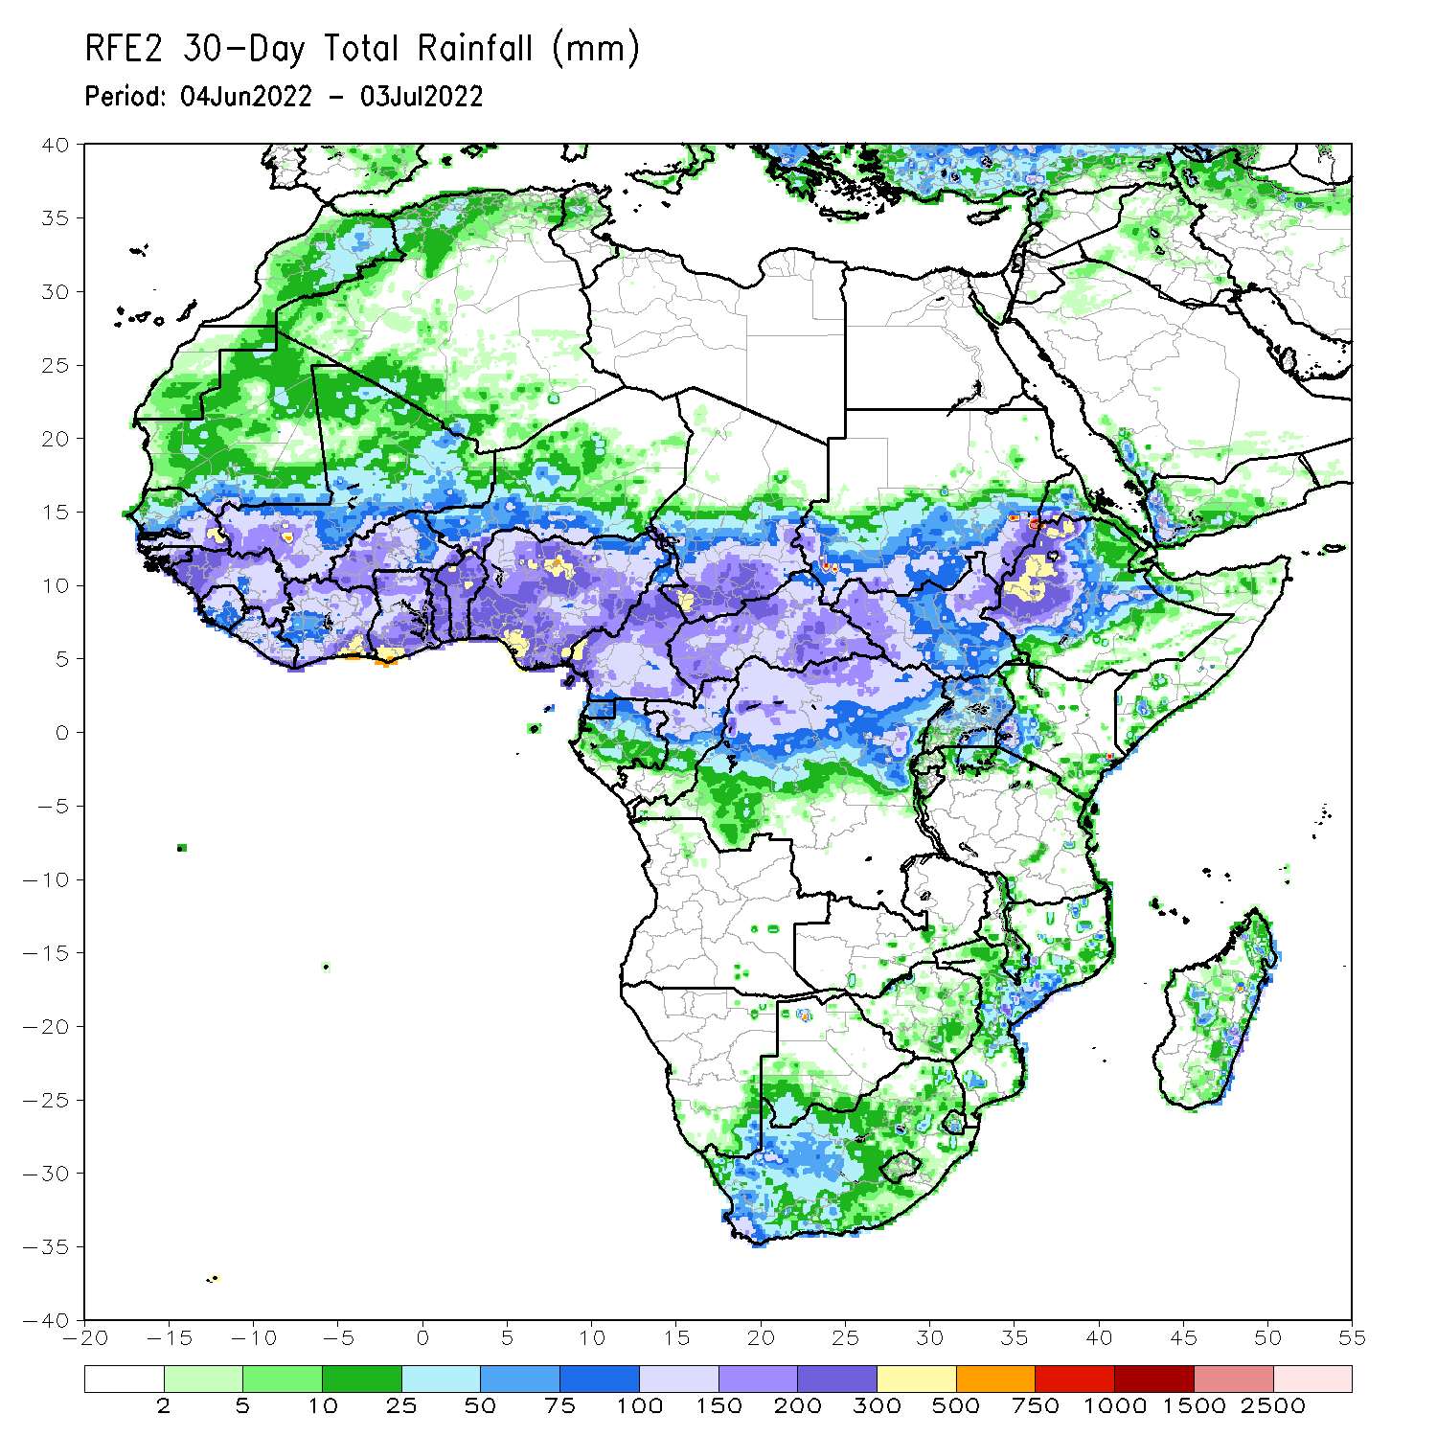
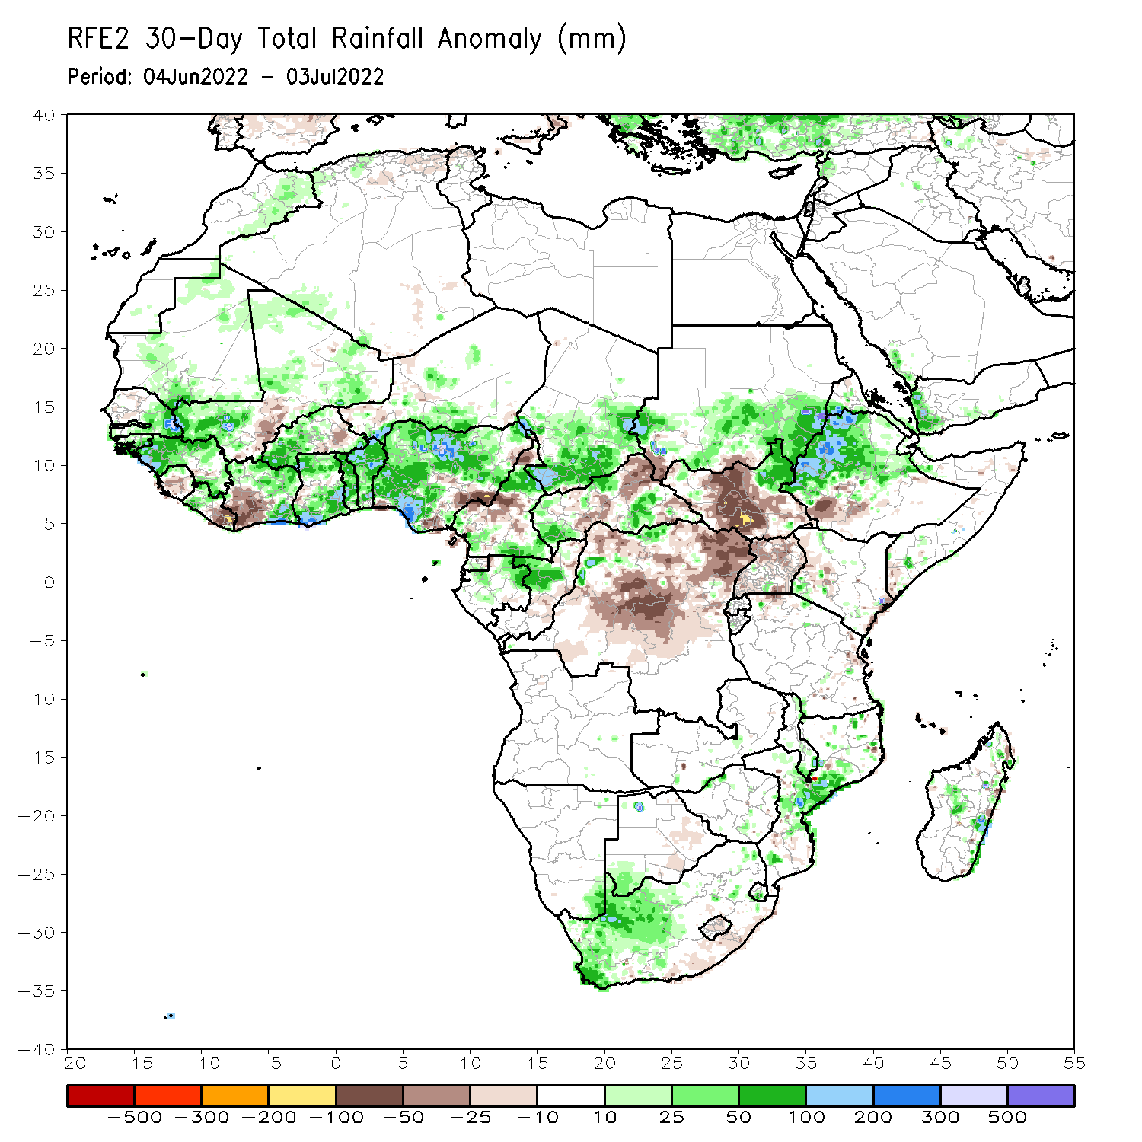
Rainfall Patterns: Last 30 Days
During the past 30 days, in East Africa, above-average rainfall was observed over southern and eastern Sudan, western and eastern South Sudan, and western and central Ethiopia. Rainfall was below-average over the central and southern parts of South Sudan. In Central Africa, rainfall was above-average over pockets of Cameroon, northern Gabon, northern Congo, pockets of CAR and parts of northern. Rainfall was below-average over parts of CAR and DRC. In Southern Africa, above-average rainfall was observed over the western portion of South Africa, and pockets of Mozambique and Madagascar. In West Africa, rainfall was above-average over eastern Senegal, Guinea, western Liberia, western Burkina Faso, Cote d’Ivoire, Ghana, Togo and Benin and several portions of Nigeria. In contrast, parts of central Mali, southwestern Cote D’ivoire, and many parts of Nigeria received below-average rainfall.
Notes:
5

Slide 6
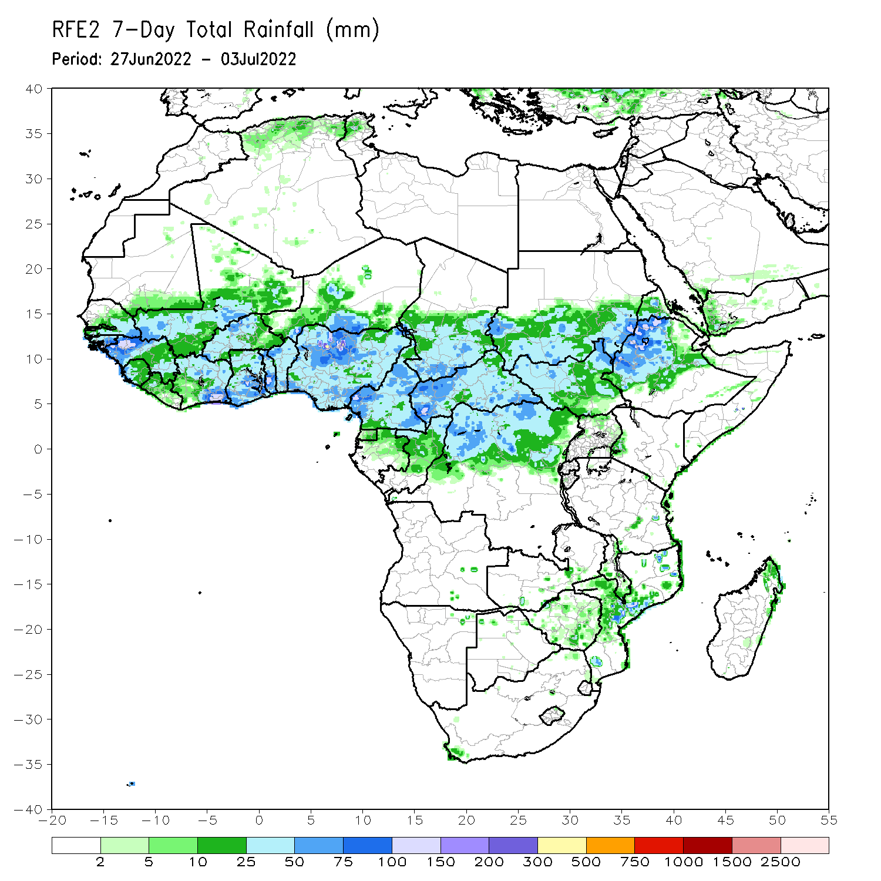
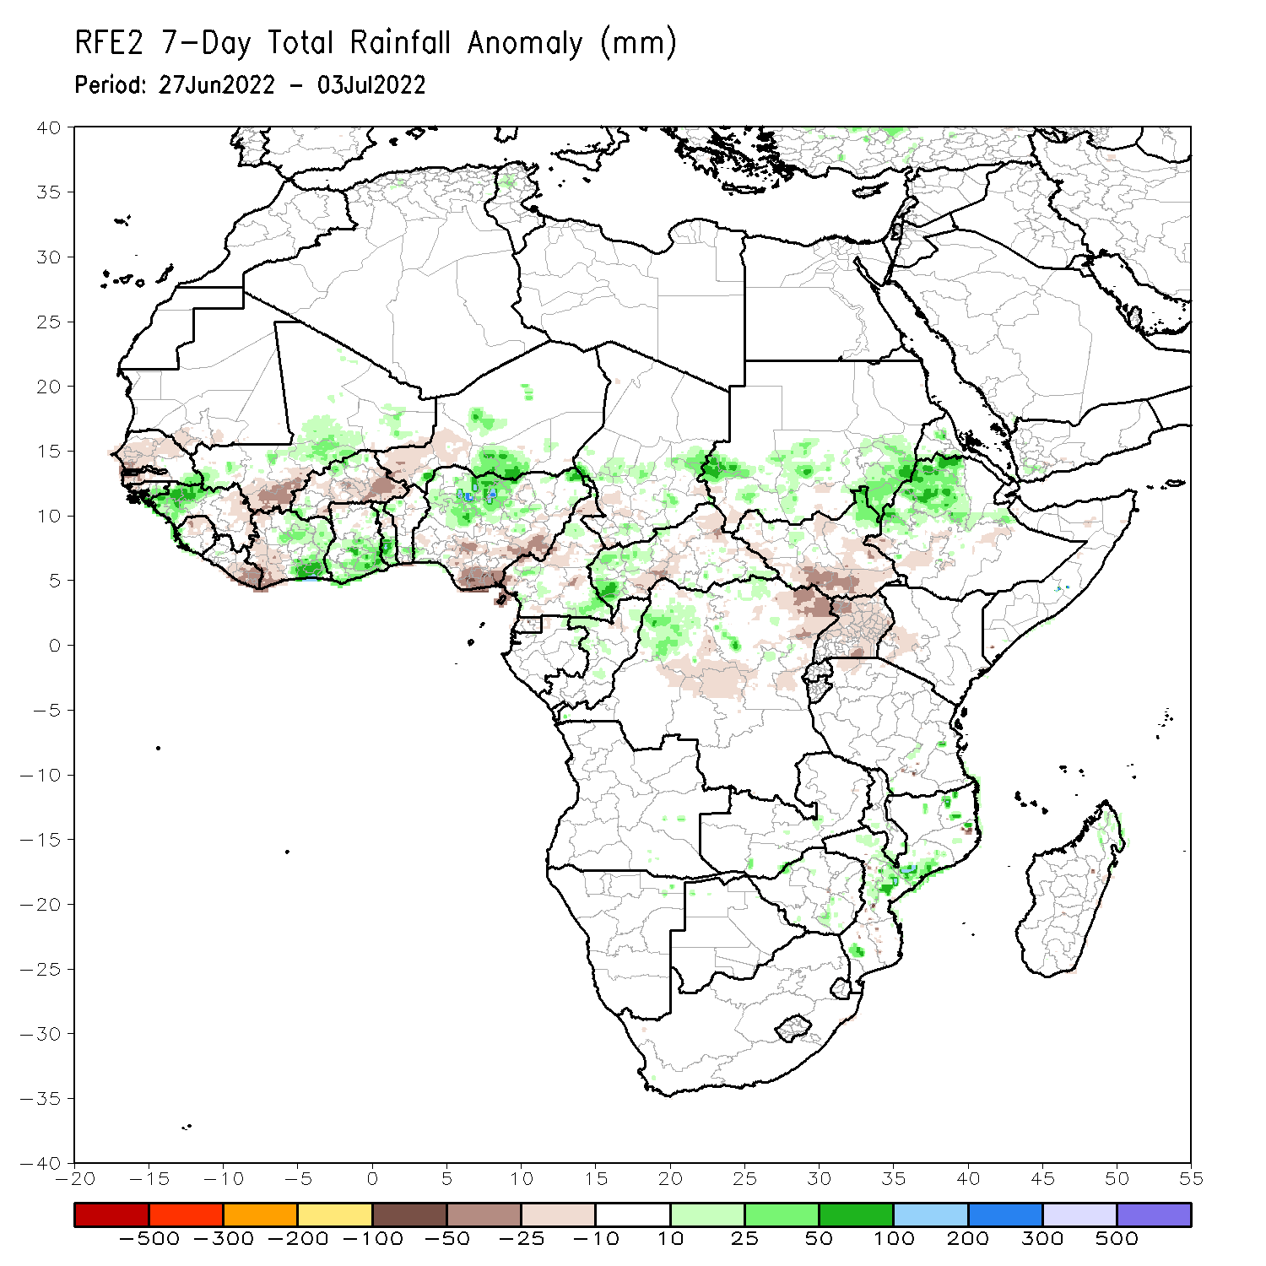
Rainfall Patterns: Last 7 Days
During the past 7 days, in East Africa, rainfall was above-average over parts of western Ethiopia, pockets of southern and eastern Sudan and pockets of eastern South Sudan, while below-average rainfall was observed over the southern portion of South Sudan. In Central Africa, rainfall was below-average over pockets of Cameroon, western CAR, and northwestern DRC. In West Africa, above-average rainfall was observed over parts of Guinea, pockets of Mali, southern Cote D’Ivoire, southern Ghana, and northern Nigeria. Meanwhile, rainfall was below-average over pockets of Senegal, Mali, Liberia, Cote d’Ivoire. Burkina Faso, and southern Nigeria.

Slide 7
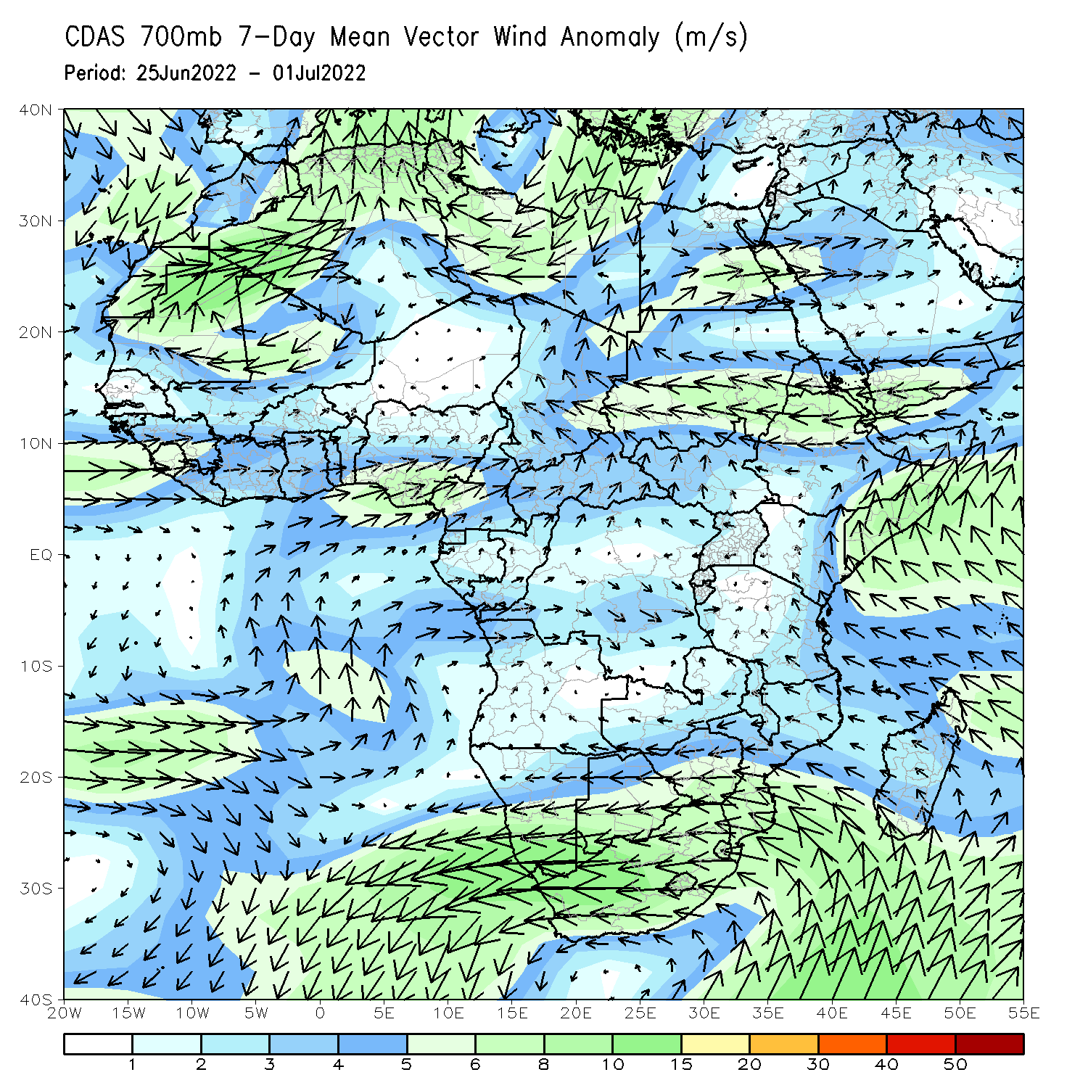
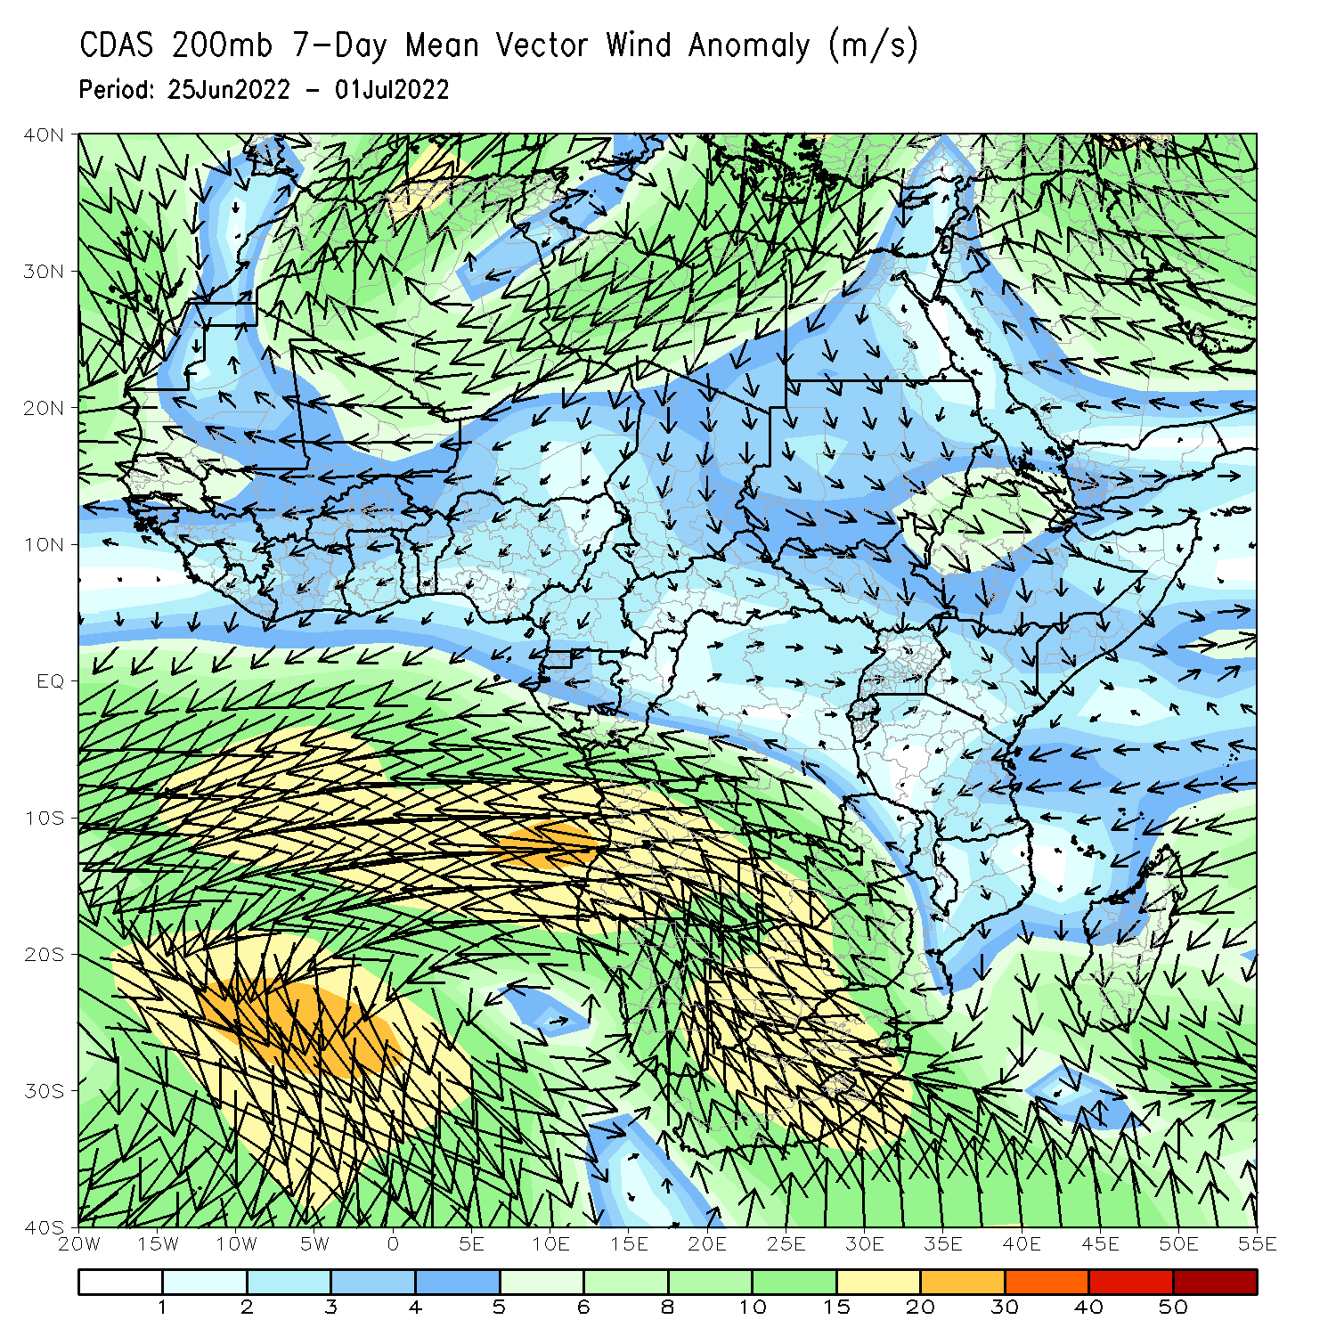
Atmospheric Circulation: Last 7 Days
At 700-hPa level (left panel), anomalous southwesterly to westerly flow was observed along the Gulf of Guinea coast.

Slide 8
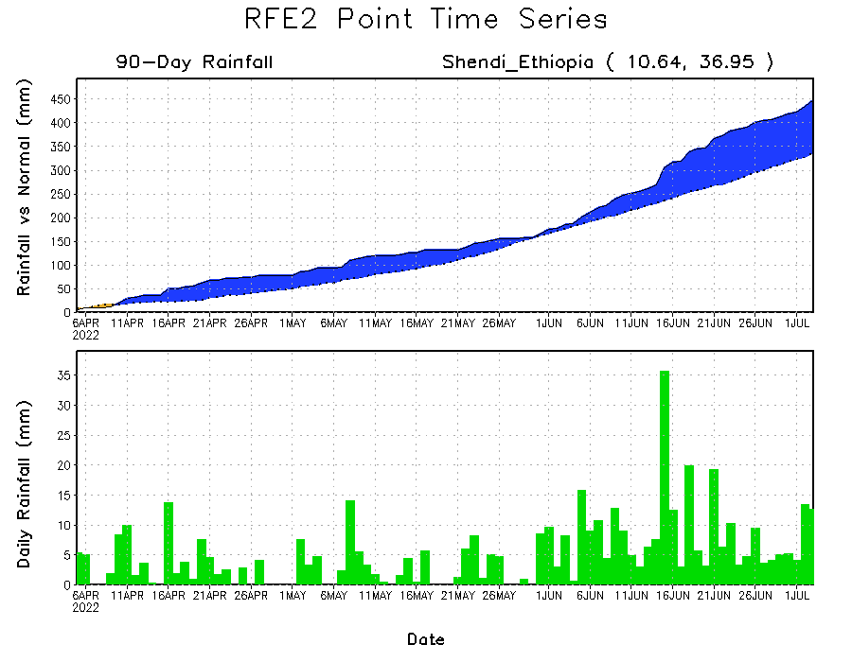
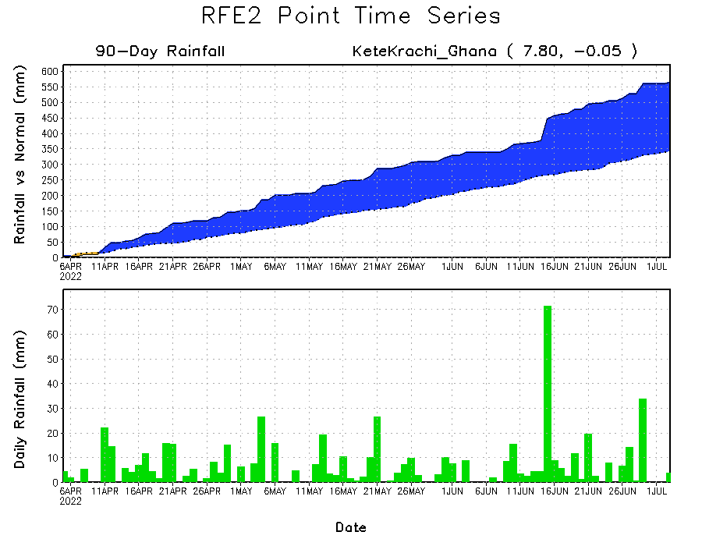
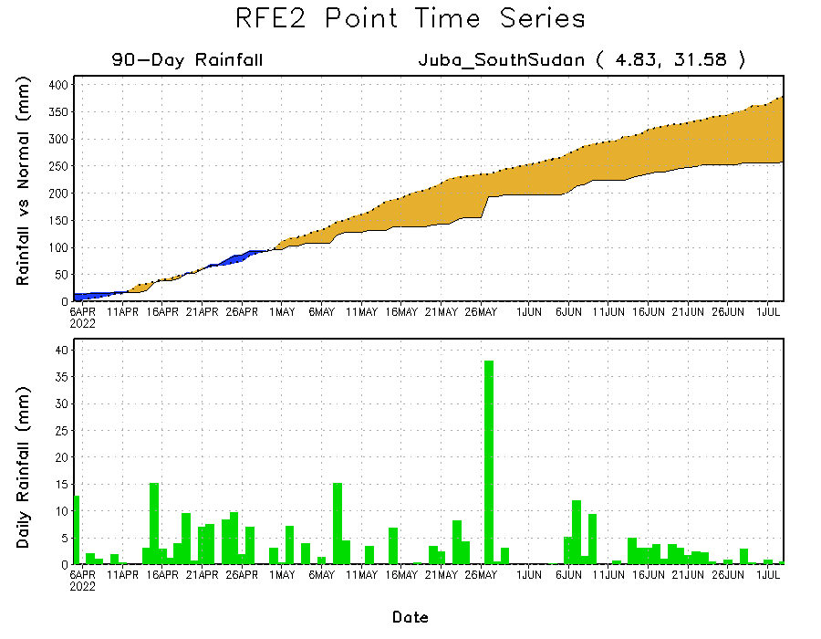
Rainfall Evolution
Daily evolution of rainfall over the last 90 days at selected locations shows increasing moisture deficits over parts of South Sudan (bottom right). Consistent heavy rains have kept significant moisture surpluses in place in southern Ghana (bottom left) and western Ethiopia (top right).

Slide 9
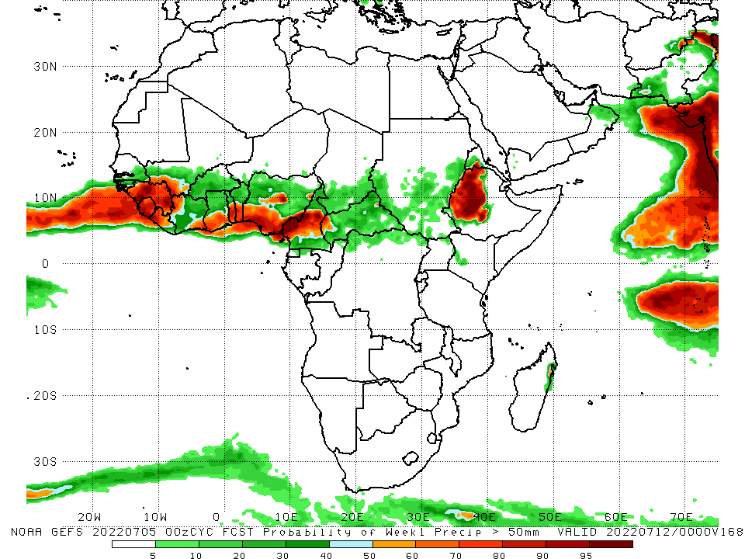
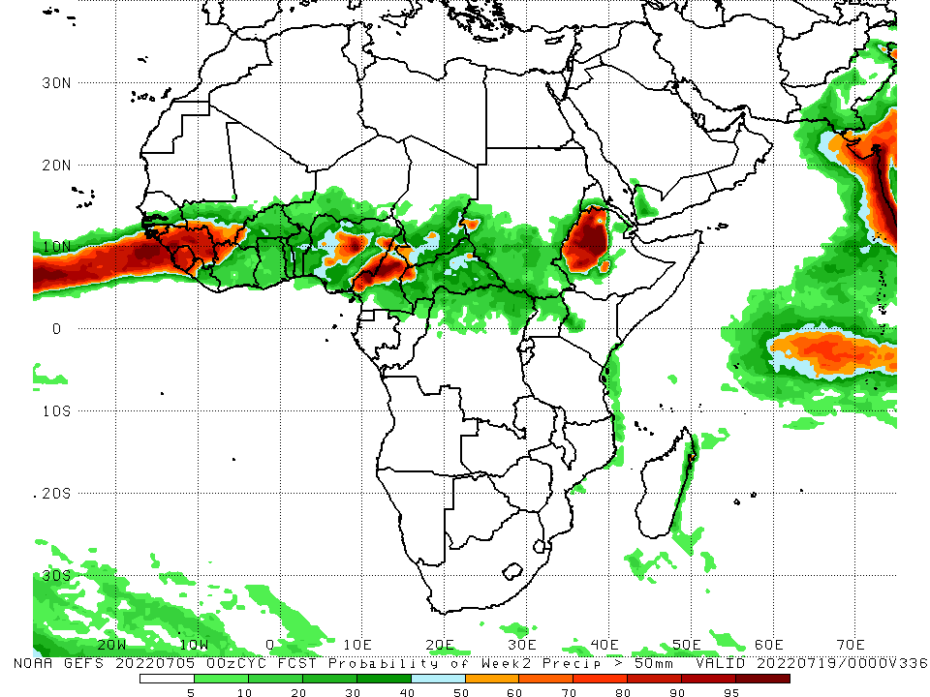
NCEP GEFS Model Forecasts Non-Bias Corrected Probability of precipitation exceedance
Week-1, Valid: 6 - 12 July, 2022
Week-2, Valid: 13 - 19 July, 2022
For week-1 (left panel) and week-2 (right panel) the NCEP GEFS indicates a moderate to high chance (over 70%) for rainfall to exceed 50 mm over Guinea, Sierra Leone, Liberia, pockets of Nigeria, Cameroon and western Ethiopia.
Notes:
9

Slide 10
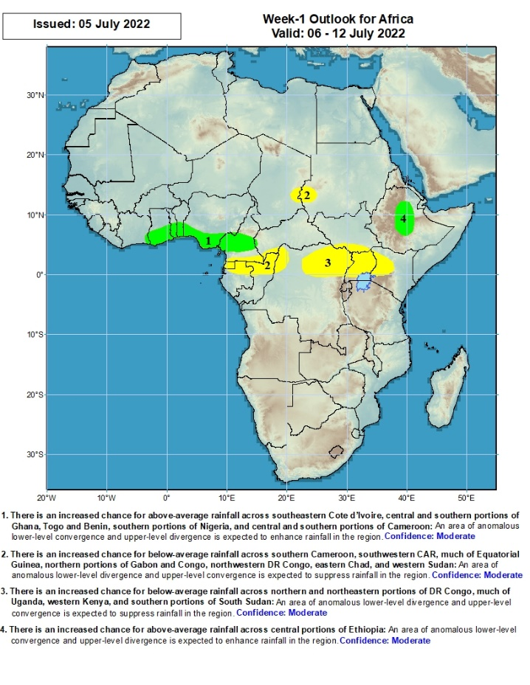
Week-1 Precipitation Outlooks
6 – 12 July, 2022
There is an increased chance for above-average rainfall across southeastern Cote d’Ivoire, central and southern portions of Ghana, Togo and Benin, southern portions of Nigeria, and central and southern portions of Cameroon: An area of anomalous lower-level convergence and upper-level divergence is expected to enhance rainfall in the region. Confidence: Moderate
There is an increased chance for below-average rainfall across southern Cameroon, southwestern CAR, much of Equatorial Guinea, northern portions of Gabon and Congo, northwestern DR Congo, eastern Chad, and western Sudan: An area of anomalous lower-level divergence and upper-level convergence is expected to suppress rainfall in the region. Confidence: Moderate
There is an increased chance for below-average rainfall across northern and northeastern portions of DR Congo, much of Uganda, western Kenya, and southern portions of South Sudan: An area of anomalous lower-level divergence and upper-level convergence is expected to suppress rainfall in the region. Confidence: Moderate
There is an increased chance for above-average rainfall across central portions of Ethiopia: An area of anomalous lower-level convergence and upper-level divergence is expected to enhance rainfall in the region. Confidence: Moderate
Notes:
10

Slide 11
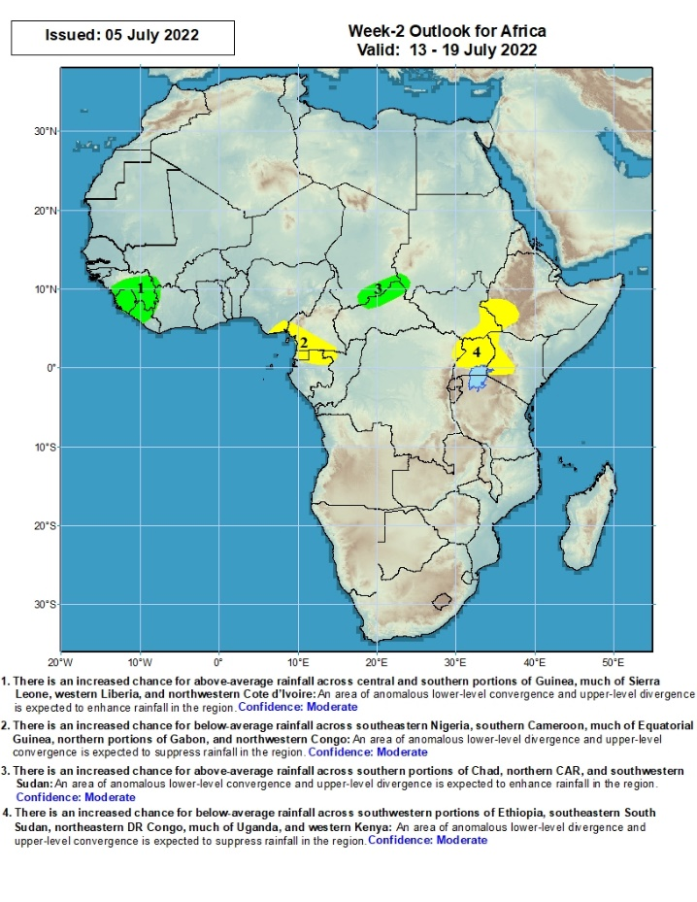
Week-2 Precipitation Outlooks
13 - 19 July, 2022
There is an increased chance for above-average rainfall across central and southern portions of Guinea, much of Sierra Leone, western Liberia, and northwestern Cote d’Ivoire: An area of anomalous lower-level convergence and upper-level divergence is expected to enhance rainfall in the region. Confidence: Moderate
There is an increased chance for below-average rainfall across southeastern Nigeria, southern Cameroon, much of Equatorial Guinea, northern portions of Gabon, and northwestern Congo: An area of anomalous lower-level divergence and upper-level convergence is expected to suppress rainfall in the region. Confidence: Moderate
There is an increased chance for above-average rainfall across southern portions of Chad, northern CAR, and southwestern Sudan: An area of anomalous lower-level convergence and upper-level divergence is expected to enhance rainfall in the region. Confidence: Moderate
There is an increased chance for below-average rainfall across southwestern portions of Ethiopia, southeastern South Sudan, northeastern DR Congo, much of Uganda, and western Kenya: An area of anomalous lower-level divergence and upper-level convergence is expected to suppress rainfall in the region. Confidence: Moderate
Notes:
11

Slide 12
Summary
During the past 30 days, in East Africa, above-average rainfall was observed over southern and eastern Sudan, western and eastern South Sudan, and western and central Ethiopia. Rainfall was below-average over the central and southern parts of South Sudan. In Central Africa, rainfall was above-average over pockets of Cameroon, northern Gabon, northern Congo, pockets of CAR and parts of northern. Rainfall was below-average over parts of CAR and DRC. In Southern Africa, above-average rainfall was observed over the western portion of South Africa, and pockets of Mozambique and Madagascar. In West Africa, rainfall was above-average over eastern Senegal, Guinea, western Liberia, western Burkina Faso, Cote d’Ivoire, Ghana, Togo and Benin and several portions of Nigeria. In contrast, parts of central Mali, southwestern Cote d’Ivoire, and many parts of Nigeria received below-average rainfall.
During the past 7 days, in East Africa, rainfall was above-average over parts of western Ethiopia, pockets of southern and eastern Sudan and pockets of eastern South Sudan, while below-average rainfall was observed over the southern portion of South Sudan. In Central Africa, rainfall was below-average over pockets of Cameroon, western CAR, and northwestern DRC. In West Africa, above-average rainfall was observed over parts of Guinea, pockets of Mali, southern Cote d’Ivoire, southern Ghana, and northern Nigeria. Meanwhile, rainfall was below-average over pockets of Senegal, Mali, Liberia, Cote d’Ivoire. Burkina Faso, and southern Nigeria.
Week-1 and week-2 outlooks call for an increased chance for above-average rainfall along the Gulf of Guinea coast, and portions of Ethiopia. In contrast, there is an increased chance for below-average rainfall over parts of Central Africa, and in the Lake Victoria region.

