Slide 1
The African Monsoon Recent Evolution and Current Status Include Week-1 and Week-2 Outlooks
Update prepared by
27 June 2022
For more information, visit:
http://www.cpc.ncep.noaa.gov/products/Global_Monsoons/African_Monsoons/precip_monitoring.shtml

Slide 2
Outline
Highlights
Recent Evolution and Current Conditions
NCEP GEFS Forecasts
Summary

Slide 3
Highlights: Last 7 Days
During the past 7 days, in East Africa, rainfall was above-average over parts of western Ethiopia, pockets of eastern Sudan and eastern South Sudan, while below-average rainfall was observed over the western portion of South Sudan, and parts of southern Sudan. In Central Africa, rainfall was over parts of Cameroon, CAR, Congo, and northern DRC. In West Africa, above-average rainfall was observed over parts of Senegal, Guinea-Bissau, pockets of Mali, southern Cote D’Ivoire, and pockets of Burkina Faso, Ghana, Togo, Benin and Nigeria. Meanwhile, rainfall was below-average over pockets of northern and eastern Nigeria.
Week-1 outlook calls for an increased chance for above-average rainfall along the Gulf of Guinea coast, parts of Central Africa, and western Ethiopia. In contrast, there is an increased chance for below-average rainfall, over the far western Sahel and in the Lake Victoria region. For week-2, the outlooks call for an increased chance for below-average rainfall across much of West and Central Africa. In contrast, there is an increased chance for above-average rainfall across western and central Ethiopia.

Slide 4
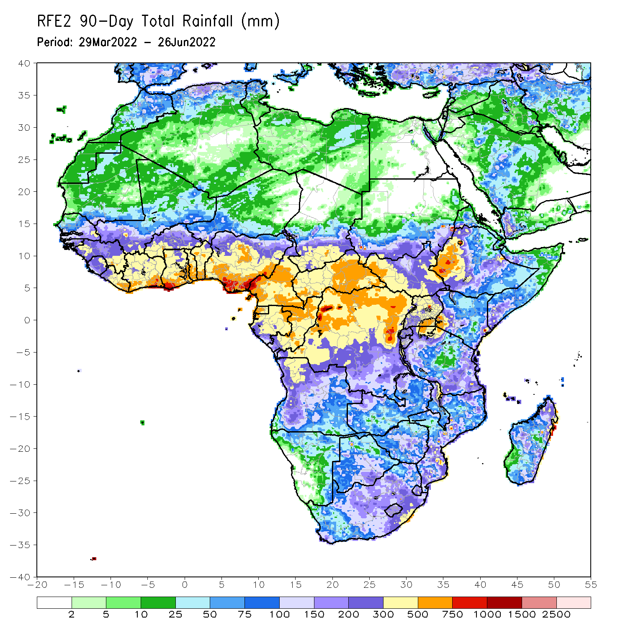
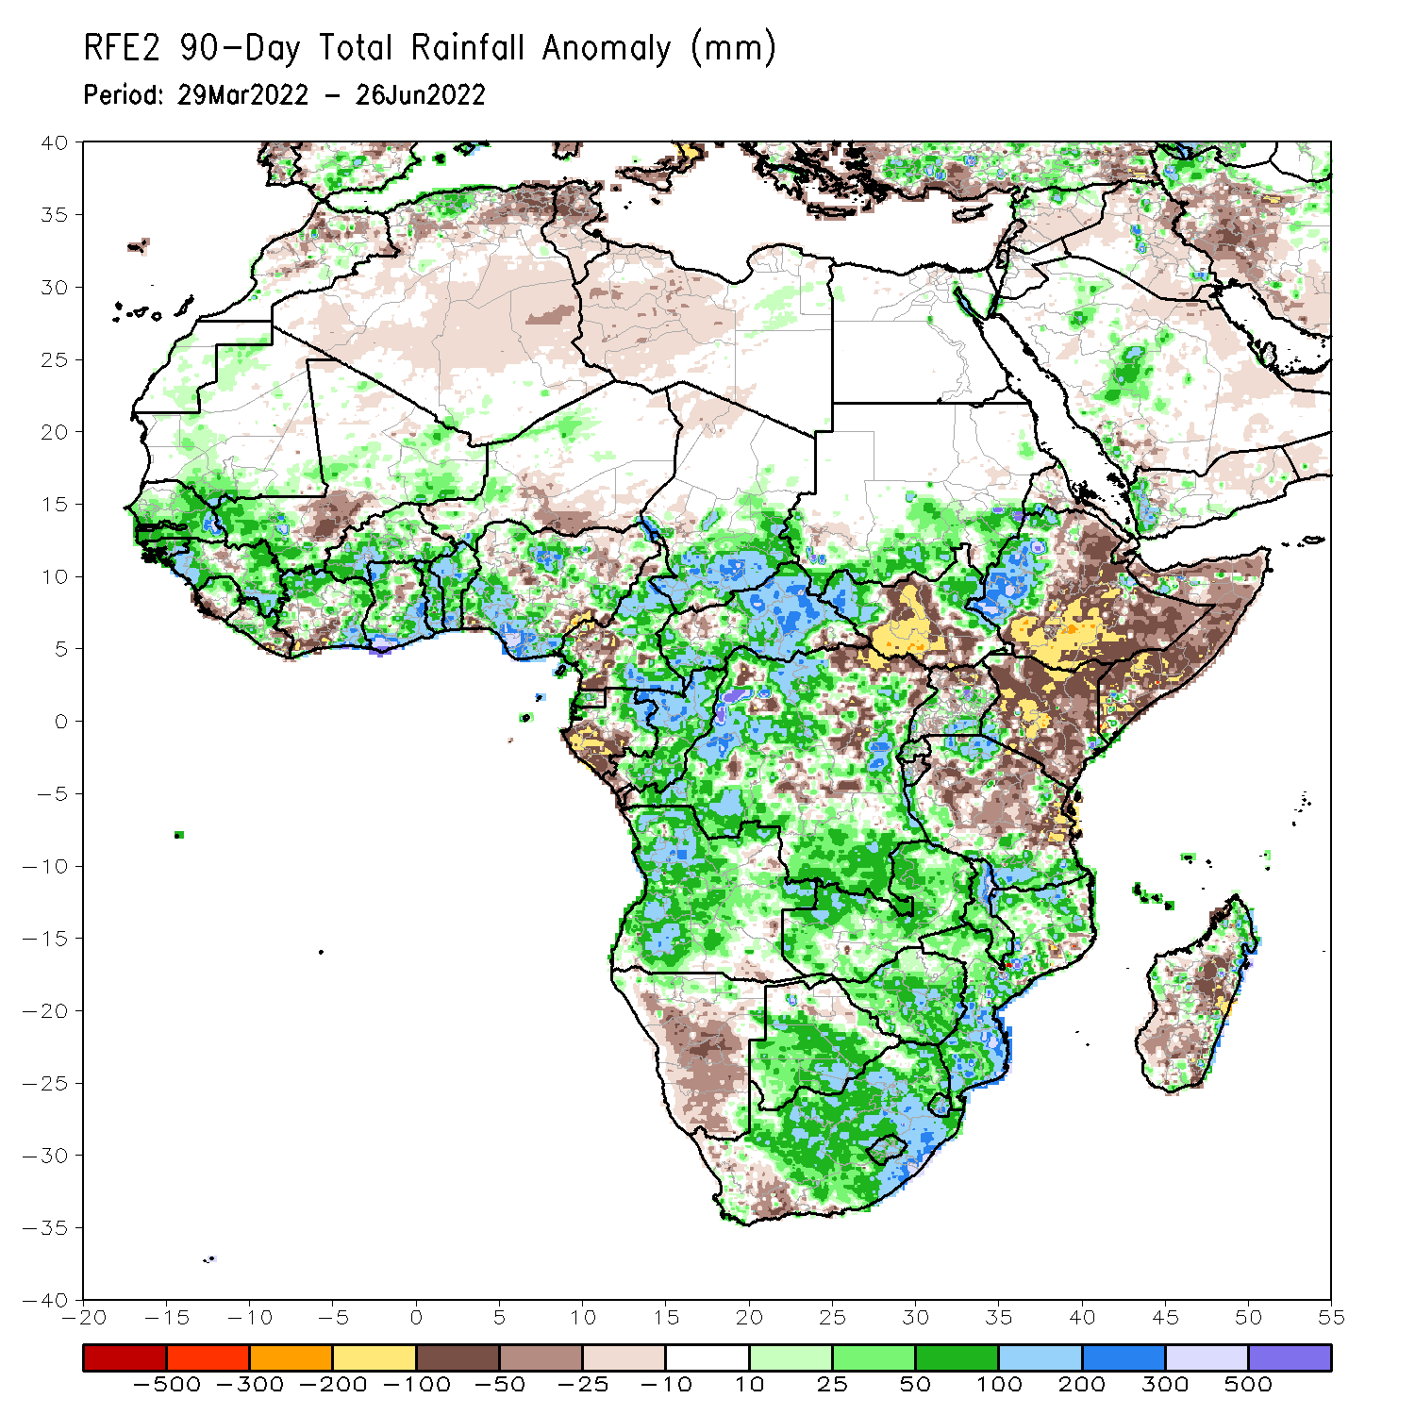
Rainfall Patterns: Last 90 Days
Over the past 90 days, in East Africa, above-average rainfall was observed over southern Sudan, the western and eastern portions of South Sudan, western Ethiopia, parts of Uganda, and parts of southern and northern Tanzania. Rainfall was below-average over central, southern and eastern Ethiopia, central and southern South Sudan, Kenya, Somalia, northern Uganda, as well as central and eastern Tanzania. In southern Africa, above-average rainfall was observed over much of Angola, Botswana, northern Namibia, Zambia, Malawi, much of Mozambique, many parts of Madagascar and much of South Africa. Below-average rainfall was observed over pockets of southeastern Angola, much of Namibia, western South Africa, and pockets of Madagascar. In Central Africa, rainfall was above-average over much of CAR, eastern Gabon, Congo, and many parts of DRC. Rainfall was below-average over parts of central and southwestern Cameroon, parts of central and northeastern DRC, and western Gabon. In West Africa, rainfall was above-average over much of the Gulf of Guinea region, as well as Senegal and the Gambia, while below-average rainfall was observed over scattered parts of Nigeria, Niger, Southwestern Cote d’Ivoire, southern Liberia, and a portion of Central Mali.
Notes:
4

Slide 5
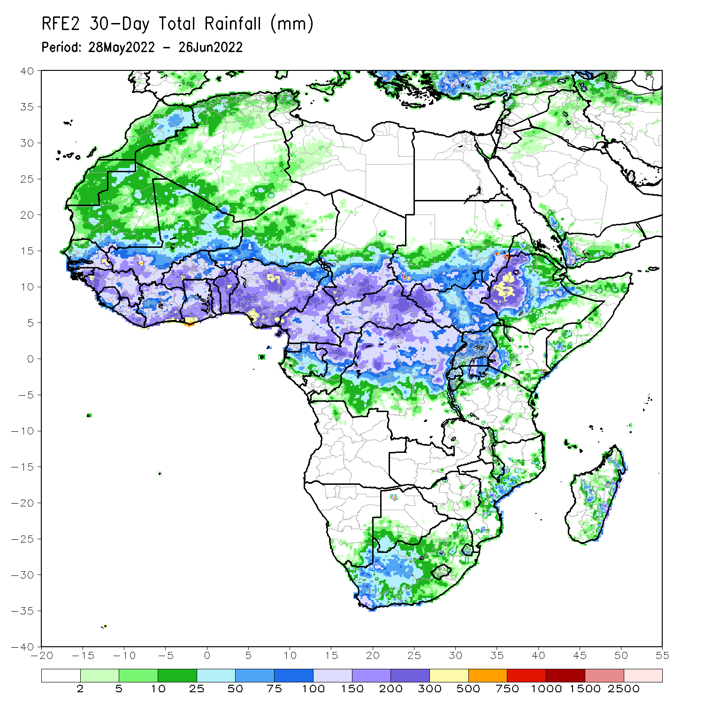
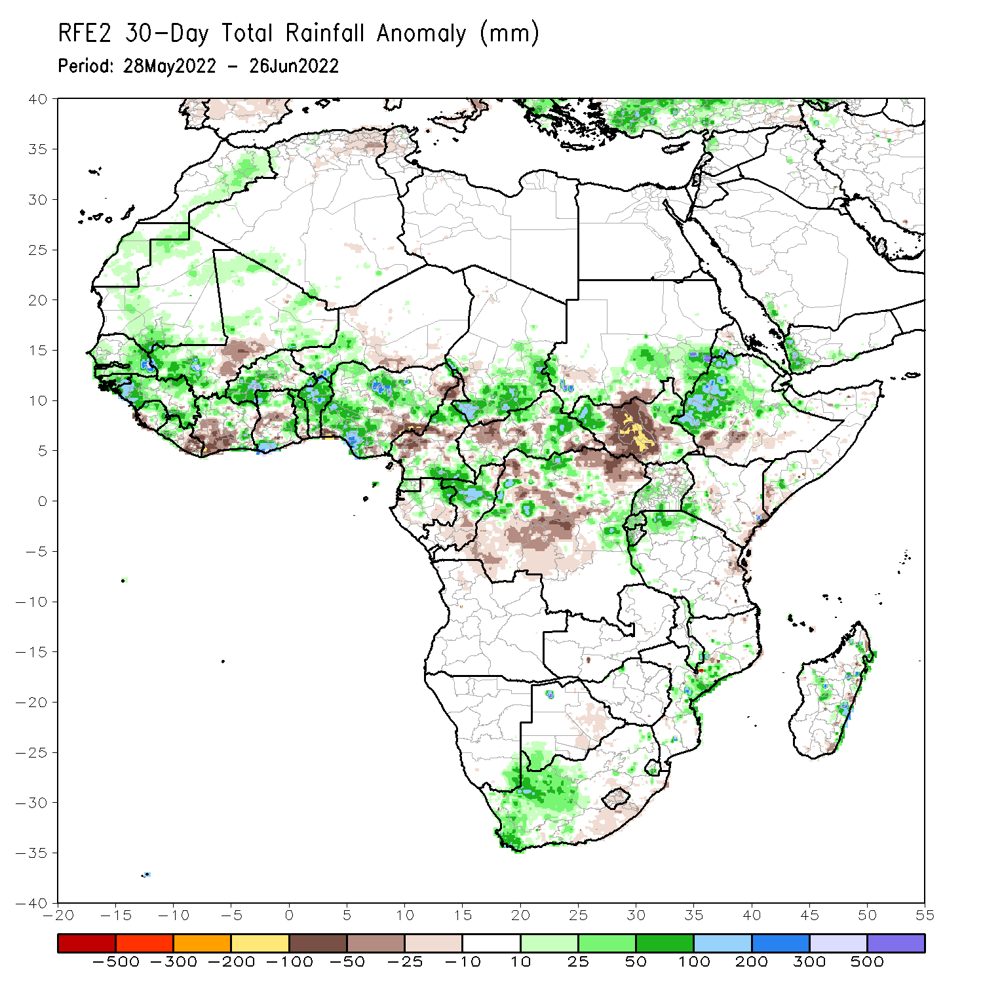
Rainfall Patterns: Last 30 Days
During the past 30 days, in East Africa, above-average rainfall was observed over western Ethiopia, parts of southern Sudan, western and eastern South Sudan, and far-northern Tanzania. Rainfall was below-average over the central parts of South Sudan, and parts of costal Kenya. In Central Africa, rainfall was above-average over pockets of Cameroon, eastern Gabon, northern Congo, eastern CAR and parts of northern and eastern DRC. Rainfall was below-average over pockets of Gabon and western and central DRC. In Southern Africa, above-average rainfall was observed over the western portion of South Africa, and pockets of Mozambique and Madagascar.. In West Africa, rainfall was above-average over Senegal, Guinea, Sierra Leone, Liberia, much of Burkina Faso, Ghana, Togo and Benin and several portions of Nigeria. In contrast, parts of central Mali, southern Cote D’ivoire, and parts of central, eastern and northern Nigeria received below-average rainfall.
Notes:
5

Slide 6
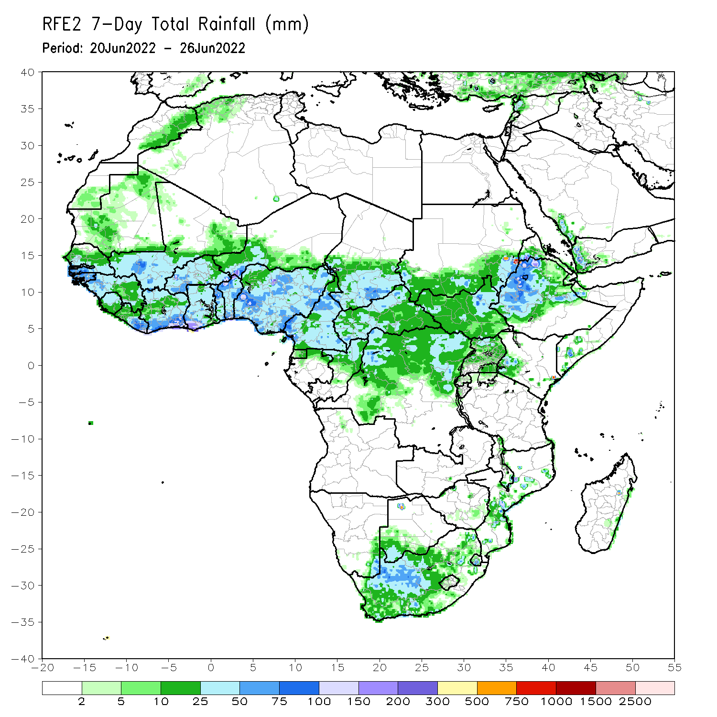
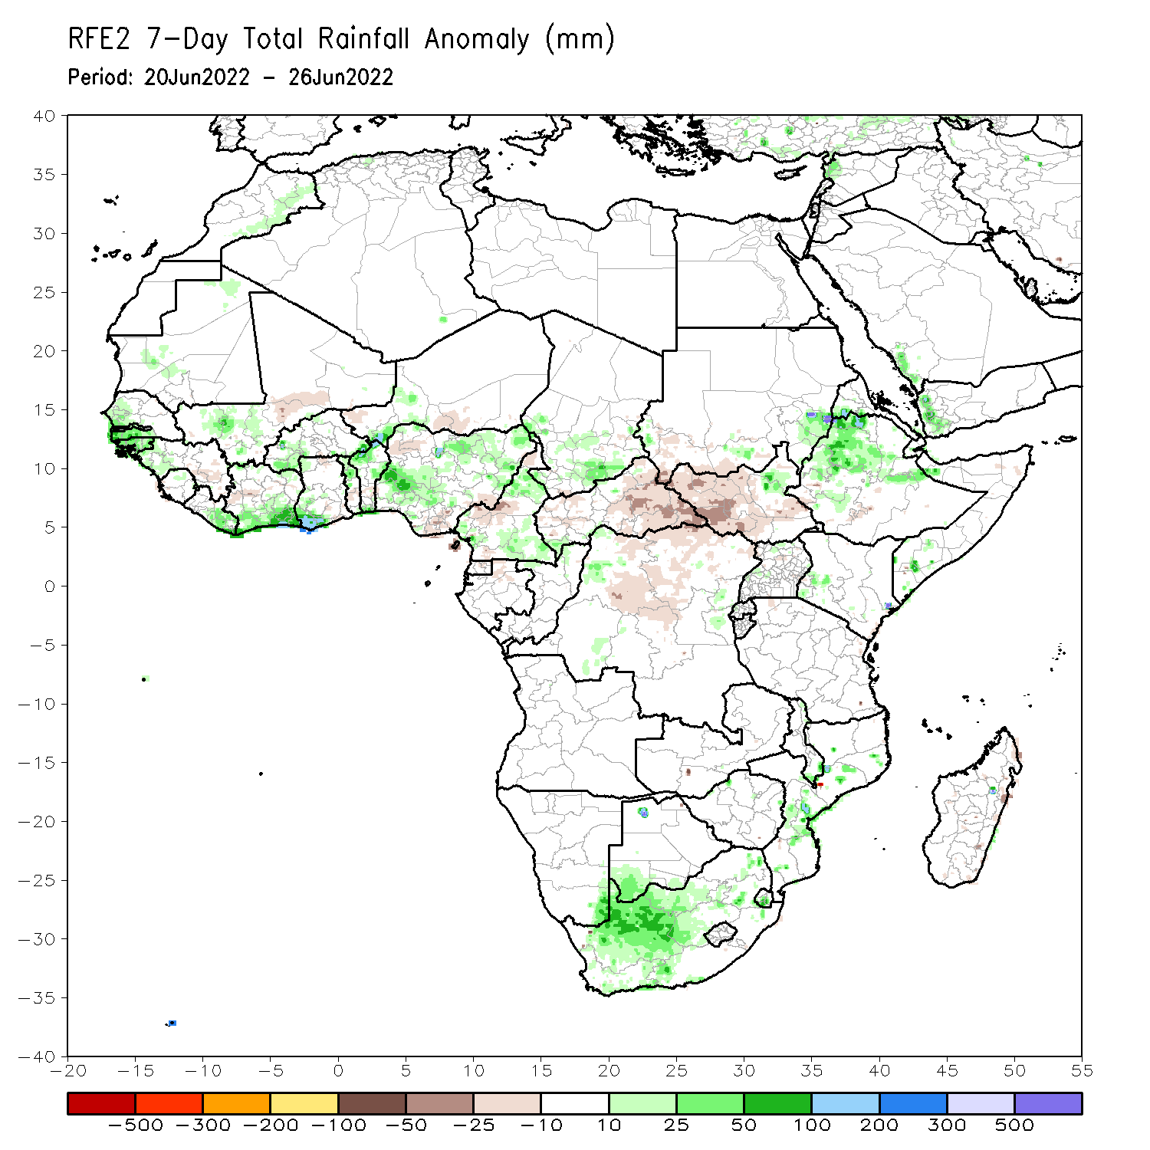
Rainfall Patterns: Last 7 Days
During the past 7 days, in East Africa, rainfall was above-average over parts of western Ethiopia, pockets of eastern Sudan and eastern South Sudan, while below-average rainfall was observed over the western portion of South Sudan, and parts of southern Sudan. In Central Africa, rainfall was over parts of Cameroon, CAR, Congo, and northern DRC. In West Africa, above-average rainfall was observed over parts of Senegal, Guinea-Bissau, pockets of Mali, southern Cote D’Ivoire, and pockets of Burkina Faso, Ghana, Togo, Benin and Nigeria. Meanwhile, rainfall was below-average over pockets of northern and eastern Nigeria.

Slide 7
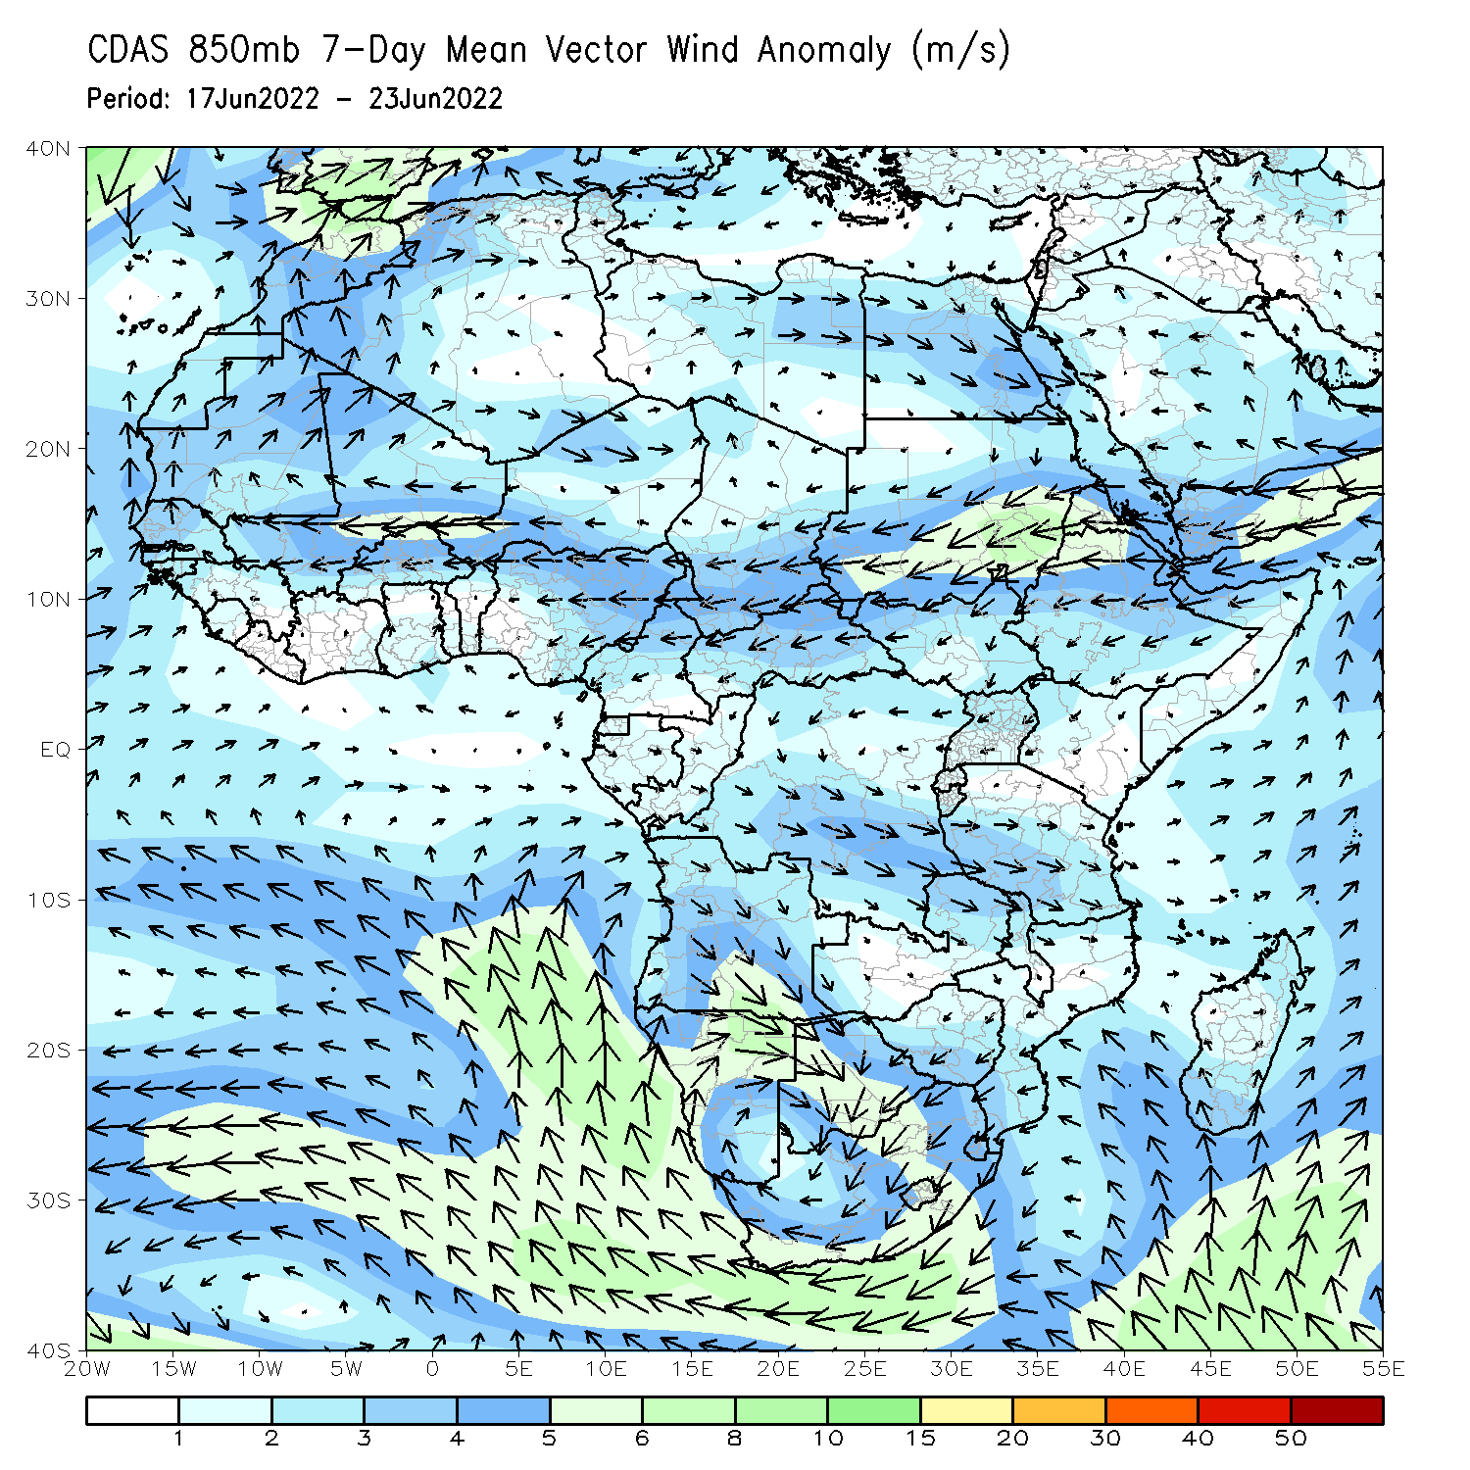
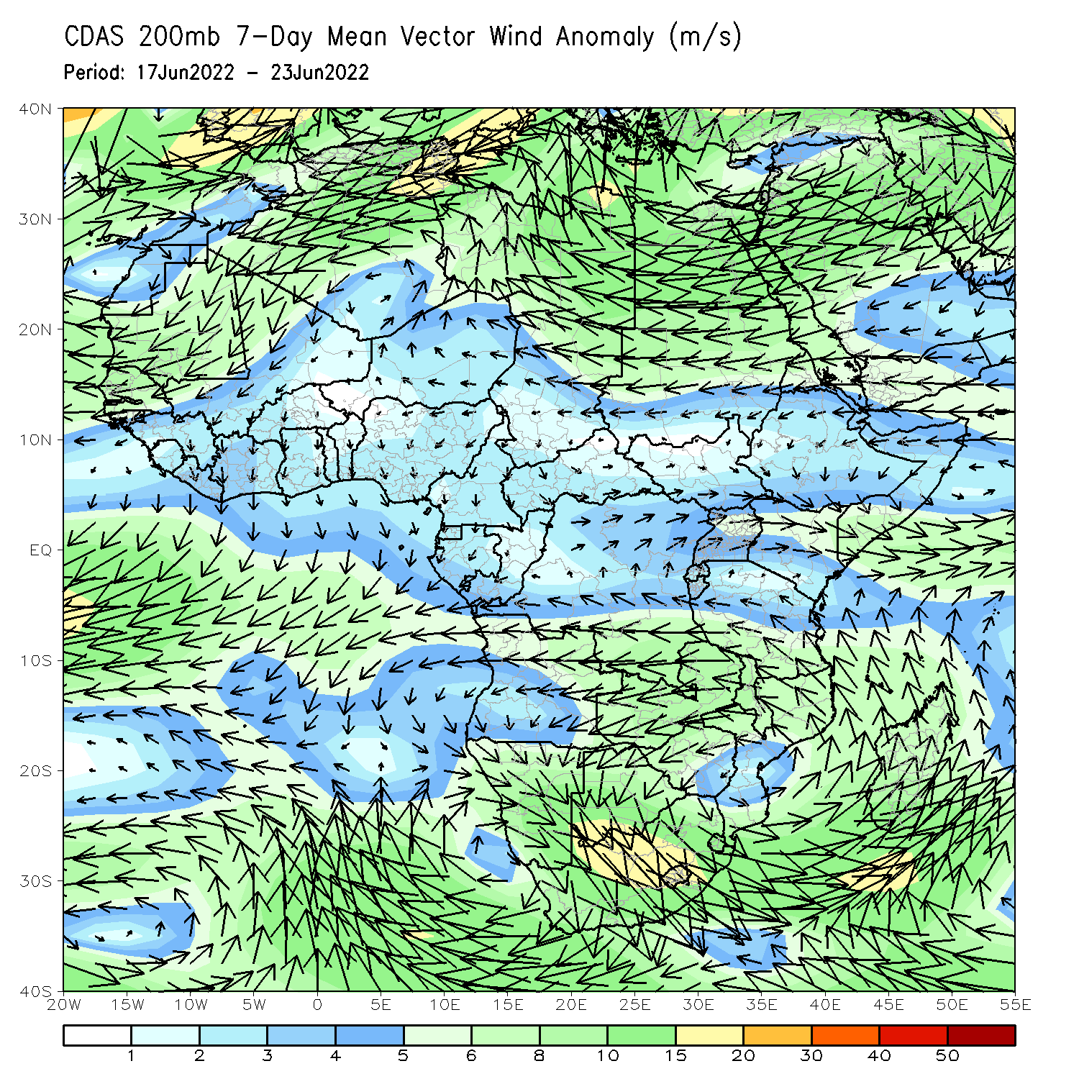
Atmospheric Circulation: Last 7 Days
At 850-hPa level (left panel), anomalous easterly flow prevailed across the Sudano-Sahelian region.

Slide 8
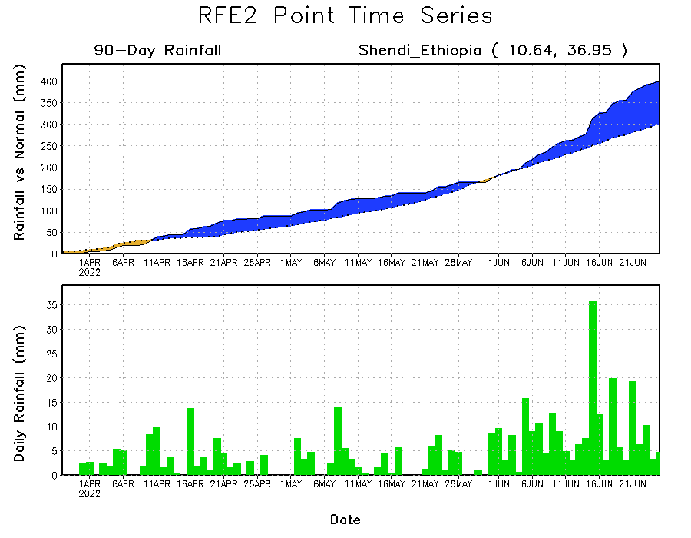
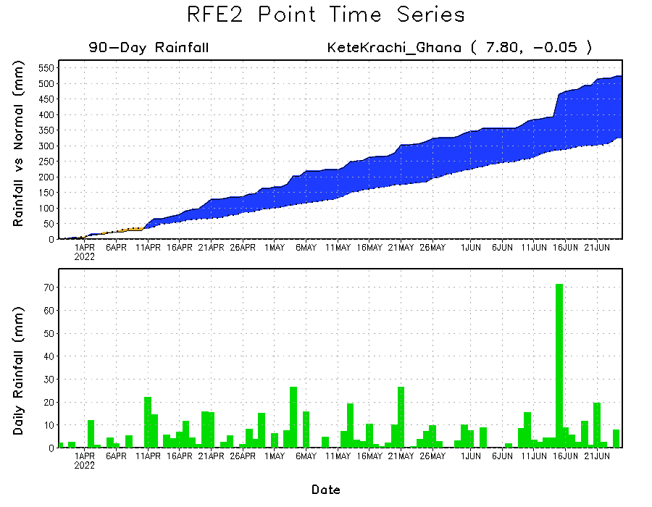
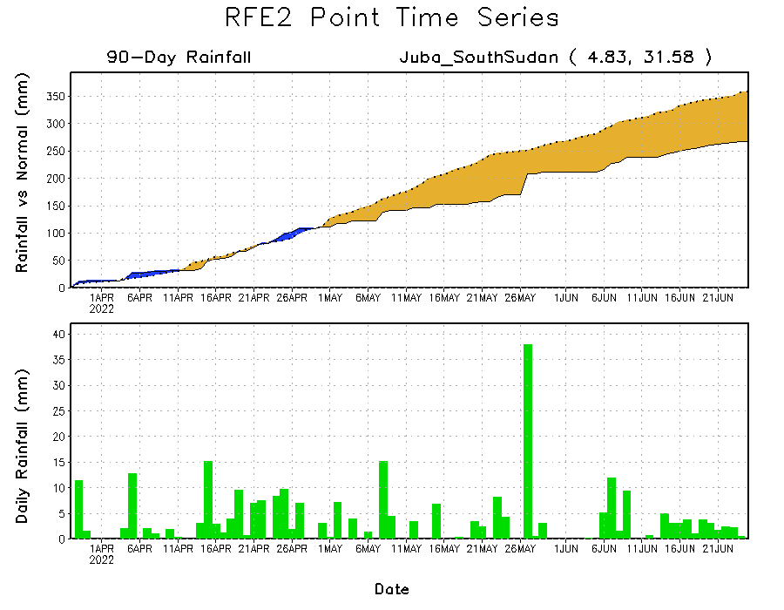
Rainfall Evolution
Daily evolution of rainfall over the last 90 days at selected locations shows increasing moisture deficits over parts of South Sudan (bottom right). Consistent heavy rains have kept significant moisture surpluses in place in southern Ghana (bottom left) and western Ethiopia (top right).

Slide 9
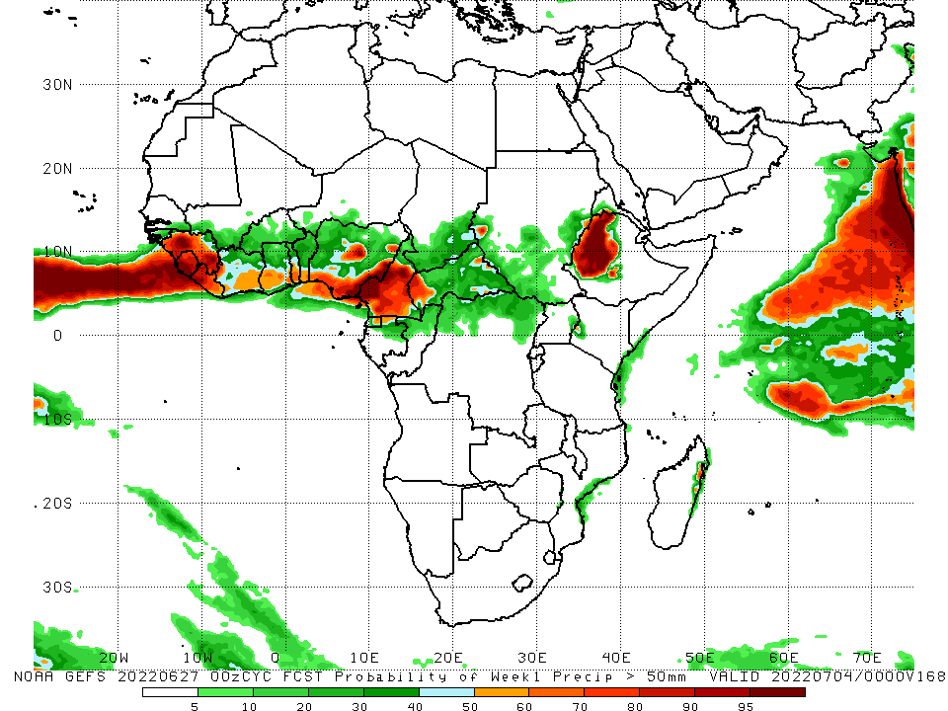
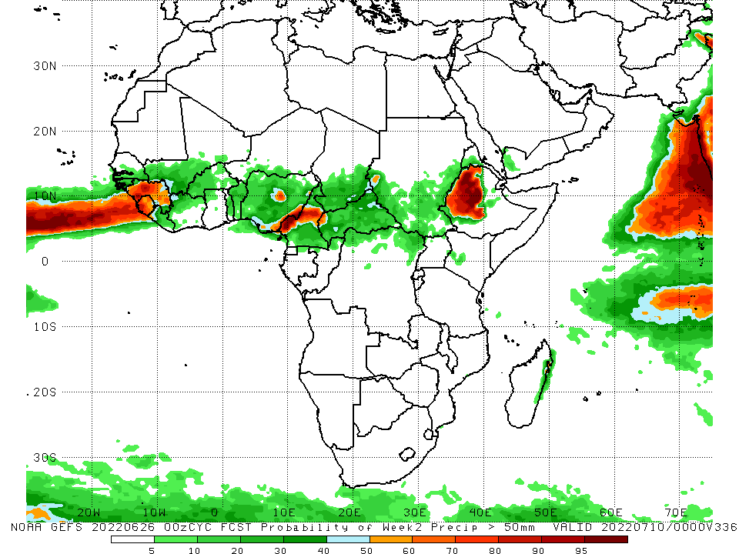
NCEP GEFS Model Forecasts Non-Bias Corrected Probability of precipitation exceedance
Week-1, Valid: 28 June - 4 July, 2022
Week-2, Valid: 5 - 11 July, 2022
For week-1 (left panel) the NCEP GEFS indicates a moderate to high chance (over 70%) for rainfall to exceed 50 mm along the Gulf of Guinea coast, and western Ethiopia. For week-2 (right panel), higher exceedance probabilities are expected to be confined to Sierra Leone, eastern Guinea, pockets of Nigeria, Cameroon, and western and Ethiopia.
Notes:
9

Slide 10
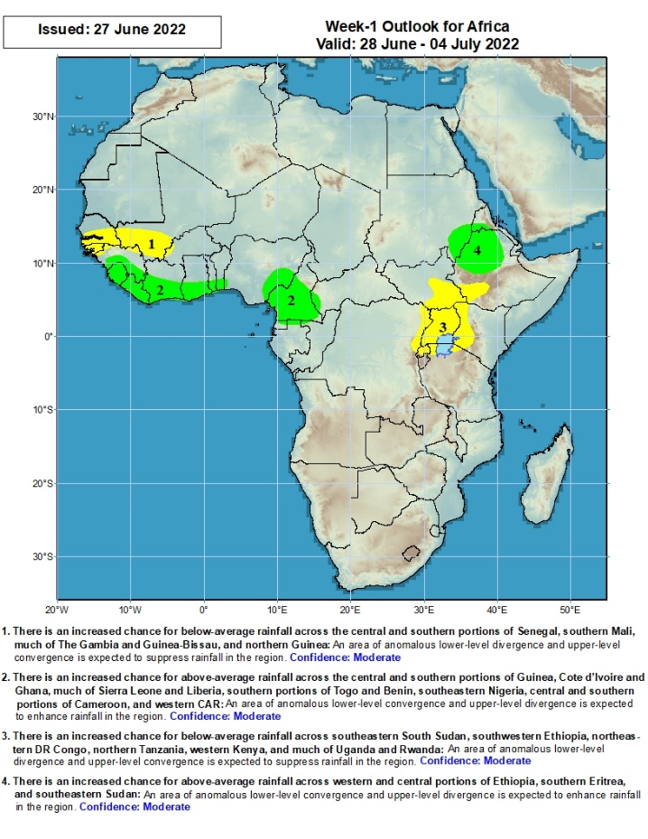
Week-1 Precipitation Outlooks
28 June – 4 July, 2022
There is an increased chance for below-average rainfall across the central and southern portions of Senegal, southern Mali, much of The Gambia and Guinea-Bissau, and northern Guinea: An area of anomalous lower-level divergence and upper-level convergence is expected to suppress rainfall in the region. Confidence: Moderate
There is an increased chance for above-average rainfall across the central and southern portions of Guinea, Cote d’Ivoire and Ghana, much of Sierra Leone and Liberia, southern portions of Togo and Benin, southeastern Nigeria, central and southern portions of Cameroon, and western CAR: An area of anomalous lower-level convergence and upper-level divergence is expected to enhance rainfall in the region. Confidence: Moderate
There is an increased chance for below-average rainfall across southeastern South Sudan, southwestern Ethiopia, northeastern DR Congo, northern Tanzania, western Kenya, and much of Uganda and Rwanda: An area of anomalous lower-level divergence and upper-level convergence is expected to suppress rainfall in the region. Confidence: Moderate
There is an increased chance for above-average rainfall across western and central portions of Ethiopia, southern Eritrea, and southeastern Sudan: An area of anomalous lower-level convergence and upper-level divergence is expected to enhance rainfall in the region. Confidence: Moderate
Notes:
10

Slide 11
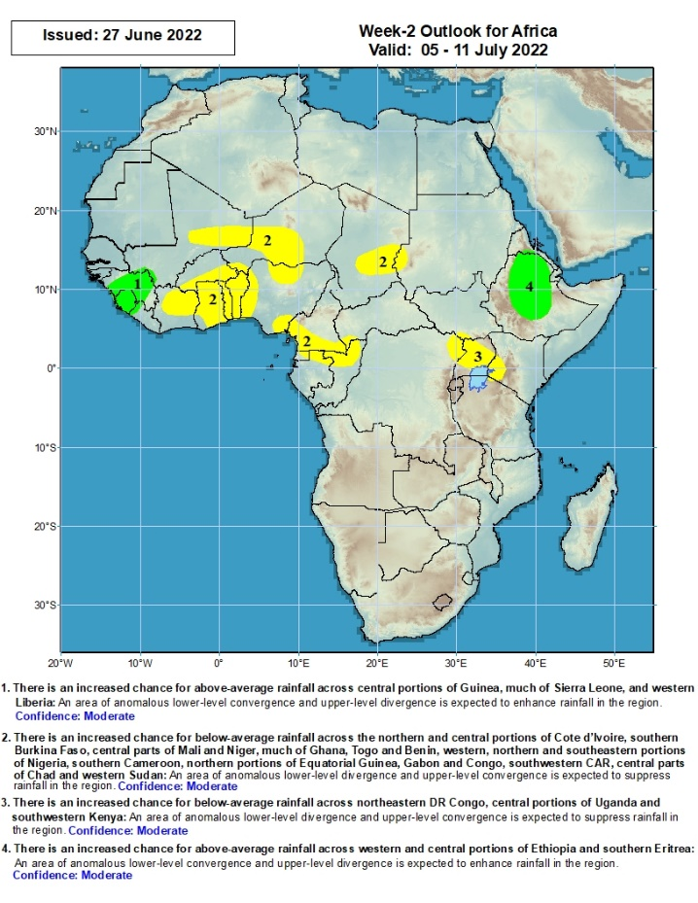
Week-2 Precipitation Outlooks
5 - 12 July, 2022
There is an increased chance for above-average rainfall across central portions of Guinea, much of Sierra Leone, and western Liberia: An area of anomalous lower-level convergence and upper-level divergence is expected to enhance rainfall in the region. Confidence: Moderate
There is an increased chance for below-average rainfall across the northern and central portions of Cote d’Ivoire, southern Burkina Faso, central parts of Mali and Niger, much of Ghana, Togo and Benin, western, northern and southeastern portions of Nigeria, southern Cameroon, northern portions of Equatorial Guinea, Gabon and Congo, southwestern CAR, central parts of Chad and western Sudan: An area of anomalous lower-level divergence and upper-level convergence is expected to suppress rainfall in the region. Confidence: Moderate
There is an increased chance for below-average rainfall across northeastern DR Congo, central portions of Uganda and southwestern Kenya: An area of anomalous lower-level divergence and upper-level convergence is expected to suppress rainfall in the region. Confidence: Moderate
There is an increased chance for above-average rainfall across western and central portions of Ethiopia and southern Eritrea: An area of anomalous lower-level convergence and upper-level divergence is expected to enhance rainfall in the region. Confidence: Moderate
Notes:
11

Slide 12
Summary
During the past 30 days, in East Africa, above-average rainfall was observed over western Ethiopia, parts of southern Sudan, western and eastern South Sudan, and far-northern Tanzania. Rainfall was below-average over the central parts of South Sudan, and parts of costal Kenya. In Central Africa, rainfall was above-average over pockets of Cameroon, eastern Gabon, northern Congo, eastern CAR and parts of northern and eastern DRC. Rainfall was below-average over pockets of Gabon and western and central DRC. In Southern Africa, above-average rainfall was observed over the western portion of South Africa, and pockets of Mozambique and Madagascar.. In West Africa, rainfall was above-average over Senegal, Guinea, Sierra Leone, Liberia, much of Burkina Faso, Ghana, Togo and Benin and several portions of Nigeria. In contrast, parts of central Mali, southern Cote d’Ivoire, and parts of central, eastern and northern Nigeria received below-average rainfall.
During the past 7 days, in East Africa, rainfall was above-average over parts of western Ethiopia, pockets of eastern Sudan and eastern South Sudan, while below-average rainfall was observed over the western portion of South Sudan, and parts of southern Sudan. In Central Africa, rainfall was over parts of Cameroon, CAR, Congo, and northern DRC. In West Africa, above-average rainfall was observed over parts of Senegal, Guinea-Bissau, pockets of Mali, southern Cote D’Ivoire, and pockets of Burkina Faso, Ghana, Togo, Benin and Nigeria. Meanwhile, rainfall was below-average over pockets of northern and eastern Nigeria.
Week-1 outlook calls for an increased chance for above-average rainfall along the Gulf of Guinea coast, parts of Central Africa, and western Ethiopia. In contrast, there is an increased chance for below-average rainfall, over the far western Sahel and in the Lake Victoria region. For week-2, the outlooks call for an increased chance for below-average rainfall across much of West and Central Africa. In contrast, there is an increased chance for above-average rainfall across western and central Ethiopia.

