Slide 1
The African Monsoon Recent Evolution and Current Status Include Week-1 and Week-2 Outlooks
Update prepared by
21 June 2022
For more information, visit:
http://www.cpc.ncep.noaa.gov/products/Global_Monsoons/African_Monsoons/precip_monitoring.shtml

Slide 2
Outline
Highlights
Recent Evolution and Current Conditions
NCEP GEFS Forecasts
Summary

Slide 3
Highlights: Last 7 Days
During the past 7 days, in East Africa, rainfall was above-average over parts of western and central Ethiopia, eastern South Sudan, and Sudan, while below-average rainfall was observed over western South Sudan and a small part of southwestern Ethiopia. In Central Africa, rainfall was above-average over parts of Congo, Gabon, and eastern Chad. Below-average rainfall was observed over Cameroon, DRC, CAR, parts of Congo, and much of Chad. In West Africa, above-average rainfall was observed over Guinea, Sierra Leone, parts of western Mali, eastern Senegal, Burkina Faso, northern Ghana, Togo, Benin and western Nigeria. Meanwhile, rainfall was below-average over Liberia, Cote D’Ivoire, southwestern Ghana, eastern Nigeria, and parts of southern Mali.
Week-1 outlook calls for an increased chance for above-average rainfall over far-western Africa and Liberia and southern Cote D’Ivoire, northwestern Nigeria, western Ethiopia in East Africa. Meanwhile, below-average rainfall is likely over central portions of West Africa, CAR and surrounding areas in Central Africa, and parts of east Africa, including Uganda. Week-2 outlook suggests an increased chance for above-average rainfall over southwestern parts of West Africa, Nigeria and Cameroon, as well as northwestern Ethiopia, while below-average rainfall is likely over parts West Africa including Senegal, The Gambia, and Guinea Bissau as well as parts of East Africa including northeastern DRC and Uganda.

Slide 4
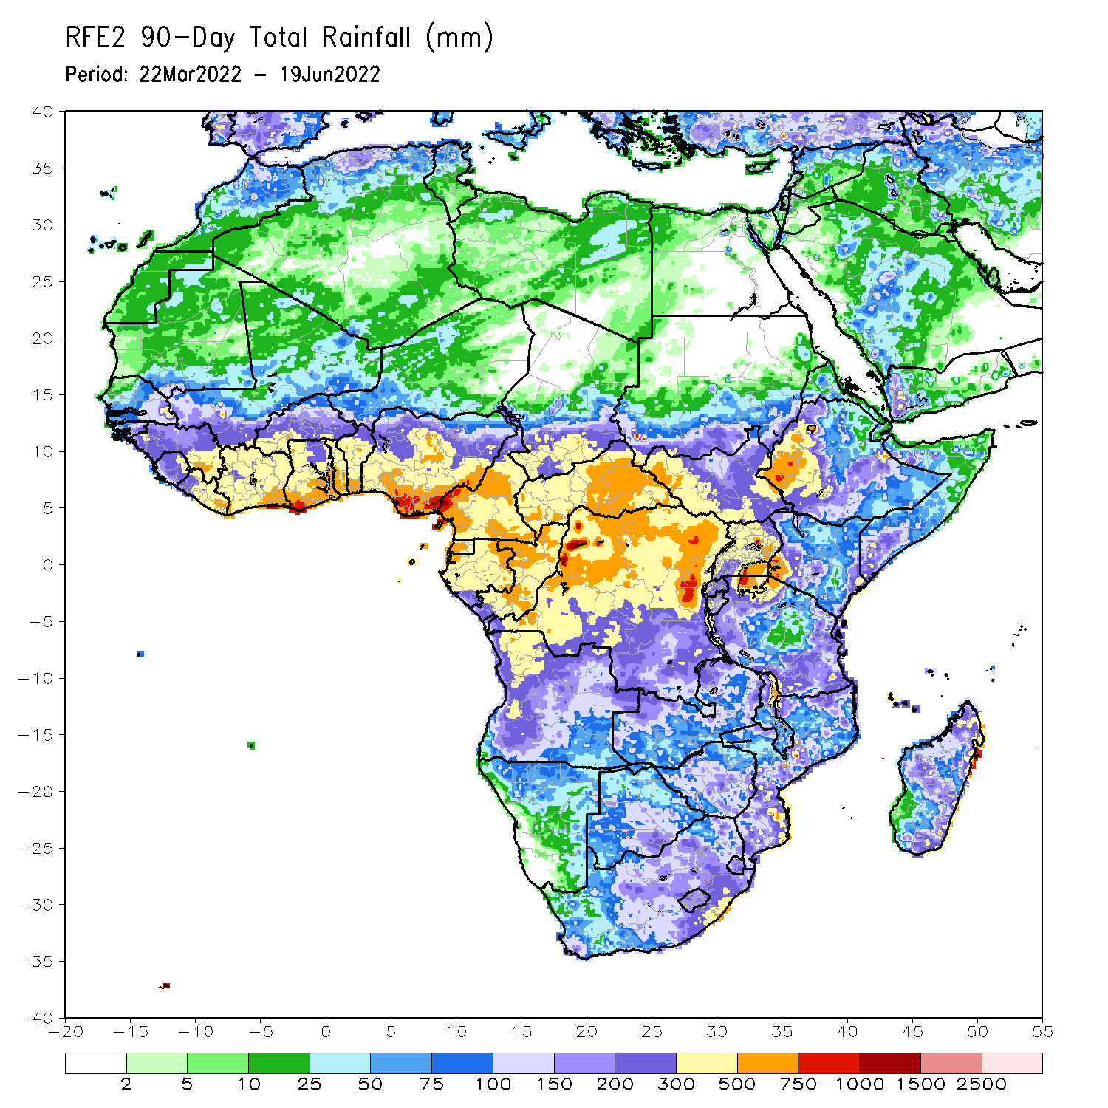
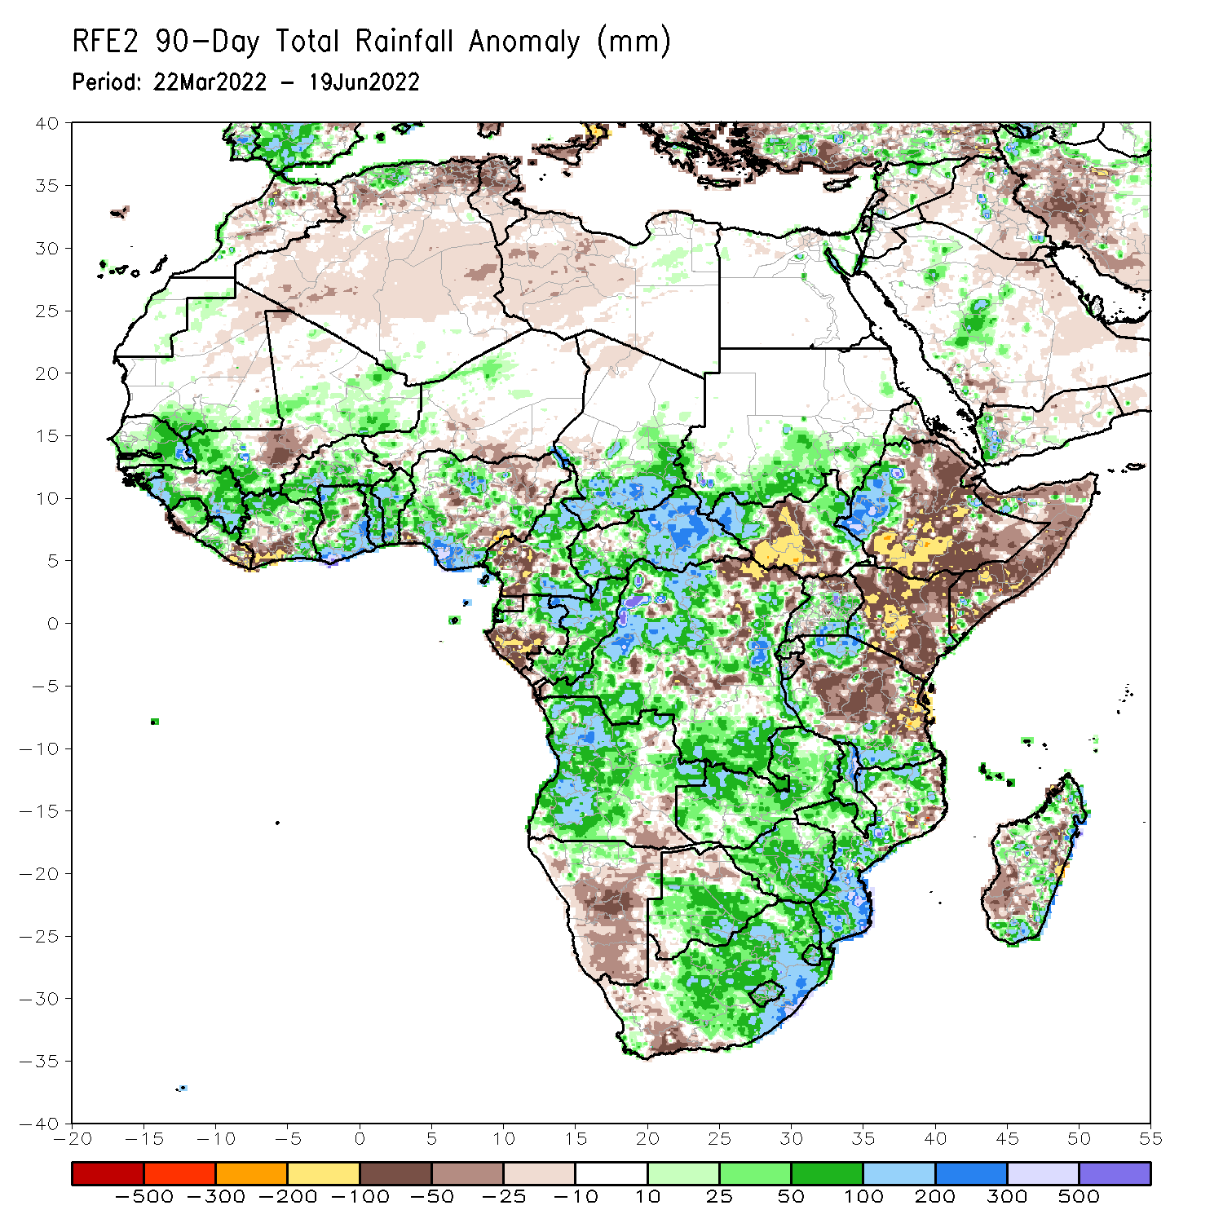
Rainfall Patterns: Last 90 Days
Over the past 90 days, in East Africa, above-average rainfall was observed over southern Sudan, the western and eastern portions of South Sudan, western Ethiopia, parts of Uganda, and parts of southern and northern Tanzania. Rainfall was below-average over central, southern and eastern Ethiopia, central and southern South Sudan, Kenya, Somalia, northern Uganda, as well as central and eastern Tanzania. In southern Africa, above-average rainfall was observed over much of Angola, Botswana, northern Namibia, Zambia, Malawi, much of Mozambique, many parts of Madagascar and much of South Africa. Below-average rainfall was observed over pockets of southeastern Angola, central and southern Namibia, western South Africa, and pockets of Madagascar. In Central Africa, rainfall was above-average over much of CAR, eastern Gabon, Congo, and many parts of DRC. Rainfall was below-average over parts of central and southwestern Cameroon, parts of central and northeastern DRC, and western Gabon. In West Africa, rainfall was above-average over much of the Gulf of Guinea region, as well as Senegal and the Gambia, while below-average rainfall was observed over scattered parts of Nigeria, Niger, Southwestern Cote d’Ivoire, southern Liberia, and a portion of Central Mali.
Notes:
4

Slide 5
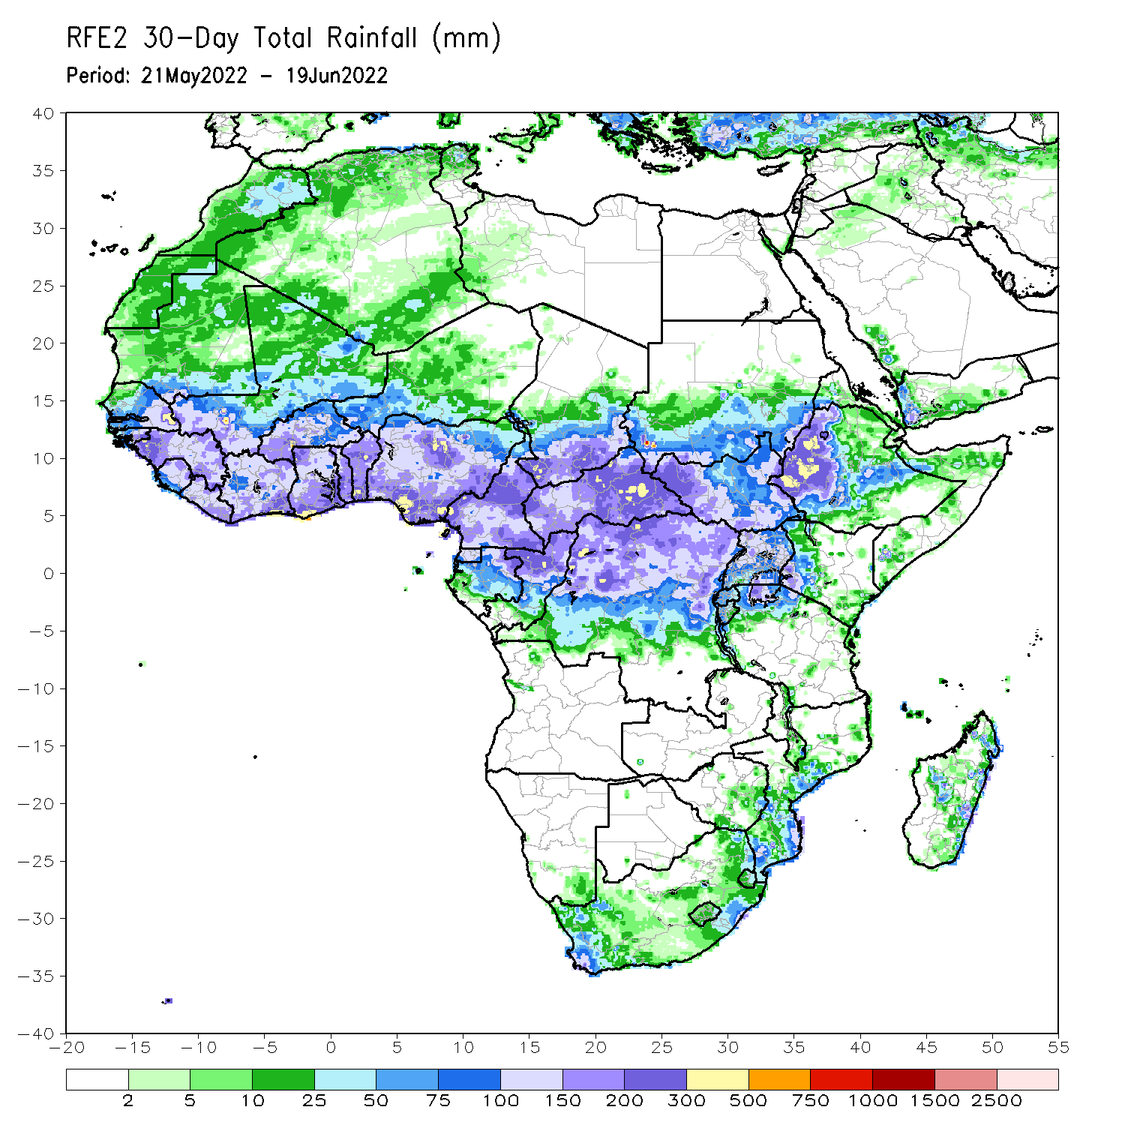
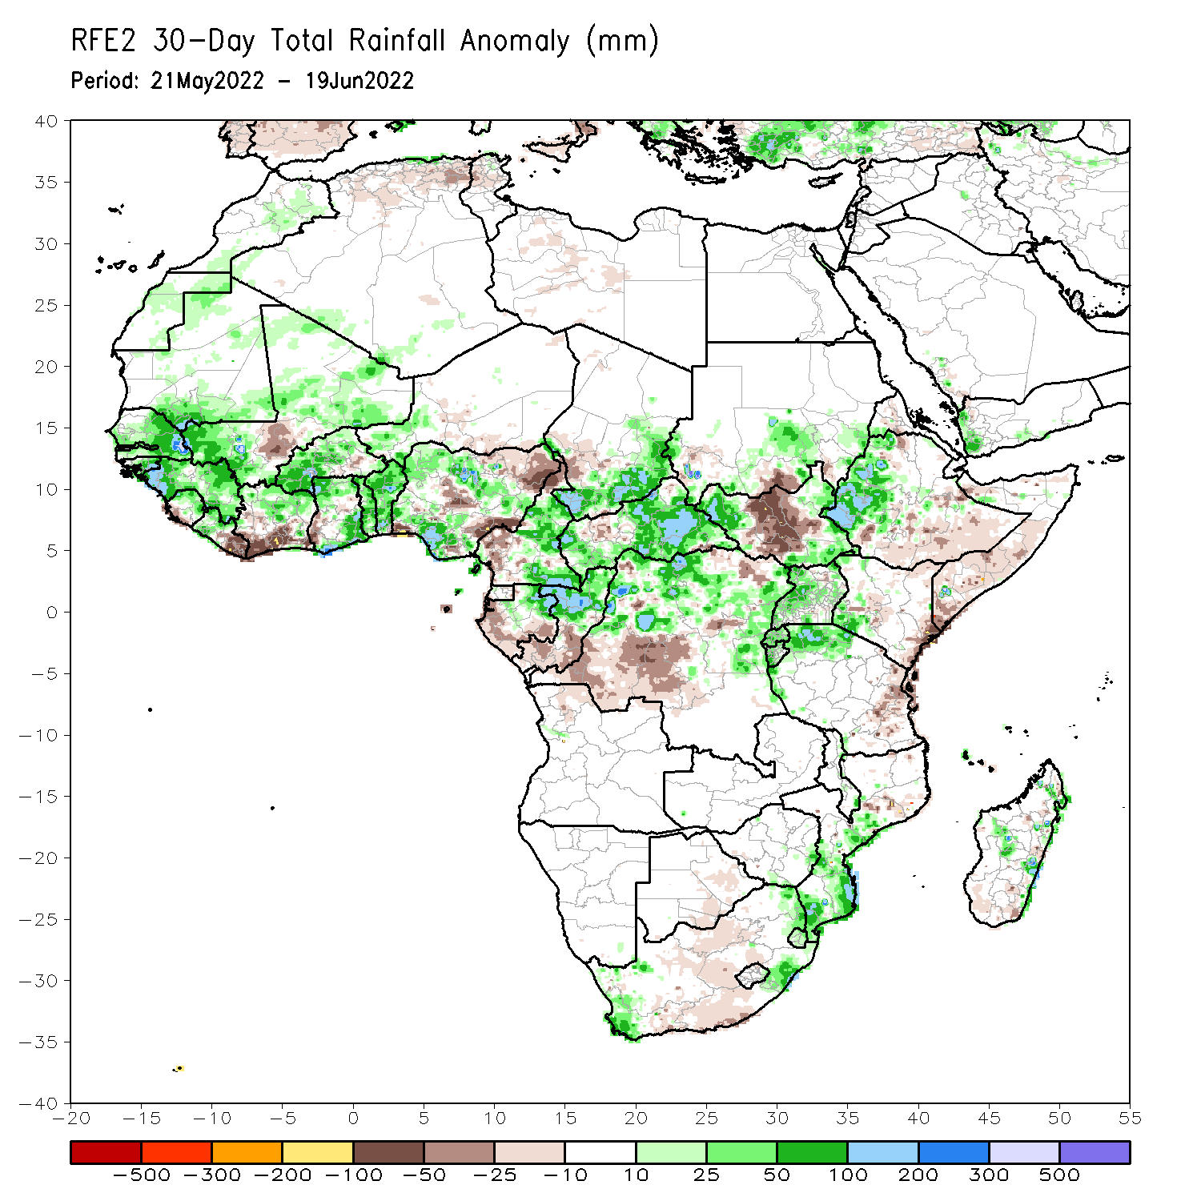
Rainfall Patterns: Last 30 Days
During the past 30 days, in East Africa, above-average rainfall was observed over western Ethiopia, parts of southern Sudan, western and eastern South Sudan, and far-northern Tanzania. Rainfall was below-average over eastern and southern Ethiopia, the central parts of South Sudan, parts of Kenya, and much of Somalia. In Central Africa, rainfall was above-average over many parts of Cameroon, eastern Gabon, northern Congo, most of CAR and northern and eastern DRC. Rainfall was below-average over parts of southern and western Gabon and western and central DRC. In Southern Africa, above-average rainfall was observed over southern and central portions of Mozambique, scattered parts of Madagascar, as well as western and eastern South Africa. Below-average rainfall was observed over southern parts of Madagascar and Central South Africa. In West Africa, rainfall was above-average over Senegal, Guinea, northern Sierra Leone, northern Liberia, much of Burkina Faso, Ghana, Togo and Benin and several portions of Nigeria. In contrast, parts of central Mali, southern Liberia and Cote D’ivoire, and parts of central, eastern and northern Nigeria received below-average rainfall.
Notes:
5

Slide 6
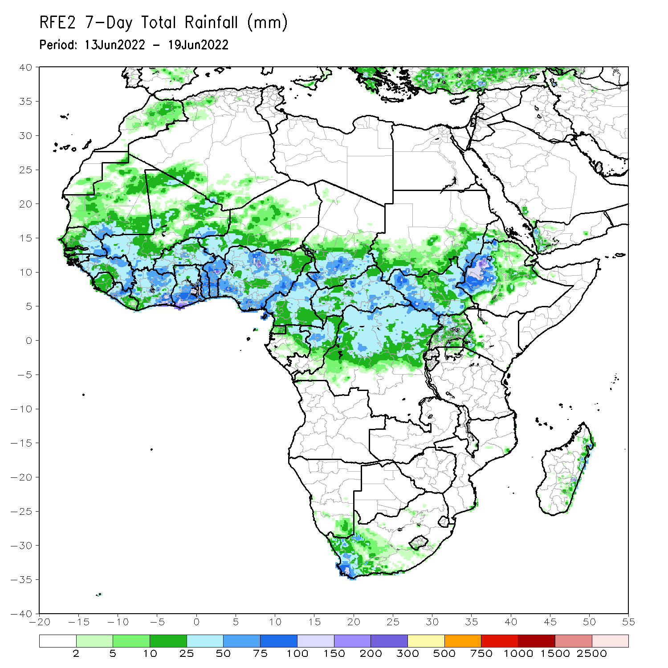
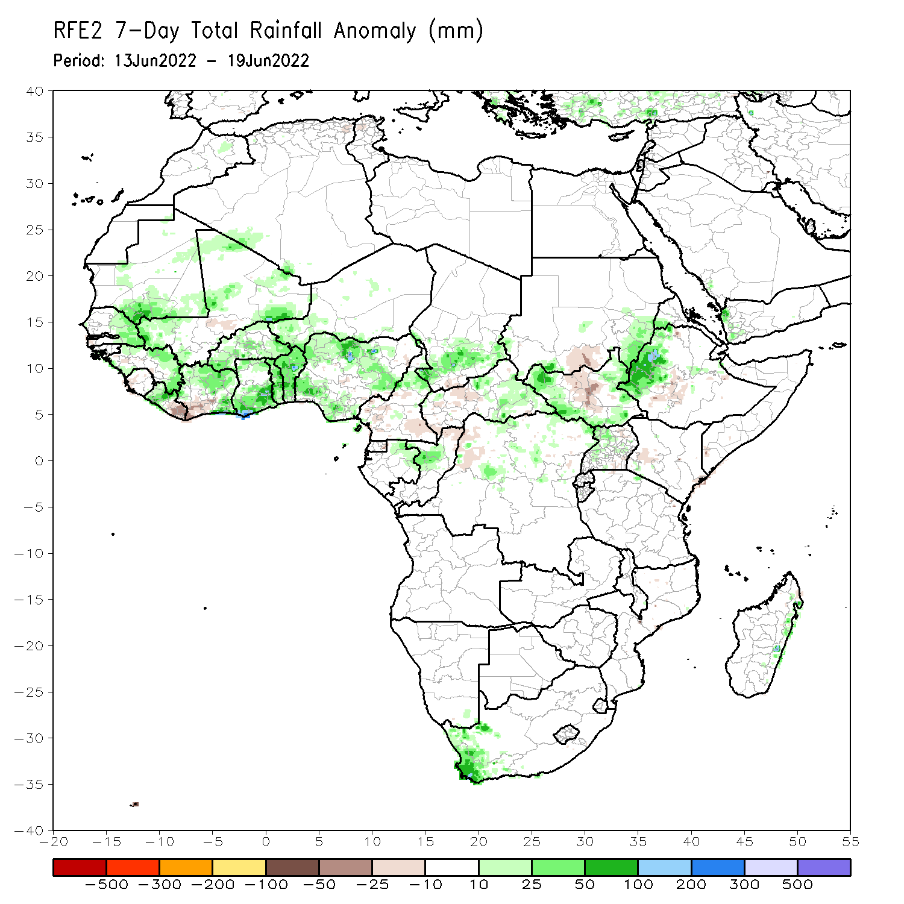
Rainfall Patterns: Last 7 Days
During the past 7 days, in East Africa, rainfall was above-average over parts of western Ethiopia, eastern, western and southern South Sudan, and eastern Sudan, while below-average rainfall was observed over central South Sudan and a small part of southwestern Ethiopia. In Central Africa, rainfall was above-average over parts of Congo, northeastern Gabon, and Chad. Below-average rainfall was observed over southern Cameroon, northwest DRC, western CAR, parts of Congo. In West Africa, above-average rainfall was observed over Guinea, parts of Mali, eastern Senegal, northern Cote D’Ivoire, western Liberia, Burkina Faso, Ghana, Togo, Benin and Nigeria. Meanwhile, rainfall was below-average over southern Liberia, southwestern Cote D’Ivoire, and parts of central Mali. Rainfall was also above average in western South Africa.

Slide 7
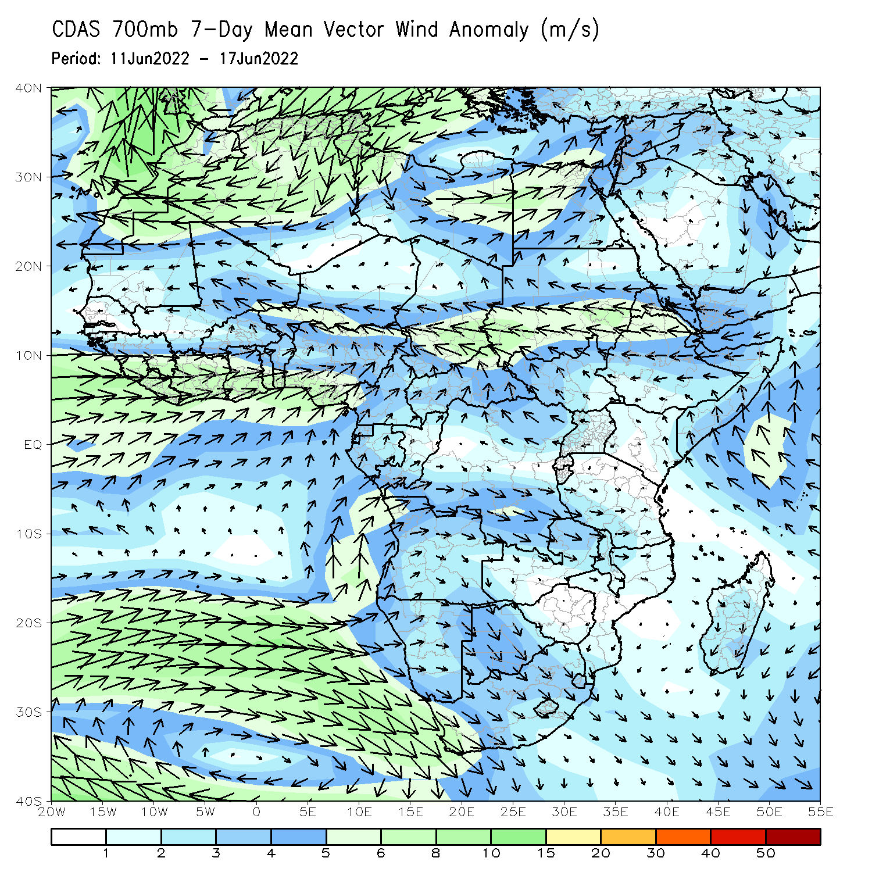
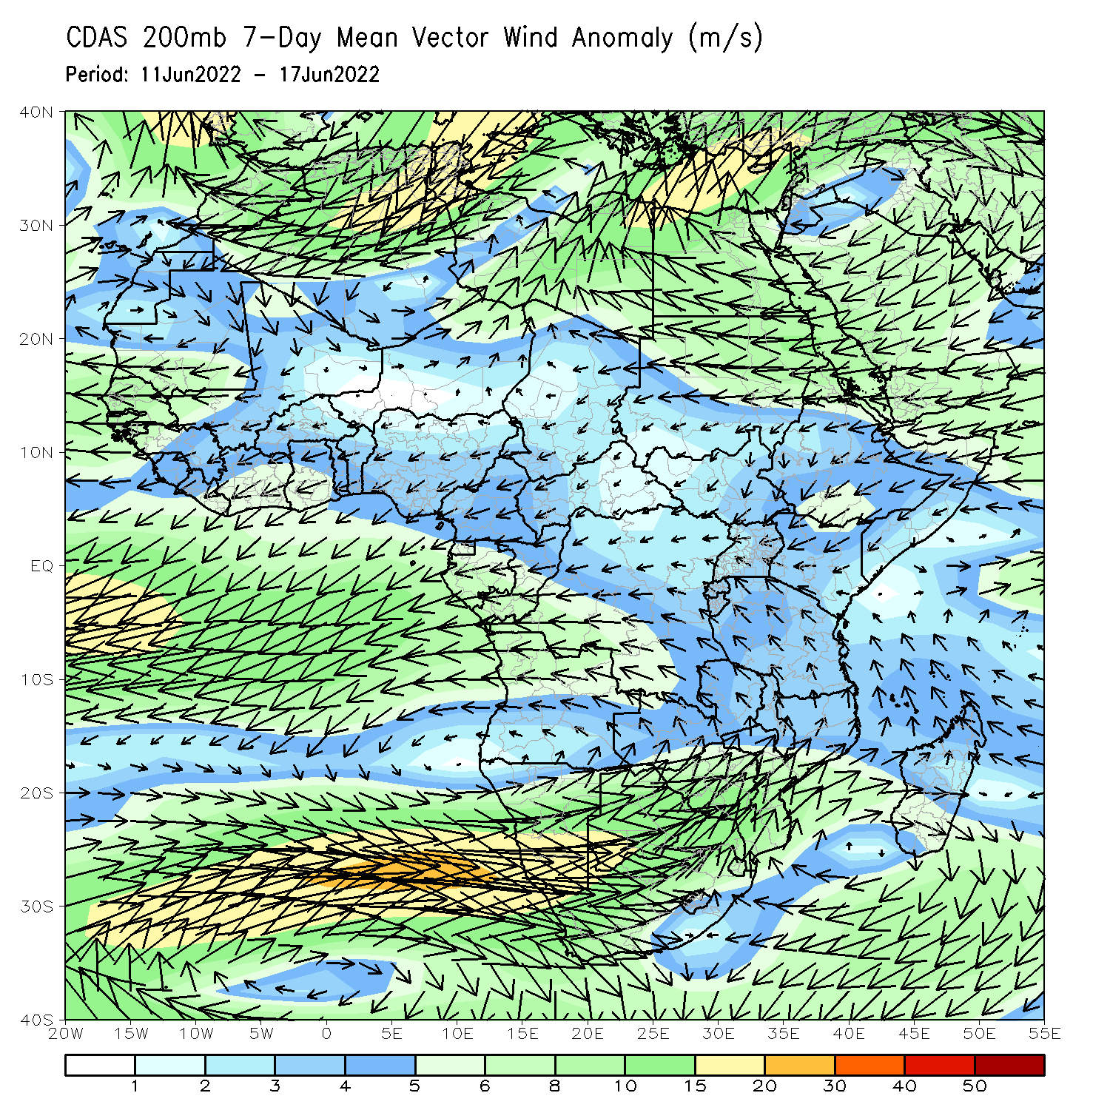
Atmospheric Circulation: Last 7 Days
At 700-hPa level (left panel), anomalous onshore flow across the Gulf of Guinea countries has ushered in moisture and contributed to enhanced rainfall in much of western Africa. Lower-level convergence over central Africa has contributed to enhanced rainfall in Chad.

Slide 8
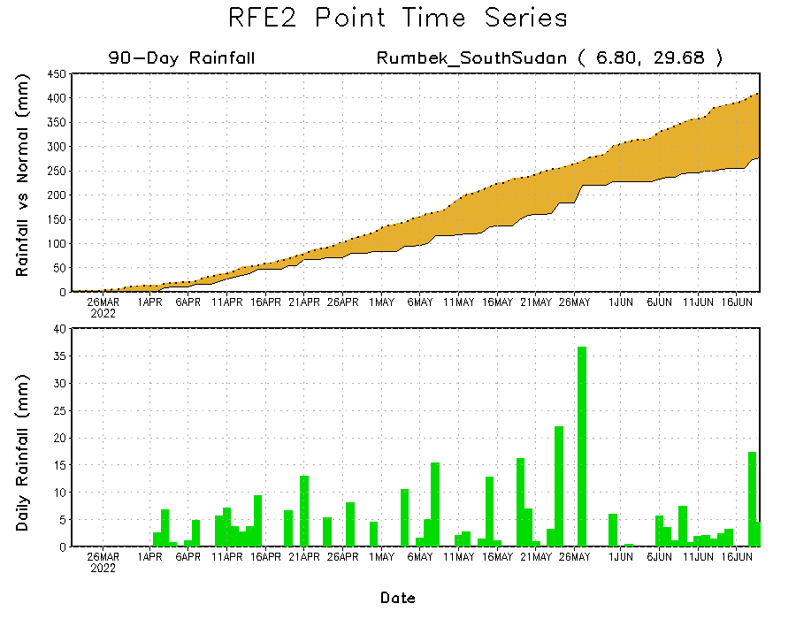
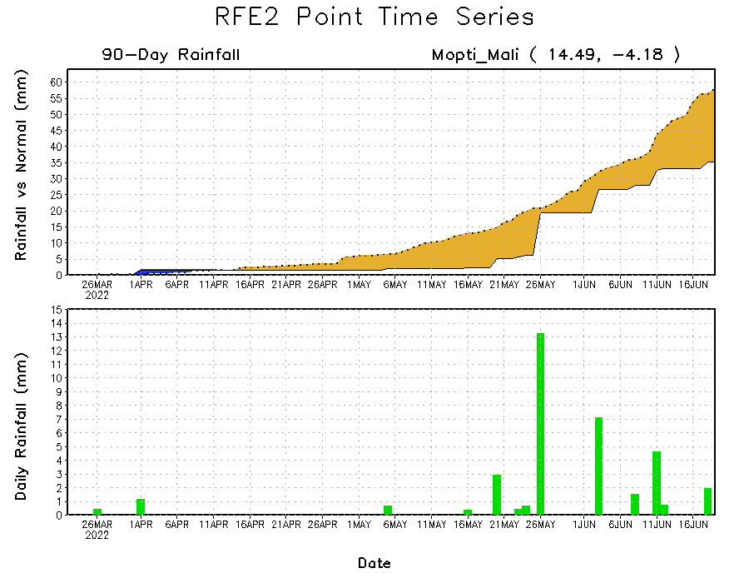
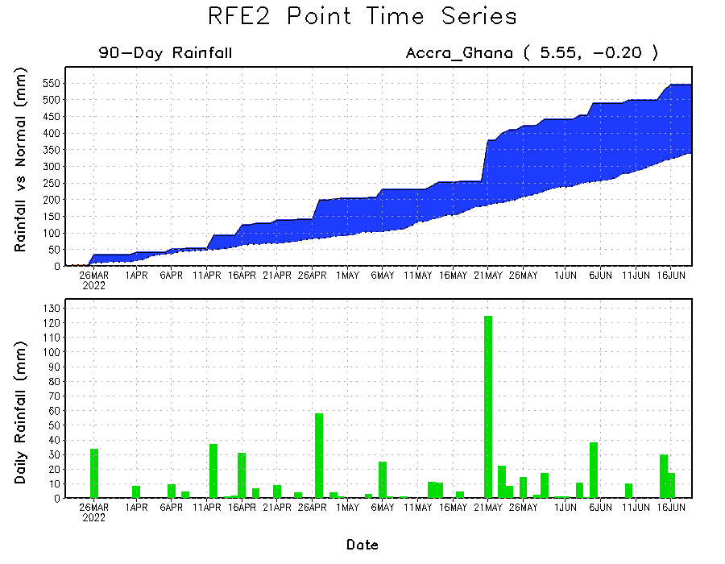
Rainfall Evolution
Daily evolution of rainfall over the last 90 days at selected locations shows increasing moisture deficits over parts of South Sudan (top right) as well as central portions of Mali (bottom right). Consistent heavy rains have kept significant moisture surpluses in place in southern Ghana (bottom left).

Slide 9
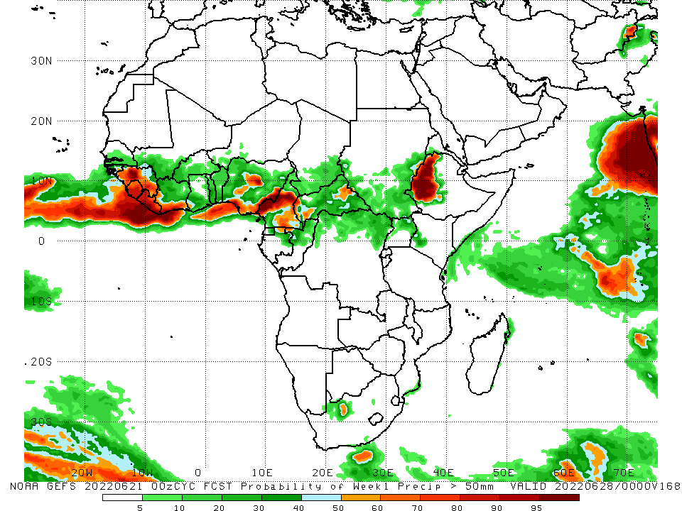
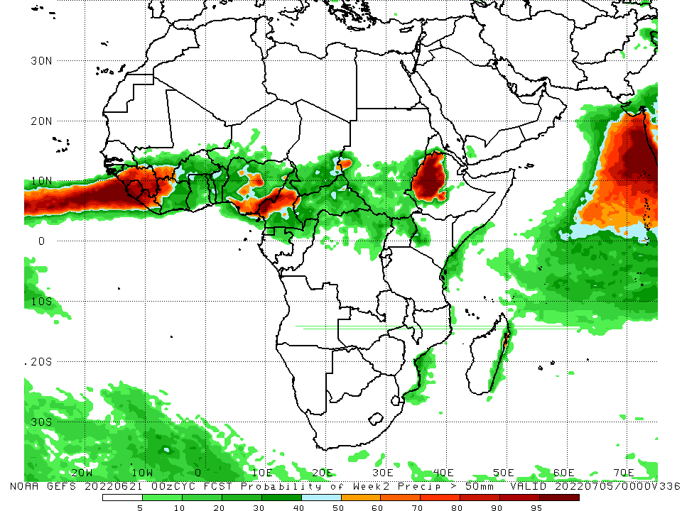
NCEP GEFS Model Forecasts Non-Bias Corrected Probability of precipitation exceedance
Week-1, Valid: 21 – 27 June, 2022
Week-2, Valid: 28 - 5 July, 2022
For week-1 (left panel) the NCEP GEFS indicates a moderate to high chance (over 70%) for rainfall to exceed 50 mm over Guinea, Sierra Leone, Liberia, southern Cote D’Ivoire, parts of Nigeria, Cameroon, and western Ethiopia. For week-2 (right panel), NCEP GEFS indicates a moderate to high chance (over 70%) for rainfall to exceed 50 mm over Guinea, Sierra Leone, Liberia, parts of Nigeria, central Cameroon, and western Ethiopia.
Notes:
9

Slide 10
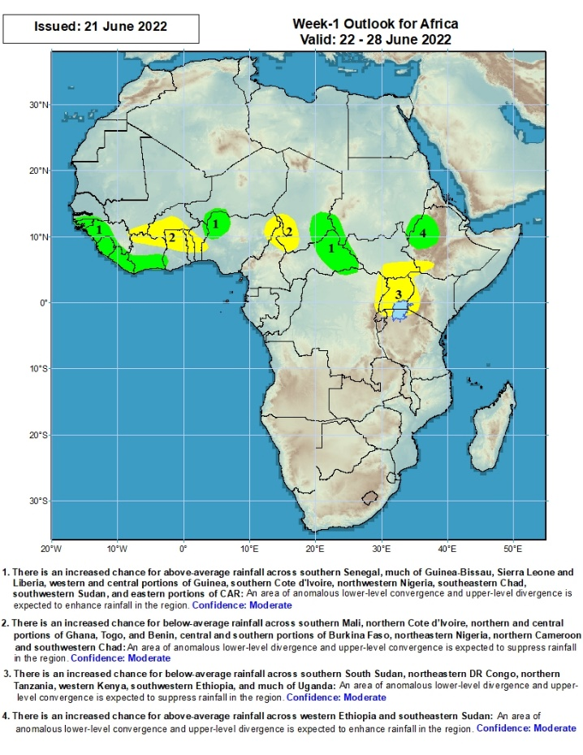
Week-1 Precipitation Outlooks
14 – 20 June, 2022
There is an increased chance for above-average rainfall across southern Senegal, much of Guinea-Bissau, Sierra Leone and Liberia, western and central portions of Guinea, southern Cote d’Ivoire, northwestern Nigeria, southeastern Chad, southwestern Sudan, and eastern portions of CAR: An area of anomalous lower-level convergence and upper-level divergence is expected to enhance rainfall in the region. Confidence: Moderate
There is an increased chance for below-average rainfall across southern Mali, northern Cote d’Ivoire, northern and central portions of Ghana, Togo and Benin, central and southern portions of Burkina Faso, northeastern Nigeria, northern Cameroon and southwestern Chad: An area of anomalous lower-level divergence and upper-level convergence is expected to suppress rainfall in the region. Confidence: Moderate
There is an increased chance for below-average rainfall across southern South Sudan, northeastern DR Congo, northern Tanzania, western Kenya, southwestern Ethiopia, and much of Uganda: An area of anomalous lower-level divergence and upper-level convergence is expected to suppress rainfall in the region. Confidence: Moderate
There is an increased chance for above-average rainfall across western Ethiopia and southeastern Sudan: An area of anomalous lower-level convergence and upper-level divergence is expected to enhance rainfall in the region. Confidence: Moderate
Notes:
10

Slide 11
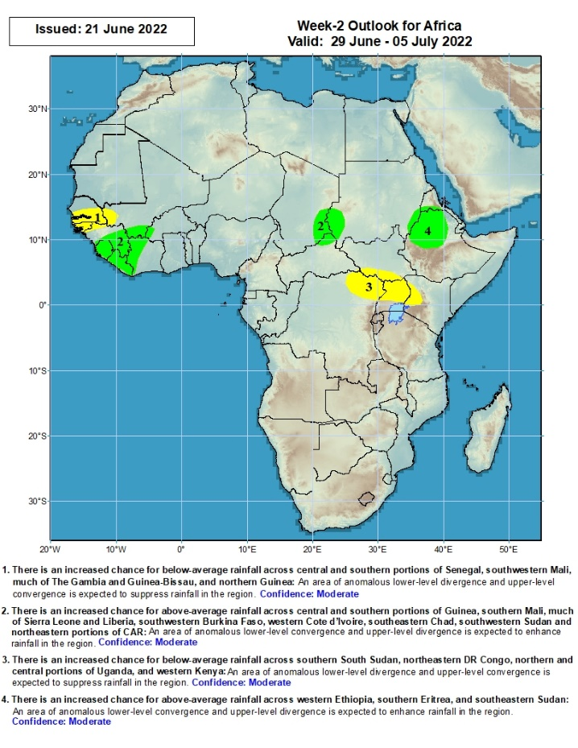
Week-2 Precipitation Outlooks
21 - 27 June, 2022
There is an increased chance for below-average rainfall across central and southern portions of Senegal, southwestern Mali, much of The Gambia and Guinea-Bissau, and northern Guinea: An area of anomalous lower-level divergence and upper-level convergence is expected to suppress rainfall in the region. Confidence: Moderate
There is an increased chance for above-average rainfall across central and southern portions of Guinea, southern Mali, much of Sierra Leone and Liberia, southwestern Burkina Faso, western Cote d’Ivoire, southeastern Chad, southwestern Sudan and northeastern portions of CAR: An area of anomalous lower-level convergence and upper-level divergence is expected to enhance rainfall in the region. Confidence: Moderate
There is an increased chance for below-average rainfall across southern South Sudan, northeastern DR Congo, northern and central portions of Uganda, and western Kenya: An area of anomalous lower-level divergence and upper-level convergence is expected to suppress rainfall in the region. Confidence: Moderate
There is an increased chance for above-average rainfall across western Ethiopia, southern Eritrea, and southeastern Sudan: An area of anomalous lower-level convergence and upper-level divergence is expected to enhance rainfall in the region. Confidence: Moderate
Notes:
11

Slide 12
Summary
During the past 30 days, in East Africa, above-average rainfall was observed over western Ethiopia, parts of southern Sudan, western and eastern South Sudan, and far-northern Tanzania. Rainfall was below-average over eastern and southern Ethiopia, the central parts of South Sudan, parts of Kenya, and much of Somalia. In Central Africa, rainfall was above-average over many parts of Cameroon, eastern Gabon, northern Congo, most of CAR and northern and eastern DRC. Rainfall was below-average over parts of southern and western Gabon and western and central DRC. In Southern Africa, above-average rainfall was observed over southern and central portions of Mozambique, scattered parts of Madagascar, as well as western and eastern South Africa. Below-average rainfall was observed over southern parts of Madagascar and Central South Africa. In West Africa, rainfall was above-average over Senegal, Guinea, northern Sierra Leone, northern Liberia, much of Burkina Faso, Ghana, Togo and Benin and several portions of Nigeria. In contrast, parts of central Mali, southern Liberia and Cote D’Ivoire, and parts of central, eastern and northern Nigeria received below-average rainfall.
During the past 7 days, in East Africa, rainfall was above-average over parts of western Ethiopia, eastern, western and southern South Sudan, and eastern Sudan, while below-average rainfall was observed over central South Sudan and a small part of southwestern Ethiopia. In Central Africa, rainfall was above-average over parts of Congo, northeastern Gabon, and Chad. Below-average rainfall was observed over southern Cameroon, northwest DRC, western CAR, parts of Congo. In West Africa, above-average rainfall was observed over Guinea, parts of Mali, eastern Senegal, northern Cote D’Ivoire, western Liberia, Burkina Faso, Ghana, Togo, Benin and Nigeria. Meanwhile, rainfall was below-average over southern Liberia, southwestern Cote D’Ivoire, and parts of central Mali. Rainfall was also above average in western South Africa.
Week-1 outlook calls for an increased chance for above-average rainfall over far-western Africa and Liberia and southern Cote D’Ivoire, northwestern Nigeria, western Ethiopia in East Africa. Meanwhile, below-average rainfall is likely over central portions of West Africa, CAR and surrounding areas in Central Africa, and parts of east Africa, including Uganda. Week-2 outlook suggests an increased chance for above-average rainfall over southwestern parts of West Africa, Nigeria and Cameroon, as well as northwestern Ethiopia, while below-average rainfall is likely over parts West Africa including Senegal, The Gambia, and Guinea Bissau as well as parts of East Africa including northeastern DRC and Uganda.

