Slide 1
The African Monsoon Recent Evolution and Current Status Include Week-1 and Week-2 Outlooks
Update prepared by
13 June 2022
For more information, visit:
http://www.cpc.ncep.noaa.gov/products/Global_Monsoons/African_Monsoons/precip_monitoring.shtml

Slide 2
Outline
Highlights
Recent Evolution and Current Conditions
NCEP GEFS Forecasts
Summary

Slide 3
Highlights: Last 7 Days
During the past 7 days, in East Africa, rainfall was above-average over parts of western and central Ethiopia, eastern South Sudan, and Sudan, while below-average rainfall was observed over western South Sudan and a small part of southwestern Ethiopia. In Central Africa, rainfall was above-average over parts of Congo, Gabon, and eastern Chad. Below-average rainfall was observed over Cameroon, DRC, CAR, parts of Congo, and much of Chad. In West Africa, above-average rainfall was observed over Guinea, Sierra Leone, parts of western Mali, eastern Senegal, Burkina Faso, northern Ghana, Togo, Benin and western Nigeria. Meanwhile, rainfall was below-average over Liberia, Cote D’Ivoire, southwestern Ghana, eastern Nigeria, and parts of southern Mali.
Week-1 outlook calls for an increased chance for below-average rainfall over parts of the central Sahel , and portions of East Africa, including Uganda Southern South Sudan and central Ethiopia. Meanwhile, above-average rainfall is likely over the Gulf of Guinea Countries, as well as CAR in Central Africa. Week-2 outlook suggests an increased chance for below-average rainfall over parts of the central Sahel , and portions of East Africa, including Uganda southern South Sudan and southwestern Ethiopia, while above-average rainfall is likely over parts West Africa stretching from Guinea through Benin, as well as eastern Ethiopia.

Slide 4
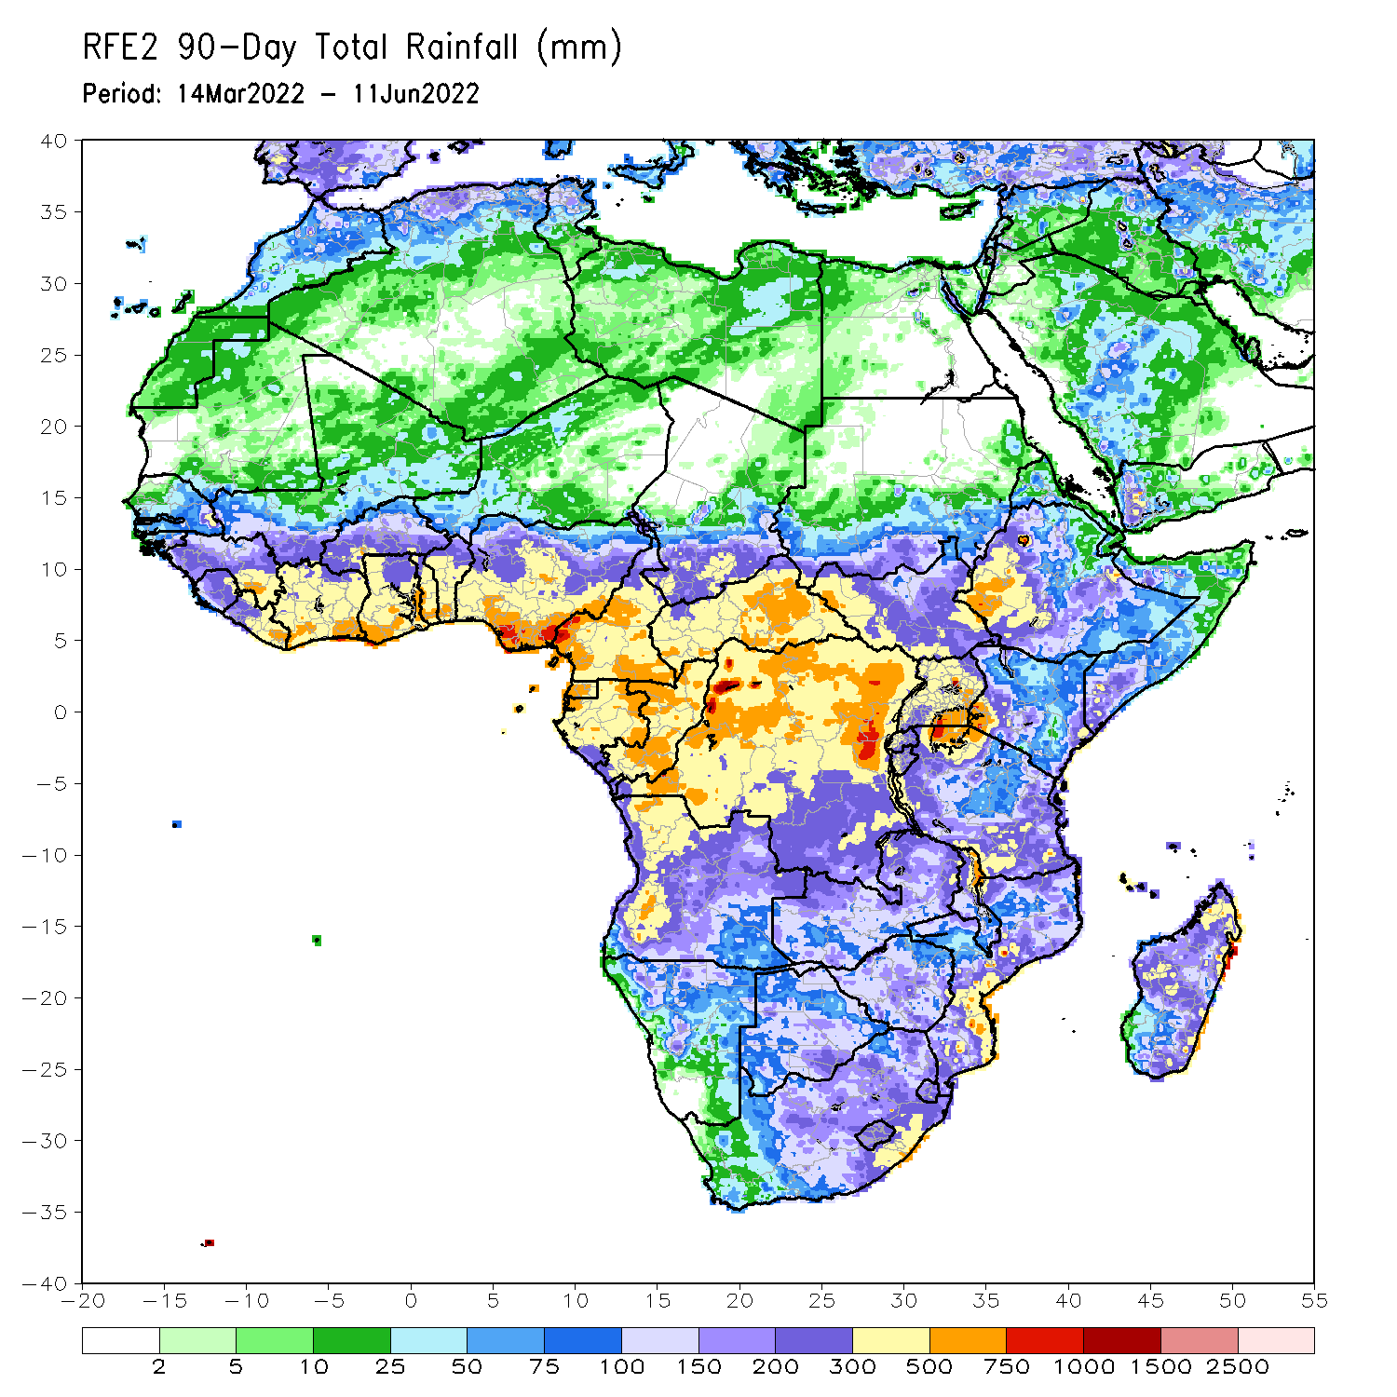
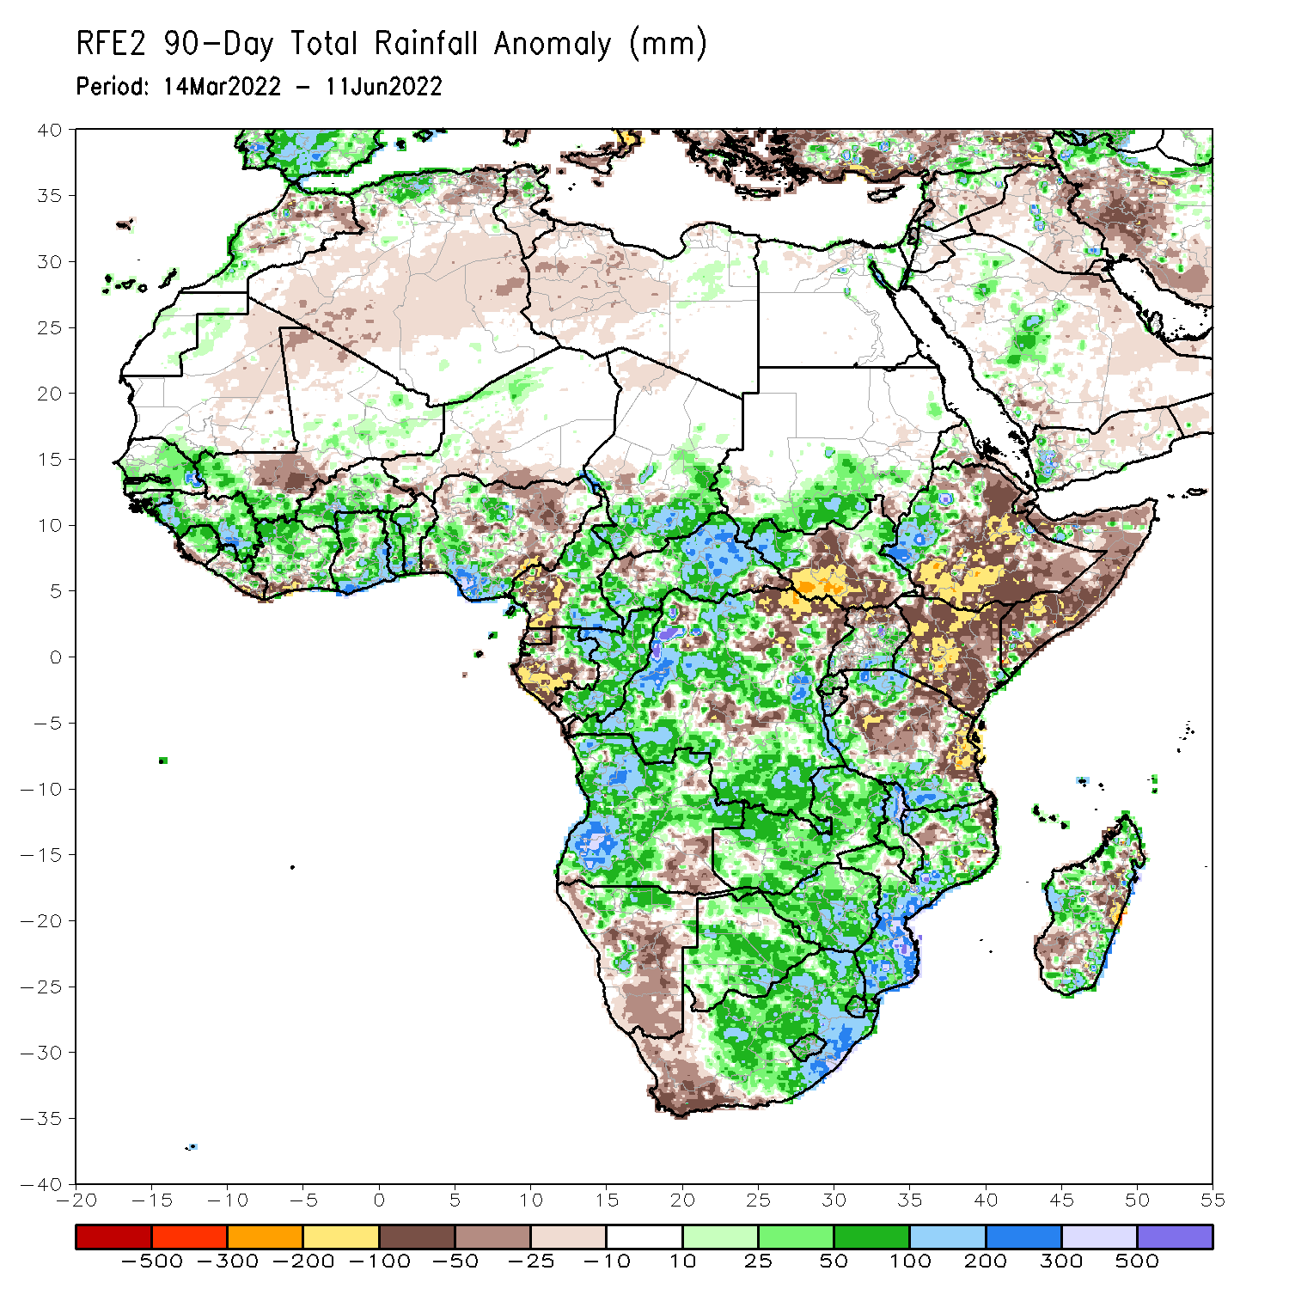
Rainfall Patterns: Last 90 Days
Over the past 90 days, in East Africa, above-average rainfall was observed over parts of southern Sudan, the western and eastern portions of South Sudan, western Ethiopia, and southern and northern parts of Tanzania. Rainfall was below-average over central, southern and eastern Ethiopia, central and southern South Sudan, Kenya, Somalia, northern Uganda, as well as central and eastern Tanzania. In southern Africa, above-average rainfall was observed over much of Angola, Botswana, northern Namibia, Zambia, Malawi, much of Mozambique, many parts of Madagascar and Much of South Africa. Below-average rainfall was observed over pockets of southeastern Angola, western and central Namibia, western South Africa, and pockets of Madagascar. In Central Africa, rainfall was above-average over much of CAR, eastern Gabon, many parts of DRC and Congo. Rainfall was below-average over parts of southwestern Cameroon, parts of central and northeastern DRC, Equatorial Guinea, and western Gabon. In West Africa, rainfall was above-average over much of the Gulf of Guinea region, as well as Senegal and the Gambia, while below-average rainfall was observed over many parts of eastern and northern Nigeria, Niger, Southwestern Cote d’Ivoire, and a portion of southern Mali.
Notes:
4

Slide 5
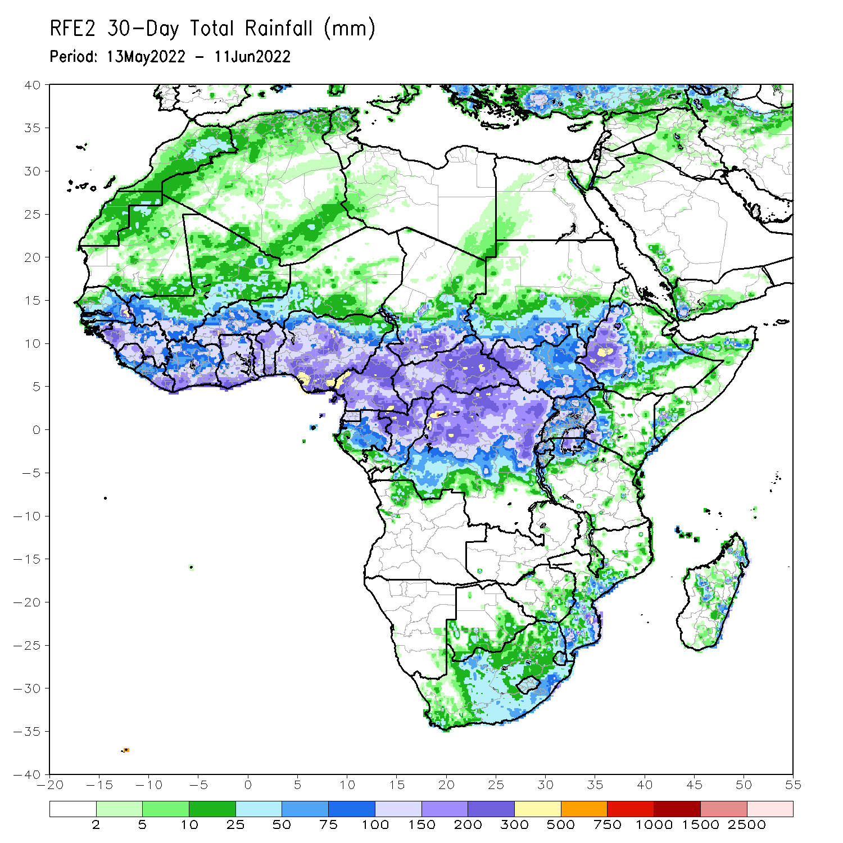
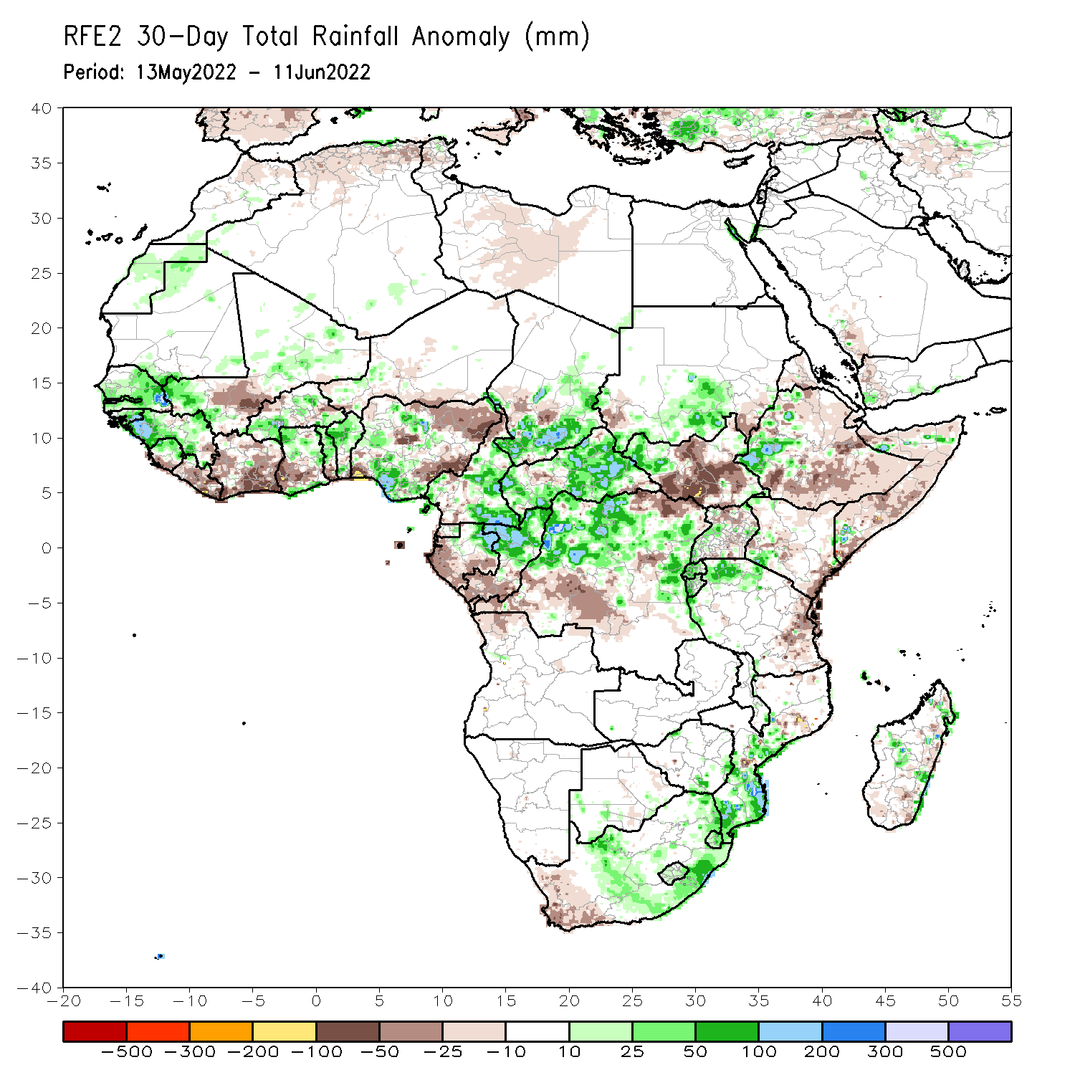
Rainfall Patterns: Last 30 Days
During the past 30 days, in East Africa, above-average rainfall was observed over western Ethiopia, parts of southern Sudan, western South Sudan, and the far northern Tanzania. Rainfall was below-average over eastern, central and southern Ethiopia, the central and southern parts of South Sudan, western and southern Kenya, parts of Uganda and much of Somalia. In Central Africa, rainfall was above-average over many parts of Cameroon, Equatorial Guinea, eastern Gabon, northern Congo, most of CAR and northern and western DRC. Rainfall was below-average over parts of Gabon and western and central DRC. In Southern Africa, above-average rainfall was observed over southern and central portions of Mozambique, scattered parts of Madagascar, as well as central and eastern South Africa. Below-average rainfall was observed over scattered parts of Madagascar and southwestern South Africa. In West Africa, rainfall was above-average over Senegal, Guinea, northern Sierra Leone, much of Burkina Faso, northern Ghana, Togo and Benin and southern and western Nigeria. In contrast, parts of southern Mali, Liberia, Cote D’ivoire, southern Ghana, and parts of eastern and northern Nigeria received below-average rainfall.
Notes:
5

Slide 6
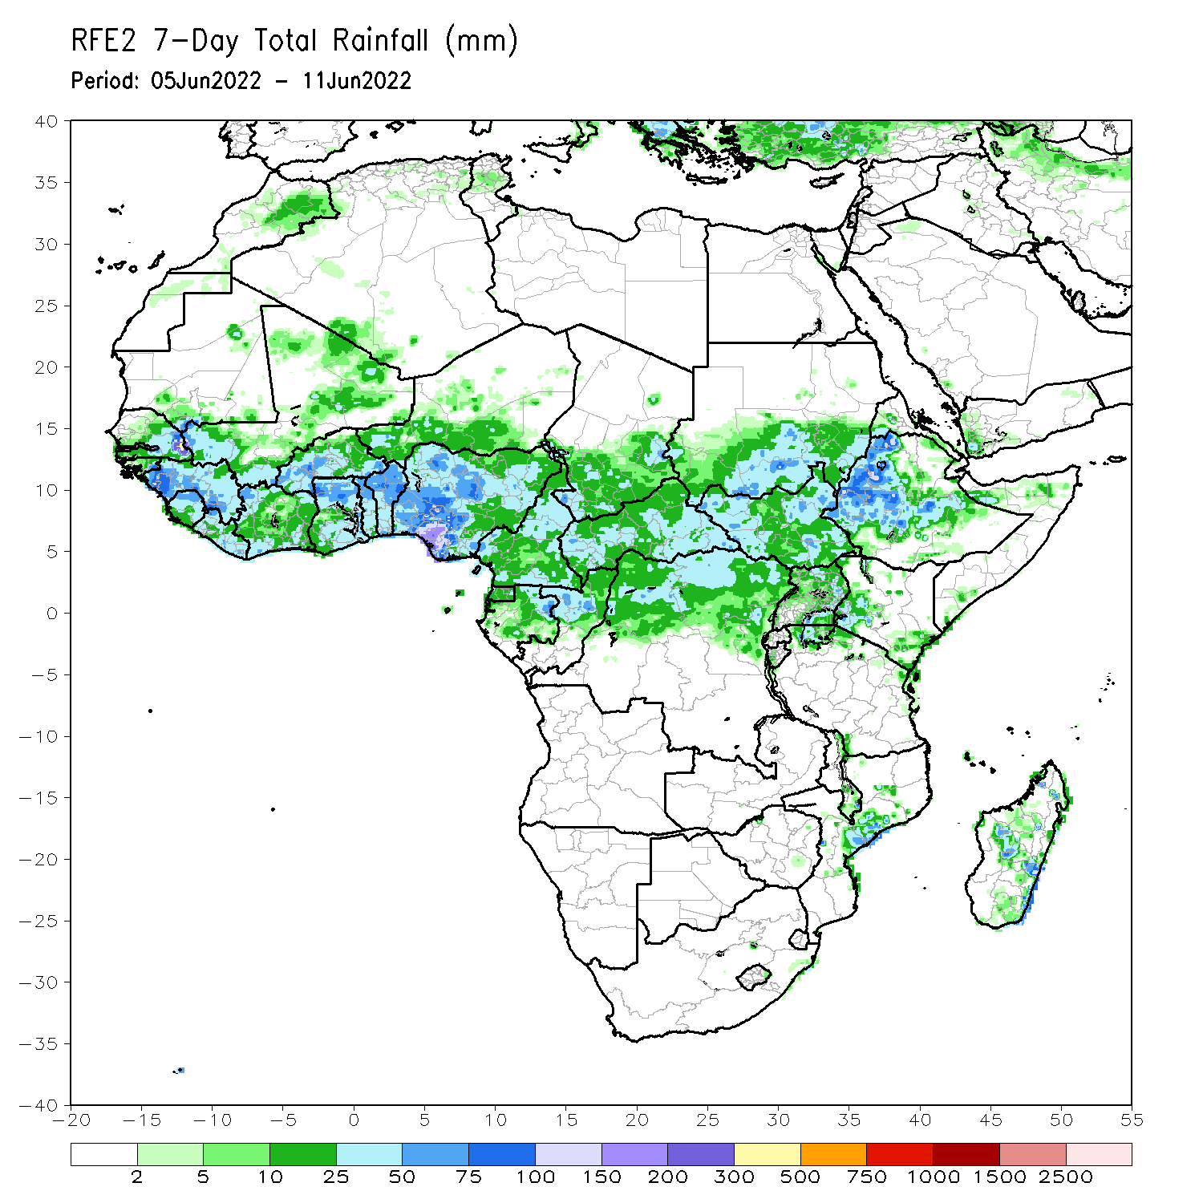
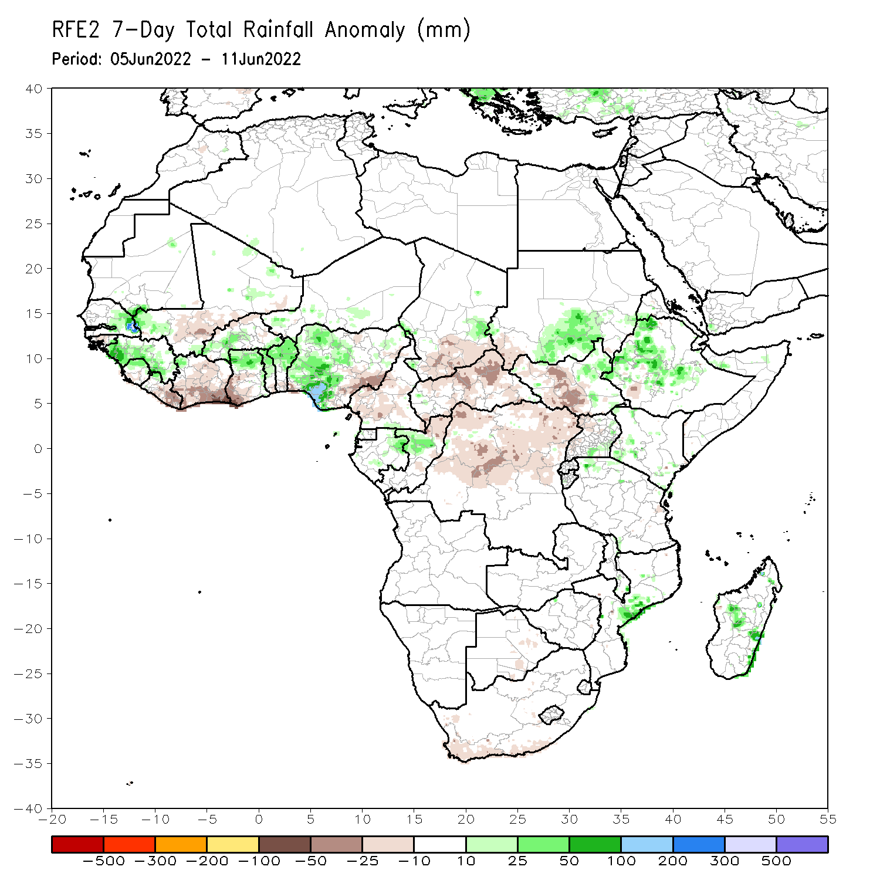
Rainfall Patterns: Last 7 Days
During the past 7 days, in East Africa, rainfall was above-average over parts of western and central Ethiopia, eastern South Sudan, and Sudan, while below-average rainfall was observed over western South Sudan and a small part of southwestern Ethiopia. In Central Africa, rainfall was above-average over parts of Congo, Gabon, and eastern Chad. Below-average rainfall was observed over Cameroon, DRC, CAR, parts of Congo, and much of Chad. In West Africa, above-average rainfall was observed over Guinea, Sierra Leone, parts of western Mali, eastern Senegal, Burkina Faso, northern Ghana, Togo, Benin and western Nigeria. Meanwhile, rainfall was below-average over Liberia, Cote D’Ivoire, southwestern Ghana, eastern Nigeria, and parts of southern Mali.

Slide 7
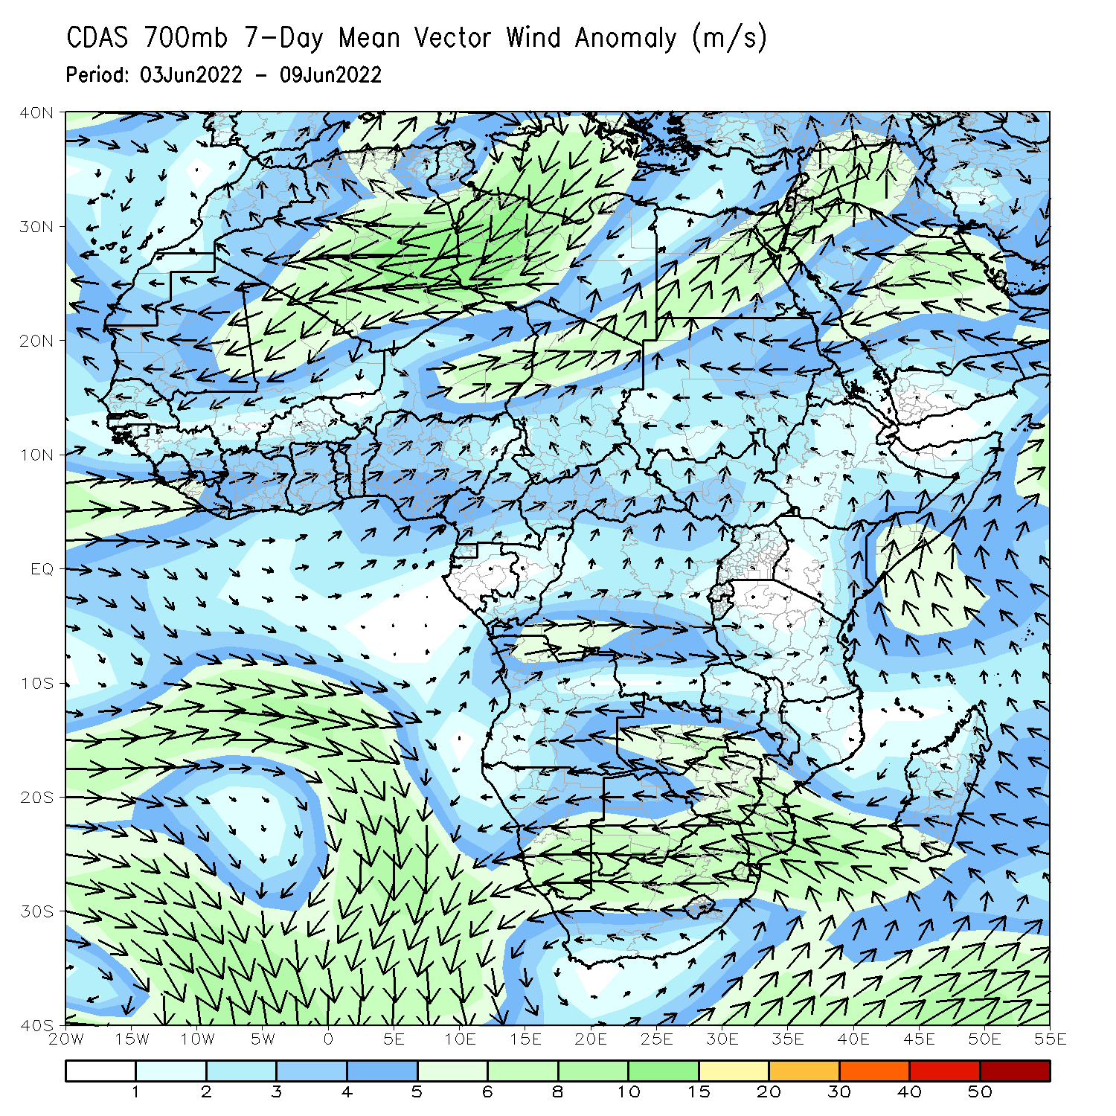
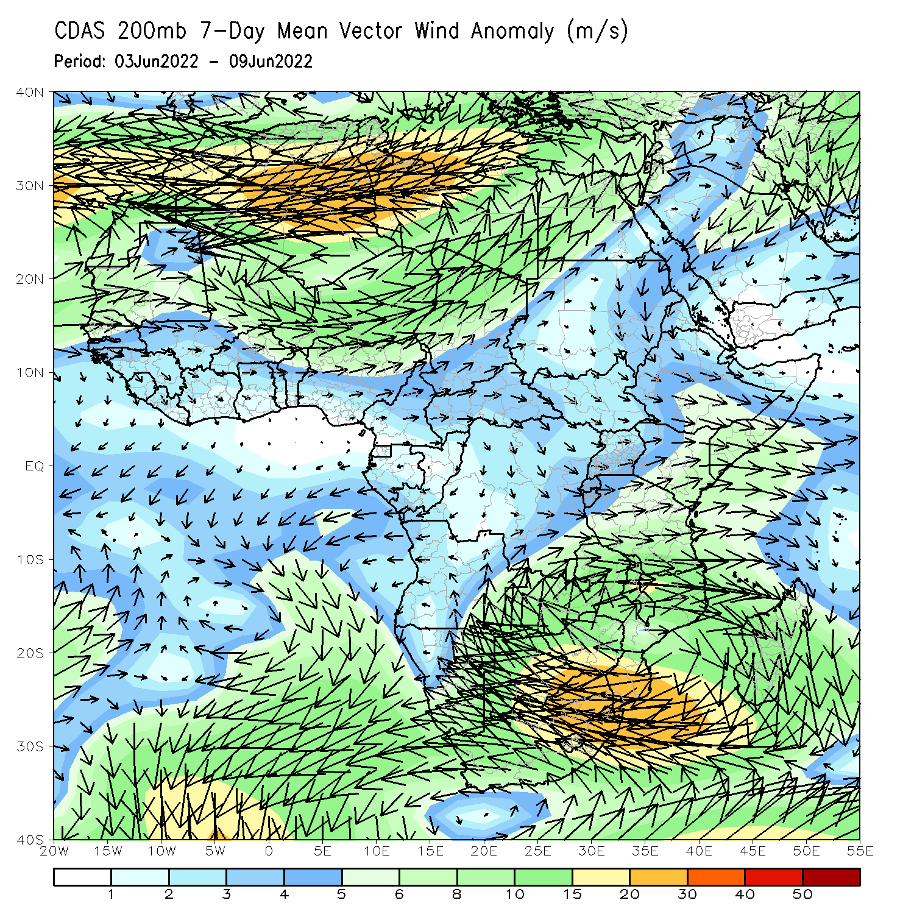
Atmospheric Circulation: Last 7 Days
At 700-hPa level (left panel), anomalous onshore flow across the Gulf of Guinea countries has ushered in moisture and contributed to enhanced rainfall in Nigeria and Guinea. Anomalous cross-equatorial flow in east Africa has contributed to enhanced rainfall in central Ethiopia.

Slide 8
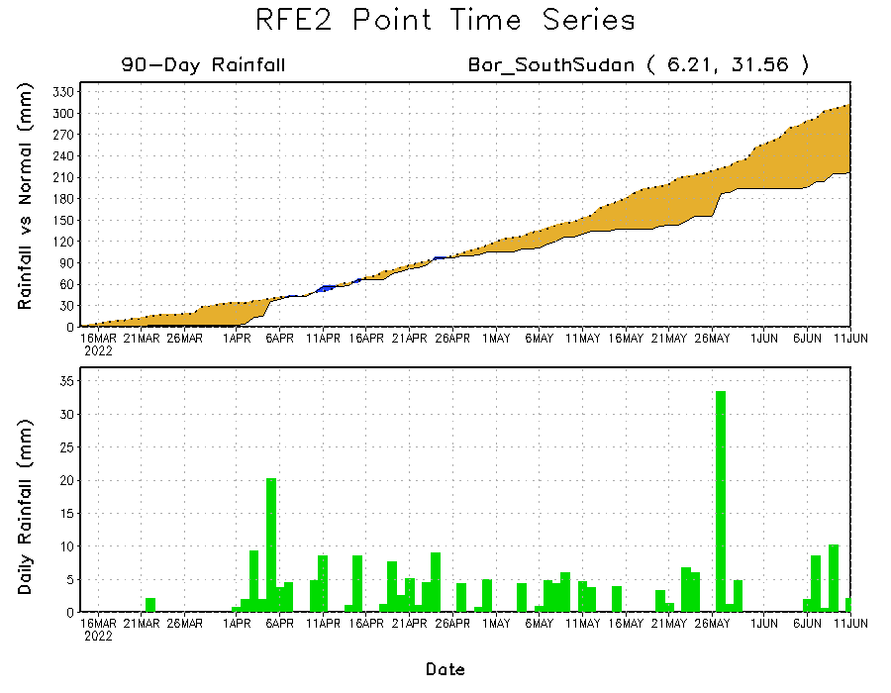
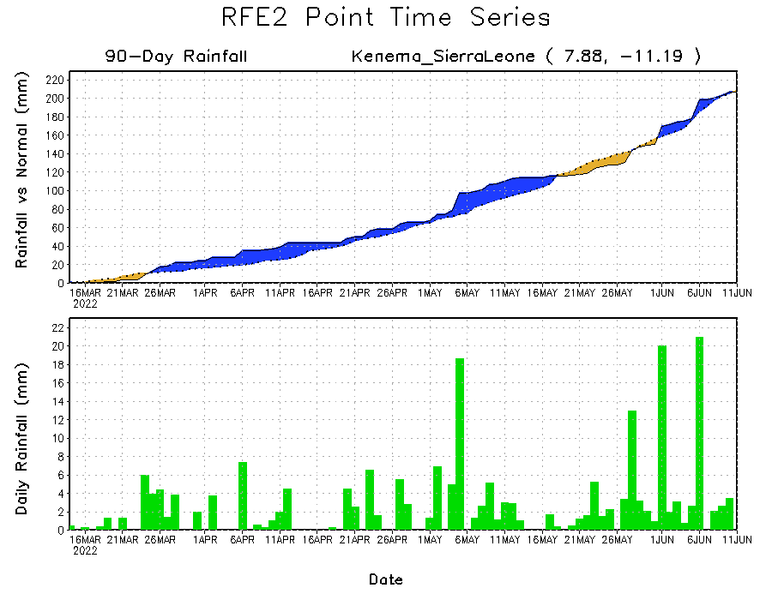
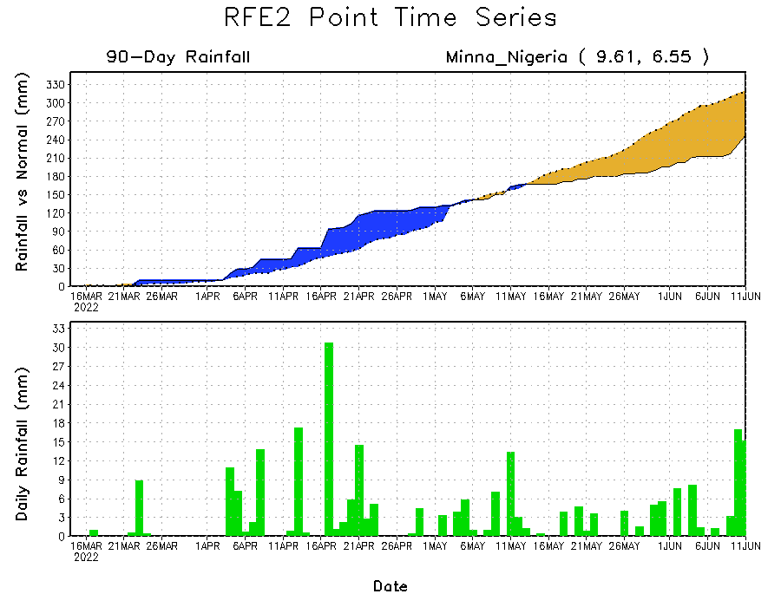
Rainfall Evolution
Daily evolution of rainfall over the last 90 days at selected locations shows increasing moisture deficits over parts of South Sudan (top right) and central portions of Nigeria (bottom right). Recent uptick in daily rainfall rates has flipped rainfall deficits to rainfall surpluses in Sierra Leone (bottom left).

Slide 9
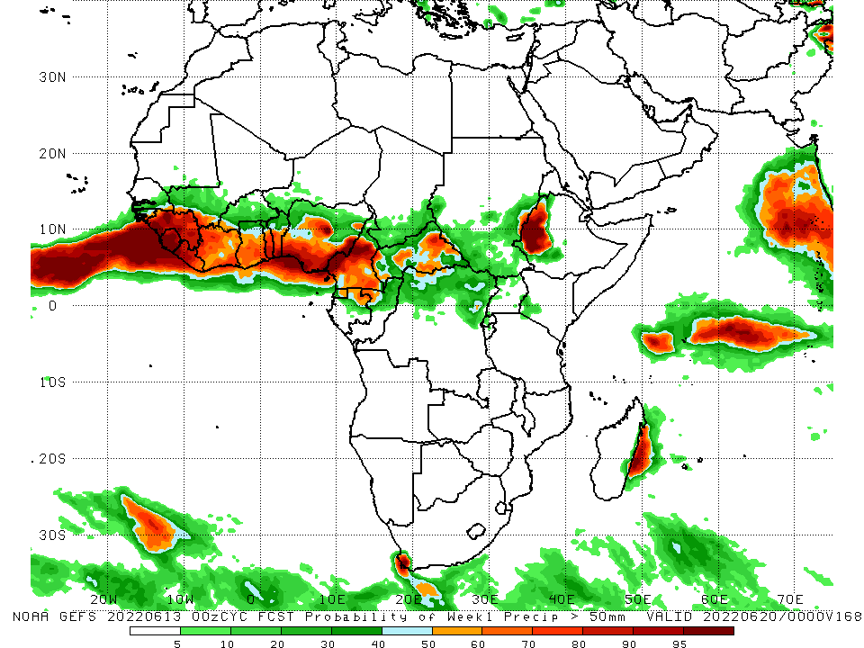
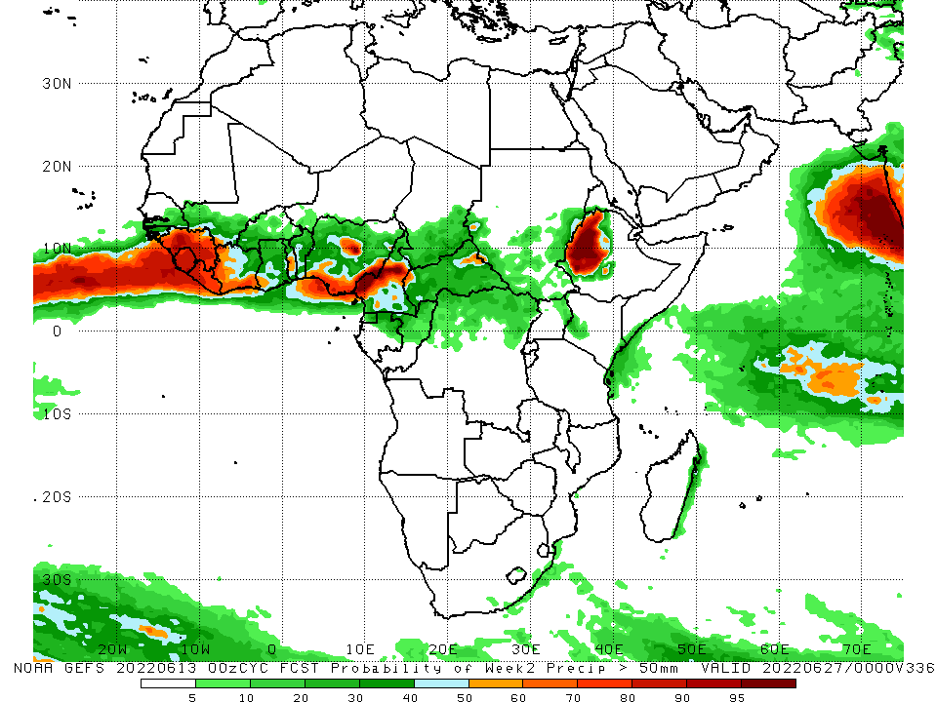
NCEP GEFS Model Forecasts Non-Bias Corrected Probability of precipitation exceedance
Week-1, Valid: 14 – 20 June, 2022
Week-2, Valid: 21 - 27 June, 2022
For week-1 (left panel) the NCEP GEFS indicates a moderate to high chance (over 70%) for rainfall to exceed 50 mm over Guinea, Sierra Leone, Liberia, southern Togo and Benin, Nigeria, Cameroon, and western Ethiopia. For week-2 (right panel), NCEP GEFS indicates a moderate to high chance (over 70%) for rainfall to exceed 50 mm over Guinea, Sierra Leone, Liberia, Nigeria, Cameroon, and western Ethiopia.
Notes:
9

Slide 10
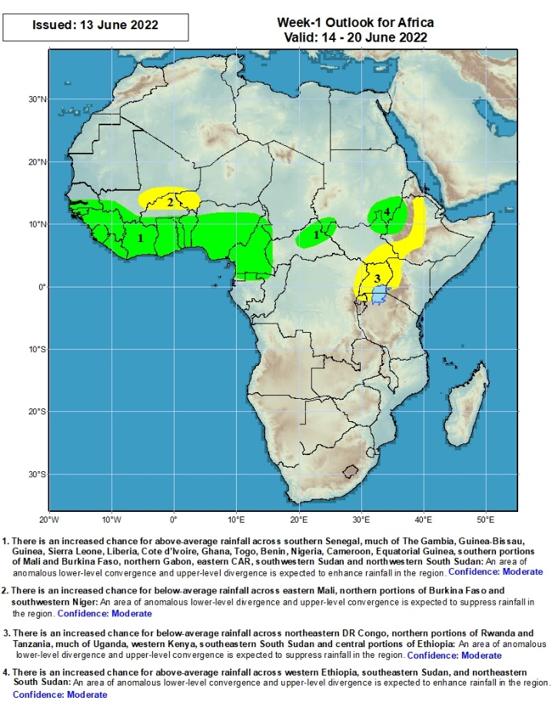
Week-1 Precipitation Outlooks
14 – 20 June, 2022
There is an increased chance for above-average rainfall across southern Senegal, much of The Gambia, Guinea-Bissau, Guinea, Sierra Leone, Liberia, Cote d’Ivoire, Ghana, Togo, Benin, Nigeria, Cameroon, Equatorial Guinea, southern portions of Mali and Burkina Faso, northern Gabon, eastern CAR, southwestern Sudan and northwestern South Sudan: An area of anomalous lower-level convergence and upper-level divergence is expected to enhance rainfall in the region. Confidence: Moderate
There is an increased chance for below-average rainfall across eastern Mali, northern portions of Burkina Faso and southwestern Niger: An area of anomalous lower-level divergence and upper-level convergence is expected to suppress rainfall in the region. Confidence: Moderate
There is an increased chance for below-average rainfall across northeastern DR Congo, northern portions of Rwanda and Tanzania, much of Uganda, western Kenya, southeastern South Sudan and central portions of Ethiopia: An area of anomalous lower-level divergence and upper-level convergence is expected to suppress rainfall in the region. Confidence: Moderate
There is an increased chance for above-average rainfall across western Ethiopia, southeastern Sudan, and northeastern South Sudan: An area of anomalous lower-level convergence and upper-level divergence is expected to enhance rainfall in the region. Confidence: Moderate
Notes:
10

Slide 11
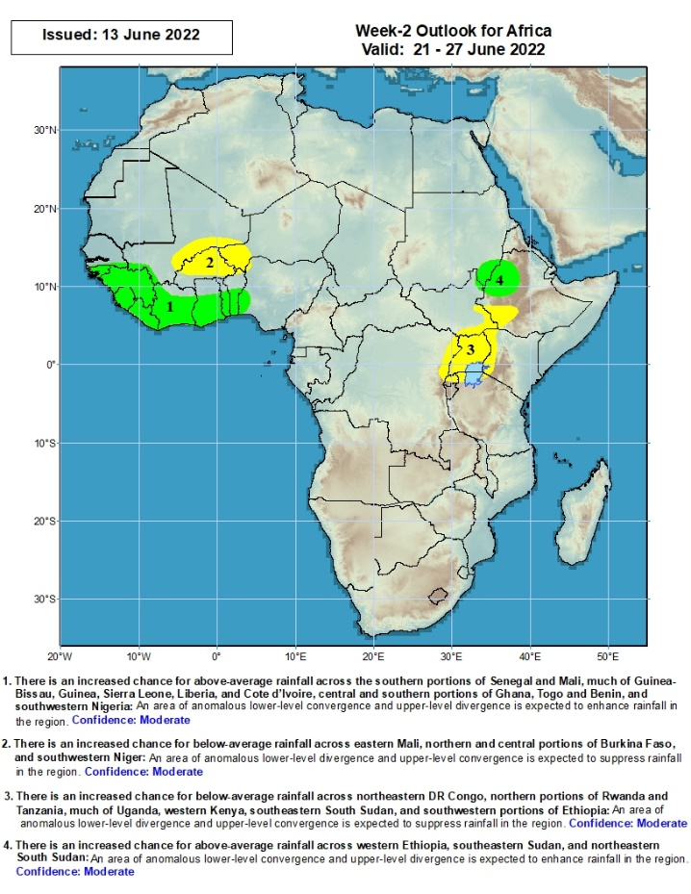
Week-2 Precipitation Outlooks
21 - 27 June, 2022
There is an increased chance for above-average rainfall across the southern portions of Senegal and Mali, much of Guinea-Bissau, Guinea, Sierra Leone, Liberia, and Cote d’Ivoire, central and southern portions of Ghana, Togo and Benin, and southwestern Nigeria: An area of anomalous lower-level convergence and upper-level divergence is expected to enhance rainfall in the region. Confidence: Moderate
There is an increased chance for below-average rainfall across eastern Mali, northern and central portions of Burkina Faso, and southwestern Niger: An area of anomalous lower-level divergence and upper-level convergence is expected to suppress rainfall in the region. Confidence: Moderate
There is an increased chance for below-average rainfall across northeastern DR Congo, northern portions of Rwanda and Tanzania, much of Uganda, western Kenya, southeastern South Sudan, and southwestern portions of Ethiopia: An area of anomalous lower-level divergence and upper-level convergence is expected to suppress rainfall in the region. Confidence: Moderate
There is an increased chance for above-average rainfall across western Ethiopia, southeastern Sudan, and northeastern South Sudan: An area of anomalous lower-level convergence and upper-level divergence is expected to enhance rainfall in the region. Confidence: Moderate
Notes:
11

Slide 12
Summary
During the past 30 days, in East Africa, above-average rainfall was observed over western Ethiopia, parts of southern Sudan, western South Sudan, and the far northern Tanzania. Rainfall was below-average over eastern, central and southern Ethiopia, the central and southern parts of South Sudan, western and southern Kenya, parts of Uganda and much of Somalia. In Central Africa, rainfall was above-average over many parts of Cameroon, Equatorial Guinea, eastern Gabon, northern Congo, most of CAR and northern and western DRC. Rainfall was below-average over parts of Gabon and western and central DRC. In Southern Africa, above-average rainfall was observed over southern and central portions of Mozambique, scattered parts of Madagascar, as well as central and eastern South Africa. Below-average rainfall was observed over scattered parts of Madagascar and southwestern South Africa. In West Africa, rainfall was above-average over Senegal, Guinea, northern Sierra Leone, much of Burkina Faso, northern Ghana, Togo and Benin and southern and western Nigeria. In contrast, parts of southern Mali, Liberia, Cote D’ivoire, southern Ghana, and parts of eastern and northern Nigeria received below-average rainfall.
During the past 7 days, in East Africa, rainfall was above-average over parts of western and central Ethiopia, eastern South Sudan, and Sudan, while below-average rainfall was observed over western South Sudan and a small part of southwestern Ethiopia. In Central Africa, rainfall was above-average over parts of Congo, Gabon, and eastern Chad. Below-average rainfall was observed over Cameroon, DRC, CAR, parts of Congo, and much of Chad. In West Africa, above-average rainfall was observed over Guinea, Sierra Leone, parts of western Mali, eastern Senegal, Burkina Faso, northern Ghana, Togo, Benin and western Nigeria. Meanwhile, rainfall was below-average over Liberia, Cote D’Ivoire, southwestern Ghana, eastern Nigeria, and parts of southern Mali.
Week-1 outlook calls for an increased chance for below-average rainfall over parts of the central Sahel , and portions of East Africa, including Uganda Southern South Sudan and central Ethiopia. Meanwhile, above-average rainfall is likely over the Gulf of Guinea Countries, as well as CAR in Central Africa. Week-2 outlook suggests an increased chance for below-average rainfall over parts of the central Sahel , and portions of East Africa, including Uganda southern South Sudan and southwestern Ethiopia, while above-average rainfall is likely over parts West Africa stretching from Guinea through Benin, as well as eastern Ethiopia..

