Slide 1
The African Monsoon Recent Evolution and Current Status Include Week-1 and Week-2 Outlooks
Update prepared by
6 June 2022
For more information, visit:
http://www.cpc.ncep.noaa.gov/products/Global_Monsoons/African_Monsoons/precip_monitoring.shtml

Slide 2
Outline
Highlights
Recent Evolution and Current Conditions
NCEP GEFS Forecasts
Summary

Slide 3
Highlights: Last 7 Days
During the past 7 days, in East Africa, rainfall was above-average over parts of western Ethiopia, western South Sudan, and the far northern Tanzania, while below-average rainfall was observed over a large portion of South Sudan and southwestern Sudan. In Central Africa, rainfall was above-average over southern Cameroon, northern Congo, Equatorial Guinea, parts of CAR and DRC, and southern Chad. Below-average rainfall was observed over northern Cameroon, parts of Gabon and DRC, and western CAR. In West Africa, above-average rainfall was observed over Guinea, Sierra Leone, Liberia, parts of Mali, and Burkina Faso, while rainfall was below-average over parts of Cote D’Ivoire, Ghana, Togo, and Nigeria.
Week-1 outlook calls for an increased chance for below-average rainfall over parts of West and East Africa, while above-average rainfall is likely over the far-western West Africa and, as well as Gabon, Equatorial Guinea, and southern Cameroon in Central Africa. Week-2 outlook suggests an increased chance for below-average rainfall over western parts of Central Africa, Uganda, and a portion of Ethiopia, while above-average rainfall is likely over far-western Africa, CAR, southern Chad and far-western Ethiopia.

Slide 4
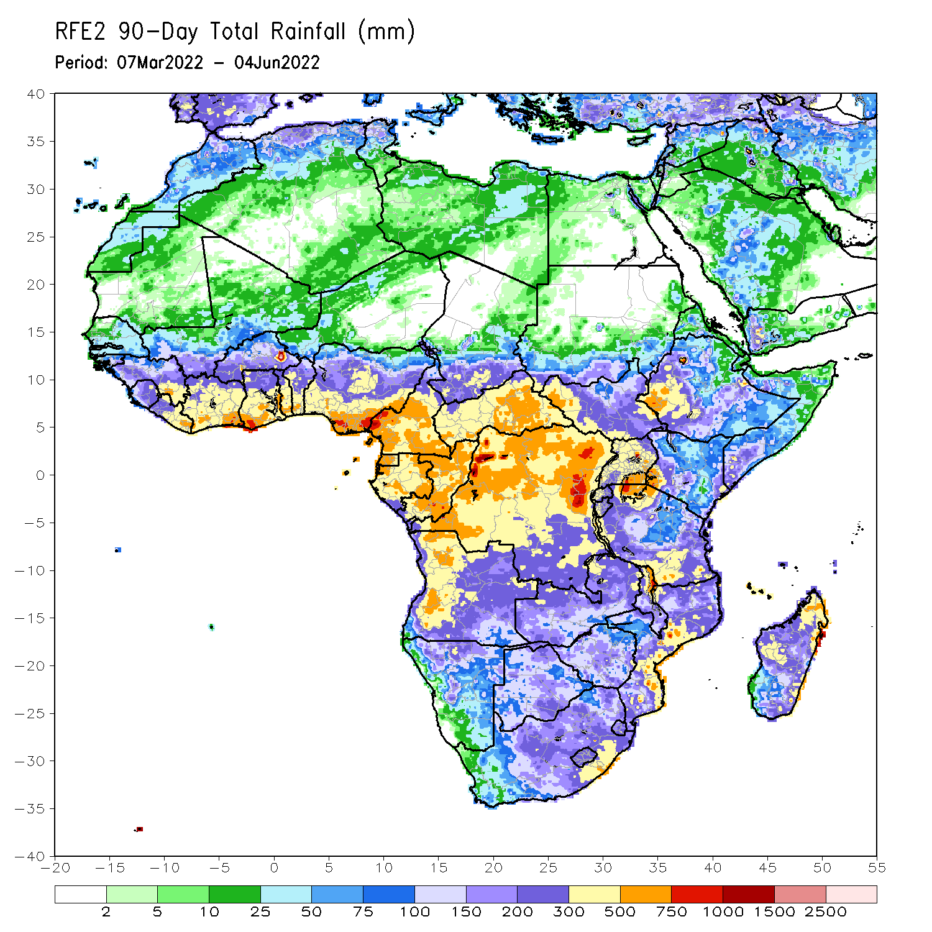
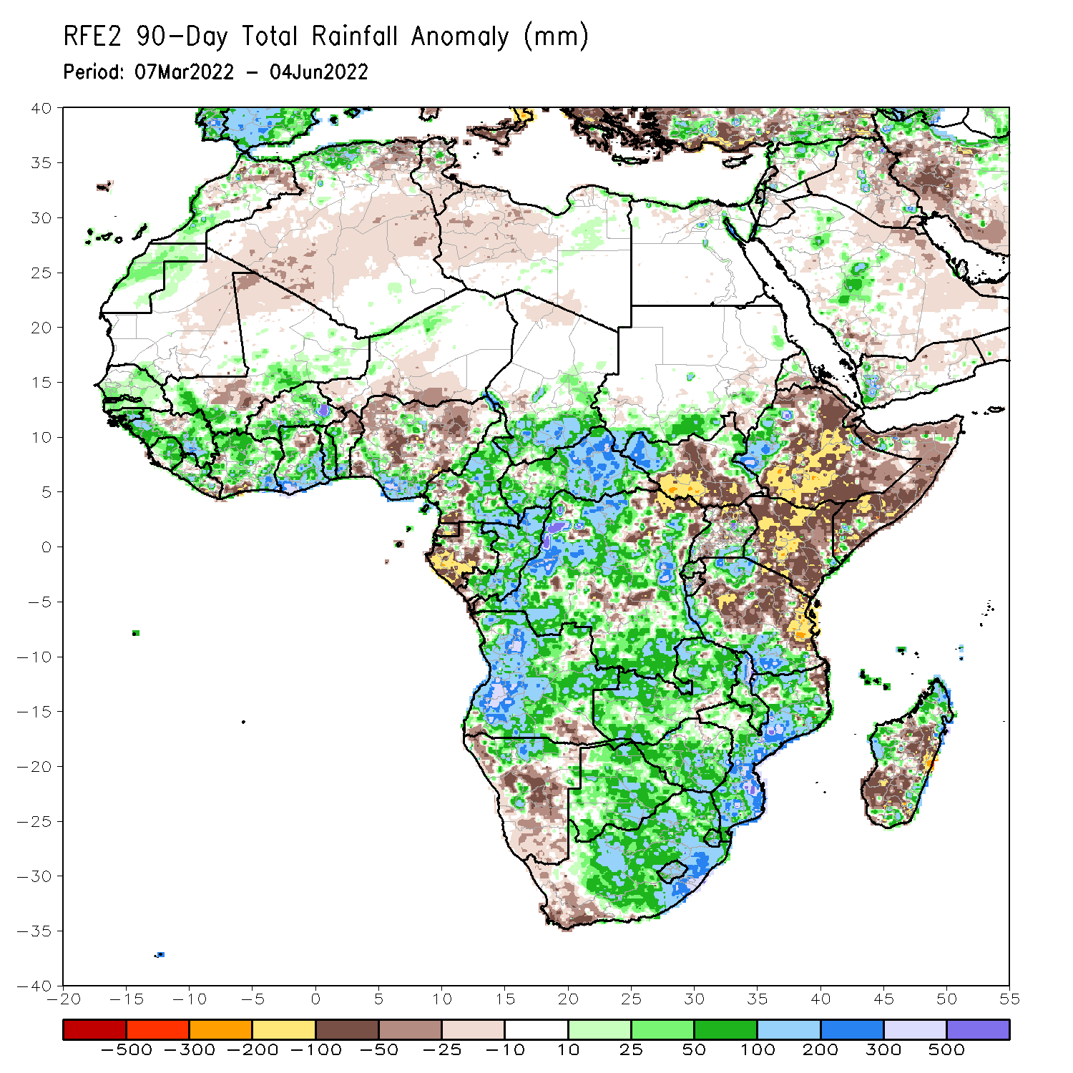
Rainfall Patterns: Last 90 Days
Over the past 90 days, in East Africa, above-average rainfall was observed over parts of southern Sudan, the western and eastern portions of South Sudan, western Ethiopia, and southern Tanzania. Rainfall was below-average over central, southern and eastern Ethiopia, central and southern South Sudan, much of Kenya, Somalia, northern Uganda, as well as northern and eastern Tanzania. In southern Africa, above-average rainfall was observed over much of Angola, Botswana, northern Namibia, Zambia, Malawi, much of Mozambique, many parts of Madagascar and Much of South Africa. Below-average rainfall was observed over pockets of southeastern Angola, western and central Namibia, western South Africa, and pockets of Madagascar. In Central Africa, rainfall was above-average over much of CAR, eastern Gabon, many parts of DRC and Congo. Rainfall was below-average over parts of southwestern Cameroon, parts of central and northeastern DRC, Equatorial Guinea, and western Gabon. In West Africa, rainfall was above-average over much of the Gulf of Guinea region, while below-average rainfall was observed over many parts of central and northern Nigeria, Niger, northern Benin and a portion of southern Mali.
Notes:
4

Slide 5
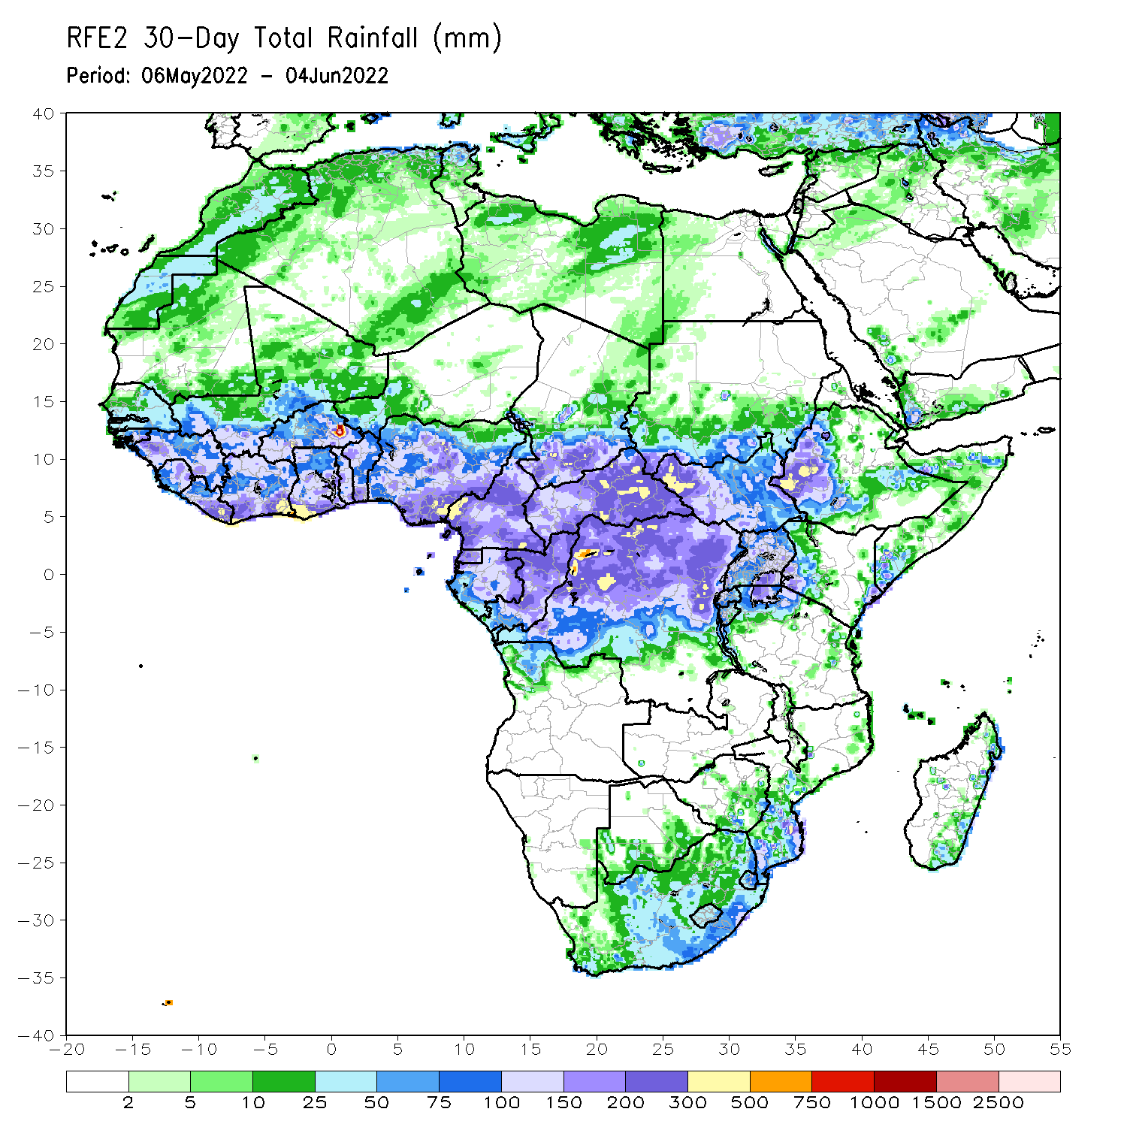
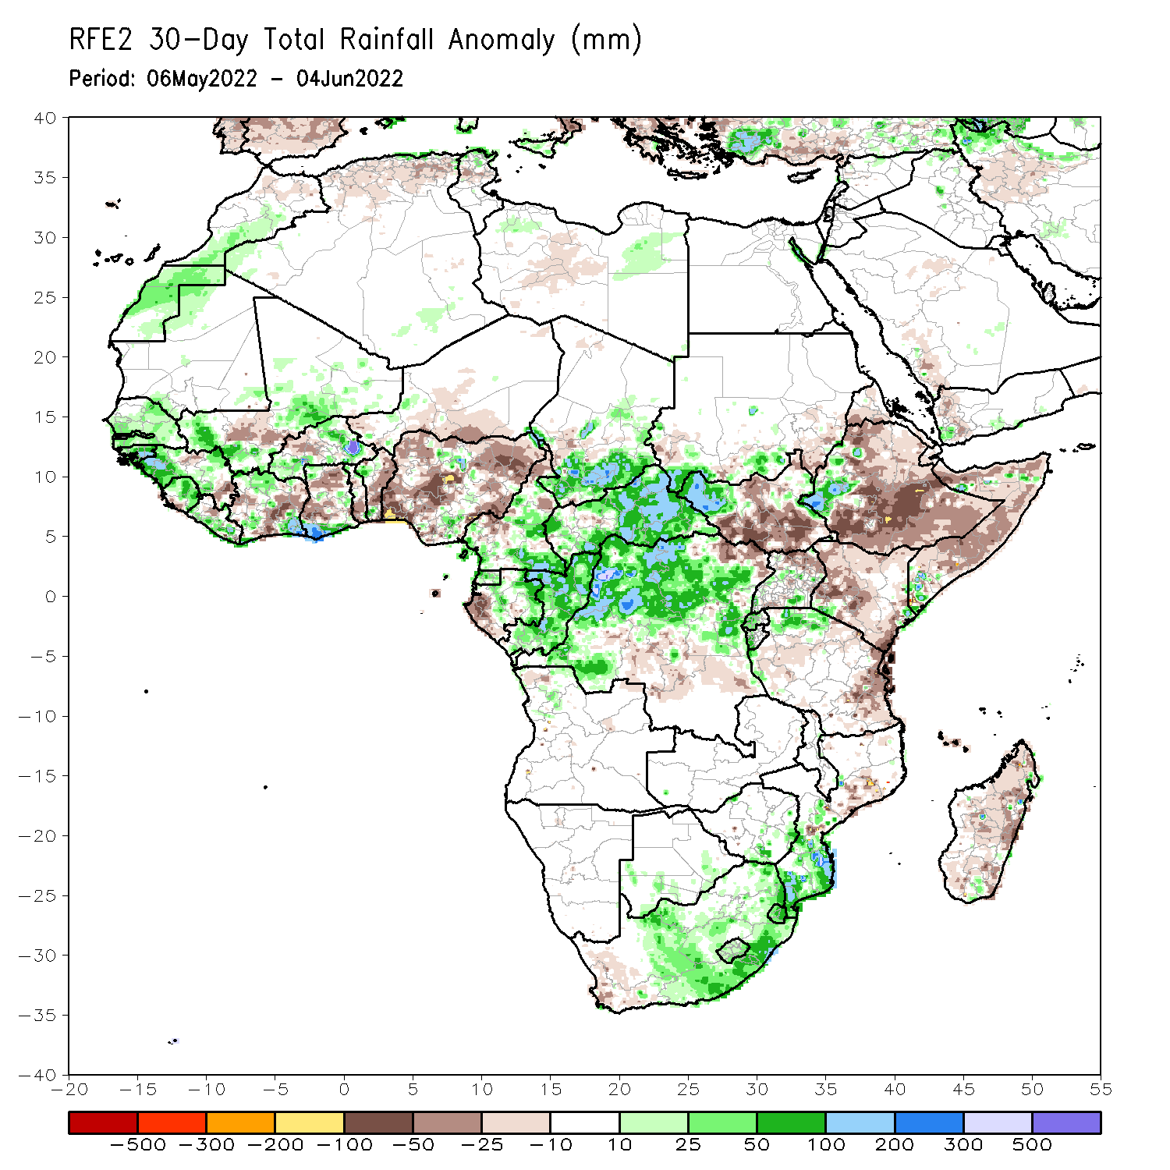
Rainfall Patterns: Last 30 Days
During the past 30 days, in East Africa, above-average rainfall was observed over western Ethiopia, parts of southern Sudan, western South Sudan, and the far northern Tanzania. Rainfall was below-average over eastern, central and southern Ethiopia, the central and southern parts of South Sudan, western, southern, and central Kenya, and much of Somalia. In Central Africa, rainfall was above-average over many parts of Cameroon, Equatorial Guinea, eastern Gabon, Congo, much of CAR and northern and western DRC. Rainfall was below-average over pockets of Gabon. In Southern Africa, above-average rainfall was observed over southern portions of Mozambique as well as central and eastern South Africa. Below-average rainfall was observed over many parts of Madagascar and southwestern South Africa. In West Africa, rainfall was above-average over parts of Senegal, Guinea, Liberia, Sierra Leone, and Cote d’Ivoire. In contrast, parts of southern Mali, central Burkina Faso, Parts of Ghana, Togo and Benin, and Nigeria received below-average rainfall.
Notes:
5

Slide 6
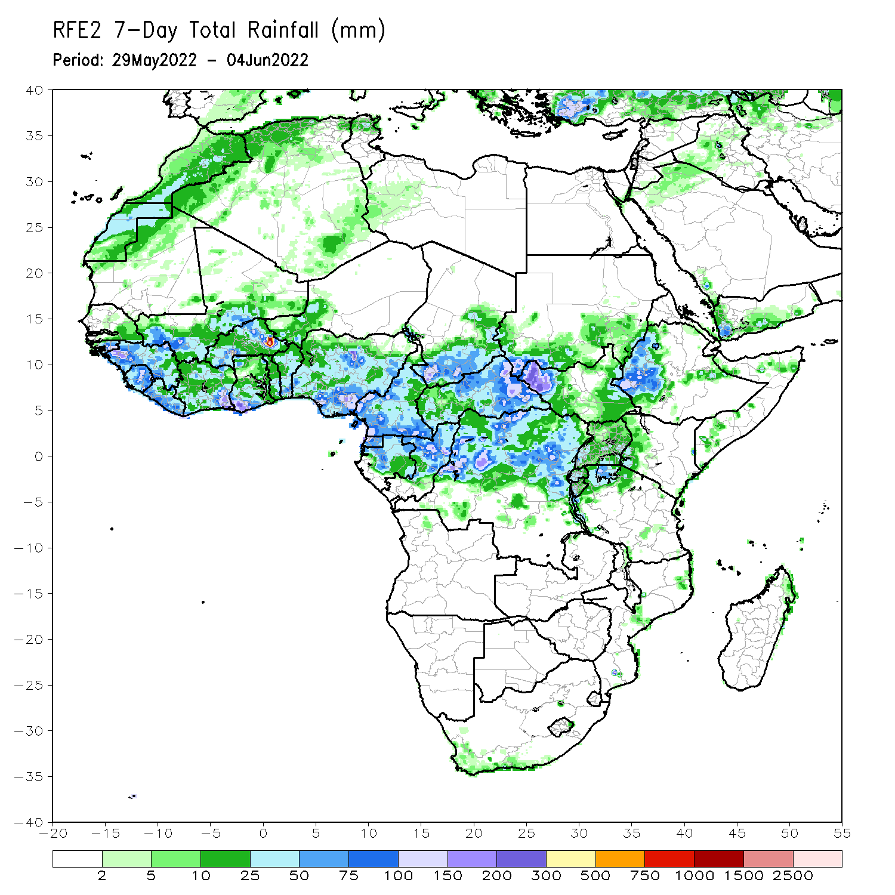
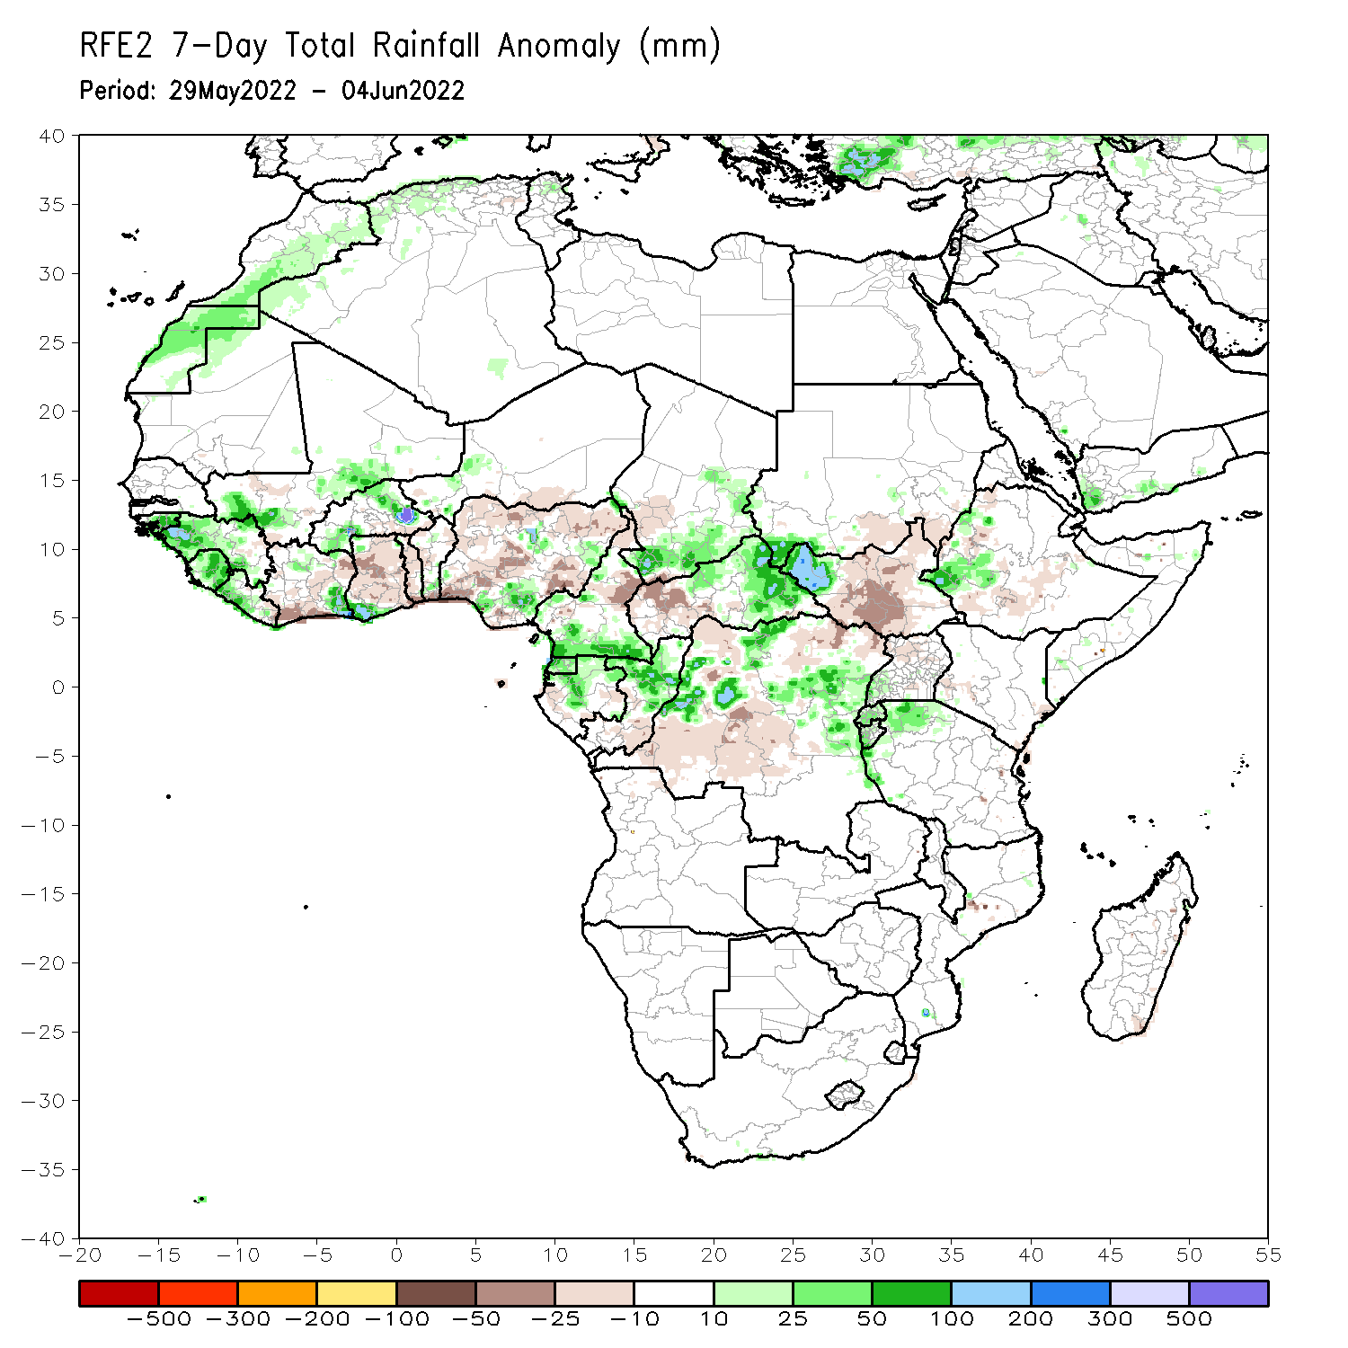
Rainfall Patterns: Last 7 Days
During the past 7 days, in East Africa, rainfall was above-average over parts of western Ethiopia, western South Sudan, and the far northern Tanzania, while below-average rainfall was observed over a large portion of South Sudan and southwestern Sudan. In Central Africa, rainfall was above-average over southern Cameroon, northern Congo, Equatorial Guinea, parts of CAR and DRC, and southern Chad. Below-average rainfall was observed over northern Cameroon, parts of Gabon and DRC, and western CAR. In West Africa, above-average rainfall was observed over Guinea, Sierra Leone, Liberia, parts of Mali, and Burkina Faso, while rainfall was below-average over parts of Cote D’Ivoire, Ghana, Togo, and Nigeria.

Slide 7
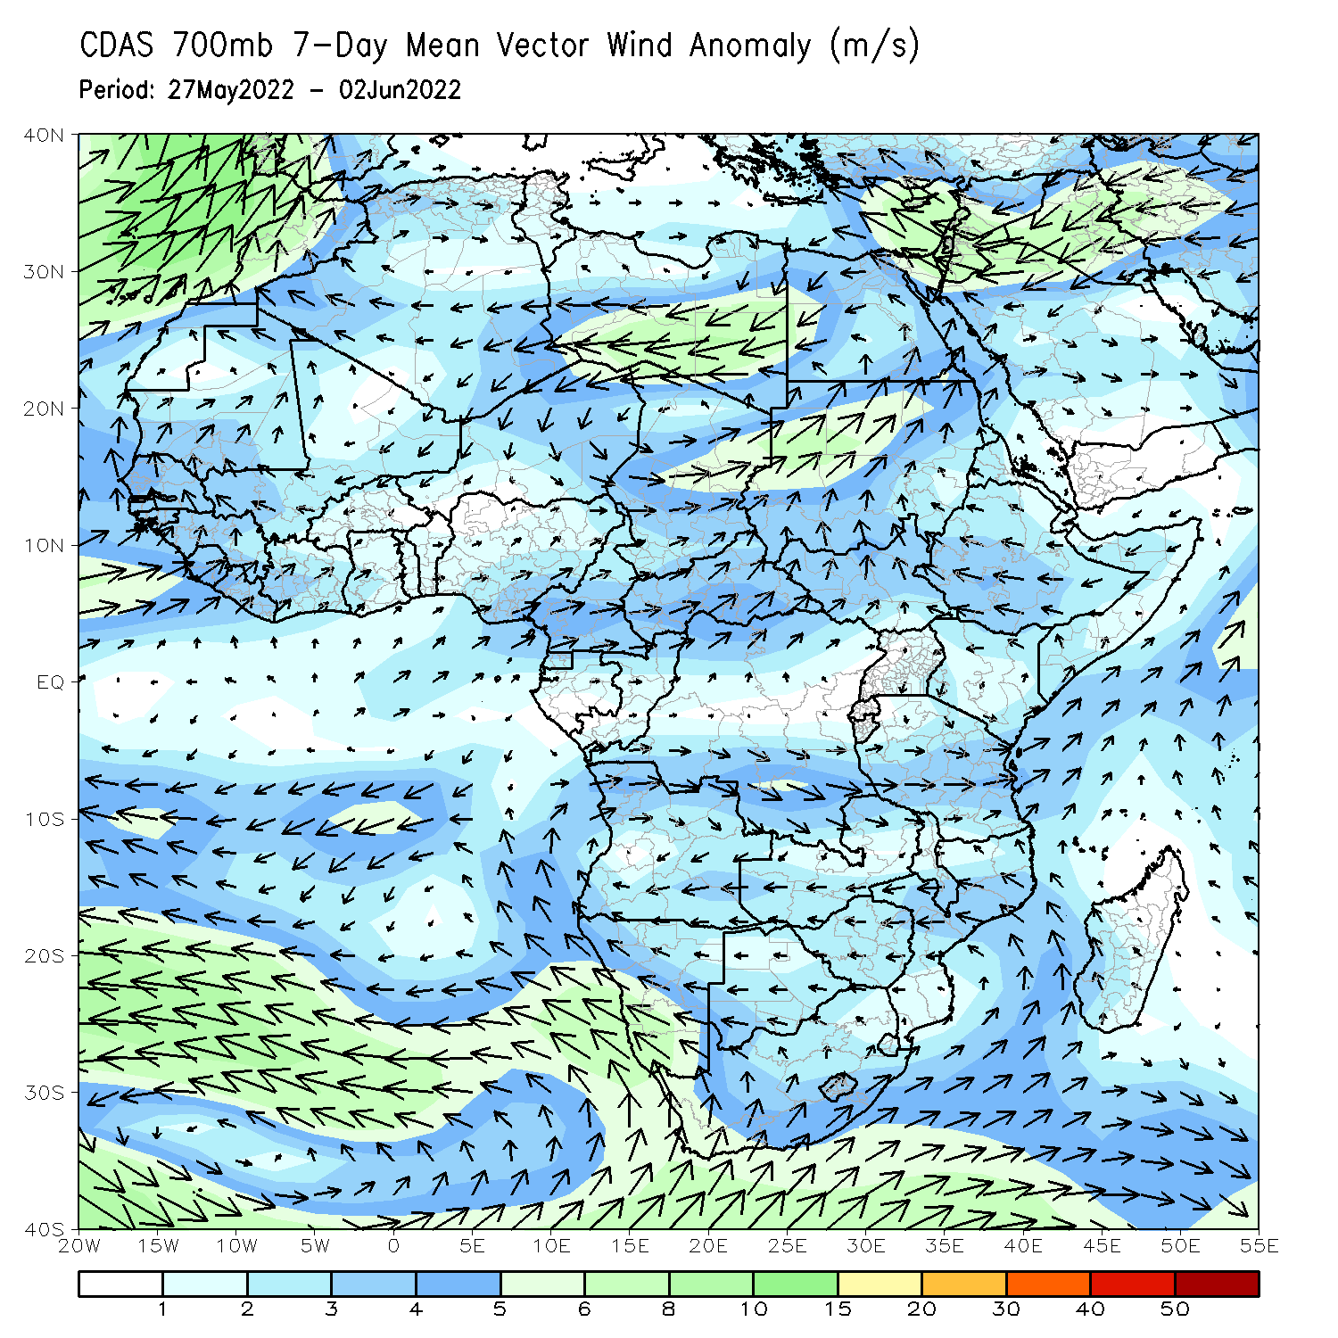
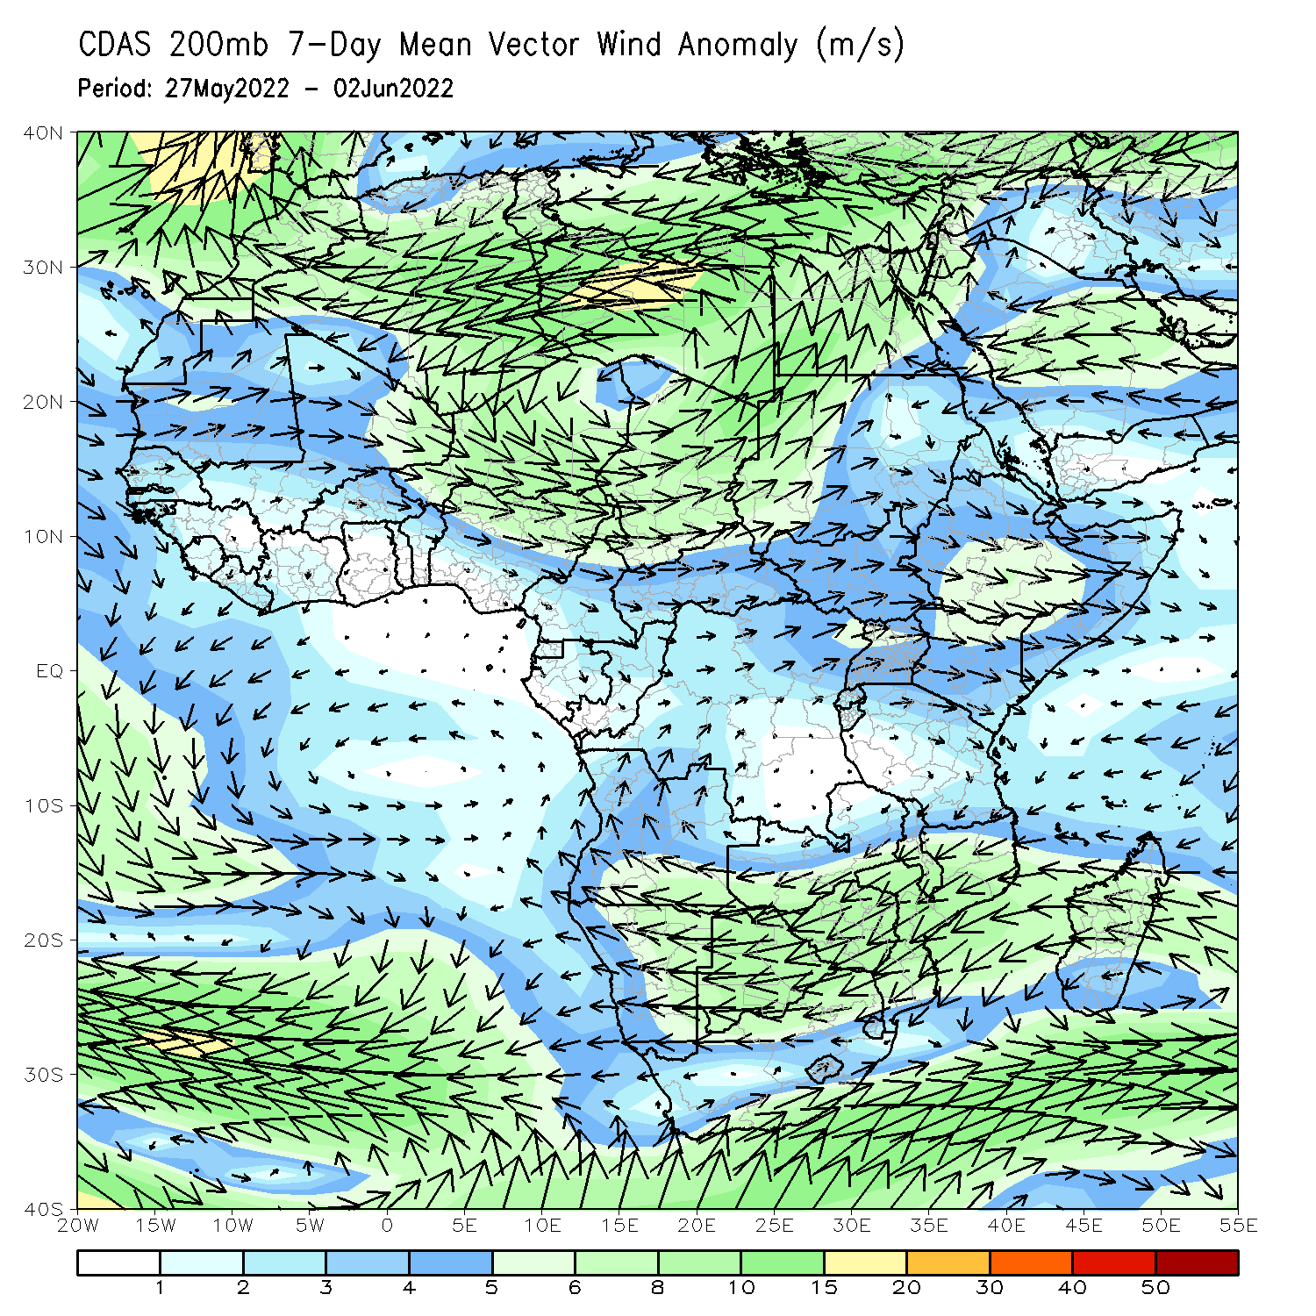
Atmospheric Circulation: Last 7 Days
At 700-hPa level (left panel), anomalous westerly flow across the far western Gulf of Guinea has ushered in moisture and contributed to enhanced rainfall in that region.

Slide 8
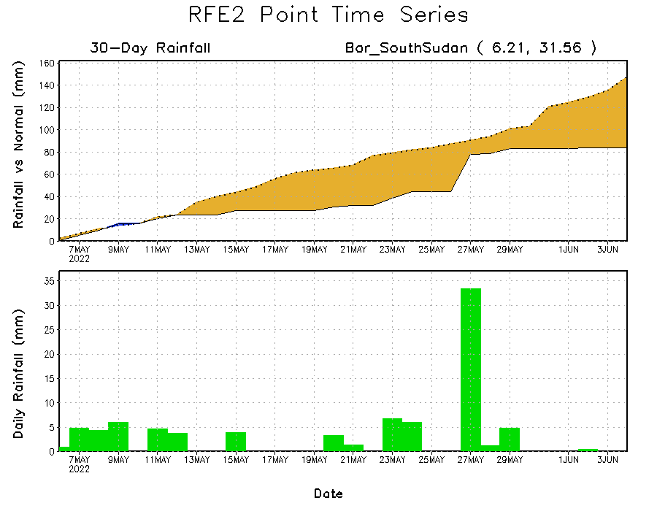
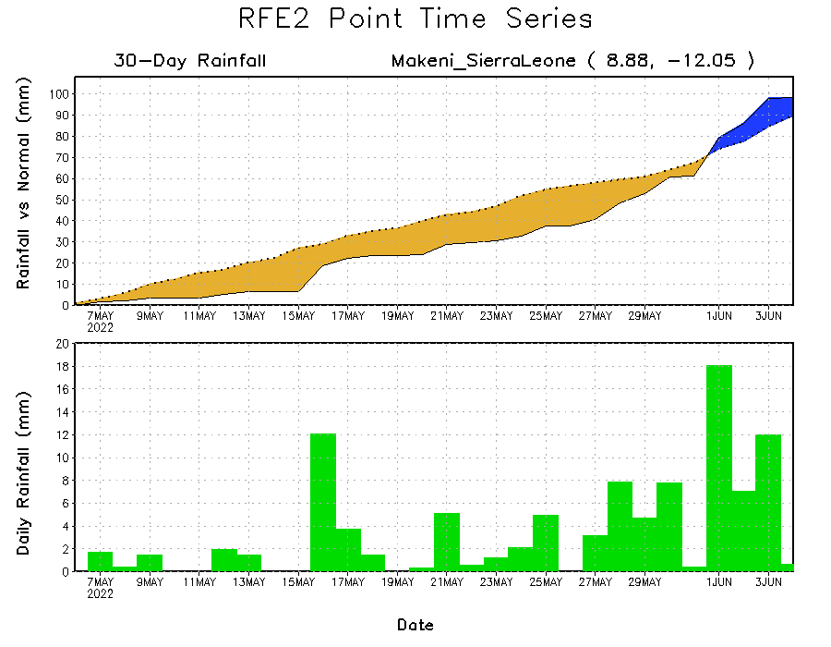
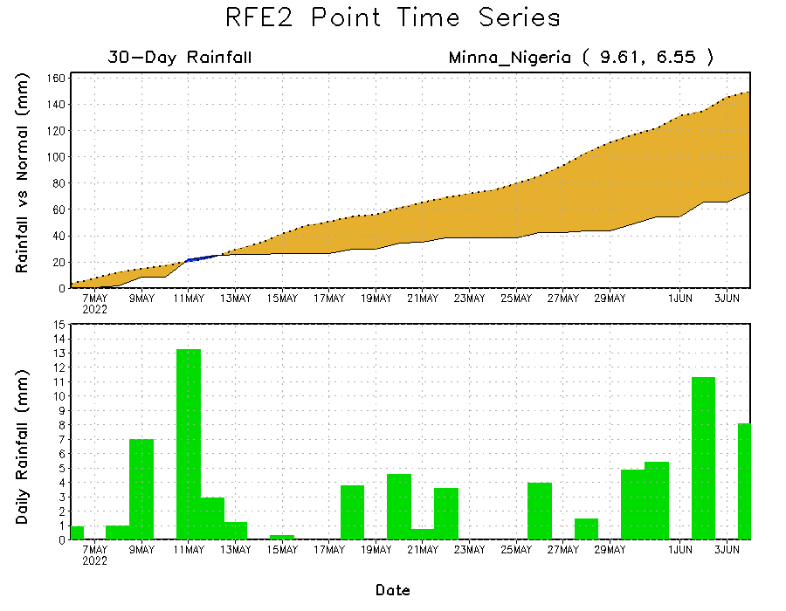
Rainfall Evolution
Daily evolution of rainfall over the last 30 days at selected locations shows increasing moisture deficits over parts of South Sudan (top right) and central portions of Nigeria (bottom right). Reason uptick in daily rainfall rates has flipped rainfall deficits to rainfall surpluses in Sierra Leone (bottom left).

Slide 9
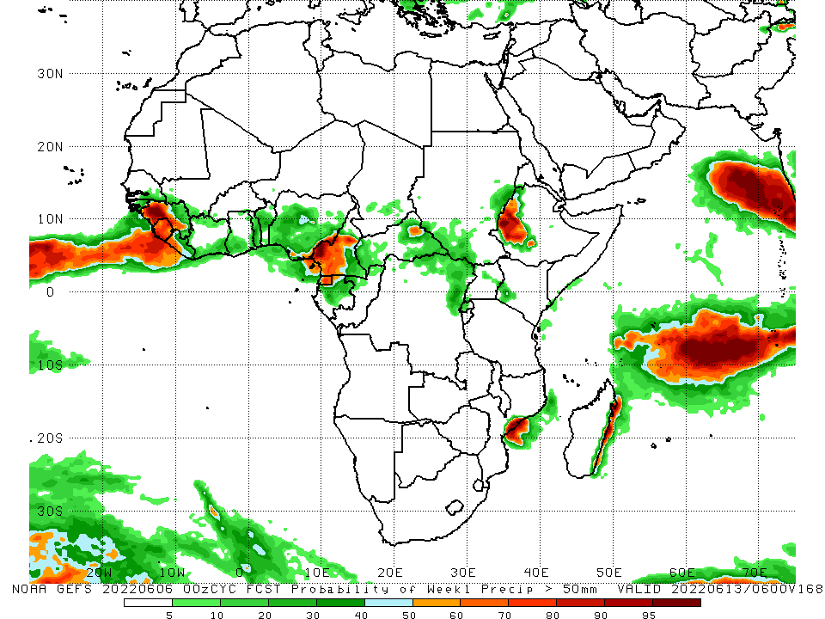
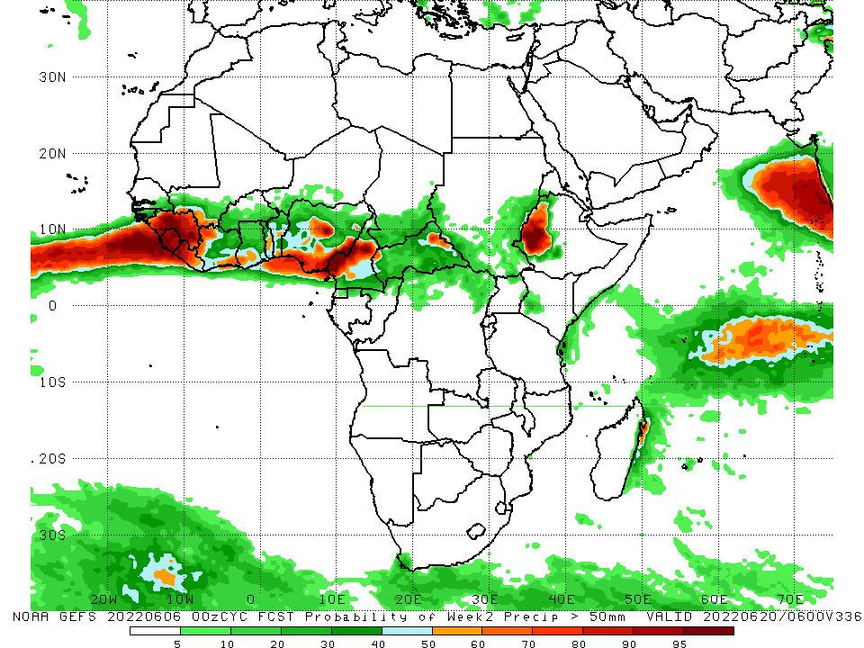
NCEP GEFS Model Forecasts Non-Bias Corrected Probability of precipitation exceedance
Week-1, Valid: 07 – 13 June, 2022
Week-2, Valid: 14 - 20 June, 2022
For week-1 (left panel) and week-2 (right panel), the NCEP GEFS indicates a moderate to high chance (over 70%) for rainfall to exceed 50 mm over Guinea, Sierra Leone, Liberia, Cameroon, northern Gabon, Equatorial Guinea, eastern CAR, and western Ethiopia.
Notes:
9

Slide 10
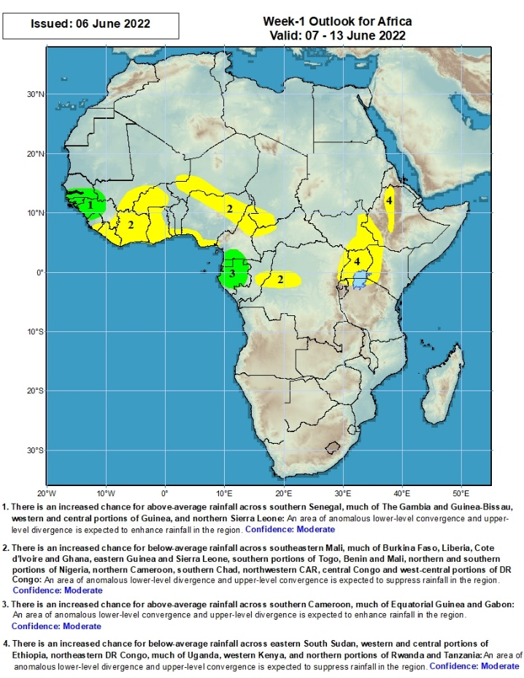
Week-1 Precipitation Outlooks
07 – 13 June, 2022
There is an increased chance for above-average rainfall across southern Senegal, much of The Gambia and Guinea-Bissau, western and central portions of Guinea, and northern Sierra Leone: An area of anomalous lower-level convergence and upper-level divergence is expected to enhance rainfall in the region. Confidence: Moderate
There is an increased chance for below-average rainfall across southeastern Mali, much of Burkina Faso, Liberia, Cote d’Ivoire and Ghana, eastern Guinea and Sierra Leone, southern portions of Togo, Benin and Mali, northern and southern portions of Nigeria, northern Cameroon, southern Chad, northwestern CAR, central Congo and west-central portions of DR Congo: An area of anomalous lower-level divergence and upper-level convergence is expected to suppress rainfall in the region. Confidence: Moderate
There is an increased chance for above-average rainfall across southern Cameroon, much of Equatorial Guinea and Gabon: An area of anomalous lower-level convergence and upper-level divergence is expected to enhance rainfall in the region. Confidence: Moderate
There is an increased chance for below-average rainfall across eastern South Sudan, western and central portions of Ethiopia, northeastern DR Congo, much of Uganda, western Kenya, and northern portions of Rwanda and Tanzania: An area of anomalous lower-level divergence and upper-level convergence is expected to suppress rainfall in the region. Confidence: Moderate
Notes:
10

Slide 11
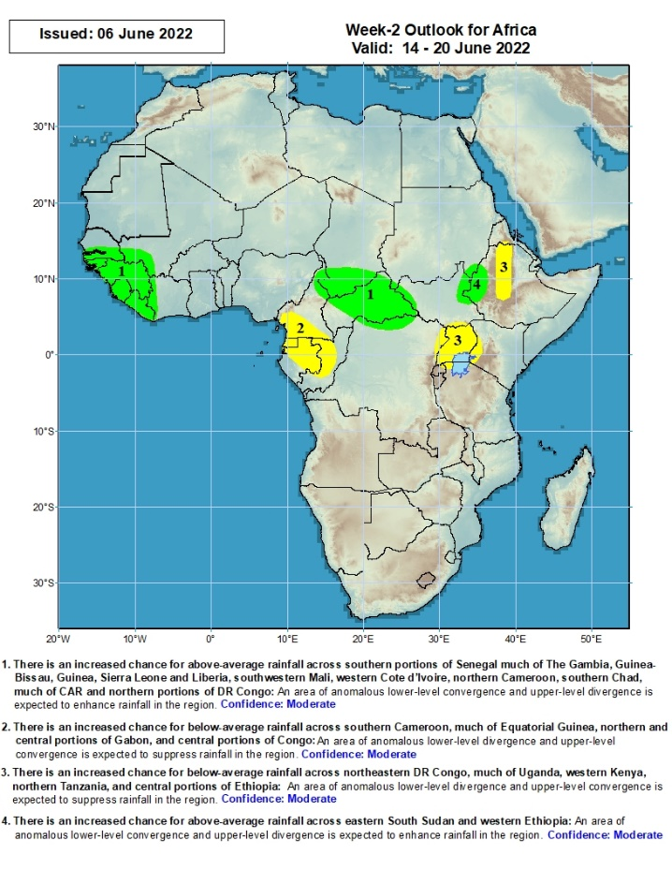
Week-2 Precipitation Outlooks
14 - 20 June, 2022
There is an increased chance for above-average rainfall across southern portions of Senegal much of The Gambia, Guinea-Bissau, Guinea, Sierra Leone and Liberia, southwestern Mali, western Cote d’Ivoire, northern Cameroon, southern Chad, much of CAR and northern portions of DR Congo: An area of anomalous lower-level convergence and upper-level divergence is expected to enhance rainfall in the region. Confidence: Moderate
There is an increased chance for below-average rainfall across southern Cameroon, much of Equatorial Guinea, northern and central portions of Gabon, and central portions of Congo: An area of anomalous lower-level divergence and upper-level convergence is expected to suppress rainfall in the region. Confidence: Moderate
There is an increased chance for below-average rainfall across northeastern DR Congo, much of Uganda, western Kenya, northern Tanzania, and central portions of Ethiopia: An area of anomalous lower-level divergence and upper-level convergence is expected to suppress rainfall in the region. Confidence: Moderate
There is an increased chance for above-average rainfall across eastern South Sudan and western Ethiopia: An area of anomalous lower-level convergence and upper-level divergence is expected to enhance rainfall in the region. Confidence: Moderate
Notes:
11

Slide 12
Summary
During the past 30 days, in East Africa, above-average rainfall was observed over western Ethiopia, parts of southern Sudan, western South Sudan, and the far northern Tanzania. Rainfall was below-average over eastern, central and southern Ethiopia, the central and southern parts of South Sudan, western, southern, and central Kenya, and much of Somalia. In Central Africa, rainfall was above-average over many parts of Cameroon, Equatorial Guinea, eastern Gabon, Congo, much of CAR and northern and western DRC. Rainfall was below-average over pockets of Gabon. In Southern Africa, above-average rainfall was observed over southern portions of Mozambique as well as central and eastern South Africa. Below-average rainfall was observed over many parts of Madagascar and southwestern South Africa. In West Africa, rainfall was above-average over parts of Senegal, Guinea, Liberia, Sierra Leone, and Cote d’Ivoire. In contrast, parts of southern Mali, central Burkina Faso, Parts of Ghana, Togo and Benin, and Nigeria received below-average rainfall.
During the past 7 days, in East Africa, rainfall was above-average over parts of western Ethiopia, western South Sudan, and the far northern Tanzania, while below-average rainfall was observed over a large portion of South Sudan and southwestern Sudan. In Central Africa, rainfall was above-average over southern Cameroon, northern Congo, Equatorial Guinea, parts of CAR and DRC, and southern Chad. Below-average rainfall was observed over northern Cameroon, parts of Gabon and DRC, and western CAR. In West Africa, above-average rainfall was observed over Guinea, Sierra Leone, Liberia, parts of Mali, and Burkina Faso, while rainfall was below-average over parts of Cote D’Ivoire, Ghana, Togo, and Nigeria.
Week-1 outlook calls for an increased chance for below-average rainfall over parts of West and East Africa, while above-average rainfall is likely over the far-western West Africa and, as well as Gabon, Equatorial Guinea, and southern Cameroon in Central Africa. Week-2 outlook suggests an increased chance for below-average rainfall over western parts of Central Africa, Uganda, and a portion of Ethiopia, while above-average rainfall is likely over far-western Africa, CAR, southern Chad and far-western Ethiopia.

