Slide 1
The African Monsoon Recent Evolution and Current Status Include Week-1 and Week-2 Outlooks
Update prepared by
31 May 2022
For more information, visit:
http://www.cpc.ncep.noaa.gov/products/Global_Monsoons/African_Monsoons/precip_monitoring.shtml

Slide 2
Outline
Highlights
Recent Evolution and Current Conditions
NCEP GEFS Forecasts
Summary

Slide 3
Highlights: Last 7 Days
During the past 7 days, in East Africa, rainfall was above-average over southwestern Ethiopia, Uganda, and the far northern Tanzania, while below-average rainfall was observed over the far southern Sudan. In Central Africa, rainfall was above-average over eastern Cameroon, northern Congo, CAR, central and northern DRC, and southeastern Chad. Below-average rainfall was observed over western Cameroon, and parts of Equatorial Guinea and Gabon. In West Africa, above-average rainfall was observed over Senegal, parts of Guinea and Mali, Sierra Leone, Liberia and Burkina Faso, while rainfall was below-average over parts of Ghana, Togo, Benin and Nigeria.
Week-1 outlooks call for an increased chance for below-average rainfall over parts of West and East Africa, while above-average rainfall is likely over the far western West Africa and, and portions of Central Africa. Week-2 outlooks suggest an increased chance for below-average rainfall along the Gulf of Guinea coast, the far northern Nigeria and southern Niger, and western Ethiopia.

Slide 4
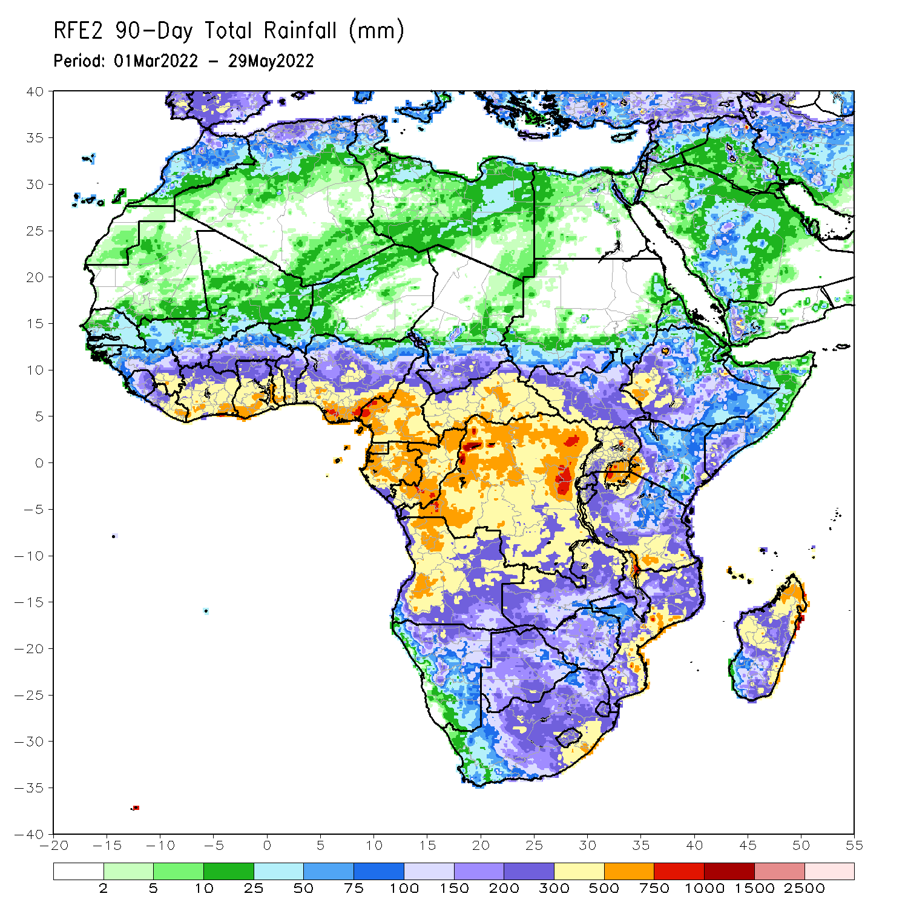
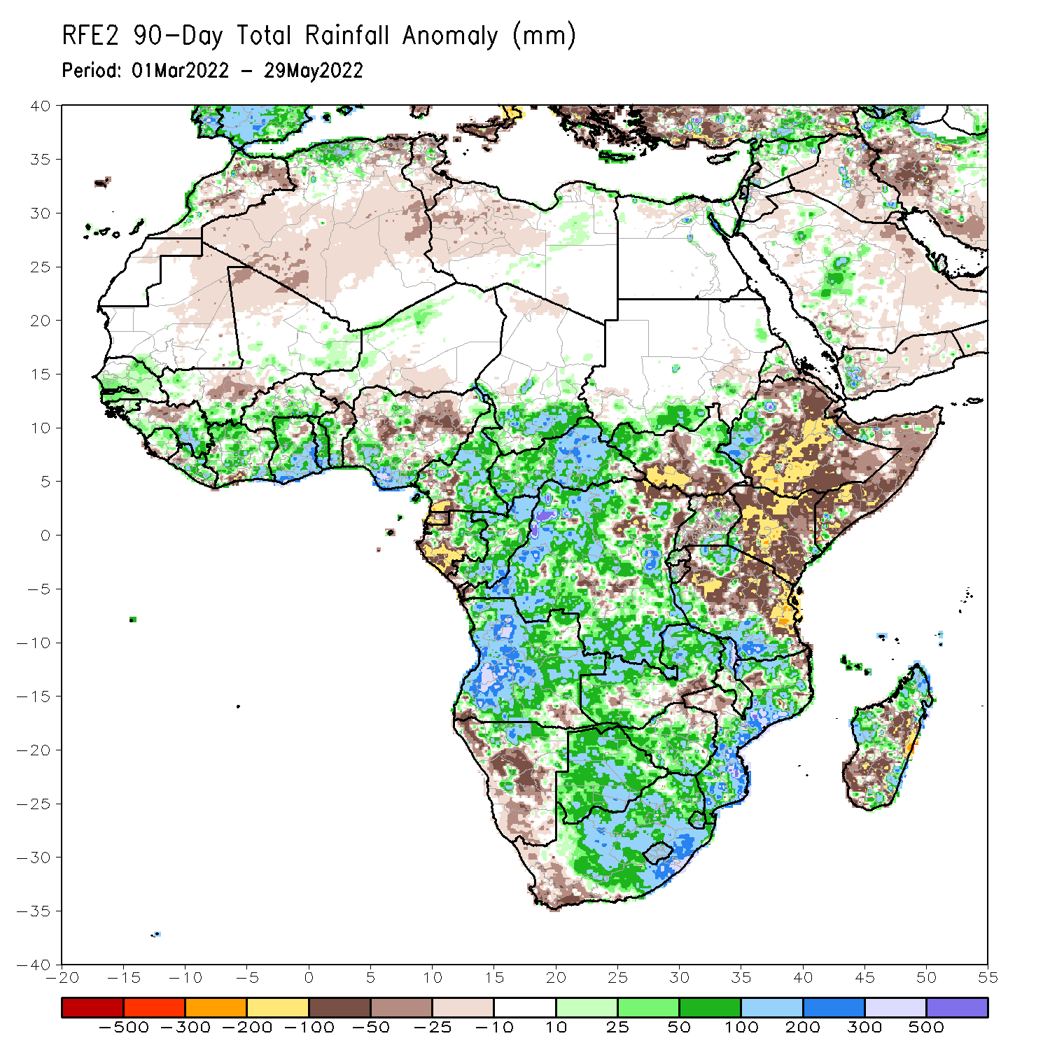
Rainfall Patterns: Last 90 Days
Over the past 90 days, in East Africa, above-average rainfall was observed over parts of southern Sudan, the western and eastern portions of South Sudan, western Ethiopia, and southern Tanzania. Rainfall was below-average over central, southern and eastern Ethiopia, central and southern South Sudan, much of Kenya, Somalia, and northern Uganda and northern Tanzania. In southern Africa, above-average rainfall was observed over much of Angola, Botswana, northern Namibia, northern Zambia, Malawi, much of Mozambique, many parts of Madagascar and South Africa. Below-average rainfall was observed over pockets of southeastern Angola, western and southern Namibia, southern Zambia, northern Zimbabwe, and pockets of Madagascar. In Central Africa, rainfall was above-average over much of CAR, eastern Gabon, many parts of DRC and Congo. Rainfall was below-average over parts of Cameroon, parts of central and eastern DRC, Equatorial Guinea, and western Gabon. In West Africa, rainfall was above-average over much of the Gulf of Guinea region, while below-average rainfall was observed over pockets of Guinea and Nigeria.
Notes:
4

Slide 5
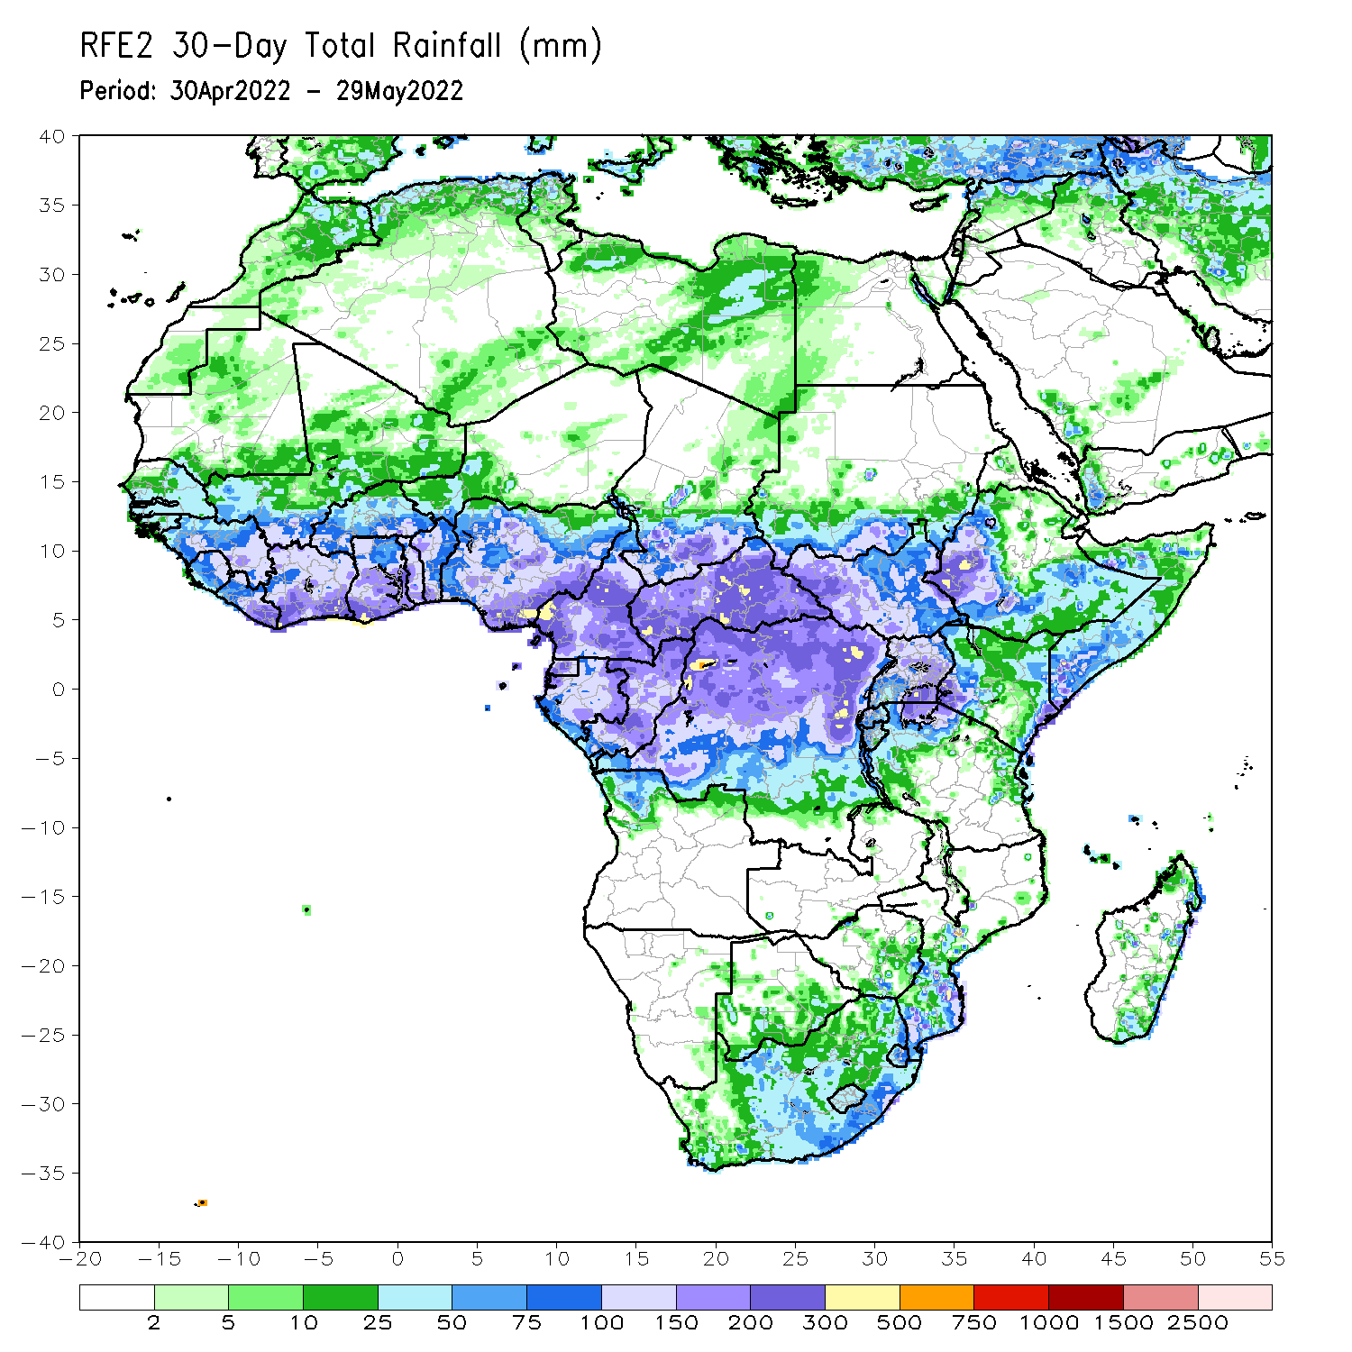
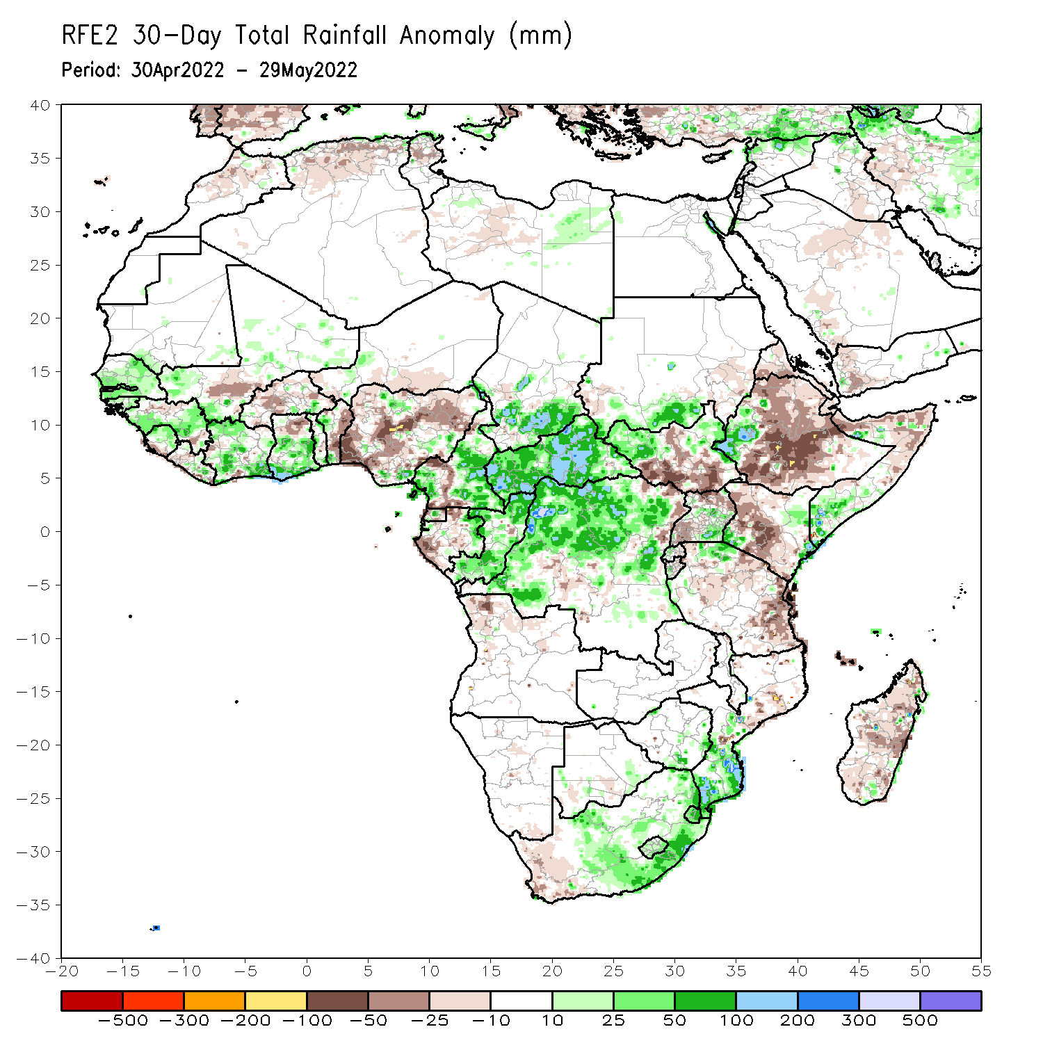
Rainfall Patterns: Last 30 Days
During the past 30 days, in East Africa, above-average rainfall was observed over southwestern Ethiopia, southern Sudan, western South Sudan, southeastern Uganda, and the far northern Tanzania. Rainfall was below-average over eastern, central and southern Ethiopia, the central and southern parts of South Sudan, western and central Kenya, and northern Somalia. In Central Africa, rainfall was above-average over Cameroon, Equatorial Guinea, northern and eastern Gabon, Congo, much of CAR and DRC. Rainfall was below-average over pockets of Gabon. In Southern Africa, above-average rainfall was observed over portions of Mozambique, central and eastern South Africa. Below-average rainfall was observed over many parts of Madagascar. In West Africa, rainfall was above-average over parts of Senegal, Guinea and Cote d’Ivoire. In contrast, southern Mali, and parts of Burkina Faso and Nigeria received below-average rainfall.
Notes:
5

Slide 6
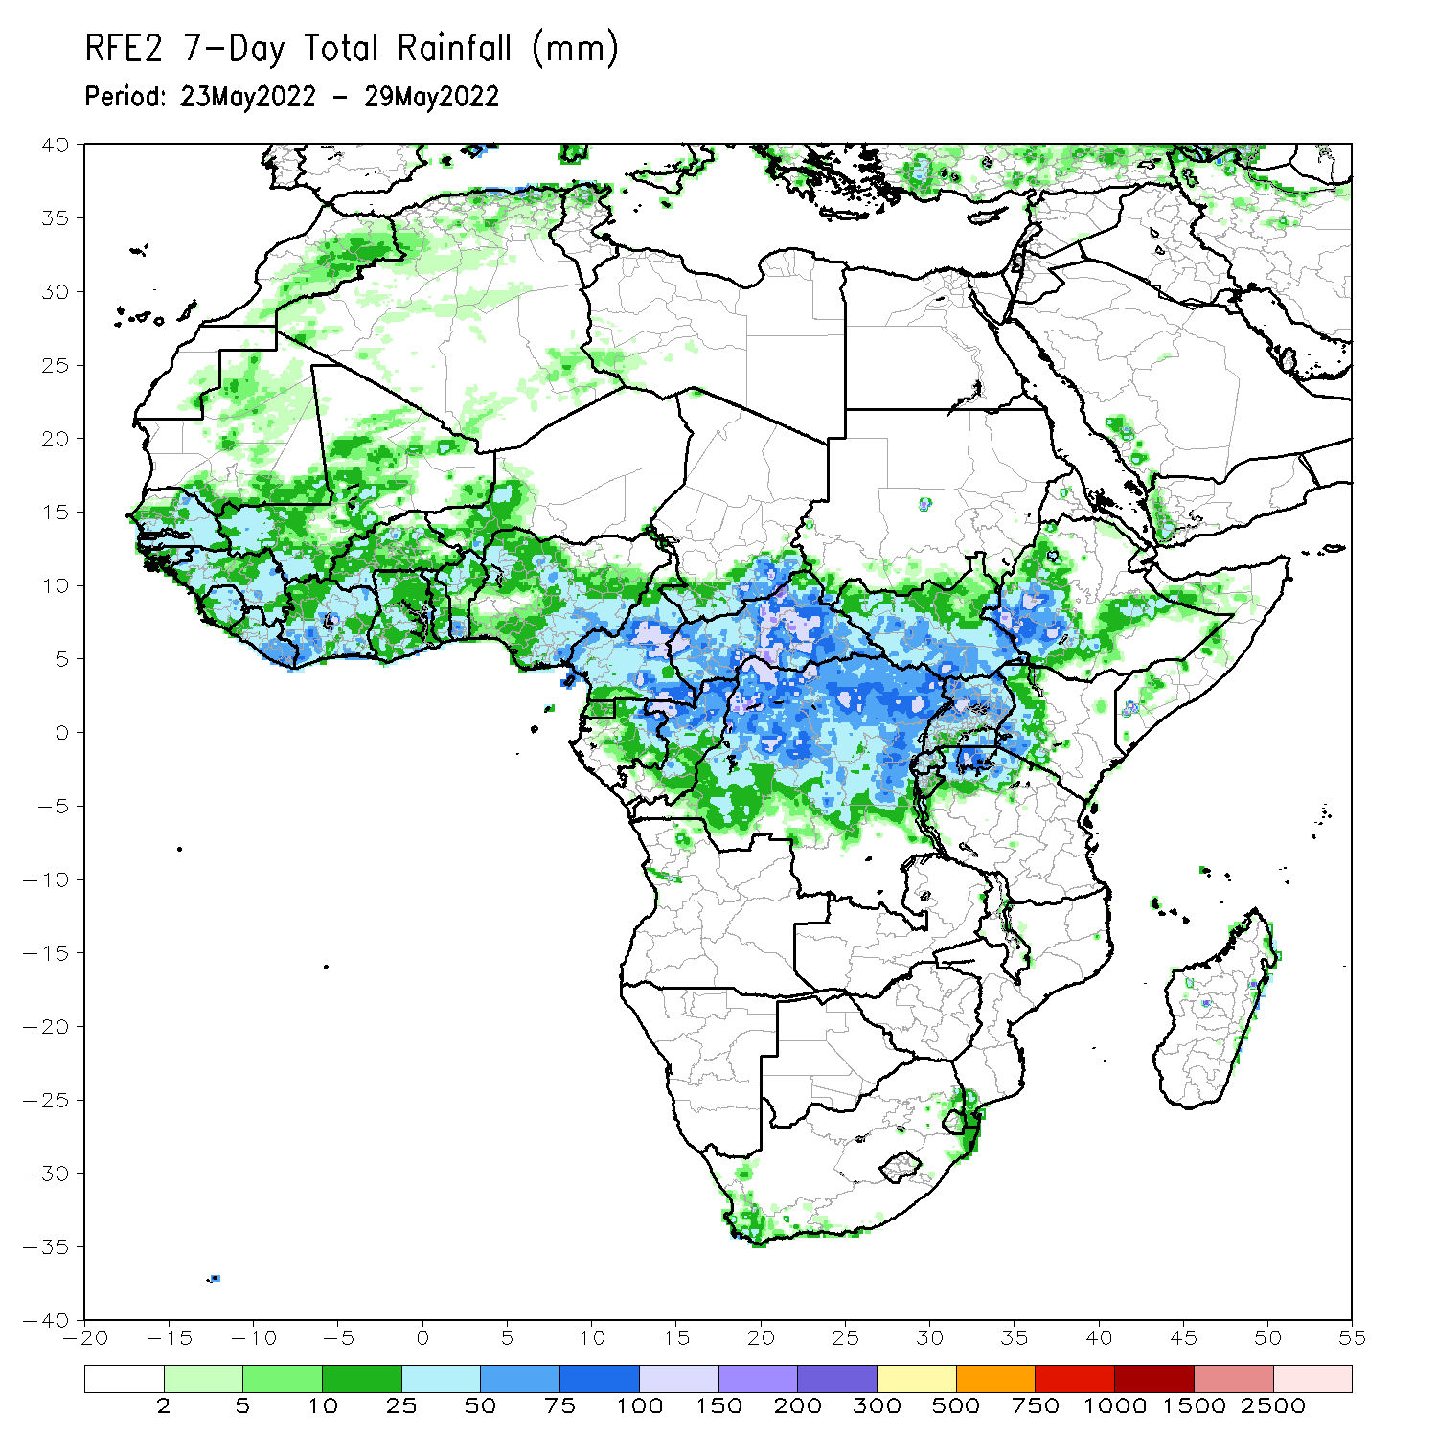
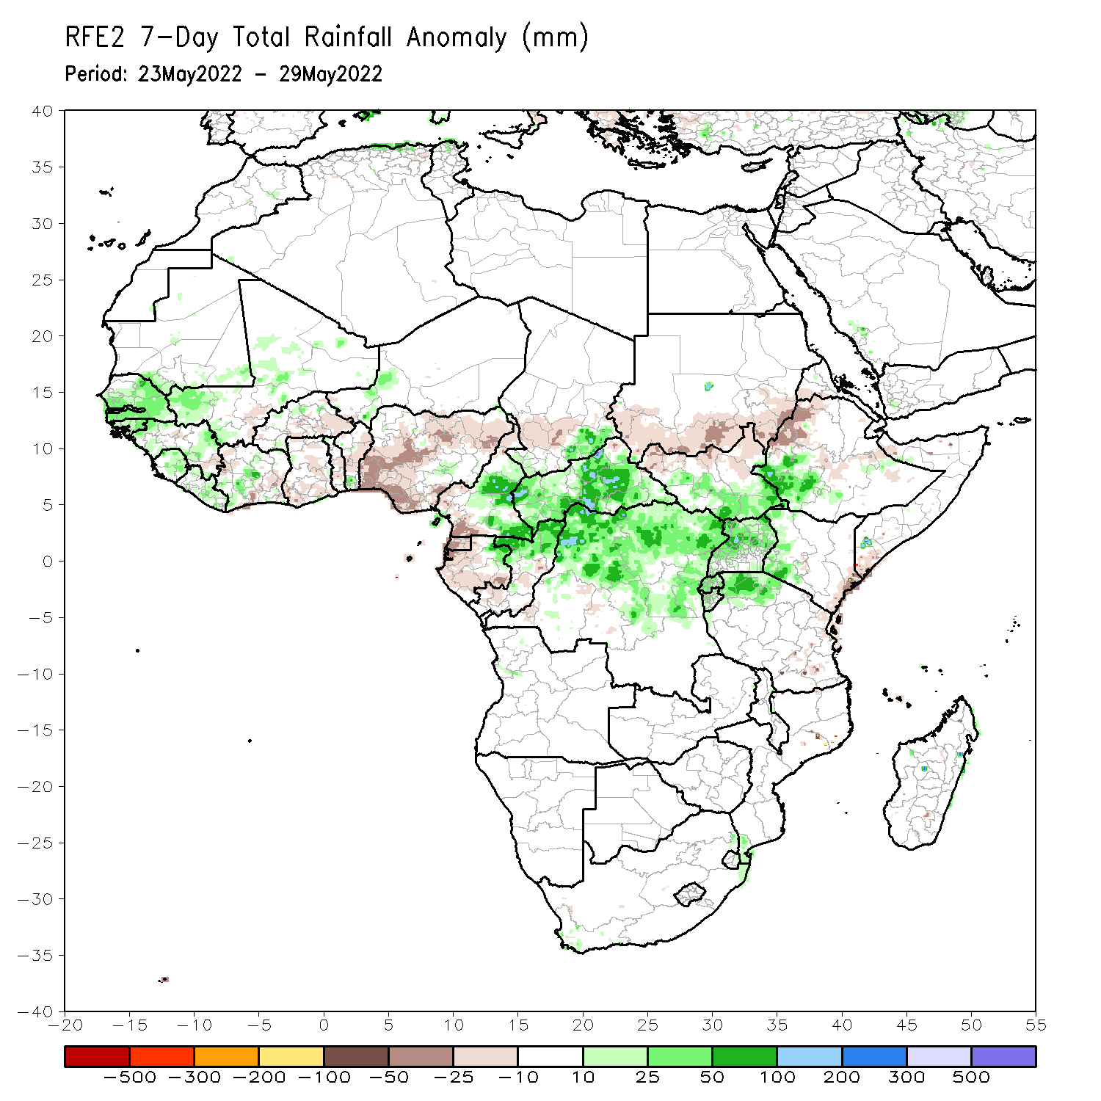
Rainfall Patterns: Last 7 Days
During the past 7 days, in East Africa, rainfall was above-average over southwestern Ethiopia, Uganda, and the far northern Tanzania, while below-average rainfall was observed over the far southern Sudan. In Central Africa, rainfall was above-average over eastern Cameroon, northern Congo, CAR, central and northern DRC, and southeastern Chad. Below-average rainfall was observed over western Cameroon, and parts of Equatorial Guinea and Gabon. In West Africa, above-average rainfall was observed over Senegal, parts of Guinea and Mali, Sierra Leone, Liberia and Burkina Faso, while rainfall was below-average over parts of Ghana, Togo, Benin and Nigeria.

Slide 7
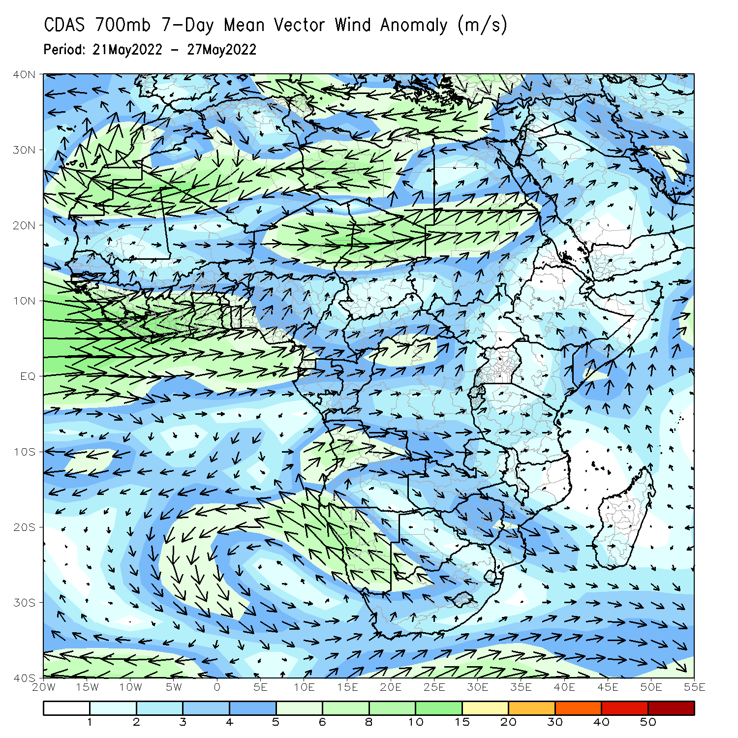
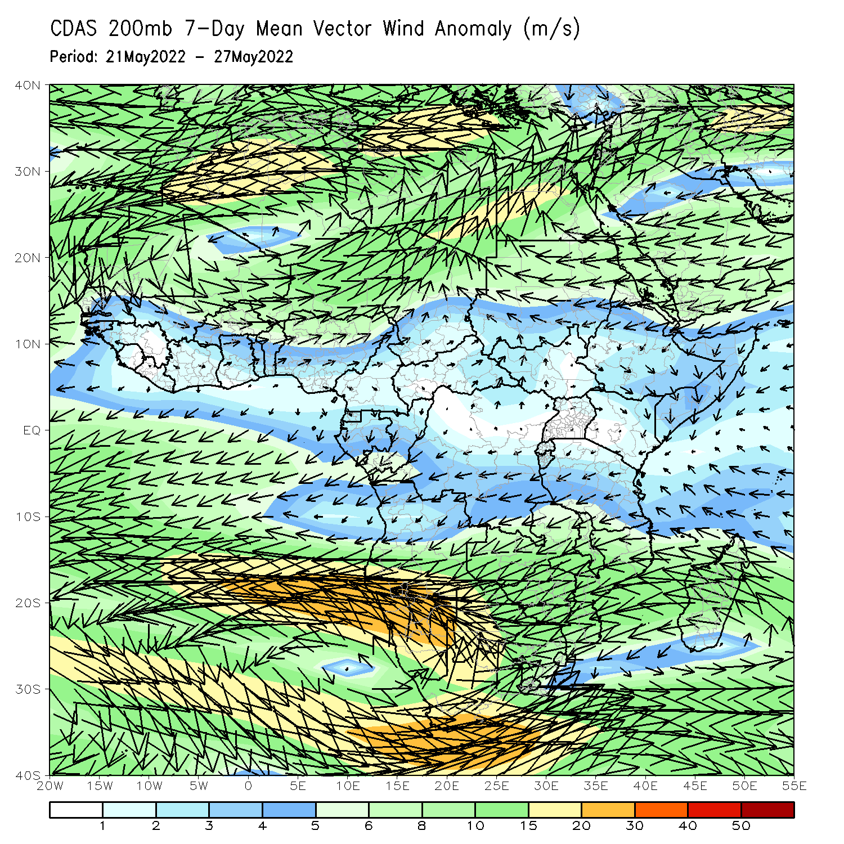
Atmospheric Circulation: Last 7 Days
At 700-hPa level (left panel), anomalous westerly flow across the Gulf of Guinea, with its associated wind convergence in Central Africa may have contributed to the observed above-average rainfall in the region (left panel).

Slide 8
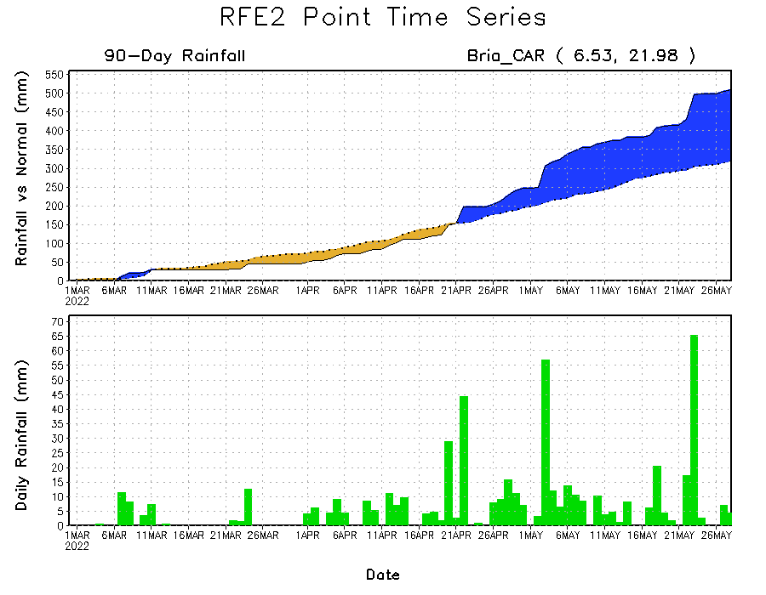
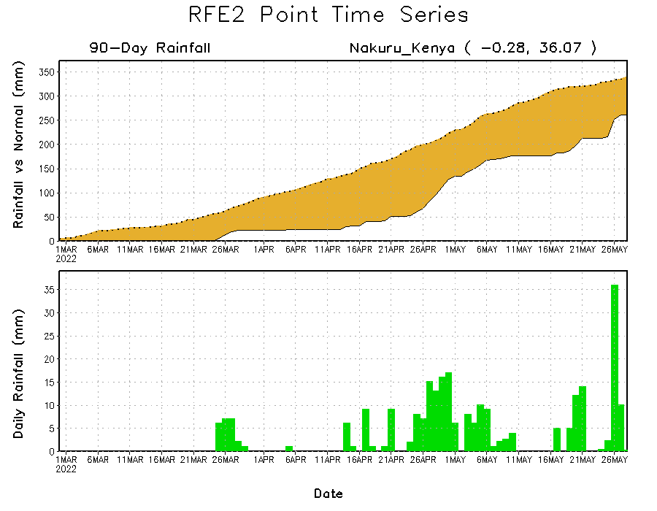
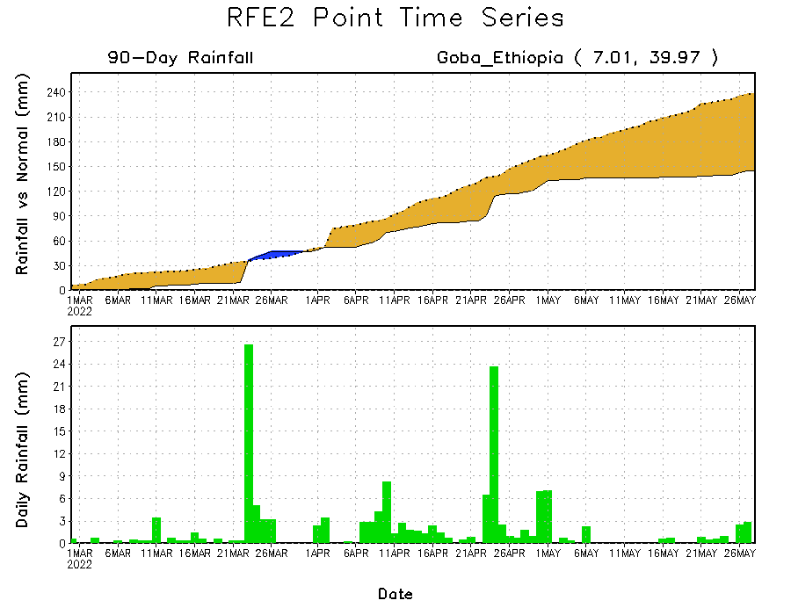
Rainfall Evolution
Daily evolution of rainfall over the last 90 days at selected locations shows moderate to heavy rainfall sustained moisture surpluses over parts of Central African Republic (top right). Seasonal total rainfall remained below-average over much of southern Ethiopia (bottom left) and Kenya (bottom right).

Slide 9
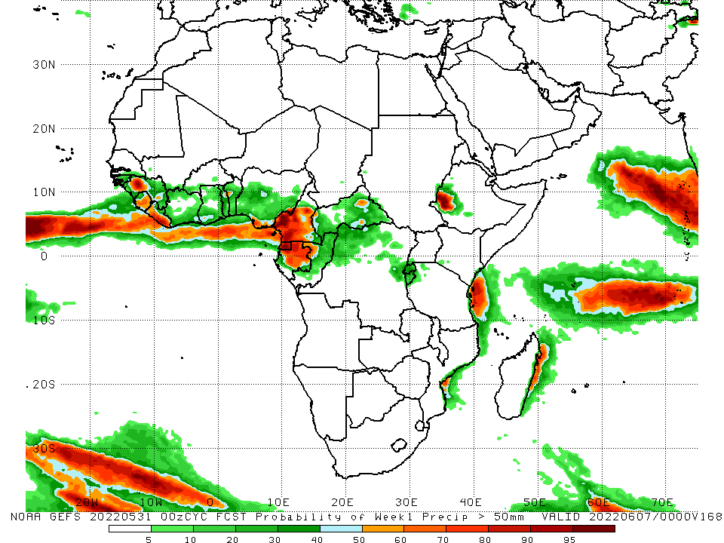
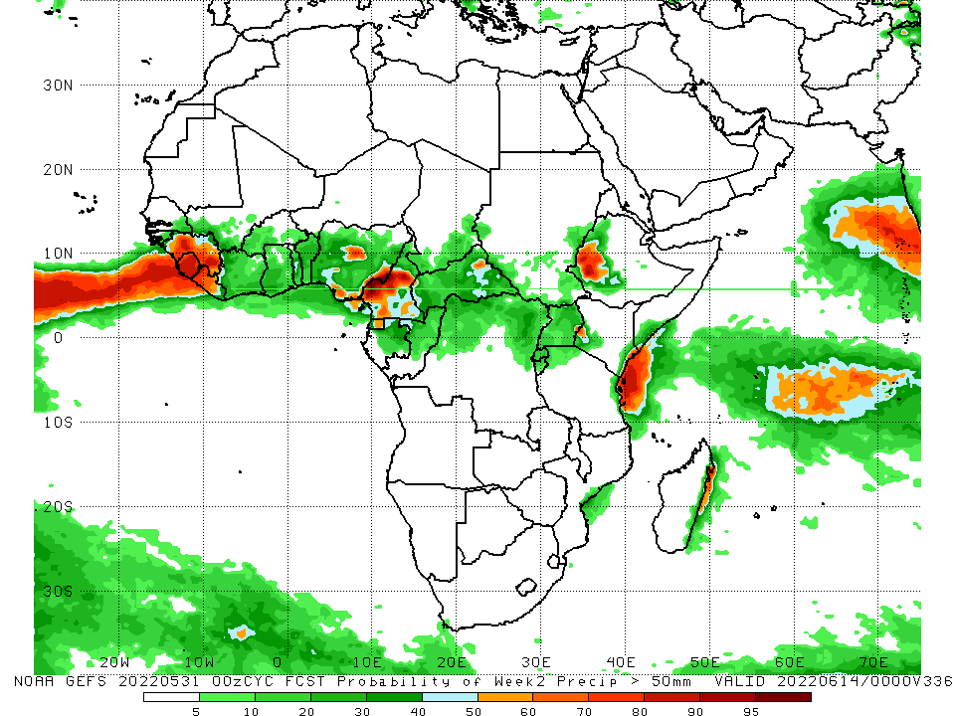
NCEP GEFS Model Forecasts Non-Bias Corrected Probability of precipitation exceedance
Week-1, Valid: 01 – 07 June, 2022
Week-2, Valid: 08 - 14 June, 2022
For week-1 (left panel) and week-2 (right panel), the NCEP GEFS indicates a moderate to high chance (over 70%) for rainfall to exceed 50 mm over Sierra Leone, Liberia, Cameroon, northern Gabon, Equatorial Guinea, the Lake Victoria region, and southwestern Ethiopia.
Notes:
9

Slide 10
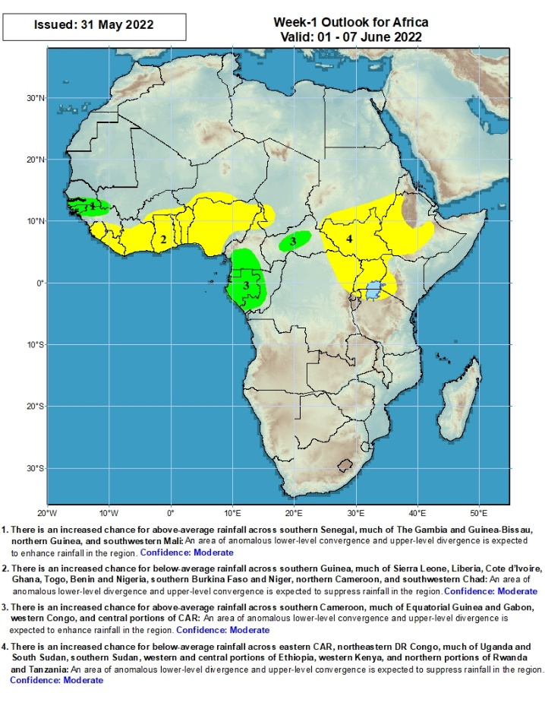
Week-1 Precipitation Outlooks
01 – 07 June, 2022
There is an increased chance for above-average rainfall across southern Senegal, much of The Gambia and Guinea-Bissau, northern Guinea, and southwestern Mali: An area of anomalous lower-level convergence and upper-level divergence is expected to enhance rainfall in the region. Confidence: Moderate
There is an increased chance for below-average rainfall across southern Guinea, much of Sierra Leone, Liberia, Cote d’Ivoire, Ghana, Togo, Benin and Nigeria, southern Burkina Faso and Niger, northern Cameroon, and southwestern Chad: An area of anomalous lower-level divergence and upper-level convergence is expected to suppress rainfall in the region. Confidence: Moderate
There is an increased chance for above-average rainfall across southern Cameroon, much of Equatorial Guinea and Gabon, western Congo, and central portions of CAR: An area of anomalous lower-level convergence and upper-level divergence is expected to enhance rainfall in the region. Confidence: Moderate
There is an increased chance for below-average rainfall across eastern CAR, northeastern DR Congo, much of Uganda and South Sudan, southern Sudan, western and central portions of Ethiopia, western Kenya, and northern portions of Tanzania and Rwanda: An area of anomalous lower-level divergence and upper-level convergence is expected to suppress rainfall in the region. Confidence: Moderate
Notes:
10

Slide 11
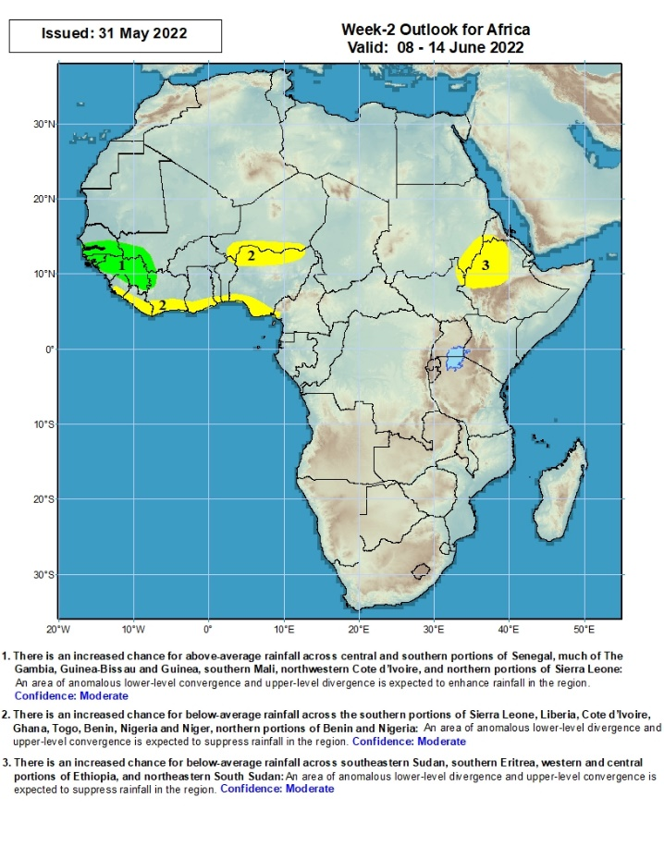
Week-2 Precipitation Outlooks
08 - 14 June, 2022
There is an increased chance for above-average rainfall across central and southern portions of Senegal, much of The Gambia, Guinea-Bissau and Guinea, southern Mali, northwestern Cote d’Ivoire, and northern portions of Sierra Leone: An area of anomalous lower-level convergence and upper-level divergence is expected to enhance rainfall in the region. Confidence: Moderate
There is an increased chance for below-average rainfall across the southern portions of Sierra Leone, Liberia, Cote d’Ivoire, Ghana, Togo, Benin, Nigeria and Niger, northern portions of Benin and Nigeria: An area of anomalous lower-level divergence and upper-level convergence is expected to suppress rainfall in the region. Confidence: Moderate
There is an increased chance for below-average rainfall across southeastern Sudan, southern Eritrea, western and central portions of Ethiopia, and northeastern South Sudan: An area of anomalous lower-level divergence and upper-level convergence is expected to suppress rainfall in the region. Confidence: Moderate
Notes:
11

Slide 12
Summary
During the past 30 days, in East Africa, above-average rainfall was observed over southwestern Ethiopia, southern Sudan, western South Sudan, southeastern Uganda, and the far northern Tanzania. Rainfall was below-average over eastern, central and southern Ethiopia, the central and southern parts of South Sudan, western and central Kenya, and northern Somalia. In Central Africa, rainfall was above-average over Cameroon, Equatorial Guinea, northern and eastern Gabon, Congo, much of CAR and DRC. Rainfall was below-average over pockets of Gabon. In Southern Africa, above-average rainfall was observed over portions of Mozambique, central and eastern South Africa. Below-average rainfall was observed over many parts of Madagascar. In West Africa, rainfall was above-average over parts of Senegal, Guinea and Cote d’Ivoire. In contrast, southern Mali, and parts of Burkina Faso and Nigeria received below-average rainfall.
During the past 7 days, in East Africa, rainfall was above-average over southwestern Ethiopia, Uganda, and the far northern Tanzania, while below-average rainfall was observed over the far southern Sudan. In Central Africa, rainfall was above-average over eastern Cameroon, northern Congo, CAR, central and northern DRC, and southeastern Chad. Below-average rainfall was observed over western Cameroon, and parts of Equatorial Guinea and Gabon. In West Africa, above-average rainfall was observed over Senegal, parts of Guinea and Mali, Sierra Leone, Liberia and Burkina Faso, while rainfall was below-average over parts of Ghana, Togo, Benin and Nigeria.
Week-1 outlooks call for an increased chance for below-average rainfall over parts of West and East Africa, while above-average rainfall is likely over the far western West Africa and, and portions of Central Africa. Week-2 outlooks suggest an increased chance for below-average rainfall along the Gulf of Guinea coast, the far northern Nigeria and southern Niger, and western Ethiopia.

