Slide 1
The African Monsoon Recent Evolution and Current Status Include Week-1 and Week-2 Outlooks
Update prepared by
09 May 2022
For more information, visit:
http://www.cpc.ncep.noaa.gov/products/Global_Monsoons/African_Monsoons/precip_monitoring.shtml

Slide 2
Outline
Highlights
Recent Evolution and Current Conditions
NCEP GEFS Forecasts
Summary

Slide 3
Highlights: Last 7 Days
During the past 7 days, in East Africa, rainfall was above-average over the western and northern parts of South Sudan, western and southeastern Ethiopia, southern Somalia, pockets of Uganda, and parts of eastern Kenya. Below-average rainfall was observed over the southern portion of South Sudan, central and southern Ethiopia, central Kenya, and northern Tanzania. In Central Africa, rainfall was above-average over portions of Cameroon, Gabon, Congo, CAR, and portions of DRC. Below-average rainfall was observed over central Congo, and western and central DRC. In West Africa, above-average rainfall was observed over many places in the Gulf of Guinea region.
Week-1 and Week-2 outlooks call for an increased chance for below-average rainfall over much of Central and East Africa. In contrast, there is an increased chance for above-average rainfall over parts of Nigeria.

Slide 4
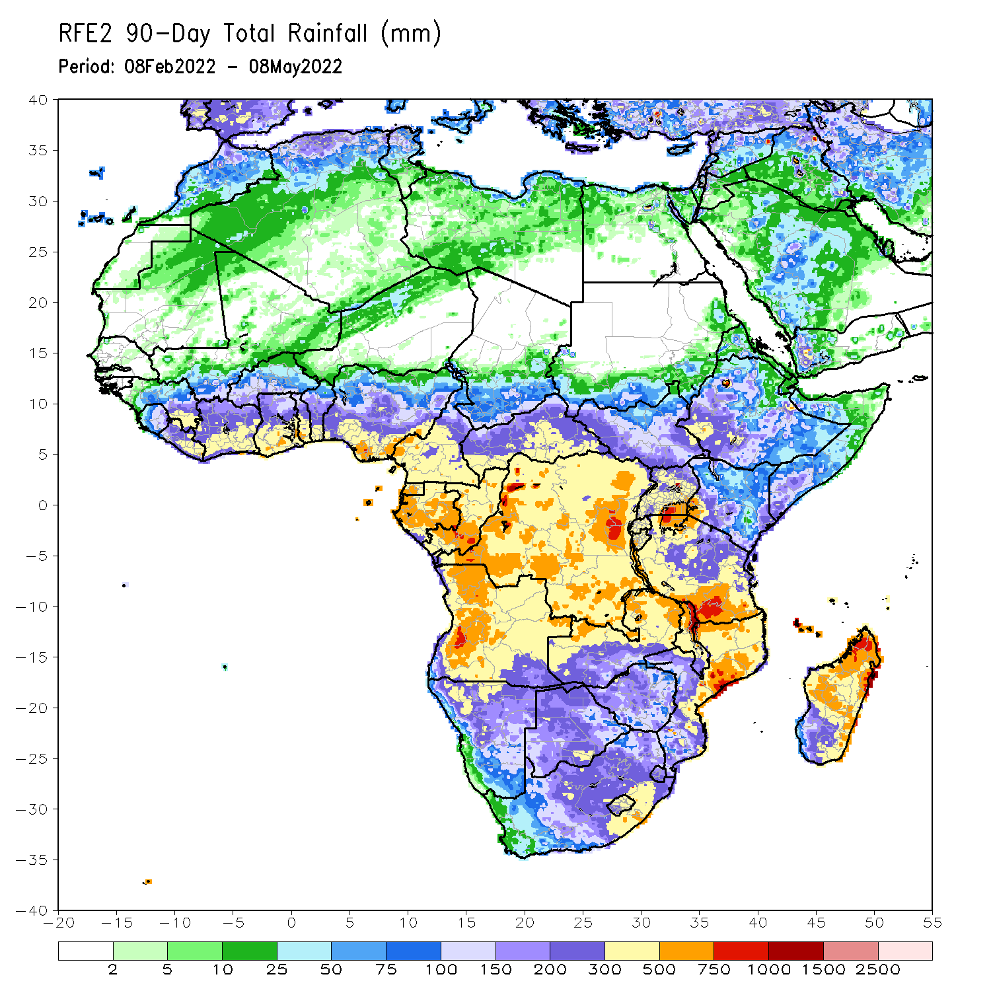
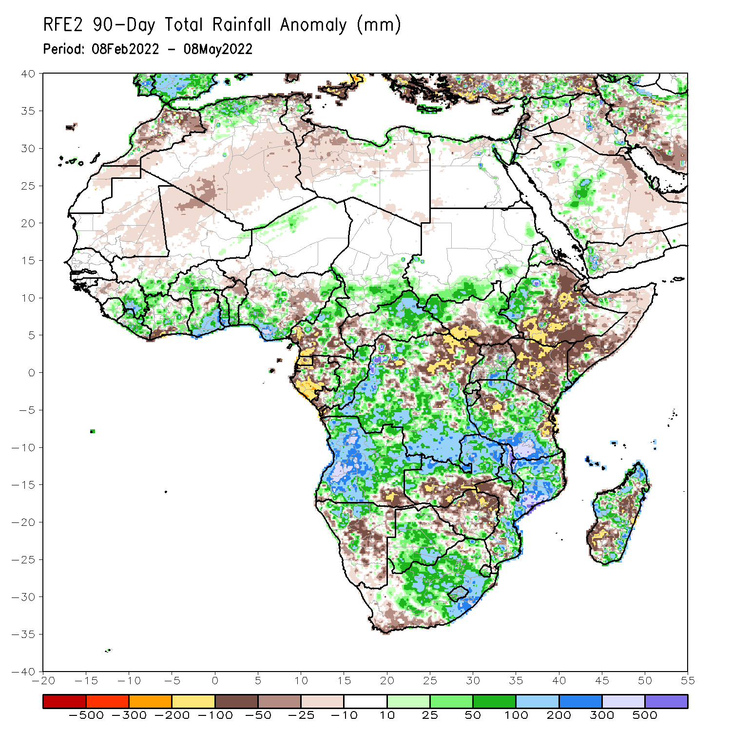
Rainfall Patterns: Last 90 Days
Over the past 90 days, in East Africa, above-average rainfall was observed over parts of South Sudan, western Ethiopia and Eritrea, pockets of Somalia, Rwanda, Burundi, southern Uganda, and much of Tanzania. Rainfall was below-average over central, southern and eastern Ethiopia, central and southern South Sudan, much of Kenya, parts of Somalia, and northern Uganda. In southern Africa, above-average rainfall was observed over much of Angola, Botswana, western and northern Namibia, central and northern Zambia, Malawi, much of Mozambique, many parts of Madagascar and South Africa. Below-average rainfall was observed over pockets of Angola and Namibia, southern Zambia, northern Botswana, much of Zimbabwe, pockets of Mozambique and Madagascar. In Central Africa, rainfall was above-average over central and eastern CAR, many parts of DRC and Congo. Rainfall was below-average over southern Cameroon, northern DRC, Equatorial Guinea, much of Gabon, and western CAR. In West Africa, rainfall was above-average over much of the Gulf of Guinea region, while rainfall was below-average over pockets of Cote d’Ivoire and Nigeria.
Notes:
4

Slide 5
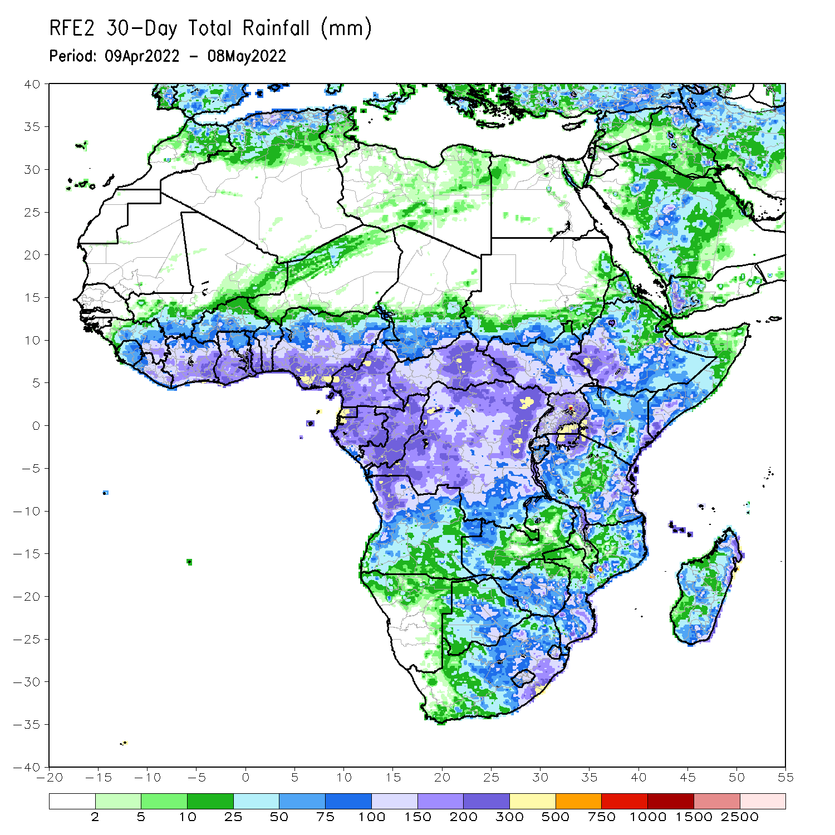
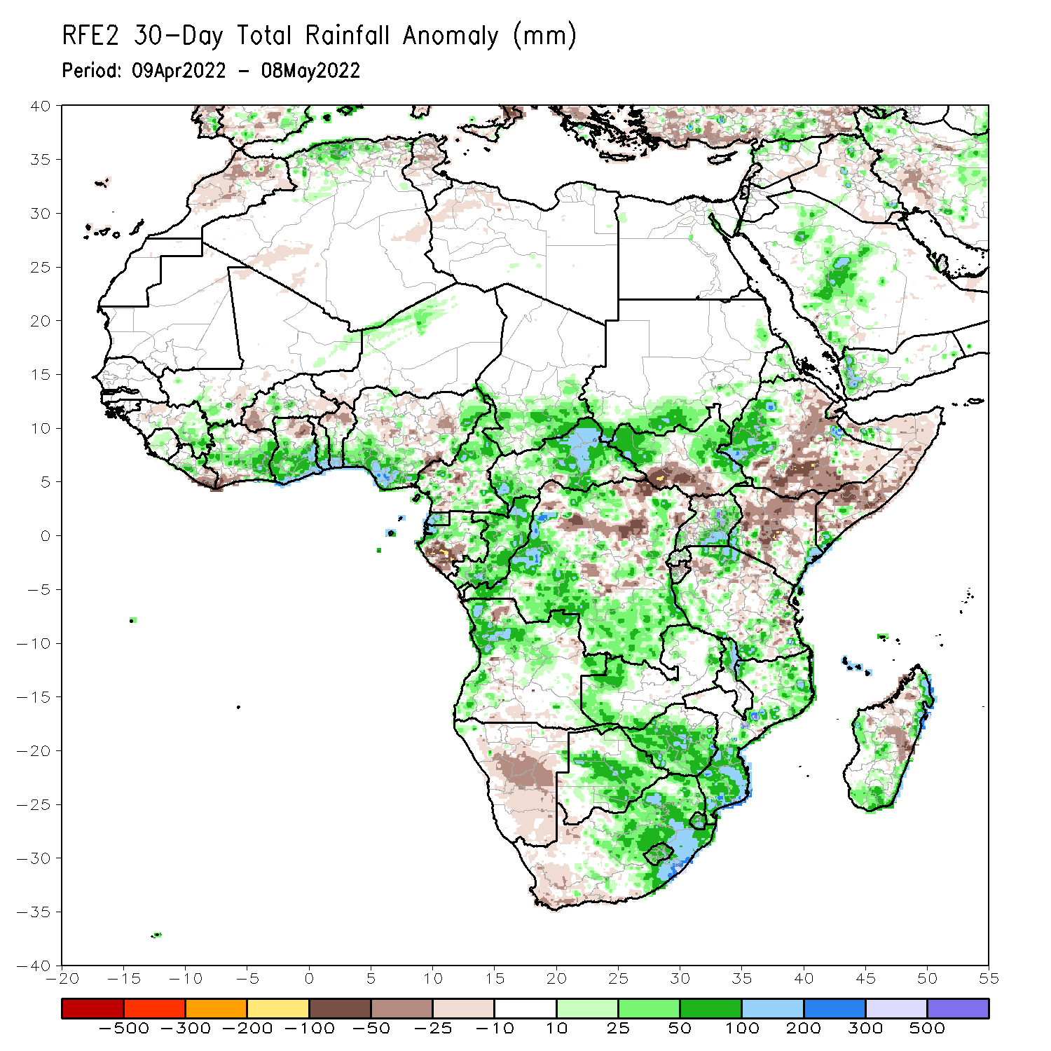
Rainfall Patterns: Last 30 Days
During the past 30 days, in East Africa, above-average rainfall was observed over western Ethiopia, northern and eastern South Sudan, pockets of Somalia, Uganda, and the far northern and southern Tanzania. Rainfall was below-average over northeastern and southern Ethiopia, pockets of central and southern South Sudan, much of Kenya, pockets of Somalia, and many parts of Tanzania. In Central Africa, rainfall was above-average over much of Cameroon, Equatorial Guinea, Gabon, Congo, much of CAR, and many parts of DRC. Rainfall was below-average over pockets of central and northern DRC. In Southern Africa, above-average rainfall was observed over western Angola, parts of Zambia, Malawi, Mozambique, Botswana, Zimbabwe and eastern South Africa. Below-average rainfall was observed over parts of Angola, Namibia, western South Africa, and pockets of Madagascar. In West Africa, rainfall was above-average over much of the Gulf of Guinea region.
Notes:
5

Slide 6
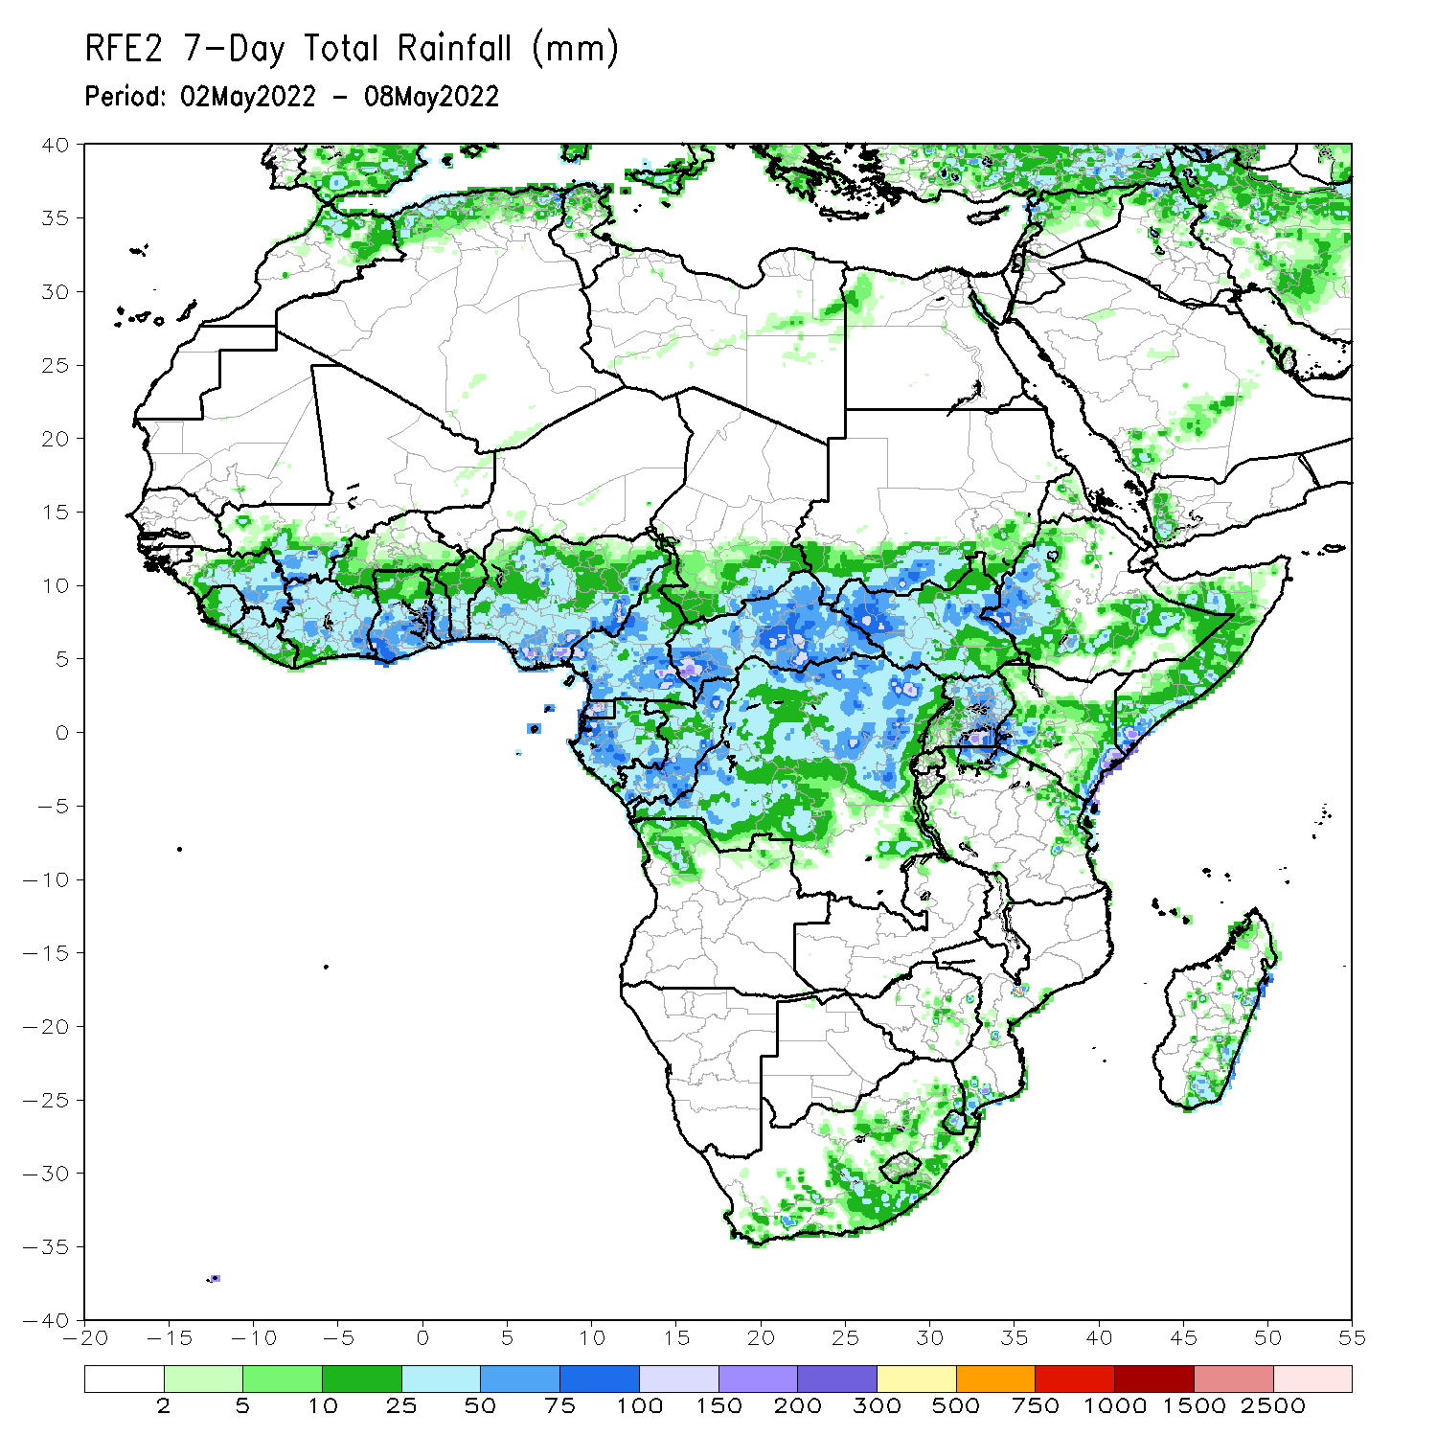
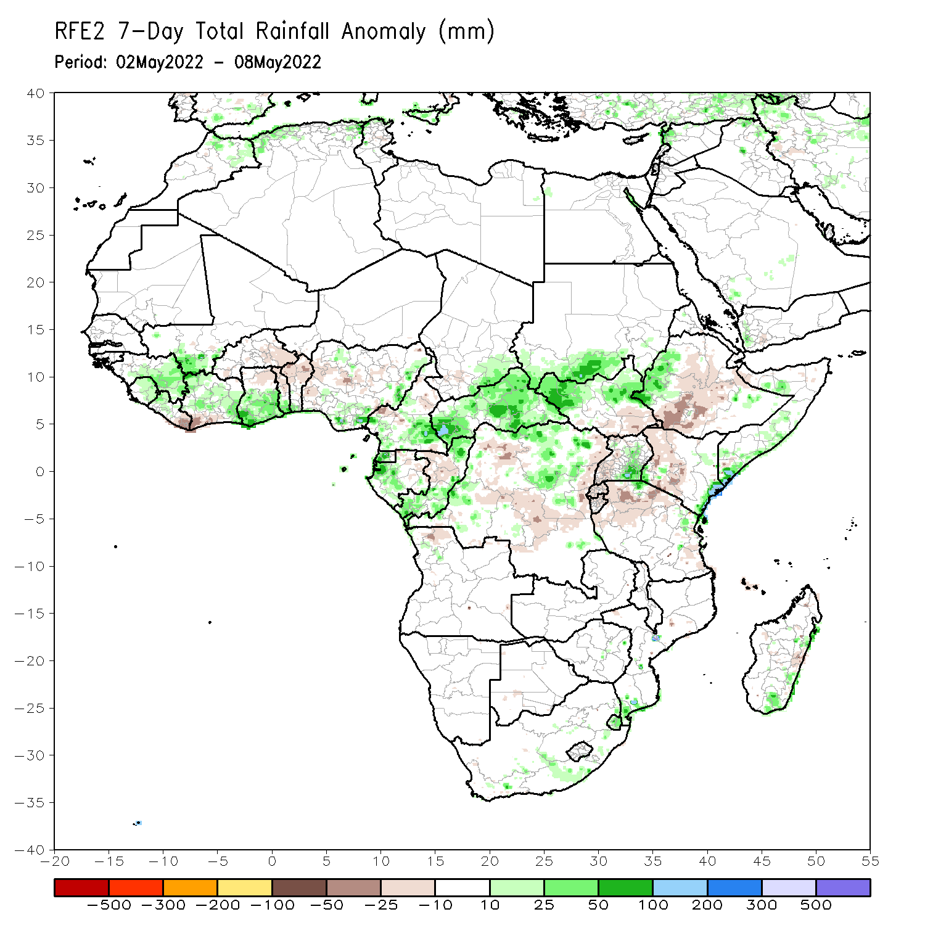
Rainfall Patterns: Last 7 Days
During the past 7 days, in East Africa, rainfall was above-average over the western and northern parts of South Sudan, western and southeastern Ethiopia, southern Somalia, pockets of Uganda, and parts of eastern Kenya. Below-average rainfall was observed over the southern portion of South Sudan, central and southern Ethiopia, central Kenya, and northern Tanzania. In Central Africa, rainfall was above-average over portions of Cameroon, Gabon, Congo, CAR, and portions of DRC. Below-average rainfall was observed over central Congo, and western and central DRC. In West Africa, above-average rainfall was observed over many places in the Gulf of Guinea region.

Slide 7
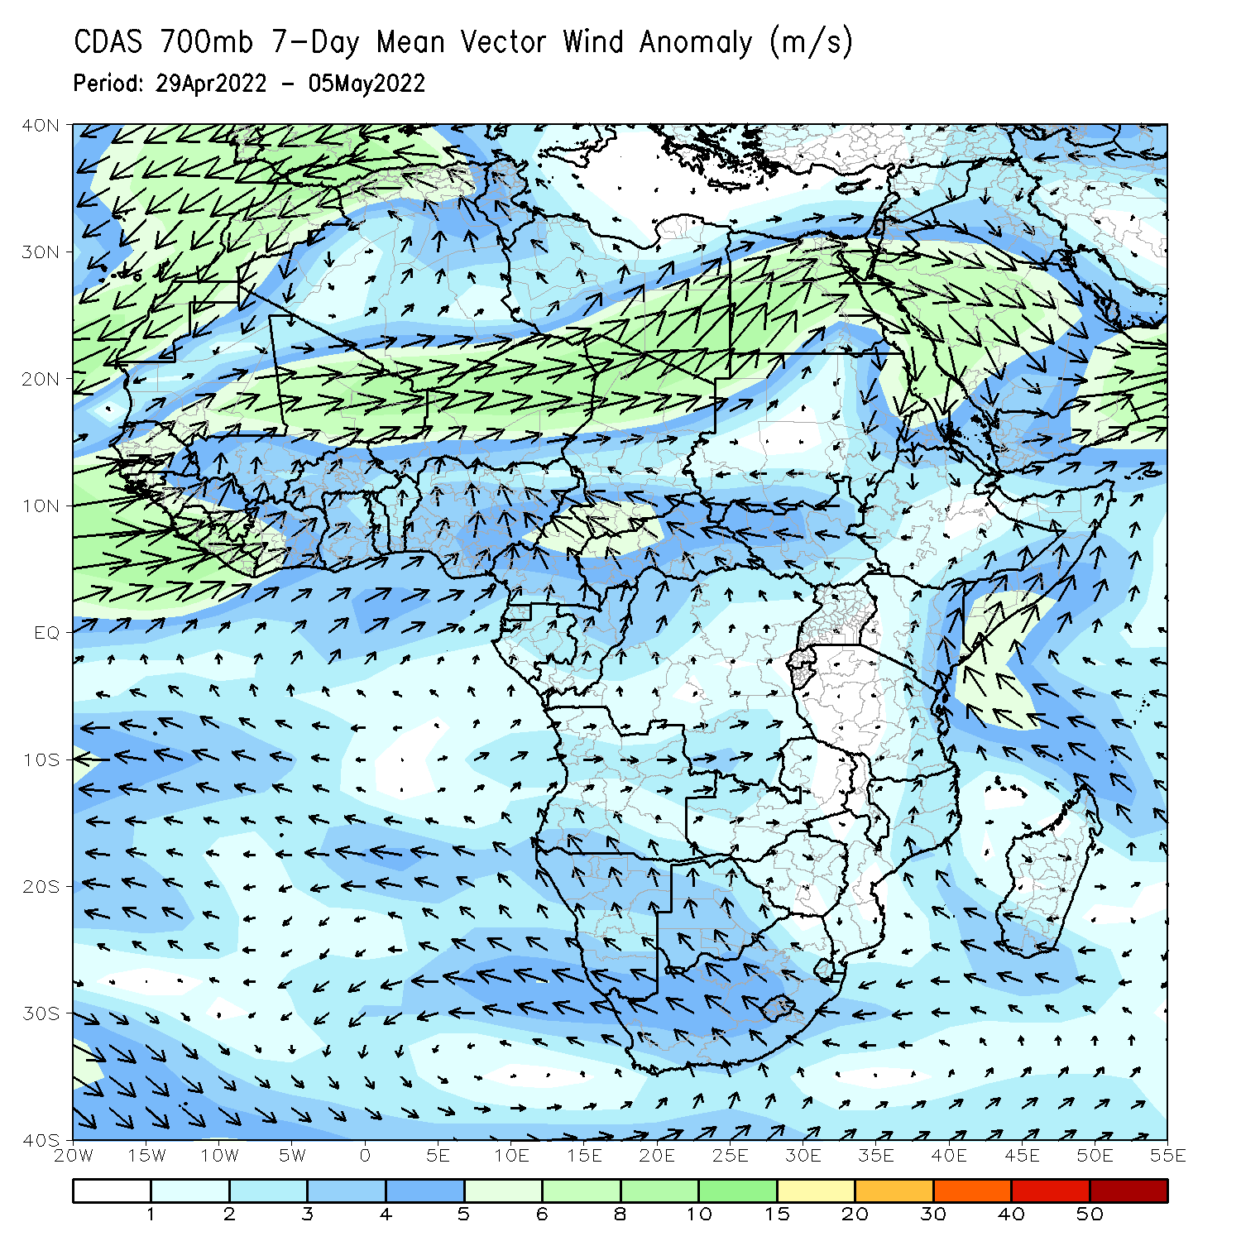
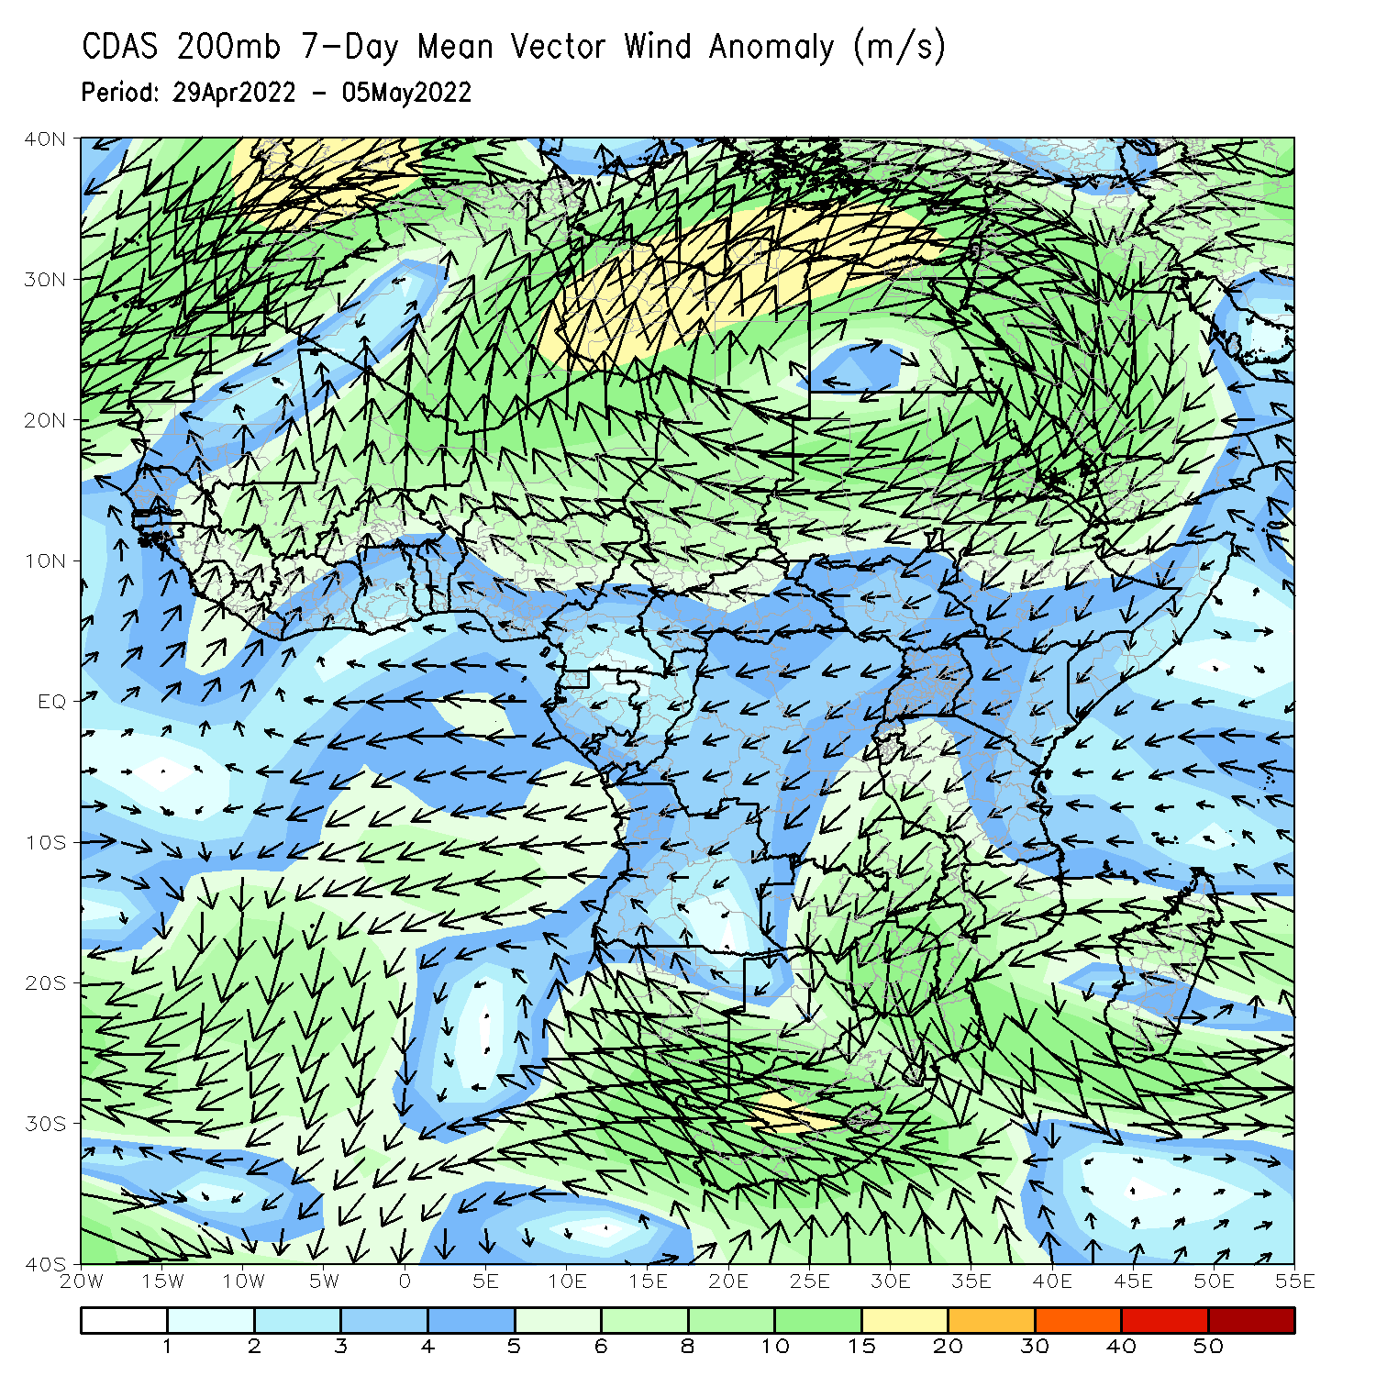
Atmospheric Circulation: Last 7 Days
At 700-hPa level (left panel), anomalous southerly flow with its associated speed convergence may have contributed to the observed above-average rainfall over the far eastern East Africa.

Slide 8
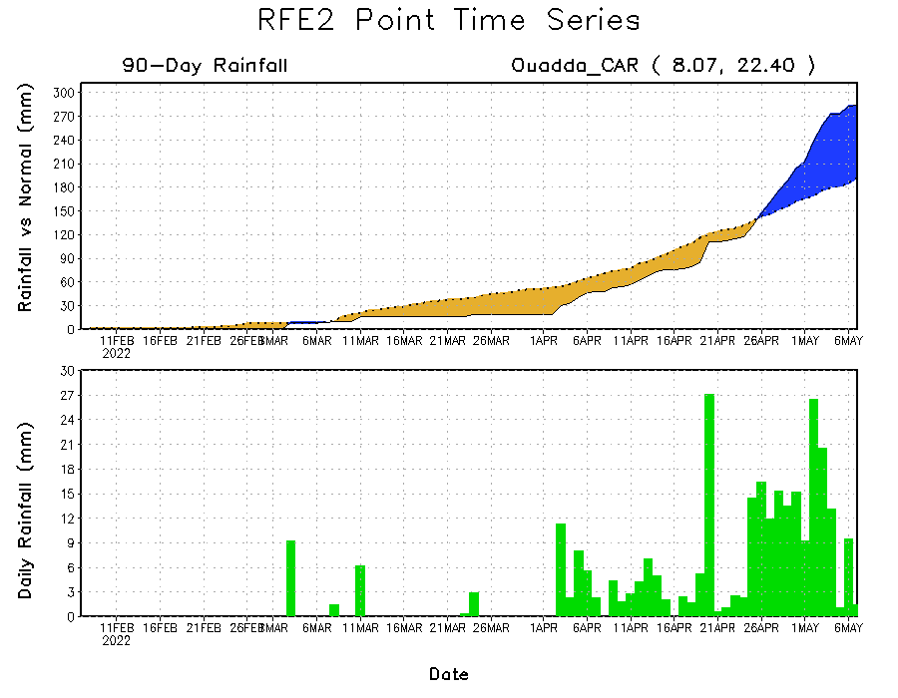
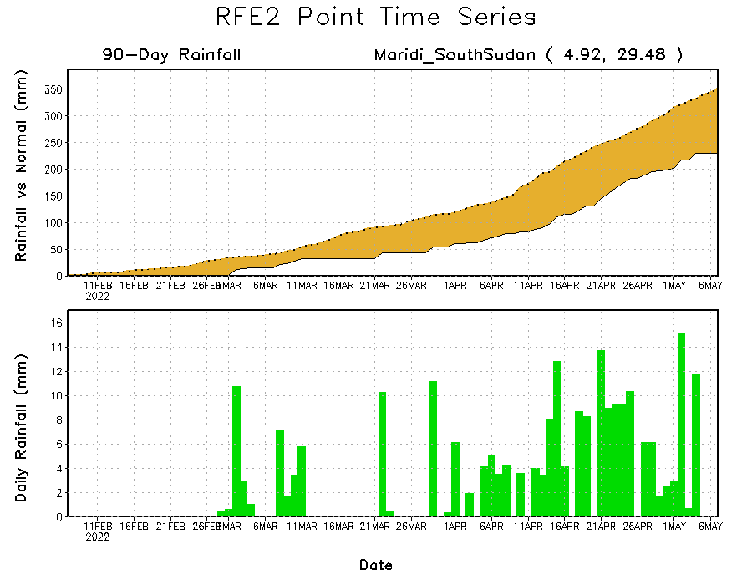
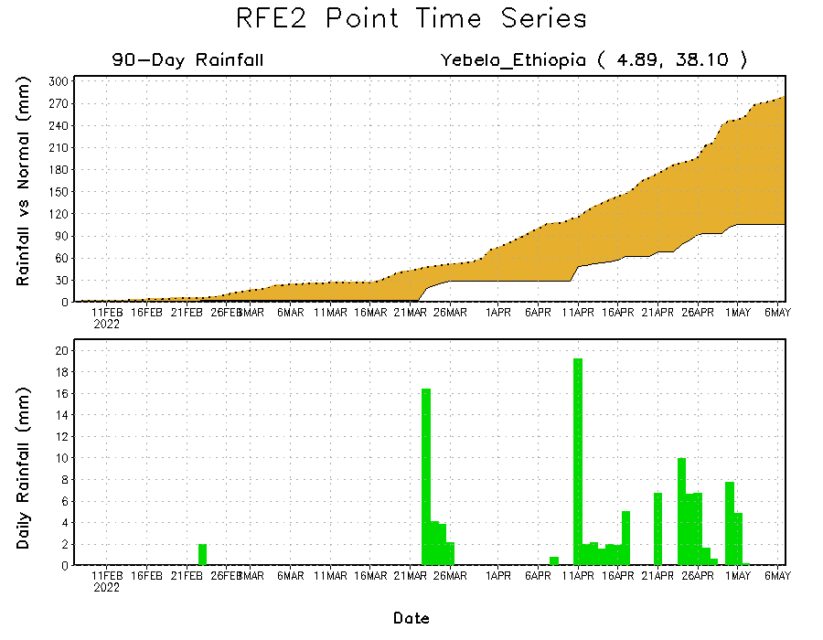
Rainfall Evolution
Daily evolution of rainfall over the last 90 days at selected locations shows moderate to heavy rainfall sustained moisture surpluses over eastern Central Africa Republic (top right). Seasonal total rainfall remained below-average over parts of southern South Sudan (bottom left) and southern Ethiopia (bottom right).

Slide 9
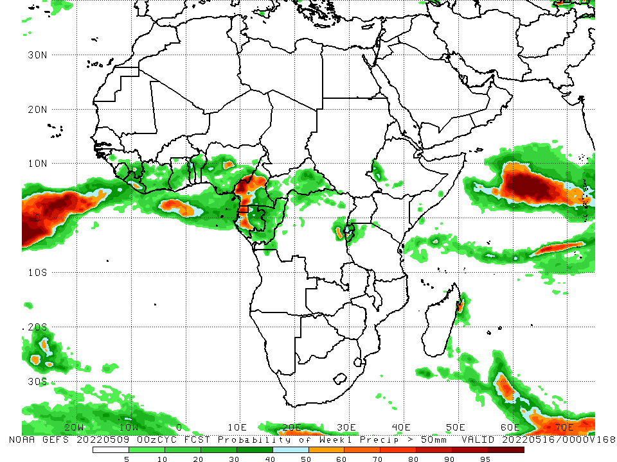
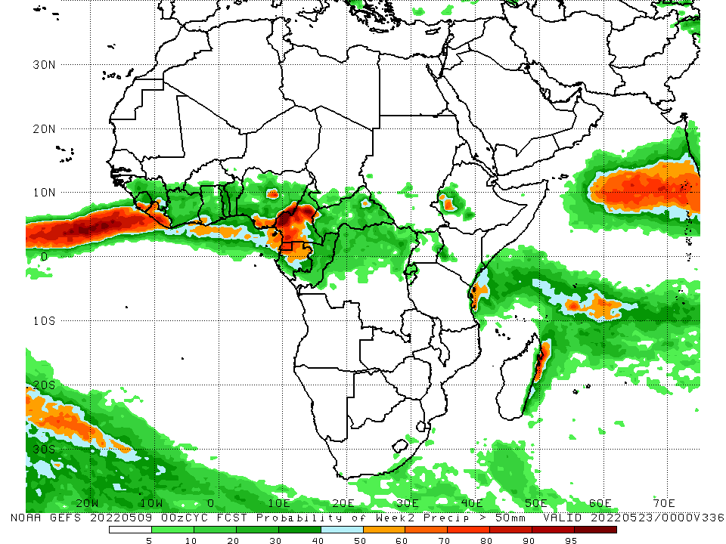
NCEP GEFS Model Forecasts Non-Bias Corrected Probability of precipitation exceedance
Week-1, Valid: 10 – 16 May, 2022
Week-2, Valid: 17 – 23 May, 2022
For week-1 (left panel) and week-2 (right panel), the NCEP GEFS indicates a moderate to high chance (over 70%) for rainfall to exceed 50 mm over pockets of Nigeria, Cameroon, Gabon and Equatorial Guinea.
Notes:
9

Slide 10
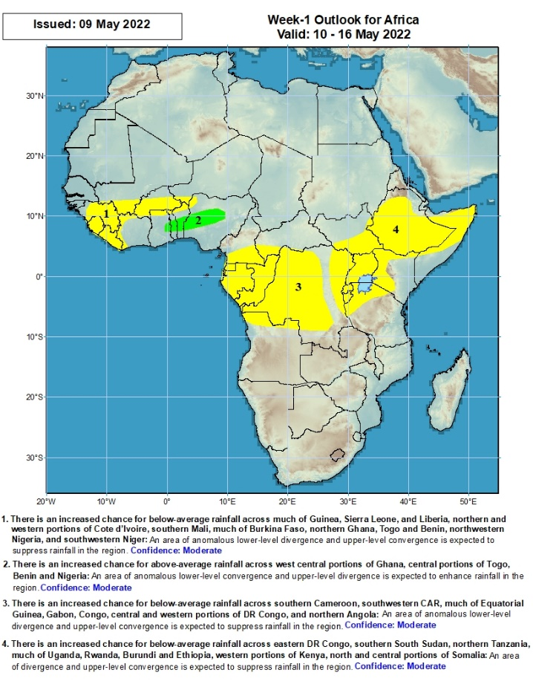
Week-1 Precipitation Outlooks
10 – 16 May, 2022
There is an increased chance for below-average rainfall across much of Guinea, Sierra Leone, and Liberia, northern and western portions of Cote d’Ivoire, southern Mali, much of Burkina Faso, northern Ghana, Togo and Benin, northwestern Nigeria, and southwestern Niger: An area of anomalous lower-level divergence and upper-level convergence is expected to suppress rainfall in the region. Confidence: Moderate
There is an increased chance for above-average rainfall across west central portions of Ghana, central portions of Togo, Benin, and Nigeria: An area of anomalous lower-level convergence and upper-level divergence is expected to enhance rainfall in the region. Confidence: Moderate
There is an increased chance for below-average rainfall across southern Cameroon, southwestern CAR, much of Equatorial Guinea, Gabon, Congo, central and western portions of DR Congo, and northern Angola: An area of anomalous lower-level divergence and upper-level convergence is expected to suppress rainfall in the region. Confidence: Moderate
There is an increased chance for below-average rainfall across eastern DR Congo, southern South Sudan, northern Tanzania, much of Uganda, Rwanda, Burundi and Ethiopia, western portions of Kenya, north and central portions of Somalia: An area of anomalous lower-level divergence and upper-level convergence is expected to suppress rainfall in the region. Confidence: Moderate
Notes:
10

Slide 11
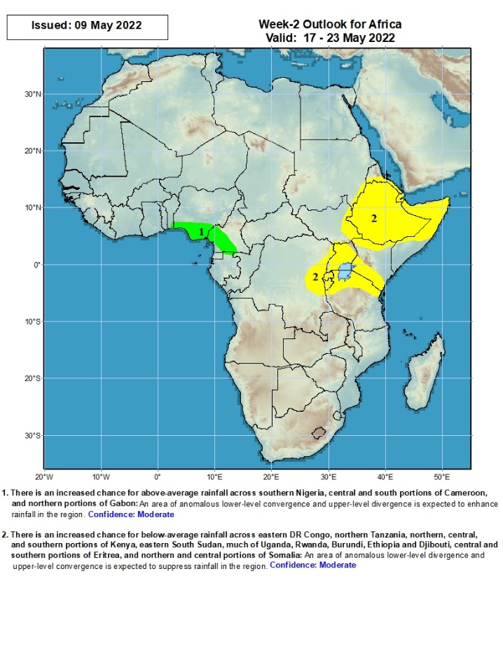
Week-2 Precipitation Outlooks
17 – 23 May, 2022
There is an increased chance for above-average rainfall across southern Nigeria, central and south portions of Cameroon, and northern portions of Gabon: An area of anomalous lower-level convergence and upper-level divergence is expected to enhance rainfall in the region. Confidence: Moderate
There is an increased chance for below-average rainfall across eastern DR Congo, northern Tanzania, northern, central, and southern portions of Kenya, eastern South Sudan, much of Uganda, Rwanda, Burundi, Ethiopia and Djibouti, central and southern portions of Eritrea, and northern and central portions of Somalia: An area of anomalous lower-level divergence and upper-level convergence is expected to suppress rainfall in the region. Confidence: Moderate
Notes:
11

Slide 12
Summary
During the past 30 days, in East Africa, above-average rainfall was observed over western Ethiopia, northern and eastern South Sudan, pockets of Somalia, Uganda, and the far northern and southern Tanzania. Rainfall was below-average over northeastern and southern Ethiopia, pockets of central and southern South Sudan, much of Kenya, pockets of Somalia, and many parts of Tanzania. In Central Africa, rainfall was above-average over much of Cameroon, Equatorial Guinea, Gabon, Congo, much of CAR, and many parts of DRC. Rainfall was below-average over pockets of central and northern DRC. In Southern Africa, above-average rainfall was observed over western Angola, parts of Zambia, Malawi, Mozambique, Botswana, Zimbabwe and eastern South Africa. Below-average rainfall was observed over parts of Angola, Namibia, western South Africa, and pockets of Madagascar. In West Africa, rainfall was above-average over much of the Gulf of Guinea region.
During the past 7 days, in East Africa, rainfall was above-average over the western and northern parts of South Sudan, western and southeastern Ethiopia, southern Somalia, pockets of Uganda, and parts of eastern Kenya. Below-average rainfall was observed over the southern portion of South Sudan, central and southern Ethiopia, central Kenya, and northern Tanzania. In Central Africa, rainfall was above-average over portions of Cameroon, Gabon, Congo, CAR, and portions of DRC. Below-average rainfall was observed over central Congo, and western and central DRC. In West Africa, above-average rainfall was observed over many places in the Gulf of Guinea region.
Week-1 and Week-2 outlooks call for an increased chance for below-average rainfall over much of Central and East Africa. In contrast, there is an increased chance for above-average rainfall over parts of Nigeria.

