Slide 1
The African Monsoon Recent Evolution and Current Status Include Week-1 and Week-2 Outlooks
Update prepared by
18 April 2022
For more information, visit:
http://www.cpc.ncep.noaa.gov/products/Global_Monsoons/African_Monsoons/precip_monitoring.shtml

Slide 2
Outline
Highlights
Recent Evolution and Current Conditions
NCEP GEFS Forecasts
Summary

Slide 3
Highlights: Last 7 Days
During the past 7 days, in East Africa, rainfall was above-average over eastern South Sudan and western Ethiopia. Below-average rainfall was observed over southeastern Ethiopia, southern Somalia, Kenya and western Tanzania. In Central Africa, rainfall was above-average over western and the far southern DRC, eastern Gabon, parts of Congo. Below-average rainfall was observed over southern Cameroon, Equatorial Guinea, western Gabon, and parts of central and eastern DRC. In Southern Africa, rainfall was above-average over parts of Angola and Zambia, Botswana, Zimbabwe, eastern South Africa, and southern and the far northern Mozambique. Rainfall was below-average over pockets of Madagascar. In West Africa, above-average rainfall was observed over parts of Cote d’Ivoire, Burkina Faso, Ghana and northern Nigeria, while rainfall was below-average over southern Nigeria.
Week-1 and Week-2 outlooks call for an increased chance for above average rainfall over parts of Central Africa and the Lake Victoria region. In contrast, there is an increased chance for below-average rainfall over parts of the Gulf of Guinea region, and eastern Ethiopia and Somalia.

Slide 4
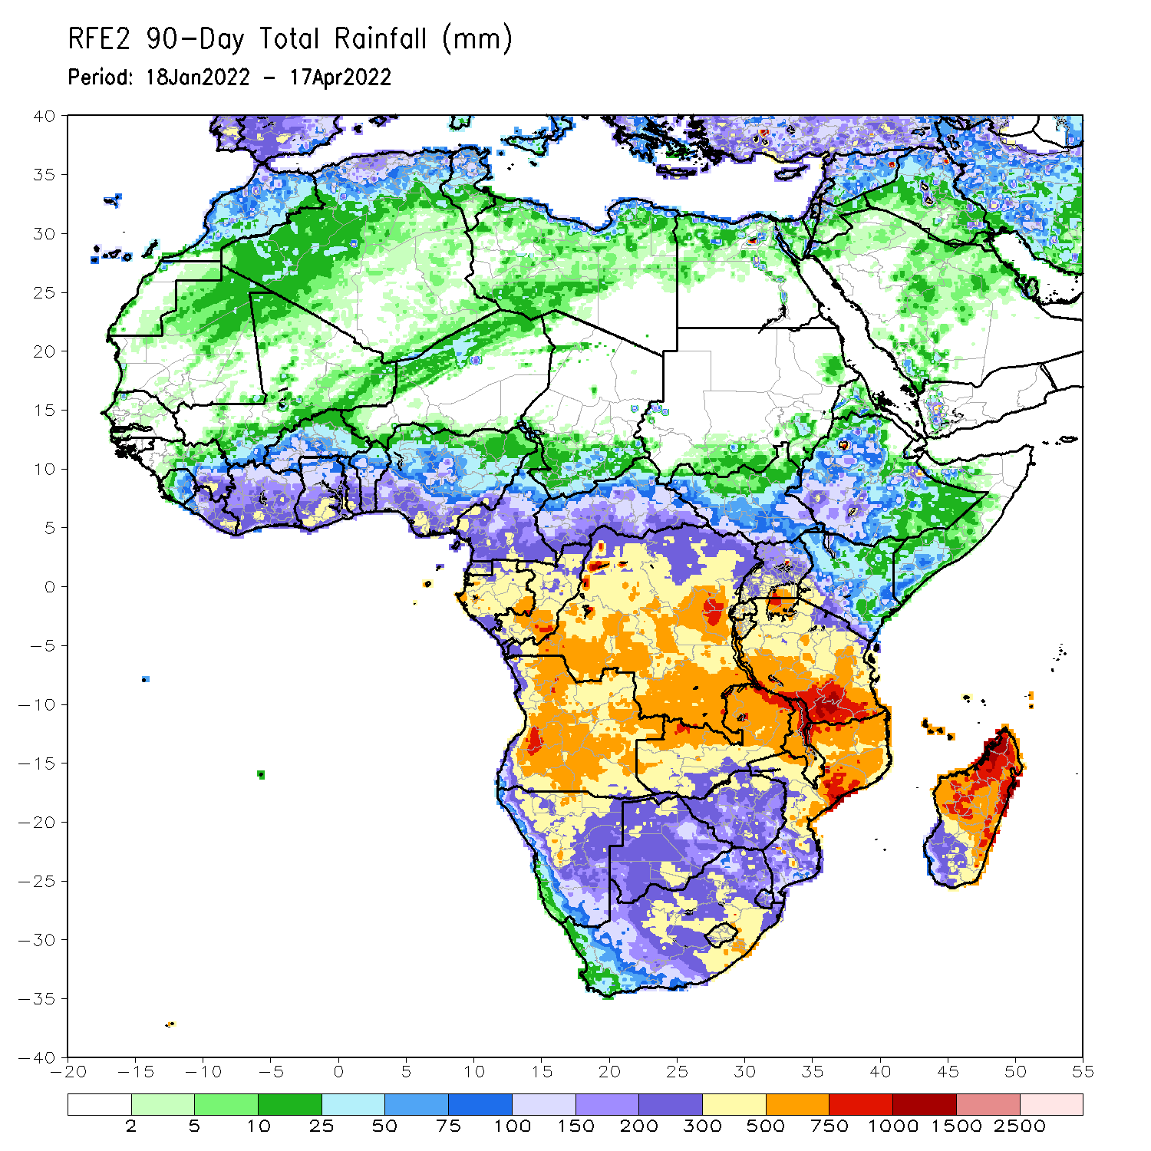
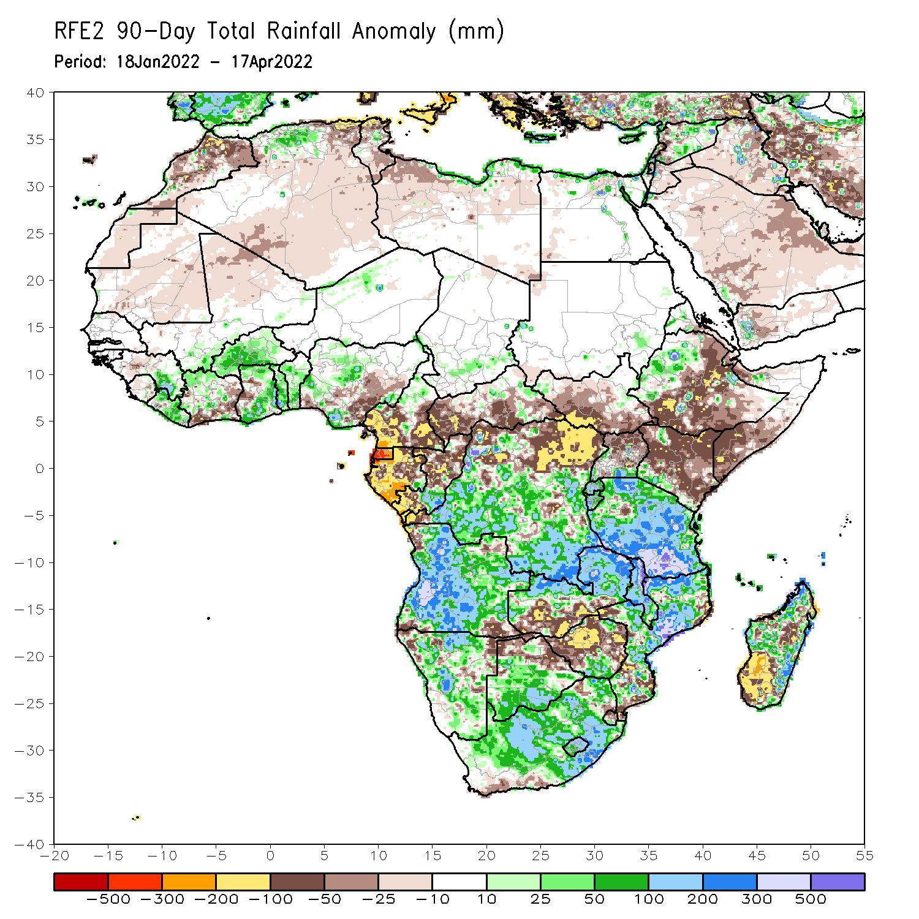
Rainfall Patterns: Last 90 Days
Over the past 90 days, in East Africa, above-average rainfall was observed over parts of western Ethiopia, Rwanda, Burundi, pockets of southern Uganda, pockets of Kenya, and much of Tanzania. Rainfall was below-average over central, southern and eastern Ethiopia, much of Kenya, southwestern Somalia, and northern Uganda. In southern Africa, above-average rainfall was observed over much of Angola, Botswana, much of Namibia, southern Zimbabwe, central and northern Zambia, Malawi, much of Mozambique, northern and eastern Madagascar, and much of South Africa. Below-average rainfall was observed over pockets of northeastern and southwestern Angola, northwestern and eastern Namibia, southern Zambia, northern Botswana, many parts of Zimbabwe, pockets of southern Mozambique and southwestern Madagascar. In Central Africa, rainfall was above-average over many parts of DRC and southern Congo. Rainfall was below-average over southern Cameroon, northern DRC, Equatorial Guinea, much of Gabon, CAR, and northern Congo. In West Africa, rainfall was below-average over portions of Cote d’Ivoire, western Ghana and parts of Nigeria, while above-average rainfall was observed over eastern Guinea, much of Liberia, Burkina Faso, many parts of Ghana and pockets of Nigeria.
Notes:
4

Slide 5
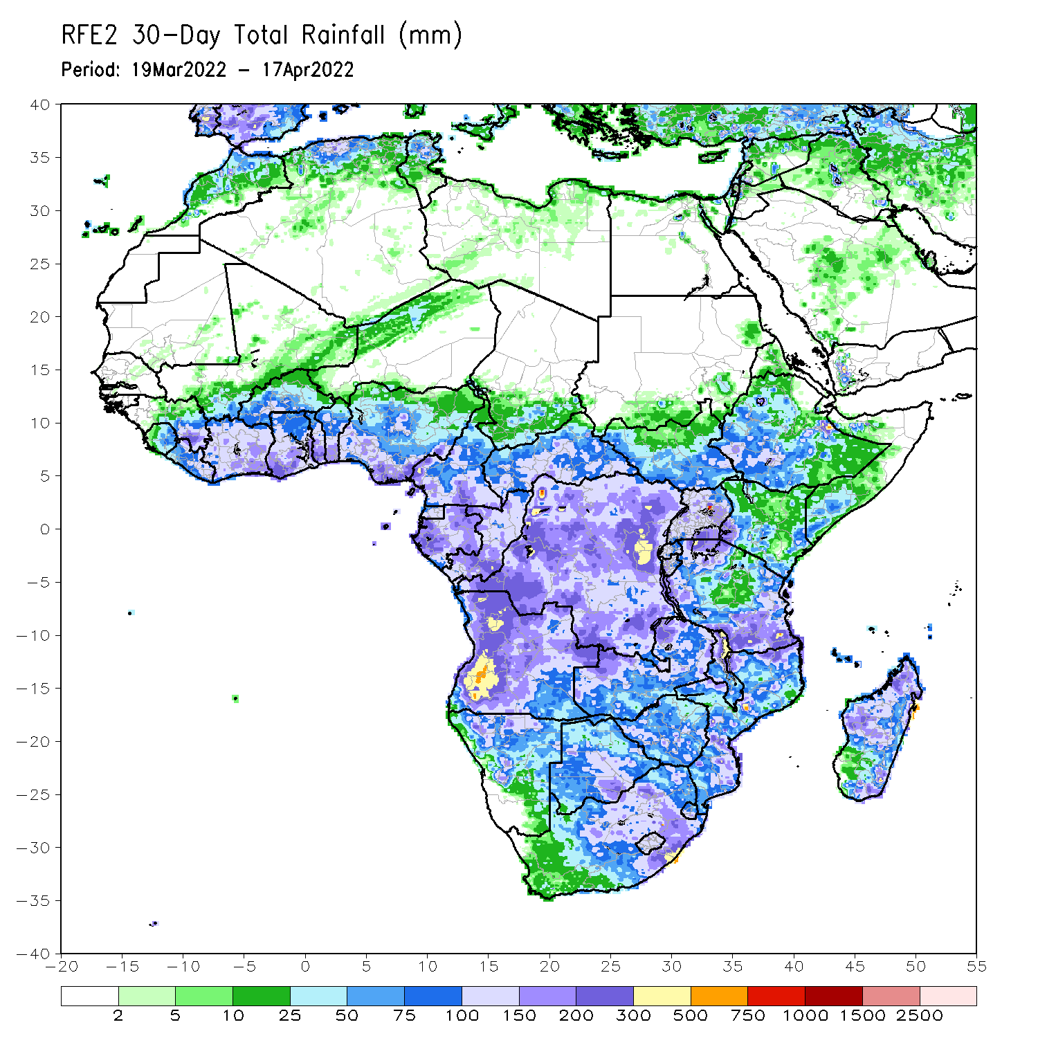
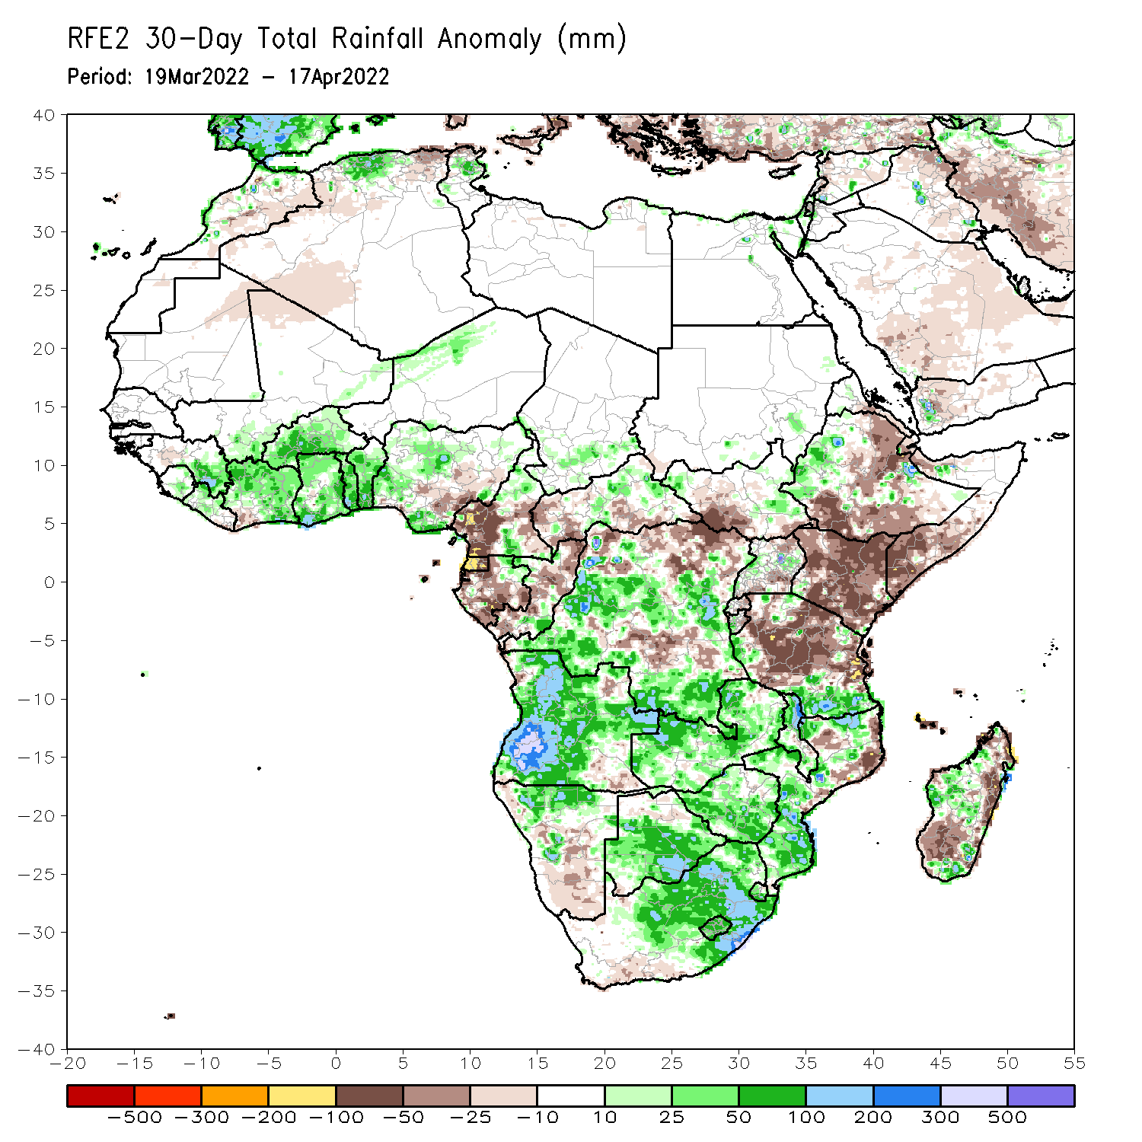
Rainfall Patterns: Last 30 Days
During the past 30 days, in East Africa, above-average rainfall was observed over parts of western Ethiopia, and the far western and southern Tanzania. Rainfall was below-average over southern, central and eastern Ethiopia, southern South Sudan, much of Kenya, southern Somalia, and central and northern Tanzania. In Central Africa, rainfall was below-average over parts of Cameroon, Equatorial Guinea, Gabon, northern Congo, southern CAR and northern DRC. Rainfall was above-average over pockets of Cameroon, southern Congo, and central and southern DRC. In Southern Africa, above-average rainfall was observed over much of Angola, Namibia, much of Zambia, Malawi, much of Mozambique, portions of Madagascar, and much of Botswana and South Africa. Below-average rainfall was observed over pockets of northeastern and southeastern Angola, and southern and the far eastern Madagascar. In West Africa, rainfall was above-average over parts of the Gulf of Guinea region.
Notes:
5

Slide 6
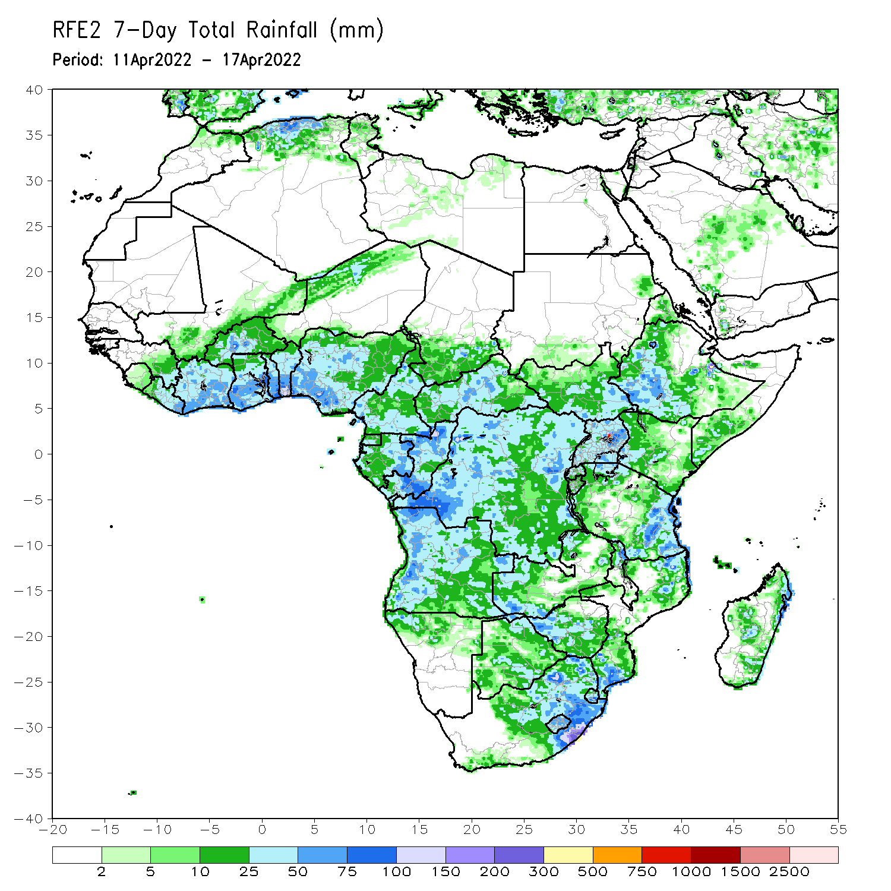
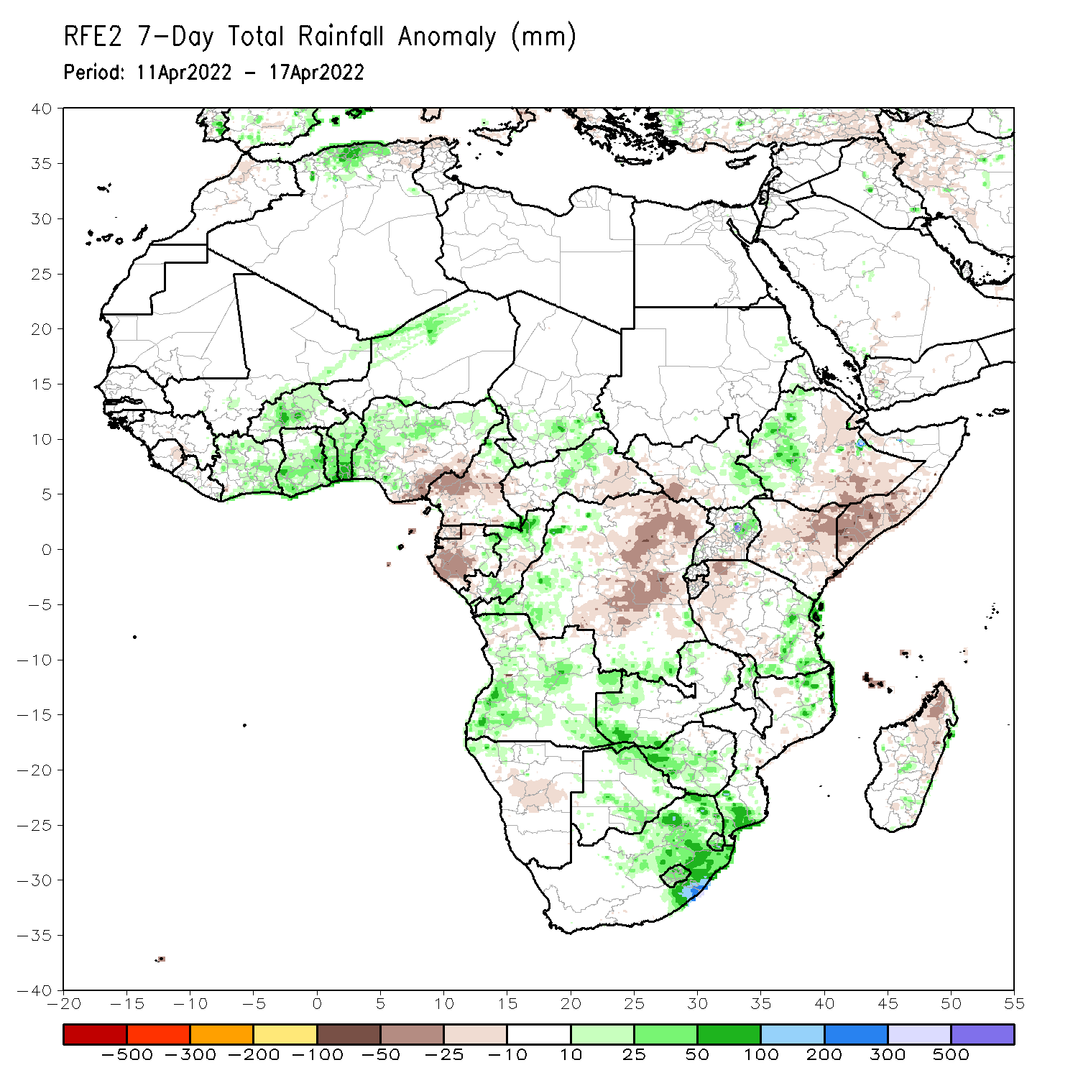
Rainfall Patterns: Last 7 Days
During the past 7 days, in East Africa, rainfall was above-average over eastern South Sudan and western Ethiopia. Below-average rainfall was observed over southeastern Ethiopia, southern Somalia, Kenya and western Tanzania. In Central Africa, rainfall was above-average over western and the far southern DRC, eastern Gabon, parts of Congo. Below-average rainfall was observed over southern Cameroon, Equatorial Guinea, western Gabon, and parts of central and eastern DRC. In Southern Africa, rainfall was above-average over parts of Angola and Zambia, Botswana, Zimbabwe, eastern South Africa, and southern and the far northern Mozambique. Rainfall was below-average over pockets of Madagascar. In West Africa, above-average rainfall was observed over parts of Cote d’Ivoire, Burkina Faso, Ghana and northern Nigeria, while rainfall was below-average over southern Nigeria.

Slide 7
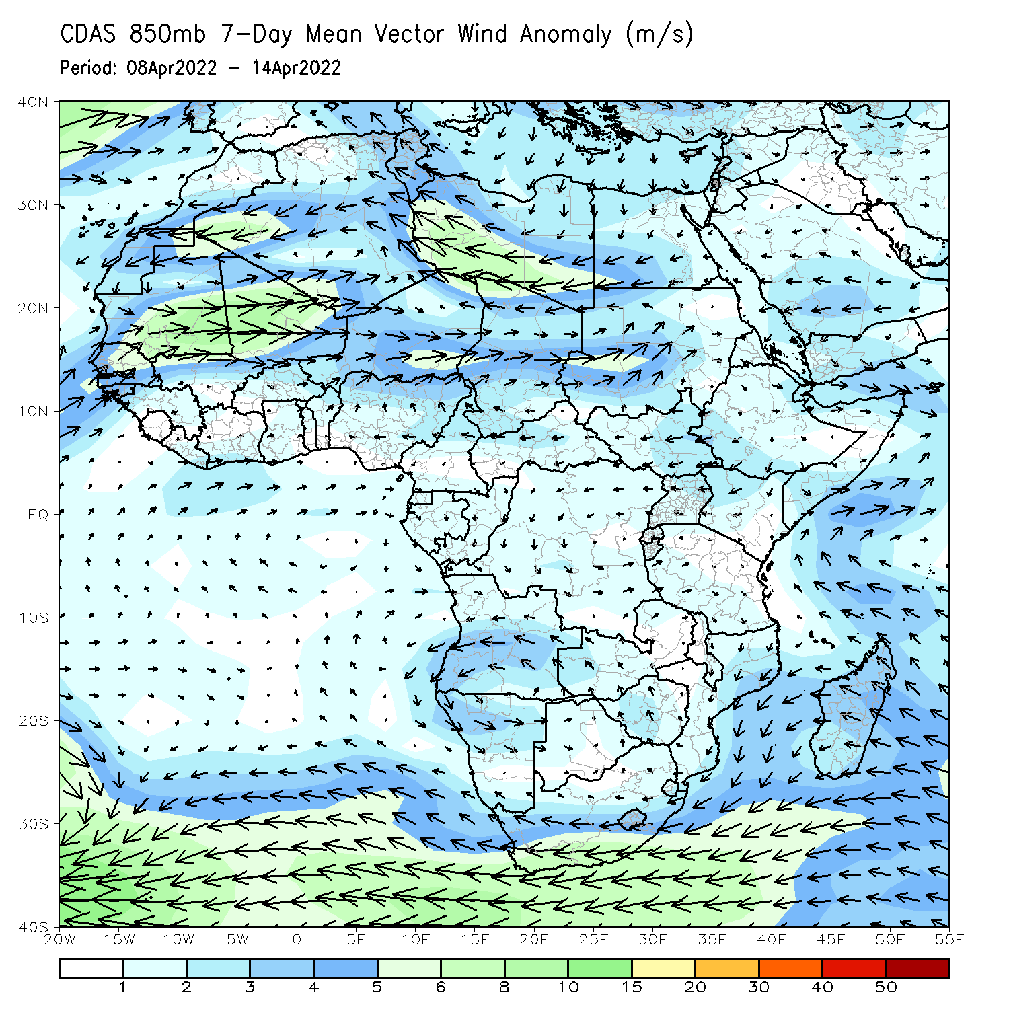
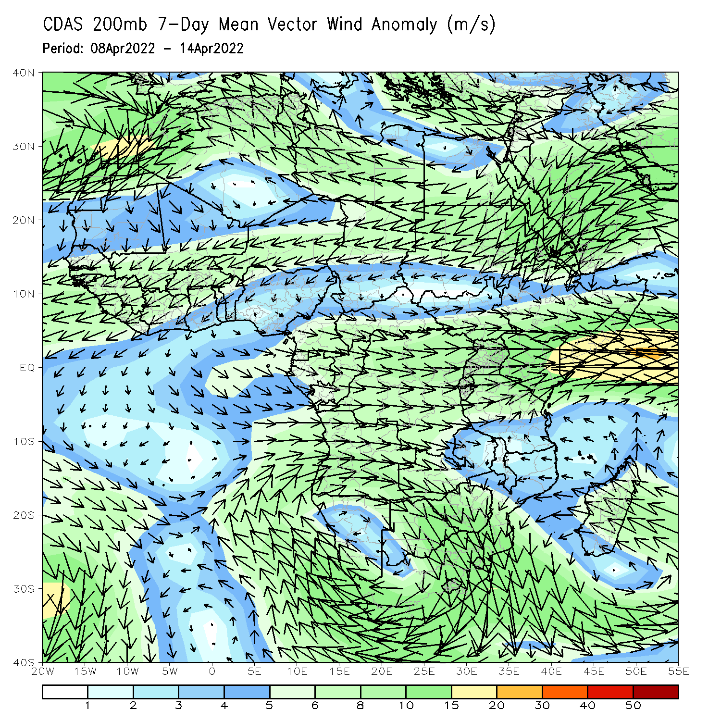
Atmospheric Circulation: Last 7 Days
At 850-hPa level (left panel), anomalous northerly flow and its associated lower-level divergence may have contributed to the observed below-average rainfall across East Africa.

Slide 8
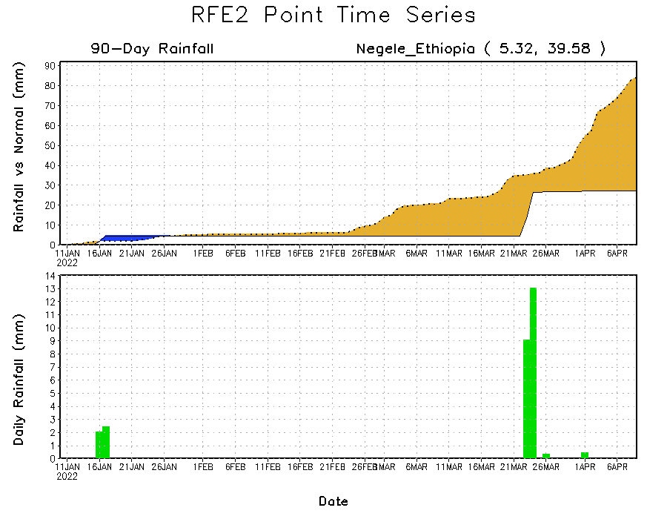
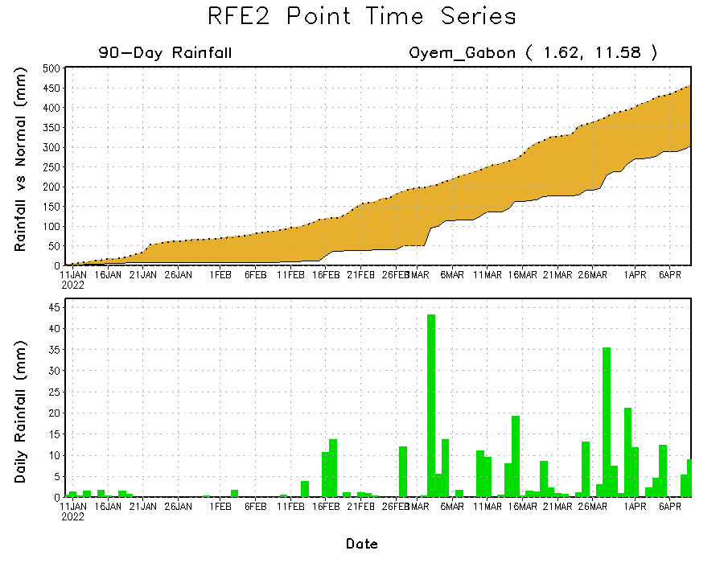
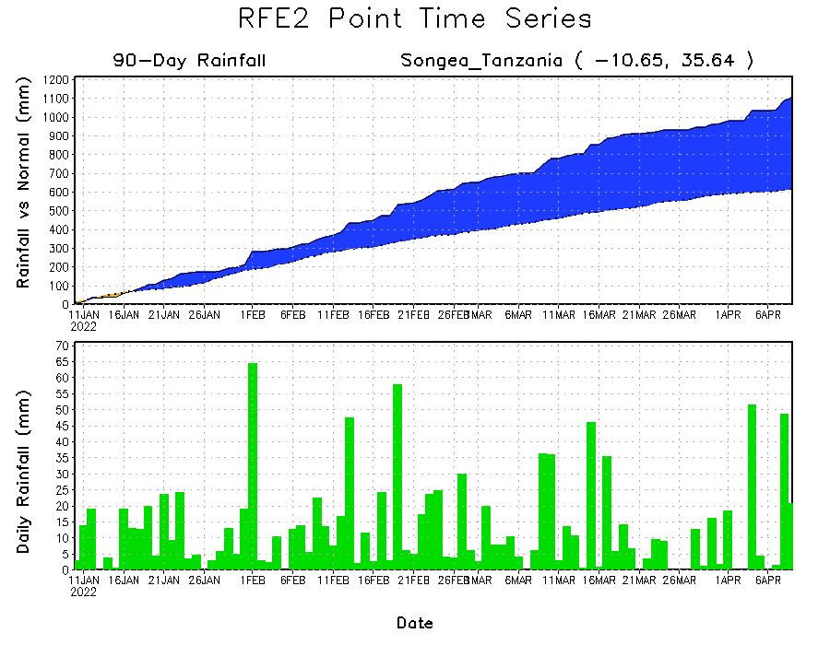
Rainfall Evolution
Daily evolution of rainfall over the last 90 days at selected locations shows moderate to heavy rainfall sustained moisture surpluses over parts of Tanzania (bottom right). Seasonal total rainfall remained below-average over parts of Ethiopia (top right) and Gabon (bottom left).

Slide 9
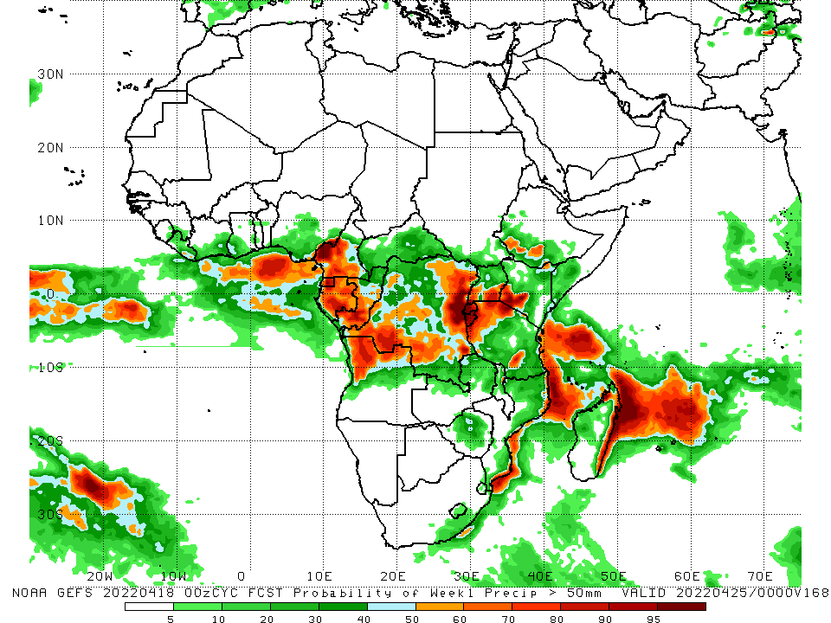
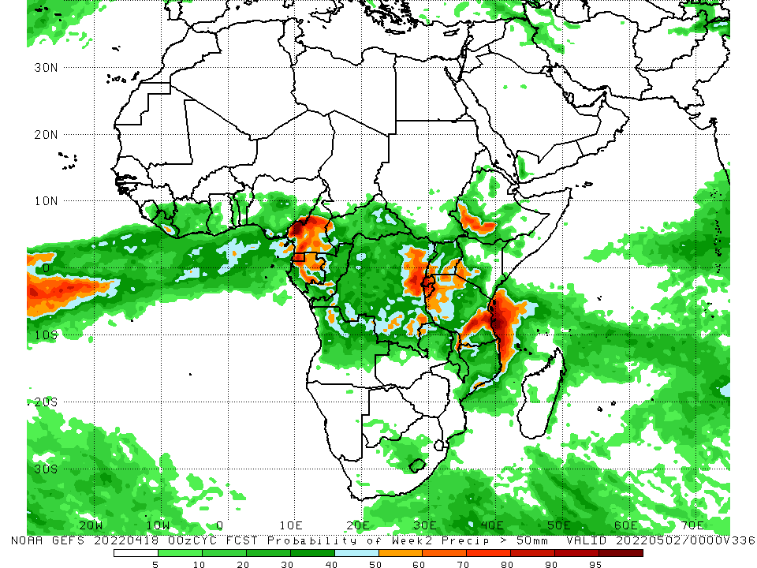
NCEP GEFS Model Forecasts Non-Bias Corrected Probability of precipitation exceedance
Week-1, Valid: 19 – 25 Apr, 2022
Week-2, Valid: 26 Apr – 02 May, 2022
For week-1 (left panel) and week-2 (right panel), the NCEP GEFS indicates a moderate to high chance (over 70%) for rainfall to exceed 50 mm over the western portion of Central Africa, eastern DRC, Rwanda, Burundi, southwestern Kenya, western Tanzania, and the far southern Ethiopia.
Notes:
9

Slide 10
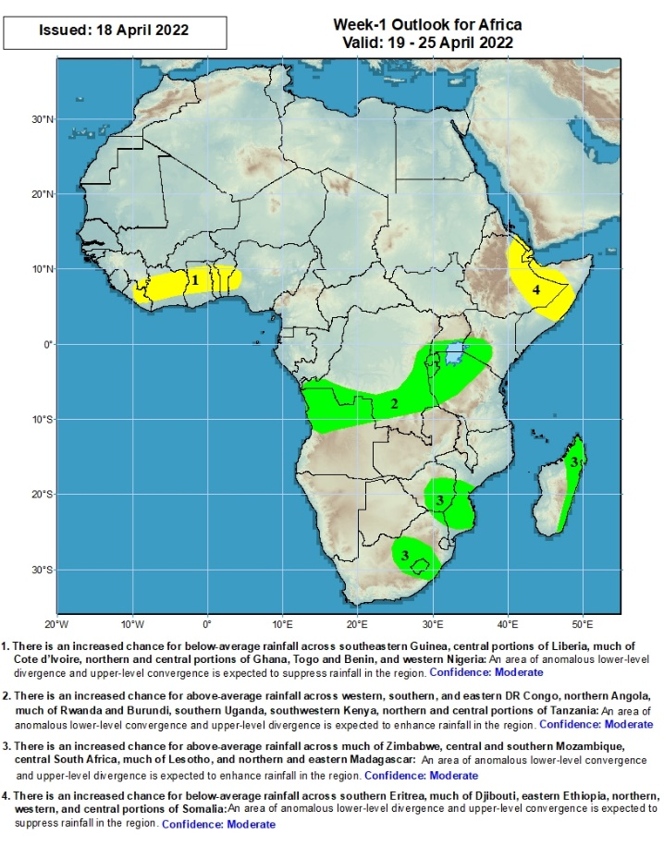
Week-1 Precipitation Outlooks
19 – 25 Apr, 2022
There is an increased chance for below-average rainfall across southeastern Guinea, central portions of Liberia, much of Cote d’Ivoire, northern and central portions of Ghana, Togo and Benin, and western Nigeria: An area of anomalous lower-level divergence and upper-level convergence is expected to suppress rainfall in the region. Confidence: Moderate
There is an increased chance for above-average rainfall across western, southern, and eastern DR Congo, northern Angola, much of Rwanda and Burundi, southern Uganda, southwestern Kenya, northern and central portions of Tanzania: An area of anomalous lower-level convergence and upper-level divergence is expected to enhance rainfall in the region. Confidence: Moderate
There is an increased chance for above-average rainfall across much of Zimbabwe, central and southern Mozambique, central South Africa, much of Lesotho, and northern and eastern Madagascar: An area of anomalous lower-level convergence and upper-level divergence is expected to enhance rainfall in the region. Confidence: Moderate
There is an increased chance for below-average rainfall across southern Eritrea, much of Djibouti, eastern Ethiopia, northern, western, and central portions of Somalia: An area of anomalous lower-level divergence and upper-level convergence is expected to suppress rainfall in the region. Confidence: Moderate
Notes:
10

Slide 11
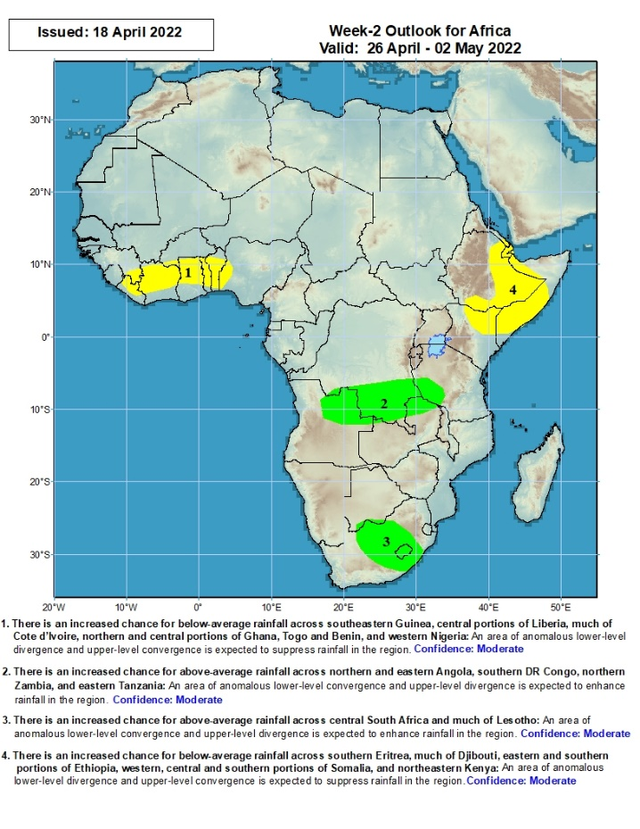
Week-2 Precipitation Outlooks
26 Apr – 02 May, 2022
There is an increased chance for below-average rainfall across southeastern Guinea, central portions of Liberia, much of Cote d’Ivoire, northern and central portions of Ghana, Togo and Benin, and western Nigeria: An area of anomalous lower-level divergence and upper-level convergence is expected to suppress rainfall in the region. Confidence: Moderate
There is an increased chance for above-average rainfall across northern and eastern Angola, southern DR Congo, northern Zambia, and eastern Tanzania: An area of anomalous lower-level convergence and upper-level divergence is expected to enhance rainfall in the region. Confidence: Moderate
There is an increased chance for above-average rainfall across central South Africa and much of Lesotho: An area of anomalous lower-level convergence and upper-level divergence is expected to enhance rainfall in the region. Confidence: Moderate
There is an increased chance for below-average rainfall across southern Eritrea, much of Djibouti, eastern and southern portions of Ethiopia, western, central and southern portions of Somalia, and northeastern Kenya: An area of anomalous lower-level divergence and upper-level convergence is expected to suppress rainfall in the region. Confidence: Moderate
Notes:
11

Slide 12
Summary
During the past 30 days, in East Africa, above-average rainfall was observed over parts of western Ethiopia, and the far western and southern Tanzania. Rainfall was below-average over southern, central and eastern Ethiopia, southern South Sudan, much of Kenya, southern Somalia, and central and northern Tanzania. In Central Africa, rainfall was below-average over parts of Cameroon, Equatorial Guinea, Gabon, northern Congo, southern CAR and northern DRC. Rainfall was above-average over pockets of Cameroon, southern Congo, and central and southern DRC. In Southern Africa, above-average rainfall was observed over much of Angola, Namibia, much of Zambia, Malawi, much of Mozambique, portions of Madagascar, and much of Botswana and South Africa. Below-average rainfall was observed over pockets of northeastern and southeastern Angola, and southern and the far eastern Madagascar. In West Africa, rainfall was above-average over parts of the Gulf of Guinea region.
During the past 7 days, in East Africa, rainfall was above-average over eastern South Sudan and western Ethiopia. Below-average rainfall was observed over southeastern Ethiopia, southern Somalia, Kenya and western Tanzania. In Central Africa, rainfall was above-average over western and the far southern DRC, eastern Gabon, parts of Congo. Below-average rainfall was observed over southern Cameroon, Equatorial Guinea, western Gabon, and parts of central and eastern DRC. In Southern Africa, rainfall was above-average over parts of Angola and Zambia, Botswana, Zimbabwe, eastern South Africa, and southern and the far northern Mozambique. Rainfall was below-average over pockets of Madagascar. In West Africa, above-average rainfall was observed over parts of Cote d’Ivoire, Burkina Faso, Ghana and northern Nigeria, while rainfall was below-average over southern Nigeria.
Week-1 and Week-2 outlooks call for an increased chance for above average rainfall over parts of Central Africa and the Lake Victoria region. In contrast, there is an increased chance for below-average rainfall over parts of the Gulf of Guinea region, and eastern Ethiopia and Somalia.

