Slide 1
The African Monsoon Recent Evolution and Current Status Include Week-1 and Week-2 Outlooks
Update prepared by
28 March 2022
For more information, visit:
http://www.cpc.ncep.noaa.gov/products/Global_Monsoons/African_Monsoons/precip_monitoring.shtml

Slide 2
Outline
Highlights
Recent Evolution and Current Conditions
NCEP GEFS Forecasts
Summary

Slide 3
Highlights: Last 7 Days
During the past 7 days, in East Africa, rainfall was above-average over parts of eastern and southern Ethiopia, pockets of Uganda, and northwestern Tanzania. Below-average was observed over central and southern Kenya, and much of Tanzania. In central Africa, rainfall was above-average over parts of southern DRC, while below-average rainfall was observed over Equatorial Guinea, Gabon, northern Congo, CAR, and parts of western DRC. In Southern Africa, rainfall was above-average over southwestern Angola, northwestern Namibia, and pockets of South Africa, southern Mozambique and central Madagascar. Rainfall was below-average over portions of Botswana, Zambia, Zimbabwe, eastern South Africa, northern Mozambique, Malawi and, parts of northern and southern Madagascar. In West Africa, above average rainfall was observed over parts of Sierra Leone, eastern Guinea, northern Cote d’Ivoire and Ghana.
Week-1 and Week-2 outlooks call for an increased chance for below-average rainfall in parts of Central Africa, and much of East Africa. In contrast, the forecasts call for an increased chance for above-average rainfall across the northern portion of Southern Africa, including Tanzania.

Slide 4
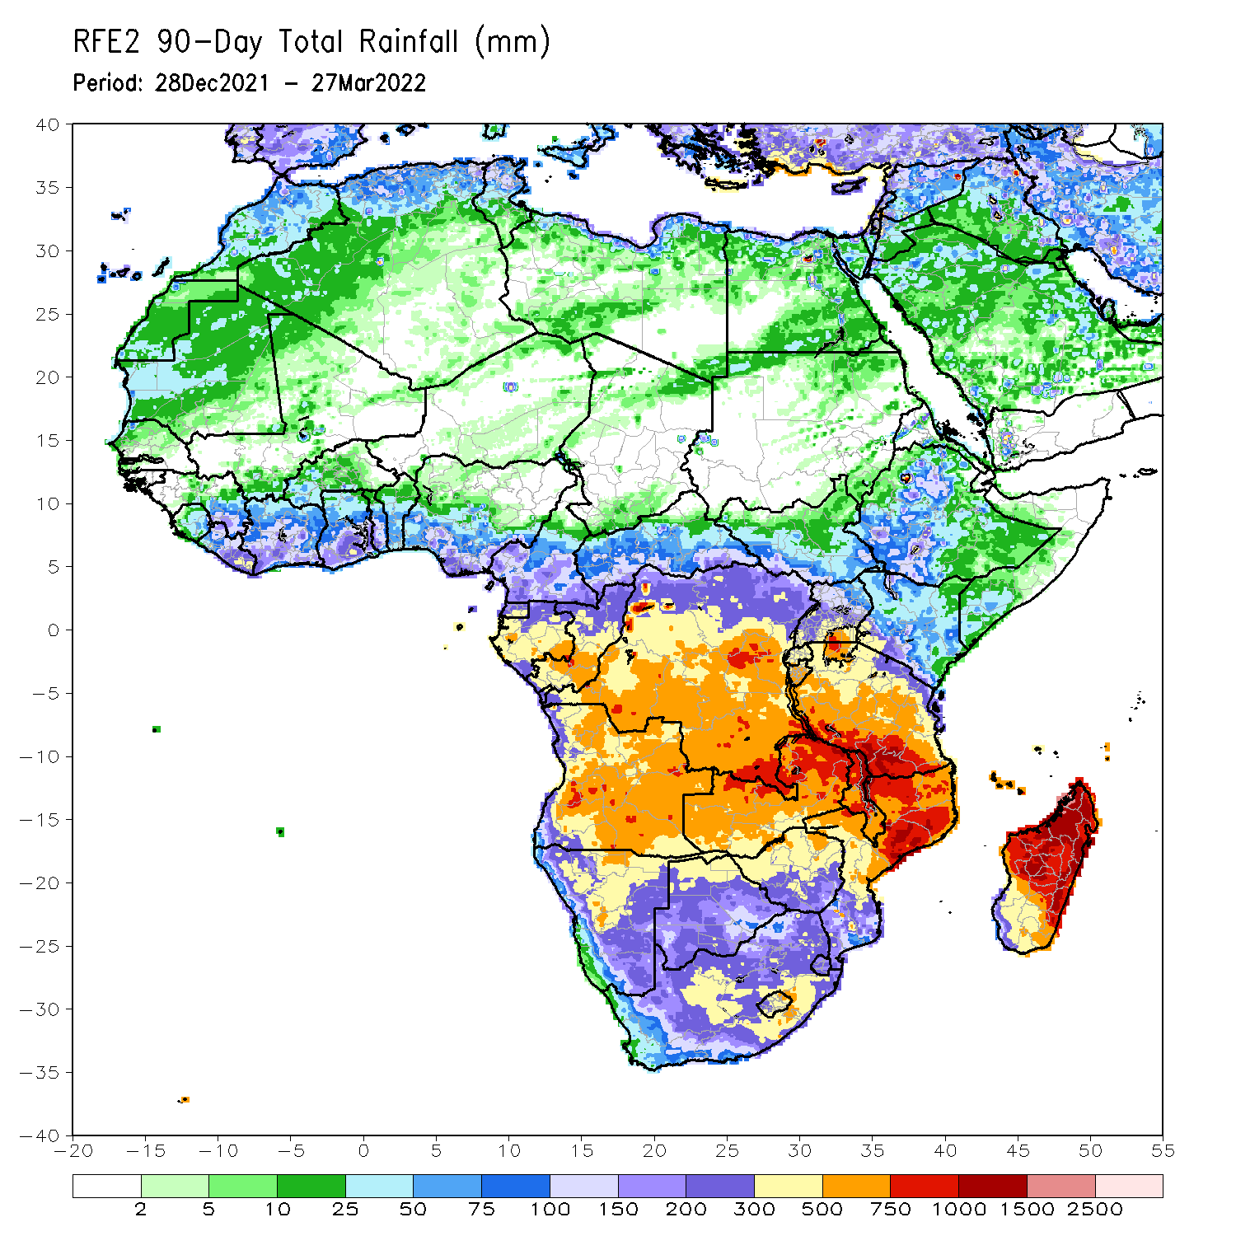
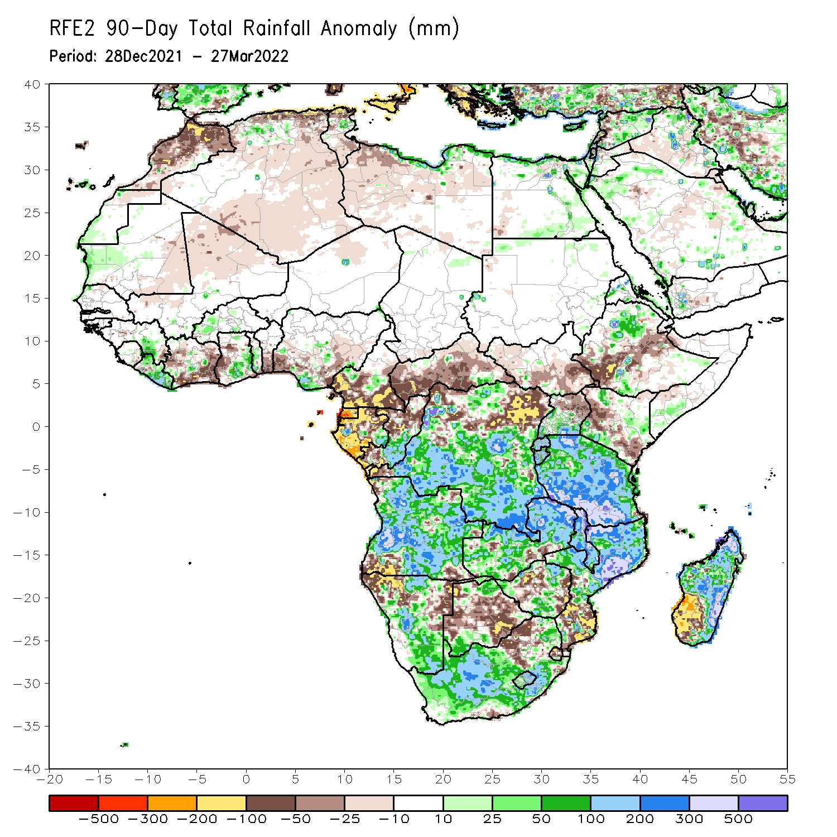
Rainfall Patterns: Last 90 Days
Over the past 90 days, in East Africa, above-average rainfall was observed over parts of northern Ethiopia, Rwanda, Burundi, southern Uganda, pockets of Kenya and southwestern Somalia, and much of Tanzania. Rainfall was below-average over central, southwestern and eastern Ethiopia, parts of western and southern Kenya, and northern Uganda. In southern Africa, above-average rainfall was observed over many parts of Angola, parts of northern and southern Botswana, central and southern Namibia, portions of Zimbabwe, much of Zambia, Malawi, central and northern Mozambique, northern and eastern Madagascar, and much of South Africa. Below-average rainfall was observed over pockets of eastern and southwestern Angola, northwestern and eastern Namibia, pockets of Zambia, many parts of Botswana, parts of Zimbabwe, southern Mozambique and southwestern Madagascar. In Central Africa, rainfall was above-average over many parts of DRC, eastern Gabon, and southern Congo. Rainfall was below-average over southern Cameroon, parts of northern DRC, Equatorial Guinea, much of Gabon, CAR, and northern Congo. In West Africa, rainfall was below-average over portions of Cote d’Ivoire and Nigeria, while above-average rainfall was observed over much of Liberia, parts of Liberia and pockets of Nigeria.
Notes:
4

Slide 5
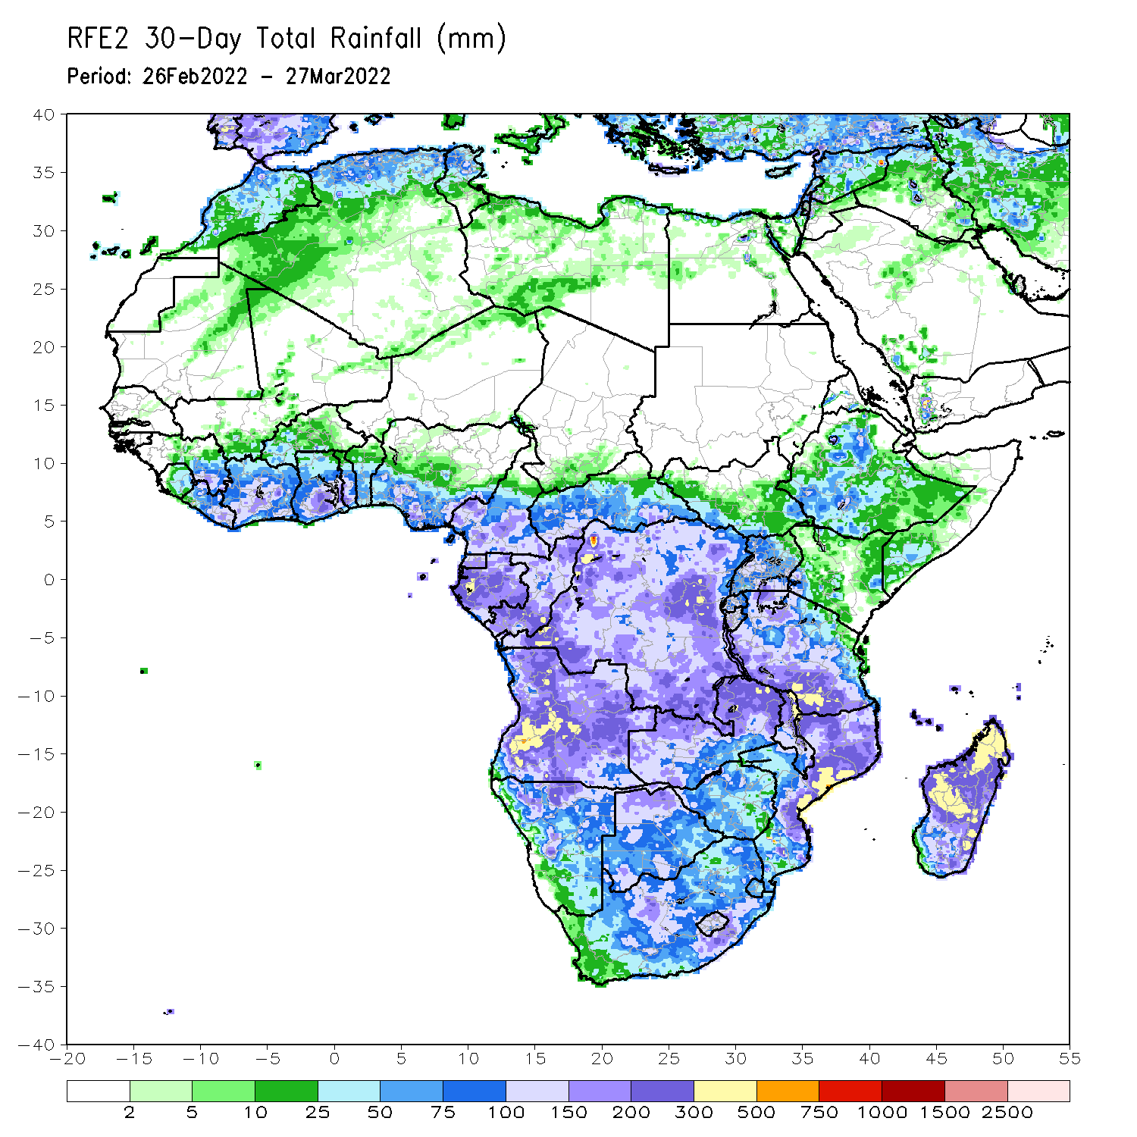
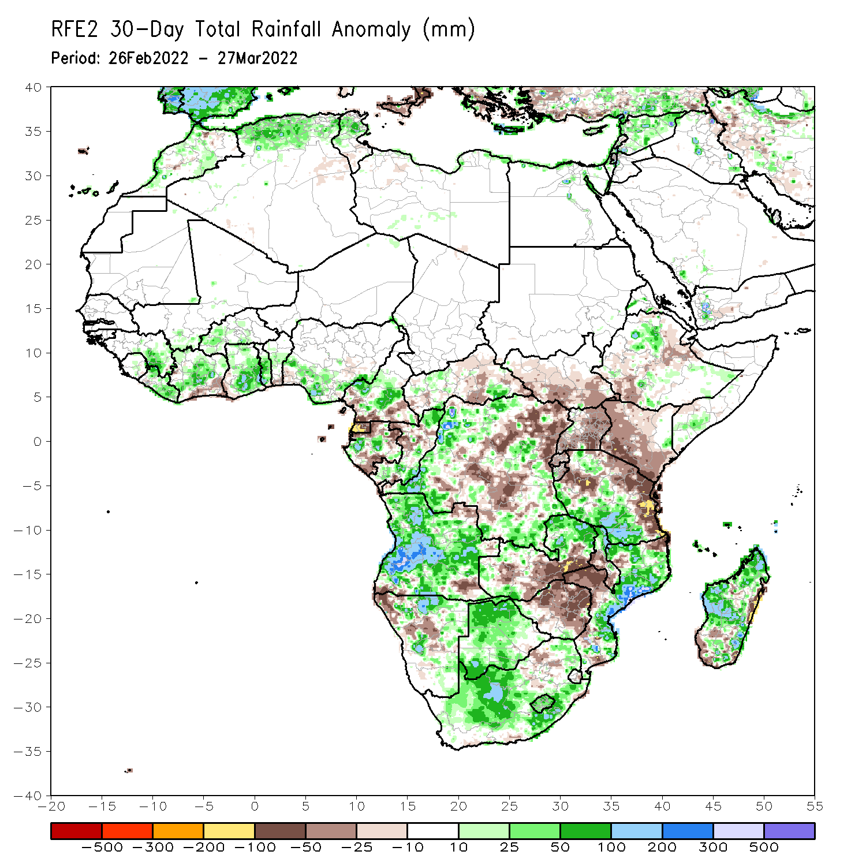
Rainfall Patterns: Last 30 Days
During the past 30 days, in East Africa, above-average rainfall was observed over pockets of Ethiopia, and much of Tanzania. Rainfall was below-average over parts of southwestern and eastern Ethiopia, southern South Sudan, Kenya, parts of western the far eastern Tanzania, and much of and Uganda. In Central Africa, rainfall was below-average over Equatorial Guinea, pockets of northern Gabon, parts of CAR and many parts of DRC. Rainfall was above-average over southern Cameroon, central Gabon, Congo, and the far northern and southern DRC. In Southern Africa, above-average rainfall was observed over much of Angola, eastern Zambia, northern Malawi, much of Mozambique, much of Madagascar, and much of Botswana and South Africa. Below-average rainfall was observed over pockets of southern Angola, parts of Namibia, western and southern Zambia, much of Zimbabwe, pockets of northeastern South Africa, and the far southern Madagascar. In West Africa, rainfall was above-average along the Gulf of Guinea coast.
Notes:
5

Slide 6
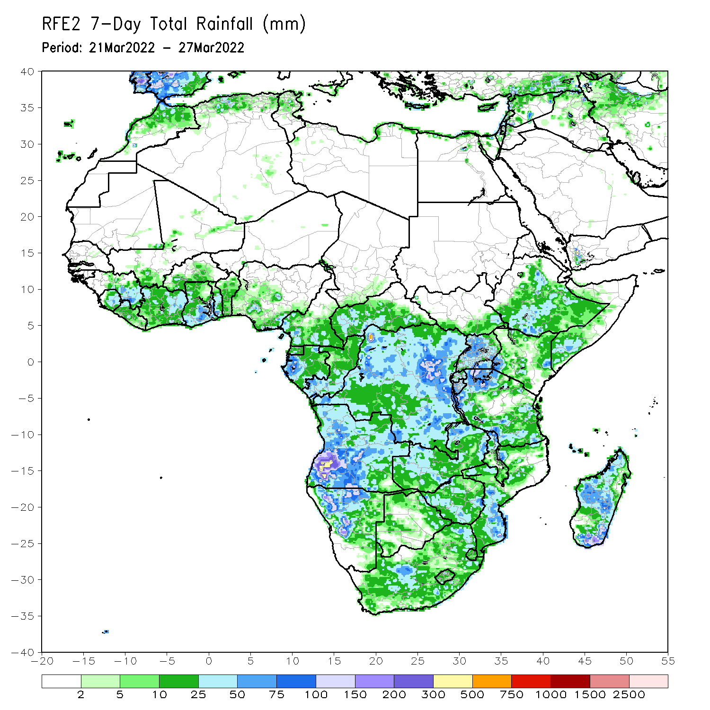
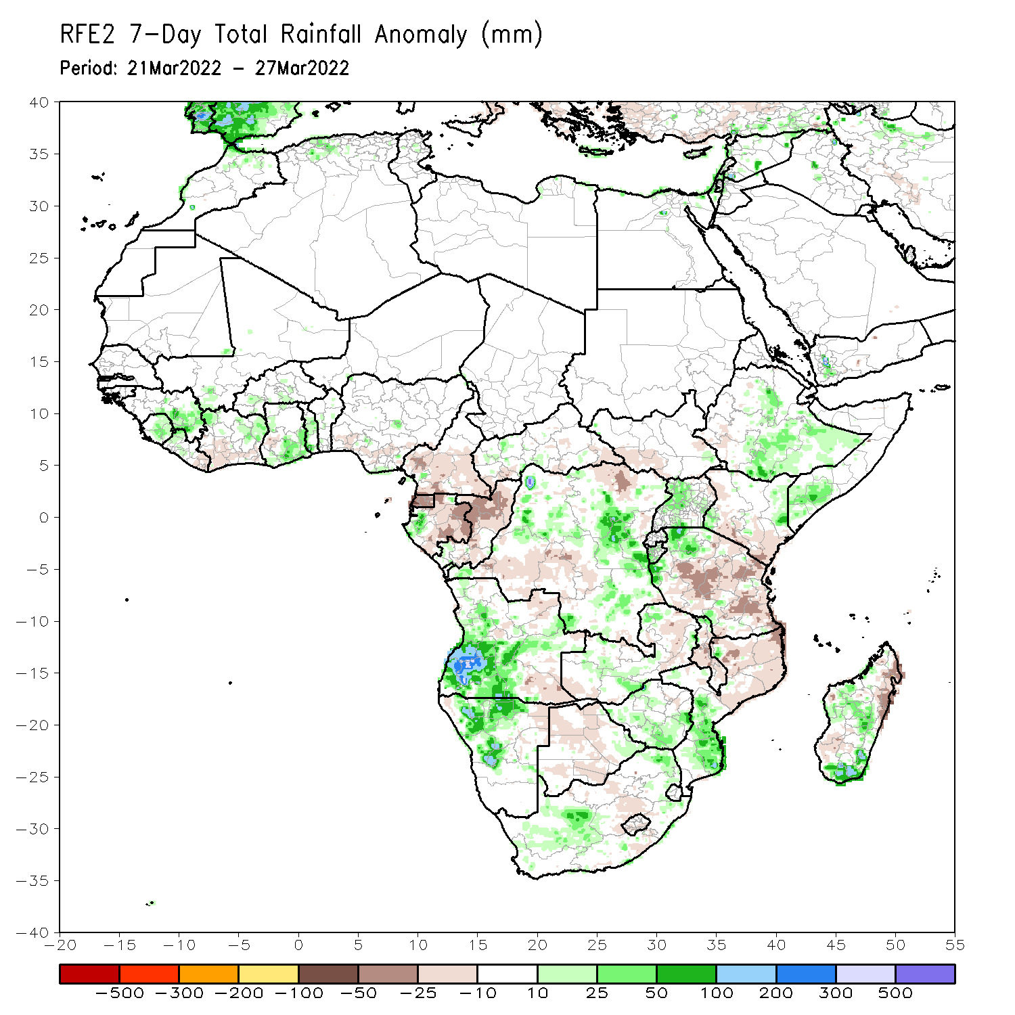
Rainfall Patterns: Last 7 Days
During the past 7 days, in East Africa, rainfall was above-average over parts of eastern and southern Ethiopia, pockets of Uganda, and northwestern Tanzania. Below-average was observed over central and southern Kenya, and much of Tanzania. In central Africa, rainfall was above-average over parts of southern DRC, while below-average rainfall was observed over Equatorial Guinea, Gabon, northern Congo, CAR, and parts of western DRC. In Southern Africa, rainfall was above-average over southwestern Angola, northwestern Namibia, and pockets of South Africa, southern Mozambique and central Madagascar. Rainfall was below-average over portions of Botswana, Zambia, Zimbabwe, eastern South Africa, northern Mozambique, Malawi and, parts of northern and southern Madagascar. In West Africa, above average rainfall was observed over parts of Sierra Leone, eastern Guinea, northern Cote d’Ivoire and Ghana.

Slide 7
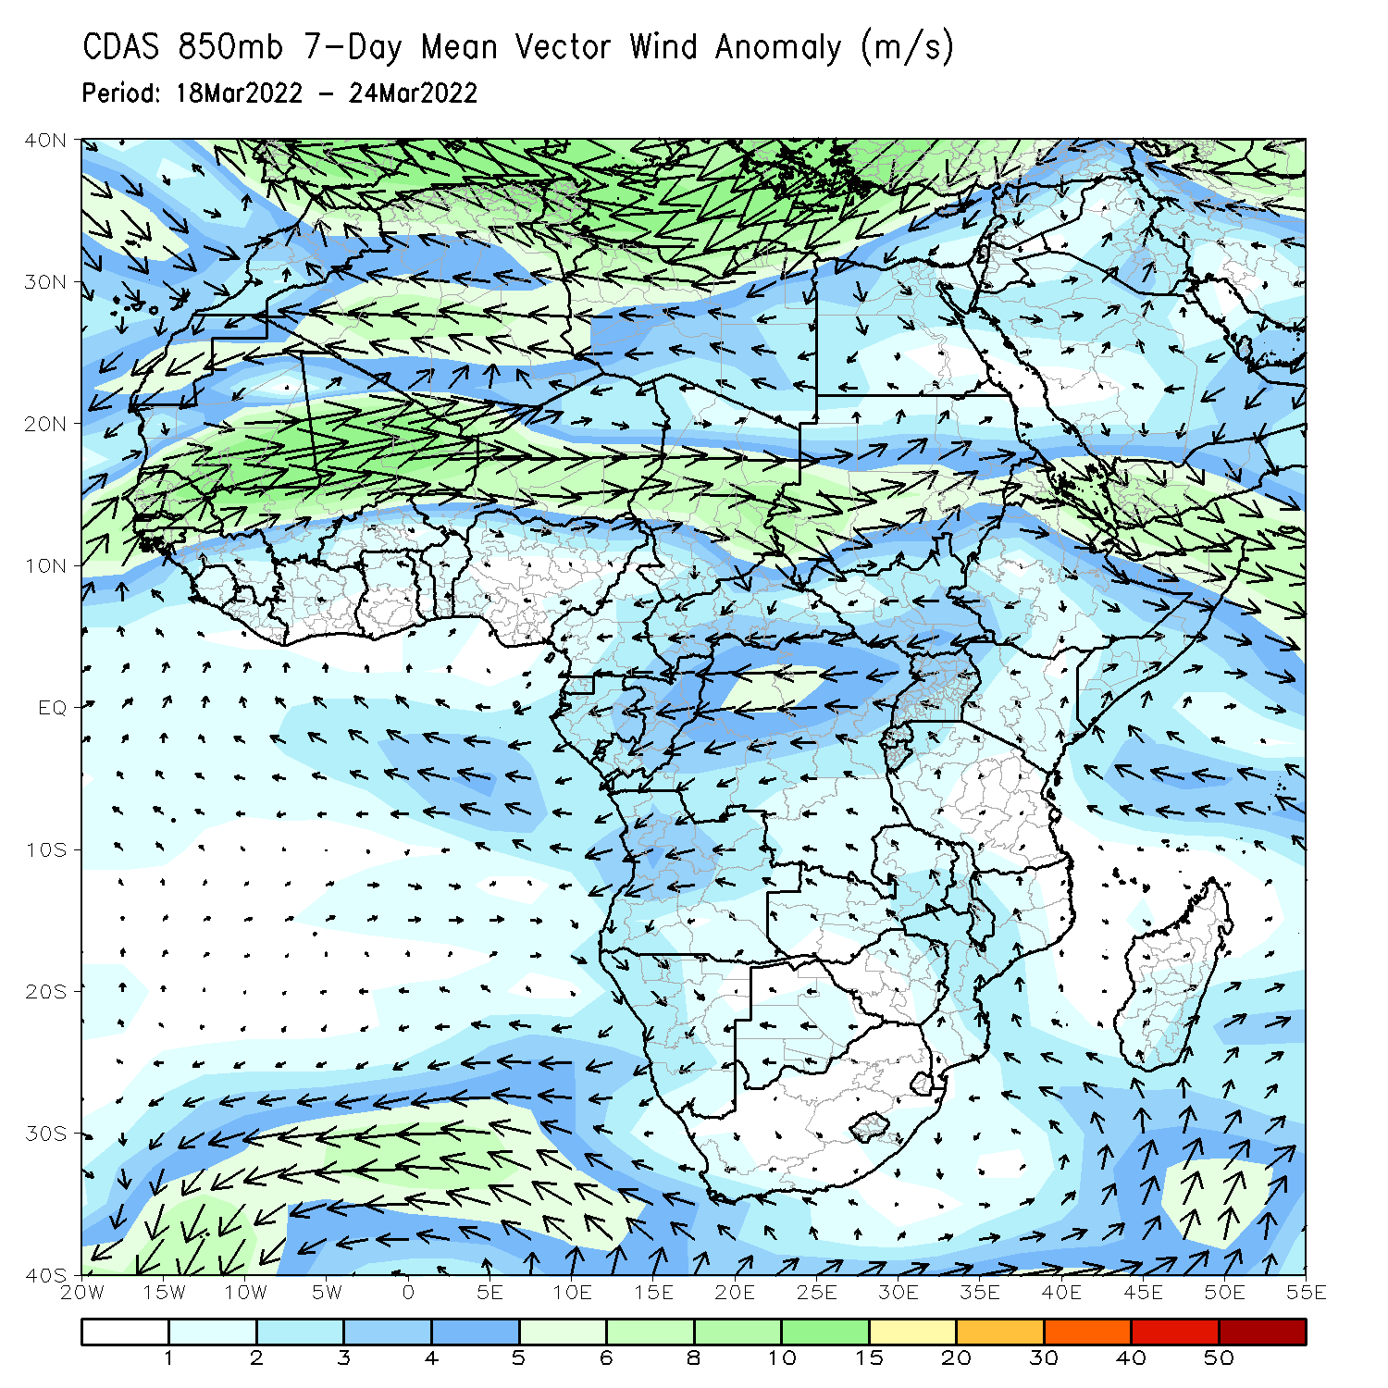
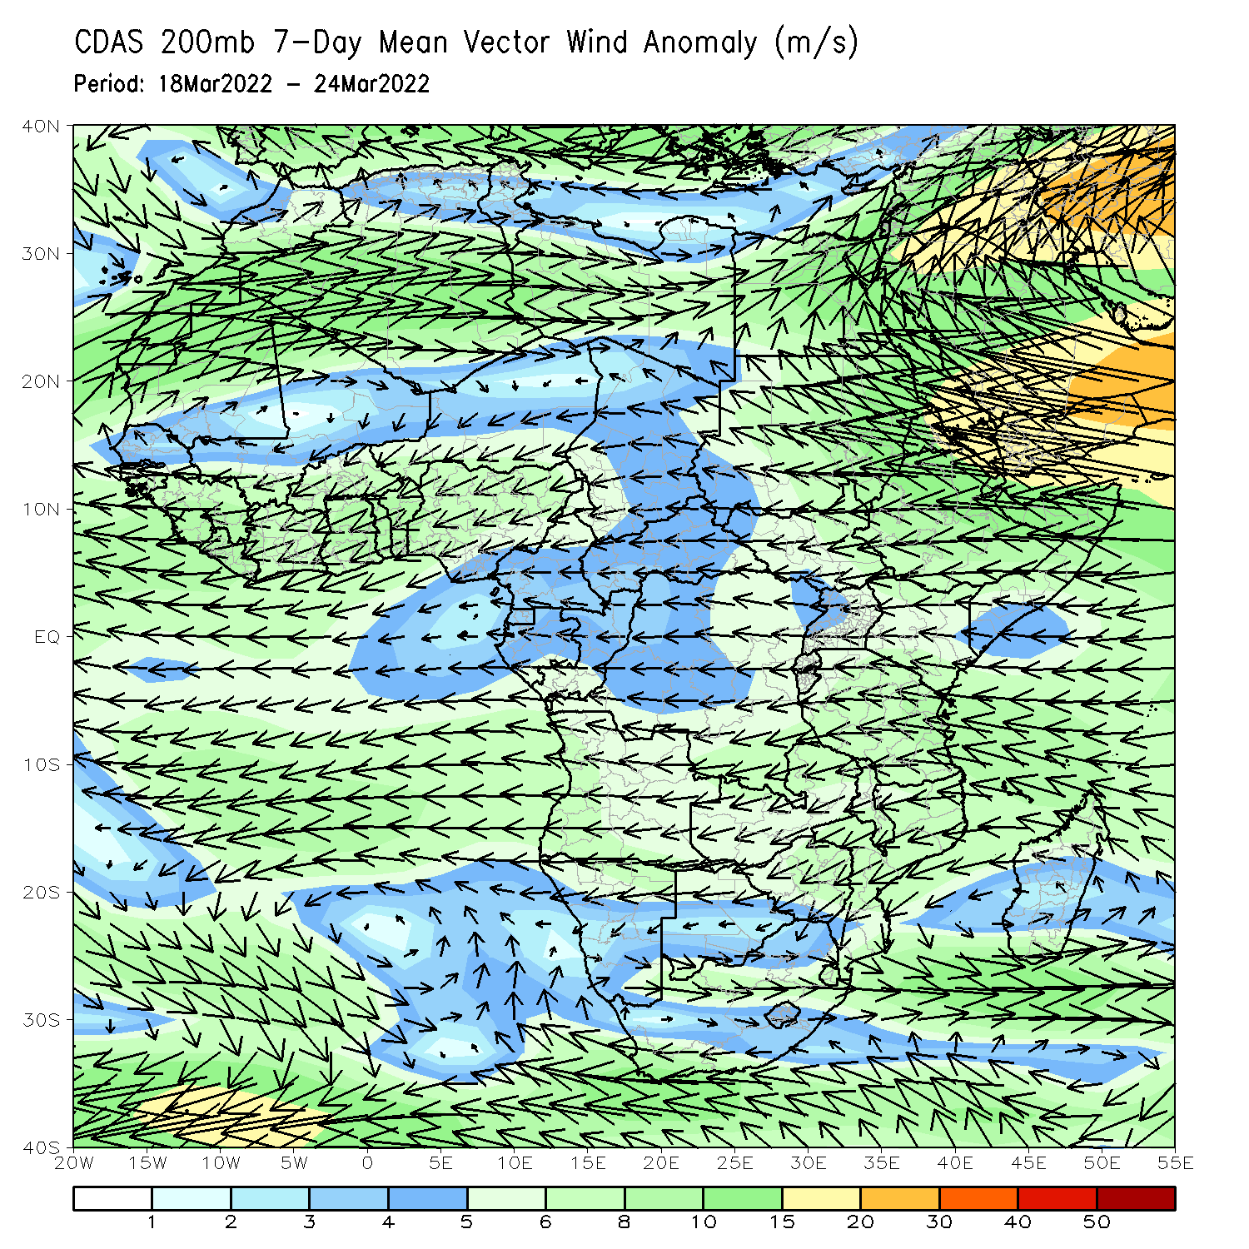
Atmospheric Circulation: Last 7 Days
At 850-hPa level (left panel), anomalous easterly flow prevailed across Central Africa, while an area of lower-level convergence was observed across equatorial East Africa.

Slide 8
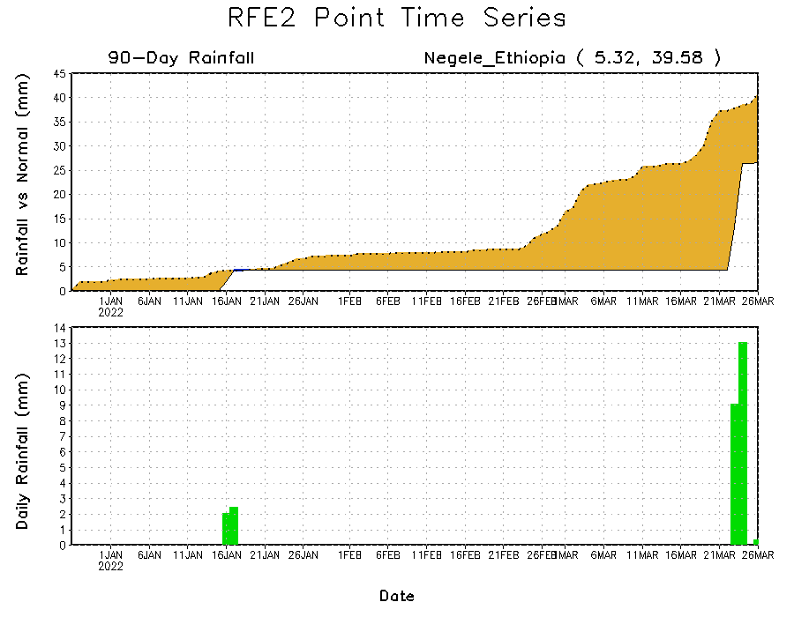
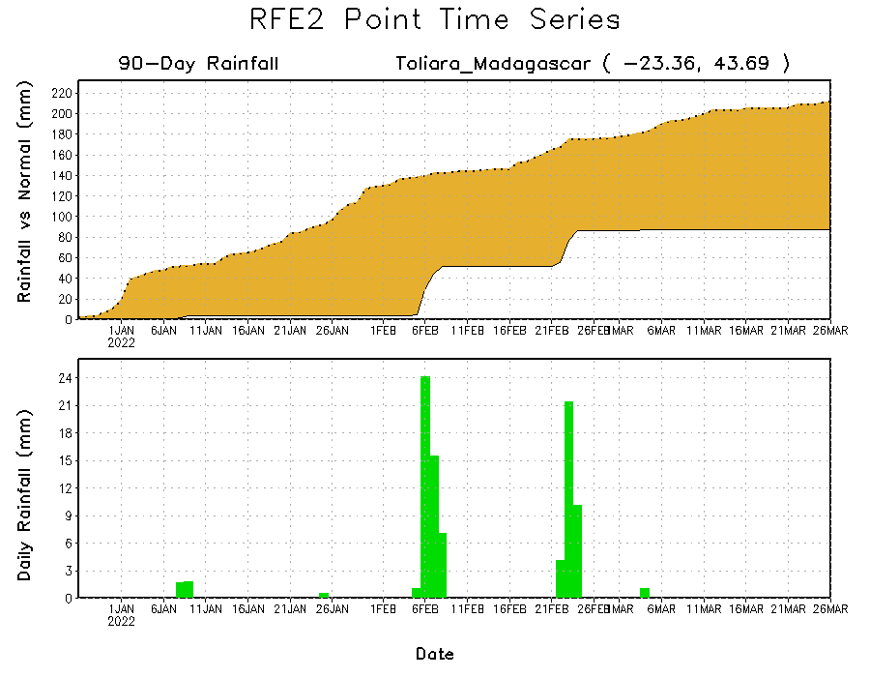
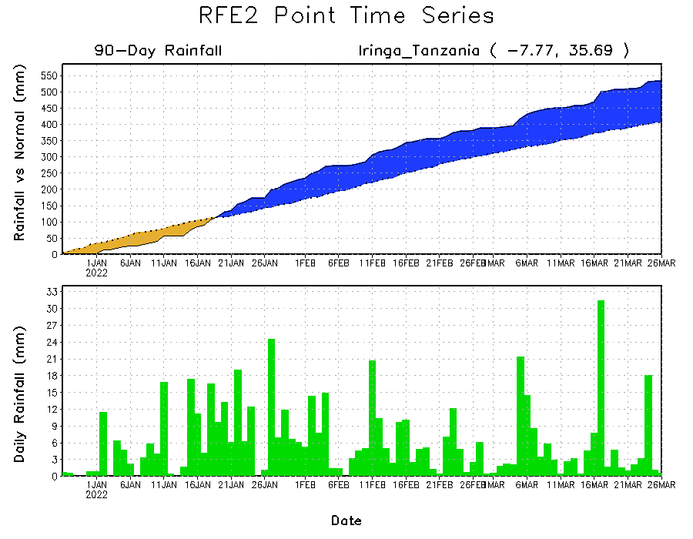
Rainfall Evolution
Daily evolution of rainfall over the last 90 days at selected locations shows moderate sustained moisture surpluses over parts of Tanzania (bottom right). The seasonal total rainfall remained below-average over parts of southern Madagascar (bottom left). Light to moderate rainfall helped to reduce accumulated rainfall deficits over parts of southern and southeastern Ethiopia (top right).

Slide 9
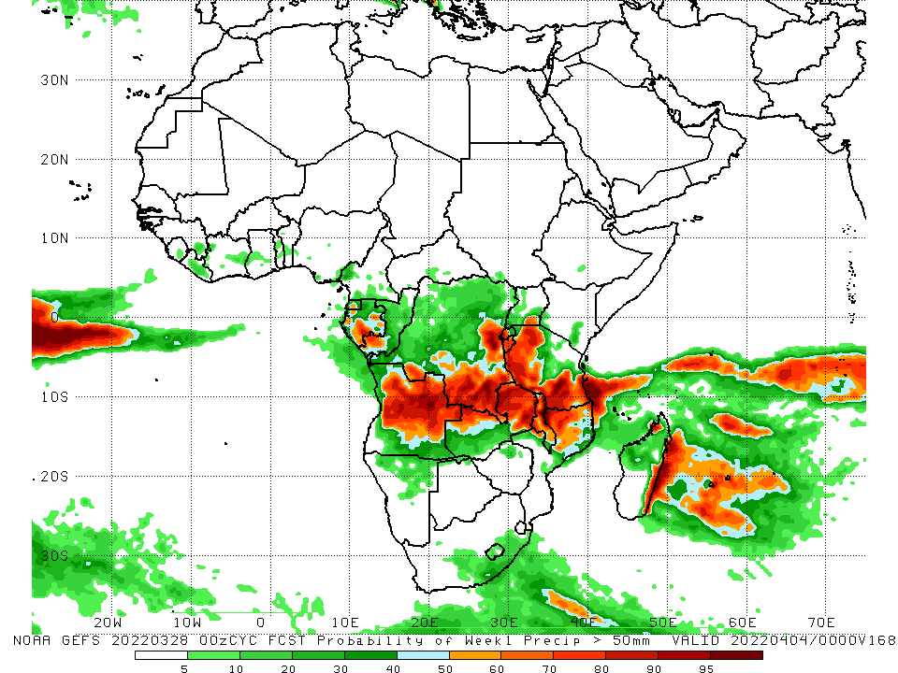
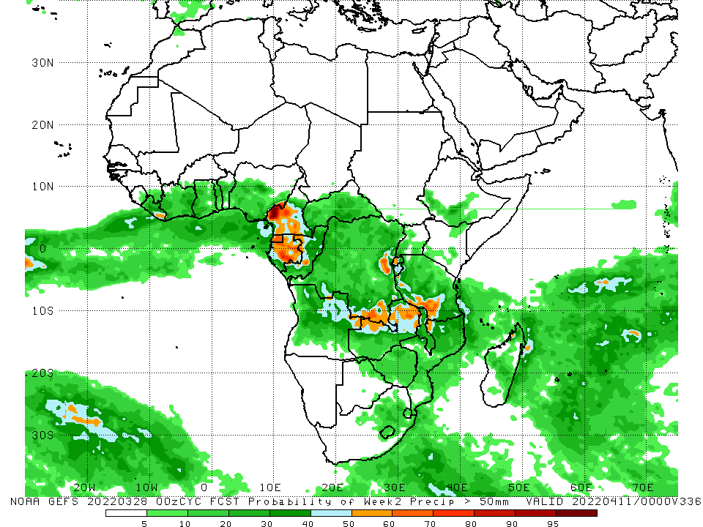
NCEP GEFS Model Forecasts Non-Bias Corrected Probability of precipitation exceedance
Week-1, Valid: 29 Mar – 04 Apr, 2022
Week-2, Valid: 05 – 11 Apr, 2022
For week-1 (left panel), the NCEP GEFS indicates a moderate to high chance (over 70%) for rainfall to exceed 50 mm over the northern portion of Southern Africa, including Tanzania, and western Gabon and pockets of eastern DRC.
Notes:
9

Slide 10
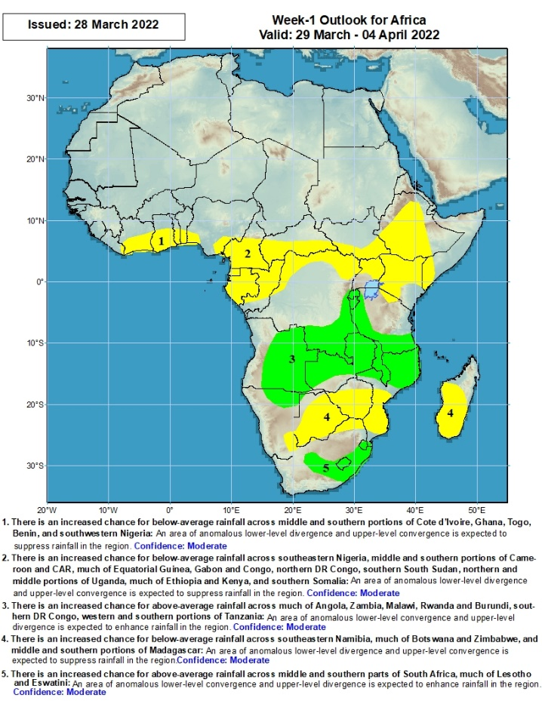
Week-1 Precipitation Outlooks
There is an increased chance for below-average rainfall across middle and southern portions of Cote d’Ivoire, Ghana, Togo, Benin, and southwestern Nigeria: An area of anomalous lower-level divergence and upper-level convergence is expected to suppress rainfall in the region. Confidence: Moderate
There is an increased chance for below-average rainfall across southeastern Nigeria, middle and southern portions of Cameroon and CAR, much of Equatorial Guinea, Gabon and Congo, northern DR Congo, southern South Sudan, northern and middle portions of Uganda, much of Ethiopia and Kenya, and southern Somalia: An area of anomalous lower-level divergence and upper-level convergence is expected to suppress rainfall in the region. Confidence: Moderate
There is an increased chance for above-average rainfall across much of Angola, Zambia, Malawi, Rwanda and Burundi, southern DR Congo, western and southern portions of Tanzania: An area of anomalous lower-level convergence and upper-level divergence is expected to enhance rainfall in the region. Confidence: Moderate
There is an increased chance for below-average rainfall across southeastern Namibia, much of Botswana and Zimbabwe, and middle and southern portions of Madagascar: An area of anomalous lower-level divergence and upper-level convergence is expected to suppress rainfall in the region. Confidence: Moderate
There is an increased chance for above-average rainfall across middle and southern parts of South Africa, much of Lesotho and Eswatini: An area of anomalous lower-level convergence and upper-level divergence is expected to enhance rainfall in the region. Confidence: Moderate
29 Mar – 04 Apr, 2022
Notes:
10

Slide 11
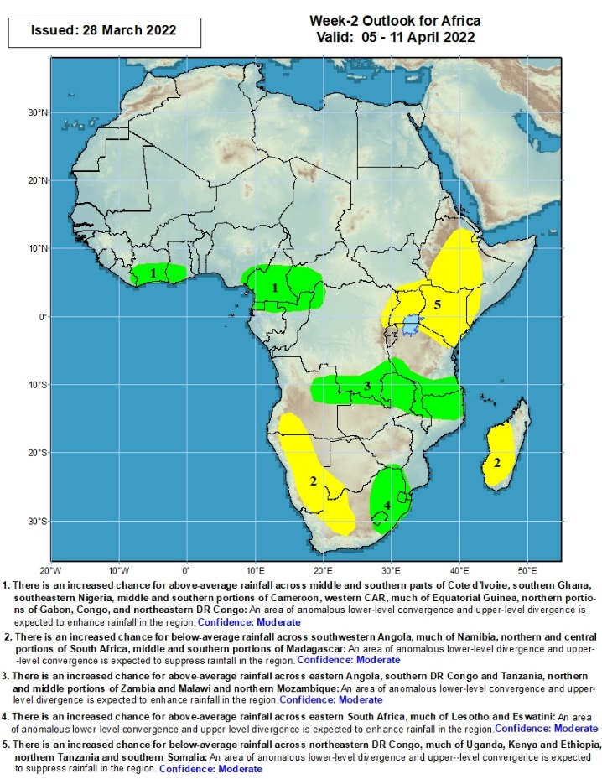
Week-2 Precipitation Outlooks
There is an increased chance for above-average rainfall across middle and southern parts of Cote d’Ivoire, southern Ghana, southeastern Nigeria, middle and southern portions of Cameroon, western CAR, much of Equatorial Guinea, northern portions of Gabon, Congo, and northeastern DR Congo: An area of anomalous lower-level convergence and upper-level divergence is expected to enhance rainfall in the region. Confidence: Moderate
There is an increased chance for below-average rainfall across southwestern Angola, much of Namibia, northern and central portions of South Africa, middle and southern portions of Madagascar: An area of anomalous lower-level divergence and upper-level convergence is expected to suppress rainfall in the region. Confidence: Moderate
There is an increased chance for above-average rainfall across eastern Angola, southern DR Congo and Tanzania, northern and middle portions of Zambia and Malawi, and northern Mozambique: An area of anomalous lower-level convergence and upper-level divergence is expected to enhance rainfall in the region. Confidence: Moderate
There is an increased chance for above-average rainfall across eastern South Africa, much of Lesotho and Eswatini: An area of anomalous lower-level convergence and upper-level divergence is expected to enhance rainfall in the region. Confidence: Moderate
There is an increased chance for below-average rainfall across northeastern DR Congo, much of Uganda, Kenya and Ethiopia, northern Tanzania, and southern Somalia: An area of anomalous lower-level divergence and upper-level convergence is expected to suppress rainfall in the region. Confidence: Moderate
05 – 11 Apr, 2022
Notes:
11

Slide 12
Summary
During the past 30 days, in East Africa, above-average rainfall was observed over pockets of Ethiopia, and much of Tanzania. Rainfall was below-average over parts of southwestern and eastern Ethiopia, southern South Sudan, Kenya, parts of western the far eastern Tanzania, and much of and Uganda. In Central Africa, rainfall was below-average over Equatorial Guinea, pockets of northern Gabon, parts of CAR and many parts of DRC. Rainfall was above-average over southern Cameroon, central Gabon, Congo, and the far northern and southern DRC. In Southern Africa, above-average rainfall was observed over much of Angola, eastern Zambia, northern Malawi, much of Mozambique, much of Madagascar, and much of Botswana and South Africa. Below-average rainfall was observed over pockets of southern Angola, parts of Namibia, western and southern Zambia, much of Zimbabwe, pockets of northeastern South Africa, and the far southern Madagascar. In West Africa, rainfall was above-average along the Gulf of Guinea coast.
During the past 7 days, in East Africa, rainfall was above-average over parts of eastern and southern Ethiopia, pockets of Uganda, and northwestern Tanzania. Below-average was observed over central and southern Kenya, and much of Tanzania. In central Africa, rainfall was above-average over parts of southern DRC, while below-average rainfall was observed over Equatorial Guinea, Gabon, northern Congo, CAR, and parts of western DRC. In Southern Africa, rainfall was above-average over southwestern Angola, northwestern Namibia, and pockets of South Africa, southern Mozambique and central Madagascar. Rainfall was below-average over portions of Botswana, Zambia, Zimbabwe, eastern South Africa, northern Mozambique, Malawi and, parts of northern and southern Madagascar. In West Africa, above average rainfall was observed over parts of Sierra Leone, eastern Guinea, northern Cote d’Ivoire and Ghana.
Week-1 and Week-2 outlooks call for an increased chance for below-average rainfall in parts of Central Africa, and much of East Africa. In contrast, the forecasts call for an increased chance for above-average rainfall across the northern portion of Southern Africa, including Tanzania.

