Slide 1
The African Monsoon Recent Evolution and Current Status Include Week-1 and Week-2 Outlooks
Update prepared by
21 March 2022
For more information, visit:
http://www.cpc.ncep.noaa.gov/products/Global_Monsoons/African_Monsoons/precip_monitoring.shtml

Slide 2
Outline
Highlights
Recent Evolution and Current Conditions
NCEP GEFS Forecasts
Summary

Slide 3
Highlights: Last 7 Days
During the past 7 days, in East Africa, rainfall was above-average over parts of northern Ethiopia and much of Tanzania. Below-average was observed over parts of southwestern and eastern Ethiopia, Uganda, and the far western and eastern Tanzania. In central Africa, rainfall was above-average over parts of southern Congo and the far western DRC. Below-average rainfall was observed over Equatorial Guinea, Gabon, northern Congo, CAR, and much of DRC. Rainfall was above-average over many places in Southern Africa. In West Africa, above-average rainfall was observed over much of Cote d’Ivoire and Ghana.
Week-1 and Week-2 outlooks call for an increased chance for below-average rainfall along the Gulf of Guinea coast, and much of Central Africa and Ethiopia. In contrast, the forecasts call for an increased chance for above-average rainfall across the northern portion of Southern Africa, including Tanzania.

Slide 4
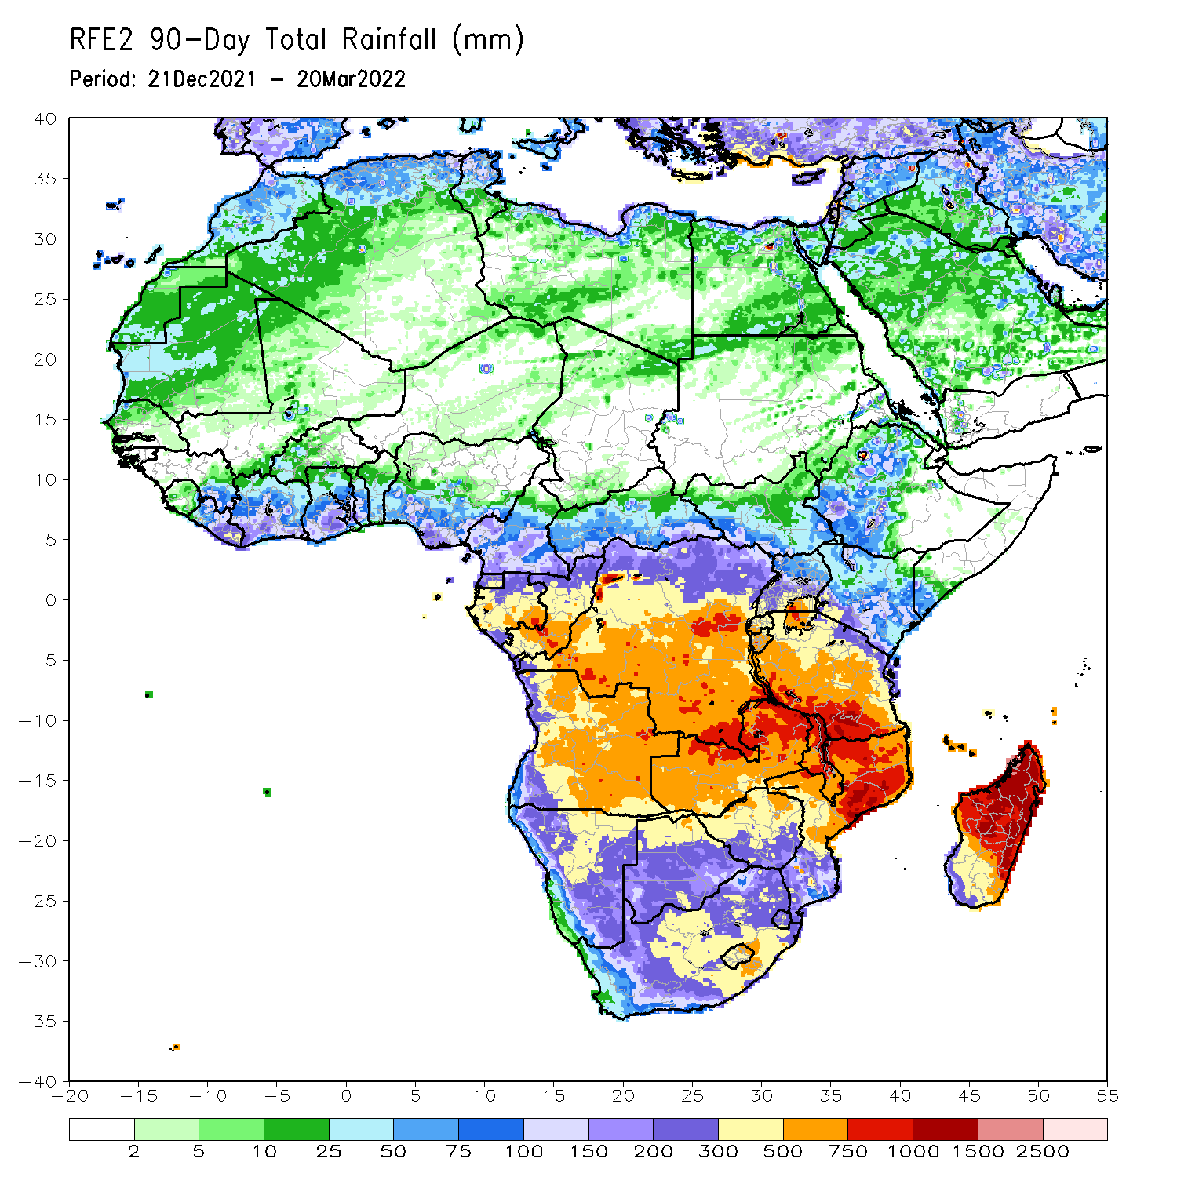
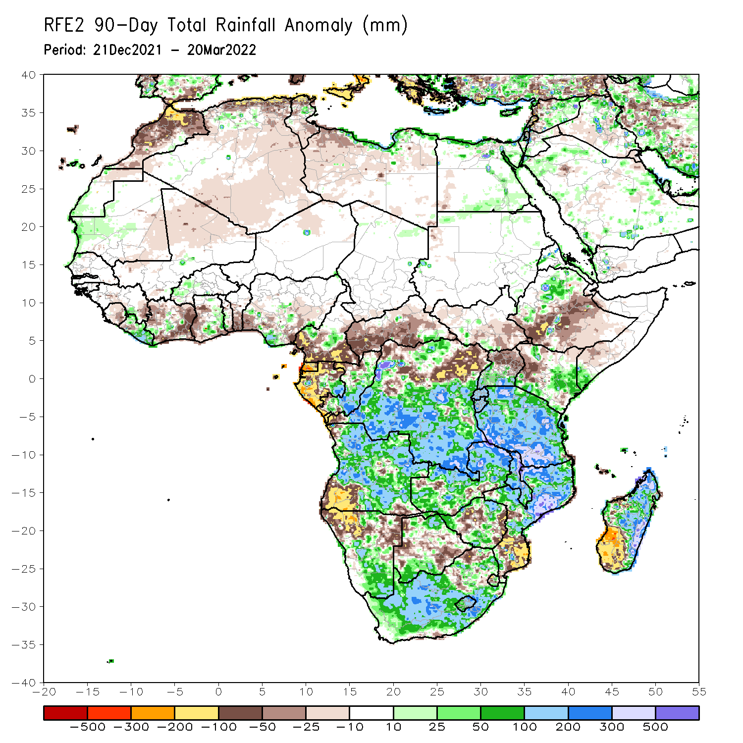
Rainfall Patterns: Last 90 Days
Over the past 90 days, in East Africa, above-average rainfall was observed over parts of northern and western Ethiopia, Rwanda, Burundi, southern Uganda, eastern and southern Kenya, southwestern Somalia, and much of Tanzania. Rainfall was below-average over central, southern and eastern Ethiopia, parts of western Kenya, and northern Uganda. In southern Africa, above-average rainfall was observed over many parts of Angola, parts of northern and southern Botswana, central and southern Namibia, portions of Zimbabwe and Zambia, Malawi, central and northern Mozambique, northern and eastern Madagascar, and much of South Africa. Below-average rainfall was observed over pockets of eastern and southwestern Angola, northern Namibia, pockets of Zambia, portions of Botswana, parts of Zimbabwe, southern Mozambique and southwestern Madagascar. In Central Africa, rainfall was above-average over central and southern DRC, eastern Gabon, and Congo. Rainfall was below-average over southern Cameroon, parts of northern DRC, Equatorial Guinea, western Gabon, much of CAR, and the far northern Congo. In West Africa, rainfall was below-average over many places in the Gulf of Guinea region, while above-average rainfall was observed over much of Liberia.
Notes:
4

Slide 5
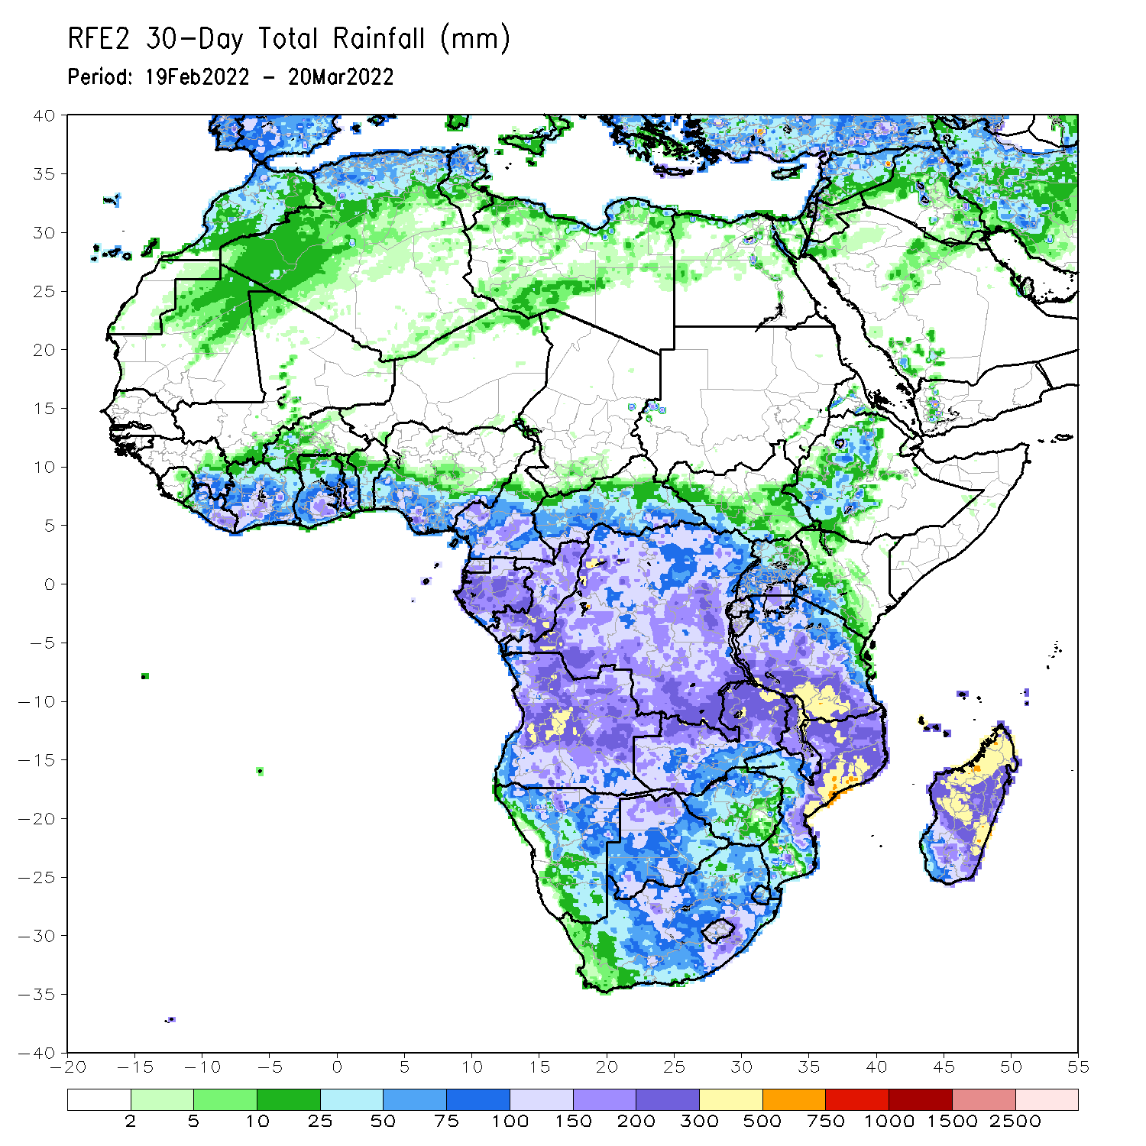
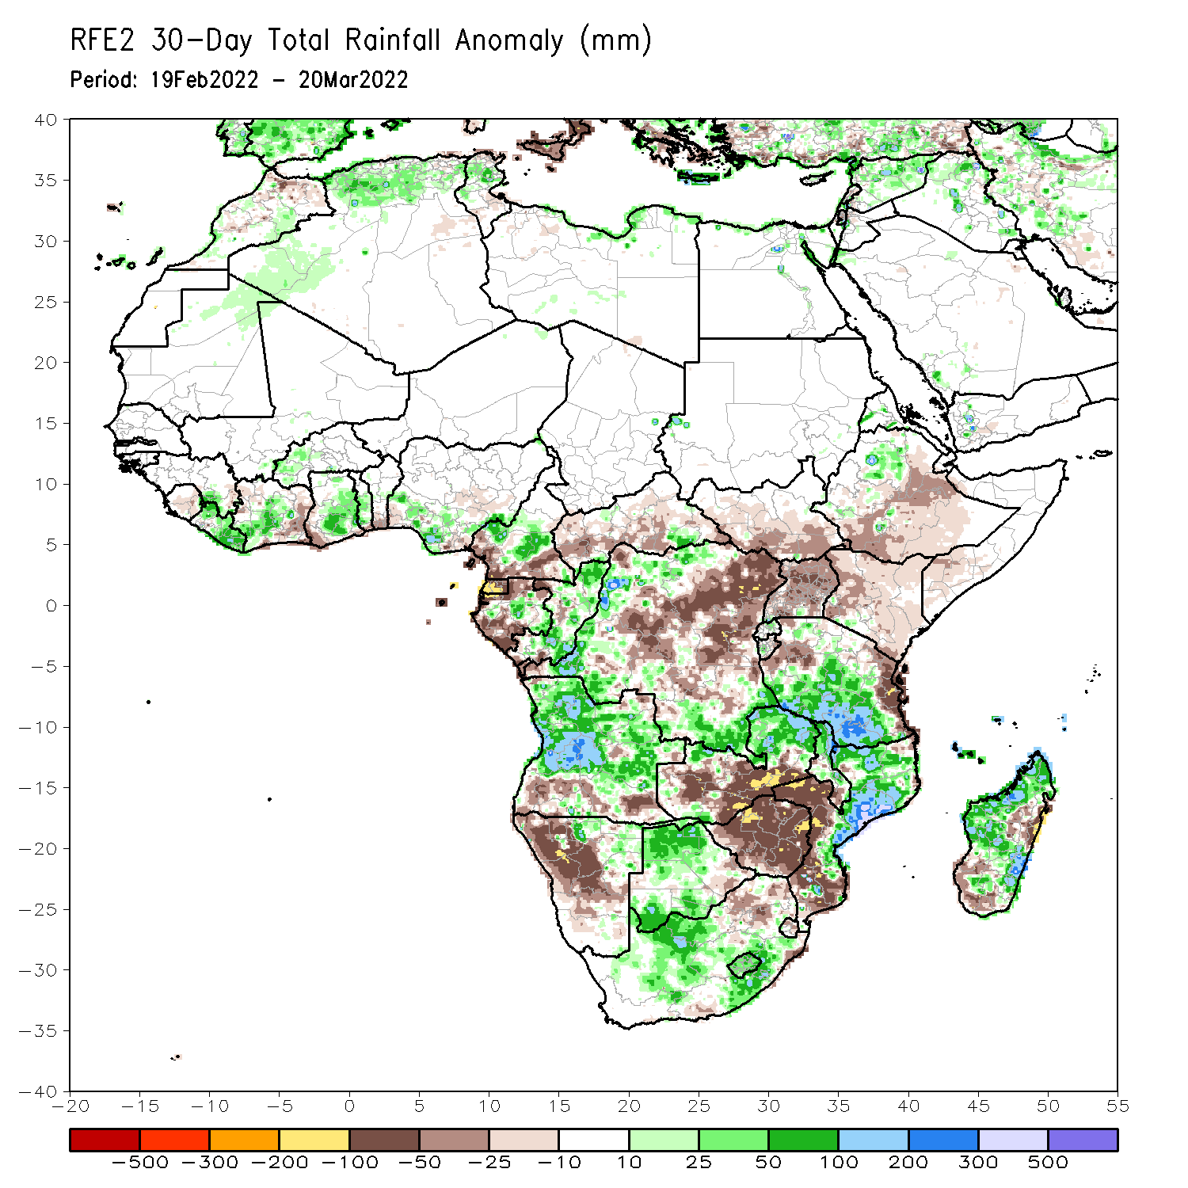
Rainfall Patterns: Last 30 Days
During the past 30 days, in East Africa, above-average rainfall was observed over parts of northern Ethiopia, and much of Tanzania. Rainfall was below-average over parts of central and eastern Ethiopia, southern South Sudan, western Kenya and Uganda. In Central Africa, rainfall was below-average over parts of southern Cameroon, Equatorial Guinea, parts of northern Gabon, CAR and many parts of DRC. Rainfall was above-average over central Cameroon, central Gabon, Congo, and the far northern and southern DRC. In Southern Africa, above-average rainfall was observed over much of Angola, northern and eastern Zambia, Malawi, central and northern Mozambique, central and much of Madagascar, and much of Botswana and South Africa. Below-average rainfall was observed over parts of southern Angola, much of Namibia, the far eastern Botswana, western and southern Zambia, much of Zimbabwe, northeastern South Africa, southern Mozambique and pockets of Madagascar. In West Africa, rainfall was above-average along the Gulf of Guinea coast.
Notes:
5

Slide 6
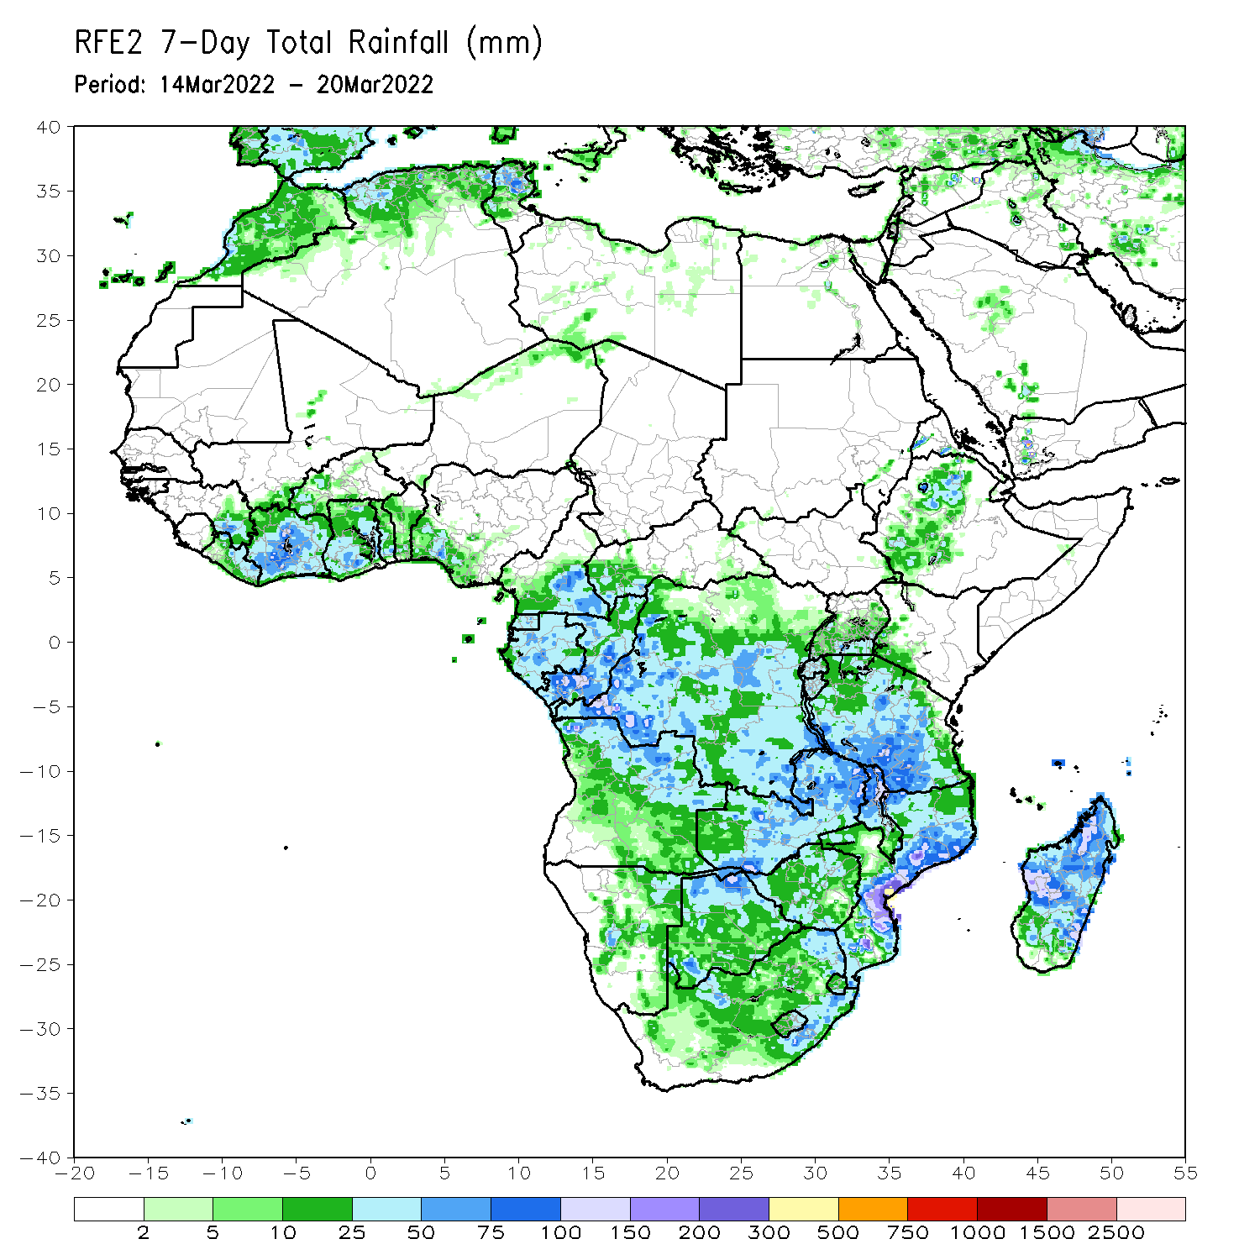
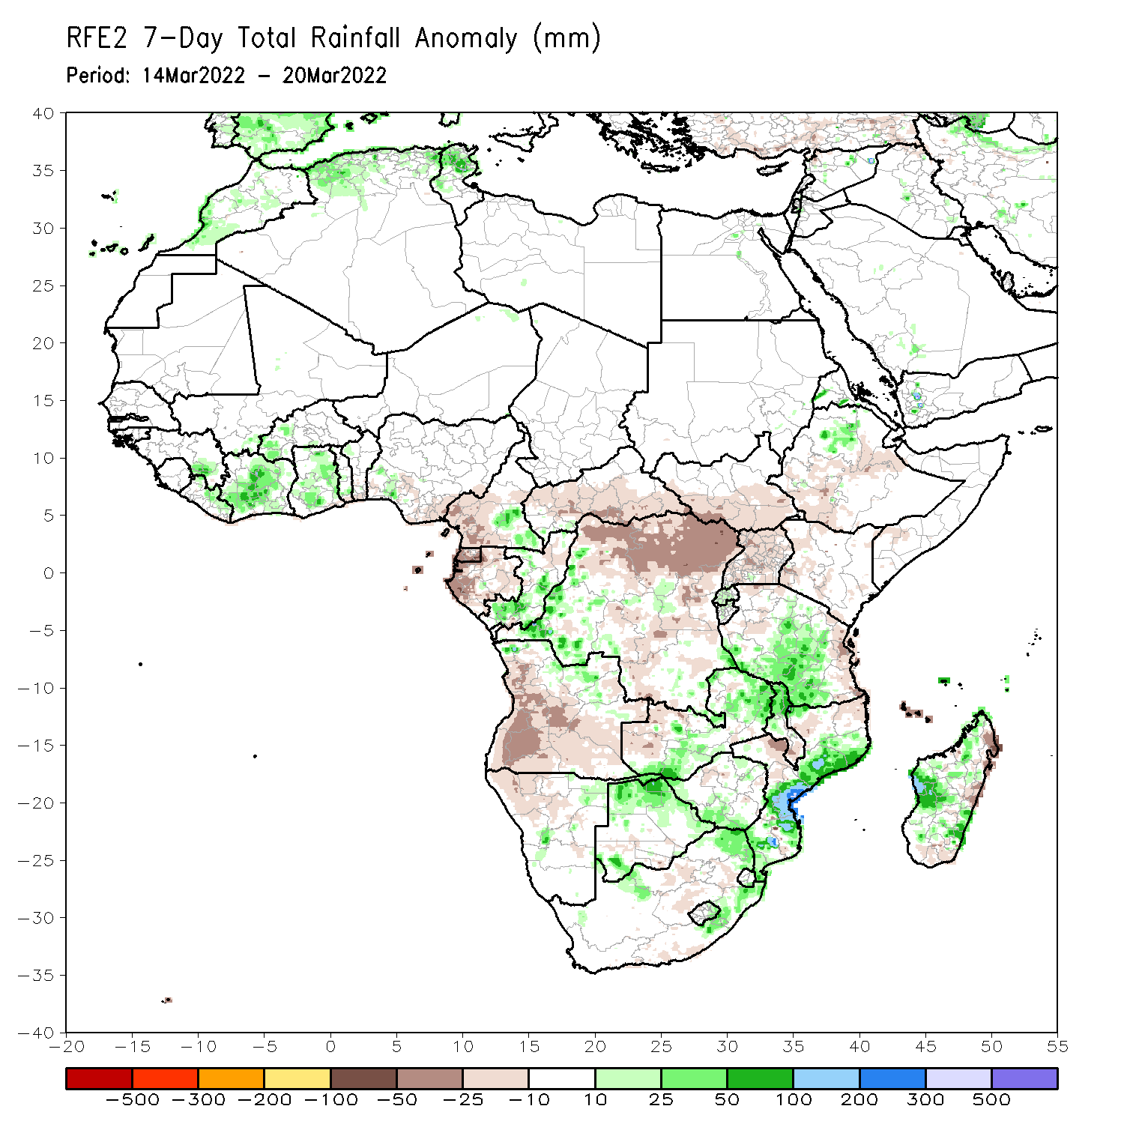
Rainfall Patterns: Last 7 Days
During the past 7 days, in East Africa, rainfall was above-average over parts of northern Ethiopia and much of Tanzania. Below-average was observed over parts of southwestern and eastern Ethiopia, Uganda, and the far western and eastern Tanzania. In central Africa, rainfall was above-average over parts of southern Congo and the far western DRC. Below-average rainfall was observed over Equatorial Guinea, Gabon, northern Congo, CAR, and much of DRC. Rainfall was above-average over many places in Southern Africa. In West Africa, above-average rainfall was observed over much of Cote d’Ivoire and Ghana.

Slide 7
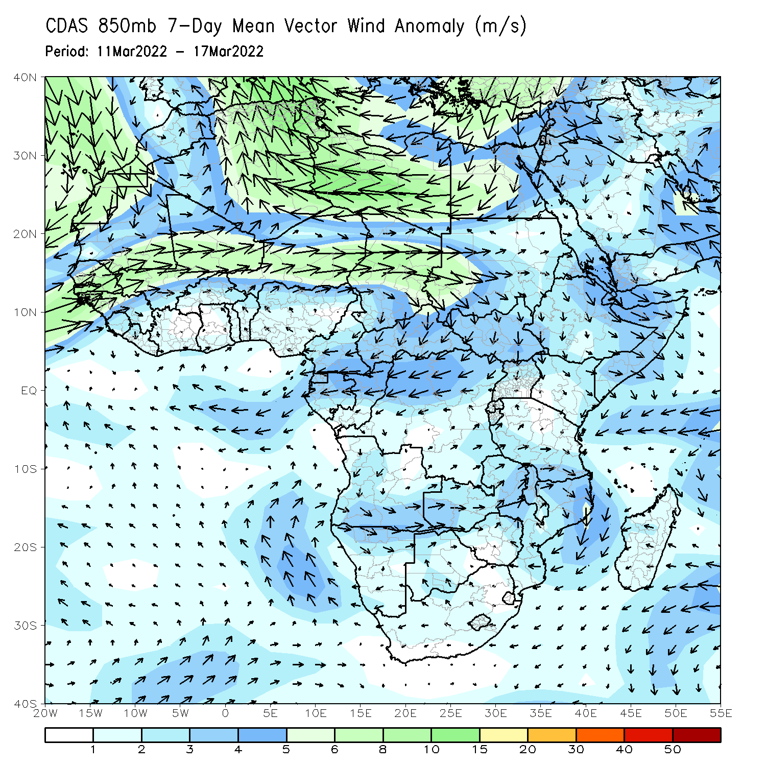
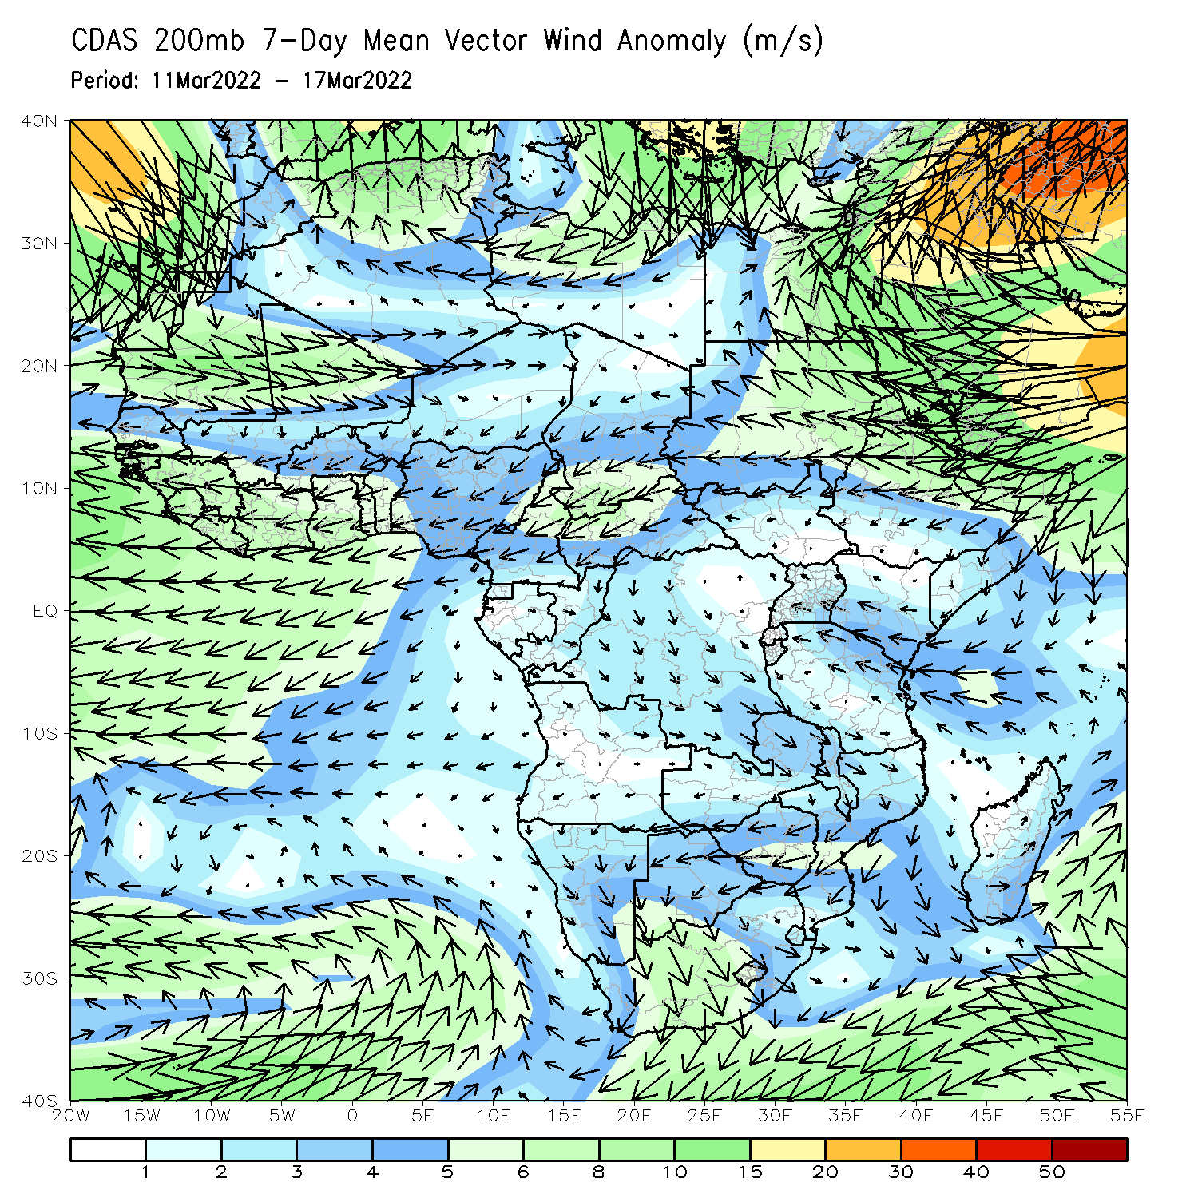
Atmospheric Circulation: Last 7 Days
At 850-hPa level (left panel), anomalous lower-level cyclonic trough may have contributed to the observed above-average rainfall across Southern Africa.

Slide 8
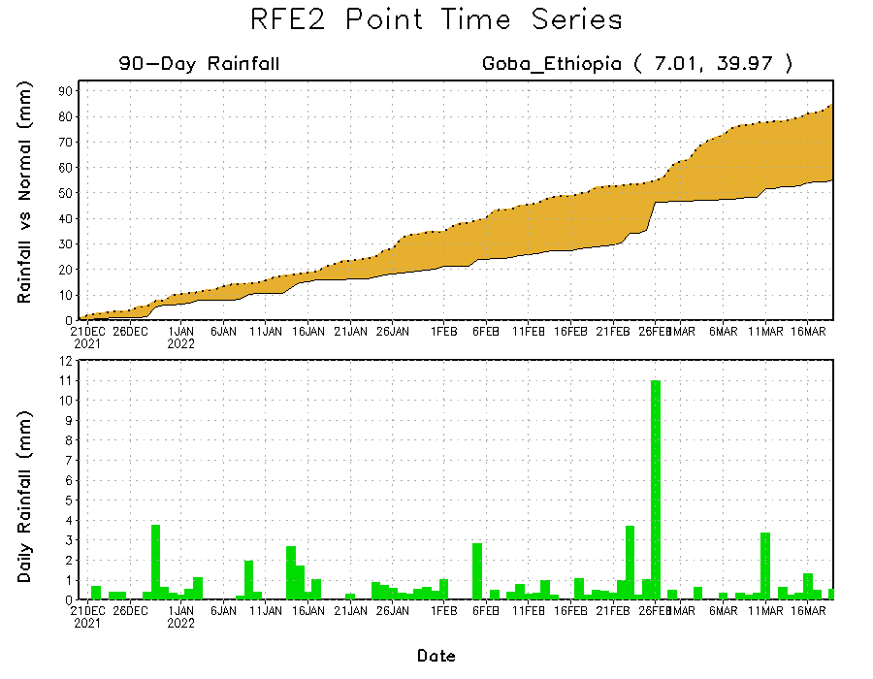
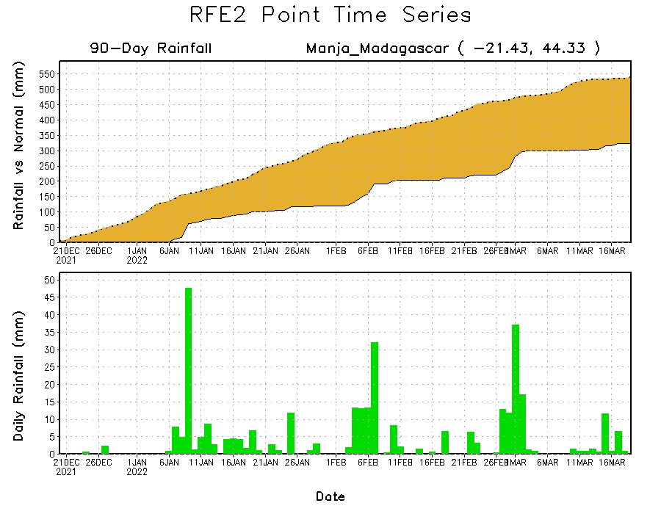
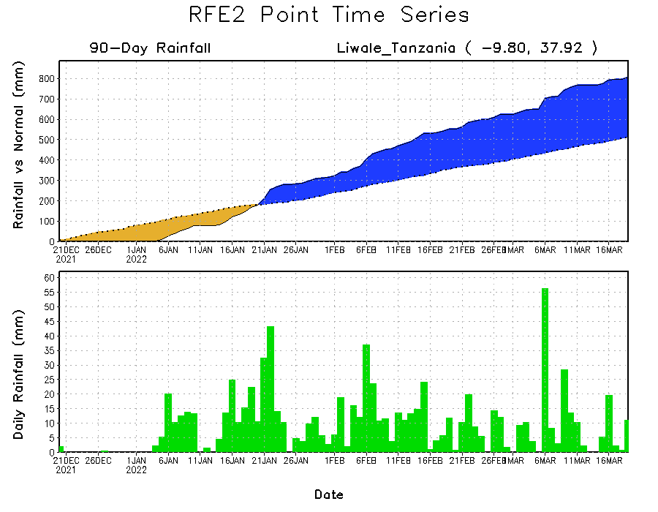
Rainfall Evolution
Daily evolution of rainfall over the last 90 days at selected locations shows moderate sustained moisture surpluses over parts of Tanzania (bottom right). The seasonal total rainfall remained below-average over parts of southern Madagascar (bottom left) and southern Ethiopia (top right).

Slide 9
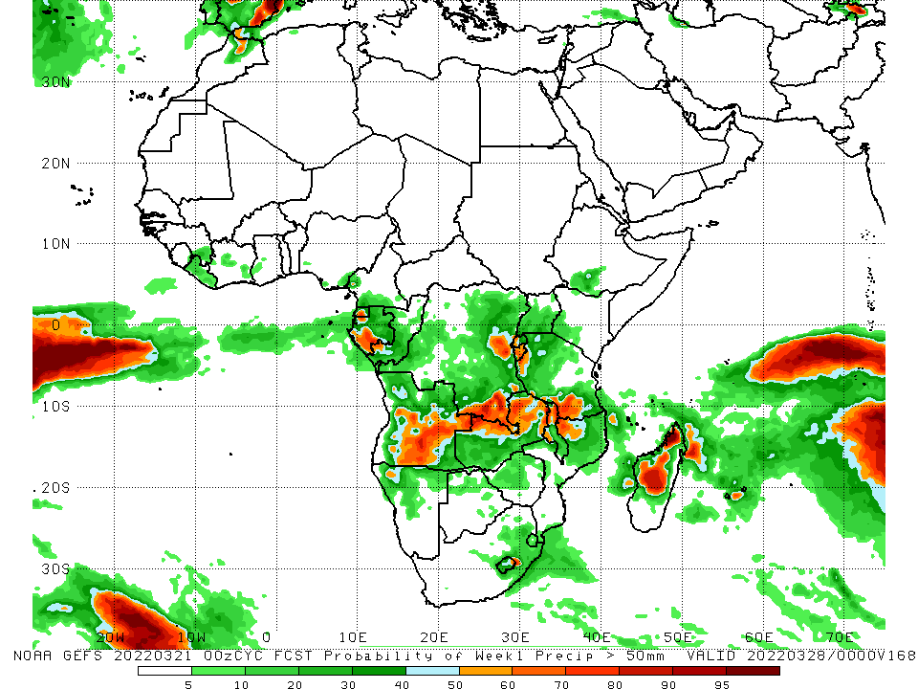
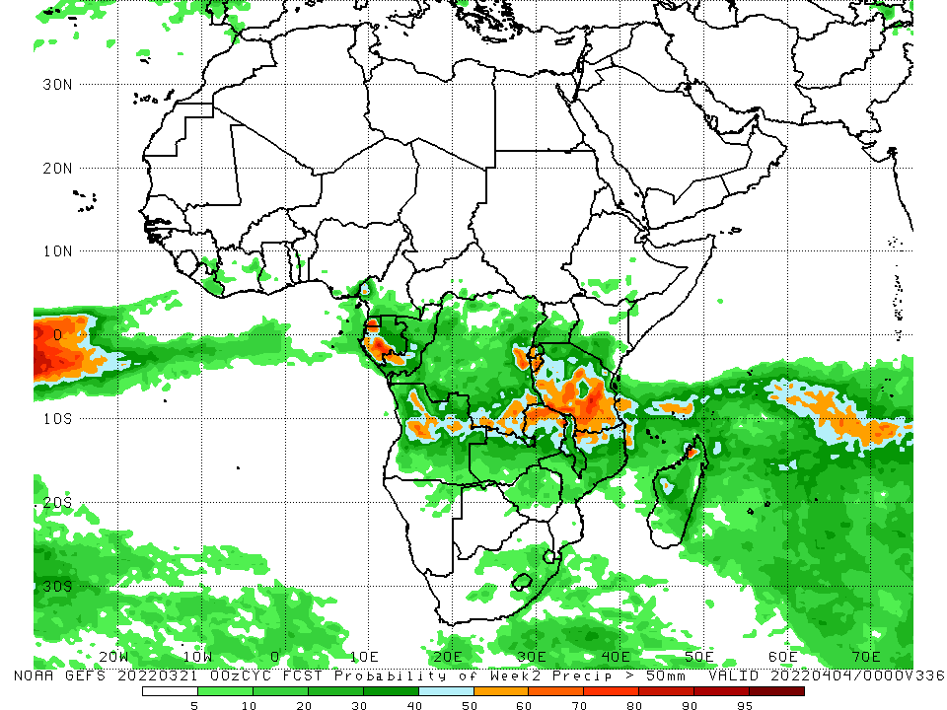
NCEP GEFS Model Forecasts Non-Bias Corrected Probability of precipitation exceedance
Week-1, Valid: 22 – 28 Mar, 2022
Week-2, Valid: 29 Mar – 04 Apr, 2022
For week-1 (left panel) and week-2 (right panel), the NCEP GEFS indicates a moderate to high chance (over 70%) for rainfall to exceed 50 mm over the northern portion of Southern Africa, including Tanzania, and western Gabon and pockets of eastern DRC.
Notes:
9

Slide 10
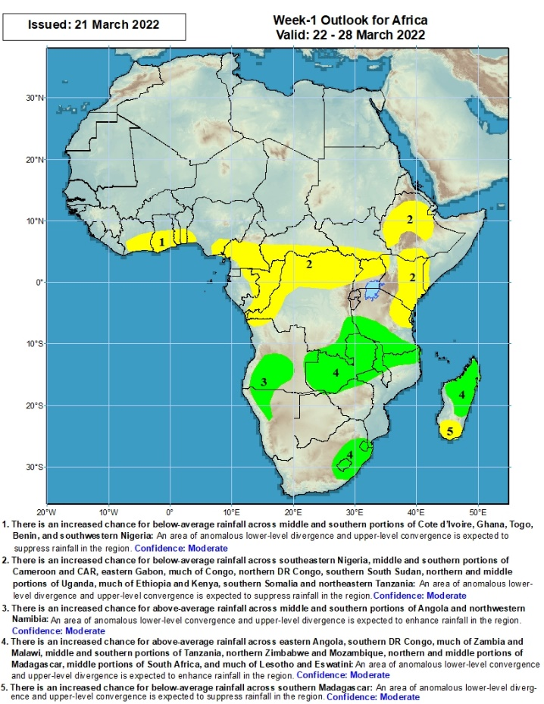
Week-1 Precipitation Outlooks
There is an increased chance for below-average rainfall across middle and southern portions of Cote d’Ivoire, Ghana, Togo, Benin, and southwestern Nigeria: An area of anomalous lower-level divergence and upper-level convergence is expected to suppress rainfall in the region. Confidence: Moderate
There is an increased chance for below-average rainfall across southeastern Nigeria, middle and southern portions of Cameroon and CAR, eastern Gabon, much of Congo, northern DR Congo, southern South Sudan, northern and middle portions of Uganda, much of Ethiopia and Kenya, southern Somalia and northeastern Tanzania: An area of anomalous lower-level divergence and upper-level convergence is expected to suppress rainfall in the region. Confidence: Moderate
There is an increased chance for above-average rainfall across middle and southern portions of Angola and northwestern Namibia: An area of anomalous lower-level convergence and upper-level divergence is expected to enhance rainfall in the region. Confidence: Moderate
There is an increased chance for above-average rainfall across eastern Angola, southern DR Congo, much of Zambia and Malawi, middle and southern portions of Tanzania, northern Zimbabwe and Mozambique, northern and middle portions of Madagascar, middle portions of South Africa, and much of Lesotho and Eswatini: An area of anomalous lower-level convergence and upper-level divergence is expected to enhance rainfall in the region. Confidence: Moderate
There is an increased chance for below-average rainfall across southern Madagascar: An area of anomalous lower-level divergence and upper-level convergence is expected to suppress rainfall in the region. Confidence: Moderate
22 – 28 Mar, 2022
Notes:
10

Slide 11
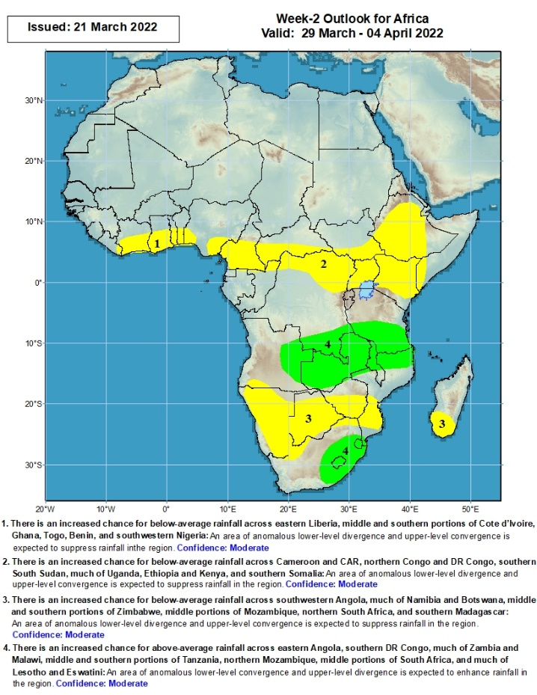
Week-2 Precipitation Outlooks
There is an increased chance for below-average rainfall across eastern Liberia, middle and southern portions of Cote d’Ivoire, Ghana, Togo, Benin, and southwestern Nigeria: An area of anomalous lower-level divergence and upper-level convergence is expected to suppress rainfall in the region. Confidence: Moderate
There is an increased chance for below-average rainfall across southeastern Nigeria, middle and southern portions of Cameroon and CAR, northern Congo and DR Congo, southern South Sudan, much of Uganda, Ethiopia and Kenya, and southern Somalia: An area of anomalous lower-level divergence and upper-level convergence is expected to suppress rainfall in the region. Confidence: Moderate
There is an increased chance for below-average rainfall across southwestern Angola, much of Namibia and Botswana, middle and southern portions of Zimbabwe, middle portions of Mozambique, northern South Africa, and southern Madagascar: An area of anomalous lower-level divergence and upper-level convergence is expected to suppress rainfall in the region. Confidence: Moderate
There is an increased chance for above-average rainfall across eastern Angola, southern DR Congo, much of Zambia and Malawi, middle and southern portions of Tanzania, northern Mozambique, middle portions of South Africa, and much of Lesotho and Eswatini: An area of anomalous lower-level convergence and upper-level divergence is expected to enhance rainfall in the region. Confidence: Moderate
29 Mar – 04 Apr, 2022
Notes:
11

Slide 12
Summary
During the past 30 days, in East Africa, above-average rainfall was observed over parts of northern Ethiopia, and much of Tanzania. Rainfall was below-average over parts of central and eastern Ethiopia, southern South Sudan, western Kenya and Uganda. In Central Africa, rainfall was below-average over parts of southern Cameroon, Equatorial Guinea, parts of northern Gabon, CAR and many parts of DRC. Rainfall was above-average over central Cameroon, central Gabon, Congo, and the far northern and southern DRC. In Southern Africa, above-average rainfall was observed over much of Angola, northern and eastern Zambia, Malawi, central and northern Mozambique, central and much of Madagascar, and much of Botswana and South Africa. Below-average rainfall was observed over parts of southern Angola, much of Namibia, the far eastern Botswana, western and southern Zambia, much of Zimbabwe, northeastern South Africa, southern Mozambique and pockets of Madagascar. In West Africa, rainfall was above-average along the Gulf of Guinea coast.
During the past 7 days, in East Africa, rainfall was above-average over parts of northern Ethiopia and much of Tanzania. Below-average was observed over parts of southwestern and eastern Ethiopia, Uganda, and the far western and eastern Tanzania. In central Africa, rainfall was above-average over parts of southern Congo and the far western DRC. Below-average rainfall was observed over Equatorial Guinea, Gabon, northern Congo, CAR, and much of DRC. Rainfall was above-average over many places in Southern Africa. In West Africa, above-average rainfall was observed over much of Cote d’Ivoire and Ghana.
Week-1 and Week-2 outlooks call for an increased chance for below-average rainfall along the Gulf of Guinea coast, and much of Central Africa and Ethiopia. In contrast, the forecasts call for an increased chance for above-average rainfall across the northern portion of Southern Africa, including Tanzania.

