Slide 1
The African Monsoon Recent Evolution and Current Status Include Week-1 and Week-2 Outlooks
Update prepared by
07 March 2022
For more information, visit:
http://www.cpc.ncep.noaa.gov/products/Global_Monsoons/African_Monsoons/precip_monitoring.shtml

Slide 2
Outline
Highlights
Recent Evolution and Current Conditions
NCEP GEFS Forecasts
Summary

Slide 3
Highlights: Last 7 Days
During the past 7 days, in East Africa, rainfall was above-average over parts of southern Tanzania. Below-average was observed over parts of southern Ethiopia, Uganda, parts of Kenya and Uganda, and northern Tanzania. In central Africa, rainfall was above-average over Equatorial Guinea, Gabon, pockets of Cameroon and Congo, and many parts of DRC. Rainfall was below-average over pockets of eastern DRC. In Southern Africa, rainfall was above-average over many parts of Angola, western Botswana, northern Zambia, central South Africa, northern Mozambique and much of Madagascar. Below-average rainfall was observed over southwestern Angola, southern Zambia, Namibia, Zimbabwe, and central and southern Mozambique. In West Africa, above-average rainfall was observed along the Gulf of Guinea coast.
Week-1 and week-2 outlooks call for an increased chance for above-average rainfall across the northern portions of Southern Africa, including southern Tanzania. In contrast, there is an increased chance for below-average rainfall in the Lake Victoria region, including southwestern and southern Ethiopia. Outlooks also call for below-average rainfall across the southern portions of Southern Africa.

Slide 4
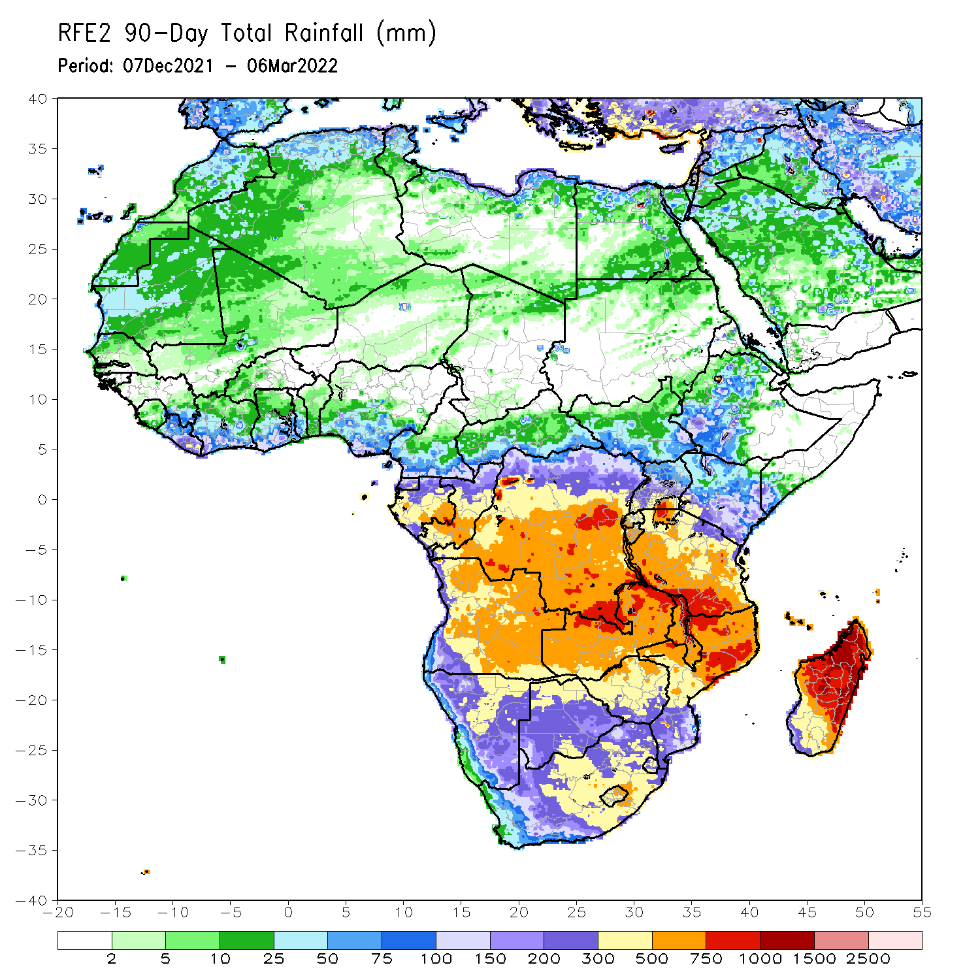
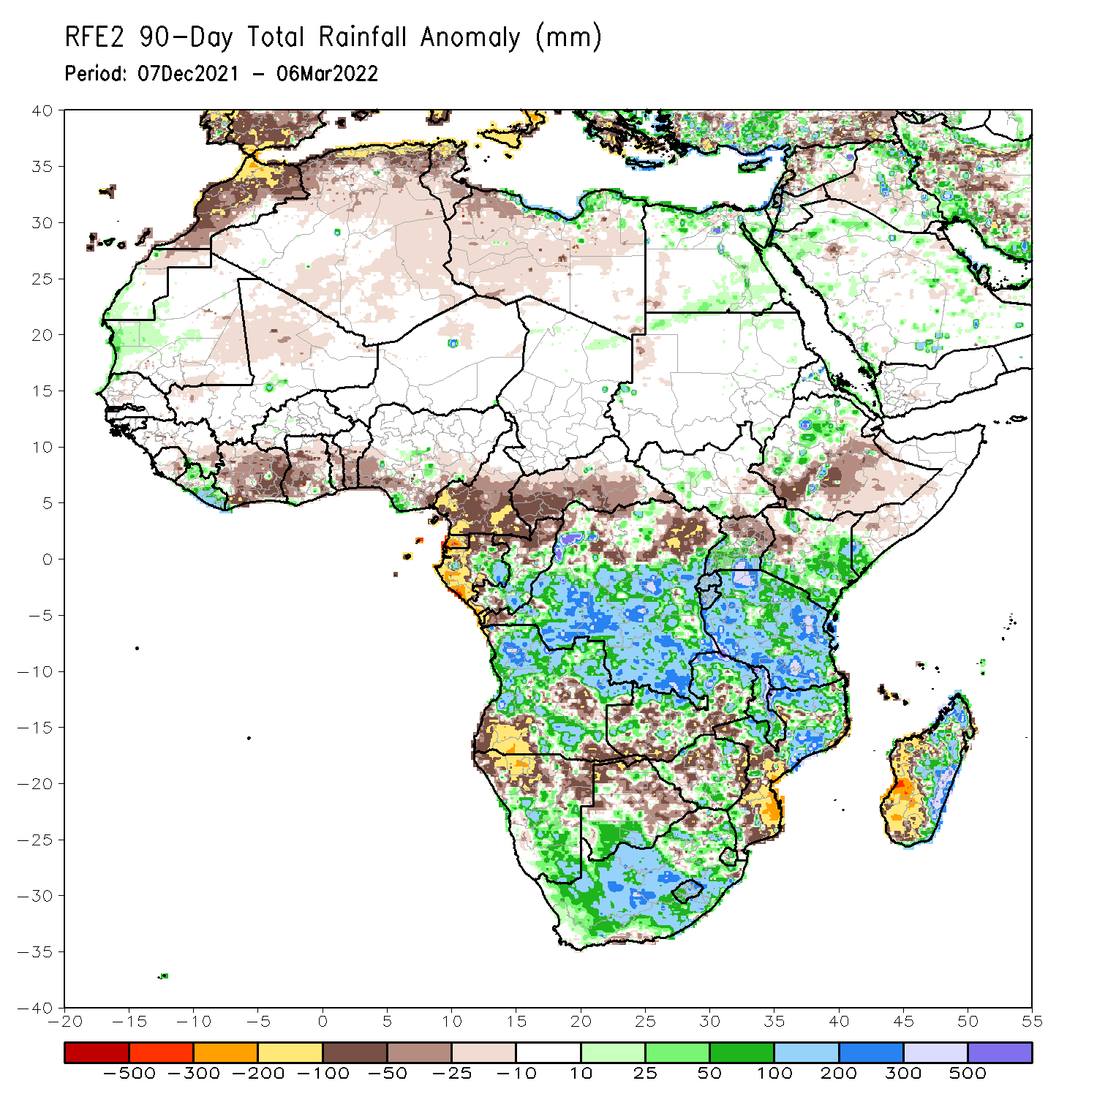
Rainfall Patterns: Last 90 Days
Over the past 90 days, in East Africa, above-average rainfall was observed over parts of northern and western Ethiopia, Rwanda, Burundi, southern Uganda, eastern and southern Kenya, southwestern Somalia, and much of Tanzania. Rainfall was below-average over southern Ethiopia, parts of western Kenya, and northern Uganda. In southern Africa, above-average rainfall was observed over many parts of Angola, southern Botswana, central and southern Namibia, portions of Zimbabwe and Zambia, Malawi, northern Mozambique, eastern Madagascar and much of South Africa. Below-average rainfall was observed over eastern and southwestern Angola, northern Namibia, pockets of Zambia, central and northern Botswana, parts of Zimbabwe, southern Mozambique and western Madagascar. In Central Africa, rainfall was above-average over many parts of DRC, eastern Gabon, and southern Congo. Rainfall was below-average over southern Cameroon, parts of northern DRC, Equatorial Guinea, western Gabon, much of CAR, and northern Congo. In West Africa, rainfall was below-average over many places in the Gulf of Guinea region, while above-average rainfall was observed over much of Liberia.
Notes:
4

Slide 5
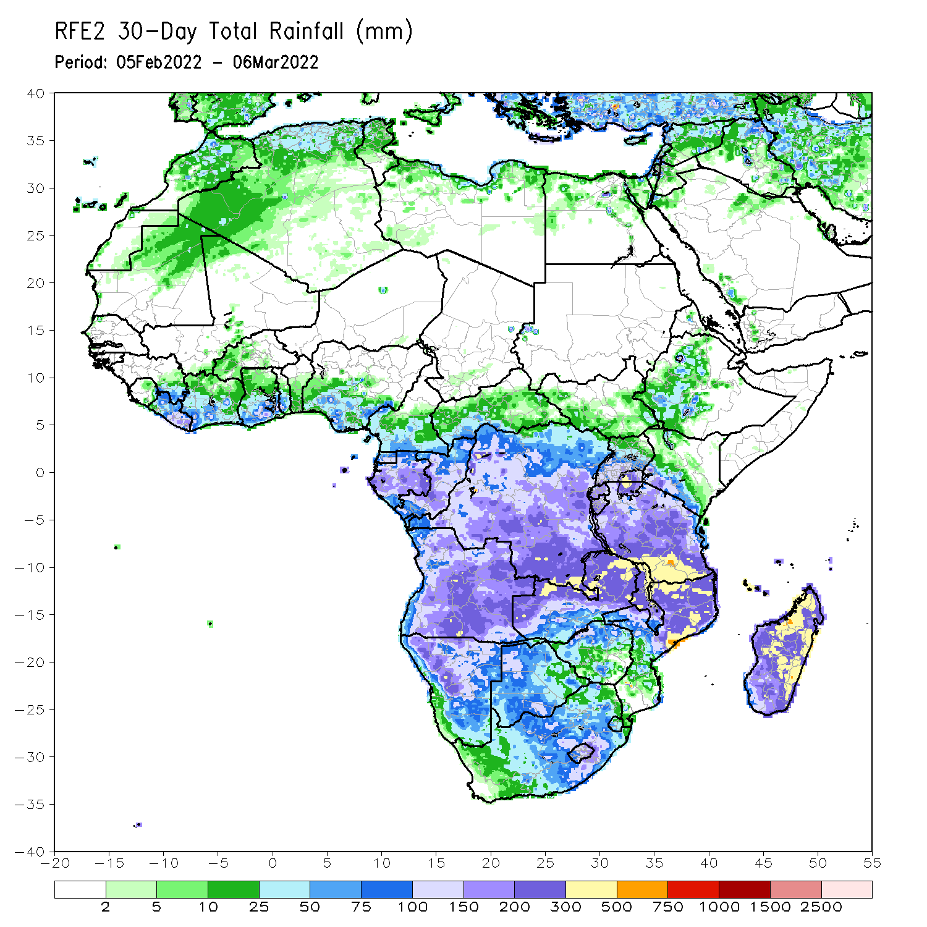
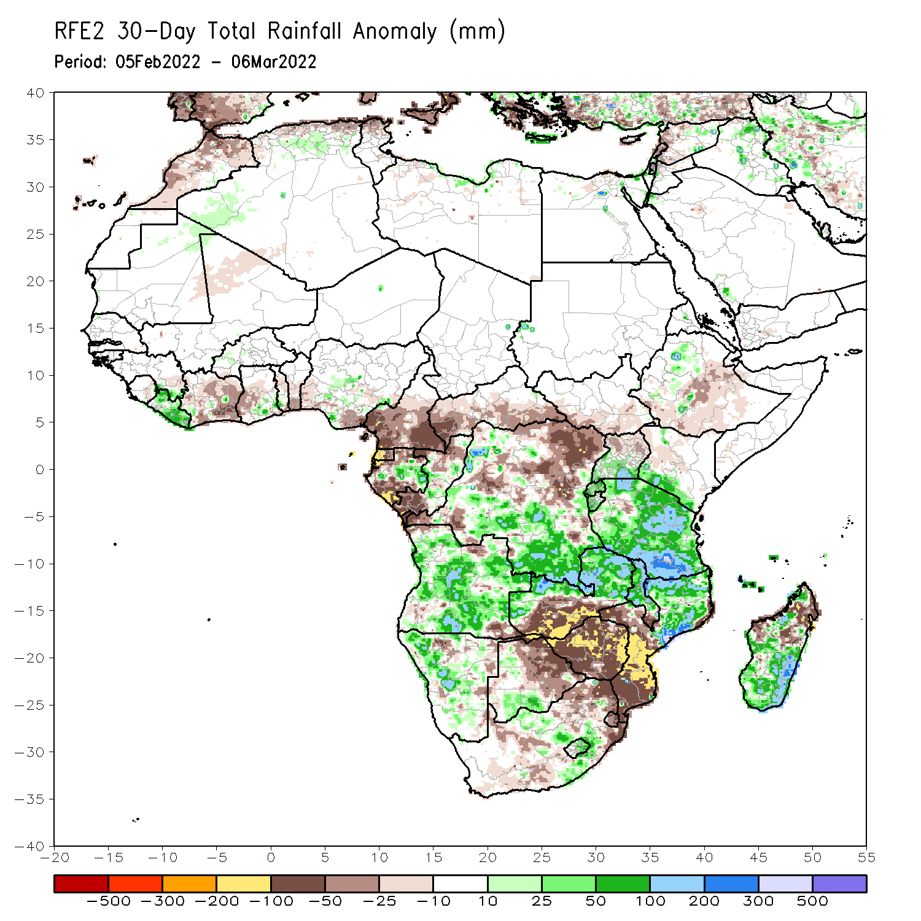
Rainfall Patterns: Last 30 Days
During the past 30 days, in East Africa, above-average rainfall was observed over pocket of northwestern Ethiopia, southern Uganda, Rwanda, Burundi, southwestern Kenya, and much of Tanzania. Rainfall was below-average over parts of central and eastern Ethiopia. In Central Africa, rainfall was below-average over Cameroon, Equatorial Guinea, southern Gabon, parts of Congo, CAR and parts of northern and eastern DRC. Rainfall was above-average over eastern Gabon, central Congo, and central and southern DRC. In Southern Africa, above-average rainfall was observed over much of Angola, many parts of Namibia, northern and eastern Zambia, Malawi, northern Mozambique, much of Madagascar, and eastern South Africa. Below-average rainfall was observed over southwestern Zambia, Botswana, southern Mozambique, western South Africa, and pockets of northern Madagascar.
Notes:
5

Slide 6
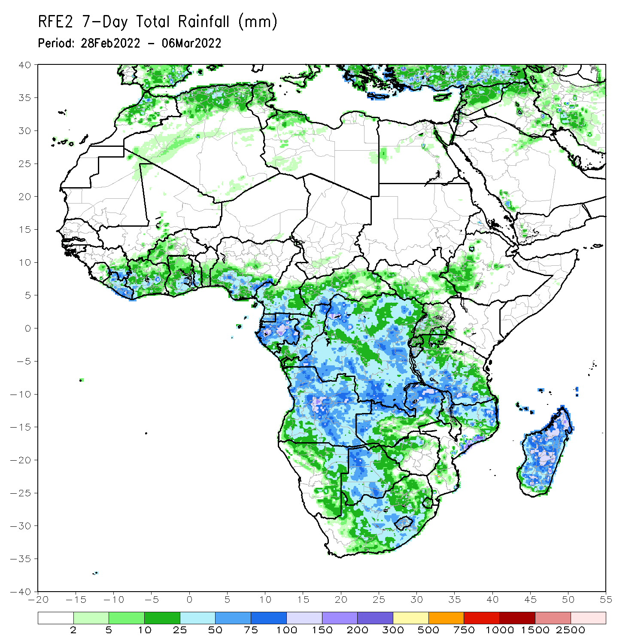
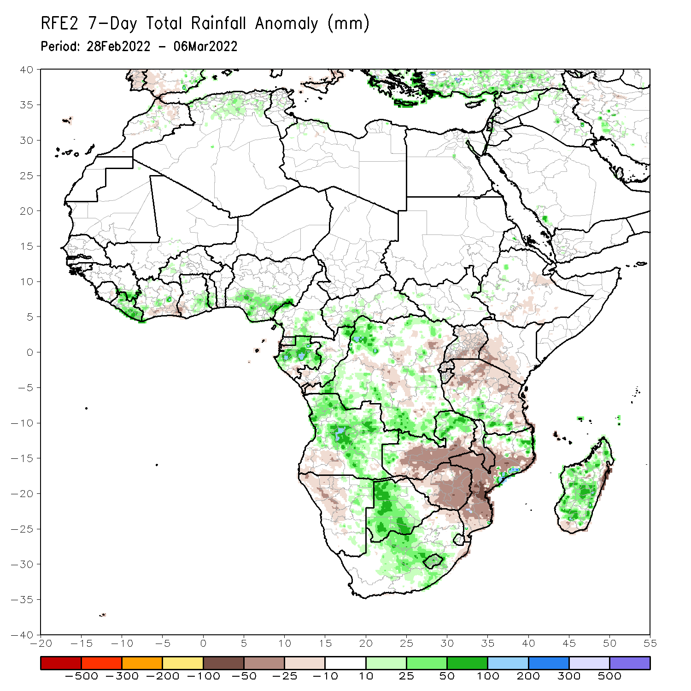
Rainfall Patterns: Last 7 Days
During the past 7 days, in East Africa, rainfall was above-average over parts of southern Tanzania. Below-average was observed over parts of southern Ethiopia, Uganda, parts of Kenya and Uganda, and northern Tanzania. In central Africa, rainfall was above-average over Equatorial Guinea, Gabon, pockets of Cameroon and Congo, and many parts of DRC. Rainfall was below-average over pockets of eastern DRC. In Southern Africa, rainfall was above-average over many parts of Angola, western Botswana, northern Zambia, central South Africa, northern Mozambique and much of Madagascar. Below-average rainfall was observed over southwestern Angola, southern Zambia, Namibia, Zimbabwe, and central and southern Mozambique. In West Africa, above-average rainfall was observed along the Gulf of Guinea coast.

Slide 7
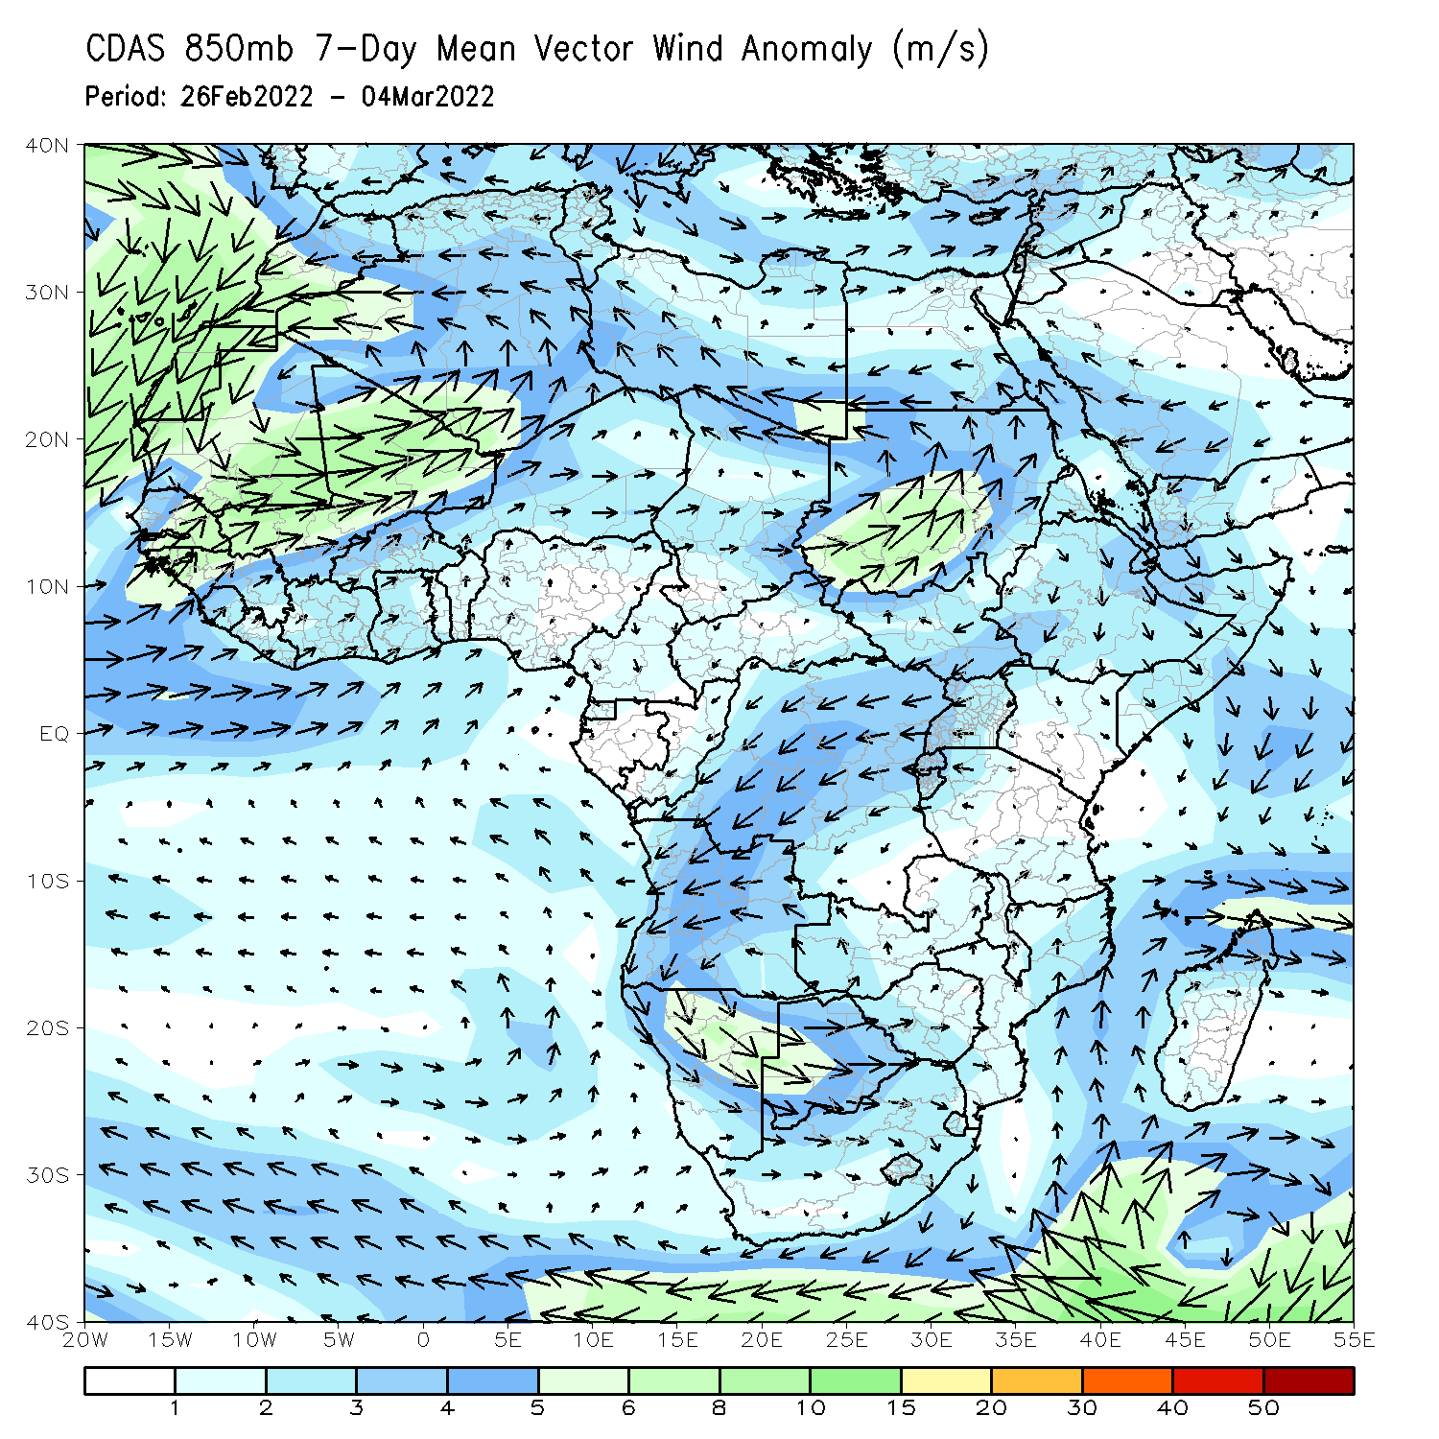
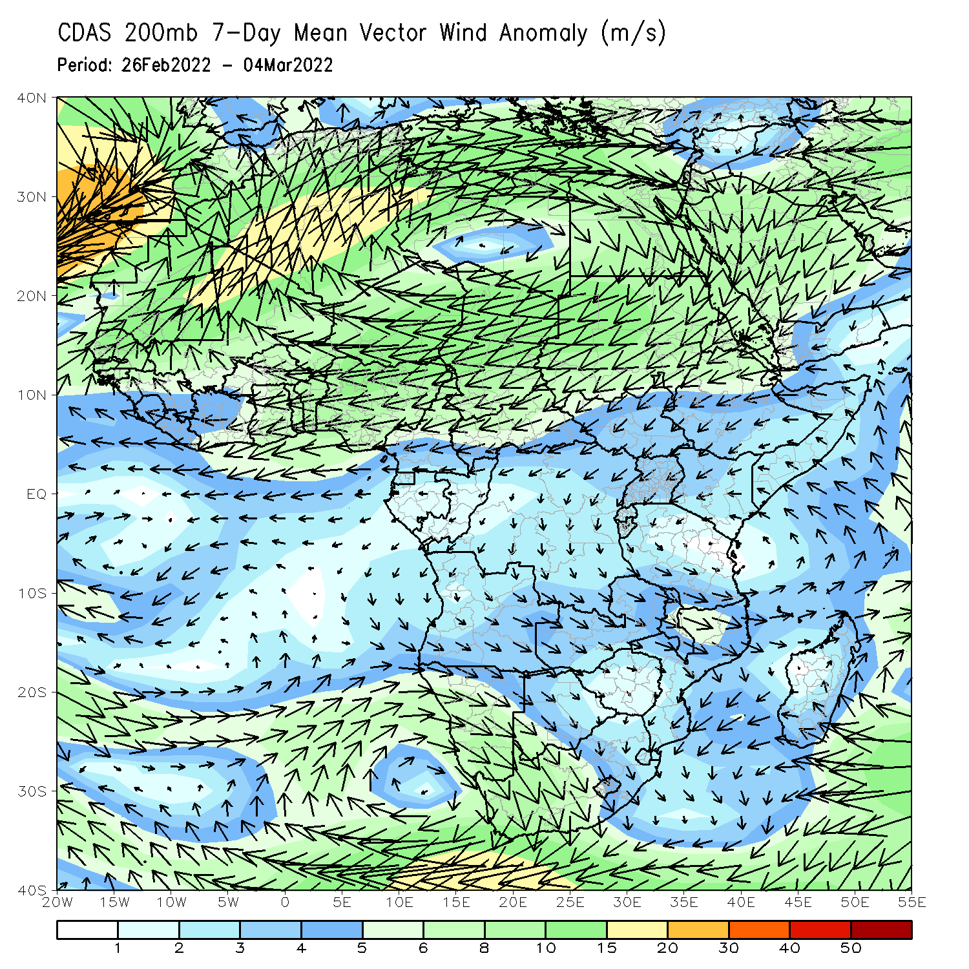
Atmospheric Circulation: Last 7 Days
At 850-hPa level (left panel), an area of anti-cyclonic circulation was observed across portions of Southern Africa.

Slide 8
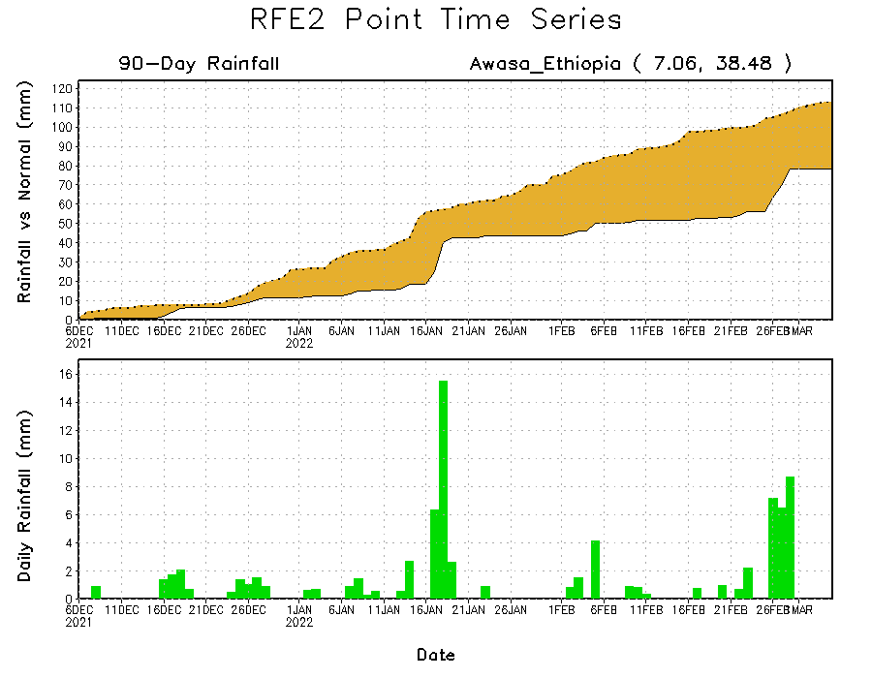
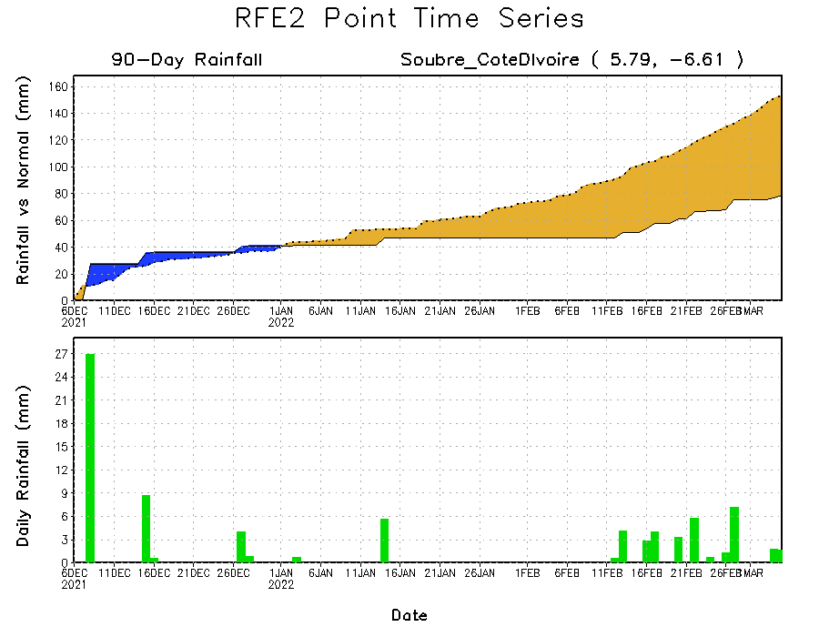
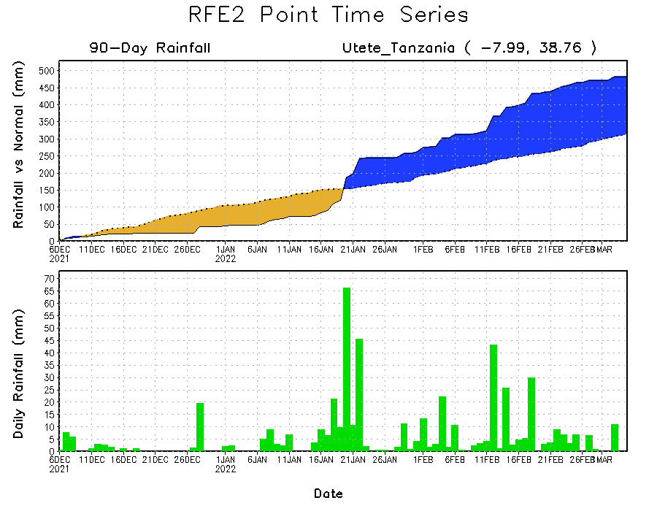
Rainfall Evolution
Daily evolution of rainfall over the last 90 days at selected locations shows moderate sustained moisture surpluses over parts of Tanzania (bottom right). The seasonal total rainfall remained below-average over parts of Cote d’Ivoire (bottom left) and southern Ethiopia (top right).

Slide 9
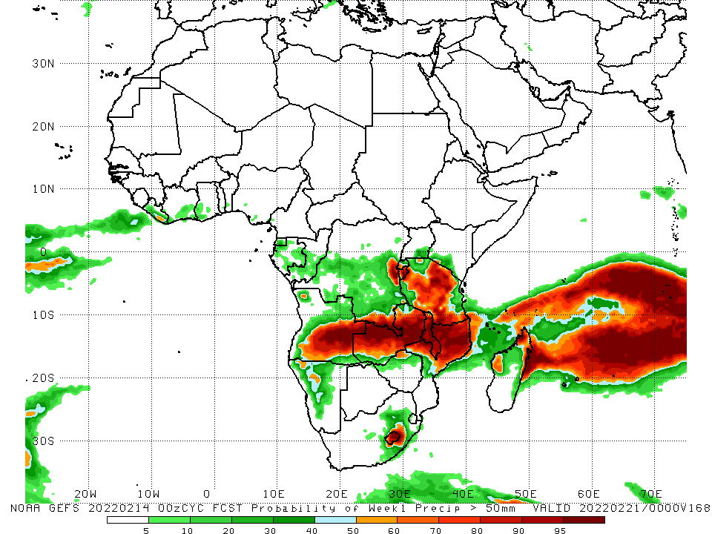
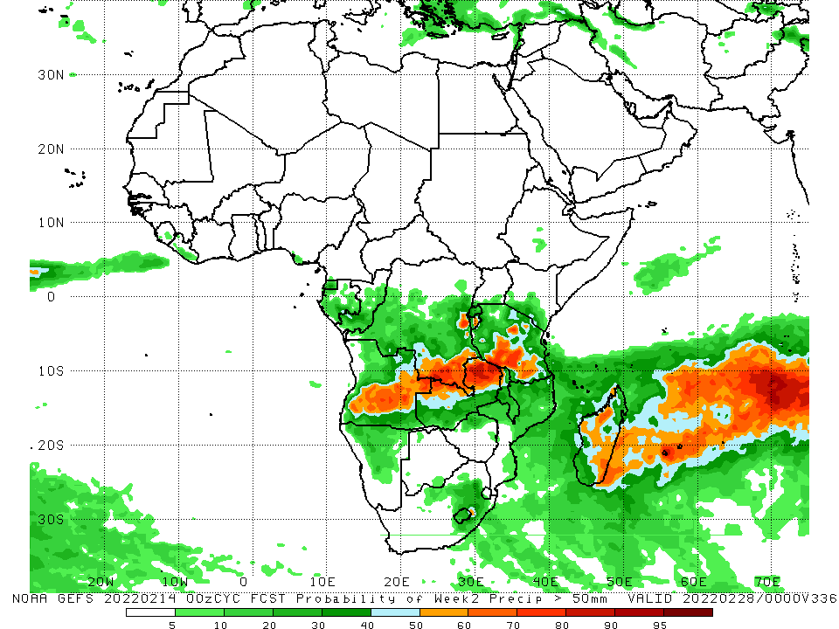
NCEP GEFS Model Forecasts Non-Bias Corrected Probability of precipitation exceedance
Week-1, Valid: 08 – 14 Mar, 2022
Week-2, Valid: 15 – 21 Mar, 2022
For week-1 (left panel), and week-2 (right panel), the NCEP GEFS indicates a moderate to high chance (over 70%) for rainfall to exceed 50 mm over the northern portions of Southern Africa, and Tanzania and parts of Madagascar..
Notes:
9

Slide 10
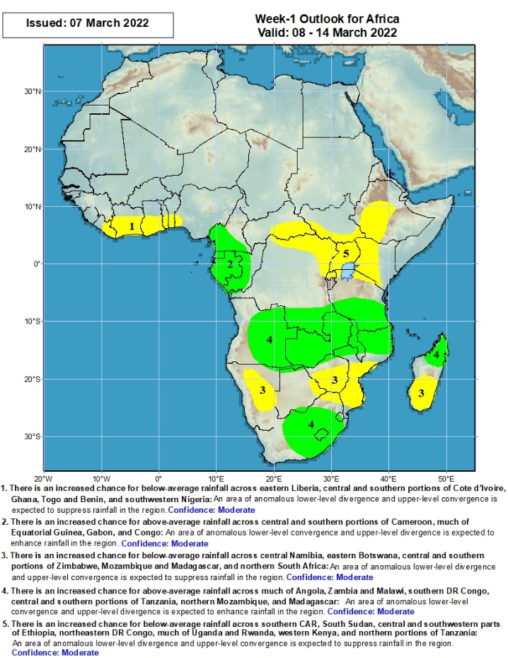
Week-1 Precipitation Outlooks
08 – 14 Mar, 2022
There is an increased chance for below-average rainfall across eastern Liberia, central and southern portions of Cote d’Ivoire, Ghana, Togo and Benin, and southwestern Nigeria: An area of anomalous lower-level divergence and upper-level convergence is expected to suppress rainfall in the region. Confidence: Moderate
There is an increased chance for above-average rainfall across central and southern portions of Cameroon, much of Equatorial Guinea, Gabon, and Congo: An area of anomalous lower-level convergence and upper-level divergence is expected to enhance rainfall in the region. Confidence: Moderate
There is an increased chance for below-average rainfall across central Namibia, eastern Botswana, central and southern portions of Zimbabwe, Mozambique and Madagascar, and northern South Africa: An area of anomalous lower-level divergence and upper-level convergence is expected to suppress rainfall in the region. Confidence: Moderate
There is an increased chance for above-average rainfall across much of Angola, Zambia and Malawi, southern DR Congo, central and southern portions of Tanzania, northern Mozambique, and Madagascar: An area of anomalous upper-level divergence combined with tropical cyclone Emnati is expected to enhance rainfall in the region. Confidence: Moderate
There is an increased chance for below-average rainfall across southern CAR, South Sudan, central and southwestern portions of Ethiopia, northeastern DR Congo, much of Uganda and Rwanda, western Kenya, and northern portions of Tanzania: An area of anomalous lower-level divergence and upper-level convergence is expected to suppress rainfall in the region. Confidence: Moderate
Notes:
10

Slide 11
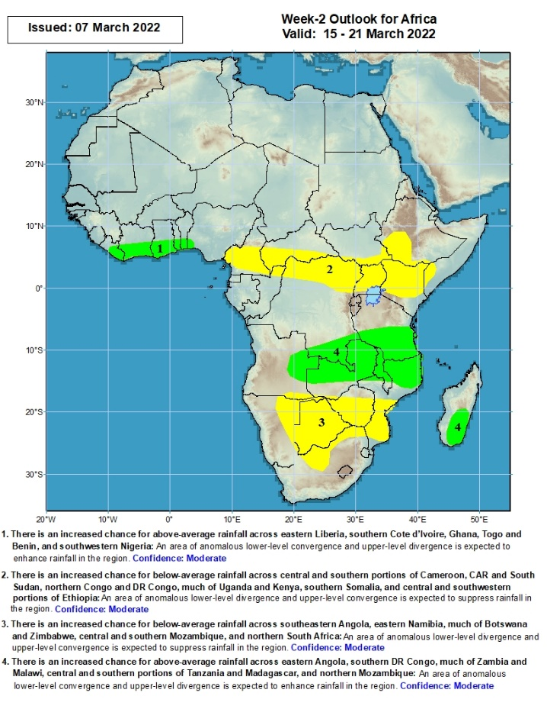
Week-2 Precipitation Outlooks
15 – 21 Mar, 2022
There is an increased chance for above-average rainfall across eastern Liberia, southern Cote d’Ivoire, Ghana, Togo and Benin, and southwestern Nigeria: An area of anomalous lower-level convergence and upper-level divergence is expected to enhance rainfall in the region. Confidence: Moderate
There is an increased chance for below-average rainfall across central and southern portions of Cameroon, CAR and South Sudan, northern Congo and DR Congo, much of Uganda and Kenya, southern Somalia, and central and southwestern portions of Ethiopia: An area of anomalous lower-level divergence and upper-level convergence is expected to suppress rainfall in the region. Confidence: Moderate
There is an increased chance for below-average rainfall across southeastern Angola, eastern Namibia, much of Botswana and Zimbabwe, central and southern Mozambique, and northern South Africa: An area of anomalous lower-level divergence and upper-level convergence is expected to suppress rainfall in the region. Confidence: Moderate
There is an increased chance for above-average rainfall across eastern Angola, southern DR Congo, much of Zambia and Malawi, central and southern portions of Tanzania and Madagascar, and northern Mozambique: An area of anomalous lower-level convergence and upper-level divergence is expected to enhance rainfall in the region. Confidence: Moderate
Notes:
11

Slide 12
Summary
During the past 30 days, in East Africa, above-average rainfall was observed over pocket of northwestern Ethiopia, southern Uganda, Rwanda, Burundi, southwestern Kenya, and much of Tanzania. Rainfall was below-average over parts of central and eastern Ethiopia. In Central Africa, rainfall was below-average over Cameroon, Equatorial Guinea, southern Gabon, parts of Congo, CAR and parts of northern and eastern DRC. Rainfall was above-average over eastern Gabon, central Congo, and central and southern DRC. In Southern Africa, above-average rainfall was observed over much of Angola, many parts of Namibia, northern and eastern Zambia, Malawi, northern Mozambique, much of Madagascar, and eastern South Africa. Below-average rainfall was observed over southwestern Zambia, Botswana, southern Mozambique, western South Africa, and pockets of northern Madagascar.
During the past 7 days, in East Africa, rainfall was above-average over parts of southern Tanzania. Below-average was observed over parts of southern Ethiopia, Uganda, parts of Kenya and Uganda, and northern Tanzania. In central Africa, rainfall was above-average over Equatorial Guinea, Gabon, pockets of Cameroon and Congo, and many parts of DRC. Rainfall was below-average over pockets of eastern DRC. In Southern Africa, rainfall was above-average over many parts of Angola, western Botswana, northern Zambia, central South Africa, northern Mozambique and much of Madagascar. Below-average rainfall was observed over southwestern Angola, southern Zambia, Namibia, Zimbabwe, and central and southern Mozambique. In West Africa, above-average rainfall was observed along the Gulf of Guinea coast.
Week-1 and week-2 outlooks call for an increased chance for above-average rainfall across the northern portions of Southern Africa, including southern Tanzania. In contrast, there is an increased chance for below-average rainfall in the Lake Victoria region, including southwestern and southern Ethiopia. Outlooks also call for below-average rainfall across the southern portions of Southern Africa.

