Slide 1
The African Monsoon Recent Evolution and Current Status Include Week-1 and Week-2 Outlooks
Update prepared by
28 February 2022
For more information, visit:
http://www.cpc.ncep.noaa.gov/products/Global_Monsoons/African_Monsoons/precip_monitoring.shtml

Slide 2
Outline
Highlights
Recent Evolution and Current Conditions
NCEP GEFS Forecasts
Summary

Slide 3
Highlights: Last 7 Days
During the past 7 days, in East Africa, rainfall was above-average over pockets of Ethiopia, and much of Tanzania and the neighboring areas of southern Kenya and southern Uganda. In central Africa, rainfall was above-average over pockets of southern DRC. Rainfall was below-average over southern Cameroon, Equatorial Guinea, Gabon, many parts of DRC, and Congo. In Southern Africa, rainfall was above-average over western Angola, northern Mozambique and parts of Madagascar. Below-average rainfall was observed over eastern and southern Angola, much of Zambia, Namibia, Botswana, Zimbabwe, South Africa, central and southern Mozambique, western and northeastern Madagascar.
Week-1 and week-2 outlooks call for an increased chance for above-average rainfall across the northern portions of Southern Africa, including southern Tanzania. In contrast, there is an increased chance for below-average rainfall across southwestern Ethiopia, western Kenya, northeastern DRC, Uganda, Rwanda, Burundi, northern Tanzania, and portions of Namibia, Botswana, southern Zimbabwe, southern Mozambique and parts of Madagascar.

Slide 4
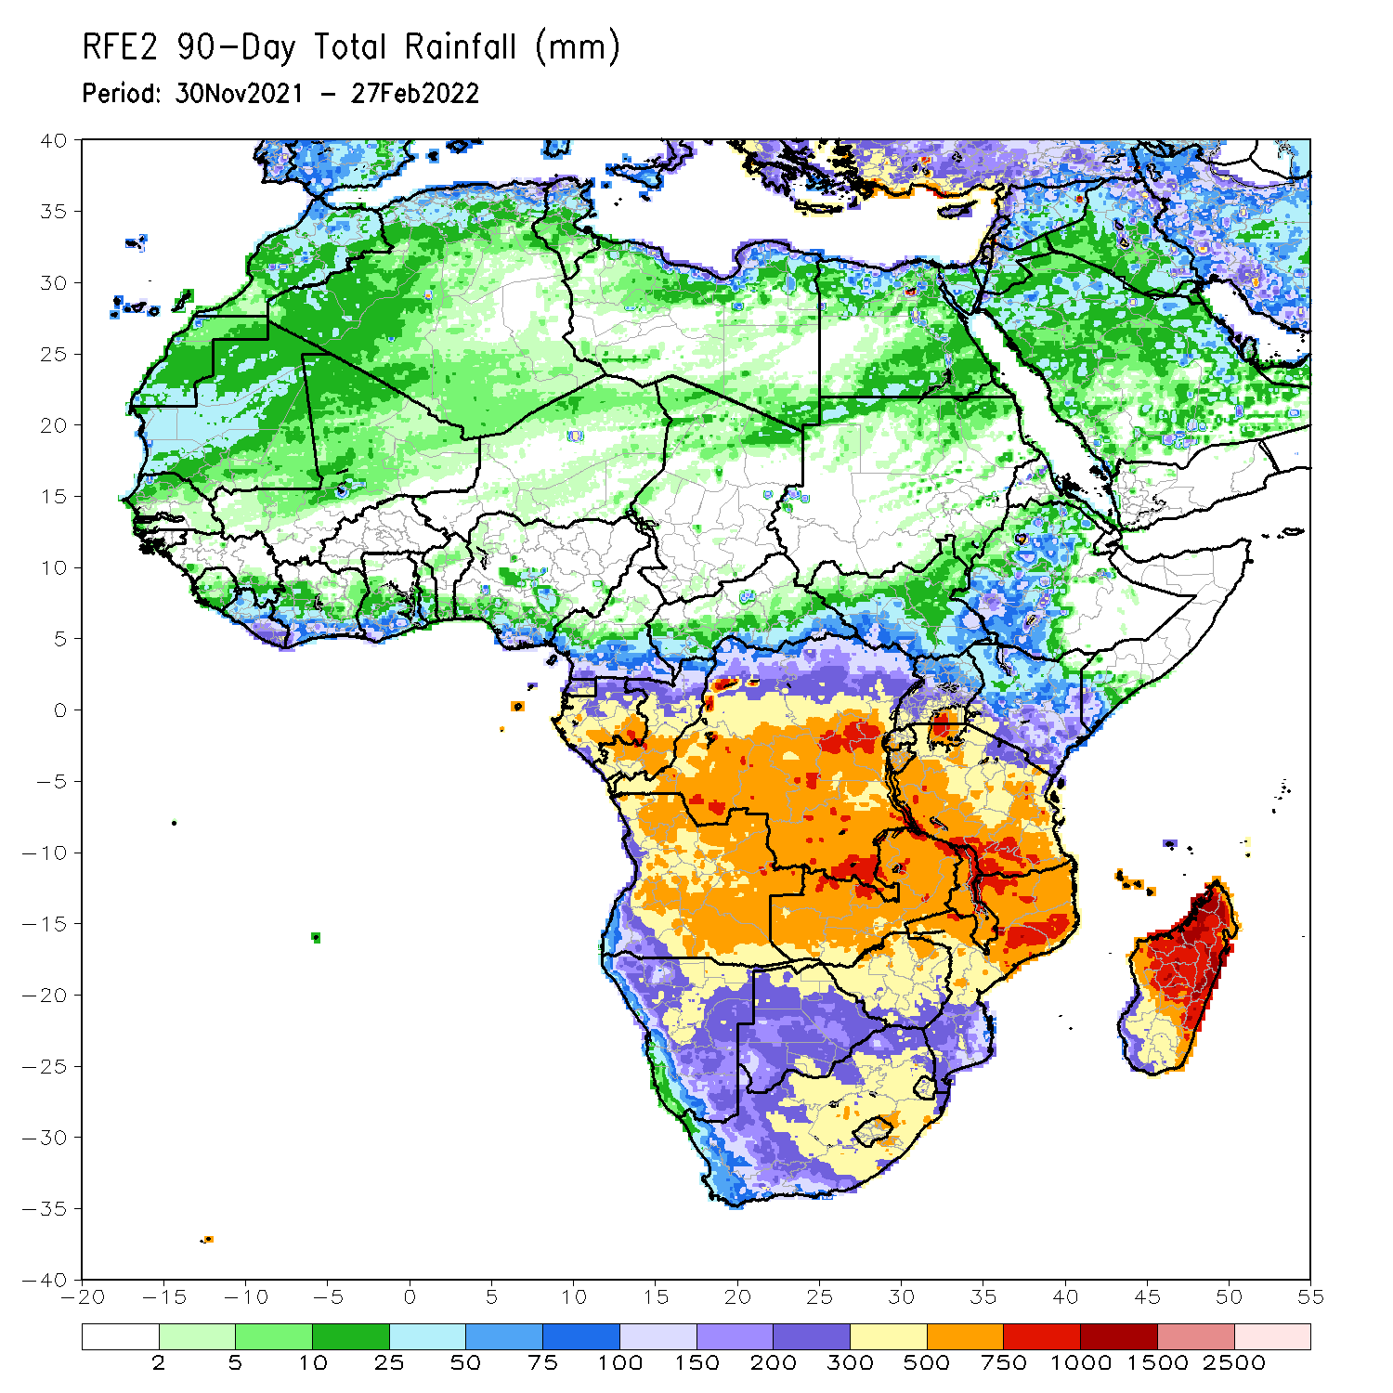
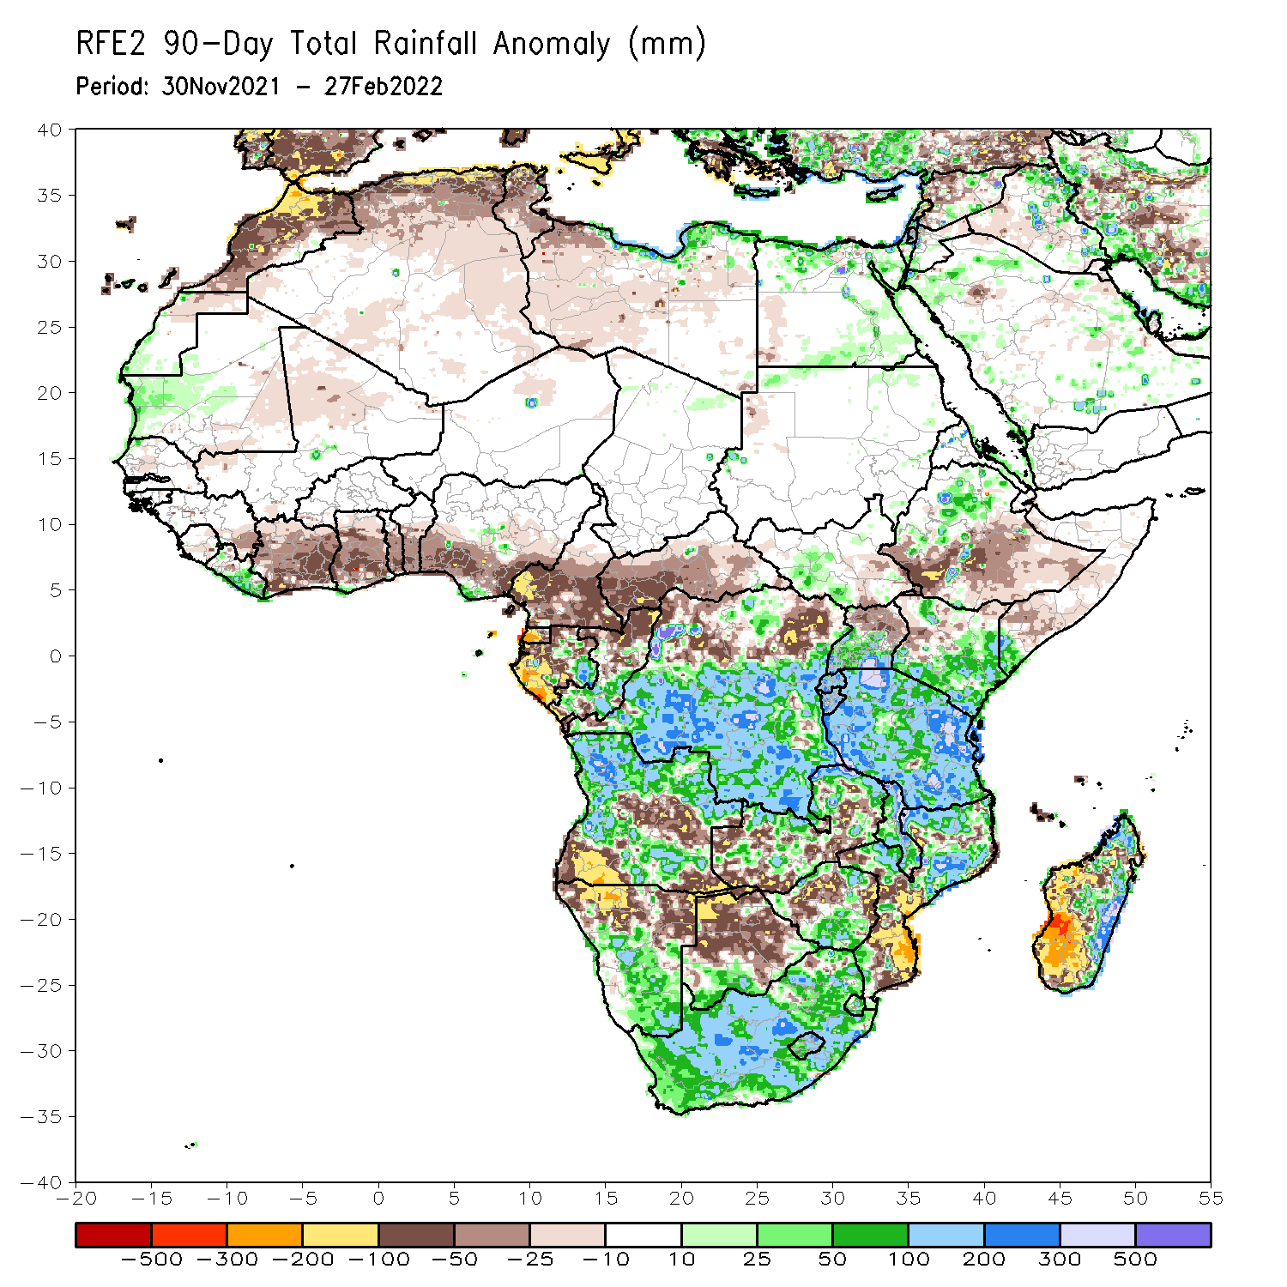
Rainfall Patterns: Last 90 Days
Over the past 90 days, in East Africa, above-average rainfall was observed over parts of northern Ethiopia, the far southern South Sudan, Rwanda, Burundi, southern Uganda, eastern and southern Kenya, southwestern Somalia, and much of Tanzania. Rainfall was below-average over southern Ethiopia, eastern South Sudan, parts of Somalia, western Kenya, and northern Uganda. In southern Africa, above-average rainfall was observed over many parts of Angola, southern Botswana, central and southern Namibia, portions of Zimbabwe and Zambia, Malawi, northern Mozambique, eastern Madagascar and much of South Africa. Below-average rainfall was observed over central and southwestern Angola, northern Namibia, pockets of Zambia, central and northern Botswana, pockets of northern Zimbabwe, parts of Mozambique and western and southern Madagascar. In Central Africa, rainfall was above-average over many parts of DRC, pockets of Gabon, and southern Congo. Rainfall was below-average over southern Cameroon, parts of northern DRC, Gabon, much of CAR, and northern Congo. In West Africa, rainfall was below-average over many places in the Gulf of Guinea region.
Notes:
4

Slide 5
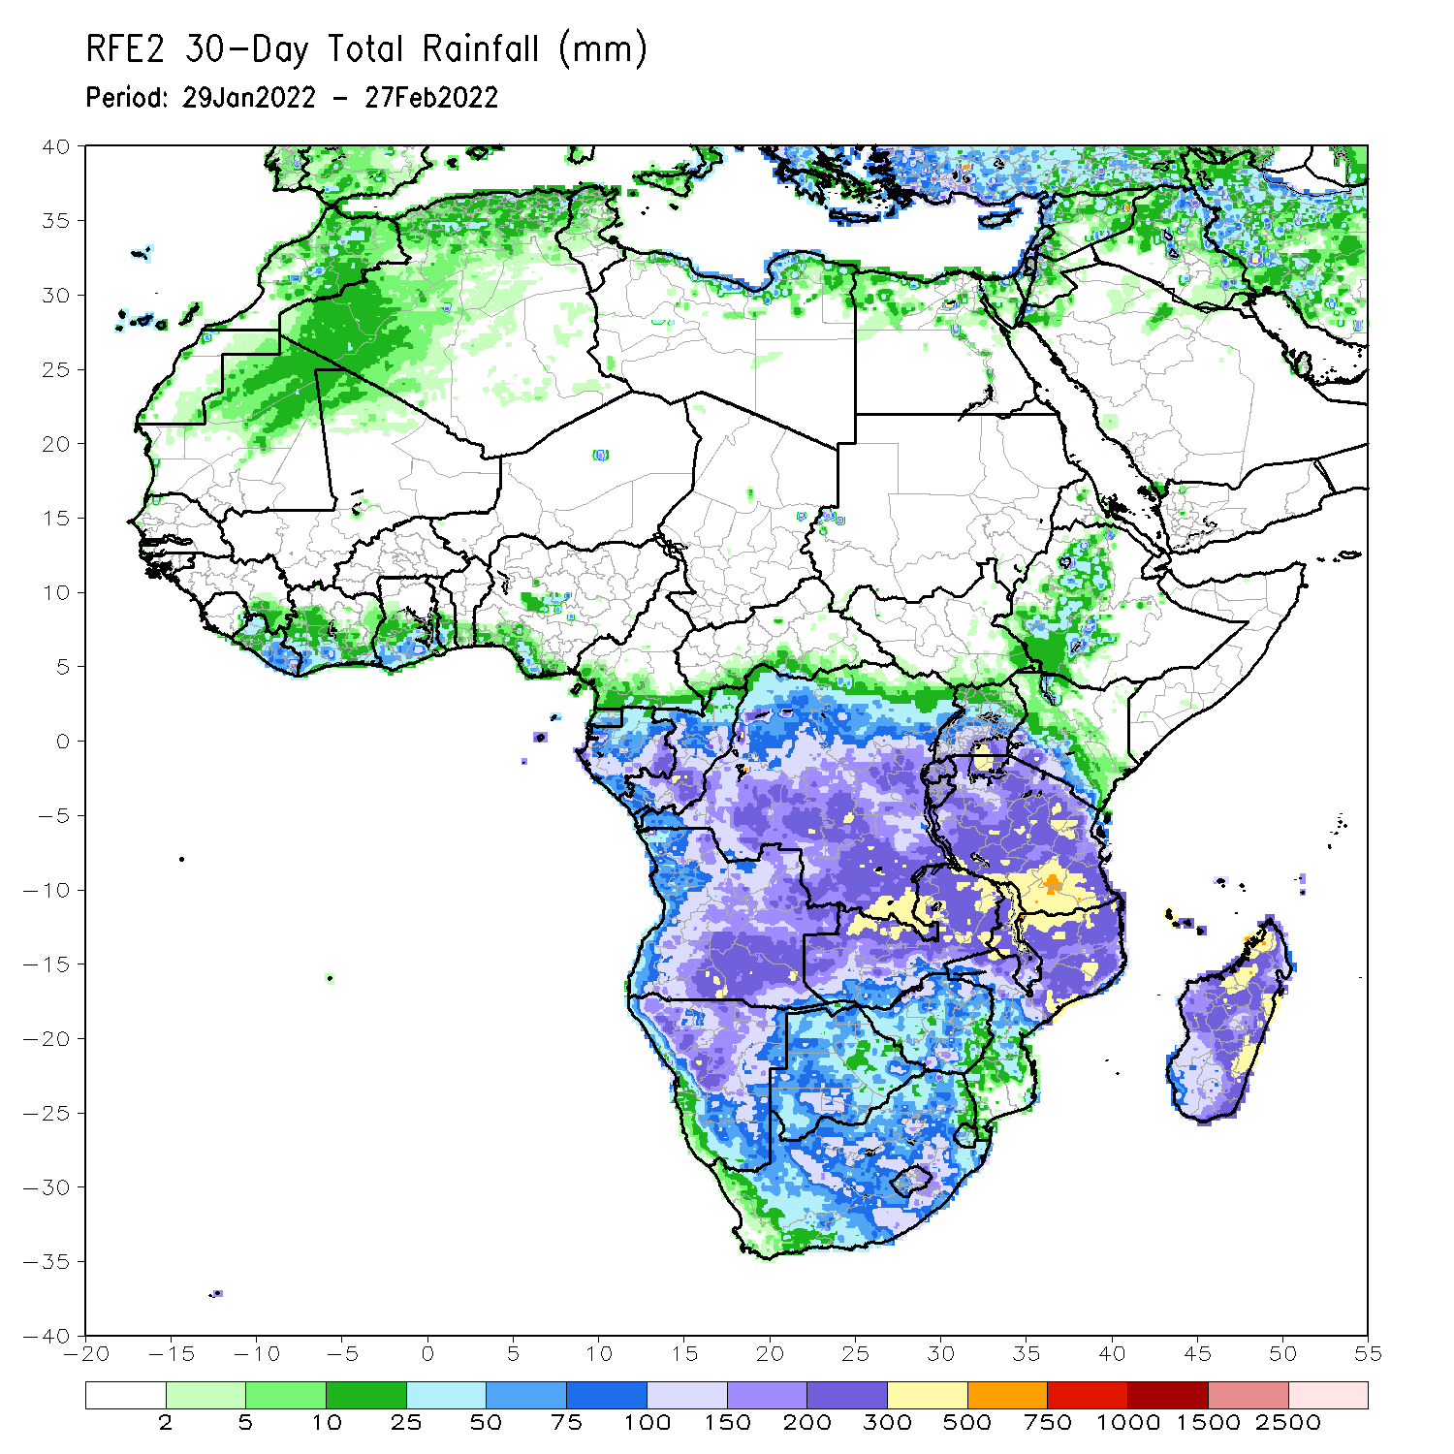
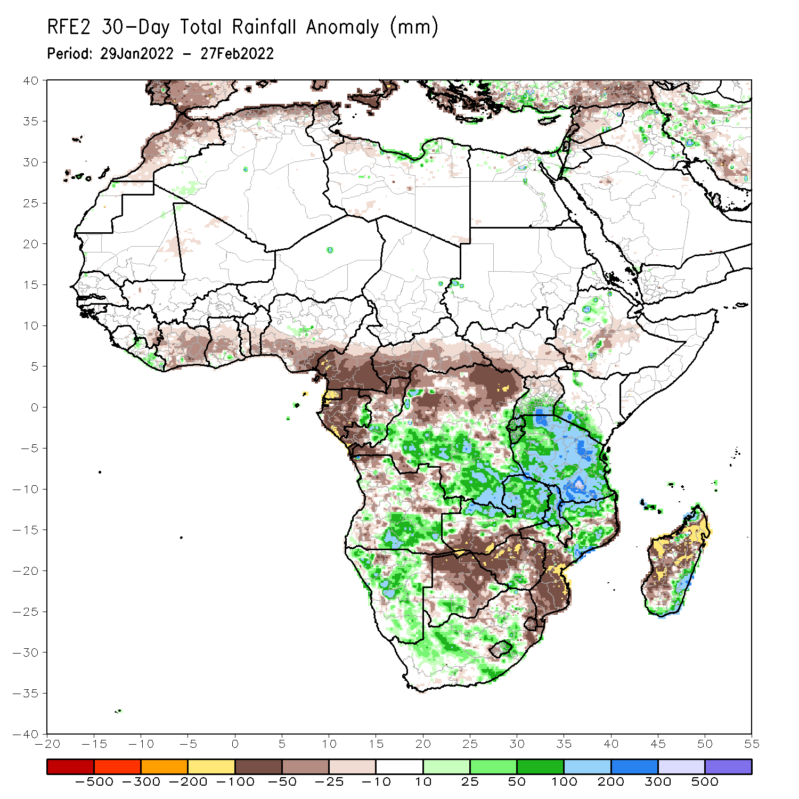
Rainfall Patterns: Last 30 Days
During the past 30 days, in East Africa, above-average rainfall was observed over pocket of Ethiopia, southern Uganda, Rwanda, Burundi, southwestern Kenya, and much of Tanzania. Rainfall was below-average over parts of southern and central Ethiopia. In Central Africa, rainfall was below-average over southern Cameroon, Equatorial Guinea, Gabon, northern Congo, CAR and parts of northern and eastern DRC. Rainfall was above-average over southern Congo, and central and southern DRC. In Southern Africa, above-average rainfall was observed over southern Angola, many parts of Namibia, parts of southern Zimbabwe, northern and eastern Zambia, Malawi, northern Mozambique, southeastern Madagascar, and much of South Africa. Below-average rainfall was observed over parts of western and northern Angola, southwestern Zambia, Botswana, southern Mozambique, and western and northern Madagascar.
Notes:
5

Slide 6
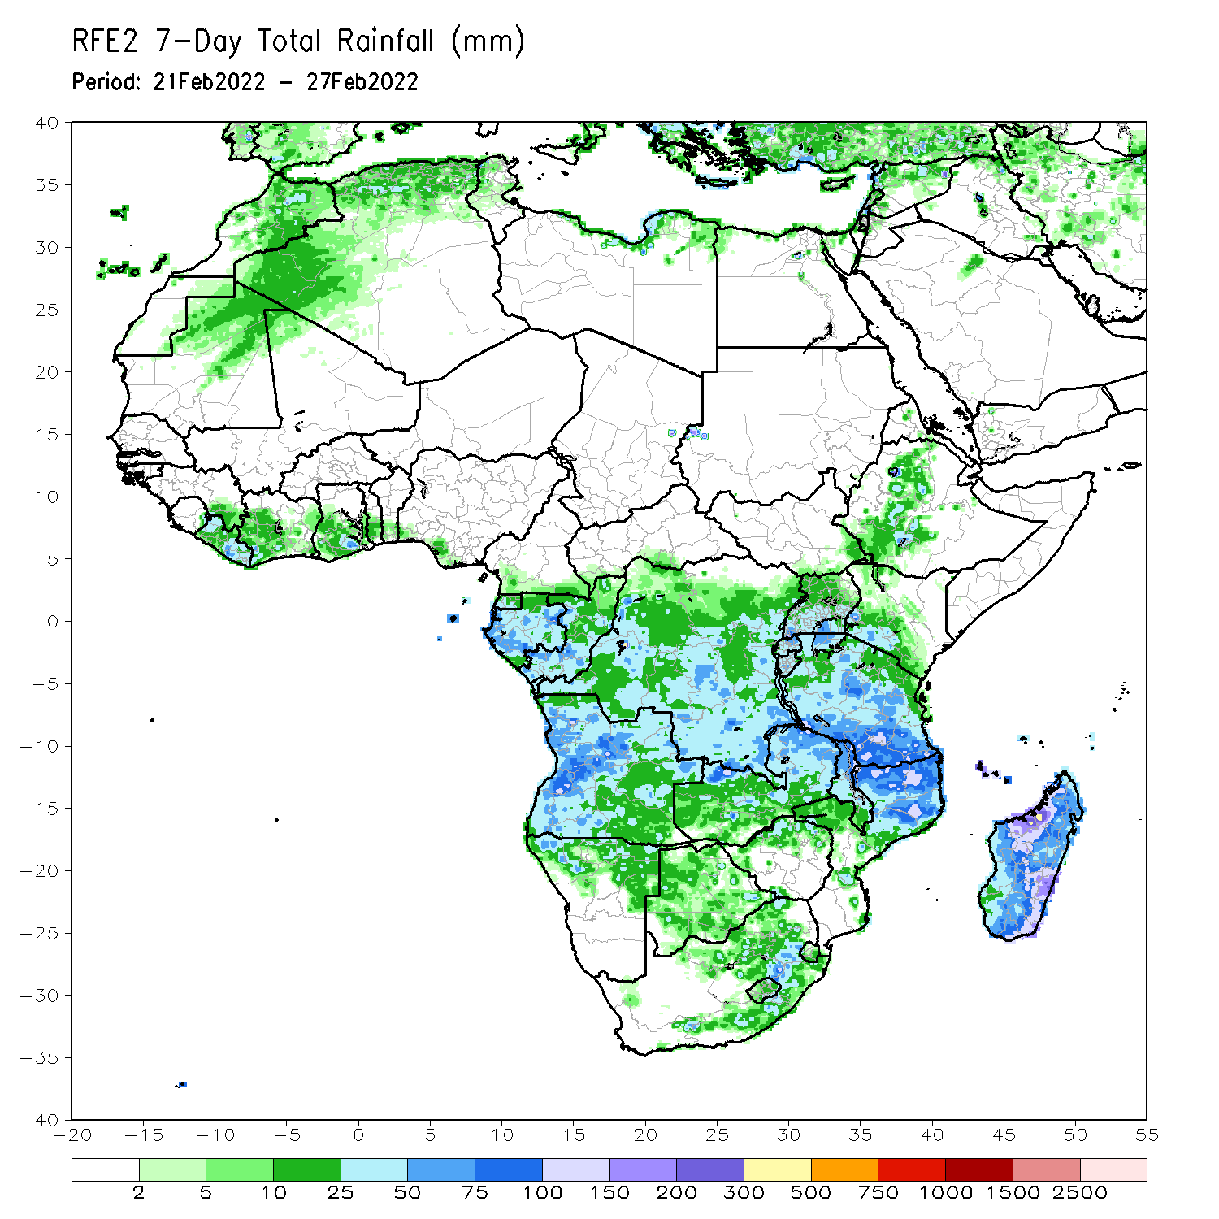
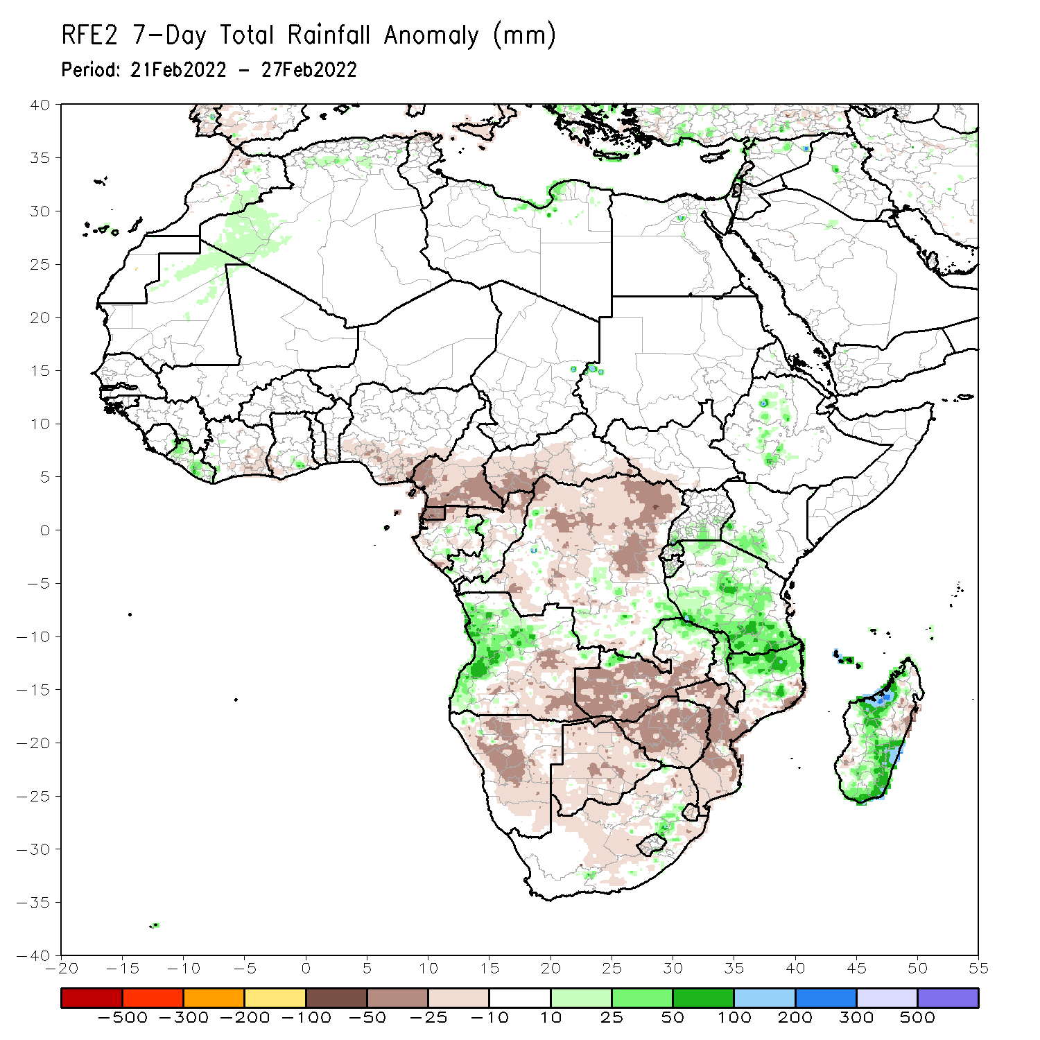
Rainfall Patterns: Last 7 Days
During the past 7 days, in East Africa, rainfall was above-average over pockets of Ethiopia, and much of Tanzania and the neighboring areas of southern Kenya and southern Uganda. In central Africa, rainfall was above-average over pockets of southern DRC. Rainfall was below-average over southern Cameroon, Equatorial Guinea, Gabon, many parts of DRC, and Congo. In Southern Africa, rainfall was above-average over western Angola, northern Mozambique and parts of Madagascar. Below-average rainfall was observed over eastern and southern Angola, much of Zambia, Namibia, Botswana, Zimbabwe, South Africa, central and southern Mozambique, western and northeastern Madagascar.

Slide 7
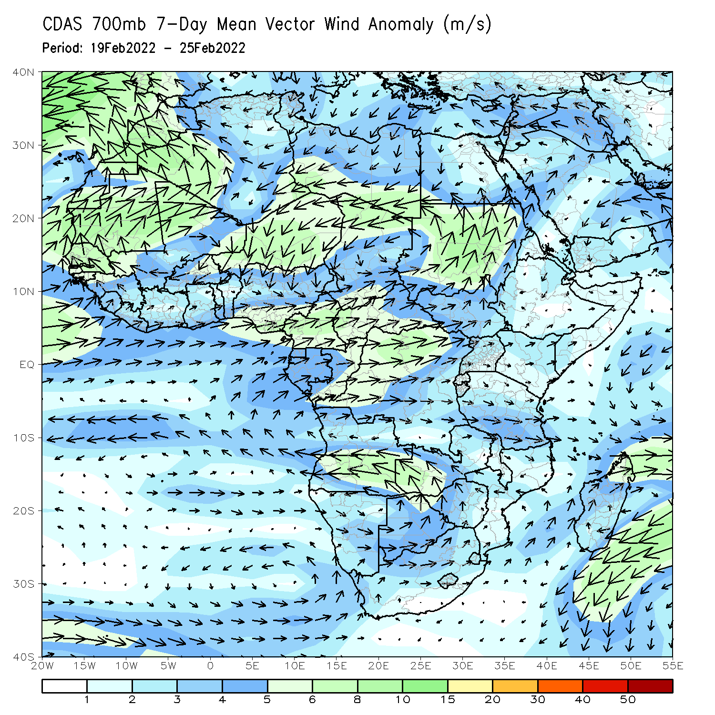
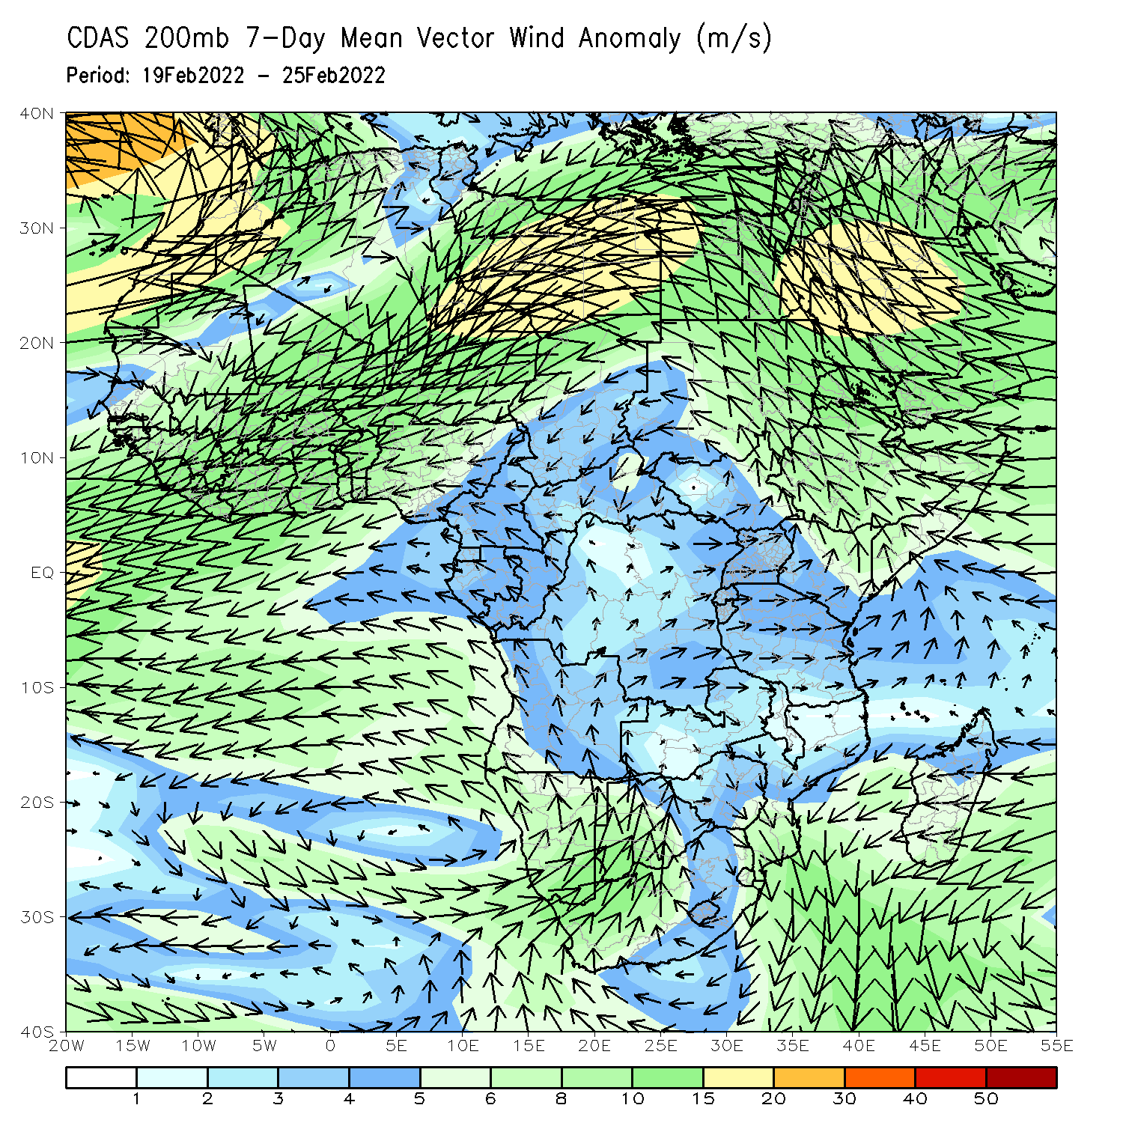
Atmospheric Circulation: Last 7 Days
At 700-hPa level (left panel), an area of cyclonic trough was observed across the northern portions of Southern Africa.

Slide 8
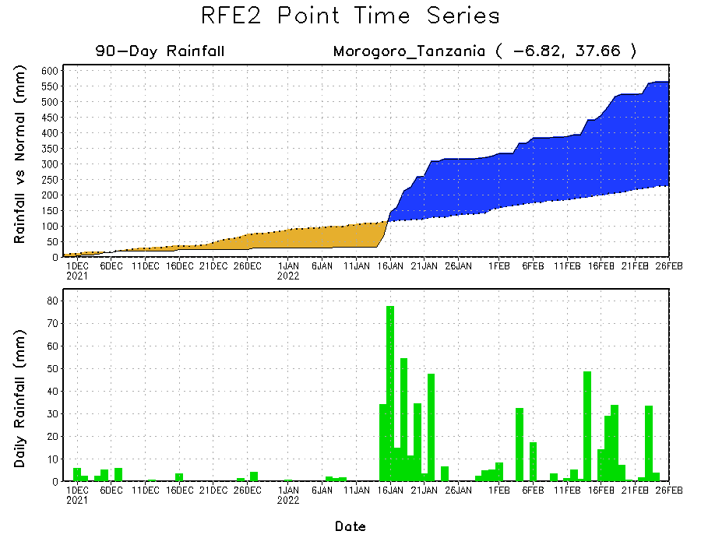
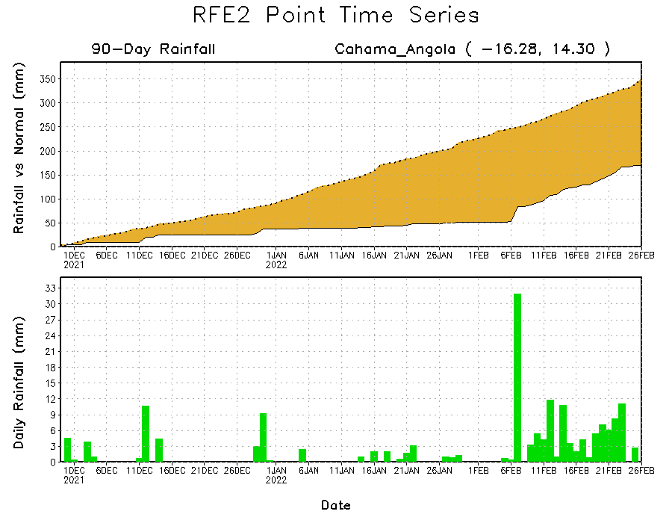
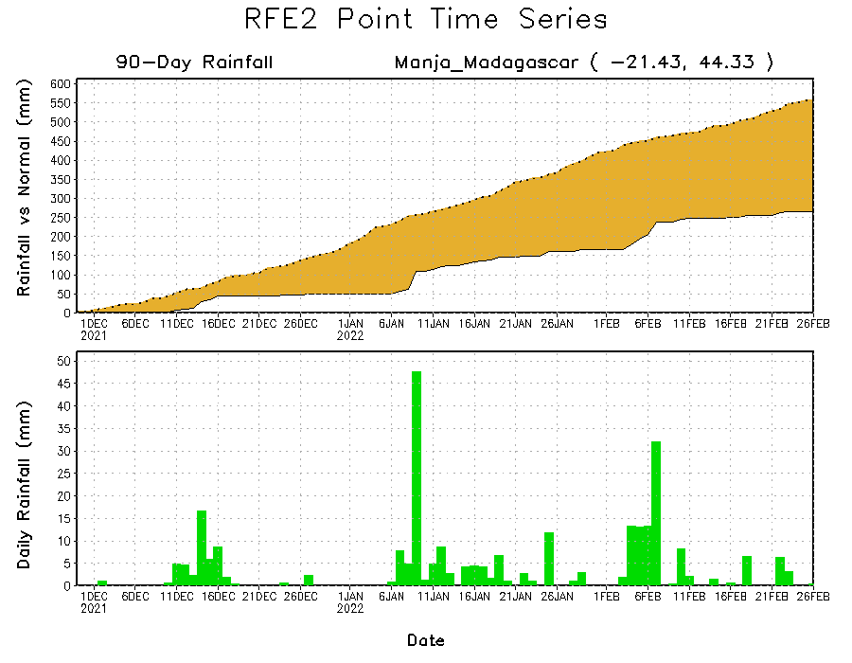
Rainfall Evolution
Daily evolution of rainfall over the last 90 days at selected locations shows moderate sustained moisture surpluses over parts of Tanzania (top right). The seasonal total rainfall remained below-average over southern Madagascar (bottom right) and southern Angola (bottom left).

Slide 9
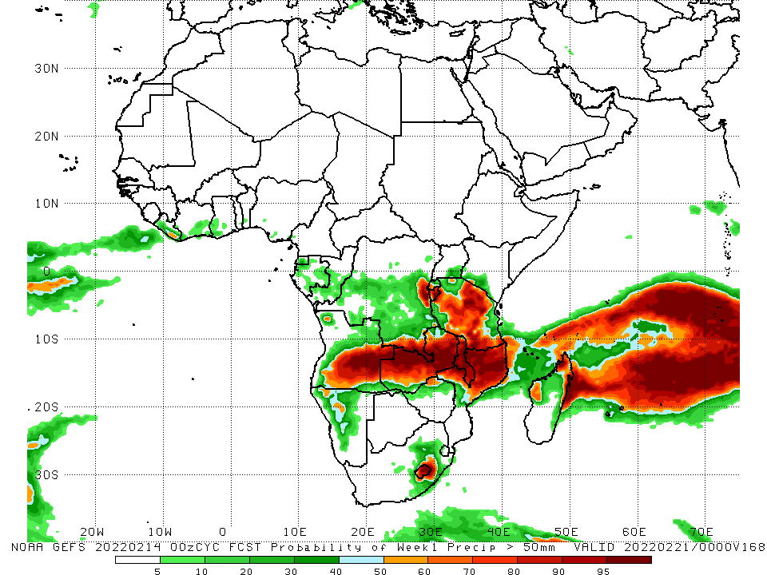
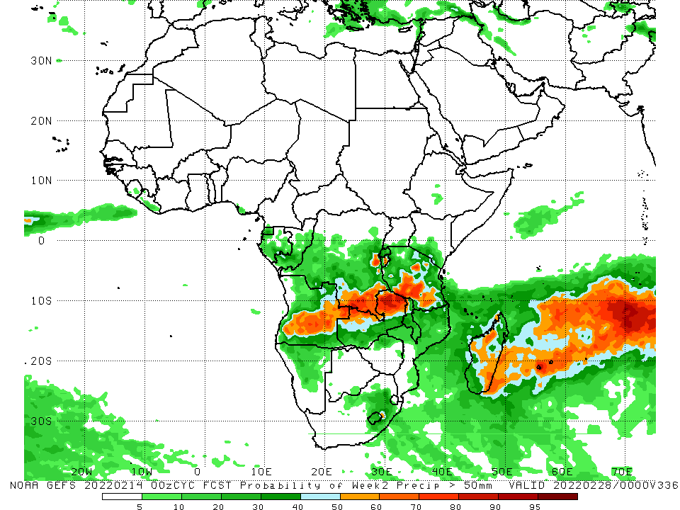
NCEP GEFS Model Forecasts Non-Bias Corrected Probability of precipitation exceedance
Week-1, Valid: 01 – 07 Mar, 2022
Week-2, Valid: 08 – 14 Mar, 2022
For week-1 (left panel), and week-2 (right panel), the NCEP GEFS indicates a moderate to high chance (over 70%) for rainfall to exceed 50 mm over the northern portions of Southern Africa, and Tanzania and parts of Madagascar..
Notes:
9

Slide 10
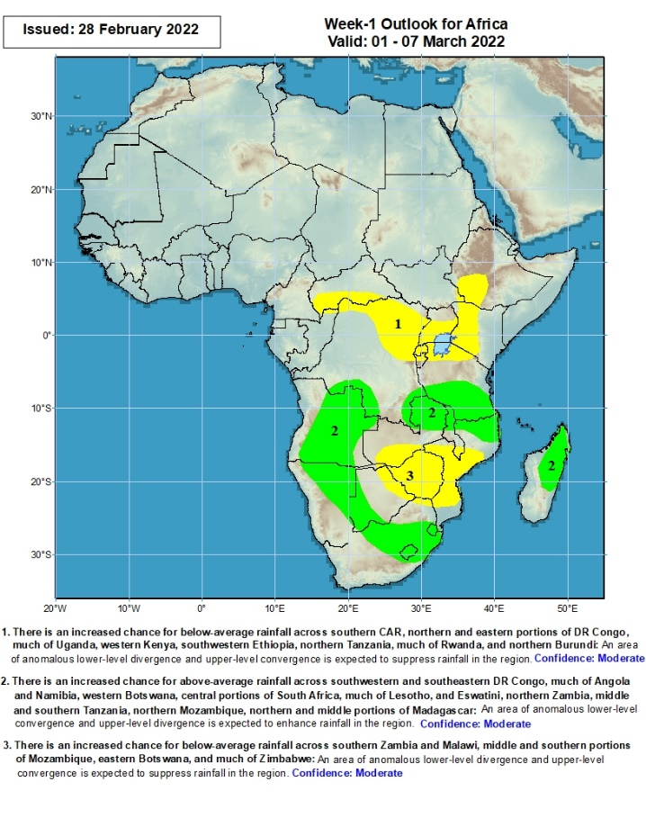
Week-1 Precipitation Outlooks
01 – 07 Mar, 2022
There is an increased chance for below-average rainfall across southern CAR, northern and eastern portions of DR Congo, much of Uganda, western Kenya, southwestern Ethiopia, northern Tanzania, much of Rwanda, and northern Burundi: An area of anomalous lower-level divergence and upper-level convergence is expected to suppress rainfall in the region. Confidence: Moderate
There is an increased chance for above-average rainfall across southwestern and southeastern DR Congo, much of Angola and Namibia, western Botswana, central portions of South Africa, much of Lesotho, and Eswatini, northern Zambia, middle and southern Tanzania, northern Mozambique, northern and middle portions of Madagascar: An area of anomalous lower-level convergence and upper-level divergence is expected to enhance rainfall in the region. Confidence: Moderate
There is an increased chance for below-average rainfall across southern Zambia and Malawi, central and southern portions of Mozambique, eastern Botswana, and much of Zimbabwe: An area of anomalous lower-level divergence and upper-level convergence is expected to suppress rainfall in the region. Confidence: Moderate
Notes:
10

Slide 11
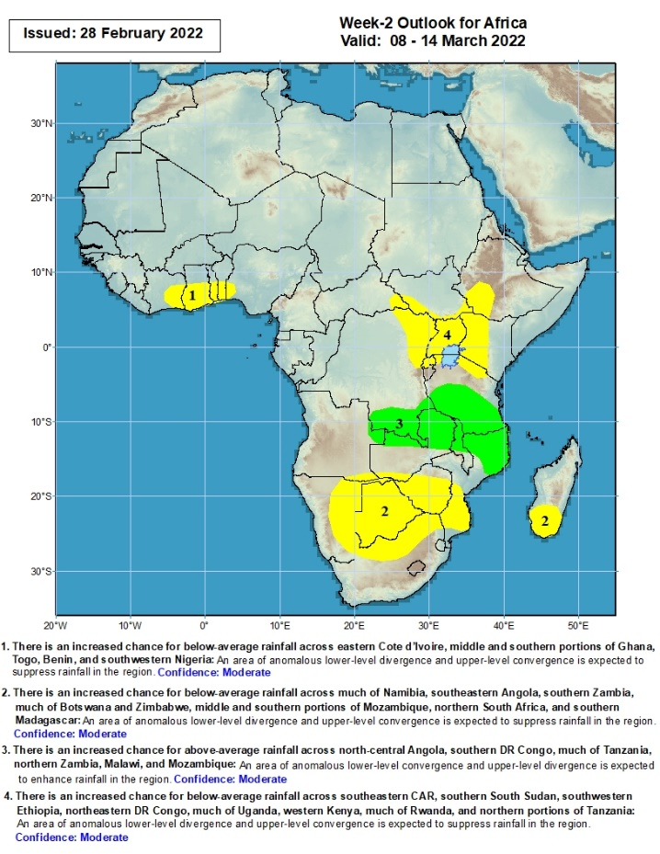
Week-2 Precipitation Outlooks
08 – 14 Mar, 2022
There is an increased chance for below-average rainfall across eastern Cote d’Ivoire, central and southern portions of Ghana, Togo, Benin, and southwestern Nigeria: An area of anomalous lower-level divergence and upper-level convergence is expected to suppress rainfall in the region. Confidence: Moderate
There is an increased chance for below-average rainfall across much of Namibia, southeastern Angola, southern Zambia, much of Botswana and Zimbabwe, middle and southern portions of Mozambique, northern South Africa, and southern Madagascar: An area of anomalous lower-level divergence and upper-level convergence is expected to suppress rainfall in the region. Confidence: Moderate
There is an increased chance for above-average rainfall across north-central Angola, southern DR Congo, much of Tanzania, northern Zambia, Malawi, and Mozambique: An area of anomalous lower-level convergence and upper-level divergence is expected to enhance rainfall in the region. Confidence: Moderate
There is an increased chance for below-average rainfall across southeastern CAR, southern South Sudan, southwestern Ethiopia, northeastern DR Congo, much of Uganda, western Kenya, much of Rwanda, and northern portions of Tanzania: An area of anomalous lower-level divergence and upper-level convergence is expected to suppress rainfall in the region. Confidence: Moderate
Notes:
11

Slide 12
Summary
During the past 30 days, in East Africa, above-average rainfall was observed over pocket of Ethiopia, southern Uganda, Rwanda, Burundi, southwestern Kenya, and much of Tanzania. Rainfall was below-average over parts of southern and central Ethiopia. In Central Africa, rainfall was below-average over southern Cameroon, Equatorial Guinea, Gabon, northern Congo, CAR and parts of northern and eastern DRC. Rainfall was above-average over southern Congo, and central and southern DRC. In Southern Africa, above-average rainfall was observed over southern Angola, many parts of Namibia, parts of southern Zimbabwe, northern and eastern Zambia, Malawi, northern Mozambique, southeastern Madagascar, and much of South Africa. Below-average rainfall was observed over parts of western and northern Angola, southwestern Zambia, Botswana, southern Mozambique, and western and northern Madagascar.
During the past 7 days, in East Africa, rainfall was above-average over pockets of Ethiopia, and much of Tanzania and the neighboring areas of southern Kenya and southern Uganda. In central Africa, rainfall was above-average over pockets of southern DRC. Rainfall was below-average over southern Cameroon, Equatorial Guinea, Gabon, many parts of DRC, and Congo. In Southern Africa, rainfall was above-average over western Angola, northern Mozambique and parts of Madagascar. Below-average rainfall was observed over eastern and southern Angola, much of Zambia, Namibia, Botswana, Zimbabwe, South Africa, central and southern Mozambique, western and northeastern Madagascar.
Week-1 and week-2 outlooks call for an increased chance for above-average rainfall across the northern portions of Southern Africa, including southern Tanzania. In contrast, there is an increased chance for below-average rainfall across southwestern Ethiopia, western Kenya, northeastern DRC, Uganda, Rwanda, Burundi, northern Tanzania, and portions of Namibia, Botswana, southern Zimbabwe, southern Mozambique and parts of Madagascar.

