Slide 1
The African Monsoon Recent Evolution and Current Status Include Week-1 and Week-2 Outlooks
Update prepared by
13 December 2021
For more information, visit:
http://www.cpc.ncep.noaa.gov/products/Global_Monsoons/African_Monsoons/precip_monitoring.shtml

Slide 2
Outline
Highlights
Recent Evolution and Current Conditions
NCEP GEFS Forecasts
Summary

Slide 3
Highlights: Last 7 Days
During the past 7 days, in East Africa, rainfall was below-average over parts of southwestern Ethiopia, portions of Somalia and Kenya, and many parts of Tanzania. Above-average rainfall was observed along coastal Tanzania. In Central Africa, rainfall was above-average over southern Cameroon, the far northern Gabon, and portions of DRC. Rainfall was below-average over Congo and pockets of DRC. In Southern Africa, rainfall was above-average over western and northern Angola and pockets of South Africa. Below-average rainfall was observed over eastern Angola, much of Zambia, Malawi, Zimbabwe, Mozambique and Madagascar.
Week-1 and week-2 outlooks call for an increased chance for below-average rainfall in the Lake Victoria region, and the northeastern portions of Southern Africa and Madagascar. In contrast, the outlooks call for an increased chance for above-average rainfall over the western portions of Central Africa, and eastern South Africa.

Slide 4
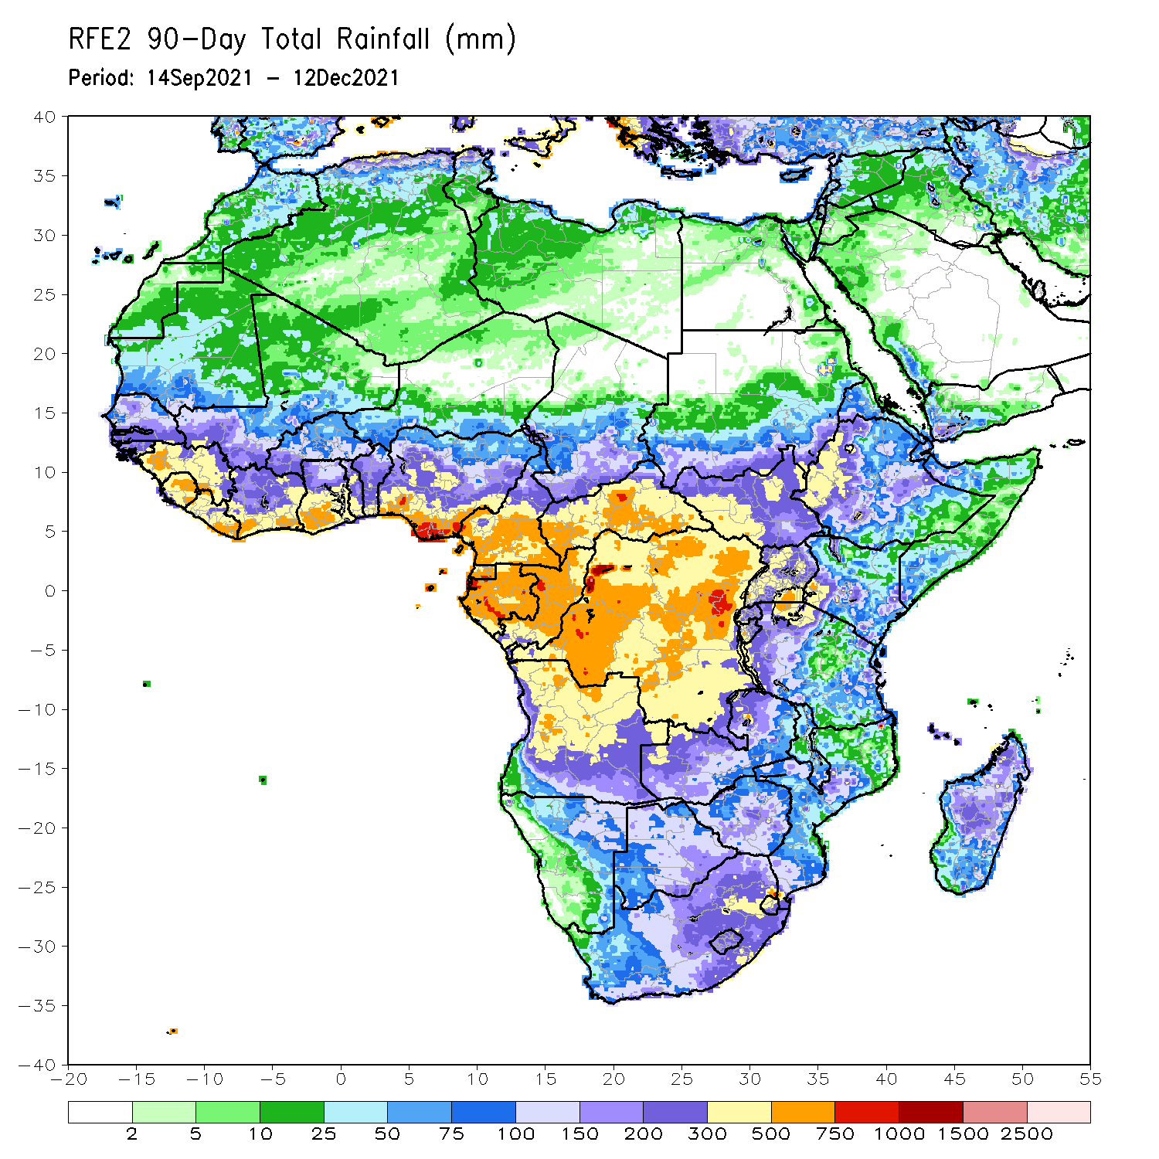
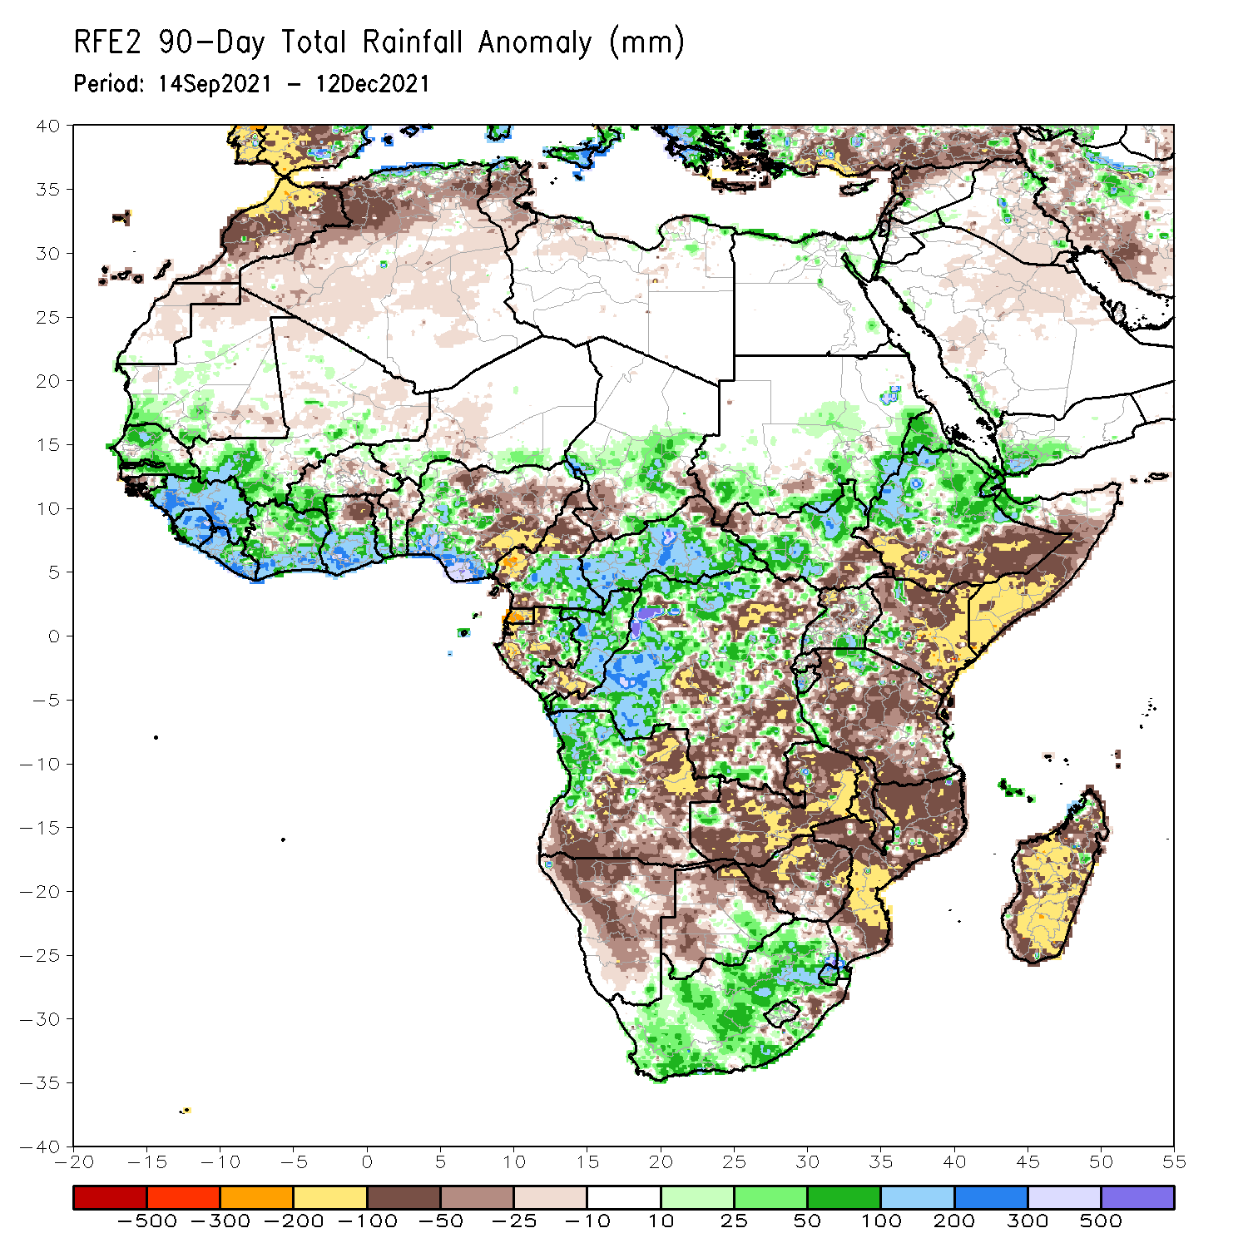
Rainfall Patterns: Last 90 Days
Over the past 90 days, in East Africa, above-average rainfall was observed over central and northern Ethiopia, Eritrea, much of South Sudan, and southern and eastern Sudan. Rainfall was below-average over the far southern Ethiopia, much of Somalia and Kenya, and many parts of Uganda and Tanzania. In southern Africa, above-average rainfall was observed over northern Angola, pockets of Zambia, and much of South Africa. Below-average rainfall was observed over central and southern of Angola, Zambia, much of Namibia, Botswana, Zimbabwe, Mozambique and much of Madagascar. In Central Africa, rainfall was above-average over western and northern DRC, eastern Gabon, Congo, much of CAR, and southeastern Chad. Rainfall was below-average over portions of central and eastern DRC, Equatorial Guinea, western Gabon, northern Cameroon and southwestern Chad. In West Africa, rainfall was above-average over much of the Gulf of Guinea region, Senegal, parts of southwestern Mali. Below-average rainfall was observed over southern Burkina Faso, northeastern Ghana, parts of Togo and Benin, and northern and eastern Nigeria.
Notes:
4

Slide 5
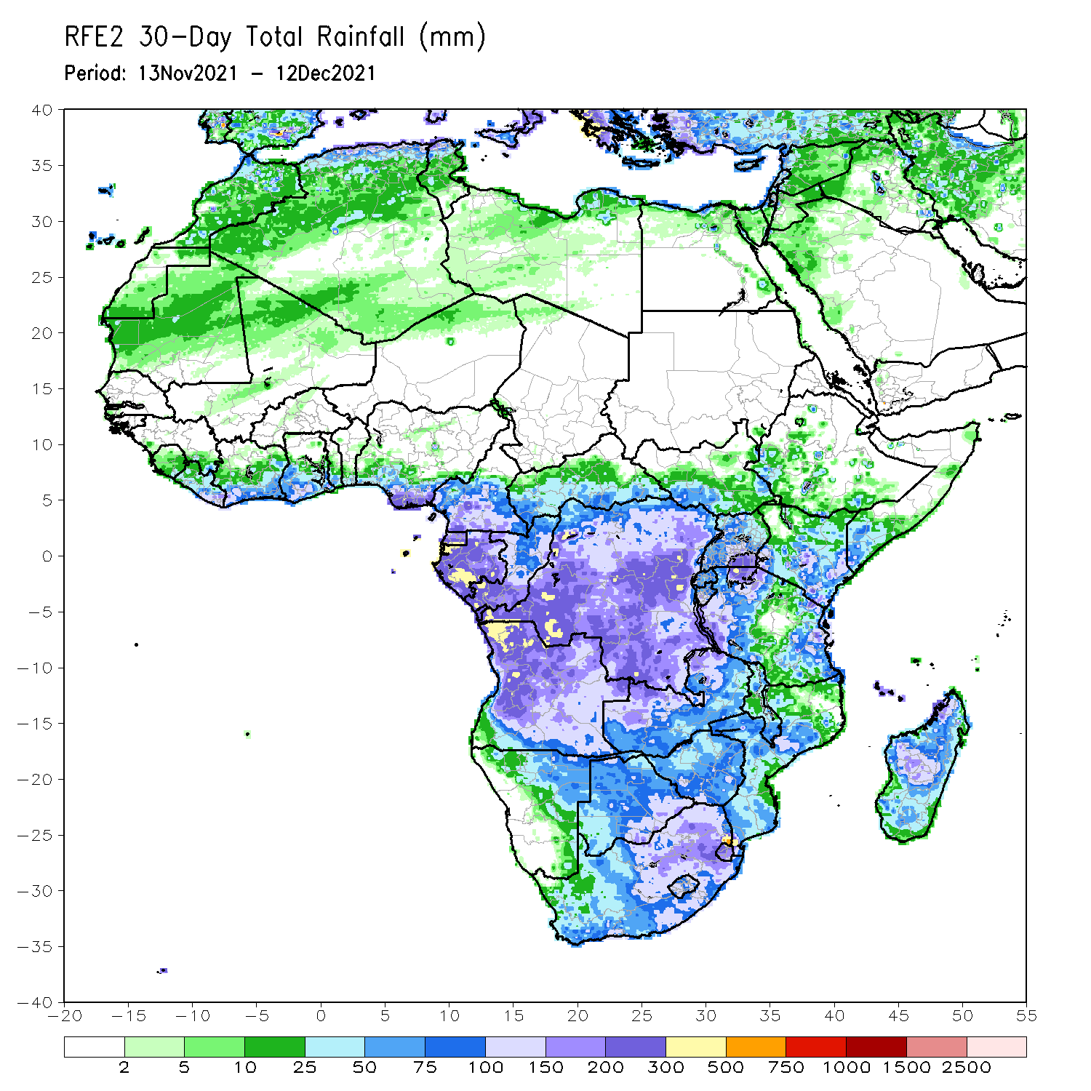
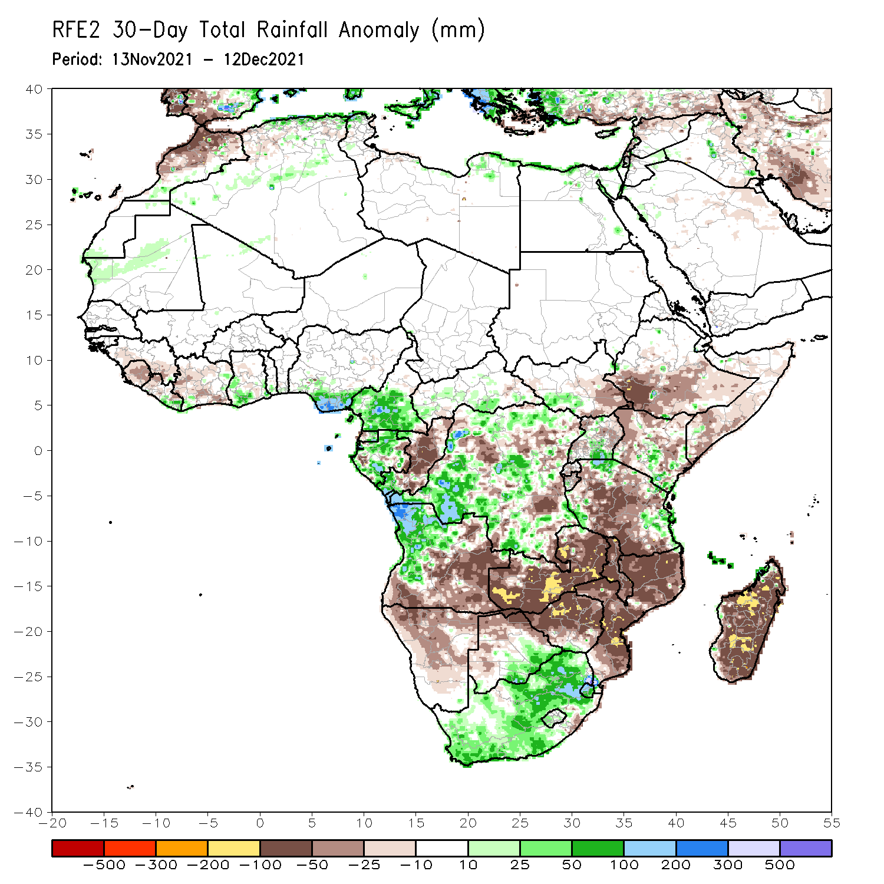
Rainfall Patterns: Last 30 Days
During the past 30 days, in East Africa, above-average rainfall was observed over pockets of Uganda and Kenya. Rainfall was below-average over southern Ethiopia, much of Somalia, Kenya, much of Uganda and much of Tanzania. In Central Africa, rainfall was below-average over portions of DRC and Congo. Rainfall was above-average over portions of Cameroon, Equatorial Guinea, Gabon, much of CAR, and portions of DRC. In West Africa, rainfall was above-average over pocket areas along the Gulf of Guinea coast. Below-average rainfall was observed over the western portions of the Gulf of Guinea region. In Southern Africa, above-average rainfall was observed over portions of northwestern Angola and much of South Africa. Below-average rainfall was observed over southern and eastern Angola, Zambia, Botswana, Zimbabwe, many parts of Mozambique, Malawi, and much of Madagascar.
Notes:
5

Slide 6
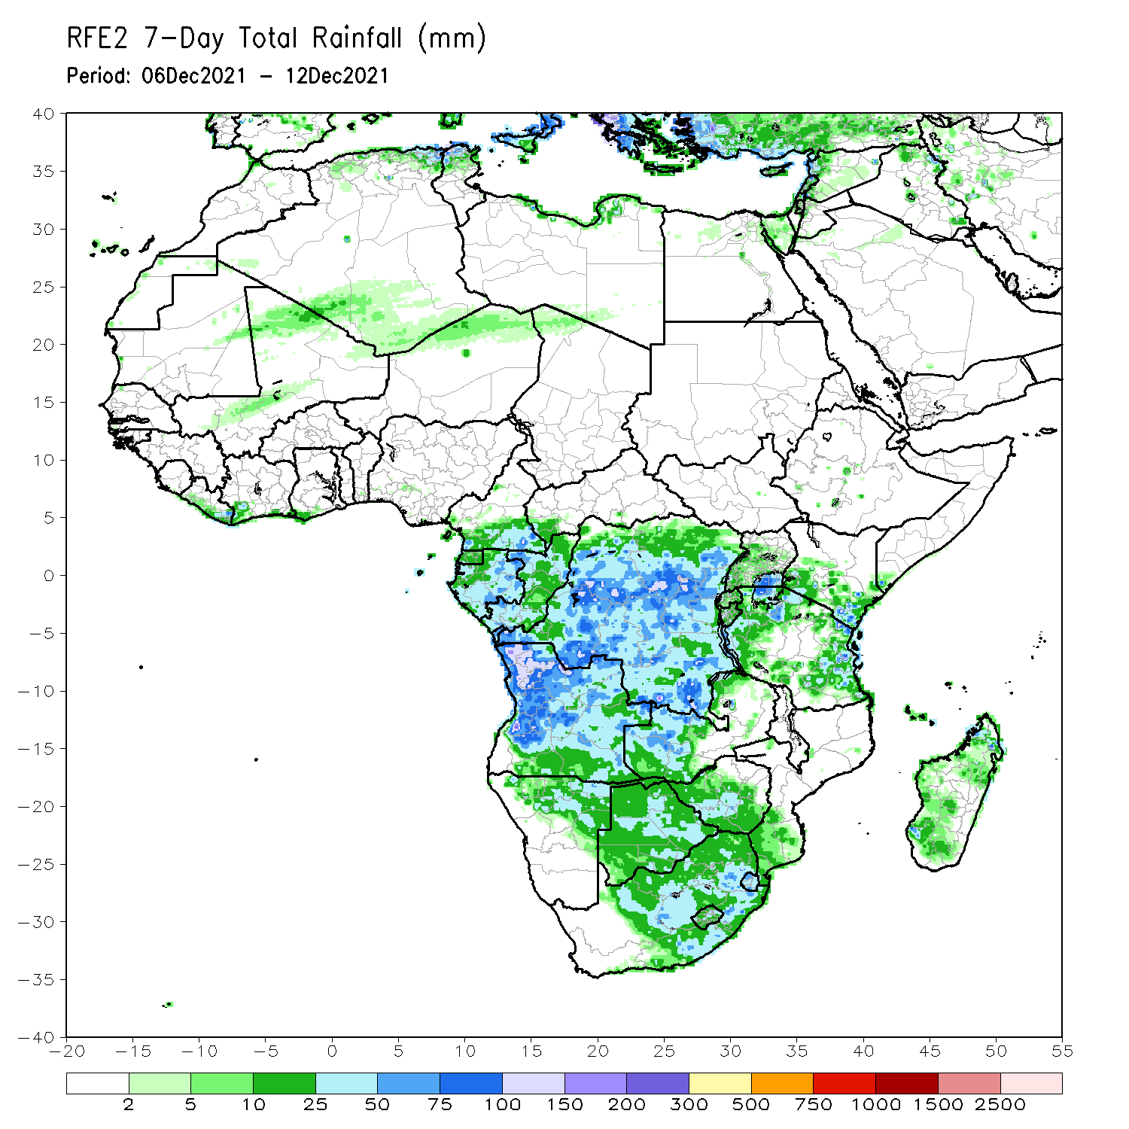
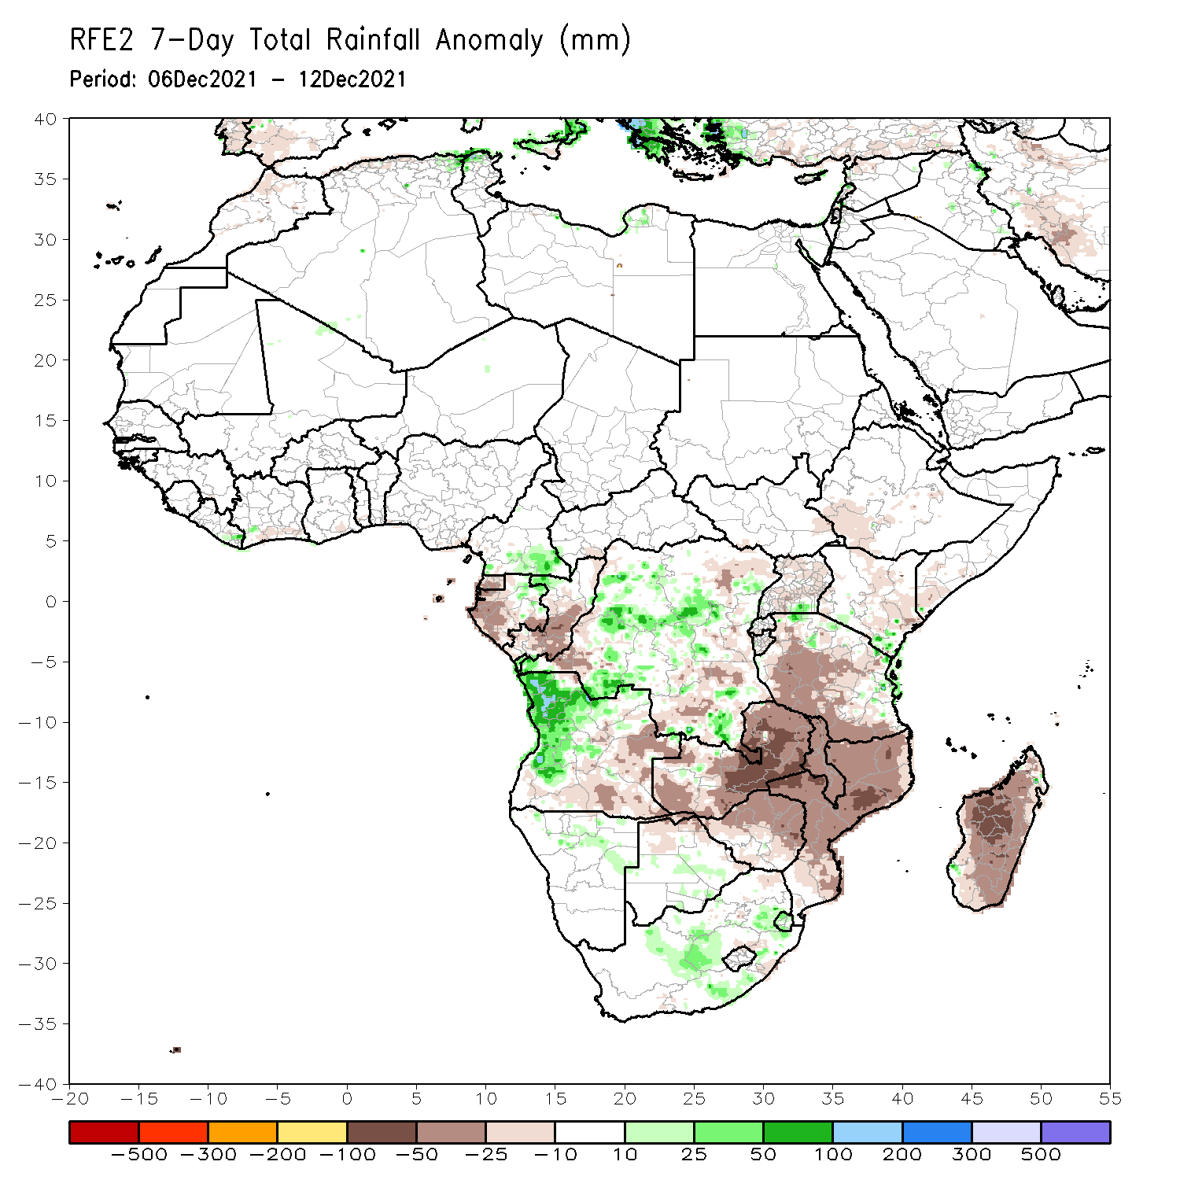
Rainfall Patterns: Last 7 Days
During the past 7 days, in East Africa, rainfall was below-average over parts of southwestern Ethiopia, portions of Somalia and Kenya, and many parts of Tanzania. Above-average rainfall was observed along coastal Tanzania. In Central Africa, rainfall was above-average over southern Cameroon, the far northern Gabon, and portions of DRC. Rainfall was below-average over Congo and pockets of DRC. In Southern Africa, rainfall was above-average over western and northern Angola and pockets of South Africa. Below-average rainfall was observed over eastern Angola, much of Zambia, Malawi, Zimbabwe, Mozambique and Madagascar.

Slide 7
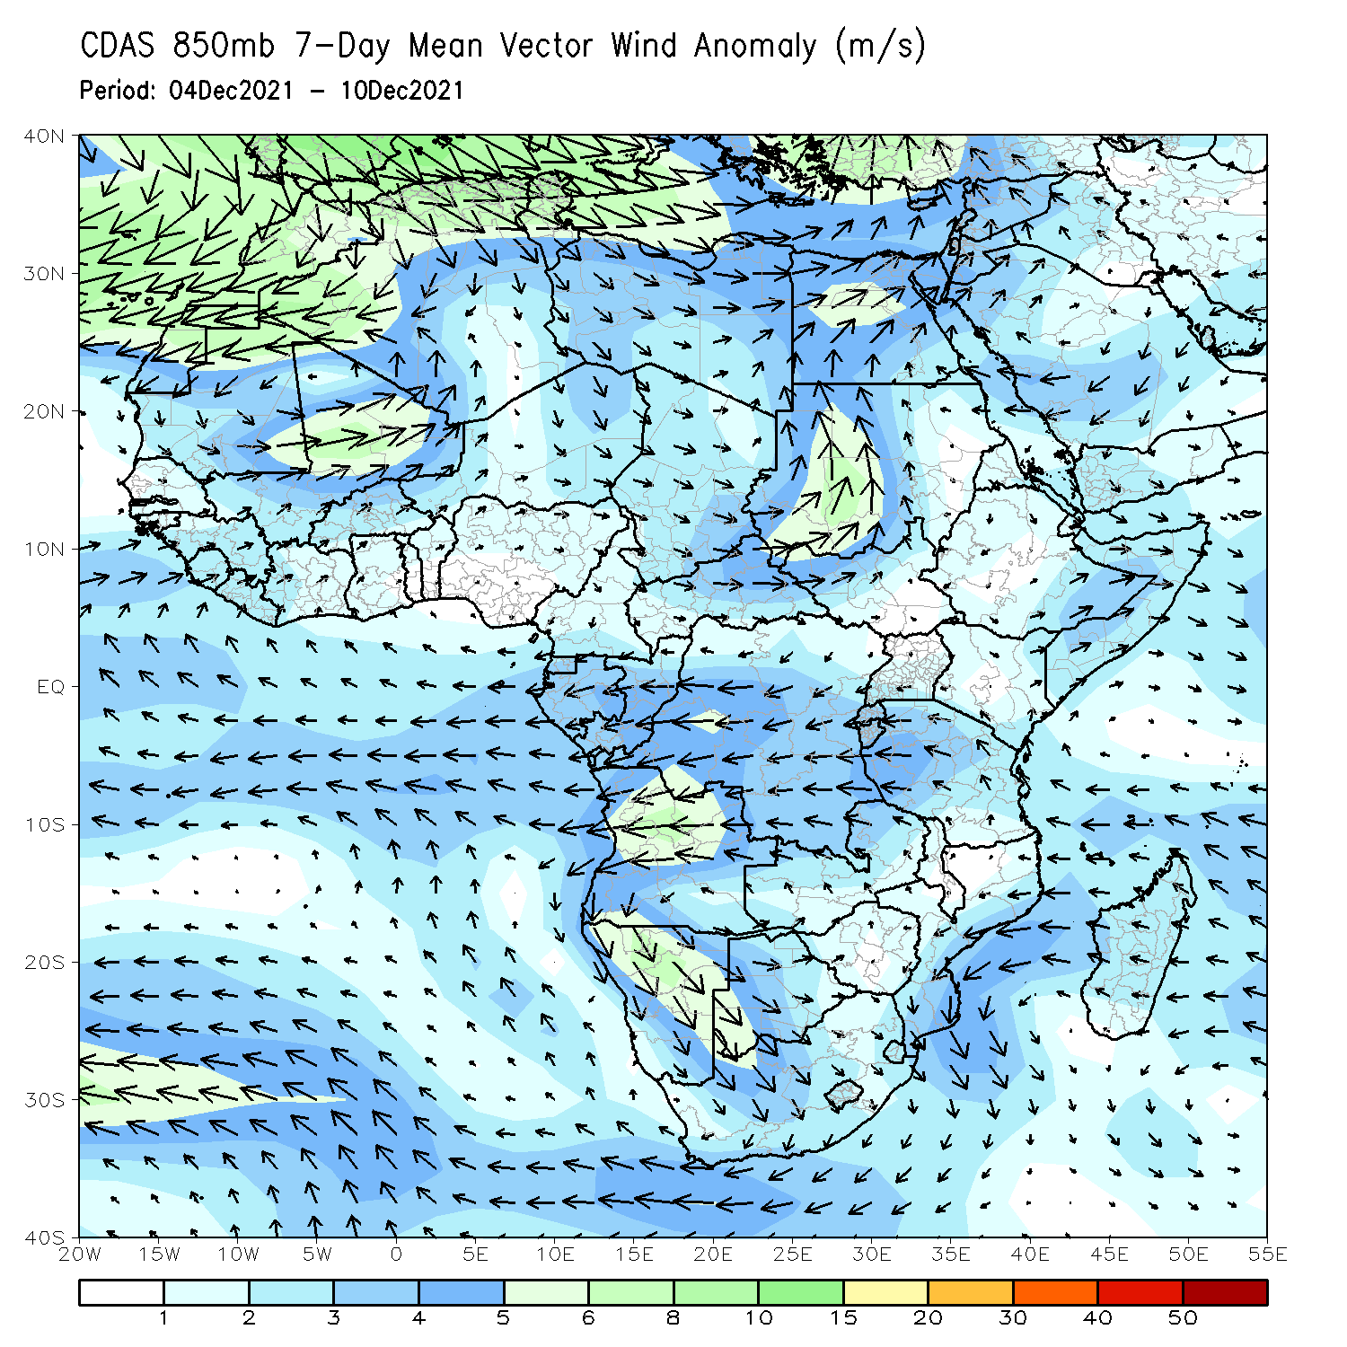
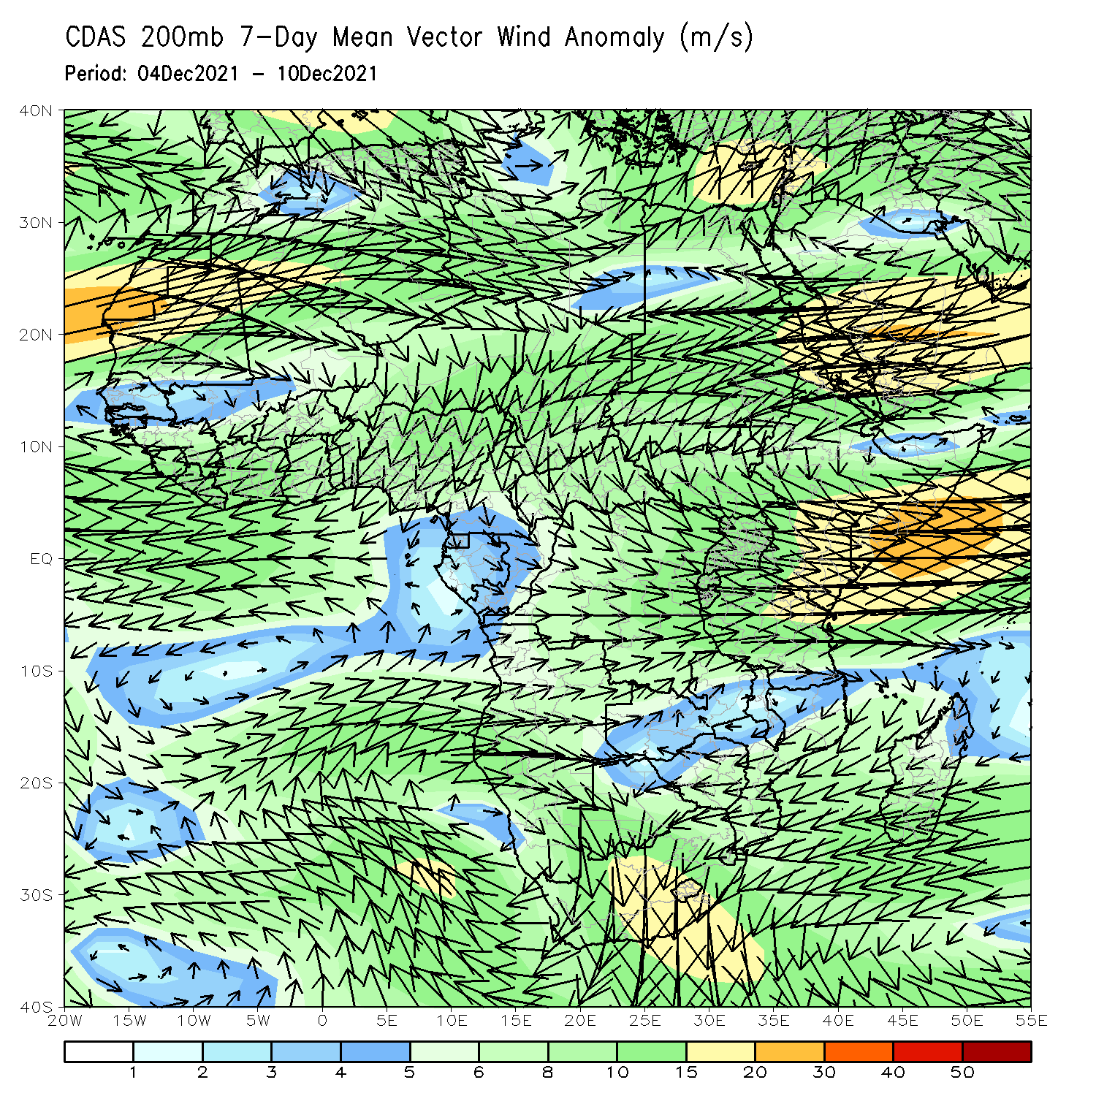
Atmospheric Circulation: Last 7 Days
At 850-hPa level (left panel), anomalous anticyclonic flow prevailed across portions of Southern Africa.

Slide 8
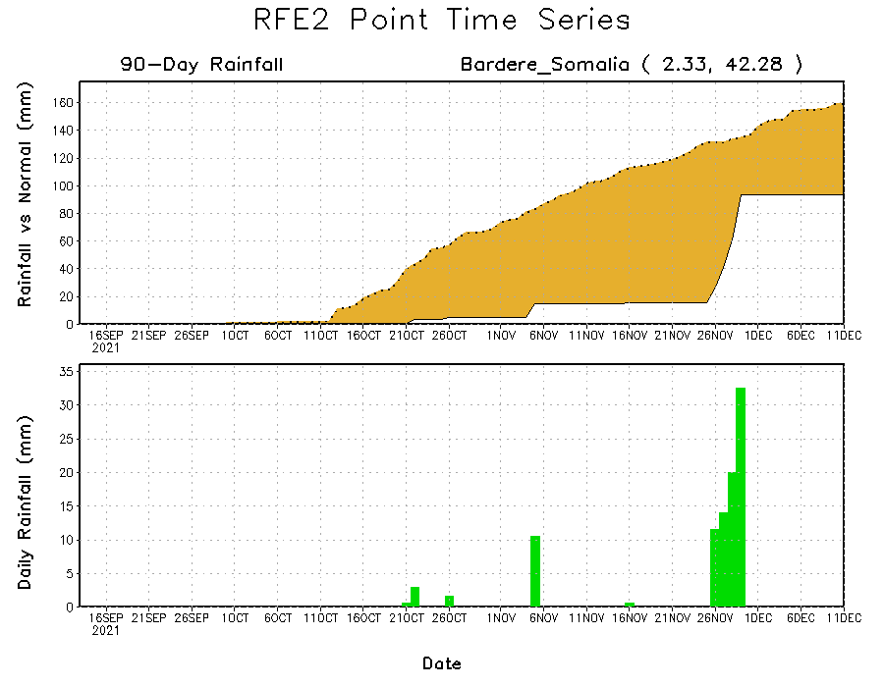
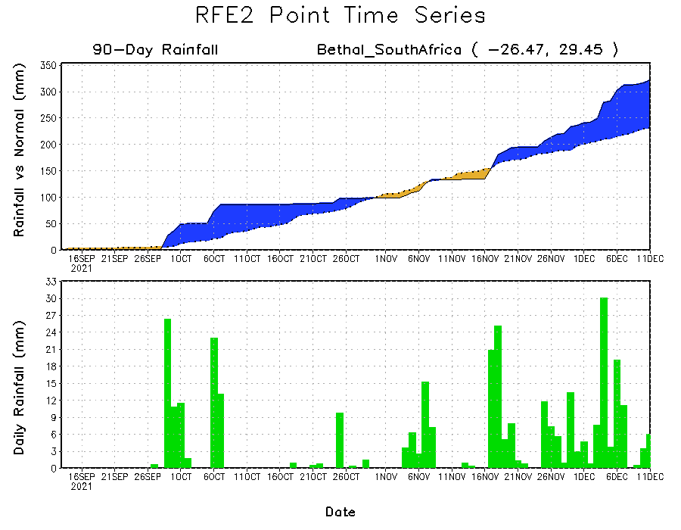
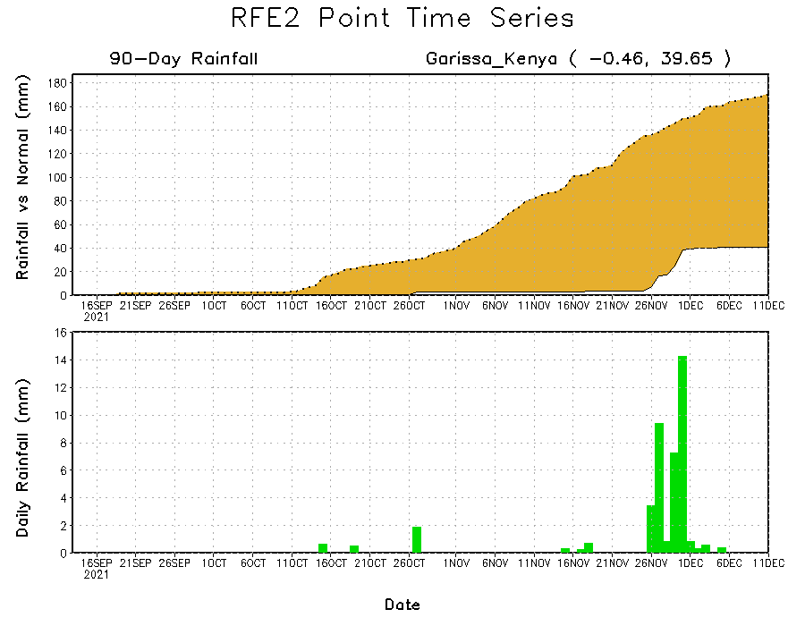
Rainfall Evolution
Daily evolution of rainfall over the last 90 days at selected locations shows moderate sustained moisture surpluses over parts of eastern South Africa (bottom left). The seasonal total rainfall remained below-average over many parts of Somalia (top right) and Kenya (bottom right).

Slide 9
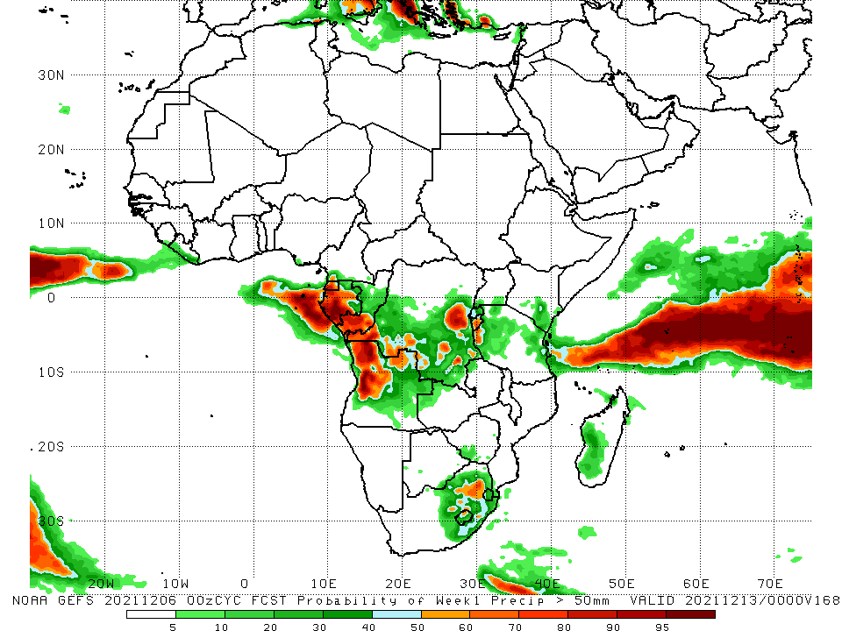
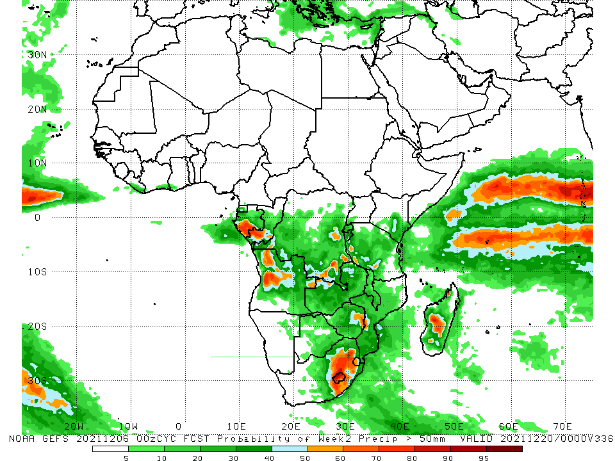
NCEP GEFS Model Forecasts Non-Bias Corrected Probability of precipitation exceedance
Week-1, Valid: 14 – 20 December, 2021
Week-2, Valid: 21 – 27 December, 2021
For week-1 (left panel), week-2 (right panel), the NCEP GEFS indicates a moderate to high chance (over 70%) for rainfall to exceed 50 mm over parts of Gabon, southern Congo, northern Angola, parts of southern and eastern DRC, western Tanzania and eastern South Africa.
Notes:
9

Slide 10
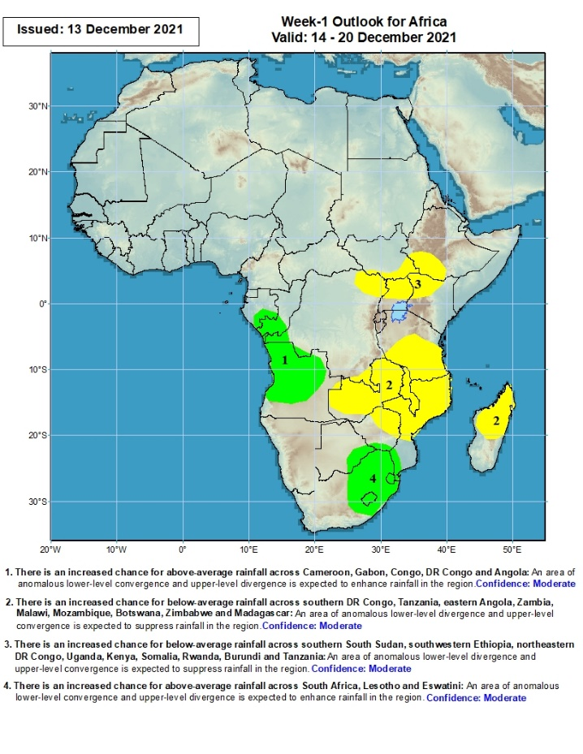
Week-1 Precipitation Outlooks
14 – 20 December, 2021
There is an increased chance for above-average rainfall across southern Gabon, Congo, western DR Congo and Angola: An area of anomalous lower-level convergence and upper-level divergence is expected to enhance rainfall in the region. Confidence: Moderate
There is an increased chance for below-average rainfall across southern DR Congo Tanzania, Zambia, Malawi, Mozambique, Zimbabwe and Madagascar: An area of anomalous lower-level divergence and upper-level convergence is expected to suppress rainfall in the region. Confidence: Moderate
There is an increased chance for below-average rainfall across southern South Sudan, southwestern Ethiopia, northeastern DR Congo, Uganda and Kenya: An area of anomalous lower-level divergence and upper-level convergence is expected to suppress rainfall in the region. Confidence: Moderate
There is an increased chance for above-average rainfall across southern Botswana, Zimbabwe, Mozambique, South Africa, Lesotho and Eswatini: An area of anomalous lower-level convergence and upper-level divergence is expected to enhance rainfall in the region. Confidence: Moderate
Notes:
10

Slide 11
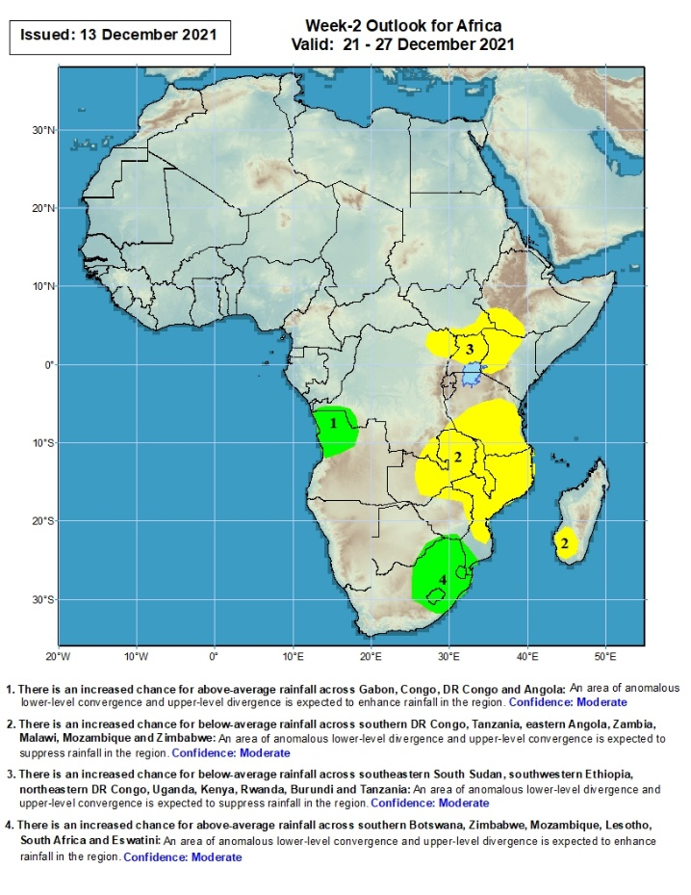
Week-2 Precipitation Outlooks
21 – 27 Dec, 2021
There is an increased chance for above-average rainfall across western DR Congo and Angola: An area of anomalous lower-level convergence and upper-level divergence is expected to enhance rainfall in the region. Confidence: Moderate
There is an increased chance for below-average rainfall across southern DR Congo Tanzania, Zambia, Malawi, Mozambique, Zimbabwe and southwestern Madagascar: An area of anomalous lower-level divergence and upper-level convergence is expected to suppress rainfall in the region. Confidence: Moderate
There is an increased chance for below-average rainfall across southern South Sudan, southwestern Ethiopia, northeastern DR Congo, Uganda and Kenya: An area of anomalous lower-level divergence and upper-level convergence is expected to suppress rainfall in the region. Confidence: Moderate
There is an increased chance for above-average rainfall across South Africa, Lesotho, Eswatini and southern Mozambique: An area of anomalous lower-level convergence and upper-level divergence is expected to enhance rainfall in the region. Confidence: Moderate
Notes:
11

Slide 12
Summary
During the past 30 days, in East Africa, above-average rainfall was observed over pockets of Uganda and Kenya. Rainfall was below-average over southern Ethiopia, much of Somalia, Kenya, much of Uganda and much of Tanzania. In Central Africa, rainfall was below-average over portions of DRC and Congo. Rainfall was above-average over portions of Cameroon, Equatorial Guinea, Gabon, much of CAR, and portions of DRC. In West Africa, rainfall was above-average over pocket areas along the Gulf of Guinea coast. Below-average rainfall was observed over the western portions of the Gulf of Guinea region. In Southern Africa, above-average rainfall was observed over portions of northwestern Angola and much of South Africa. Below-average rainfall was observed over southern and eastern Angola, Zambia, Botswana, Zimbabwe, many parts of Mozambique, Malawi, and much of Madagascar.
During the past 7 days, in East Africa, rainfall was below-average over parts of southwestern Ethiopia, portions of Somalia and Kenya, and many parts of Tanzania. Above-average rainfall was observed along coastal Tanzania. In Central Africa, rainfall was above-average over southern Cameroon, the far northern Gabon, and portions of DRC. Rainfall was below-average over Congo and pockets of DRC. In Southern Africa, rainfall was above-average over western and northern Angola and pockets of South Africa. Below-average rainfall was observed over eastern Angola, much of Zambia, Malawi, Zimbabwe, Mozambique and Madagascar.
Week-1 and week-2 outlooks call for an increased chance for below-average rainfall in the Lake Victoria region, and the northeastern portions of Southern Africa and Madagascar. In contrast, the outlooks call for an increased chance for above-average rainfall over the western portions of Central Africa, and eastern South Africa.

