Slide 1
The African Monsoon Recent Evolution and Current Status Include Week-1 and Week-2 Outlooks
Update prepared by
06 December 2021
For more information, visit:
http://www.cpc.ncep.noaa.gov/products/Global_Monsoons/African_Monsoons/precip_monitoring.shtml

Slide 2
Outline
Highlights
Recent Evolution and Current Conditions
NCEP GEFS Forecasts
Summary

Slide 3
Highlights: Last 7 Days
During the past 7 days, in East Africa, rainfall was below-average over parts of southwestern Ethiopia and Tanzania. Above-average rainfall was observed over portions of Kenya, and coastal Tanzania. In Central Africa, rainfall was above-average over southern Cameroon, much of Gabon, and portions of DRC. Rainfall was below-average over pockets of DRC. In Southern Africa, rainfall was above-average over many parts of Angola and South Africa. Below-average rainfall was observed over much of Zambia, Malawi, Zimbabwe, Mozambique and Madagascar. In West Africa, above-average rainfall was observed along coastal Nigeria.
Week-1 and week-2 outlooks call for an increased chance for below-average rainfall over much of equatorial East Africa and the northern portions of Southern Africa. In contrast, the outlooks call for an increased chance for above-average rainfall over the western portions of Central Africa, and eastern South Africa.

Slide 4
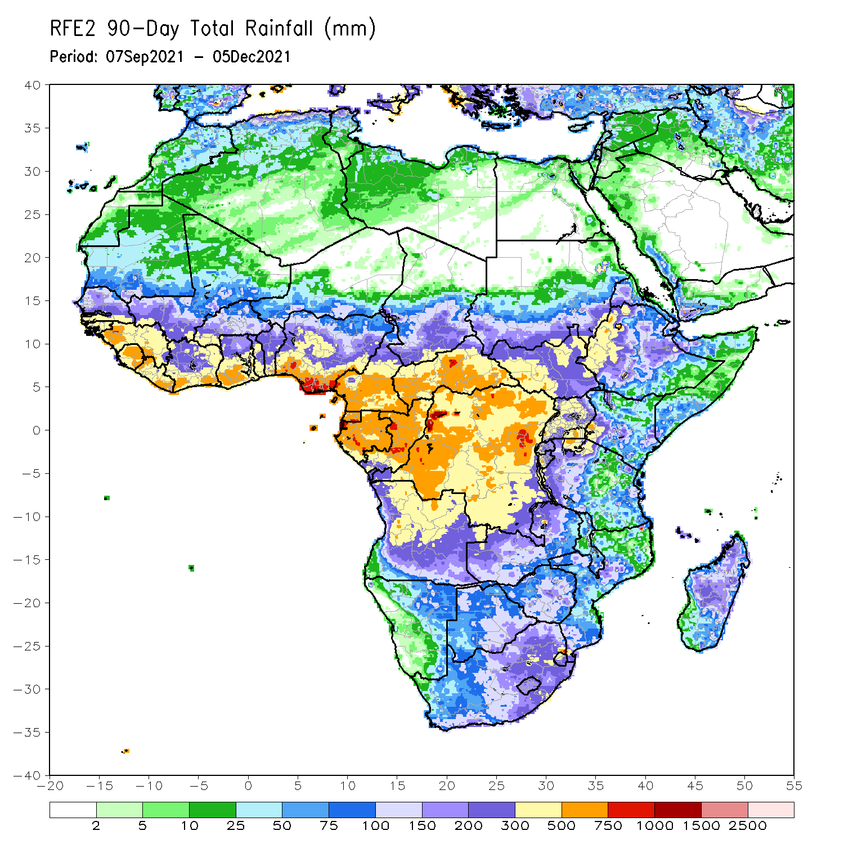
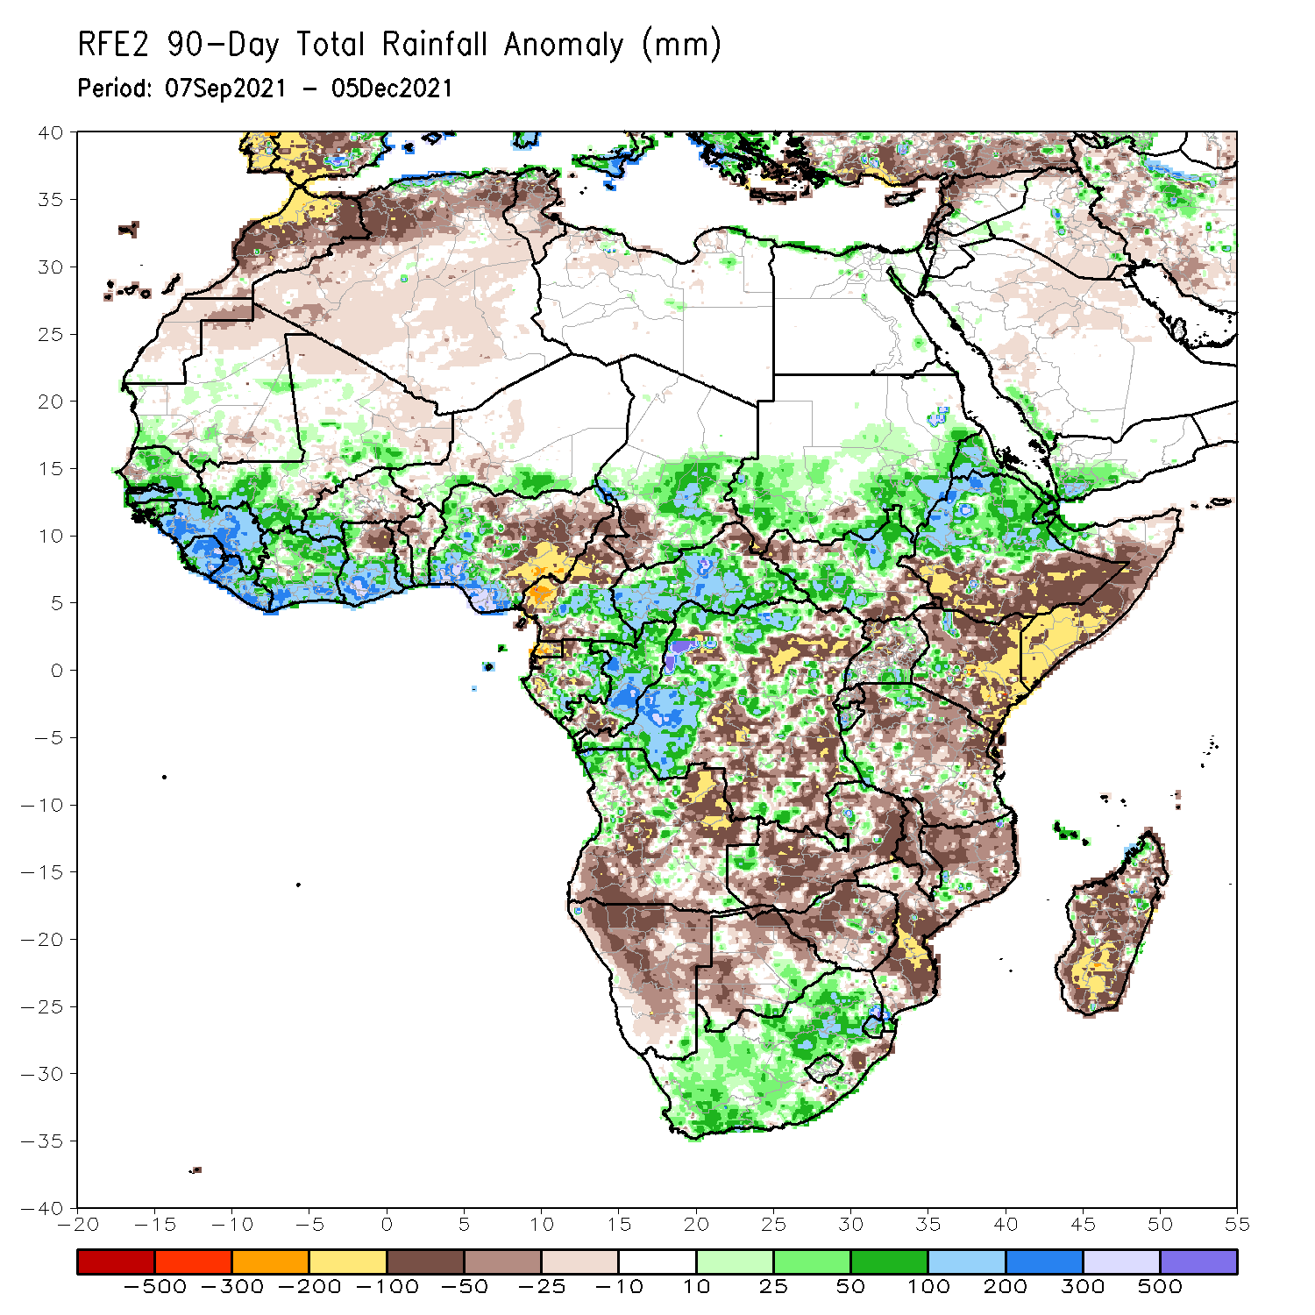
Rainfall Patterns: Last 90 Days
Over the past 90 days, in East Africa, above-average rainfall was observed over central and northern Ethiopia, Eritrea, much of South Sudan, and southern and eastern Sudan. Rainfall was below-average over the far southern Ethiopia, much of Somalia and Kenya, and many parts of Uganda and Tanzania. In southern Africa, above-average rainfall was observed over northern Angola, pockets of Zambia and Mozambique, and much of South Africa. Below-average rainfall was observed over central and southern of Angola, Zambia, much of Namibia, Botswana, Zambia, Mozambique and much of Madagascar. In Central Africa, rainfall was above-average over western and northern DRC, eastern Gabon, Congo, much of CAR, and southeastern Chad. Rainfall was below-average over portions of central and eastern DRC, Equatorial Guinea, western Gabon, northern Cameroon and southwestern Chad. In West Africa, rainfall was above-average over much of the Gulf of Guinea region, Senegal, parts of southwestern Mali. Below-average rainfall was observed over central Mali, southern Burkina Faso, northeastern Ghana, parts of Togo and Benin, and northern and eastern Nigeria.
Notes:
4

Slide 5
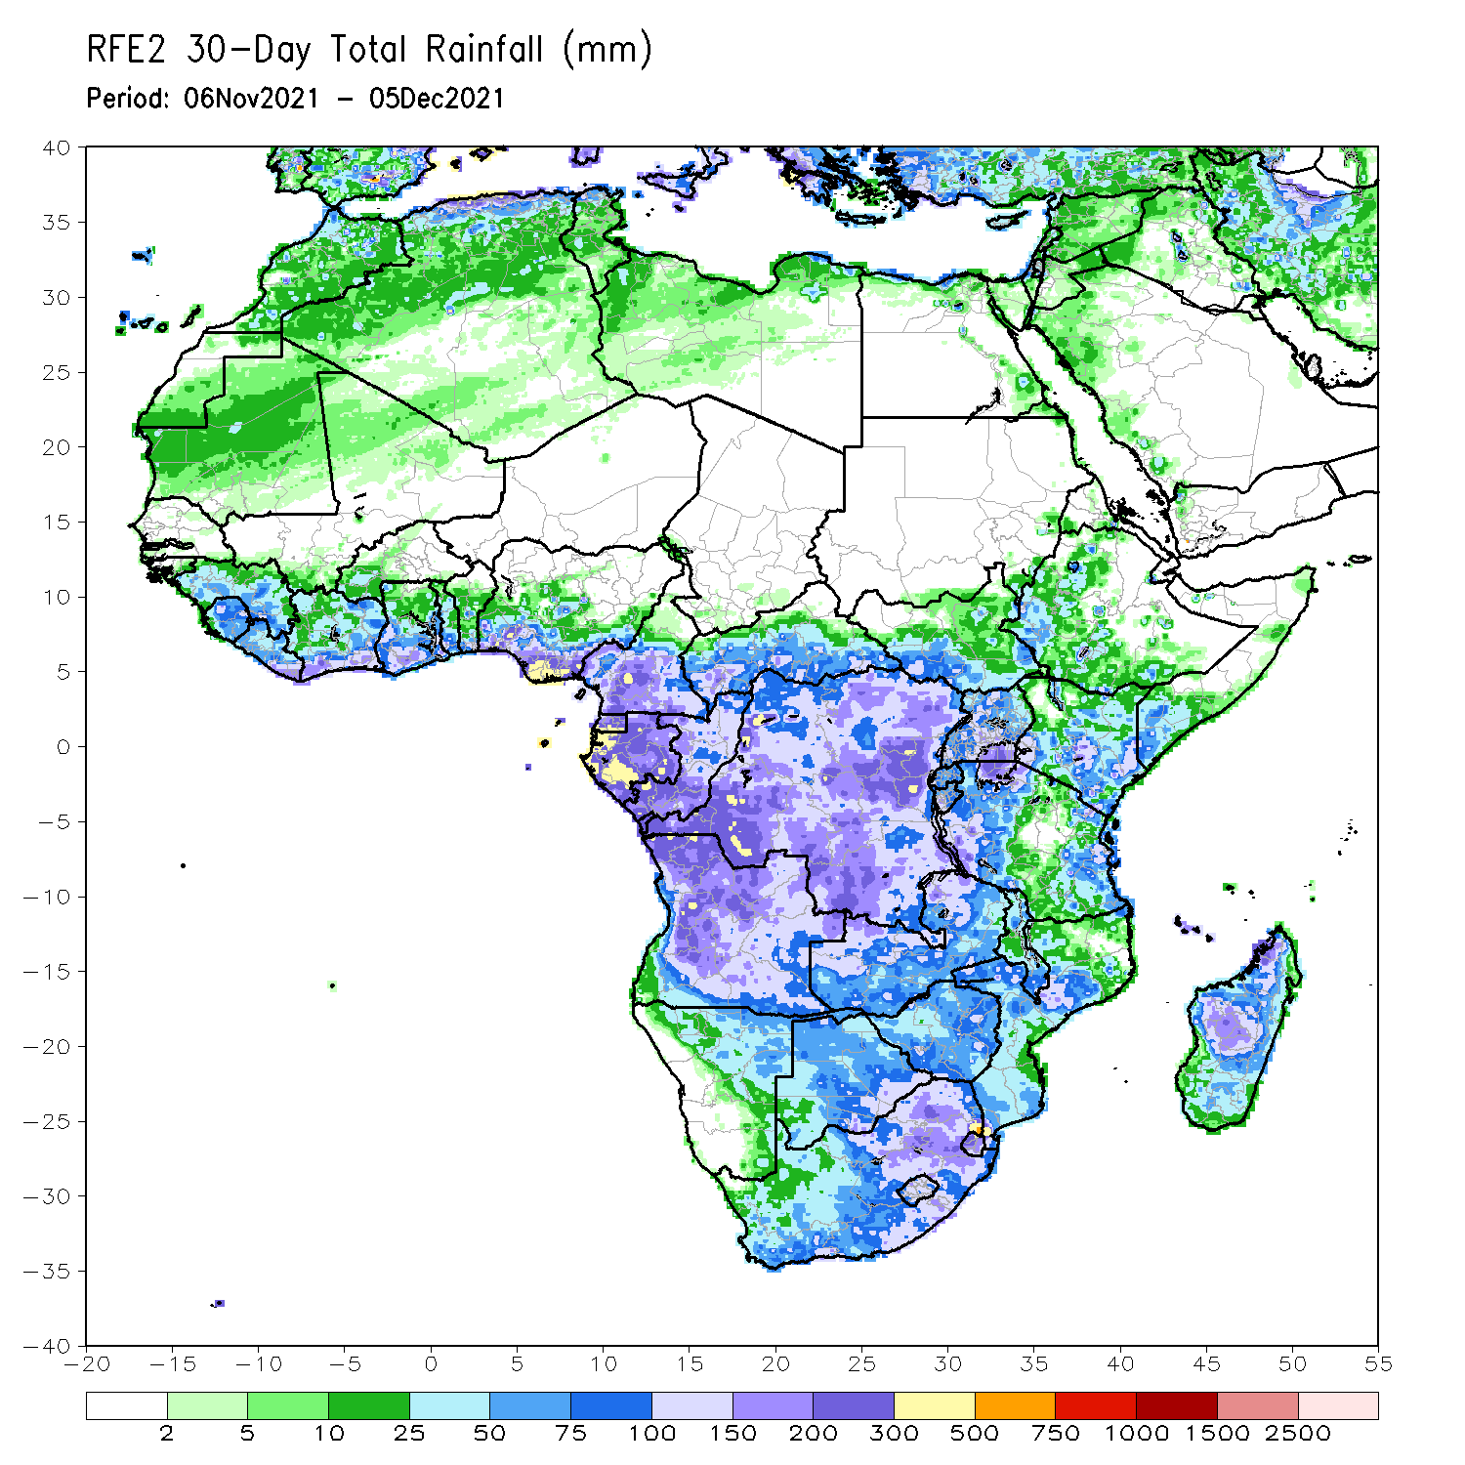
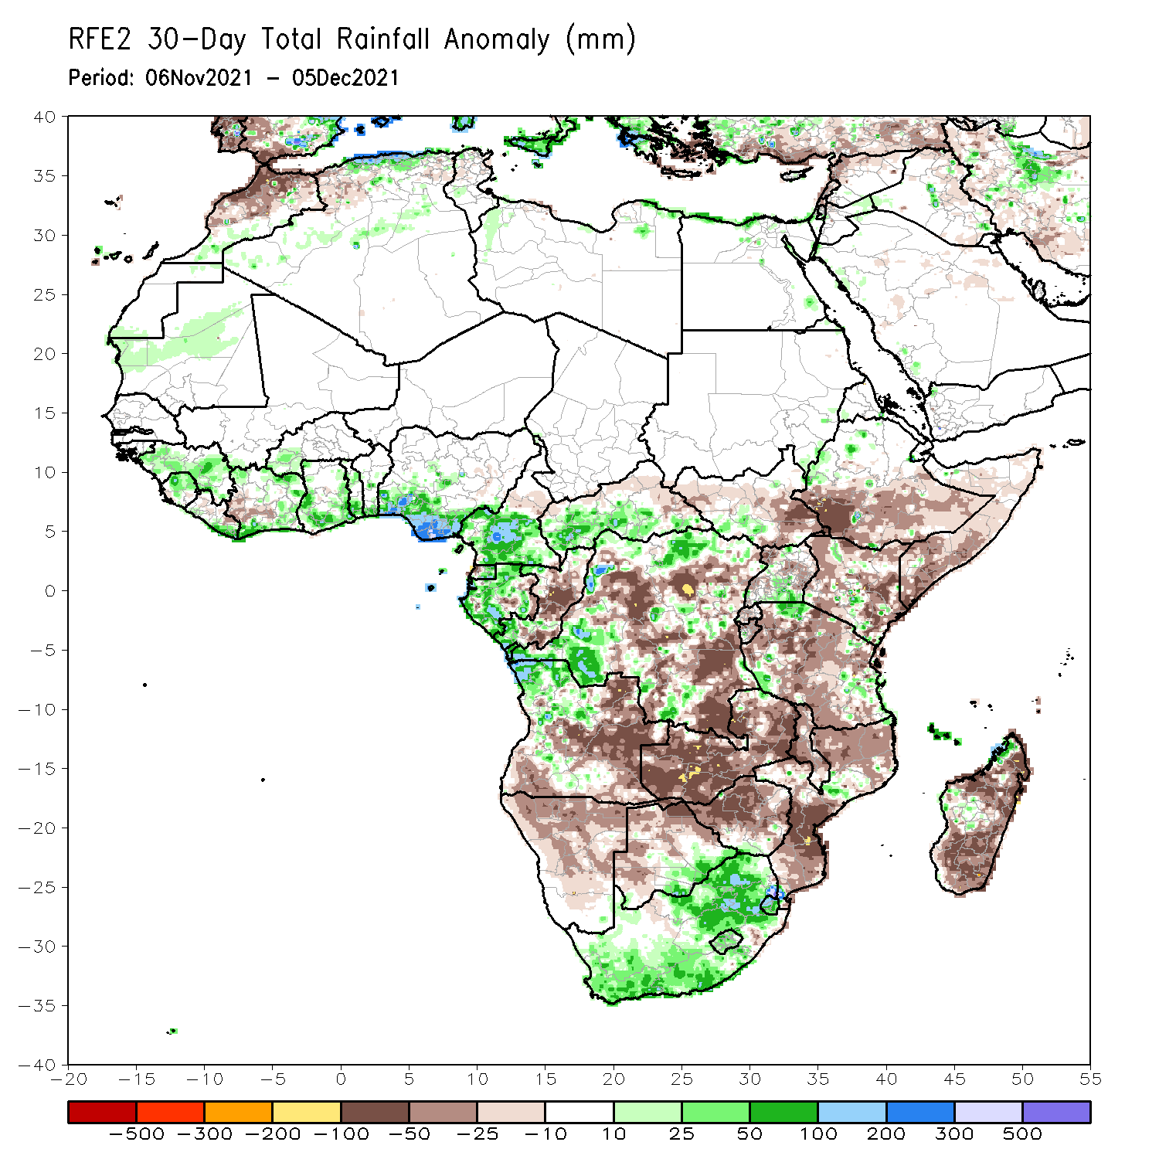
Rainfall Patterns: Last 30 Days
During the past 30 days, in East Africa, above-average rainfall was observed over pockets of western Ethiopia and northern Tanzania. Rainfall was below-average over southern Ethiopia, much of Somalia, Kenya, Uganda and much of Tanzania. In Central Africa, rainfall was below-average over many parts of DRC, Congo, Equatorial Guinea, and pockets of Gabon. Rainfall was above-average over portions of Cameroon, much of CAR, and pockets of DRC. In West Africa, rainfall was above-average over much of the Gulf of Guinea region. Below-average rainfall was observed over pockets of eastern Cote d’Ivoire. In Southern Africa, above-average rainfall was observed over portions of northwestern Angola, much of South Africa, and pockets of Mozambique. Below-average rainfall was observed over southern and eastern Angola, Zambia, Botswana, Zimbabwe, many parts of Mozambique, Malawi, and much of Madagascar.
Notes:
5

Slide 6
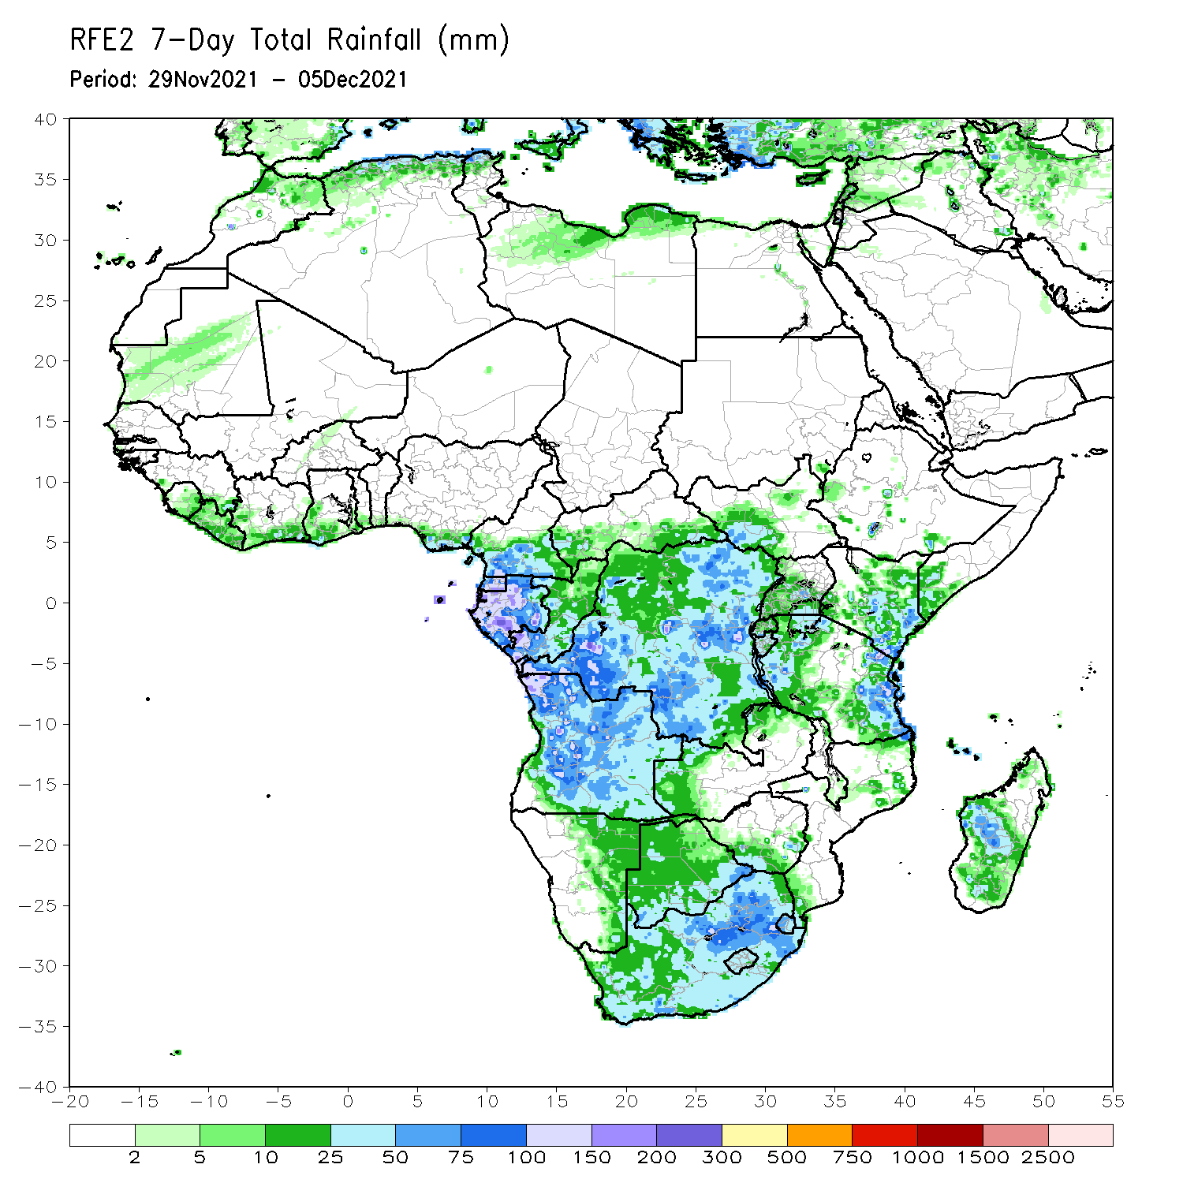
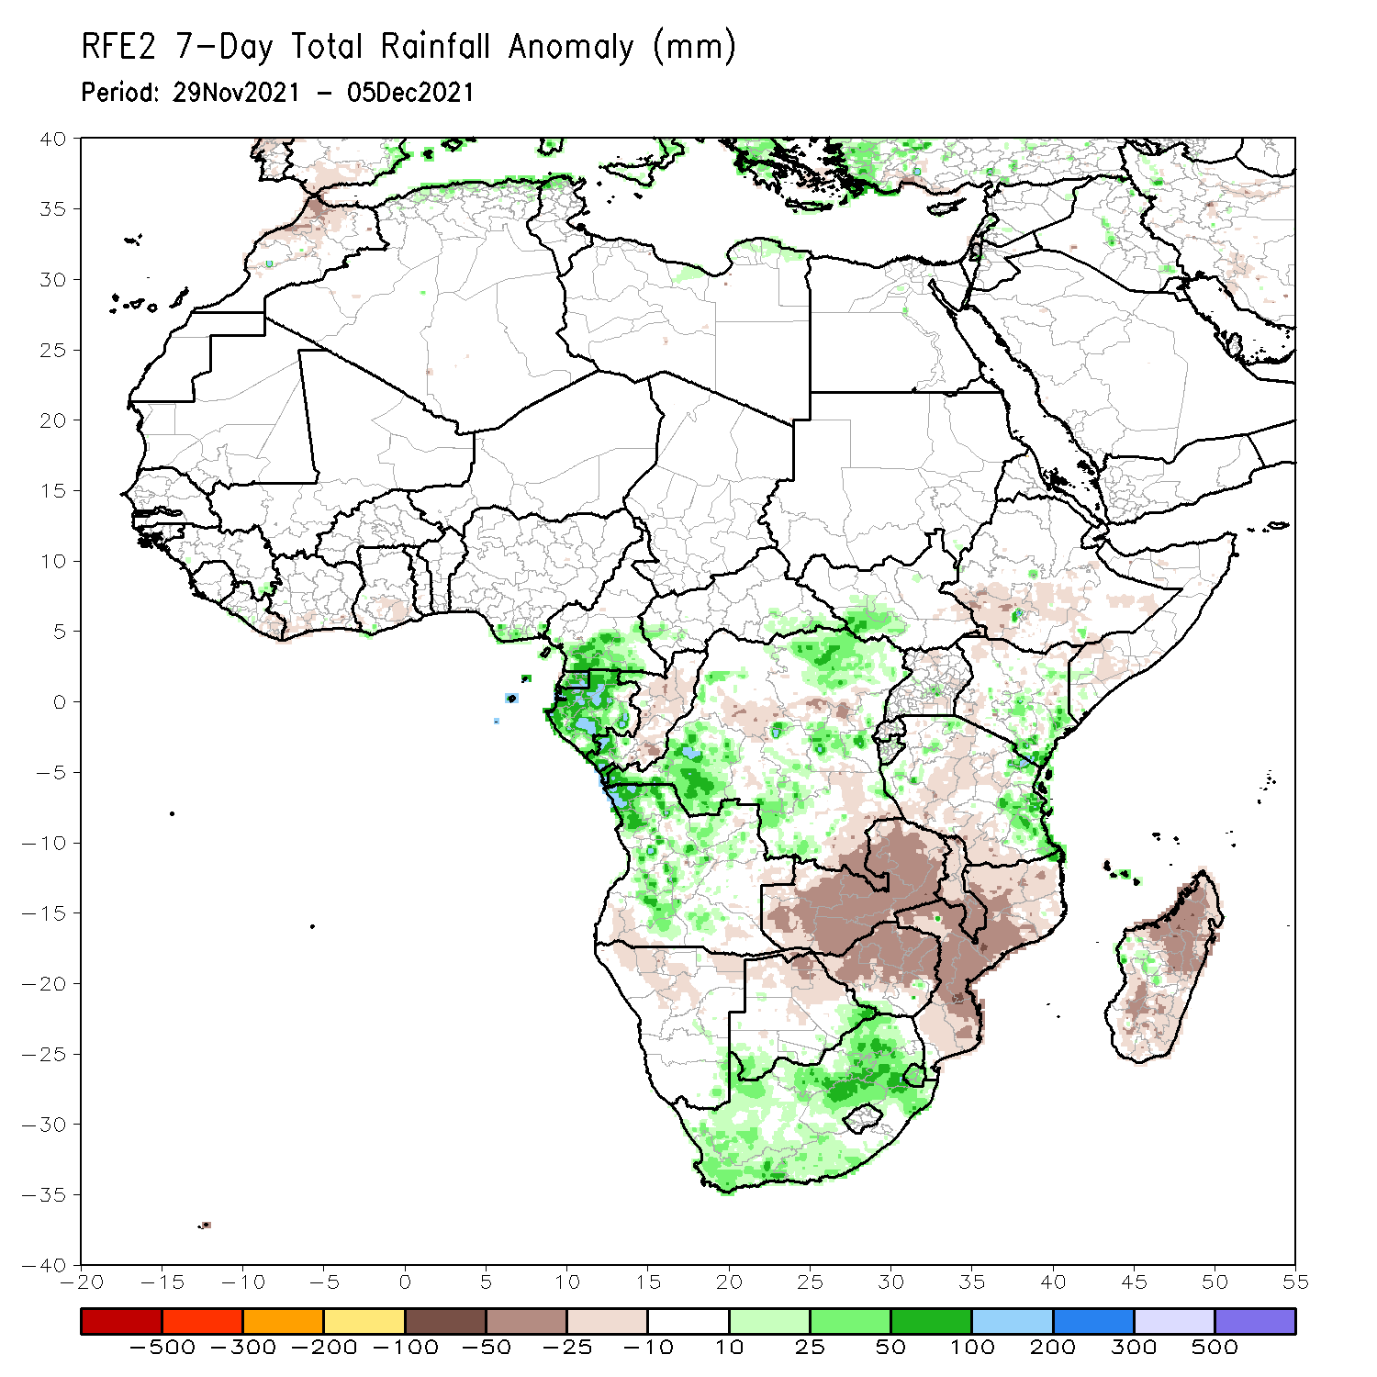
Rainfall Patterns: Last 7 Days
During the past 7 days, in East Africa, rainfall was below-average over parts of southwestern Ethiopia and Tanzania. Above-average rainfall was observed over portions of Kenya, and coastal Tanzania. In Central Africa, rainfall was above-average over southern Cameroon, much of Gabon, and portions of DRC. Rainfall was below-average over pockets of DRC. In Southern Africa, rainfall was above-average over many parts of Angola and South Africa. Below-average rainfall was observed over much of Zambia, Malawi, Zimbabwe, Mozambique and Madagascar. In West Africa, above-average rainfall was observed along coastal Nigeria.

Slide 7
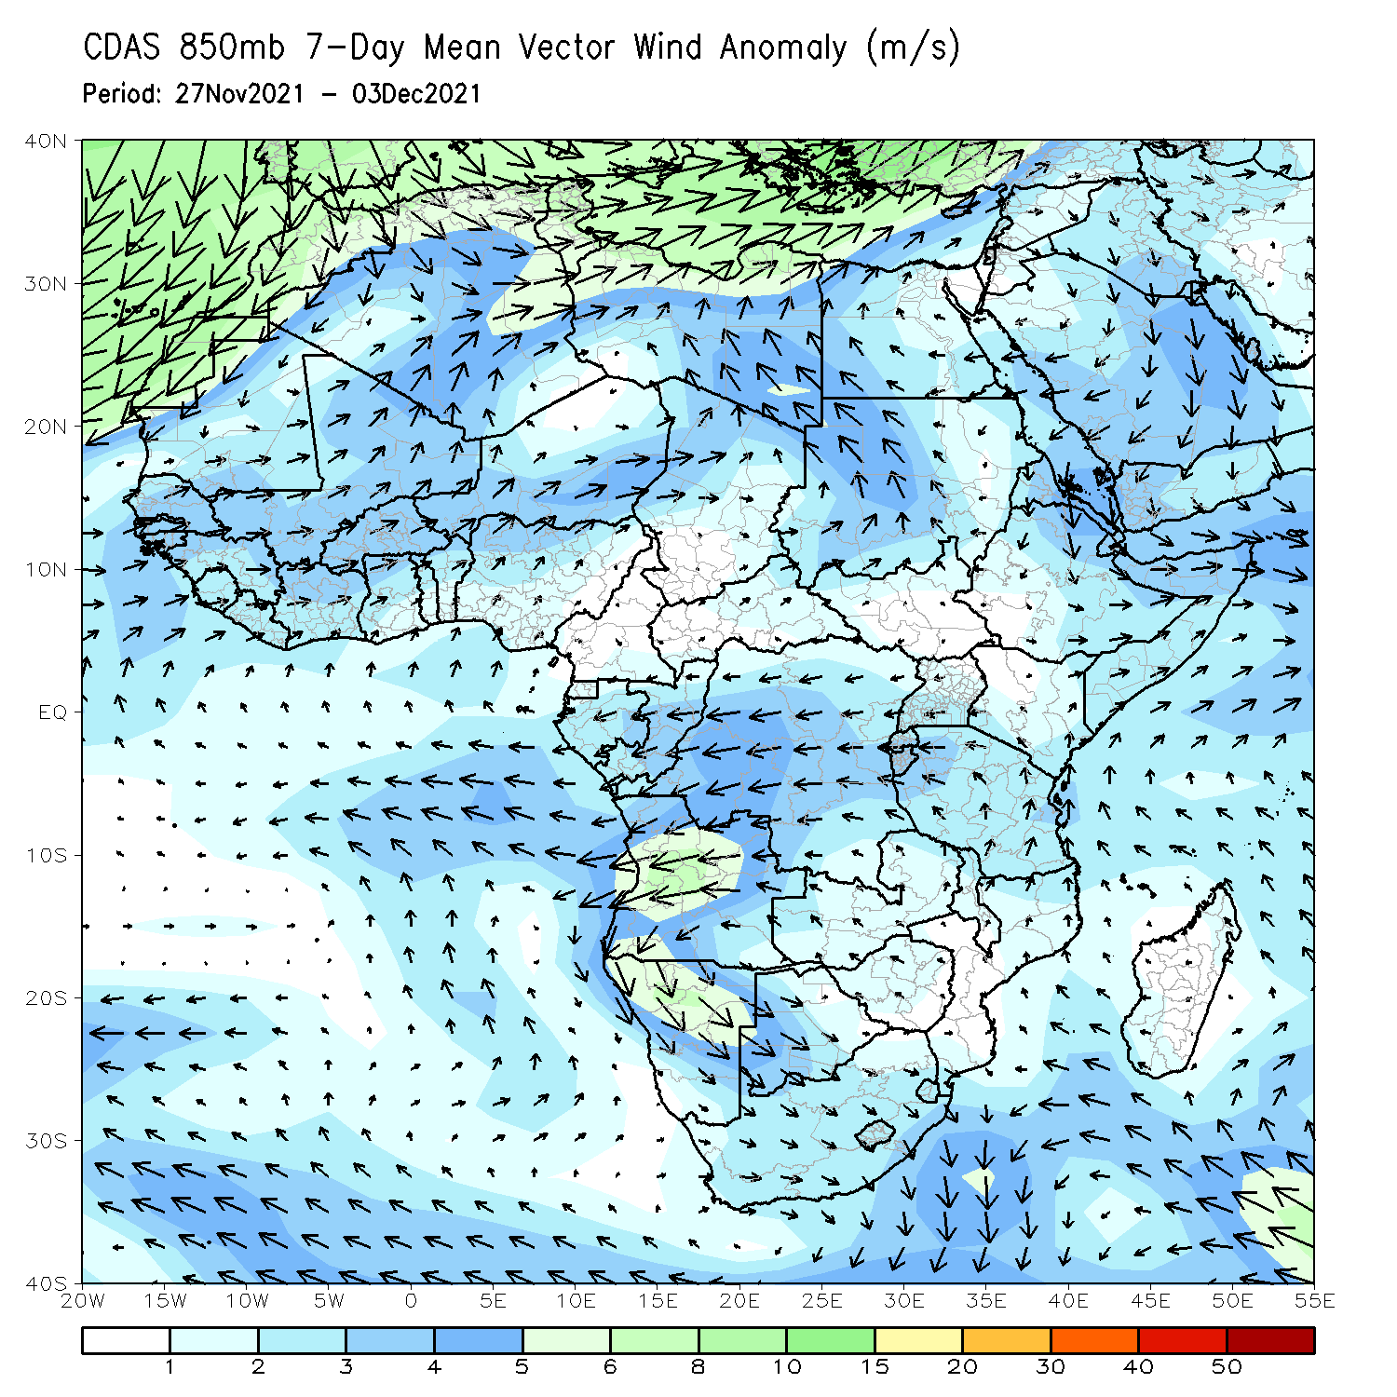
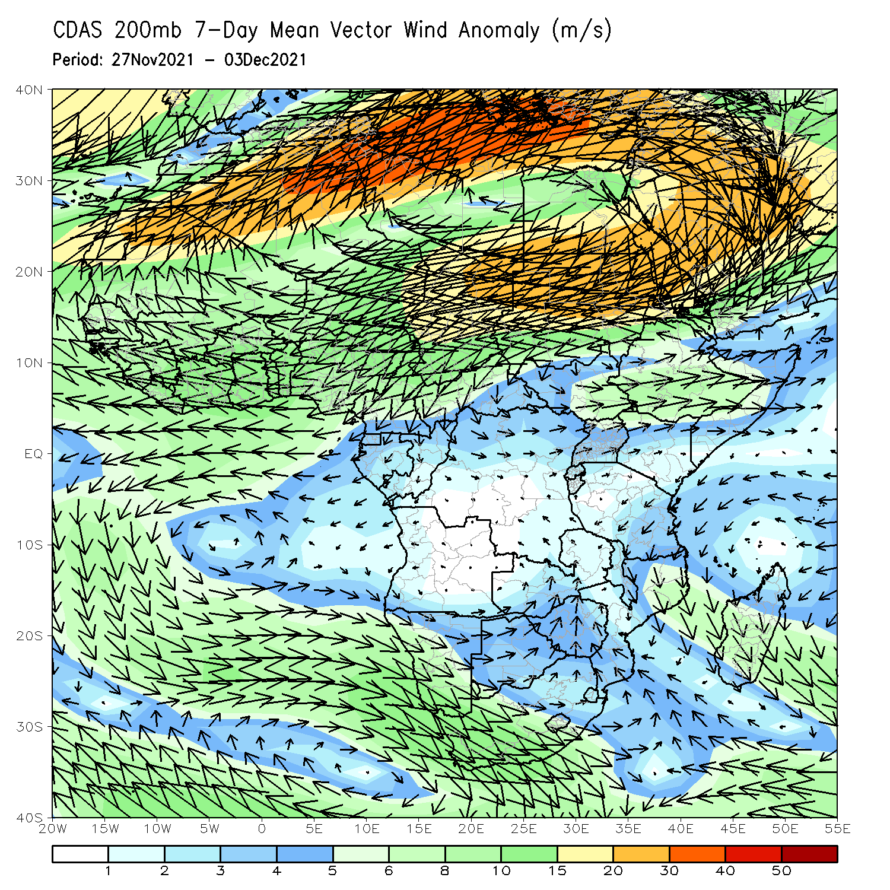
Atmospheric Circulation: Last 7 Days
At 850-hPa level (left panel), anomalous anticyclonic flow prevailed across portions of Southern Africa.

Slide 8
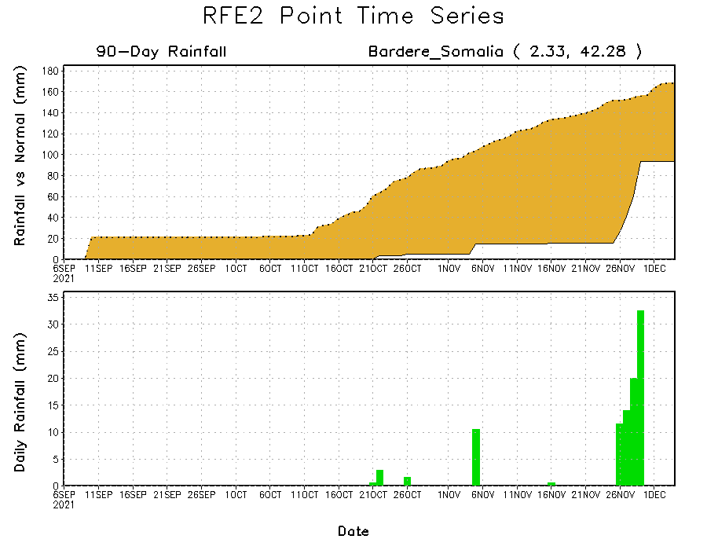
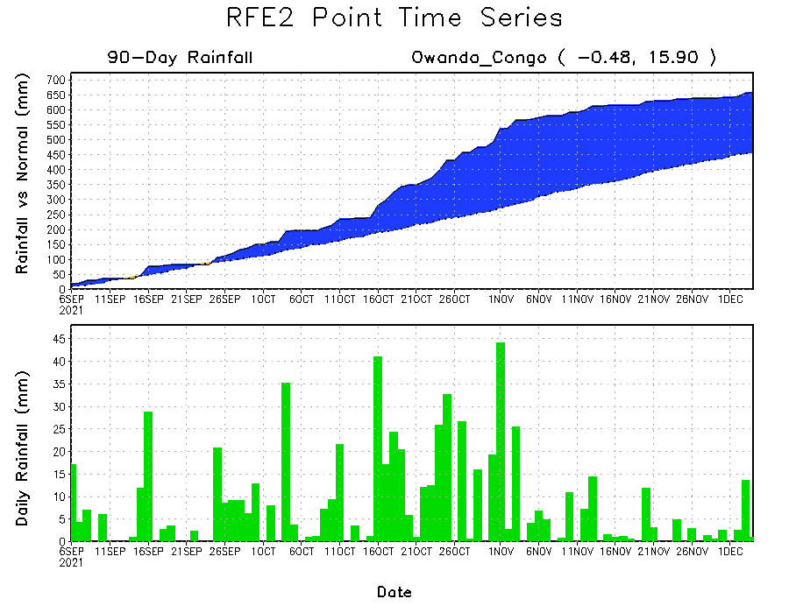
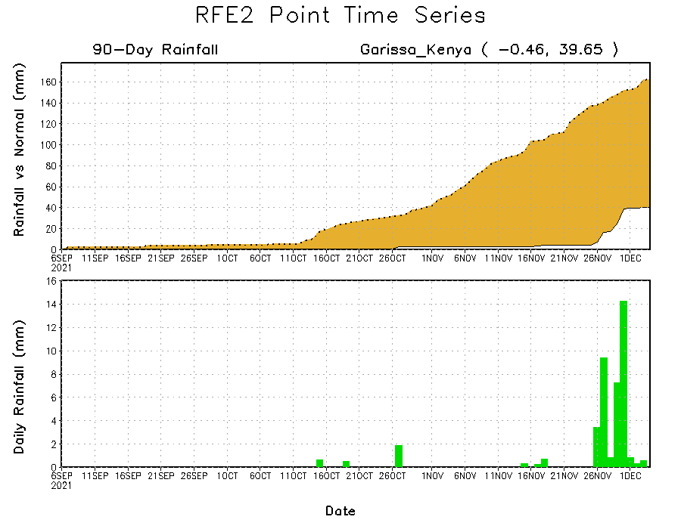
Rainfall Evolution
Daily evolution of rainfall over the last 90 days at selected locations shows moderate sustained moisture surpluses over parts of Congo (bottom left). Light to moderate rainfall has helped to erode accumulated rainfall deficits over parts of East Africa, However, the seasonal total rainfall remained below-average over many parts of Somalia (top right) and Kenya (bottom right).

Slide 9
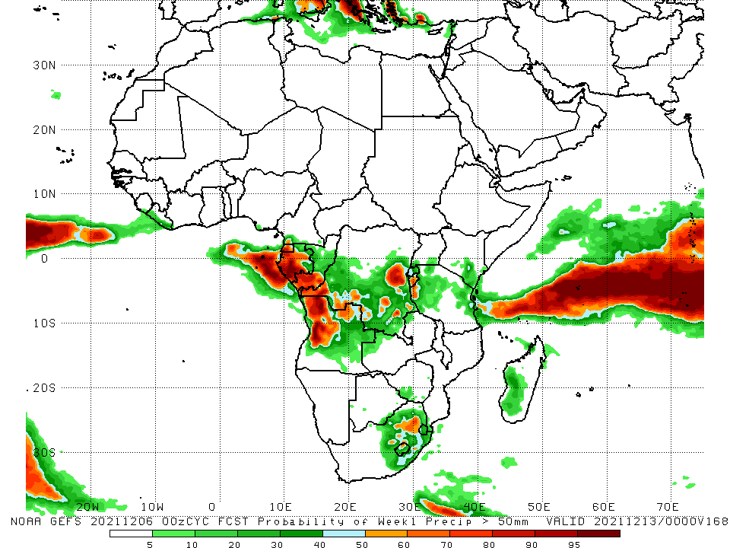
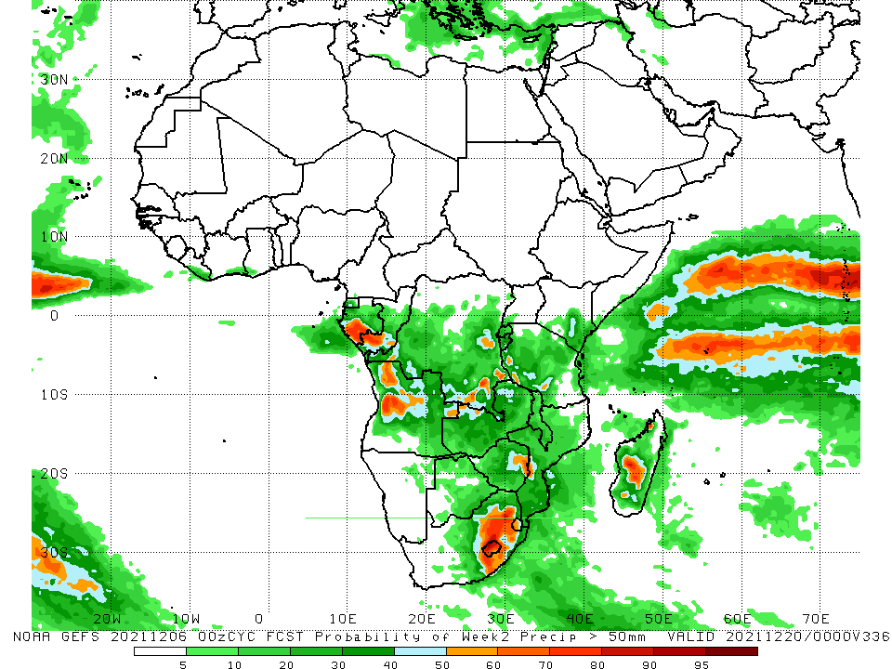
NCEP GEFS Model Forecasts Non-Bias Corrected Probability of precipitation exceedance
Week-1, Valid: 07 – 13 December, 2021
Week-2, Valid: 14 – 20 December, 2021
For week-1 (left panel), week-2 (right panel), the NCEP GEFS indicates a moderate to high chance (over 70%) for rainfall to exceed 50 mm over parts of Gabon, southern Congo, northern Angola, pockets of DRC, western Tanzania and eastern South Africa.
Notes:
9

Slide 10
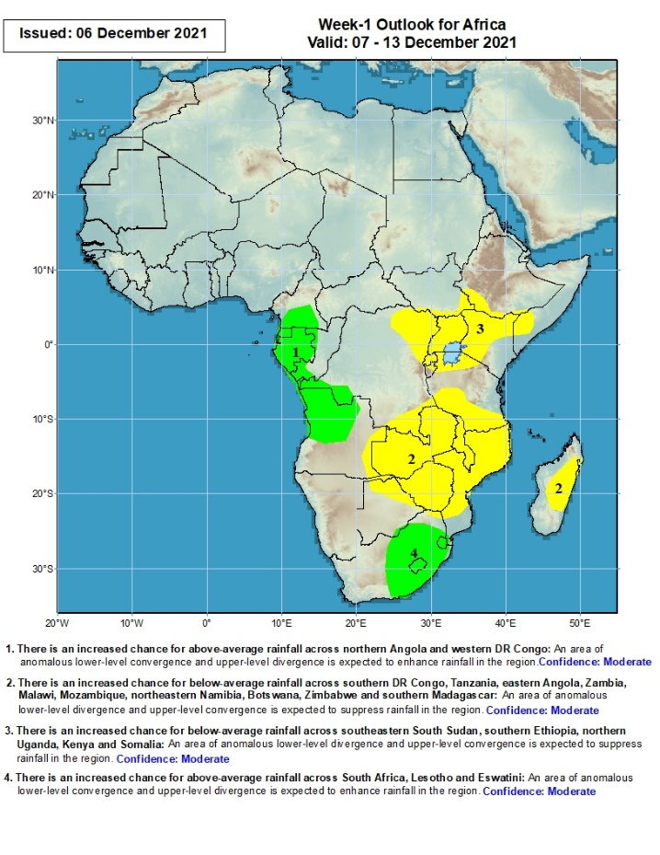
Week-1 Precipitation Outlooks
07 – 13 December, 2021
There is an increased chance for above-average rainfall across southern Cameroon, Gabon, southern Congo, DR Congo and northern Angola: An area of anomalous lower-level convergence and upper-level divergence is expected to enhance rainfall in the region. Confidence: Moderate
There is an increased chance for below-average rainfall across southern DR Congo, southern Tanzania, eastern Angola, Zambia, Malawi, Mozambique, Botswana, Zimbabwe and Madagascar: An area of anomalous lower-level divergence and upper-level convergence is expected to suppress rainfall in the region. Confidence: Moderate
There is an increased chance for below-average rainfall across southern South Sudan, southwestern Ethiopia, northeastern DR Congo, and portions of Uganda, Kenya, Somalia, Rwanda, Burundi and Tanzania: An area of anomalous lower-level divergence and upper-level convergence is expected to suppress rainfall in the region. Confidence: Moderate
There is an increased chance for above-average rainfall across eastern South Africa, Lesotho and Eswatini: An area of anomalous lower-level convergence and upper-level divergence is expected to enhance rainfall in the region. Confidence: Moderate
Notes:
10

Slide 11
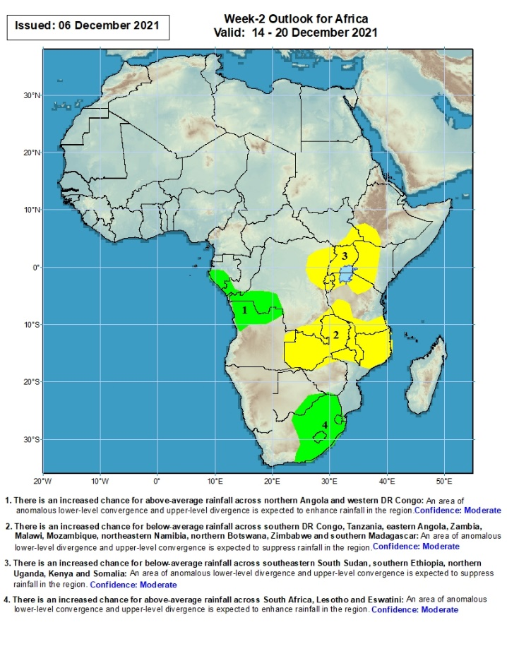
Week-2 Precipitation Outlooks
14 – 20 Dec, 2021
There is an increased chance for above-average rainfall across southern Gabon, southern Congo, southwestern DR Congo and northern Angola: An area of anomalous lower-level convergence and upper-level divergence is expected to enhance rainfall in the region. Confidence: Moderate
There is an increased chance for below-average rainfall across southern DR Congo Tanzania, eastern Angola, Zambia, Malawi, Mozambique and Zimbabwe: An area of anomalous lower-level divergence and upper-level convergence is expected to suppress rainfall in the region. Confidence: Moderate
There is an increased chance for below-average rainfall across southeastern South Sudan, southwestern Ethiopia, northeastern DR Congo, Uganda, Kenya, Rwanda, Burundi and Tanzania: An area of anomalous lower-level divergence and upper-level convergence is expected to suppress rainfall in the region. Confidence: Moderate
There is an increased chance for above-average rainfall across southern Botswana, Zimbabwe, Mozambique, Lesotho, South Africa and Eswatini: An area of anomalous lower-level convergence and upper-level divergence is expected to enhance rainfall in the region. Confidence: Moderate
Notes:
11

Slide 12
Summary
During the past 30 days, in East Africa, above-average rainfall was observed over pockets of western Ethiopia and northern Tanzania. Rainfall was below-average over southern Ethiopia, much of Somalia, Kenya, Uganda and much of Tanzania. In Central Africa, rainfall was below-average over many parts of DRC, Congo, Equatorial Guinea, and pockets of Gabon. Rainfall was above-average over portions of Cameroon, much of CAR, and pockets of DRC. In West Africa, rainfall was above-average over much of the Gulf of Guinea region. Below-average rainfall was observed over pockets of eastern Cote d’Ivoire. In Southern Africa, above-average rainfall was observed over portions of northwestern Angola, much of South Africa, and pockets of Mozambique. Below-average rainfall was observed over southern and eastern Angola, Zambia, Botswana, Zimbabwe, many parts of Mozambique, Malawi, and much of Madagascar.
During the past 7 days, in East Africa, rainfall was below-average over parts of southwestern Ethiopia and Tanzania. Above-average rainfall was observed over portions of Kenya, and coastal Tanzania. In Central Africa, rainfall was above-average over southern Cameroon, much of Gabon, and portions of DRC. Rainfall was below-average over pockets of DRC. In Southern Africa, rainfall was above-average over many parts of Angola and South Africa. Below-average rainfall was observed over much of Zambia, Malawi, Zimbabwe, Mozambique and Madagascar. In West Africa, above-average rainfall was observed along coastal Nigeria.
Week-1 and week-2 outlooks call for an increased chance for below-average rainfall over much of equatorial East Africa and the northern portions of Southern Africa. In contrast, the outlooks call for an increased chance for above-average rainfall over the western portions of Central Africa, and eastern South Africa.

