Slide 1
The African Monsoon Recent Evolution and Current Status Include Week-1 and Week-2 Outlooks
Update prepared by
30 August 2021
For more information, visit:
http://www.cpc.ncep.noaa.gov/products/Global_Monsoons/African_Monsoons/precip_monitoring.shtml

Slide 2
Outline
Highlights
Recent Evolution and Current Conditions
NCEP GEFS Forecasts
Summary

Slide 3
Highlights: Last 7 Days
During the past 7 days, southern Nigeria received weekly rainfall totals of over 150 mm (moisture surpluses of over 100 mm). Precipitation was well above-average in Liberia, Côte d’Ivoire, Ghana, southeastern Sudan, portions of Eritrea, and northern Ethiopia (more than 50 mm above the mean).
The week-1 outlooks depict an increased chance for above-average rainfall across much of the Gulf of Guinea region, parts of eastern Sudan western Ethiopia and western Eritrea. Conversely, there is an increased chance for below-average rainfall across parts of southern Mauritania, southern Mali, Burkina Faso, and southwestern Niger.
The week-2 outlooks call for an increased chance for above-average rainfall across much of Guinea, Sierra Leone, western Mali, the Lake Victoria region, parts of eastern Sudan western Ethiopia and western Eritrea. In contrast, there is an increased chance for below-average rainfall across much of Senegal, southern Mauritania, southern Mali, eastern Côte d'Ivoire, Ghana,, southern Togo, southern Benin and southwestern Nigeria.

Slide 4
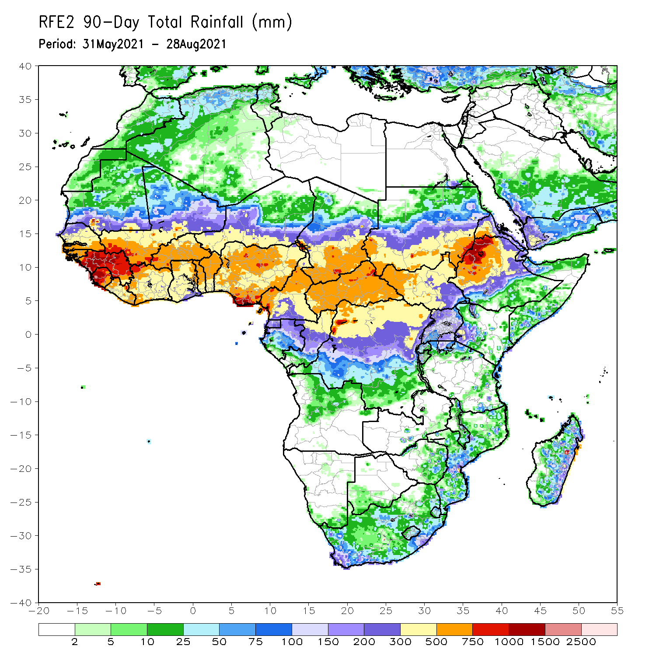
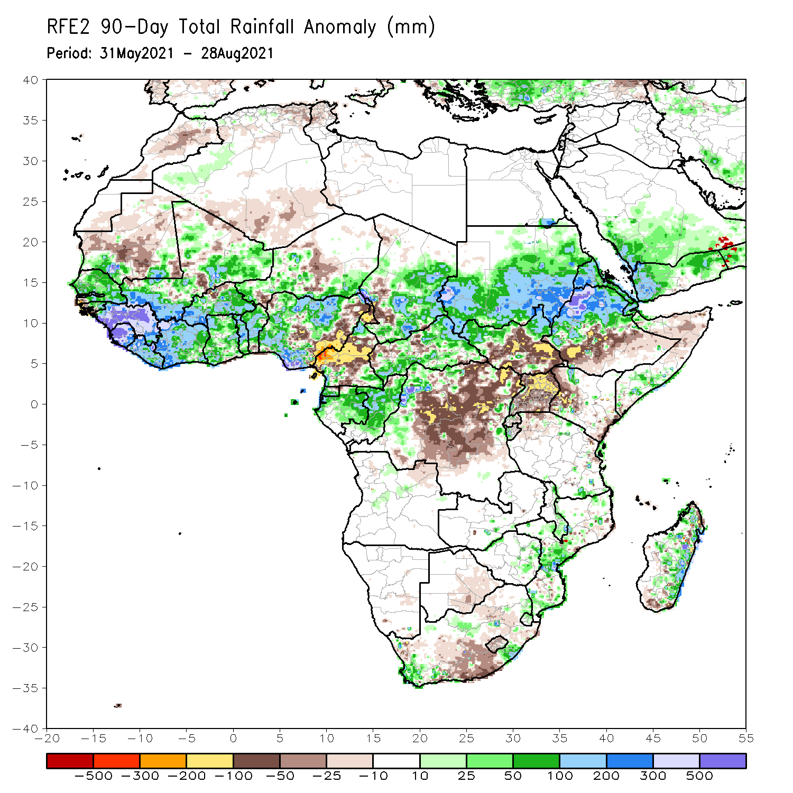
Rainfall Patterns: Last 90 Days
Over the past 90 days, in East Africa, above-average rainfall was observed over Sudan, northern South Sudan, Eritrea, northern Ethiopia, and local areas in northern and southern Somalia. Rainfall was below-average over central and southern South Sudan, southern Ethiopia, western Kenya, and Uganda.
In southern Africa, local areas in South Africa and Zimbabwe, and many parts of Mozambique and eastern Madagascar experienced moisture surpluses. Light moisture deficits were present in Botswana, much of South Africa and Lesotho, and portions of Madagascar.
In Central Africa, positive precipitation anomalies were found over central and southern Chad, much of CAR, southeastern Cameroon, Equatorial Guinea, Gabon, Congo, and local areas in northwestern DRC. Negative precipitation anomalies occurred in southwestern Chad, much of Cameroon, and much of DRC.
In West Africa, much of Senegal, eastern Guinea-Bissau, Guinea, Sierra Leone, Liberia, Côte d’Ivoire, central and southwestern Mali, much of Burkina Faso, Ghana, Togo, Benin, and northern and southern Nigeria observed moisture surpluses. Southwestern Senegal, western Guinea-Bissau, northern Burkina Faso, and central and eastern Nigeria experienced moisture deficits.
Notes:
4

Slide 5
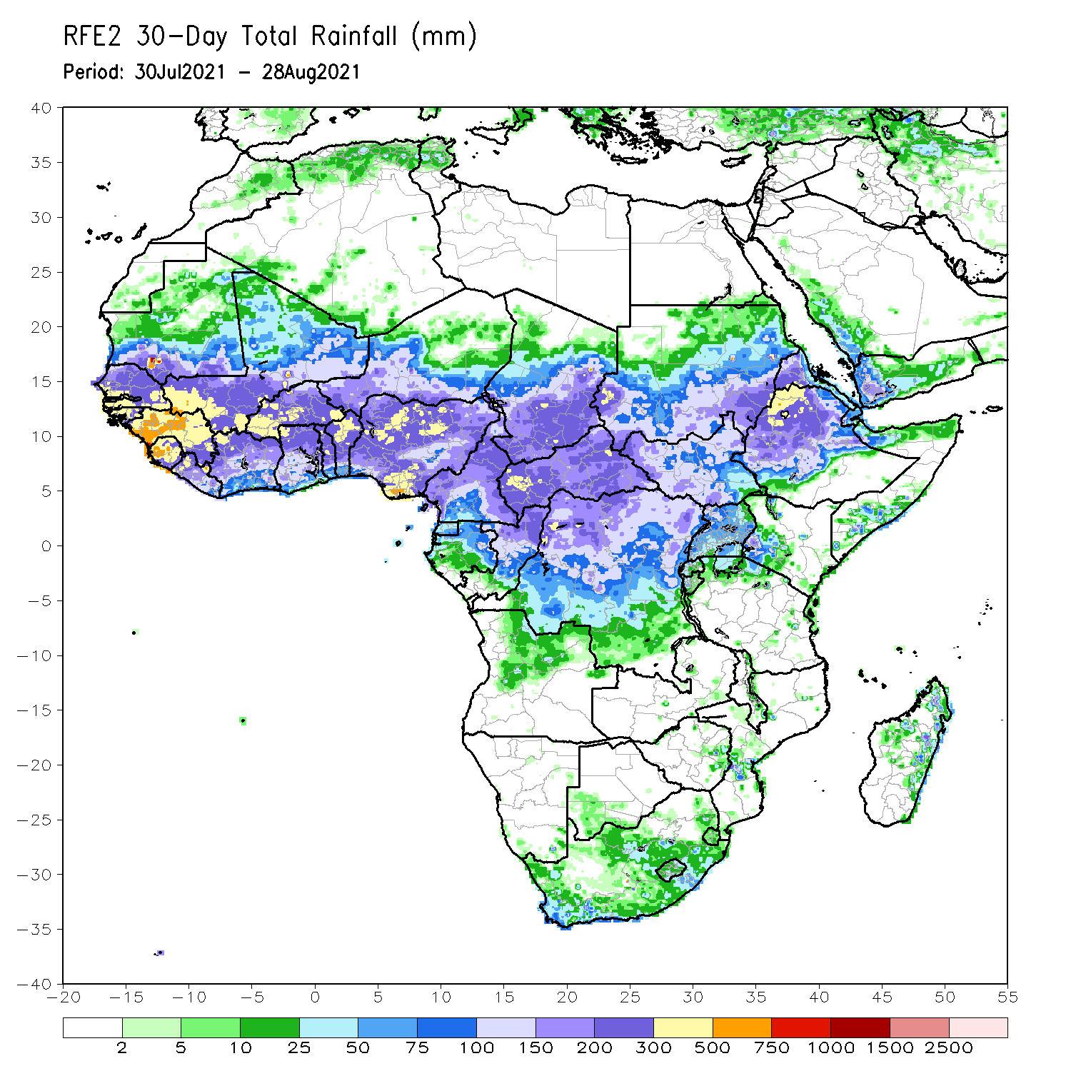
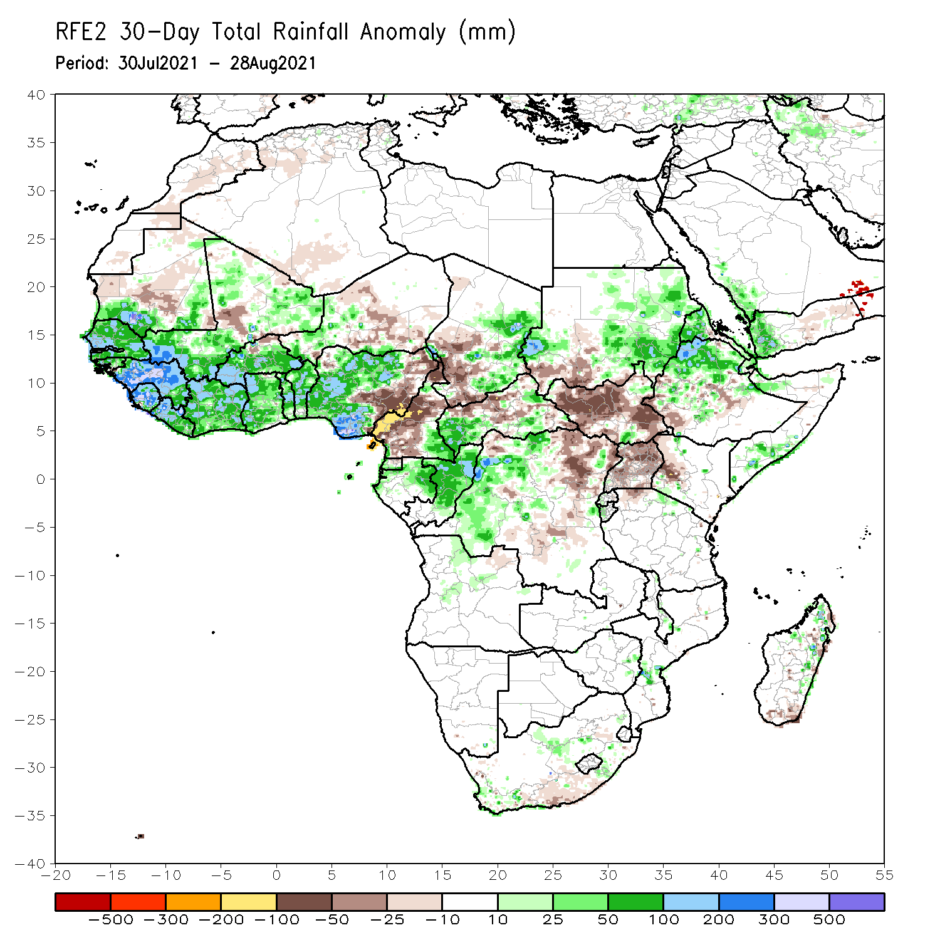
Rainfall Patterns: Last 30 Days
During the past 30 days, in East Africa, above-average rainfall was observed over western and eastern Sudan, Eritrea, northern Ethiopia, and local areas in northern and southern Somalia. Rainfall was below-average over southern Sudan, South Sudan, Uganda, and western Kenya.
In Central Africa, eastern Chad, southwestern CAR, southeastern Cameroon, Gabon, Congo, and western DRC experienced positive rainfall anomalies. Conversely, western Chad, much of Cameroon, and portions of CAR and eastern DRC experienced negative rainfall anomalies.
In West Africa, moisture surpluses were present across southern Mauritania, Senegal, Guinea-Bissau, Guinea, Sierra Leone, much of Mali and Burkina Faso and the Gulf of Guinea countries. Eastern Nigeria, central Mali, northern Burkina Faso, and parts of Niger observed moisture deficits.
Notes:
5

Slide 6
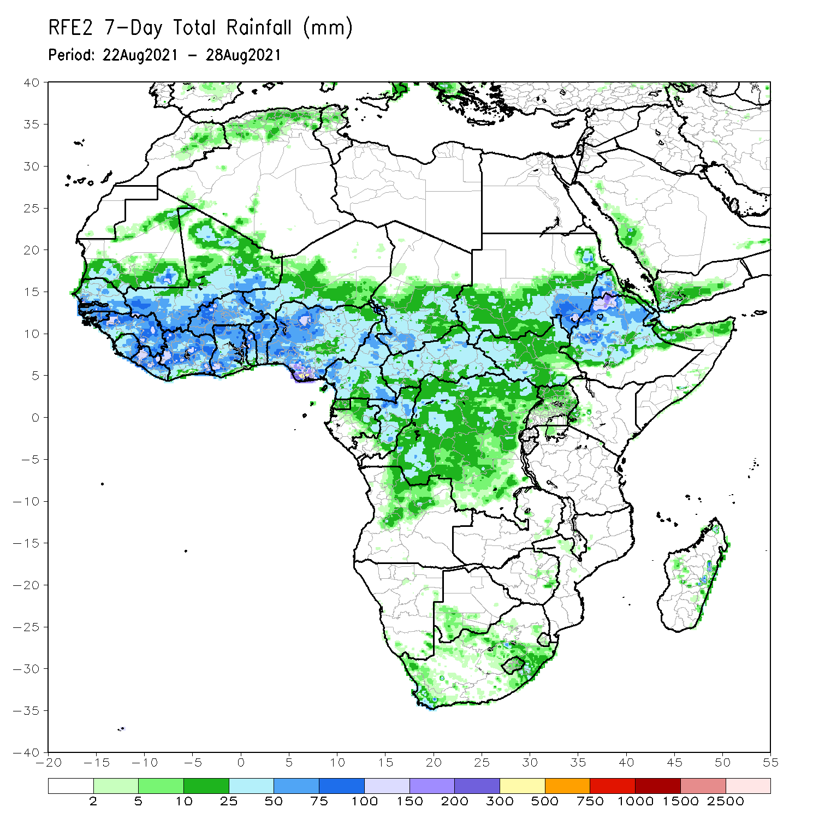
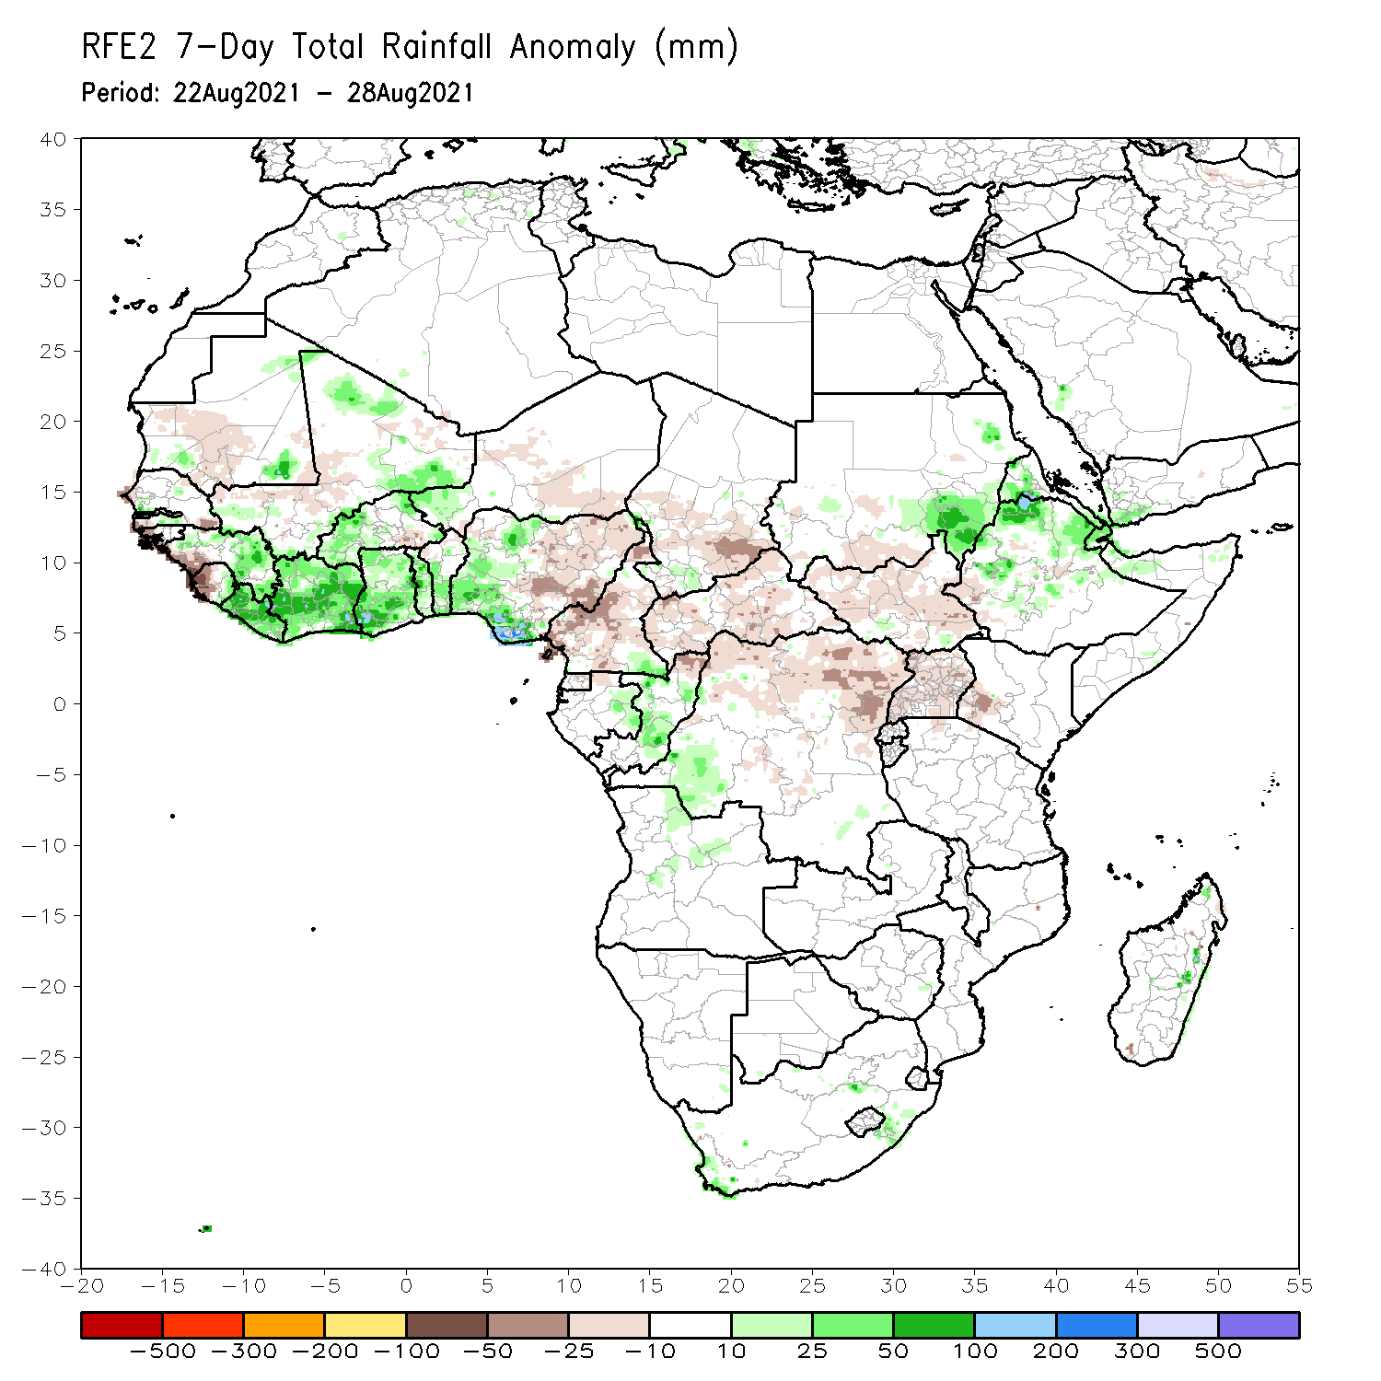
Rainfall Patterns: Last 7 Days
During the past 7 days, much of the East African region observed near-normal to below-normal rainfall, except local areas in eastern Sudan, Eritrea, northern Ethiopia, and northern Somalia.
Light moisture deficits were present over much of Central Africa. Light moisture surpluses were present over southeastern Cameroon, eastern Gabon, much of Congo, and southwestern DRC.
In West Africa, much of Guinea, eastern Sierra Leone, Liberia, Côte d’Ivoire, Ghana, Togo, Benin, western and southern Nigeria, many parts of Burkina Faso, and southwestern Niger observed above-average rainfall. Parts of southern Senegal, western Guinea-Bissau, western Guinea, western Sierra Leone, and eastern Nigeria experienced below-average rainfall conditions.

Slide 7
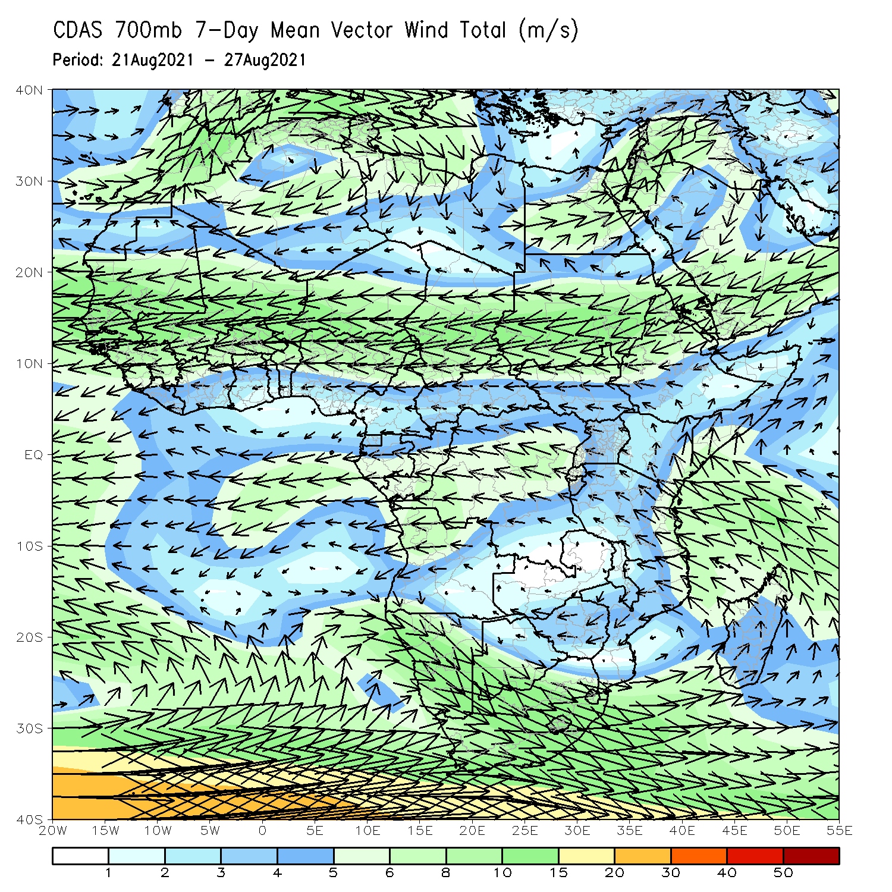
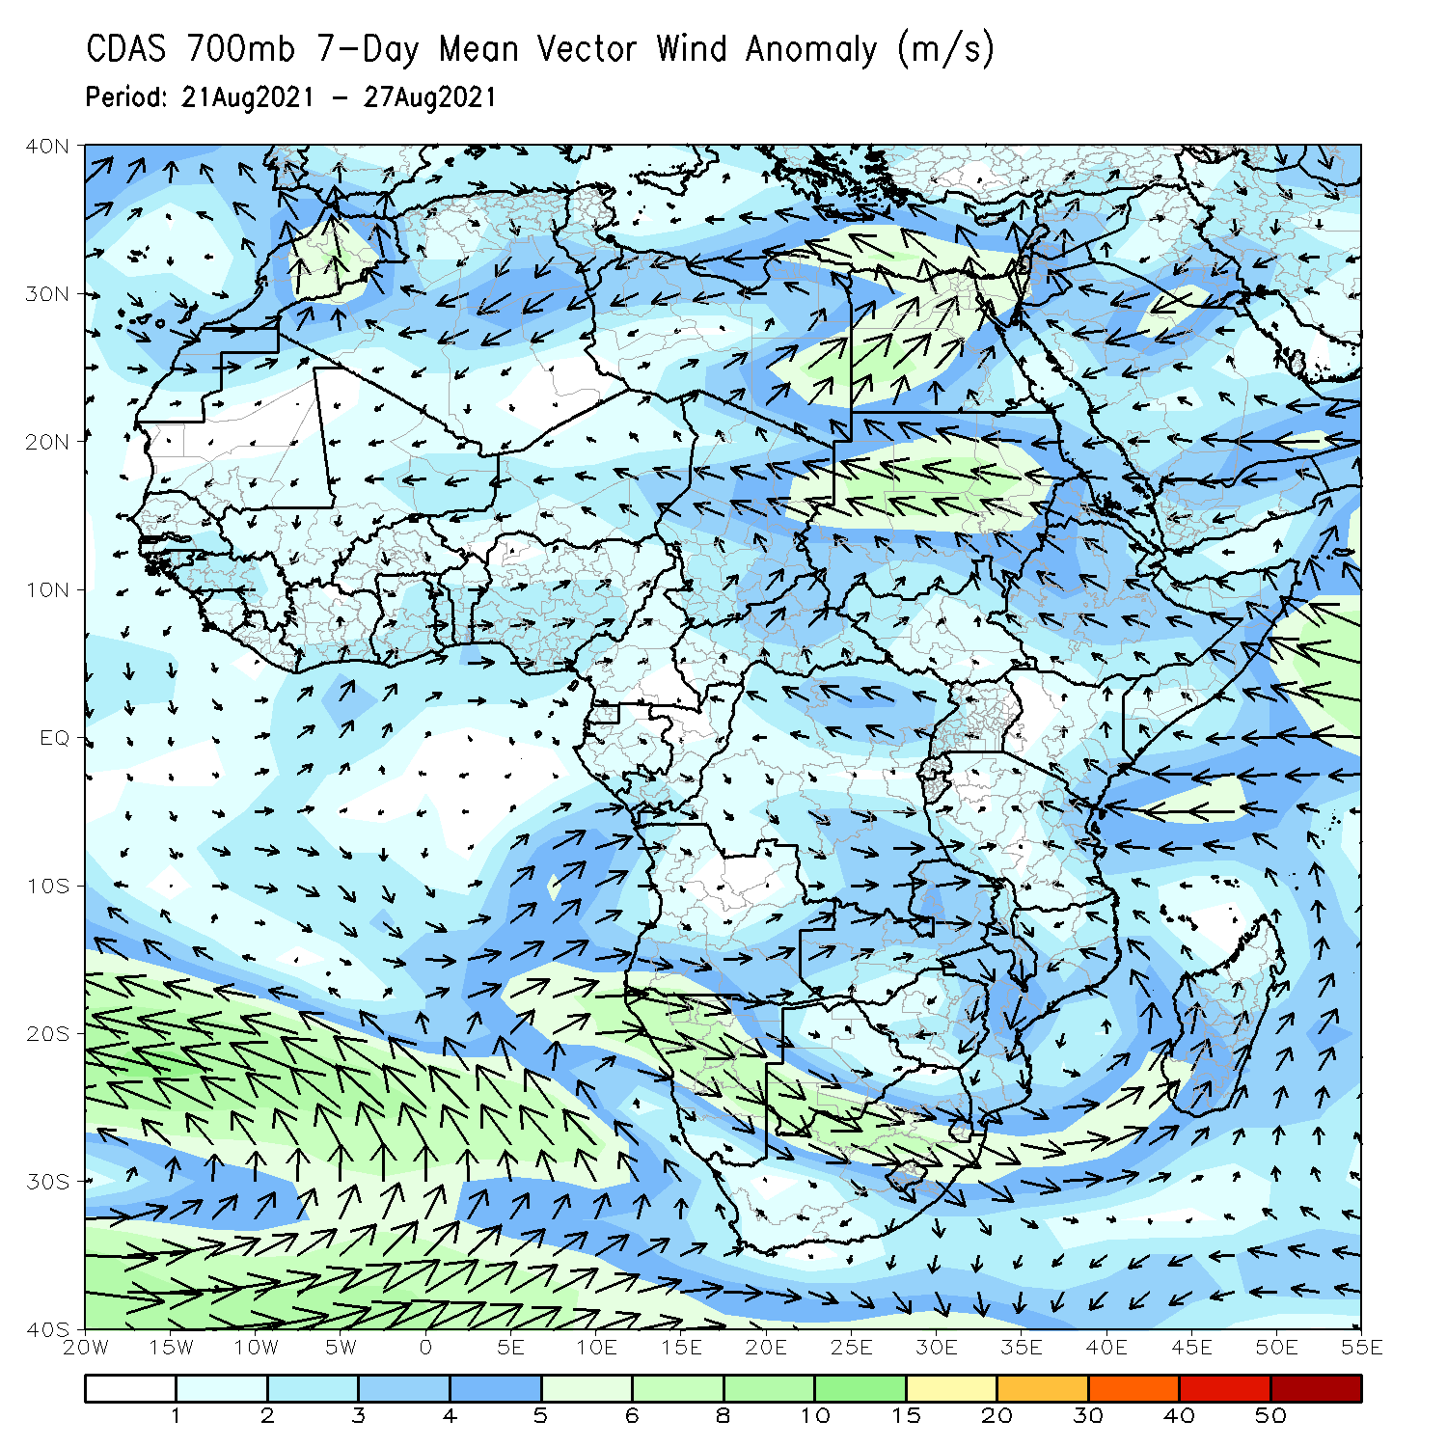
Atmospheric Circulation: Last 7 Days
The 700-hPa atmospheric circulation pattern features a cyclonic circulation over the southern part of Africa (left panel).
An anomalous cyclonic circulation was present over the eastern part of West Africa. The anomalous southwesterly over the Gulf of Guinea countries may have contributed to enhanced rainfall in those areas. A region of easterly anomaly from Red Sea to Chad likely helped to enhance rain in Eritrea, northern Ethiopia, and Sudan (right panel).

Slide 8
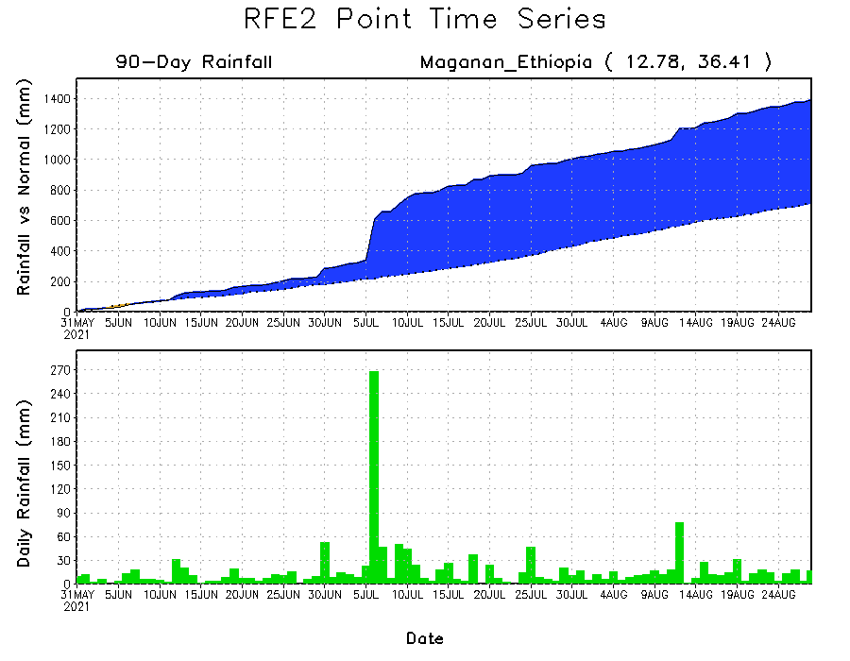
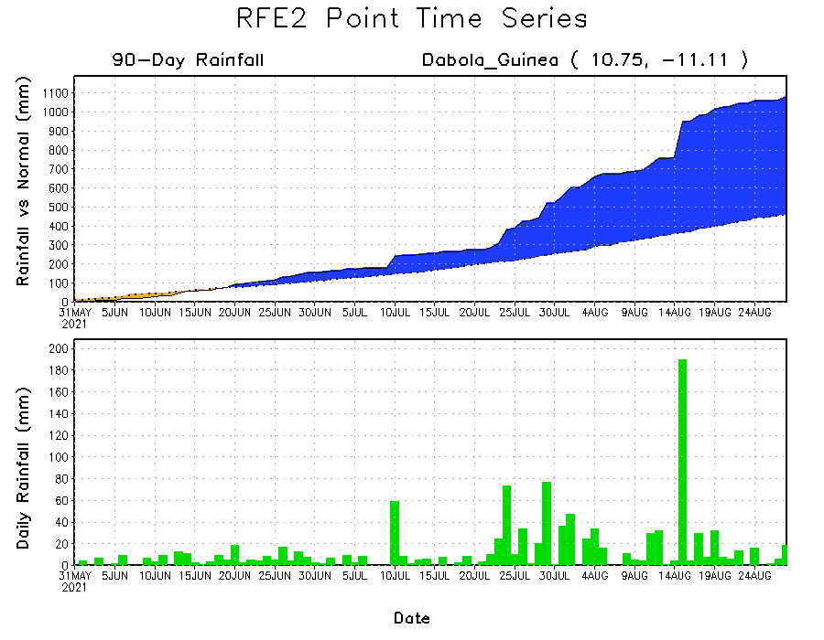
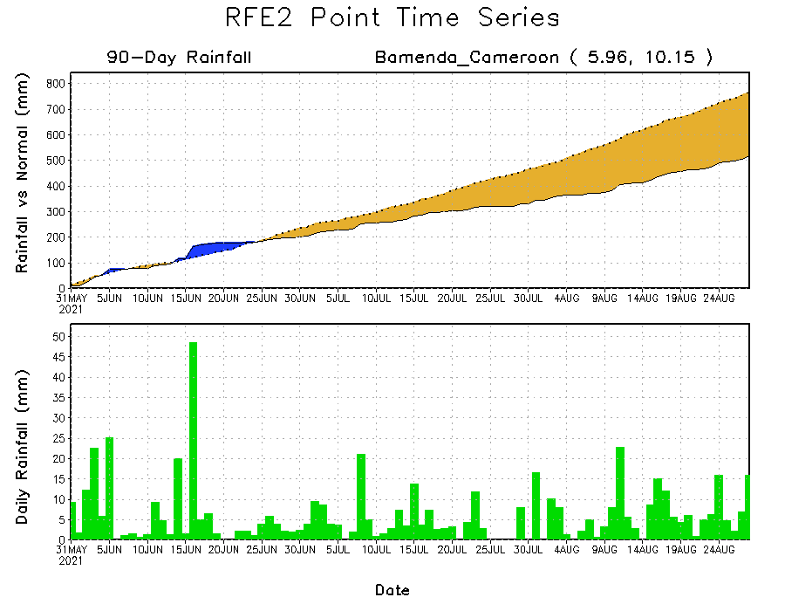
Rainfall Evolution
Daily evolution of rainfall over the last 90 days at selected locations shows moderate to heavy rainfall sustained moisture surpluses over Guinea (bottom left) and northwestern Ethiopia (top right). In contrast, seasonal total rainfall remained below-average over southwestern Cameroon (bottom right).

Slide 9
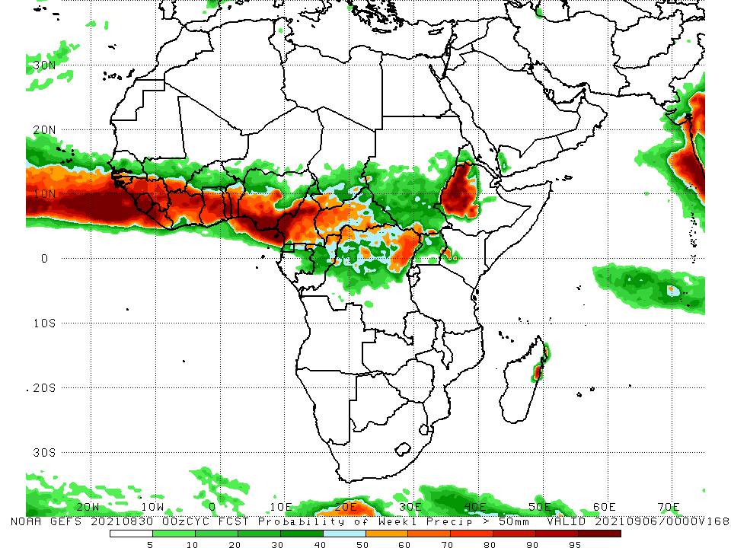
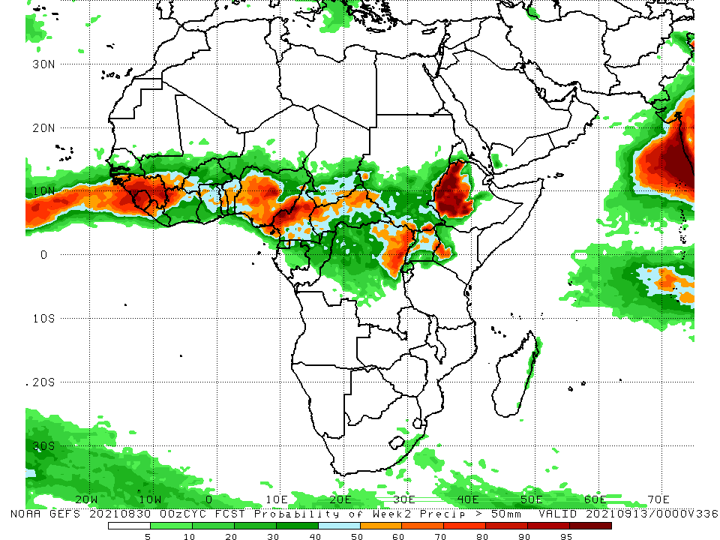
NCEP GEFS Model Forecasts Non-Bias Corrected Probability of precipitation exceedance
Week-1, Valid: 31 August – 6 September 2021
Week-2, Valid: 7 – 13 September 2021
For week-1 (left panel), the NCEP GEFS forecasts indicate a moderate to high chance (over 70%) for rainfall to exceed 50 mm over southern Senegal, Guinea-Bissau, Guinea, Sierra Leone, Liberia, southwestern Burkina Faso, the Gulf of Guinea countries, southern Chad, CAR, northern Congo, northern DRC, and western Ethiopia.
Week-2 forecast (right panel) depicts an increased chance for weekly rainfall to exceed 50 mm in Guinea-Bissau, Guinea, Sierra Leone, northern Liberia, southern Mali, western Burkina Faso, northern Côte d’Ivoire, portions of Ghana, Togo, Benin, much of Nigeria, Cameroon, southern Chad, CAR, northeastern DRC, parts of Uganda, western Kenya, and western Ethiopia.
Notes:
9

Slide 10
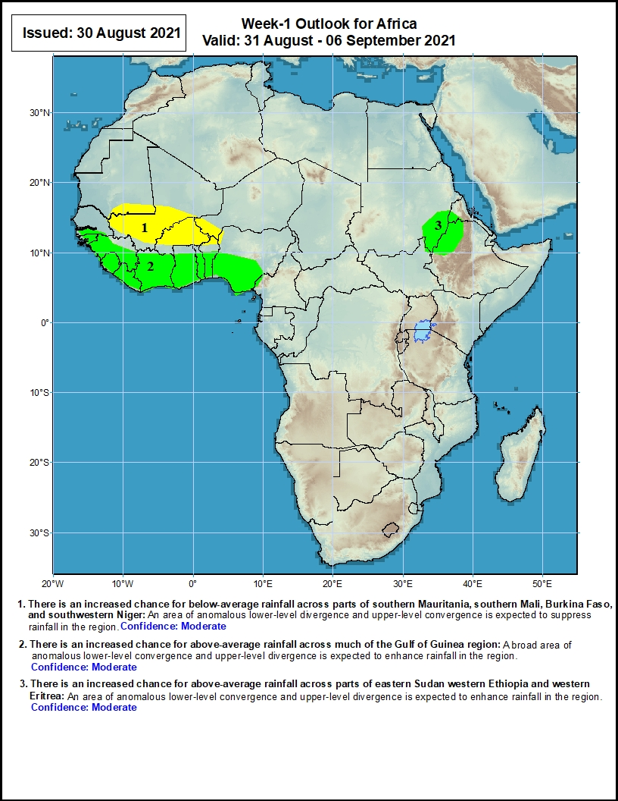
Week-1 Precipitation Outlooks
31 August – 6 September 2021
There is an increased chance for below-average rainfall across parts of southern Mauritania, southern Mali, Burkina Faso, and southwestern Niger: An area of anomalous lower-level divergence and upper-level convergence is expected to suppress rainfall in the region. Confidence: Moderate
There is an increased chance for above-average rainfall across much of the Gulf of Guinea region: A broad area of anomalous lower-level convergence and upper-level divergence is expected to enhance rainfall in the region. Confidence: Moderate
There is an increased chance for above-average rainfall across parts of eastern Sudan western Ethiopia and western Eritrea: An area of anomalous lower-level convergence and upper-level divergence is expected to enhance rainfall in the region. Confidence: Moderate
Notes:
10

Slide 11
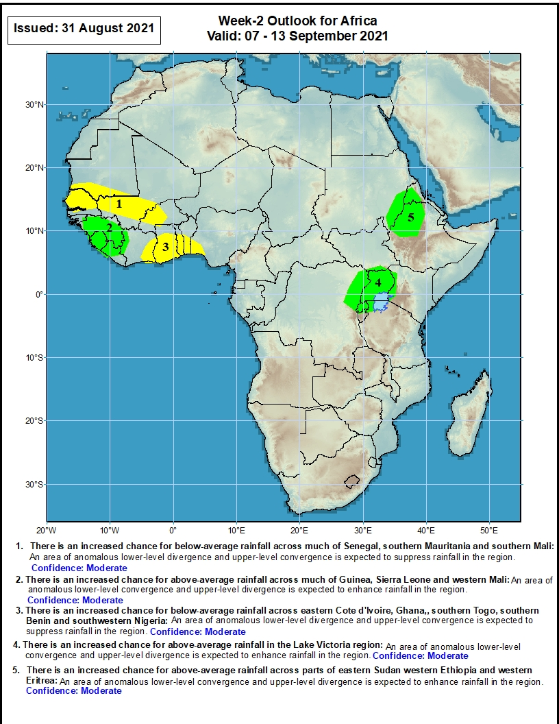
Week-2 Precipitation Outlooks
7 – 13 September 2021
There is an increased chance for below-average rainfall across much of Senegal, southern Mauritania and southern Mali: An area of anomalous lower-level divergence and upper-level convergence is expected to suppress rainfall in the region. Confidence: Moderate
There is an increased chance for above-average rainfall across much of Guinea, Sierra Leone and western Mali: An area of anomalous lower-level convergence and upper-level divergence is expected to enhance rainfall in the region. Confidence: Moderate
There is an increased chance for below-average rainfall across eastern Côte d'Ivoire, Ghana, southern Togo, southern Benin and southwestern Nigeria: An area of anomalous lower-level divergence and upper-level convergence is expected to suppress rainfall in the region. Confidence: Moderate
There is an increased chance for above-average rainfall in the Lake Victoria region: An area of anomalous lower-level convergence and upper-level divergence is expected to enhance rainfall in the region. Confidence: Moderate
There is an increased chance for above-average rainfall across parts of eastern Sudan western Ethiopia and western Eritrea: An area of anomalous lower-level convergence and upper-level divergence is expected to enhance rainfall in the region. Confidence: Moderate
Notes:
11

Slide 12
Summary
During the past 30 to 90 days, in East Africa, above-average rainfall was observed over Sudan, Eritrea, northern Ethiopia, and local areas over northern and southern Somalia. Rainfall was below-average over South Sudan, much of CAR, central Ethiopia, Uganda, and western Kenya. In Central Africa, moisture surpluses were found in eastern Chad, portions of CAR, southeastern Cameroon, Equatorial Guinea, Gabon, Congo, and part of northwestern DRC. Moisture deficits occurred in Cameroon, southwestern Chad, and central and eastern DRC. Much of the West African region observed above-average rainfall. Eastern Nigeria continued to experience drier than normal conditions.
During the past 7 days, much of the East African region observed near-normal to below-normal rainfall conditions, except local areas in eastern Ethiopia, Eritrea, northern Ethiopia, and northern Somalia. In Central Africa, rainfall was slightly above-average over southeastern Cameroon, eastern Gabon, Congo and western DRC. The remainder of the Central African region observed light moisture deficits. Moisture surpluses were present over the Gulf of Guinea countries. Local areas along the western coast of West Africa and eastern Nigeria experienced below-normal precipitation.
The week-1 outlooks depict an increased chance for above-average rainfall across much of the Gulf of Guinea region, parts of eastern Sudan western Ethiopia and western Eritrea. Conversely, there is an increased chance for below-average rainfall across parts of southern Mauritania, southern Mali, Burkina Faso, and southwestern Niger.
The week-2 outlooks call for an increased chance for above-average rainfall across much of Guinea, Sierra Leone, western Mali, the Lake Victoria region, parts of eastern Sudan western Ethiopia and western Eritrea. In contrast, there is an increased chance for below-average rainfall across much of Senegal, southern Mauritania, southern Mali, eastern Côte d'Ivoire, Ghana,, southern Togo, southern Benin and southwestern Nigeria.

