Slide 1
The African Monsoon Recent Evolution and Current Status Include Week-1 and Week-2 Outlooks
Update prepared by
16 August 2021
For more information, visit:
http://www.cpc.ncep.noaa.gov/products/Global_Monsoons/African_Monsoons/precip_monitoring.shtml

Slide 2
Outline
Highlights
Recent Evolution and Current Conditions
NCEP GEFS Forecasts
Summary

Slide 3
Highlights: Last 7 Days
During the past 7 days, the heaviest rainfall totaling more than 150 mm was observed in western Guinea, central Sierra Leone, southern Nigeria, and eastern Chad. The pattern resulted in large positive rainfall anomalies of over 100 mm in those areas.
The week-1 outlooks depict an increased chance for above-average rainfall across southern Senegal, Guinea-Bissau, Guinea, Sierra Leone, southwestern Mali, northern Côte d'Ivoire, western Burkina Faso, eastern Nigeria, Cameroon, southern Chad, and western CAR. Conversely, there is an increased chance for below-average rainfall across central Mali, central and eastern Burkina Faso, southern Niger, northern Benin, and northwestern Nigeria.
The week-2 outlooks call for an increased chance for above-average rainfall across southern Senegal, Guinea-Bissau, Guinea, Sierra Leone, southwestern Mali, northwestern Côte d'Ivoire, eastern Sudan, northeastern South Sudan, and western Ethiopia. In contrast, there is an increased chance for below-average rainfall across northeastern Côte d'Ivoire, southern Burkina Faso, central and northern Ghana, Togo, Benin, northern DRC, Rwanda, western Uganda, and western South Sudan.

Slide 4
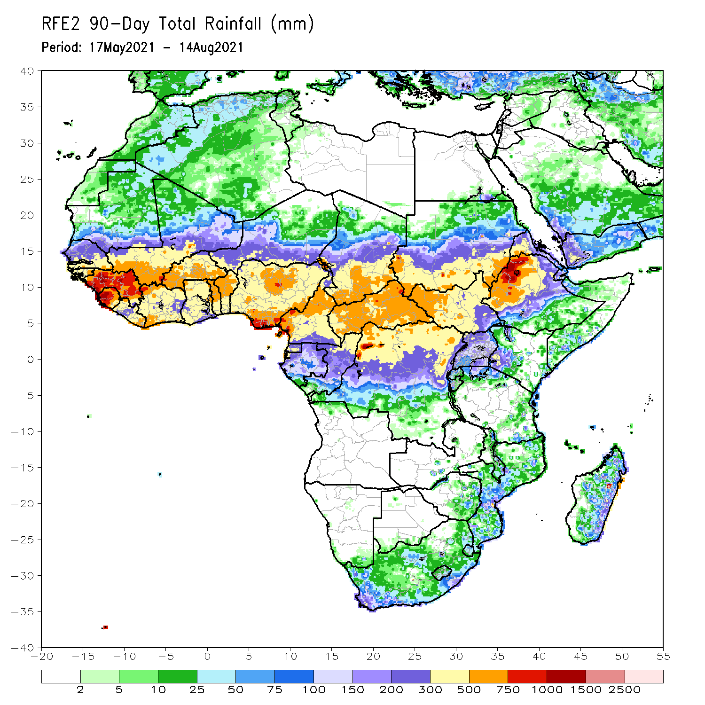
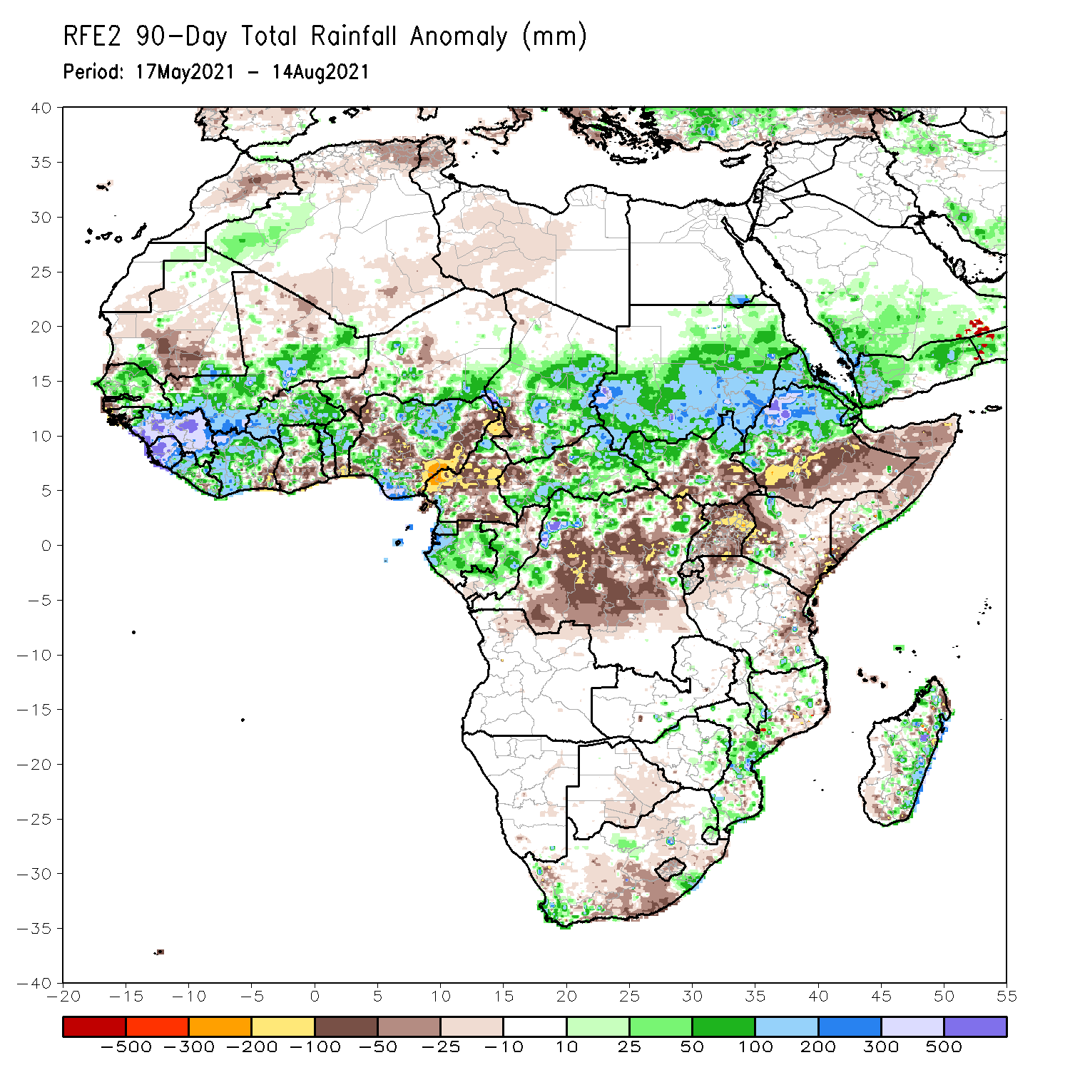
Rainfall Patterns: Last 90 Days
Over the past 90 days, in East Africa, rainfall was well above-average over Sudan, northern South Sudan, Eritrea, and northern Ethiopia. Below-average rainfall was observed central and southern South Sudan, southern Ethiopia, Somalia, Uganda, Kenya, and northwestern and eastern Tanzania.
In southern Africa, above-average rainfall was observed over local areas in South Africa and Zimbabwe, and many parts in Mozambique and Madagascar. Light moisture deficits were observed over Botswana, much of South Africa, and portions of Madagascar.
In Central Africa, positive precipitation anomalies were found over central and southern Chad, much of CAR, Equatorial Guinea, Gabon, central Congo, and local areas in northern DRC. Negative precipitation anomalies occurred in southwestern Chad, much of Cameroon, portions of CAR, northern Gabon, northern Congo, and northeastern and central DRC.
In West Africa, moisture surpluses were observed over much of Senegal, eastern Guinea-Bissau, Guinea, Sierra Leone, Liberia, western and northern Côte d’Ivoire, central and southern Mali, Burkina Faso, northern Ghana, northern Togo, northern Benin, parts of Niger, and northern and southern Nigeria. Western Guinea-Bissau, northern Mali, southeastern Côte d’Ivoire, southern Ghana, southern Togo, southern Benin, and parts of Niger and Nigeria experienced moisture deficits.
Notes:
4

Slide 5
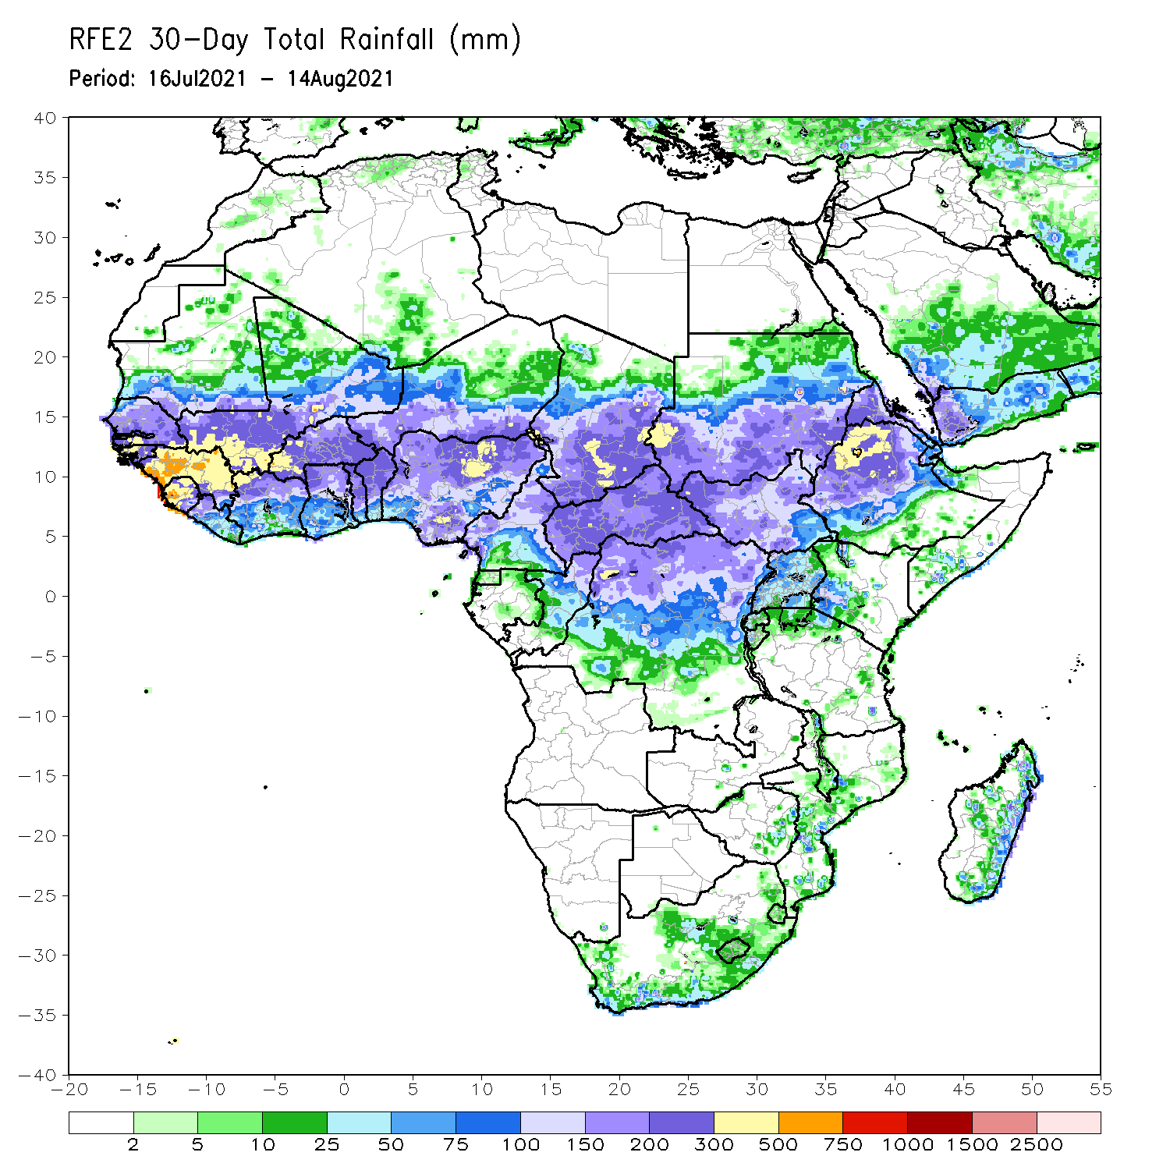
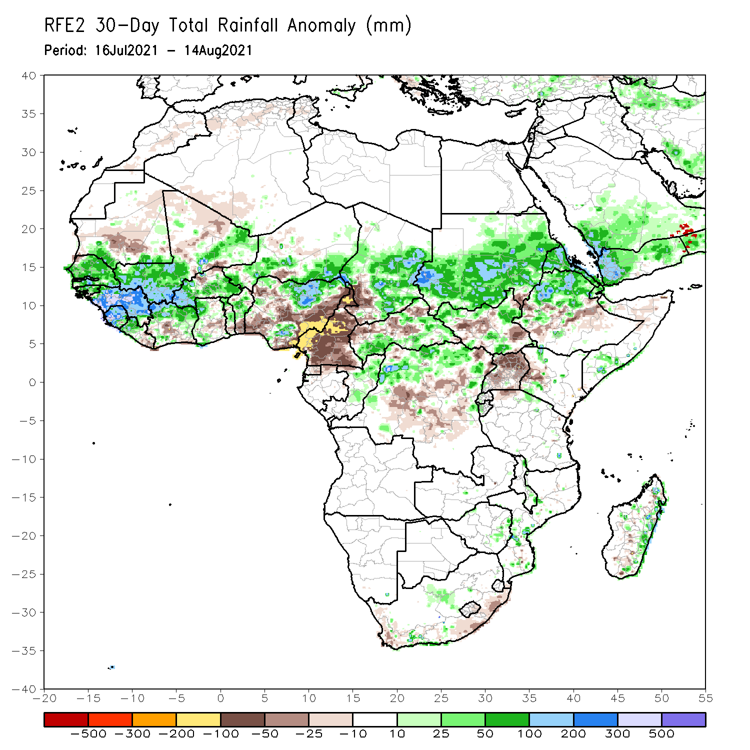
Rainfall Patterns: Last 30 Days
During the past 30 days, in East Africa, above-average rainfall was observed over Sudan, local areas in northern and southern South Sudan, Eritrea, northern Ethiopia, and local areas in southern Somalia. Rainfall was below-average over central Ethiopia, parts of South Sudan, western Kenya, and Uganda.
In southern Africa, scattered positive rainfall anomalies were found in Mozambique and eastern Madagascar. Light negative rainfall anomalies were observed over the southern part of South Africa.
In Central Africa, rainfall was well above-average over central and southeastern Chad, portions of CAR, northern DRC, and northern Congo. Conversely, below-average conditions were found over Cameroon, southwestern Chad, parts of CAR, and central DRC.
In West Africa, rainfall was above-average over Senegal, Guinea-Bissau, Guinea, Sierra Leone, northern Liberia, northern Côte d’Ivoire, southern Mali, Burkina Faso, northern and southern Ghana, northern Togo, northern Benin, southern Niger and northern and southern Nigeria. Moisture deficits were observed over southern Liberia, northern Mali, northern Burkina Faso, southern Côte d’Ivoire, southern Ghana, southern Togo, southern Benin, and many parts of Nigeria.
Notes:
5

Slide 6
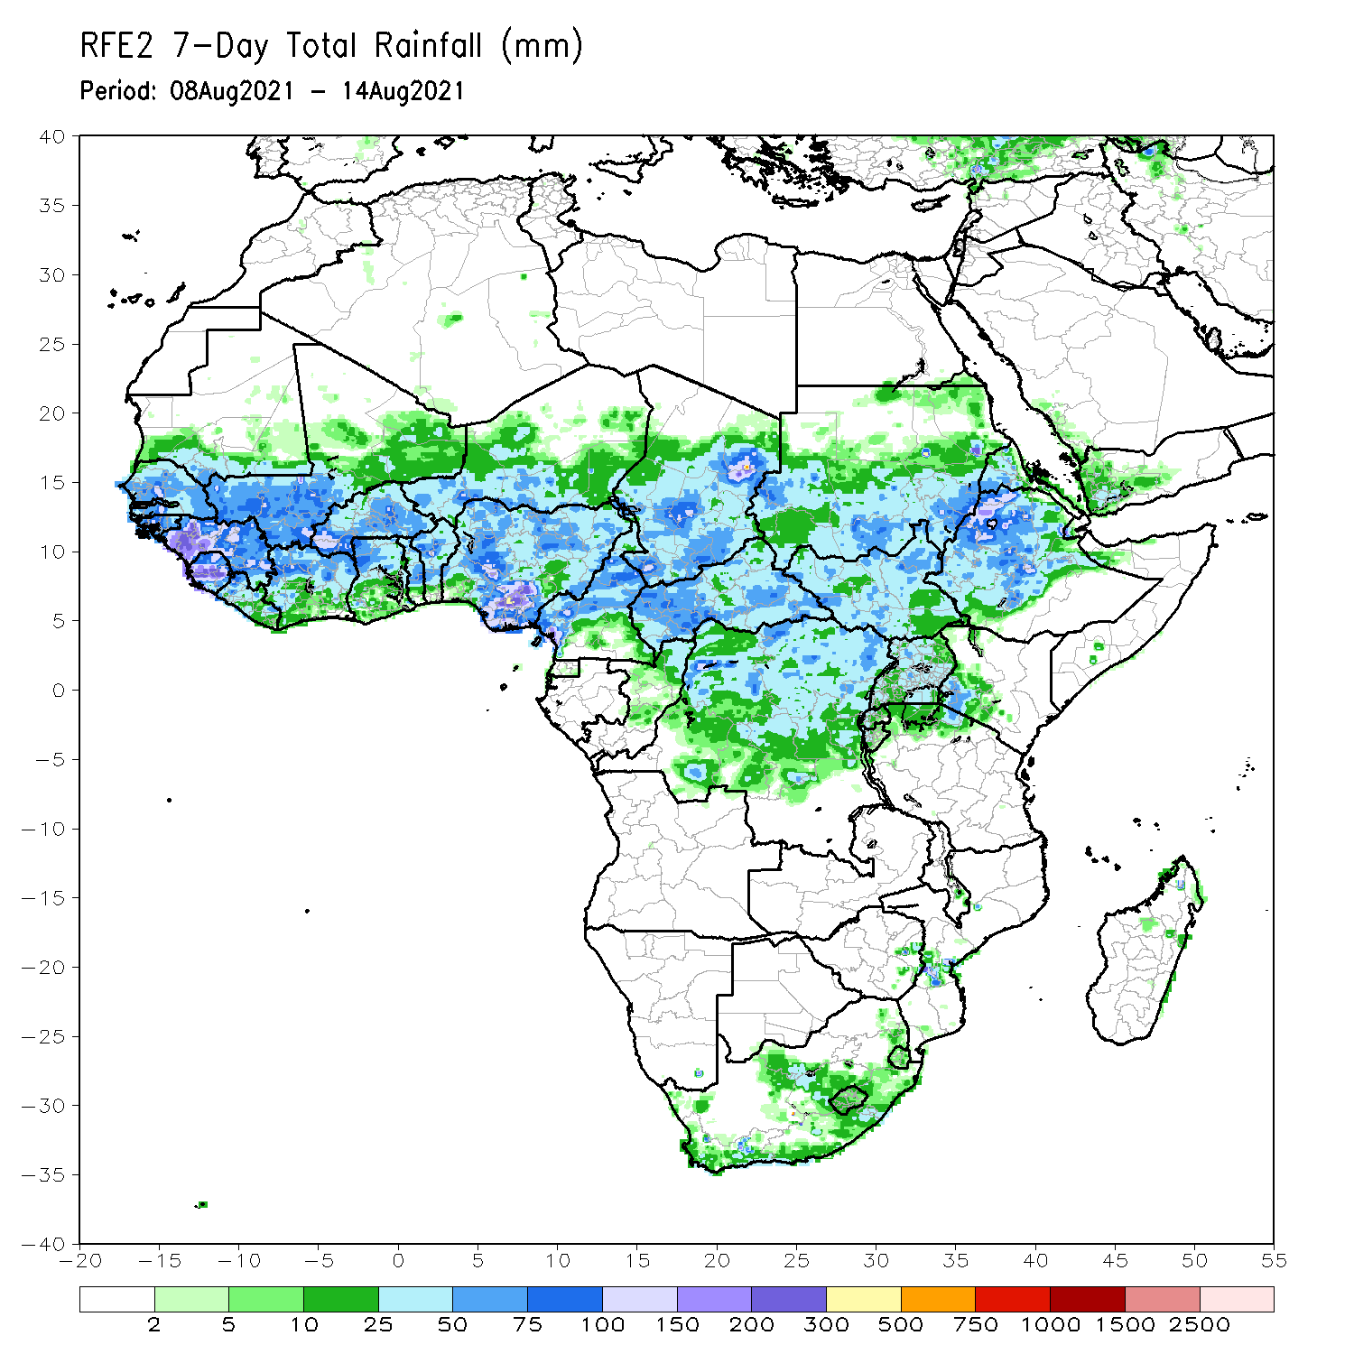
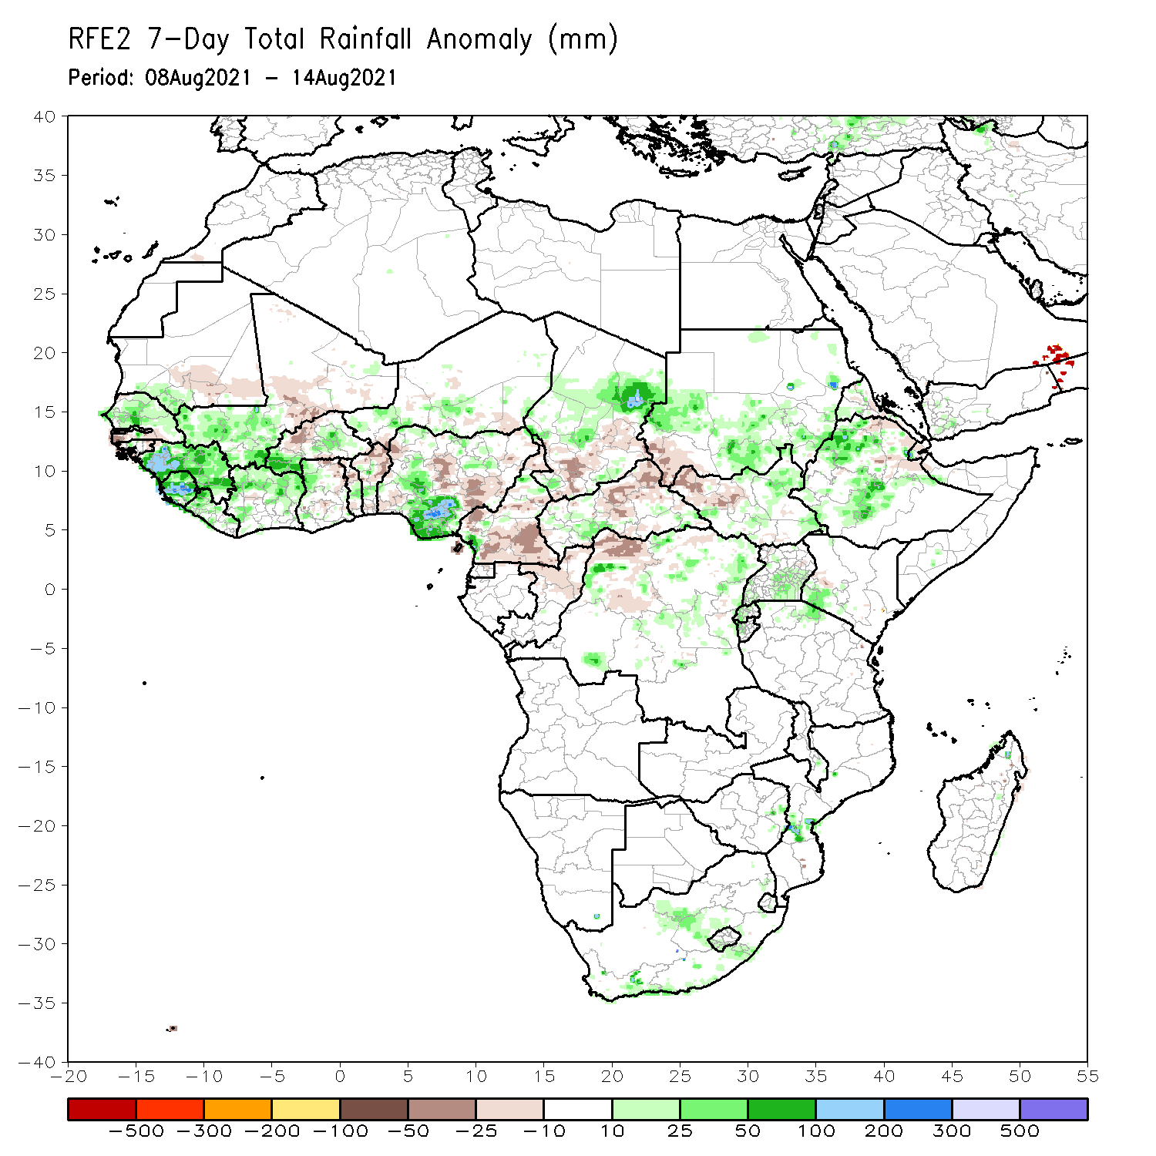
Rainfall Patterns: Last 7 Days
During the past 7 days, in East Africa, rainfall was above-average over central and southeastern Sudan, southern and eastern South Sudan, western Ethiopia, and southern Uganda. Precipitation was slightly below-average over southwestern Sudan and western South Sudan.
In southern Africa, local areas in South Africa and Mozambique observed wetter than normal conditions.
In Central Africa, rainfall was above-average over central Chad and pocket areas in CAR and DRC. Southern Chad, much of Cameroon, eastern CAR, northern Congo, and local areas in northern DRC experienced below-average rainfall.
In West Africa, Senegal, Guinea, Sierra Leone, Liberia, southwestern Mali, southwestern and eastern Burkina Faso, Côte d’Ivoire, northern Ghana, southern Niger, and northern and southern Nigeria observed above-average rainfall. Central Mali, northern Burkina Faso, northern Togo, northern Benin, and parts of Nigeria experienced below-average rainfall conditions.

Slide 7
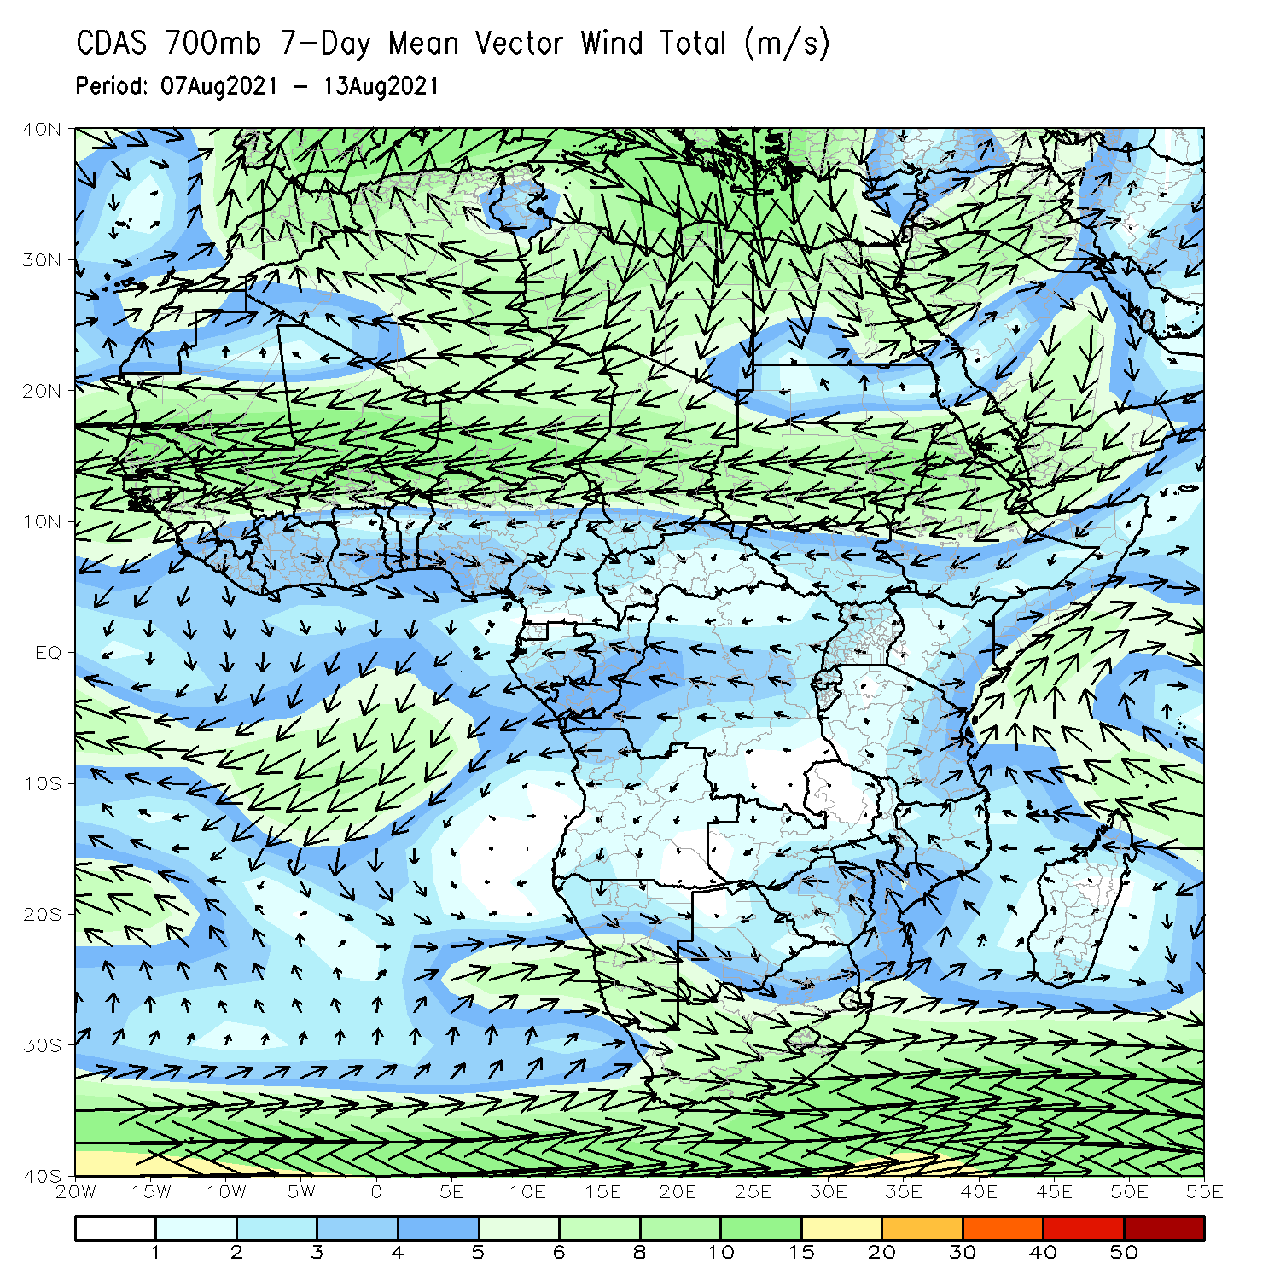
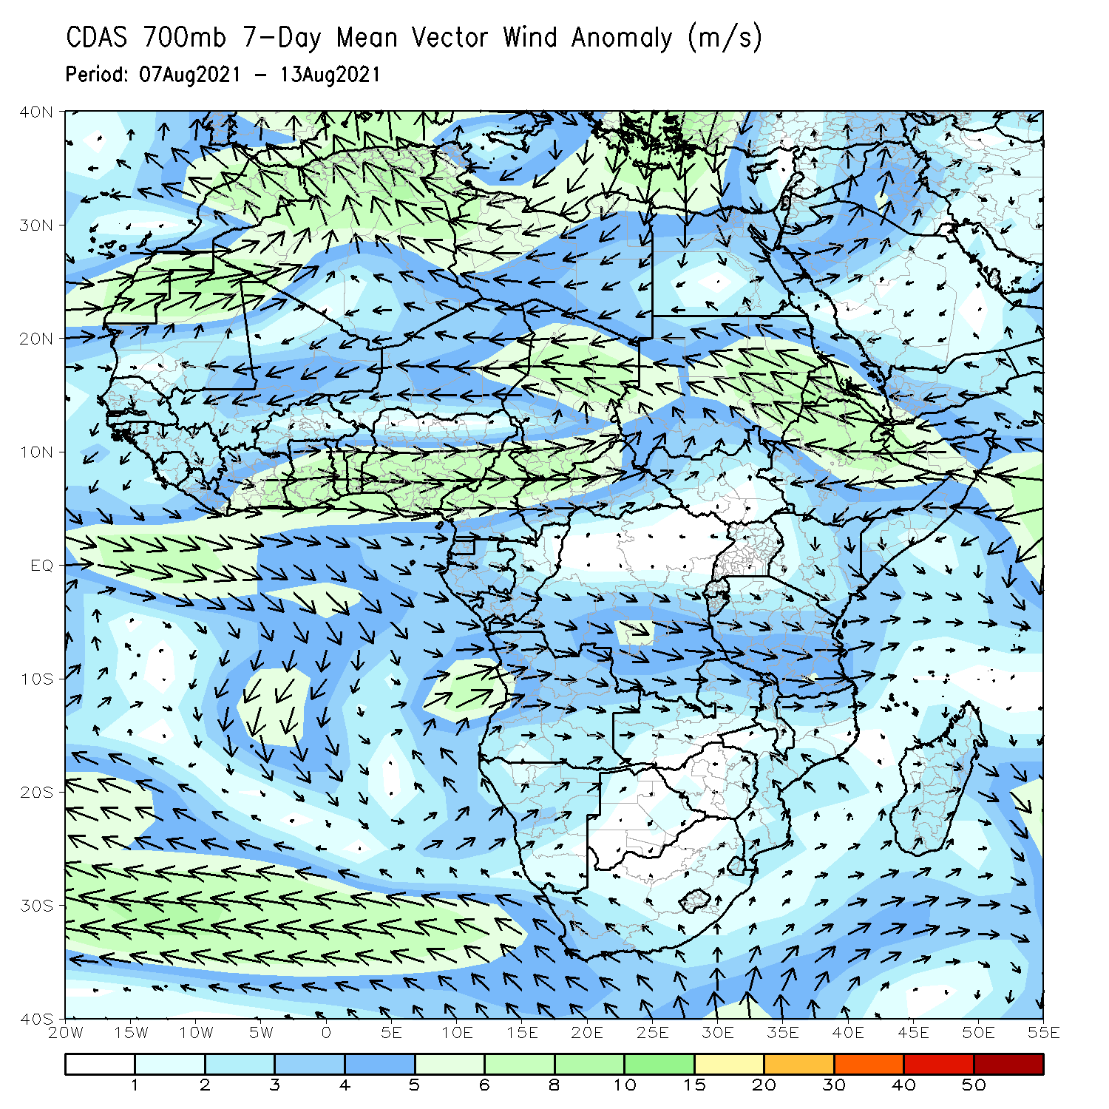
Atmospheric Circulation: Last 7 Days
The 700-hPa atmospheric circulation pattern features easterly flow stretching from Eritrea to Senegal. A cyclonic circulation located over southern Africa may have contributed to enhanced rainfall in South Africa, Zimbabwe, and Mozambique (left panel).
An anomalous cyclonic circulation was present over the Sahel and the countries in the Gulf of Guinea. The strong cyclonic flow over Chad and Ethiopia likely helped enhance rain in those areas (right panel).

Slide 8
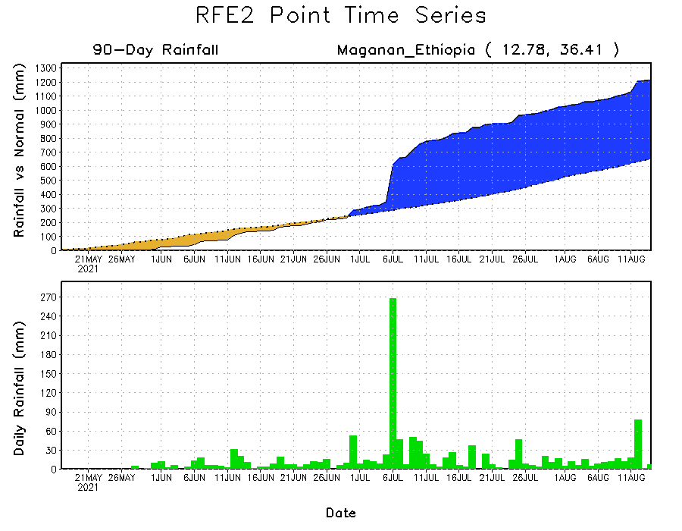
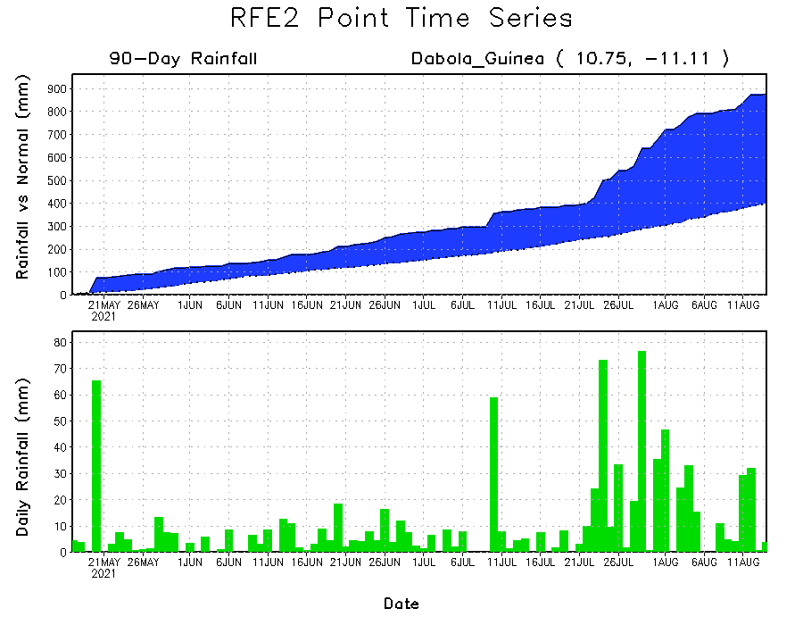
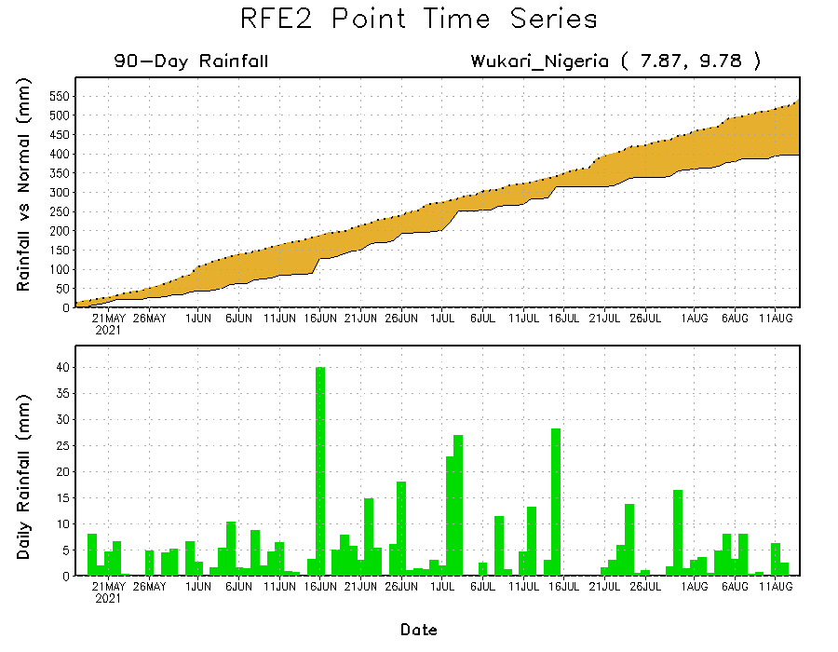
Rainfall Evolution
Daily evolution of rainfall over the last 90 days at selected locations shows moderate to heavy rainfall sustained moisture surpluses over parts of Guinea (bottom left) and western Ethiopia (top right). In contrast, seasonal total rainfall remained below-average over eastern Nigeria (bottom right).

Slide 9
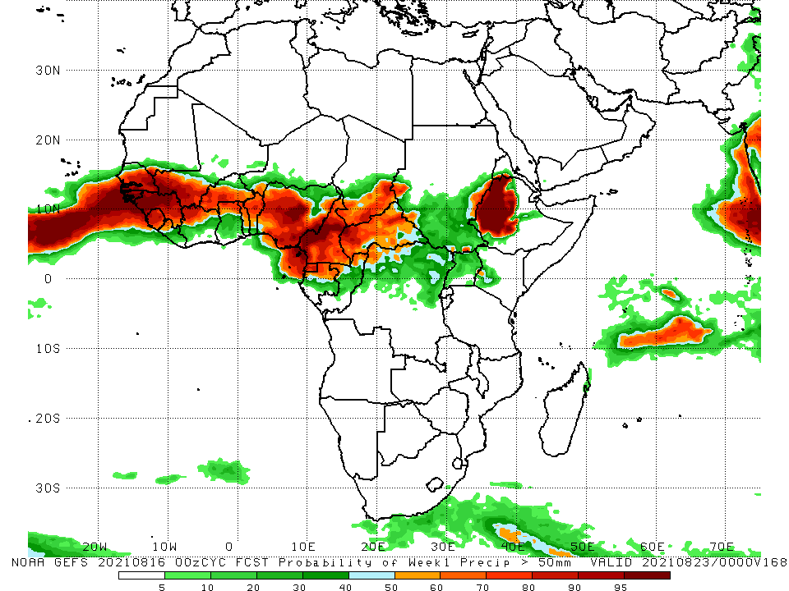
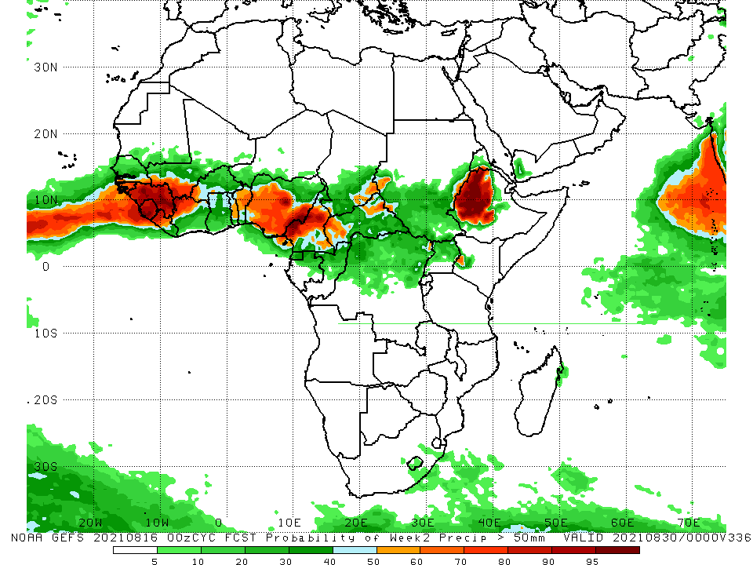
NCEP GEFS Model Forecasts Non-Bias Corrected Probability of precipitation exceedance
Week-1, Valid: 17 – 23 August, 2021
Week-2, Valid: 24 – 30 August, 2021
For week-1 (left panel), the NCEP GEFS indicates a moderate to high chance (over 70%) for rainfall to exceed 50 mm over Senegal, Guinea-Bissau, Guinea, Sierra Leone, northern Liberia, southwestern Mali, southern Burkina Faso, northern Côte d’Ivoire, northern Ghana, Togo, Benin, southern Niger, Nigeria, Cameroon, Equatorial Guinea, northern Gabon, northern Congo, southern Chad, CAR, northern DRC, local areas in eastern and western Sudan and South Sudan, and western Ethiopia.
Week-2 forecast (right panel) depicts an increased chance for weekly rainfall to exceed 50 mm over southern Senegal, Guinea-Bissau, Guinea, Sierra Leone, northern Liberia, southern Mali, northern Ghana, western Burkina Faso, Togo, Benin, Nigeria, Cameroon, southwestern and southeastern Chad, western and northeastern CAR, western Ethiopia, and pocket areas in western Kenya.
Notes:
9

Slide 10
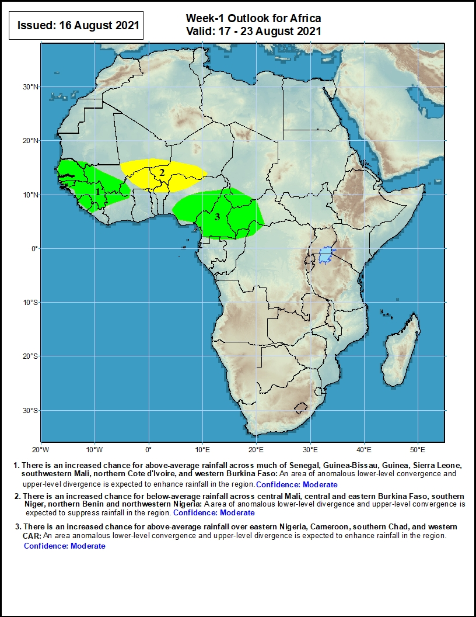
Week-1 Precipitation Outlooks
17 – 23 August, 2021
1. There is an increased chance for above-average rainfall across southern Senegal, Guinea-Bissau, Guinea, Sierra Leone, southwestern Mali, northern Côte d'Ivoire, and western Burkina Faso: An area of anomalous lower-level convergence and upper-level divergence is expected to enhance rainfall in the region.
2. There is an increased chance for below-average rainfall across central Mali, central and eastern Burkina Faso, southern Niger, northern Benin and northwestern Nigeria: A area of anomalous lower-level divergence and upper-level convergence is expected to suppress rainfall in the region.
3. There is an increased chance for above-average rainfall over eastern Nigeria, Cameroon, southern Chad, and western CAR: An area anomalous lower-level convergence and upper-level divergence is expected to enhance rainfall in the region.
Notes:
10

Slide 11
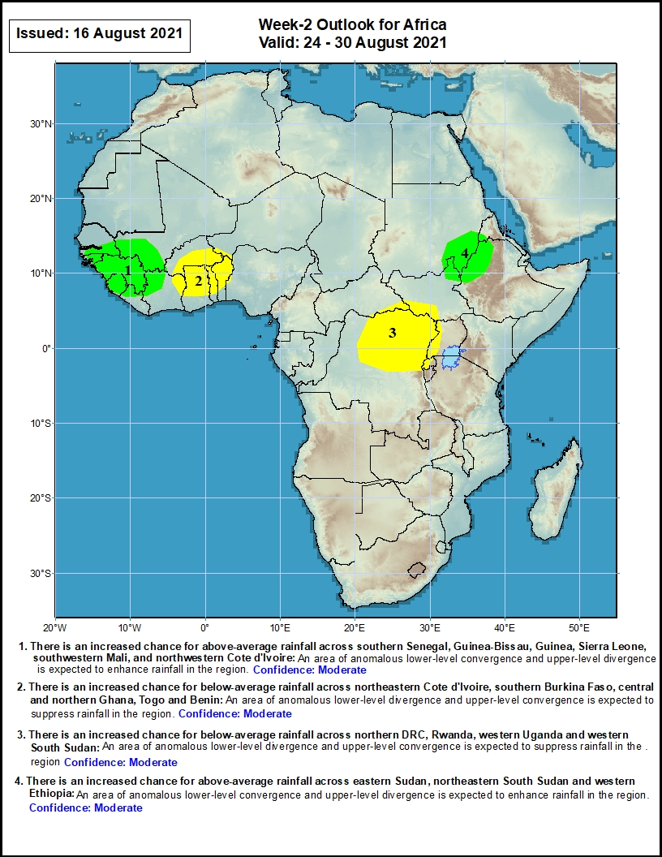
Week-2 Precipitation Outlooks
24 – 30 August, 2021
1. There is an increased chance for above-average rainfall across southern Senegal, Guinea-Bissau, Guinea, Sierra Leone, southwestern Mali, and northwestern Côte d'Ivoire: An area of anomalous lower-level convergence and upper-level divergence is expected to enhance rainfall in the region.
2. There is an increased chance for below-average rainfall across northeastern Côte d'Ivoire, southern Burkina Faso, central and northern Ghana, Togo and Benin: An area of anomalous lower-level divergence and upper-level convergence is expected to suppress rainfall in the region.
3. There is an increased chance for below-average rainfall across northern DRC, Rwanda, western Uganda and western South Sudan: An area of anomalous lower-level divergence and upper-level convergence is expected to suppress rainfall in the region.
4. There is an increased chance for above-average rainfall across eastern Sudan, northeastern South Sudan and western Ethiopia: An area of anomalous lower-level convergence and upper-level divergence is expected to enhance rainfall in the region.
Notes:
11

Slide 12
Summary
During the past 30 to 90 days, in East Africa, above-average rainfall was observed over Sudan, parts of South Sudan Republic, Eritrea, and northern Ethiopia. Rainfall was below-average over portions of South Sudan, central and southern Ethiopia, and Uganda. In Central Africa, rainfall was below-average over parts of central DRC, Cameroon, southwestern Chad, and portions of CAR. Rainfall was above-average over much of Chad and CAR, Equatorial Guinea, Gabon, Congo, and local areas in northern DRC. In West Africa, rainfall was above-average over Senegal, Guinea, Sierra Leone, northern Liberia, southern Mali, Burkina Faso, northern Côte d’Ivoire, northern Togo, northern Benin, southern Niger, and portions of Nigeria. Below-average rainfall was observed over southern Ghana, southern Togo, southern Benin, and portions of Nigeria.
During the past 7 days, in East Africa, rainfall was above-average over much of Sudan, southern and eastern South Sudan, and western Ethiopia. Light moisture deficits were observed over southwestern Sudan, and northwestern South Sudan. In Central Africa, rainfall was above-average over central Chad. Below-average rainfall was observed over southern Chad, much of Cameroon and CAR, northern Congo, and northwestern DRC. In West Africa, above-average rainfall was observed over Senegal, Guinea, Sierra Leone, Liberia, southwestern Mali, parts of Burkina Faso, Côte d’Ivoire, and parts of southern Nigeria. Below-average rainfall was observed over central Mali, northern Burkina Faso, northern Benin, and portions of Nigeria.
The week-1 outlooks depict an increased chance for above-average rainfall across southern Senegal, Guinea-Bissau, Guinea, Sierra Leone, southwestern Mali, northern Côte d'Ivoire, western Burkina Faso, eastern Nigeria, Cameroon, southern Chad, and western CAR. Conversely, there is an increased chance for below-average rainfall across central Mali, central and eastern Burkina Faso, southern Niger, northern Benin, and northwestern Nigeria.
The week-2 outlooks call for an increased chance for above-average rainfall across southern Senegal, Guinea-Bissau, Guinea, Sierra Leone, southwestern Mali, northwestern Côte d'Ivoire, eastern Sudan, northeastern South Sudan, and western Ethiopia. In contrast, there is an increased chance for below-average rainfall across northeastern Côte d'Ivoire, southern Burkina Faso, central and northern Ghana, Togo, Benin, northern DRC, Rwanda, western Uganda, and western South Sudan.

