Slide 1
The African Monsoon Recent Evolution and Current Status Include Week-1 and Week-2 Outlooks
Update prepared by
02 August 2021
For more information, visit:
http://www.cpc.ncep.noaa.gov/products/Global_Monsoons/African_Monsoons/precip_monitoring.shtml

Slide 2
Outline
Highlights
Recent Evolution and Current Conditions
NCEP GEFS Forecasts
Summary

Slide 3
Highlights: Last 7 Days
During the past 7 days, weekly rainfall totals exceeded 150 mm (moisture surpluses of over 100 mm) in southern Senegal, Guinea-Bissau, Guinea, parts of southern Mali, northwestern Côte d’Ivoire, and pocket areas in western Burkina Faso.
Week-1 outlooks call for an increased chance for above-average rainfall over southern Senegal, Guinea-Bissau, Guinea, Sierra Leone, southern Mali northern Cote d'Ivoire, western Burkina Faso, northern Benin, southern Niger, northern Nigeria, Chad, western Sudan, eastern Sudan and western Ethiopia. In contrast, the outlooks call for an increased chance for below-average rainfall over eastern Cote d'Ivoire, central Ghana, Togo, Benin, southwestern Nigeria, northern Congo, southern CAR and northern DRC.
Week-2 outlooks call for an increased chance for above-average rainfall across Guinea, Sierra Leone, southern Mali, Burkina Faso, northern Ghana, northern Togo, northern Benin, southern Niger, northern Nigeria, southern Chad and western Sudan. In contrast the outlooks call for an increased chance for below-average rainfall across northern Congo, southern CAR and northern DRC.

Slide 4
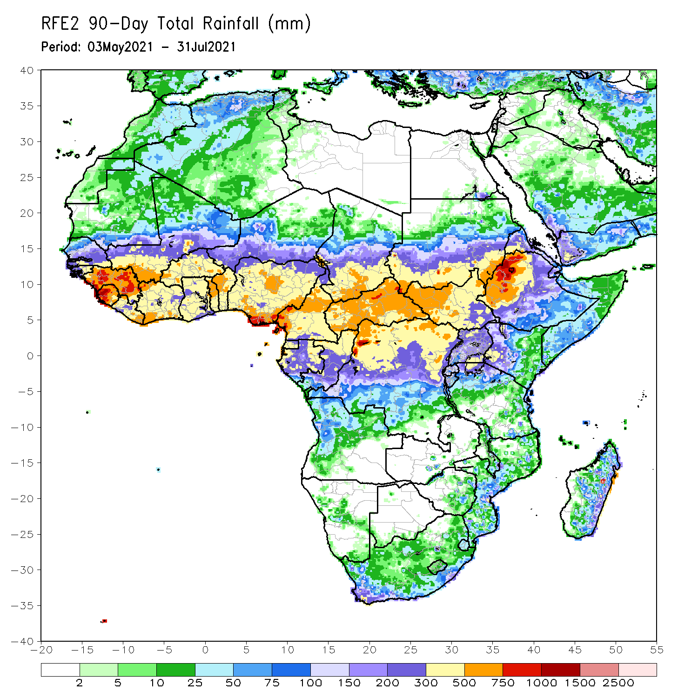
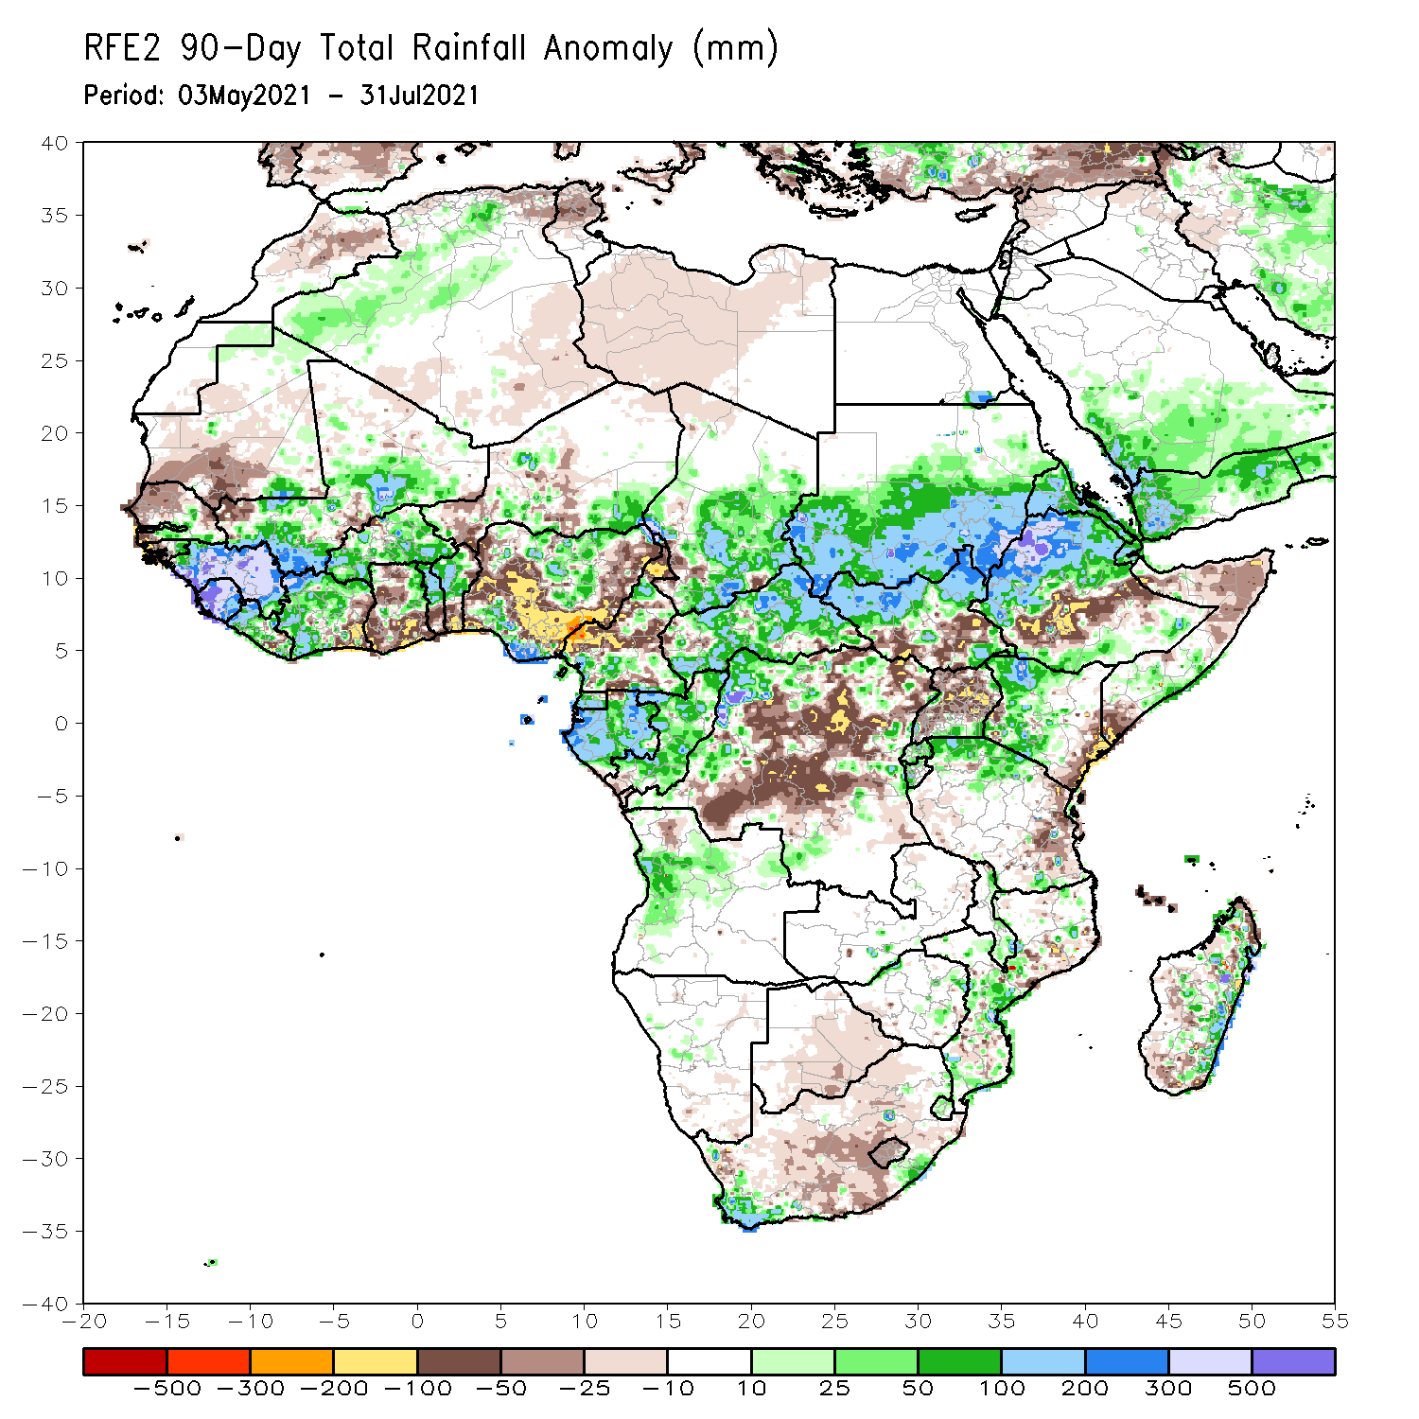
Rainfall Patterns: Last 90 Days
Over the past 90 days, in East Africa, rainfall was well above-average over southern Sudan, northern South Sudan, Eritrea, northern and southern Ethiopia, western Kenya, and northern Tanzania. Below-average rainfall was observed over parts of southern South Sudan, central Ethiopia, much of Uganda, northern and southern Somalia, eastern Kenya, and eastern Tanzania.
In southern Africa, above-average rainfall was observed over the far southern part of South Africa, local areas in Mozambique, eastern Madagascar, and northern Angola. Light moisture deficits were observed over Botswana, much of South Africa, and western Madagascar.
In Central Africa, positive precipitation anomalies were found over southern Chad, CAR, Equatorial Guinea, Gabon, Congo, and portions of DRC. Negative precipitation anomalies occurred in much of Cameroon and northeastern and central DRC.
In West Africa, moisture surpluses were observed over Guinea, Sierra Leone, Liberia, Côte d’Ivoire, southern and central Mali, Burkina Faso, northern Togo, northern Benin, southeastern Niger, and northern and southern Nigeria. Much of Senegal, western Guinea-Bissau, local areas in Mali, southeastern Côte d’Ivoire, Ghana, southern Togo, southern Benin, and portions of Niger and Nigeria experienced moisture deficits.
Notes:
4

Slide 5
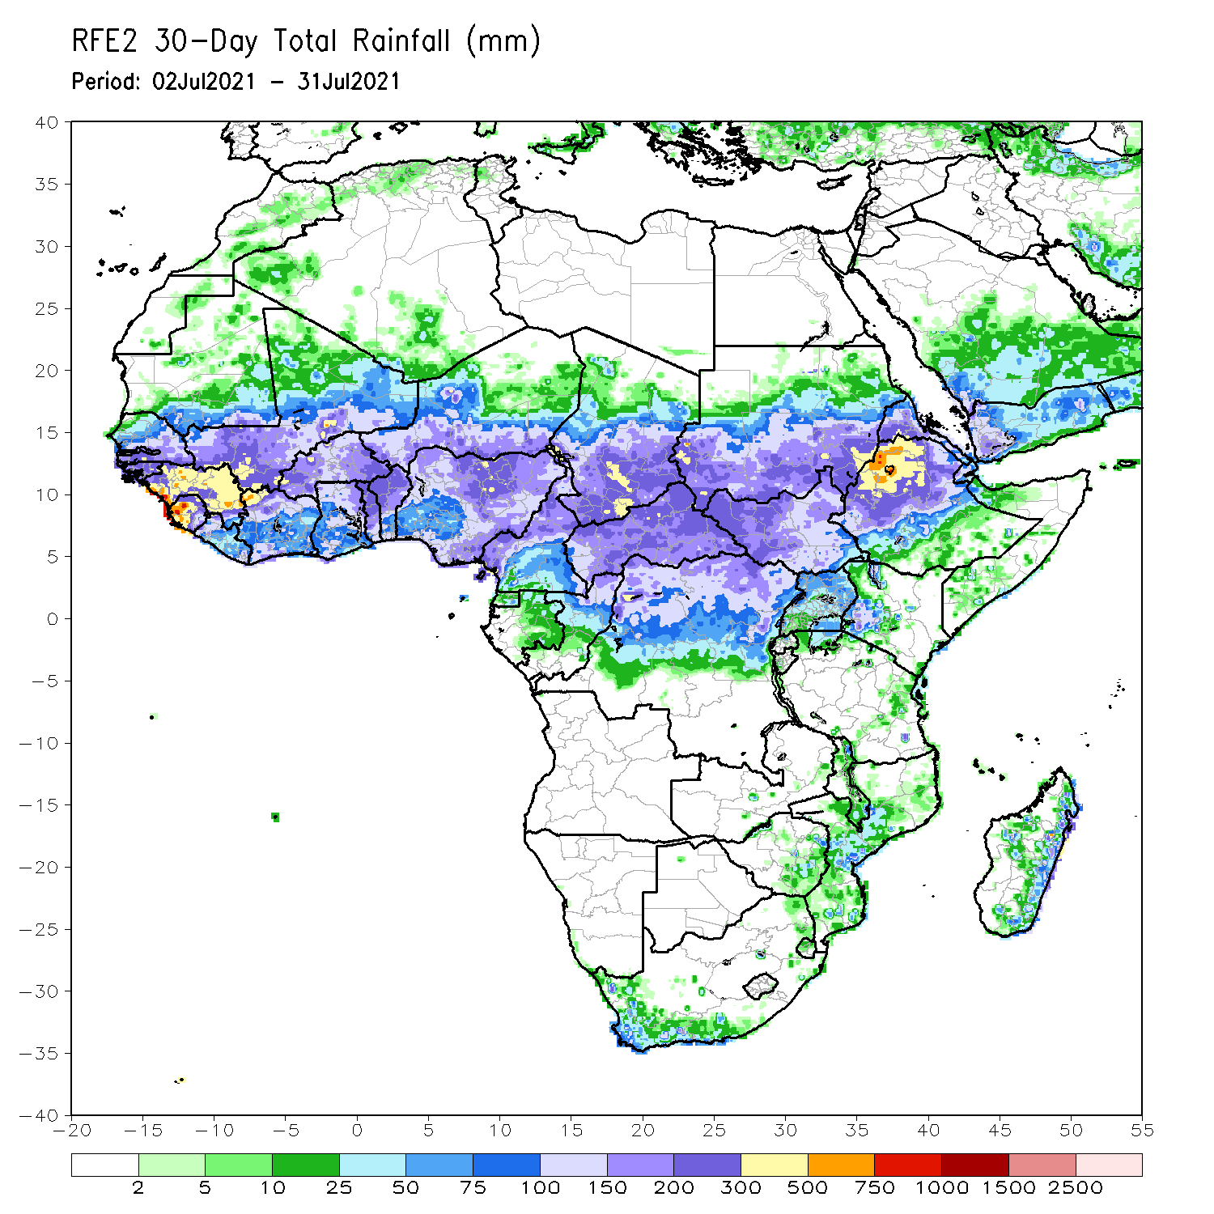
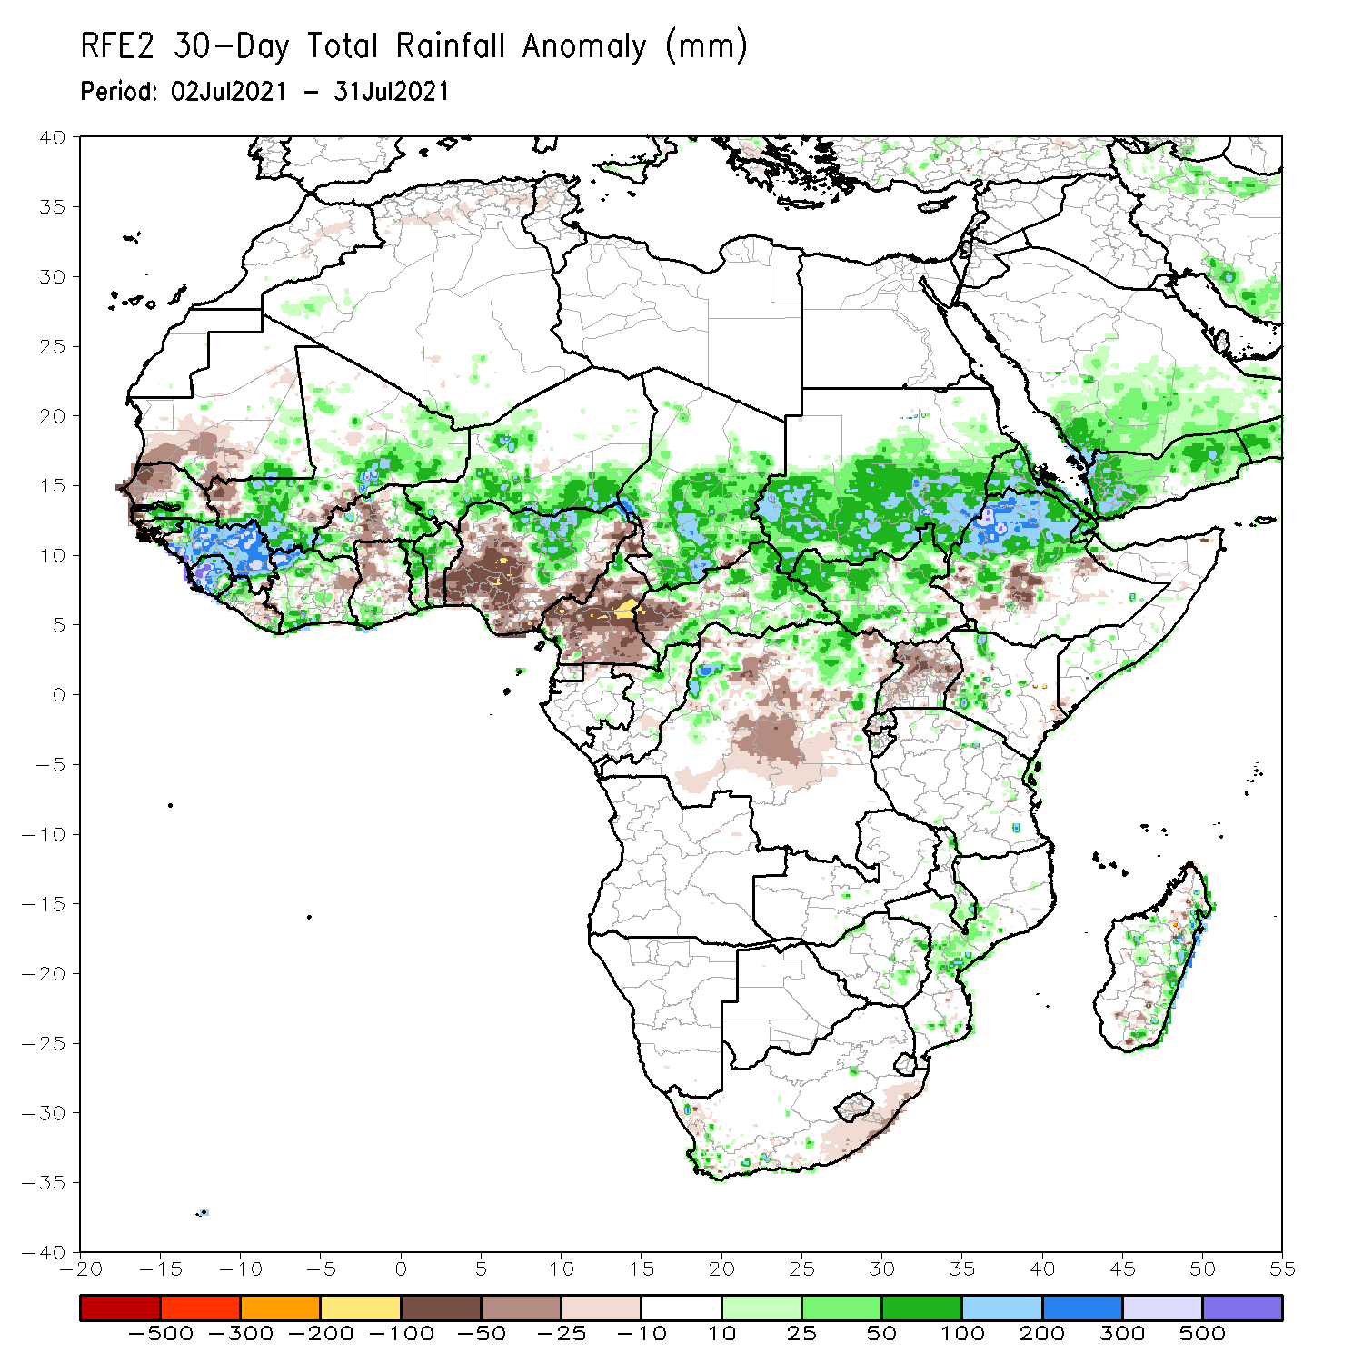
Rainfall Patterns: Last 30 Days
During the past 30 days, in East Africa, above-average rainfall was observed over the southern Sudan, South Sudan, Eritrea, northern Ethiopia, and local areas in western Kenya. Rainfall was below-average over central Ethiopia and Uganda.
In southern Africa, portions of Mozambique and eastern Madagascar experienced positive rainfall anomalies.
In Central Africa, rainfall was well above-average over Chad, much of CAR, local areas in northern DRC, and northern Congo. Conversely, below-average conditions were found over many parts of Cameroon, western CAR, and central DRC.
In West Africa, rainfall was above-average over southern and eastern Senegal, eastern Guinea-Bissau, Guinea, Sierra Leone, northern and southern Liberia, parts of Côte d’Ivoire, much of Mali, eastern and western Burkina Faso, northern Togo, northern Benin, Niger and northern Nigeria. Moisture deficits were observed over northern and western Senegal, local areas in Mali, central Burkina Faso, northern Ghana, southern Benin, and many parts of Nigeria.
Notes:
5

Slide 6
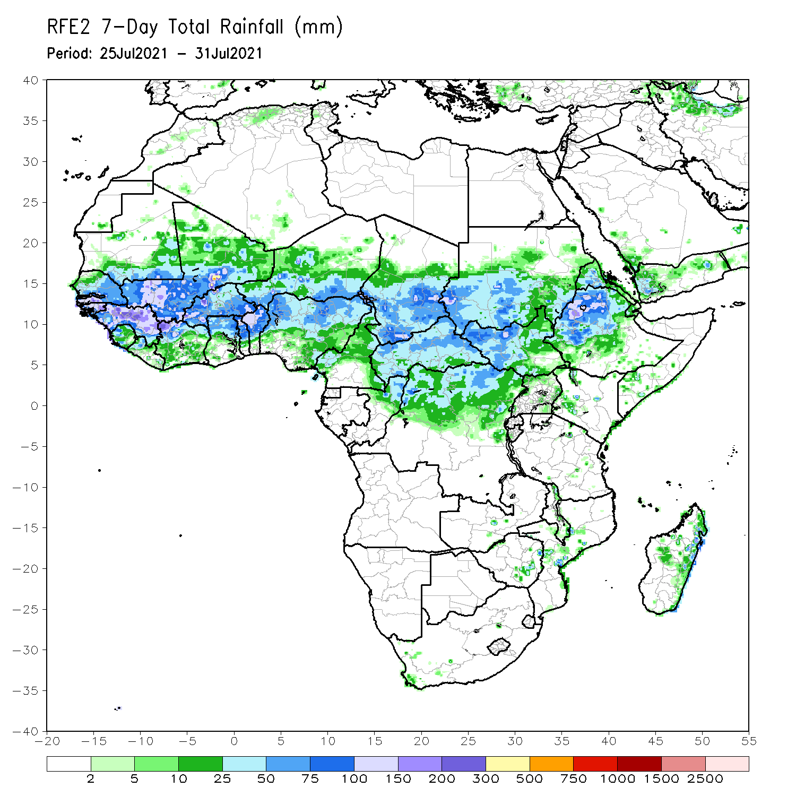
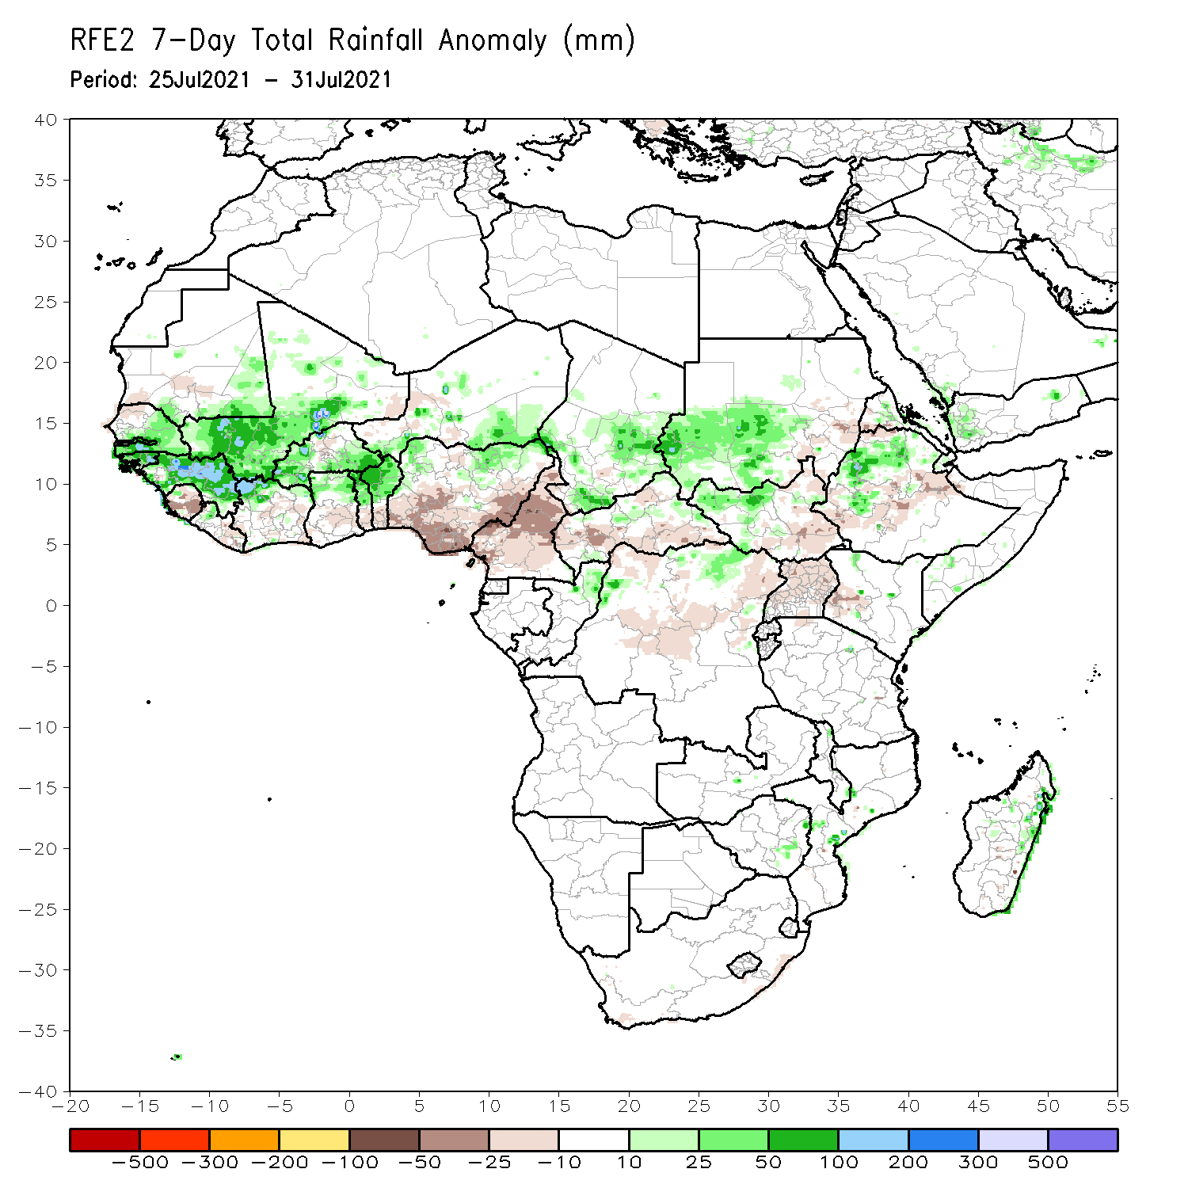
Rainfall Patterns: Last 7 Days
During the past 7 days, in East Africa, rainfall was above-average over southwestern Sudan, northwestern South Sudan, local areas in Eritrea, and northwestern Ethiopia. Precipitation was slightly below-average over southeastern Sudan, eastern South Sudan, Uganda, western Kenya, and parts of Ethiopia.
In Central Africa, rainfall was above-average over southern Chad, pocket areas in CAR, northern Congo, and northern DRC. Cameroon, many parts of CAR and DRC experienced below-average rainfall.
In West Africa, southern and eastern Senegal, Guinea-Bissau, Guinea, Mali, northern Côte d’Ivoire, Burkina Faso, northern Ghana, northern Togo, northern Benin, southern Niger and northern Nigeria observed above-average rainfall. Northwestern Senegal, Sierra Leone and much of Nigeria experienced below-average rainfall conditions.

Slide 7
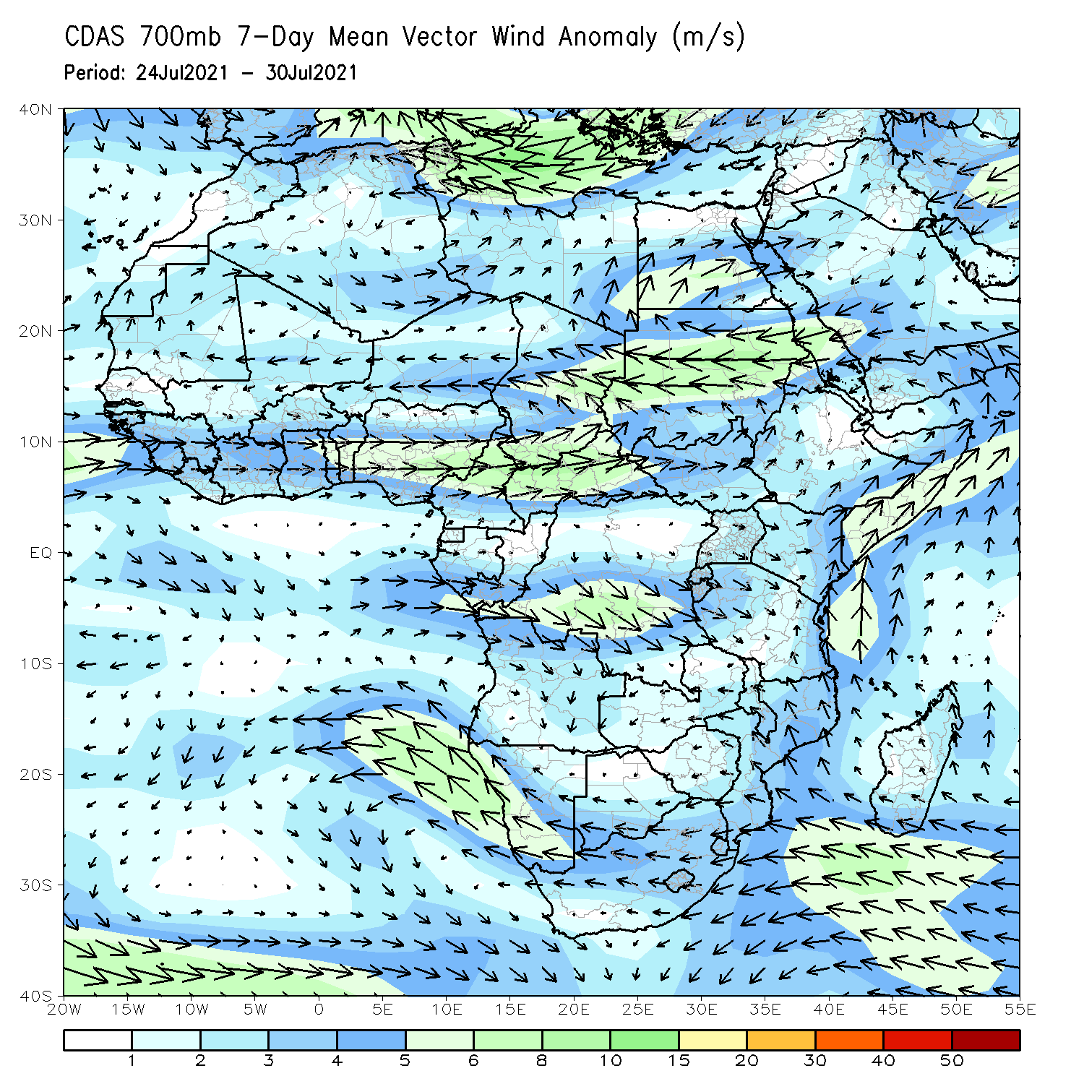
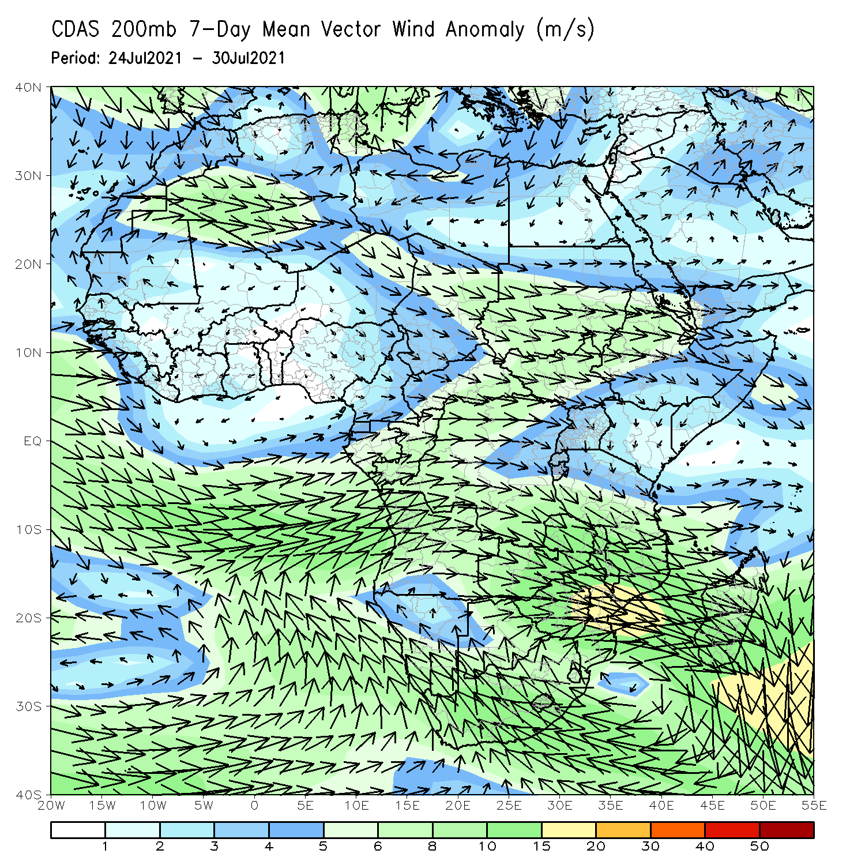
Atmospheric Circulation: Last 7 Days
The 700-hPa atmospheric circulation pattern features an anomalous cyclonic circulation over the western part of the Sahel (left panel).

Slide 8
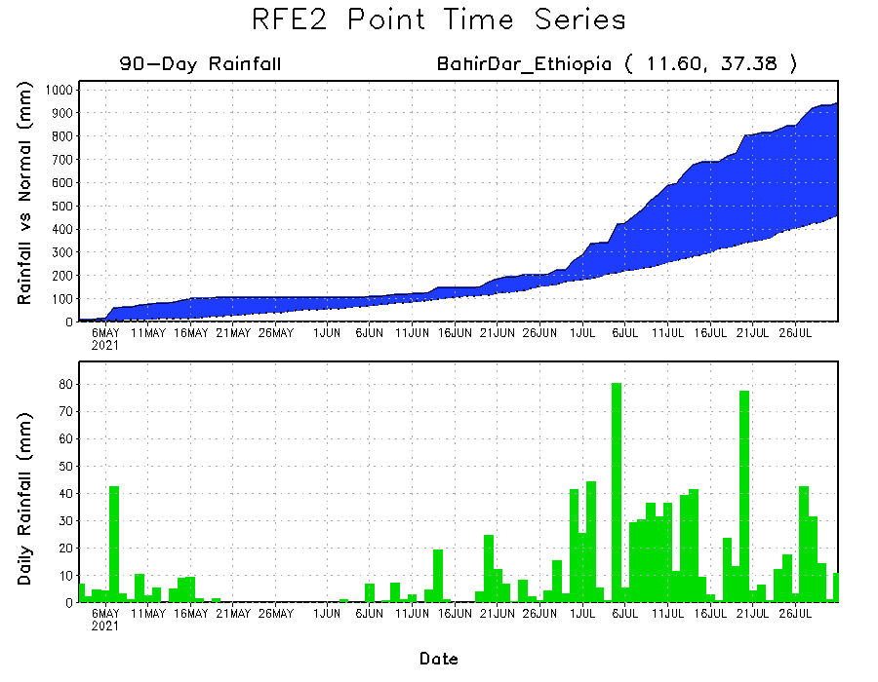
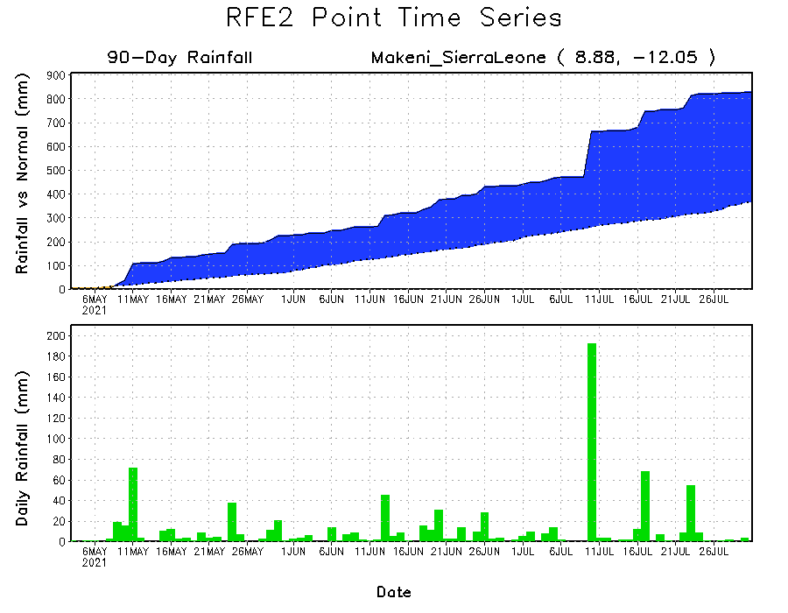
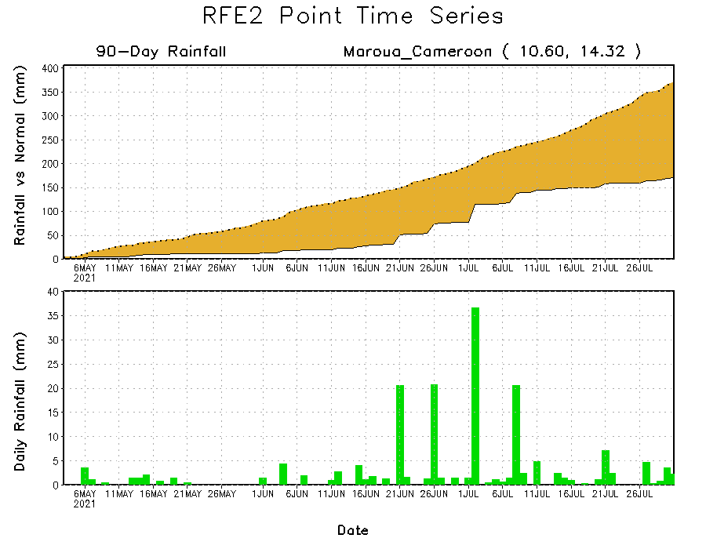
Rainfall Evolution
Daily evolution of rainfall over the last 90 days at selected locations shows moderate to heavy rainfall sustained moisture surpluses over parts of Sierra Leone (bottom left) and western Ethiopia (top right). In contrast, seasonal total rainfall remained below-average over northern Cameroon (bottom right).

Slide 9
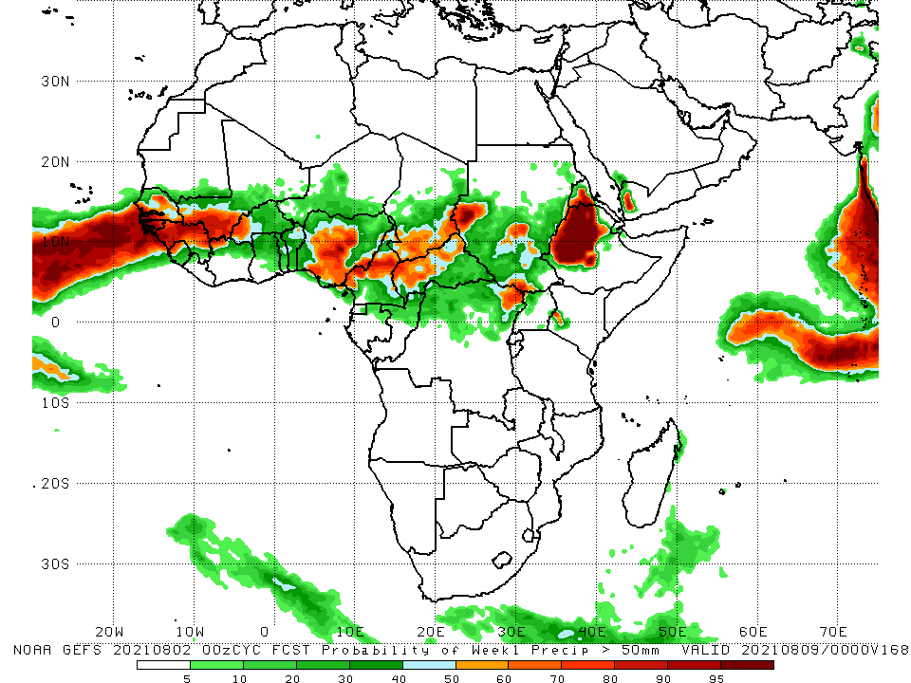
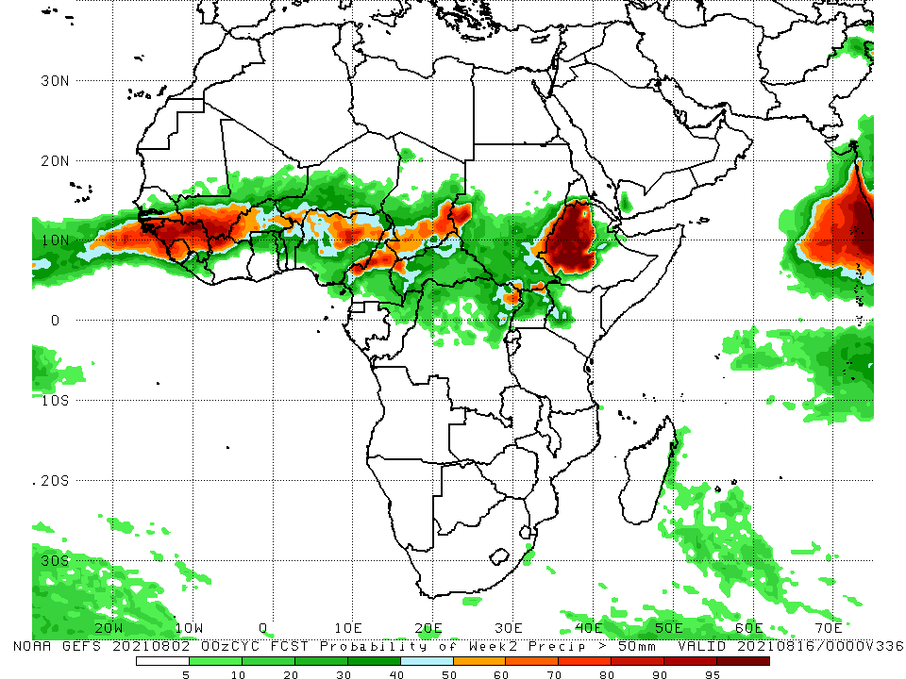
NCEP GEFS Model Forecasts Non-Bias Corrected Probability of precipitation exceedance
Week-1, Valid: 03 – 09 August, 2021
Week-2, Valid: 10 – 16 August, 2021
For week-1 (left panel) and week-2 (right panel), the NCEP GEFS indicates a moderate to high chance (over 70%) for rainfall to exceed 50 mm over Senegal, Guinea-Bissau, Guinea, Sierra Leone, southern Mali, northern Côte d’Ivoire, Burkina Faso, Nigeria, Cameroon, southern Chad, CAR, parts of Sudan and South Sudan, northeastern DRC, portions of Eritrea, and western Ethiopia.
In addition, week-2 forecast depicts an increased chance for weekly rainfall to exceed 50 mm over southern Niger.
Notes:
9

Slide 10
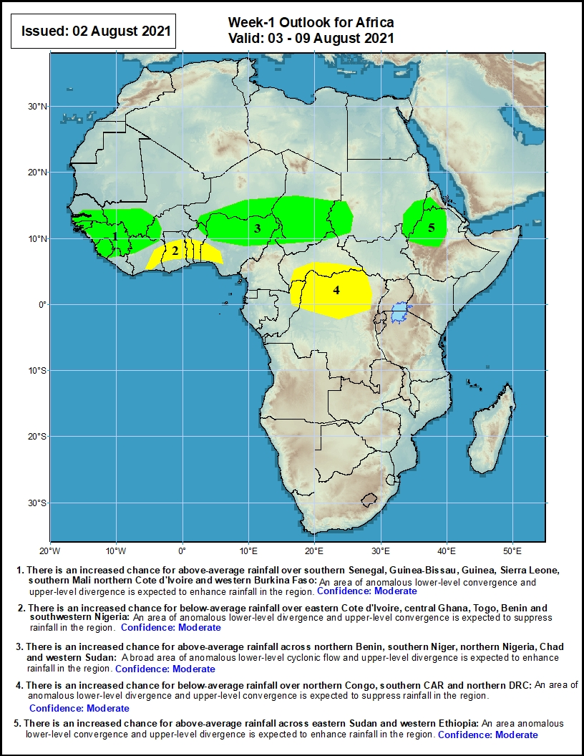
Week-1 Precipitation Outlooks
03 – 09 August, 2021
There is an increased chance for above-average rainfall over southern Senegal, Guinea-Bissau, Guinea, Sierra Leone, southern Mali northern Cote d'Ivoire and western Burkina Faso: An area of anomalous lower-level convergence and upper-level divergence is expected to enhance rainfall in the region.
There is an increased chance for below-average rainfall over eastern Cote d'Ivoire, central Ghana, Togo, Benin and southwestern Nigeria: An area lower-level divergence and upper-level convergence is expected to suppress rainfall in the region.
There is an increased chance for above-average rainfall across northern Benin, southern Niger, northern Nigeria, Chad and western Sudan: A broad area of anomalous lower-level cyclonic flow and upper-level divergence is expected to enhance rainfall in the region.
There is an increased chance for below-average rainfall over northern Congo, southern CAR and northern DRC: An area of anomalous lower-level divergence and upper-level convergence is expected to suppress rainfall in the region.
There is an increased chance for above-average rainfall across eastern Sudan and western Ethiopia: An area anomalous lower-level convergence and upper-level divergence is expected to enhance rainfall in the region.
Notes:
10

Slide 11
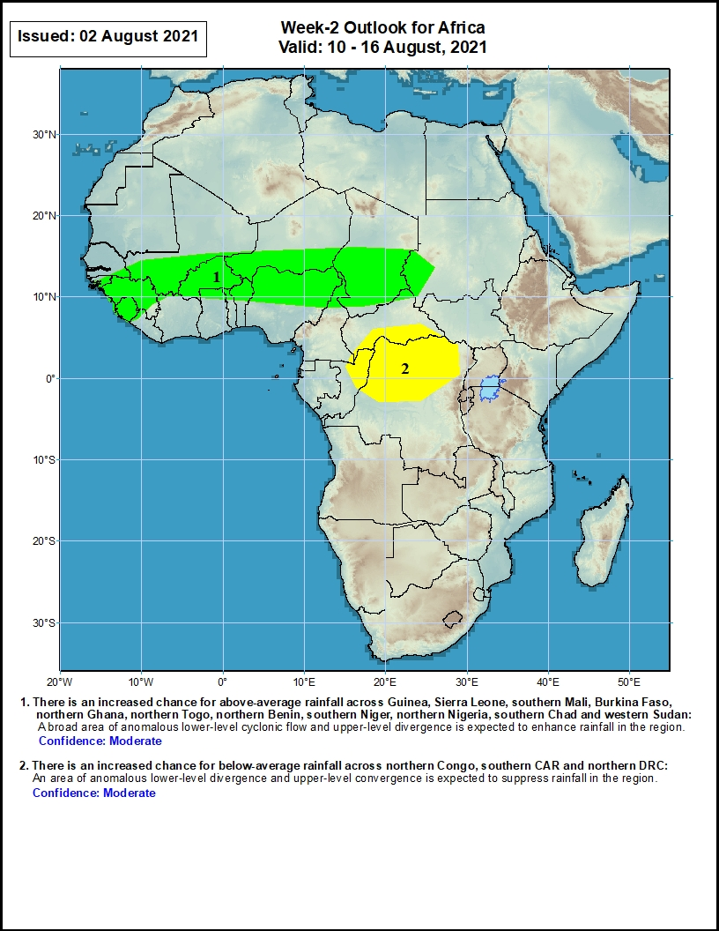
Week-2 Precipitation Outlooks
10 – 16 August, 2021
There is an increased chance for above-average rainfall across Guinea, Sierra Leone, southern Mali, Burkina Faso, northern Ghana, northern Togo, northern Benin, southern Niger, northern Nigeria, southern Chad and western Sudan: A broad area of anomalous lower-level cyclonic flow and upper-level divergence is expected to enhance rainfall in the region.
There is an increased chance for below-average rainfall across northern Congo, southern CAR and northern DRC: An area of anomalous lower-level divergence and upper-level convergence is expected to suppress rainfall in the region.
Notes:
11

Slide 12
Summary
During the past 30 to 90 days, in East Africa, above-average rainfall was observed over the southern parts of Sudan and northern South Sudan Republic, Eritrea, and many parts of Ethiopia. Rainfall was below-average over central Ethiopia, and Uganda. In Central Africa, rainfall was below-average over parts of central DRC, and Cameroon. Rainfall was above-average over Equatorial Guinea, Gabon, Congo, much of CAR, and pockets of DRC. In West Africa, rainfall was above-average over southern Senegal, Guinea, Sierra Leone, Liberia, much of Mali, Burkina Faso, Côte d’Ivoire, northern Togo, northern Benin, parts of Niger, and northern Nigeria. Below-average rainfall was observed over portions of Senegal, western Guinea-Bissau, Ghana, southern Togo, southern Benin, and portions of Nigeria.
During the past 7 days, in East Africa, rainfall was above-average over southwestern Sudan, western South Sudan, local areas in Eritrea, and northwestern Ethiopia. Below-average rainfall was observed over southeastern Sudan, eastern South Sudan, much of Uganda, and portions of Ethiopia and Eritrea. In Central Africa, rainfall was above-average over southern Chad, parts of CAR, northern Congo, and local areas in northern DRC. Below-average rainfall was observed over Cameroon, much of CAR and DRC. In West Africa, above-average rainfall was observed over much of the Sahel region. Below-average rainfall was observed over much of the Gulf of Guinea region, and over northwestern Senegal, and local areas in northern Burkina Faso and western Niger.
Week-1 outlooks call for an increased chance for above-average rainfall over southern Senegal, Guinea-Bissau, Guinea, Sierra Leone, southern Mali northern Cote d'Ivoire, western Burkina Faso, northern Benin, southern Niger, northern Nigeria, Chad, western Sudan, eastern Sudan and western Ethiopia. In contrast, the outlooks call for an increased chance for below-average rainfall over eastern Cote d'Ivoire, central Ghana, Togo, Benin, southwestern Nigeria, northern Congo, southern CAR and northern DRC.
Week-2 outlooks call for an increased chance for above-average rainfall across Guinea, Sierra Leone, southern Mali, Burkina Faso, northern Ghana, northern Togo, northern Benin, southern Niger, northern Nigeria, southern Chad and western Sudan. In contrast the outlooks call for an increased chance for below-average rainfall across northern Congo, southern CAR and northern DRC.

