Slide 1
The African Monsoon Recent Evolution and Current Status Include Week-1 and Week-2 Outlooks
Update prepared by
06 July 2021
For more information, visit:
http://www.cpc.ncep.noaa.gov/products/Global_Monsoons/African_Monsoons/precip_monitoring.shtml

Slide 2
Outline
Highlights
Recent Evolution and Current Conditions
NCEP GEFS Forecasts
Summary

Slide 3
Highlights: Last 7 Days
During the past 7 days, in East Africa, rainfall was above-average over parts of eastern and southern Sudan, South Sudan, and western Ethiopia. In Central Africa, rainfall was below-average over pockets of northern DRC, Cameroon and western CAR. Above-average rainfall was observed over pockets of Congo and northeastern DRC. In West Africa, above-average rainfall was observed over many places in the Gulf of Guinea countries. Below-average rainfall was observed over pockets of Senegal, Mali, Sierra Leone, eastern Guinea, Burkina Faso, western Niger, and parts of Nigeria.
Week-1 and week-2 outlooks call for an increased chance for above-average rainfall over the far western and eastern portions of the Gulf of Guinea region, and the western portions of the Greater Horn of Africa. In contrast, the outlooks call for an increased chance for below-average rainfall over the central portions of the Gulf of Guinea region, and the northern portions of Central Africa.

Slide 4
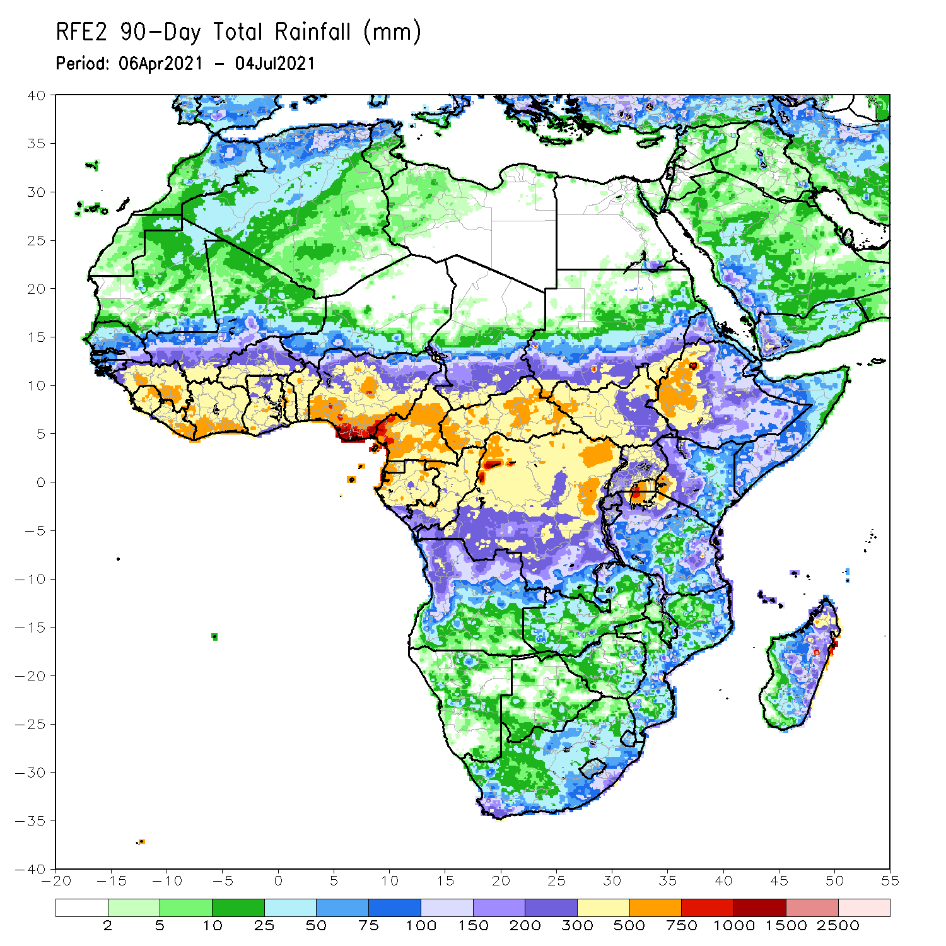
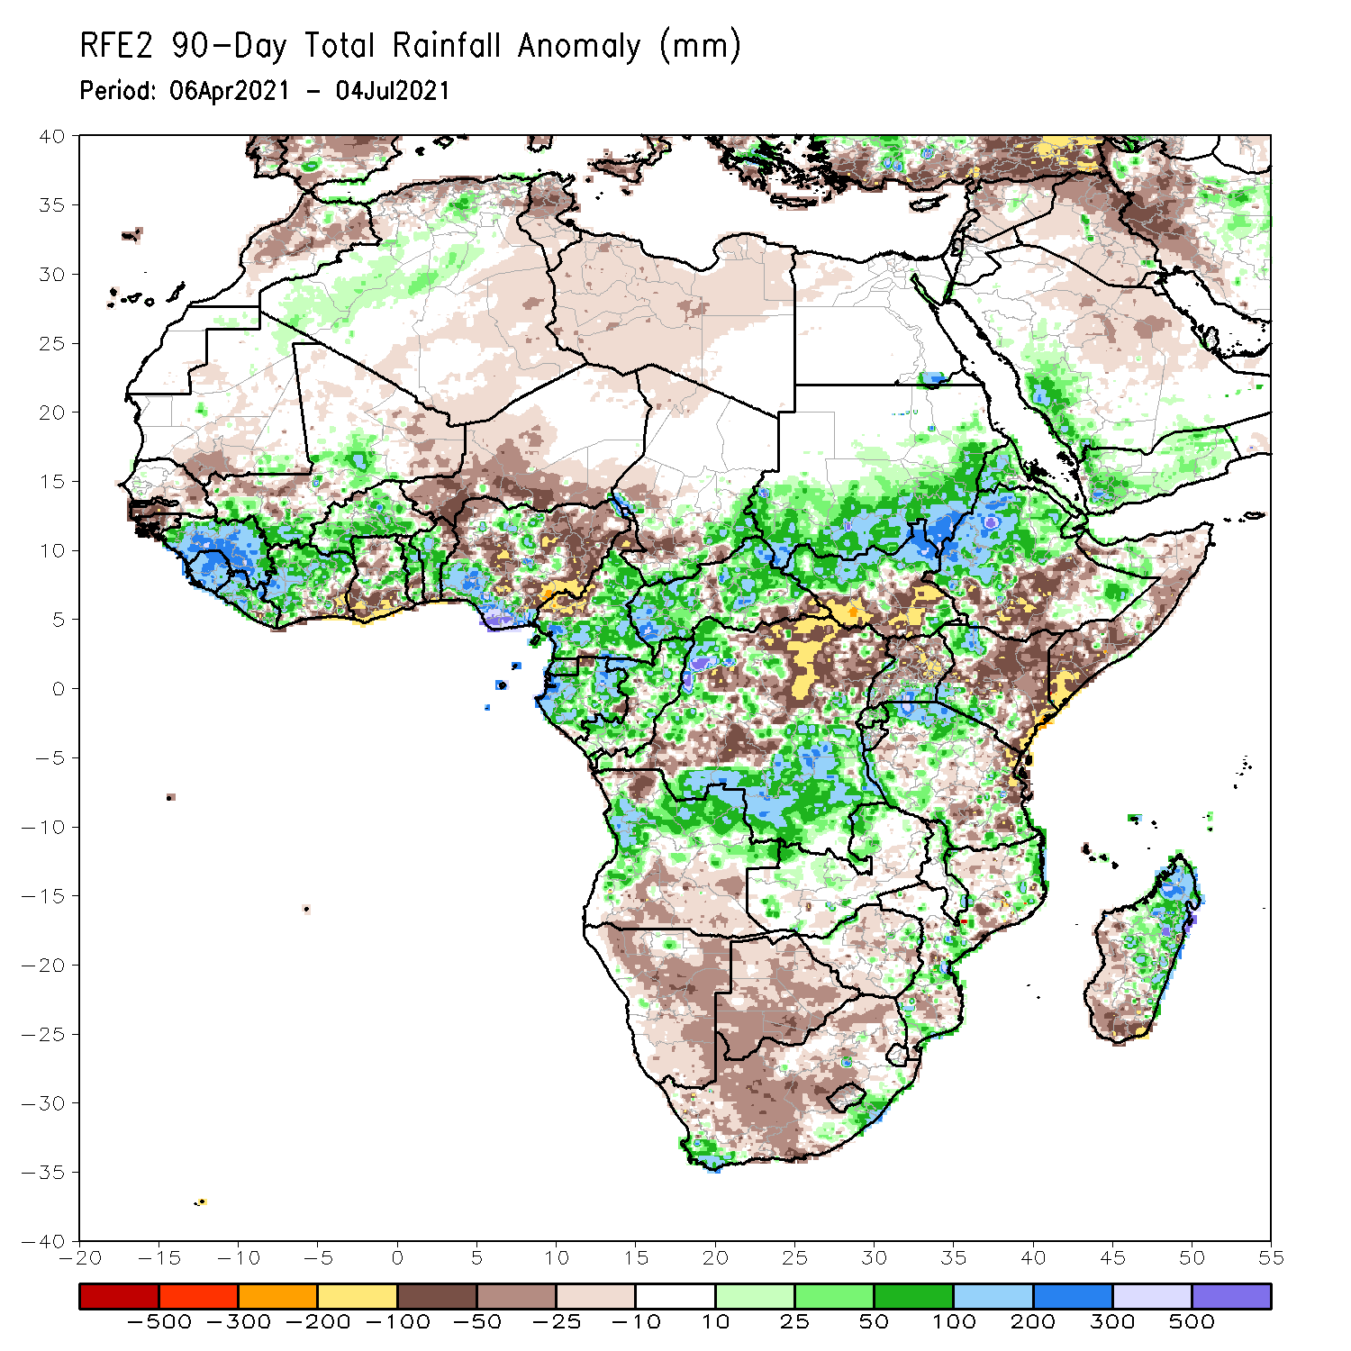
Rainfall Patterns: Last 90 Days
Over the past 90 days, in East Africa, above-average rainfall was observed over western Ethiopia, northern South Sudan, southern and eastern Sudan, Eritrea, parts of southern Uganda, pockets of southeastern Ethiopia, western Kenya, and northern Tanzania. Rainfall was below-average over parts of southern Ethiopia, central and southern Somalia, and central and eastern Kenya. Rainfall was also below-average over southern South Sudan, northern Uganda and parts of southern Tanzania. In southern Africa, above-average rainfall was observed over the far northern Southern Africa, while below-average rainfall was observed over the central and southern portions of Southern Africa. In Central Africa, rainfall was above-average over western and southern DRC, Equatorial Guinea, Gabon, Congo, and much of CAR. Rainfall was below-average over northeastern and central DRC, pockets of central CAR, and western Cameroon. In West Africa, rainfall was above-average over much of Guinea, Sierra Leone, Cote d’Ivoire, Burkina Faso, northern Benin, and southern Nigeria. Below-average rainfall was observed over coastal Cote d’Ivoire, parts of Ghana, southern Togo, Niger, and northern Nigeria.
Notes:
4

Slide 5
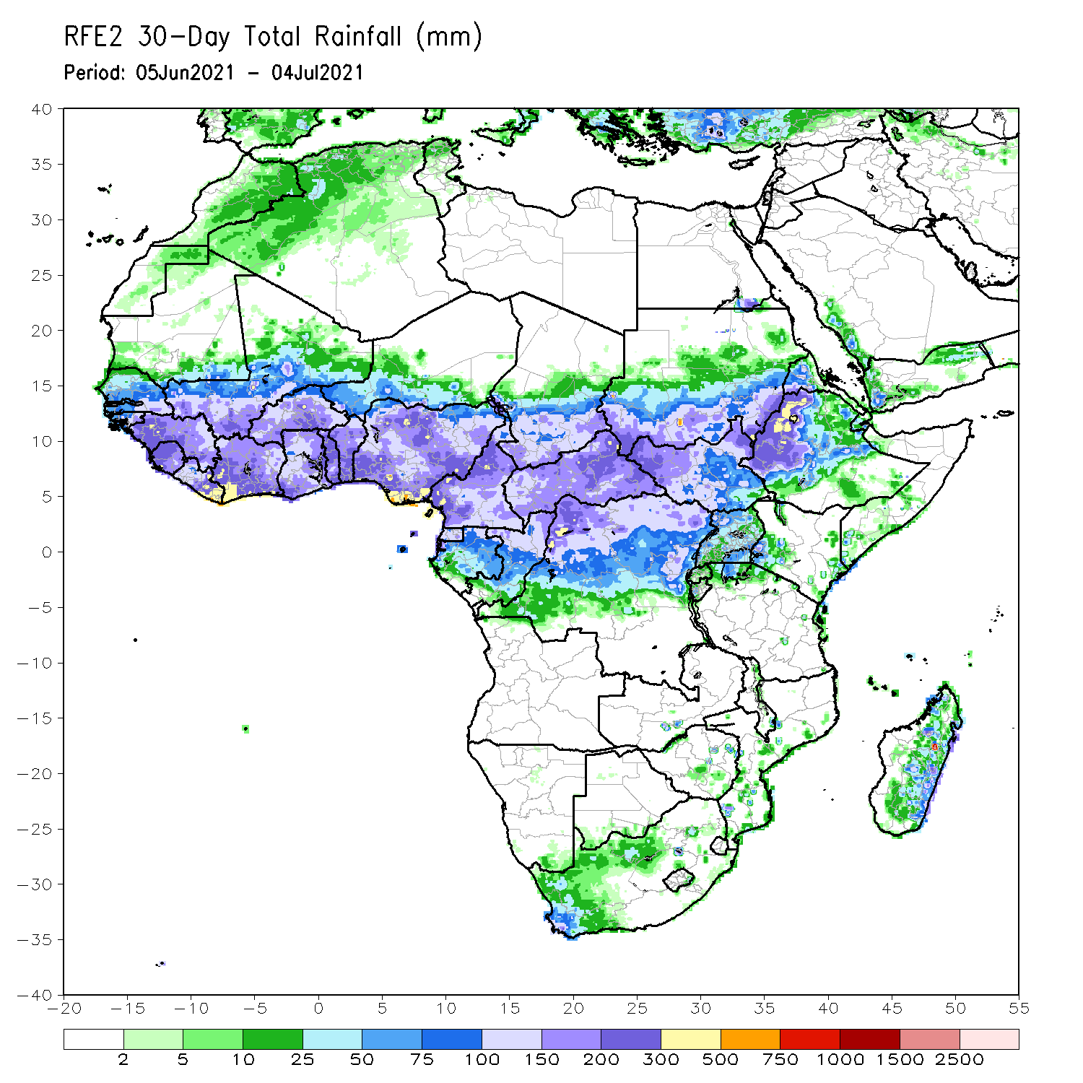
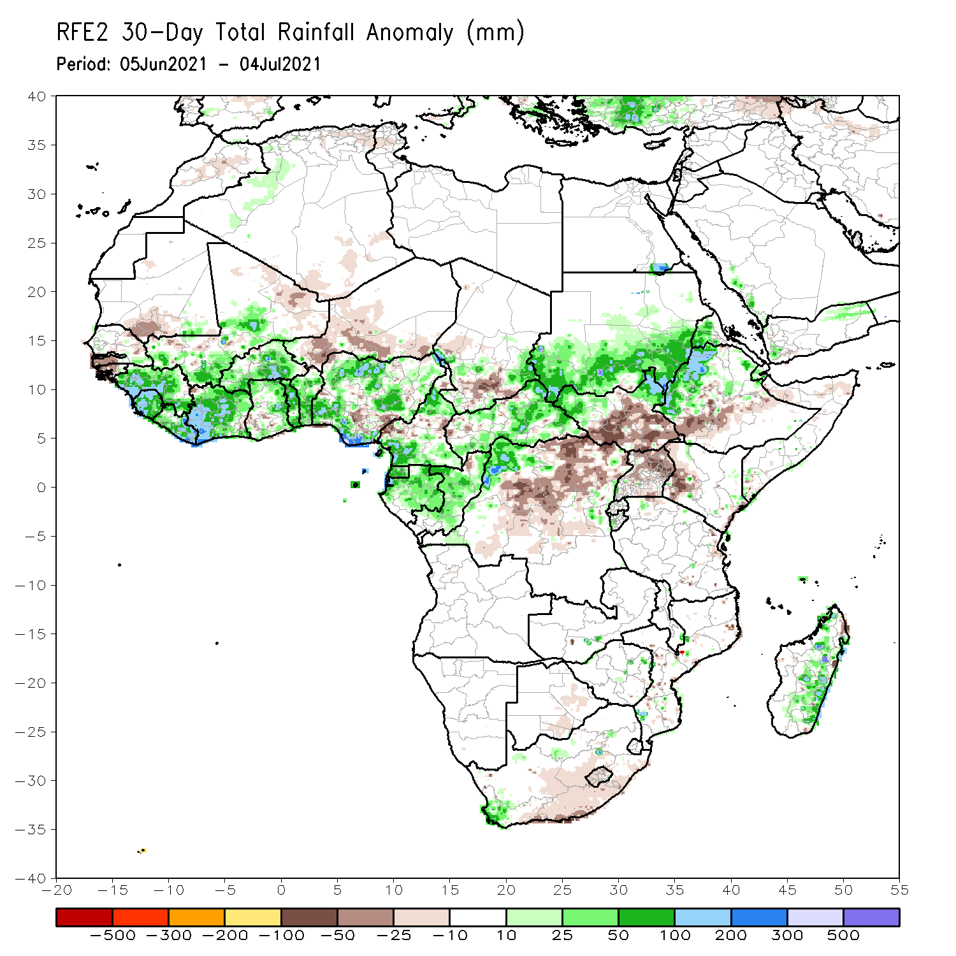
Rainfall Patterns: Last 30 Days
During the past 30 days, in East Africa, above-average rainfall was observed over the southern and eastern parts of Sudan and northern South Sudan Republic, and western Ethiopia. Rainfall was below-average over southern South Sudan, parts of southern Ethiopia, Uganda, and western Kenya. In Central Africa, rainfall was below-average over parts of central and northeastern DRC. Rainfall was above-average over Equatorial Guinea, Gabon, Congo, much of CAR, and northwestern DRC. In West Africa, rainfall was above-average over much of the Gulf of Guinea region and the neighboring areas of the Sahel. Below-average rainfall was observed over Guinea-Bissau, Niger, and pockets of Nigeria.
Notes:
5

Slide 6
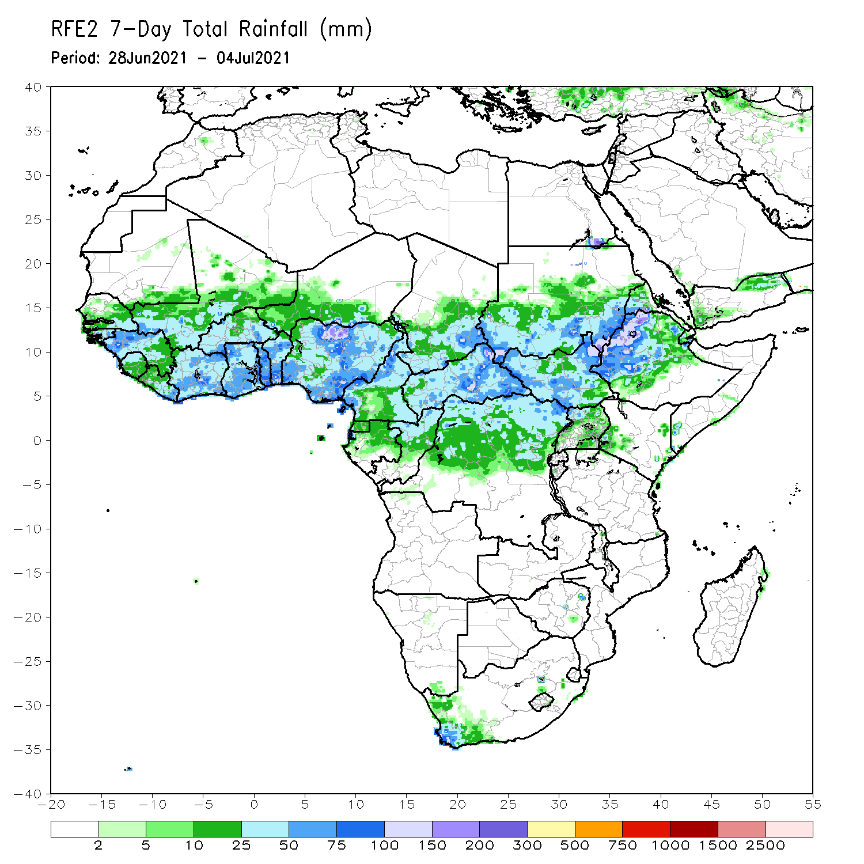
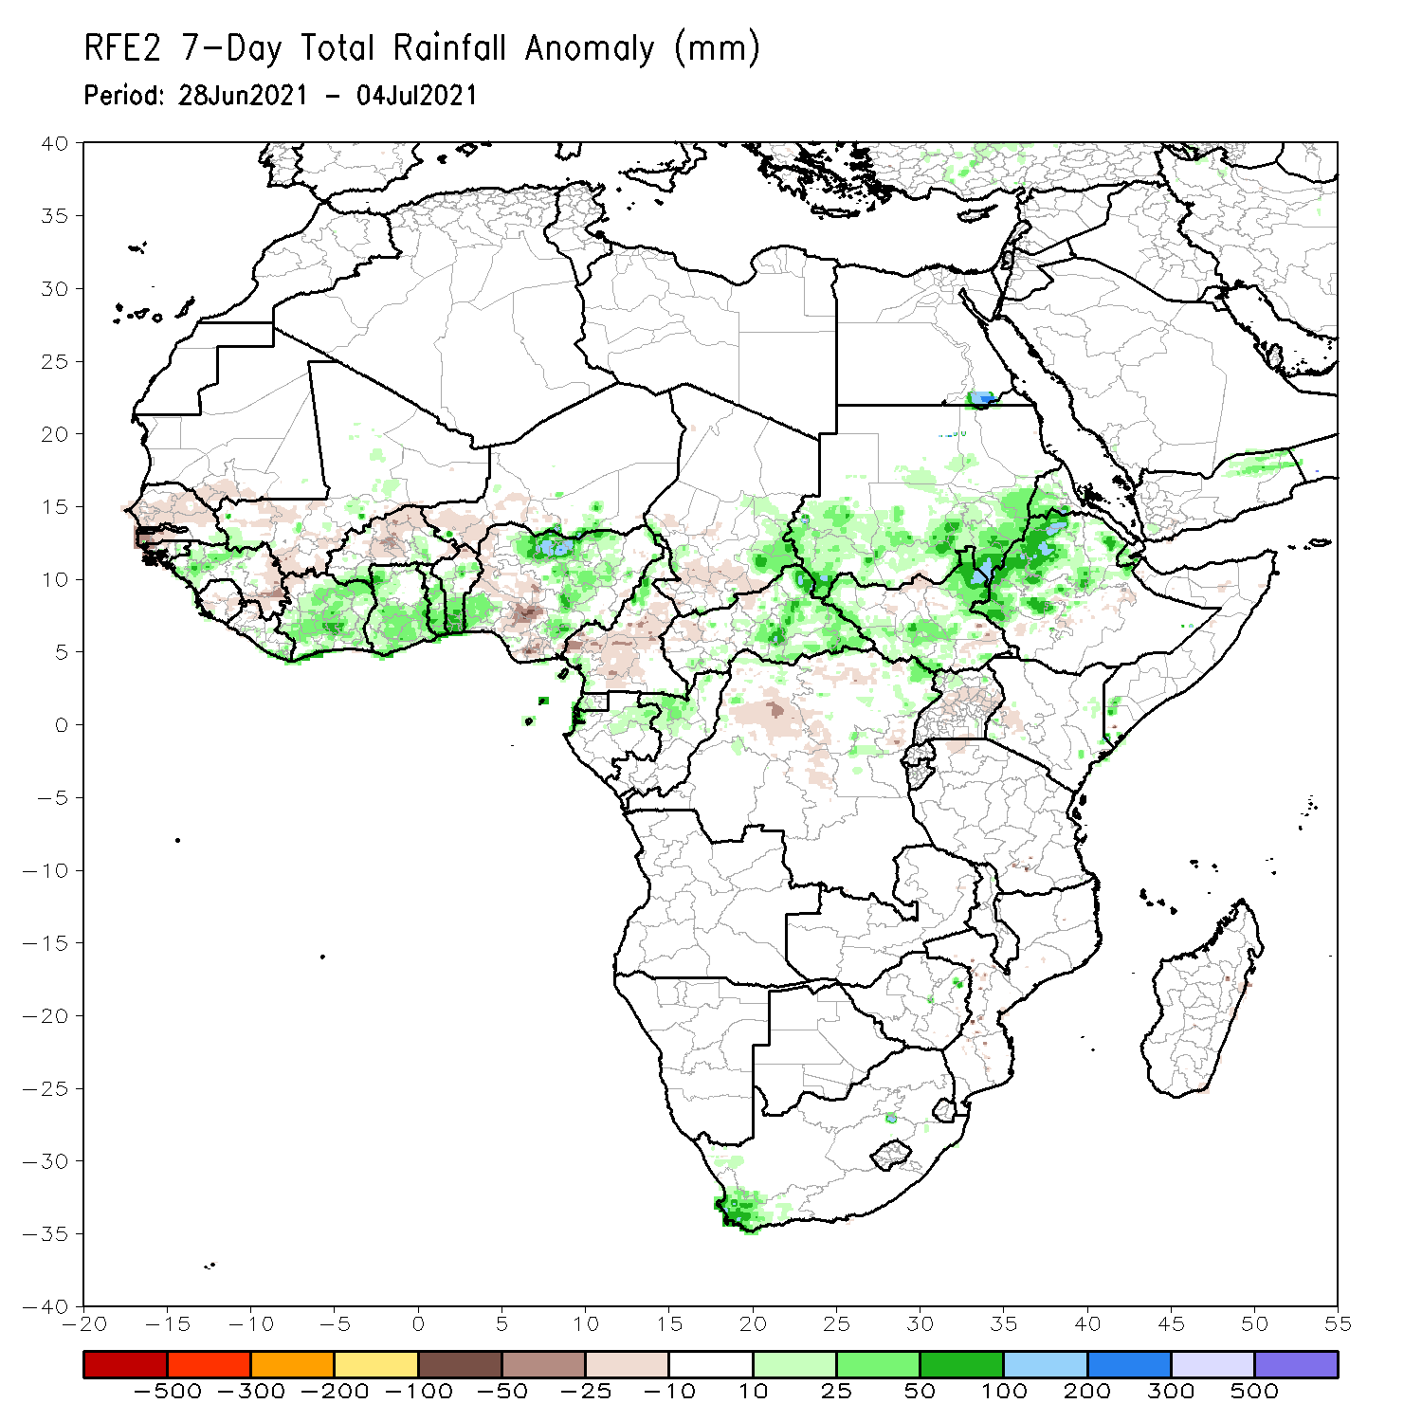
Rainfall Patterns: Last 7 Days
During the past 7 days, in East Africa, rainfall was above-average over parts of eastern and southern Sudan, South Sudan, and western Ethiopia. In Central Africa, rainfall was below-average over pockets of northern DRC, Cameroon and western CAR. Above-average rainfall was observed over pockets of Congo and northeastern DRC. In West Africa, above-average rainfall was observed over many places in the Gulf of Guinea countries. Below-average rainfall was observed over pockets of Senegal, Mali, Sierra Leone, eastern Guinea, Burkina Faso, western Niger, and parts of Nigeria.

Slide 7
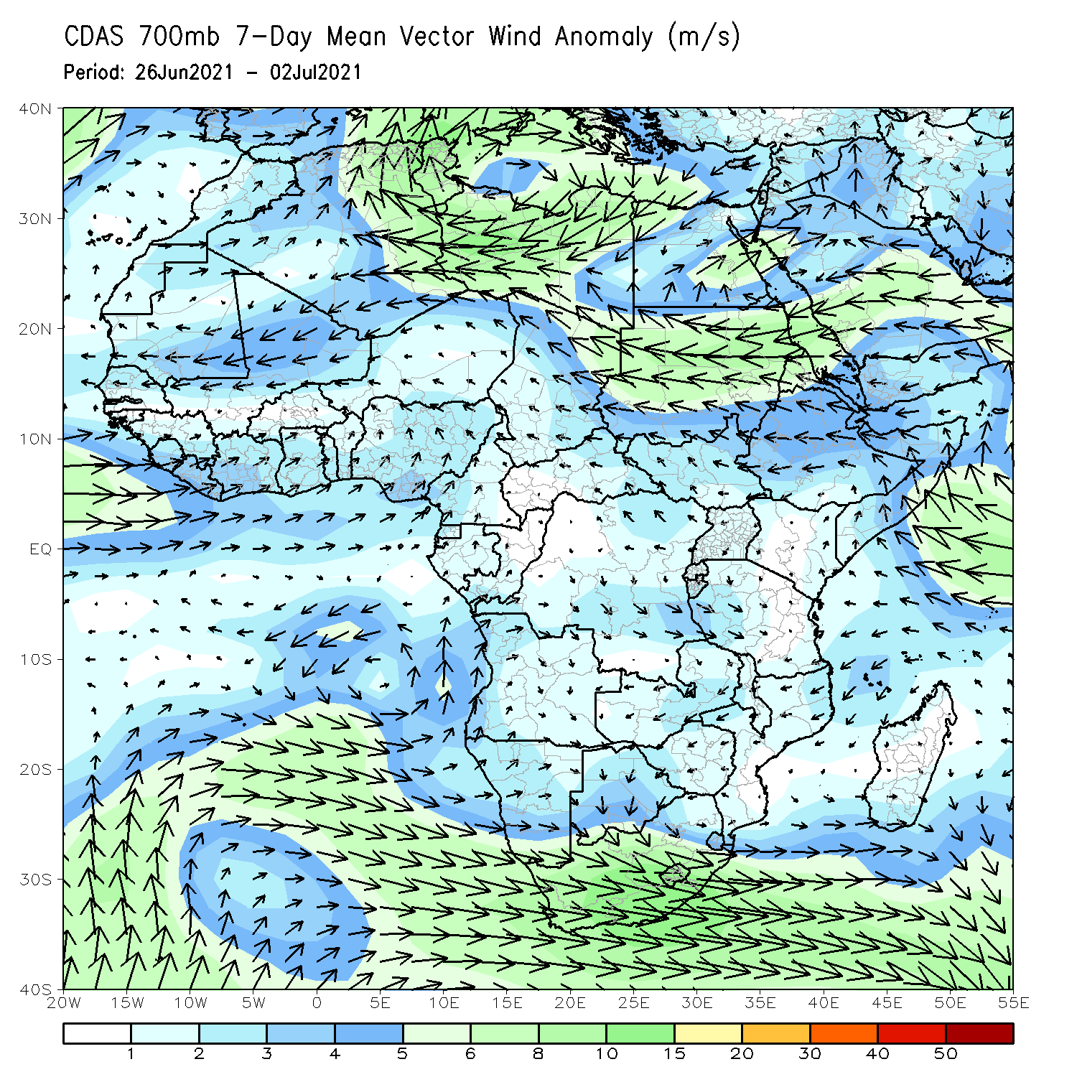
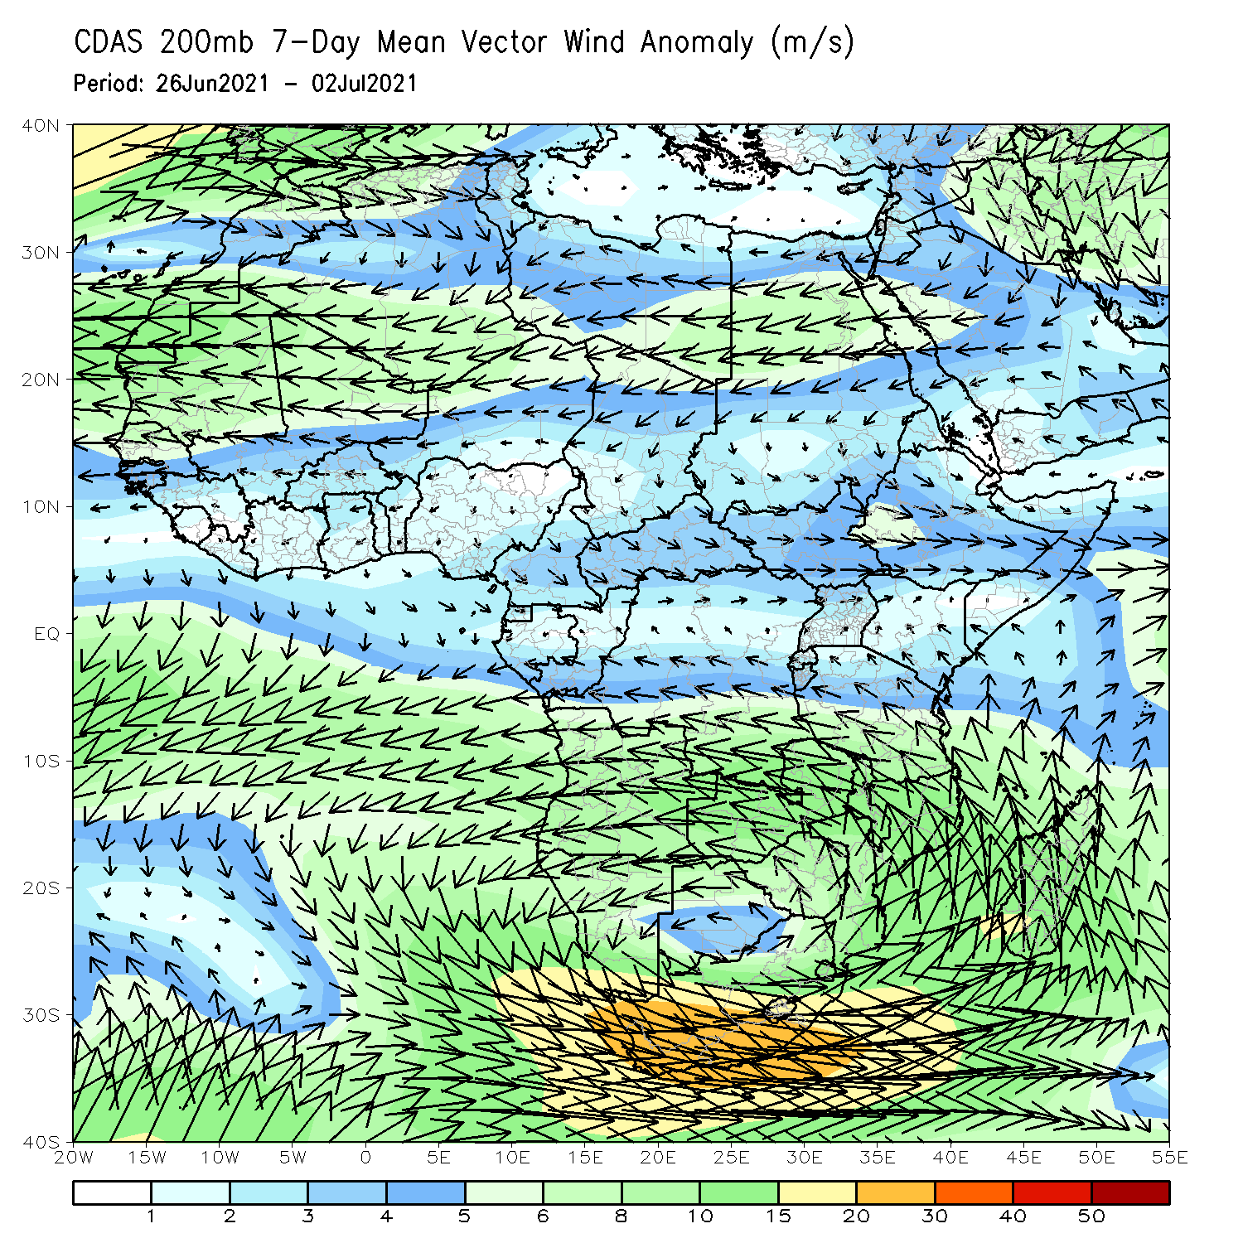
Atmospheric Circulation: Last 7 Days
At 700-hPa level (left panel), anomalous westerly to southwesterly flow with its associated cyclonic turning was observed across the Gulf of Guinea region.

Slide 8
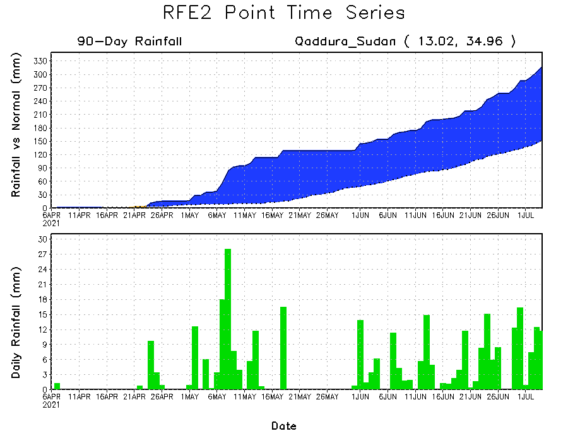
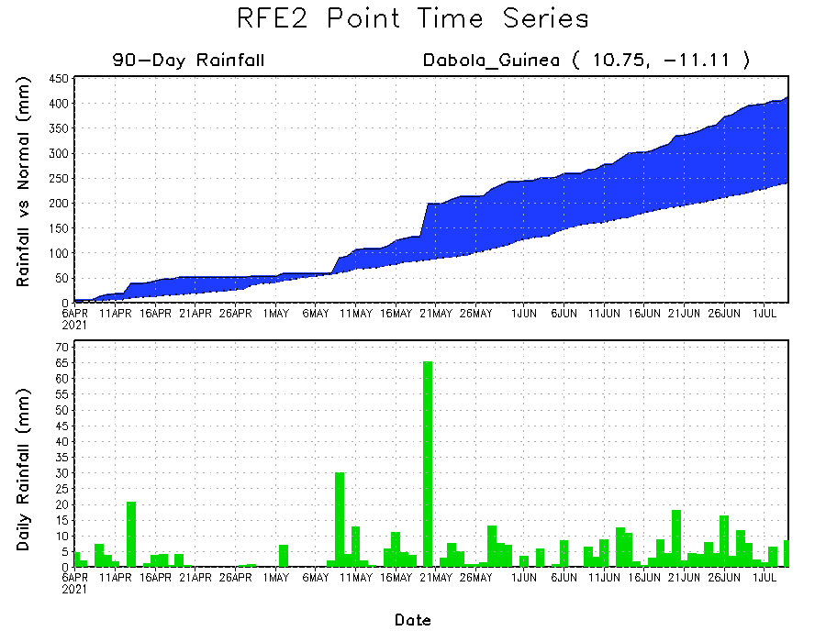
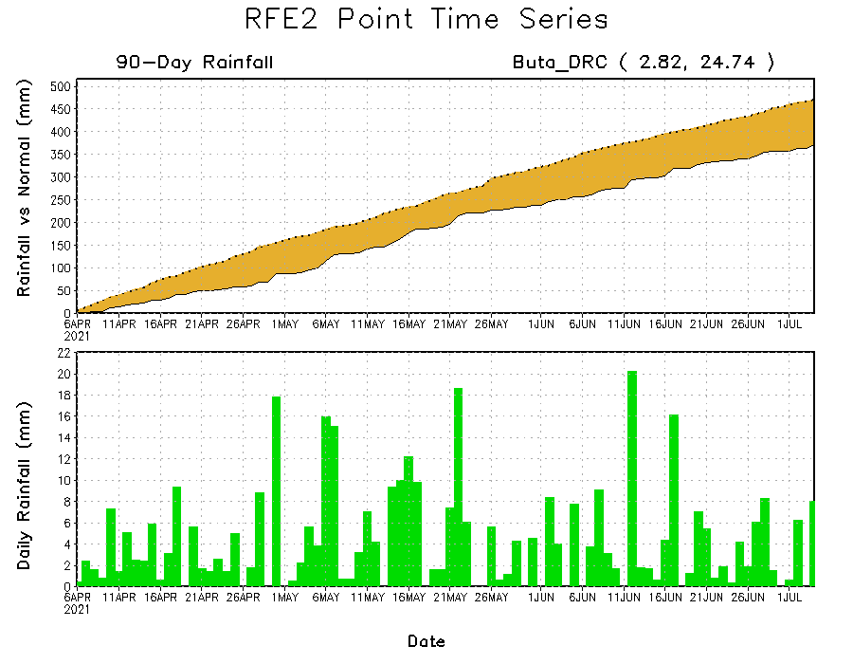
Rainfall Evolution
Daily evolution of rainfall over the last 90 days at selected locations shows moderate to heavy rainfall sustained moisture surpluses over parts of Guinea (bottom left) and eastern Sudan (top right). In contrast, seasonal total rainfall remained below-average over northeastern DRC (bottom right).

Slide 9
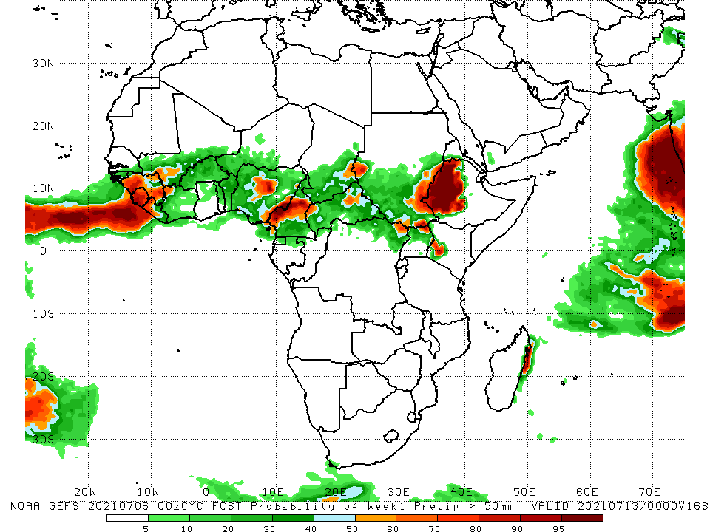
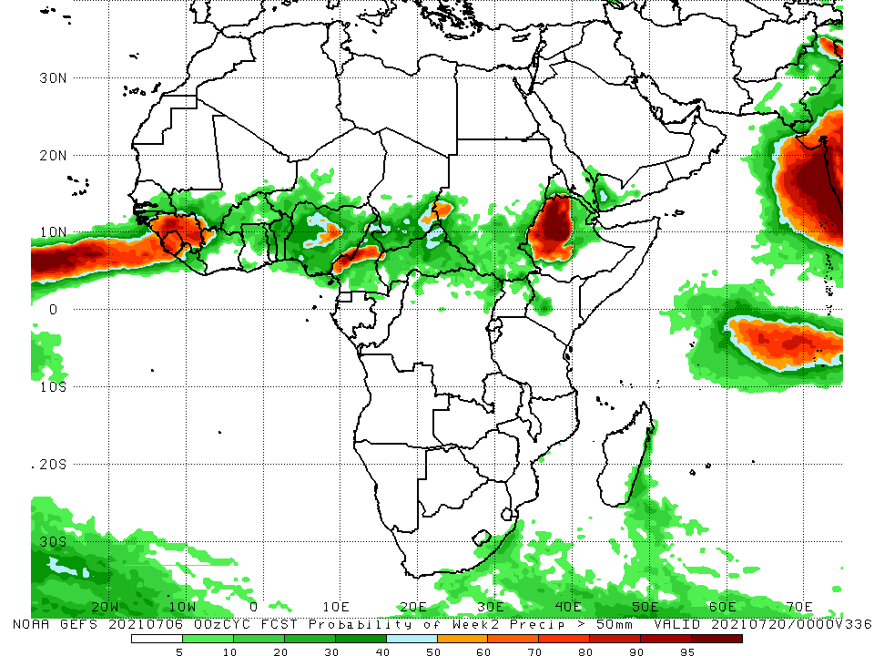
NCEP GEFS Model Forecasts Non-Bias Corrected Probability of precipitation exceedance
Week-1, Valid: 07 – 13 July, 2021
Week-2, Valid: 14 – 20 July, 2021
For week-1 (left panel) and week-2 (right panel), the NCEP GEFS indicates a moderate to high chance (over 70%) for rainfall to exceed 50 mm over much of Guinea, Sierra Leone, Liberia, parts of Nigeria, Cameroon, and western Ethiopia.
Notes:
9

Slide 10
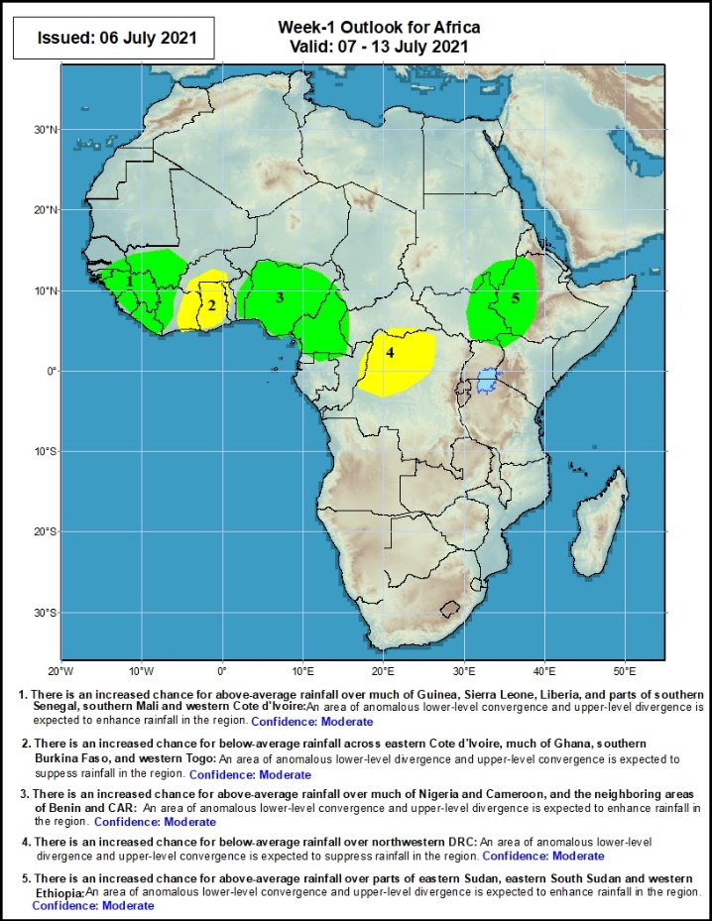
Week-1 Precipitation Outlooks
07 – 13 July, 2021
There is an increased chance for above-average rainfall over much of Guinea, Sierra Leone, Liberia, and parts of southern Senegal, southern Mali and western Cote d'Ivoire: An area of anomalous lower-level convergence and upper-level divergence is expected to enhance rainfall in the region. Confidence: Moderate
There is an increased chance for below-average rainfall across eastern Cote d'Ivoire, much of Ghana, southern Burkina Faso, and western Togo: An area of anomalous lower-level divergence and upper-level convergence is expected to suppress rainfall in the region. Confidence: Moderate
There is an increased chance for above-average rainfall over much of Nigeria and Cameroon, and the neighboring areas of Benin and CAR: An area of anomalous lower-level convergence and upper-level divergence is expected to enhance rainfall in the region. Confidence: Moderate
There is an increased chance for below-average rainfall over northwestern DRC: An area of anomalous lower-level divergence and upper-level convergence is expected to suppress rainfall in the region. Confidence: Moderate
There is an increased chance for above-average rainfall over parts of eastern Sudan, eastern South Sudan and western Ethiopia: An area of anomalous lower-level convergence and upper-level divergence is expected to enhance rainfall in the region. Confidence: Moderate
Notes:
10

Slide 11
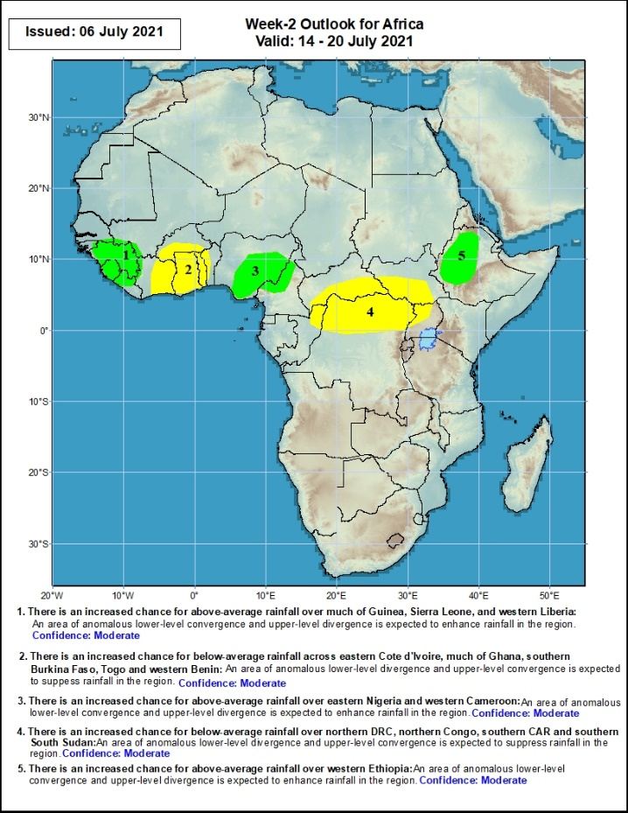
Week-2 Precipitation Outlooks
14 – 20 July, 2021
There is an increased chance for above-average rainfall over much of Guinea, Sierra Leone, and western Liberia: An area of anomalous lower-level convergence and upper-level divergence is expected to enhance rainfall in the region. Confidence: Moderate
There is an increased chance for below-average rainfall across eastern Cote d'Ivoire, much of Ghana, southern Burkina Faso, Togo and western Benin: An area of anomalous lower-level divergence and upper-level convergence is expected to suppress rainfall in the region. Confidence: Moderate
There is an increased chance for above-average rainfall over eastern Nigeria and western Cameroon: An area of anomalous lower-level convergence and upper-level divergence is expected to enhance rainfall in the region. Confidence: Moderate
There is an increased chance for below-average rainfall over northern DRC, northern Congo, southern CAR and southern South Sudan: An area of anomalous lower-level divergence and upper-level convergence is expected to suppress rainfall in the region. Confidence: Moderate
There is an increased chance for above-average rainfall over parts of eastern Sudan, eastern South Sudan and western Ethiopia: An area of anomalous lower-level convergence and upper-level divergence is expected to enhance rainfall in the region. Confidence: Moderate
Notes:
11

Slide 12
Summary
During the past 30 days, in East Africa, above-average rainfall was observed over the southern and eastern portions of Sudan and northern South Sudan Republic, and western Ethiopia. Rainfall was below-average over southern South Sudan, parts of southern Ethiopia, Uganda, and western Kenya. In Central Africa, rainfall was below-average over parts of central and northeastern DRC. Rainfall was above-average over Equatorial Guinea, Gabon, Congo, much of CAR, and northwestern DRC. In West Africa, rainfall was above-average over much of the Gulf of Guinea region and the neighboring areas of the Sahel. Below-average rainfall was observed over Guinea-Bissau, Niger, and pockets of Nigeria.
During the past 7 days, in East Africa, rainfall was above-average over parts of eastern and southern Sudan, South Sudan, and western Ethiopia. In Central Africa, rainfall was below-average over pockets of northern DRC, Cameroon and western CAR. Above-average rainfall was observed over pockets of Congo and northeastern DRC. In West Africa, above-average rainfall was observed over many places in the Gulf of Guinea countries. Below-average rainfall was observed over pockets of Senegal, Mali, Sierra Leone, eastern Guinea, Burkina Faso, western Niger, and parts of Nigeria.
Week-1 and week-2 outlooks call for an increased chance for above-average rainfall over the far western and eastern portions of the Gulf of Guinea region, and the western portions of the Greater Horn of Africa. In contrast, the outlooks call for an increased chance for below-average rainfall over the central portions of the Gulf of Guinea region, and the northern portions of Central Africa.

